Slide 1

Report on Transnational Access in AIDA2020
WP 10, 11, 12
Marko Mikuž
J. Stefan Inst. & Univ. Ljubljana, Slovenia
for the Transnational Access Team
AIDA2020 2nd Annual Meeting, Paris, April 6, 2017

Slide 2
TA in AIDA2020
WP10: Beam test facilities (TA1)
WP11: Irradiation test facilities (TA2)
WP12: Detector characterisation facilities (TA3)
Aim: Provide support for evaluation of detector technologies in terms of radiation hardness, particle response and electromagnetic interference
  Resources usage monitored by User Selection Panel
  Supplemented by WP15: Upgrade of beam and irradiation test infrastructure (JRA3)

Slide 3
TA Tasks - Facilities
10.1: CERN PS and SPS Test Beams
10.2: DESY-II Test Beam Facility
11.1: CERN IRRAD & GIF++
11.2: JSI TRIGA Reactor, Slovenia
11.3: KIT KAZ, Germany
11.4: UCLouvain CRC, Belgium
11.5: UoB MC40 Cyclotron, UK
12.1: RBI-AF, Croatia
12.2: ITAINNOVA – EMClab, Spain

Slide 4
TA in Paris
Full Wed morning dedicated to common meeting of all three TA WP’s
  preceded by WP15 meeting on Tue afternoon
Meeting with talks from each facility reporting progress and flagging problems
  well attended, only one remote presentation
  lively discussion, input from users, management and advisers, mostly on common problems
A few highlights follow, choice arbitrary, look at talks to get complete picture

Slide 5
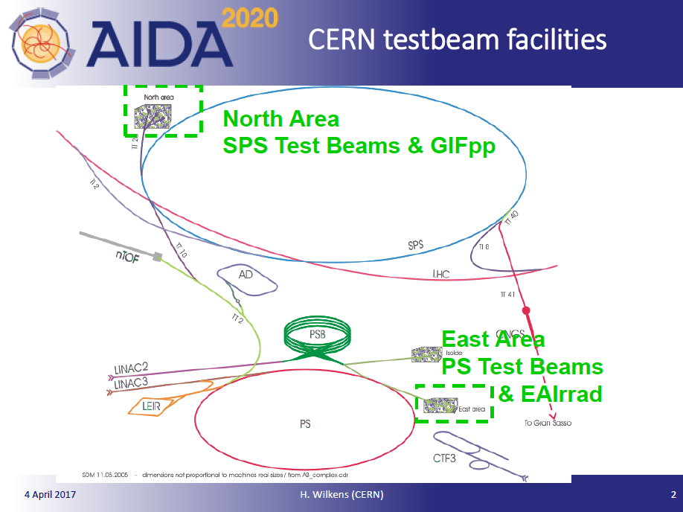
10.1: CERN Test Beams

Slide 6
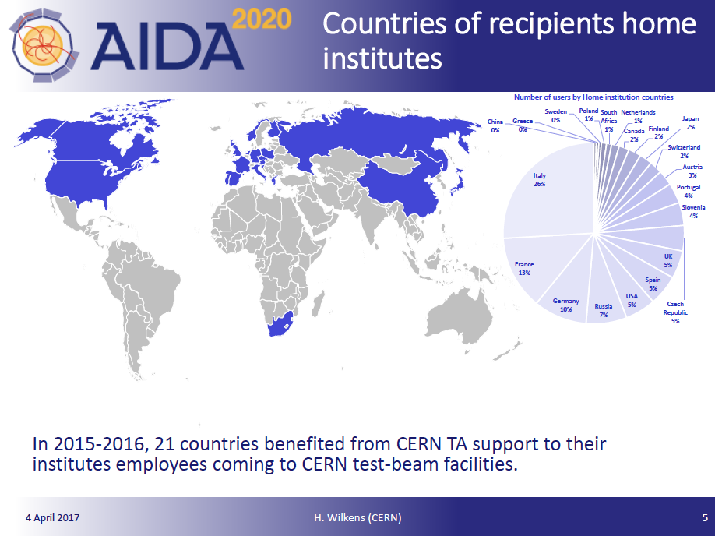
10.1: CERN Test Beams
AIDA2020 allows TB access to
users outside of CERN community !

Slide 7
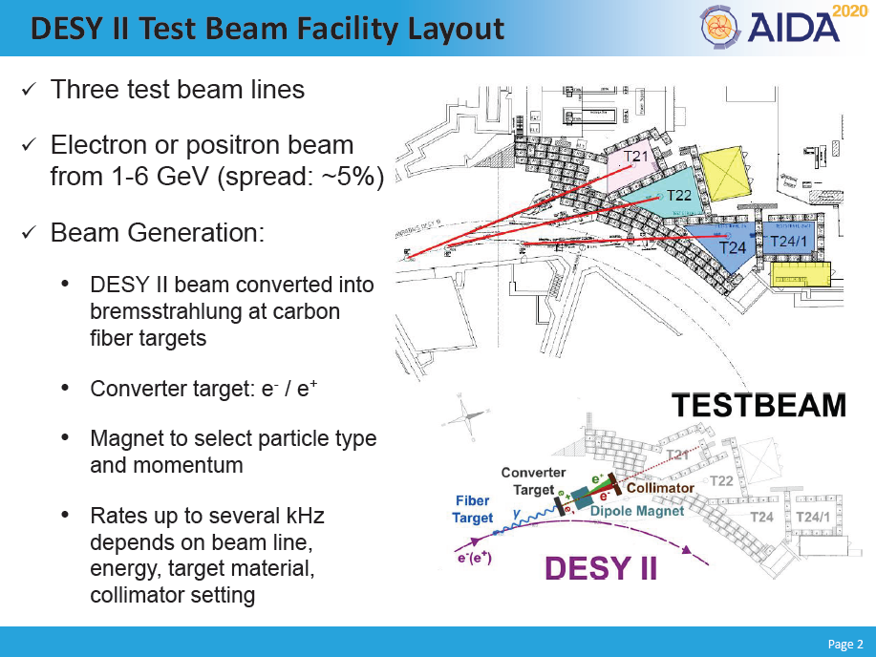
10.2: DESY Test Beams

Slide 8
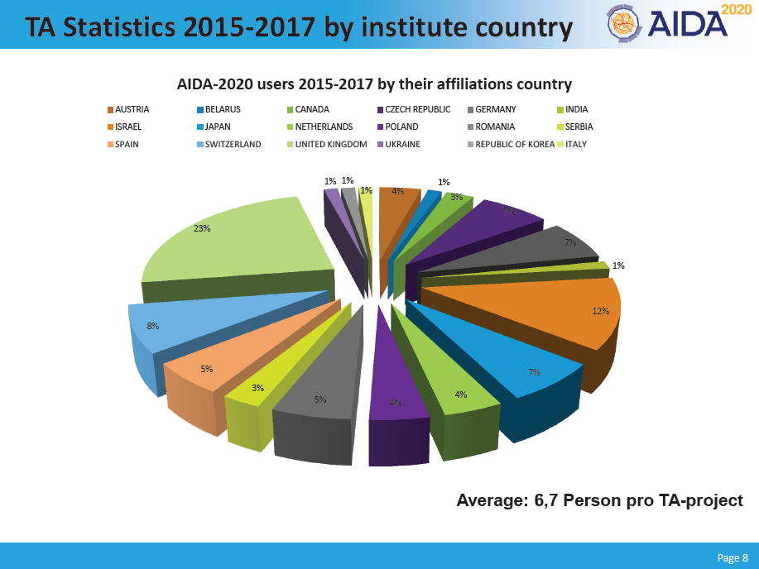
10.2: DESY Test Beams

Slide 9
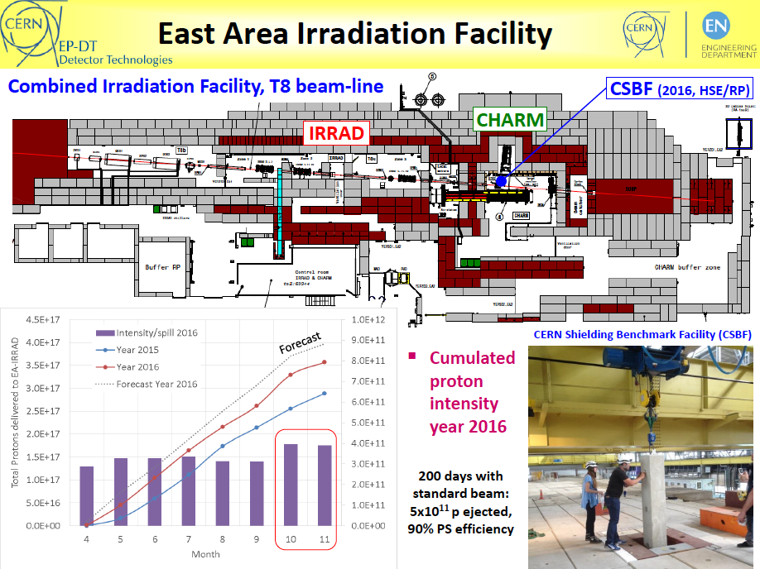
11.1: CERN IRRAD & GIF++

Slide 10
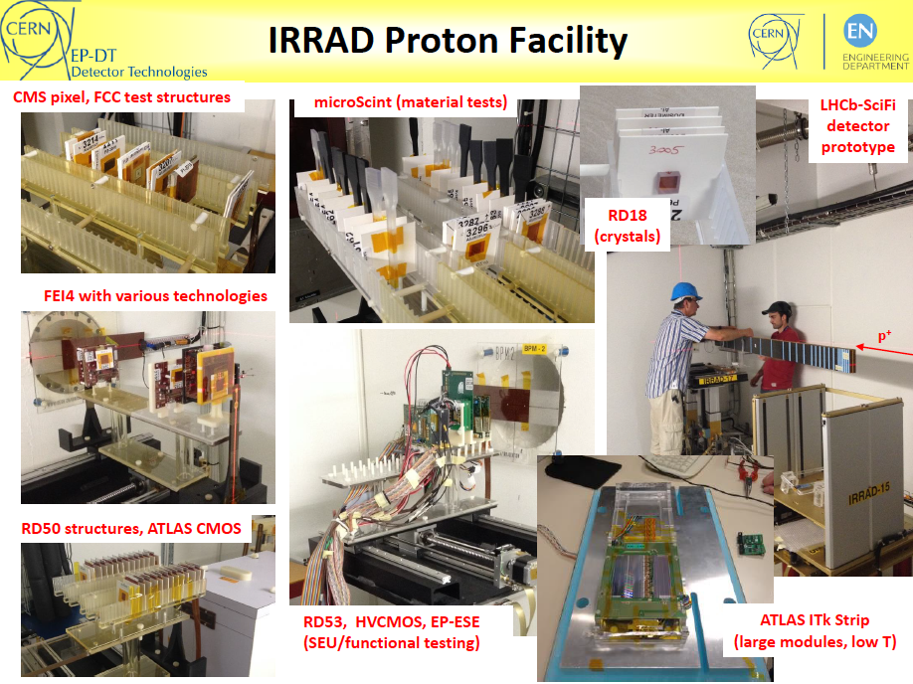
11.1: CERN IRRAD & GIF++

Slide 11
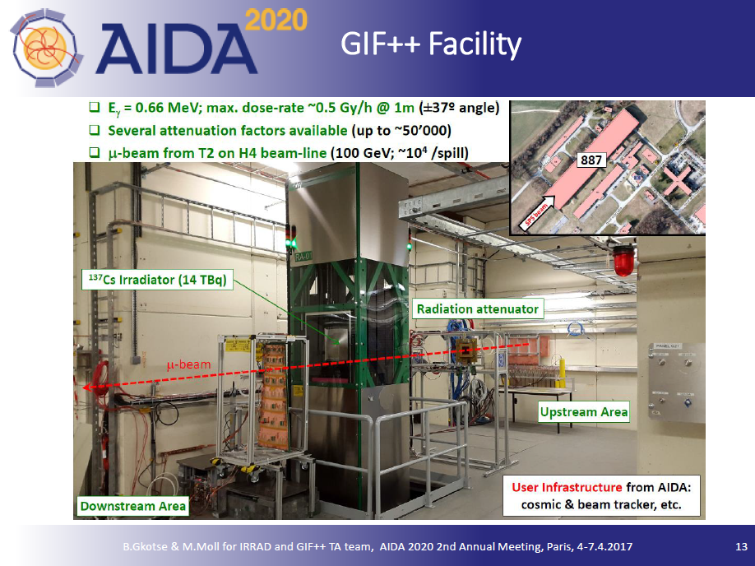
11.1: CERN IRRAD & GIF++

Slide 12
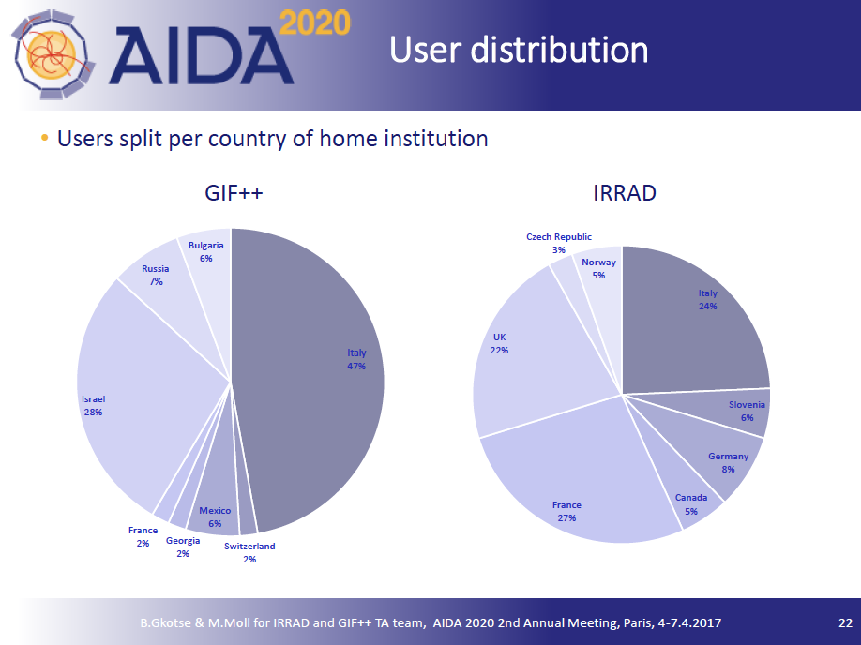
11.1: CERN IRRAD & GIF++

Slide 13
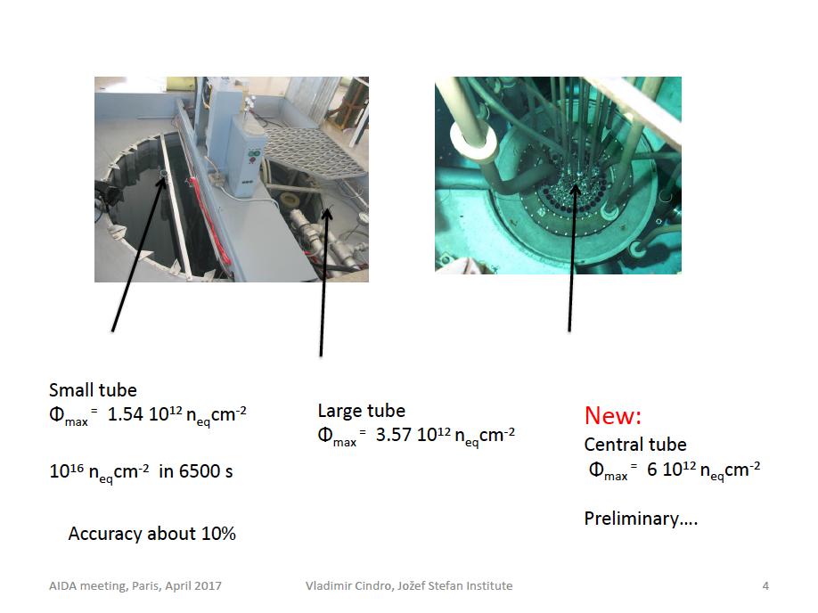
11.2: JSI TRIGA Reactor

Slide 14
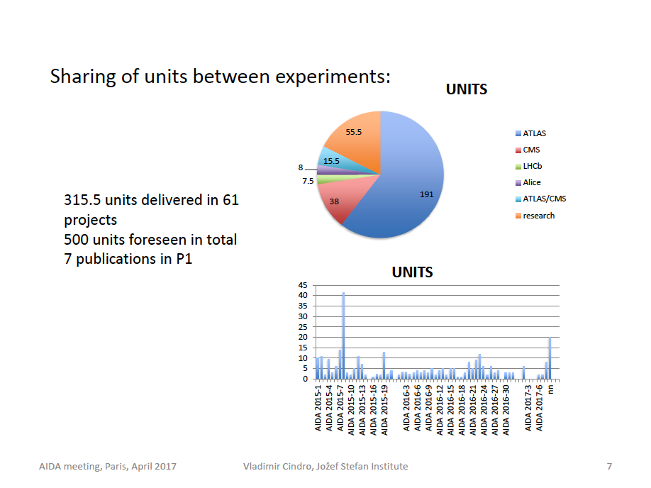
11.2: JSI TRIGA Reactor

Slide 15
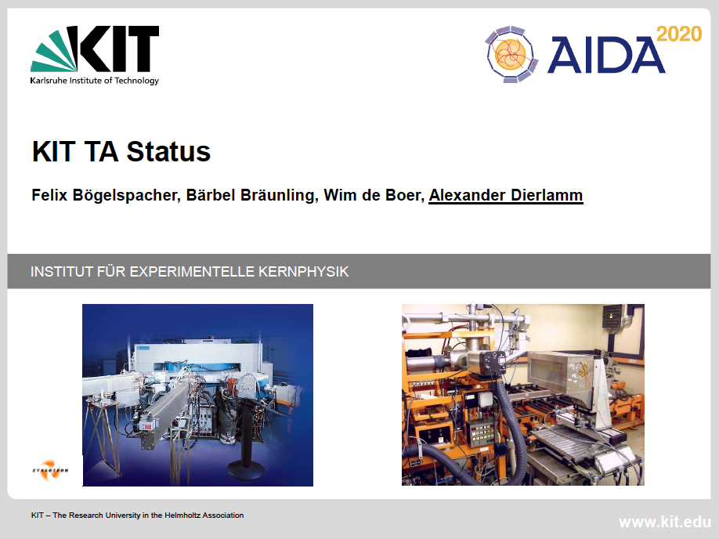
11.3: KIT KAZ

Slide 16
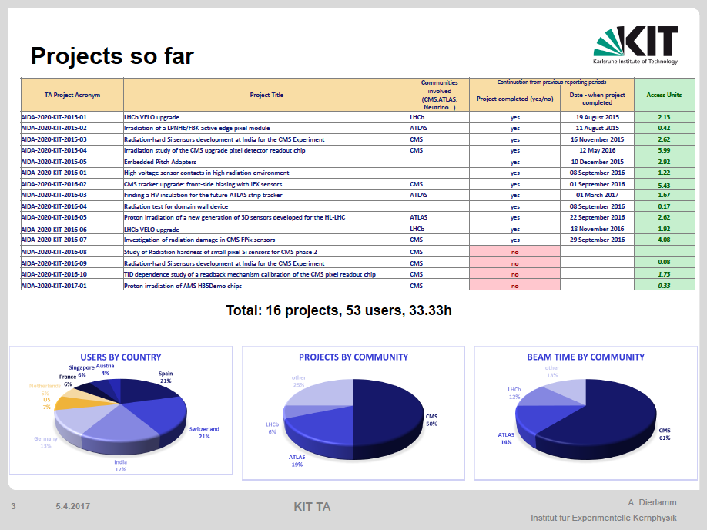
11.3: KIT KAZ

Slide 17
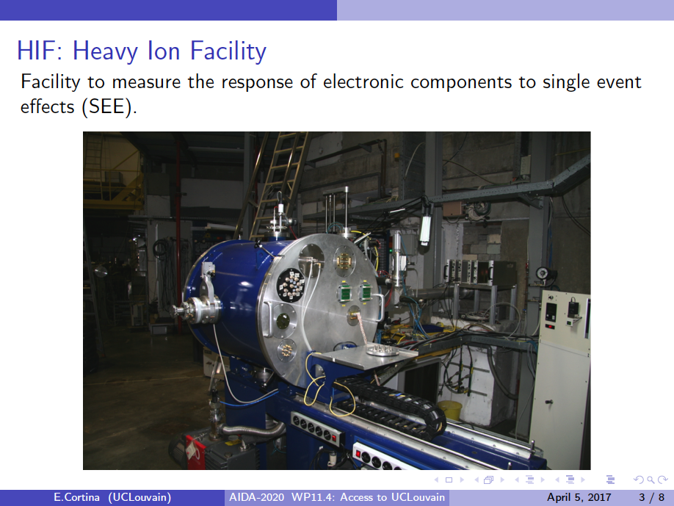
11.4: UCLouvain CRC

Slide 18
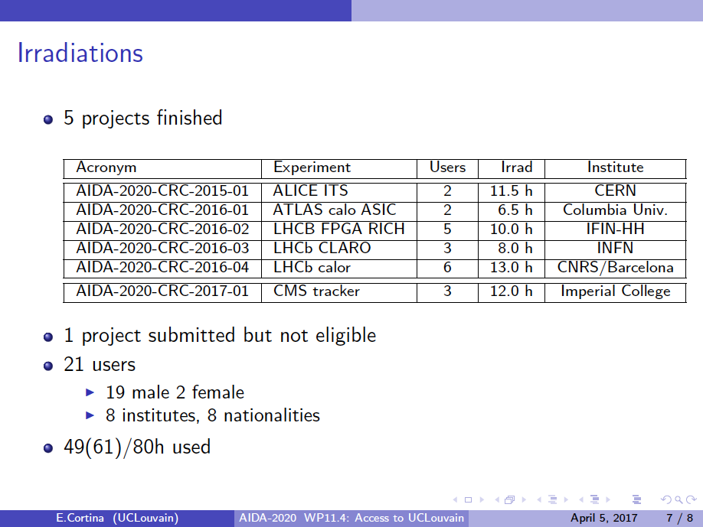
11.4: UCLouvain CRC

Slide 19
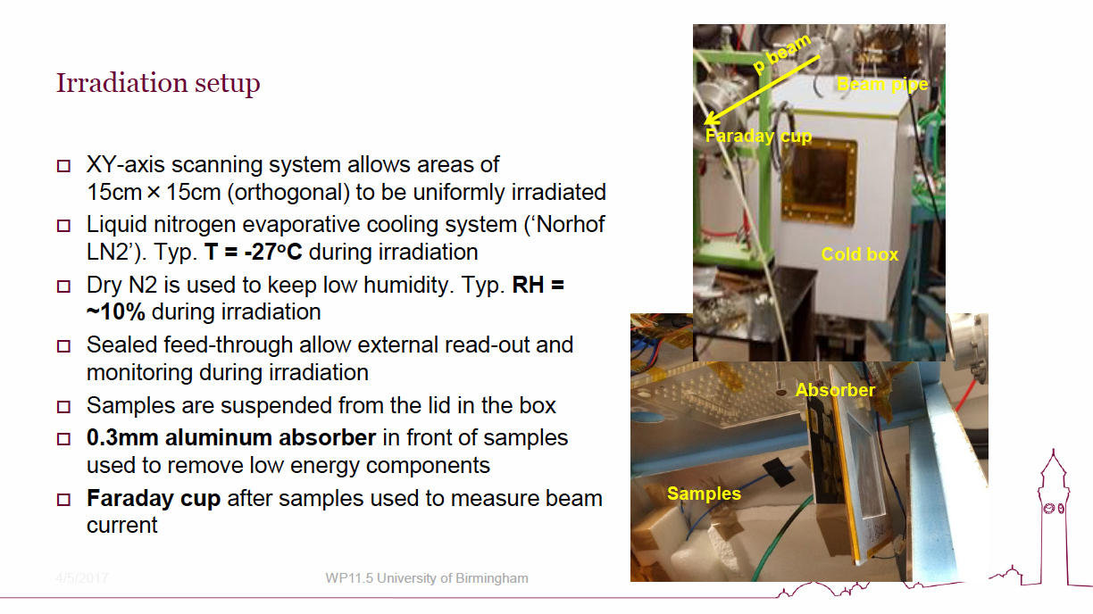
UoB MC40 Cyclotron

Slide 20
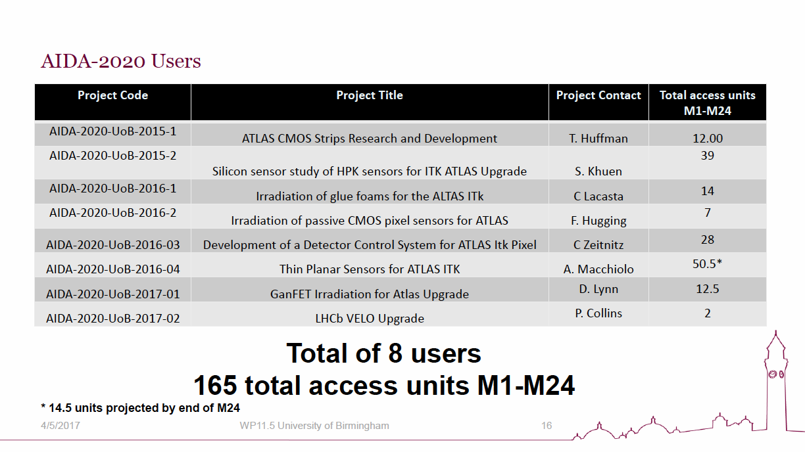
UoB MC40 Cyclotron

Slide 21
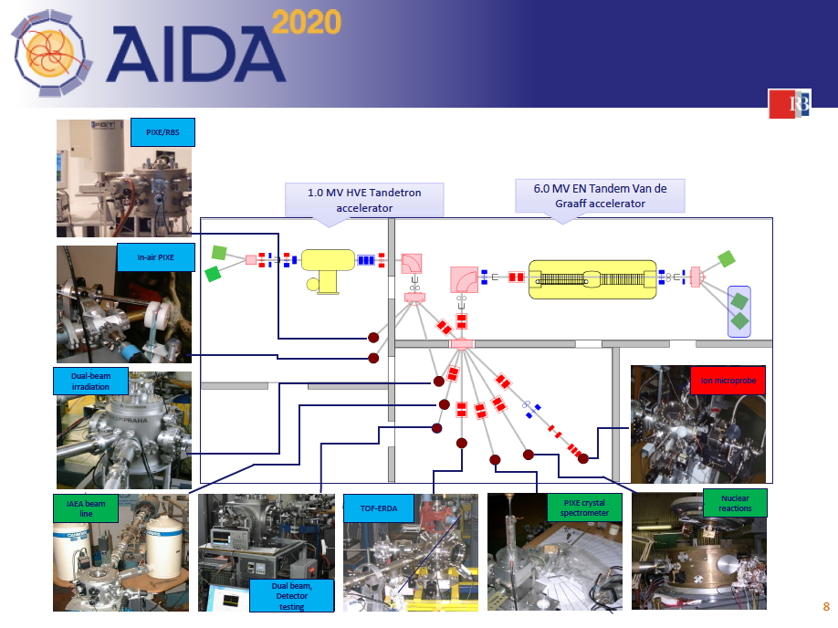
RBI-AF

Slide 22
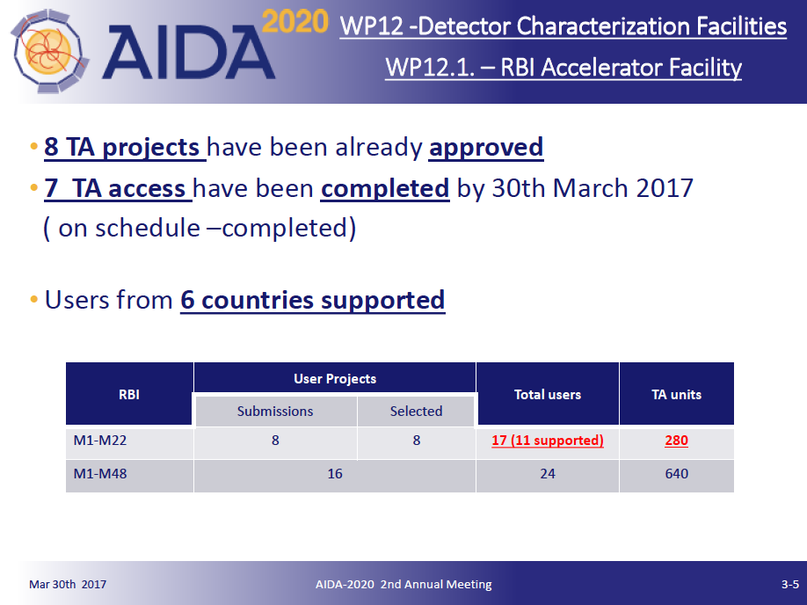
RBI-AF

Slide 23
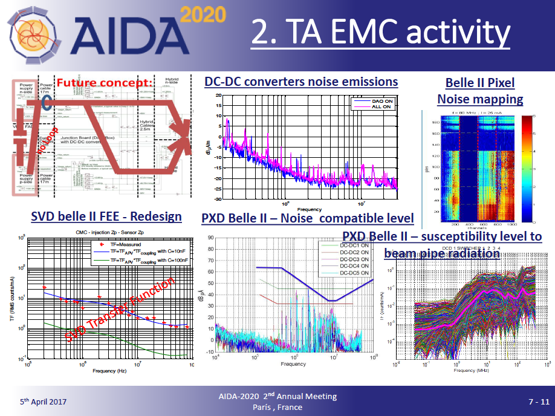
ITAINNOVA – EMClab

Slide 24
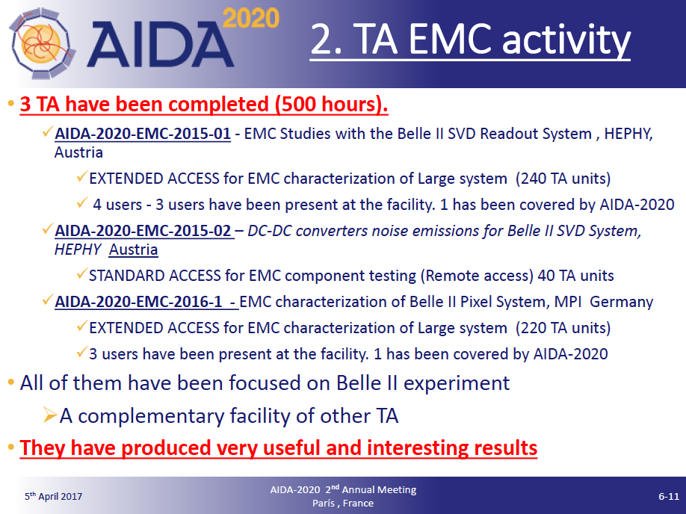
ITAINNOVA – EMClab

Slide 25
Overall Comments
Facilities fully complementary
  test beam, irradiations, characterization
Test beams
  DESY available during CERN winter shut-down
Irradiations
  charged hadrons: low and high energy
  neutrons
  heavy ions: single event effects
  gammas for large scale objects

Slide 26
Common Problems
Number of projects and users somewhat on the low side
  people hate filling forms...
  ask PI’s to check in the complete team of users
    needed for statistics on gender, countries etc.
Hard to trace publications
  our main scientific output !
  remind PI’s of their (signed !) duty 12&24 months after finishing TA access

Slide 27
Resources Usage
The only TA deliverable: Access Units
  some of them (@CERN&DESY) fully covered by institutes budget
  some (partially) covered by AIDA
    large AU cost range (80-850 EUR) due to different cost models and (partial) coverage from other funds
    AU budgets per facility more balanced: 50-125 kEUR
Two access modes
  users on site: visits (partially) supported by AIDA2020
    test beams, some irradiations (SEE)
  remote access: facilities receive samples and ship them back to users
    most irradiations

Slide 28
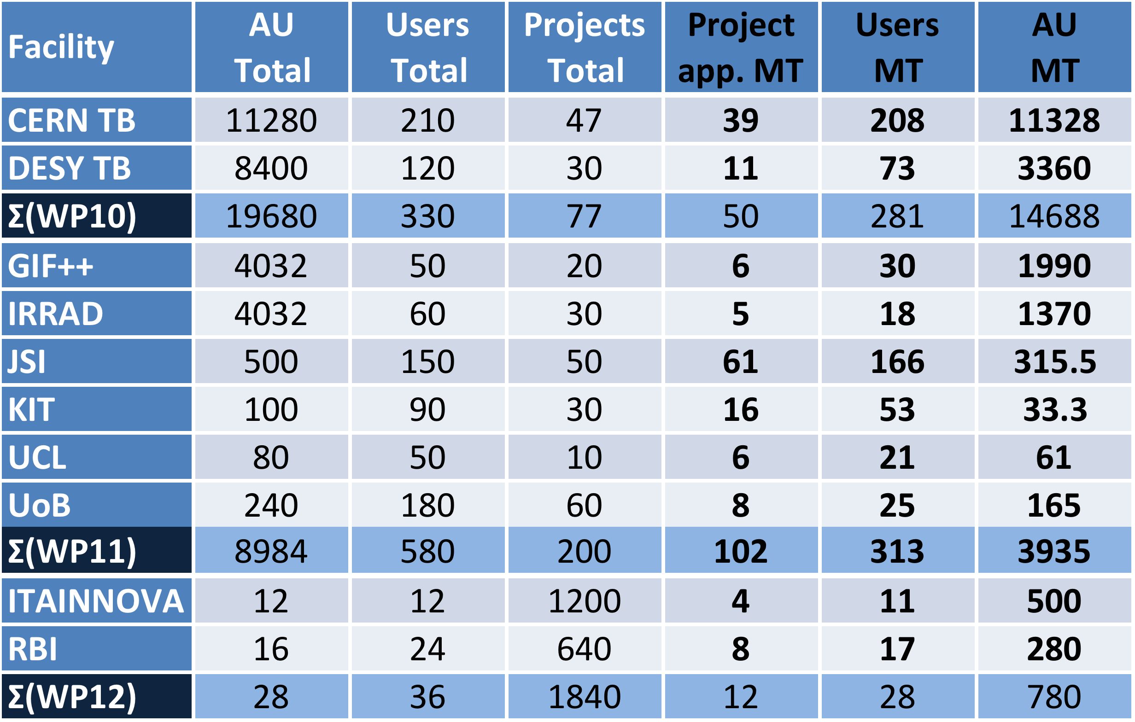
4y Pledge & MT(M1-24) Usage

Slide 29
Usage of AU at MT

Slide 30
Fraction of MT AU to pledge

Slide 31
Comments
CERN TB:
  used all AU and user support funds
  can/will do more, support for outside users limited to CERN logistics (non-trivial !)
DESY TB:
  somewhat behind, expected to catch up
CERN: GIF++/IRRAD:
  somewhat behind, predominantly because of beam schedule May-Nov
JSI:
  a bit ahead, but within reasonable tolerance
  tangential channel (additional load) commissioned (D15.9)
  charge for add-on/large projects if (projected to) run out of AIDA funds
KIT:
  somewhat low usage, heavier demand when module QA for HL-LHC trackers
UCL:
  fully caught up, most % AU usage of all (small overall allocation)
  all projects HIF oriented (SEE/SEL), PR seems to have worked !
UoB:
  a bit ahead, small allocation
ITTANOVA, RBI
  great start-up, nearly on-track

Slide 32
Summary
TA in AIDA2020 well under way
  so far, all facilities on track for successful completion of their AU pledge
  good complementarity
  no major problems
  no corrective actions foreseen
... a true European success story !

