Slide 1
AIDA-2020
WP2: Innovation & Outreach
Aurelie Pezous, CERN
AIDA-2020 2nd Annual Meeting, 3-7th April 2017

Slide 2
Objectives
  Scientific Coordination
  Communication, dissemination and outreach
  Industrial relations and technology transfer
  Management of the Proof-of-Concept (PoC) fund
  Pre-industrialisation of large area silicon detectors

Slide 3
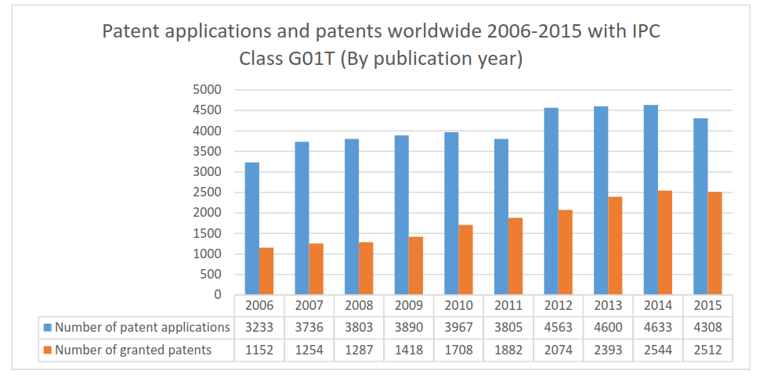
Task 2.3 Industrial relations and technology transfer
Key technological areas (identification of technologies for potential transfer to industry)
  Technology landscape: correlation patents-R&D
  Data set and tools: Thomson Innovation and Intellixir
  57 technologies identified
Notes:
33% augmentation for patent appliction
Number of granted patents almost double for the same period
High interest on the detector industry side

Slide 4
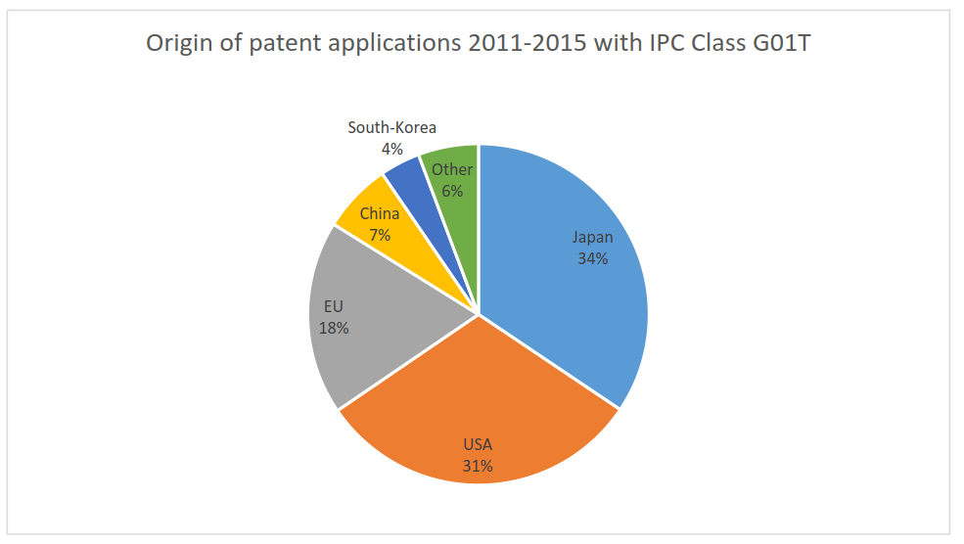
Task 2.3 Industrial relations and technology transfer

Slide 5
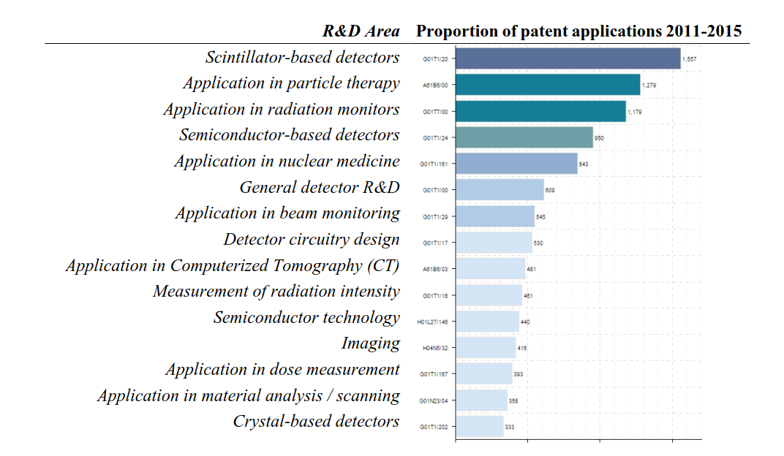
Task 2.3 Industrial relations and technology transfer
Notes:
High importance of medicine

Slide 6
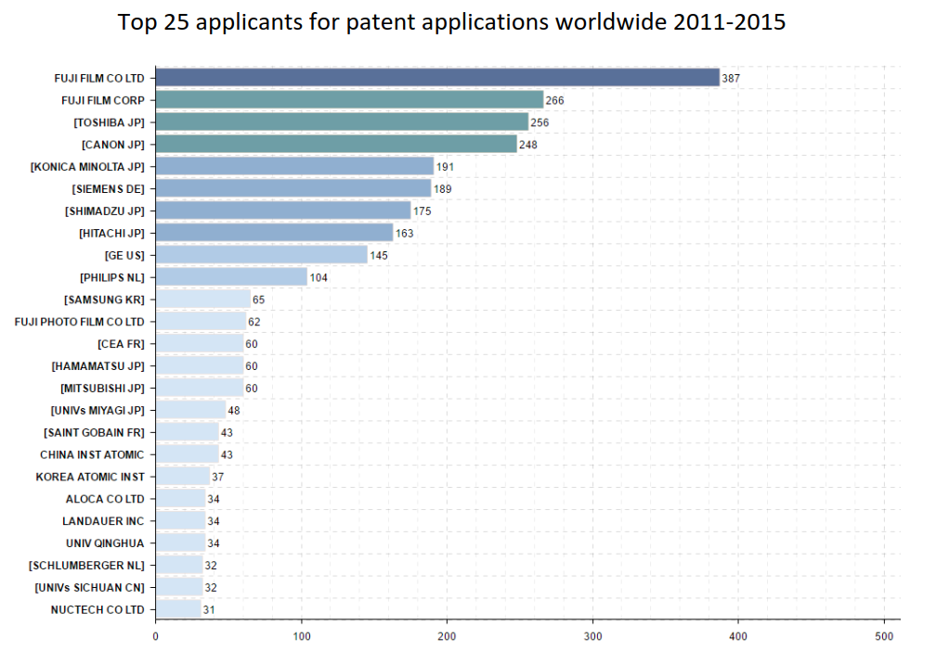
Task 2.3 Industrial relations and technology transfer

Slide 7
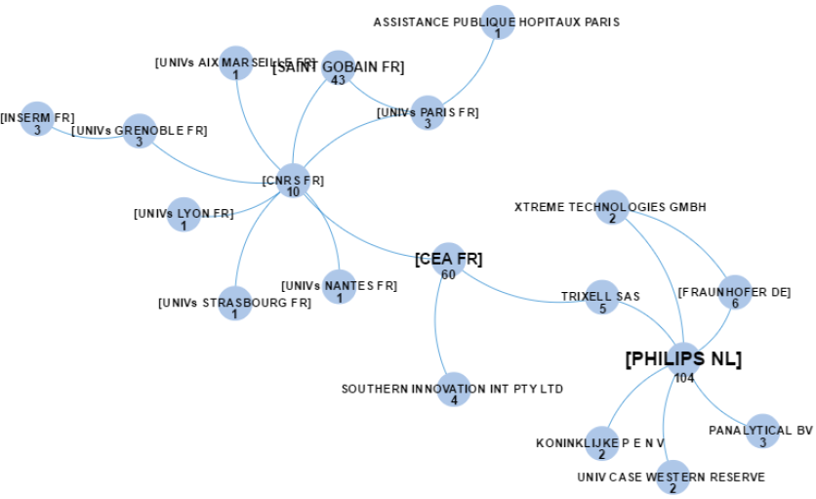
Task 2.3 Industrial relations and technology transfer

Slide 8
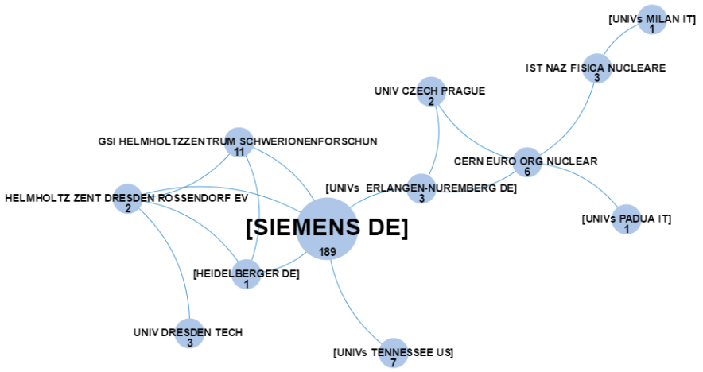
Task 2.3 Industrial relations and technology transfer

Slide 9
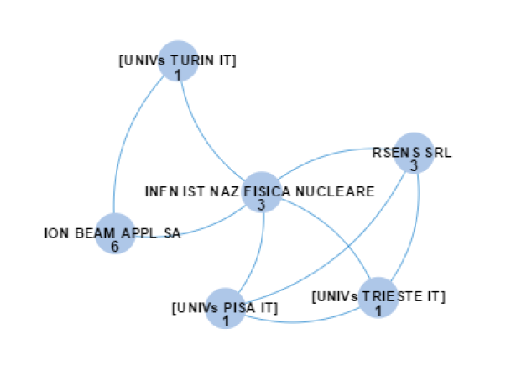
Task 2.3 Industrial relations and technology transfer

Slide 10
Task 2.3 Industrial relations and technology transfer
Understand who is working with who:
  Industrial partnership
  Academia-Industry
List of EU companies active in detectors

Slide 11
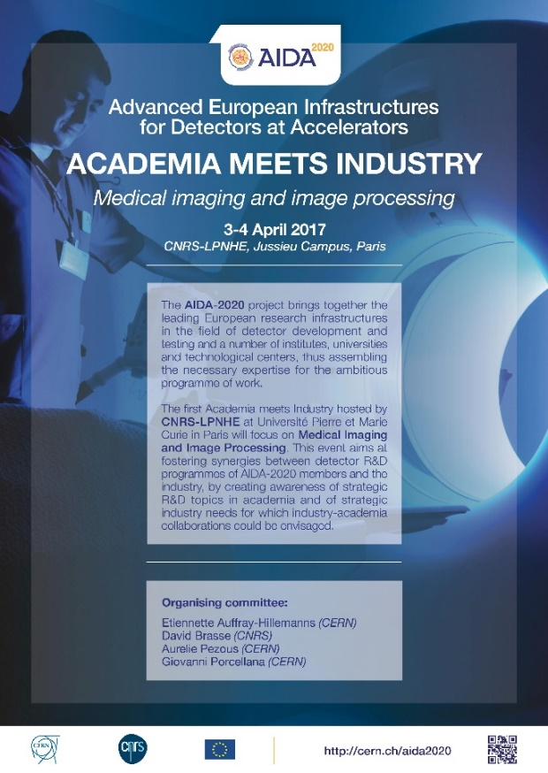
Task 2.3 Industrial relations and technology transfer
Academia meets Industry-Key elements:
  17 speakers:
    7 from industry
    10 from academia
  5 companies with a booth
  60 participants

Slide 12
Task 2.3 Industrial relations and technology transfer
Major topics:
  Scintillators
  PET/MRI/CT
  Machine learning
  Data treatment

Slide 13
Task 2.4 Management of the Proof-of-Concept (PoC) fund
Objectives of PoC:
  General field of detector development
  Collaborative project industry oriented
  Bringing technologies closer to the market
→ Impact beyond high energy physics

Slide 14
Task 2.4 Management of the Proof-of-Concept (PoC) fund
11 valid proposals received
Evaluation Panel meeting 25/11/2016
Interview of the 5 highest ranking projects 14/12/2016
3 projects funded:
Budget € | Title | Lead Institute | Partners
45,600 € | Silicon‐based Microdosimetry System for Advanced Radiation Therapies | Instituto de Microelectronica de Barcelona
74,825 € | Advanced Through Silicon Vias for Pixel Detectors | University of Bonn | Fraunhofer IZM
66,641 € | RaDoM | CERN | Politecnico di Milano, Mi.am

Slide 15

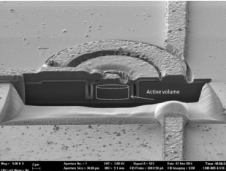
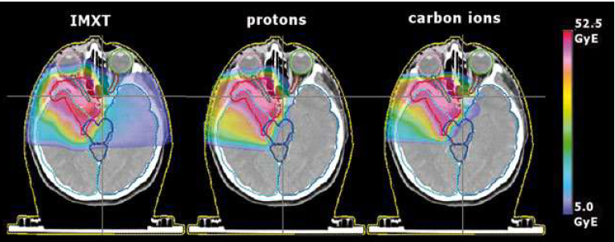
Silicon‐based Microdosimetry System for Advanced Radiation Therapies
Sensors fabrication is a 1st step
Should be integrated with pTDC
Application outside HEP:
  Medical application-hadron therapy
Tech transfer options:
  Licence the product to industry
  Create a spin-off
Notes:
proposed by Instituto de Microelectronica de Barcelona. The project aims to develop a tool optimised for a clinical setting using silicon microsensors and multi-channel read-out electronics for use in anti-cancer treatments.
P time to Digital Converters

Slide 16

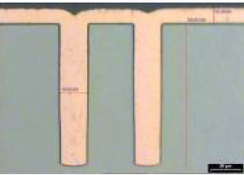
Advanced Through Silicon Vias for Pixel Detectors
TSV on HEP detectors are ongoing developement
Stabilization of the processes
Application outside HEP:
  Environment: IR Sensors
  Medical application: Endoscopy
Tech transfer options:
  Joint development with IZM
  Democratisation of TSV
Notes:
led by the University of Bonn, and partnering with Fraunhofer IZM. The project plans to demonstrate the feasibility of very thin readout chips with via-last Through Silicon Vias (TSVs) in hybrid-pixel detectors.
Contact free imaging

Slide 17
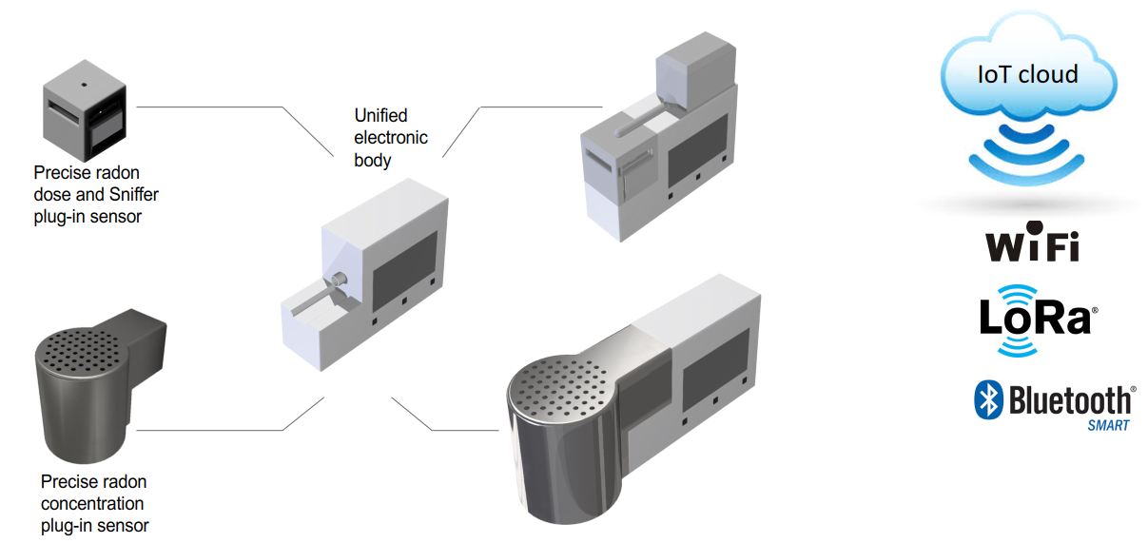
RaDoM
Produce 10 prototypes
Adress the market
Application outside HEP:
  Environmental
  Public health
Tech transfer options:
  Create a company
Notes:
lead by CERN in conjunction with Politecnico di Milano, Mi.am. This project aims to develop new hardware and software for combatting the health risks of radon under the requirements of the Swiss “National Action Plan concerning Radio 2012-2020”.

Slide 18
Task2.5 Pre-industrialisation of large area silicon detectors
Monopoly situation in planar large-area silicon detectors
Market survey:
  Common MS CMS/ATLAS
  Identify an EU company able to produce sensors on a large scale
Infineon:
  Experience with fully depleted devices
  Fruitful collaboration with HEPHY

Slide 19
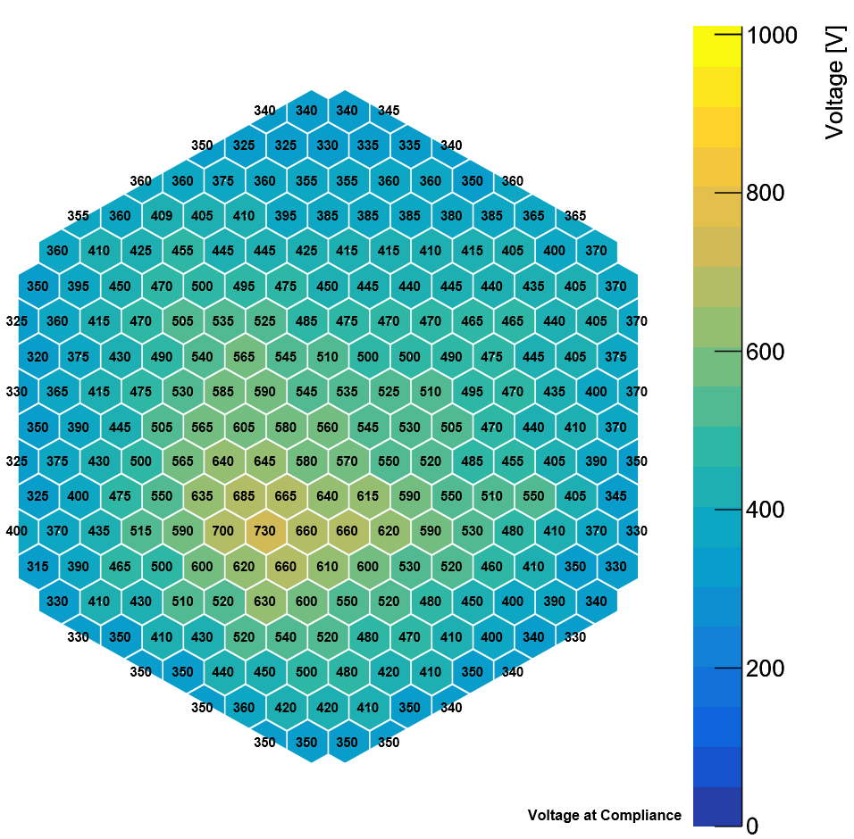
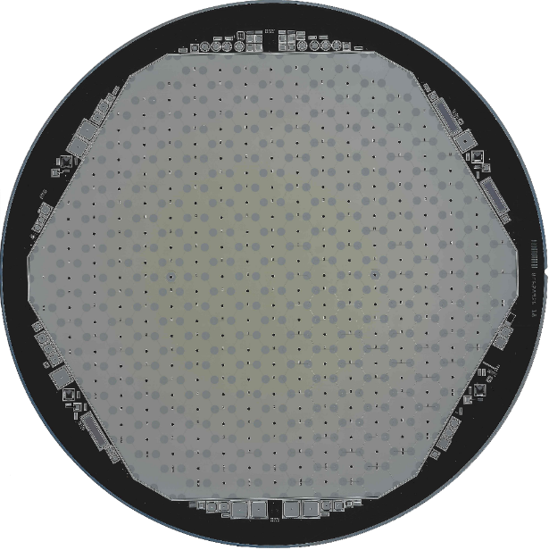
Task2.5 Pre-industrialisation of large area silicon detectors
Improving from 1st batch to 2nd batch
Probe card under developement
40 µm
21 µm
80 µm
60 µm

Slide 20
Milestones and Deliverables
Deliverables since last annual meeting
  D2.1: Key technological areas (identification of technologies for potential transfer to industry)
  D2.2: PoC selection (selection and definition of grants for the projects)
Milestones since last annual meeting
  MS10:Criteria to define, identify, and select key technologies for the PoC Fund
  MS30:Identification of European company(s) interested in large area sensor production
  MS38: Review and selection of the project(s) to support through the PoC Fund

Slide 21
Milestones and Deliverables
Expected milestones:
  MS45: 1st AIDA-2020 “Academia meets Industry” event (M24)
  MS71: Progress review of the selected projects(s) for the PoC Fund (M34)
  MS79:2nd AIDA-2020 “Academia meets Industry” event (M36)

Slide 22
Coming year
Follow-up PoC projects
Strenghten the links with TTO
Organize AMI-2 : any idea?

Slide 23
Contact me !
Notes:
Feedback on anything else we could do for project participants re communication. This could be internally or externally.

