Slide 1
WP15 Report
Upgrade of beam and irradiation test infrastructure
Federico Ravotti (CERN) & Marcel Stanitzki (DESY)
AIDA-2020 Second Annual Meeting - LPNHE

Slide 2
WP 15 Structure
Task 15.1: Scientific coordination (CERN, DESY)
Task 15.2: Improvements of test beam infrastructure for high precision
tracking (CERN, DESY)
Task 15.3: Improvements of the DESY test beam infrastructure (DESY)
Task 15.4: Improvements of the test beam infrastructure at LNF (INFN)
Task 15.5: Improvements of the infrastructure for irradiation tests
(CERN, INFN, VU, INRNE, JSI, USFD*)
*associated partner linked to CERN

Slide 3
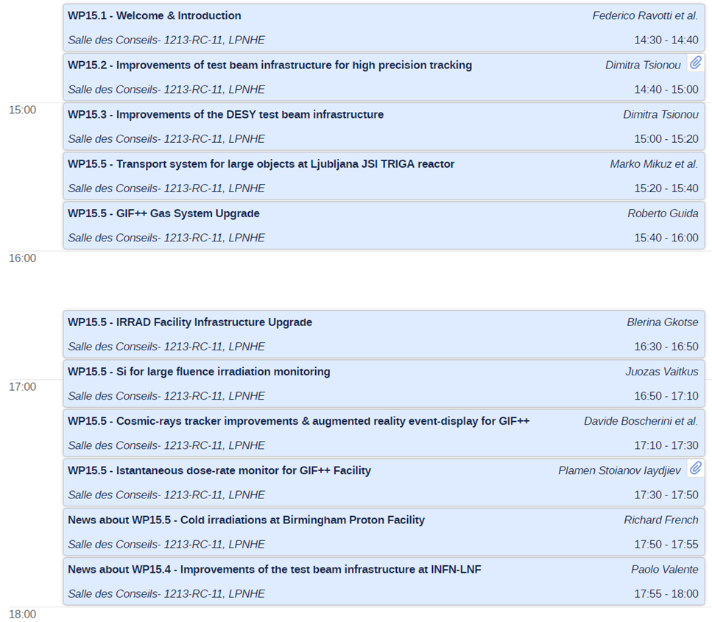
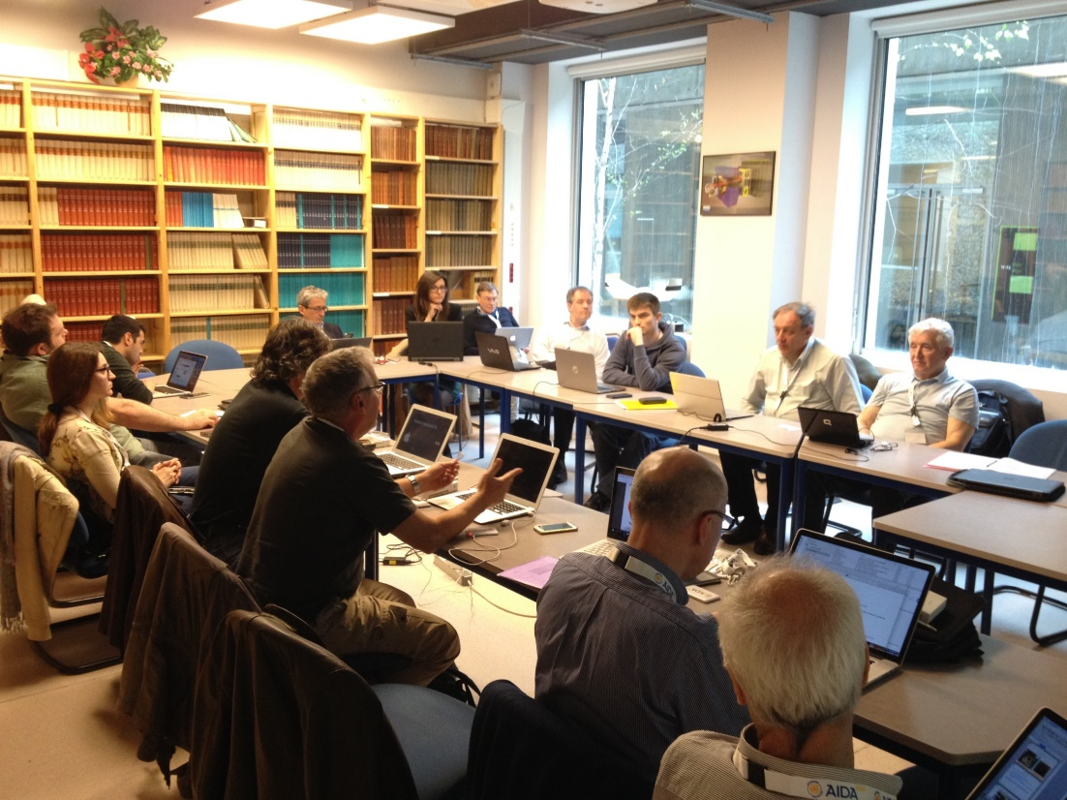
WP 15 Session (Tue. Afternoon)
Task 15.1
Tasks 15.2 - 15.3
(DESY activities)
Task 15.5
News about USFD activities (Task 15.5)
News about INFN-LNF activities (Task 15.4)
About 20 people in the room
Interesting technical discussions with facilities coordinators / sharing ideas
First “feedback”: emphasize the AIDA-2020 specific contributions within the tasks

Slide 4
Milestones & Deliverables
Upcoming (M24)
  Milestones
    MS59: Silicon strip reference tracker hardware ready (WP15.3)
      → Will be delayed
  Deliverables
    D15.1: CERN pixel beam telescope for the PS (WP15.2)
      → Already Published
    D15.6: CERN proton facility upgrade (WP15.5)
      → Being prepared
    D15.10: GIF++ gas system (WP15.5)
      → Being prepared

Slide 5
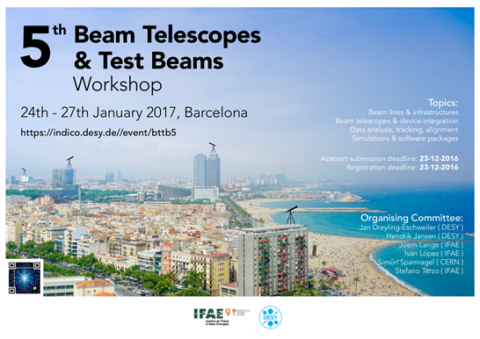
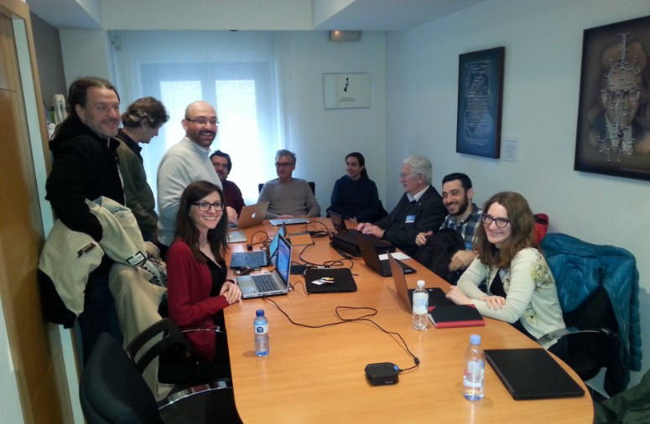
Task 15.1:
Scientific Coordination
WP15 satellite meeting at BTTB
The BTTB series has been a very successful format for:
  test beam & irradiation facilities users
  beam telescope users
  facility coordinators
WP15 has a large overlap of activities and participants with BTTB (in particular within Tasks 15.2, 15.3 and 15.4)
Upgrade activities for irradiation facilities (Task 15.5) are driven by user requirements

Slide 6
Task 15.2:
Telescope for the CERN PS
D15.1 ACHIEVED

Slide 7
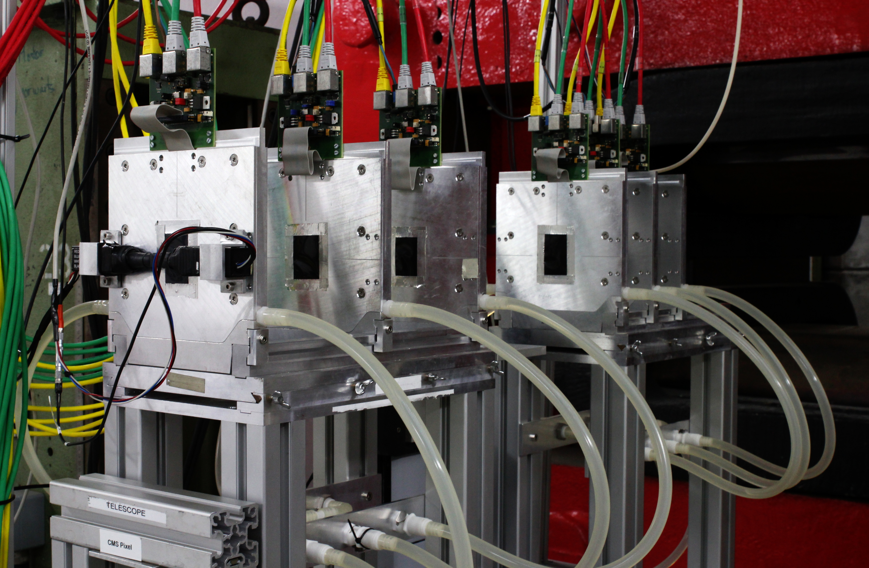
Task 15.2: EUDET-Style Telescopes around the World
EUDET-type beam telescope family
No. | Name | Location | Funded by | Year
1 | AIDA Telescope | CERN SPS | EUDET/AIDA FP6/7
2 | ANEMONE | Bonn | U Bonn | 2011
3 | ACONITE | CERN SPS | ATLAS | 2012
4 | DATURA | DESY | DESY | 2012
5 | CALADIUM | Fermilab | Carleton U | 2013
6 | DURANTA | DESY | DESY | 2015
7 | AZALEA | CERN PS | AIDA-2020 | 2016
Users can go to different test beam facilities and use the same beam tracking infrastructure
Telescope Support
portal: http://telescopes.desy.de
contact: telescope-coor@desy.de

Slide 8
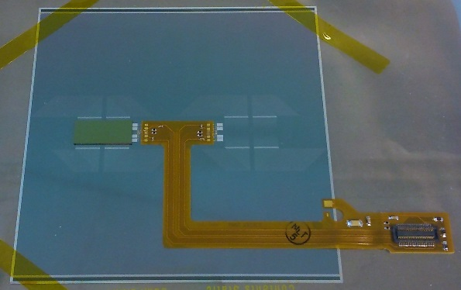
Task 15.3: Improvements of the DESY test beam infrastructure
WP15.3.1: External silicon tracker for 1T magnet in the DESY test beam
  KPiX chip will be used to read out the Silicon sensors
  DAQ hardware and software setup already at DESY
  Sensors that fulfil the required characteristics (spatial resolution <10μm) have been identified
  Requirements severely limit sensor choice
  DESY has placed an order Mid November 2016 with Hamamatsu for a production of 25 Silicon strip sensors
    Total cost 49K (including NRE mask cost and production of 25 sensors)
    Lengthy process beyond our control
    Confirmed delivery date: end of July 2017
10 cm
Si strip sensor
KPiX
Delay of MS59 (M24) inevitable

Slide 9
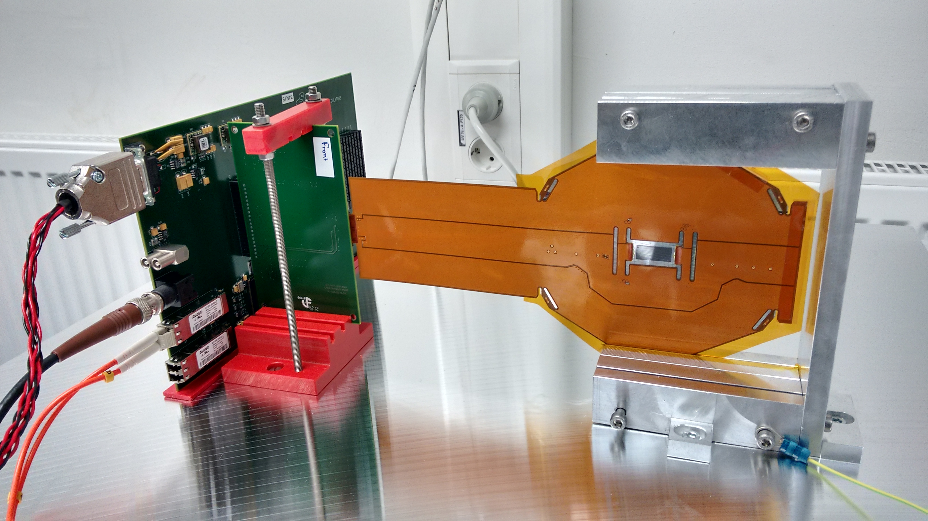
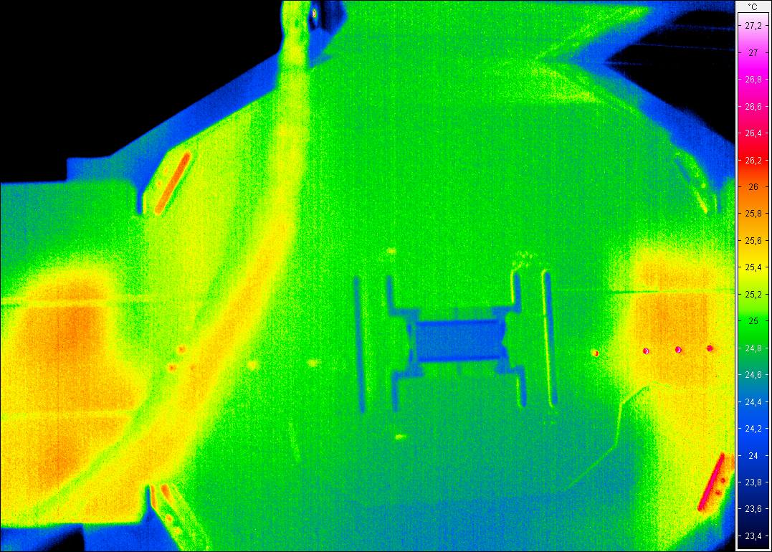
Task 15.3: Improvements of the DESY test beam infrastructure
Having the tracking sensor so late is an issue
But:
  we already have a KPiX plus an ECAL sensor → DAQ-wise identical
  using this for development & DAQ integration
  beam test in May at DESY
other components status:
  mechanical structures (“cassettes”) are currently being designed after successful thermal tests
  power supply system has been decided, will be ordered soon
DAQ & EUDAQ2 integration:
  new Postdoc starts April 1st
  close collaboration with WP5

Slide 10
Task 15.3: Improvements of the DESY test beam infrastructure
The sensors will be late, hence MS59 will slip
  Estimate now to have completed and tested modules by November 2017
  Other hardware will be ready before that
Impact on D15.2
  Expect to be on time for D15.2 in M36
Rationale
  DAQ can be already tested and integrated with ECAL sensor
  First test beam in May 2017
  Other components will all be ready and waiting, when the sensors are back
  New Postdoc starting on April 1st with 100% on AIDA-2020 WP15.3
  Weekly status meetings to track progress
  Currently we have 3.5-month contingency till M36
D15.2 (M36)

Slide 11
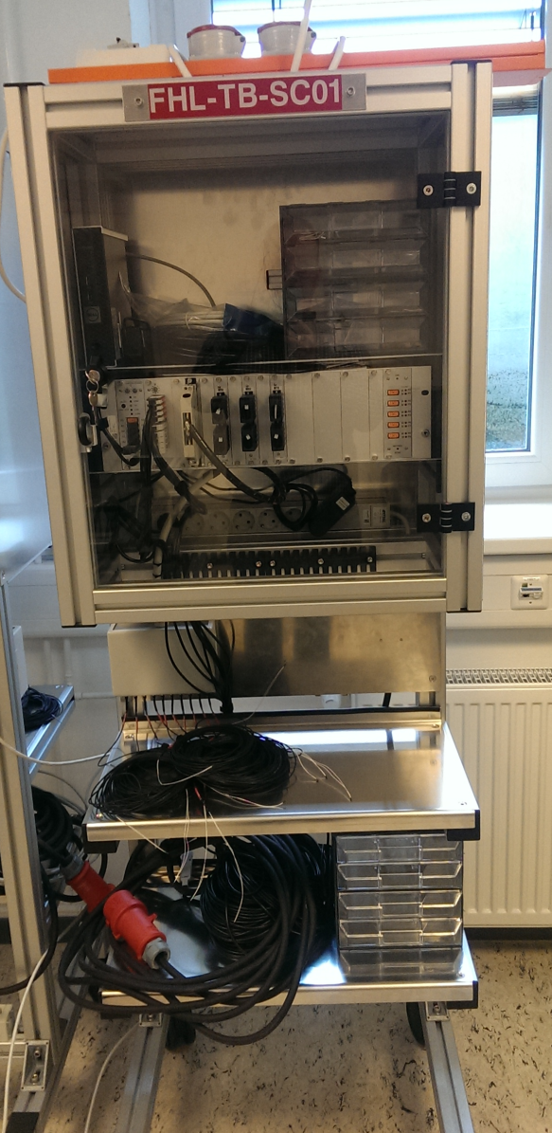
Task 15.3: Improvements of the DESY test beam infrastructure
WP15.3.2: Environmental parameter monitoring for DESY test beam areas
  Common rack-based slow control system (commercial)
  Milestone report MS33 was delivered on time
  Current Activities:
    Testing of all the sensors and the logging software
  Plans:
    Integrate slow control data in EUDAQ2
    Early user test in July 2017 (Summer Students)
    Roll-out for user operations in fall 2017
    Write report
  D15.3 on time for M30
D15.3 (M30)

Slide 12
Task 15.4: Improvements of the test beam infrastructure at LNF
Additional beam line equipment:
MS34 DELAYED
(M18 → M30)
D15.4 (M30)
Actions since November 2016
  Workshop with 20 companies in the field of magnet construction, in order to:
    Have magnets with a very good correspondence with specifications
    Speed-up delivery & better control on design and validation phase (magnetic measurements)
    Improve KTT
  Provide to the producer an advanced design of the required magnets
  Delay on the bids w.r.t to the schedule IS re-absorbed by the fact that the designs are practically already done by LNF

Slide 13
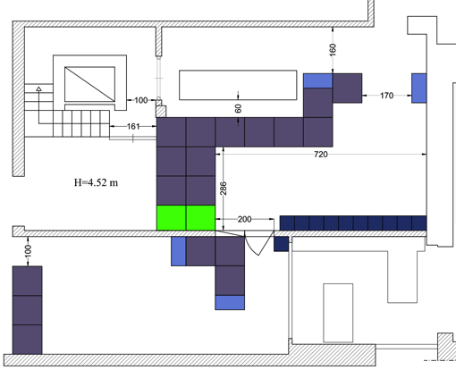
Task 15.4: Civil Engineering
For speeding up the execution of the building modifications, we removed the motorized shielded door (on the side of the external wall), replacing it with a removable structure of concrete blocks (chicane)
Much easier (and cheaper): the only modification to the building structure is the opening of two (normal) doors

Slide 14
Task 15.4: Status April 2017
March
All bids for magnets procurement out by the end of January
  But we will provide to the supplier a detailed design
Civil engineering preliminary project approved
  Working on the executive one (external company)
BTF closed to the users from mid July (apart 2-3 weeks in Sep.)
Design slightly modified in order to avoid modifications of the line inside the LINAC tunnel
  Brings interference with the operation of the collider complex to ≈0
  Easier installation (and alignment)
  Also requires 1 quad less (slightly increased the gradient of the other quads)
Vacuum requirements relaxed: the two BTF lines will be separated by the main LINAC vacuum by a 0.5 mm Be window (already existing); design modified in order to host pumping ports
  Vacuum components design on-going
Infrastructure and installation:
  Thermic, hydraulic and electric calculations completed
  Specs for “on-the-shelf” power supplies
  Cooling and power supply for new line started
Project reviewed and simplified, final version being prepared

Slide 15
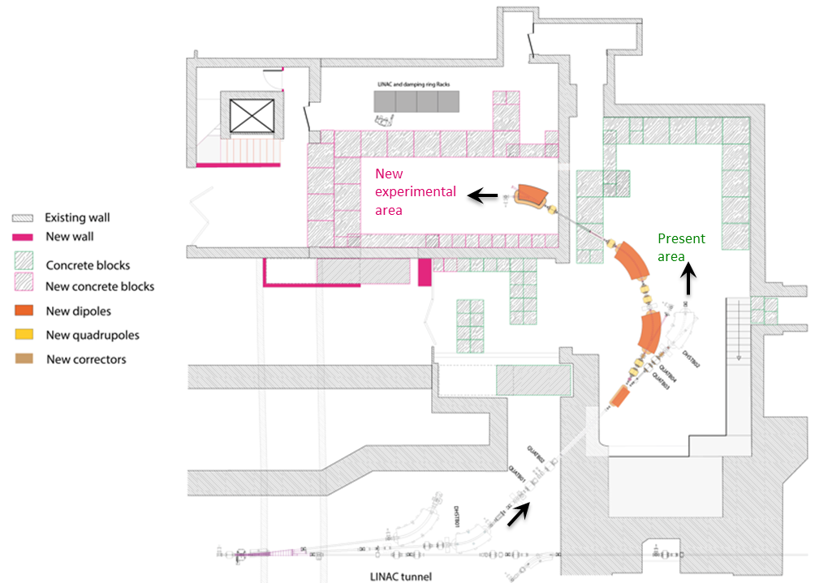
Task 15.4: Impact on D15.4
A lot of effort made to re-gain a few month!
Considering the time margin needed for:
  Magnetic measurements (in house to speed up delivery time)
  Installation
  Commissioning of the new line
  In addition, DAFNE collider run has been extended by three months (from Dec. ’17 to end of Mar. ‘18), also shifting maintenance schedule of the complex in the next months.
Request to move the deliverable from M30 to M35
  5 month slippage
  Compared to 12 month for MS34
D15.4 (M30 → M35)
P. Valente (April 3rd): “we are already buying the conductor for the coils and the pure iron for the DC magnets for speeding up. (…) The tracking detector for the new line is working, we are now analysing data, this deserves a full report soon”
  MS70 (M30)

Slide 16


Task 15.5: Improvements of the infrastructure for irradiation tests
D15.6 – CERN Proton Facility Upgrade
  contactless fluence monitor (VU)
  IRRAD samples & users management software / storage area equipment (CERN)
  CERN online database on irradiation facilities of interest for HEP (CERN)
D15.7 – RadHard instrumentation for CERN Proton Facility (CERN)
D15.8 – Cold Irradiations at Birmingham Facility (USFD)
D15.9 – Large objects transport system for JSI neutron irradiations (JSI)
D15.10 – Upgrade of GIF⁺⁺ Facility gas system (CERN)
D15.11 – GIF⁺⁺ Facility Upgrade
  instantaneous dose-rate monitor (INRNE)
  improved cosmic-rays tracker & demonstrator of augmented reality (INFN)
M24
M44
M36
M24
M48

Slide 17
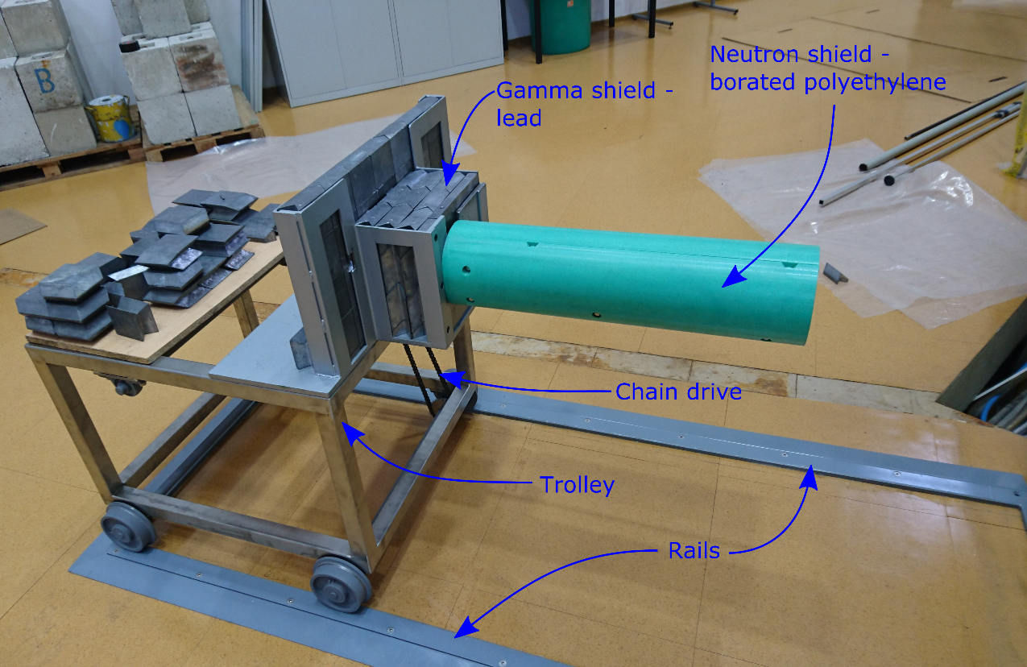
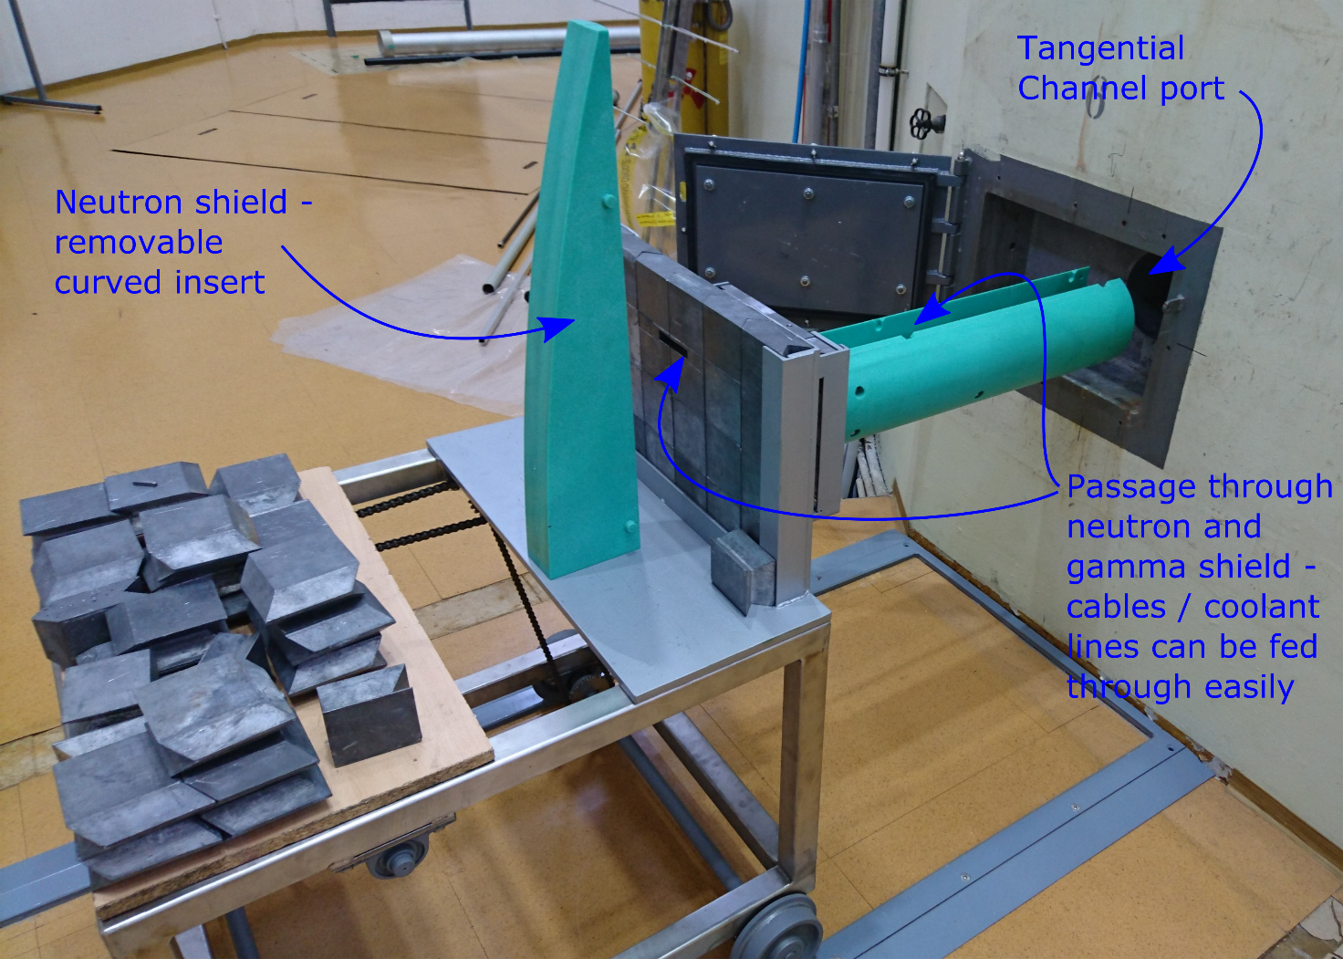
Task 15.5: JSI TRIGA
Reactor Transport System
The design and construction of the irradiation device / transport system for large object irradiations at the JSI TRIGA reactor has been successfully achieved
Max. lateral dimension in the channel is 14.6 cm. The device is operational and enables on-line irradiation testing with fast neutron flux >2×10¹¹ n/cm²/s
Early 2017: Experimental verification of the n spectra and n and γ flux profiles
D15.9 ACHIEVED

Slide 18
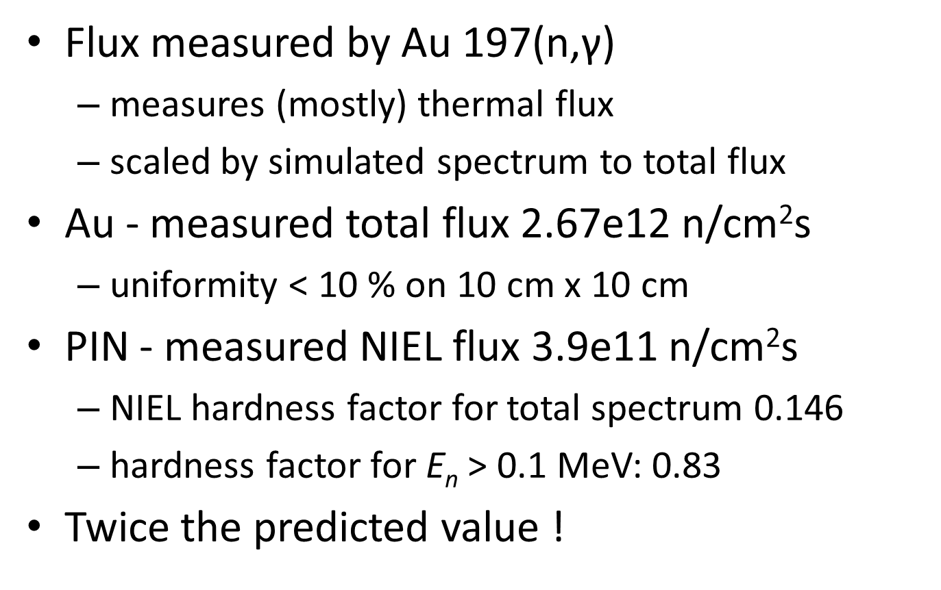
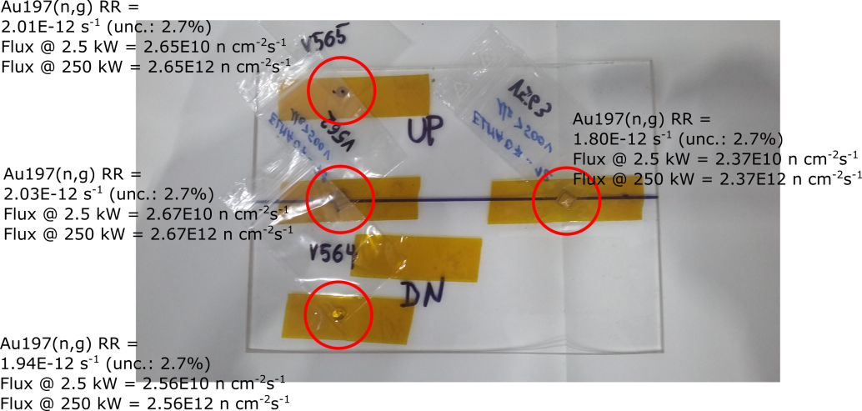
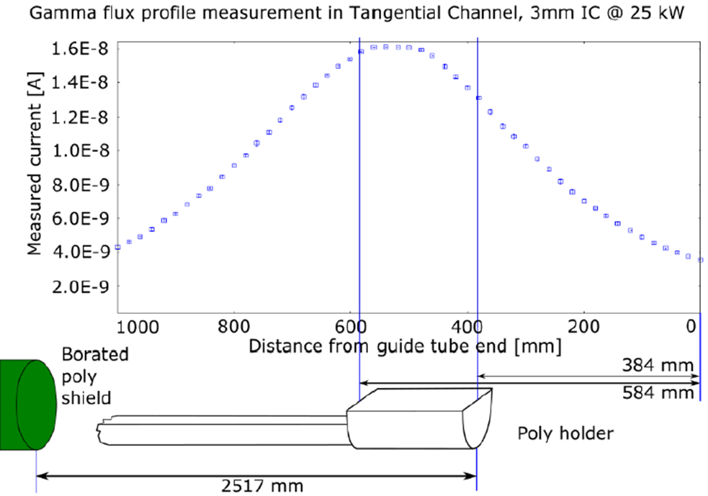
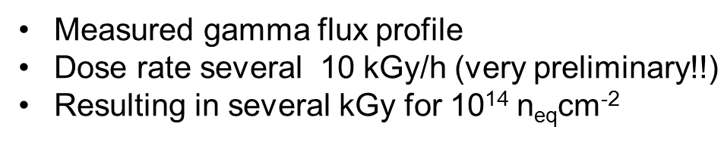
Task 15.5: JSI Channel Commissioning Measurements
06 April 2017

Slide 19
Task 15.5: CERN Proton Facility
D15.6: CERN proton facility upgrade
  Facility management system, storage area, contactless fluence monitor and online database on irradiation facilities are operational at the CERN proton facility.
  MS16, MS35
  Due M24
D15.7 : Radiation-hard facility instrumentation for the CERN proton facility
  Beam profile monitor operational, box allowing to irradiate samples at -40 degrees C installed in the beam line and sample holders on radiation hard material produced and tested up to 10¹⁷ p/cm².
  MS36, MS85 (M36)
  Due M44
  See more details on B. Gkotse’ s presentation on WP15 session

Slide 20
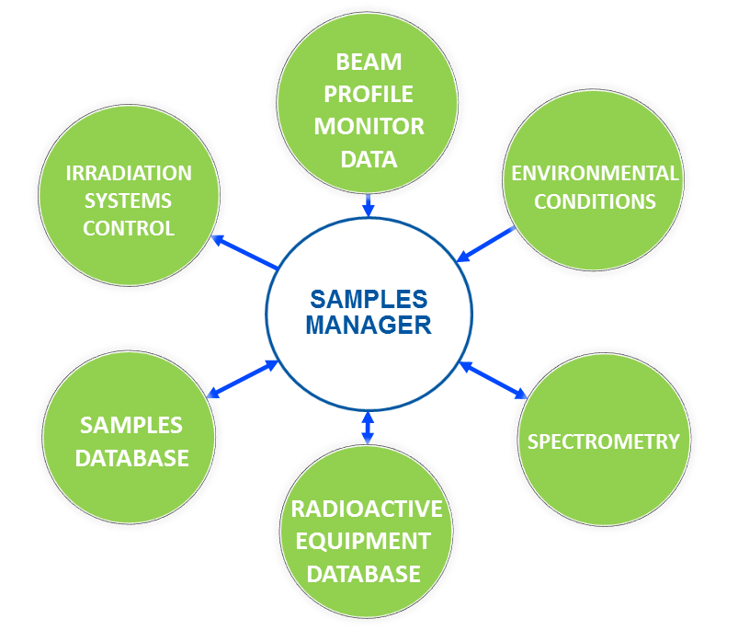
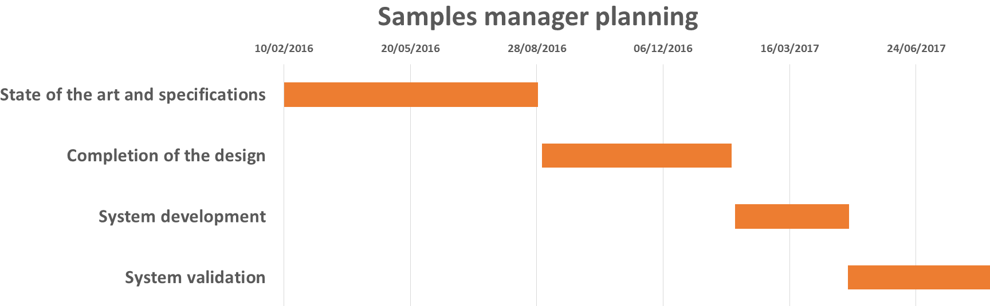
Task 15.5: CERN Proton Facility Samples Manager
Summer 2016 (MS16)
Specifications
Database structure
Design
Software
Spring 2017 (D15.6)
Development
Validation
D15.6
Detailed Specification document: AIDA-2020-MS16
(*) PhD Student funded through AIDA-2020
D15.6 (M24)
20

Slide 21
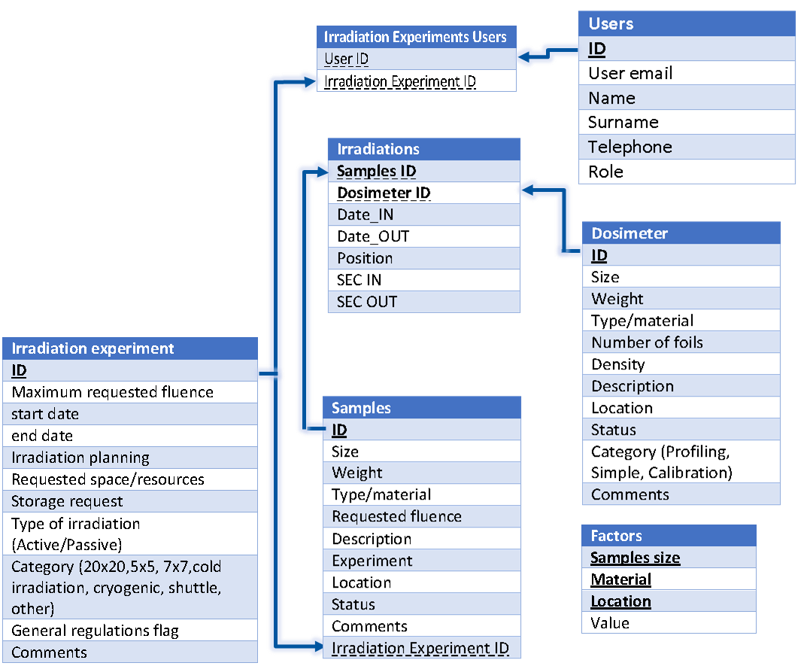
Task 15.5: CERN Proton Facility Samples Manager
Specifications
Database structure
Design
Software
Development
Validation
D15.6 (M24)
21

Slide 22




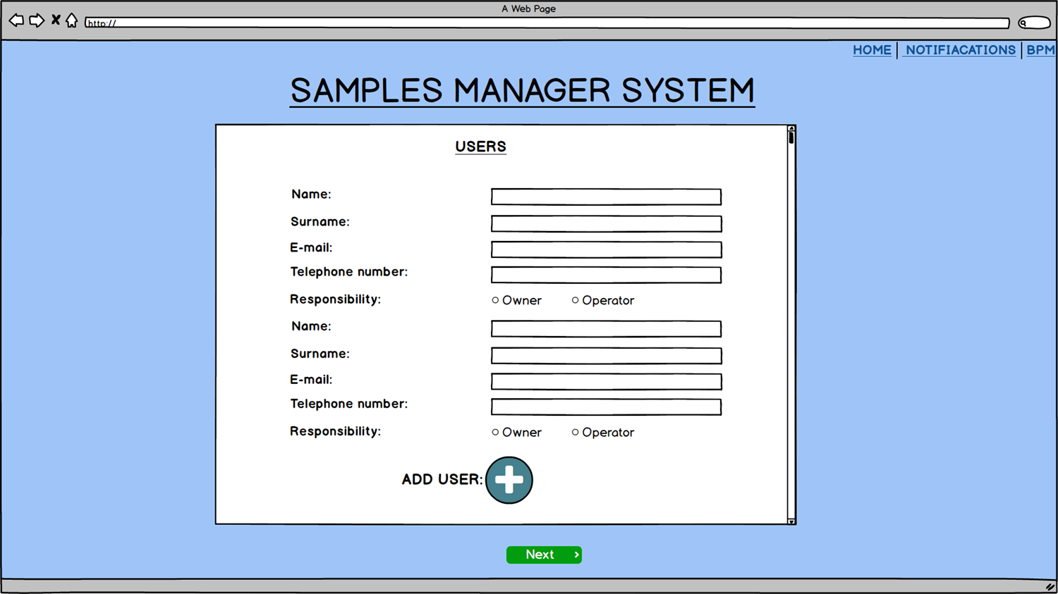
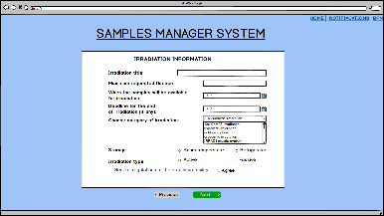
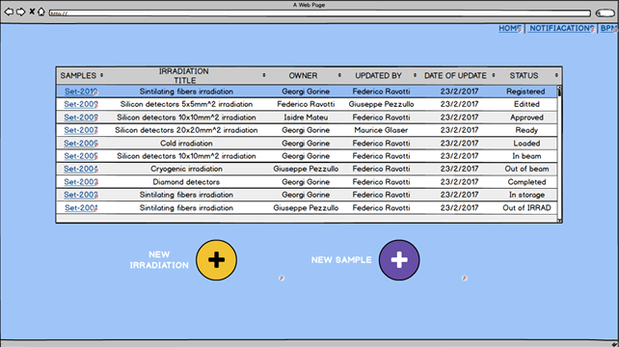
Task 15.5: CERN Proton Facility Samples Manager
Specifications
Design of the interfaces according to the specifications and the requirements of the users and the coordinators
Design with balsamiq mockups
Software development with Oracle database, Django, Bootstrap and Angular
Database structure
Design
Software
Development
Validation
Balsamiq Mockups
D15.6 (M24)
22

Slide 23
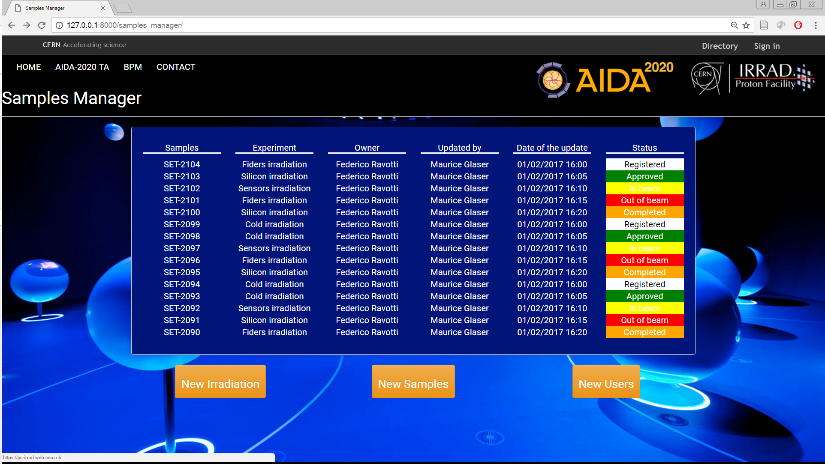
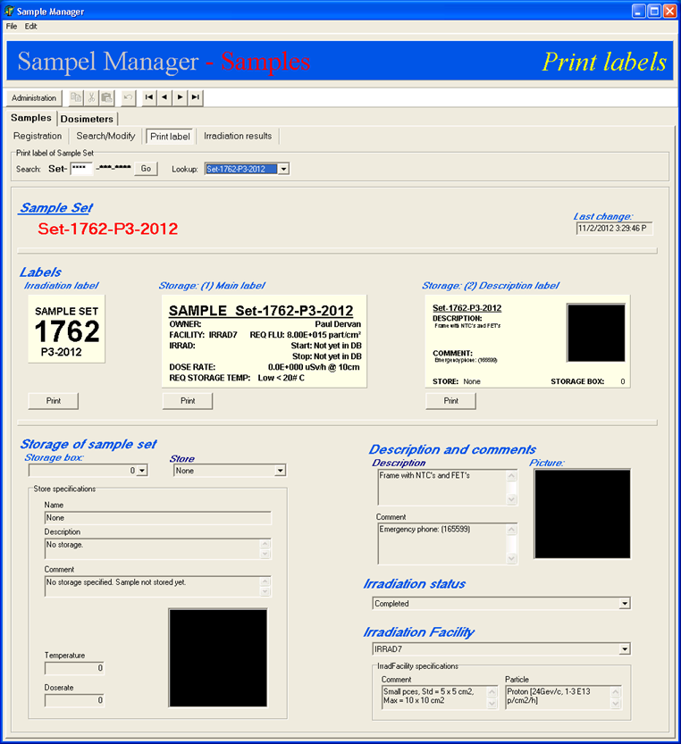
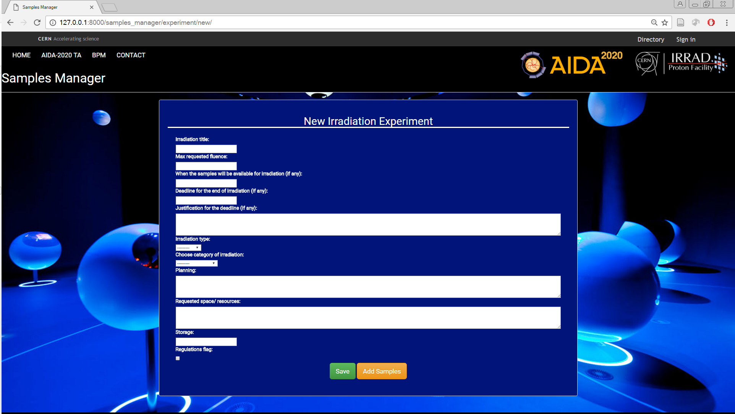
Task 15.5: CERN Proton Facility Samples Manager
Centralised system for the overall IRRAD facility operation
Interfaces customised according to users
Overall display of the beam and environmental conditions
Compatible with the CERN computing infrastructure and procedures (TREC)
Secured with the CERN authentication system (SSO)
New system
Old system
D15.6 (M24)
23

Slide 24
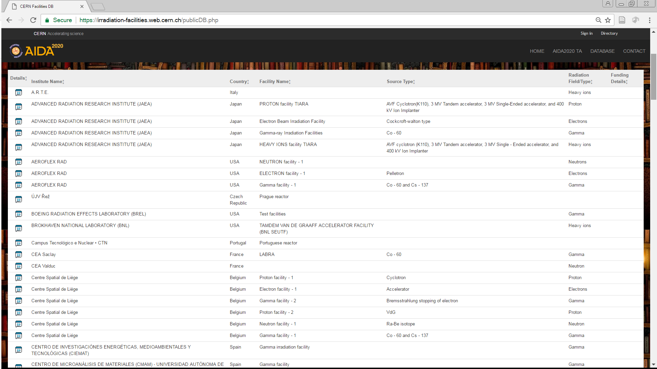
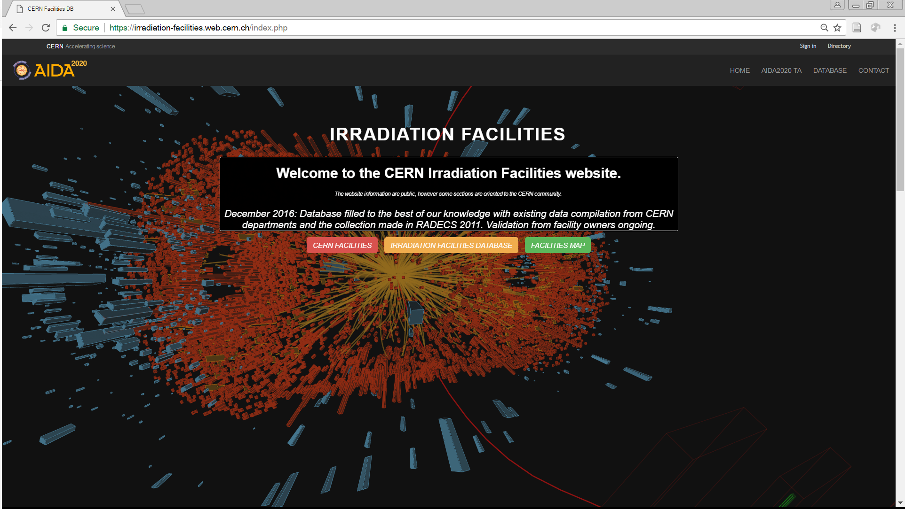
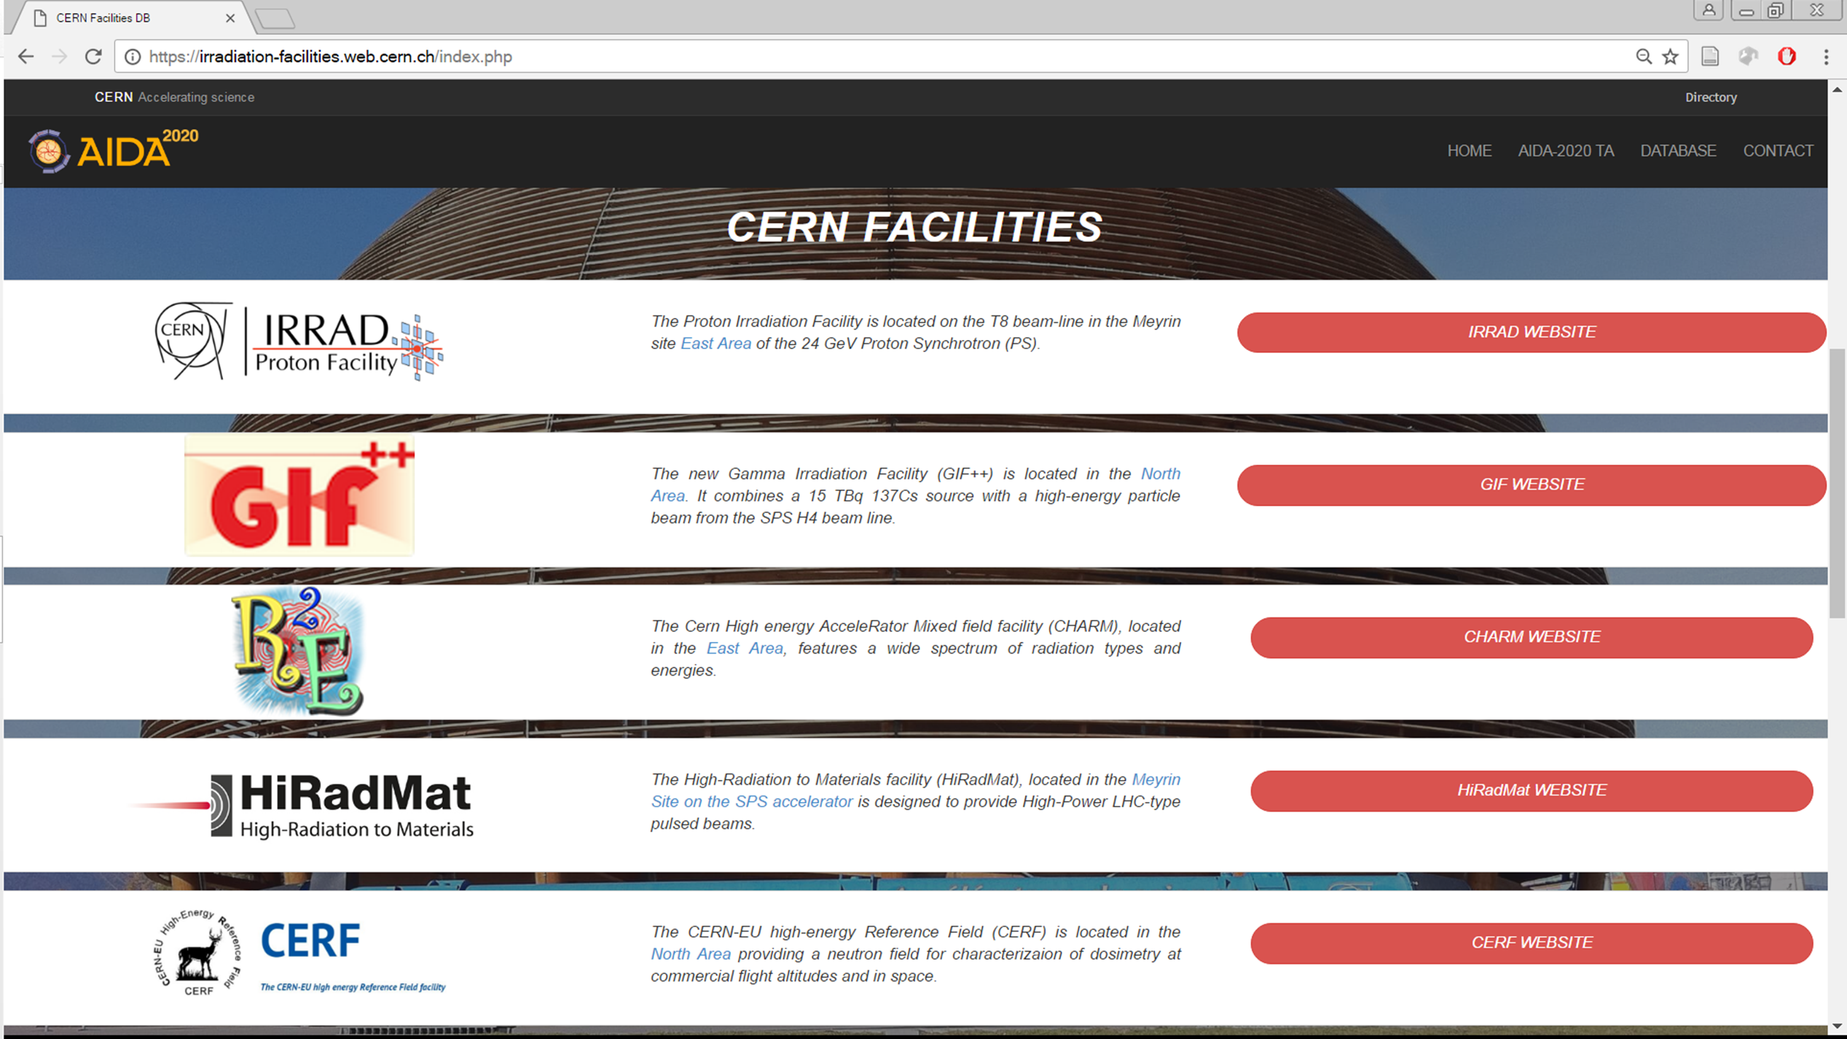
Task 15.5: CERN Proton Facility Irradiation Facilities Database
Facilities worldwide
Deliverable in EU-project AIDA-2020
Unified entry point for irradiation facilities at CERN and worldwide
Essential (but exhaustive) collection of information
182 entries initially loaded
Data validation in progress since Feb. 8th
Homepage
CERN Facilities
irradiation-facilities.web.cern.ch
D15.6 (M24)
24

Slide 25
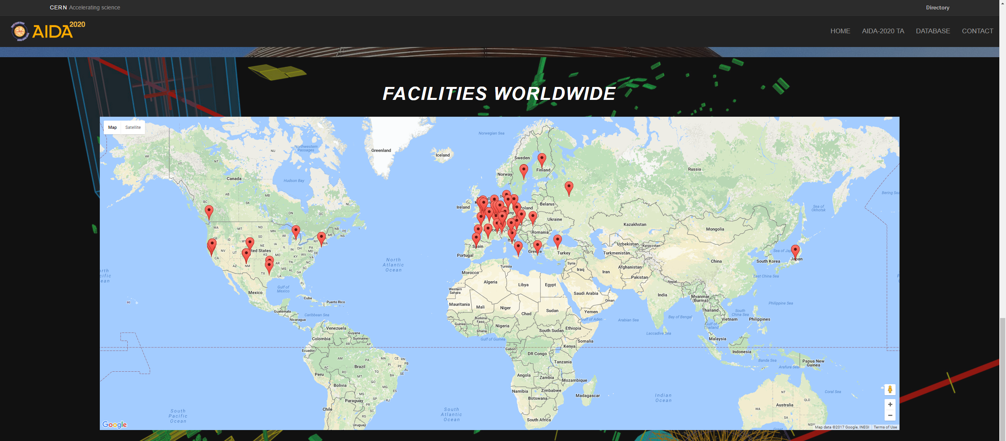
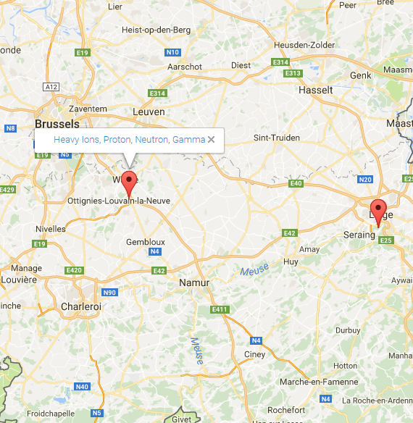
Task 15.5: CERN Proton Facility Irradiation Facilities Database
Open access data, secured with the CERN authentication system (SSO)
Search filters by country, source or radiation field
Irradiation facilities worldwide map
Possibility to ADD a new facility and EDIT an existent one by the facility coordinator
Auto-maintenance (regular reminders)
D15.6 (M24)
25

Slide 26
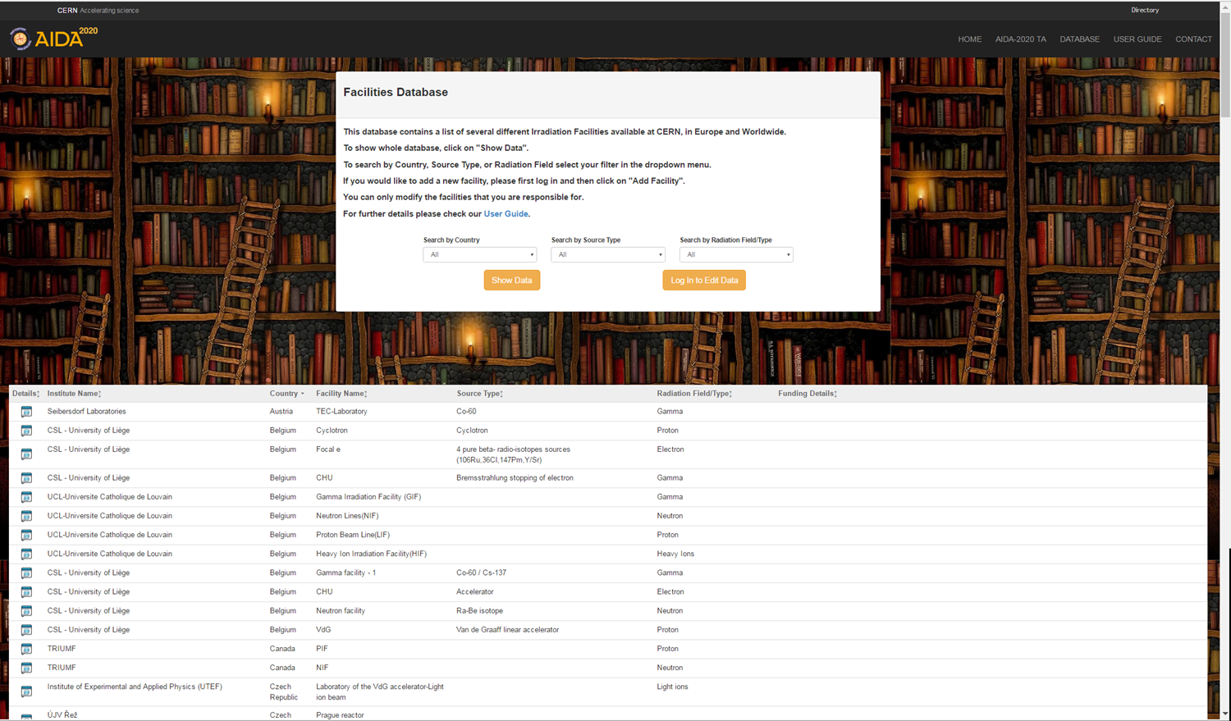
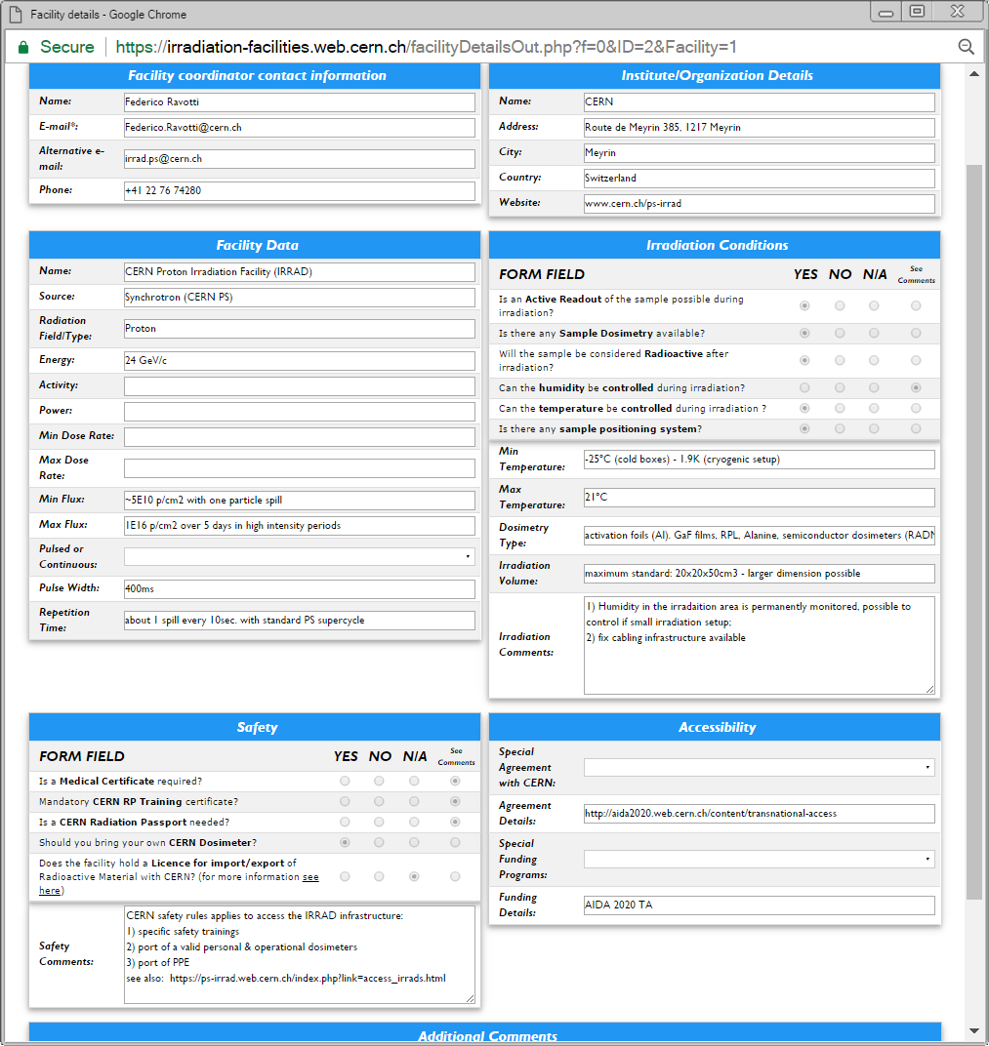
Task 15.5: CERN Proton Facility Irradiation Facilities Database
D15.6 (M24)
26

Slide 27
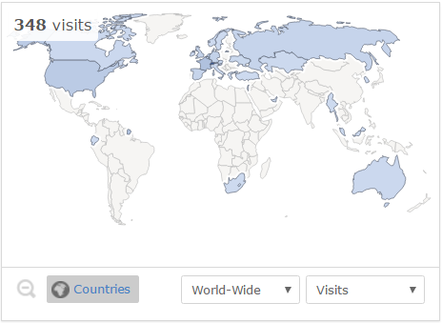
Task 15.5: CERN Proton Facility Irradiation Facilities Database
42 entries have been validated so far by the Facility Coordinators
The website has been visited ~350 times
Follow up:
Send second reminder to the Facility Coordinators that did not reply yet
Article on AIDA-2020 newsletter being released
Send the first “annual” validation reminder (test the notification system) by the end of 2017
Contact CERN colleagues to remove outdated information from old CERN websites
D15.6 (M24)
27

Slide 28
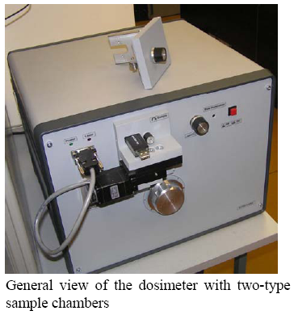
Task 15.5: CERN Proton Facility - Contactless fluence monitor
The pure c-Si high resistivity materials appear to be the best option for reliable monitoring of hadron irradiations over wide fluence range from 10¹¹ to 5×10¹⁶ cm⁻².
Silicon material used in the microelectronics can be also recommended for high fluence monitoring.
Further recombination and trapping studies
10²
MS35 ACHIEVED
10¹²
D15.6 (M24)

Slide 29
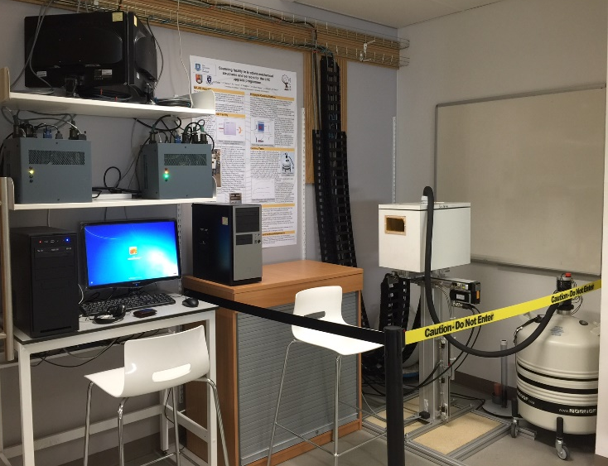
Task 15.5: Cold Irradiations at Birmingham Facility – LN₂ Cooling
The University of Birmingham Cyclotron irradiation facility provides limited access to enable new development of the system.
To ease pressure on the schedule a duplicate scanning system and cold box has been produced by Sheffield.
Over the course of 2016, using irradiation running data and evaluation in Sheffield, the prototype cold box has been evaluated and proven to work reliably with better cooling to prevent silicon sensor annealing.
The new cold box design is completed (MS36).
Waiting for a workshop slot to be available to begin production – Plan: end 2017.
  Due to the low level of funding from AIDA2020 and removal of a UK-ALTAS staff post at USFD, it is prohibited to request a production advancement at this time.
D15.8 (M36)

Slide 30
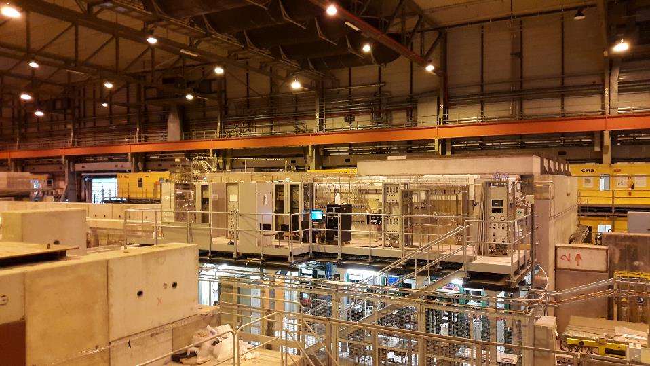
Task 15.5:
GIF⁺⁺ Gas System Upgrade
R&D on gaseous detectors at GIF++:
  mainly detectors for muon systems of the LHC experiments
  about 15 setups (between 20-30 detectors)
  real size detectors and prototypes (several m² active surface each)
  7 different types of muon detector technologies (CSC, DT, GEM, GRPC, MM, RPC, TGC)
  test duration varies from few months to years
06 April 2017

Slide 31
Task 15.5:
GIF⁺⁺ Gas System Upgrade
The gas systems infrastructure is a key element for successful R&D programs at GIF++
New mixing units have been developed and built
  → Installed and operational
Additional gas-distribution panels have been included at supply & at gas system
New gas recirculation modules have been developed and built
  → one operational since 2015, one since 2016 and one recently installed
  Further developments ongoing to have gas recirculation systems allowing operation of detectors requiring high gas filtering capacity
  → New design for an automated purifier (ATLAS and CMS RPC R&D)
Gas analysis and especially gas chromatography are available to all GIF++ users
  → GC operational since beginning 2016
  → Second IR analyser installed in 2016
  → Automated O₂/H₂O analysis rack available in 2017
D15.10 on Track for M24 (report being prepared)
(*) supported by Tech Students funded through AIDA-2020
D15.10 (M24)

Slide 32
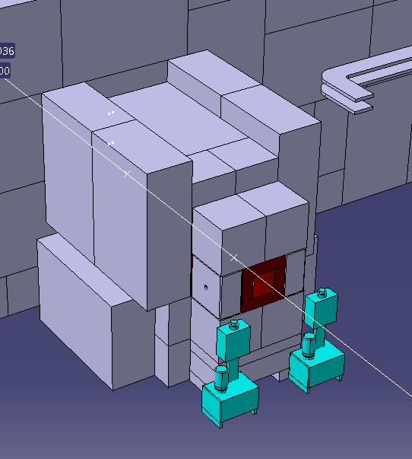
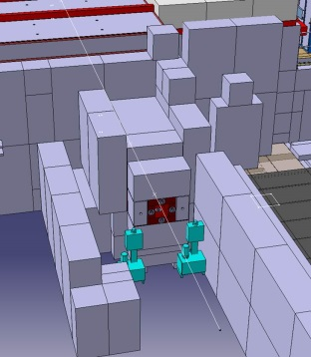
Task 15.5: GIF⁺⁺ Facility Upgrade
Improved cosmic-rays tracker:
The design of the chambers for the GIF++ cosmic tracker extension has been completed.
New RPC chambers to instrument the vertical walls of the GIF++ bunker are in preparation
Chamber mechanics is at CERN
Production of chamber active elements (gas volumes, readout panels) planned for next summer (material for electrodes being purchased)
Chamber position to be finalized according to constraints
Augmented reality demonstrator:
Waiting for the DAQ system to be ready
starting soon too develop software with simulated data for test purposes
Setup of the infrastructure will start soon:
- installation of position markers inside the bunker
- development of software for the observer position reconstruction (3D-coordinates inside GIF++ bunker)
Downstream Upstream
MS37 ACHIEVED
MS86 (M36)
D15.11 (M48)

Slide 33
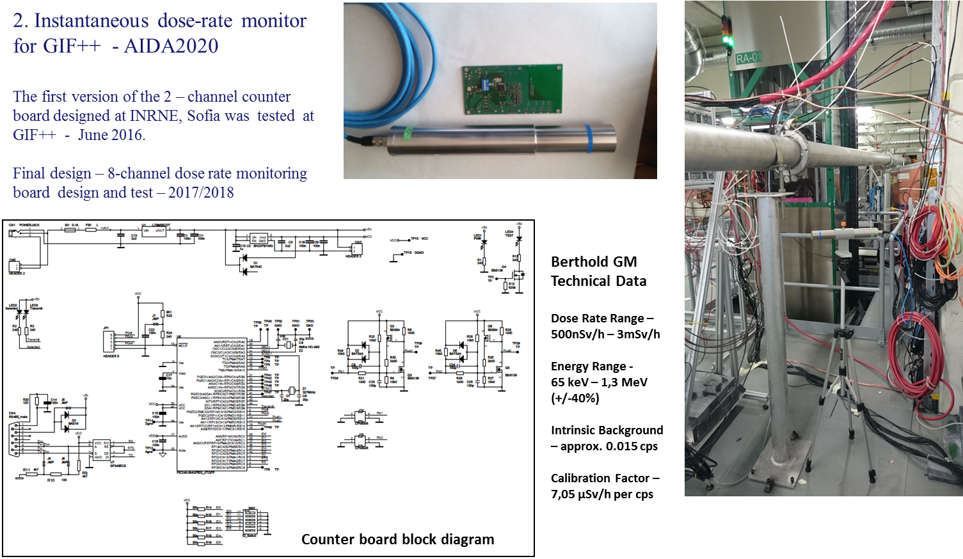
Task 15.5: GIF⁺⁺ Facility Upgrade
MS85 (M36)
D15.11 (M48)
06 April 2017

Slide 34
AIDA-2020 WP 15
Thank you for your attention!

