Slide 1
WP13 – JRA 1
WP13 = JRA1 = Innovative gas detectors
WP COORDINATORS:
Silvia Dalla Torre, Imad Laktineh

Slide 2
WP13, SCIENTIFIC ASPECTS
1/4
REMINDER
2 TECHNOLOGIES: the future of GAS DETECTORS
  RPCs
  MPGDs
TASKs grouped in 3 major sectors
  Advanced detector developments, namely detector R&D:
    TASK 13.2, including 5 activities
  Tools to facilitate the detector development, namely technological R&D oriented to detector development by realizing dedicated lab instruments:
    TASK 13.3, including 3 activities
  Preparation for large series production, namely establishing techniques and protocols for large size/series construction, QA, production transfer to industry:
    TASK 13.4, including 7 activities
The program is a good balance between
  R&D for better and better detector performance matching the requirements of present and future experiments
  Tool development and TT to ensure the construction of large experimental set-ups (and facilitating applications beyond research)

Slide 3
INSTITUTIONS & ACTIVITIES
11 beneficiary groups
9 partner groups
In total : 13 Institutions

Slide 4
THIS REPORT
The focus of the activity report is on
  last year activity
  deliverables and milestones expected in the next months
    2 DELIVERABLES, M24
    4 MILESTONES, M24
    1 MILESTONE, M26

Slide 5
RPCs

Slide 6
RPCs vs AIDA2020-WP13
what is strategic and how WP13 answers to the quest
Low resistivity RPCs for high rates TASKs 13.2.1, 13.2.3
Fast timing RPCs TASK 13.2.2
Large RPCs TASKs 13.2.2, 13.4.1
Eco-friendly gases TASKs 13.2.3
Large production TASK 13.4.6
REMINDER

Slide 7
Low resistance RPCs for high rates
Test at CERN SPS
~10¹⁰ Ω/cm
~10¹²-10¹³ Ω/cm

Slide 8
Low resistance RPCs for high rates
Test at CERN SPS
1 m²
~10¹⁰ Ω/cm
This activity results in a fully satisfactory matching of the milestome MS52
~10¹²-10¹³ Ω/cm

Slide 9
Fast timing RPCs
Reading out the strips at the 2 ends
1 m²
Evaluation of the PETIROC ASIC
σ = 202 ps

Slide 10
ANOTHER INGREDIENT TOWARDS HIGH RATES

Slide 11
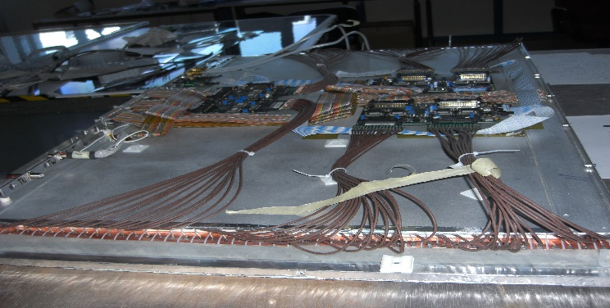
LARGE SIZE RPCs
Towards large size also with new low R materials:
Enginering mosaic-type layers (gas tight!)
Dedicated large-size clean room with specific equipment

Slide 12
ECO-FRIENDLY GASSES

Slide 13
LARGE PRODUCTION, ENGINEERING PHASE

Slide 14
LARGE PRODUCTION, QC
Detector quality control:
Measurements of the electrode resistivity
Control of the gap production

Slide 15
MPGDs

Slide 16
MPGDs vs AIDA2020-WP13
what is strategic and how WP13 answers to the quest
Novel architectures TASKs 1.2.4, 1.2.5
    Finer time resolution
    Finer space resolution
    Higher gain
    Higher rate capability
    Simplified construction
Tools for lab and experiments TASKs 1.3.1, 1.3.2, 1.3.3
Quality Control TASKs 1.4.3, 1.4.4, 1.4.5
Large production and TT TASKs 1.4.2, 1.4.7
Applications beyond science TASKs 1.2.4, 1.2.5, 1.4.3, 1.4.4, 1.4.5, 1.4.2, 1.4.7
REMINDER

Slide 17
μR-WELL
Home house
REMINDER
local high rate, so far
large area irradiation at test beam, next June

Slide 18
μR-WELL
Home house
Home house
REMINDER
local high rate, so far
large area irradiation at test beam, next June
This recent activity is more advanced respect to the milestone MS53.
Previously presented results fully match of the milestome MS53.

Slide 19
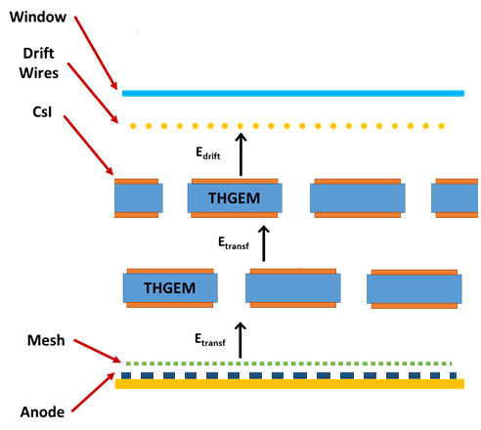
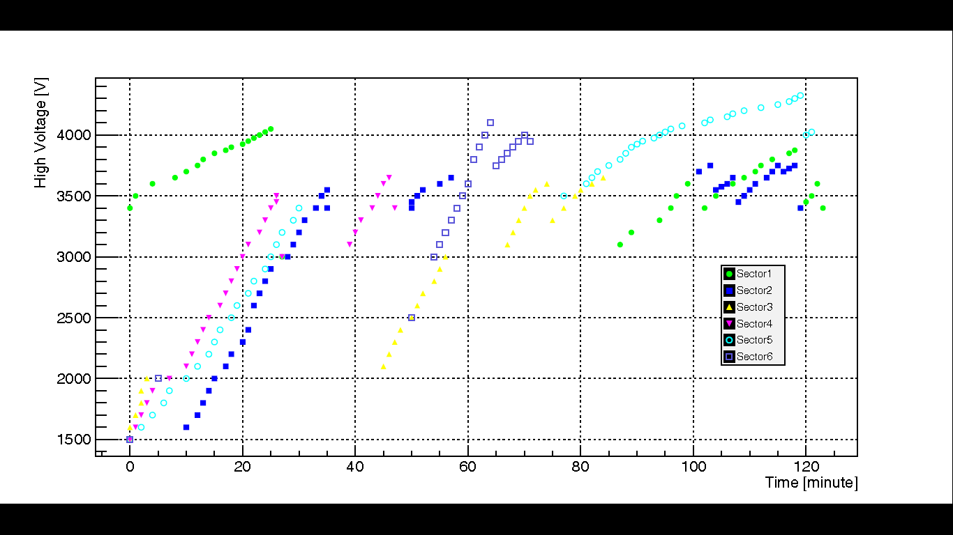
HIGH GAIN MPGD
Staggered THGEMs
THGEMS by Permaglas ME730
by RESARM Engineering Plastics SA
Raw material characterization
Electrostatic properties by Paschen test
GAIN UNIFORMITY SCAN: σ: 13%
ENERGY RESOLUTION: 20 %
GAIN vs TIME
  Charging-up
  Ion motion in the bulk material
REMINDER
Nominal thickness 0.7 mm
  /Δ/ < 4%; σ < 2%
Nominal thickness 1 mm
  /Δ/ < 2%; σ < 1%
90% PASCHEN limit
Conclusions:
Robust material, remarkable uniformity performance
Easy to operate and limited gain dependence vs time
Good potentialities for high gain multilayer devices
Interesting as a replacement for THGEM by etchableglass
approaches: much cheaper !

Slide 20
HIGH GAIN MPGD
Staggered THGEMs
THGEMS by Permaglas ME730
by RESARM Engineering Plastics SA
Raw material characterization
Electrostatic properties by Paschen test
GAIN UNIFORMITY SCAN: σ: 13%
ENERGY RESOLUTION: 20 %
GAIN vs TIME
  Charging-up
  Ion motion in the bulk material
Nominal thickness 0.7 mm
  /Δ/ < 4%; σ < 2%
Nominal thickness 1 mm
  /Δ/ < 2%; σ < 1%
REMINDER
Nominal thickness 0.7 mm
  /Δ/ < 4%; σ < 2%
Nominal thickness 1 mm
  /Δ/ < 2%; σ < 1%
This activity results in a fully satisfactory matching of the milestome MS61
90% PASCHEN limit
Conclusions:
Robust material, remarkable uniformity performance
Easy to operate and limited gain dependence vs time
Good potentialities for high gain multilayer devices
Interesting as a replacement for THGEM by etchableglass
approaches: much cheaper !

Slide 21
INTEGRATION OF FE-chips IN SRS

Slide 22
DEVELOPMENT OF
MPGD-dedicated ELECTRONIC TOOLS
 | Task 13.3.2
Deliverable [M24] | High Voltage Power Supply for MPGD
NOW
NEXT STEP
LAST YEAR

Slide 23
DEVELOPMENT OF
MPGD-dedicated ELECTRONIC TOOLS
 | Task 13.3.2
Deliverable [M24] | High Voltage Power Supply for MPGD
This activity results in a fully satisfactory matching of the DELIVERABLE D13.6
NOW
NEXT STEP
LAST YEAR

Slide 24
DEVELOPMENT OF
MPGD-dedicated ELECTRONIC TOOLS
 | Task 13.3.2
Deliverable [M24] | High Voltage Power Supply for MPGD
 | (Floating) Pico ammeter
 | Signal Processing
 | Monitoring and Control Unit
FemtoBox: femto-ammeter
Microcontroller
of environmental parameters:
Present version WIN_CC OA
Next version: Raspberry Pi
APIC:
Charge Preamplifier
– Shaper Amplifier
Chain
Chips
commercially
available

Slide 25
Development of a general purpose readout electronics for MPGDs
Chip SALTRO16 ASIC
Status summary
The packaging of the SALTRO16 ASIC:s is underway.
Delivery expected mid June.
The design of the Development Board is ready
A first version of the DAQ system enables readout of data
NOW smaller packing possible
To avoid carrier difficulties:
Chips at NOVAPACK

Slide 26
QA: Control of foil/micromesh mechanical tensioning
Moiré fringe interferometry ON LARGE SIZE, engineered → resolution: 31 μm
Fiber Brag Grating
(FBG) sensors
embedded in MPGDs
and tested

Slide 27
QA: Control of foil/micromesh mechanical tensioning
Moiré fringe interferometry ON LARGE SIZE, engineered → resolution: 31 μm
Fiber Brag Grating
(FBG) sensors
embedded in MPGDs
and tested
This activity result in a fully satisfactory matching of the milestome MS54

Slide 28
QA: Leopard scanning system for THGEMs/GEMs
Small size prototype of optical / gain scanning, high resolution

Slide 29
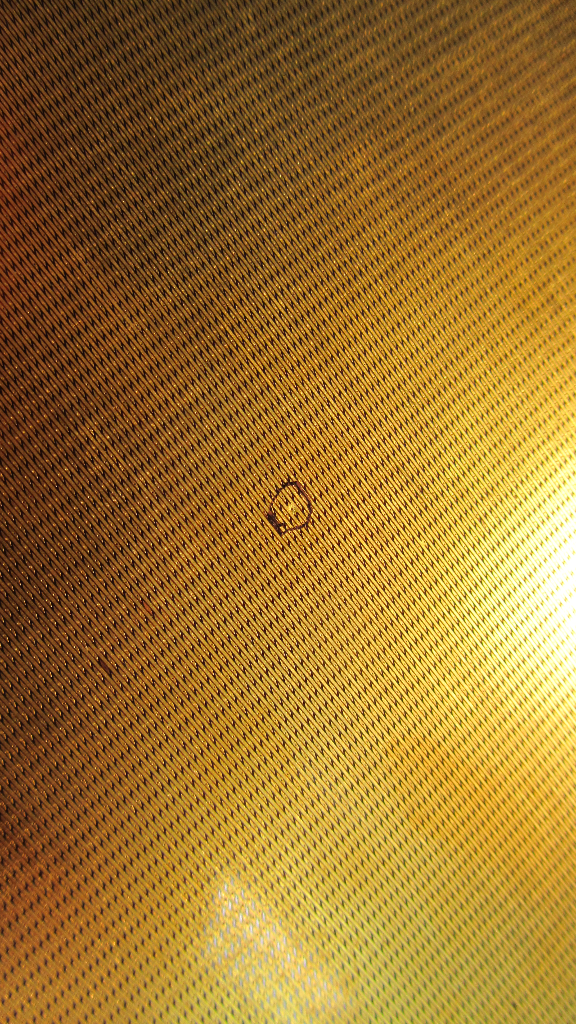
QA: the electrical integrity of electrode patterns
automatic system to ensure the electrical integrity of electrode patterns by pulse reflection method
EXAMPLE:
2D readout geometry

Slide 30
QA: the electrical integrity of electrode patterns
automatic system to ensure the electrical integrity of electrode patterns by pulse reflection method
EXAMPLE:
2D readout geometry
EXAMPLE:
2D readout geometry
This activity result in a fully satisfactory matching of the milestone MS55

Slide 31
LARGE PRODUCTION: RESISTIVE LAYERS

Slide 32
LARGE PRODUCTION: RESISTIVE LAYERS
This activity result in a fully satisfactory matching of the DELIVERABLE D13.7

Slide 33
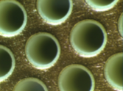
LARGE PRODUCTION: TOWARDS INDUSTRIALIZATION
Anode PCB for ATLAS NSW
Now standard production at ELVIA and ELTOS
THGEM INDUSTRIAL TRANSFER
First example:
THGEM for COMPASS RICH produced by ELTOS
30x60 cm², thickness 0.4 mm
  Hole pitch 800 µm and diameter 400 µm, no rim
  Large production of THGEM (LEM) for WA105,
  Both ELTOS and ELVIA production satisfactory

Slide 34
MANAGEMENT
&
ADMINISTRATIVE
ASPECTS

Slide 35
DELIVERABLES, NEXT MONTHS
report already submitted
to AIDA2020 management
= 30/4/2017

Slide 36
MILESTONES, NEXT MONTHS
report already submitted
to AIDA2020 management
= 30/4/2017
report already to be submitted
to AIDA2020 management
= 30/6/2017
REMINDER:
Milestone successfully matched (1 May 2016)

Slide 37
WP13 papers (Dec. 2016)
1 | F. Lagarde, M. Gouzevitch, I. Laktineh, V. Buridon, X. Chen et al. High rate, fast timing Glass RPC for the high {\eta} CMS muon detectors XIIIth Workshop on Resistive Plate Chambers and related detectors, Feb 2016, Ghent, Belgium. Journal of Instrumentation, 11, pp.C09006, 2016
2 | The μ-RWELL: “A compact, spark protected, single amplification-stage MPGD”, Nucl. Instr. & Meth A 824 (2016) 565.
3 | M. Alexeev et al., ”The gain in Thick GEM multipliers and its time-evolution”, 2015 JINST 10 (2015) P03026.
4 | M. Alexeev et al., “Status of the Development of Large Area Photon Detectors based on THGEMs and Hybrid MPGD architectures for Cherenkov Imaging Applications”, Nucl. Instrum. Meth. A824 (2016) 139.
5 | S. Dalla Torre, “The brilliant present and the promising perspectives of the Micropattern Gaseous Detectors”, Nuclear Physics News, Vol 26 (2016), no 3.
6 | L. Benussi for the CMS GEM collaboration, « A novel application of Fiber Bragg Grating (FBG) sensors in MPGD », arXiv:1512.08529 [physics.ins-det] INFN-15-10-LNF To be published in JINST (http://cds.cern.ch/record/2118619)

Slide 38
SURVEY of RESOURCES
third survey with confirmation of previous indications
(previous surveys on 4/6/15, on 15/6/16)
  Manpower available for the various activities
    No critical issue detected
  Complementary (respect to EC contribution) financial resources for equipment and consumables:
    In general they look available
  Laboratory infrastructures
    Adequate labs and related equipment available (all partners)

Slide 39
WP13 MANAGEMENT
Coordination strategy and its implementation:
  Close activity monitoring by regular meetings
    In the last year: 20/1/2017, 5/4/2017
  Help line:
    The task coordinators are invited to promptly contact the WP coordinators if difficulties arise (technical, financial, manpower)
      No need in the past year
  Facilitate the integration of the community:
    facilitate the implementation of all potential synergies also between the different technologies
      Several appearing: resistivity, screen printing and sputtering, foil planarity, lab equipment, novel eco-friendly gas mixtures, …
    WP13 meetings useful also from this point of view

Slide 40
WP13 MANAGEMENT
WP13 within AIDA2020
2 reports (talks) by WP13 at the AIDA2020 Steering Committee meetings
  On 23/9/2016
  On 2/2/2017
Written periodical reports
  P1 report (18 months); WP13 contribution sent to management on 5/12/2016
  WP14 mid term report (2 years): WP13 contribution sent to management on 28/3/2017
Synergies with WP4 (Micro-electronics)
Possibility of synergies with WP8 (Large scale cryogenic liquid detectors)
Arising synergies with WP2 (Innovation and Outreach)
  related to WP13 dedication to TT

Slide 41
SUMMARIZING
WP13 : 20 groups from 13 different Institutions
  AIDA2020-WP13 is cultural common house for the gas detector community in Europe
All the activities (tasks) are progressing well and there is no delay respect to the foreseen planning
  For both technologies: RPCs and MPGDs
  Activity progress also tested by matching DELIVERABLES and MILESTONES:
  In WP13 so far: 2 deliverables, 6 (1+4+1) milestones
  Resources available as required by the work planning
  Some examples of novel investigation domains originally not foreseen: vitality !
Synergies with different WPs within AIDA2020 also present:
  There is space to improve further

Slide 42
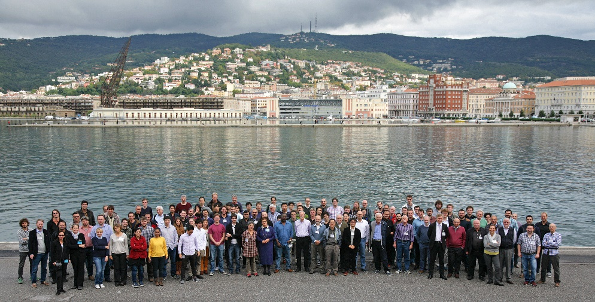
Advertisement :
MPGD2017 – 5th international Conference on MPGDs
at Temple University (Philadelphia)
May 2017
It follows:
MPGD2009, Kolympari-Crete, Greece
MPGD2011, Kobe, Japan
MPGD2013, Zaragoza, Spain
MPGD2015, Trieste, Italy
MPGD2015 - TRIESTE

Slide 43
BACK-UP

Slide 44
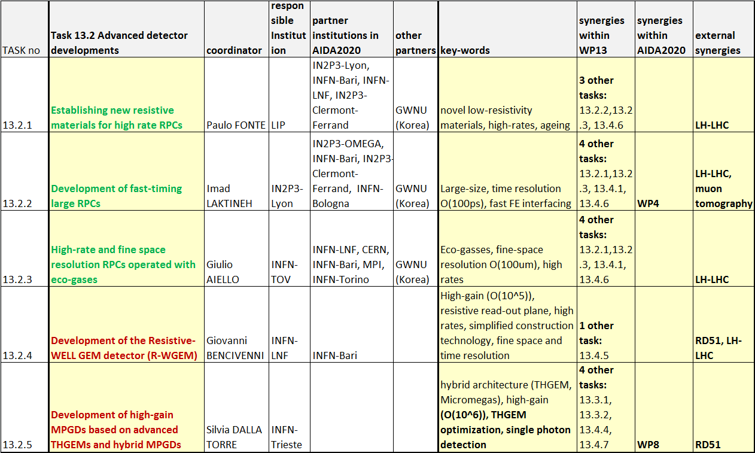
WP13, SCIENTIFIC ASPECTS
2/4

Slide 45
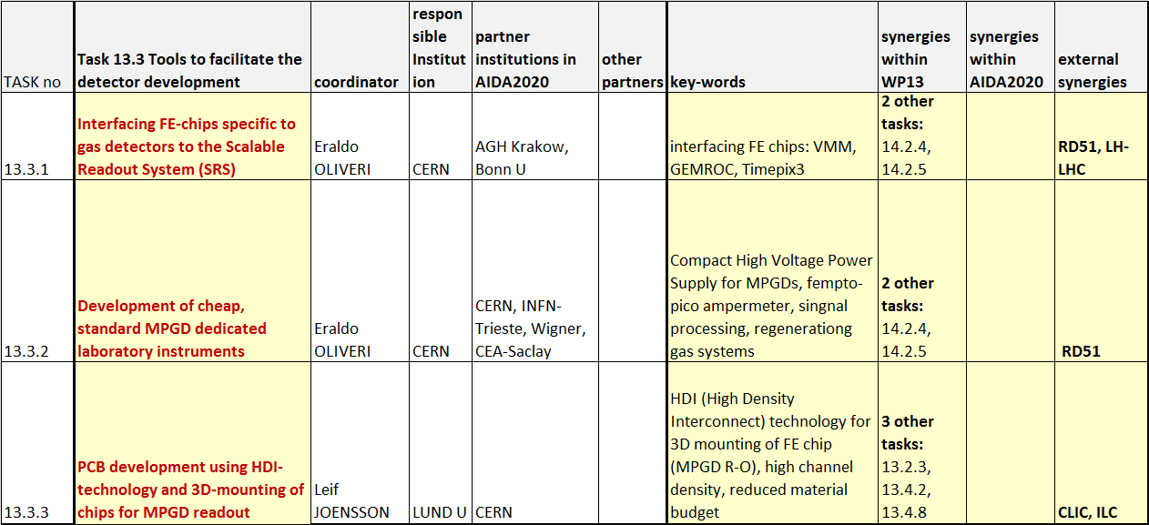
WP13, SCIENTIFIC ASPECTS
3/4

Slide 46
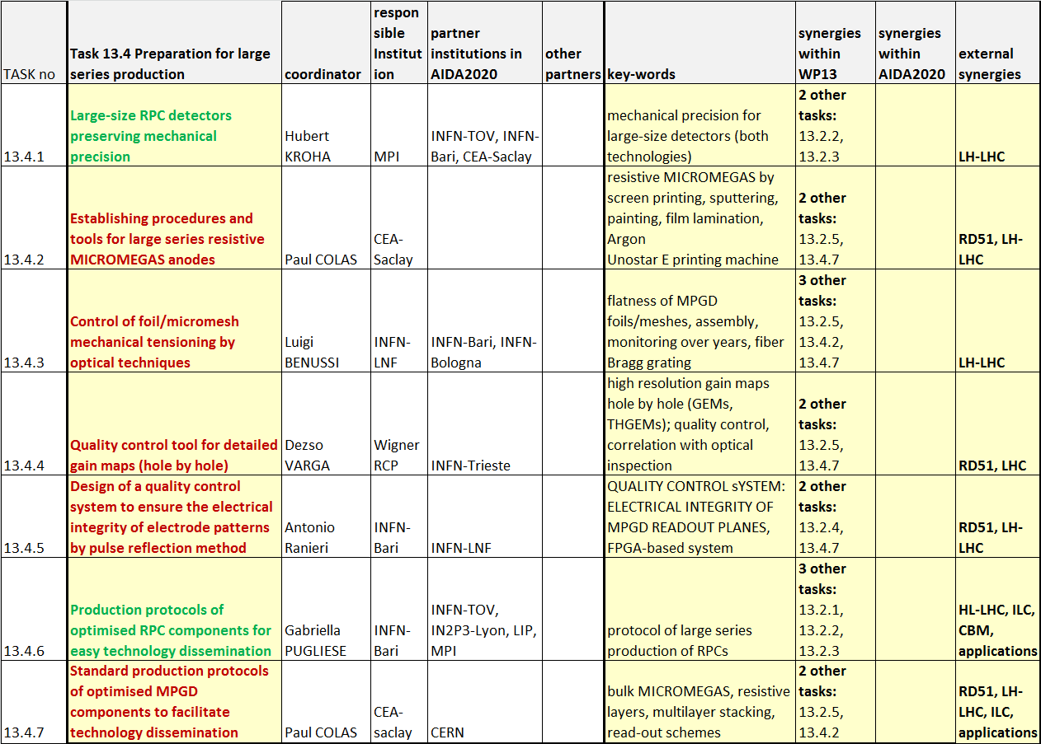
WP13, SCIENTIFIC ASPECTS
4/4

