Slide 1
Summary of WP7 activities
Anna Macchiolo, Iván Vila
Paris, 2nd AIDA-2020 Annual Meeting, 07.04.2017

Slide 2









Overview: Tasks
Device Simulation
Layout optimization.
Radiation damage modeling
Sensor manufacturing
Development & improvement of manufacturing processes for planar, 3D and LGAD devices.
MPWR for thinned 3D and slim/active edge planar.
Detector performance assessment
Hybrid thin planar & 3D pixels for HL-LHC environment.
Very small size and thin pixel sensors for CLIC.
Optimization signal multiplication structures.
Low Gain Avalanche Detectors for timing and tracking

Slide 3
Approaching WP7 Deliverables
Deliverable | Responsible Group | Month due
D7.1 Simulation of 3D pixel sensor cells | INFN | M18 (OCT 2016)
D7.2 Simulation active edge | CERN | M18 (OCT 2016)
D7.3 LGAD simulation | INFN | M18 (OCT 2016)
D7.4 TCAD model radiation damage | INFN | M46 (MAR 2019)
D7.5 Wafer Layout MPW run WP7 | CSIC | M30 (NOV 2017)
D7.6 Initial pixel characterization | UNIMAN | M24 (APRIL 2017)
D7.7 Final pixel characterization | MPG-MPP | M46 (MAR 2019)
D7.8 LGAD characterization | INFN | M46 (MAR 2019)
D7.6 Based on devices from previous non-AIDA funded runs & WP7 2016 test beam results→ report is being circulated within WP7

Slide 4
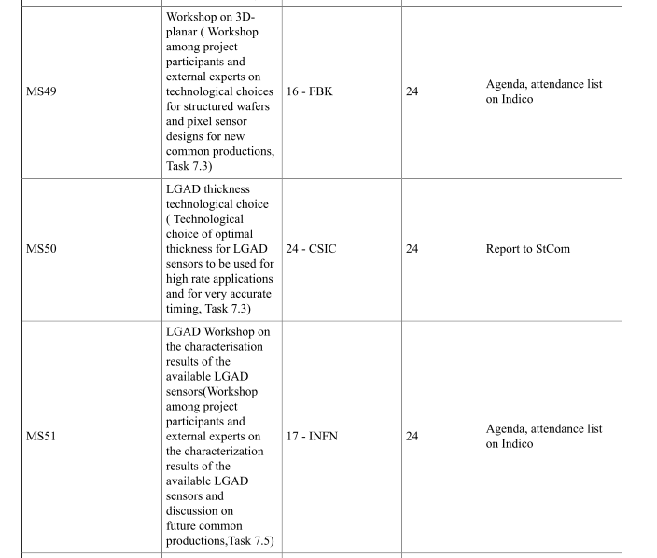

Coming Milestones
Dedicated workshop on the three sensor technologies (MS49, MS50) as full-day satellite meeting after the Trento Workshop (23th February)

Slide 5
Common sensor productions
At least three common productions foreseen in WP7, one for each technology
  Processing of MPWR for 3D and planar pixel sensors on thinned substrates, compatible with the RD53 chip
Common submission of LGAD sensors
  Prototyping of LGAD sensors on thin substrates, down to a bulk thickness of 50 μm
Deliverable | Responsible Group | Month due
D7.5 Wafer Layout MPW | CSIC | M30 (OCT 2017)
Milestone | Responsible Group | Month due
MS87 MPW runs completion | CSIC | M42 (OCT 2018)
3D production at FBK starting 1st QT of 2017
3D production at CNM beginning this week.
In the second half of 2017 → trying to achieve MS87 ahead of time
Active edge production at FBK
LGAD production at CNM

Slide 6
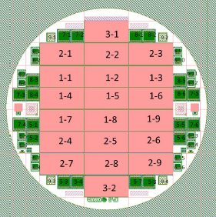
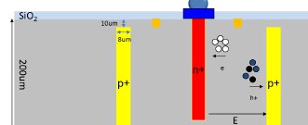
WP7 3D production at CNM
4” 200 μm thick wafers with double sided technology (developed and adopted for IBL), production started and due in Q4 2017
Hole diameter 8 μm
Mainly RD53 chip compatible sensors (pitch 50x50 μm²):
  10 RD53 50x50um² 1E
  6 RD53 25x100um² 1E
  • 4 RD53 25x100um² 2E
Temporary metal for Quality Assurance before UBM and flip-chipping

Slide 7
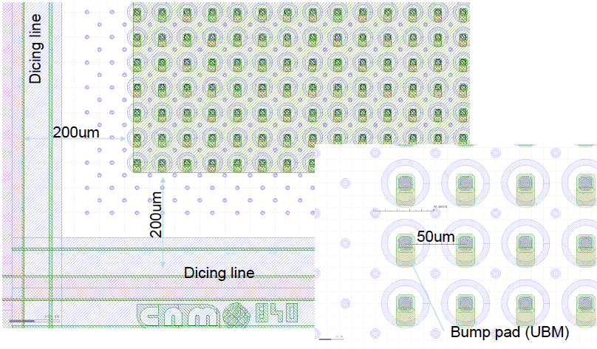
3D at CNM: 50x50 μm² cells

Slide 8
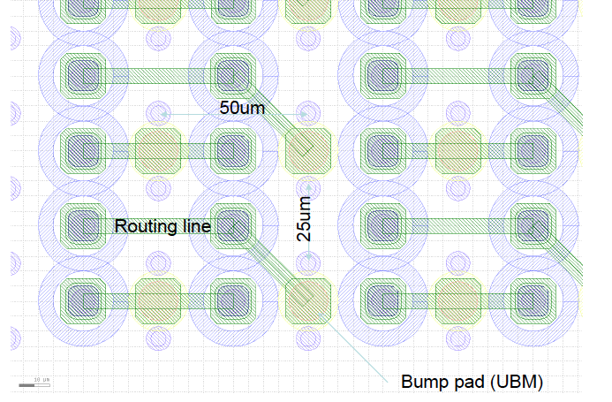
3D at CNM: 25x100 μm² cells

Slide 9
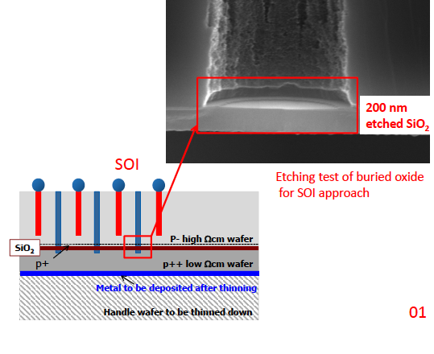
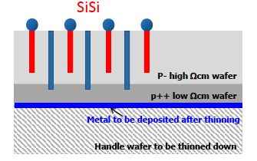
3D sensors at FBK
Single‐sided process
• “Thin” active layer (130 m): Si-Si or SOI
• Ohmic columns depth > active layer
• Junction columns depth < active layer
• Column diameter ~ 5 um
• Holes partially filled with poly
• Very slim edge (100 m)

Slide 10
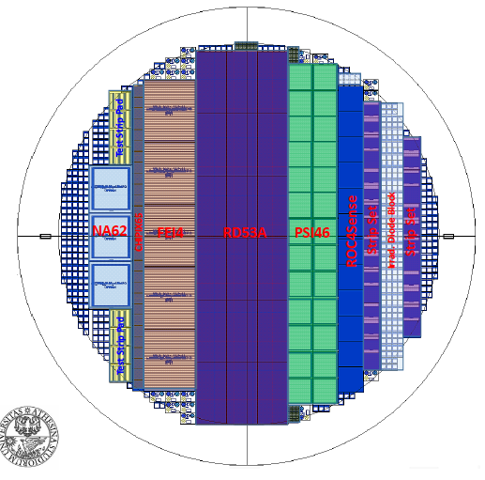
WP7 3D production at FBK
Wafers and photolitographic masks supplied by INFN
This wafer includes several improved
designs as per earned experience from
the first production at FBK.
• Aside conventional FEI4 and PSI46
complaint pixel sensors, the state of
art RD53A and ROC4Sense compatible
designs are introduced.

Slide 11
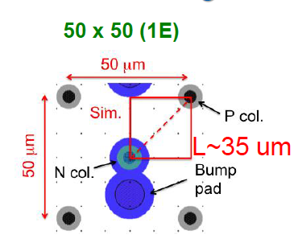
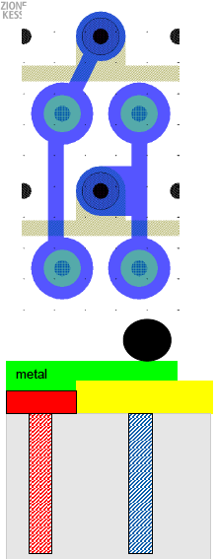
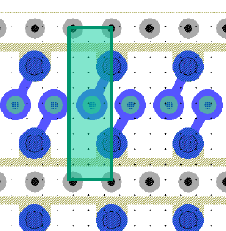
RD53 sensors - FBK
25x100 μm² can be difficult in 2E configuration:
- Place bumps on ohmic column
- Study radiation hardness of 1E configuration
50x50 μm² can be designed with relaxed distances between bump and columns

Slide 12
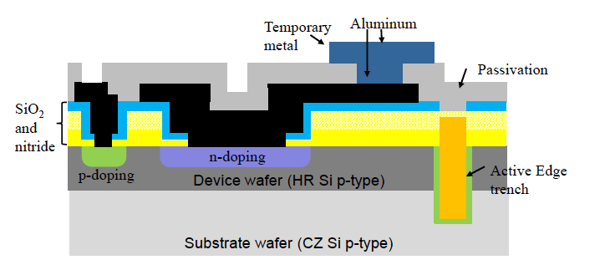
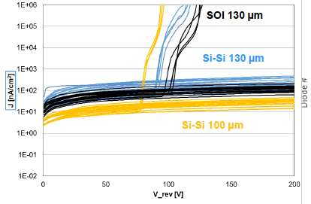
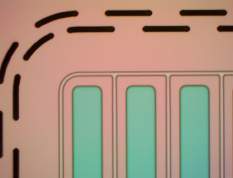
Active edge planar sensors- FBK
12 wafers on Si-Si and SOI material
Staggered trenches
Wafers now at IZM for interconnection

Slide 13
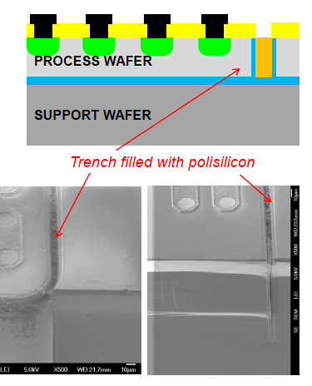
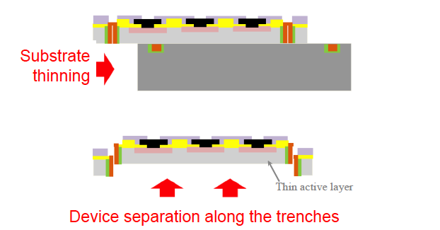
WP7 Edgeless production at FBK
Continuous trenches - Width < 10 um
SOI (preferred) or Si-Si wafers with 100 and 130 μm thickness
Poly-silicon filling
Substrates thinning leads to structure separation

Slide 14
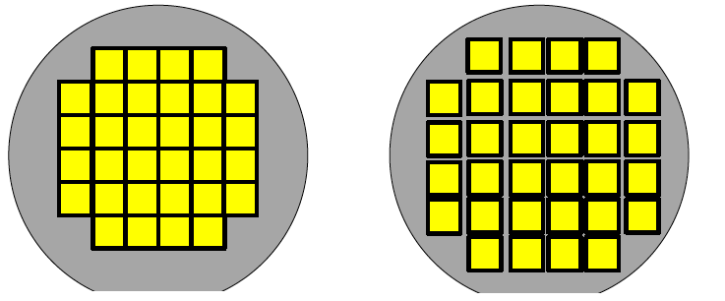
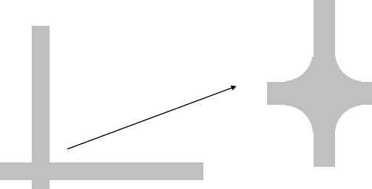
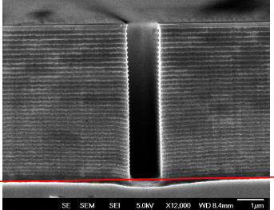
WP7 Edgeless production at FBK
Grid Layout
Island Layout
Choice of “grid” or “island” layout
Grid layout probably easier to make the structures separate from each other during carrier thinning
Island layout helps to avoid problems at the crossing points between trenches
Local increase of DRIE etching rate and enlargement of the trench that is then problematic to fill

Slide 15
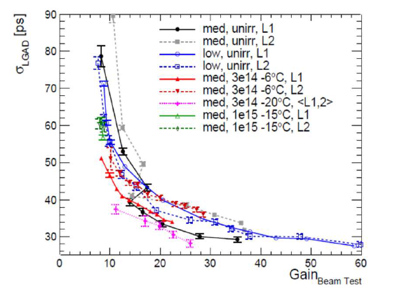
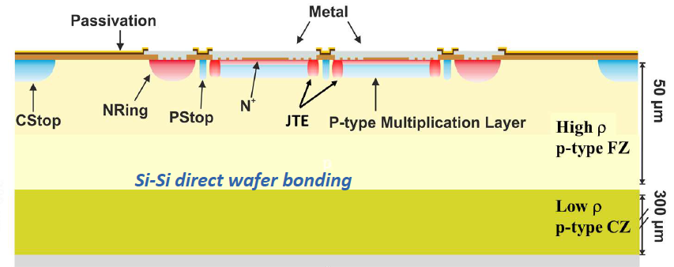
LGAD sensors for timing
Example of LGAD structure for ATLAS HGTD applications
Previous studies demonstrated the LGAD gain reduction when fluence increases.
There is no gain for fluences higher than 2·10¹⁵ n_{eq} /cm²
Gain degradation described by acceptor removal mechanism → electrical deactivation of the Boron dopant and reduction of the multiplication layer electric field due to the trapping of thermal carriers in radiation induced traps
Several mitigation strategies: thinner bulk works, Gallium doping does not improve

Slide 16
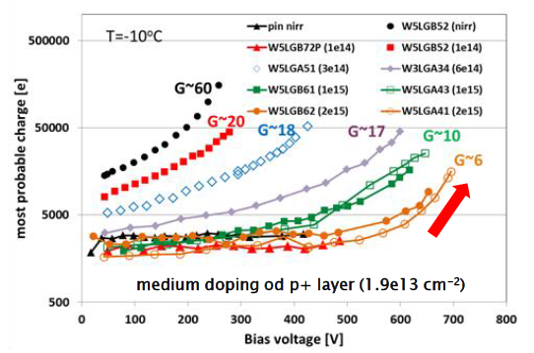
WP7 LGAD production at CNM
G. Kramberger Trento meeting 2017
At 2e15 the LGAD charge collection is very similar to pin diodes
Gain coming from multiplication effects in the bulk (impact ionization) become important
Common WP7 production aims to investigate thinner bulks to enhance the multiplication effects after irradiation (higher fields in thinner sensors)
  50 um active thickness as reference
  Thickness around 30 um to investigate possible improvements in radiation hardness → precise target thickness to be determined with simulation at CNM

Slide 17
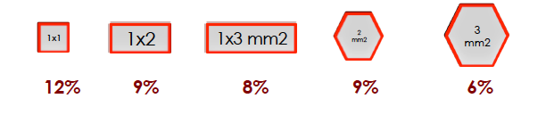
WP7 LGAD production at CNM
Insert matrix of diodes: with various sizes 1x1 mm², 2x2 mm² pads to study edge termination.
Reduce feature size of p-stop and JTE in the inter-pad region to reach >95% area where multiplication can take place
With present design 30 um width with no signal multiplication in the inter-pad region
Insert long/short strips to investigate the feasibility of achieving an ultra low material budget tracking + timing

Slide 18
Results of prototype characterization

Slide 19
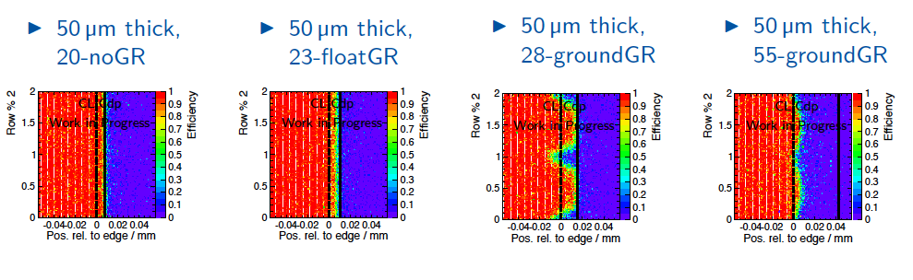
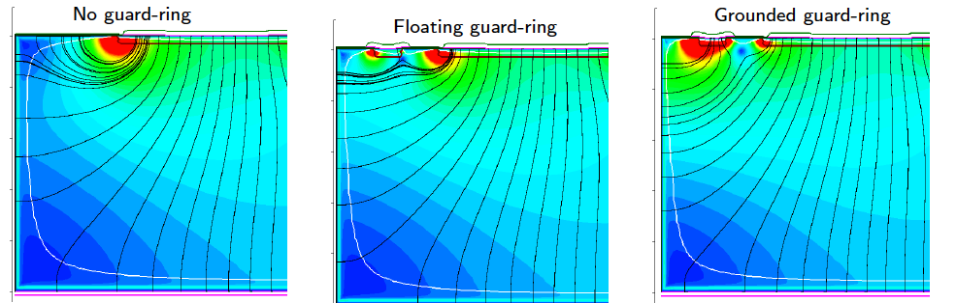
Planar sensors with active edges for CLIC
Timepix3 assemblies (55x55 um² pixel cells)
50 um thickness
20 um edge

Slide 20
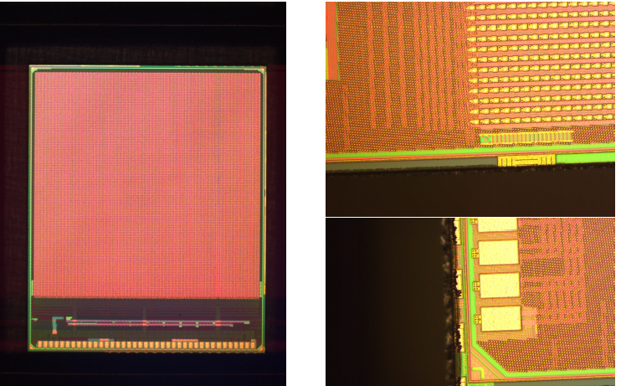
Planar sensors with active edges for CLIC
50 um thin ADVACAM sensors with active edges assembled to CLICpix chip (25x25 μm²)
Expected resolution achieved close to digital one because most of the clusters are 1-hit
Fast decrease of the efficiency with the threshold
Lower threshold expected with new chip CLICpix2, 128x128 matrix, 25 um pitch

Slide 21
Thin planar sensors after irradiation
Comparison of hit efficiencies after an irradiation to 1x10¹⁶ n_{eq}/cm² shows an earlier hit efficiency saturation for the module with 100 µm thick sensor compared to the CIS module with a 150 µm thick sensor.
Thin planar sensors
Lower operation bias voltages at high fluence results in lower power dissipation and help to relax the requirements on the cooling system

Slide 22
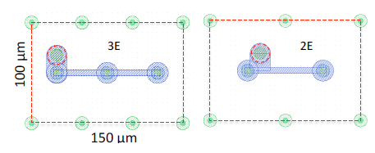
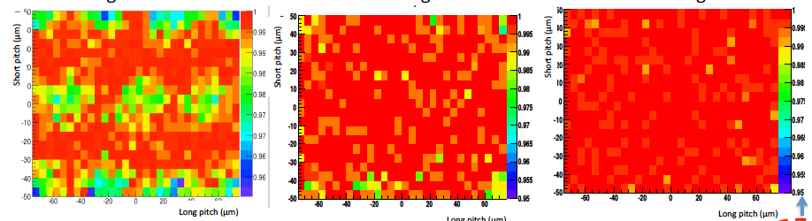
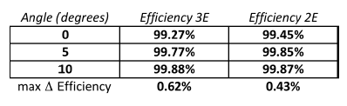
Thin 3D sensors evaluation
3D 130 μm thin sensors with 2E and 3E configuration – FBK production
0 degrees
5 degrees
10 degrees
Hit efficiency of 3D 130 μm thin sensors with 3E configuration
Interconnected to CMS pixel chip PSI46dig
30V bias voltage

Slide 23
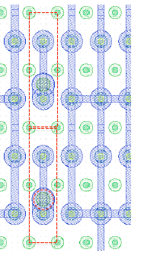
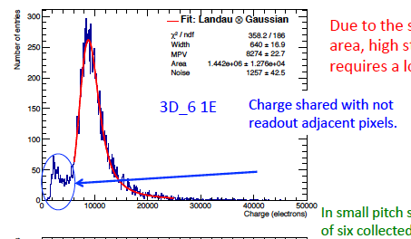
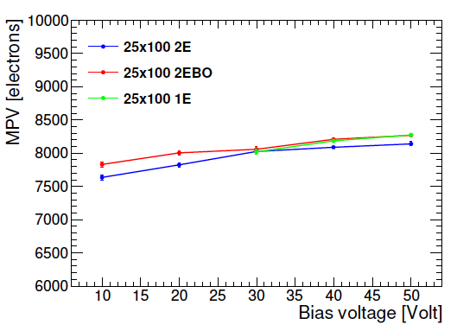
3D sensors: small pitch 25x100 μm²
3D 130 μm thin sensors
Interconnected to CMS pixel chip PSI46dig
Only one out of 6 columns is read-out while the others are grounded
100
25
No striking differences among the three 25μm pitch 3D prototypes, all of them behaving well

Slide 24
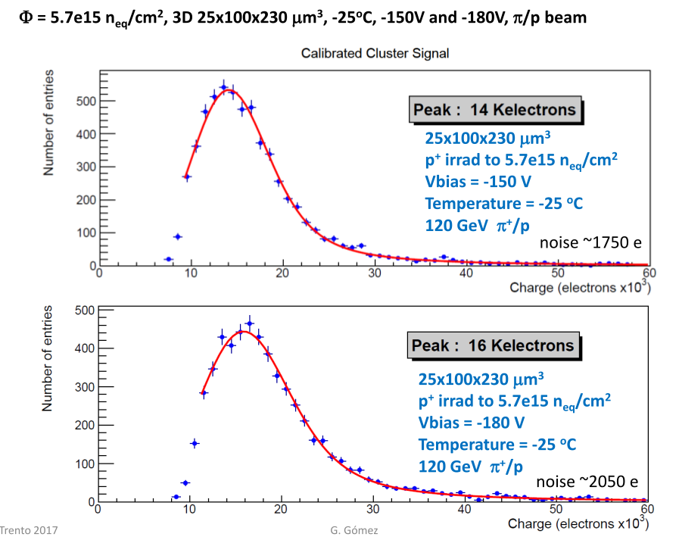
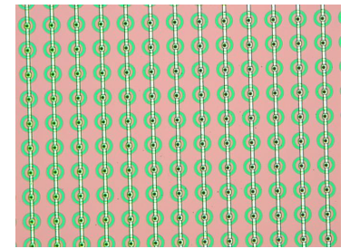
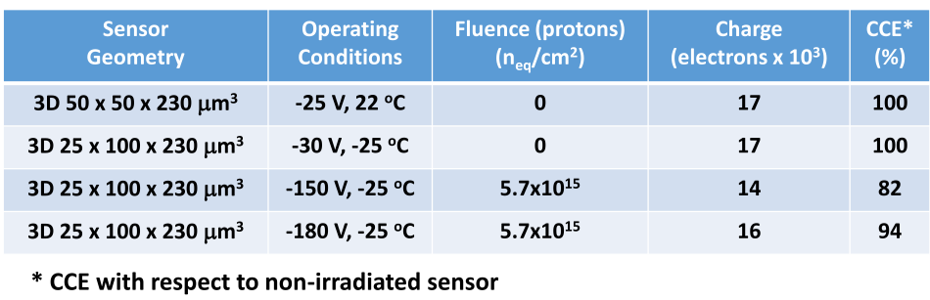
3D strips with 50x50 μm² cells
3D 50x50 µm² pixel cells produced at CNM where the junction columns are shorted through a metal line
Read-out through the Beetle chip
Very high CCE at 5.7e15 already at moderate bias voltages

Slide 25
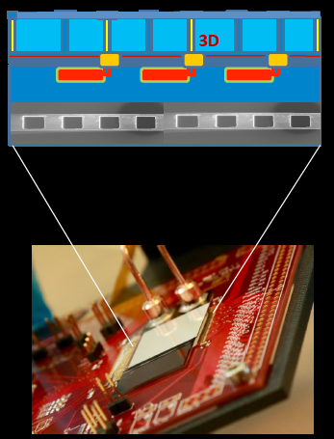
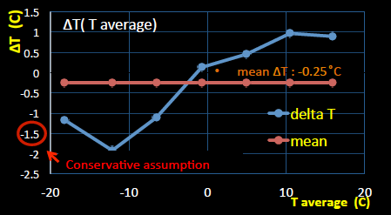
3D sensors with μ-channel cooling
CNM 3D sensor from CNM IBL qualification batch
FE-I4A: thinned to 100um at IZM
Si-Si micro-channels designed by CERN PH-DT, produced by PH-DT in EPFL CMi cleanroom, direct bonding CSEM
Cross activity with WP9
Thermal Figure of Merit= ΔT . A / Power =
4 K cm²/ W for example ITK studies ~ 13 K cm²/ W

Slide 26
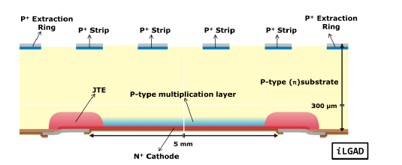
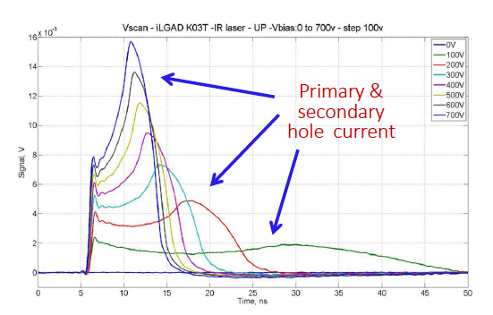
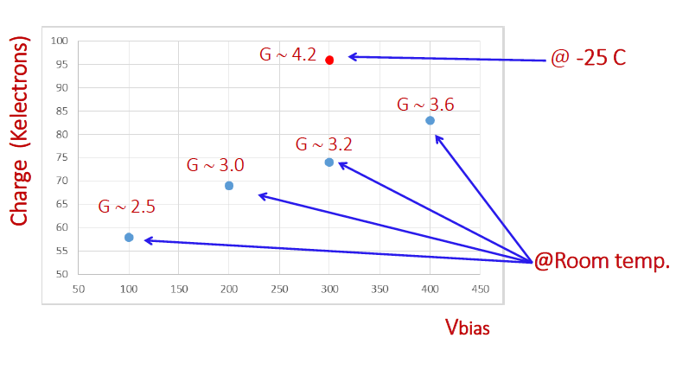
p-in-p LGAD strips – Inverted LGADs
P-in-p LGADs with segmented cathod, hole read-out
DC-strip with 160 um pitch
Gain capability of strip devices demonstrated with Infrared Laser Transient Current
Results from WP7 test-beam: at -25C a S/N value of 90 has been achieved

Slide 27
Simulation activities

Slide 28
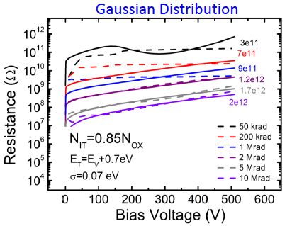
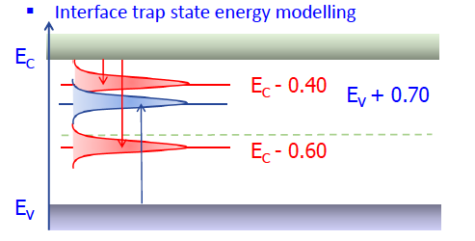
The Perugia Model
Develop a TCAD model for the study of radiation damage effect in silicon detectors valid up to the particle fluence expected at the end of HL-LHC operations in the inner layers of vertex detectors at HL-LHC (ATLAS and CMS)
Update on the TCAD surface damage model
Interstrip resistance
Gated Control diode
Simulation vs Measurements for Interstrip res.
Gaussian modelling of the interface state energy

Slide 29
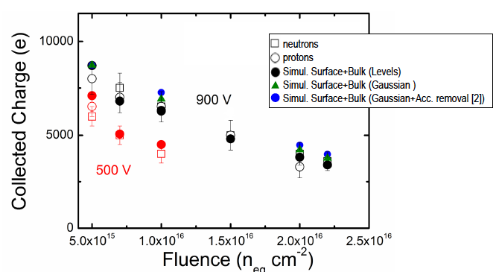
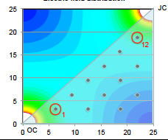
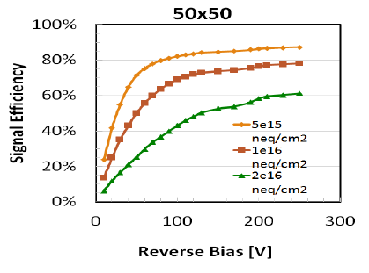
The Perugia Model
Nice agreement with charge collection results obtained on irradiated strips
Perugia model applied to study 3D charge collection properties after irradiation -
Simplified domain (~2d)
1 um thick slice (1/4 or 1/8 pixel)

Slide 30
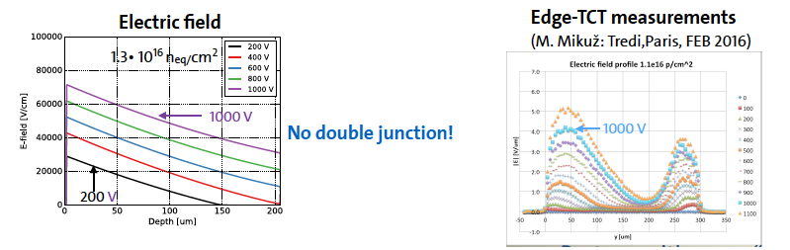
The Perugia Model
Nice agreement with charge collection results obtained on irradiated strips
.. Some possible features to be checked and evaluated in the future:

Slide 31
Simulation outlook
At the moment the Perugia model is the only one available in our community where a systematic tuning is being performed with charge collection data above 1e15
In order to perform a systematic comparison among different models for implementing radiation damage in TCAD simulations a larger set of data on charge collection for segmented devices (strip + pixels) should be compiled – try to start this effort in WP7 collecting results from R&D activities carried out in the framework of ATLAS and CMS
The deliverable on the TCAD model is foreseen for the end of the project,
enough time to check and refine tunings of the TCAD models

Slide 32
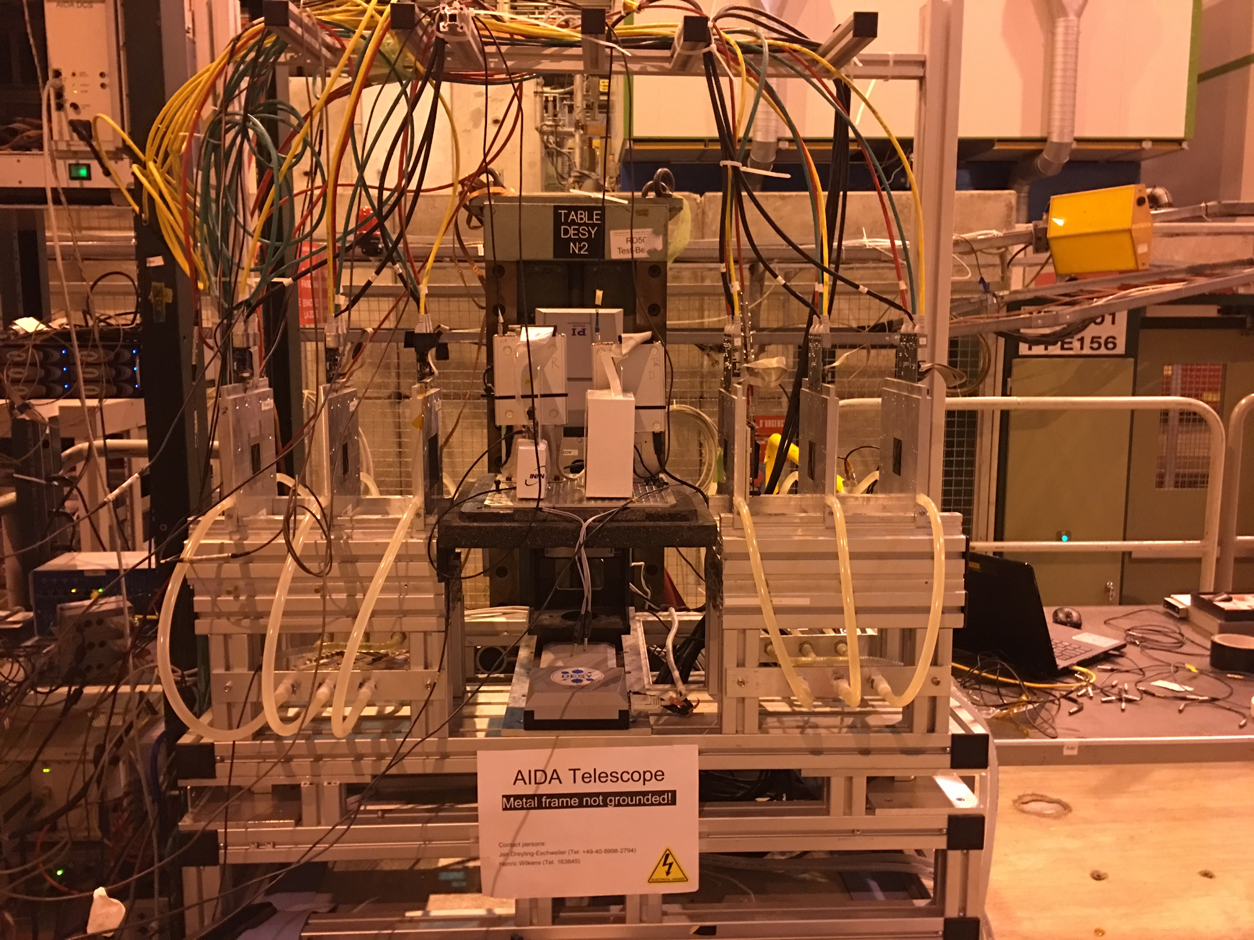
WP7 test-beam 2017
We got one week of test-beam awarded at CERN-SPS in H6 (both H6A and H6B areas)
17-24 May
Cooling box and two telescopes available
Open to all groups participating to WP7
← see Ivan summary talk today

Slide 33
Conclusions and Outlook
WP7 activities have entered the most important phase of our activities
Knowledge acquired through simulation activities and preliminary characterization of devices has been injected into the design and organization of common sensor runs
- Work done across ATLAS, CMS, CLIC communities → sharing of information and optimization of resources
All deliverables and milestones on time, trying to advance the completion of common runs in such a way that enough time is available for a complete characterization of the devices before the end of the project

