Slide 1

Second Annual Meeting
WP4 Status Report
Christophe de la Taille (CNRS/IN2P3)
Valerio Re (INFN/Univ. Bergamo)
LPNHE, Paris, April 7, 2017

Slide 2
WP4: microelectronics and interconnections
WP Coordinators: Christophe de la Taille, Valerio Re
Goal : provide chips and interconnections to detectors developed by other WPs
Task 1: Scientific coordination (CNRS-OMEGA, INFN-UNIBG)
Task 2 : 65 nm chips for trackers (CERN)
  Fine pitch, low power, advanced digital processing
Task 3 : SiGe 130nm for calorimeters/gaseous (IN2P3)
  Highly integrated charge and time measurement
Task 4 : interconnections between 65 nm chips and pixel sensors (INFN)
  TSVs in 65 nm CMOS wafers, bonding of 65 nm chips to sensors, exploration of fine pitch bonding processes

Slide 3
AIDA WP4 milestones
MS4.1 Architectural review of deliverable chips in 65nm run M14 (accomplished)
MS4.2 Final design review of 65nm M30 (October 2017)
MS4.3 Test report of deliverable D4.1 M46 (February 2019)
MS4.4 Selection of SiGe foundry M14 (accomplished)
MS4.5 Final design review of deliverable chips in SiGe run M30 (October 2017)
MS4.6 Test report of deliverable D4.2 M46
MS4.7 Selection of TSV process M14 (accomplished)
MS4.8 Final design review of deliverable D4.3 (TSV in 65nm) M30 (October 2017)
MS4.9 Test report of deliverable D4.3 M46

Slide 5
Deliverable chips in 65 nm
This work is carried out in the frame of the CERN RD53 international R&D program developing a first generation of pixel readout chip prototypes for ATLAS and CMS at HL-LHC
Develop expertise on TSMC 65 nm CMOS selected by CERN for HEP
Two small size prototypes were fabricated and are available for testing with sensors
A large-scale prototype will be submitted May 2017 in an engineering run
This will deliver full wafers for the interconnection with pixel sensors (task 4.4)

Slide 6
65 nm CMOS radiation hardness studies
The 65 nm process qualified for 500 Mrad
  Limited leakage current
  A strong drive loss for small size PMOS devices and the damage increases with the temperature
  RD53 Front end chip (pixel environment )
    Avoid the use of narrow or short transistors for analog design
    Corner Models developed for 200 Mrad and 500 Mrad and used to characterize digital cells
    DRAD chip designed by CERN group indicates which digital libraries can be used
    The temperature effect can be avoided and delayed by keeping cold : -20°C for 5 years and keeping unbiased at room temp for few months
SEU tolerant latches for pixel and global configurations were designed and tested
A new prototype designed to test the effect of the DNW on the SEU tolerance and will be used to test and qualify the Monitoring block, temperature and irradiation sensors as it is implemented in the RD53A chip
M. Menouni, CPPM

Slide 7
Small-medium size 65 nm CMOS prototypes
Two different chips with a 64x64 50 µm x 50 µm pixel matrix ( about 16 mm²) with different architectures for the analog front-end and the digital readout, different techniques for digital-to-analog isolation,…
FE65_P2 (Bonn, LBNL), submitted end of September 2015, delivered by the foundry in December 2015 and successfully tested by UBONN with good results. FE65-P2 chips were connected to pixel sensors and the resulting modules were tested in a beam at CERN and SLAC
CHIPIX65 demonstrator (INFN): submitted July 2016, delivered by the foundry at the end of September 2016. This chip is also fully functional, and tests gave very good results in terms of noise and threshold dispersion. The CHIPIX65 prototype will be soon connected to 3D and planar pixel sensors.

Slide 8
Lino Demaria, INFN Torino

Slide 9
Threshold and noise performance at 600 Mrad
Synchronous and asynchronous front-end are both working fine, with good threshold dispersion and noise, even after exposure to 600 Mrad TID at - 20 °C
Next: bump bonding to sensors (planar and 3D)

Slide 10
Submission of large-scale 65 nm chip RD53A
Full design review (with external experts) at CERN in December 2016.
The review was successful: reviewer’s recommendations provided useful guidelines towards the submission of the chip
Submission is scheduled at the end of May 2017

Slide 11
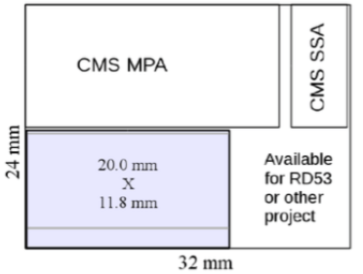
RD53A - Large Scale prototype
The efforts of the RD53 collaboration are leading to the submission of the RD53A chip
400 x 192 pixel, 50um x 50um pixel, 20mm x11.8mm chip
Goal: demonstrate in a large format IC
  suitability of 65nm technology (including radiation tolerance)
  high hit rate: 3 GHz/cm²
  trigger rate: 1 MHz
  Low threshold operation with chosen isolation strategy and power distribution
Not intended to be a production chip
  will contain design variations for testing purposes (with 3 different versions of the analog very front-end)
  wafer scale production will enable prototyping of bump bonding assembly with realistic sensors in new technology
Final design almost ready
Submission: May 31, 2017
Luigi Gaioni, INFN Pavia, Univ. Bergamo

Slide 12
RD53A main specifications
http://cds.cern.ch/record/2113263
From the Spec. document
Hit rate: up to 3 GHz/cm² (75 kHz pixel hit rate)
Detector capacitance: < 100 fF (200 fF for the edge pixels)
Detector leakage: 10 nA (20 nA for the edge pixels)
Trigger rate: max 1 MHz
Trigger latency: 12.5 us
Low threshold: 600 e- → severe requirements on noise and dispersion
Min. in-time overdrive: < 600e-
Noise occupancy: < 10⁻⁶ (in a 25ns interval)
Hit loss @ max hit rate: 1%
Radiation tolerance: 500 Mrad @ -15°C

Slide 13
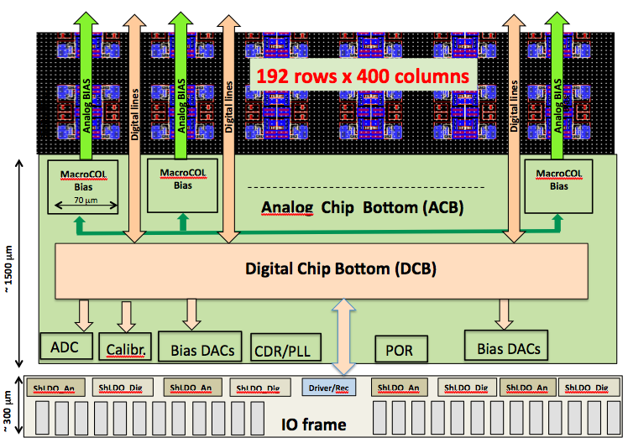
RD53A floorplan

Slide 14
RD53A Pixel floorplan
50% Analog Front End (AFE) - 50% Digital cells
A “quad”
Digital logic
The “analog island” concept
AFE
35
15
The pixel matrix is built up of 8x8 pixel cores → 16 analog islands (quads) embedded in a flat digital synthesized sea
A pixel core can be simulated at transistor level with analog simulator
All cores (for each FE flavour) are identical → Hierarchical verifications

Slide 15
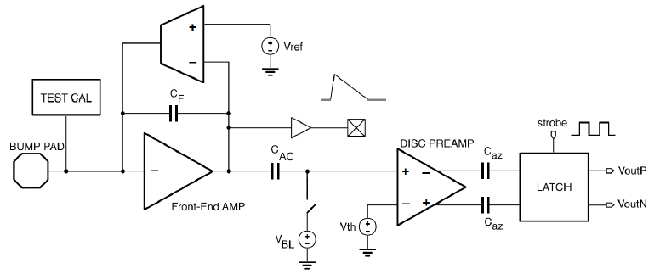
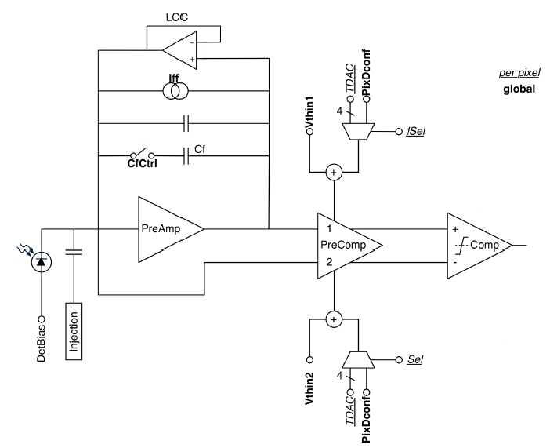
Analog front-ends
Synchronous AFE
Linear AFE
Differential AFE
3 different version of the analog FE (AFE) will be integrated in RD53A
Three design reviews (the last one in March 28, 2017) have been carried out for the AFEs.
Final verifications of the AFEs on-going

Slide 16
Simulation and verification of the digital architecture
Sara Marconi, INFN Perugia
Verification Environment for PIXel chips (VEPIX53) for:
  Modularity, reusability of same testbench:
    different tests
    multiple design stages
    different designs/design blocks
  In this presentation, focus on SEUs for the pixel array logic
  Based on estimated cross-section (5·10⁻¹⁴ cm²):
    protection strategy is needed for pixel configuration latches
      ~ 1% pixels already affected after 20s of operation
      hardening by cell design, special latches (CPPM, Marsiglia) and/or re-freshing configuration
    finite state machine protection not required if capable of recovering automatically
      to be proven with simulations under operating conditions
    no protection is needed for hit data during trigger latency
      corruption probability during latency < 10⁻⁸

Slide 17
Pixel array logic organization
192(400)x400 pixels
Basic layout unit: 8x8 digital Pixel Core → synthesized as one digital circuit
8x8
pix
8x8
pix
1x4 pixel region
OR
2x8 pixel region
8x8
pix
8x8
pix
One Pixel Core contains multiple Pixel Regions and some additional arbitration and clock logic
Pixel Regions share most of logic and trigger latency buffering
    Distributed Buffering Architecture (FE65_P2 based):
    distributed TOT storage
    Centralized Buffering Architecture (CHIPIX65 based (4x4)):
    centralized TOT storage
    Integrated with Synch FE

Slide 18
  Digital architecture comparison and choice
  Architecture optimization and comparison by means of the VEPIX53
1st architecture: distributed 1x4 pixel region
Logic resources shared in PR composed of 1x4 pixels
Distributed buffering (i.e. hit storage) scheme
  shared timestamp memory
  distributed memory for charge information
  (4-bit ToT = Time Over Threshold)
2nd architecture: centralized 2x8 pixel region
  Logic resources shared in PR composed of 2x8 pixels
  Centralized buffering scheme
    shared timestamp
    shared ToT information
  Data stored in buffer are reduced

Slide 19
Submission status
Analog Front-ends:
  Synchronous & Linear AFEs: final version ready → integrated with CORE
  Differential AFE: final version ready → integration with CORE on going
Analog Chip Bottom (ACB): assembly ready (RD53 IP blocks). Simulation with analog and mixed-signal simulator ongoing
Digital: RTL ready, verifications on-going
Shunt-LDO: 2A version of Shunt-LDO submitted on 19th Oct. 2016
  Test of prototypes just started and looks promising
  Irradiation campaign carried out
  Simulation of full power system ShLDO-Bandgap-POR ongoing
  Integration in IO Frame: almost done
IO Frame: bottom PADs frame almost ready → 199 PADs with 100um pitch; passivation opening: 58um x 86 um; TSV Compatible. Top PAD frame (test and monitoring) assembly on-going.

Slide 20
WP4.3 : SiGe 130 nm
(CNRS-IPNL, CNRS-OMEGA, DESY, AGH-UST)
Select best SiGe 130/180 nm process for high speed/high dynamic range ASIC design to upgrade current SiGe 350 nm AMS process MS22 M14
Deliver SPIROC3 SiPM readout for calorimeter readout of WP14
Deliver RPC high timing readout chip for WP13
D4.2 M36 resp CNRS (OMEGA)
Share expertise within SiGe HEP community
  Studies for LHC run 2, ILC…

Slide 21
SiGe processes evaluation
130 nm SiGe processes evaluated
  Tower Jazz design kit not supplied
  ST Micro 130 nm SiGe
Evaluation on different test vehicles
  ATLAS LAr upgrade
  CMS HGCAL
  ATLAS HGTD high speed timing
  CMS muon RPCs high speed timing
No significant improvement compared to regular CMOS
  Better transconductance hindered by Rbb’
Decision to choose TSMC 130 nm CMOS
  Qualified by CERN for high radiation environment
  Wider community (see examples next slides)

Slide 22
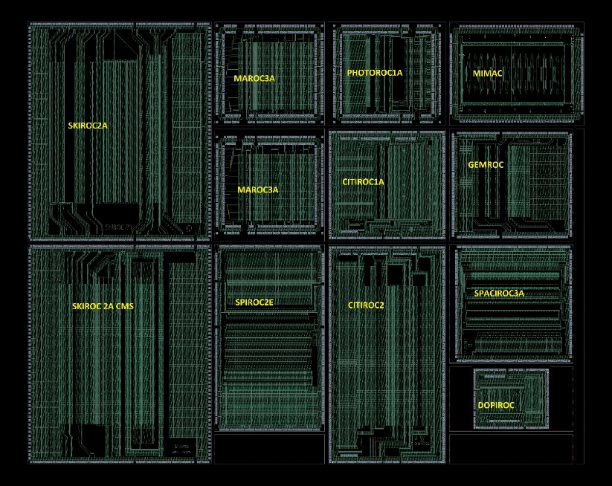
AIDA2020 at OMEGA in 2016
Fabrication and test of 800 SPIROC2E and SKIROC2_CMS in SiGe 0,35
  Will equip large scale prototypes of WP14
Move to TSMC130nm for HL-LHC and AIDA2020
4 chips submitted in MPW 130nm (May&Dec 2016)
  LAUROC : Liquid Argon Upgrade Read Out Chip (ATLAS)
  HGCAL TV1 : Test Vehicle 1 for CMS HGCAL
  ALTIROC : Atlas Lgad Timing ROC for ATLAS HGTD
  HGCAL TV2 : test vehicle 2 for CMS HGCAL
Nathalie Seguin-Moreau, OMEGA

Slide 23

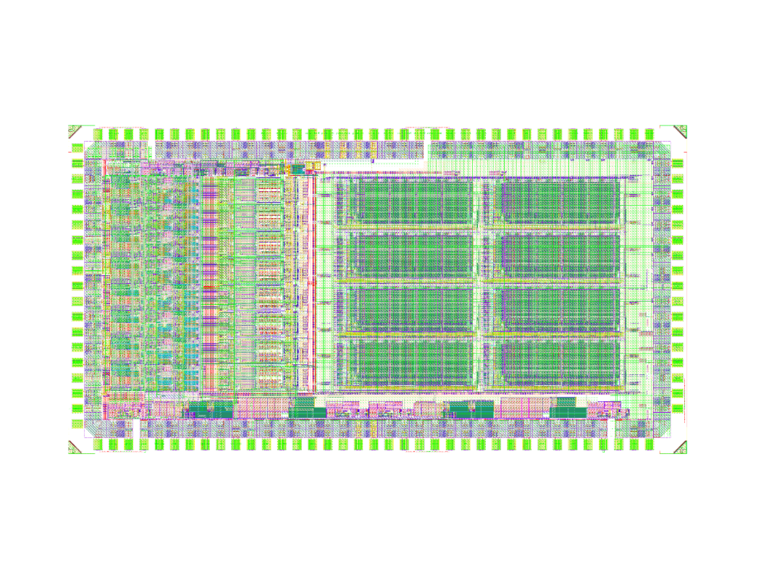
HGCAL: Test Vehicle TV1, TV2 and HGROCv1
TV2
Test Vehicle 1: TSMC130 nm
Various PA, shapers, discris, no digital part
Submitted in may 2016, received in august 2016
Many measurements performed on the different configurations: good analog perf (noise, linearity)
Test Vehicle 2: TSMC130nm
TV2 groups 8*analog channels + ADC + 32x512 RAM (CERN)
TV2 submitted in December 2016 (HGCAL milestone) and received at the end of March 2017. Tests should begin in May 2017
HGROCv1: TSMC130nm, under design, submission next June
32 channel ASIC
Complete channel (analog+digital): FE+TOT/TOA+ TDC+RAM+ serialiser, transmiitter …
Partners: Saclay (TDC for TOA), CERN, Imperial College (TDC for TOT) ….
Omega/Imperial College/CERN
CERN
CEA Saclay
CERN

Slide 24

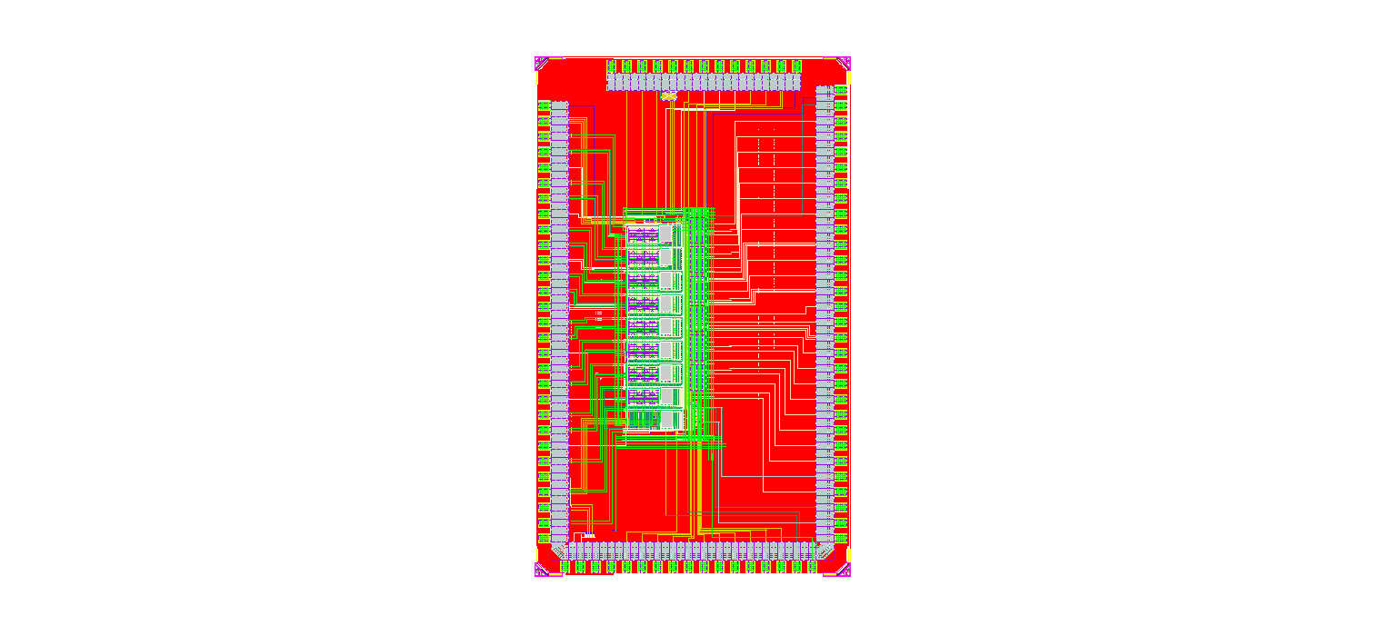
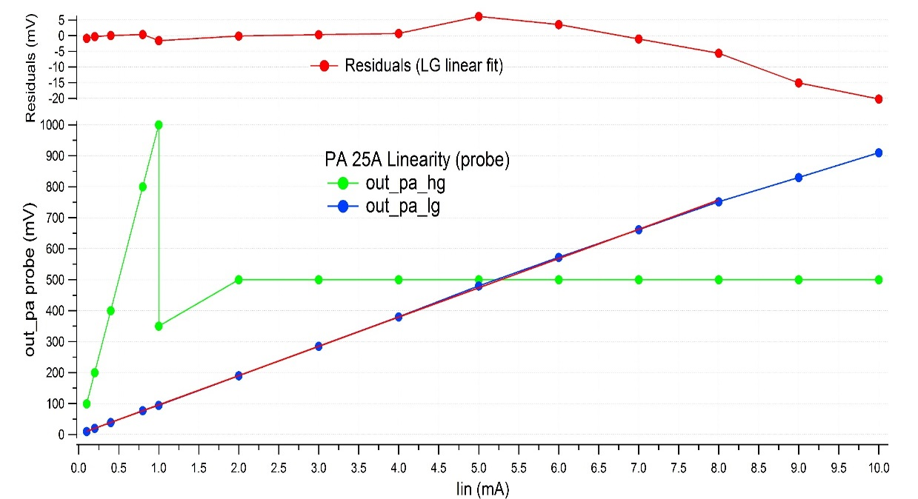
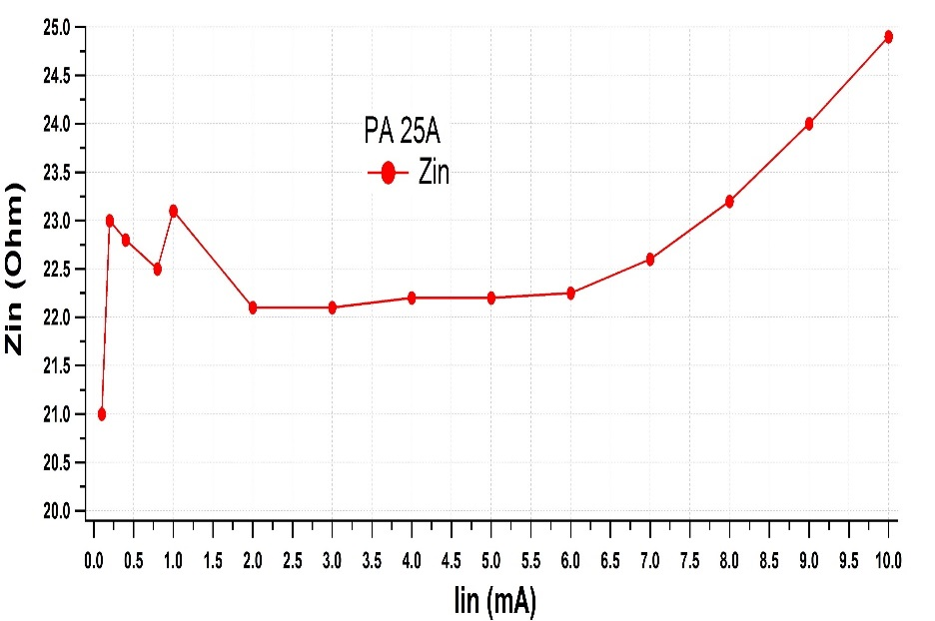
LAUROC for LAr EM Calo upgrade
LAUROC (TSMC 130nm) is a new innovative line-terminating preamp (25 or 50 Ω) featuring “electronically cooled” resistance (<10 Ω)
8 analog channels (Preamps mainly): Submitted in May 2016, received in August 2016
Good testbench performance (input impedance and linearity)
But excessive noise compared to simulations
Linearity : High and low gain
Zin vs Input current
±0.5%
High gain (0-1-mA)
Low gain (1-10 mA)

Slide 25

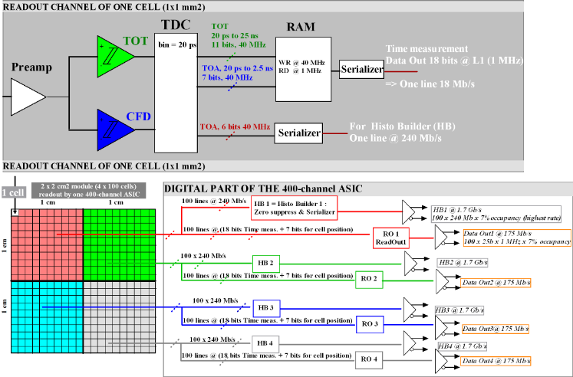
ALTIROC for HGTD
ALTIROC = ATLAS LGAD Timing ROC
  Submission of a chip (TSMC130 nm) in December 2016 (MPW CERN/IMEC), received at the end of March 2017
  20 ps timing measurement with LGAD sensors for ATLAS HGTD
  Test chip bondable to sensors of 1x1 mm² and 2x2 mm²
  Integrates 8 channels with High speed preamp (1 GHz) + TOT + Constant Fraction Discriminator (20 ps)
  Tests should start in May 2017
Will evolve to 400 ch chip
  With internal TDC (Collaboration with SLAC)
  Bump bonded to sensor

Slide 26
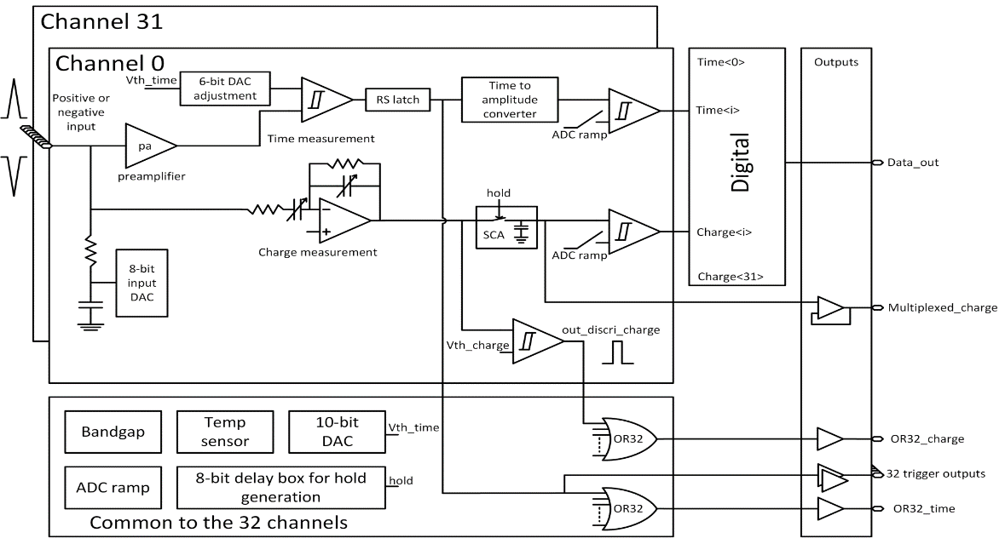

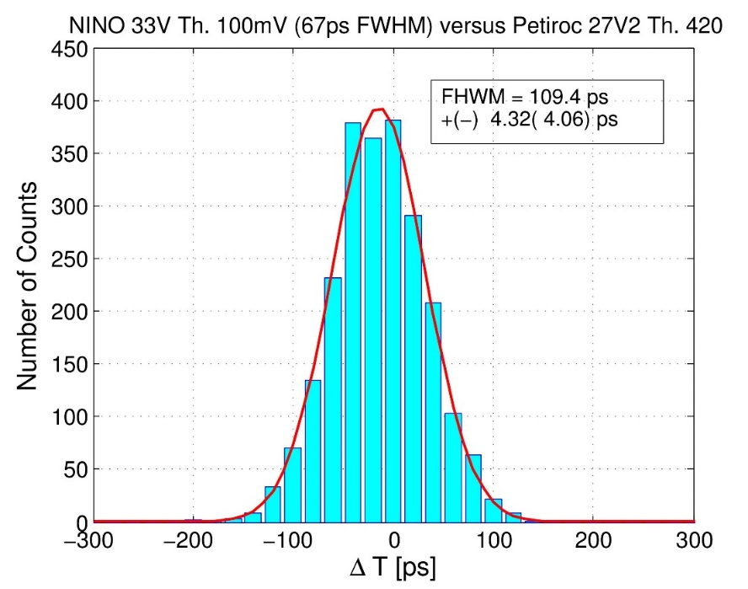
PETIROC2 to PETIROC3 (High Timing RPC WP13)
PETIROC2A features high speed time and charge measurement (AMS 0,35µm SiGe )
  32 channels braodband amplifiers+discriminators
  G = 25 BW = 0.9 GHz GBW = 20 GHz
  Minimum Threshold <1 mV
  Low power : 6 mW/ch
  10 ps jitter in analog operation (external TDC)
  50 – 90 ps with internal TDC (synchronous/asynchronous)
Submission of PETIROC3 in TSMC 130 nm in 2017
  High speed preamp + discriminator
  TDC from IPNL Lyon
  Milestone for AIDA 2020 project WP13
FWHM= 110 ps
© S. Gundacker (CERN)

Slide 27
Hervé Mathez, IPNL Lyon
TDC ASIC for fast timing with RPC multigap detectors, processing signals from the PETIROC chip

Slide 30
Marek Idzik, AGH Krakow

Slide 32
Task 4.4 Interconnections and TSVs
(CERN, INFN-GE, INFN-PV, INFN-PG, CNRS-CPPM, CNRS-LAL, MPG-MPP, UBONN, UNIGLA)
Produce through-silicon vias on wafers from Task 4.2
Connect chips with TSVs to detectors from WP7
Test radiation hardness of interconnections

Slide 33
Candidate processes for TSV
WP4 groups are currently working with two different technology providers for Through-Silicon Vias in 130 nm CMOS FE-I4 pixel readout chips:
IZM (via last tapered TSVs) (Bonn)
CEA-LETI (via last TSVs + RDL + direct wafer-to-wafer bonding) (Glasgow)
Results are available. Plans are to extend this study to 65 nm CMOS wafers from the RD53 engineering run.

Slide 34
Goals of TSV processing
Test processes for peripheral TSVs on the 130 nm FEI4 chip, and apply them to the 65 nm RD53A chip
  Allow for 4 side buttable modules
  Enable wafer-to-wafer assembly
  Remove wirebonds for greater module robustness
The RD53A chip will be designed so that it is “TSV enabled” (i.e. , compliant with TSV design rules); this involves the peripheral bonding pad regions
MS4.7 Selection of TSV process M14 (June 2016) was accomplished: both processes (IZM and CEA-LETI) were selected for the following stages of WP4

Slide 35
TSVs and RDLs with ATLAS FEI4 FE chips: CEA-LETI process
Project started with CEA Leti on TSV-last process in FE-I4 chips
  Connect chip M1 metal layer from front to back of chip via TSVs
Front side processing with either UBM only or bumps
  UBM only → solder on sensors
  Bumps → UBM on sensor
Back side processing RDL
  Specific FE-i4 layout for laser soldering, same specs as Medipix
  Pad layout to compensate thermal stressed during re-flow after flip-chip (demonstrated to work in previous project between Glasgow and LETI)
Richard Bates, Glasgow

Slide 36
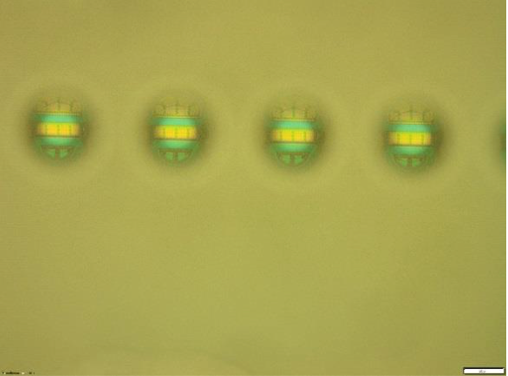
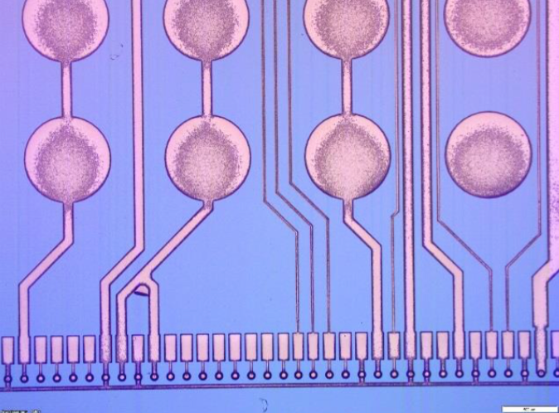
TSV etched through silicon down to M1
RDL processing
60 μm
TSV lined using full wafer Silicon Oxide & Silicon Nitride deposition
Etch back full wafer to open the oxide/nitride on the bottom of the TSV
Damascene process to fill with copper
Excessive copper applied
  Aim was to reduce TSV resistance
  6-8 μm requested c.f. standard thickness < 5 μm
Caused delamination of large RDL laser solder pads
  Pulling away underlying oxide layer as well
  1 of the 3 wafers not so bad and useable for module building
TSV contact on front side metal :
low and repeatable contact between 2 ground TSVs
  6 Ohm including RDL line and probe resistance

Slide 37
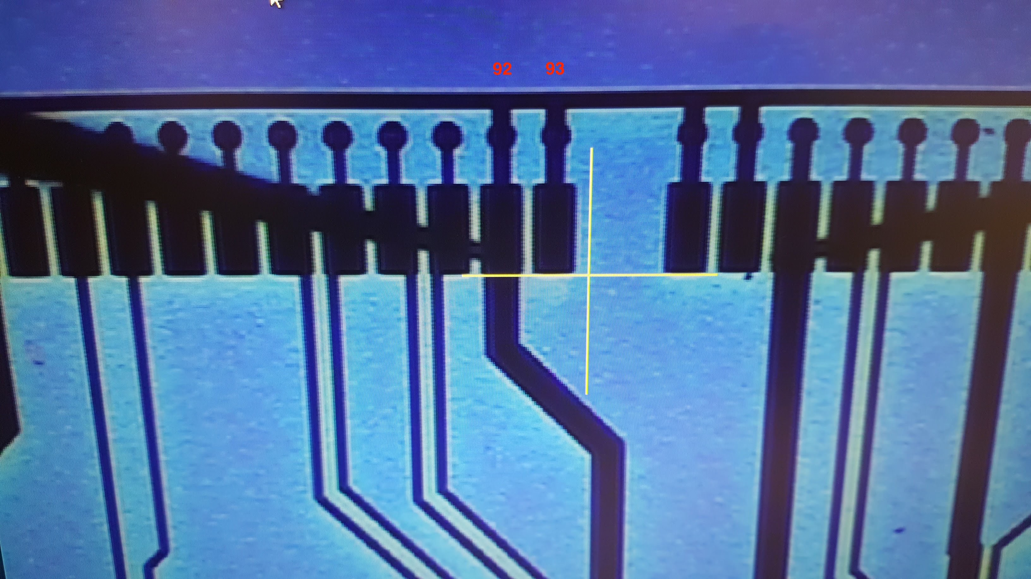
Wafer level testing started Jan 2017
Soon realised that there was an RDL error
Second run of wafers being processed at CEA LETI
  Front side with Solder bumps
  Front side processing finished
  Bumps inspected and appear perfect
  Ready for transfer to support wafer for backside processing
VDDD line connected to GND bus
  Error during translation of RDL design to wafer design software
  Chip not testable
Probed all power lines and currents reasonable
  TSVs connected to M1 and isolated from wafer
Wafers retuned to LETI for FIB
  Only central die edited due to FIB reach
  Error corrected
  Tested on probe – no shorts!

Slide 38
F. Hügging, Bonn

Slide 43
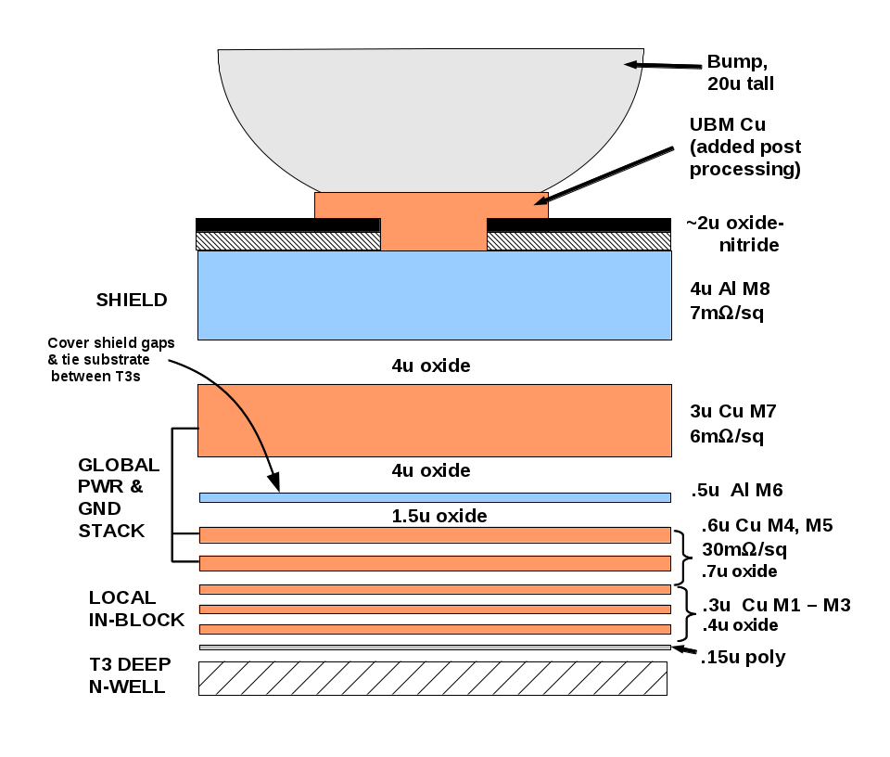
TSV compatible design of RD53A
Bonding pads in RD53A are compatible with TSV fabricated with a backside etching process .These pads have all metal layers from M3 to the actual aluminum pad. M1 and M2 were removed to reduce parasitic capacitance and optimize the performance of high-speed drivers.
This structure was checked by IZM and they think it is OK. No problems are foreseen for the CEA-LETI process as well.

Slide 44
WP4 outlook
WP4 appears to be on track with respect to the 2017 milestones (MS4.8: TSV design review in 65 nm chip; possible delay will depend on how we define the meaning of this milestone)
Pixel readout chip prototypes in 65 nm CMOS are available for testing sensors from WP7
Thanks to synergies with RD53 (65 nm CMOS engineering run), also longer term schedule looks reasonable

Slide 45
AIDA WP4 deliverables
D4.1 CMOS 65 nm engineering run (availability of the run with the “ATLAS/CMS” and CLICPIX pixel chips) (CERN)
M36 (April 30, 2018)
D4.2 BICMOS SiGe engineering run (availability of run with SiPM calorimeter-WP14 and gas detectors-WP13 chips) (CNRS)
M36 (April 30, 2018)
D4.3 Through Silicon Vias production (fabrication of TSV in wafers of deliverable 4.1) (INFN)
M42 (October 31, 2018)

