Slide 1
WP5: Data Acquisition System for Beam Tests
D. Cussans, on behalf of WP5

Slide 2
Outline
Introduction:
  Aim of WP5: Common DAQ
  Enhancements with respect to AIDA
Status
  Hardware – Trigger/Timing Logic Unit (TLU)
  DAQ – EUDAQ 2
  Data model –
    mixing triggered, self-triggered, continuously integrating detectors
  Data Quality Monitoring – DQM4HEP
Project Planning
Conclusion

Slide 3
Aims
Make software and hardware tools to make beam-test DAQ : Easier / Better / Nicer
Focused on supporting Linear Collider R&D, but aiming to be general.
A tool-kit for making DAQ systems
  Inspired by XDAQ package
Tools to build common DAQ systems from existing DAQ systems
  Common run-control

Slide 4
Enhancements
- Highlights
 | AIDA | AIDA-2020
DAQ software (EUDAQ) | Single data collector Fixed FSM Focused on beam telescope | Scalable data collector Flexible state machine General
Data Model | Tag event with trigger number | Tag event with trigger and/or timestamp
Data Quality Monitoring | Dedicated to pixel detectors | Use DQM4HEP framework - general
Hardware (TLU) | Aging FPGA family 4 trigger inputs | Current model FPGA 6 trigger inputs Low jitter clock
Beam telescope | Trigger rate < O(10kHz) | Trigger rate < O(1MHz)

Slide 5
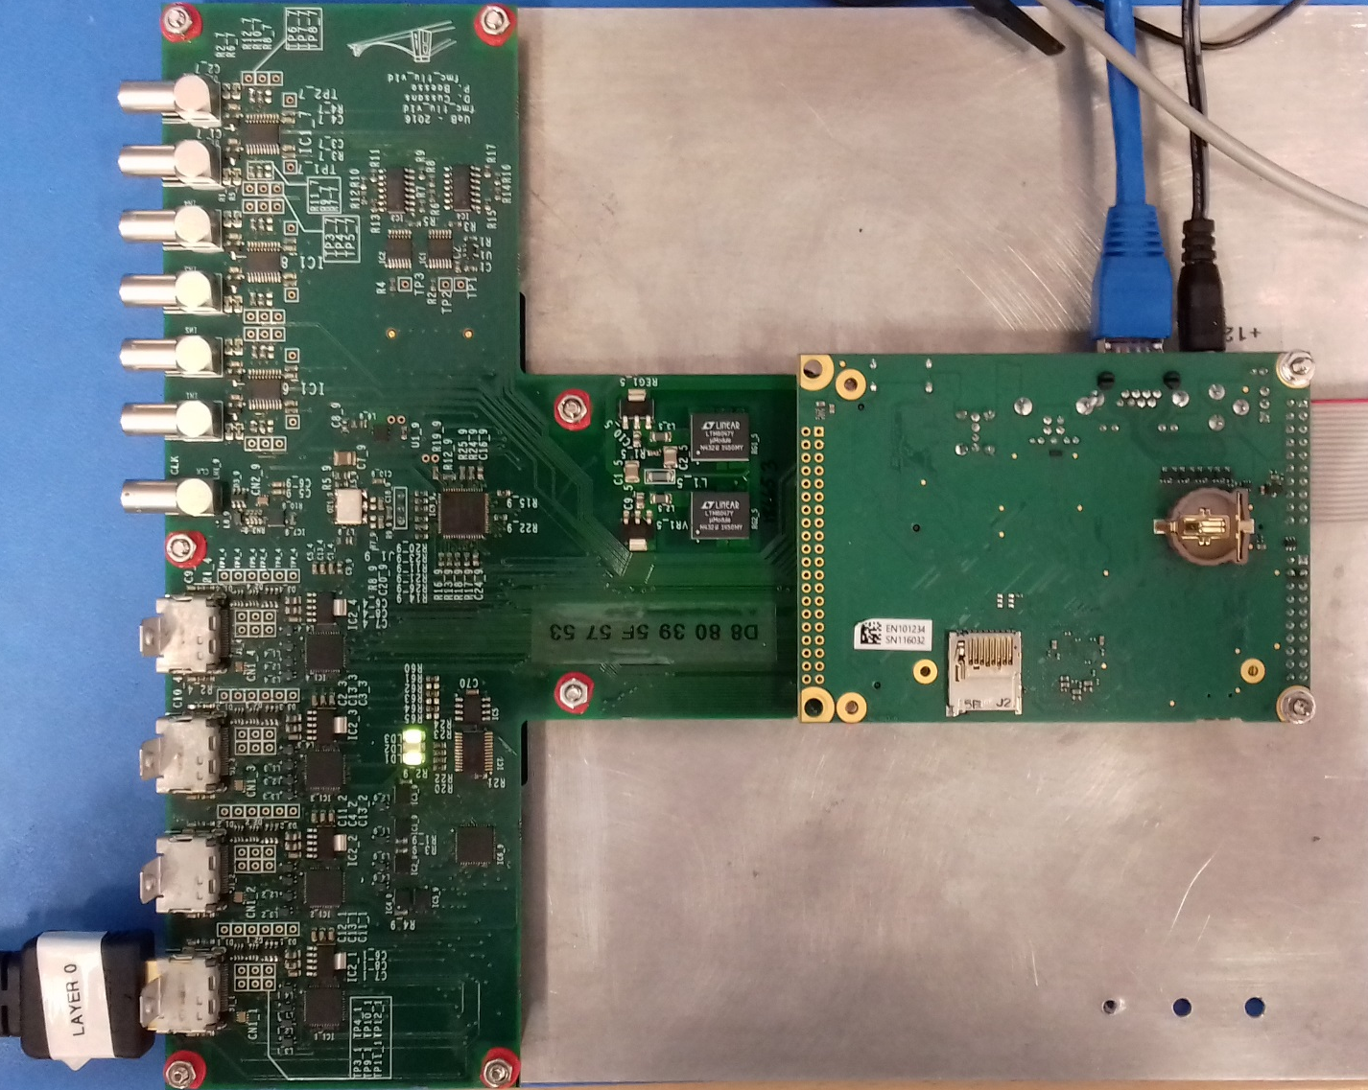
Hardware
New hardware based on the successful miniTLU one
More trigger inputs (4→6)
Increased number of DUT (3→4)
Multiple clock generation options
  On-board oscillator
  DUT
  Differential LEMO
  Highly configurable clock chip
mini-HDMI → HDMI connectors
Fast threshold discriminators for trigger detection
Firmware ported to Xilinx series 7 devices
Launching production in 2 weeks – contact us if interested in a unit

Slide 6
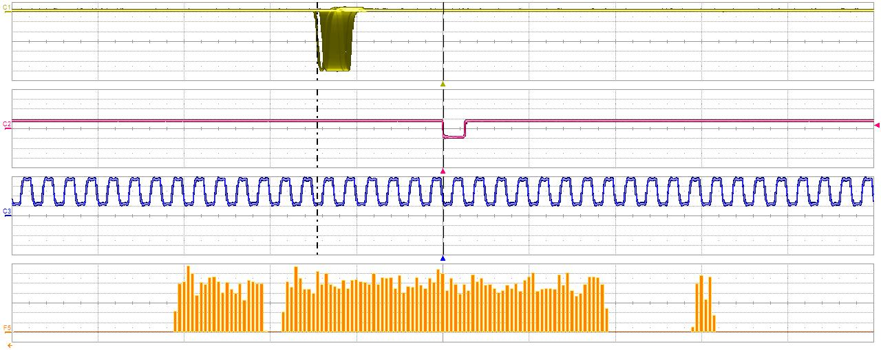
Latency test (non optimized)
INPUT PULSE
TRIGGER TO DUT
~116 ns
40 MHz clock
~25 ns
Delay
PULSE GENERATOR
TRIGGER IN
TLU
DUT signal
OSCILLOSCOPE

Slide 7
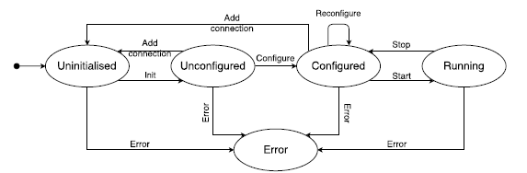
DAQ Software –
Run Control
RunControl maintains a database about the address of clients and sends command to them.
The Standard RunControl EUDAQ is enough for most user cases.
New in EUDAQ2
QT GUI is decoupled from RunControl and EUDET-telecope
User can reuse the GUI with their own RunControl without touch GUI code.
Provide flexible to have dedicated RunControl to integrate with other DAQ system .
The FSM states EUDAQ clients are checked by RunControl
FSM state
04/04/2017 Yi Liu DESY EUDAQ: A common data acquisition framework 5/14

Slide 8
DAQ Software –
EUDAQ 1 Event building
EUDAQ 1 philosophy : common readout frames in synchronization with trigger id driven by the TLU → trigger number and event number are the same !
DUT1
DataCollector,
Merges together
RawDataEvents
With the same
Trigger ID
DUT1Producer:
RawDataEvent
Trigger ID
DUT2
DUT2Producer:
RawDataEvent
Trigger ID
TLU
TLUProducer:
Creates TLUEvents
(basically trigger ID and
timestamp)
RawDataEvent
Trigger ID
Online conversion to other formats
(LCIO, etc) is possible with
The converters but not necessary

Slide 9

DAQ Software –
Event Building
Using only a trigger ID to merge multiple data sources inefficient when integration time is different ( externally triggered / self-triggered / continuous integration
Stream 0
Stream 1
Stream n
……
Time
In generic case, sub events can arrives in any random time.
How to defined a physical event?
How to defined a valid trigger?
Which detector is the trigger device?
- Users can write their own event builder
- Generic DataCollectors for direct synchronization by timestamp and trigger number cases are provided. (next page)
04/04/2017 Yi Liu DESY EUDAQ: A common data acquisition framework 8/14

Slide 10
Event sync by Timestamp-pair
DAQ Software –
Event Building
Time length of incoming Event is flexible.
Time slice of merged event is variable
All Producers are equal to each others
Can cope with unmatched data (e.g. noise hits)
√
ts_end n
Event N
Time slice
√n
√n
√n
Time
Xn
√n
√n
ts_begin n
√n
ts_end n-1
Event N-1
Time slice
n-1
n-1
n-1
n-1
n-1
Producer A B C D E F G
04/04/2017 Yi Liu DESY EUDAQ: A common data acquisition framework 9/14

Slide 11
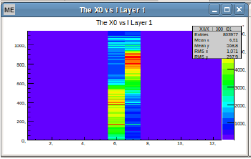
Event Model for Common Beam Tests
Devices under test
EUDAQ 2
DQM4HEP
Analysis module for
common DQ 1
Data Collector of all producers + conversion to LCIO file
LCIO objects,
built events
Detector 1
Producer 1
AHCAL vs telescope spatial correlations using common (time) events
Detector 2
Producer 2
...
…
...
...
Analysis module
for common DQ 2
Data Collector Producer X, file format Y
Detector N
Producer N
Events of detector X saved in format Y
...
RawDataEvents
(TS &/or trigger ID)
Analysis module
for detector X DQ
EUDAQ 2
RunControl
+Logger N
EUDAQ 2 – DQM4HEP interface (to be done)
Adrian Irles

Slide 12
Data Quality Monitoring
Using DQM4HEP framework from IN2P3
Interface to EUDAQ based system underway
  Reading from files already works
  Providing method for serialization of event data being developed
    Will allow true online monitoring
  Integration with EUDAQ run control underway
DQM4HEP can also be used for environmental parameter monitoring for DESY test beam areas
  See WP15.3.2
Tom Coates. Remi Ete, Antoine Pingault

Slide 13
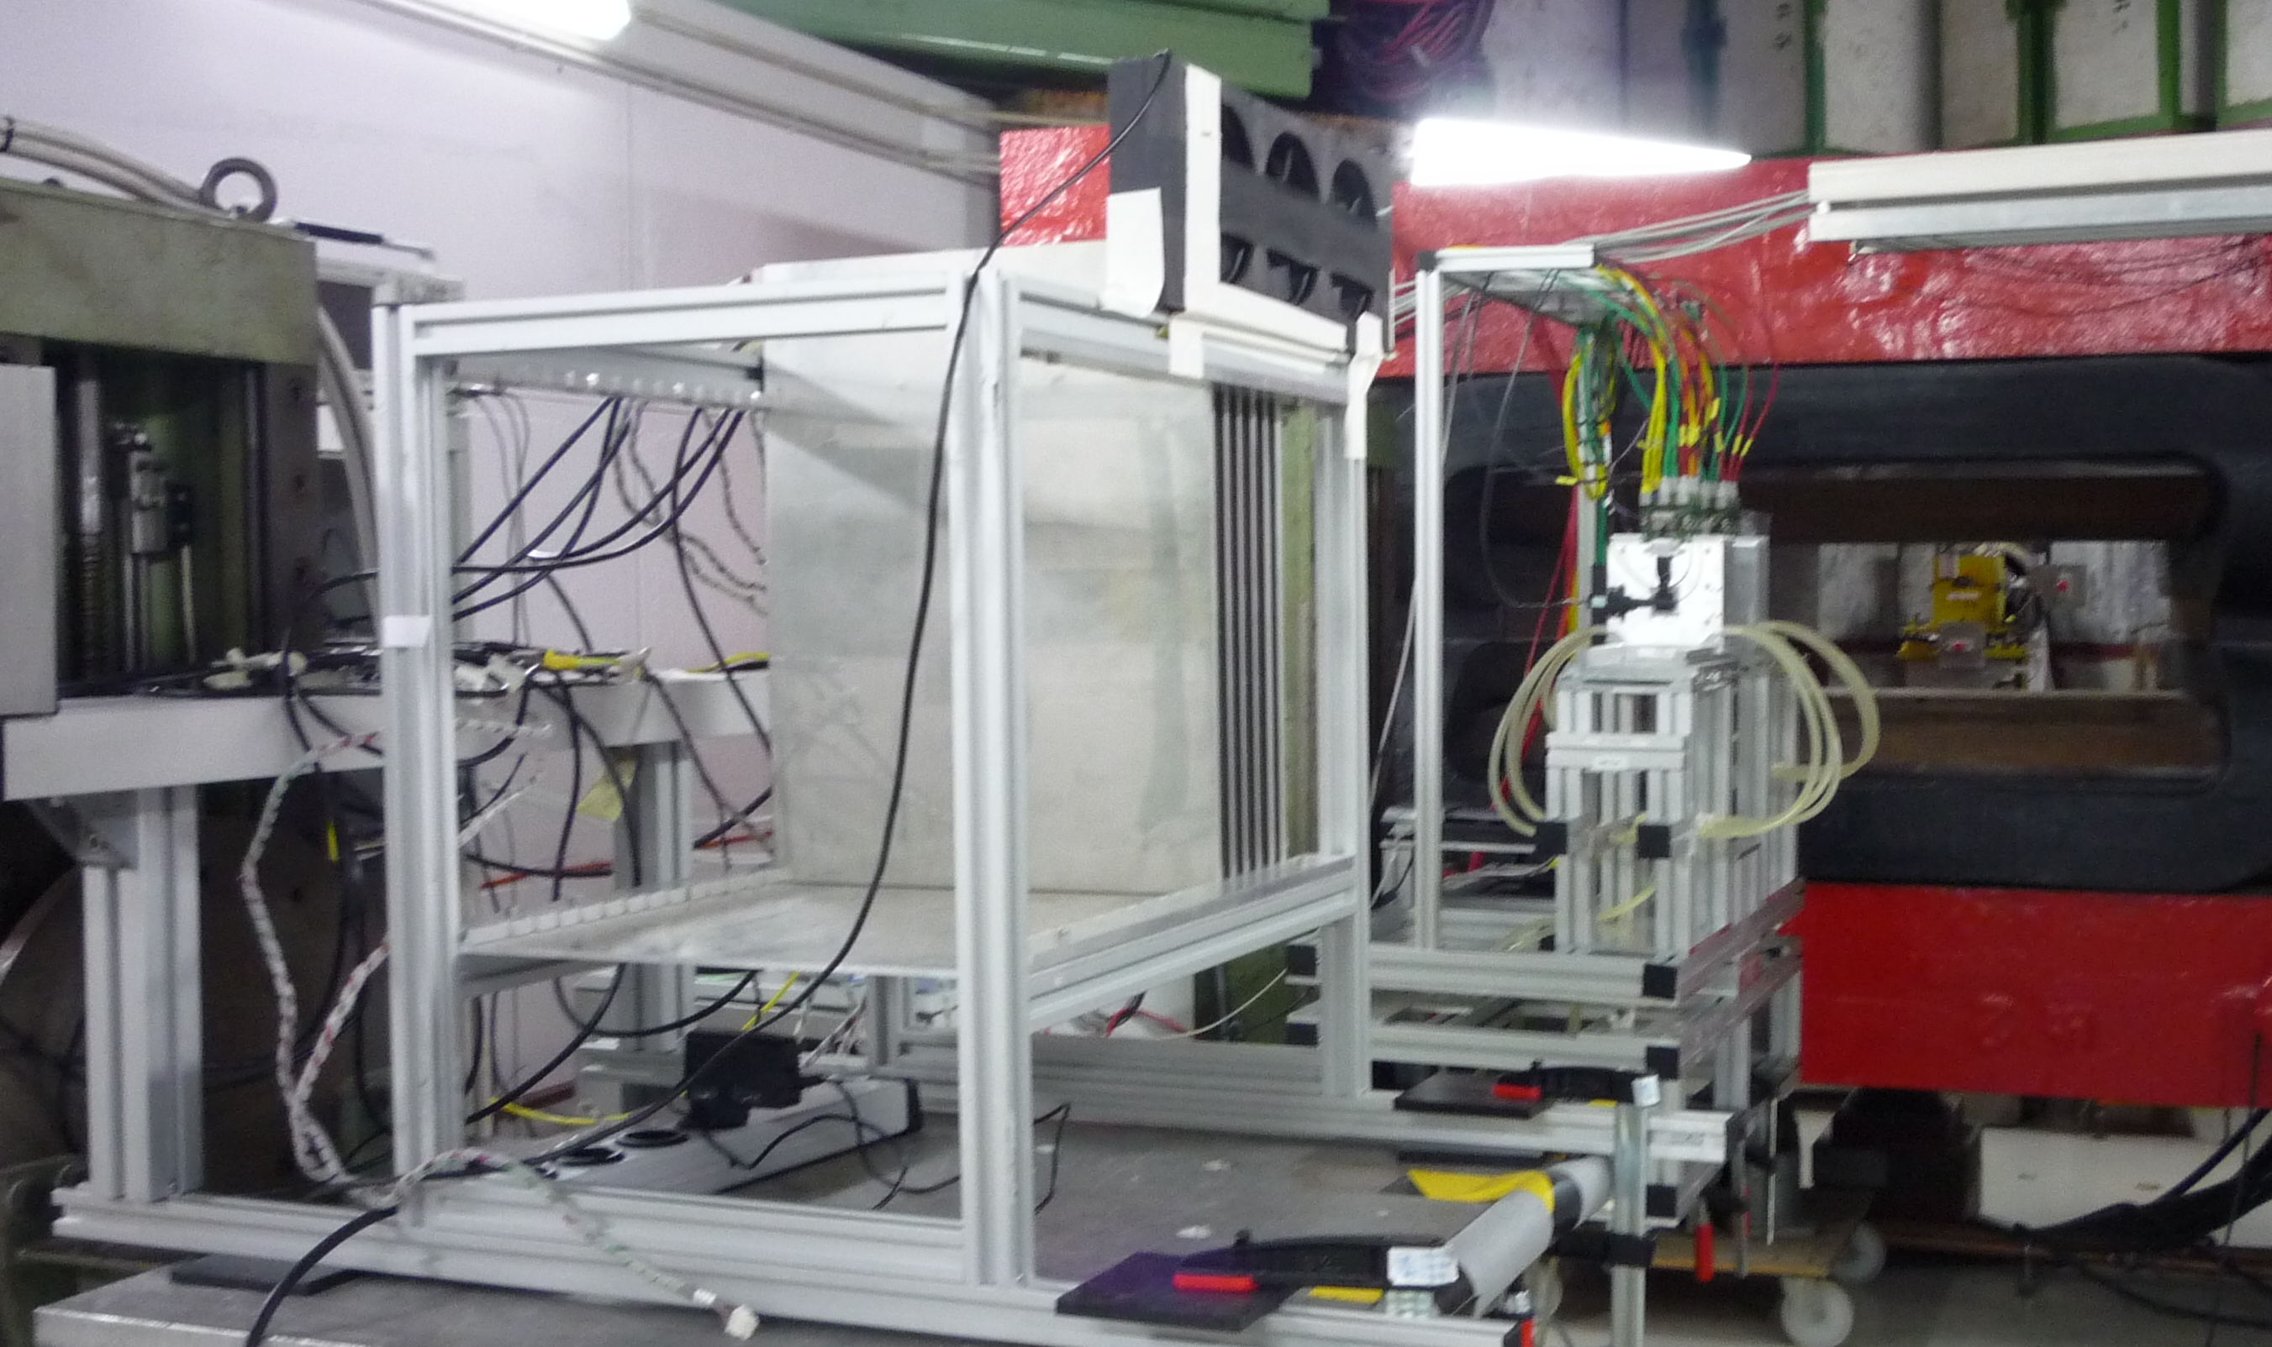
CALICE AHCAL / AIDA Beam-telescope combined beam-test
KLAUS
box

Slide 14

CALICE AHCAL / AIDA Beam-telescope combined beam-test
3 Synchronizations: TriggerID or Readout cycle(ROC) or TimesStamps(TS)
EUDET Trigger Logic Unit (TLU): TrigID (+TS)
AHCAL (CCC+LDA+DIFs): TrigID+ROC+TS
Beam Telescope: Event# (~TrigID)
2017: Mini-TLU (BIF): ROC+TS
2017: Klaus: ROC
TLU
TrigID
TrigID
TrigID+
TS1
CCC
ROC
+clk
event#
Telescope
EUDAQ
ROC+
TrigID+
clk
ROC
ROC
+TS3
Mimosa
Mimosa
KLAUS
LDA
ROC+
TrigID
+TS2
Mimosa
Mimosa
Mimosa
Mimosa
BIF
6x
DIF
DIF
DIF
6x
DIF
DIF
DIF
Jiri Kvasnicka , Katja Kruger

Slide 15
CALICE AHCAL / AIDA Beam-telescope combined beam-test
3 Synchronizations: TriggerID or Readout cycle(ROC) or TimesStamps(TS)
EUDET Trigger Logic Unit (TLU): TrigID (+TS)
AHCAL (CCC+LDA+DIFs): TrigID+ROC+TS
Beam Telescope: Event# (~TrigID)
2017: Mini-TLU (BIF): ROC+TS
2017: Klaus: ROC
TLU
TrigID
TrigID
TrigID+
TS1
CCC
ROC
+clk
event#
Telescope
EUDAQ
ROC+
TrigID+
clk
ROC
ROC
+TS3
Mimosa
Mimosa
KLAUS
LDA
ROC+
TrigID
+TS2
Mimosa
Mimosa
Mimosa
Mimosa
BIF
6x
DIF
DIF
DIF
6x
DIF
DIF
DIF
Jiri Kvasnicka , Katja Kruger

Slide 16
CALICE AHCAL / AIDA Beam-telescope combined beam-test
3 Synchronizations: TriggerID or Readout cycle(ROC) or TimesStamps(TS)
EUDET Trigger Logic Unit (TLU): TrigID (+TS)
AHCAL (CCC+LDA+DIFs): TrigID+ROC+TS
Beam Telescope: Event# (~TrigID)
2017: Mini-TLU (BIF): ROC+TS
2017: Klaus: ROC
TLU
TrigID
TrigID
TrigID+
TS1
CCC
ROC
+clk
event#
Telescope
EUDAQ
ROC+
TrigID+
clk
ROC
ROC
+TS3
Mimosa
Mimosa
KLAUS
LDA
ROC+
TrigID
+TS2
Mimosa
Mimosa
Mimosa
Mimosa
BIF
6x
DIF
DIF
DIF
6x
DIF
DIF
DIF
Jiri Kvasnicka , Katja Kruger

Slide 17
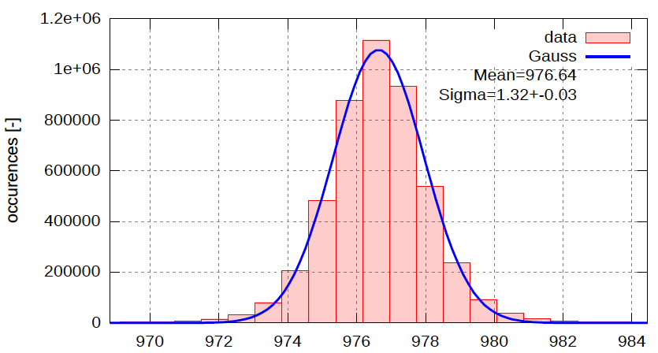
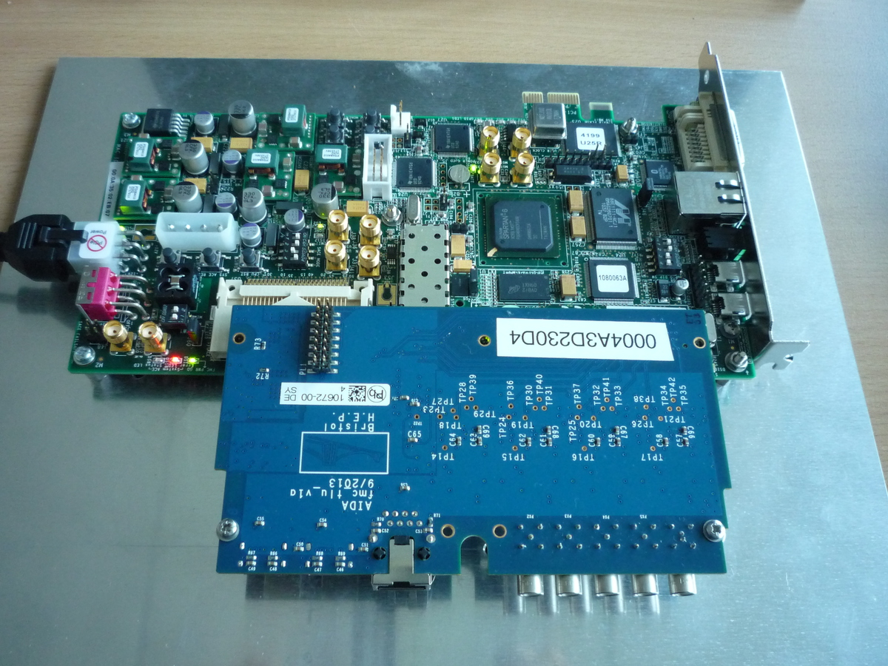
BIF (Beam Interface): Timestamping external signals
difference
BIF time-
stamps
Modified firmware of the AIDA mini-TLU
  Receives AHCAL clock
  Knows AHCAL fast commands from HDMI
Records timestamps from 4 inputs (lemo)
+ start&stop of acquisition
  Estimated time jitter: 1 ns
acquisition is gated (=records only when AHCAL active)
Implemented in the “slave mode” - acts like another LDA/DIF
[ns]
Trigger
Spill
CCC
…
Up to 8
LDAs
LDA
PC
beam
triggers
BIF
DIF
Jiri Kvasnicka , Katja Kruger

Slide 18
CALICE AHCAL / AIDA Beam-telescope combined beam-test
3 Synchronizations: TriggerID or Readout cycle(ROC) or TimesStamps(TS)
EUDET Trigger Logic Unit (TLU): TrigID (+TS)
AHCAL (CCC+LDA+DIFs): TrigID+ROC+TS
Beam Telescope: Event# (~TrigID)
2017: Mini-TLU (BIF): ROC+TS
2017: Klaus: ROC
TLU
TrigID
TrigID
TrigID+
TS1
CCC
ROC
+clk
event#
Telescope
EUDAQ
ROC+
TrigID+
clk
ROC
ROC
+TS3
Mimosa
Mimosa
KLAUS
LDA
ROC+
TrigID
+TS2
Mimosa
Mimosa
Mimosa
Mimosa
BIF
6x
DIF
DIF
DIF
6x
DIF
DIF
DIF
Jiri Kvasnicka , Katja Kruger

Slide 19
CALICE AHCAL / AIDA Beam-telescope combined beam-test
3 Synchronizations: TriggerID or Readout cycle(ROC) or TimesStamps(TS)
EUDET Trigger Logic Unit (TLU): TrigID (+TS)
AHCAL (CCC+LDA+DIFs): TrigID+ROC+TS
Beam Telescope: Event# (~TrigID)
2017: Mini-TLU (BIF): ROC+TS
2017: Klaus: ROC
TLU
TrigID
TrigID
TrigID+
TS1
CCC
ROC
+clk
event#
Telescope
EUDAQ
ROC+
TrigID+
clk
ROC
ROC
+TS3
Mimosa
Mimosa
KLAUS
LDA
ROC+
TrigID
+TS2
Mimosa
Mimosa
Mimosa
Mimosa
BIF
6x
DIF
DIF
DIF
6x
DIF
DIF
DIF
Jiri Kvasnicka , Katja Kruger

Slide 20
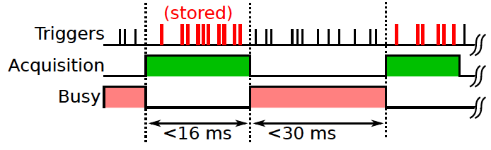
EUDAQ2: New event building
simple data collectors available in EUDAQ (triggerID sync / timestamp sync)
here event building is more complex → need a custom data collector
data format kept compatible with EUDAQ1 → analysis in DQM4HEP unchanged
AHCAL
producer
ASICs
ROC,
BXID
ASICs
ROC,
BXID
AHCAL_same_bxid
ROC
TS_start,
TS_bxid (opt. TS_trig)
triggerID
ASICs
ROC,
BXID
AHCAL_same_bxid
ROC
TS_start,
TS_bxid (opt. TS_trig)
triggerID
ASICs
ROC,
BXID
AHCAL_same_bxid
ROC
TS_start,
TS_bxid (4 us range)
triggerID
EUDAQ_evt
TrigID(Event#)
Timestamp
AHCAL custom
data collector
ROC= ROC,
TS_trig=bxid
TS
overlap
AHCAL_same_bxid
LDA
ROC,
TS_start,
TS_trig,
triggerID
LDA
ROC,
TS_start,
TS_trig,
triggerID
TrigID=
Event#
LDA TS
ROC,
TS_start,
TS_trig,
triggerID
LDA TS
BIF
ROC
TS_start
TS_trigger
BIF (opt.)
Telescope
producer
Telescope
BIF
producer
Mimosa
Event#
Mimosa
Event#
Telescope
Event#
AHCAL data from Labview
Adrian Irles, Jiri Kvasnicka

Slide 21
Event building of AHCAL
Built
“Validated
AHCAL BXID
Events”
LDA trigger Timestamp
Same BXIDs
put together:
ASIC1
ASIC2
ASIC2
TS_start
BXID 0
BXID 0
BXID 0
BXID 0
BXID 0
BXID 0
BXID 42
trigger
BXID 42
BXID 42
BXID 42
BXID 42
BXID 80
BXID 80
BXID 108
BXID 108
BXID 108
BXID 108
BXID 140
BXID 140
trigger
BXID 140
BXID 140
BXID 140
BXID 140
BXID 140
time
Building

Slide 22
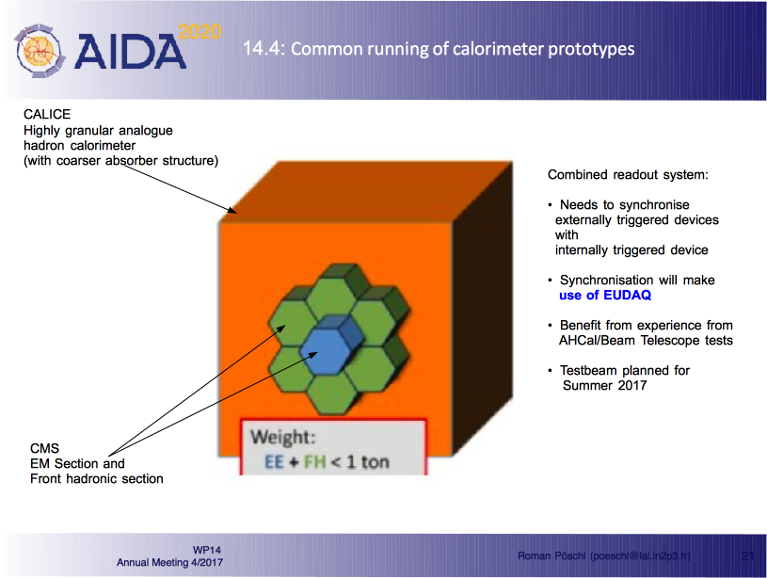
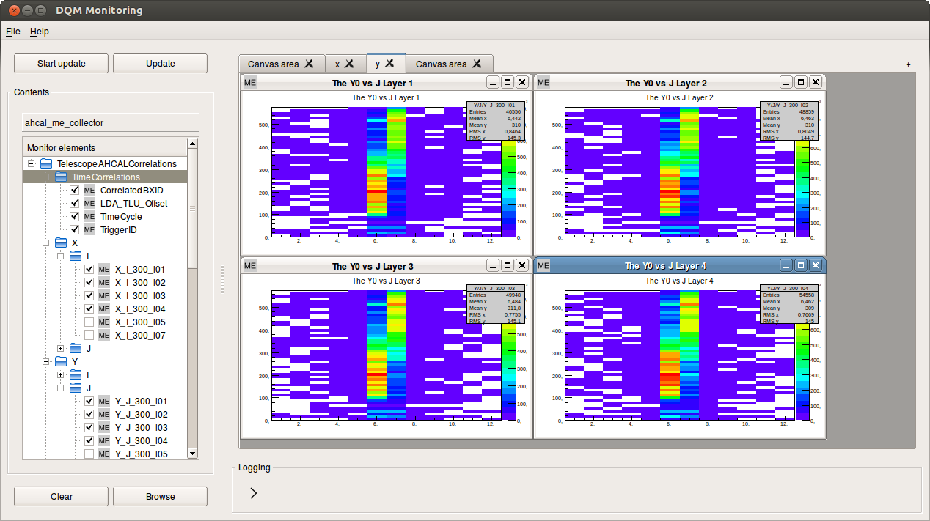
Combined Beam Tests
CMS HGCAL / CALICE AHCAL
Correlations - AHCAL and telescope are synchronous
We look at the spatial correlation
of x and y axes of:
  Pixel telescope (1x2 cm)
  Ahcal (36x36 cm, 3cm granularity)
Beam aims at corner between 4 tiles
beam
pix
pix
pix
y
pix
x
AHCAL
12x12 tiles
36x36 cm
y
beam
Dec 2016
x

Slide 23
Combined Beam Tests
CMS HGCAL / CALICE AHCAL
EUDAQ already used by ATLAS and CMS pixel beam test communities
CMS HGCAL planning to use EUDAQ for combined beam-test with Calice AHCAL:
Tanmay Mudholkar , CMS

Slide 24
Combined Beam Tests –
CMS HGCAL / CALICE AHCAL
… including DQM tool
Andrey Pozdnyakov , CMS

Slide 25
Project Planning - Deliverables
D5.1 Interface Definitions ( M15 , Done ).
D5.2 Trigger Logic Ready ( M30 ).
  Testing prototypes
  Will make modifications and produce TLUs for AIDA-2020 beam-lines.
    Units are costing more than expected → Will have to have a tight definition of AIDA-2020 beam-line
    Will manufacture TLUs for other users at “Cost price”
    May add features to make TLU useful for DUNE as well → larger production run →Lower cost. (… and risk of design problems in final unit not borne by AIDA-2020 WP5 … )
D5.3 DAQ Software ( M30 ).
  Basically, EUDAQ 2.0
D5.4 , D5.5 Data acquisition hardware ( M30 )
  Linked to D5.2
D5.6 Common DAQ system used in combined beam tests ( M45 )
  Already running combined beam tests between different Calo systems.
  Integration of Silicon strip tracker progressing

Slide 26
Project Planning -
Milestones 1/2
MS43 , M21 ( TLU Design ready ) reached.
  Prototype TLU exists. Report written
MS46 , M24 ( EUDAQ interfaces to other DAQs available. )
  Reached after release of EUQDAQ 2.0
    EUDAQ 2.0 release due this month.
    Reaching milestone on time will be tight.
MS47 , M24 ( Online event data model available. )
  Linked with EUDAQ 2.0 release
MS62 , M27 ( Development of run control ready )
  Reached when EUDAQ 2.0 is released
MS66 , M30 ( TLU ready hardware )
  See D5.2
MS67 , M30 ( Data quality tools ready )
  Using DAQ4HEP tools ( Ete, Pingault , Mirabito. IN2P3 ) and enhancing integration with EUDAQ
  Looks OK.

Slide 27
Project Planning -
Milestones 2/2
MS68 ( Slow control system ready ) , M30
  Linkage toWP15.3.2
  Can use DQM4HEP framework
MS80 (Common DAQ system ready for combined beam-tests) , M36
  Already mounting common beam-tests between different ILC detector prototype DAQ systems.

Slide 28
Conclusion
Common DAQ work-package exists to provide tools for beam-test users
  Linkage with many AIDA-2020 work-packages ( e.g. , beam-line infrastructure , calorimeter )
  Linkages outside AIDA-2020 – e.g. LHC groups using beam-telescopes.
Work on
  Hardware for synchronization (TLU)
  Data model for in-homogenous detectors
  DAQ Software (EUDAQ 2) – WP15.2
  DQM Software (using DQM4HEP)
…. going well. Expect to meet milestones on time ( or with only small delay )

