Slide 1
Advanced Software (WP3) summary
Frank Gaede, DESY
Witek Pokorski, CERN
AIDA-2020 Second Annual Meeting
07.04.2017

Slide 2
Content
Overview of WP3
  Deliverables and milestones
Status of the tasks
Conclusion

Slide 3
WP3 Overview
Advanced simulation and reconstruction for HEP
Core software
  DD4hep and USolids extensions
  alignment and conditions data
  EDM toolkit and framework extensions
Simulation
  DDG4: Geant4 based simulation toolkit
Reconstruction
  advanced tracking tools
  advanced particle flow algorithms
address high performance computing in all tasks: parallelization, vectorization → added value
Partners:
  CERN, DESY, LAL, LLR, U-Manchester, U-Cambridge

Slide 4
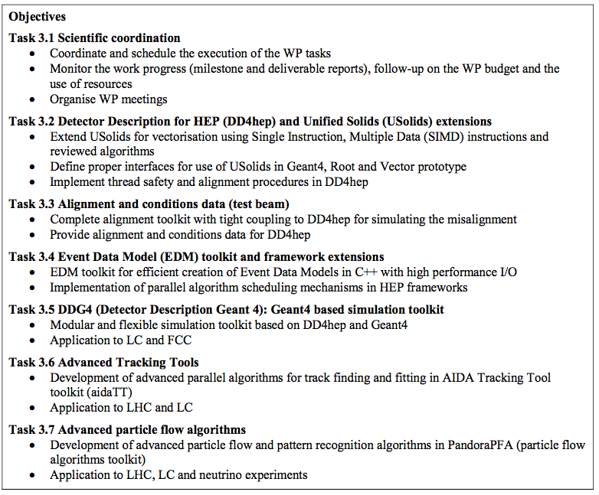
WP3 Overview

Slide 5
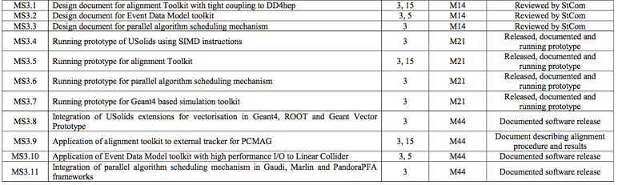
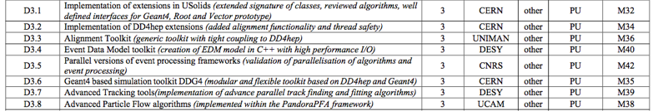
WP3 Milestones and deliverables
4 milestones for M21 achieved
achieved
achieved

Slide 6
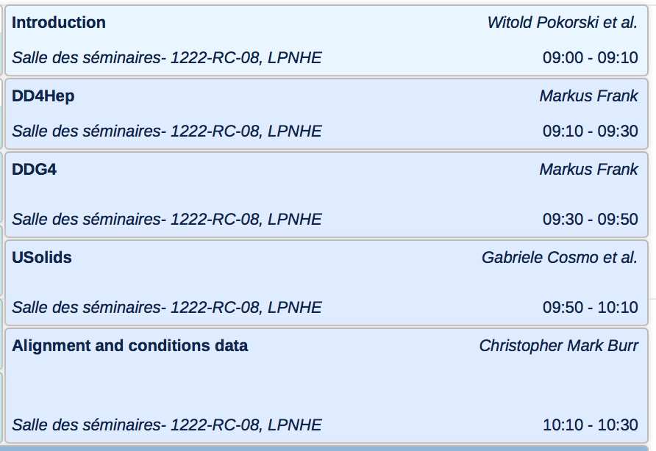
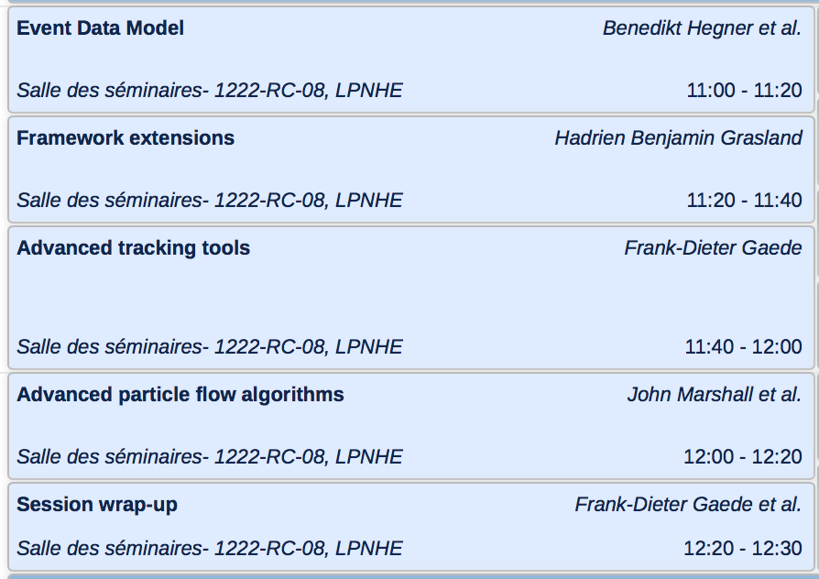
2nd Annual Meeting WP3 session

Slide 7
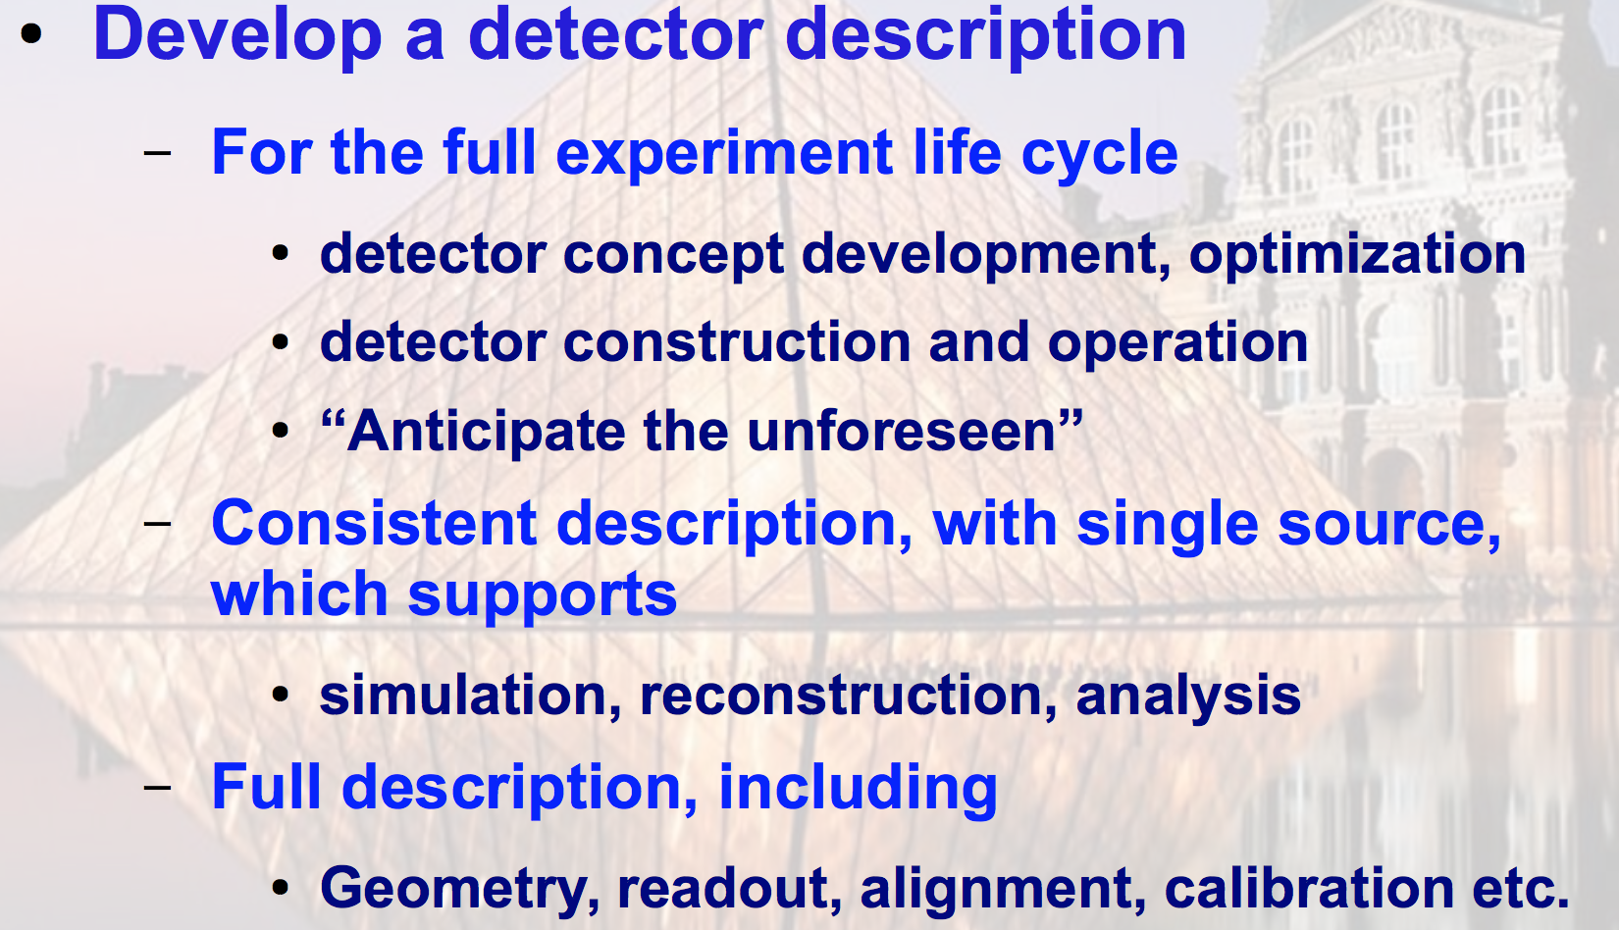
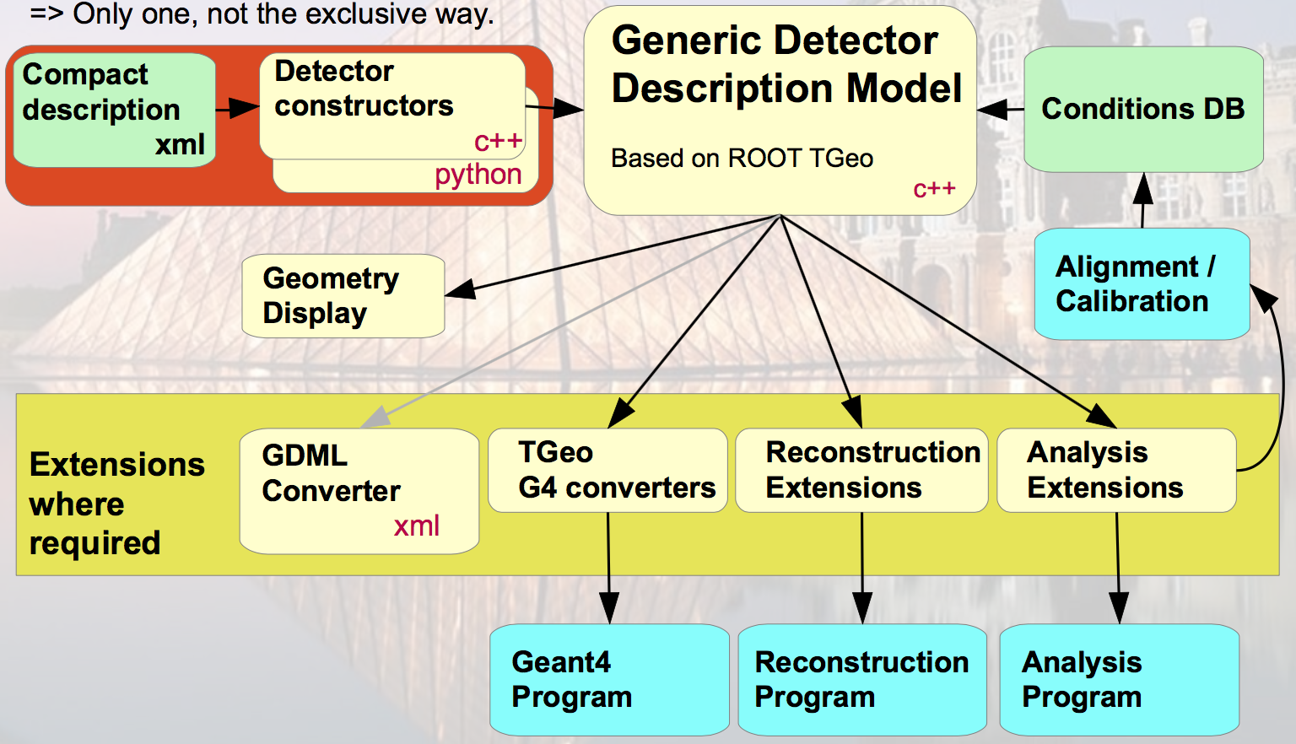
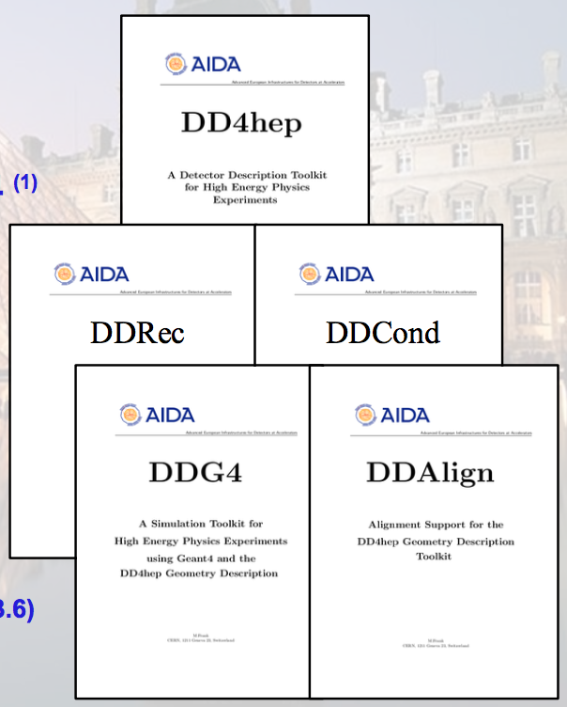
DD4hep - goals
M.Frank
core modules
current main development
simulation using Geant4

Slide 8
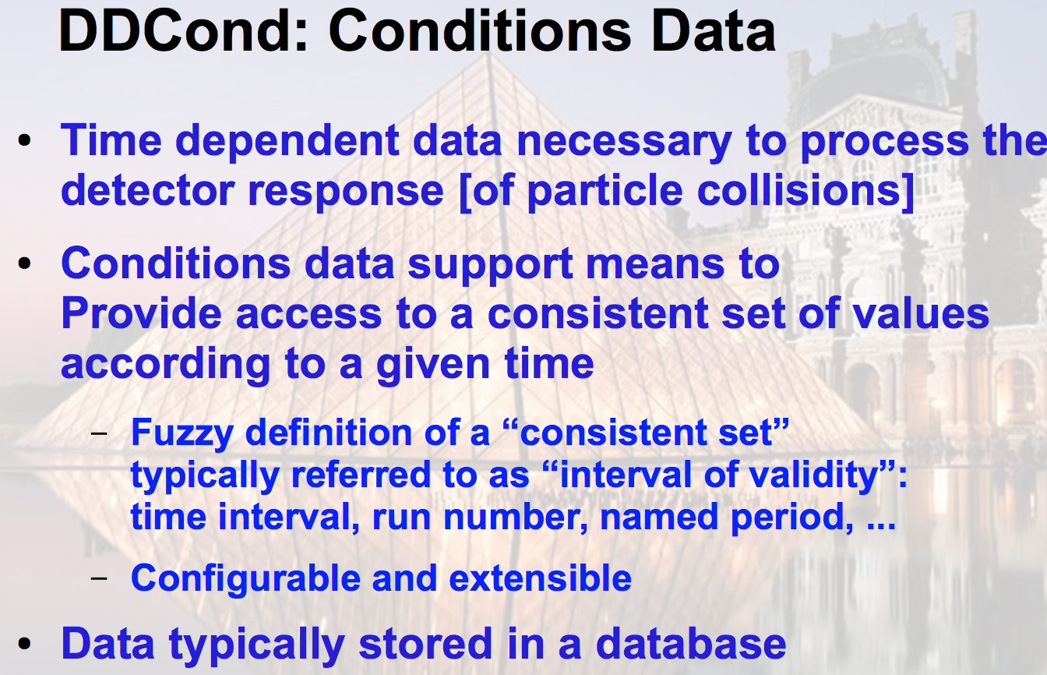
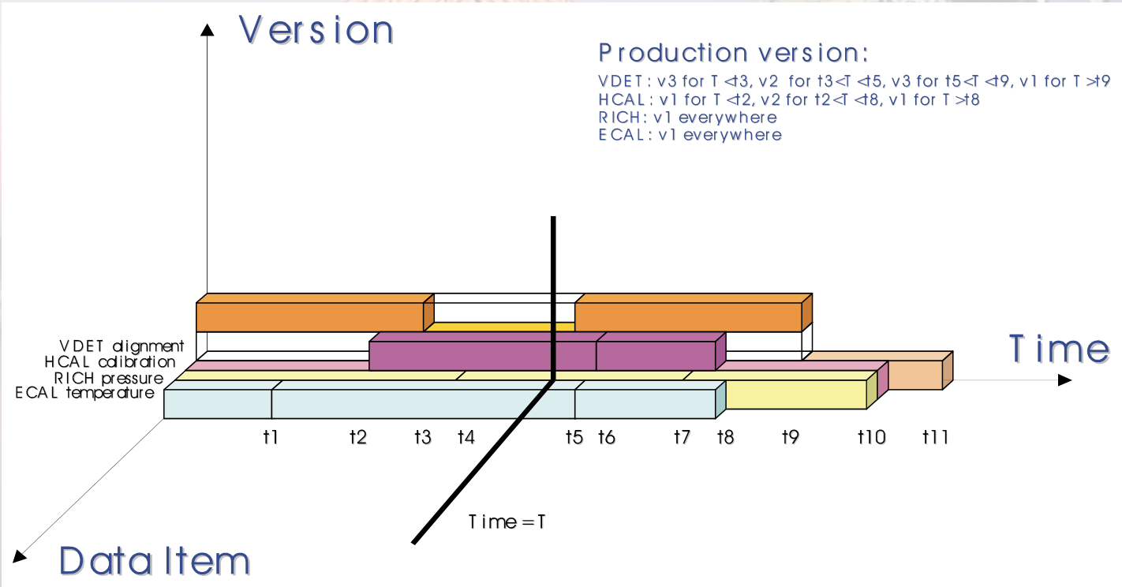
DD4hep/DDCond
M.Frank

Slide 9
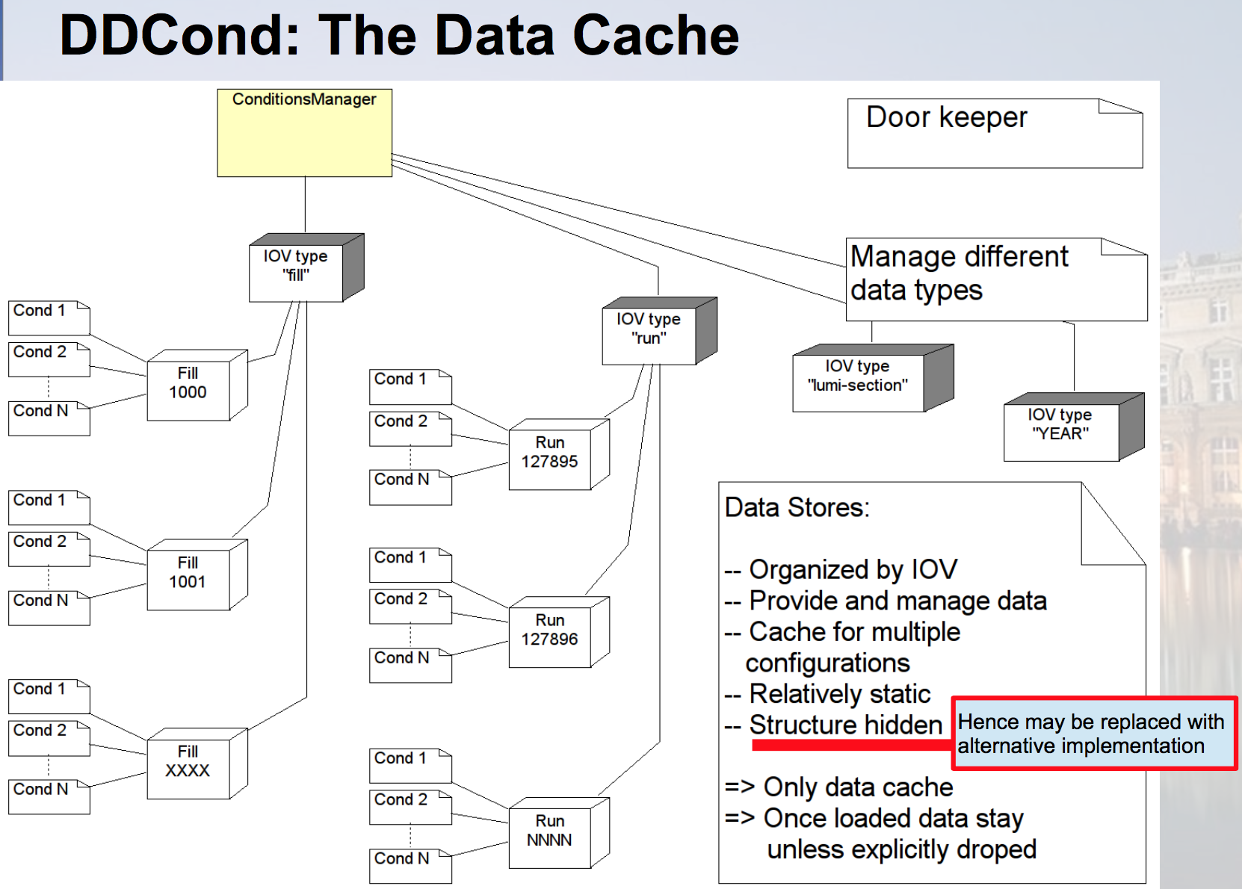
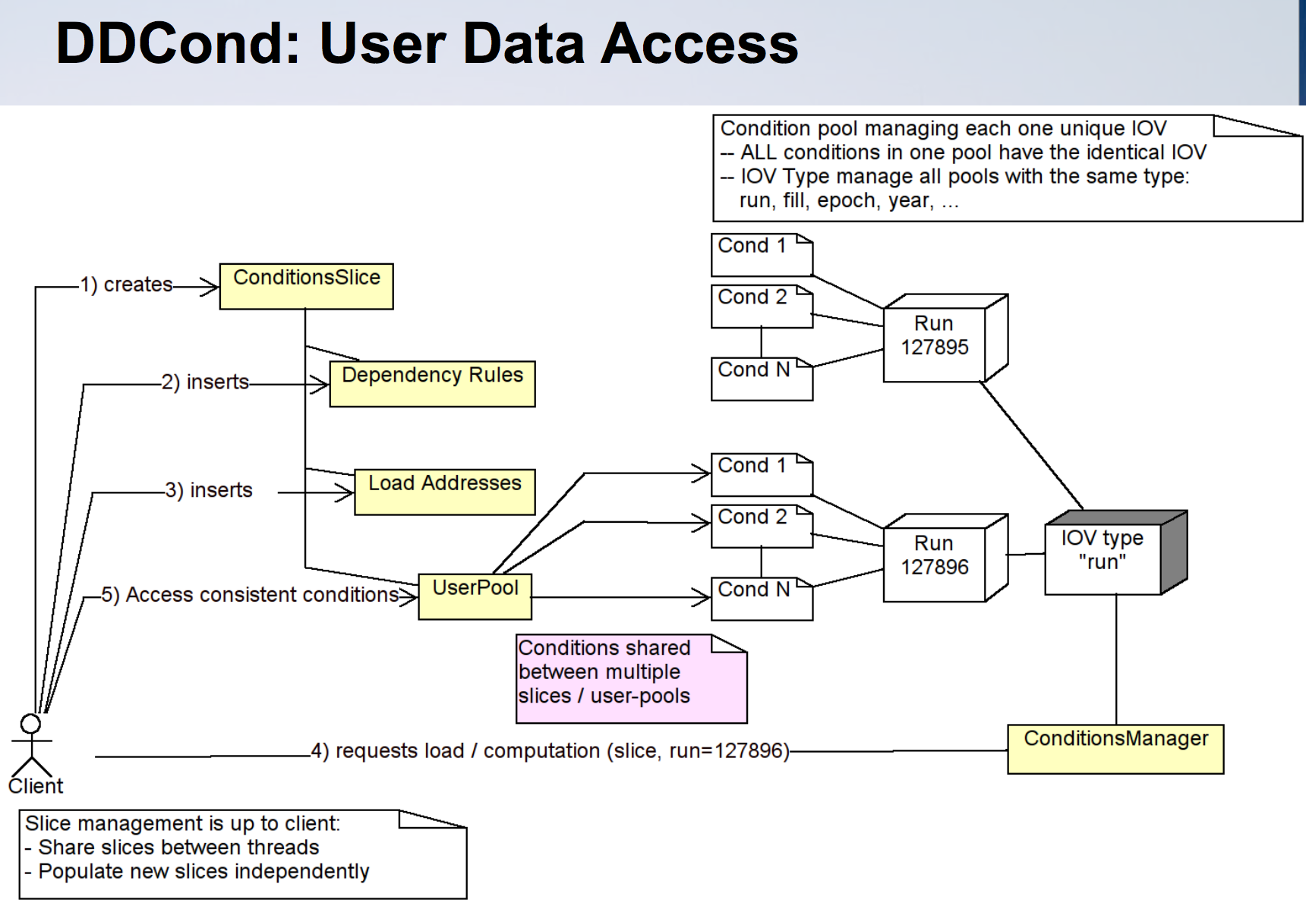
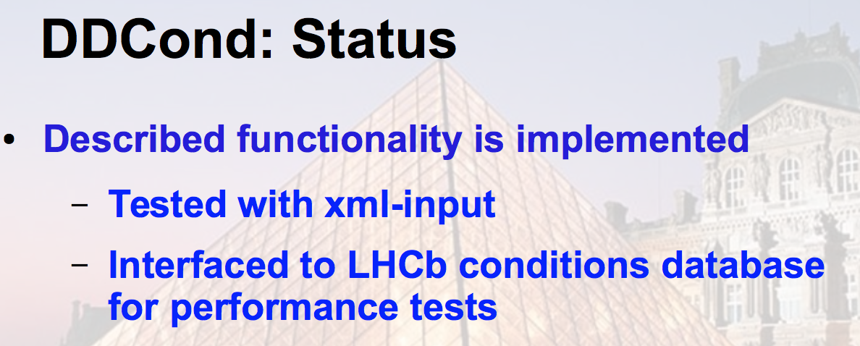
DD4hep/DDCond
M.Frank

Slide 10
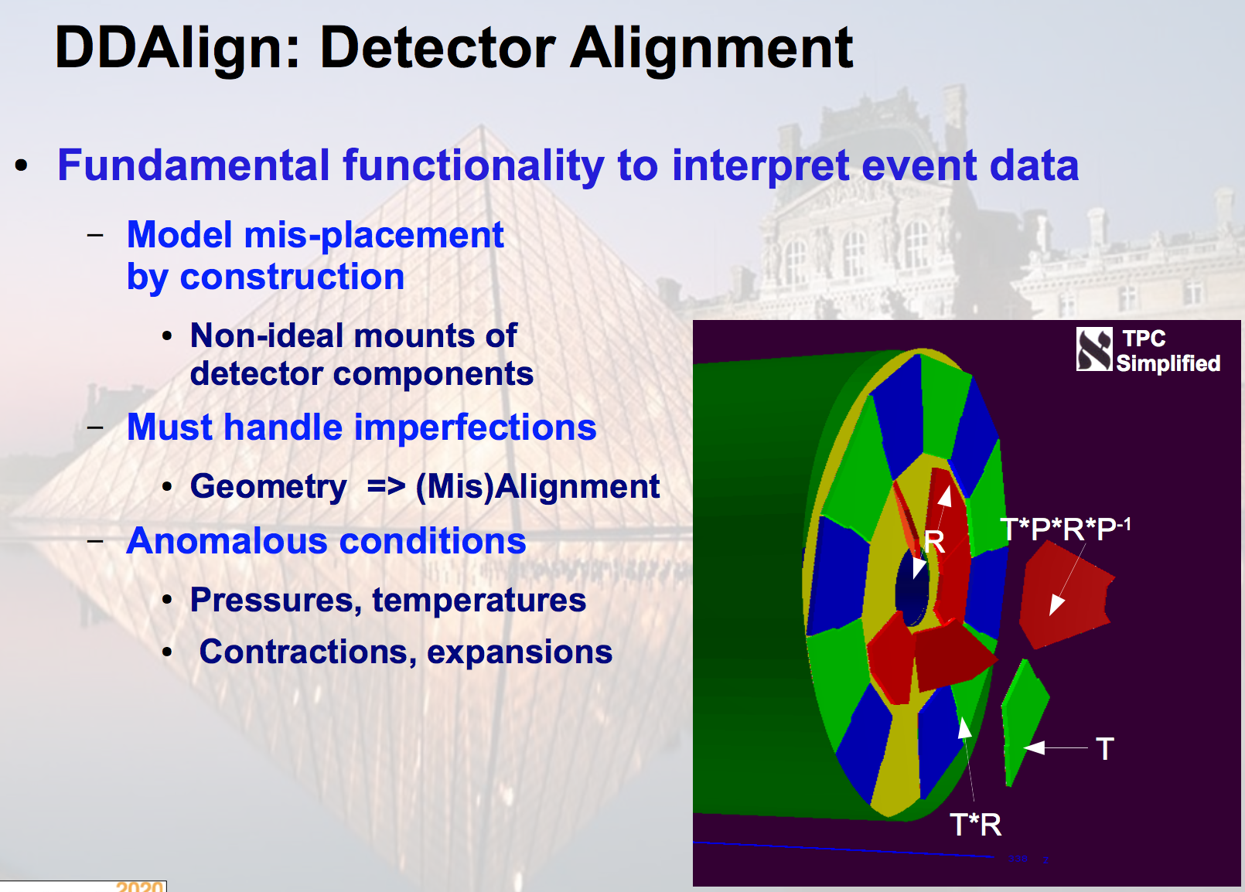
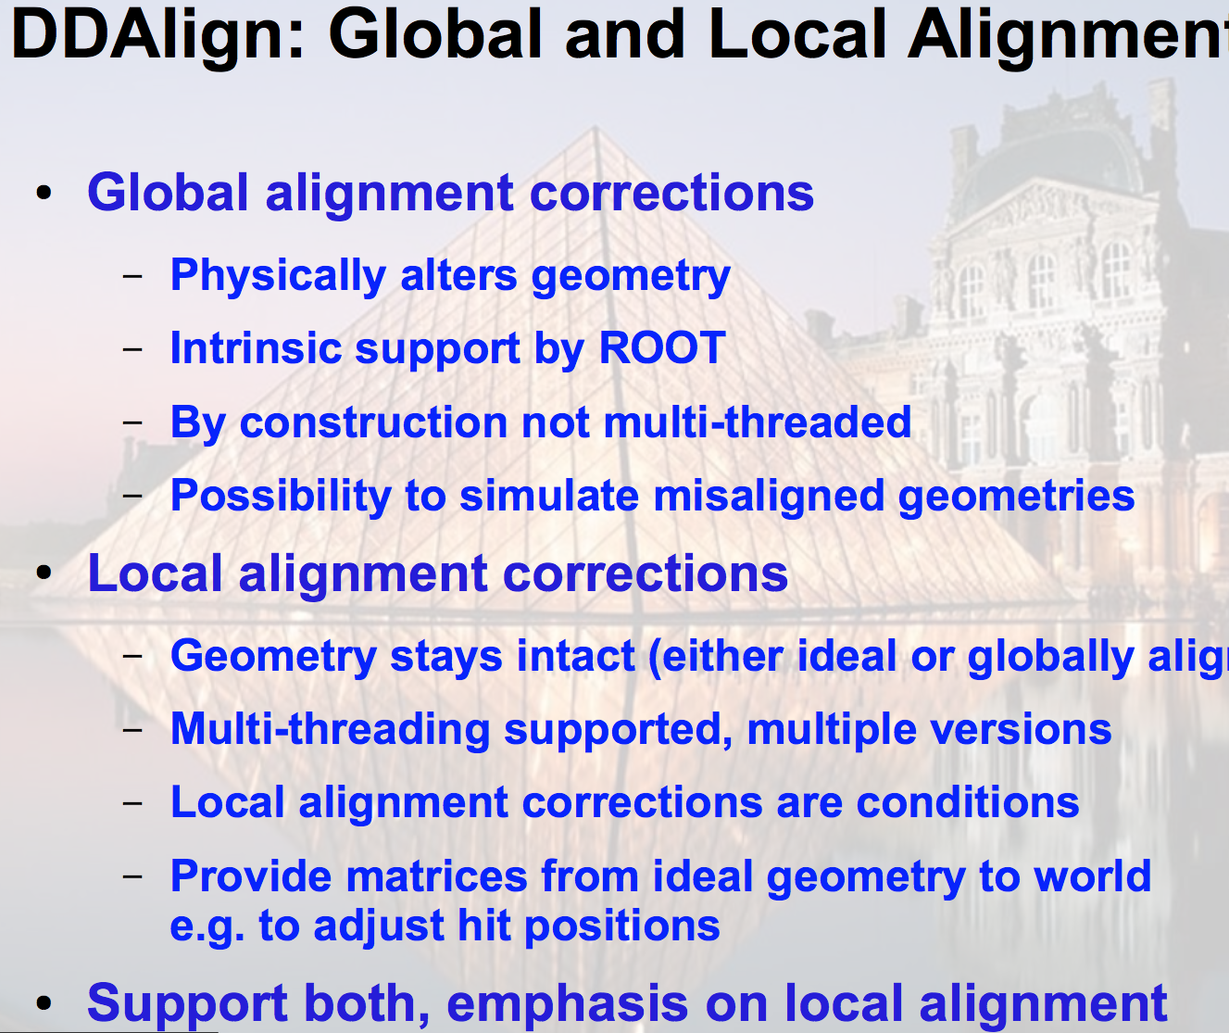
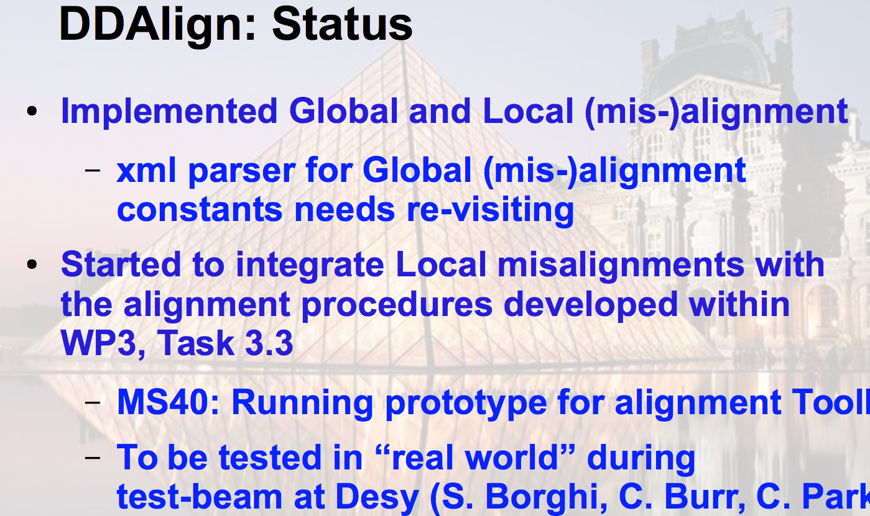
DD4hep/DDAlign
M.Frank

Slide 11
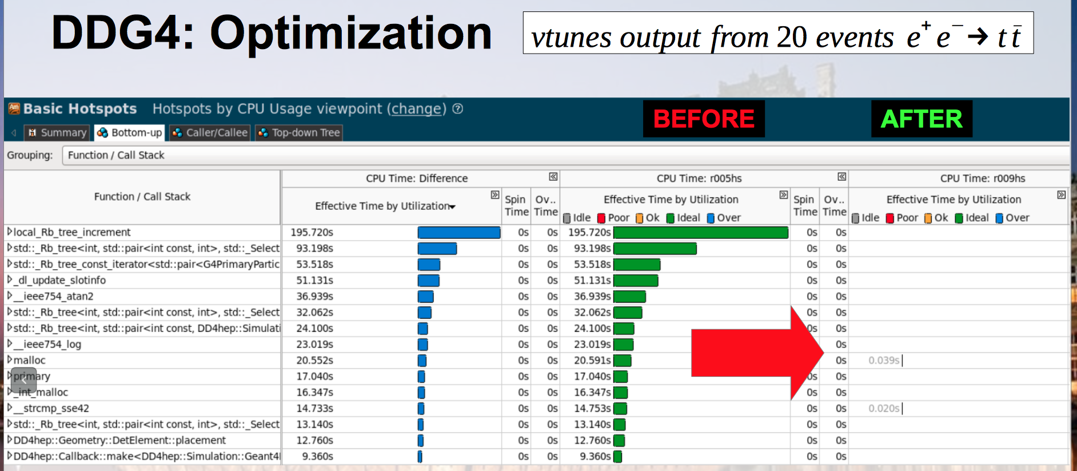
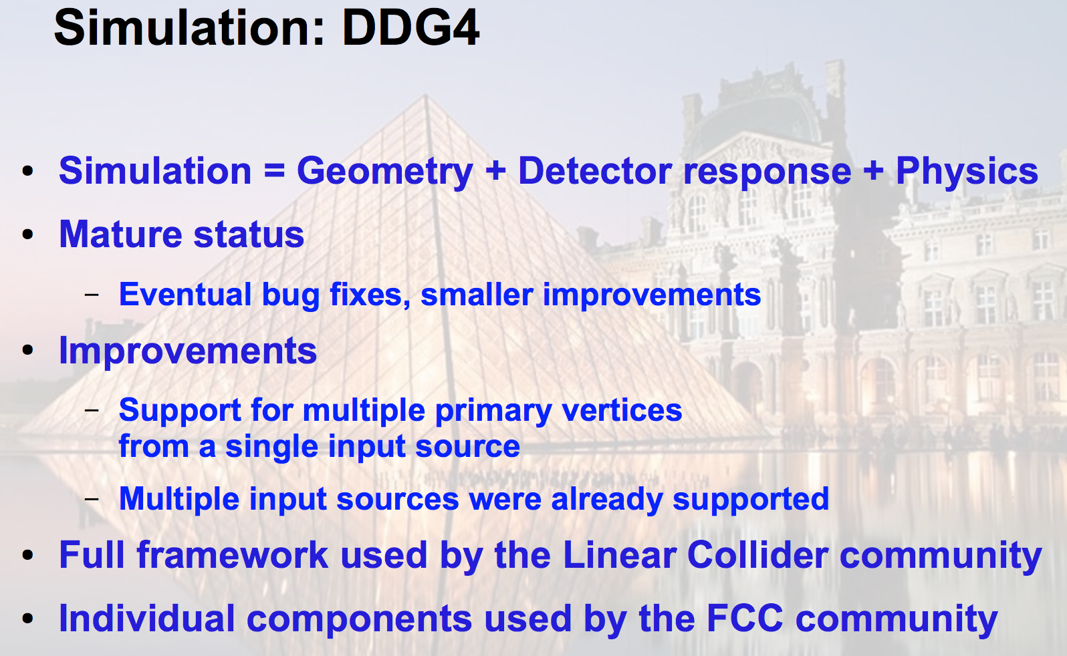
DD4hep/DDG4
M.Frank

Slide 12
Usolids/VecGeom
G.Cosmo, M. Gheata
USolids (Unified Solids) library: started as AIDA project
  Aiming to develop a new library of geometrical primitives to unify and improve algorithms existing in Geant4 and ROOT
VecGeom: started as a project for developing a vectorised geometry modeler (as main requirement of GeantV)
  Vectorization of algorithms, boost further performance and port to parallel architectures
Geant4
geometry
modeler
ROOT/TGeo
AIDA USolids
VecGeom
~1995
~2002
~2010
~2013

Slide 13
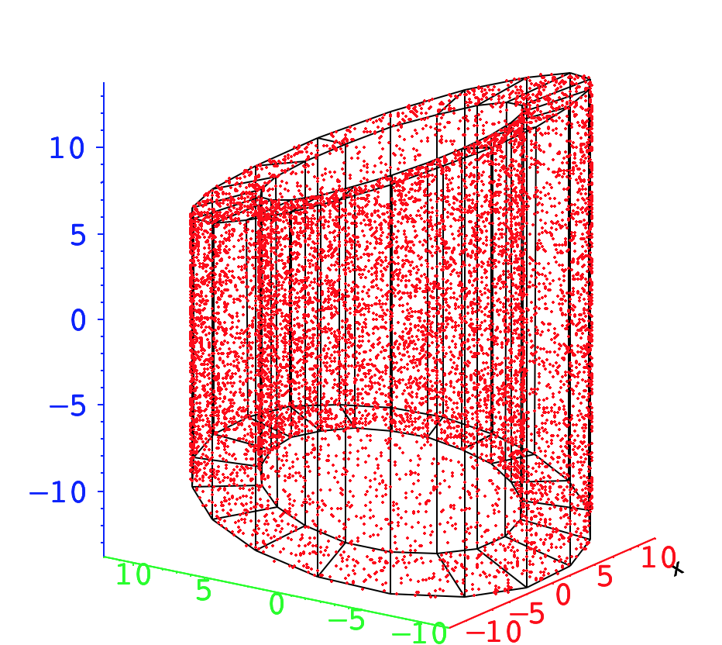
USolids/VecGeom MS 39 achieved
G.Cosmo, M. Gheata
Running prototype of USolids using SIMD instructions
USolids package revised and extended to support vector signatures
  usage of SIMD (Single Instruction, Multiple Data)
  extension of API to provide vector signatures
prototype is now available with VecGeom v00.03.00 and can be used for detector simulation in Geant4 and from ROOT
  required for MS42

Slide 14
USolids/VecGeom MS 42 achieved
G.Cosmo, M. Gheata
Running prototype for Geant4 based simulation toolkit
Geant4 simulation toolkit can now make use of VecGeom primitives replacing the original Geant4 shapes
latest Geant4 release 10.3 tested against VecGeom v00.03.00
Validation performed on realistic detector setups like the CMS or the LHCb full geometries

Slide 15
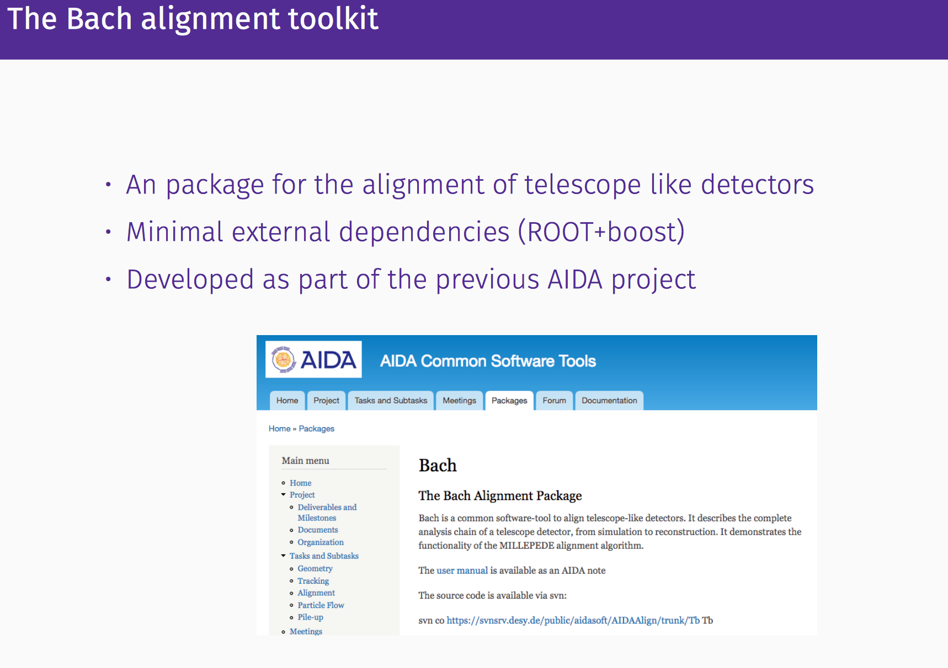
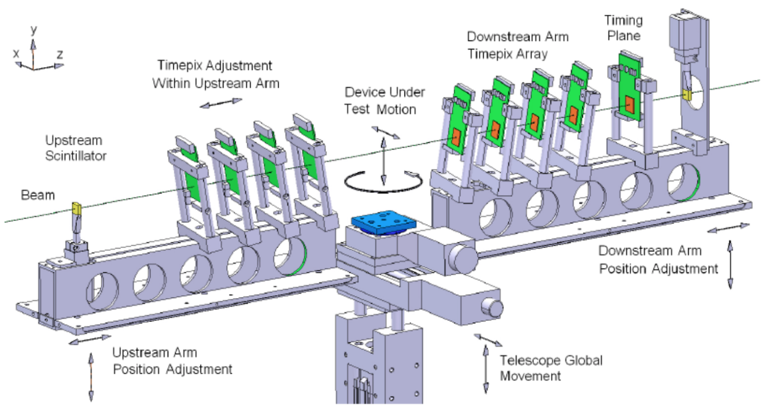
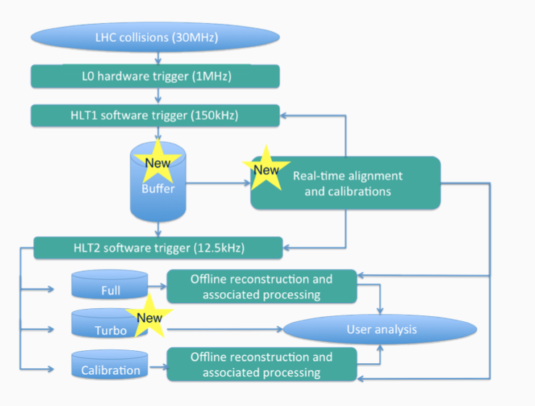
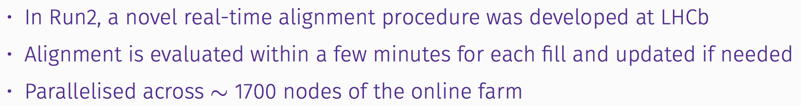
Alignment toolkit
S.Borghi, C.Burr, C.Parks

Slide 16
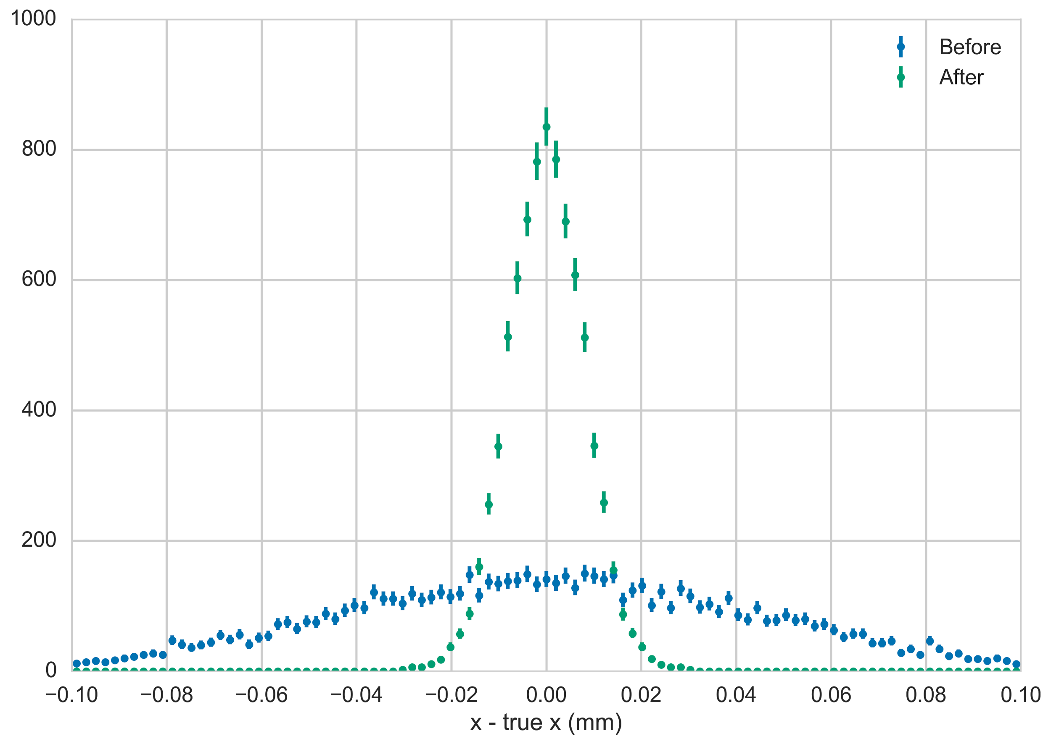

Alignment MS40 achieved
S.Borghi, C.Burr, C.Parks
Milestone: MS40 Running prototype for alignment toolkit
prototype alignment package capable of correcting misalignments in DD4hep geometries
  can be read back with DDAlign
preliminary validation performed to show the true alignment can successfully recovered; future work further improve the integration with DD4hep.
Difference between the position of a detector element and the true position in x (left) and y (right). The blue points show the positions simulated with random misalignments. The green points show the position after running the alignment package.

Slide 17
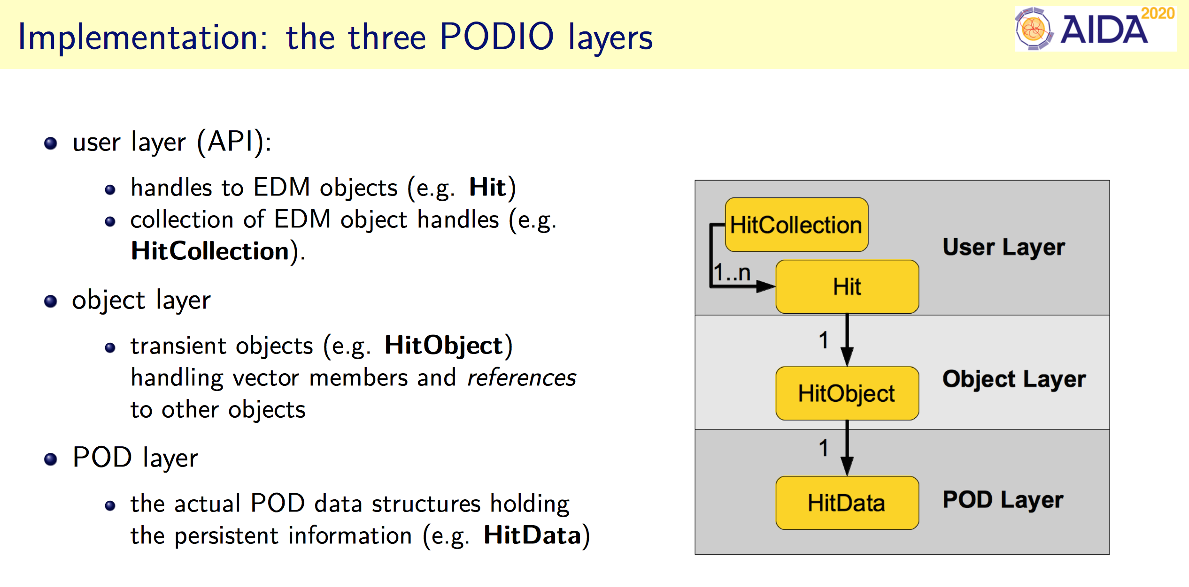
EDM Toolkit
B. Hegner, F. Gaede
      solving the problems of overly complex, deep object hierachies with many virtual function calls and non-optimal I/O performance
      exploiting C++ objects <-> Plain Old Data structures duality

Slide 18
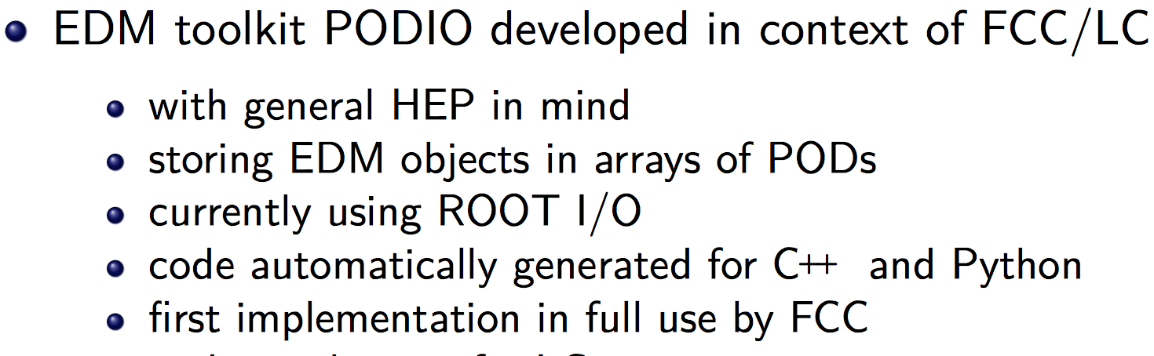
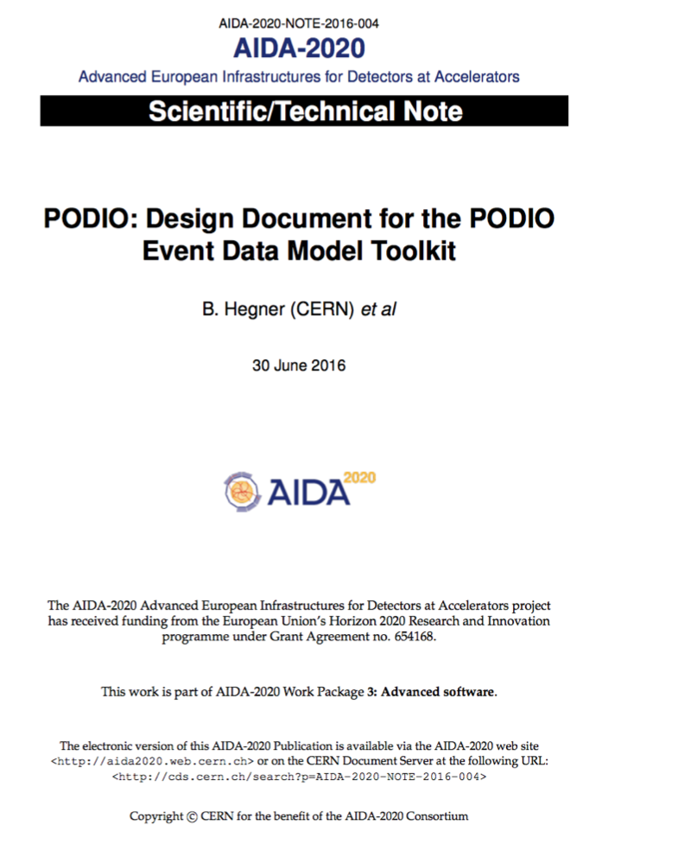
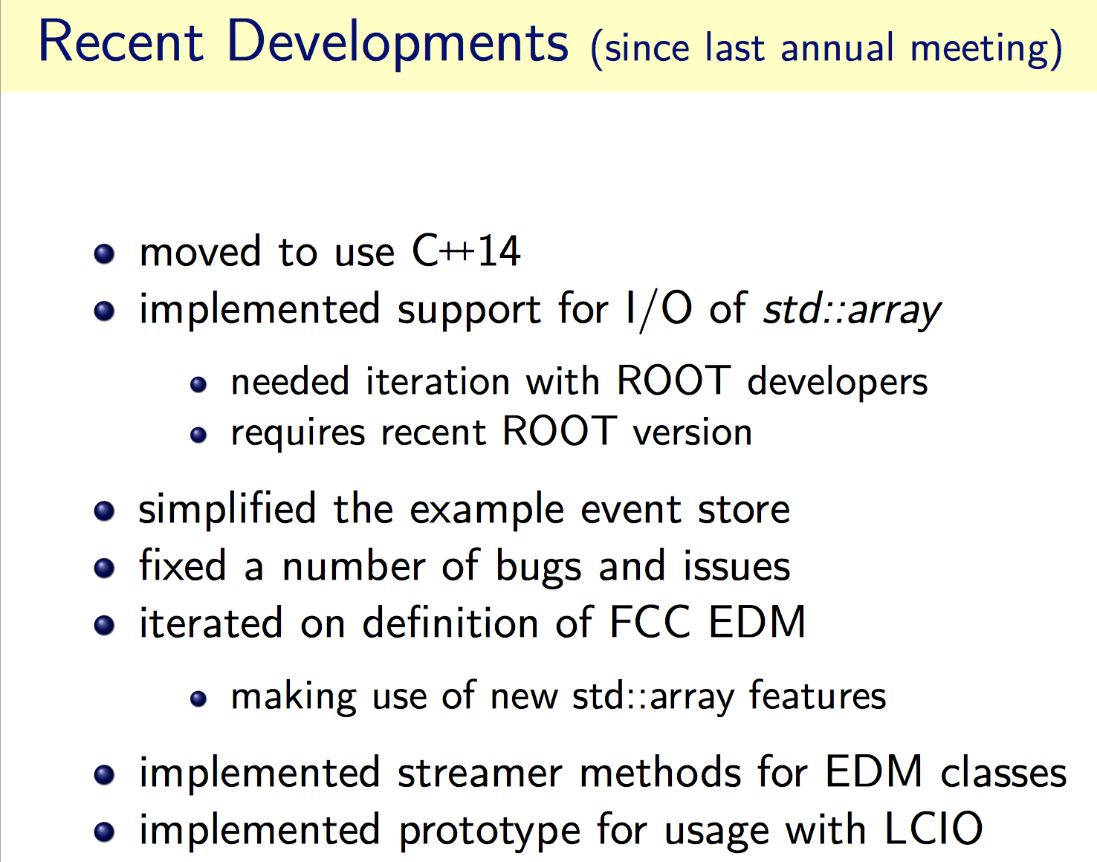
EDM Toolkit status
B. Hegner, F. Gaede

Slide 19
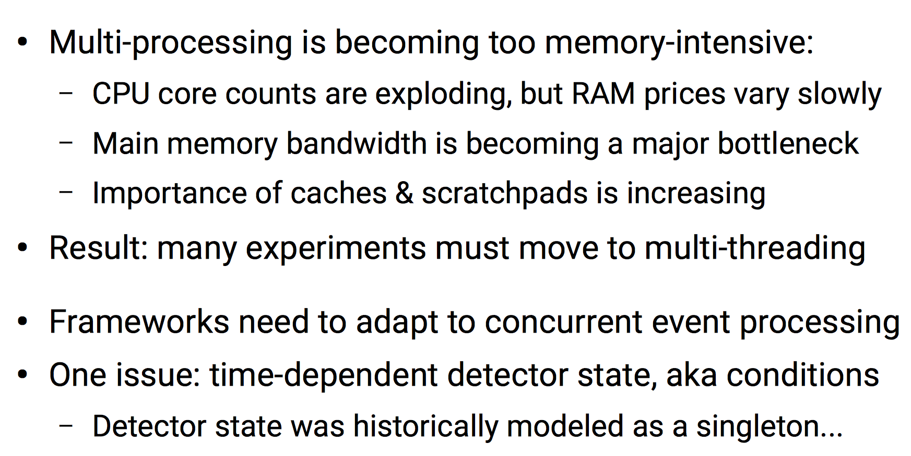
Framework Extensions
H.Grasland et al

Slide 20
Framework Extensions
H.Grasland et al
Milestone MS41 achieved
Running prototype for parallel algorithm scheduling mechanism
main focus on the concurrent detector condition handling
common condition handling interface for the Gaudi framework implemented allowing in particular to
  Register condition inputs and outputs
  Allocate and access condition storage through a backend-agnostic interface
  Tune balance between event processing efficiency and condition memory usage.
  Delegate the processing of the “raw” conditions to Gaudi algorithms
https://gitlab.cern.ch/hgraslan/conditions-prototype

Slide 21
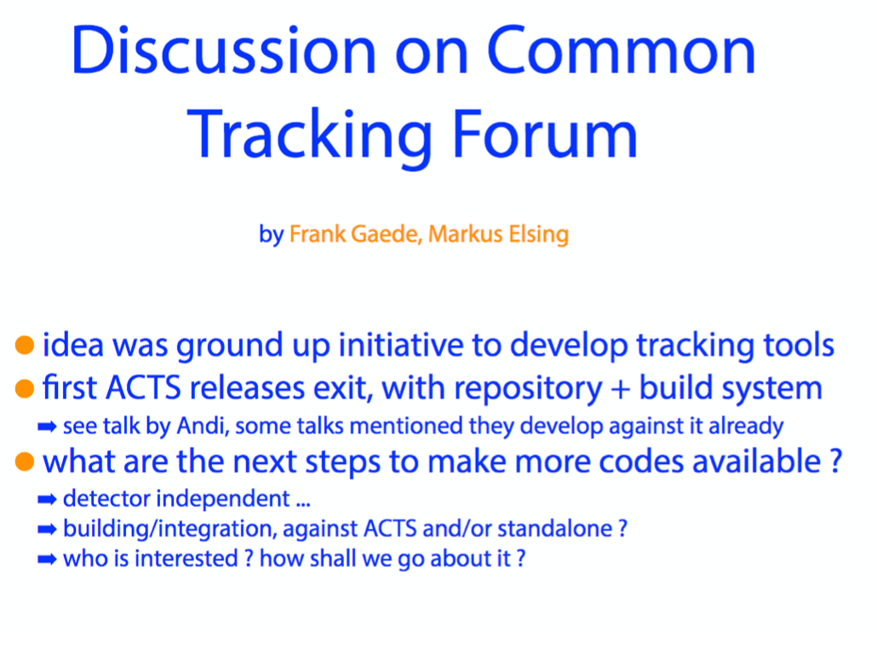
Advanced tracking tools
F.Gaede, H. Grasland
Task objectives
  Development of advanced parallel algorithms for track finding and fitting in AIDA Tracking Tool toolkit (aidaTT) Application to LHC and LC
ACTS (A Common Tracking Software) was released as open source software
  Based on ATLAS Run2 tracking software
  Used for FCC, use planned for ATLAS Run3, interest from LC
Decided to invest large fraction of the work in ACTS
  Parallelization of track finding and fitting tools
  Integration of generic pattern recognition tools from aidaTT Investigate application of ACTS to LC software

Slide 22
Advanced tracking tools
F.Gaede, H. Grasland
recent LAL work on ACTS (A Common Tracking System)
  made the ACTS test framework multithreaded, allowing to process multiple events in parallel
  Recent activity: working on consistent implemention of const correctness in ACTS ( remove mutable in code)
DESY
  Current focus on validation of tracking tools for two new ILD simulation models for large MC production
  Started to evaluate use of ACTS for iLCSoft
  Plan to contribute generic pattern recognition algorithms from iLCSoft (developed in AIDA) to the ACTS ecosystem
    Activity planned for second half of the year

Slide 23
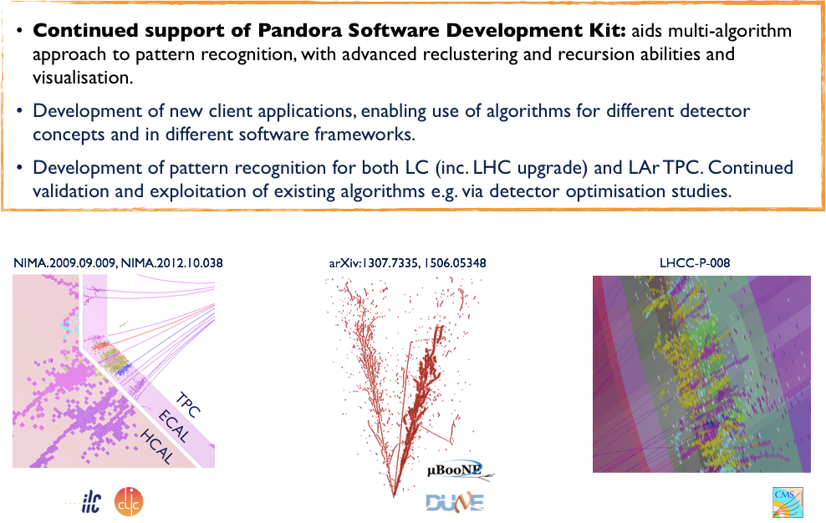
Advanced PFA
L.Escudero for the Pandora team

Slide 24
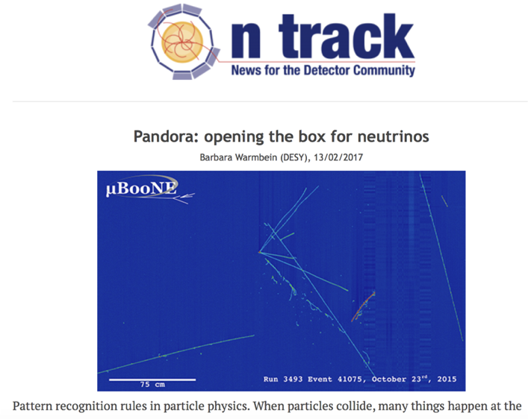
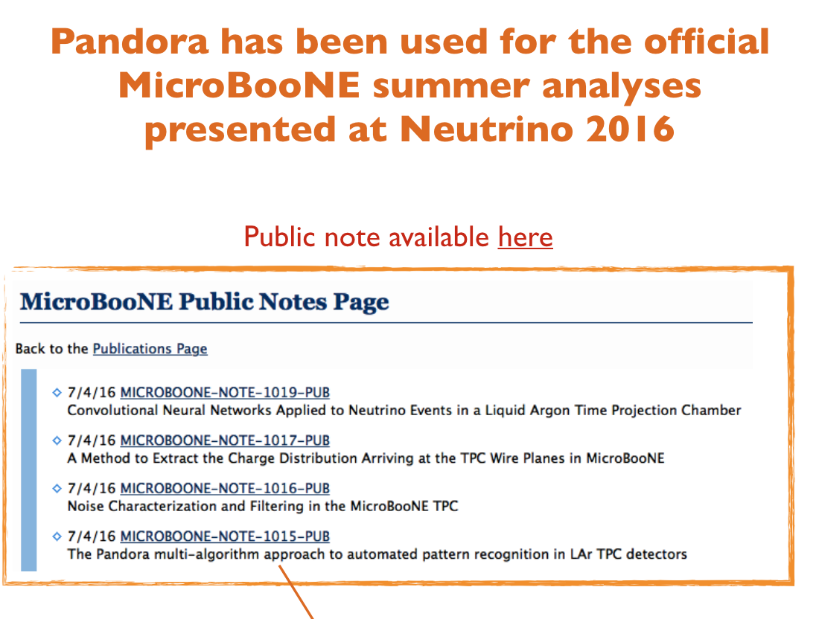
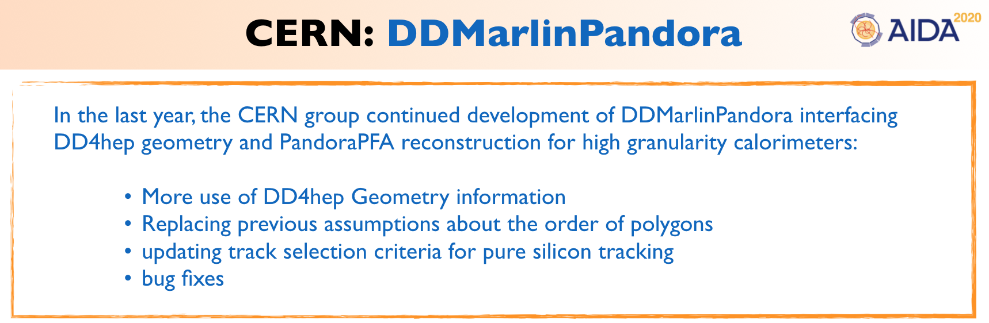
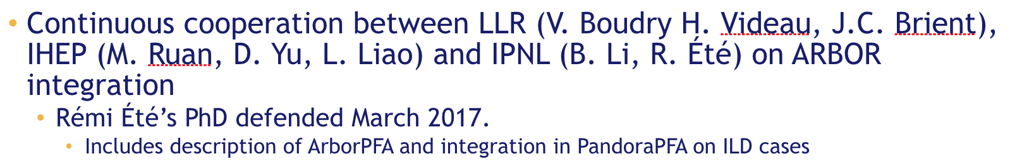
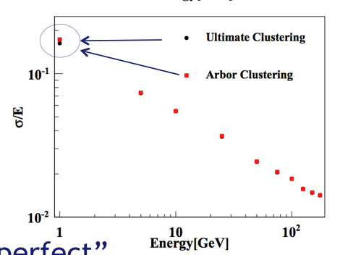
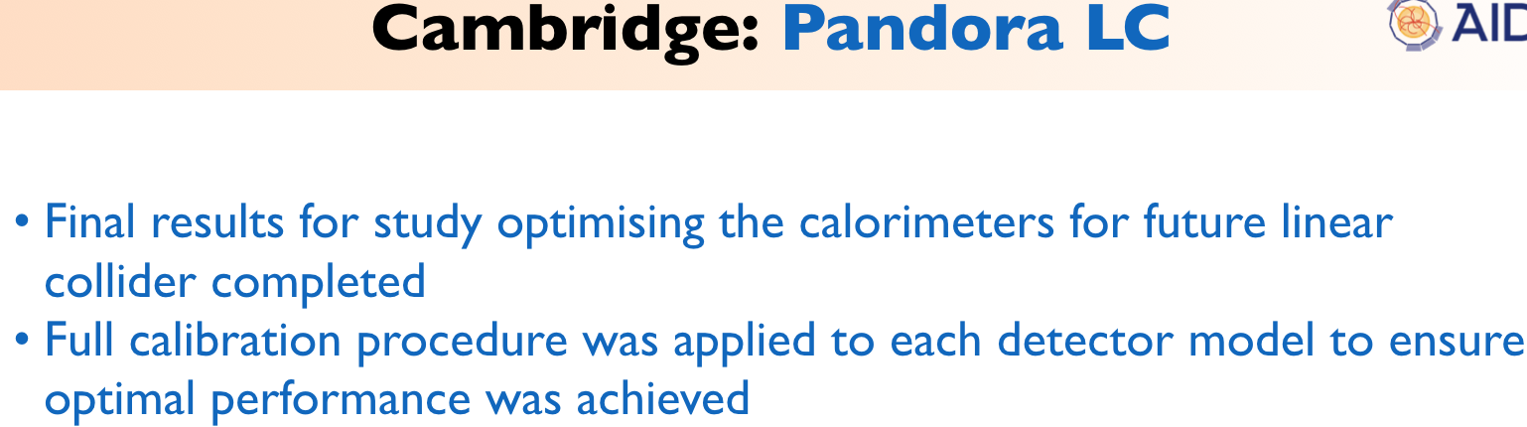
Advanced PFA
L.Escudero
MicroBooNE paper in preparation!(with the Editorial Board now)

Slide 25
Summary
    AIDA-2020 Advance Software WP3 addresses core, simulation and reconstruction software for HEP
    all the WP3 tasks going according to the plan
      good progress in the software development
      good communication
        running regular phone meetings (every ~6 weeks) with all the WP3 task coordinators invited
    all milestones until now achieved on time
    next deliverables for M32+ all well within the reach

