Slide 1
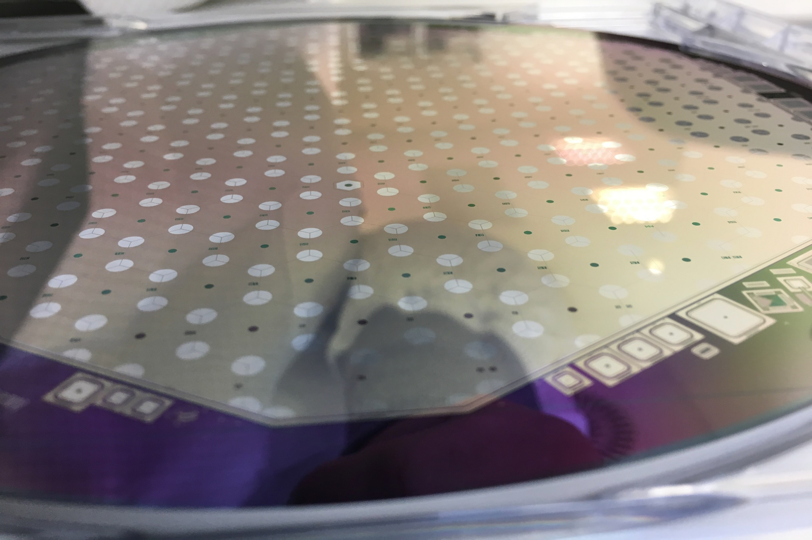
Task 2.5 Pre-industrialisation of large area silicon detectors
(OEAW, CNRS-LLR, KIT, UNILIV, UniFreiburg)
2st annual meeting AIDA-2020

Slide 2
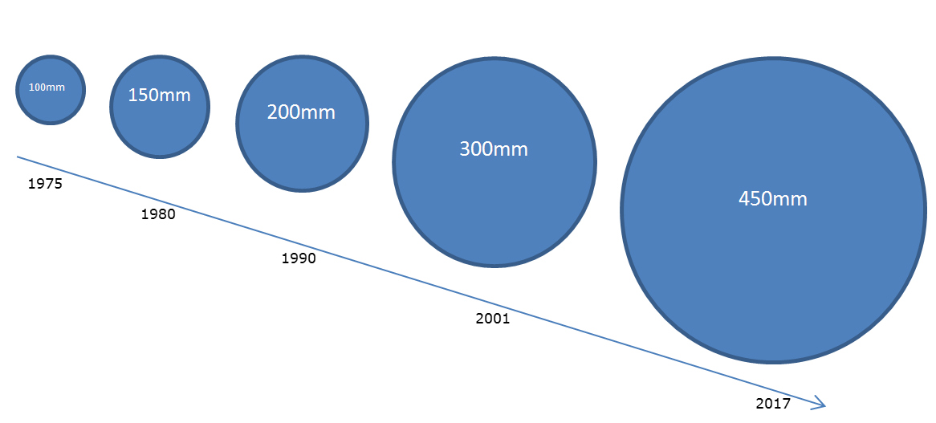
Demand on Sensors
Market Survey
Silicon surface
  Today: Up to 200 m² (CMS)
  Similar size for the upgrades of CMS and ATLAS (~200 m² each)
  Significant increase for CMS HGCal ~ 600 m²
Wafer Size
  NA11 started with 2” and 3”
  Today 6” (150 mm) is standard (used by LHC Experiments)
  → Introduced in the Industry in the 80ies!

Slide 3









Vendors known to the HEP community
Market Survey
Small Scale Production
(few 10-100 wafers per year)
  Many institutes and companies
  6” available at many sites
  Broad spectra of quality and price
For large scale production
(few 1.000 – 10.000 wafers per year)
  Up to now only one producer
  Japanese company

Slide 4

Dual Source Strategy
Market Survey
To have (at least) a second option which can immediately take over in case of problems is in principle not a bad idea
  Imagine: quality issues, bankruptcy, earthquakes,…

Slide 5
Common CMS/ATLAS Market survey for Tracker Sensors
Market Survey
Enabling factors:
Strip sensors for ATLAS and CMS are very similar
Different specifications are not so significant for the production
Advantages:
Shows the combined demand of the largest projects of the coming years to interested companies
We can share qualification work among the two collaborations
BUT: A very large fraction of sensor production is not reflected in this MS: CMS High Granularity Calorimeter
  Nevertheless, we are syncing these efforts between tracker and HGCal

Slide 6
CMS/ATLAS Market Survey Procedure
Market Survey
Each interested company has to successfully pass a three step qualification procedure to be eligible to receive the Invitation to Tender!
Step 1: Companies need to return the “Technical Questionnaire” document where the responses need to fulfil the requirements set in the “Qualification Criteria” document -> ADIA-2020 Milestone MS30 (2016)
Step 2: Companies need to provide samples free of charge of functional devices of e.g. previous project -> reported here
  ATLAS and CMS qualified samples developed by HEPHY-ÖAW as 8” proof-of-principle
(Step 3: CMS/ATLAS orders (and remunerates) a batch of prototype sensors according to CMS layout and specs)

Slide 7
Market Survey results
Market Survey
ADIA-2020 Milestone MS30
Eight companies replied to the market survey
  Some “usual suspects”
  some jumped into business only recently
Existing collaborations with “new” companies:
  Infineon (CMS, HEPHY)
  Novati (CMS, US groups)
  Lfoundry (CALICE)
Company | Country | Wafer size | AC-Coupled strip sensors | DC-coupled PS-p sensors
Advacam (VTT) | Finland | 6“/(8“) |  | x
BEL | India | 6“ |  | x
CiS Erfurt | DE | 4“ | x | x
Hamamatsu | Japan | 6“/(8“) | x | x
Infineon | AT/DE | 8“ | x | x
Lfoundry | Italy | 8“ | x | x
Micron | UK | 6“ | x | x
Tezzaron/Novati | USA | 8“ | x | x
Demand according to Markey Survey:
 | AC-Coupled strip sensors | DC-coupled PS-p sensors
ATLAS | 23’000 on 6”
CMS | 27’500 sensors ≈ 23’500 6” wafers | 8’500 sensors ≈ 4’250 6” wafers

Slide 8
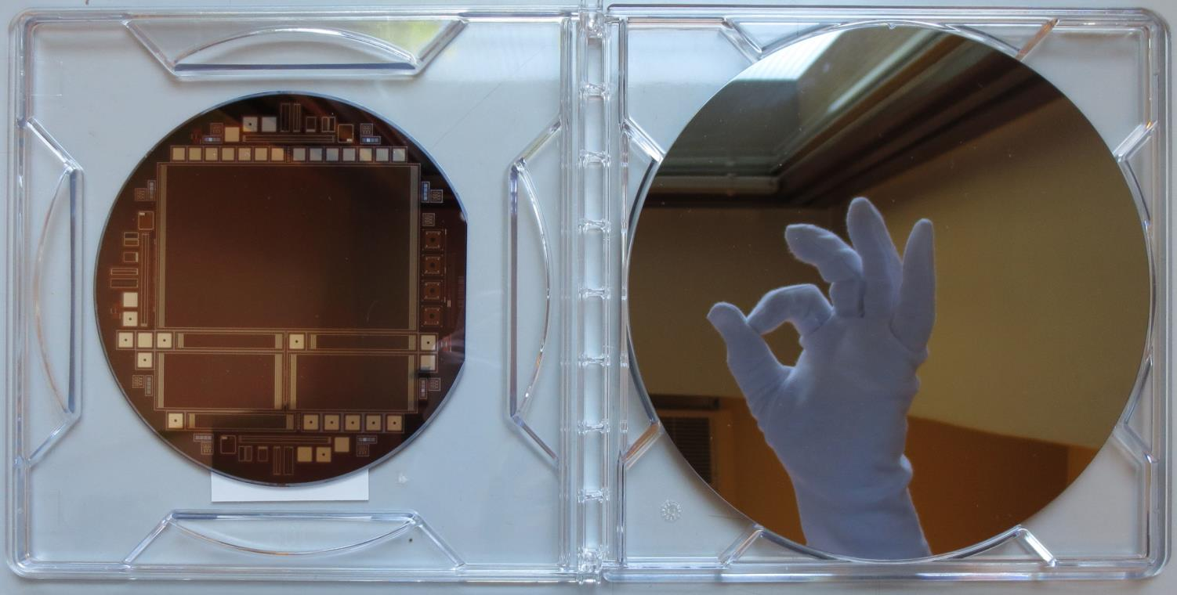
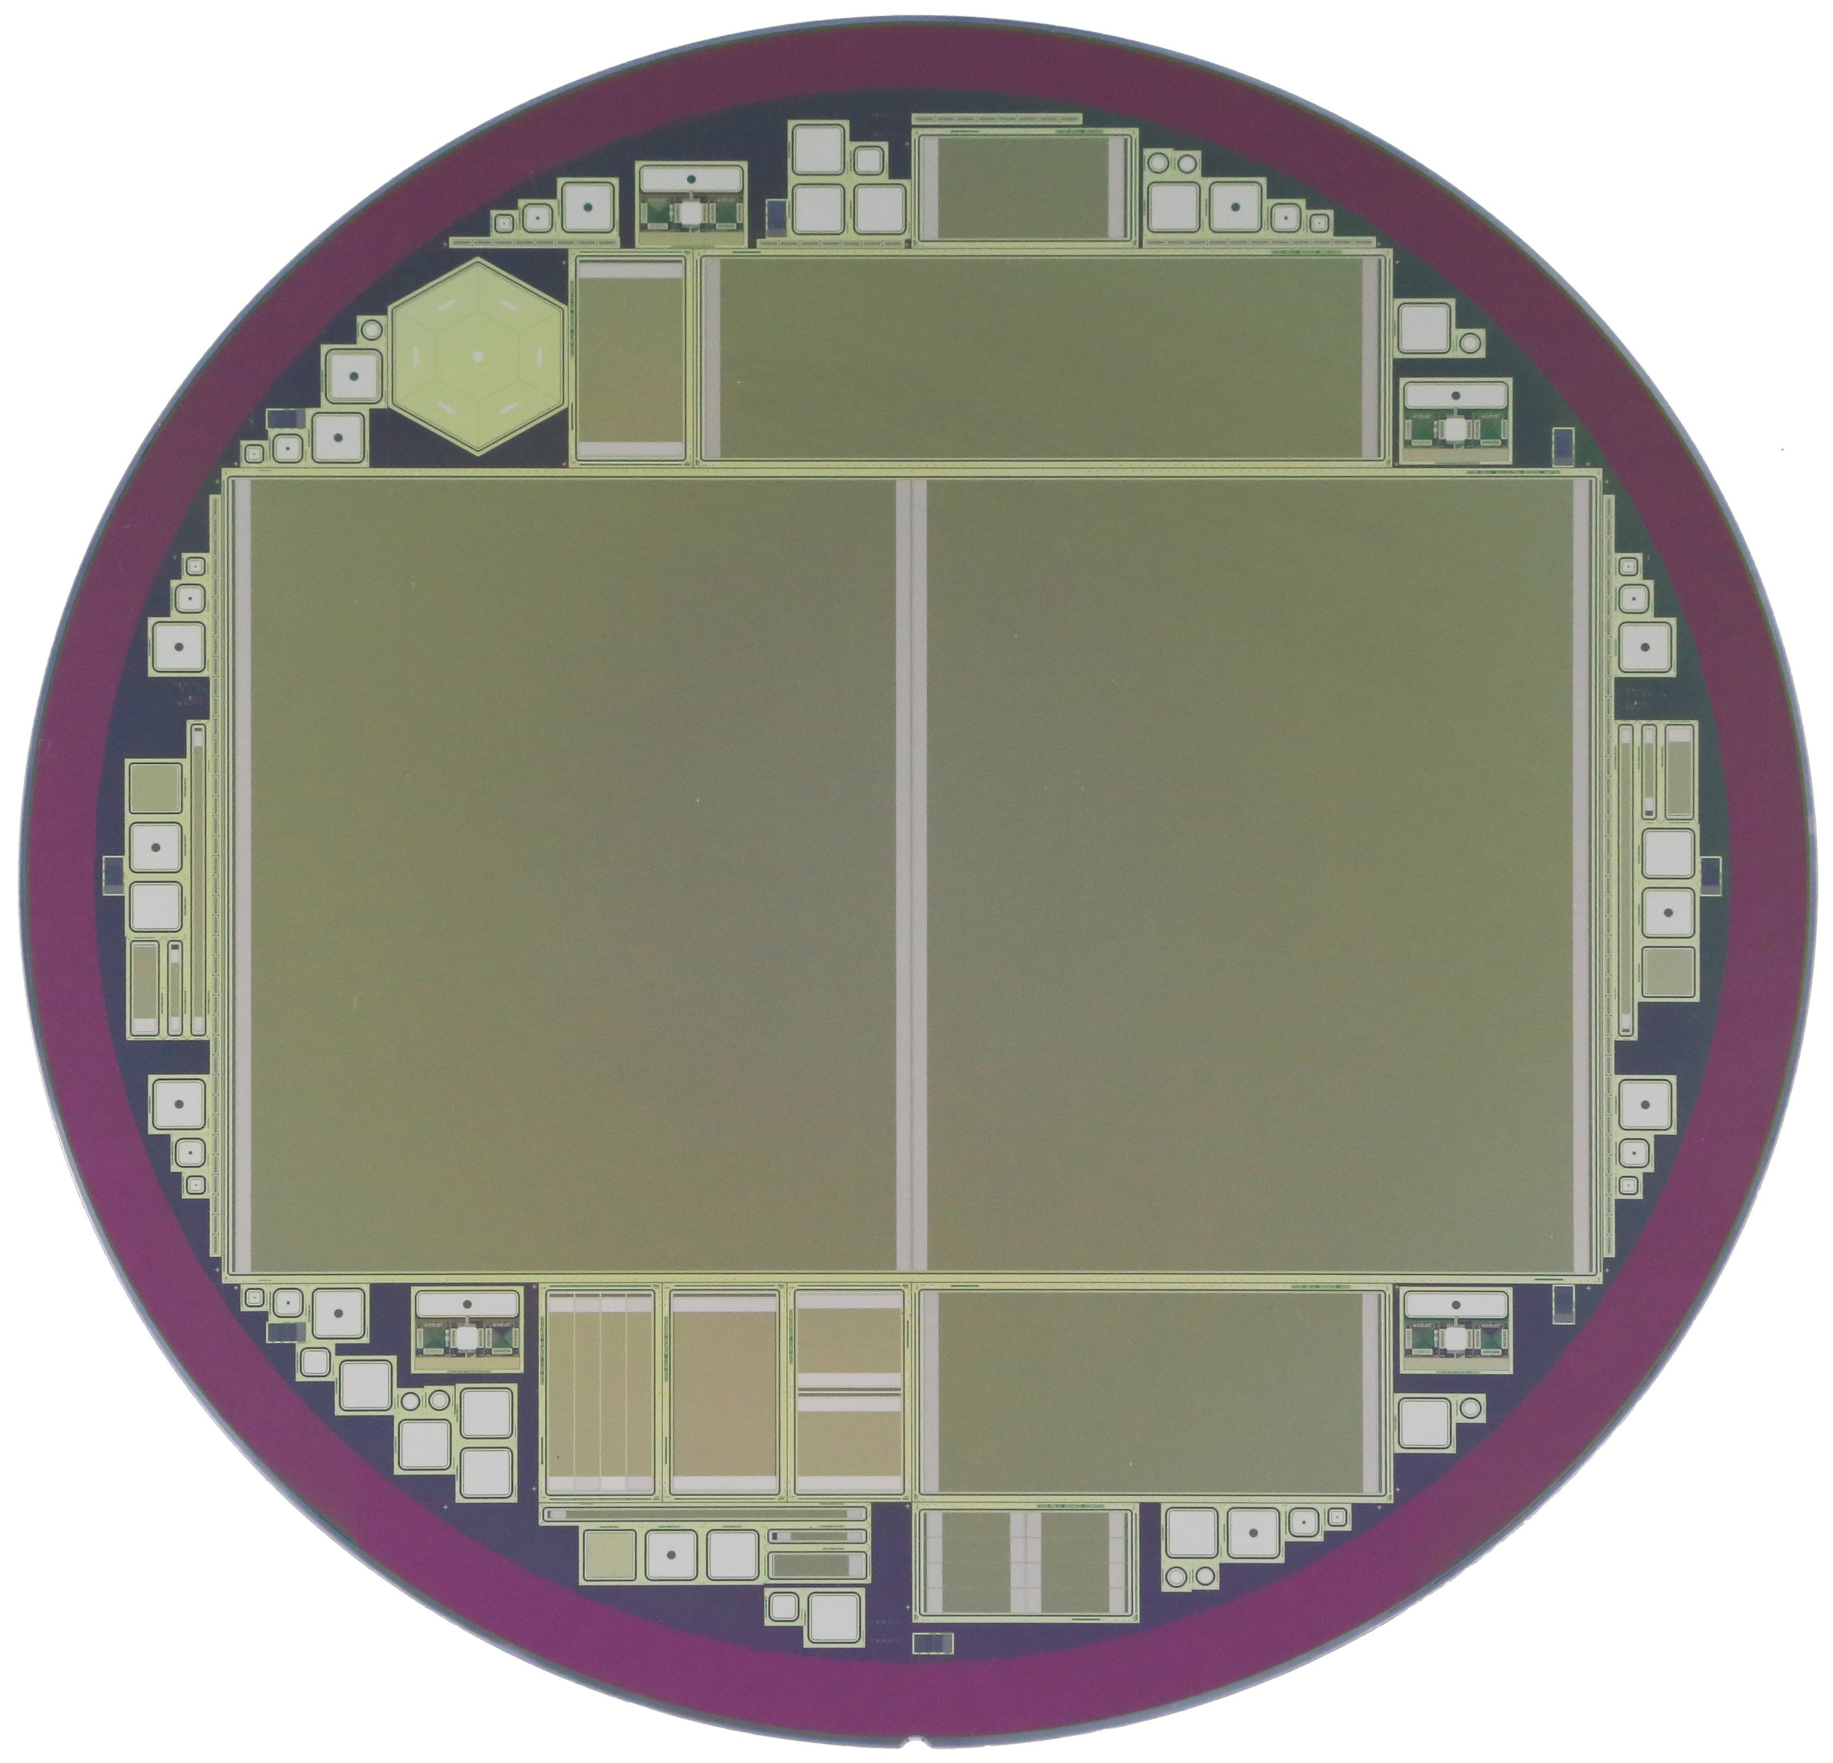
Focus on Infineon
Market Survey
Although other companies also replied to market survey, we are concentrating to only one company here, since there is already a fruitful collaboration between them and HEPHY
Infineon is an European Semiconductor company
  Focus on power devices -> experience with fully depleted devices
6” p-on-n sensors (2012) → bare 8” wafer (2014)
Fully processed
8” wafer (end 2015)

Slide 9
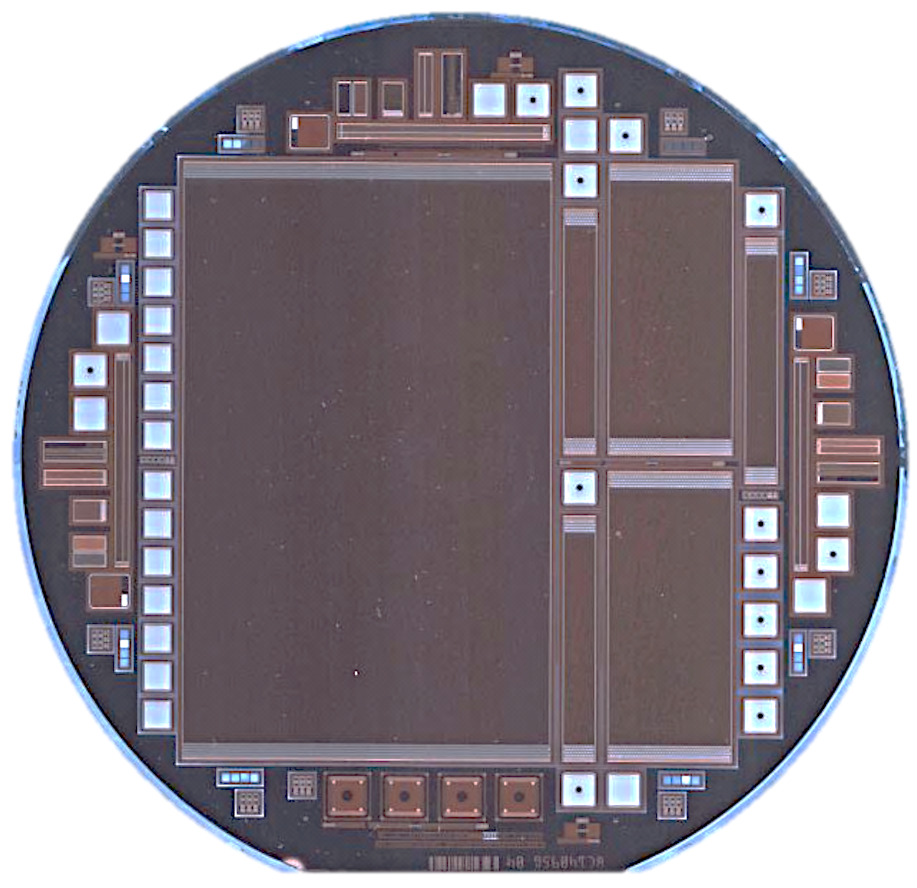
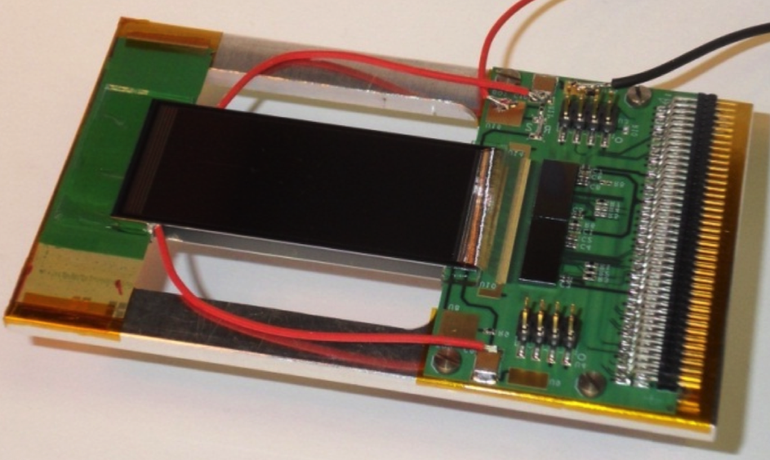
Collaboration HEPHY -- Infineon
Market Survey
2009: Project started between HEPHY and IFX
by private contacts and a “semi-official” visit of HEPHY staff and students to Infineon Villach
2012: First production of 6” p-on-n sensors
  Goal: re-produce the current CMS tracker sensors
  Several batches in 5 different runs with good quality, but some issues, eventually tracked down to charge-ups
Since 2014: Working on 8” n-in-p process for CMS tracker phase II upgrade
  First production finished in October 2015
  Second batch currently under production with many improvements
Since 2015: Development of sensors for CMS High-granularity calorimeter
  ~15 wafers delivered with different thicknesses
6“ p-on-n
Wafers:
Charge-up during dicing
generates zone with low
Inter-strip resistance
Module equipped with Infineon sensors
9

Slide 10
Tracker sensors
”CMS” should read KIT and HEPHY-ÖAW
“ATLAS” should read “Freiburg” and “Uliverpool”

Slide 11

Specifications and Wafer Layout
Tracker Sensors
Specifications
  High resistive float-zone p-type base material
  Resistivity of 7 kΩ cm
  200 μm physical and active thickness
Wafer Layout
  Main sensor 2S long → elongated version of 2S for CMS
    ≅ 10 cm x 15 cm, strip length ≅ 7.5 cm, w/p ≅ 0.25
    2032 strips segmented into two parts
  8 different baby sensors
    Irradiations
    P-stop geometry studies, etc.
  Test structures
    Diodes, MOS, GCD, dielectric breakdown, etc.
  “HGC-shaped” test diode
1016
1
7.56 cm
15.12 cm
9.13 cm
1017
2032

Slide 12
Split Groups of 1st batch
Tracker Sensors
Infineon processed 25 wafers in total
23 delivered to HEPHY
Four 2S long assembled to modules for beam tests
One 2S long destroyed during handling
18 2S long sensors available for detailed testing
Split groups
6 different realizations of Pstop
  3 different implantation doses
  2 different thermal budgets
2 different Pspray implantation doses
5 different R_{poly} implantations
PStop | 01 | 02 | 03 | 04 | 05 | 06 | 07 | 08 | 09 |  |  |  |  |  |  | 16 | 17 | 18 | 19 | 20 | 21 | 22 | 23 | 24 | 25
PSpray |  |  |  |  |  |  |  |  |  | 10 | 11 | 12 | 13 | 14 | 15
PSpray A |  |  |  |  |  |  |  |  |  | 10 | 11 | 12
PSpray B |  |  |  |  |  |  |  |  |  |  |  |  | 13 | 14 | 15
Pstop early A | 01 | 02 | 03
Pstop early B |  |  |  | 04 | 05 | 06
Pstop early C |  |  |  |  |  |  | 07 | 08 | 09
Pstop late A |  |  |  |  |  |  |  |  |  |  |  |  |  |  |  | 16 | 17 | 18
Pstop late B |  |  |  |  |  |  |  |  |  |  |  |  |  |  |  |  |  |  | 19 | 20 | 21 | 22
Pstop late C |  |  |  |  |  |  |  |  |  |  |  |  |  |  |  |  |  |  |  |  |  |  | 23 | 24 | 25
Rpoly A | 01 | 02 | 03 | 04 | 05
Rpoly B |  |  |  |  |  | 06 | 07 | 08 | 09
Rpoly C |  |  |  |  |  |  |  |  |  | 10 | 11 | 12 | 13 | 14 | 15
Rpoly D |  |  |  |  |  |  |  |  |  |  |  |  |  |  |  | 16 | 17 | 18 | 19 | 20
Rpoly E |  |  |  |  |  |  |  |  |  |  |  |  |  |  |  |  |  |  |  |  | 21 | 22 | 23 | 24 | 25

Slide 13
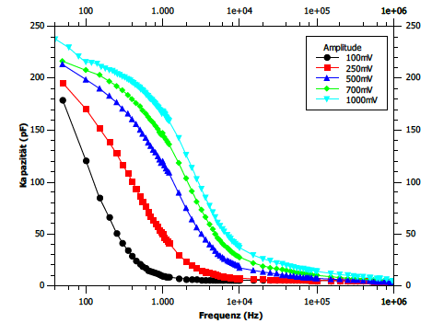
Coupling Capacitance Issues
Tracker Sensors
The coupling capacitance of 2S long sensor shows a dependency on the measuring frequency and amplitude and strip number
Tracked to Schottky contact (too low strip implantation) and differences in metallization in 1st batch
1st batch
Implantation significantly improved on 2nd batch
Metal line thickness improved a bit
2nd batch

Slide 14
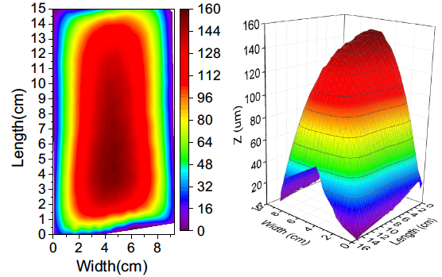
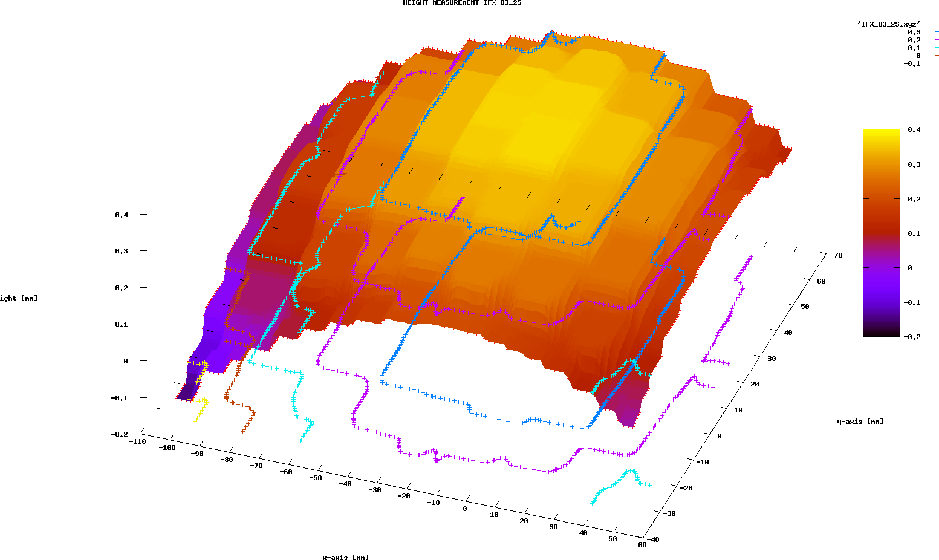
Sensor Bow
Tracker Sensors
03_2S
CMS 2S Sensors
Application of vacuum visibly flattens 2S sensor on the chuck
CMS reports sensor bows of 160um and 80um
ATLAS 03_2S seems to have bow about 400um…

Slide 15
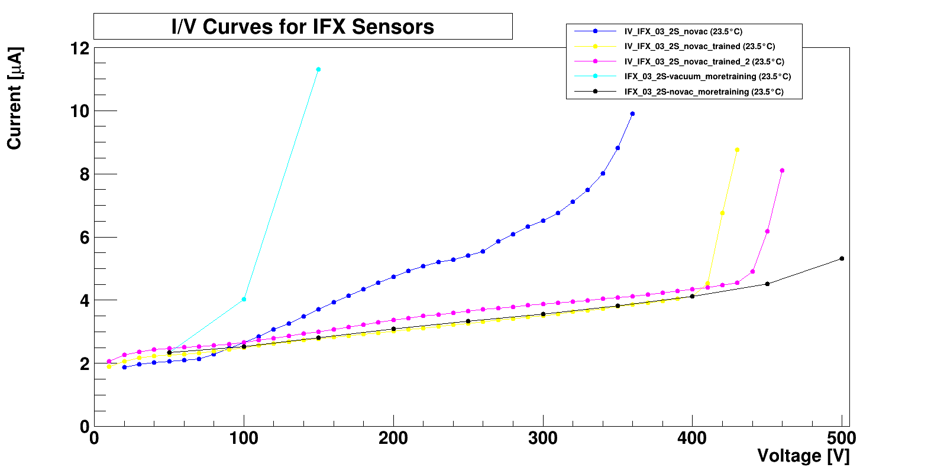
HV Stability
Tracker Sensors
CMS 2S vs. Diodes
CMS found more stable IV
for smaller sensors rather the large 2S ones (15x10cm²)
ATLAS also saw vacuum dependence of current
  “Training” allowed to achieve higher breakthrough voltages
Both saw humidity dependence of breakthrough
With feedback provided to IFX they are working on improvements
ATLAS ”training”
Humidity
dependence

Slide 16
HGC Sensors

Slide 17
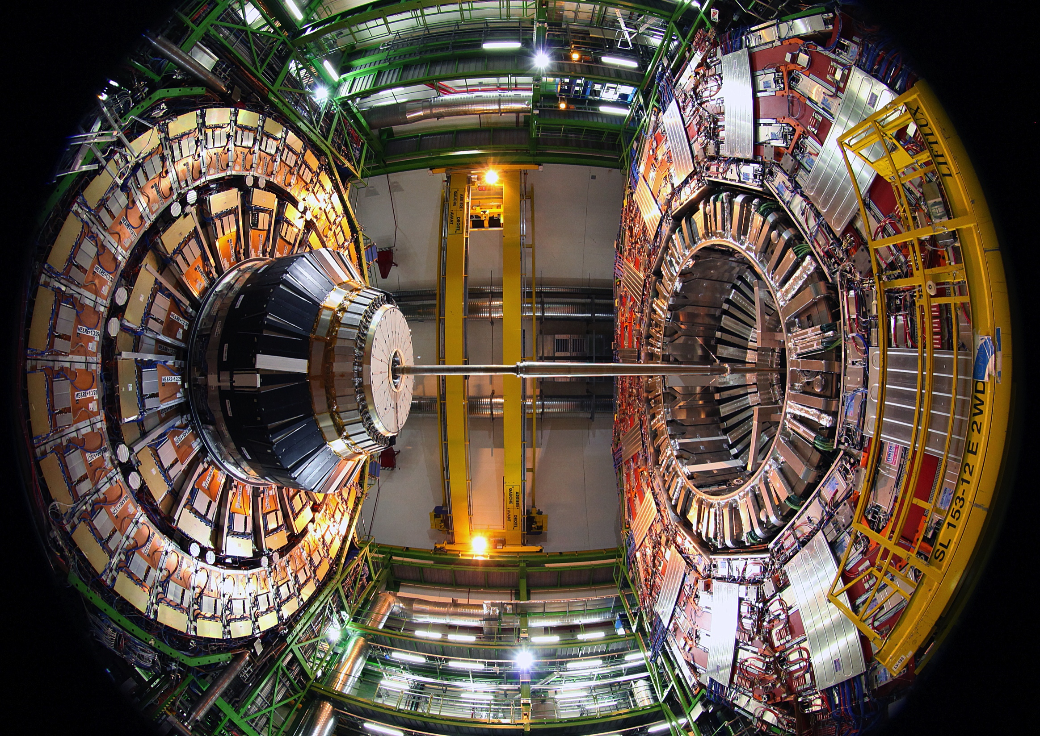
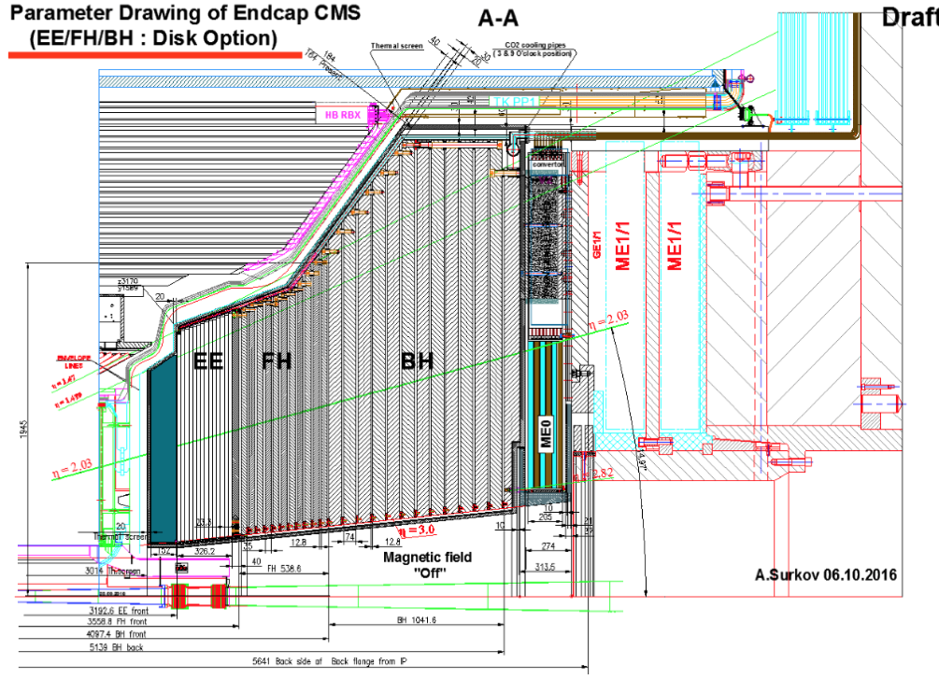
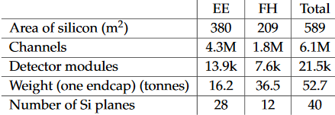
CMS Phase II Endcap Calorimeter
HGC sensors
Planned upgrade project to be installed during LS3 (2023-2025)

Slide 18
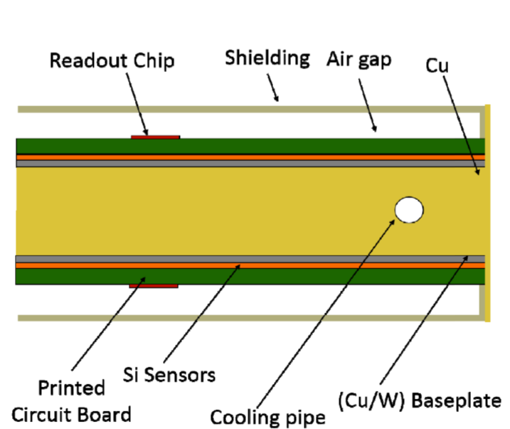
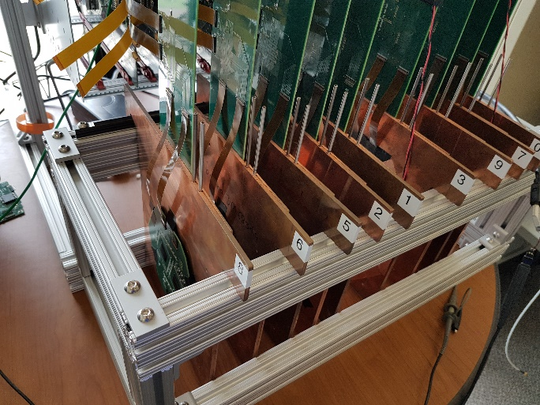
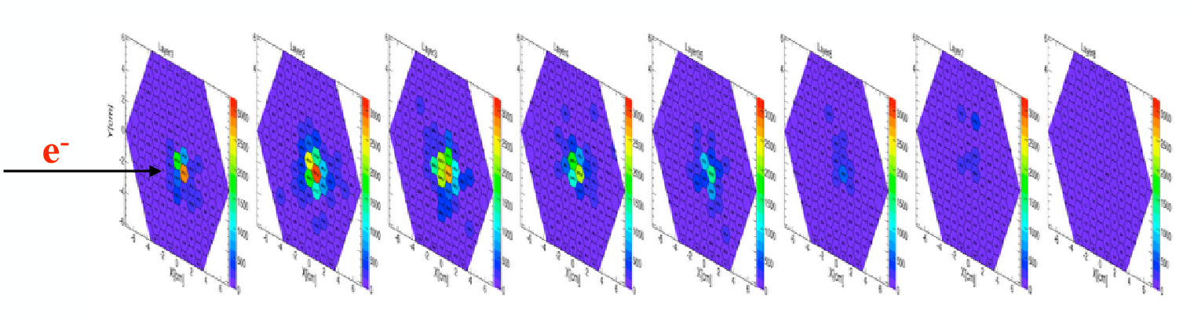
Test Beam Setup
HGC sensors
Modules built using 6“ sensor from HPK and SKIROC readout chip
Modules mounted on absorber plates
used for Testbeam at FNAL (July 2016)
HGC EE prototype up to 16 layers was successfully constructed and operated
250 GeV Electron passing through the 8 layers

Slide 19
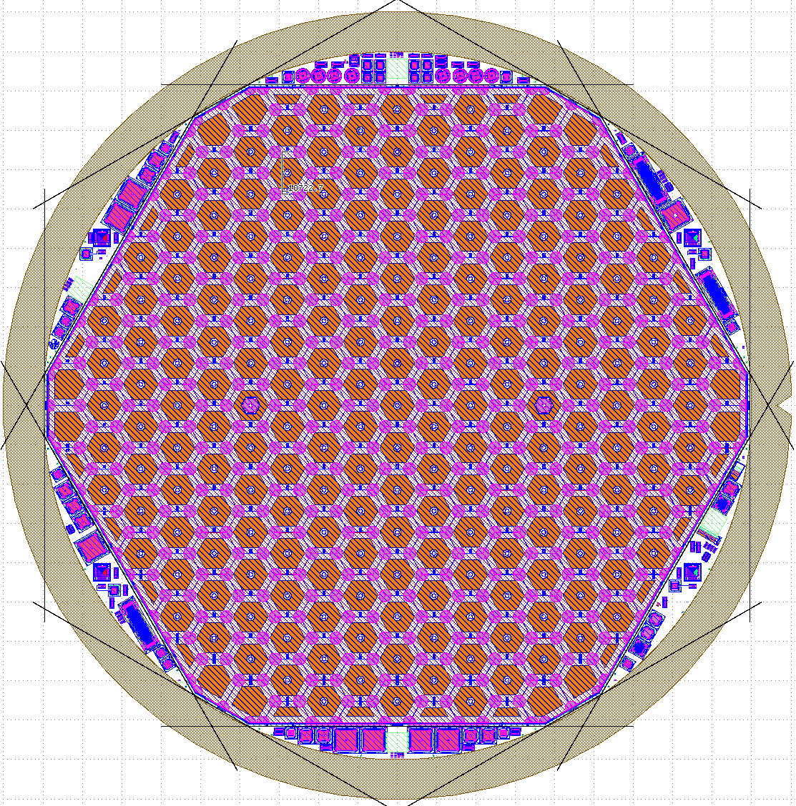
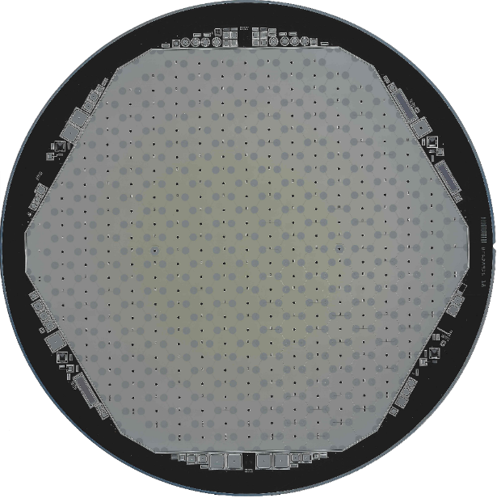
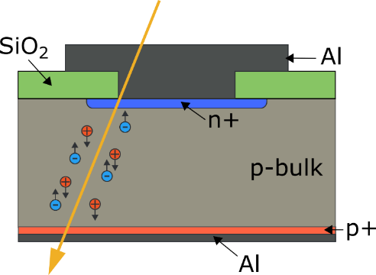
8-inch Infineon Prototype Wafer
HGC sensors
Each cell: n-on-p Diode
8-inch n-on-p Wafer designed
Wafer production:
First 5 wafers of order arrived in November 2016
Next 16 wafers of order arrived in February 2017
Wafer Thickness: 200 µm
235 cells (diodes)
~1 cm² pad size
Hexagonal structure to use the space on wafer more efficiently
Large size of sensor (≈ 18 cm x 16,5 cm) no standard size, therefore new measurement setups need to be developed
Size leads to additional difficulties in irradiations of full 8“ sensor

Slide 20
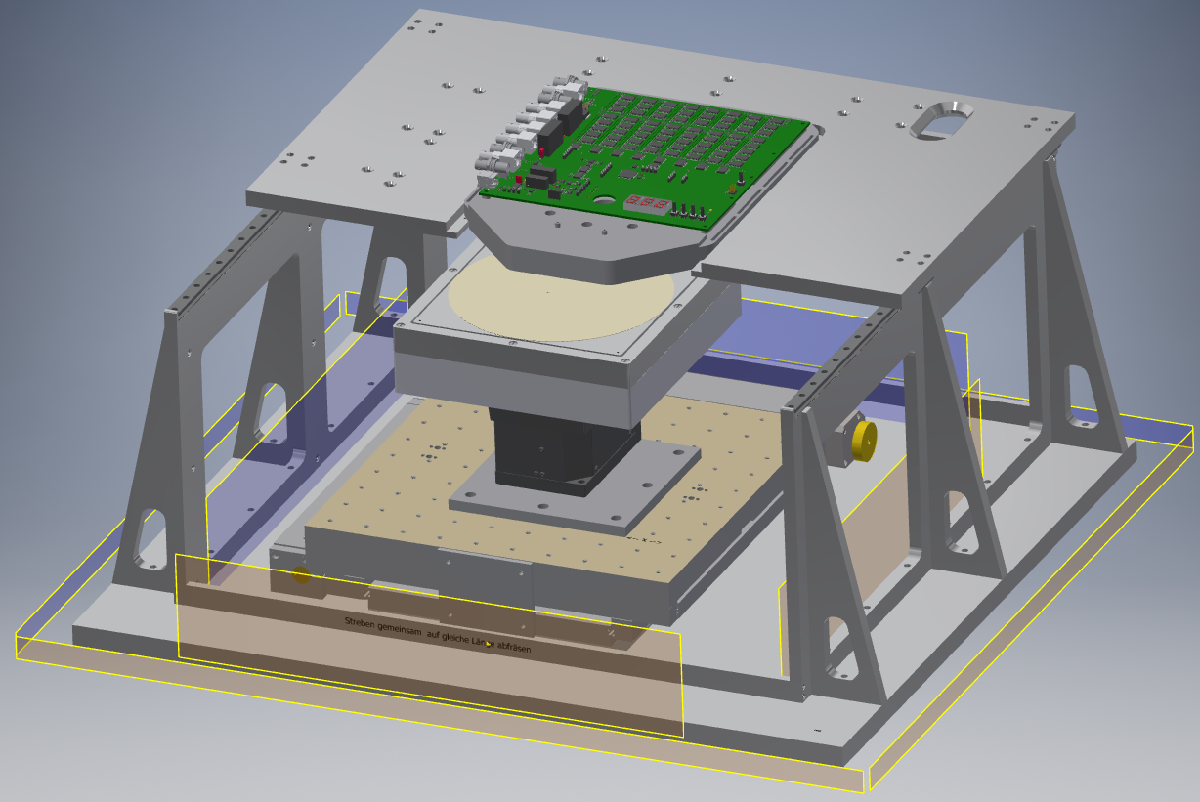
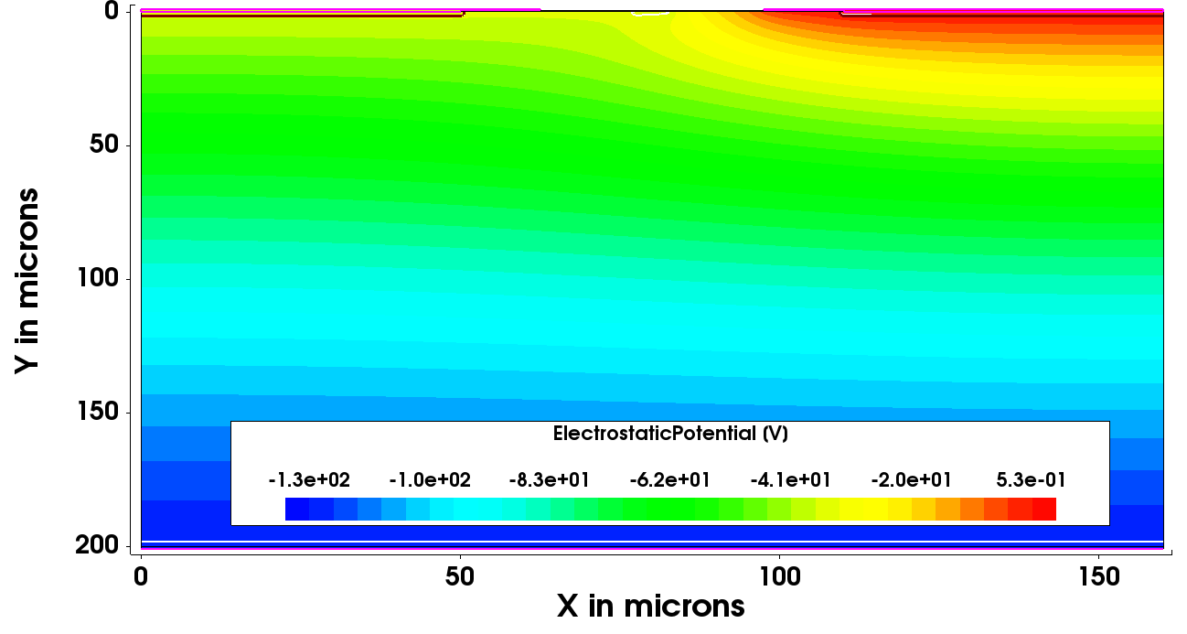
Measurement Challenges
HGC sensors
>200 individual diodes without any bias rail
IV/CV curves not fully significant due to lateral extension of depletion zone
Ways for characterization:
  Single Needle (by motorized XYZ-table; preferred by Infineon)
  7-Needle-Probecard (HPK)
  Full probe card (switching card developed by CERN)
CERN switching card
CERN 6” probe card
- 36.2 V
0 V
125 V
Planned HEPHY Setup

Slide 21
IV Curves of 200 µm thick IFX HGC Sensors
HGC sensors
Wafer 3
Wafer 2
Wafer 8
Single Needle IV-Curves with HV on Needle
Backplane on GND
Temperature 22 +/-1 C
Humidity 45-50%
All IV-curves measured by hand at the moment
  ~8 hours per wafer
Wafer 14
Wafer 20

Slide 22
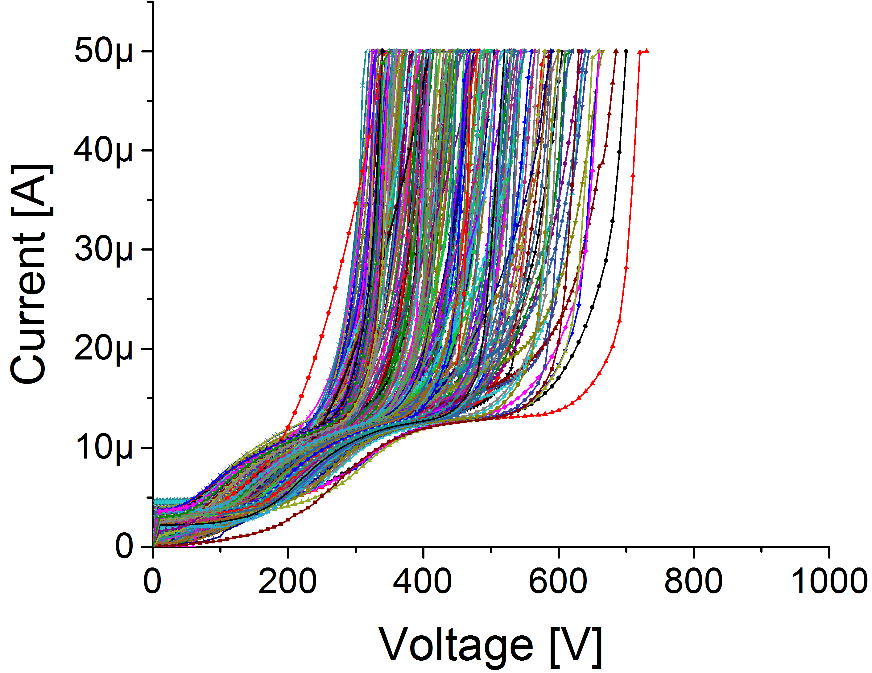
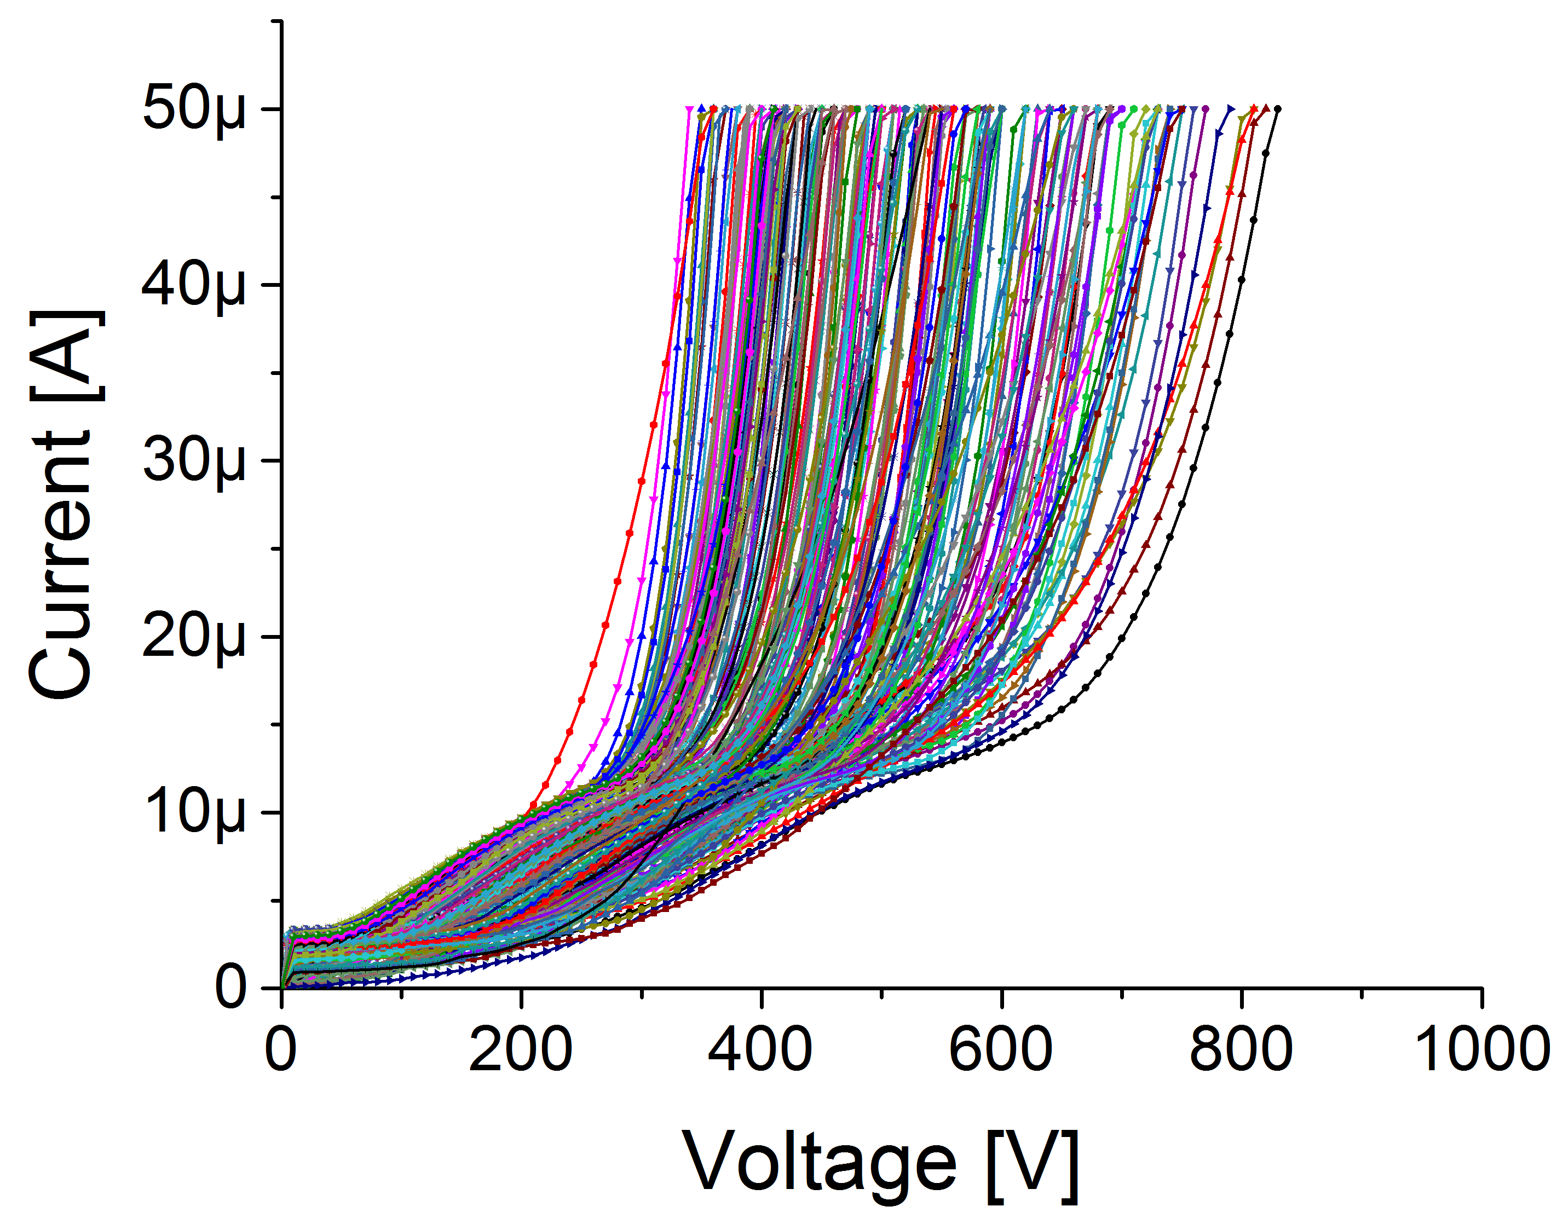
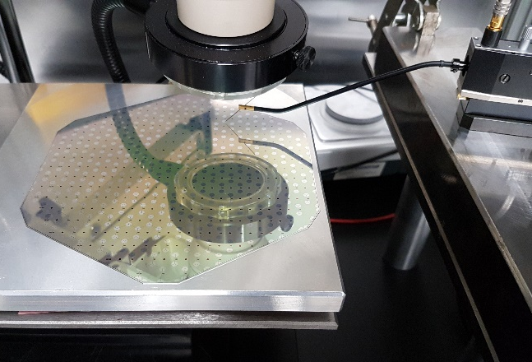
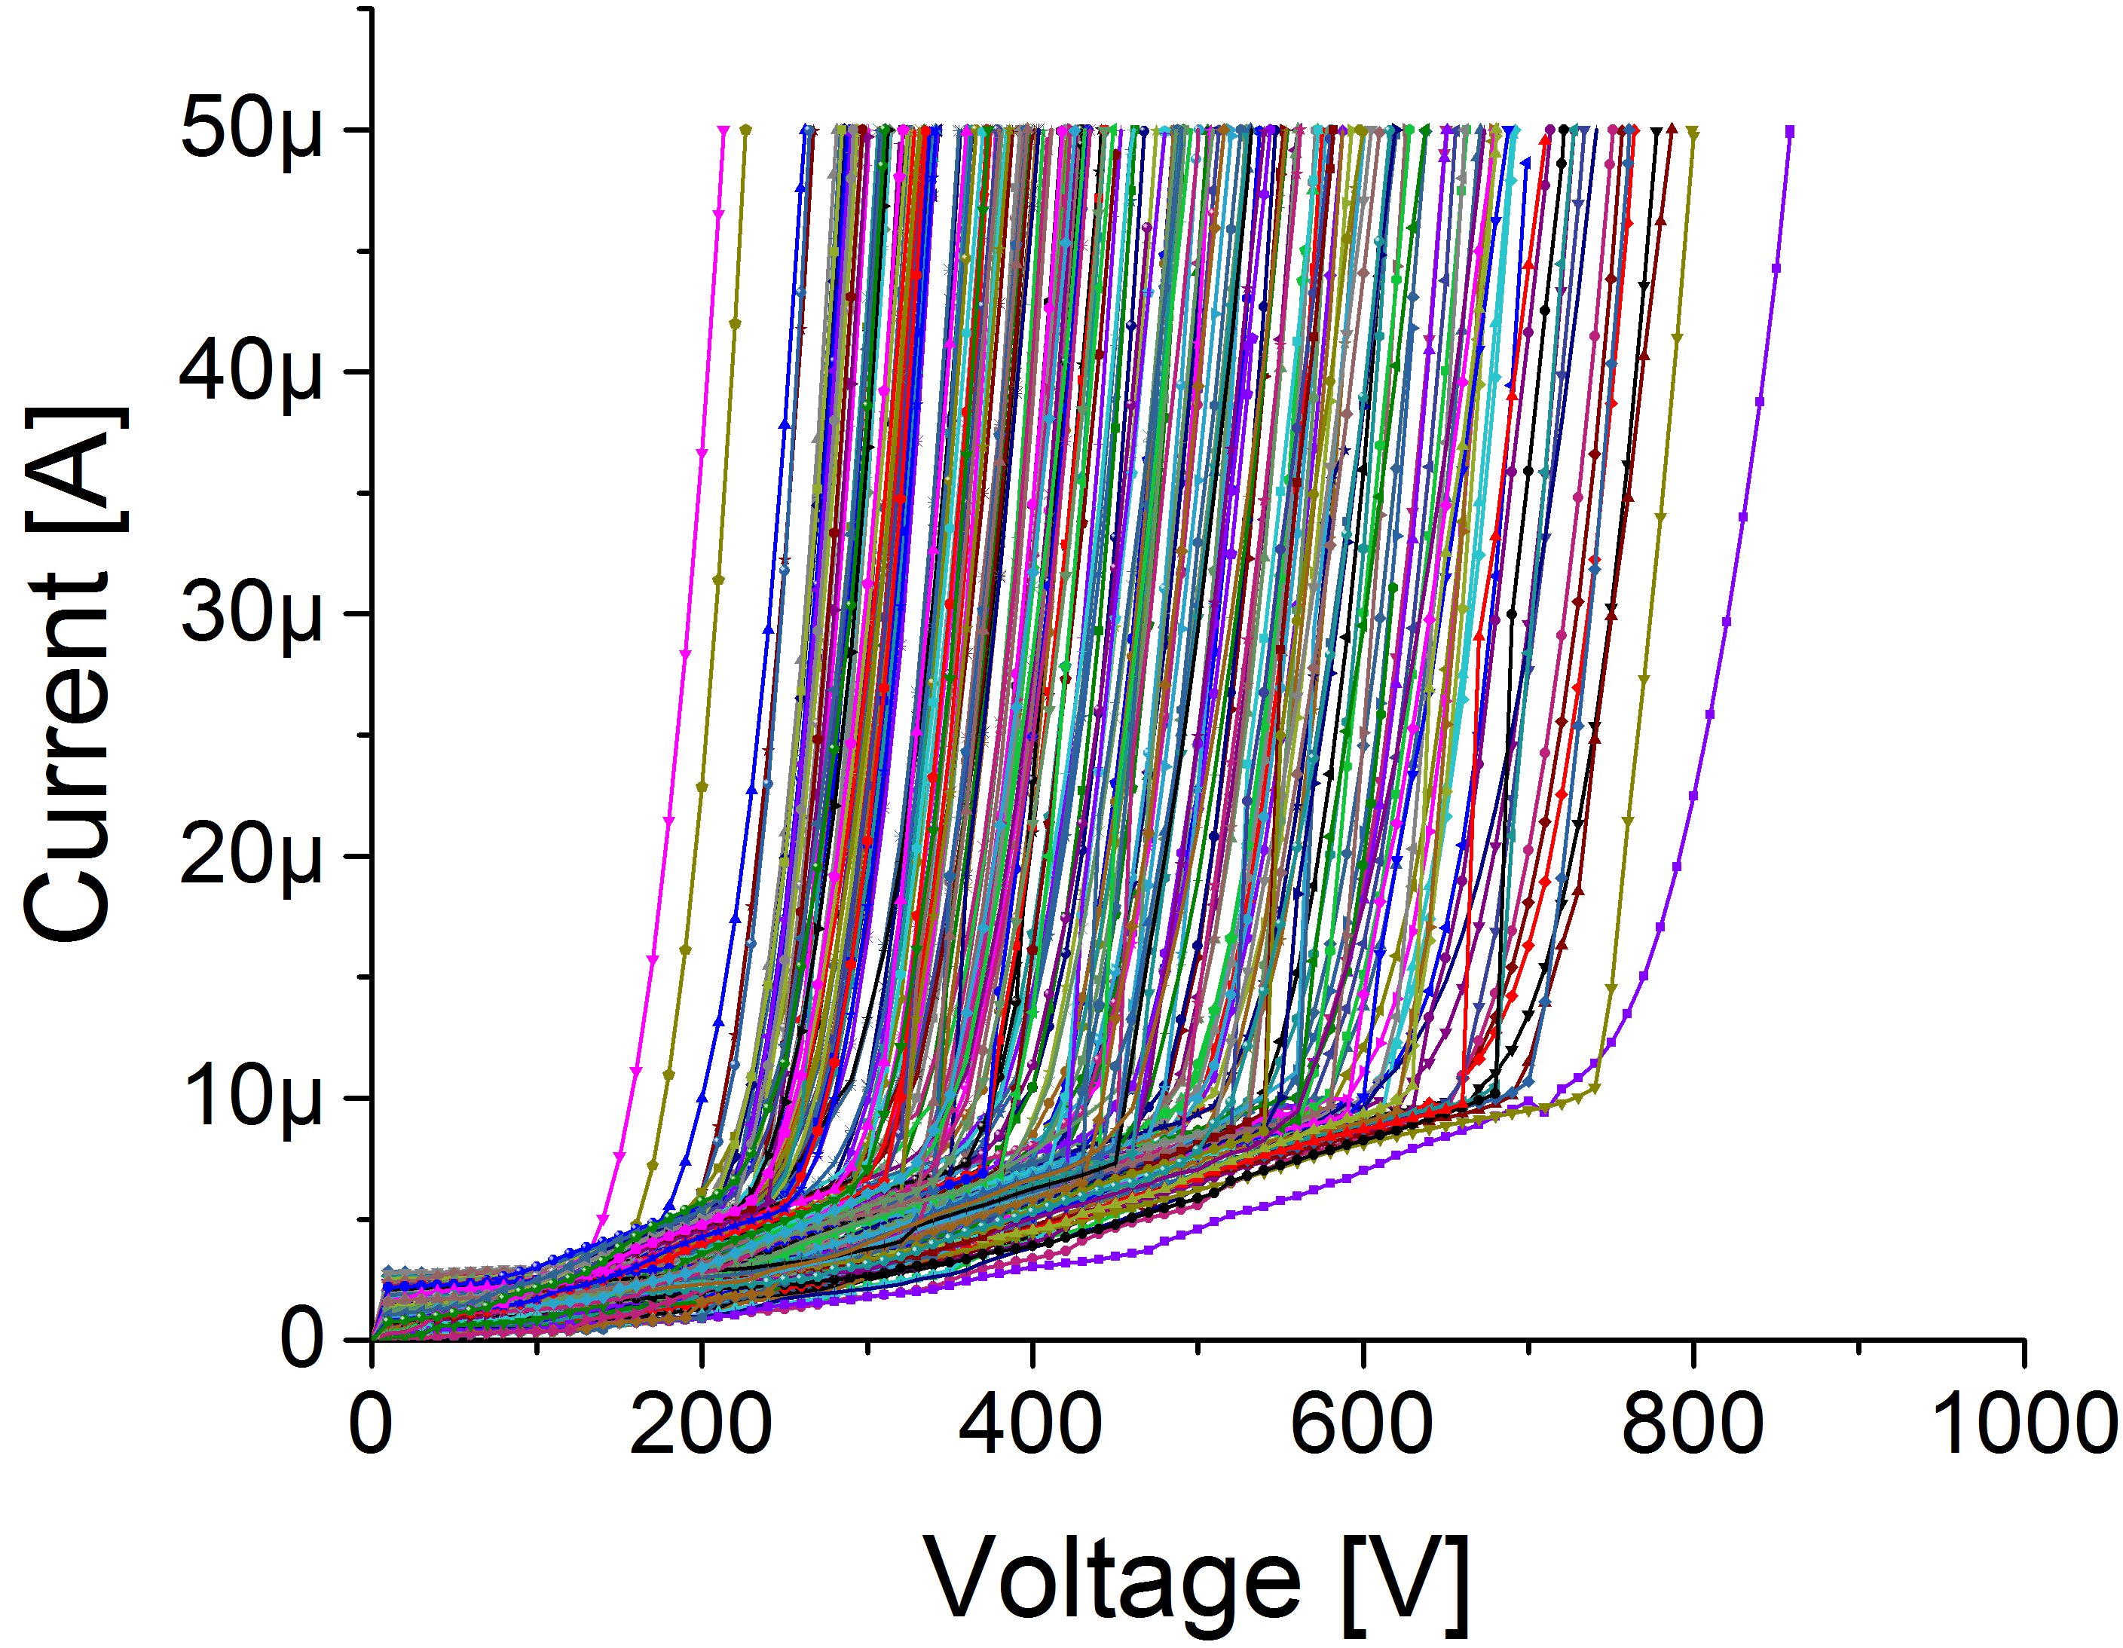
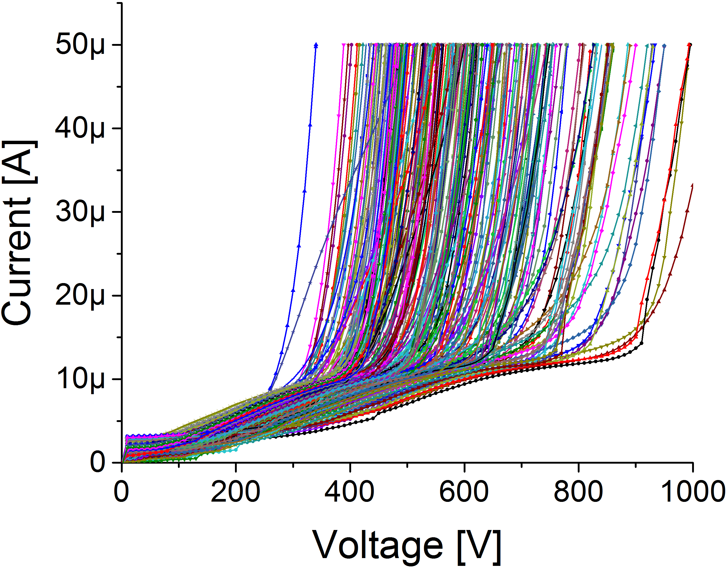
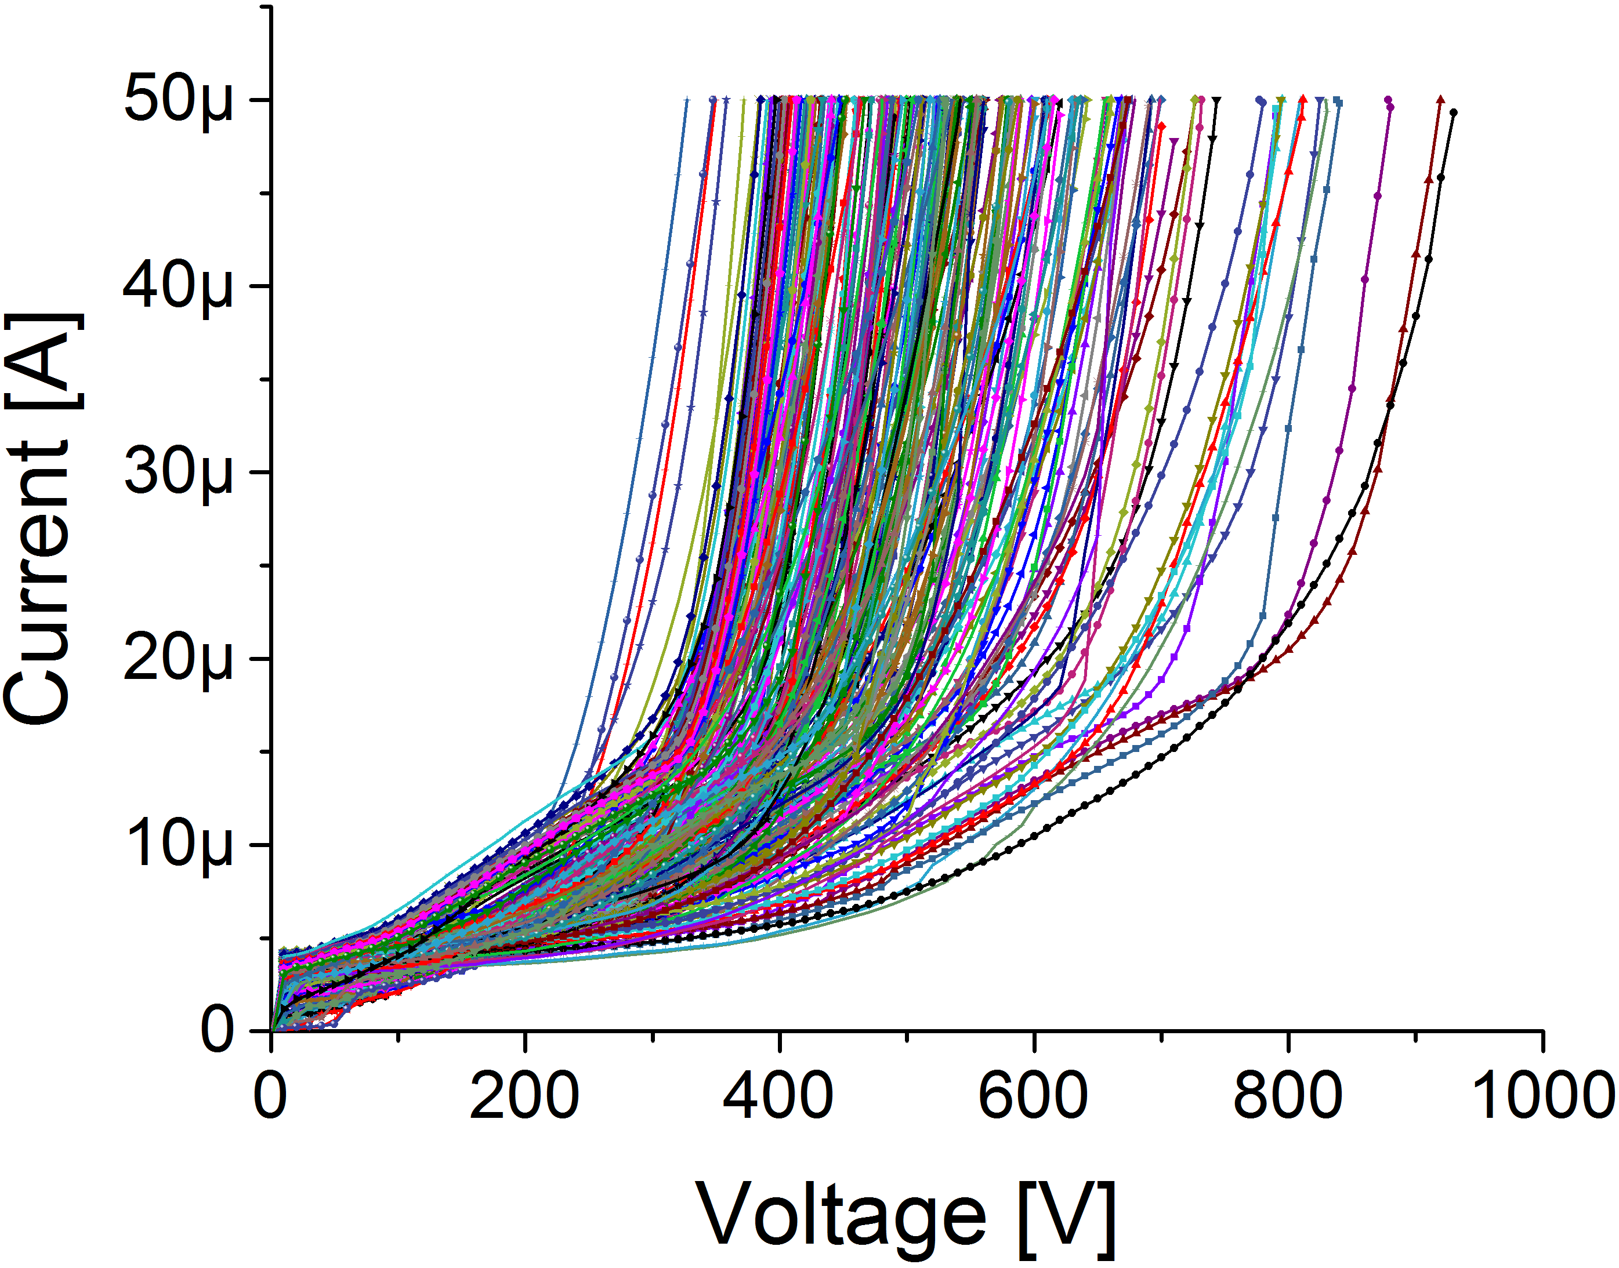
IV Curves of 300 (350) µm thick IFX HGC Sensors
HGC sensors
Wafer 4
Wafer 6
H: 45-50%
T= (23 ± 2)°
Wafer 16
Wafer 18
Wafer 25

Slide 23
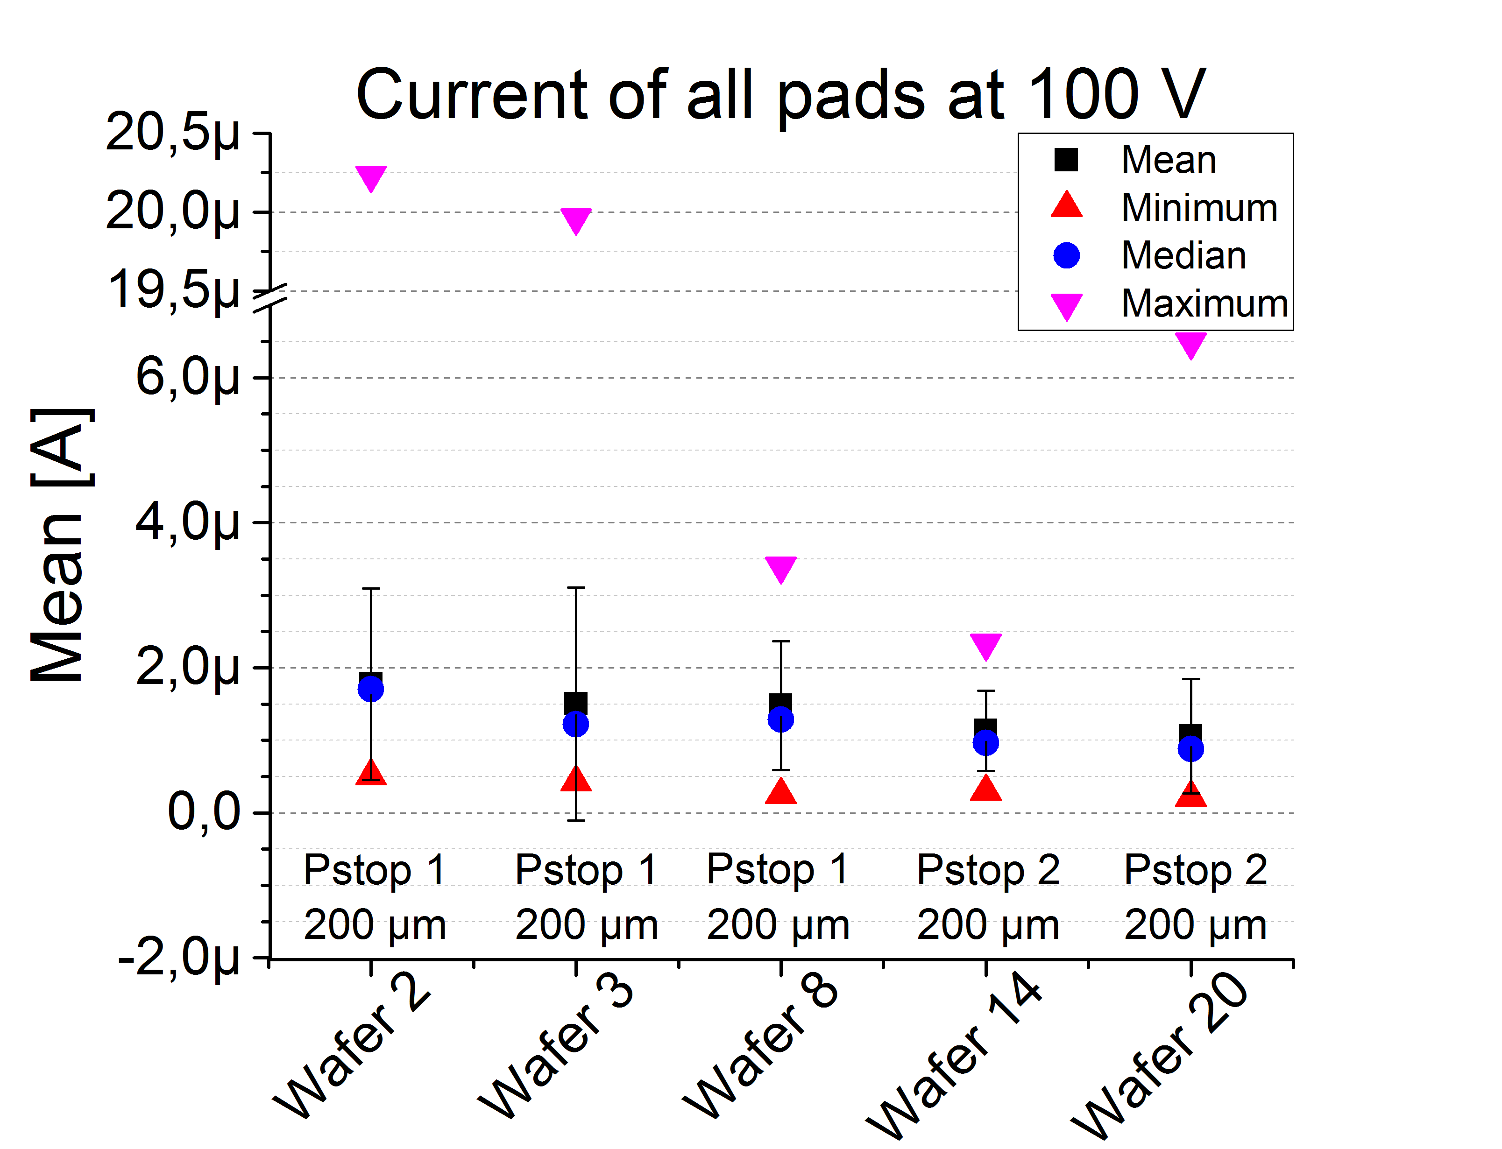
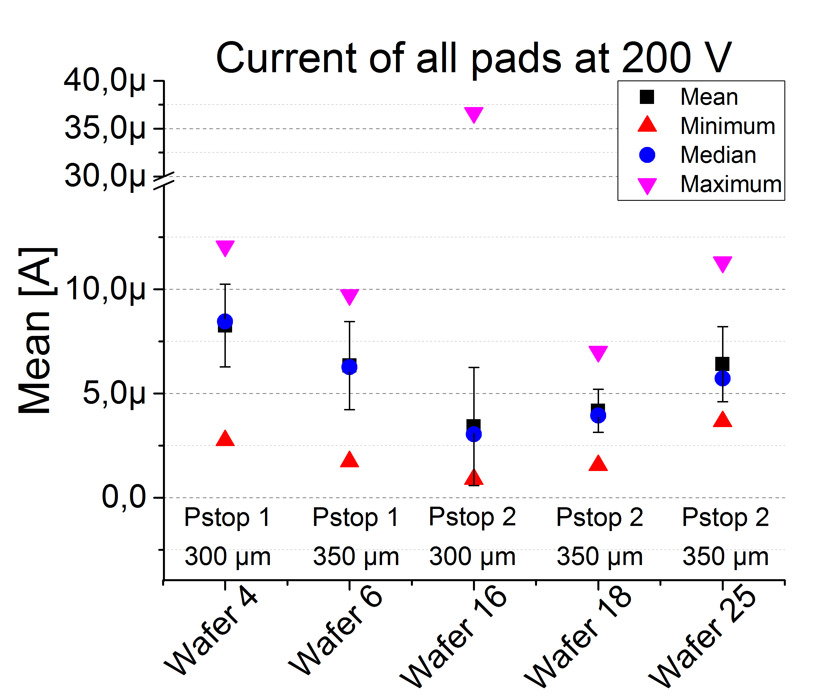
Current Statistics for Single Needle Measurements
HGC sensors
Plots show the presence of a defect cell on a wafer (high maximum)
Mean/Median shows that implantation dose “p-stop 2” gives lower currents
300-350µm
200µm

Slide 24
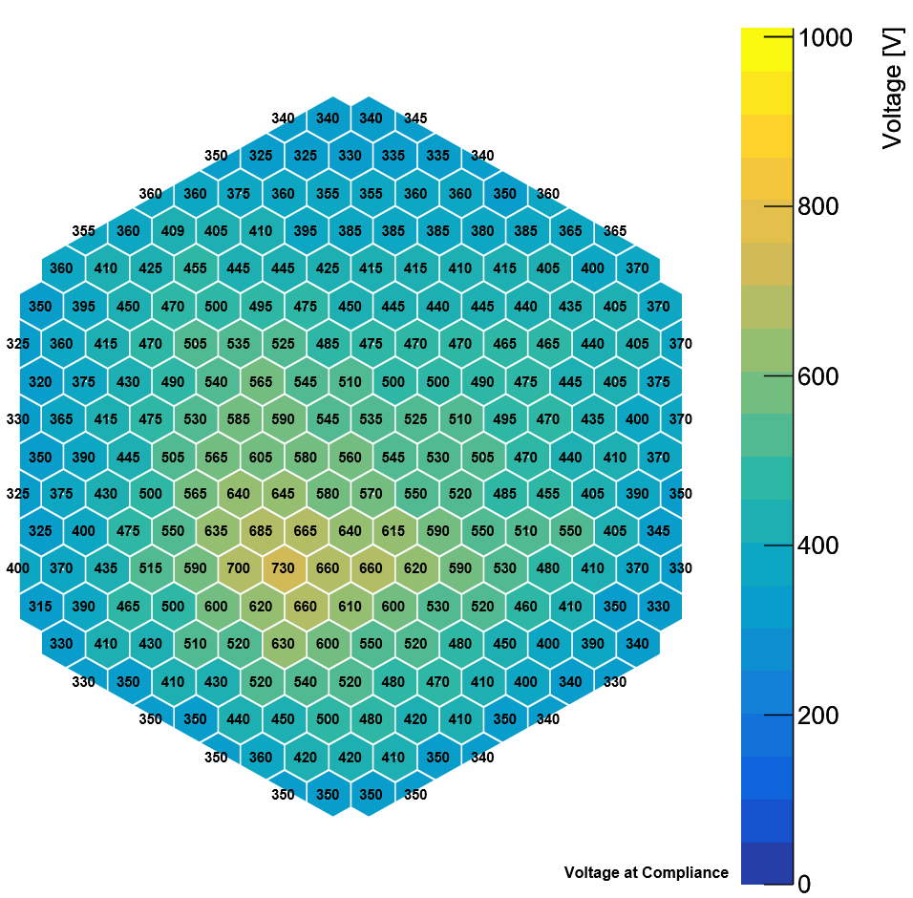
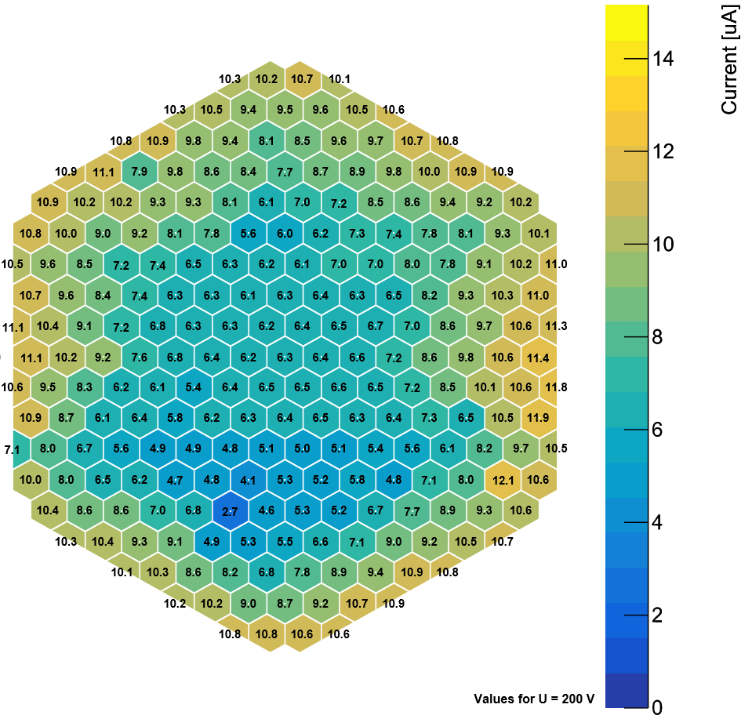
Single Needle IV mapped to geometry
HGC sensors
IV curves mapped to 8“ 256 pad HGC sensor geometry
4 Quadrants with different pad spacing can be seen in voltage and current behavior
Pads on outside draw ~ 2 times the current
40 µm
21 µm
40 µm
21 µm
80 µm
60 µm
80 µm
60 µm
„break through voltage“
(50 µA compliance)
Current @ 200 V

Slide 25
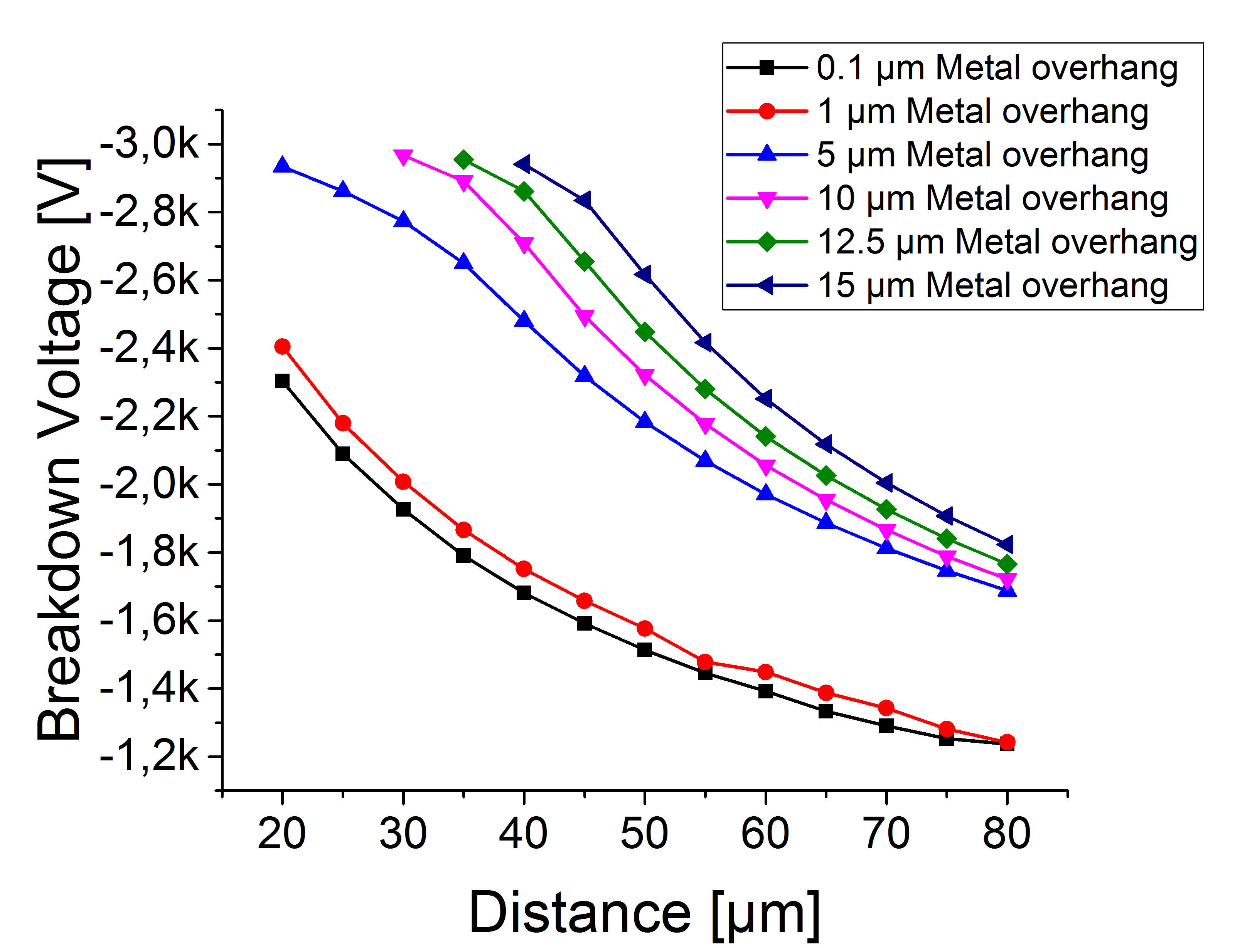
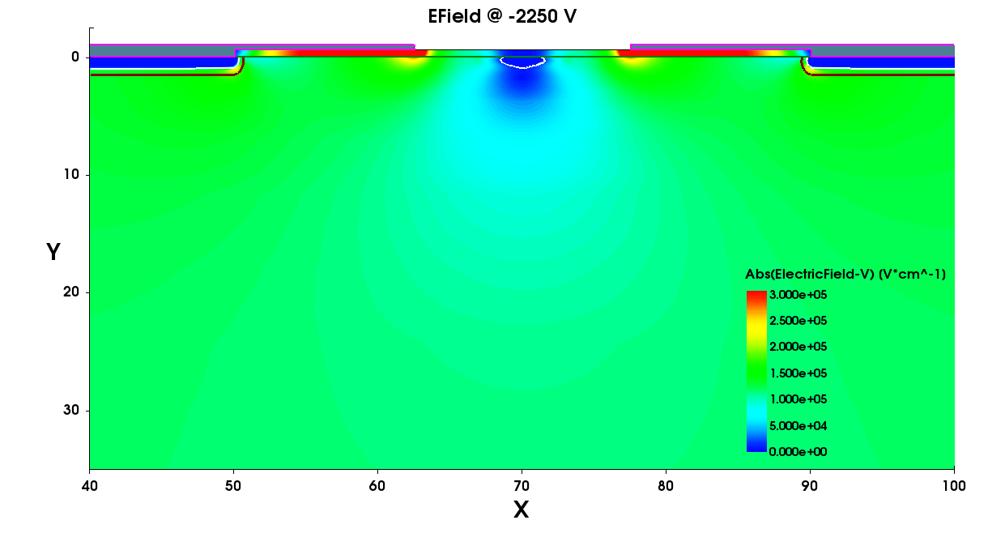
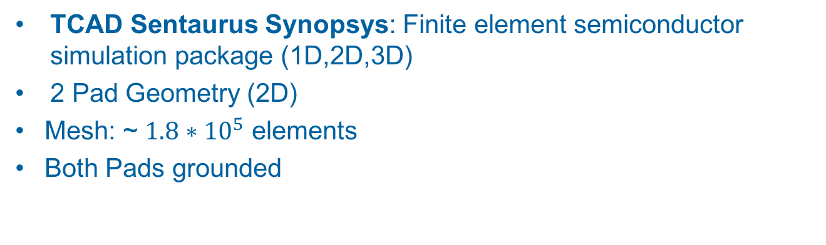
2D Breakdown Simulation
HGC sensors
TCAD Sentaurus Synopsys: Finite element semiconductor simulation package (1D,2D,3D)
2 Pad Geometry (2D)
Mesh: ~ $1.8∗{10}^{5}$ elements
Both Pads grounded
Pad Implant
P-Stop
Metal overhang
N- pad implant
Larger pad to pad distance leads to lower breakdown voltage
In contradiction to single needle measurements
P- bulk doping

Slide 26
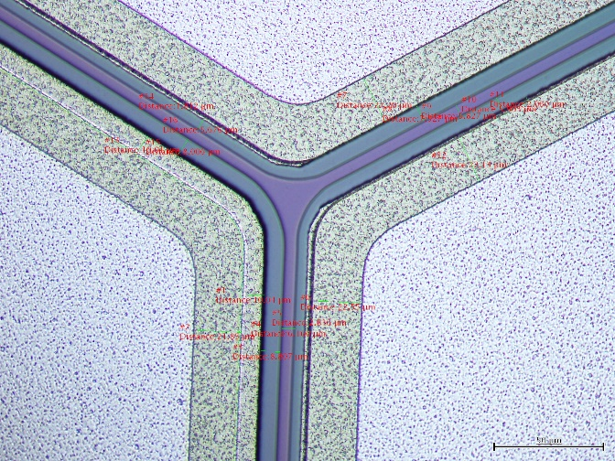
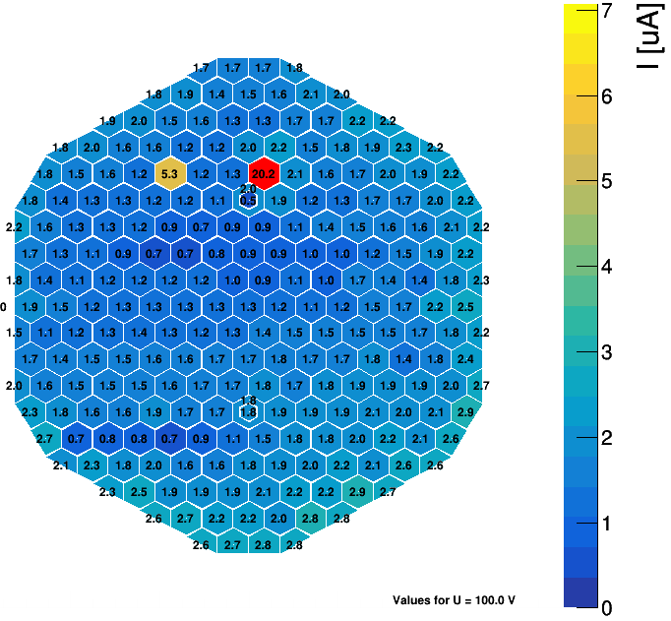
Metal Overhang at 21µm pad distance
HGC sensors
Sensor design contains four regions with different pad distances 21/40/60/80µm
Region with 21µm pad distance:
Metal overhang design value 5 µm
Metal overhang here < 1µm
High current of cell
Issue caused by process:
Metal deposition after backside thinning, thus small sag during photolithography and metal etching causing inhomogeneous metal etching
-> Infineon is working on improvement
Current @ 100 V

Slide 27
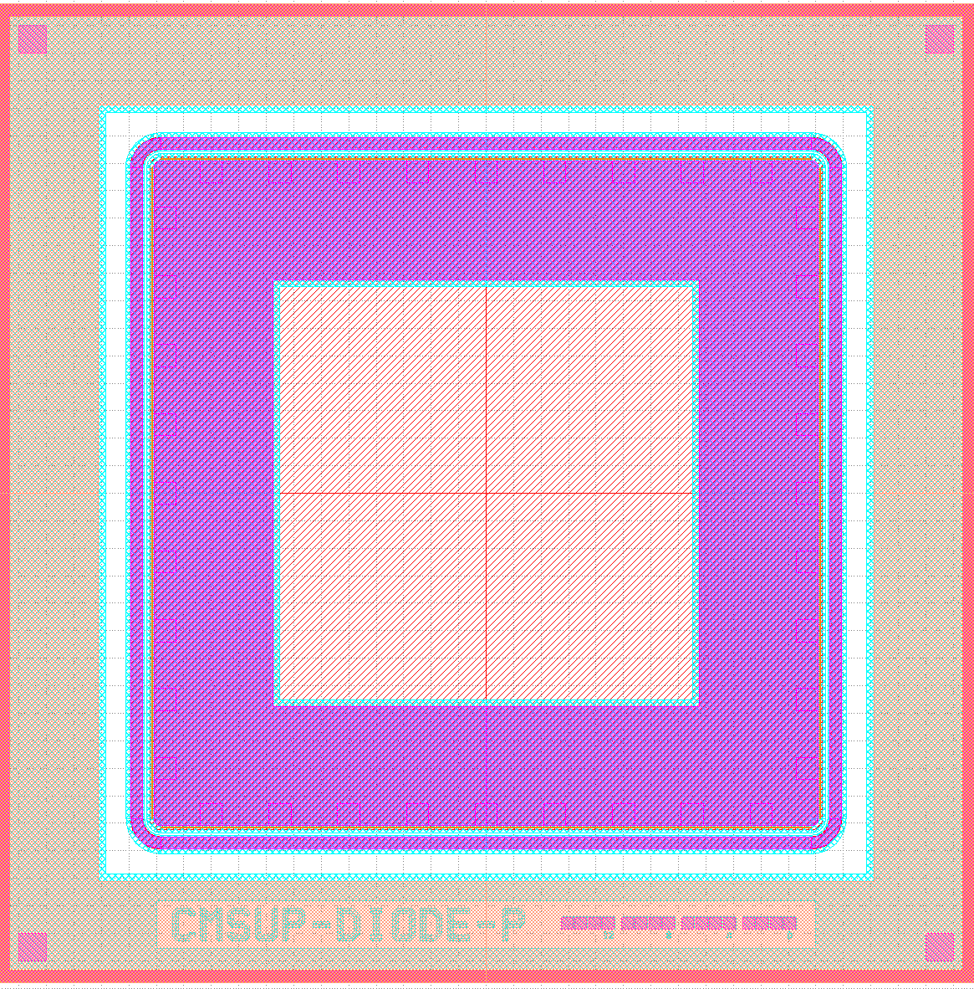
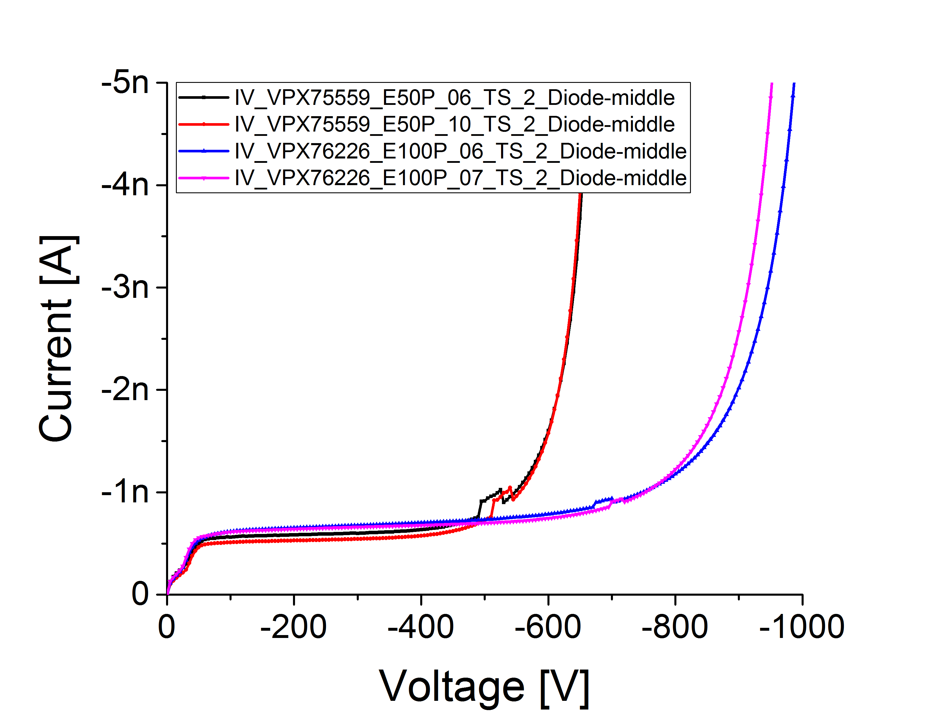
100-140µm thick sensors
HGC sensors
Infineon produced 8” sensors with both, physical and active thickness of 140µm
  Unclear if mechanical stability of such thin sensors is feasible
  No decision if IFX will offer 140µm for the series production
We are working on two alternative approaches with Infineon:
  Epitaxial sensors (currently only n-type bulk available)
  New process with alternative backside processing (improves quality on all thicknesses, especially on metal overhang)
Old epitaxial HPK sensors
for comparison:
Planar diodes with
Epi thickness of
50 µm
70 µm
100 µm

Slide 28
Summary
Monopoly situation in planar large-area silicon detectors exists
CMS and ATLAS performed a market survey to find interested companies for providing sensors for the trackers of both experiments (~200m² each)
  CMS HGCal adds another 600m²
  All with the same timescale (Phase II Upgrade 2023-2025)
European vendor Infineon interested in large-volume productions, e.g.:
  Prototype sensors for CMS tracker and HGCal produced
  ATLAS evaluated sensors as Step 2 of market survey
  Constant improvement visible from batch to batch
Challenges Academia – Industry
    Project started on technical side without involvement of business/legal departments
    This changed now as project became more mature
    Now also administrative / legal / IP discussion for prototype orders via CERN

