Slide 1
WP-15
Upgrade of beam and irradiation test infrastructure
Federico Ravotti (CERN) & Marcel Stanitzki (DESY)

Slide 2
WP 15 Structure
Task 15.1: Scientific coordination (CERN, DESY)
Task 15.2: Improvements of test beam infrastructure for high precision
tracking (CERN, DESY)
Task 15.3: Improvements of the DESY test beam infrastructure (DESY)
Task 15.4: Improvements of the test beam infrastructure at LNF (INFN)
Task 15.5: Improvements of the infrastructure for irradiation tests
(CERN, INFN, VU, INRNE, JSI, USFD*)
*associated partner linked to CERN

Slide 3
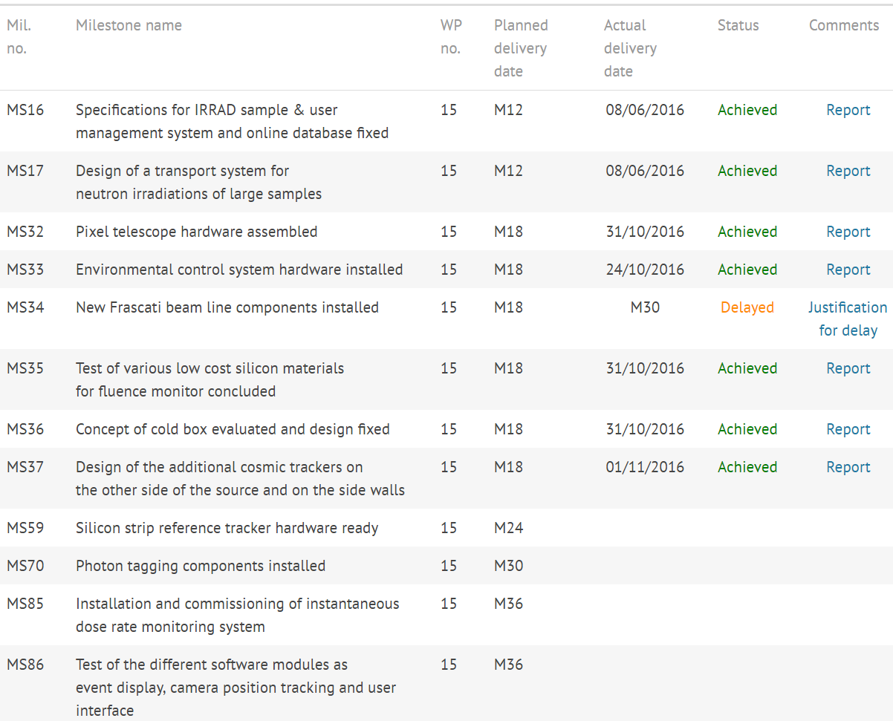
Milestones
delayed: late sensor delivery …
delayed ?

Slide 4
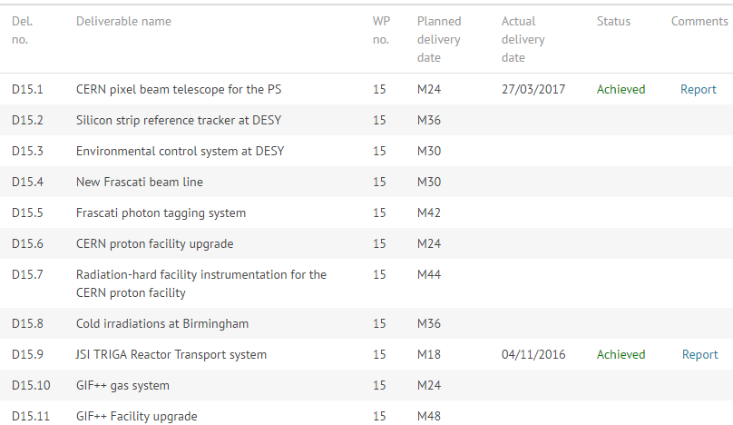
Deliverables
delayed to M35 ?

Slide 5
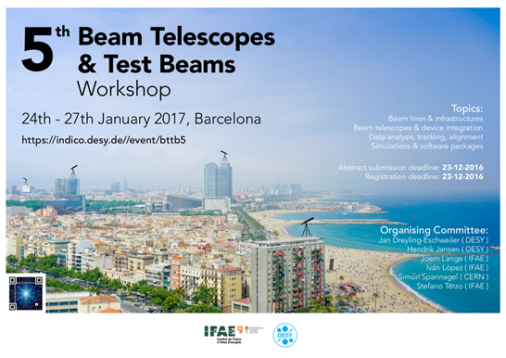
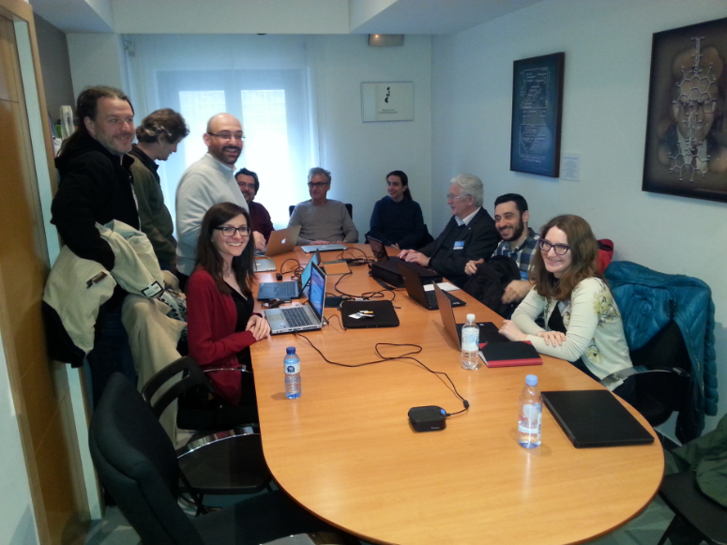
WP15 Meeting at BTTB
The BTTB series has been a very successful format for:
  test beam & irradiation facilities users
  beam telescope users
  facility coordinators
WP15 has a large overlap of activities and participants with BTTB (Tasks 15.2, 15.3, 15.4)
Upgrade activities for irradiation facilities (Task 15.5) are driven by user requirements

Slide 6

Reporting
AIDA-2020 comes with a certain amount of paperwork:
  Annual Reports, Milestone Reports, Deliverable Reports, etc…
  contractual obligation with the EU
  reports need to be read & edited by WP15 management, AIDA-2020 management before being uploaded on the EU system.
Coming reports:
  MS59: Silicon strip reference tracker hardware ready
  D15.1: CERN pixel beam telescope for the PS
  D15.6: CERN proton facility upgrade
  D15.10: GIF++ gas system

Slide 7
Outreach
27 records for WP15 in CDS so far (including official reports)
  http://cds.cern.ch/collection/AIDA-2020?ln=en
Please, let us know about your publications related to WP15 activities:
  journal publications, conference/workshop papers, scientific/technical notes, academic dissertations, posters, presentations and handouts, press articles, etc …
  please, remember the AIDA-2020 acknowledgement text: http://aida2020.web.cern.ch/science/publications
AIDA-2020 Transnational Access (TA) promotional videos:
  https://www.youtube.com/channel/UCIpwLrDr1w3TNL9t7wLZH1g

Slide 8
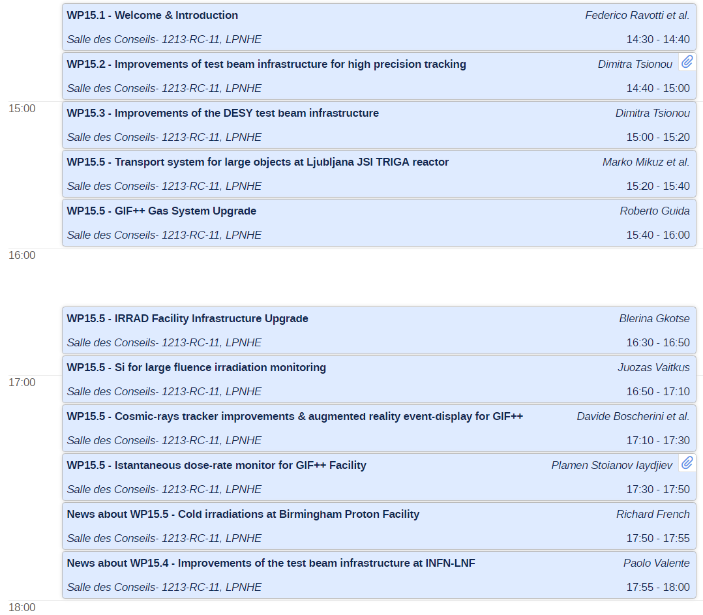
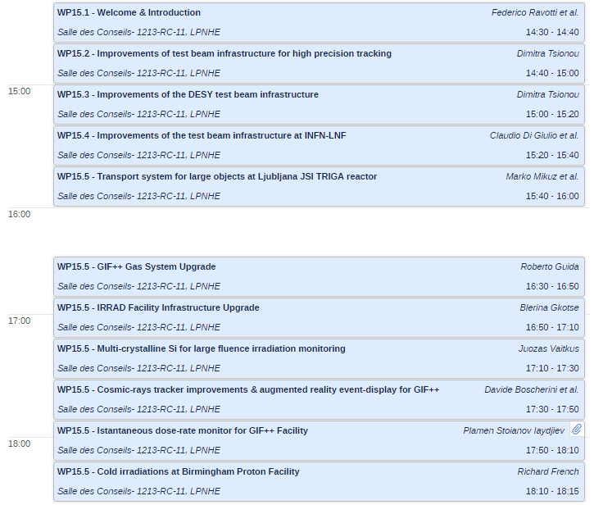
Today’s (Final) Program …
Test-beams & Tracking
Irradiation Facilities
Short update from
LNF (WP 15.4) and
USDF (WP 15.5)

