Slide 1

Transport System for
Large objects at
Ljubljana JSI TRIGA Reactor
(part of WP15.5)
V. Radulović, L. Snoj. V. Cindro,
Marko Mikuž
J. Stefan Inst. & Univ. Ljubljana, Slovenia
AIDA2020 2nd Annual Meeting, Paris, April 4, 2017

Slide 2
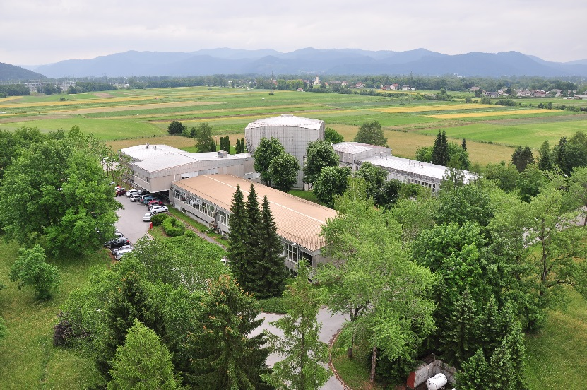
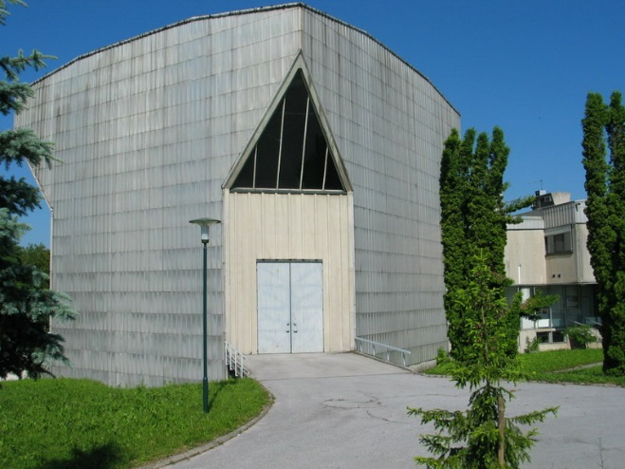
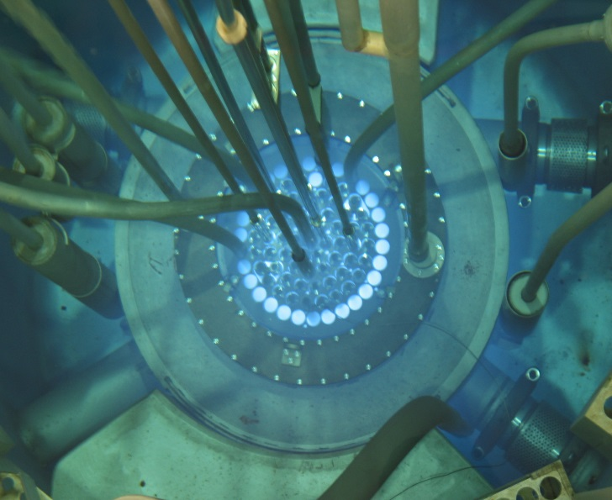
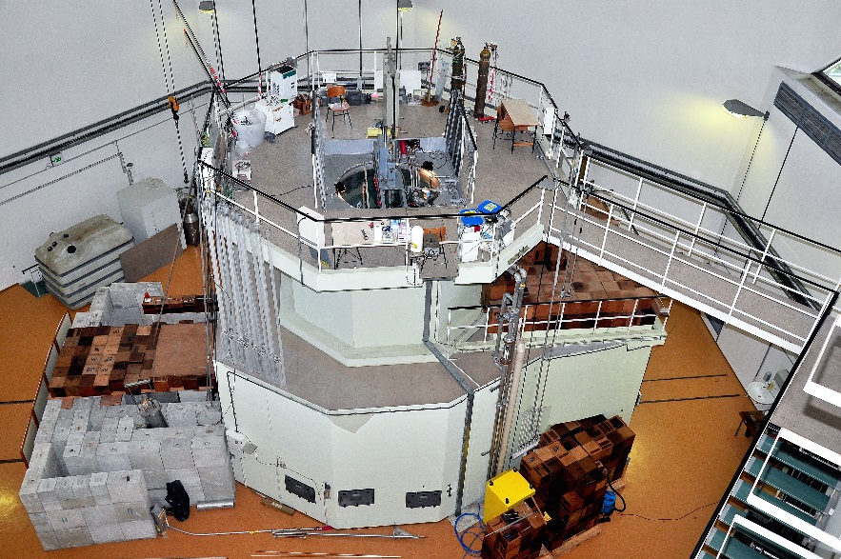
TRIGA Mark II Reactor
1st criticality:
  31st May, 1966
P_{max}
  250 kW (steady state)
  1 GW (pulse)
Fuel
  UZrH (12 wt. % U)
  enrichment = 20 %
Notes:
2
2

Slide 3
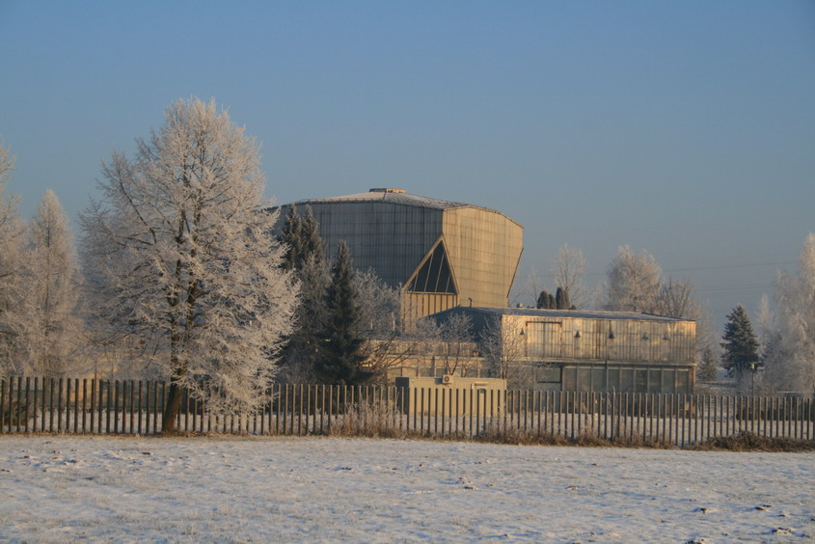
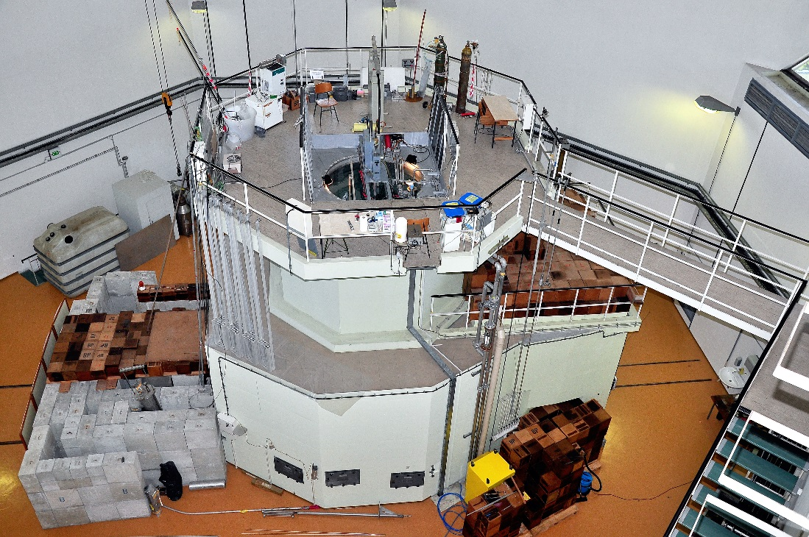
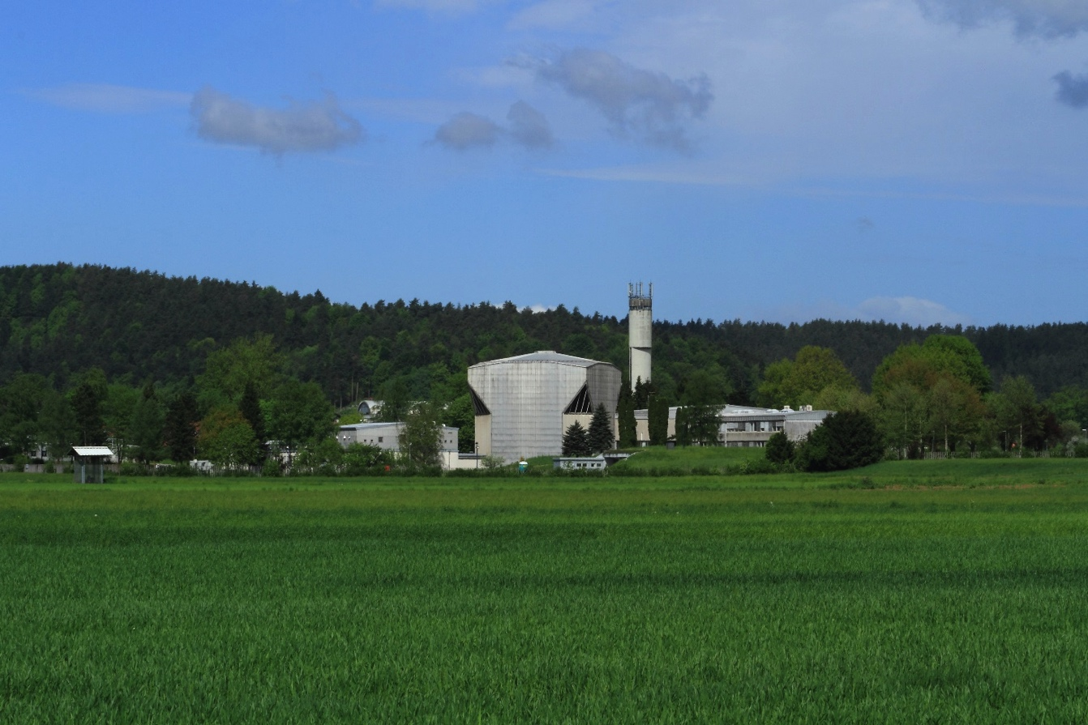


Slide 4
Naris

Slide 5
TLORIS
New irradiation facility

Slide 6
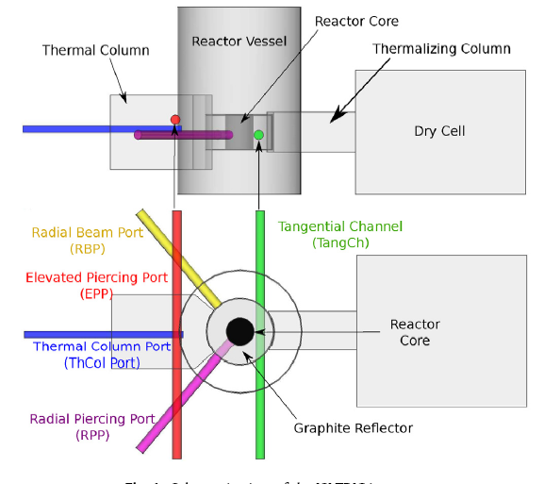
TRIGA Irradiation Channels

Slide 7
Goal
Develop and install a large sample irradiation (2R < 15 cm) facility in the tangential channel of the JSI TRIGA reactor

Slide 8
Deliverable 15.9 in M18
Transport system for neutron irradiation of large objects at JSI:
In the framework of the AIDA-2020 project, Work Package 15 - Upgrade of beam and irradiation test infrastructure, a new irradiation device / transport system which will enable the irradiation of larger samples, up to 12 cm in diameter, has been installed in the Tangential Channel of the JSI TRIGA reactor in Ljubljana, Slovenia. This report documents the design and installation of the irradiation device / transport system.

Slide 9
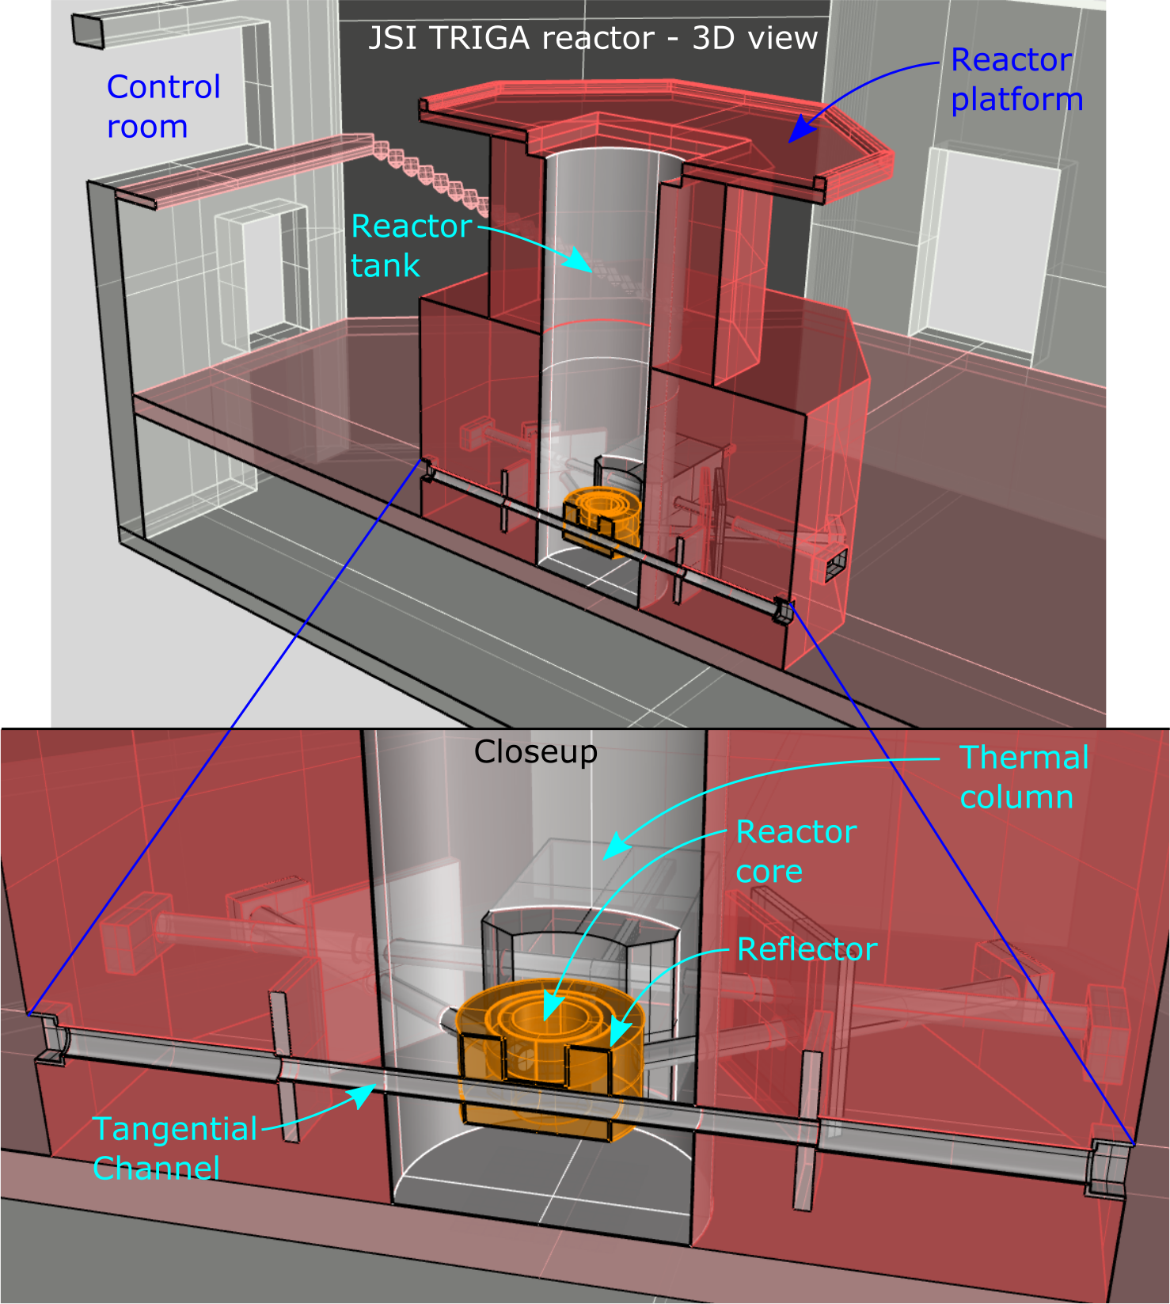
3-d Modelling

Slide 10
Chronology
Extraction of cold neutron source used in the past for neutron diffractometry
Decontamination and inspection of channel interior
Documentation required to obtain the authorization for the installation of the irradiation device from TRIGA Reactor Safety Committee and Slovenian Nuclear Safety Administration
Authorization granted in August 2016
Channel completed in October 2016

Slide 11
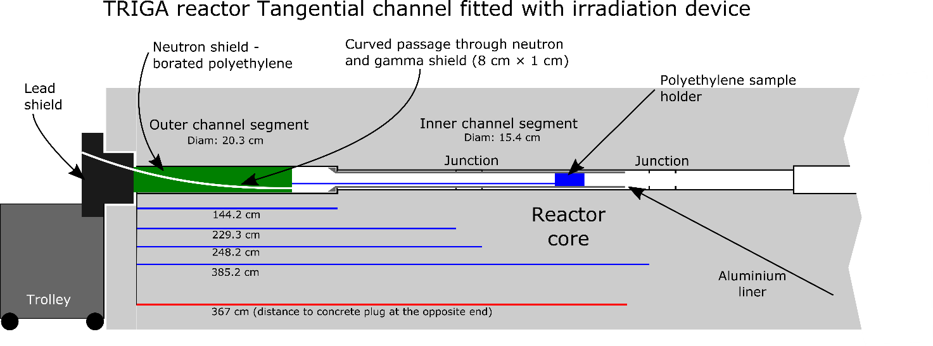
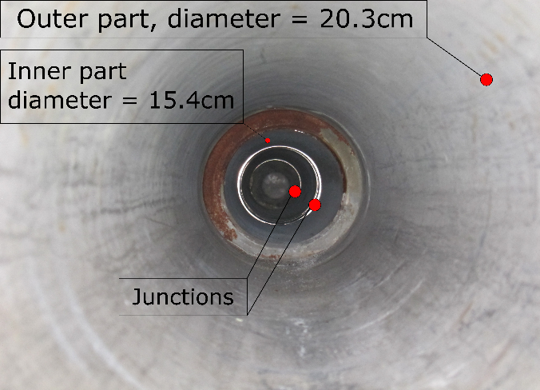
Detailed View

Slide 12
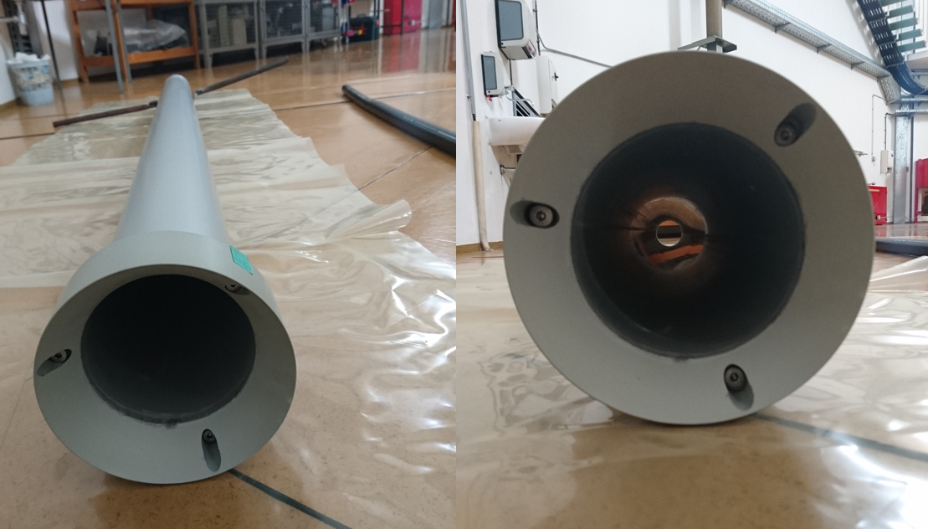
Insertion Tube
Aluminium liner with 14.6 cm inside diameter
Protection of internal components
Facilitates insertion and withdrawal of samples

Slide 13
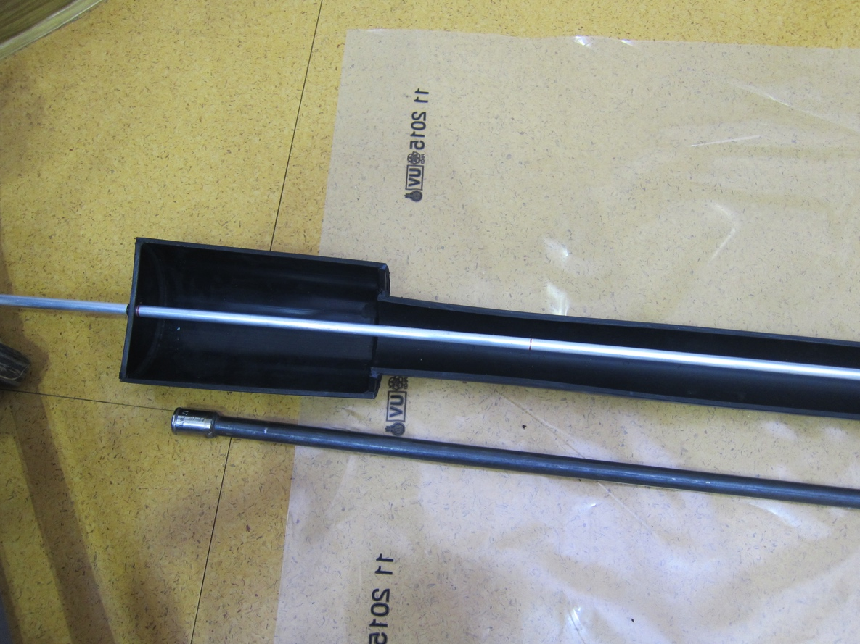
Sample Support Structure
Sample support structure made from PE100
Support jig for sample should be custom made !
Allows routing of cables to the sample

Slide 14
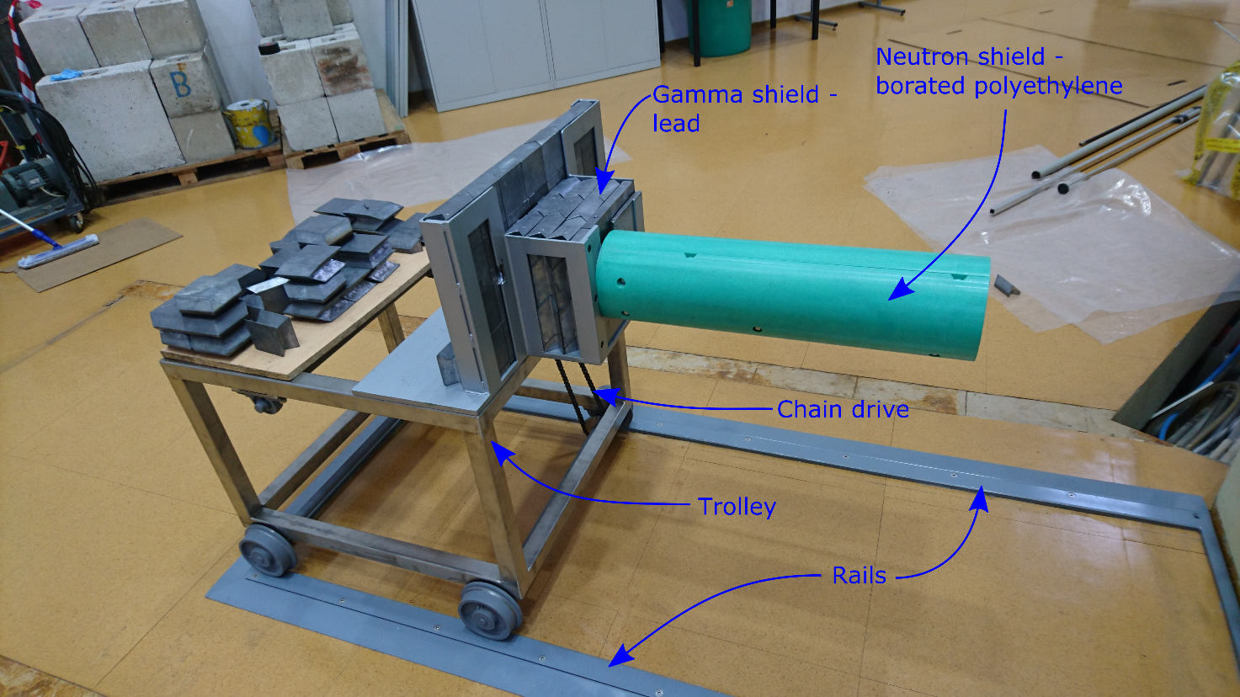
Shielding Plug
Neutron shield made from borated polyethylene
Gamma dose rate at surface of Pb ≈ mSv/h
Concrete bricks

Slide 15
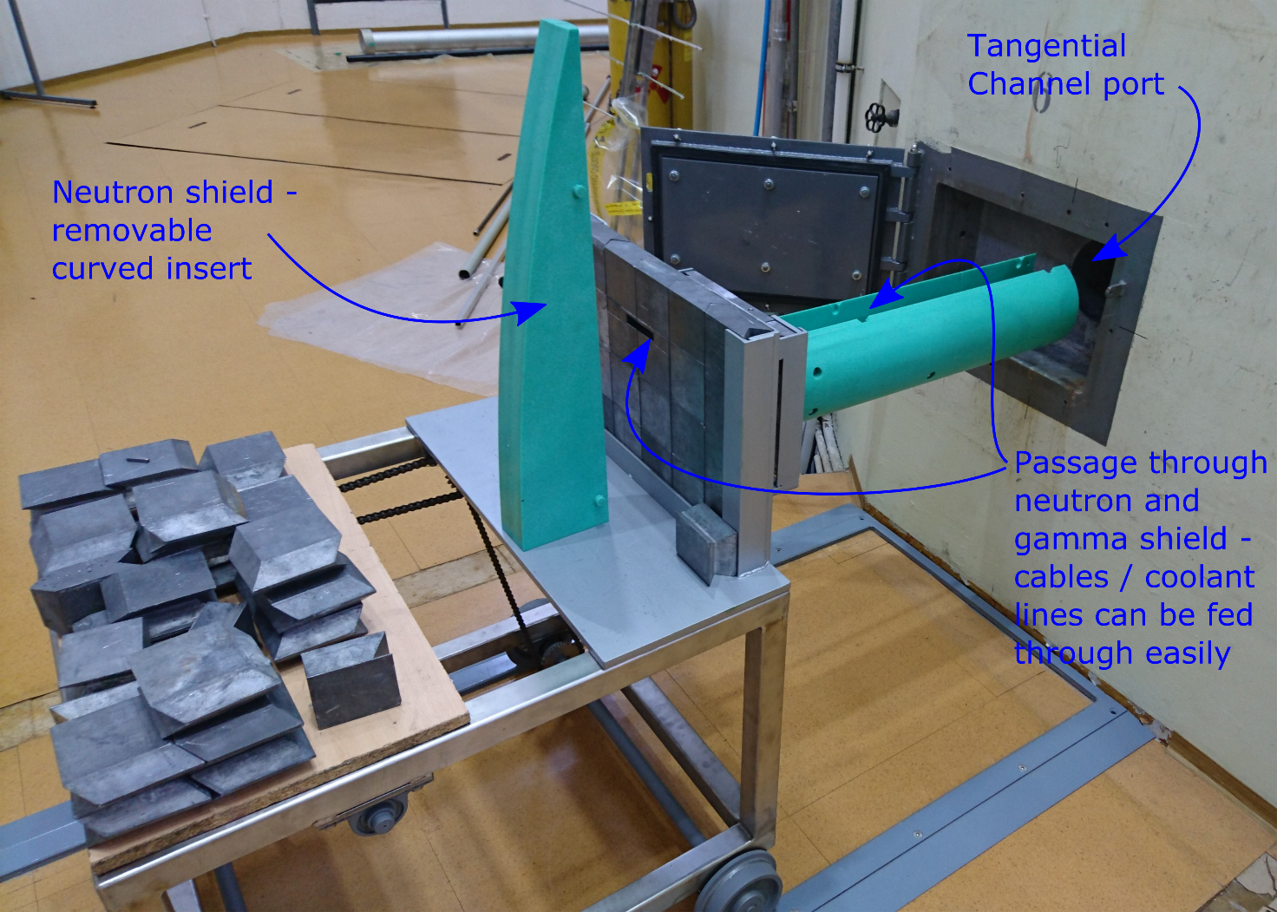
Plug Insertion

Slide 16
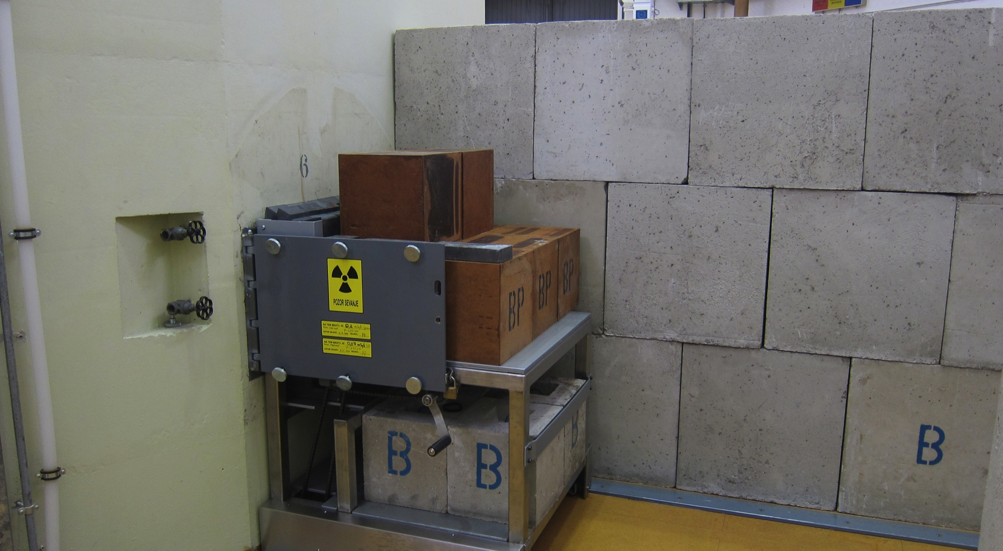
Channel Closed

Slide 17
Channel Characteristics
Inner diameter: 14 cm
Neutron flux characterisation:
  L. Snoj et al., Appl. Rad. Isot. 70 (2012) 483–488
Predicted neutron flux: 1.3e12 n/cm²s
  Thermal (E<0.625 eV): 58 %
  Epithermal (0.625 eV < E < 100 keV): 25 %
  Fast ( E > 100 keV): 17 % -> 2.3e11 n/cm²s
    1e15 n_{eq}/cm² in 1 ½ hours

Slide 18
Neutron Spectra
Thermal
Epi-thermal
Fast
Tangential channel

Slide 19
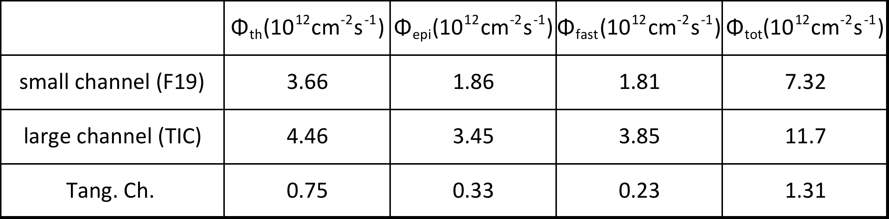
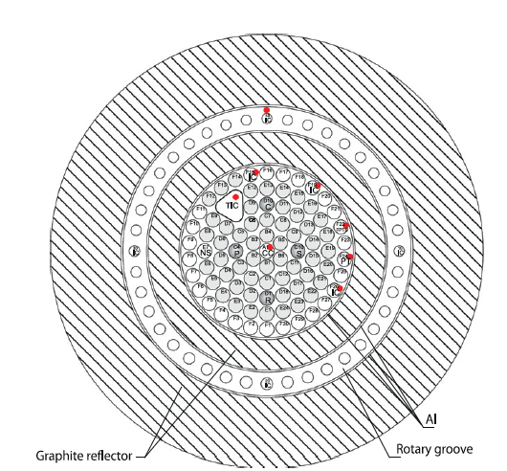
Predicted Fluxes
Thermal neutrons <0.625 eV
Epithermal neutrons 0.625 eV – 0.1 MeV
Fast neutrons > 0.1 MeV
Core simulation
Agreement with measurements in small channel
within 10 %

Slide 20
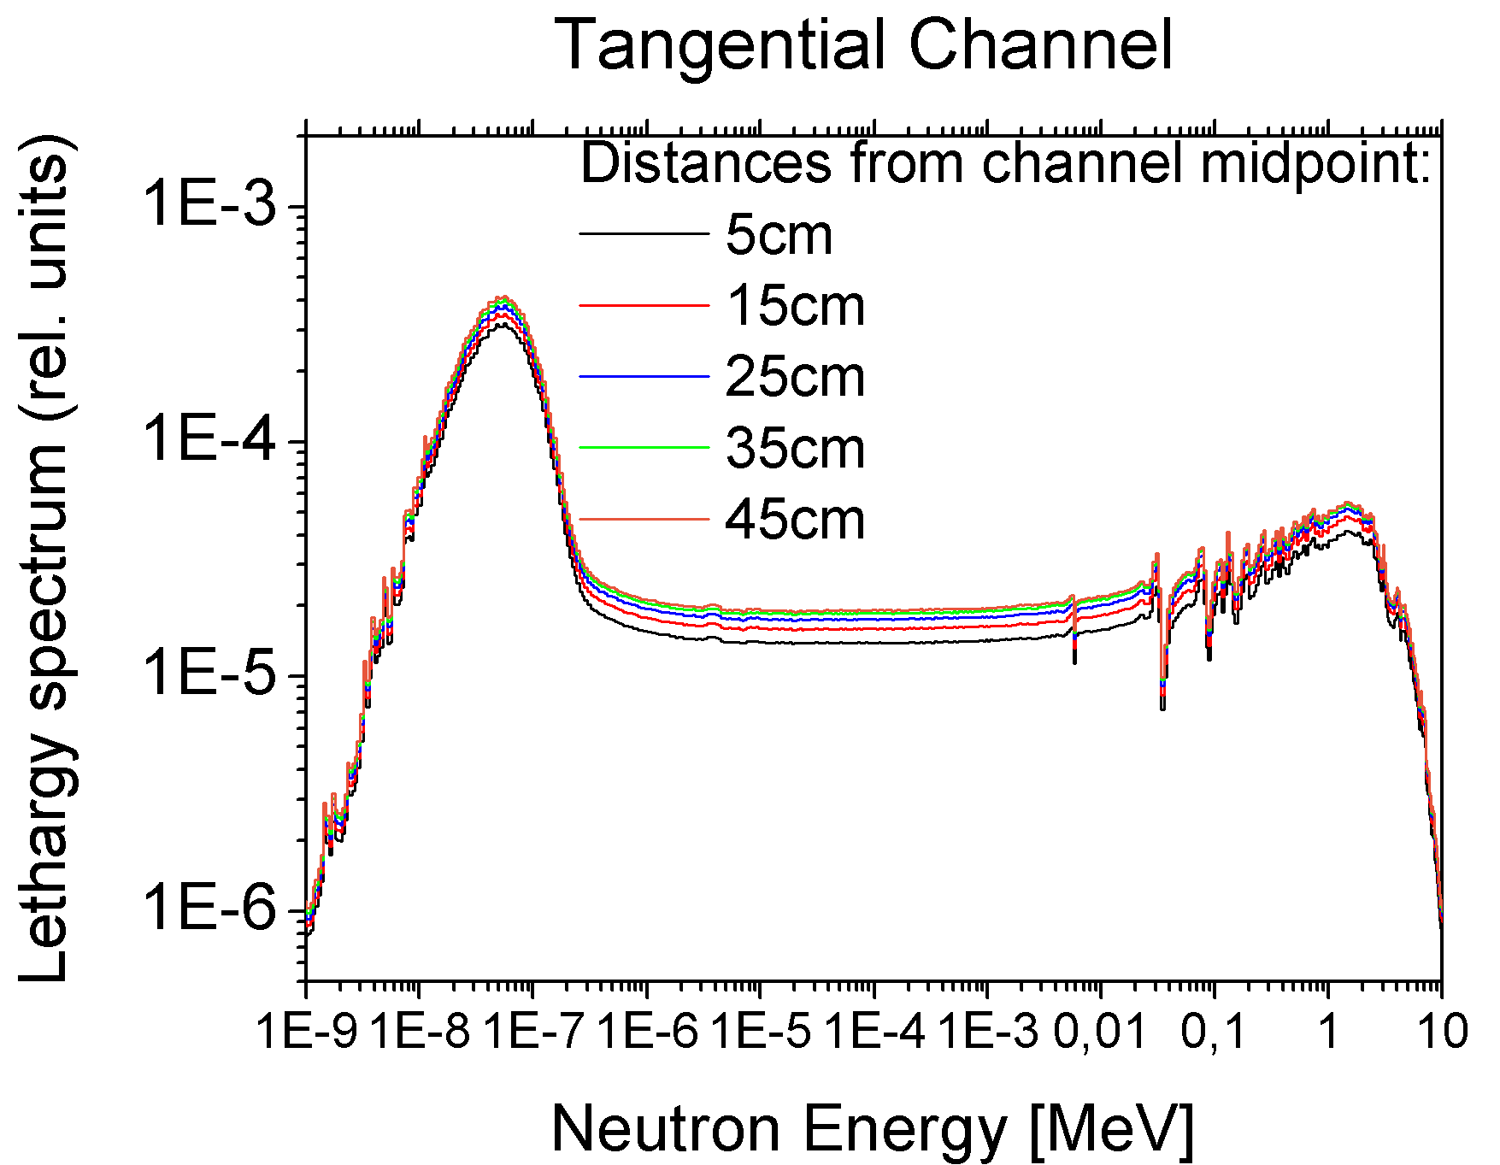
Flux Along Channel

Slide 21
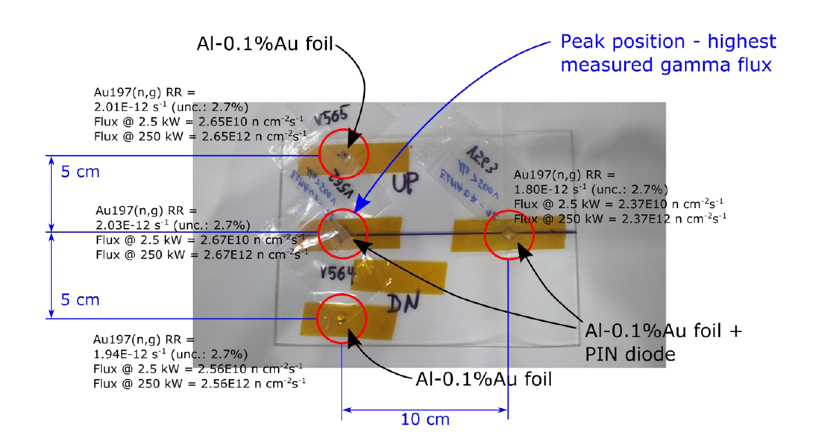
Neutron Flux Measurement

Slide 22
Neutron Flux
Flux measured by Au 197(n,γ)
  measures (mostly) thermal flux
  scaled by simulated spectrum to total flux
Au - measured total flux 2.67e12 n/cm²s
  uniformity < 10 % on 10 cm x 10 cm
PIN - measured NIEL flux 3.9e11 n/cm²s
  NIEL hardness factor for total spectrum 0.146
  hardness factor for E_{n} > 0.1 MeV: 0.83
Twice the predicted value !

Slide 23
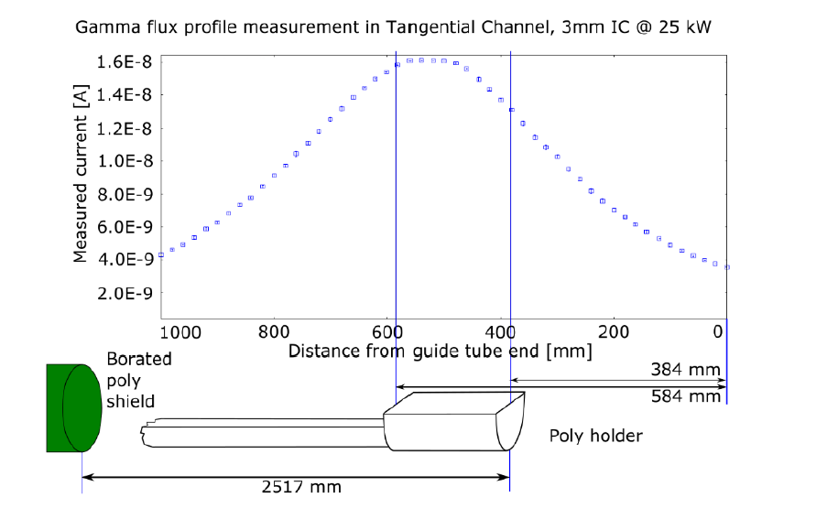
Gamma Flux
Measured gamma flux profile
Dose rate several 10 kGy/h (very preliminary!!) –
Resulting in several kGy for 10¹⁴ n_{eq}cm⁻²

Slide 24
Summary
New irradiation facility at JSI reactor installed and being commissioned
  characterization in progress
  first measurements indicate 2x predicted flux
Allows irradiation of ~12 x 20 cm samples
  services possible
10¹⁵ n_{eq}cm⁻² in less than one hour
Ready to receive samples!

