Slide 1

IRRAD Facility Infrastructure Upgrade
Blerina Gkotse, Maurice Glaser, Georgi Gorine, Isidre Mateu, Emanuele Matli, Giuseppe Pezzullo, Federico Ravotti
CERN EP-DT, BE-OP

Slide 2
Outline
CERN Milestones & Deliverables
CERN Proton irradiation Facility (IRRAD)
Samples manager
  Progress
  Specifications
  Database structure
  Design & Software Choice
  New User Interface
Irradiation facilities database
  Features
  Database
  Facility Details
  Administrator View
  Statistics & Outlook
RadHard Sample Holders for IRRAD
  Preliminary Results of mechanical tests
Conclusion
AIDA-2020 D15.6
AIDA-2020 D15.7

Slide 3

CERN Milestones & Deliverables
M24
M12
CERN Proton Facility (IRRAD)
  Online database on EU irradiation facilities of interest for HEP
  Improve IRRAD infrastr. / user friendliness
    equip area to store/handle activated materials
    sample and user management software system
    upgrade contactless fluence monitoring
      -Vilnius University
    high-granularity & fast Beam Profile Monitor
    test sample holders for extremely-high fluence
    thermal box to -40ºC for CERN & Birmingham
      -University of Sheffield
CERN Gamma Irradiation Facility (GIF++)
  Extension / upgrade of GIF⁺⁺ Gas system
  New online dose-rate monitor (INRNE)
  Extension of the cosmic ray tracker on the side walls (INFN)
  Demonstrator for an augmented reality event display (INFN)
D15.6: CERN Proton Facility Upgrade (all items operational)
MS16: specification for management system and online DB ready & documented
See the talk of Prof. Juozas Vaitkus
D15.7: Radiation Hard Facility Instrumentation ready & installed
M44
See the talk of Richard French
See the talk of Roberto Guida

Slide 4
Outline
CERN Milestones & Deliverables
CERN Proton irradiation Facility (IRRAD)
Samples manager
  Progress
  Specifications
  Database structure
  Design & Software Choice
  New User Interface
Irradiation facilities database
  Features
  Database
  Facility Details
  Administrator View
  Statistics & Outlook
RadHard Sample Holders for IRRAD
  Preliminary Results of mechanical tests
Conclusion

Slide 5
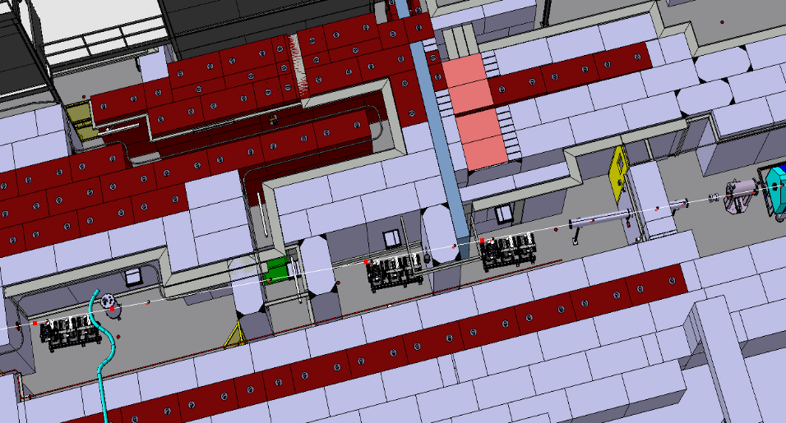
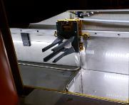
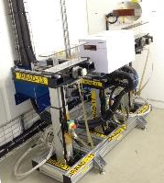
CERN Proton Irradiation Facility (IRRAD)
Testing components of the HEP experiments
Beam of 24 GeV/c and size of 12×12 mm²
Spills of 400msec every ~10sec
Fluence of 1×10¹⁶ p/cm² in 14 days
Scanning also in dimensions of 10×10cm²
Low temperature irradiation (-25°C)
Shuttle System
Access
Chicane
IRRAD Tables
BEAM
Cryostat
with LHe 1.9K
Detectors
Electronics
30m
Calorimeter samples
ps-irrad.web.cern.ch
  Federico.Ravotti@cern.ch
5
5

Slide 6
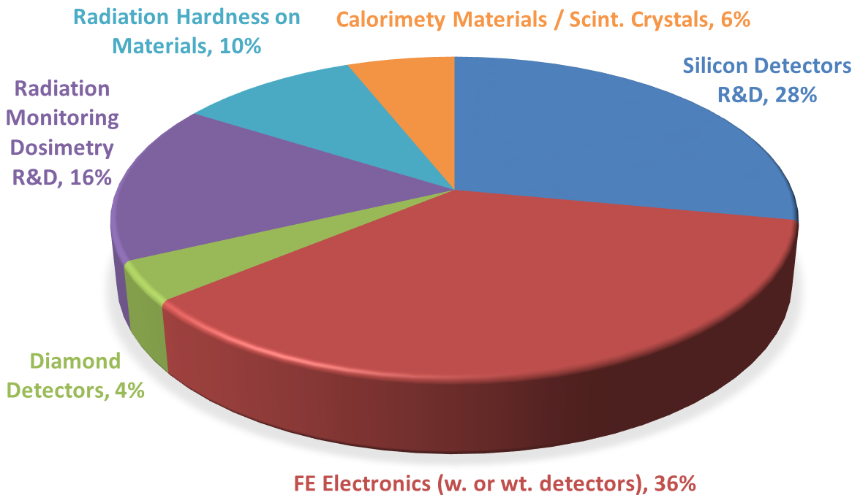
Proton IRRADiation Facility in 2016
Radiation damage studies
Test of prototypes & final assemblies before installation
Test and calibration of components
Registered Experiments (web) | 52 | 49 executed (94%)
Number of users / user teams | 28 | ~70% LHC experiments
Number of samples / irradiated objects | 416 | 246 “SET” numbers
Samples size (MIN/MAX) | 2mm × 2mm | 250cm × 13cm × 4cm
MAX target proton fluence per experiment | 1×10¹⁷ p/cm² (5×5mm² FWHM) | ~27MGy in silicon
Delivered proton (typical MIN/MAX) | ~2×10¹¹ p/cm² (1 spill) | ~4.2×10¹⁶ p/cm² (5×5mm² FWHM) ~1.6×10¹⁶ p/cm² (20×20mm² FWHM)
Irradiation time (typical MIN/MAX) | 400 ms | ~60 days ~76 days

Slide 7
Outline
CERN Milestones & Deliverables
CERN Proton irradiation Facility (IRRAD)
Samples manager
  Progress
  Specifications
  Database structure
  Design & Software Choice
  New User Interface
Irradiation facilities database
  Features
  Database
  Facility Details
  Administrator View
  Statistics & Outlook
RadHard Sample Holders for IRRAD
  Preliminary Results of mechanical tests
Conclusion

Slide 8
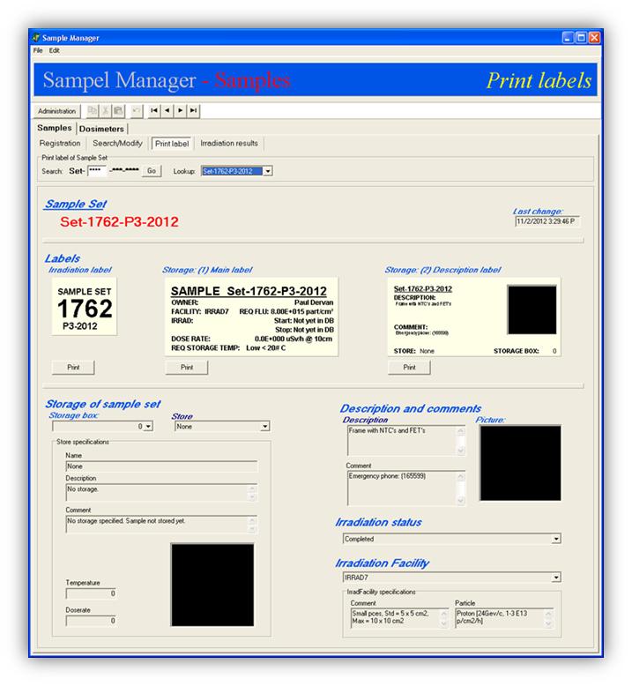
Samples Manager
Old system
Outdated system
  Facility renewed in 2014
  Evolution of CERN technologies
  New CERN procedures
Increasing amount of data
Lack of multiple user profiles
Need for a new user friendly system for centralized data management of the IRRAD facility.

Slide 9
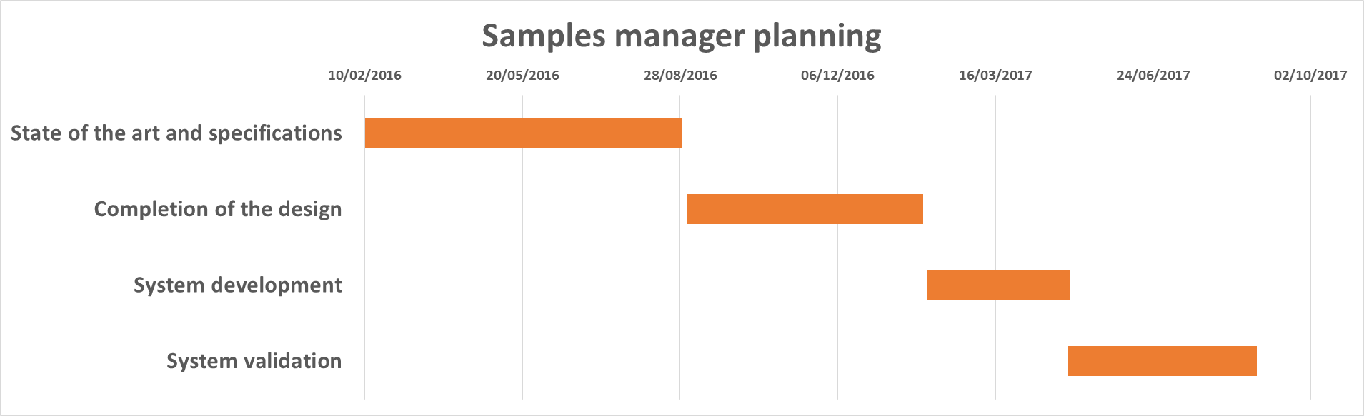
Progress
Specifications
Summer 2016 (MS16)
Database structure
Design
Software
Spring 2017 (D15.6 being prepared)
Development
Validation
D15.6
Notes:
Validation on going for the next months.

Slide 10
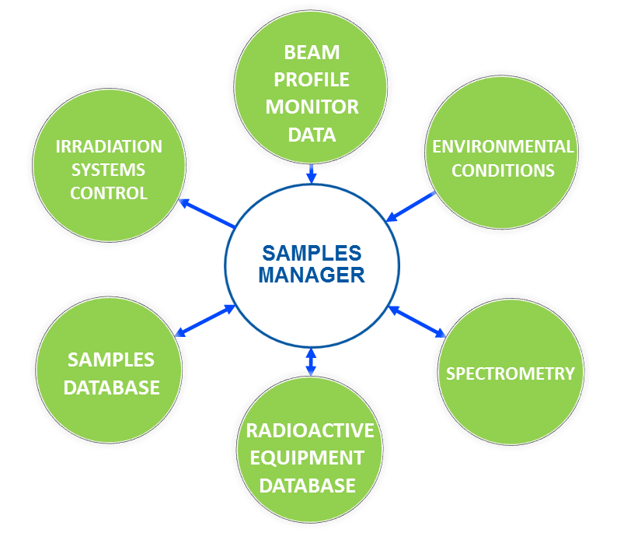
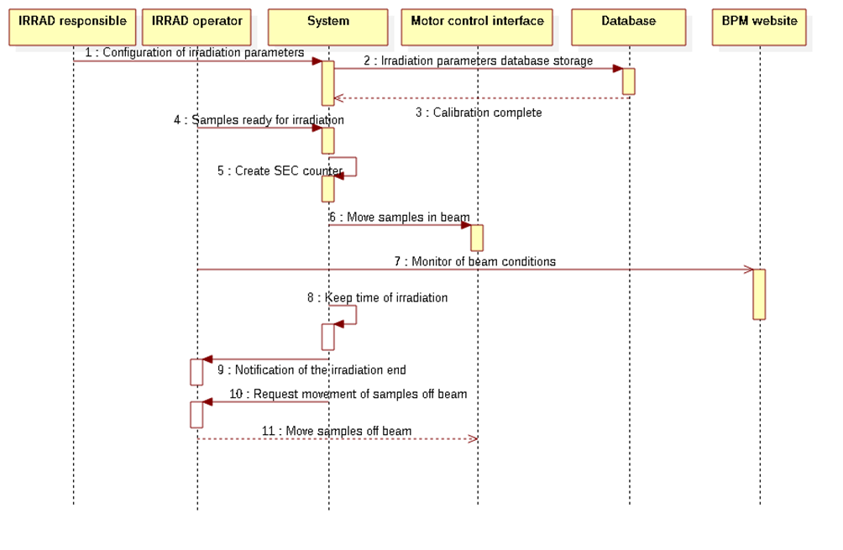
Specifications
Specifications
Database structure
Design
Software
Development
Validation
Samples irradiation procedure sequence diagram
Specifications on cds.cern.ch/record/2159521/files/AIDA-2020-MS16.pdf

Slide 11
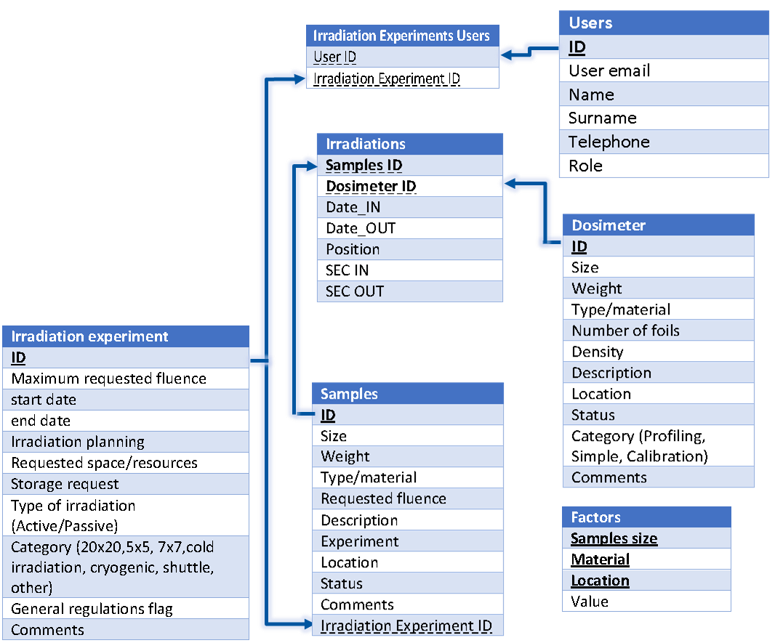
Database Structure
Specifications
Database structure
Design
Software
Development
Validation
Notes:
But first let’s the progress on this project. We started by the knowledge we had from the irradiations of the IRRAD facility and then we also explored the technologies and the software used in other facilities to manipulate the data. With this knowledge be formed the user communities, the features and the use cases of the IRRAD facility. All these are described in this AIDA-2020-MS16 report. Here you can see some use case and sequence diagrams used there.

Slide 12




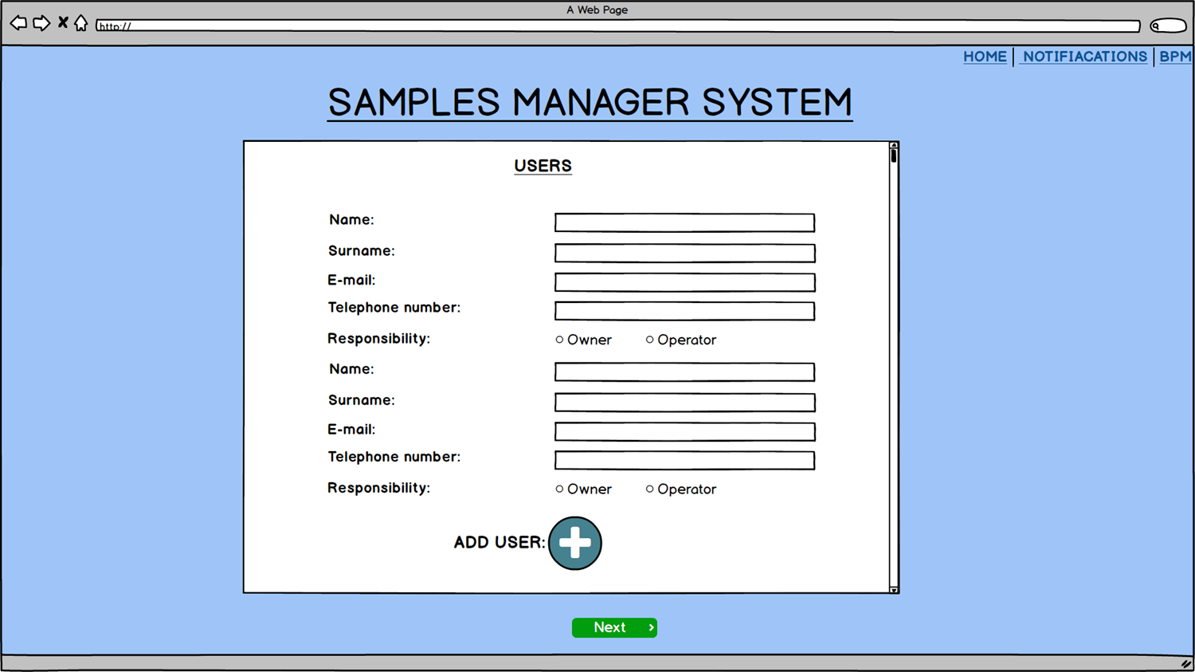
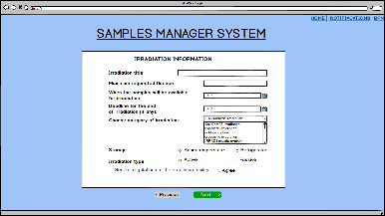
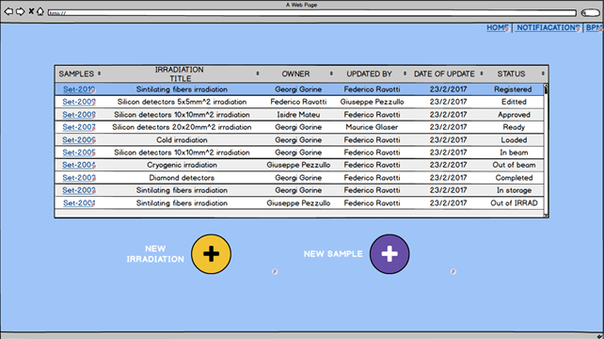
Design & Software Choice
Specifications
Design of the interfaces according to the specifications and the requirements of the users and the coordinators
Design with balsamiq mockups
Software development with Oracle database, Django, Bootstrap and Angular
Database structure
Design
Software
Development
Validation
Balsamiq Mockups
Notes:
But first let’s the progress on this project. We started by the knowledge we had from the irradiations of the IRRAD facility and then we also explored the technologies and the software used in other facilities to manipulate the data. With this knowledge be formed the user communities, the features and the use cases of the IRRAD facility. All these are described in this AIDA-2020-MS16 report. Here you can see some use case and sequence diagrams used there.

Slide 13
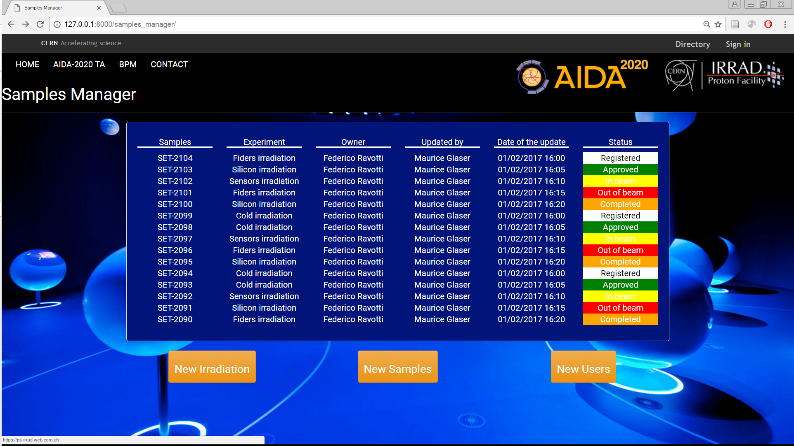
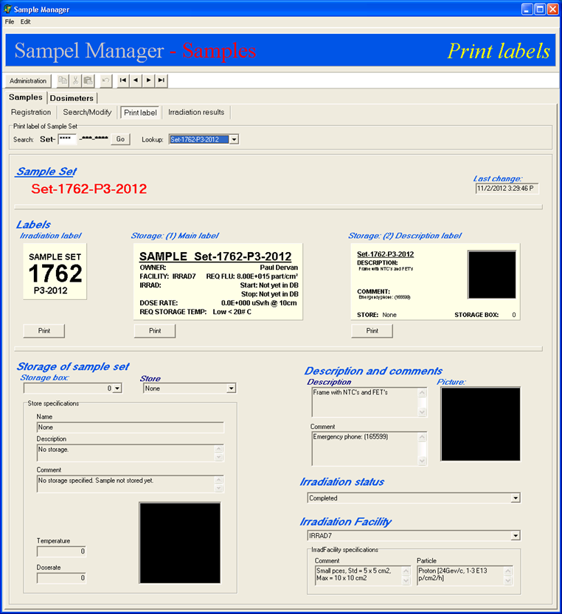
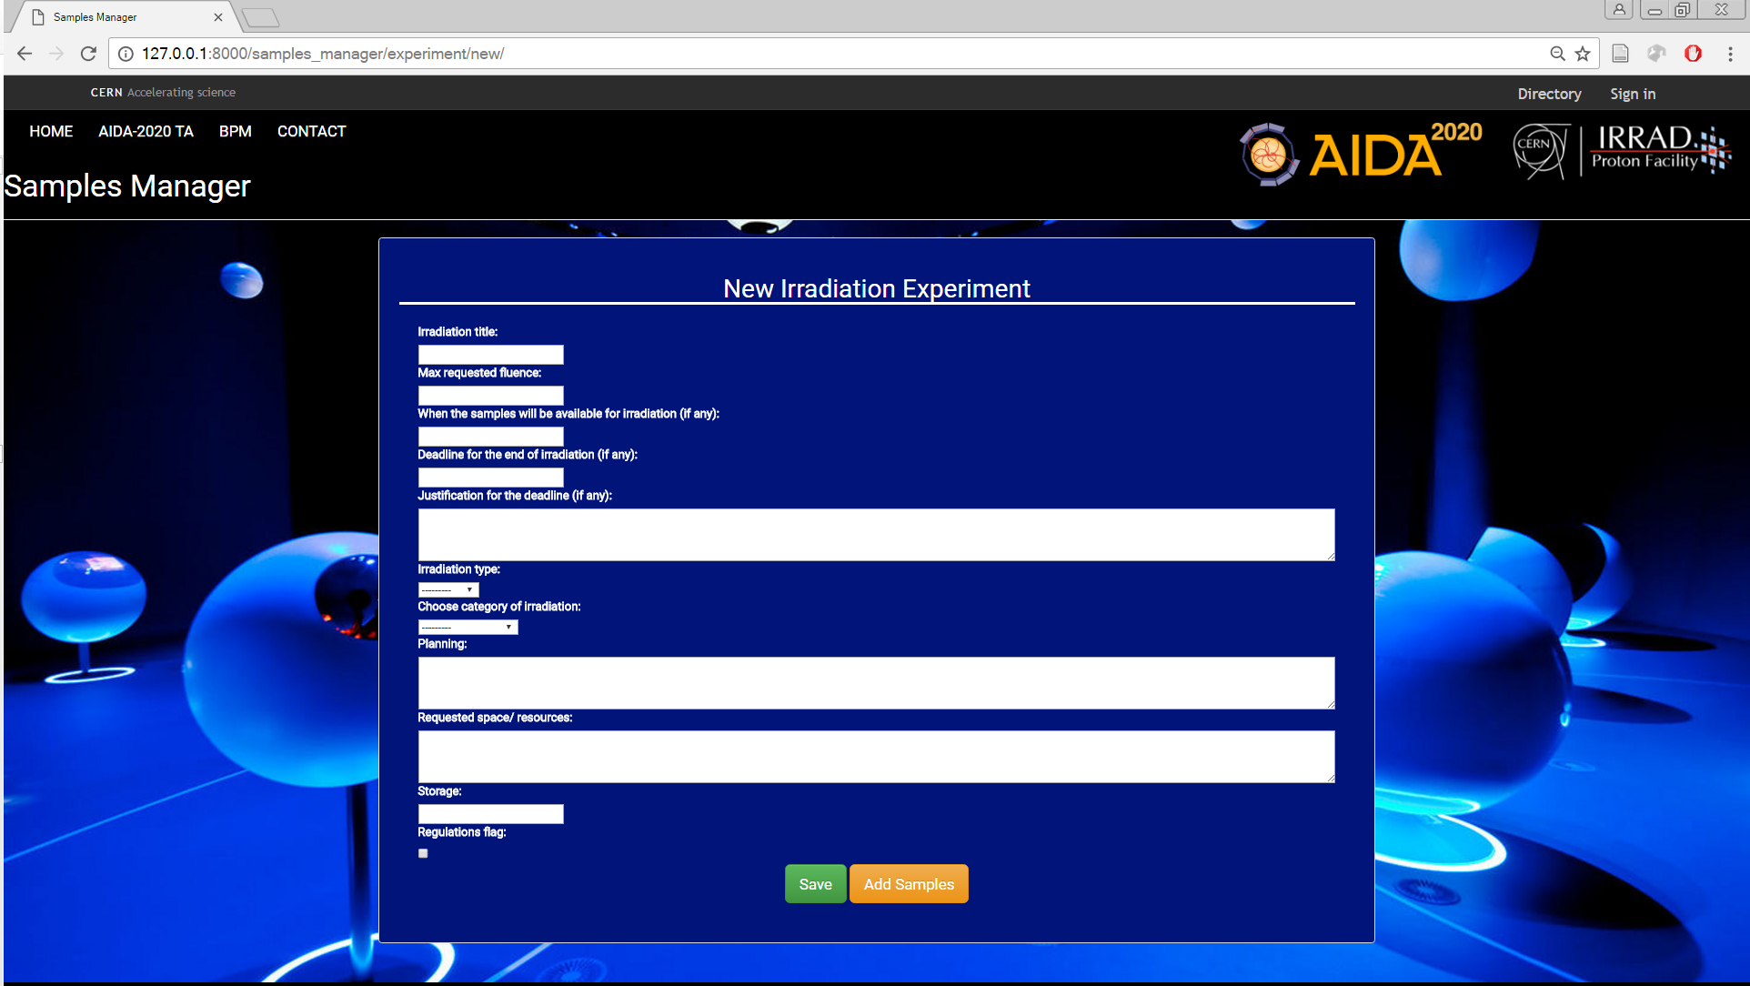
New User Interface
Old system
New system
Centralised system for the overall IRRAD facility operation
Interfaces customised according to users
Overall display of the beam and environmental conditions
Compatible with the CERN computing infrastructure and procedures (TREC)
Secured with the CERN authentication system (SSO)
Notes:
Here you have the old but still in use interface. However for the reason that I previously mentioned we are planning to build a new system that will integrate all the irrad components data. For these components I’m going to speak in a while.

Slide 14
Outline
CERN Milestones & Deliverables
CERN Proton irradiation Facility (IRRAD)
Samples manager
  Progress
  Specifications
  Database structure
  Design & Software Choice
  New User Interface
Irradiation facilities database
  Features
  Database
  Facility Details
  Administrator View
  Statistics & Outlook
RadHard Sample Holders for IRRAD
  Preliminary Results of mechanical tests
Conclusion

Slide 15
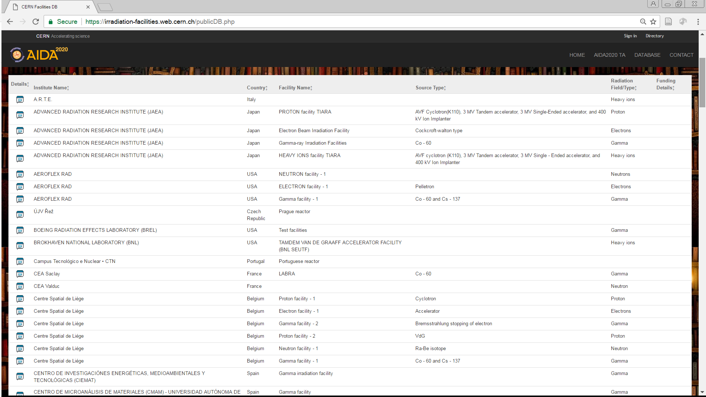
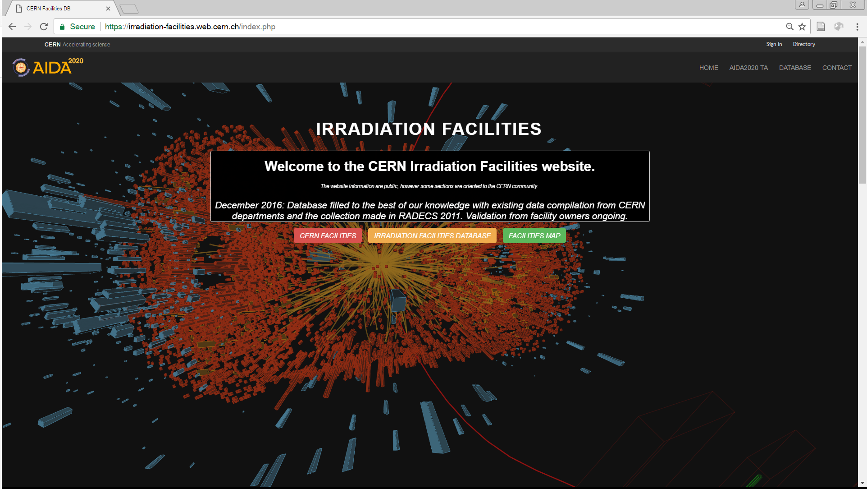
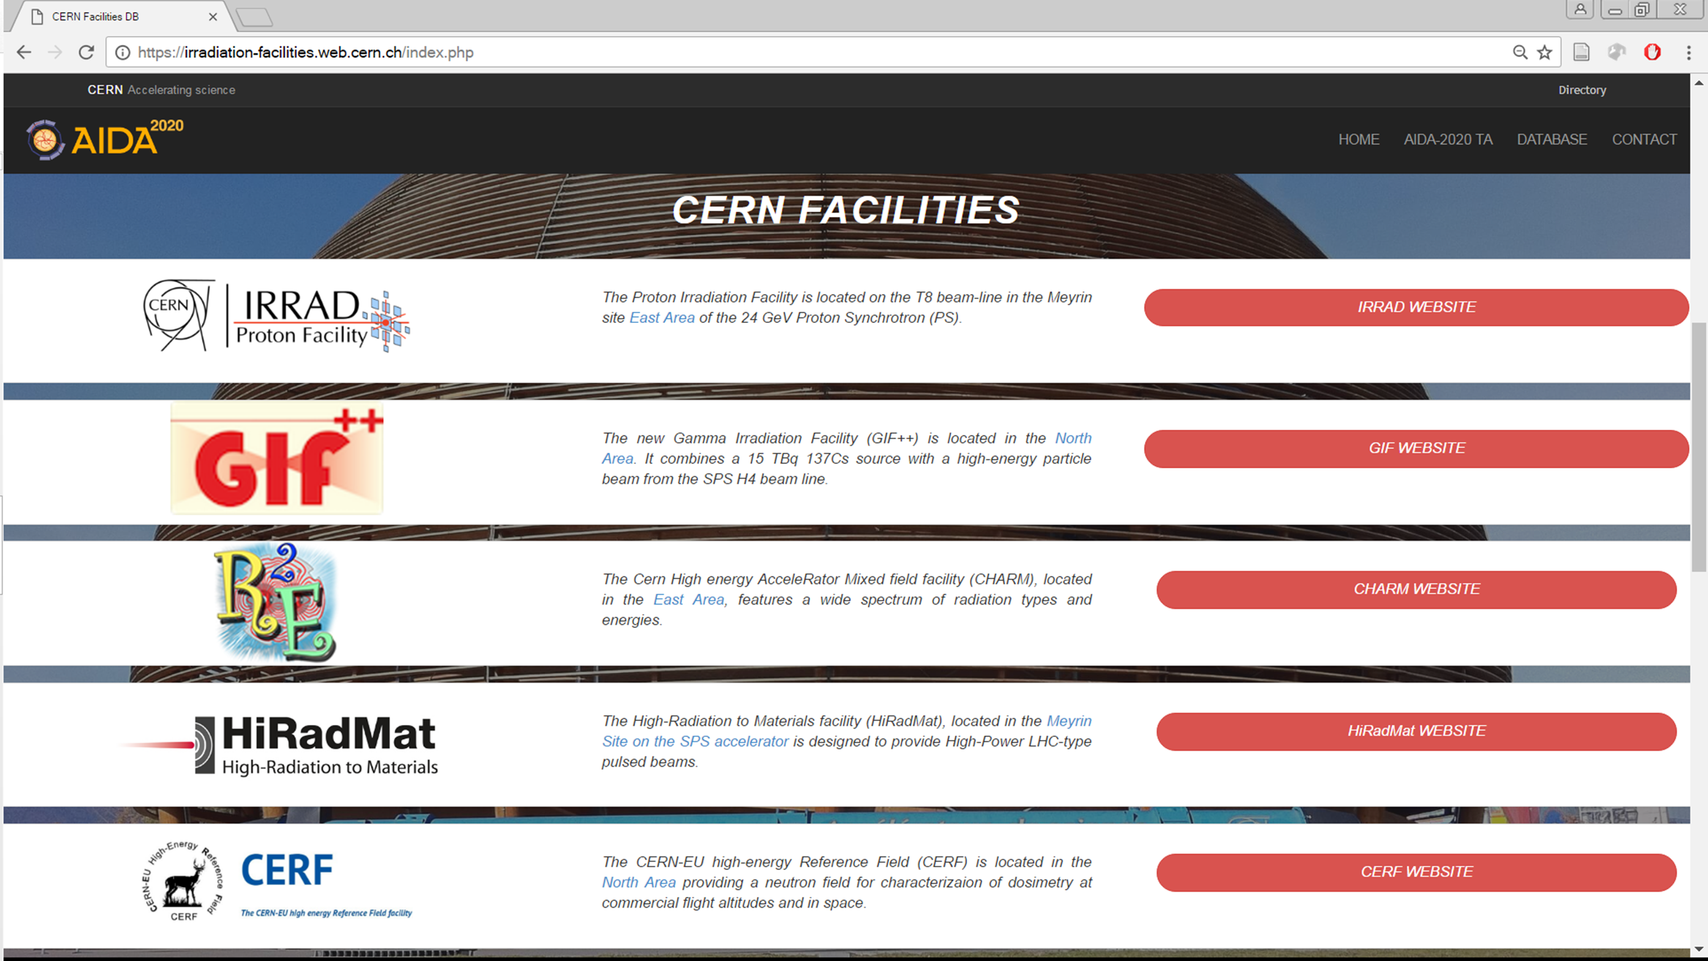
Irradiation Facilities Database
Deliverable in EU-project AIDA-2020
Unified entry point for irradiation facilities at CERN and worldwide
Essential (but exhaustive) collection of information
182 entries initially loaded
Data validation in progress since Feb. 8th
Facilities worldwide
Homepage
CERN Facilities
Address: cern.ch/irradiation-facilities

Slide 16
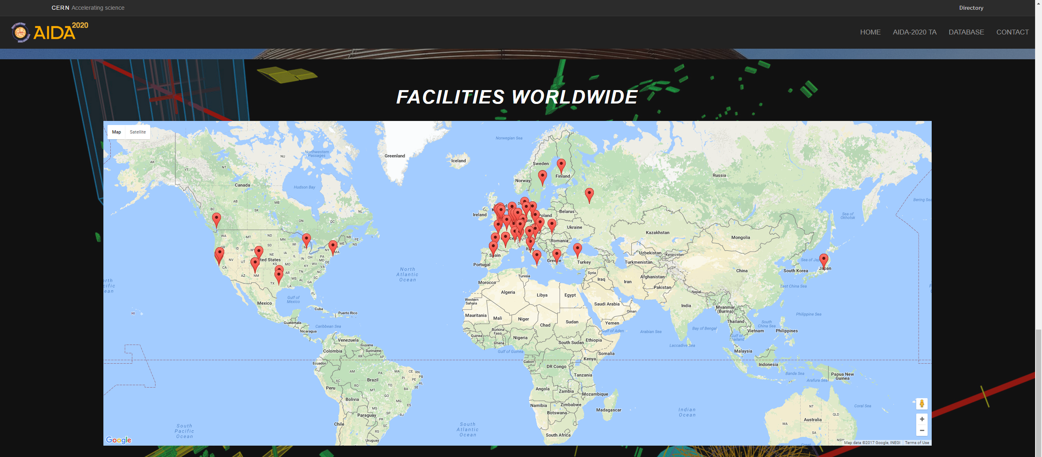
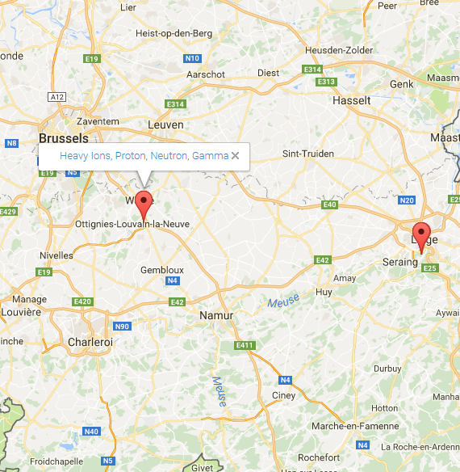
Features
Open access data, secured with the CERN authentication system (SSO)
Search filters by country, source or radiation field
Irradiation facilities worldwide map
Possibility to ADD a new facility and EDIT an existent one by the facility coordinator
Auto-maintenance (regular reminders)

Slide 17
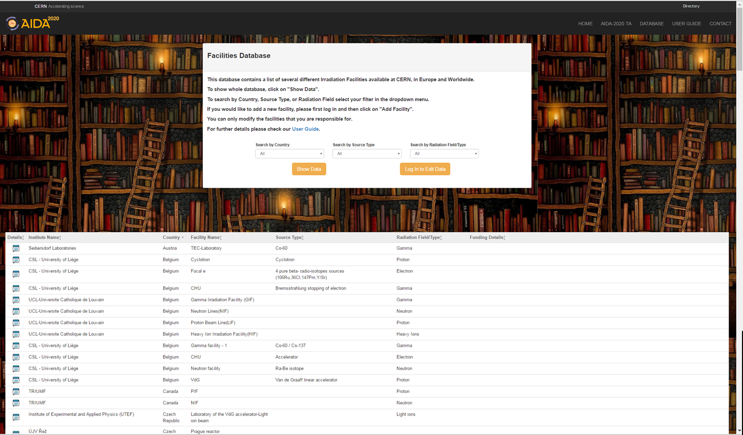
Database

Slide 18
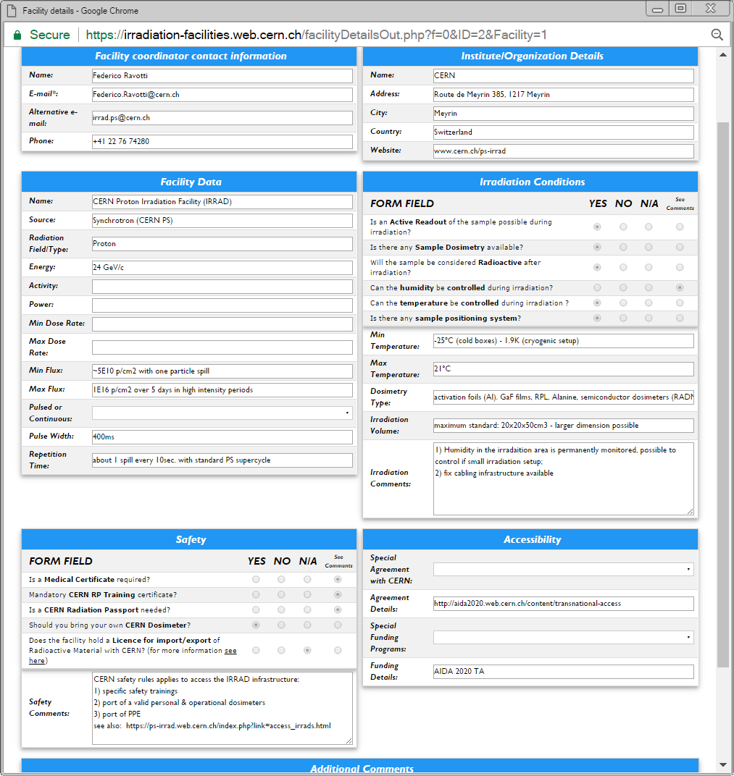
Facility Details
Coordinator, Institute
Facility data
Irradiation conditions
Safety
Accessibility
  AIDA-2020 TA!
Additional comments

Slide 19
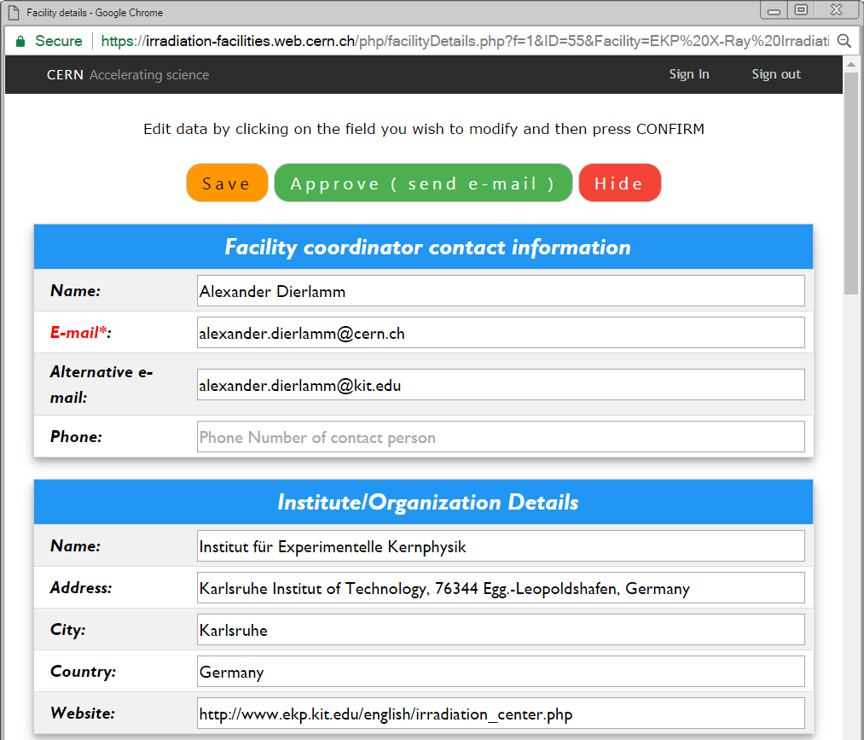
Administrator View
Modifications or new submissions are screened by the Admin team, corrected (if necessary) and finally approved. Data become then available (again) for public view.
Facility Coordinators are informed by e-mail.
A Facility Coordinator can also request to delete his Facility: data are still in the database but removed from public view.
User Manual: https://cds.cern.ch/record/2244674/files/AIDA-2020-NOTE-2017-002.pdf

Slide 20
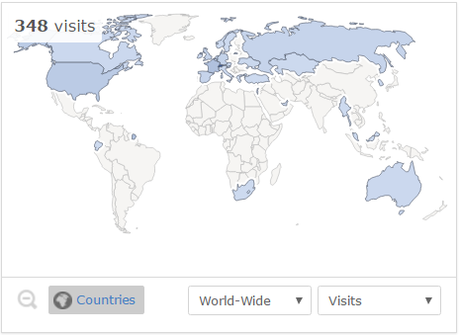
Statistics & Outlook
42 entries have been validated so far by the Facility Coordinators
The website has been visited ~350 times
Follow up:
Send second reminder to the Facility Coordinators that did not reply yet
Article on AIDA-2020 newsletter being released
Send the first “annual” validation reminder (test the notification system) by the end of 2017
Contact CERN colleagues to remove outdated information from old CERN websites

Slide 21
Outline
CERN Milestones & Deliverables
CERN Proton irradiation Facility (IRRAD)
Samples manager
  Progress
  Specifications
  Database structure
  Design & Software Choice
  New User Interface
Irradiation facilities database
  Features
  Database
  Facility Details
  Administrator View
  Statistics & Outlook
RadHard Sample Holders for IRRAD
  Preliminary Results of mechanical tests
Conclusion

Slide 22
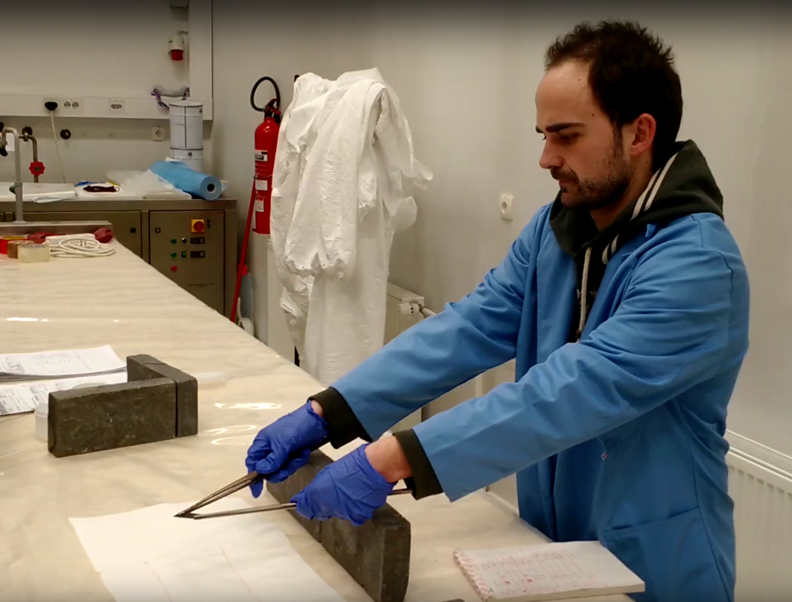
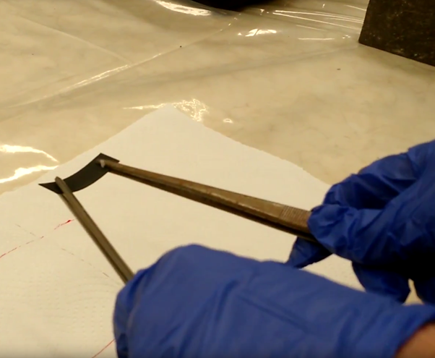
RadHard Sample Holders for IRRAD
Current material used for the samples holders are from pure cellulose (getting damaged >10¹⁷ p/cm²)
Performing irradiation and tests in TRIGA reactor in JSI*
D15.7: Radiation Hard Facility Instrumentation ready & installed
M44
*Many thanks to I. Mandic, V.Cindro and JSI operation team for the support!

Slide 23
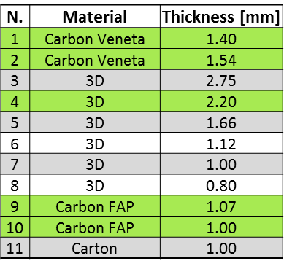
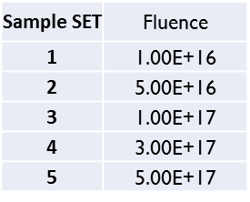
Preliminary Results of Mechanical Tests
Holders tested:
The standard IRRAD holder start failing > 5×10¹⁶ n/cm²
The 3D printer material breaks at 1×10¹⁷ n/cm² and gets activated as much as the cellulose
The carbon fibres has the best results so far

Slide 24
Conclusion
Samples Manager core application developed and soon under validation
Irradiation facilities database completed ahead of schedule (February) and data are being validated and maintained
The deliverable report D15.6 to be submitted in the end of April (M24)
First measurements ongoing on new sample holder materials irradiated at JSI in March (D15.7)
Next IRRAD run starting in May 2017. Detailed schedule:
ps-irrad.web.cern.ch/documents/run2017/Schedule_IRRAD_CHARM_2017_v2.pdf
Contact for IRRAD: irrad.ps@cern.ch
Contact for irradiation Facilities database: Irradiation.Facilities@cern.ch

Slide 25
D ON THANK YOU! IRRADIATON FACILITIES

Slide 26
Samples Manager
SAMPLES MANAGER
BEAM PROFILE MONITOR DATA
IRRADIATION SYSTEMS CONTROL
ENVIRONMENTAL CONDITIONS
SAMPLES DATABASE
SPECTROMETRY
RADIOACTIVE EQUIPMENT DATABASE

Slide 27
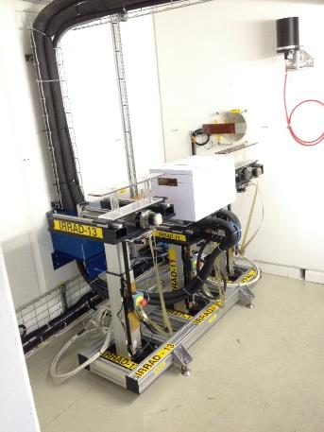
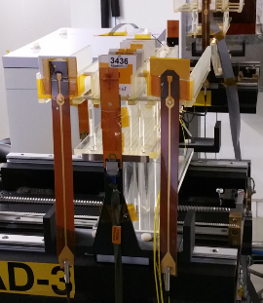

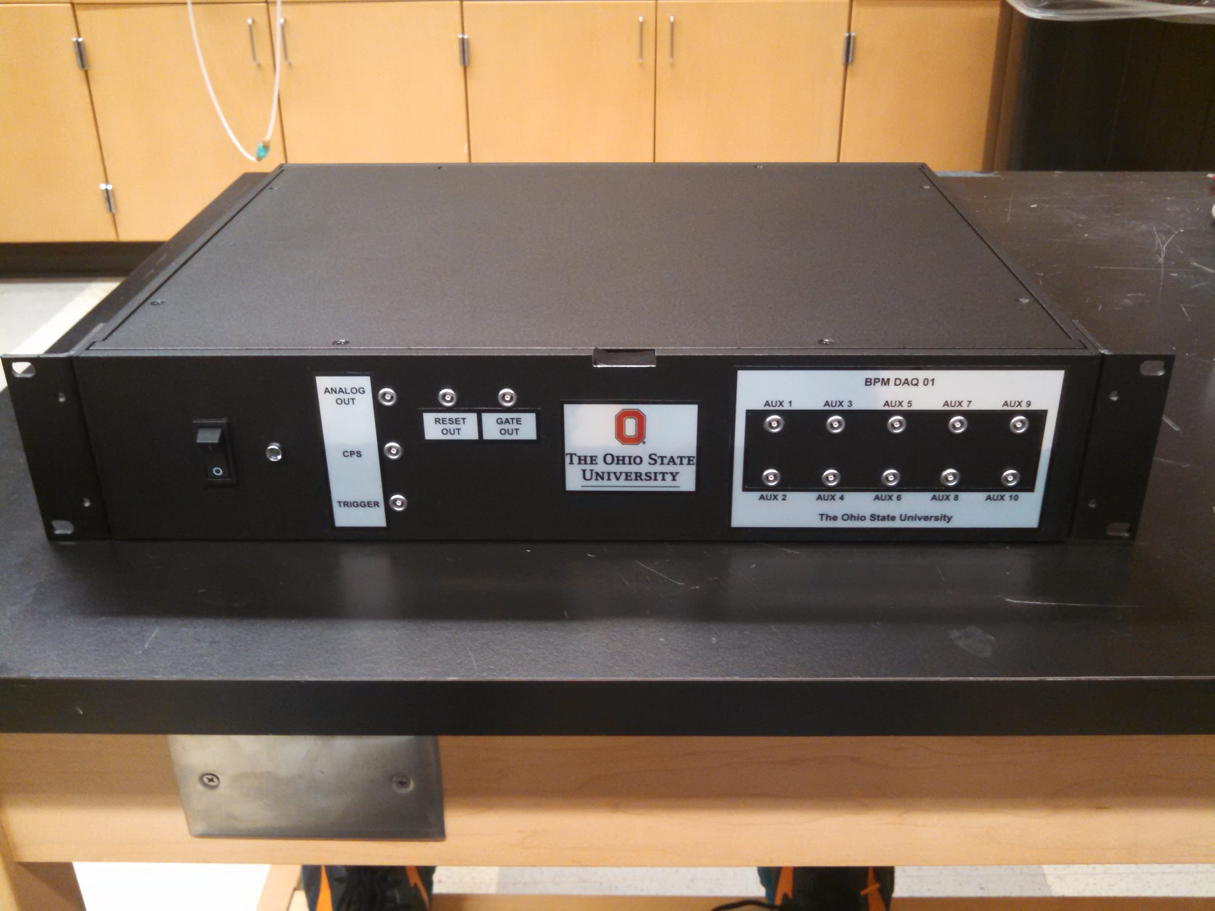


BPM Detectors and DAQ Unit
Fixed BPM
For the beam alignment
Mini and single-pad BPMs
IRRAD tables alignment purpose and “in-beam” detection
D15.7: Radiation Hard Facility Instrumentation ready & installed
Fixed-BPM2
p⁺
p⁺
Fixed-BPM detector
M44
e⁻
e⁻
p⁺
e⁻
Transversal beam profile
BPM DAQ unit 25-35m away from fixed-BPM device.
27

Slide 28
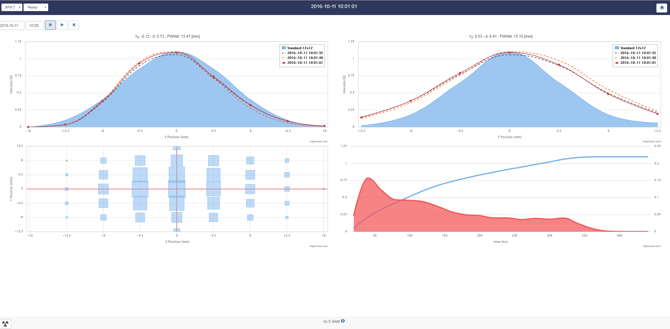
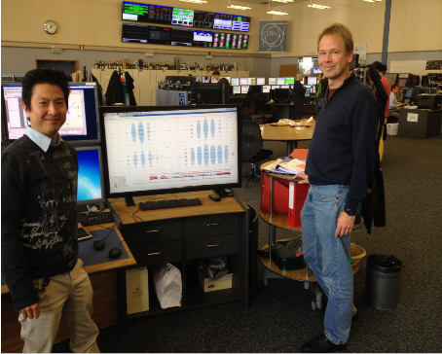
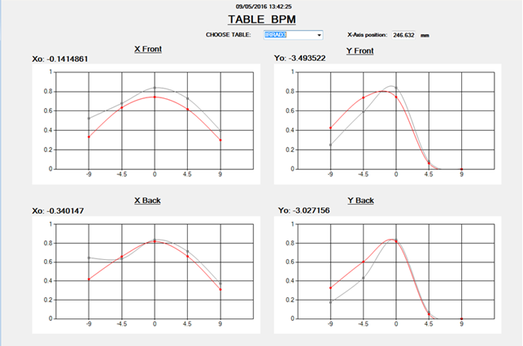
Beam Profile Monitors (BPMs)
fixed-BPM Gaussian fit
Measured profile
Reference profile
BPM DISPLAY AT CCC
Longitudinal profile provided by central pad charge
Transversal profile
Beam monitoring at CERN Control Center (CCC)
https://op-webtools.web.cern.ch/irrad/index.php
mini BPM Gaussian fit
28

Slide 29
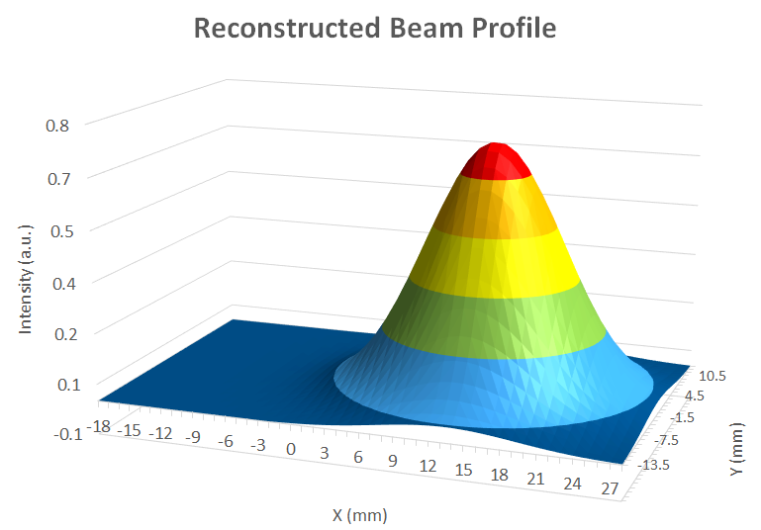
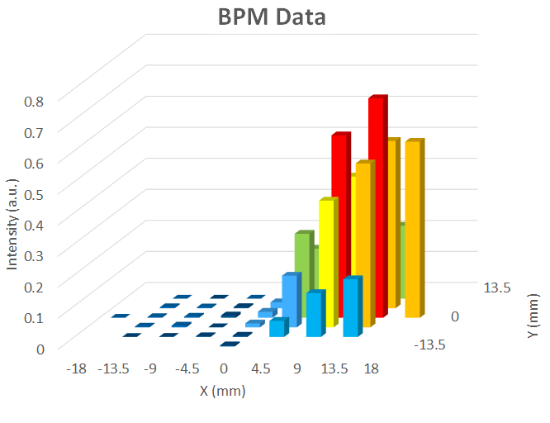
Upgrade: New 3D Fitting Tool Validation
Better accuracy required by:
  CERN Control Center (CCC)
  IRRAD team
  IRRAD users
Developed within AIDA-2020, D15.7
All BPM channel values included
Initial values for the algorithm: the maximum value and its XY position
SciPy function for least square minimization
Validated over hundreds of spills against other fitting methods

Slide 30
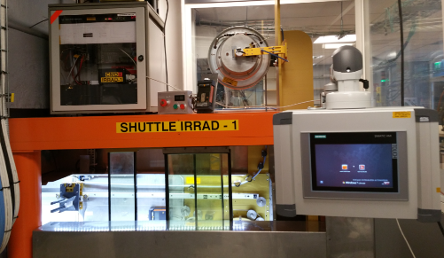
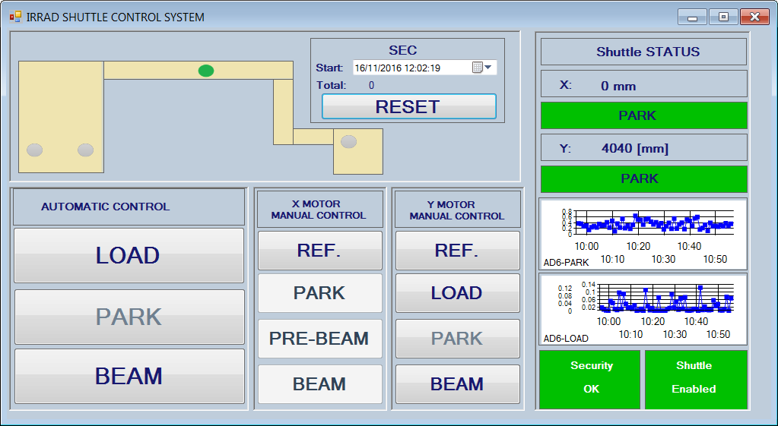
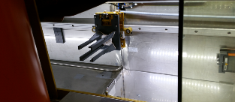

Shuttle-IRRAD1 Description
System to place samples in beam without accessing the area.
No need to stop the beam
Manual control
Software control
Dose rate monitoring
Safe handling of samples as priority

Slide 31
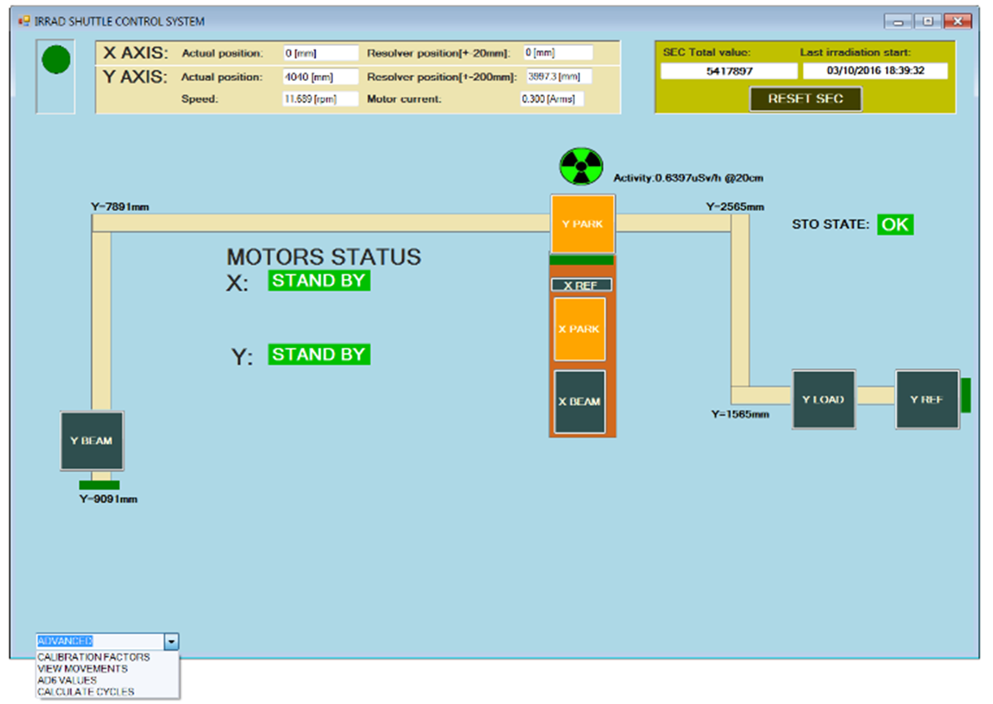
Shuttle-IRRAD1 Control Interfaces
Remote control of the shuttle via Ethernet
Two interfaces:
  Administrators-full control
  Users-simplified version
Y- Axis positions: Reference, Load, Park and Beam
X-Axis positions: Reference, Park, Pre-Beam and Beam
Counting beam intensity while shuttle in beam
Software interlock when samples radioactivity is too high
Administrator interface
User interface

Slide 32
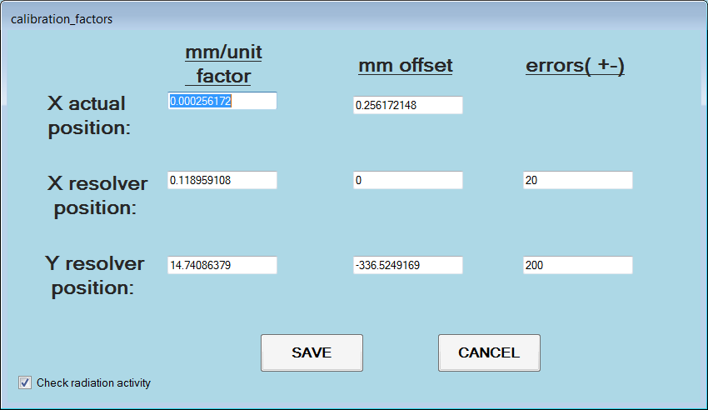
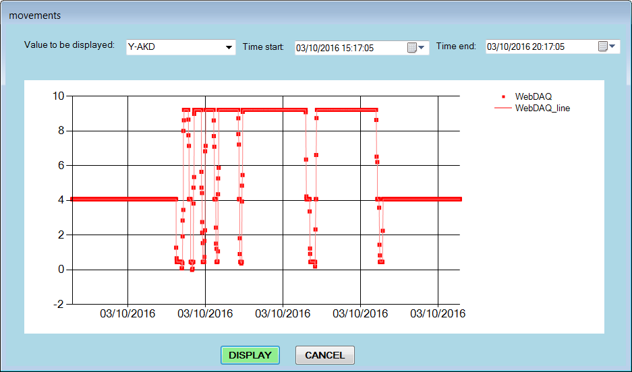
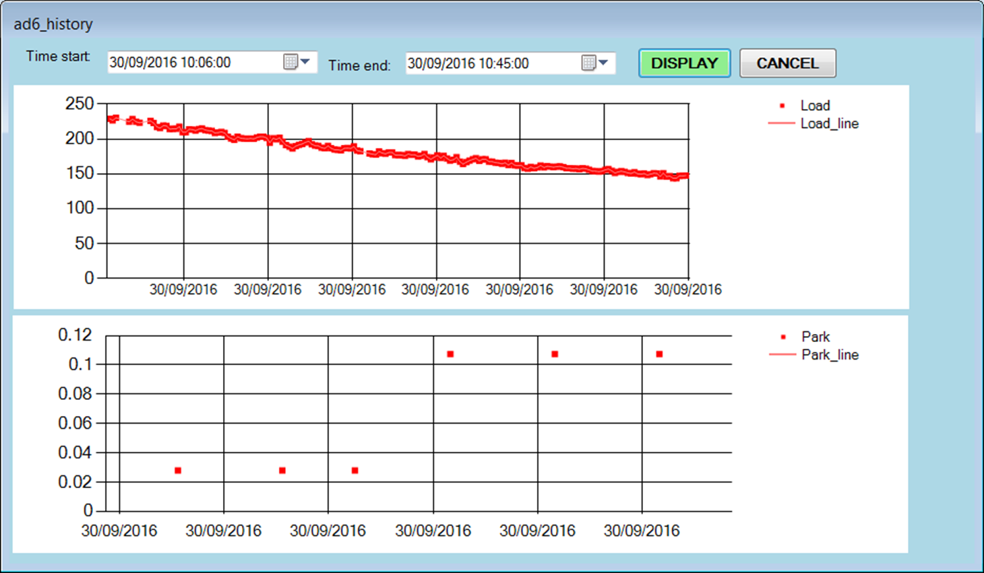
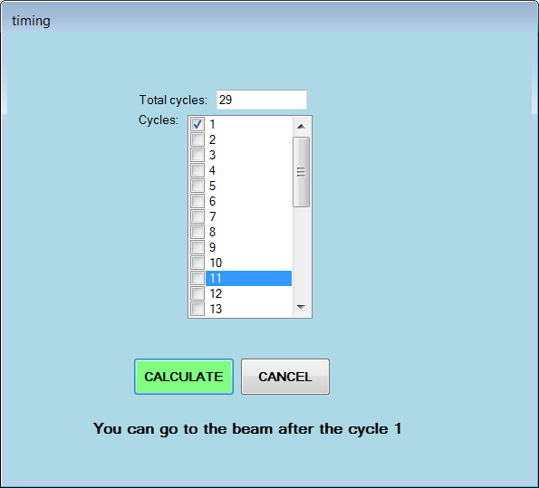
DAQ and Shuttle Monitoring
Calibration factors
Shuttle positions monitoring (both axis)
Dose rate monitoring (samples radioactivity)
Calculation of the proper timing to place the samples in beam (for short time irradiations)

Slide 33
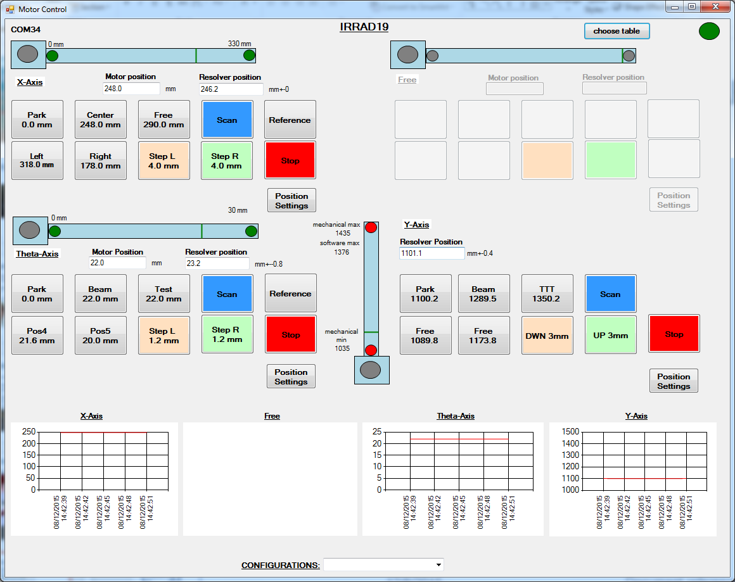
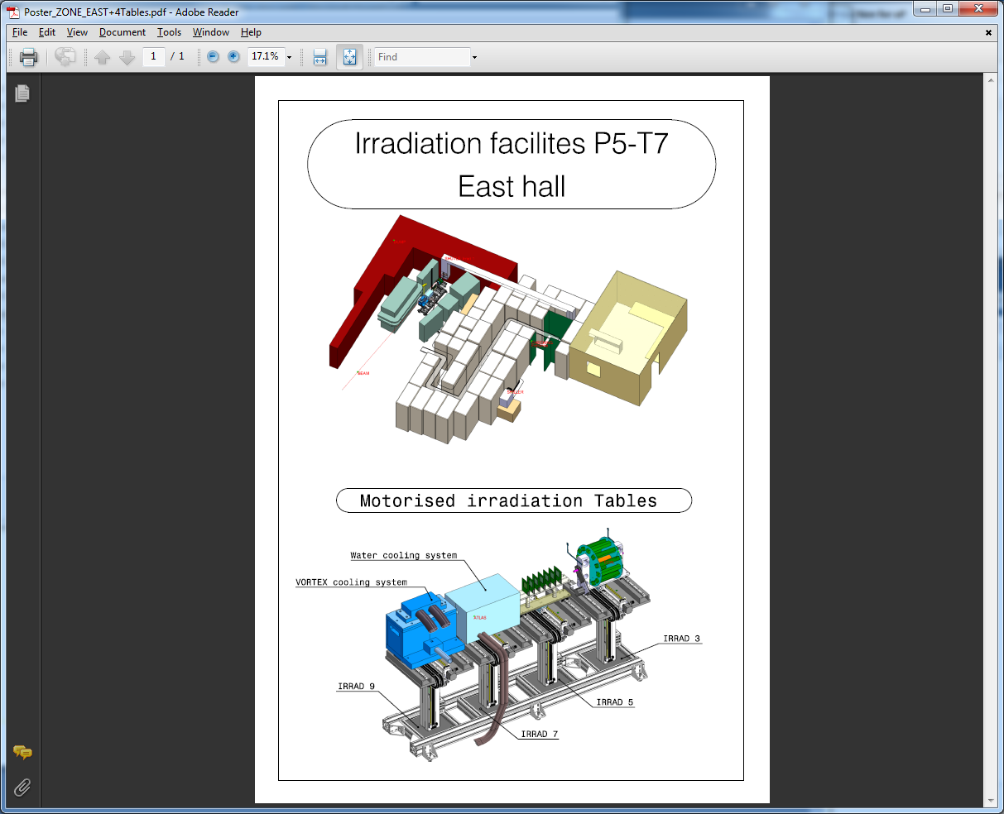
IRRAD Tables Control
XY and theta axis movement
Positions definition
Speed definition
Motors calibration
Storage of calibration and system configuration parameters
Positions history
BEAM
y
θ
x

Slide 34
Samples Manager Dataflow
Beam Profile Monitor
IRRAD System controls
Beam longitudinal profile
Temperatures
Beam transversal profile
IRRAD tables positions
Beam intensities
Shuttle positions
SEC
Dose rate
ORACLE DATABASE

