Slide 1




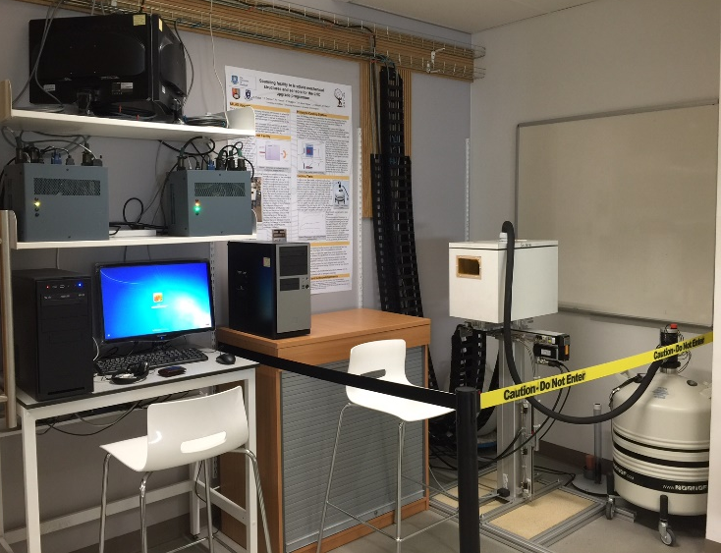
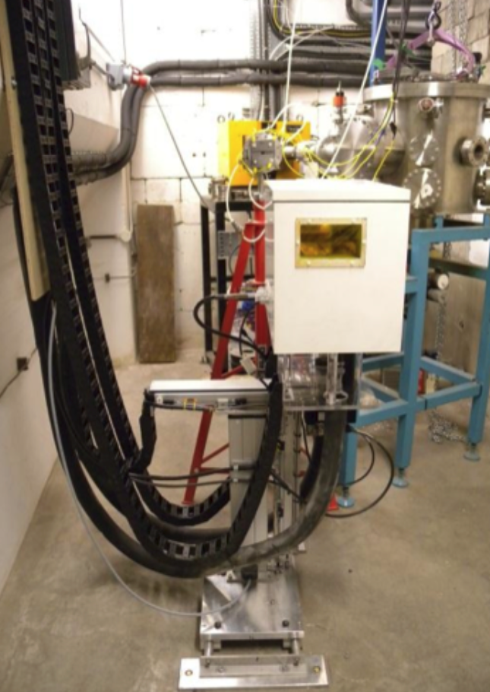

  LN2 Cooling Development
  D15.8 Cold Irradiations at Birmingham Cyclotron Facility
The LN2 cooling system is working exceptionally well. It can achieve a stable 120 temperature of -50 C in 30 minutes. The xy scanning robot then moves the sample mounted in the cold box through the proton beam to complete a cold irradiation. Issues with any annealing of sensors have now been solved (see B’ham presentations). [Bottom left image]
Resource efficiency has improved allowing parallel development with UoB irradiation programme activities. The second scanning system robot with liquid nitrogen cooling is completed. [Top right image]
Located within the new “Robotics Foundry” housed within the first series of new buildings at USFD. This new seven storey, 5355 m2 building is specifically for collaborative, inter-disciplinary research groups in this case, Sheffield Robotics
  Duplicate system completed
  Fully networked with UoB system to allow real-time software updates and trouble shooting / alterations
  Remote connection to UoB system 99% completed
  Tele-operation of the UoB system from Sheffield or the Sheffield system from UoB is now possible via remote connection
  UoB staff being trained on the use and development of the scanning system.
The current cold box is to be replaced with a new design, reducing area and payload on the scanning robot system ~ mid 2017
  Production of new cold box est end 2017
  UoB staff training during 2017
  Teleoperation of systems needs careful safety analysis.
  Networked support needs use and evaluation.
The new cold box design is completed. Waiting for a workshop slot to be available to being production. Due to the low level of funding from AIDA2020 and removal of a UK-ALTAS staff post at USFD, it is prohibited to request a production advancement at this time.

