Slide 1
AIDA 2020
WP8/NA7 Large scale cryogenic liquid detectors
Charge readout and dual-phase
AIDA-2020 Annual meeting LPNHE
WP8 Report 5/4/2017
D.Autiero (IPNL Lyon)

Slide 2
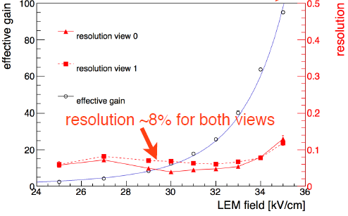
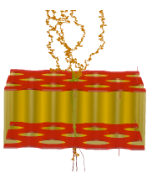
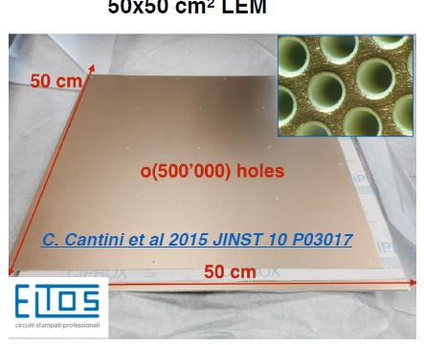
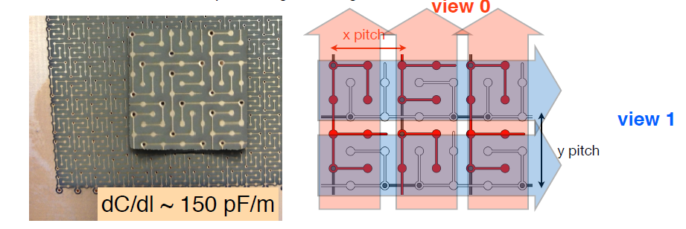
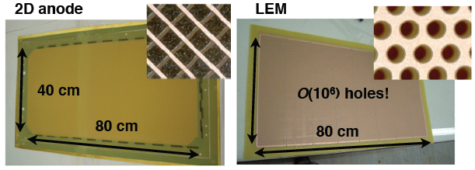
Dual-phase readout:
Long drift, high S/N: extraction of electrons from the liquid and multiplication with avalanches in pure argon with micro-pattern detectors like LEM (Large Electron Multipliers)
Tunable gain (~20 minimum), two symmetric collection views, coupling to cold electronics
Anode 0V
2 mm
Collection field 5 kV/cm
LEM (1mm)
25-35 kV/cm
GAr
Extraction field 2 kV/cm
1 cm
Grid
LAr
Drift field 0.5-1 kV/cm
500 um holes
800 um pitch
Anode PCB

Slide 3
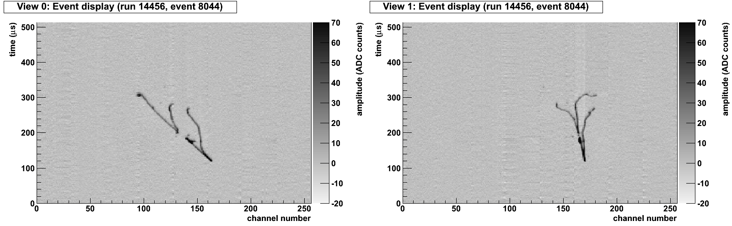
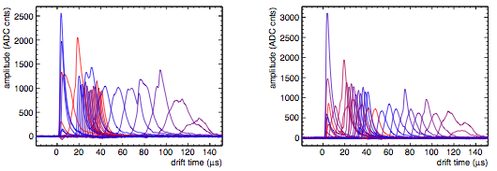
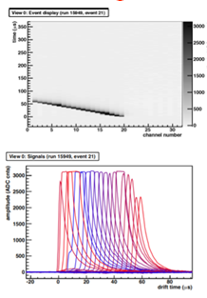
Dual-phase prototypes
measuring real data events since 6 years with active volumes from 3 to 250 liters:
> 15 millions of cosmic events collected in stable conditions
S/N~100 for m.i.p. achieved starting from gain ~15
3x1x1 m³ setup and 6x6x6 m³ DP ProtoDUNE at CERN
S/N≈100
S/N≈100
80cm
Collection
Collection
View x
View y
S/N≈800
Literature:
NIM A617 (2010) p188-192
NIM A641 (2011) p 48-57
JINST 7 (2012) P08026
JINST 8 (2013) P04012
JINST 9 (2014) P03017
JINST 10 (2015) P03017
Max achieved gain ~200

Slide 4
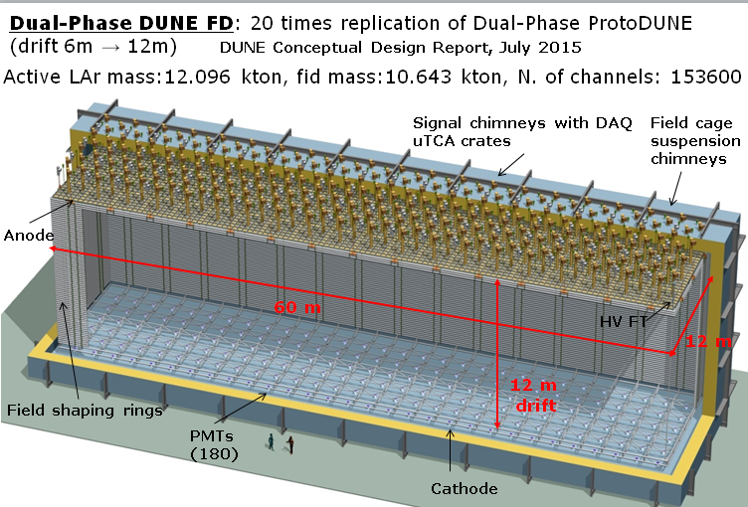
Dual-phase 10 kton FD module
80 CRP units
60 field shaping rings
240 signal FT chimneys
240 suspension chimneys
180 PMTs
153600 readout channels
Advantages of double-phase design:
Anode with 2 collection (X, Y) views (no induction views), no ambiguities
Strips pitch 3.125 mm, 3 m length
Tunable gain in gas phase (20-100), high S/N ratio for m.i.p. > 100, <100 KeV threshold, min. purity requirement 3ms → operative margins vs purity, noise
Long drift projective geometry: reduced number of readout channels
No materials in the active volume
Accessible and replaceable cryogenic FE electronics, high bandwidth low cost external uTCA digital electronics

Slide 5
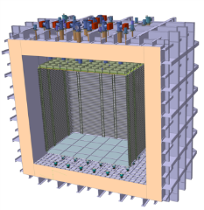
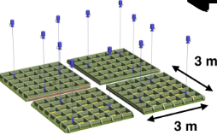
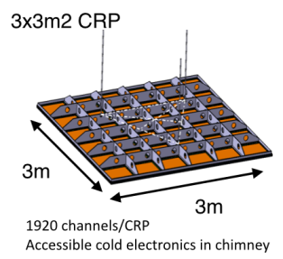
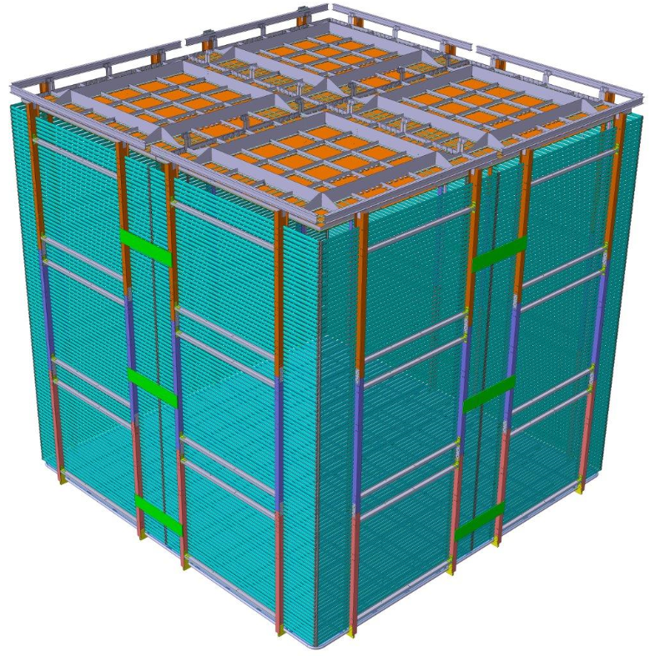
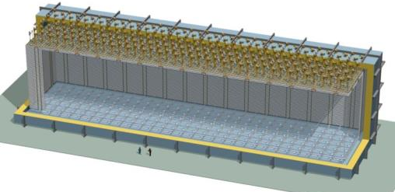
The Dual-Phase ProtoDUNE/WA105 6x6x6 m³ detector is built out of the same 3x3m² Charge Readout Plane units (CRP) foreseen for the 10 kton Dual-Phase DUNE Far Detector (same QA/QC and installation chains)
WA105: 4 CRP
10 kton: 80 CRP
6 m
12 m
6 m
6 m
60 m
5

Slide 6
Dual phase liquid argon TPC
6x6x6 m³ active volume
Event size: drift window of
7680 channels x 10000 samples ⇒ 146.8 MB
X and Y charge collection strips
3.125 mm pitch, 3 m long →7680 readout channels
Segmented anode
in gas phase with
dual phase amplification
3 m
E=0.5-1.0 kV/cm
Drift coordinate
6 m = 4 ms
sampling 2.5 MHz
(400 ns), 12 bits
10000 samples
per drift window
LAr volume
Drift
dE/dx → ionization
Prompt UV
light
6 m
6 m
Cathode
Photomultipliers
6

Slide 7
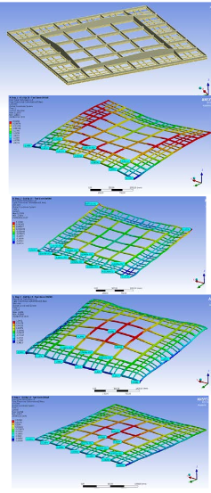
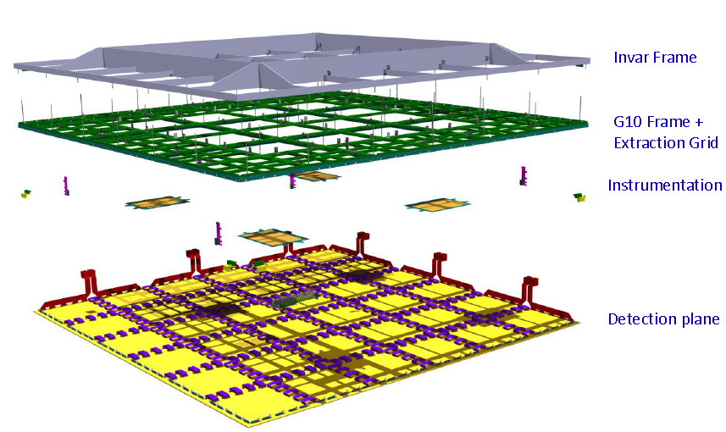
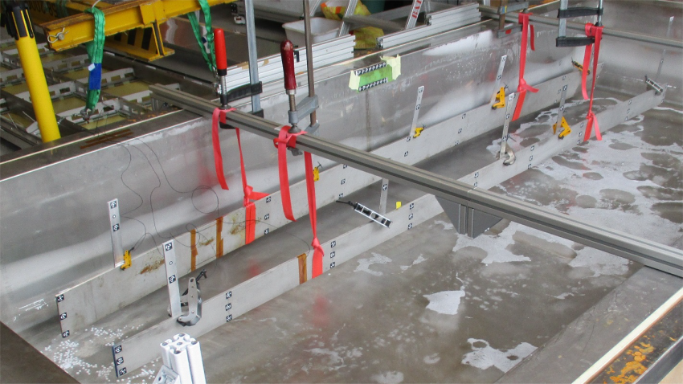
3x3 m² CRPs integrating the LEM-anode sandwiches (50x50 cm²) and their suspension feedthroughs
→ Invar frame + decoupling mechanisms in assembly in order to ensure planarity conditions +-0.5 mm (gravity, temperature gradient) over the 3x3 m² surface which incorporates composite materials and ensure minimal dead space in between CRPs
→See talks by
B. Aimard (CRPs) and A. Delbart (LEM-anodes production) in DP parallel session
CRP mechanical structure design:
→ campaign of cold bath tests + photogrammetry on differential effects in thermal contraction, design of decoupling mechanism

Slide 8
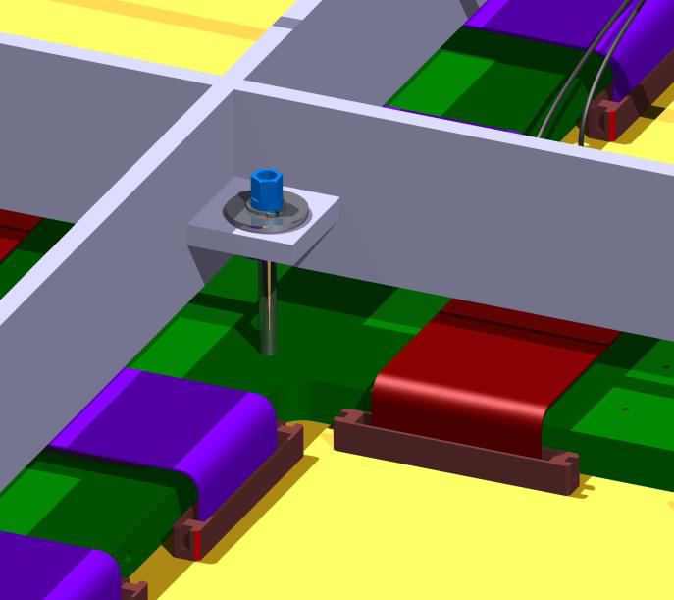
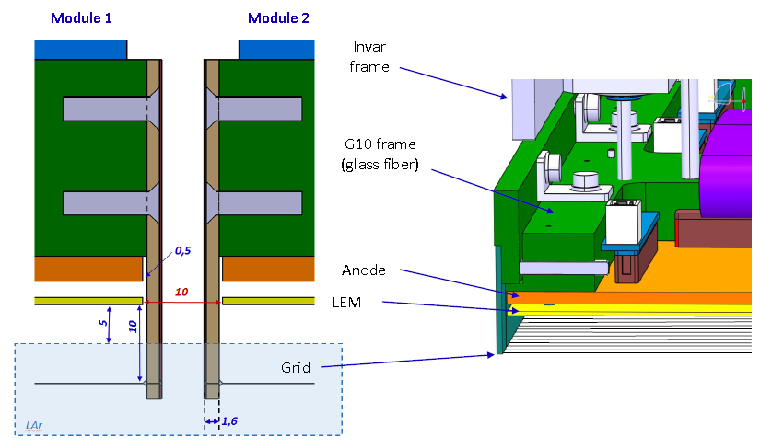
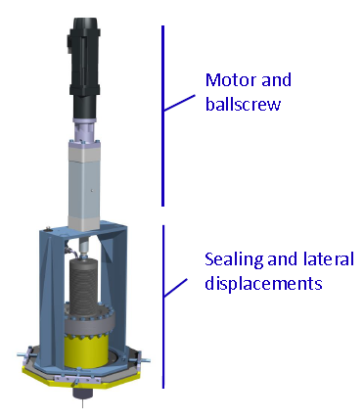
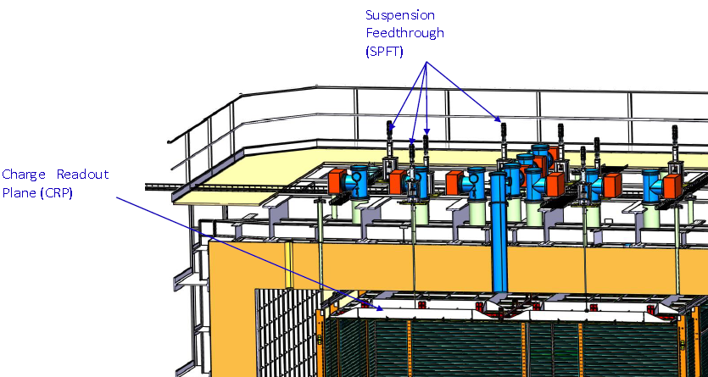
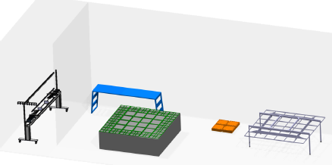
Thermal decoupling supports of G10 frame on invar frame
Integration of the grid of submerged extraction wires in the frame minimizing dead space in between CRPs. Tests for the wires system design
Suspension feedthroughs
Tooling, assembly and installation procedures defined → getting ready for production
CRPs

Slide 9
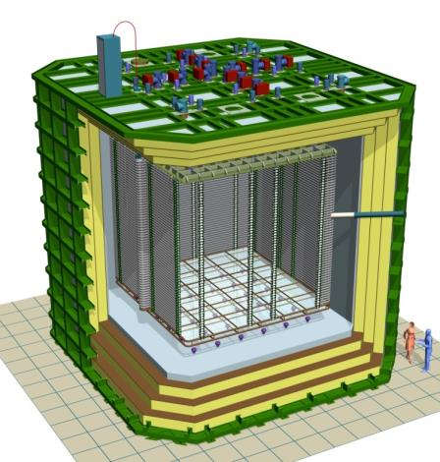
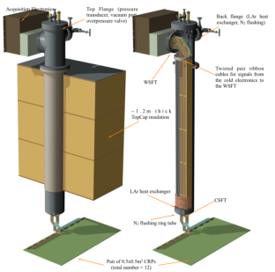


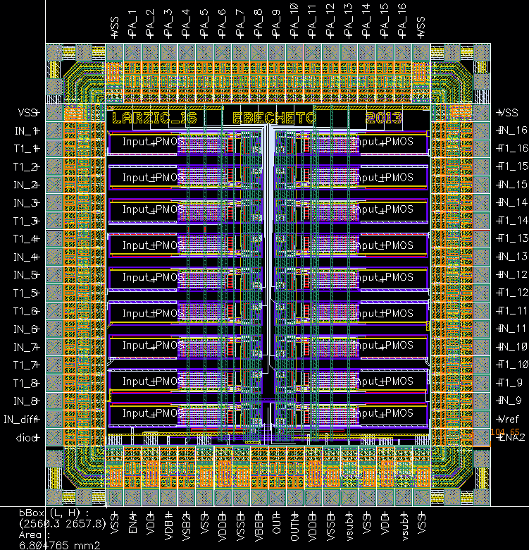
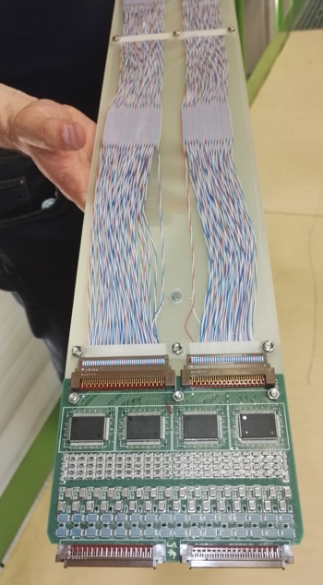
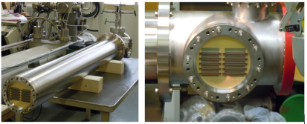
WA105 Accessible cold front-end electronics and uTCA DAQ system 7680 ch
Full accessibility provided by the double-phase charge readout at the top of the detector
Digital electronics at warm on the tank deck:
Architecture based on uTCA standard
1 crate/signal chimney, 640 channels/crate
→ 12 uTCA crates, 10 AMC cards/crate, 64 ch/card
Cryogenic ASIC amplifiers (CMOS 0.35um) 16ch externally accessible:
Working at 110K at the bottom of the signal chimneys
Cards fixed to a plug accessible from outside
→Short cables capacitance, low noise at low T
Warm
FE cards mounted on insertion blades
ASICs 16 ch.
(CMOS 0.35 um)
uTCA crate
Cold
CRP
Signal chimney
9

Slide 10
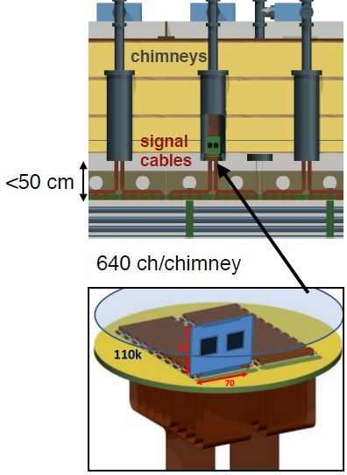
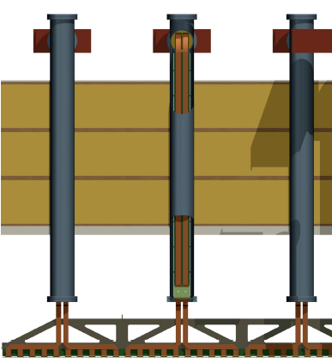
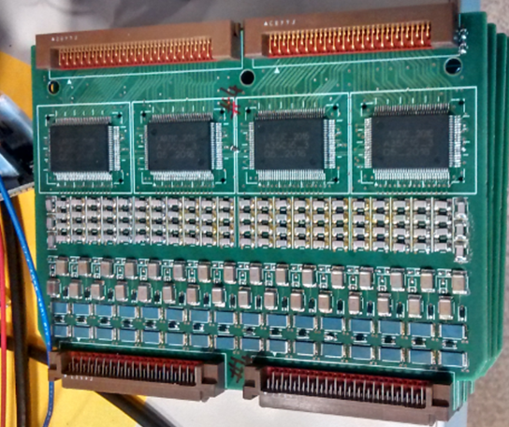
Cost effective and fully accessible cold front-end electronics and DAQ
Ongoing R&D since 2006→ in production for 6x6x6 (7680 readout channels)
ASIC (CMOS 0.35 um) 16 ch. amplifiers working at
~110 K to profit from minimal noise conditions:
FE electronics inside chimneys, cards fixed to a plug accessible from outside
Distance cards-CRP<50 cm
Dynamic range 40 mips, (1200 fC) (LEM gain =20)
1300 e- ENC @250 pF, <100 keV sensitivity
Single and double-slope versions
Power consumption <18 mW/ch
Produced at the end of 2015 in 700 units (entire 6x6x6)
1280 channels installed on 3x1x1
DAQ in warm zone on the tank deck:
Architecture based on uTCA standard
Local processors replaced by virtual processors emulated in low cost FPGAs (NIOS)
Integration of the time distribution chain (improved PTP)
Bittware S5-PCIe-HQ 10 Gbe backend with OPENCL and high computing power in FPGAs
Production of uTCA cards started at the end of 2015, pre-batch already deployed on 3x1x1
ASIC 16 ch.
CMOS 0.35um
Analog FE cards
(64 ch)
Large scalability (150k channels for 10kton) at low costs

Slide 11
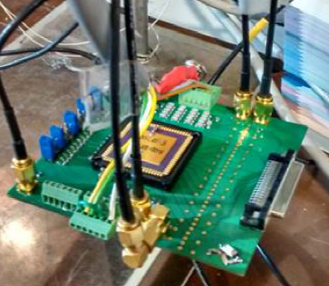
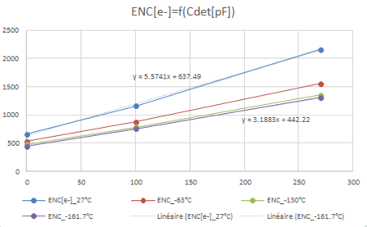
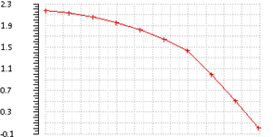

Cryogenic FE electronics :
Dual-slope ASICs final version
  16 channels
  Double slope gain with “kink” at 400 fC
  1200 fC dynamic range
(batch of 25 circuits) tested in January 2016, fully satisfactory. Full production for 6x6x6 produced and purchased (700 chips).
~log regime up to 1200 fC
Kink at 400 fC
~13 mip with LEM gain = 20

Slide 12

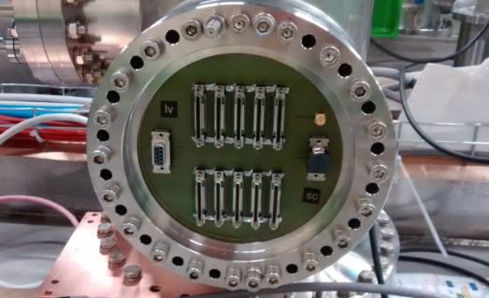
FE-cards designed in 2016 together with chimneys warm flanges PCBs
20 FE cards (1280 channels) produced and installed on 3x1x1 pilot detector at CERN
Warm flange PCB with VHDCI connections to uTCA crate for digitization

Slide 13
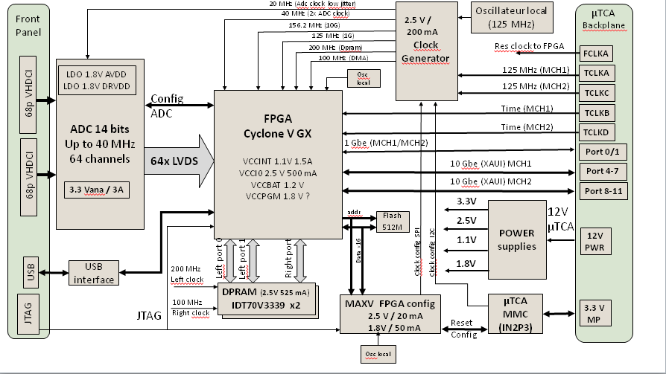

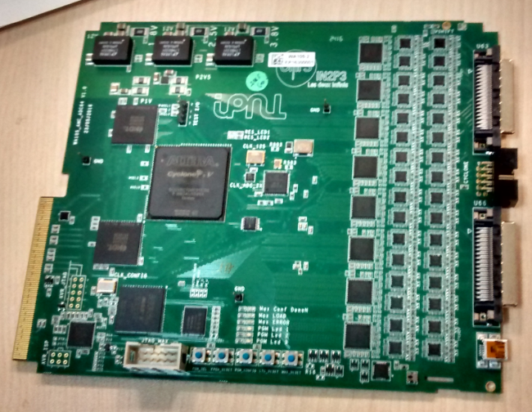
uTCA DAQ system:
64 channels AMC digitization cards (2.5-25 MHz, 12 bits output, 10 GbE connectivity
Demonstrator card with 64 ADC channels built and tested in 2015 for the definition of the final card
Purchase of main components (ADCs, FPGAs, IDT memories) of the final cards by end of 2015 to equip the entire 6x6x6
Final design of digitization PCBs May 2016
First assembled cards received in August 2016.
20 cards produced by September 2016 to equip the 3x1x1
Cards production going to be completed with the 2017 budget of remaining 100 FE and uTCA cards for 6x6x6 (main components available)
The warm flange PCB design is based on an extension of the ones of the 3x1x1

Slide 14
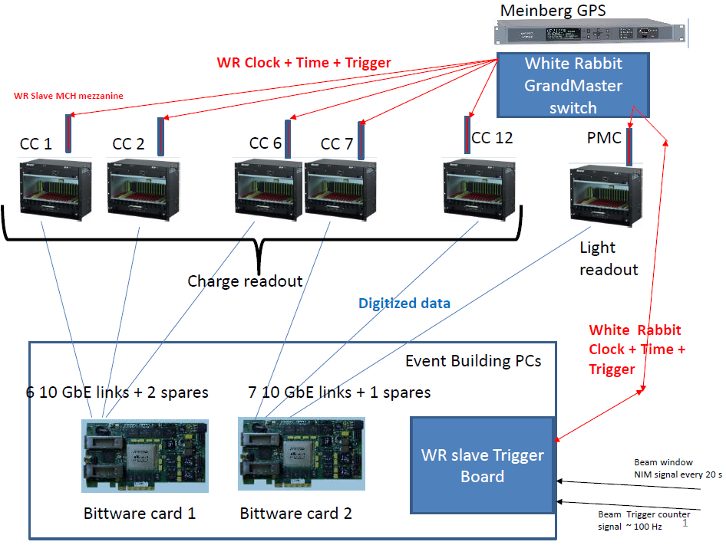
Global uTCA DAQ architecture
integrated with « White Rabbit » (WR) Time and Trigger distribution network
+ White Rabbit slaves nodes in uTCA crates +
WR system (time source, GM, trigger system, slaves)

Slide 15
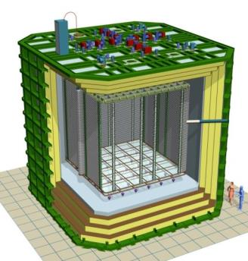
DAQ timing-trigger integration
uTCA crate of LRO
x12 Charge readout WR links
Trigger counter
Cosmic muon
Start of spill signal (cable)
External trigger plane
for cosmics
Light
Crate with NIM logic
PMTs
for light readout
PC with WR time stamping card
Time stamps:
Beam trigger
Start of spill
External cosmic trigger
Calibration pulses
Light readout WR link
WR switch
(optical links 1 Gbps)
Beam triggers from SPS
Tertiary beam line ~100Hz

Slide 16
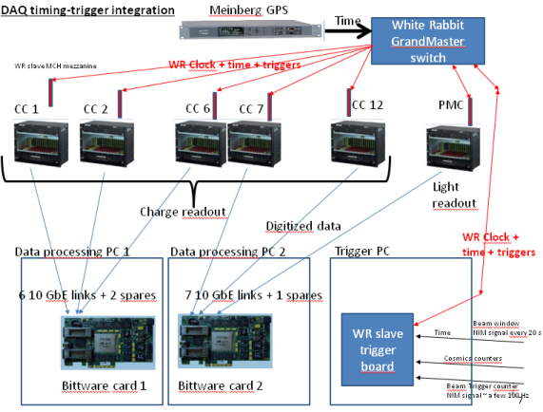
Beam instrumentation
detectors
electrical signals
VME crate for beam DAQ
NIM crate for trigger logic
Beam trigger logic signals
SPS start of spill
WR card
WR network
Beam instrumentation DB
Protune-DP offline or online processing
Beam data
output
queries

Slide 17
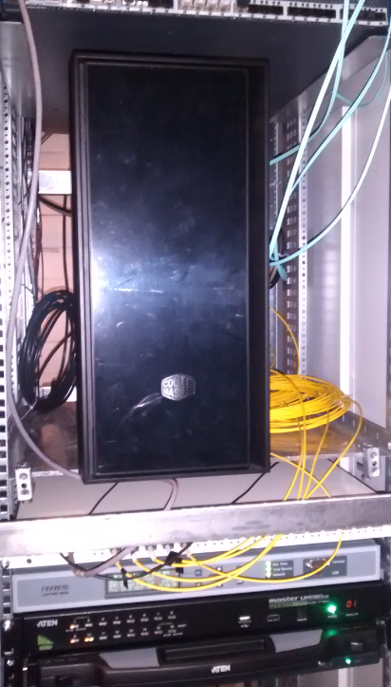
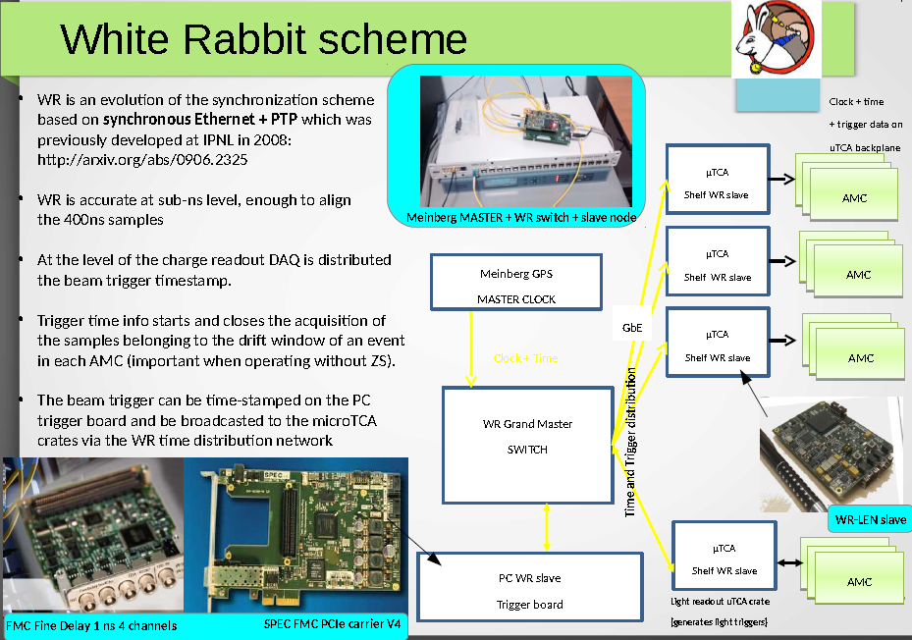
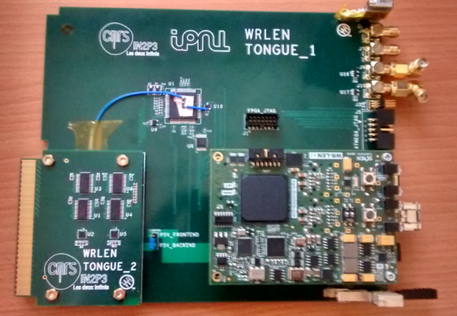
White Rabbit trigger time-stamping PC (SPEC + FMC-DIO)
White Rabbit Grand-Master
GPS unit
White Rabbit uTCA slave node based on WRLEN developed and produced for entire 6x6x6
Other components of the chain (GPS receiver, WR grandmaster, SPEC+ FMC-DIO + 13 WRLEN ) available commercially

Slide 18
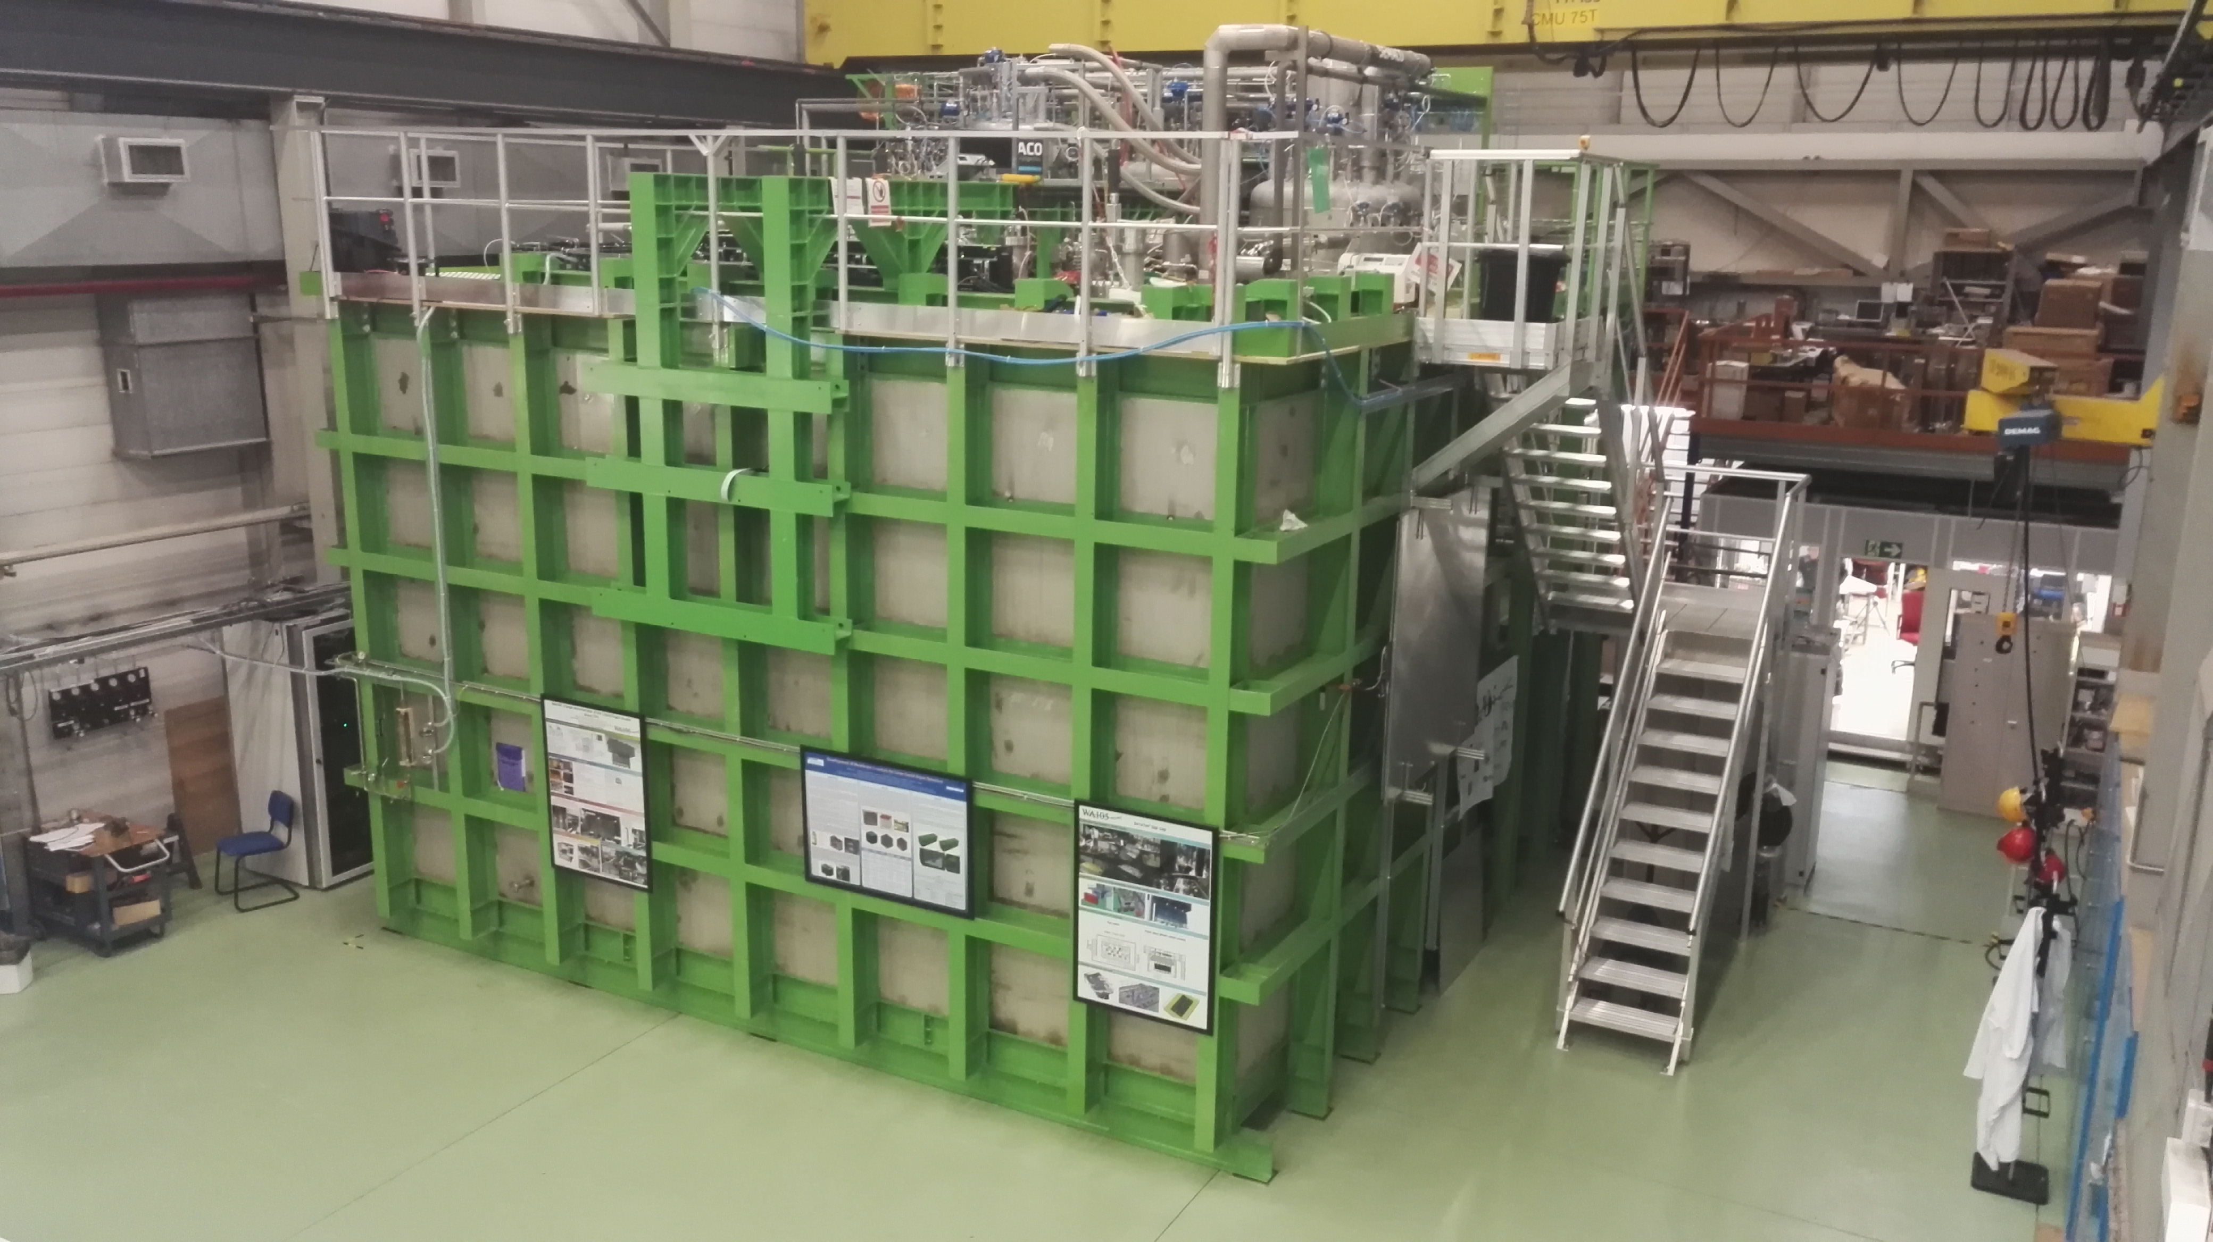
6x6x6: 12 uTCA crates (120 AMCs, 7680 readout channels)
3x1x1: 4 uTCA crates (20 AMCs, 1280 readout channels)
Event builder, network, GPS/White Rabbit GM,
WR Trigger PC
Signal Chimneys and uTCA crates

Slide 19
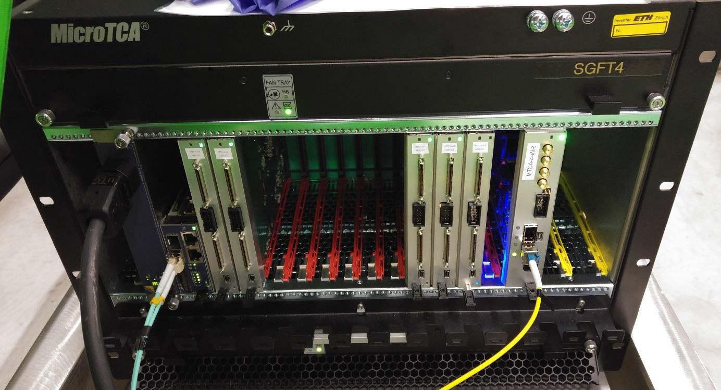
How a crates was looking like before VHDCI signals cabling to the warm flange
WR uTCA slave
card node with WRLEN mezzanine
MCH
AMC 64 channels
digitization cards
10 Gbit/s data link
White Rabbit optical link

Slide 20
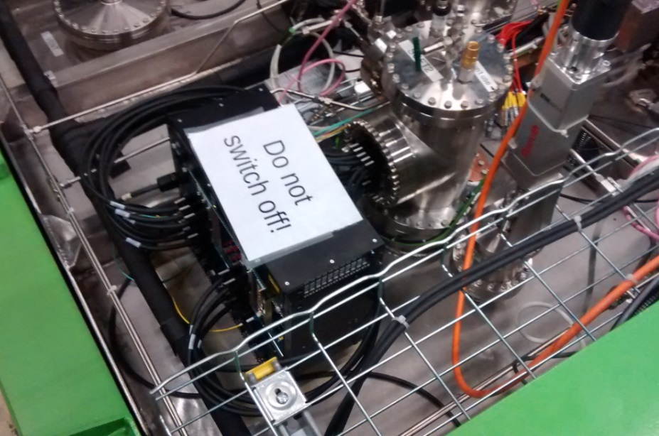
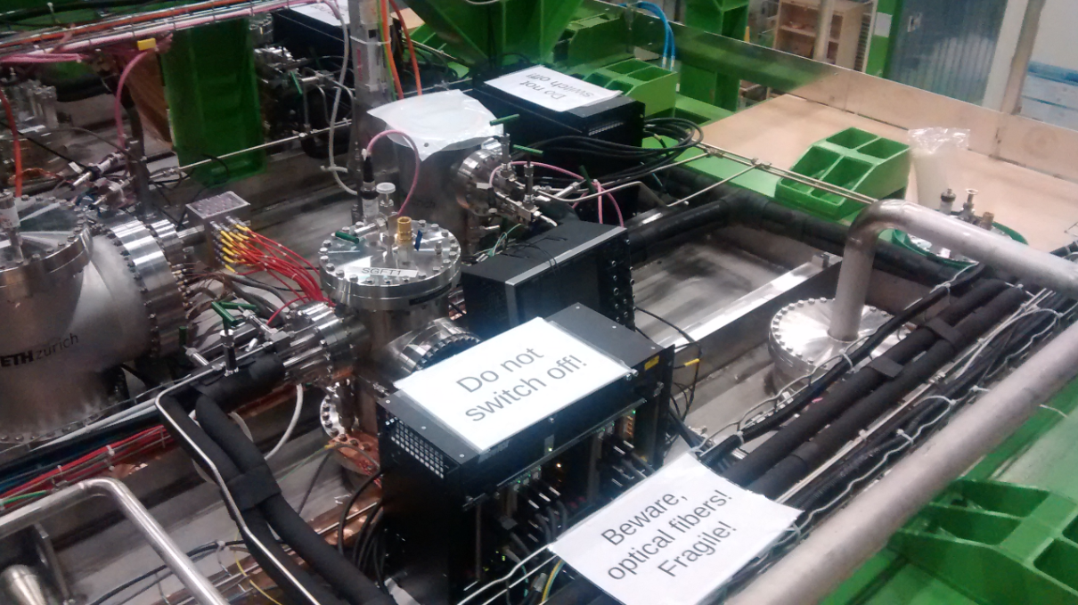
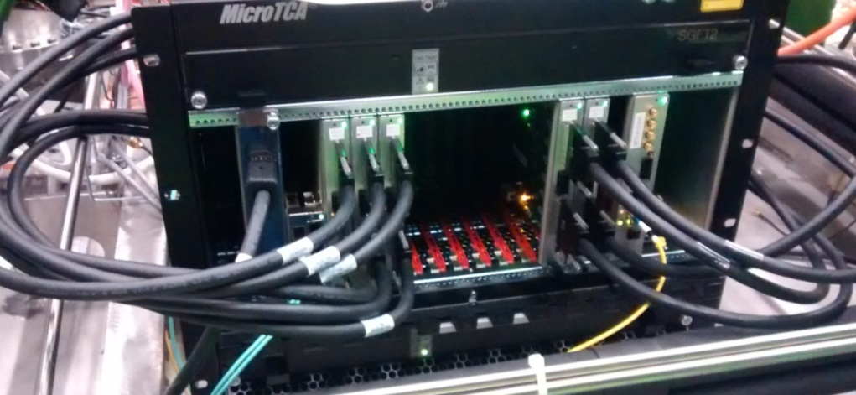
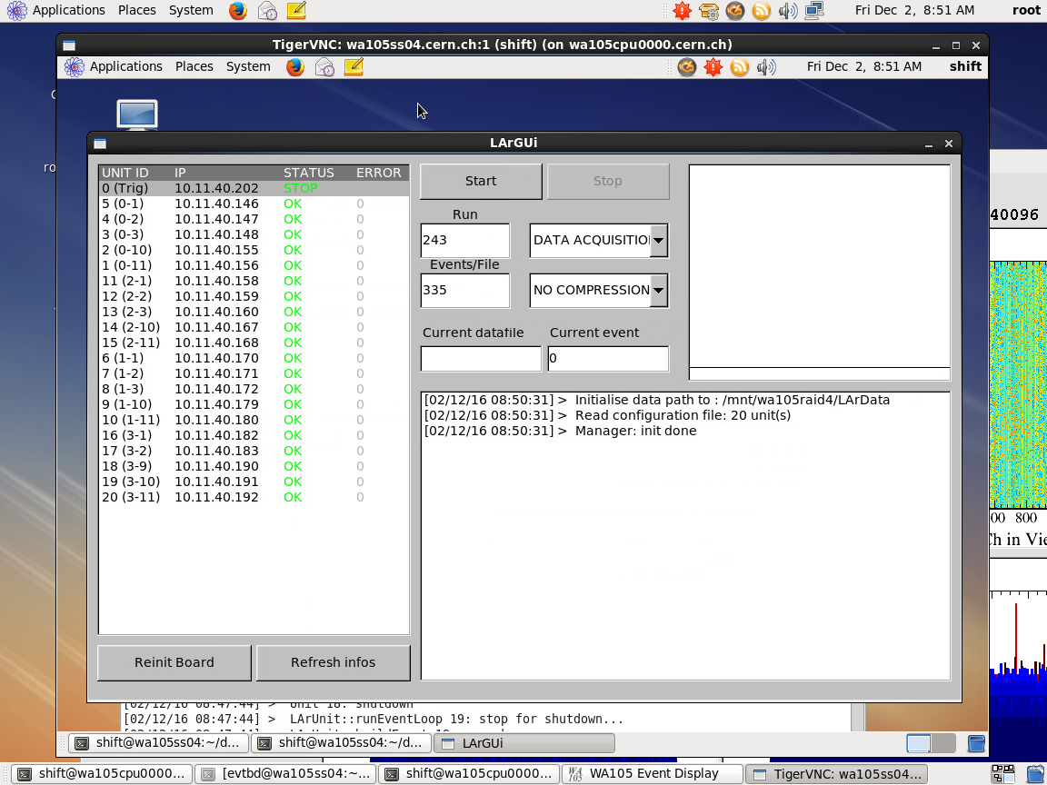
Top cap picture with uTCA crates cabled to signal chimneys
Run control with 20 AMCs
Automatic data processing on online storage/processing farm for purity and gain analysis + data transfer on EOS
Stable system, noise conditions at warm 1.5-1.7 ADC counts RMS

Slide 21
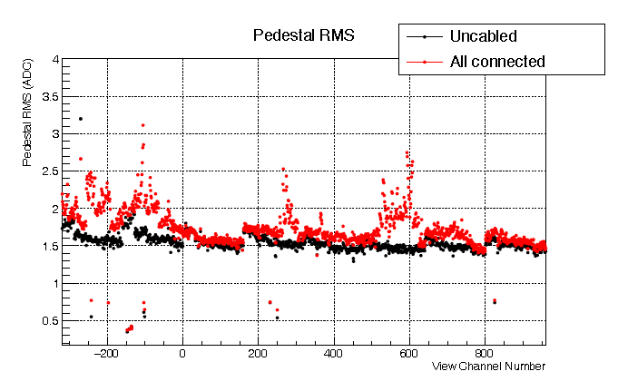
Several campaigns of checking of the grounding conditions/noise measurements since June 2016.
Good noise conditions with some residual small issues related to slow-control/HV grounding and cabling
→ Average RMS noise 1.7 ADC counts (0.82 mV) at warm with all systems active and cabled 1.5 ADC counts with slow control/HV cables disconnected from flanges
The grounding scheme for the 6x6x6 is more sophisticated with the cryostat, FE electronics and slow control completely insulated from external environment and only referred to cryostat ground.

Slide 22
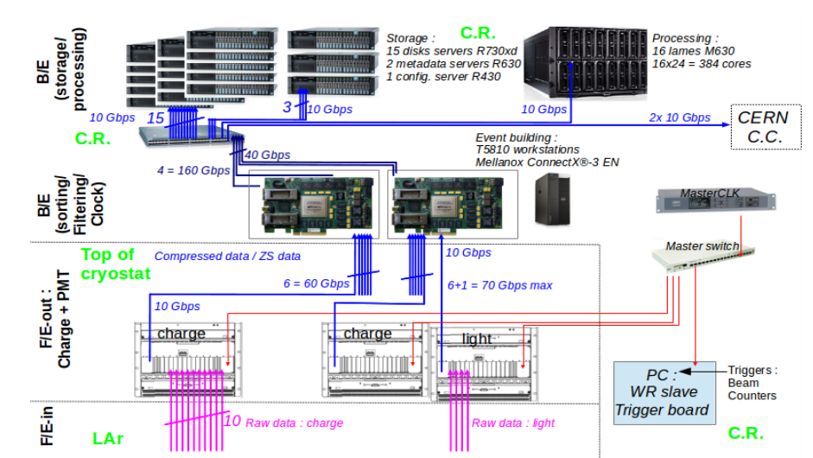
Online processing and storage facility: internal bandwidth 20 GB/s, 1 PB storage, 384 cores: key element for online analysis (removal of cosmics, purity, gain, events filtering)
C.R. stands for Counting Room

Slide 23


First design of online storage/processing DAQ back-end farm performed in 2016 (1PB, 300 cores, 20Gb/s data flow),
Smaller test scale system already installed and operative for 3x1x1
Tests to finalise the architecture of final online storage/processing facility.
Thanks to CERN/IT support

Slide 24

Typical event signature for ground surface Liquid Ar TPC operation
For each beam trigger we can have on average 70 cosmics overlapped on the
drift window after the trigger (these cosmics may have interacted with the detector in the
4 ms before the trigger and in the 4 ms after the trigger → chopped tracks, “belt conveyor” effect
Example of cosmics only event
(in one of the views)

Slide 25
Typical event signature for ground surface Liquid Ar TPC operation
drift
The « belt conveyor » effect
+- 4 ms around the beam trigger time
t=beam trigger - 2 ms
t=beam trigger → reconstructed event
drift
t=beam trigger
t=beam trigger + 2 ms
reconstructed event
25

Slide 26

During spills it is needed a continuous digitization of the light in the +-4 ms around the trigger time (the light signal is instantaneous and keeps memory of the real arrival time of the cosmics)
→ Sampling can be coarse up to 400 ns just to correlate to charge readout
→ Sum 16 samples at 40MHz to get an effective 2.5 MHz sampling like for the charge readout
The LRO card has to know spill/out of spill
Out of spill it can define self-triggering light triggers when “n” PMTs are over a certain threshold and transmit its
time-stamp over the WR

Slide 27
Conclusions:
Intensive developments on charge readout and dual-phase during the last years
Large scale charge readout system already implemented on the 3x1x1 prototype
Looking forward to the final demonstration with the 6x6x6 protoDUNE-DP at CERN

