Slide 1
High rate and fine space resolution RPCs operated with eco-gases
G. Aielli for the WP13.2.3 collaboration
Aida kickoff meeting - CERN – 4/6/2015

Slide 2
Motivations tasks and strategy
Almost 10000 RPCs have been installed for the experiments at LHC (Alice, ATLAS, CMS)
An established standard: Gas, Material, Internal structure.
A new challenge: a new generation of RPCs for HL-LHC and beyond
Inherit the overall simplicity in the new standard
We target at a new level of performance in (non necessarily at the same time):
  Rate capability → tens of kHz/cm^2
  6x packing factor for installing in narrow spaces
  Space-time resolution up to → 0.2 ns x 100 μm
  Ability to run with inexpensive and eco-compatible gases
The strategy: strong integration of detector and electronics
  A new generation of FE electronics, based on SiGe transistors
  Inexpensive high performance low power FE from Amplifier to the TDC
This opens a wide parameter space in the detector design and now exploitable

Slide 3
Task organization within the WP
Sub-Task13.2.3
Sub-Task MPGD
ECOGAS
CERN
INFN-TO
U Gangneung-Wonju
INFN-LNF
Sub-Task RPC
Industrial production
Sub-Task RPC
Precision mechanics
INFN-TOV
HIGH SPACE RESOLUTION
INFN-BA
MPI-Munich
NEW GENERATION GAPS
INFN-BO
15.5.4 GIF++
enhancement

Slide 4
Task table
Activity | Institute | Main focus | Facility
Eco-Gas | INFN-TOV | Charge distribution vs. mixture | CR test +High grade electronics setup
 | INFN-LNF | Precise analysis of the gas mix | CR test + gas chromatograph
 | INFN-TO | Non flammable gas mix – ALICE case | Large area large acceptance CR test
 | GangneungWonju | New mixtures on MRPCs | MRPC test setup
 | CERN | An eco compatible gas system | CERN gas group lab and GIF++
New RPCs | INFN-TOV | Optimize more gap layouts for high rate and resolution | Detector construction and test workshop.
 | INFN-BA | New materials and procedures | By the RPC production companies
 | INFN-BO | The ATLAS case and GIF++ CR trigger | CR test station
High Space resolution | INFN-TOV | High grade large size faraday cage | Detector construction and test workshop.
 | MPI Munich | High grade mechanics | Detector construction site

Slide 5
Overall planning
Full test of a New RPC with recirculated eco-gas M13.2
Chemical analysis after irradiation
Start of recirculating ageing test at GIF++
Identify one or few gas mixtures with good performance under cosmic test
2015
2016
2017
2018
2019
High rate and performance of low spatial resolution chambers
ATLAS/CMS/ALICE new prototypes test
High resolution prototype working at high rate
Optimization of large-size precise RPC structures D13.3
High rate High resolution, large surface test

Slide 6
Research of a new gas mixture
The European Community has prohibited the production and use of gas mixtures with Global Warming Power > 150 (GWP(CO2) = 1)
  This is valid mainly for industrial (refrigerator plants) applications
  Scientific laboratories would be excluded
  CERN could require to stick to these rules anyhow
C2H2F4 is the main component of the present RPC gas mixture:
  GWP(C2H2F4) = 1430, GWP(SF6) = 23900, GWP(iC2H10) = 3.3
  C2H2F4 and SF6 Crucial to ensure a stable working point in avalanche
To test molecules similar to C2H2F4 but with lower GWP
  See http://arxiv.org/abs/1505.00701v1 for a review
HFO=1234ze (1,3,3,3-Tetrafluoropropene) has been identified as a possible choice
State of the art:
“new RPC gas mixtures for large area apparatuses” Presented at RPC14 workshop by B. Liberti and Published on JINST: R. Cardarelli et al. JINST 9 C11003 doi:10.1088/1748-0221/9/11/C11003
“A study of HFO-1234ze (1,3,3,-Tetrafluoropropene) as an eco-friendly replacement in RPC detectors. : L.Benussi et al. http://arxiv.org/abs/1505.01648

Slide 7
Eco Gas progress
Several results have been published as proceedings of the RPC2016 conference (authors have been reminded to authors AIDA2020 logo…)
Common ATLAS-CMS effort
Start to see promising gas candidates to have a sufficient streamer free operation point
B. Liberti et al.
D. Piccolo et al.

Slide 8
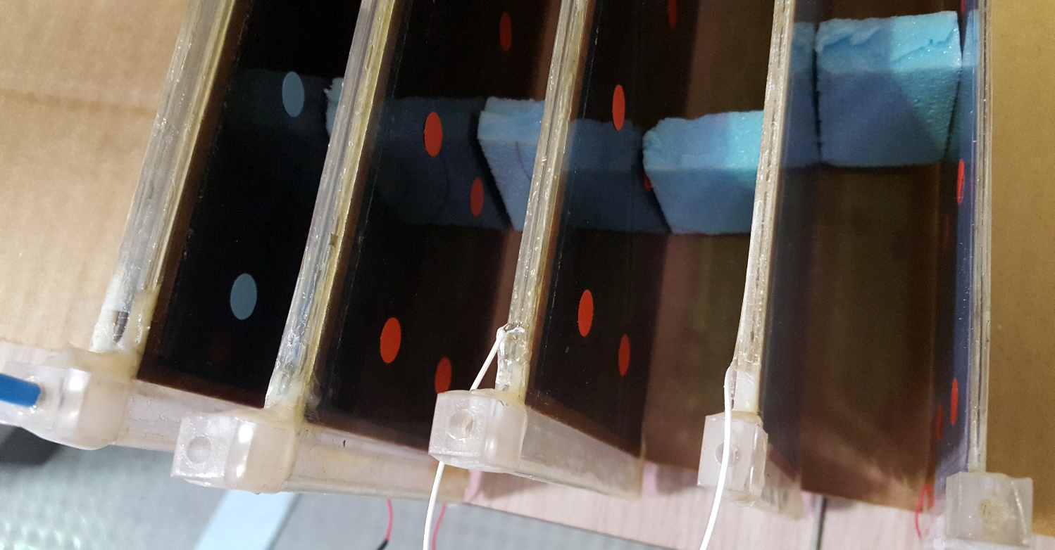
Further R&D for Phase2
Thinner gas gaps for higher rate and time resolution → systematic comparison between 2 mm, 1 mm, 0.5 mm
Thinner electrodes with respect to ATLAS and CMS (1.8 and 2 mm)
Tested 1.2 mm and 0.8 mm
New materials for the electrodes under study (phenolic glass)
Better mechanical properties, same resistivity as bakelite…
Systematic tests ongoing

Slide 9
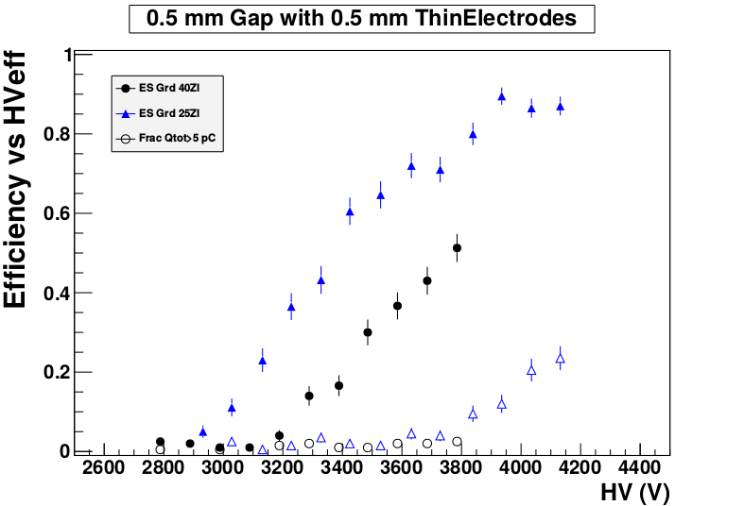
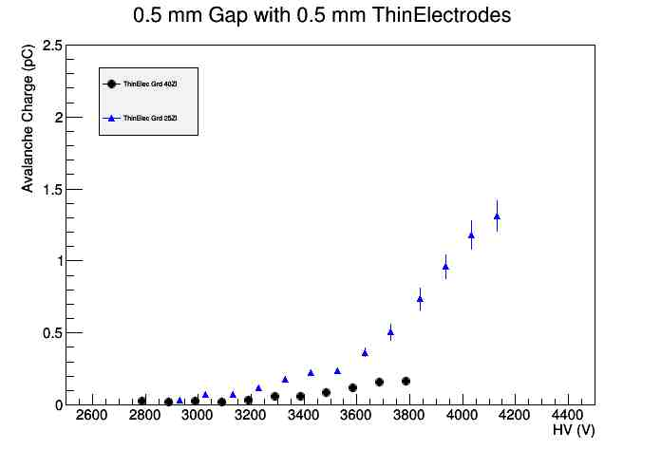
Pure phenolic glass Efficiency vs HV
Pushing classic RPC to the limit
Prompt charge comparison vs HV
4 mm foam plates separates the gas volume from the readout stripe
fraction of charge exceeding 5 pC
4 mm foam plates separates the gas volume from the readout stripe

Slide 10
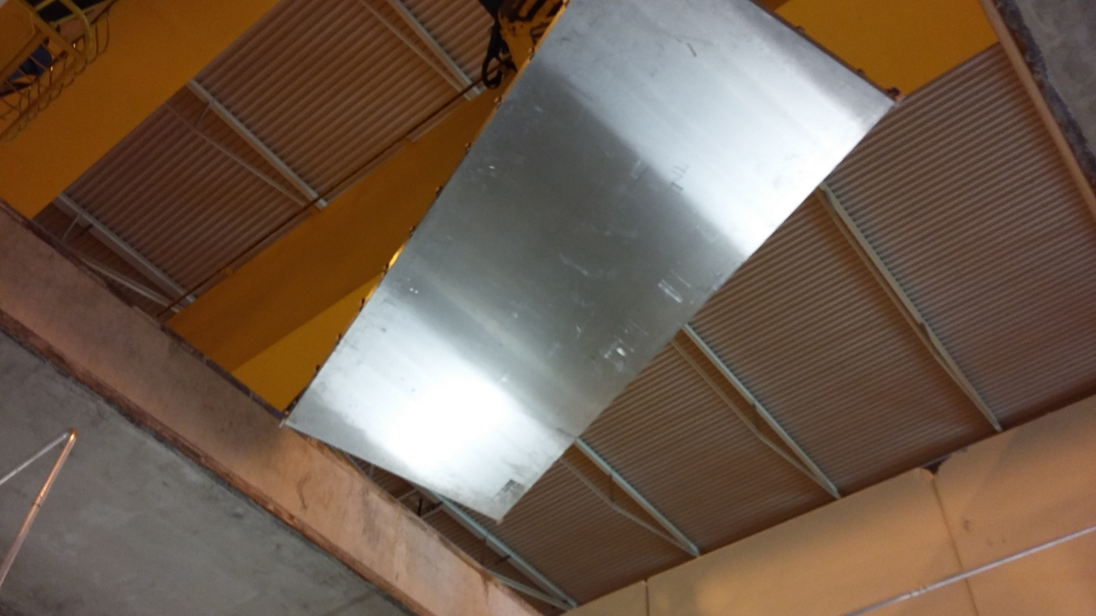
A new generation of RPCs is coming…

Slide 11
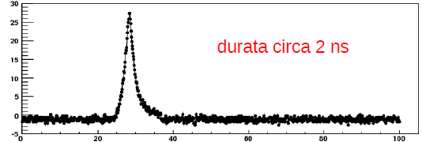
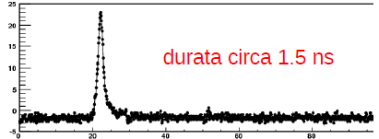
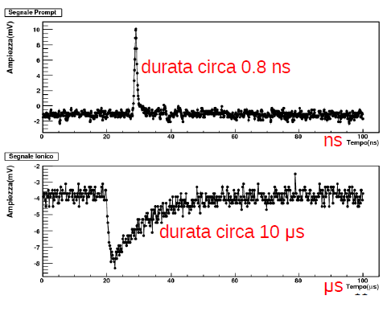
A new generation of RPCs
R&D themes and initiatives
Form Factor: exploring gap and electrode thickness and segmentation
  Thinner gas gap → better timing, position, lower thickness
  Thinner electrodes → better S/N, lower weight
  Multi-gap → better efficiency, timing, charge spectrum
High spatial resolution readout:
  Form factor optimization→ higher signal localization
  High grade Faraday cage → allows sensitive FE
  Charge through ToT → charge centroid
New FE concept:
  New design: Fast, sensitive and low capacitance noise
  Si-Ge technology: extremely low noise and high speed
Amplitude (mV)
Duration about 3 nsec
2mm
Time (nsec)
Amplitude (mV)
Duration about 1.7 nsec
1mm
Time (nsec)
Amplitude (mV)
Duration about 1.0 nsec
0.5 mm
Time (nsec)

Slide 12
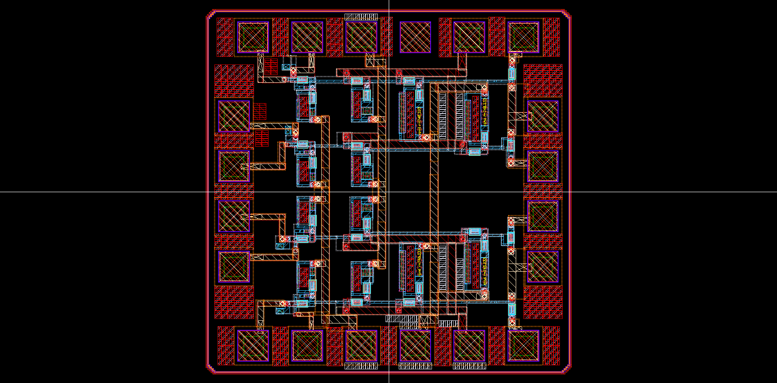
The new FE electronics
High sensitivity to increase the rate
High time precision for charge readout and meantimer functions

Slide 13
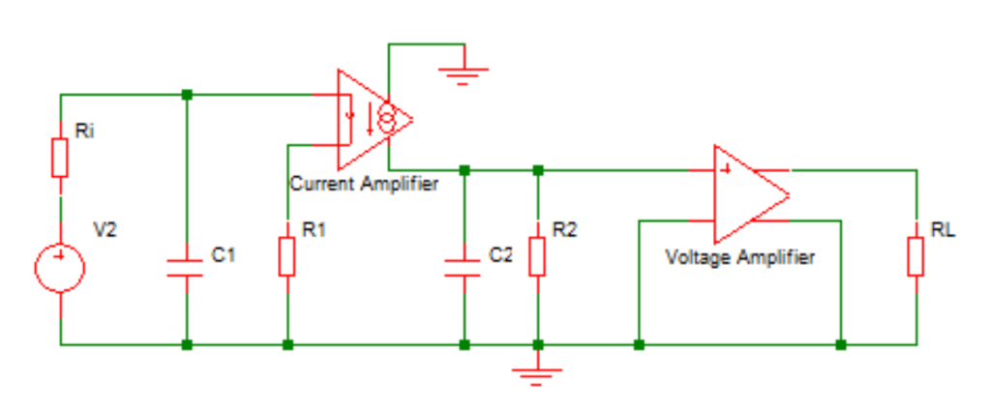
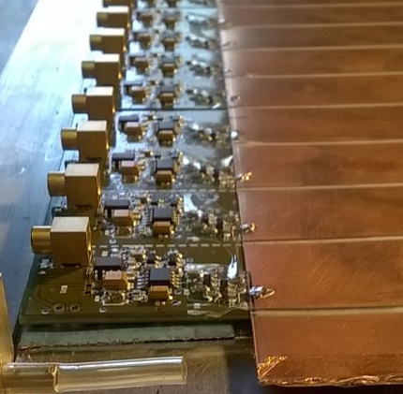
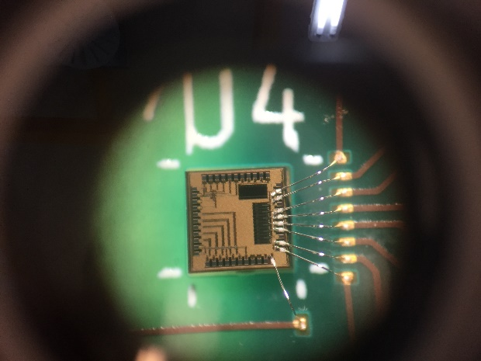
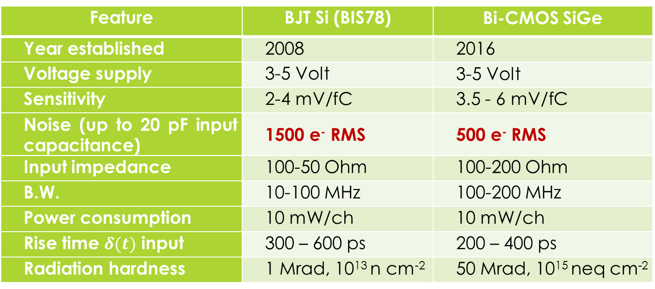
The new Amplifier
Feature | BJT Si (BIS78) | Bi-CMOS SiGe
Year established | 2008 | 2016
Voltage supply | 3-5 Volt | 3-5 Volt
Sensitivity | 2-4 mV/fC | 3.5 - 6 mV/fC
Noise (up to 20 pF input capacitance) | 1500 e⁻ RMS | 500 e⁻ RMS
Input impedance | 100-50 Ohm | 100-200 Ohm
B.W. | 10-100 MHz | 100-200 MHz
Power consumption | 10 mW/ch | 10 mW/ch
Rise time $δ(t)$ input | 300 – 600 ps | 200 – 400 ps
Radiation hardness | 1 Mrad, 10¹³ n cm⁻² | 50 Mrad, 10¹⁵ neq cm⁻²
Test IC produced and tested on Diamond and Silicon

Slide 14
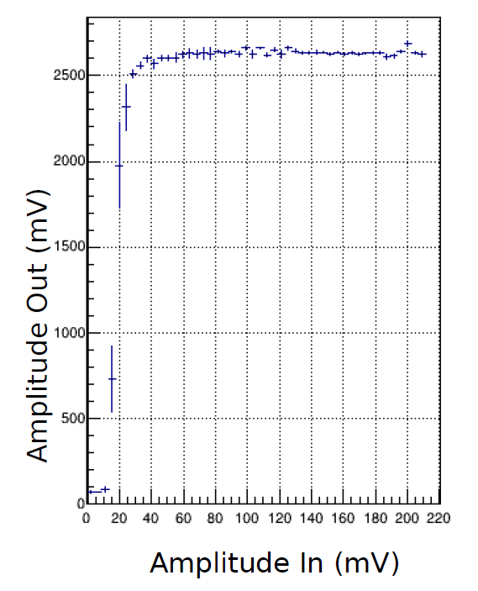
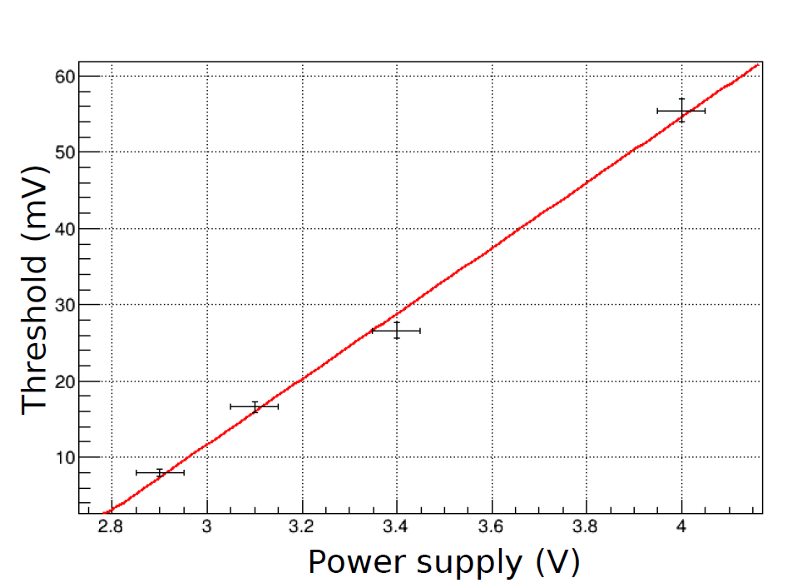
A new discriminator

Slide 15
RPC FE electronics for Phase1 projects
Final prototype FE boards
Layer 1 : In, Components, Amplifier and Discriminator
Layer 2 : Analogic Ground plane
Layer 3 : Amplifier/Discriminator connection and TTL Output
Layer 4 : Digital Ground plane

Slide 16
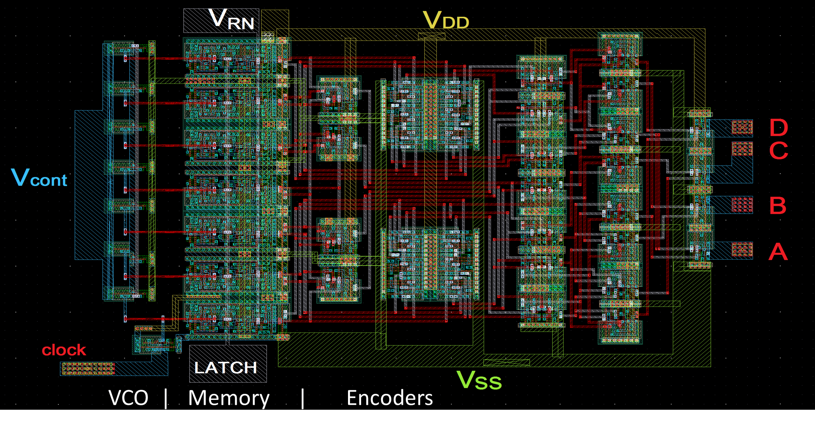
A new Full custom TDC

Slide 17
TDC development
Why a new TDC? Nothing suitable found on the market
This TDC is a multipurpose circuit suitable for fast devices and developed within an independent project by R. Cardarelli.
Scheduled for RPC upgrade, Silicon PET scanners,
Three foundry run performed.
Achieved:
  4 channels TDC
  30 pS; 1 mW/channel
Next steps:
  Integrate Analog and digital part (Amplifier-discriminator-TDC)
  Multichannel final prototype
Ultimate goal: 1 ps TDC ~1mW/channel

Slide 18
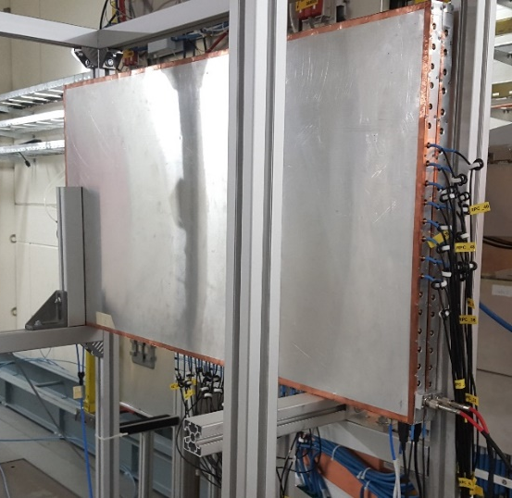
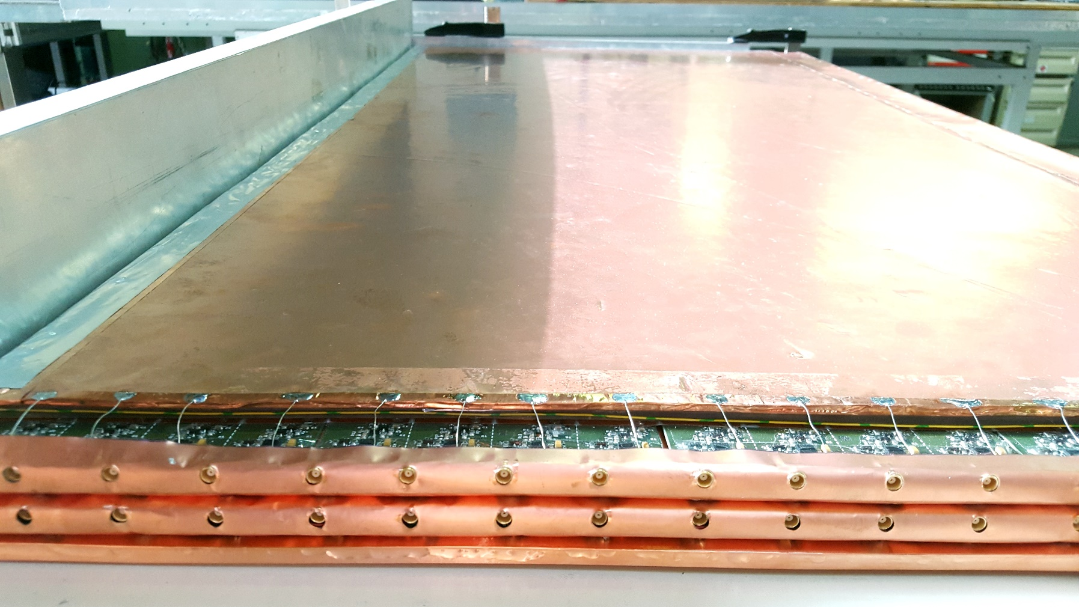
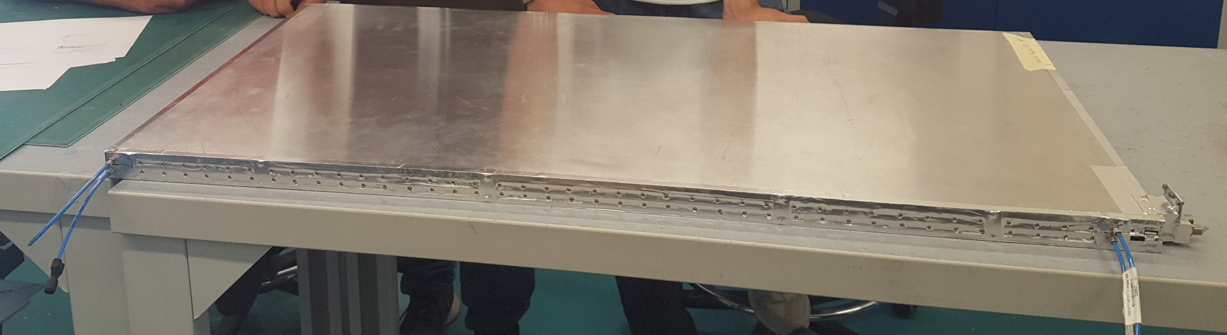
High rate test on a multiplet
From 2 singlets
Intermediate size 50 x 100 cm^2 singlets with full X-Y readout → 2x X-Y doublet
A crucial test: Inner Faraday cages independency
35 mm total thickness all in
Tested gap cross talk < 10⁻⁴
Gas gap: 1 mm
Electrodes: 1.2 mm
Y
X

Slide 19
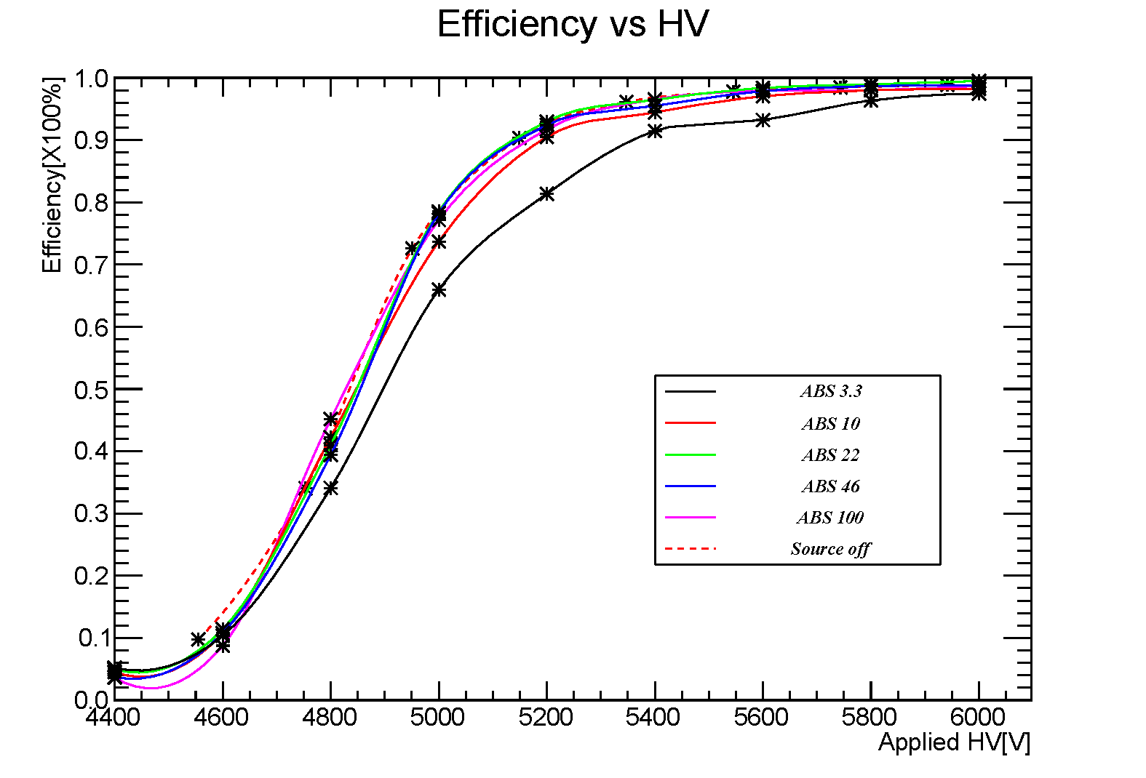
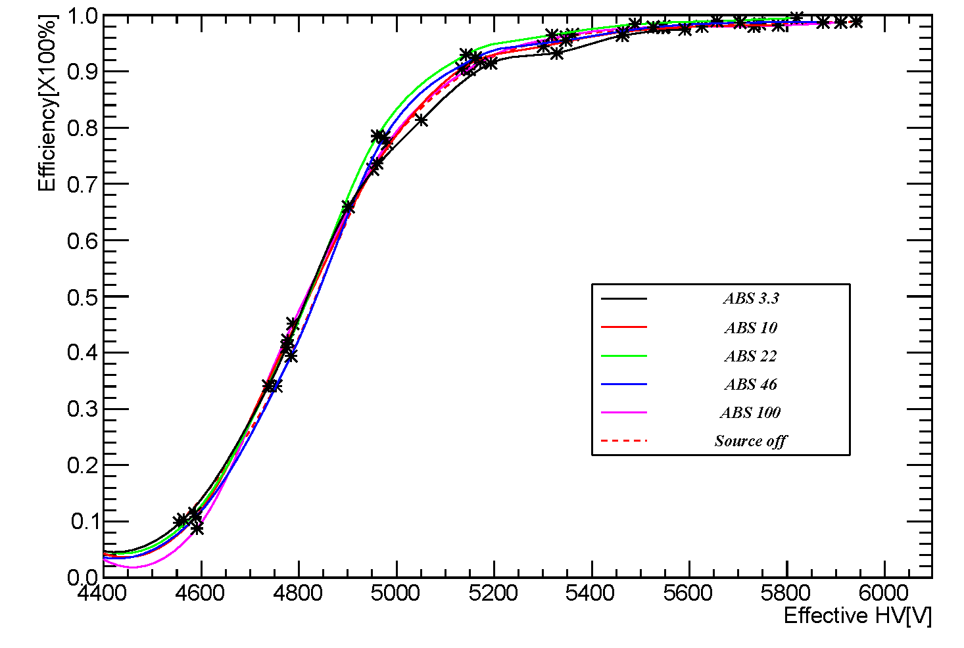
Efficiency at high rate
Trigger from 2 scintillators 12x12 cm^2
Use 1 chamber as monitor and calculate the efficiency of the other chamber.
An efficient hit must be correlated in time (20 ns) and space (+- 1 strip) with the monitor hit on both x-y views
Analysis debugged and results improved !
~ HL-LHC background
~7*HL-LHC background
5400V is an excellent working point (95% eff.)

Slide 20
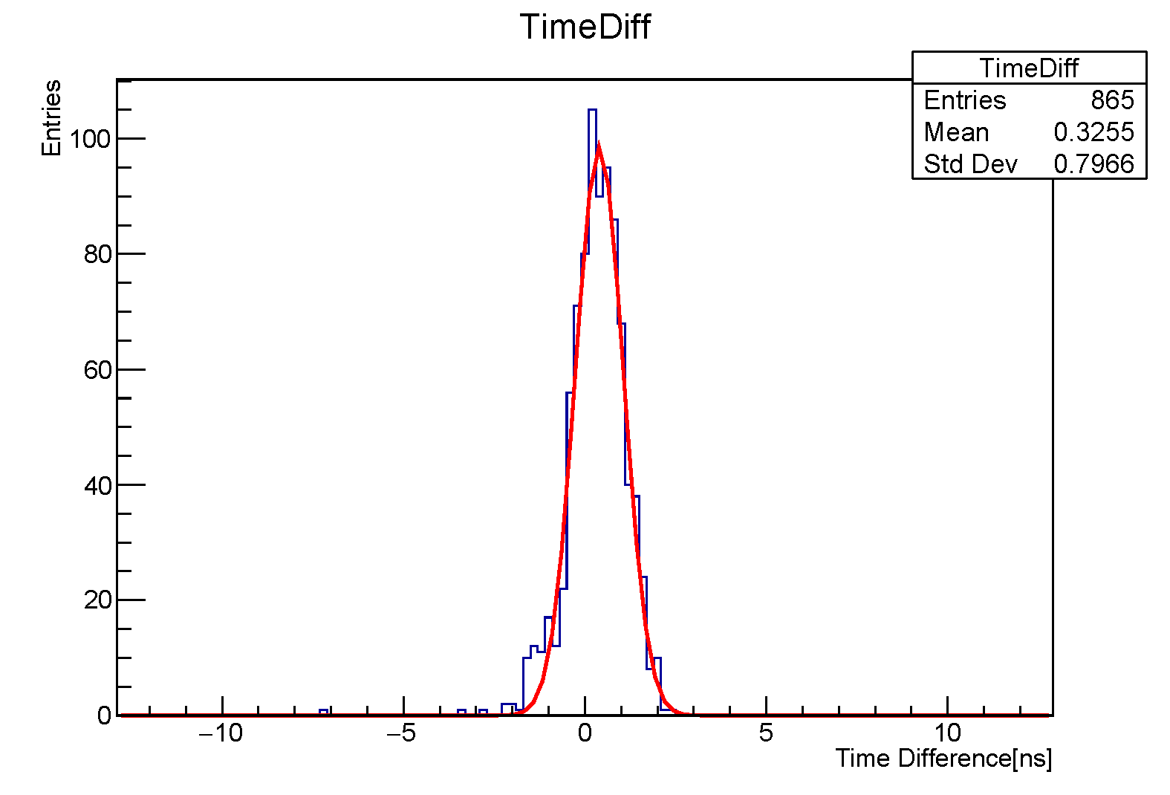
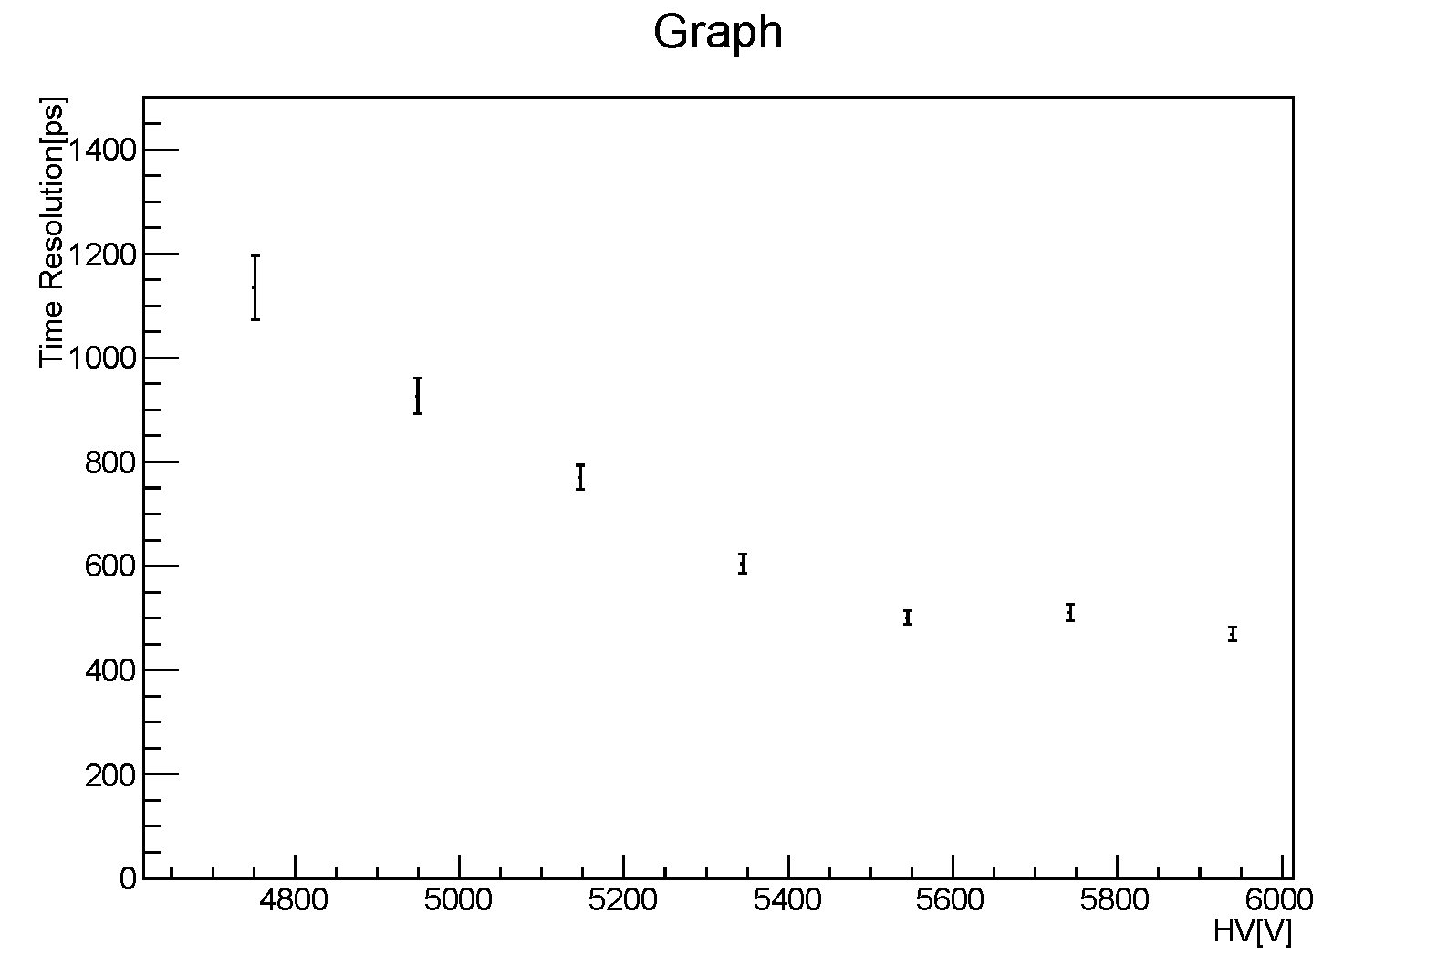
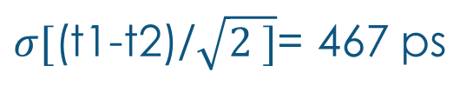
Time resolution at high rate
$σ[$(t1-t2)/$\sqrt{2 ]}$= 467 ps
The hv in time resolution is corrected by temperature and humidity.
Time diff is at 6000 V without source.
No skew correction and no channel calibration applied

Slide 21
Efficiency VS HV

Slide 22
Cluster Size VS HV(no time cut is applied)
Δt

Slide 23
Cluster Size VS HV(4ns time cut is applied)

Slide 24
Cluster Size VS HV(3ns time cut is applied)

Slide 25
Cluster Size VS HV(2ns time cut is applied)

Slide 26
Cluster Size VS HV(1.5ns time cut is applied)

Slide 27
Cluster Size VS HV(1ns time cut is applied)

Slide 28
Cluster Size VS HV(0.7ns time cut is applied)

Slide 29
Simulation of the readout panel
A major effort is required in redesigning the new readout panel
An extensive simulation is needed systematically exploring a vast parametric space including (non exhaustive list):
  Strip pitch
  Strip distance
  Strip inner segmentation
  Guard wire
  Dielectric thickness
  Dielectric permittivity
  Strip termination
  Presence of orthogonal readout strips
  Distance of the strips
  Resistive electrode thickness
  Resistive electrode material
  Gas gap width
  Graphite thickness
A collaboration can be created to:
setup a MW Studio simulation
Produce and test prototypes

Slide 30
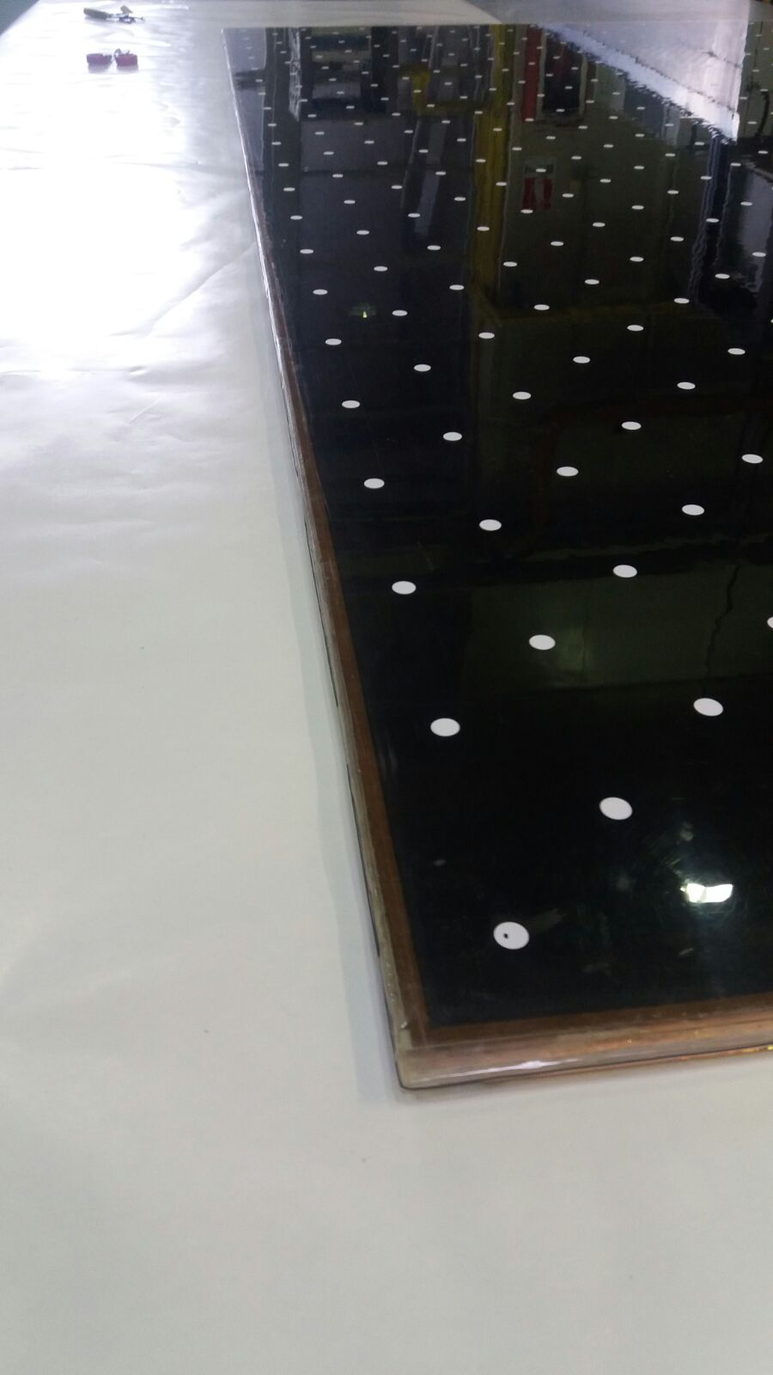
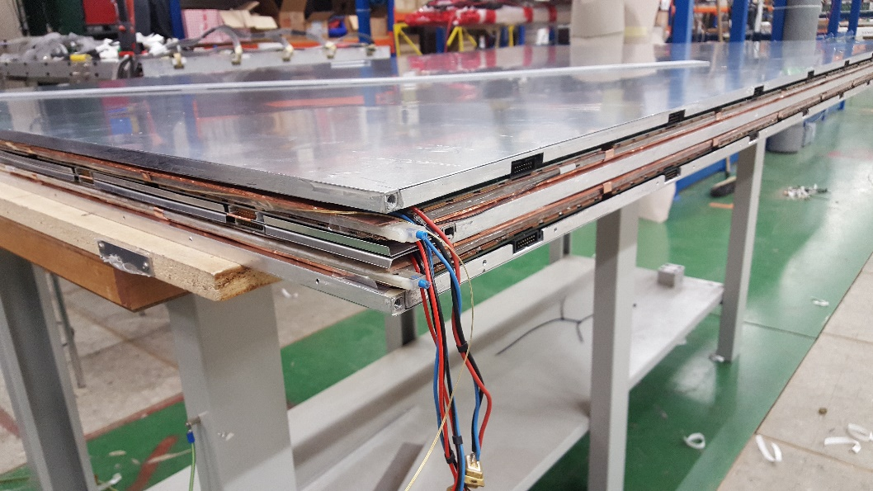
Large prototypes in ATLAS
The gas gap current behaves very well
8 large size gaps have been produced
1 mm gas gap
1.2 mm electrodes
180X100 cm^2
Two real ATLAS stations assembled and installed in sector 13
This is a large scale test of the new gap technology
BME chamber
BME gas gap

Slide 31
Status of AIDA-2020 WP 13.4.1
Preparation for large series production: large-detector size preserving mechanical precision
Hubert Kroha
Max-Planck-Institut für Physik, Munich
AIDA 2020 Annual Meeting, Paris, 05.04.2017

Slide 32
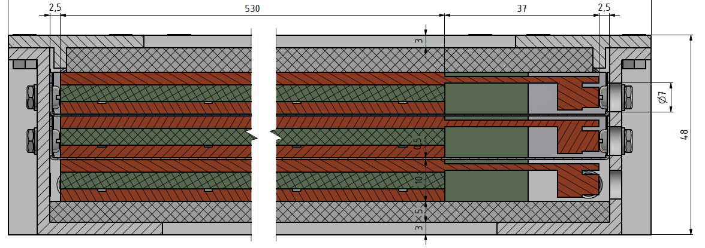
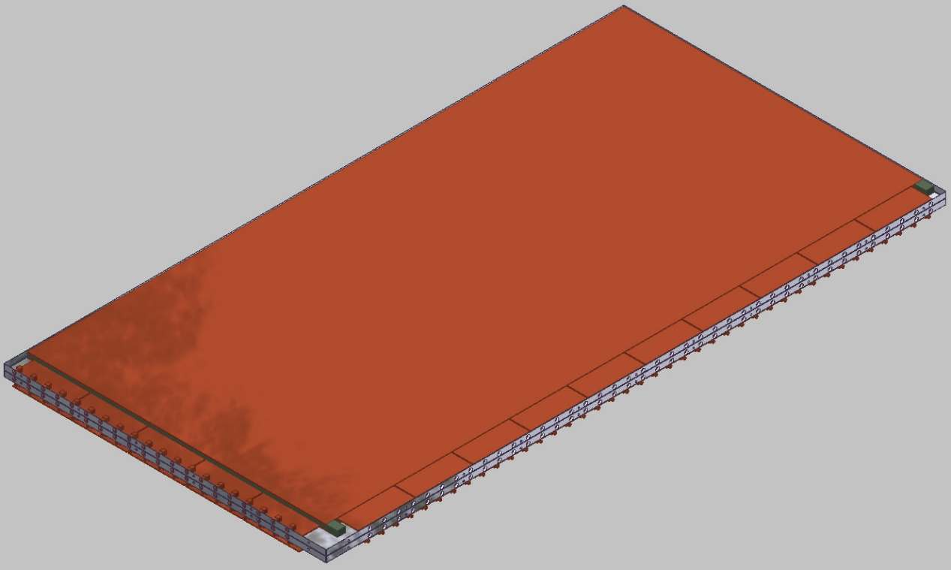
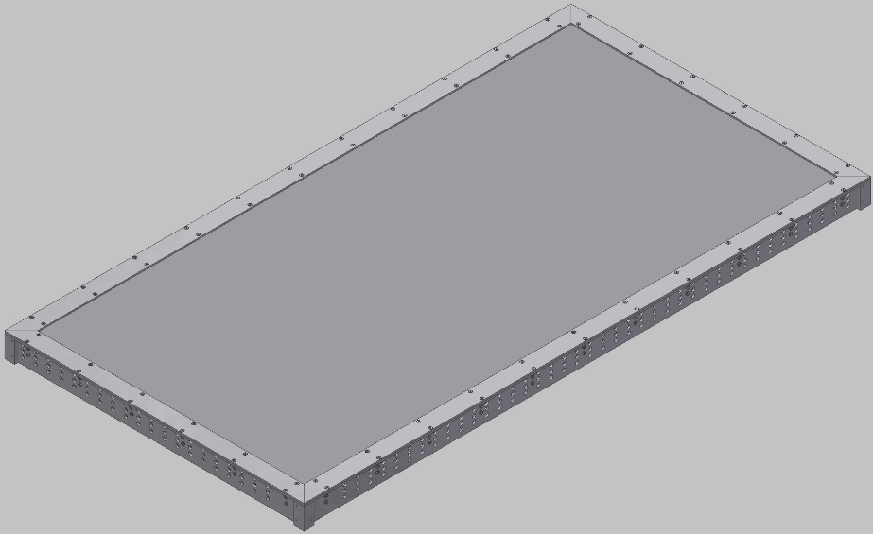
Thin-Gap RPC Prototype Design and Assembly
Triplet of thin-gap RPCs with 1mm gas gap in support frame and Faraday cage with only 48 mm overall thickness as needed for the ATLAS muon detector for HL-LHC.
Design of prototype chamber optimised and completed in 2016.
Prototype assembly is in progress:
Mounting of gas gaps with readout strip panels and electronics produced by Univ. Rome II into the Faraday cage and support structure.

Slide 33
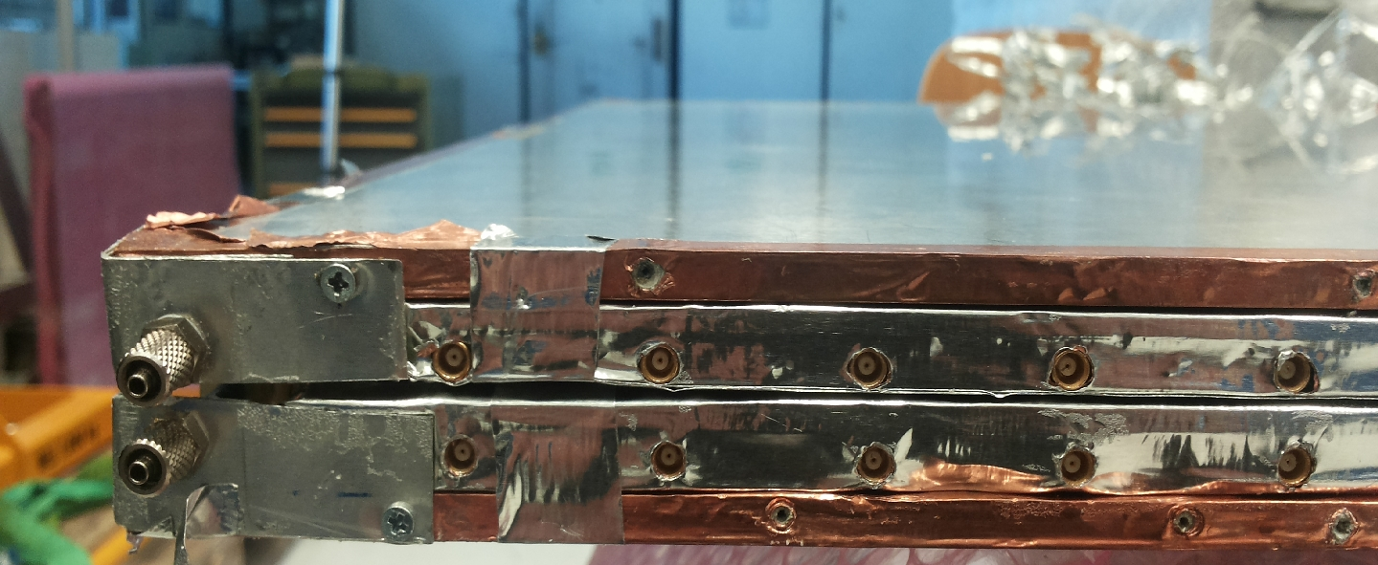
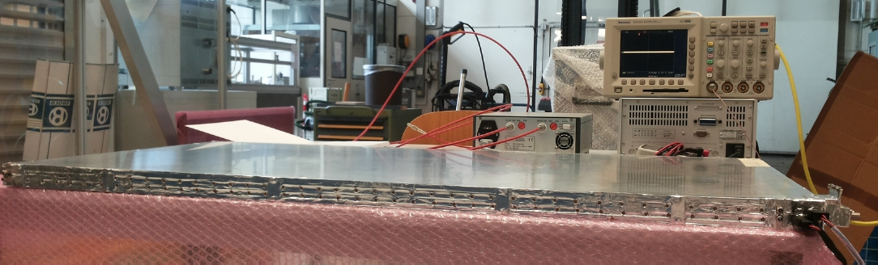
Prototype Assembly and Test
Thin-gap RPC gas gap test and preparation for triplet prototype assembly at MPI.

Slide 34
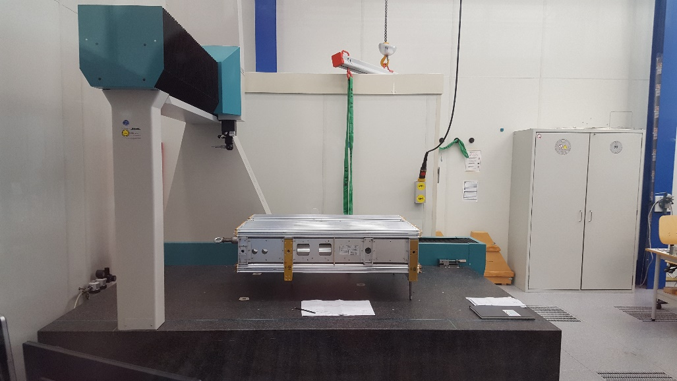
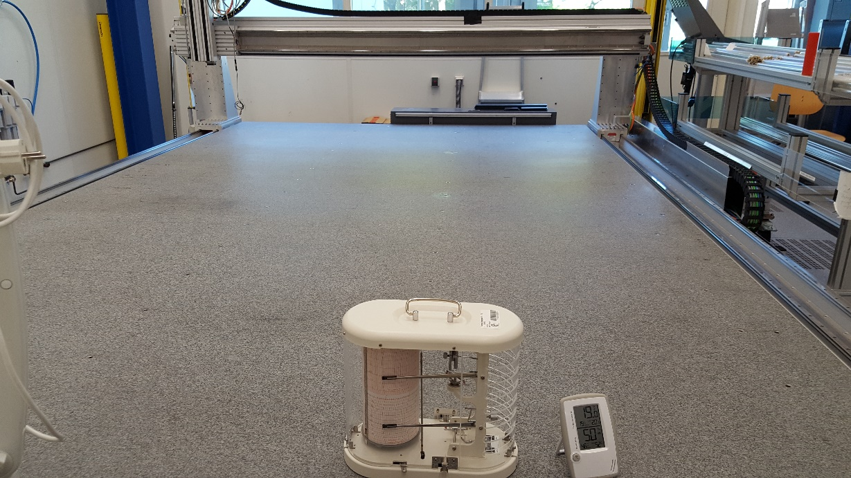
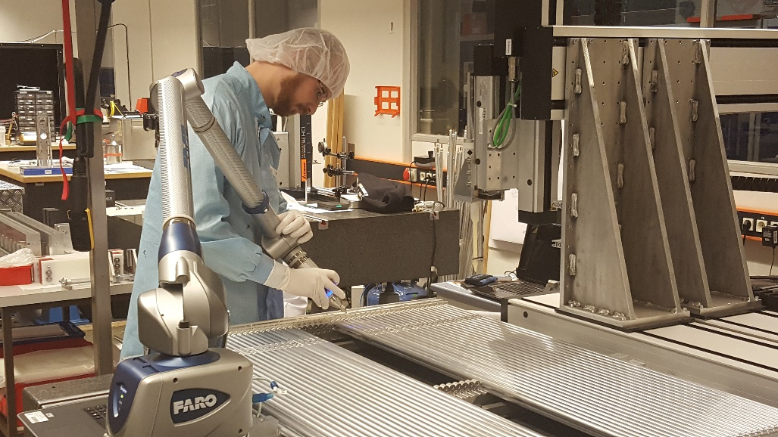
Preparation for Assembly of Large Chambers
Clean room with large (4.5 m x 2.5 m), precise (5 μm) granite table with x-y-z glueing machine (left) and
large (2 m x 1.5 m x 1m) coordinate measuring machine and other measuring equipment (right)
ready for assembly and measurement of large, thin RPCs and micro-pattern gas detectors.

Slide 35
Conclusions and Schedule
Work package on schedule
Task | 2015 |  |  |  | 2016 |  |  |  | 2017 |  |  |  |  |  | 2018
1 Design
2 Prototype assembly & mech. test
3 Electronics test
4 Testbeam
5 Design optimisation
6 Testbeam
7 Design optimisation

Slide 36
BACKUP

Slide 37
Research framework and resources
Part of this research subjects are co-founded by:
  INFN R&D program for HL-LHC RPCs, which involves the Italian groups
  ATLAS/CMS/ALICE respective upgrade programs
It will exploit the already existing facilities of the associated institutes for test and prototype construction purposes
It will exploit the GIF++ facility both as users and as developers
It will benefit of the results of an existing R&D program focused on the development of a next generation FE for fast detectors (e.g. RPCs, solid state, etc), which is a pre-requisite for many aspects of the proposed research
Gangneung-Wonju National University will benefit Korean matching fund for AIDA-2020

Slide 38
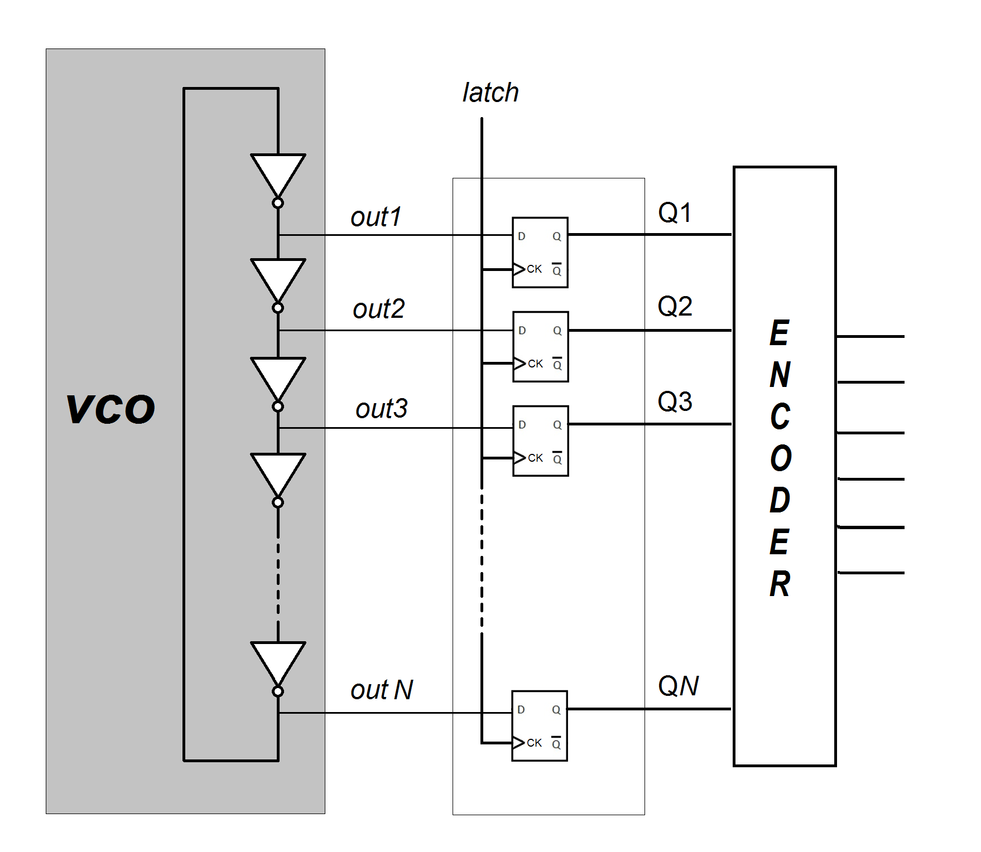
TDC block diagram
Simple design, exploiting the SiGe technology performance
The new TDC prototype is produced and tested in lab successfully
Peak performance 20 pS!
Power consumption 1-2 mW/channel

Slide 39
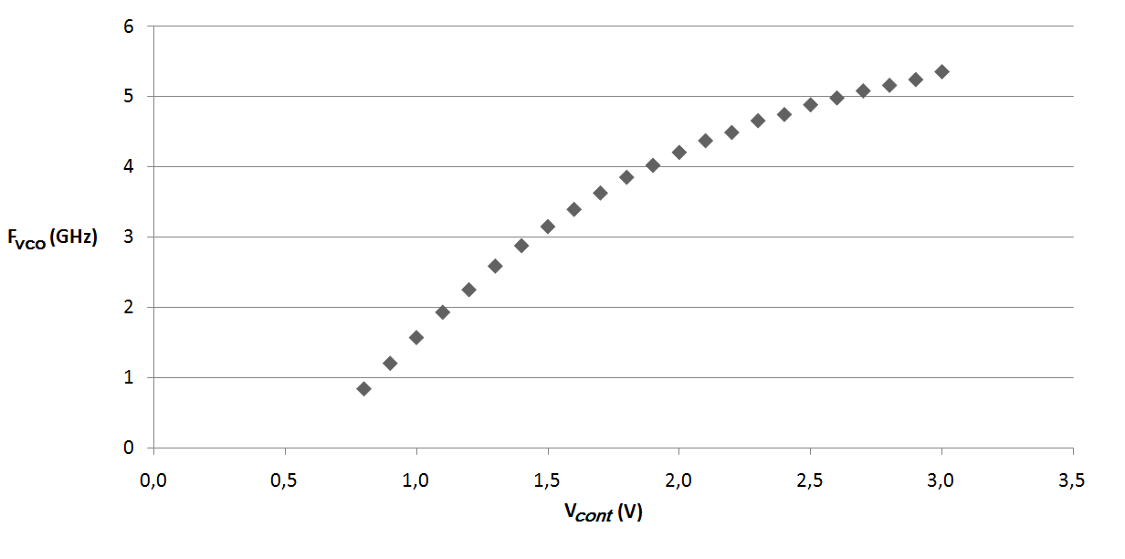
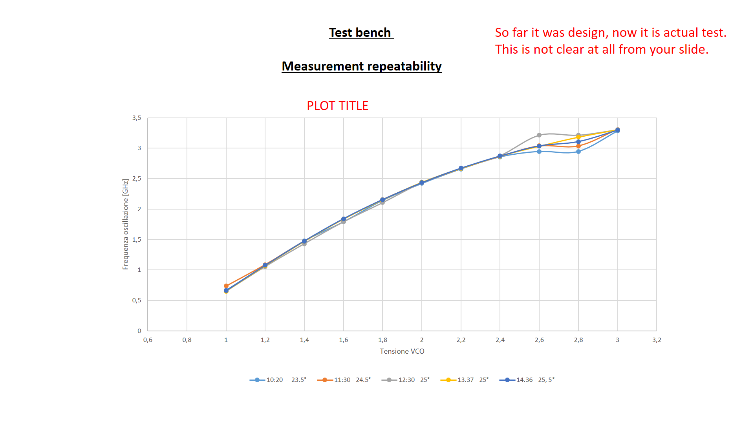
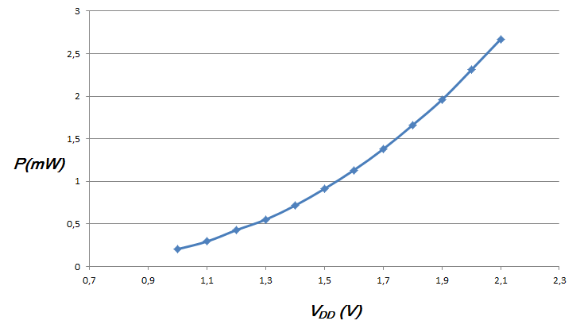
Simulation by Virtuoso software
Experimental Test bench
Range Frequency oscillation Vs applied voltage
Range Frequency oscillation Vs voltage applied
F_{vco}(GHz)
Power consumption of the VCO
Power consumption is very low, given the excellent timing performance.
We repeated the measurements at different times and different temperatures.
In this test we supplied voltage only to the VCO.
Comparing simulation and test bench, there is a deterioration of about 35%, as expected.
The oscillations appear by applying higher then foundry specifications voltages

Slide 40
The 2d meantimer concept
Combining the advantages of x-y strip readout and of the meantimer.
2N channels for 2D homogeneous readout
No limitation of the detector resolution due to the meantimer
Electronics out of the active area
Performance driven by the FE electronics and the digitization: it requires high performance Amplifier-discriminator-TDC chain
Conceptually it is compatible with the classic ATLAS RPC layout down to the discriminator so it can be retrofitted on the present ATLAS RPCs. It would be sufficient to replace the readout electronics

Slide 41
Charge based discrimination
24/02/2016
G. Aielli - RPC 2016
68% fake cut
95.5% efficiency
Overall fakes cut: 89%
Overall efficiency: 95%
…Using a poor time resolution
Saturated and uncalibrated amplifiers
Non optimized CS
Cable length uncertainties….
100 ps resolution
200 ps resolution
1cm

