Slide 1


LABORATORI NAZIONALI DI FRASCATI
www.lnf.infn.it
The µ-RWELL (13.2.4) and Tools for its large scale implementation (13.4.5)
G. Bencivenni¹
R. De Oliveira², P. De Simone¹, G. Felici¹ , M. Gatta¹ G. Morello¹,
A. Ochi³ , M. Poli Lener¹, A. Ranieri^{4,},V. Valentino⁴
Laboratori Nazionali di Frascati - INFN
CERN
Kobe University
INFN Sezione di Bari
AIDA2020 WP13 - Paris, Apr. 5th,2017

Slide 2
WP 13.2.4: the µ-RWELL detector

Slide 3
Motivation
  The R&D on µ-RWELL is mainly motivated by the wish of improving the
  stability under heavy irradiation
  & simplify as much as possible
  construction/assembly procedures

Slide 4
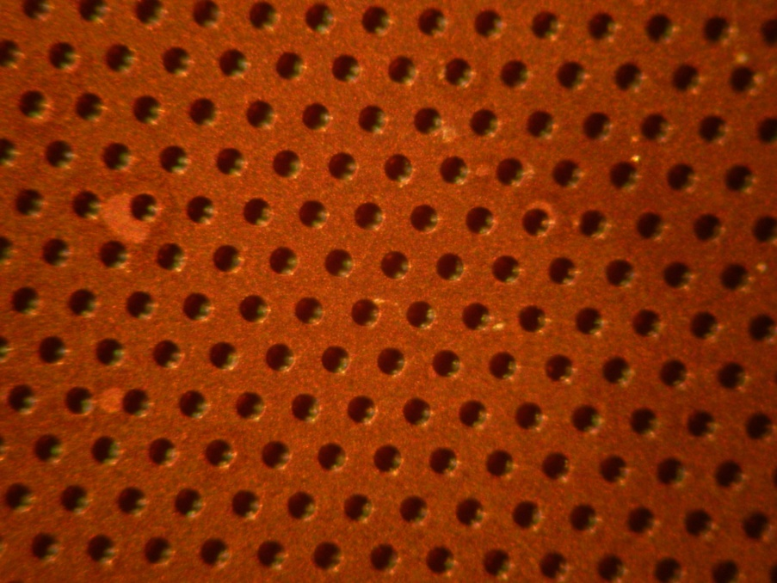
The detector architecture
G. Bencivenni et al., 2015_JINST_10_P02008
The µ-RWELL is composed of only two elements:
the µ-RWELL_PCB and the cathode
The µ-RWELL_PCB, the core of the detector, is realized by coupling:
a “WELL patterned kapton foil” as “amplification stage”
a “resistive layer” for discharge suppression & current evacuation:
  “Single resistive layer” (SL) <<100 kHz/cm²: single resistive layer → surface resistivity <<100 MΩ/☐ (CMS-phase2 upgrade; SHIP)
  “Double resistive layer” (DL) >> 1 MHz/cm²: more sophisticated resistive scheme must be implemented (MPDG_NEXT- LNF) suitable for LHCb-Muon upgrade
a standard readout PCB
Drift cathode PCB
Copper top layer (5µm)
Well pitch: 140 µm
Well diameter: 70-50 µm
Kapton thickness: 50 µm
DLC layer (<0.1 µm)
R ̴100 MΩ/□
1
2
3
Rigid PCB readout
electrode
µ-RWELL PCB
(*) DLC = Diamond Like Carbon
High mechanical & chemical resistant material
4

Slide 5
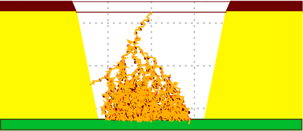
Principle of operation
Applying a suitable voltage between top copper layer and DLC the “WELL” acts as multiplication channel for the ionization.
top copper layer
HV
kapton
The charge induced on the resistive foil is
dispersed with a time constant, τ = ρC ,
determined by
the surface resistivity, ρ
the capacitance per unit area, which depends on the distance between the resistive foil and the pad readout plane, t
the dielectric constant of the insulating medium, ε_{r} [M.S. Dixit et al., NIMA 566 (2006) 281]
resistive stage
ρ
Insulating medium
ε_{r}
t
Pad/strip r/out
Not in scale
The main effect of the introduction of the resistive stage is the suppression of the transition from streamer to spark
As a drawback, the capability to stand high particle fluxes is reduced, but an appropriate grounding of the resistive layer with a suitable pitch solves this problem (see High Rate scheme)

Slide 6
Main detector features
The µ-RWELL is a single-amplification stage, intrinsically spark protected MPGD characterized by:
simple assembly procedure:
  only two components → µ-RWELL_PCB + cathode
  no critical & time consuming assembly steps:
    no gluing
    no stretching (→ no stiff & large frames needed)
    easy handling
  suitable for large area with PCB splicing technique w/small dead zone
cost effective:
  1 PCB r/o, 1 µ-RWELL foil, 1 DLC, 1 cathode and very low man-power
easy to operate:
  very simple HV supply → only 2 independent HV channels or a trivial passive divider (while 3GEM detector → 7 HV floating/channels )

Slide 7
  µ-RWELL: the AIDA program (2016/17)
Optimization of the detector parameters:
  surface resistivity vs gain, rate capability, charge spread, space resolution (completed – paper to be submitted)
  study & implementation of the resistive layer segmentation vs rate capability (completed - paper to be written )
Work to be done in the first 24 months (M24) of the project

Slide 8
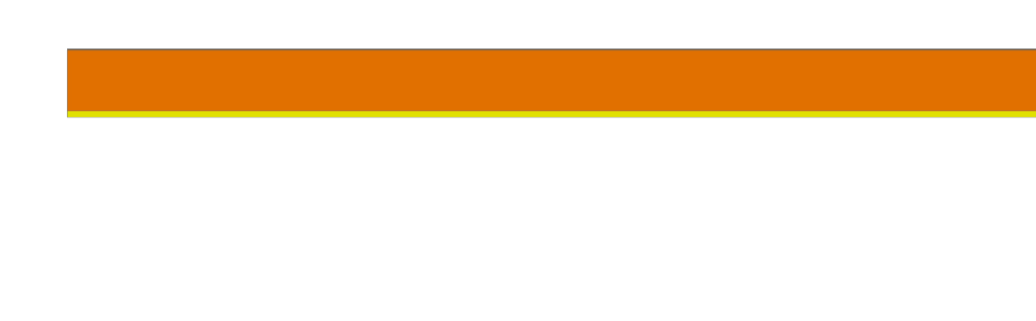
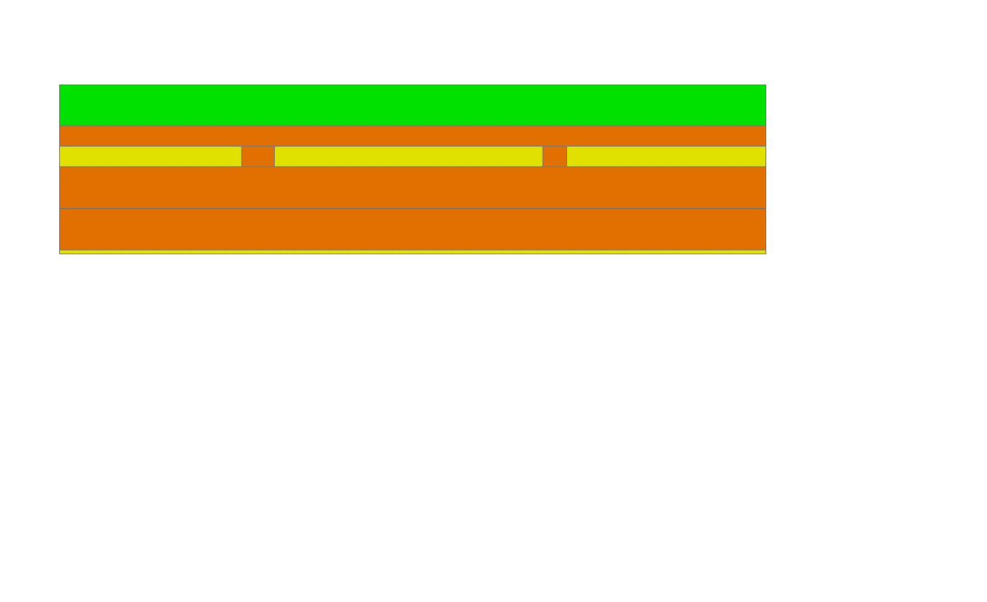
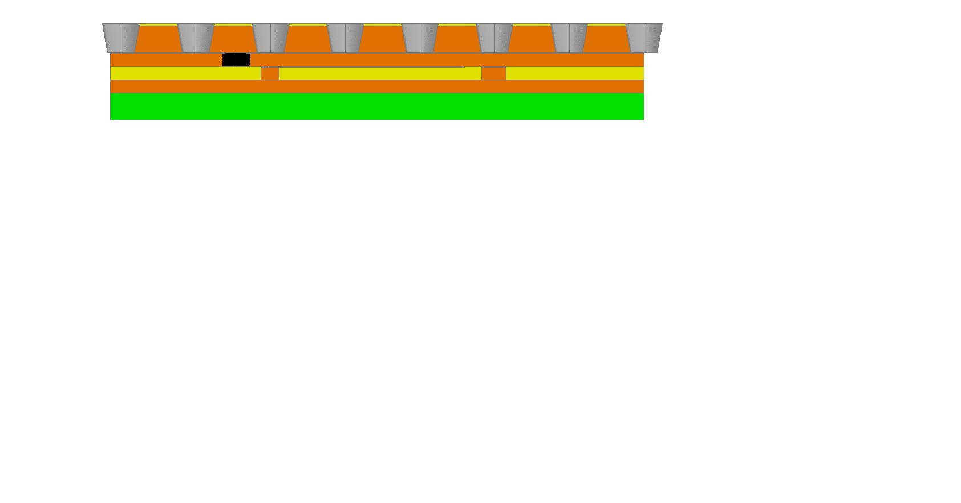
The Low Rate scheme (CMS/SHiP)
Copper layer 5 µm
1
Kapton layer 50 µm
DLC layer: 0.1-0.2 µm (10-200 MΩ/☐)
DLC-coated kapton base material
2
Insulating medium (50 µm)
PCB (1-1.6 mm)
DLC-coated base material after copper and kapton chemical etching (WELL amplification stage)
3

Slide 9
Detector performance:
Lab Tests

Slide 10
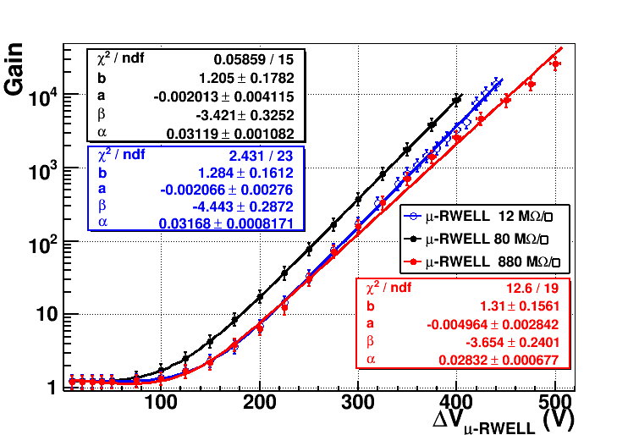
Detector Gain
Prototypes with different resistivity (12-80-880 MΩ/☐) have been tested with X-Rays (5.9 keV), with different gas mixtures, and characterized by measuring the gas gain in current mode.
Ar/iC₄H₁₀= 90/10
WELL kapton thickness = 50µm

Slide 11
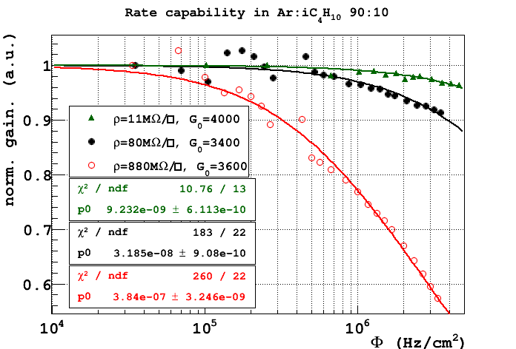
Rate capability with X-rays (single layer)
Rate capability fitted with the function:
local irradiation
Rate for a drop ΔG = -3%
Φ = 77 kHz/cm² - 880 MΩ/☐
Φ = 850 kHz/cm² - 80 MΩ/☐
Φ = 3.4 MHz/cm² - 11 MΩ/☐
for m.i.p.×7
The gain decrease is correlated with the voltage drop due to the resistive layer: larger the resistivity lower the rate capability.
local irradiation ≠ global irradiation

Slide 12
Detector performance:
Beam Tests

Slide 13
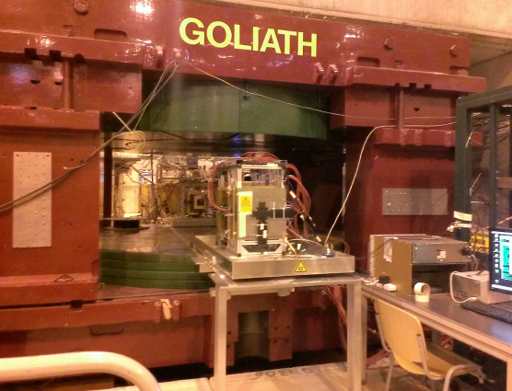
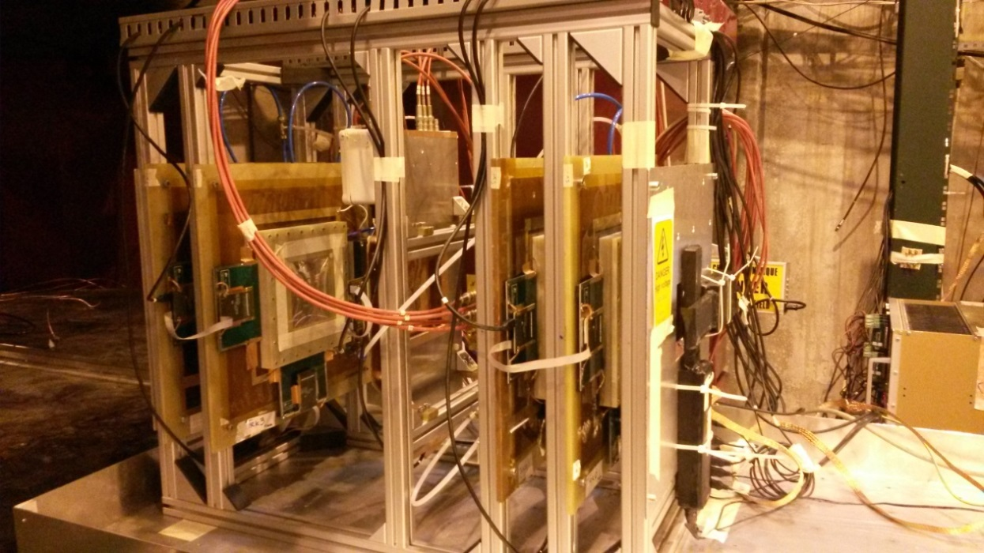
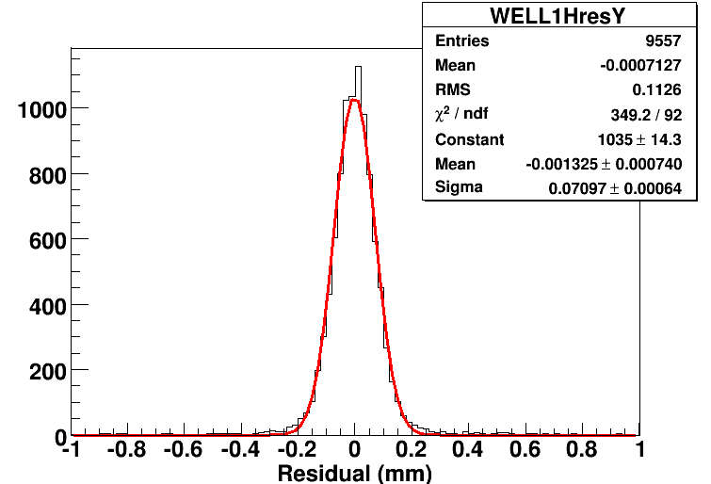
Beam tests results
H4 Beam Area (RD51)
Muon beam momentum: 150 GeV/c
Goliath: B up to 1.4 T
μ-RWELL prototype
12-80-880 MΩ /□
400 µm pitch strips
APV25 (CC analysis)
Ar/iC₄H₁₀ = 90/10
BES III-GEM chambers
σ_{RWELL} = (52+-6) µm
@ B= 0T after TRKs contribution subtraction
GEMs Trackers

Slide 14
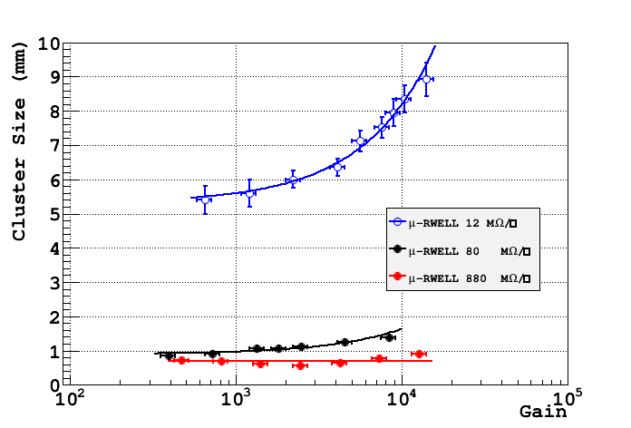
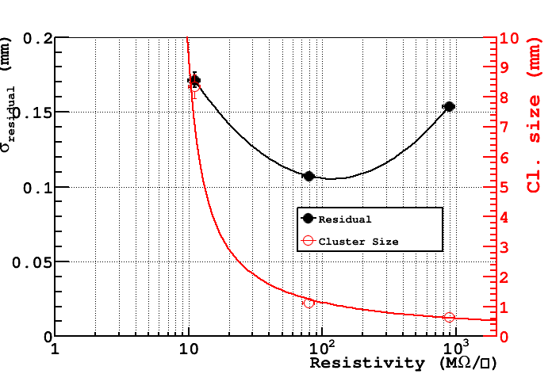
Space resolution vs resistivity
CC analysis
The “space resolution” (σ of the residual – no subtraction of the external trackers contribution) exhibits a minimum around 100MΩ/□.
→ at low resistivity the charge spread increases and then σ is worsening.
→ at high resistivity the charge spread is too small (Cl_size → 1 fired strip) then the Charge Centroid method becomes no more effective (σ → pitch/√12)

Slide 15
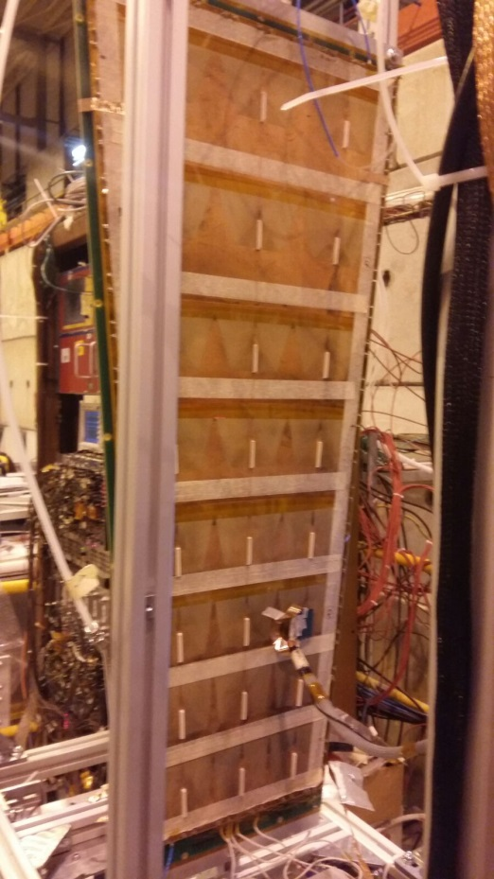
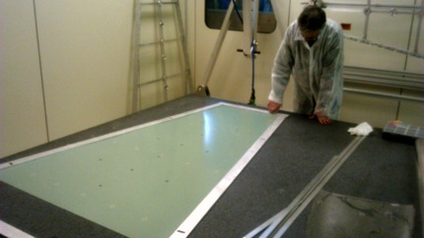
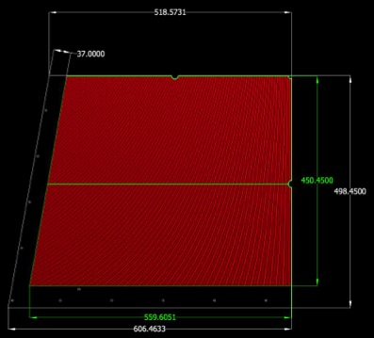
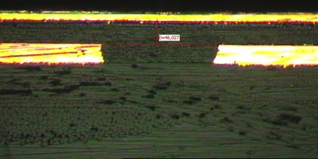
Technology Transfer to Industry
In the framework of the CMS-phase2 muon upgrade we have developed large size µ-RWELLs , in strict collaboration with Italian industrial partners (ELTOS & MDT).
The work is performed in two years with following schedule:
Construction & test of the first 1.2x0.5m² (GE1/1) µ-RWELL 2016 - DONE
Mechanical study and mock-up of 1.8x1.2 m² (GE2/1) µ-RWELL 2017 - DONE
Construction of the first 1.8x1.2m² (GE2/1) µ-RWELL (only M4 active) > 2018
DONE
1.8x1.2m² (GE2/1) µ-RWELL
~40 times larger than small protos !!!
~200 times larger than small protos !!!
mock-up
ELTOS tests

Slide 16
Towards a High Rate scheme
single resistive layer, edge grounding,
2D evac.
current
d
double resistive
layer, 3D grounding
d’
top layer
r
(1cm)d’
r
d (50cm)
conductive vias
bottom layer
(*) point-like irradiation, r << d
Ω is the resistance seen by the current generated by a radiation incident in the center of the detector cell
Ω ~ ρ_{s} x d/2πr
Ω’ ~ ρ_{s}’ x 3d’/2πr
Ω/ Ω’ ~ (ρ_{s} / ρ_{s}’) x d/3d’
If ρ_{s} = ρ_{s}’ → Ω/ Ω’ ~ ρ_{s}/ρ’_{s} * d/3d’ = 50/3 = 16.7
(*) Morello’s model: appendix A-B (G. Bencivenni et al., 2015_JINST_10_P02008)
Notes:
Let’s switch to the high rate scheme.
To do that try to compare a single resistive layer detector 50x50 cm2 large , with grounding all around its edge and 2D current evacuation,
with a second 50x50 cm2 detector, “orthogonally” grounded every cm2, by means “through-vias” between the top resistive layer
and a second bottom resistive layer. In this second scheme we can imagine that from the point of view of
the resistive layer the detector is practically divided in basic cells 1 cm2 large, and we can speak about a sort of 3D grounding scheme.
The two versions (the single layer & the double layer with through vias) have clearly different performance.
The ratio between the resistance …. Comes out to be of the order of 20 … (under the assumption that the resistivity is the same).
The double layer clearly allows better performance in terms of uniformity response (or equivalently in terms of rate capability).

Slide 17
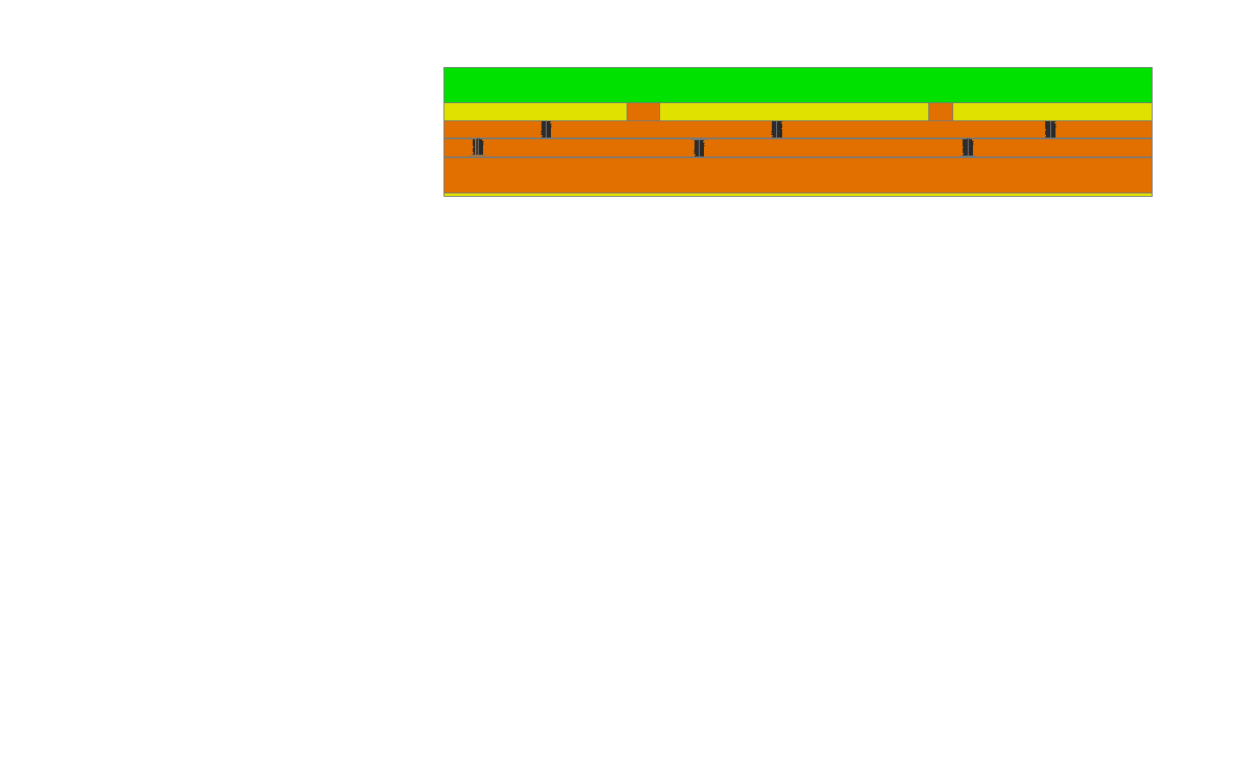
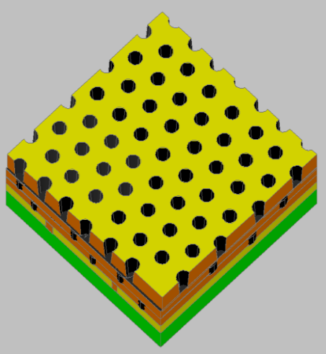
The High Rate scheme (LHCb)
Copper layer 5 µm
1
Kapton layer 50 µm
DLC layer: 0.1 – 0.2 µm
(10-200 MΩ/☐)
2
2nd resistive kapton layer with ∼ 1/cm² “through vias” density
DLC-coated kapton base material
3
2nd resistive kapton layer
insulating layer
pad/strips readout on standard PCB
“through vias” for grounding
4
DLC-coated base material after copper and kapton chemical etching ( WELL amplification stage)

Slide 18
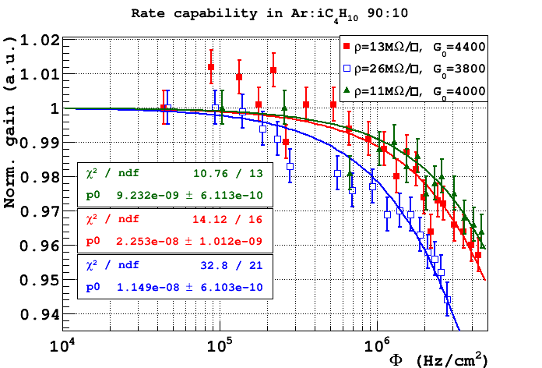
Rate capability with X-rays (double layer)
Double resistive layer w/ 1x1 cm² through-vias grounding pitch
local irradiation
for m.i.p.×7
Φ = 3.4 MHz/cm²; Φ = 2.8 MHz/cm²; Φ = 1.6 MHz/cm²
Local irradiation is practically equivalent to global irradiation

Slide 19
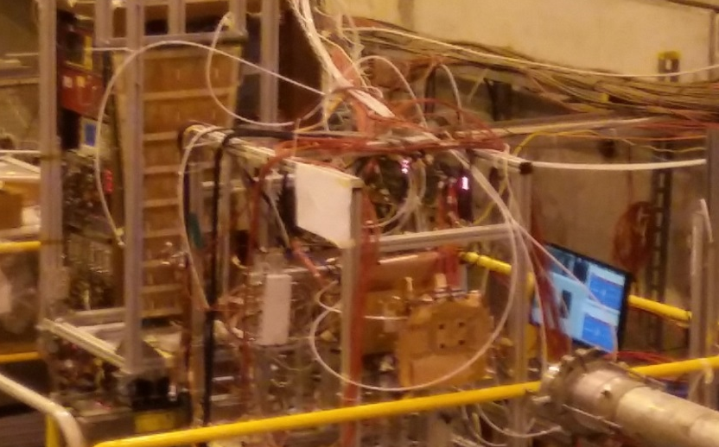
Beam Test (CMS/LHCb collaboration)
H8 Beam Area (18th Oct. – 9th Nov 2016)
Muon/Pion beam: 150 GeV/c
3 μ-RWELL prototypes
40-35-70 MΩ /□
VFAT (digital FEE)
Ar/CO₂/CF₄ = 45/15/40
N° 2 µ-RWELL protos
10x10 cm2
40-35 MΩ/☐
Double resistive layer scheme
400 µm pitch strips
Beam
S3
S2
S1
GEM Tracker 1
GEM Tracker 2
N° 1 µ-RWELL proto
100x50 cm2
70 MΩ/☐
Single resistive layer scheme
800 µm pitch strips
Trigger=S1+S2+S3
GOAL: time resolution measurement (never done before)

Slide 20
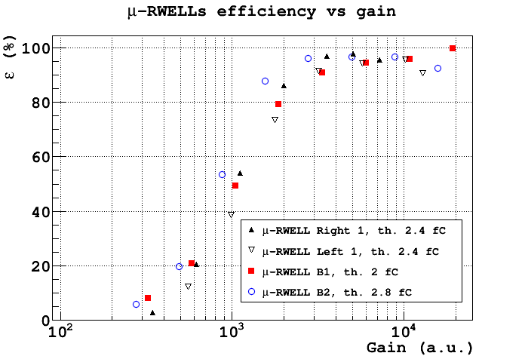
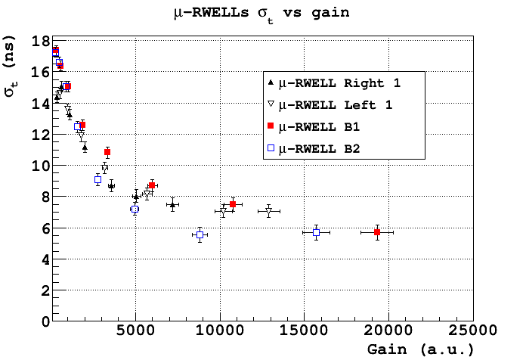
Time Performance
97%
5.7ns
Different chambers with different dimensions and resistive schemes exhibit a very similar behavior although realized in different sites (large detector realized @ ELTOS)
The saturation at 5.7 ns is dominated by the fee (measurement done with VFAT2).
To be compared with a measurement done with GEM by some of us in 2004 (LHCb) giving a σ_{t} = 4.5 ns with VTX chip [1].
[1] G. Bencivenni et al, NIM A 494 (2002) 156

Slide 21
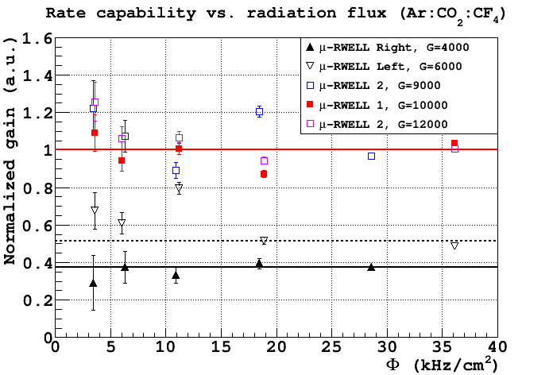
Performance vs Rate
The detectors rate capability (with Ed=3.5 kV/cm) has been measured in current mode with a pion beam and irradiating an area of >3 x 3 cm² (FWHM) (medium size irradiation, ~10 cm² spot)
Double resistive layer
(High Rate scheme)
Single resistive layer
(Low Rate scheme)

Slide 22

SUMMARY of WP13.2.4
The µ-RWELL R&D in AIDA2020 is matching the schedule, with very good results.
The most important performance of the detector have been measured:
  gas gain > 10⁴
  intrinsically spark protected
  rate capability >> 1 MHz/cm² (HR version)
  space resolution < 60µm
  time resolution < 6 ns
The 1st milestone has been succesfully fulfilled:
MS13.3: Small-size prototype of the μ -RWELL (built and qualified prototype - M24)
The 2nd milestone foreseen for M44:
D13.4 : Large-size prototype of μ-RWELL (a large-size fully engineered and validated prototype of the μ-RWELL - demonstrator)

Slide 23
WP 13.4.5: tools for readout PCB QC

Slide 24
Task 13.4.5
Design of an automatic system to check the electrical integrity of electrode patterns by pulse reflection method
Preparation of tools for large series production
Activity 2016-2017 subdivided in two sub-tasks:
Design and implementation of a TDC embedded structure in the Time Domain Reflectometer (TDR) control logic
Construction of the prototype chamber with μ-RWell technology & related readout PCB for CMS R&D phase_2, as proof of concept for the TDR
AIDA2020 Mid-term report WP13, task 13.4.5, PARIS2017 meeting
Partecipants: INFN-Bari, INFN-LNF

Slide 25

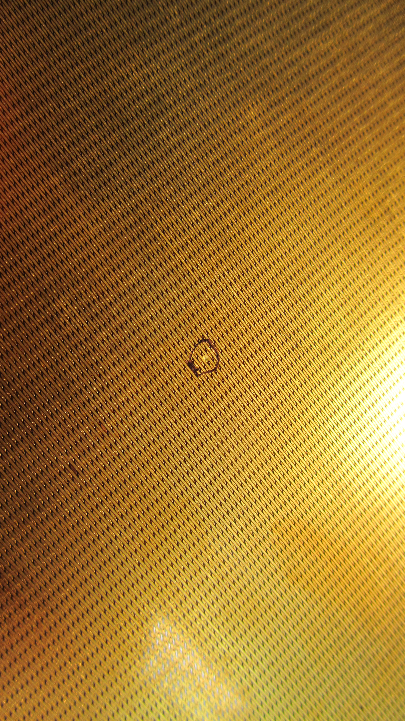
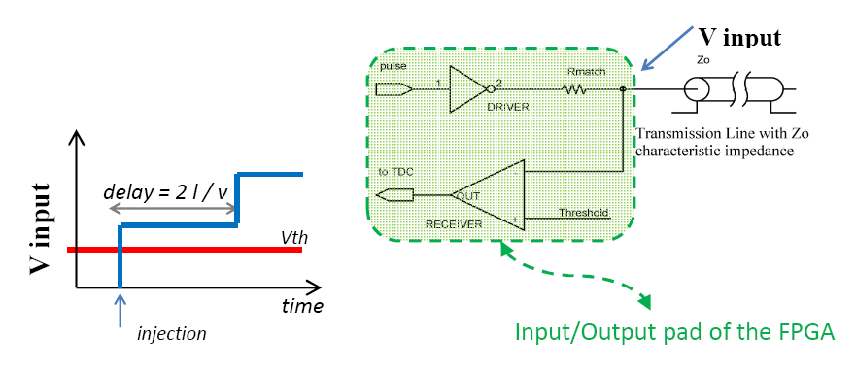
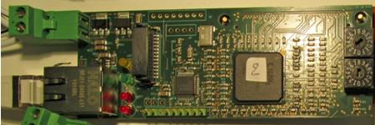
Design of a TDC embedded structure in control logic (I)
TDR exploits time measurements -> TDC
The aim of this work is the development of a device capable to find defects on a micro-strips readout plane of a MPGD under test through the search of discontinuities in the impedance profile which cause reflection of injected pulses.
The drawing shows the run of a signal, in this case a transition from low to high state, injected into an un-terminated transmission line
The first edge occurs when the signal is injected at the input while the second edge is observed after that the signal reflected comes back (in red a threshold level)
Example: 2D readout geometry
AIDA2020 Mid-term report WP13, task 13.4.5, PARIS2017 meeting
EXAMPLE:
2D readout geometry
A time resolution of about 100 ps is required to appreciate length differences of about 1 cm
ISSUE: Temperature stability:
  The only reliable method is to put one TDC/channel
1’st TDR proto’s

Slide 26
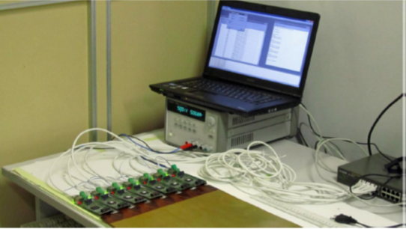
Design of a TDC embedded structure in control logic
TDR exploits time measurements -> TDC
By analysing the delay of the reflected signal, it is possible to evaluate the length of a transmission line, a micro-strip in the device under test. This length will be as expected by design if the micro-strip is intact, then shorter if there is an interruption somewhere along the strip and longer or shorter, due to multiple reflections, whether some close strips are shorted together
A 2nd release of the TDR board has foreseen n.4 TDCs per FPGA , so that each TDC sequentially read/out n.32 strip channels. Wrt the previous version, the new board is more stable and precise and doesn’t require tedious repeating calibration procedures, having solved the problem of thermal instability.
AIDA2020 Mid-term report WP13, task 13.4.5, PARIS2017 meeting
EXAMPLE:
2D readout geometry
Temperature stability issue solved with new release:
  The only reliable method is to put one TDC/channel
  The new release contains one TDC per channel
  32 channels embedded in one FPGA
2’nd TDR electronics card
Workbench with 7 TDR modules connected to an anodic sheet under test and through Ethernet to PC for logging and control

Slide 27
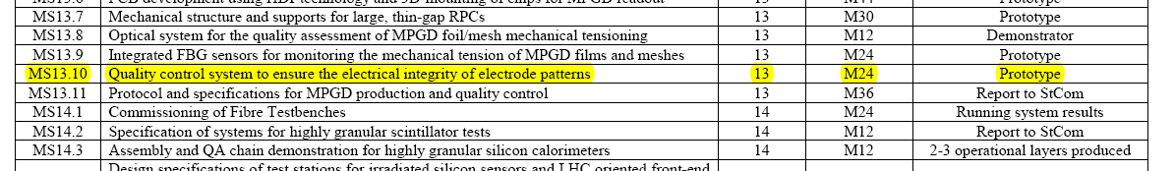
Summary
Milestones & Deliverables
MS13.10 - Quality control system to ensure the electrical integrity of readout electrode for MPGDs (prototype of a Time Domain Reflectometer: M24) → succesfully fulfilled
AIDA2020 Mid-term report WP13, task 13.4.5, PARIS2017 meeting
  Designed a new TDC scheme inside the FPGA (firmware) to overcome the temperature instability
  As soon as new anodic foils will be delivered for a GE2/1 CMS chamber based on the µ-RWell technology, tests with TDR device will be performed and results will be reported

Slide 28
Thanks for the attention

Slide 29
backup

Slide 30
  WELL amplification stage: thickness studies
The increase of the thickness of the amplification stage (Kapton base material thickness) from the standard (GEM like) 50 µm up to 125 µm should result in a increase of the detector gain.
The program for THICK µ-RWELL was started by the end of 2016
BUT
We discovered etching problem with single mask technique (the natural one for µ-RWELL): the needed etching along the whole thickness (125 µm) results in a too large diameter hole (> 100 µm) thus strongly affecting the effective GAIN of the hole itself (exactly the opposite of the desired goal)
THEN
Some change in the manufacturing of the high gain detector is clearly required (→ double mask etching + floating amplification stage; …)
Anyway we have demonstrated that using suitable gas mix the detector achieve a Gain 2-3 x 10⁴

Slide 31
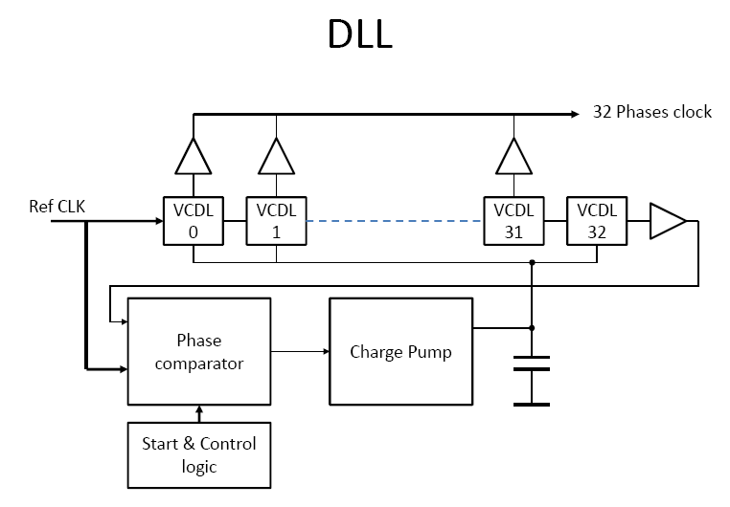
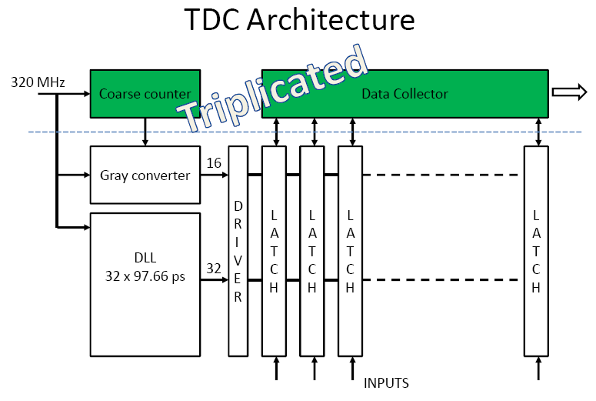
Design of a TDC embedded structure in control logic (II)
New architecture characteristics
Reference clock 320 MHz (better than that previous version: 250MHz)
Measured (after simulation) timing resolution: ≤ 100ps
5 bits fine counter + 16 bits coarse counter
33 channels (32 comparator + 1 test input)
AIDA2020 Mid-term report WP13, PARIS2017 meeting
EXAMPLE:
2D readout geometry

Slide 32
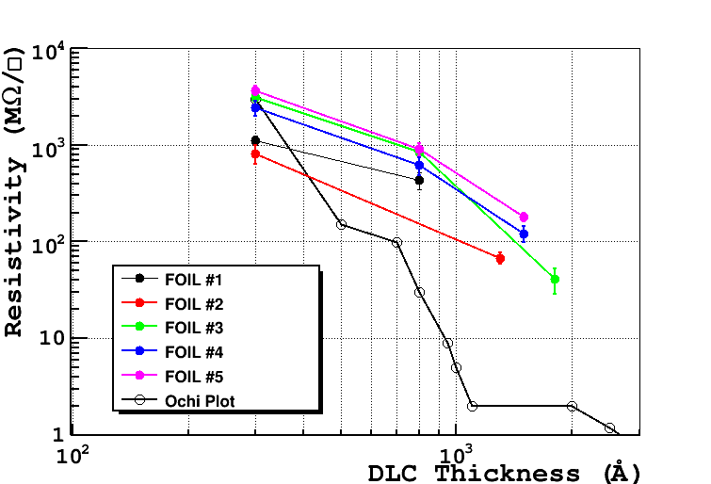
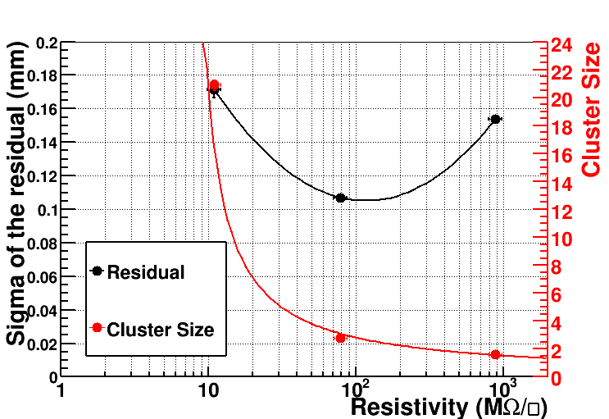
DLC sputtering on Kapton foils (supervised by A.Ochi)
DLC sputtering on large Kapton foils (w/copper on one side) completed @ Be-Sputter Co., Ltd (Japan)
 | Foil 1 (800A) | Foil 2 (1300A) | Foil 3 (1800A) | Foil 4 (1500A) | Foil 5 (1500A)
Average Surface Resistivity MΩ/ | 433±90 | 68±9 | 41±12 | 122±22 | 180±17
Ar/ISO=90/10

Slide 33
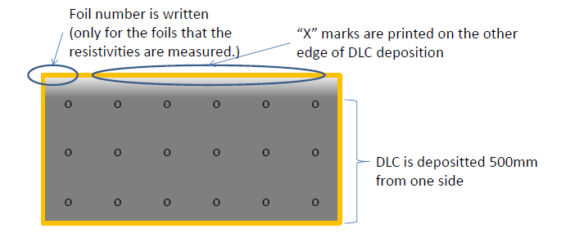
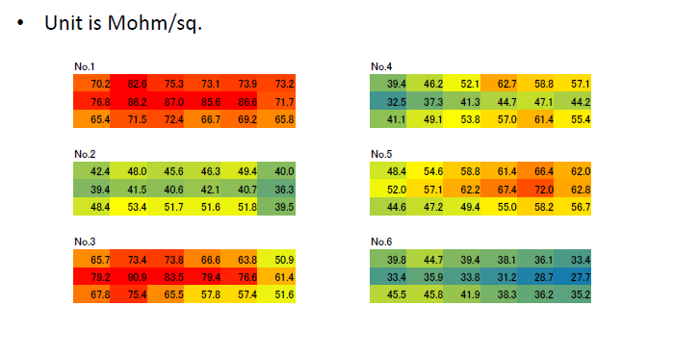
Surface resistivity map (A. Ochi, Kobe – Univ., Japan)
Surface resistivity measured on a 18 points of the 600x1200 mm2 kapton base material

Slide 34
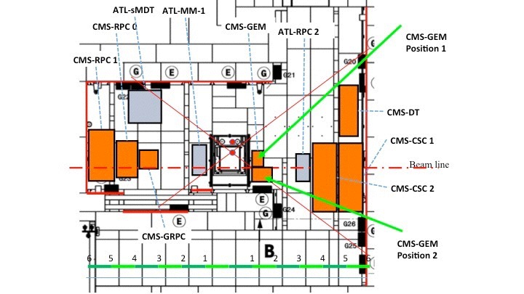
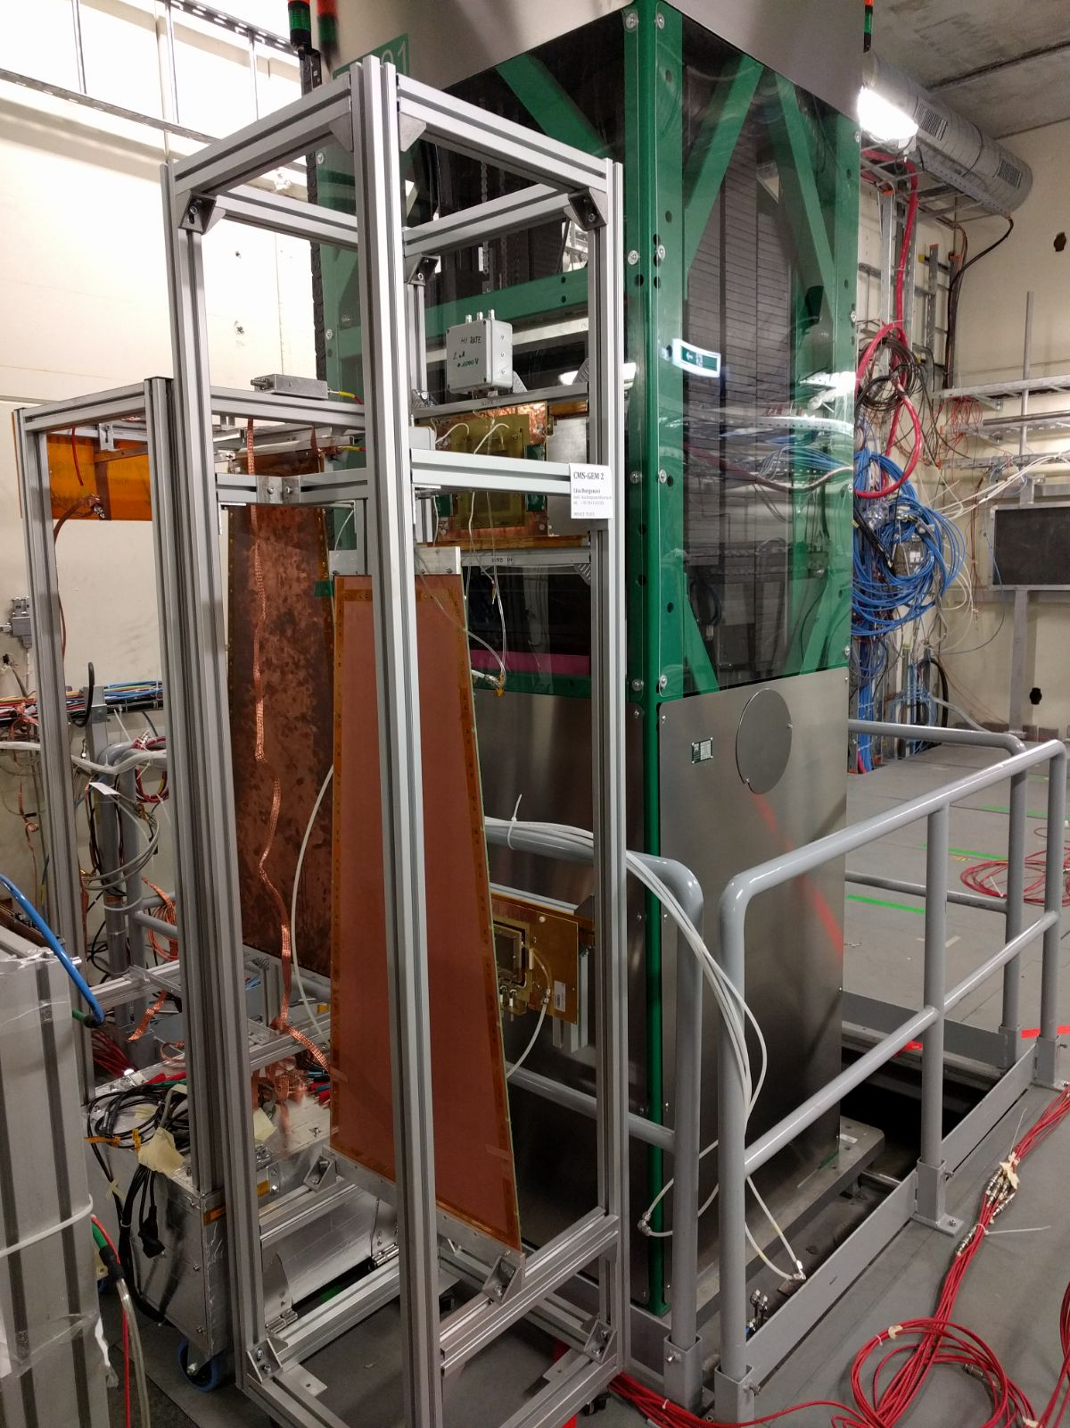
Ageing test @ GIF++

Slide 35
  µ-RWELL detector: the AIDA2020 program (II)
Detector engineering for large area tracking & digital calorimetry applications:
    Design of large area demonstrator
    Large area readout design
    Study of FEE-detector coupling
  Work to be done in the second 24 months (M24-48)

Slide 36
MILESTONES
MS13.3: Small-size prototype of the μ-RWELL (a built and qualified prototype - M24)
D13.4 : Large-size prototype of μ-RWELL (a large-size fully engineered and validated prototype of the μ-RWELL (demonstrator - M44)

Slide 37
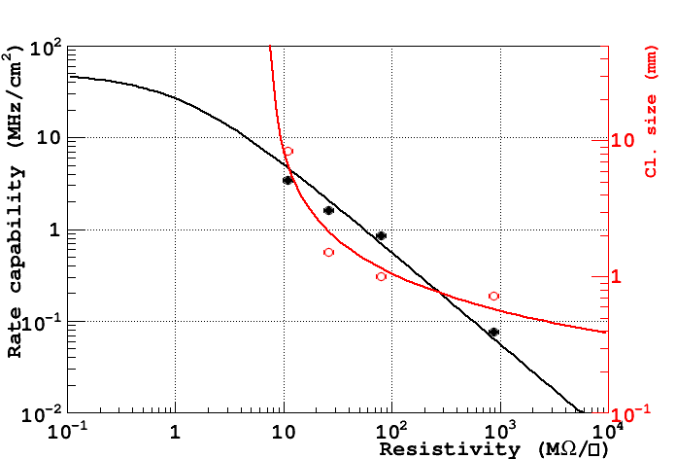
Combining the information
pad r/o
strip/pixel r/o
Too low
Too high
Qualitatively: low resistivity → pad r/out & higher rate
high resistivity → strip/pixel r/out & lower rate

