Slide 1
WP13 – TASKs 13.2.4&5
Development of high-gain MPGDs based on advanced THGEMs and hybrid MPGDs
TASK COORDINATOR: Silvia Dalla Torre
PARTICIPANTS: INFN - Trieste

Slide 2
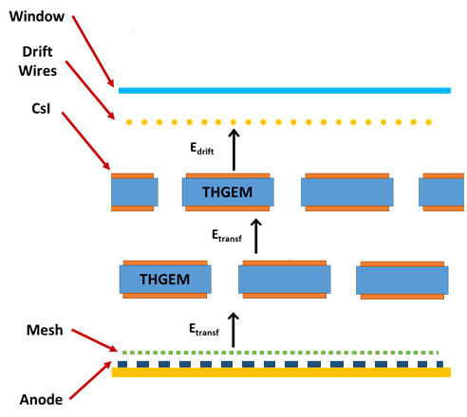
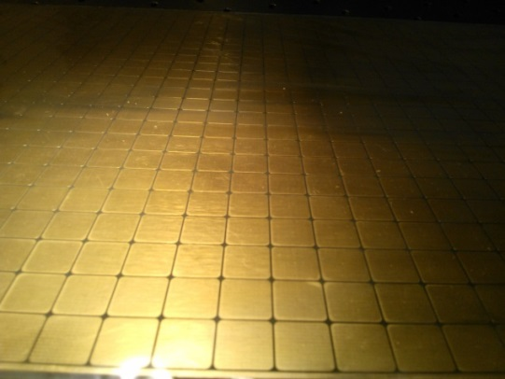
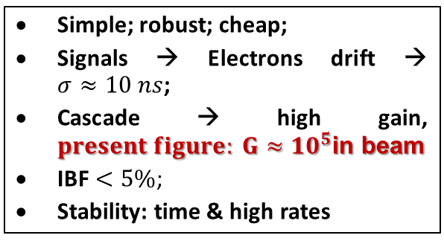
THE DETECTOR
The detector requiring further development
Hybrid Detector (2 x THGEMs + Micromesh)
Simple; robust; cheap;
Signals → Electrons drift → $σ≈10 ns$;
Cascade → high gain, $present figure: G≈{10}^{5}$in beam
IBF $<5\%$;
Stability: time & high rates
Staggered THGEMs
Multi-Pad Anode (12mm X 12mm)
Double THGEM: t = 0.4 mm; p = 0.8 mm; h = 0.4 mm
Resistive MM by discrete elements

Slide 3
RESISTIVE MM by DISCRETE ELEMENTS

Slide 4
Goals and Applications
High-Gain MPGD : stable operation also in radiactive environment at gain O (10⁶)
  Presently, in experiment < 10⁴
Simplify the production: new THGEM candidate materials to be characterized
  Presently, fiberglass
  A few attempts by glass substrate
Simplify the construction and get better performance: further development in the field of discrete element MMs
  At present limited to “large” pad size (~ 1 cm²)
APPLICATIONS:
  Detection of single photons
  Sensors in cryogenic noble liquid detector of rare events
  Applications beyond research

Slide 5
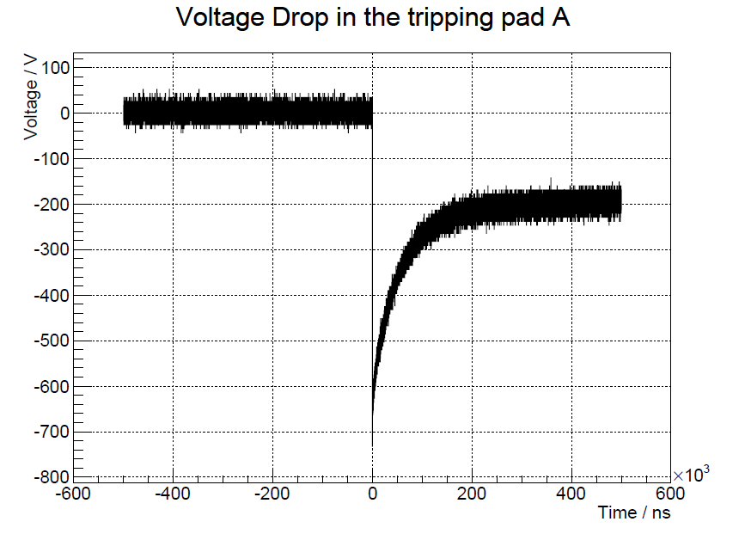
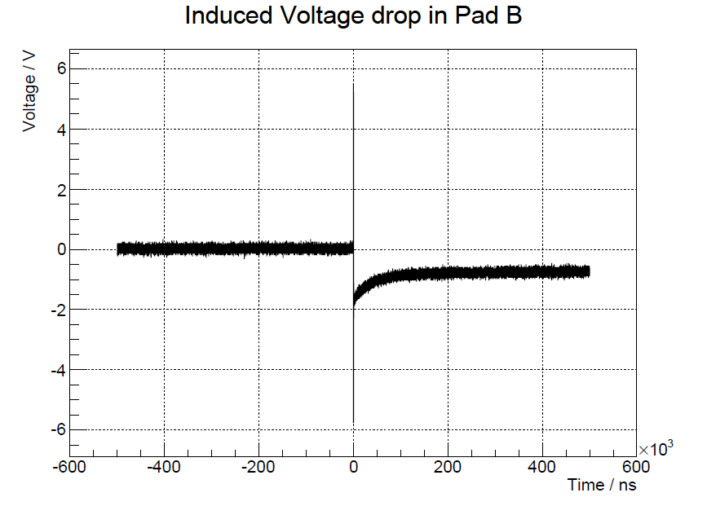
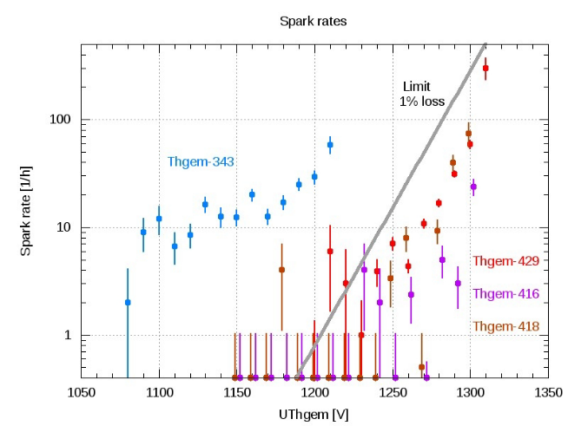
Activities reported in the past
Detailed studies about
  Discharge propagation in RESISTIVE MM by DISCRETE ELEMENTS
  Discharge rates in large-size THGEMs, their correlation with THGEM quality and their usage as quality control monitors
-2V
600 μs
600 μs

Slide 6
Qualification of THGEMs by
PERMAGLAS
(MS 13.4, M26)

Slide 7
About PERMAGLAS
Permaglas ME730 by RESARM Engineering Plastics SA
  Epoxy glass fibre material, amorphous, machinable
  The plate planarity is obtained by machining
    Purchased by us:

Slide 8
THICKNESS UNIFORMITY
Raw material characterization
Nominal thickness 0.7 mm
  /Δ/ < 4%; σ < 2%
Nominal thickness 1 mm
  /Δ/ < 2%; σ < 1%
→ Very good thickness uniformity!

Slide 9
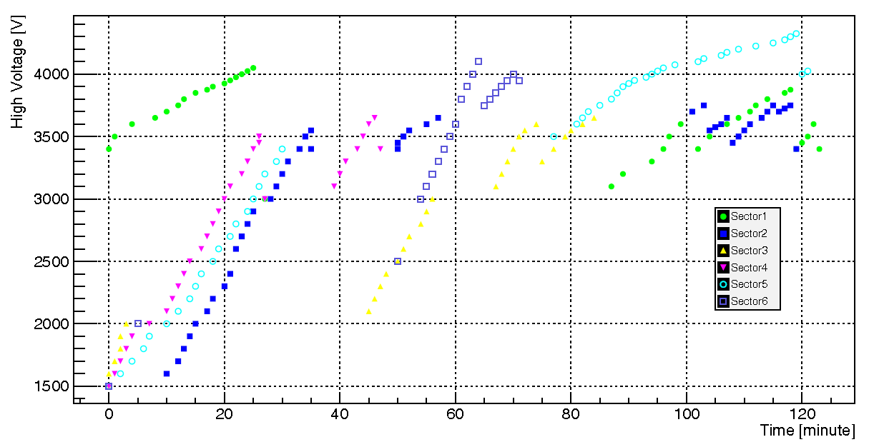
ELECTROSTATIC PROPERTIES
PASCHEN test
90% PASCHEN limit

Slide 10
CHARACTERIZATION MEASUREMENTS

Slide 11
The most relevant results obtained with the
PERMAGLASS THGEM

Slide 12
RESULTS
UNIFORMITY SCAN:
  σ: 13%
ENERGY RESOLUTION:
  20 %
GAIN PERFORMANCE:
  A robust device

Slide 13
TIME DEPENDENT EFFECTS
CHARGING UP STUDIES
Effect of the ion motion in the material

Slide 14
CONCLUSIONS about PERMAGLAS THGEM
Robust material offering remarkable uniformity performance
Difficult to get good quality thin foils
Easy to operate and limited gain dependence on rate (charging up) and time (ion displacement in the bulk dielectric)
Good potentialities for high gain multilayer devices
Interesting as a replacement for THGEM by etchable glass approaches: much cheaper !

