Slide 1

WP13
Innovative gas detectors
WP13 Task 13.3.1 and 13.3.2
“Tools to facilitate detector development”

Slide 2
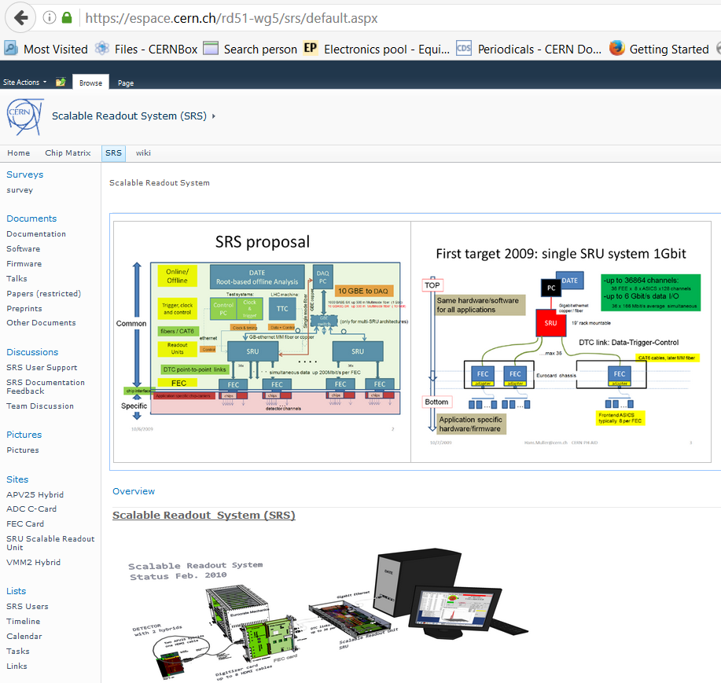
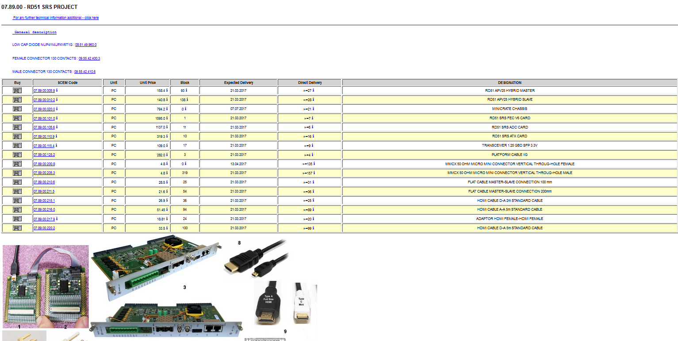
WP13 Task 13.3.1:
Interfacing FE-chips specific to gas detectors to the Scalable Read-out System (SRS)
Task 13.3.1 | AIDA 2020 Key/Partner Institutes
VMM (ATLAS NSW, ESS, RD51) | CERN
GEMROC | AGH Krakow/CERN
Timepix3 (LC-TPC) | University of Bonn

Slide 3
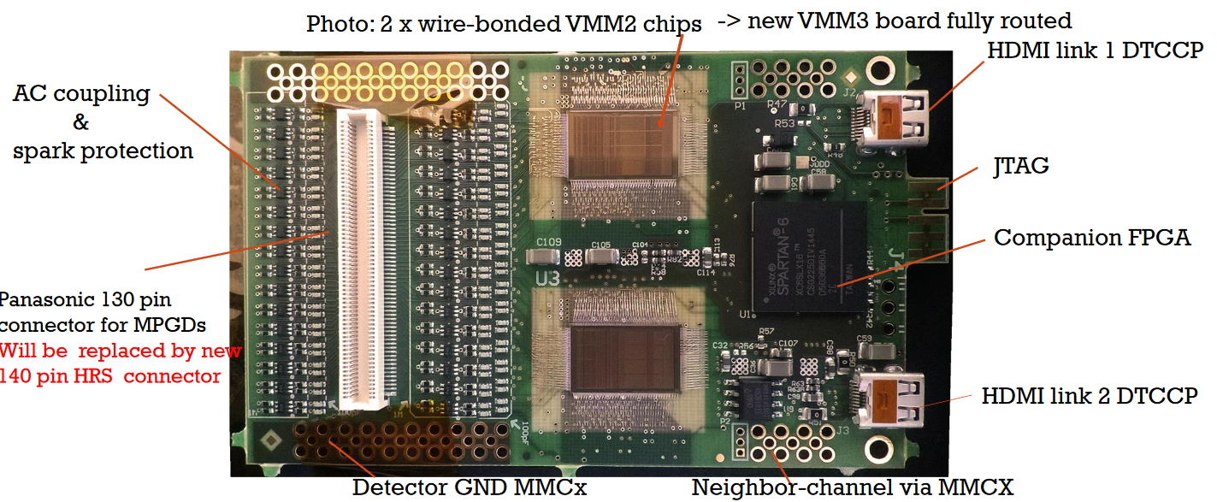
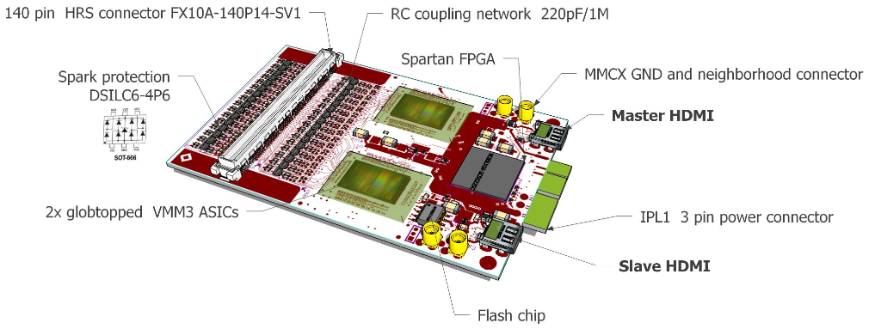
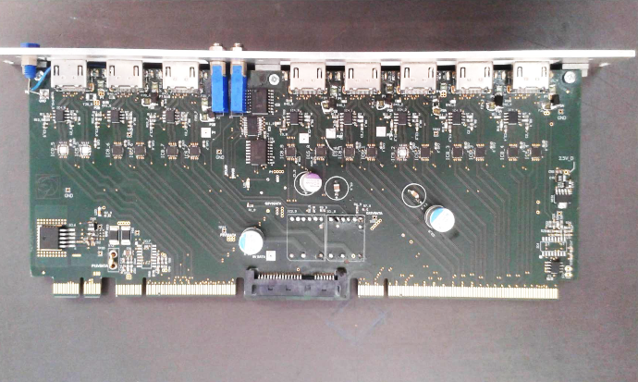
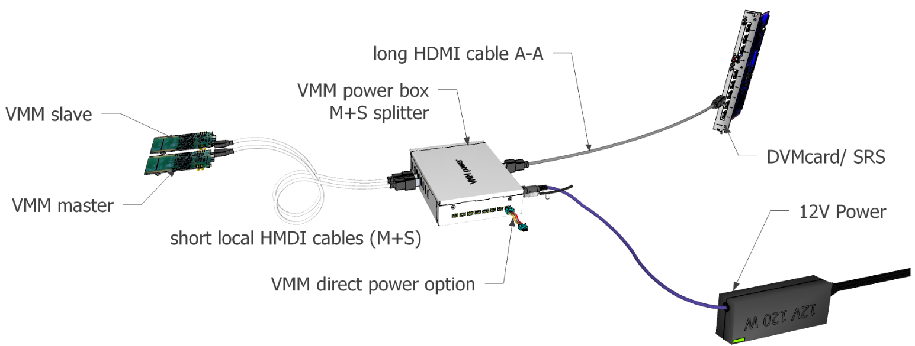
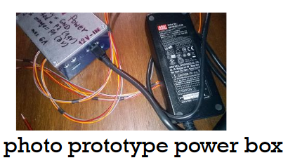
AIDA2020 in the VMM&SRS integration.
https://indico.cern.ch/event/588409/contributions/2402680/attachments/1386875/2110888/SRS_status_in_December_2016.pdf
Support for the RD51 hybrid (wire bonded) VMM
VMM2 done
VMM3 ongoing
RD51 VMM2 Hybrid done (@CERN) and tested
RD51 VMM3 Hybrid at the bonding lab (@CERN) - 20th March 2017
Support for the interface digital card (CARD)
New Design finalized (powering schema driven) Few test needed before going to production
Support for the commercialization process in view of future production processes
(Bonding outside CERN and parts procurements for users)
Support for the development of a new powering and connectivity schema
New Development
Prototype tested
PCB design started
Starting the process...

Slide 4
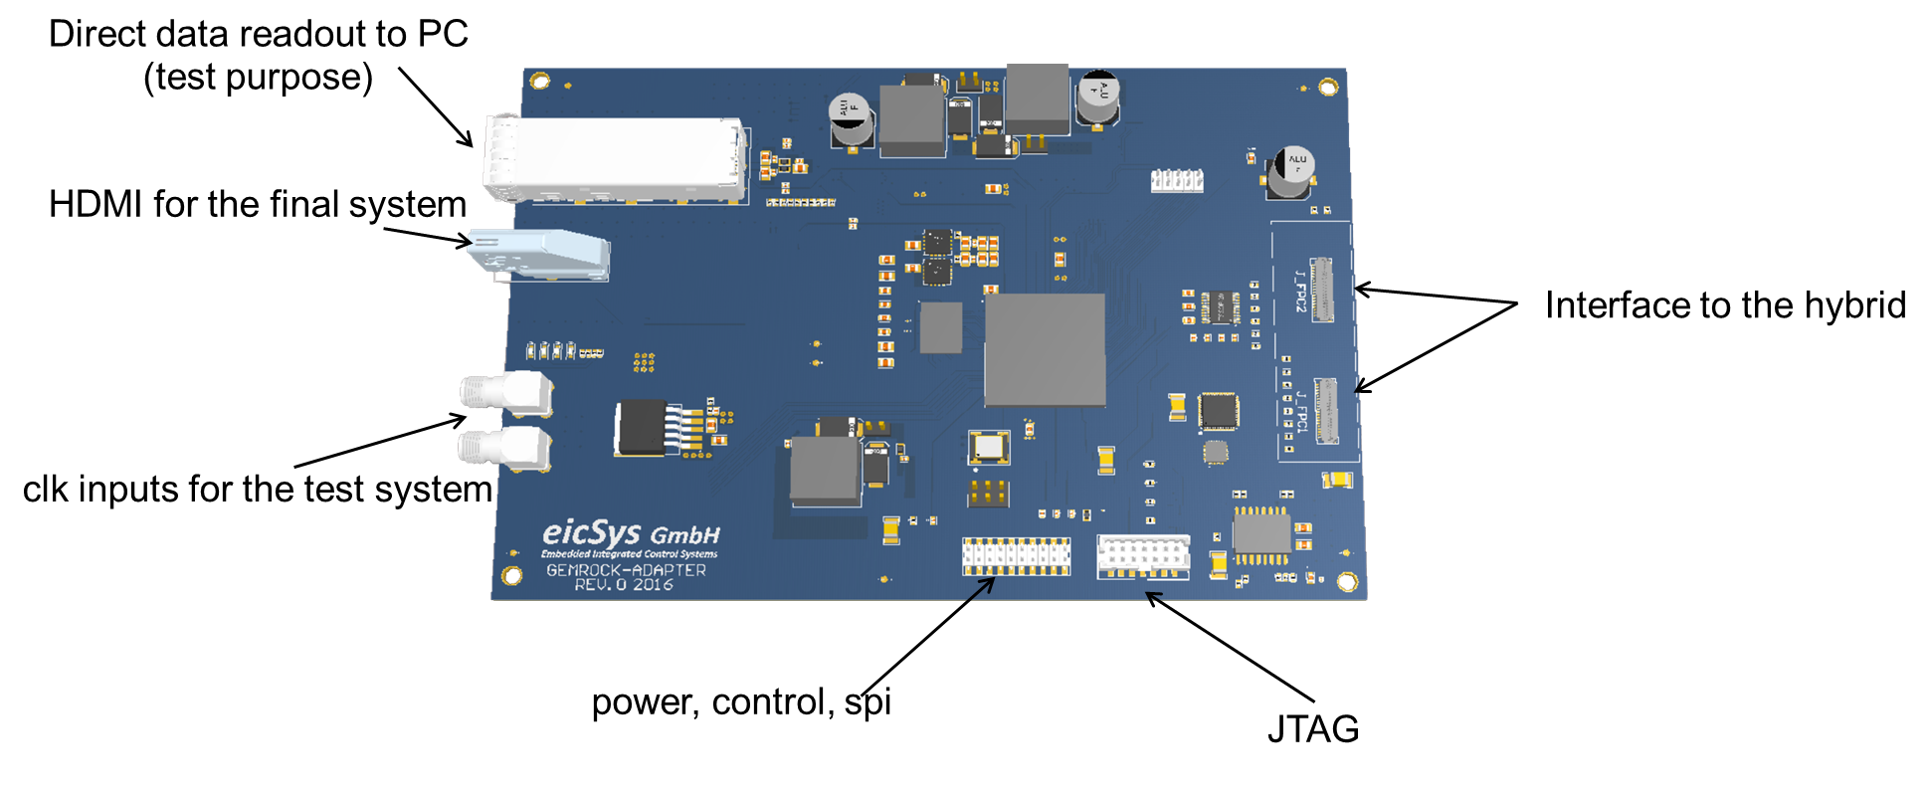
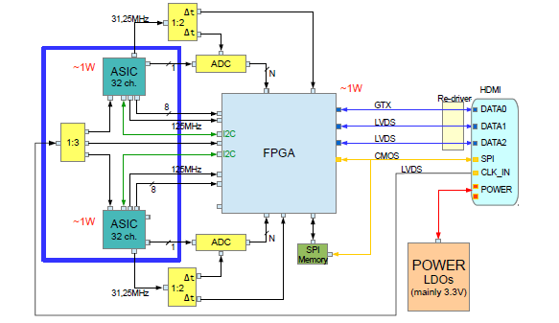

GEMROC and ATCA SRS
https://indico.cern.ch/event/496113/session/2/contribution/11/attachments/1241018/1824951/ATCA-SRS-GEMROC.pdf
Initial Plan: development of a new hybrid to host the GEMROC interface with SRS ATCA.
Current Plan: use the developed adapter to complete (firmware/software) an SRS-ATCA readout system of GEMROC (and leave the design of a new hybrids eventually for the new GEMROC chips).
GEMROC AGH hybrids @ eicSys
Adapter for AGH hybrid manufactured and assembled
1st firmware version ready
Testing expected in Spring 2017

Slide 5
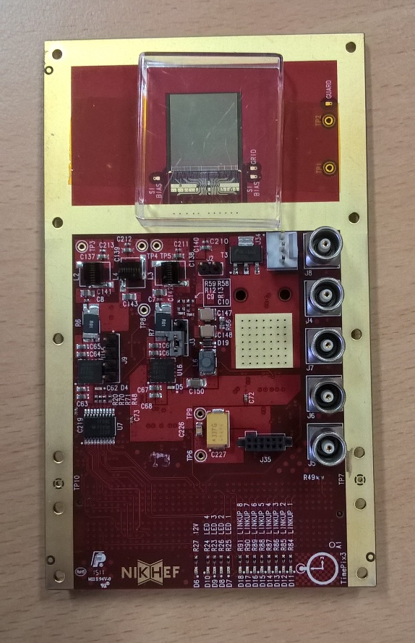
Timepix3 Readout for SRS
Status:
- Man power has been identified
- Planning for readout has started
- First Timepix3 ASIC has been bonded on chip carrier provided by Nikhef.
- SPIDR readout for cross checks is available.
Current plan (might change!):
- Implement communication with ASIC
- Implement ASIC control
- Implement reduced set functionality for readout mode (e.g. only frame based readout)
- No high rate readout is envisioned for now.
- Expand system to a large number of ASICs.
First Timepix3 bonded in Bonn

Slide 6
SRS/FE ASICs Summary
VMM
RD51 wire bonded hybrid (VMM2 done/tested, VMM3 ongoing – probably done at the day of the meeting).
Digital Interface Card DCARD (new design done and ready for production).
Alternative powering/connectivity schema.
Industrialization/Commercialization process.
GEMROC
AGH Hybrid in eicSys.
Adapater card finalized, ready for production, test planned for spring 2017.
Adapter considered as final final solution for the ACTA-SRS/GEMROC readout
Timepix3
Timepix3 bonded in BONN
SPIDR readout ready for cross check studies
SRS Integration (frame-based) to cope with large number of hybrids (high rate readout not envisioned)

Slide 7
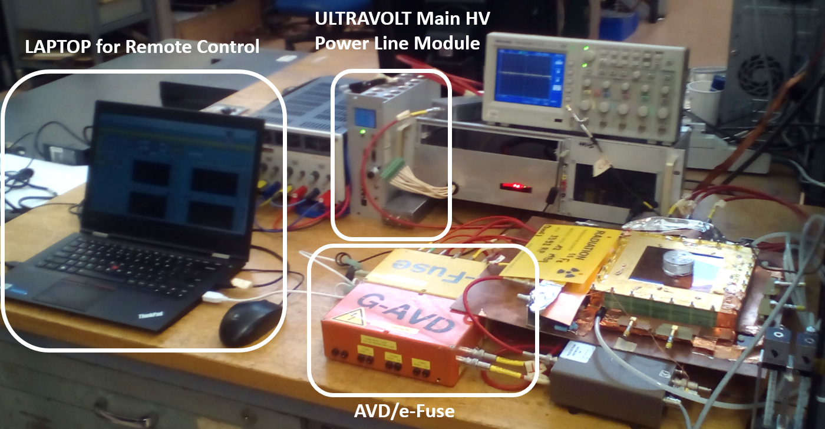
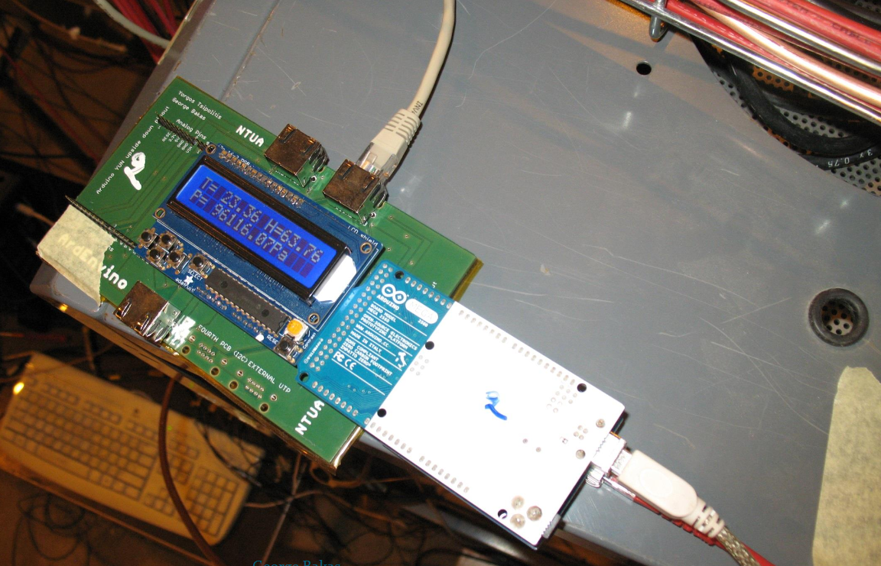
WP13 Task 13.3.2:
Development of cheap, standard MPGD dedicated laboratory instruments
Task 13.3.2 | Ref. Institute/Person
High Voltage Power Supply for MPGD | CERN
Signal Processing | CERN
(Floating) Pico ammeter | CERN
Win_CC integrated Monitoring Unit | NTUA
Instrumentation

Slide 8

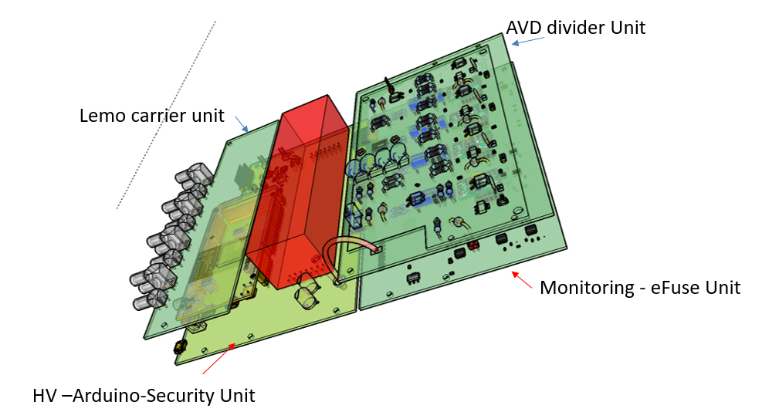
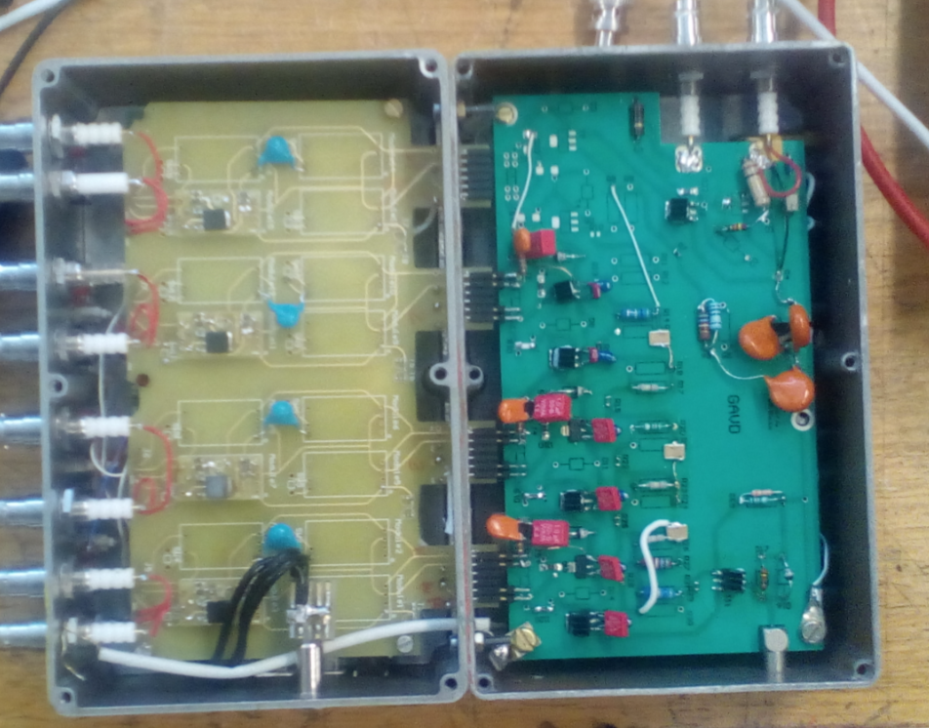
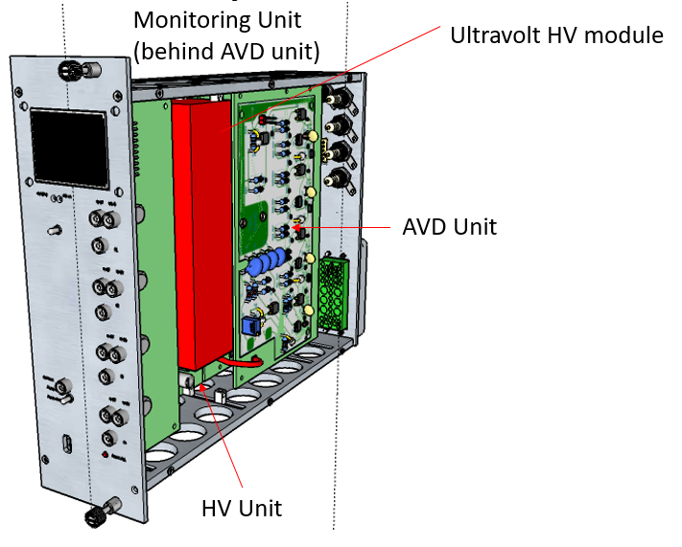
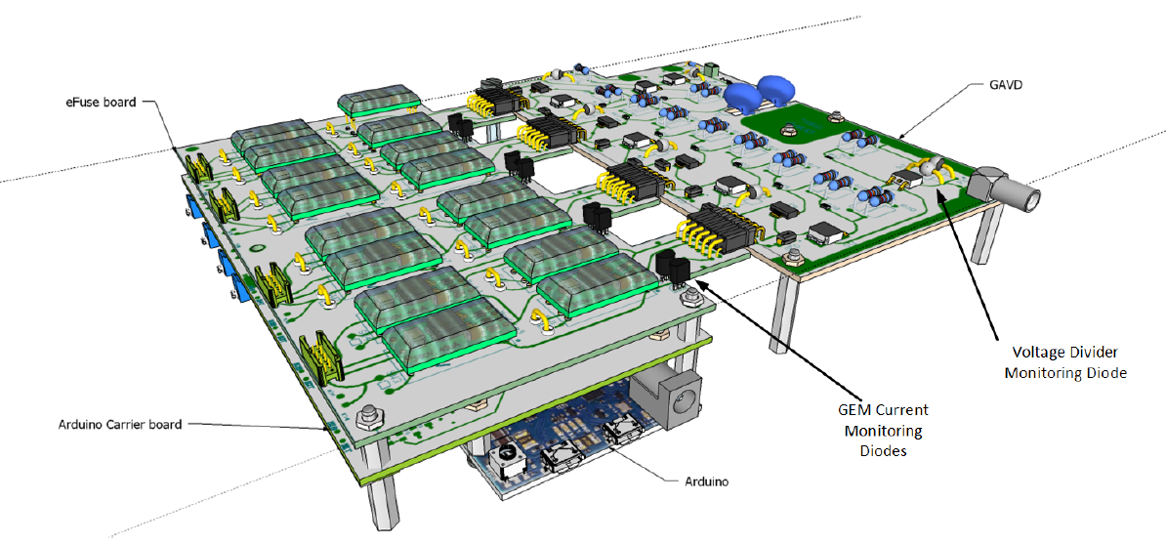
High Voltage for MPGDs: AIDA2020 Deliverable [M24]
Compact MPGD HV power supply: The desktop AVD is a remotely controllable, compact HV power supply for the operation of MPGD based detectors with up to nine user-defined fields. Specially designed for the operation of gaseous detectors, this supply includes active field stabilizers to compensate for dynamic loads and circuitry to protect from short circuits and sparking. The embedded control and monitoring system supervises all parameters and, associated with online Labview software, records and displays trending data of all HV channels. The front panel controls, combined with a status display, allow for local operation. The NIM-AVD unit will be fully contained within a dual-sized NIM module and, via a power adapter, it can be operated as desktop MPGD supply without NIM crate.
.. To demonstrator..
.. In view of indust./commerc. version
From Active Voltage Divider design..
Muller, H: https://indico.cern.ch/event/525268/contributions/2296989/attachments/1335971/2009486/AVD_NIM_for_Aveiro_2016.pdf
Dimitris, K. V.: https://cds.cern.ch/record/2047018/files/GEM%20voltage%20supply%20and%20real-time%20monitoring%20V.%20Karaventzas.pdf
Ginting, M. F. : https://cds.cern.ch/record/2205761/files/Program-Controlled%20HV%20Module%20in%20AVD%20for%20MPGD.pdf
Ginting, M. F. :https://indico.cern.ch/event/525268/contributions/2296989/attachments/1335979/2009499/High_Voltage_Module_in_AVD.pdf

Slide 9
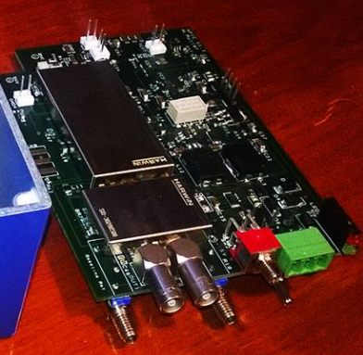
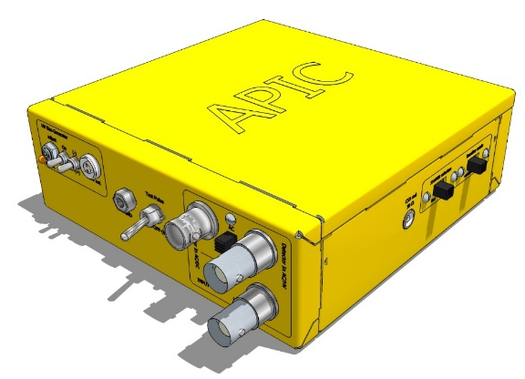
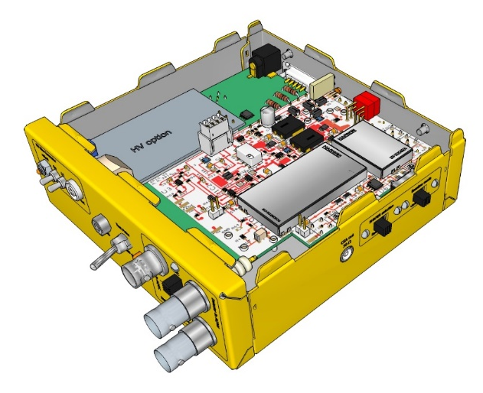
A-PIC.. CSA & shaper & ….
Prototyping completed (all components commercially available – nothing custom), Ready for industrialization/commercialization
50 OHM outputs: Preamplifier and 2 x Shaper (+)/(-)
Spark protection: 0-failure since > 1 year in experiments
Preamplifier gain 2mV/fC
AC Input coupling from HV planes (SHV) or DC from strips/pads (BNC)
SHV input for detector Bias Voltage ( RF filter included)
Gain trimmer 1-1000 (max +/-1.5V)
Baseline selection fixed (0V) or tunable +/- 1.5V
Input rates up 4 MHz rates with 20 ns shaper
MPGD version: shaper 20ns/400 ns
MPPC version: shaper 4000/8000ns
Test pulse 5ns rise time (switch permanent/off/ single)
Battery autonomy 24h, charger cables from NIM or Solar panel
Battery-low blinking LED
commercial APICs: NIM trigger (CSA), Bias 25-70V for MPPC

Slide 10
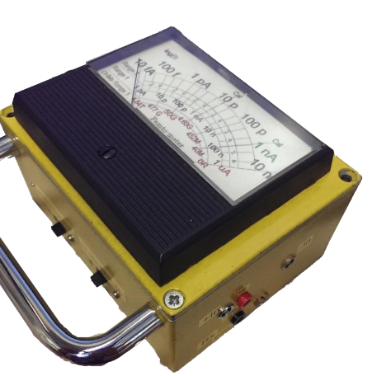
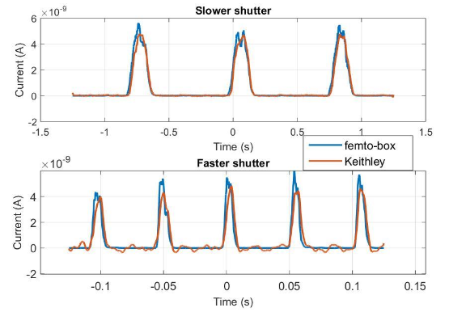
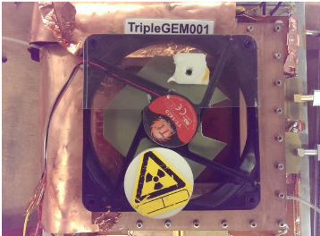
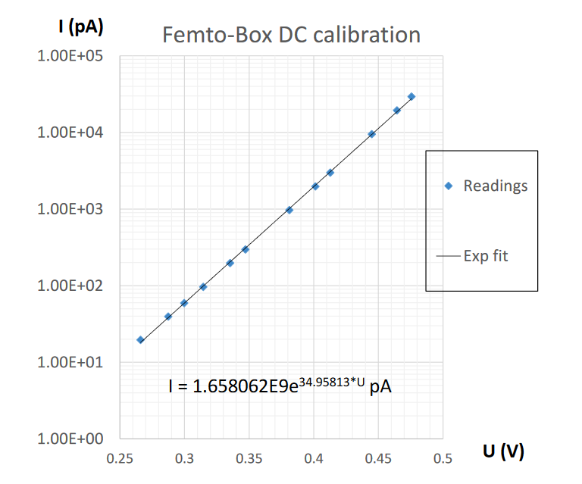
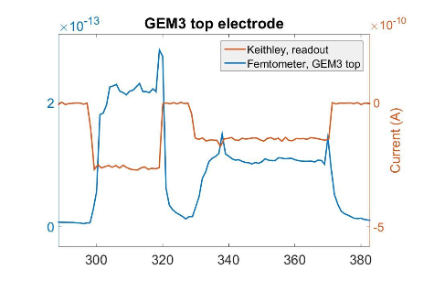
FemtoBox (femto ammeter) – Calibration Stability, Real-time and floating operation
Still Prototyping phase – no AIDA resources used until now
Calibration and stability
Real Time Anode Current readout with shuttered source
Optimization of the readout schema for fast response and double polarity readout done
Real-time measurement @ GND Real-time measurement floating
Floating Operation, preliminary tests: Electrons and ions (floating readout) currents on top/bottom GEM3 electrodes (shuttered source)
200fA
Keithley @ anode (gnd),
FEMTO floating
300pA
Studies performed within a 2016 CERN Summer Student Project
More details on: L. Kähkönen https://indico.cern.ch/event/525268/contributions/2296990/attachments/1335996/2009717/Femto-box_presentation3.pdf

Slide 11
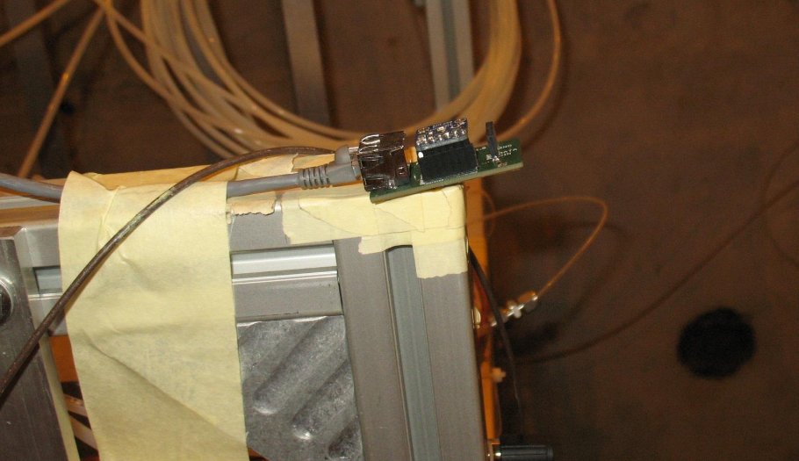
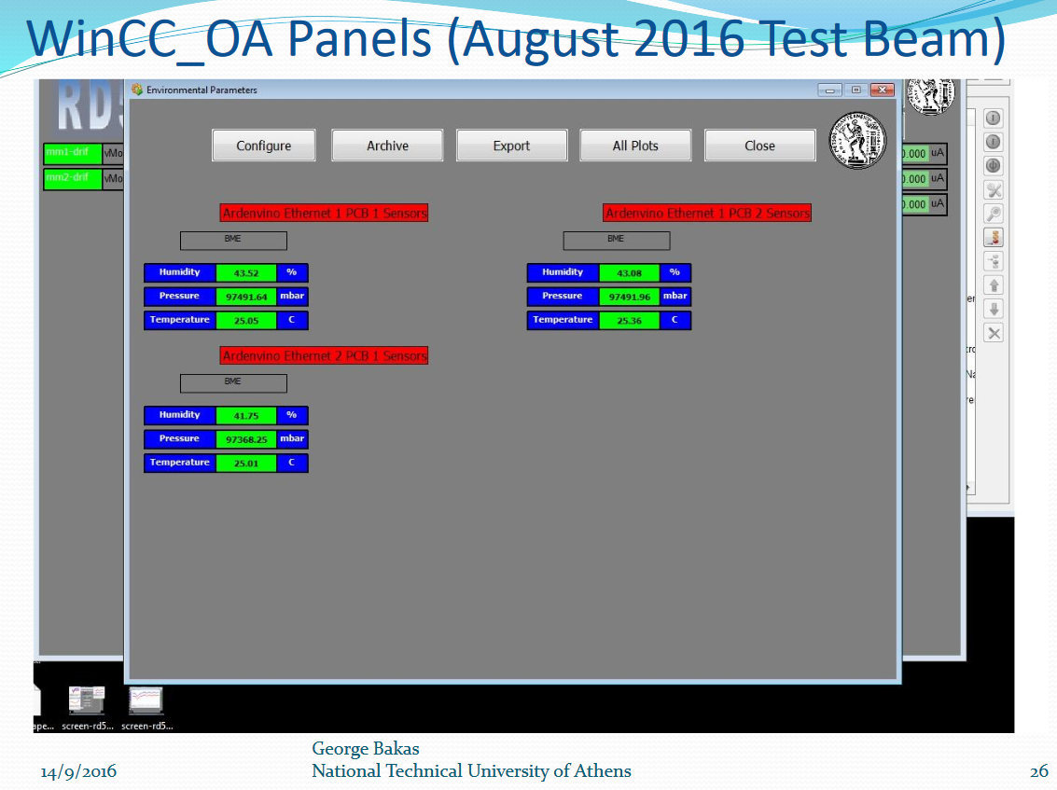
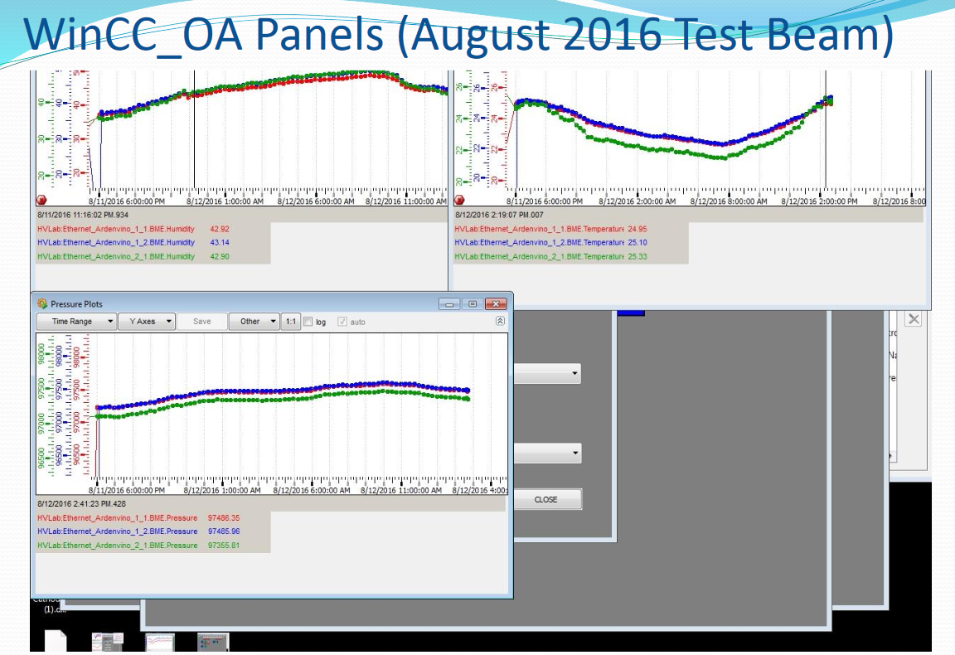
Microcontroller based monitoring System integrated in WIN_CC OA
Implementation of additional and delocalized sensors done
Control and monitoring Interface implemented in Win_CC DCS
Operation in RD51 test beam in the Slow Control DCS framework
Next: Raspberry Pi based version
More details on: G.Bakas https://indico.cern.ch/event/525268/contributions/2297858/attachments/1336293/2010154/presentation_port1.pdf

Slide 12
Instrumentation Summary…
Active Voltage Divider (High Voltage for multi electrodes MPGDs)
  Active Voltage Divider and e-fuse protection prototype done
  High voltage main power module implemented
  Control/Monitoring Software available
  NIM type version as a next step for the final version
Charge sensitive preamplifier & Shaper (APIC)
  Finalized and ready for commercialization
Femtobox
  New studies performed (new circuit implemented, calibration, real-time measurements and floating operation) – Still R&D Phase
PVSS/Win_CC integrated monitoring unit
  Arduino Version operative
  New Rasberri Pi Version in the plans
About 7.5k spent

Slide 13

Tools for MPGD developments
Control of foil/micromesh mechanical tensioning by optical techniques
WP 13
Task Coordinator L. Benussi

Slide 14
WP13
From AIDA2020 proposal
Control of foil/micromesh mechanical tensioning by optical techniques
  engineering an optical system for quality assessment of mechanical tensioning and flatness of MPGD films and meshes.
  prototyping integrated Fiber Bragg Grating sensors for monitoring the mechanical tension of MPGD films (GEMs) and meshes (MICROMEGAS).
Flatness of MPGD foils/meshes must be assured within about 100microns and monitored over long term detector lifetime (10-20 years)
Flatness QC during assembly
Continuous monitoring during operation
Sharing of activities among partners
Laboratori Nazionali di Frascati
  Engineering, Fiber Bragg Grating sensors deployment, tests in clean room
INFN Bari
  Film stretching mechanics
INFN Bologna
  Tests of stretched foils

Slide 15
WP13
Milestones
MS Number | MS Description | Task | Due by | Result type
MS13.8 | Optical system for the quality assessment of MPGD foil/mesh mechanical tensioning | 13.4.3 | M12 | Demonstrator
MS13.9 | Integrated FBG sensors for monitoring the mechanical tension of MPGD films and meshes | 13.4.3 | M24 | Prototype
Matched !
Report in
preparation
Milestones | Year 1 | Year 2 | Year 3 | Year 4
Design/qualify an optical interferometric system
Engineering interferometric system MS13.8
Qualify FBG sensors
Proof of concept integration of FBG MS13.9
Long term characterization of FBG
Qualification at test beams

Slide 16
WP13
Optical setup for Moiré fringes
Moiré interferometry for large area surfaces
Phase shift algorithm greatly improves resolution on transverse displacement
    R= ± 30um reached over small areas
    Engineering over large areas in progress
    Milestone JUNE 2016
White light projector and viewing TV camera equipped with identical objectives and grating (grating: 120 lines/mm)
Viewing TV camera on step-motor translation stage to implement precise Phase Shift
Setup optical geometry: reference plane perpendicular to bisector of angle between projection and
viewing direction
Procedure:
  Optimize intensity and contrast of Moiré fringes with live visual inspection of un processed image;
  Define required translation of TV-camera to produce 360° degree Phase Shift;
  Grab n.5 images with precise phase shift and PC-processing according to 5-bucket algorithm

Slide 17
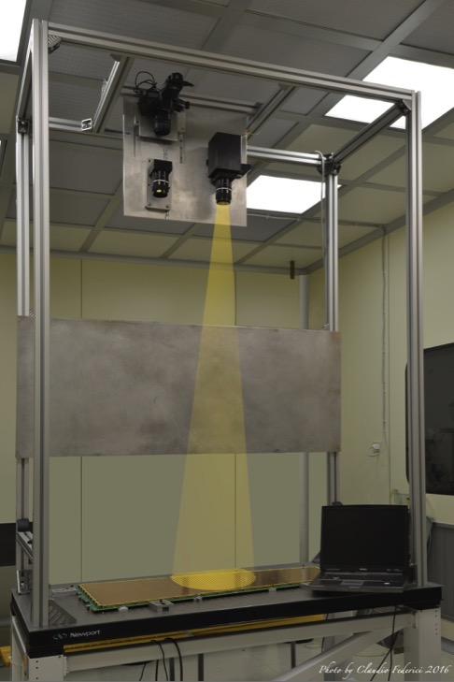
WP13
Optical setup for Moiré fringes, large size version
Project Ronchi grating on MPGD
View Ronchi grating through second identical grating
Detect Moiré fringes
View Moiré fringes
3
1
2
After completing the system engineerization, focus of work
on solving light reflex on full GEM chamber surface making
the fringes non optimally clear
Also analyzing the calibration wedge
The light reflection solved by tilting the GEM chamber (about 10deg). This introduces a global fringe shift known and easy to be corrected.
4

Slide 18
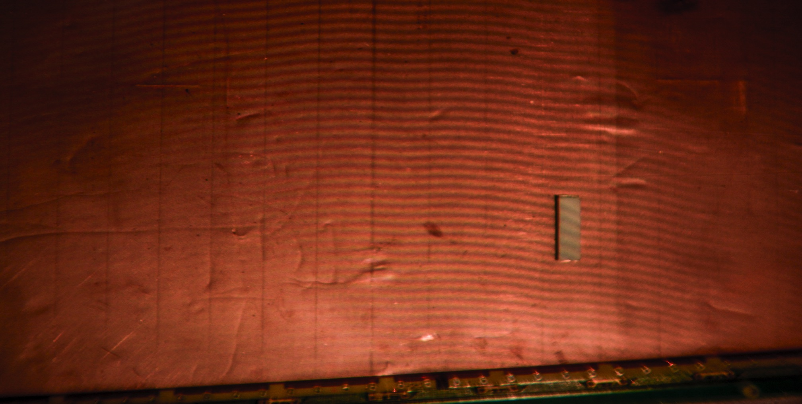
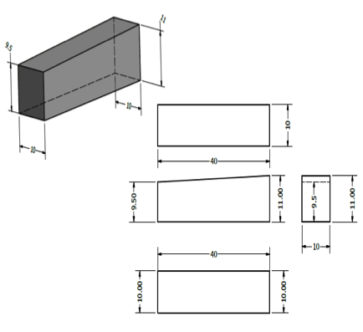
WP13
Optical setup for Moiré fringes
Wedged specimen is used for resolution calibration
A first evaluation of the Resolution R con be done by counting N fringes between points with known Δh provides resolution R (points are chosen at center of dark fringe for best precision) can be easily calculated R = Δh/N. For the specimen used we have Δh=1.5 mm
Real full image
If we are able to evaluate possible substructure or light intensity variations between the N fringes the resolution R can be further improved

Slide 19

WP13
Optical setup for Moiré fringes
Real full image
After the Phase-shift corrections 16 fringes are visible on the total specimen length.
Real image specimen piece
Software generated
without phase shift algorithm
By applying 5 bucket
phase shift algorithm

Slide 20
WP13
Optical setup for Moiré fringes
Between the 16 fringes is clearly possible observe the variation from dark to light pixels represented in the upper plot by the slopes between the peaks (the dark max of the fringes). By evaluating the slope we can assume we can appreciate 1/3 of the single peak height.
This leads to the resolution R = Δh/N = (1500/16)*(1/3) = 31 μm, very close to the target resolution of 30 μm

Slide 21
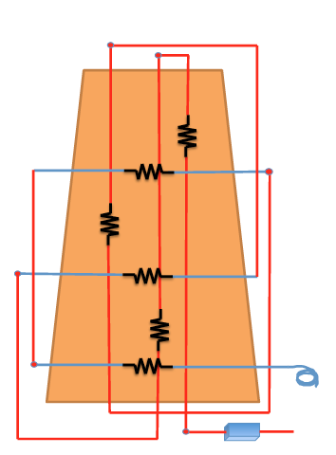
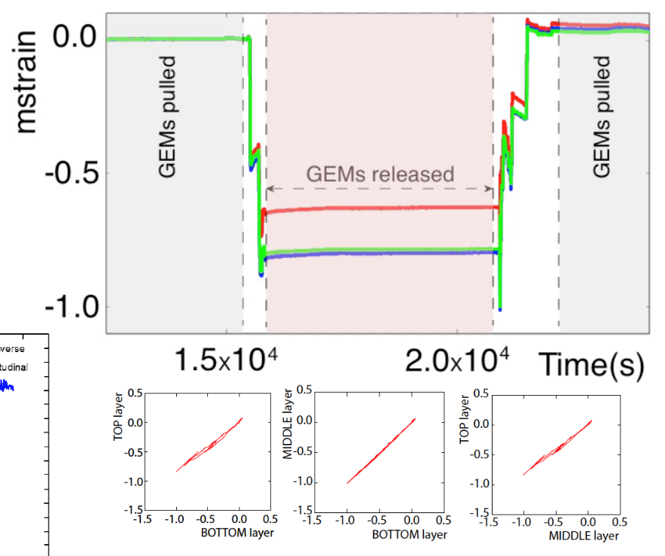
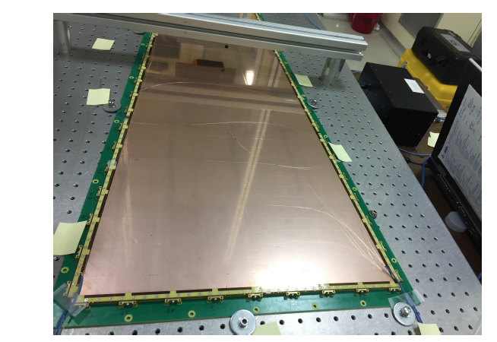
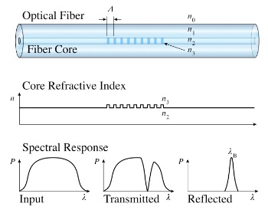
WP13
FBG sensors embedded in MPGD detectors
A Fiber Bragg Grating (FBG) is a type of phase Bragg grating written in a short segment of optical fiber that reflects by diffraction only specific wavelengths of light and transmits all others. The sensitivity of FBG in terms of strain, relative elongation w.r.t. the initial length is of the order of 1 p.p.m. A FBG can therefore be used as a strain measurement tool since variation of the FBG translates into different light frequency response. In order to validate the mechanical stretching technique used in GE1/1 assembly we affixed a network of FBG sensors

Slide 22
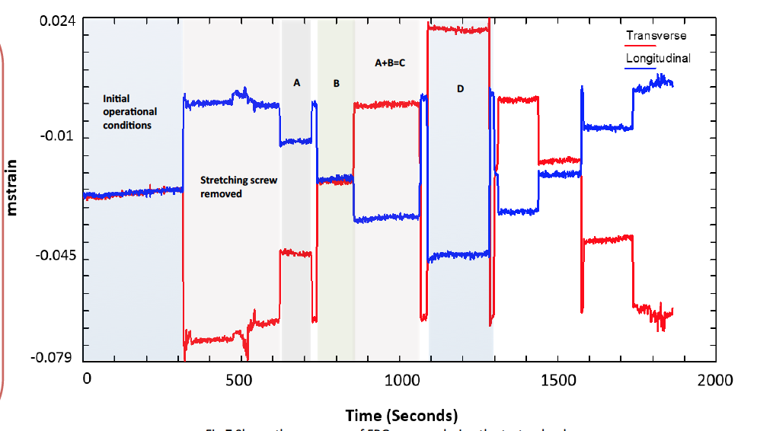
WP13
FBG as tensile load gauge
Another important application of FBG in GEM chamber construction is the possibility to perform precise measurement of the tensile load applied to the foils, of the different layers, in the same moment.
We successfully verified the possibility of this idea on a large size area triple GEM chamber (~1m²)
☞ Not in the AIDA2020 original program. NEW IDEA!
GEM foil
FBG
Sample weights

Slide 23
WP13
Conclusions
Target resolution than 30um reached with Moiré setup✓
Moiré Engineering demonstrator ready (milestone M12) ✓
FBG test on CMS GE11 chamber completed successfully both as tensile load monitor and as tensile load gauge✓
Both task have been successfully completed ✌︎
Results have been presented in several international conferences during last year.
  Elba2015
  MPGD2015
  IWASI2015
  EPS2015
  SIF2015

