Slide 1
AIDA 2nd ANNUAL MEETING
WP13 Task 4.2 and 4.7
Gaseous detectors Task 13.4.7
MPGD detectors to industry
Preparation for large series production: standard production protocols of optimized MPGD components to ease technology dissemination
(project leader : Fabien Jeanneau)
Gaseous detectors Task 13.4.2
Resistive anode Micromegas
Preparation for large series production: procedures and tools for large series resistive micromegas anodes
(project leader : Stephan Aune)
These two tasks are very interrelated. The Resistive Anode task has a deliverable now (D13.7 for M24)

Slide 2
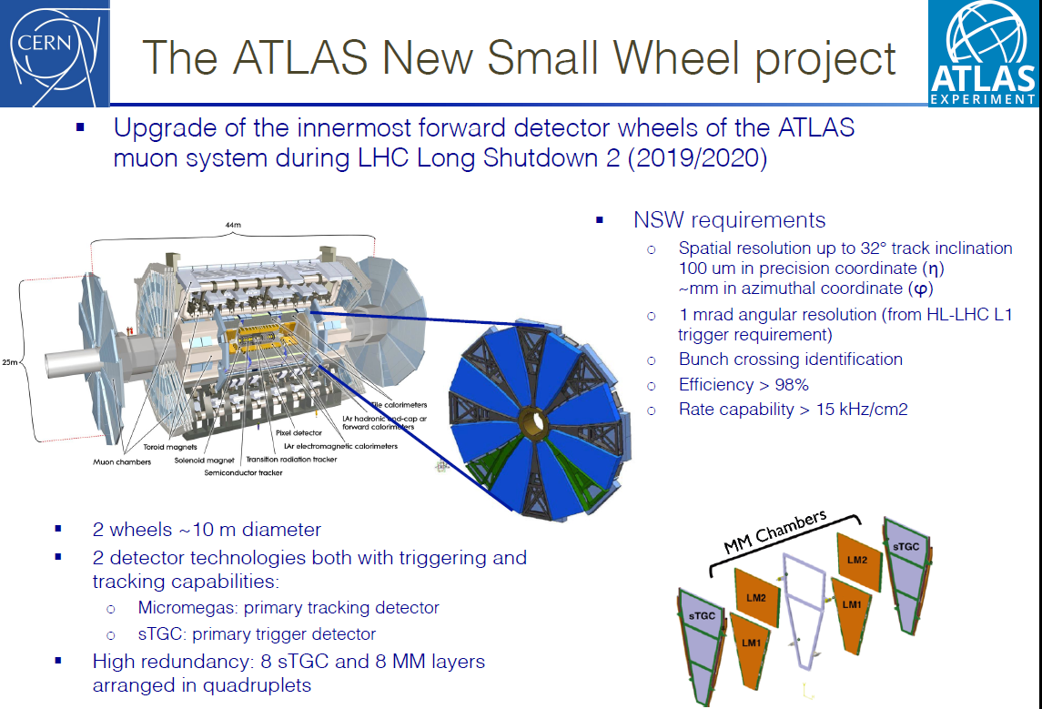
ATLAS NSW
P. Iengo, RD51, Feb 2017

Slide 3
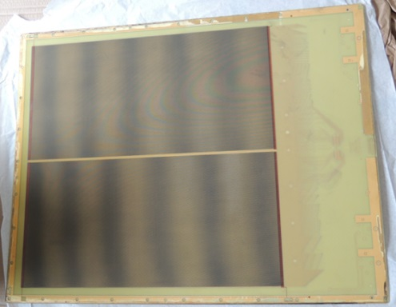
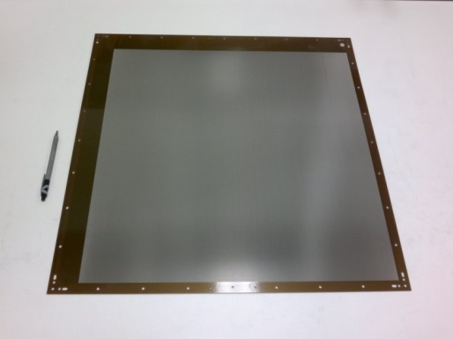
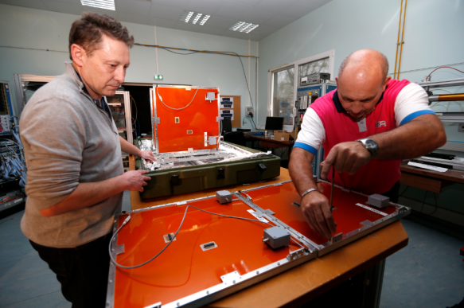
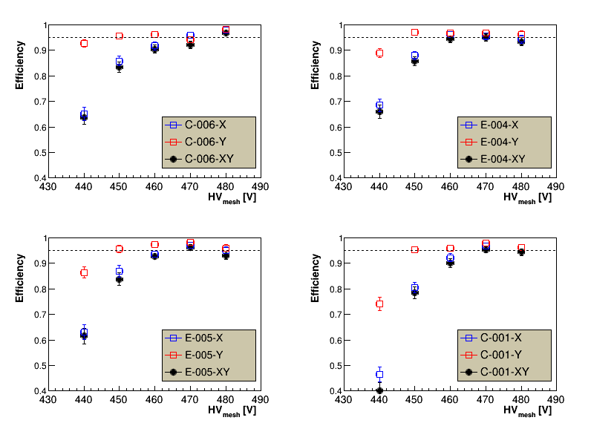
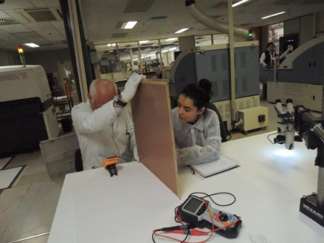
R&D – know how transfer
→ Know-how transfer to ELVIA-PCB since several years
LARGE MICROMEGAS FOR NSW (ATLAS MUON CHAMBERS)
2013
End 2015
March 2016
Transfer in progress
First operational prototypes in 2015
Now NSW under construction
Compatible performance between Cern and Elvia prototypes
CERN
ELVIA
ELVIA
CERN

Slide 4
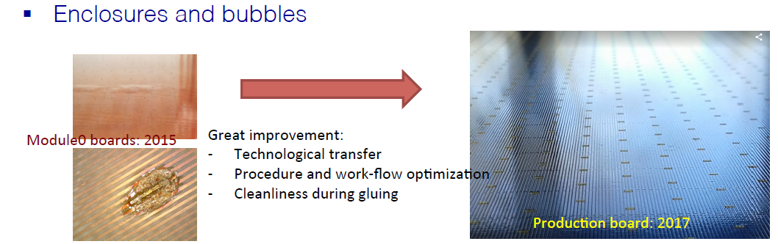
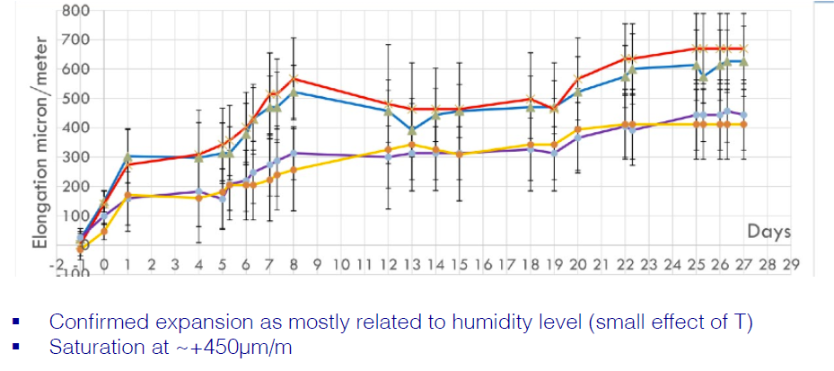
Improvement of the quality

Slide 5
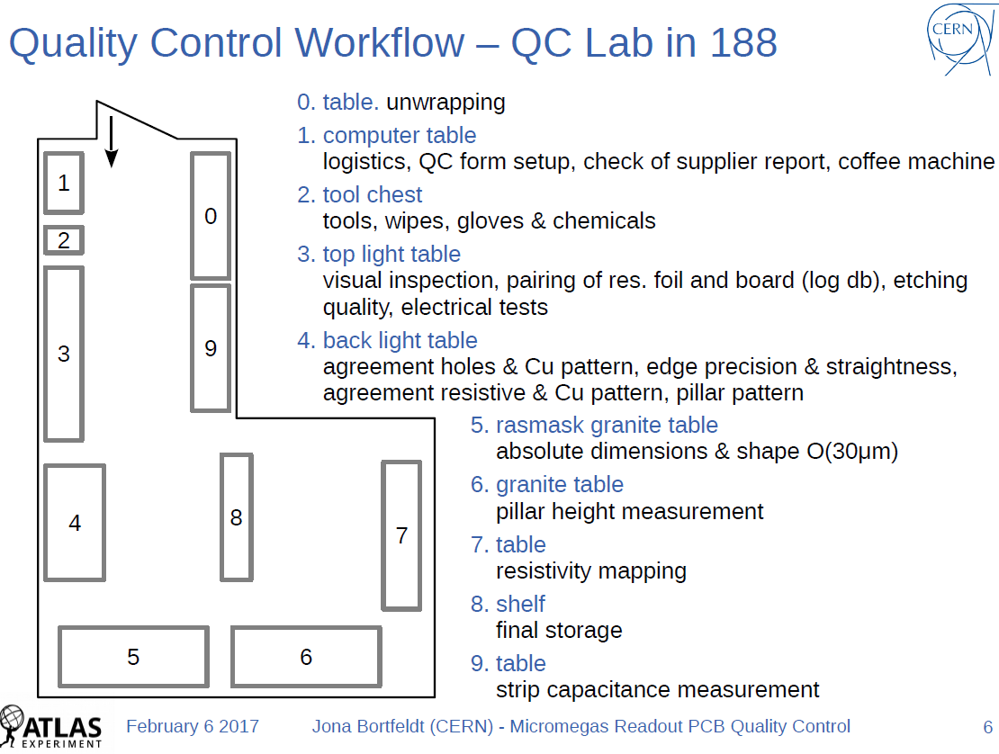
PRODUCTION – Quality Control
→ Now ELTOS and ELVIA are doing the production and CERN is doing the QC

Slide 6
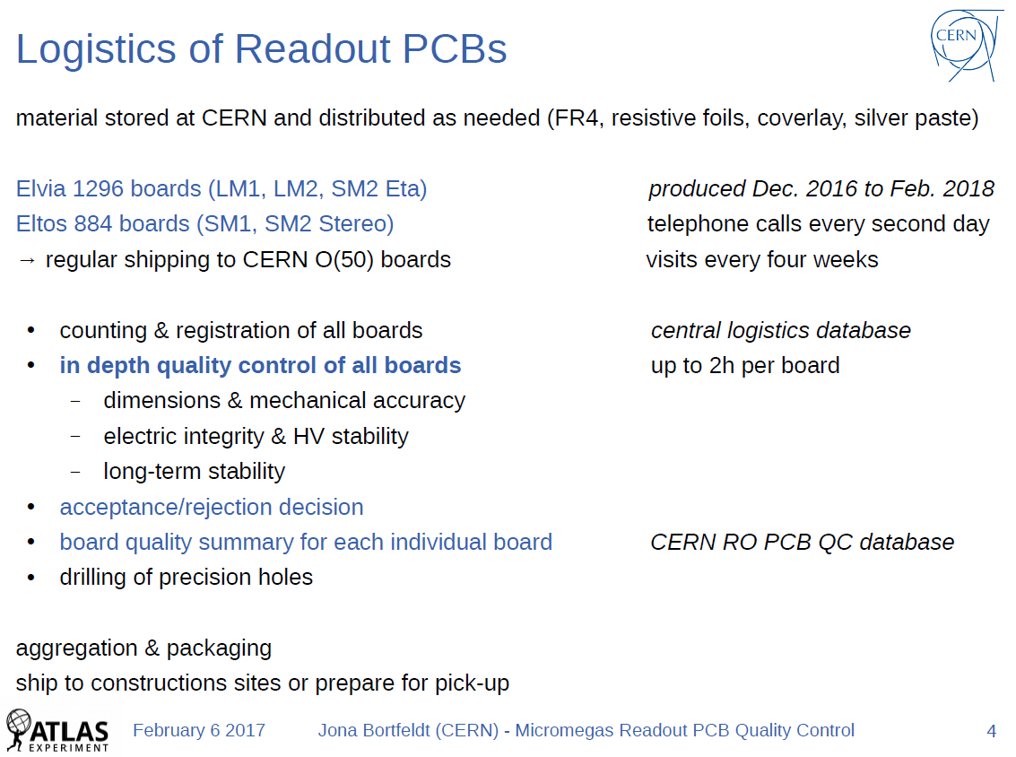
PRODUCTION – Quality Control

Slide 7
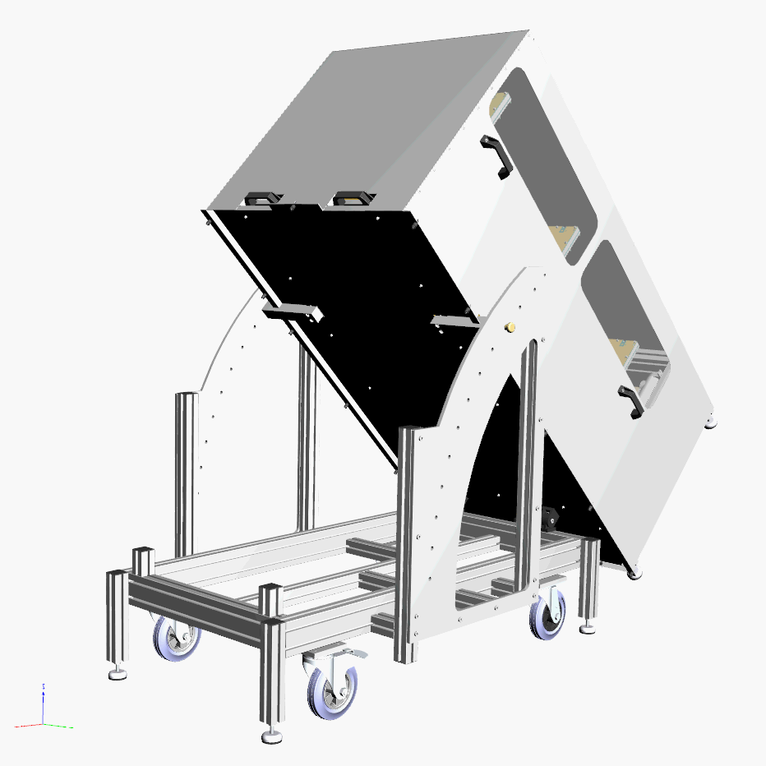
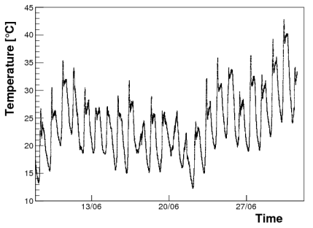
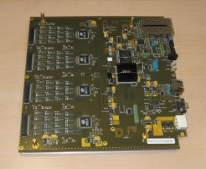

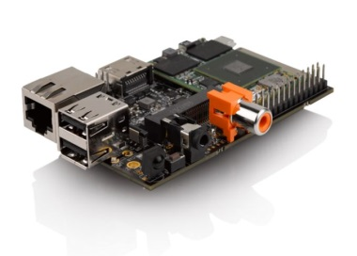
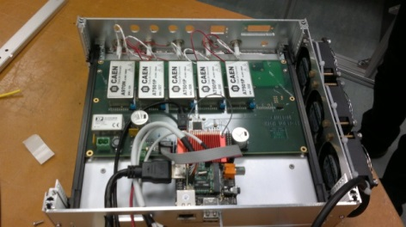
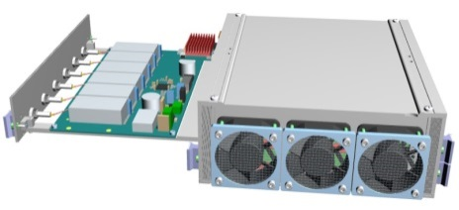
A system for muon tomography
1st muon telescope with multiplexed Micromegas
→ 1st use of MM tracker outside
Temperatures fluctuations from 11 to 43°C
Online feedback on T (P)
→ FEU from Clas12
→ Self-trigger mode
→ Miniaturized CAEN HV modules
→ Nano-PC (Hummingboard)
Set & monitor HV
Acquisition & storage
→ Compact electronic system
→ 30 W of consumption
→ 3.5 months of data taking
Including 1.5 on battery + solar boards
S. Bouteille, S. Procureur et al. Large resisitve 2D Micromegas with genetic multiplexing …

Slide 8
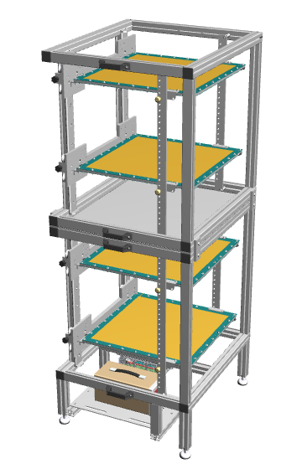
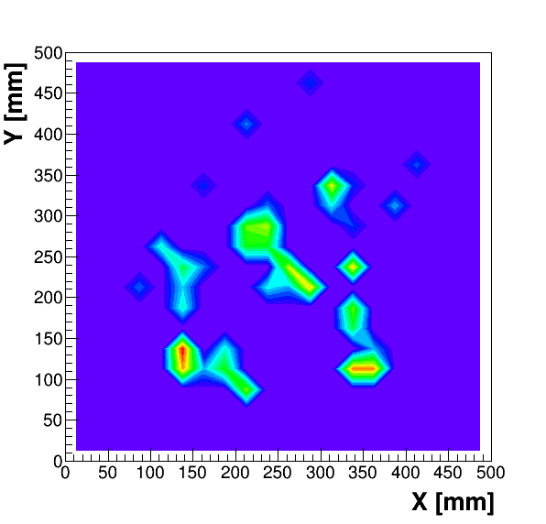
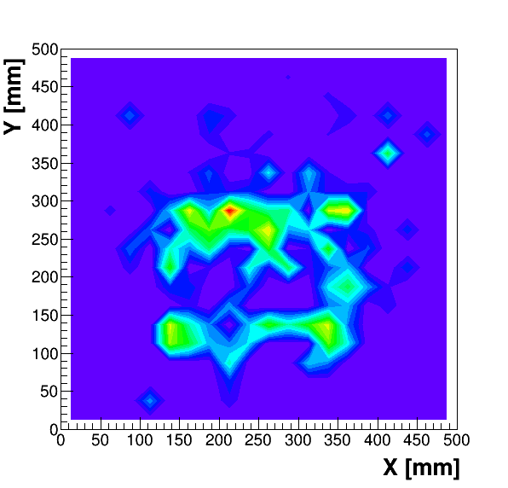
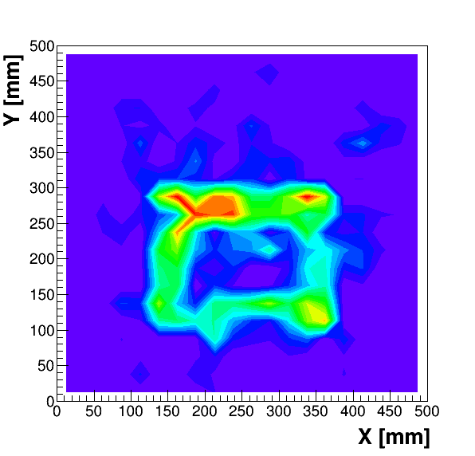

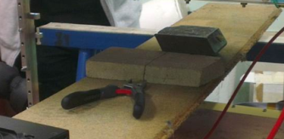
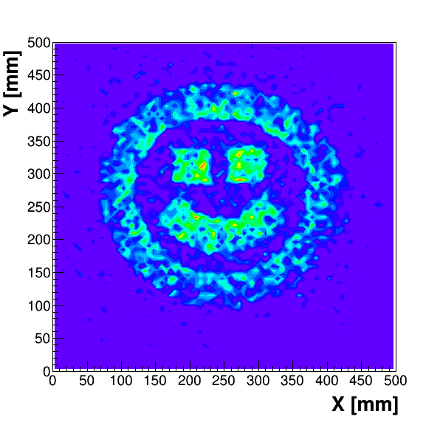
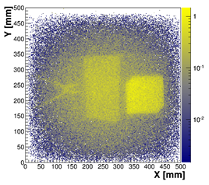
Muon Tomograpy projects:
TomoMu, Mcube, MIMOSA
Small setup for communication purpose (La Diagonale Paris-Saclay)
→ 4 MG2D-v2 detectors
2’
10’
30’
Lead Square
→ Can be used as a transportable
scanner for in situ imaging:
Instrument unique in the word, benefit
from excellent resolution of MM
« Muona Lisa »
S. Bouteille, S. Procureur et al. A Micromegas-based telescope for muon tomography: the WatTo experiment

Slide 9
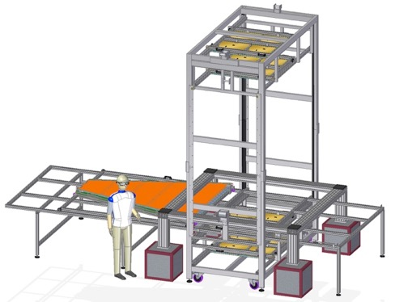
Cosmic test bench for Atlas/NSW modules
full test to obtain a gain homogeneity and efficiency map, identify dead channels and noisy channels
Use of cosmic bench made out of Micromegas multiplexed detectors for the M3 projet at Saclay
12 Micromegas detectors (0.5 x 0.5 m2) with DREAM electronics
Scan LM1 module in 5 steps with DREAM electronics

Slide 10
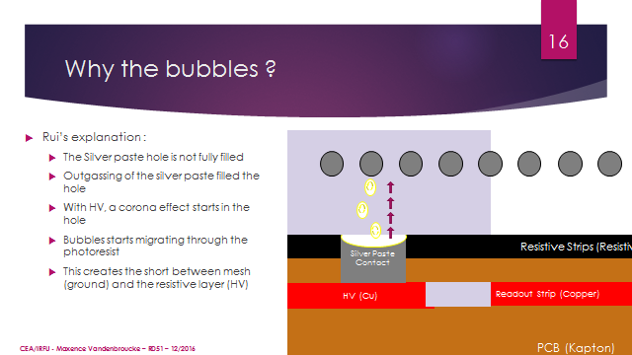
Improvement of reliability : interplay CLAS12/NSW

Slide 11
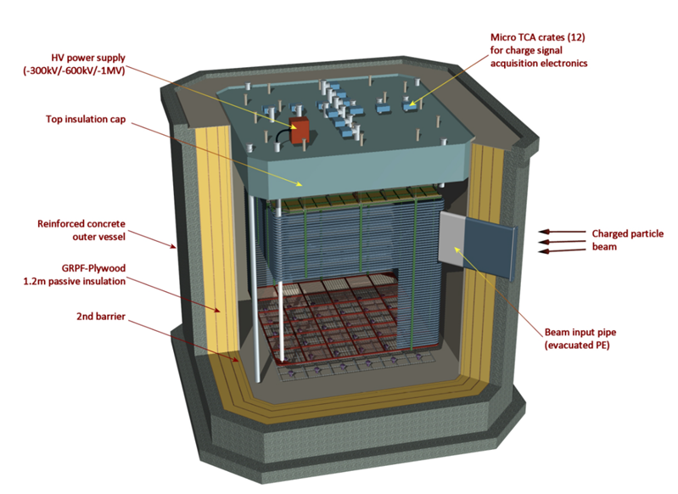

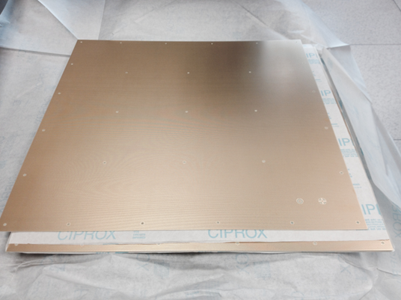

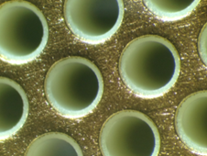
The WA105 Project at CERN
300t fiducial mass (6×6×6m³) TPC operating in Dual phase Liquid Argon (DLAr)
Aim to demonstrate the scalability of the DLAr technique to ∼10kt detectors for the future neutrino programme DUνE in U.S.A. (∼2025)
WA105 : 36m² readout plane instrumented with 144 MPGDs of LEM (Large Electron Multiplier) type
LEM :
  1mm thick FR4 substrate with thin copper sheets on both sides
  50×50cm² active area
  amplification through φ =500 µm holes (800 µm pitch)
  40 µm rim
  read out by charge collection
  with A 2D anode
6m
LEM
6m
50 × 50 cm²
800 µm
∼ 450k holes !
E_{LEM} > 30 kV/cm
in pure Ar @ 87°K
500 µm
The WA105 DLAr demonstrator
40 µm
HV

Slide 12
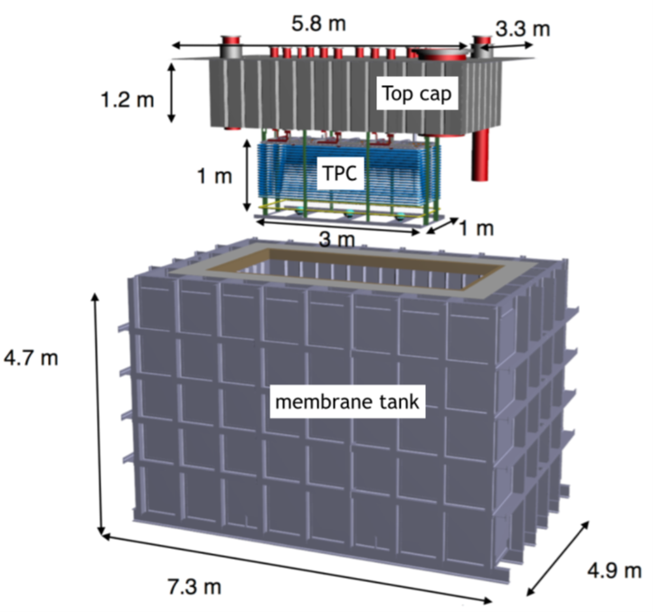
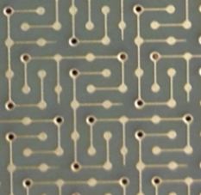
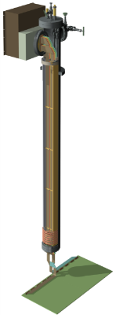
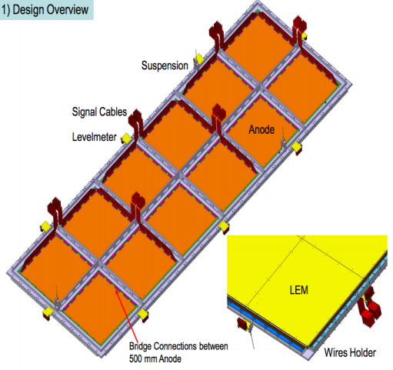
The 3×1×1m³ DLAr prototype
The 3m³ prototype is being assembled in Bldg. 182 at CERN
Aim to validate the technical solutions for the 300t WA105 demonstrator (under construction at prevessin)
Commissionning delayed by insulation defect
Now ELTOS and ELVIA involved in a pre-production. Both are satisfactory.
X-Y symmetric
anode
The Charge Readout Plane

Slide 13

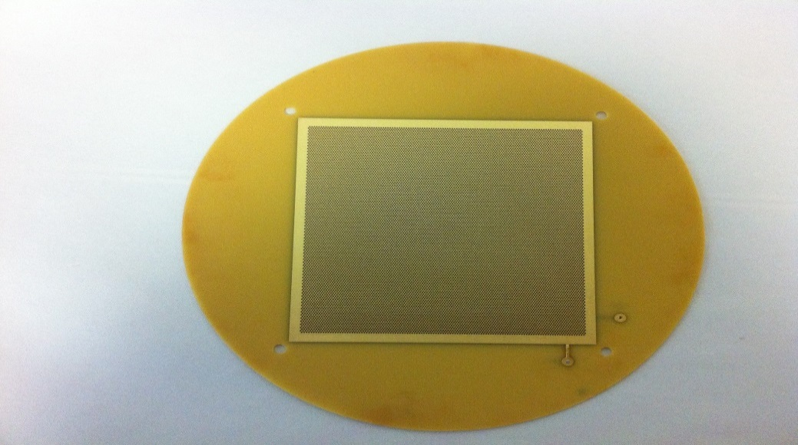
Partnership with ELVIA
Started in February 2016 a partnership with ELVIA (France) in view of the future LEM production for the WA105 demonstrator :
  LEM specifications, tolerances and construction process (drilling, desmearing, polishing, …)
  Visit by Irfu of the production site in Coutances (May 2016)
First production of small (10×10cm²) LEM prototypes (April 2016):
  Geometry quality (PCB thickness, size of holes and rims, …) is ok
  HV tests in air ok (up to 3.5 - 4.0kV)
  Gain measurements with α source in argon @NTP
Then 50×50cm² LEM samples have been produced by ELVIA
10×10 cm²
LEM prototype
1 mm thick
500 µm hole
with 40 µm rim

Slide 14
Resistive anode techniques
Resistive anode stabilizes Micromegas and allows a charge spreading necessary to improve resolution of Micromegas
Can be applied to other MPGDs but necessary for Micromegas
Many open ways to be explored to apply the resistive material: screen printing, sputtering, painting, film lamination, etc…
Several techniques are used and developed to measure surface resistivity of a coverlay.

Slide 15
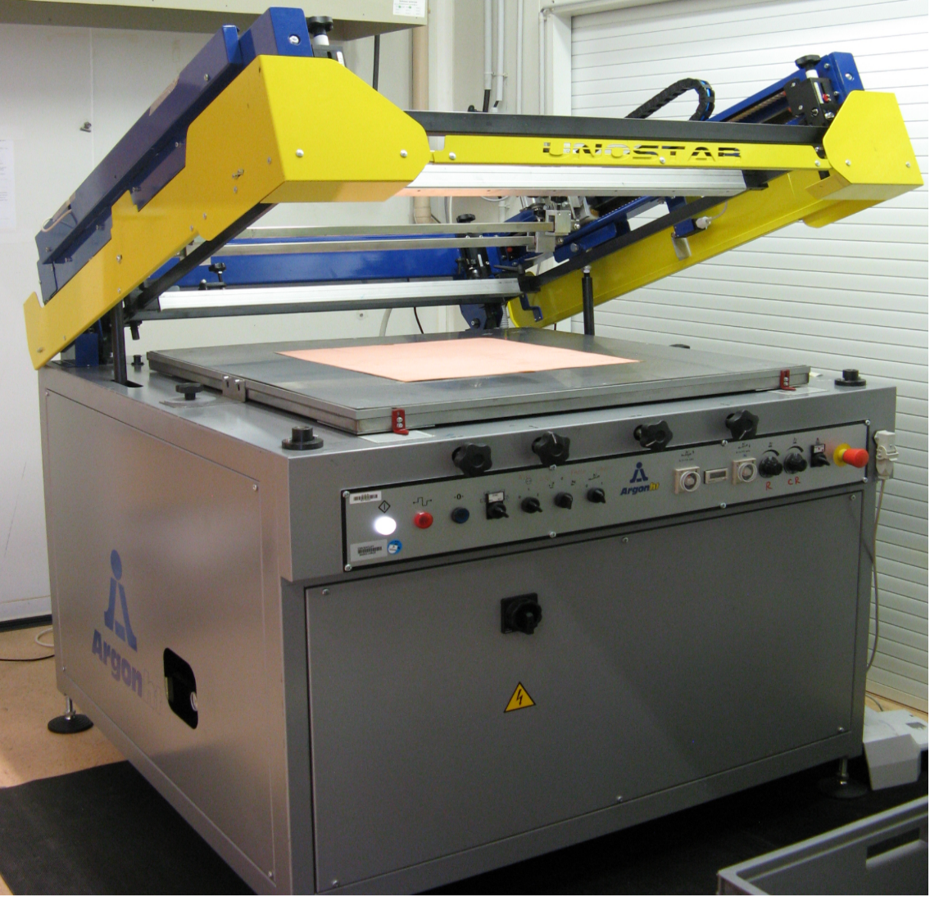
RESISTIVE MICROMEGAS AND RPC
Screen printing machine used on various materials (glass, kapton,…) with various inks and various patterns (Uniform, strips)
Protocols have been developped (curing temperature, curing time, uniformity test,…)
Tools have been designed or acquired (resistivity measurement, alignment)

Slide 16
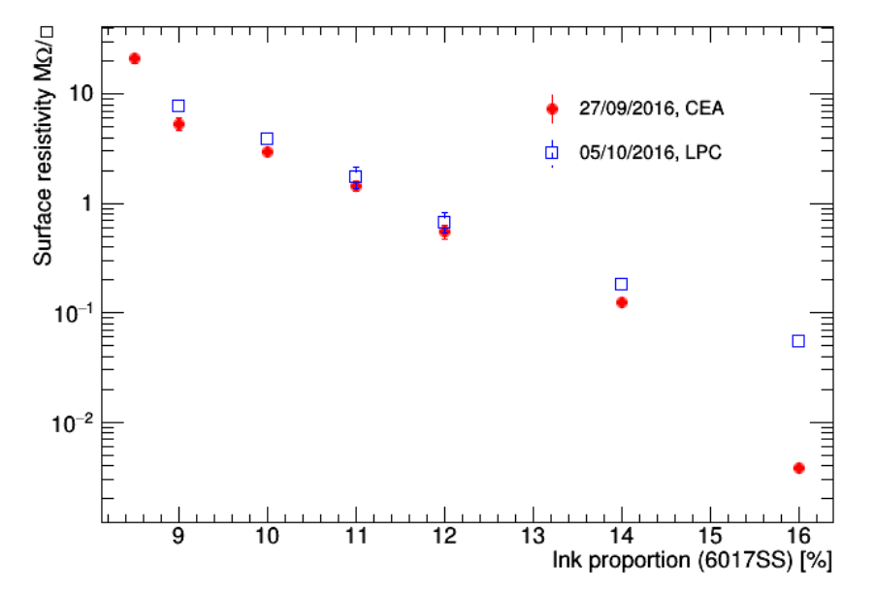
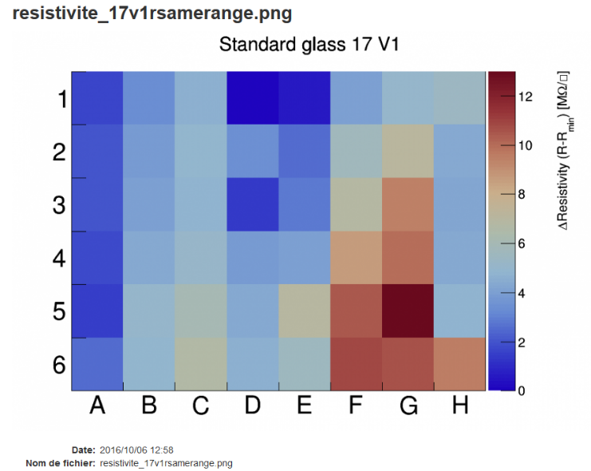


Recent developments
The bi component paste (Electrodag 6017SS + PM-404TM) resistivity can be adjusted.
Uniformity test

Slide 17
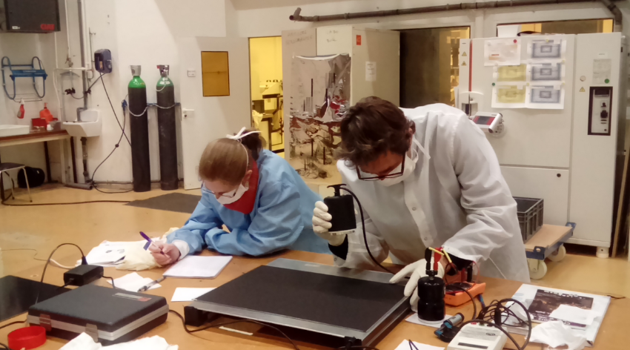
DELIVERABLE D13.7 being completed
S. Aune and C. Carlogenu measuring the resistivity with a circular probe in the bulk lab at Saclay

Slide 18
STATUS SUMMARY (after 2 years)
Total Spending after 24 months : 32600 euro out of 95000 and 8.3 person.months out of 15.
Several techniques being developped, experience of transfer to industry gained and monitored, very positive results:full large resistive and standard detectors under construction IN INDUSTRY
ELVIA and ELTOS are involved in Micromegas (NSW) and LEMs/THGEMs (WA105). Other large Micromegas for Muography. Resistive techniques are developped for muography (volcanos, pyramids)
Thanks to S. Aune, D. Attié, A. Delbart, F.Jeanneau, M. Kebbiri, E. Mazzucato and Nathalie Laurion

Slide 19
BACKUP

Slide 20
Project characteristics
Project leader : Stephan Aune
Beneficiary : CEA
Net EU contribution : 65 k€
Milestones (internal) : Purchase of material, screen design, Screen printing tests (M12), resistivity measurement techniques, tool design and purchase (M24); redaction of the protocol. Reports in RD51.
Deliverable : Resistive anode manufacturing (protocols and tools for the large-size and large-scale production of resistive anodes for MICROMEGAS)

Slide 21
Project characteristics
Project leader : Fabien Jeanneau
Beneficiary : CEA
Other contributors : CERN, …
Net EU contribution : 35 k€
Milestones: Protocol and specifications for MPGD production and quality control (M36)
Internal Milestones: orders of detector series to at least two PCB companies (M8) characterization and tests and iterations.
Deliverable. Report on working detectors.

