Slide 1
WP 11.5: University of Birmingham MC40 Cyclotron
Tony Price (on behalf of the UK irradiation team)
AIDA-2020 2nd Annual Meeting, Paris
5th April 2017

Slide 2



The UK irradiation team
David Parker (AIDA-2020 Responsible)
Mike Smith
John Wilson
Kostas Nikolopoulos
Phil Allport (AIDA-2020 Contact)
Laura Gonella
Tony Price
Juergen Thomas
Imran Iqbal
Daniel Briglin
James Broughton
Matt Baca
Jack Lindon
Paul Dervan (ATLAS-UK Irradiations)
Gianluigi Casse
Sven Wonsak
Richard French
Hector Marin-Reyes
Paul Hodgson
Kerry Parker
Evangelos Kourlitis
Sam Edwards
Paul Kemp-Russell
Simon Dixon

Slide 3
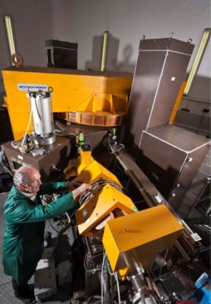
MC40 Cyclotron
The MC40 cyclotron at the University of Birmingham is primarily used for radio-isotope production for mainly medical applications
Proton energies up to 40 MeV possible at extraction
Currents ranging from pA to μA
It was commissioned as an irradiation facility for particle physics in early 2013 and has irradiated over 300 samples
Established through STFC support for UK ATLAS Upgrade
AIDA-2020 Transnational Access Facility as “Remote Scientific Service”

Slide 4
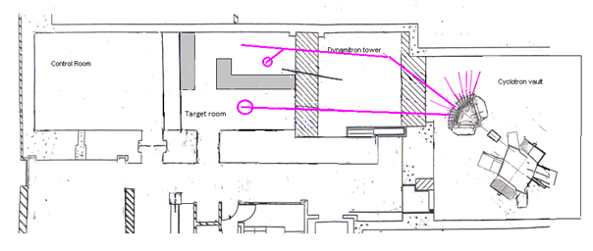
Irradiation Facility
Proton current: up to 2μA (cooling permitting)
Beam spot: 10mm × 10mm via collimation
Flux: up to 10¹³ protons/s/cm²
Typically:
E_beam= 27MeV
I_beam = 0.1-0.4μA
ATLAS/AIDA
Metallurgy (UoB)
Control room
Shielding
Cyclotron
Medical and Nuclear Physics (UoB)

Slide 5
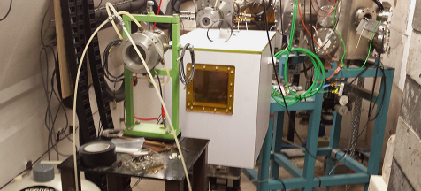
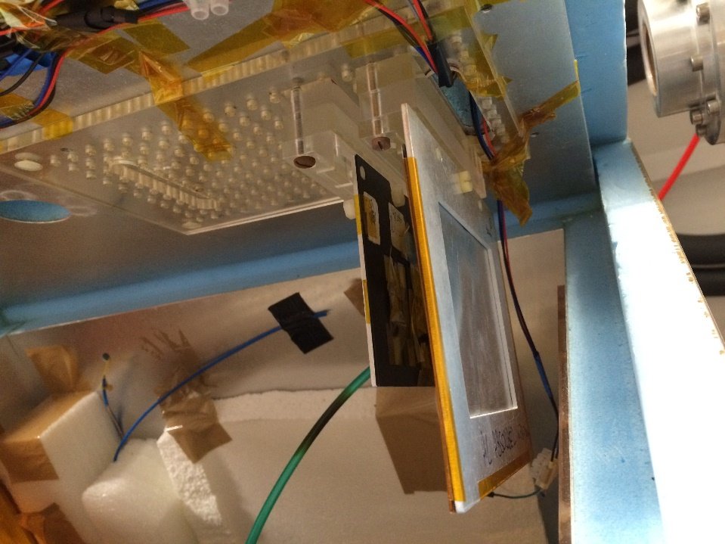
Irradiation setup
p beam
Beam pipe
Faraday cup
XY-axis scanning system allows areas of 15cm×15cm (orthogonal) to be uniformly irradiated
Liquid nitrogen evaporative cooling system (‘Norhof LN2’). Typ. T = -27ºC during irradiation
Dry N2 is used to keep low humidity. Typ. RH = ~10% during irradiation
Sealed feed-through allow external read-out and monitoring during irradiation
Samples are suspended from the lid in the box
0.3mm aluminum absorber in front of samples used to remove low energy components
Faraday cup after samples used to measure beam current
Cold box
Absorber
Samples

Slide 6
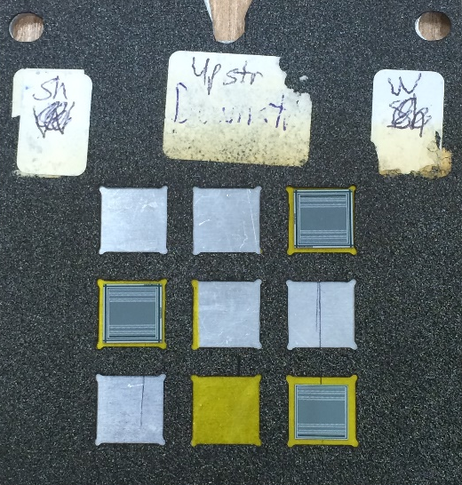
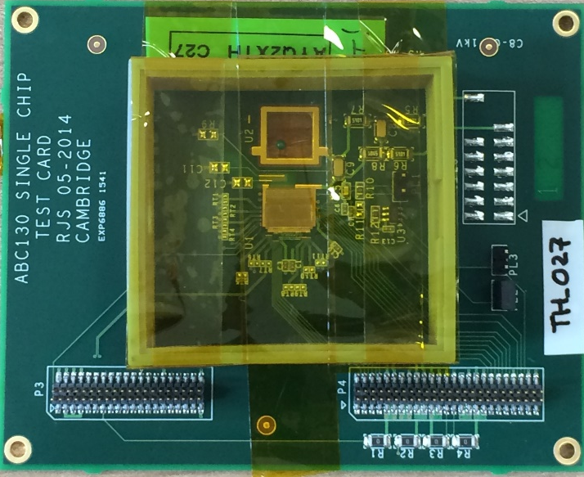
Samples preparation
ATLAS12 mini sensors (strips)
Carbon fiber frames are available to predetermined dimensions to fit bare sensors
Sensors are held in place with kapton tape
For ASICs on PCB a 3D printed frame is used to protect the wire bonds
Carbon frame with sensors/PCBs fixed to Al-frame which can be fixed to the lid of the box
Nickel foils cut to appropriate areas are placed in front of the sample to determine the fluence
ABC130 chip on PCB

Slide 7
Irradiation modes
Scanning irradiation
  Sample equal or larger in area than the beam
  User specified scan path to ensure uniform irradiation
  Typ. samples are scanned in 2.5mm spaced rows at an horizontal speed of 4mm/s
Point-to-point irradiation
  Sample smaller than the beam
  Fixed beam position
  More sensitive to beam non-uniformity
Gafchromic film is used before irradiation to measure the beam position and profile to set the scan parameters/beam position on sample

Slide 8
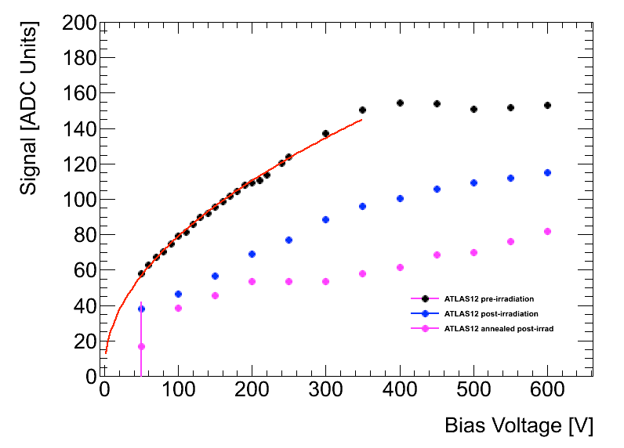
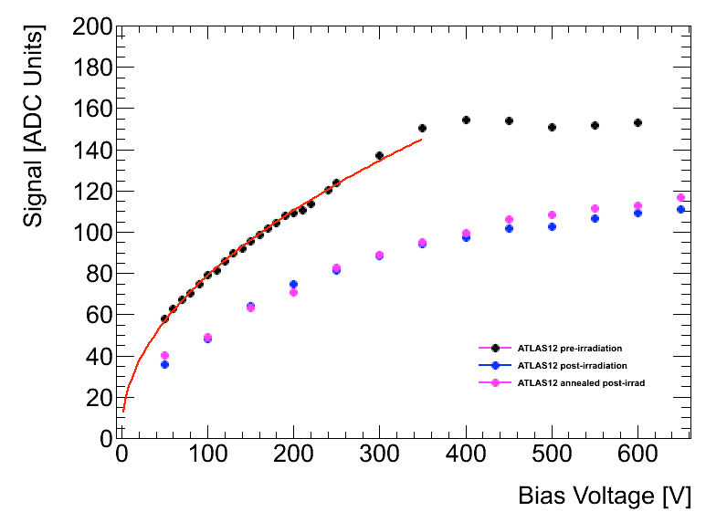
Early Results and Problems
Pre-rad Irrad Annealed (80min@60ºC)
ATLAS12 mini sensor
0.5*10¹⁵n_{eq}/cm²
However, for quite a few irradiation runs at the Birmingham cyclotron the signal has been seen to be anomalously low compared to results at other facilities for the same fluence
These irradiation samples also showed evidence of broad clusters
Prague, Freiburg and Santa Cruz also reported reduced inter-strip isolation for sensors irradiated at Birmingham
In some cases, annealing tended to further reduce the signal
ATLAS12 mini sensor
0.5*10¹⁵n_{eq}/cm²

Slide 9
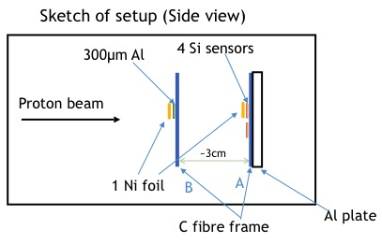
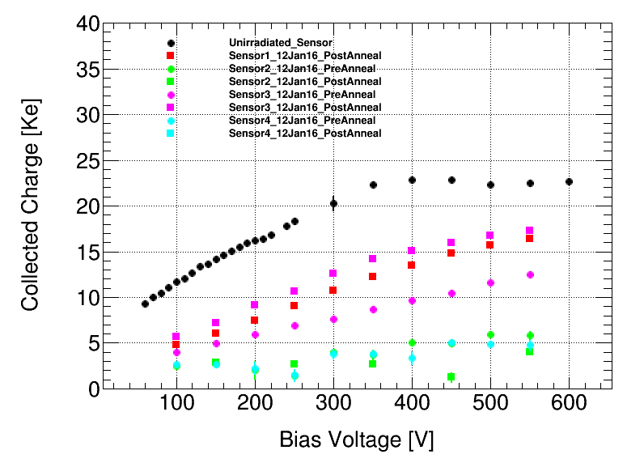
Investigations
ATLAS12 mini sensors
Scanning mode irradiation, I = 100nA, v = 4mm/s
0.5*10¹⁵n_{eq}/cm²
Sensors downstream (i.e. behind 0.3mm of Al) show good results
Kapton enclosure and Ni foil make no significant difference

Slide 10
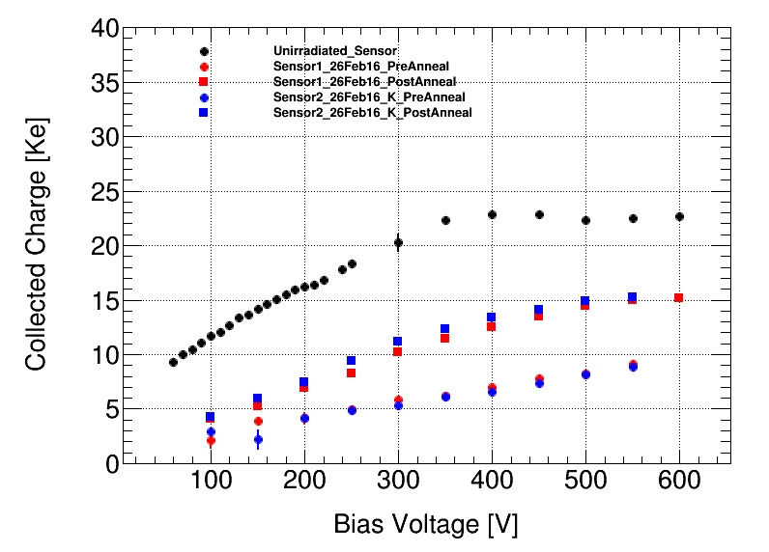
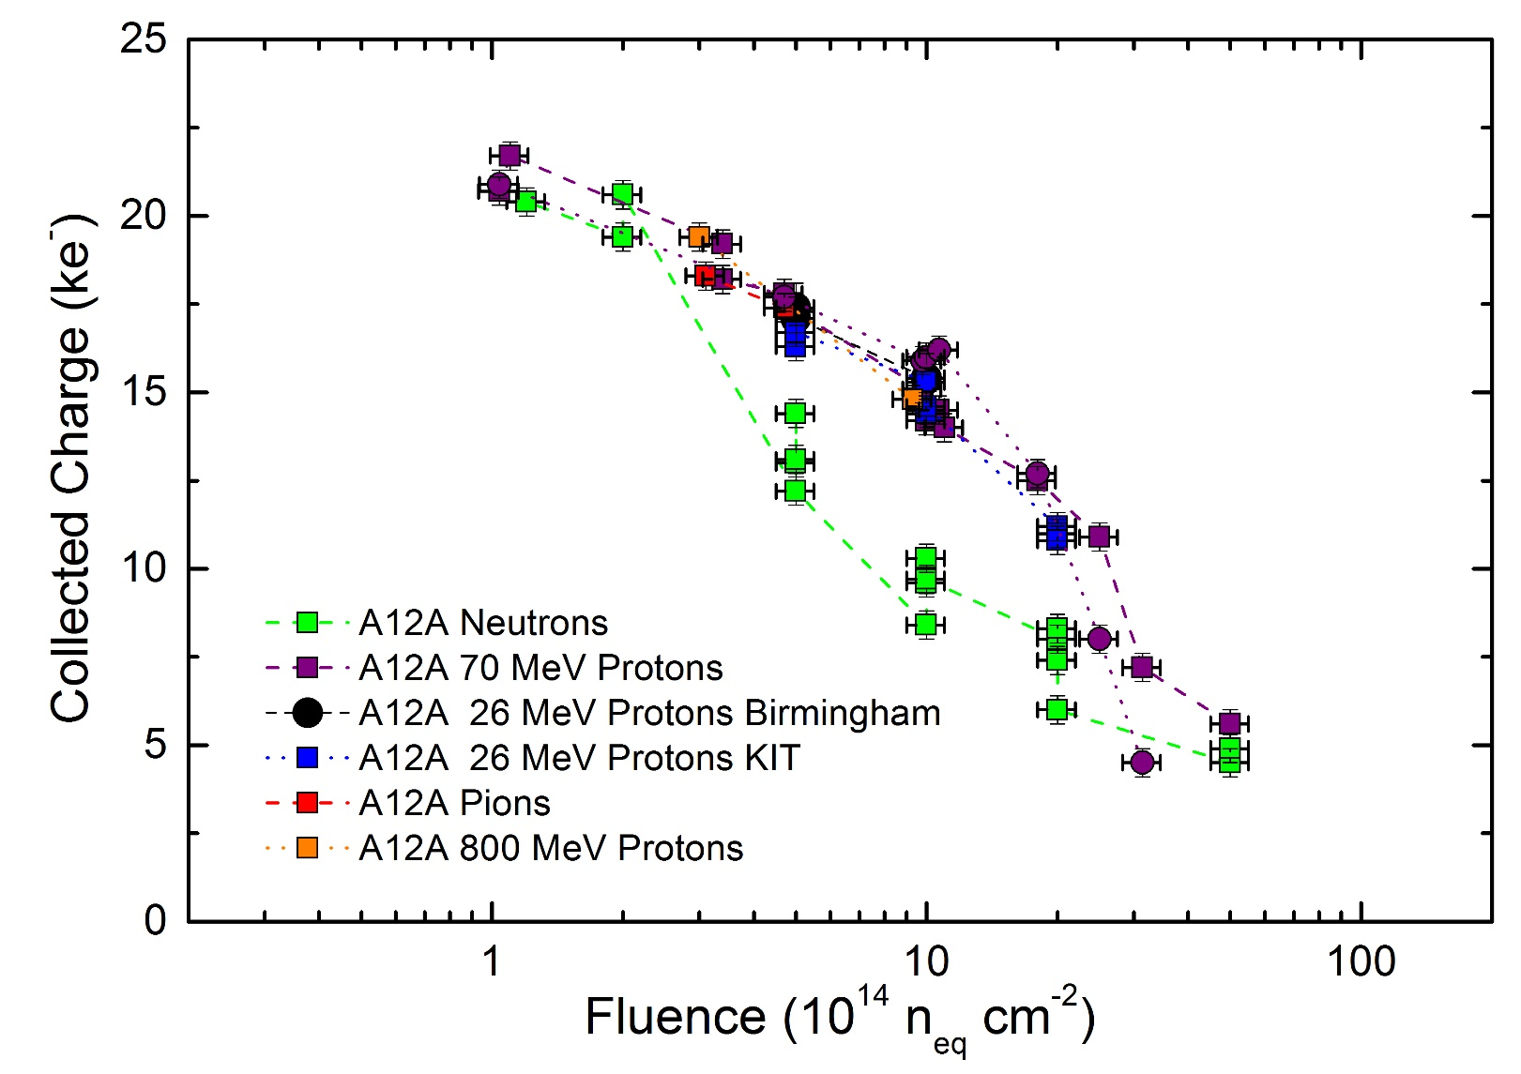
Results with 300μm Al shield
ATLAS12 mini sensors
Red: Point-to-point mode, I = 100nA
Blue: Scanning mode, I = 400nA, v = 4mm/s
1.0*10¹⁵n_{eq}/cm²
Plotted by A. Affolder
Preliminary
Bias voltage = 500V
80min@60C

Slide 11
Bragg peak
Optimal energy is 26.85 MeV with a Gaussian spread of 0.15 MeV
Apparatus placed ~1m downstream (only available position at time of measurement).
Energy loss corrected for this distance
As a consequence of the large separation between the end of the beam line and apparatus there are no low energy components measured in the plot
Repeat measurements 5cm from collimator did not yield expected signal for low energy protons
Investigations still ongoing

Slide 12
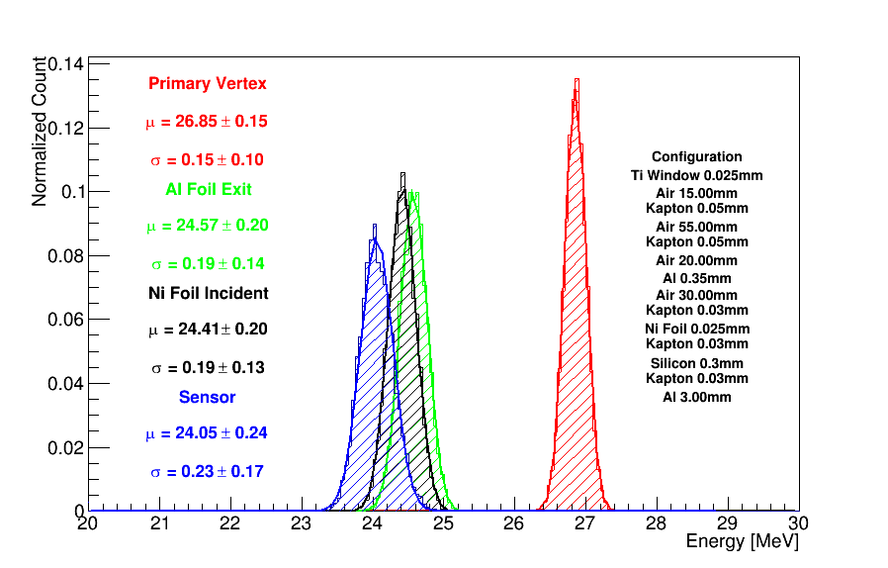
Beam Energy at Target
Geant4 Simulation of beamline and cold box

Slide 13
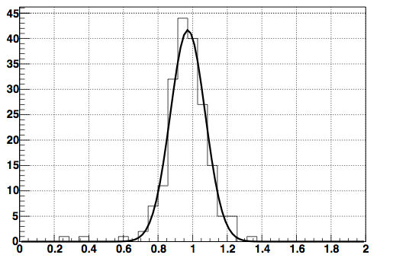
Dosimetry
Ni-57 + p cross section
The fluence is measured using Ni foils placed in front of the sample
The activity of the Ni-57 isotope is measured with a germanium spectrometer
Intensity of 1377keV peak + cross section for production of Ni-57 = number of incident protons
Measured and target fluence agree within 10%
Proton current monitored whilst irradiating on FC downstream of material
Passive material causes scattering and beam loss. Different factor required for every new irradiation set-up
Work currently underway to monitor the beam during irradiations before the sample
# measurement = 194
Average = 0.97
Sigma = 0.10
Fluence Received / Target Fluence

Slide 14
Hardness Factor
The hardness factor we currently use for our protons is 2.2
However, different values can be found in the literature for 23MeV protons
  KIT: k = 2
  Tables from RD50: k = ~2.58
  M. Moll reported k = 1.85 for 26 MeV protons in 2014
Decided to measure the hardness factor for our setup
M. Moll, Radiation Damage in Silicon Particle detectors, PhD thesis

Slide 15
Hardness Factor Measurements
UoB Masters project
Rhiann Canavan, Patrick Knights
Irradiated BPW34F diodes to various fluences between 10¹¹ and 10¹³ protons/cm² measured on Nickel foil
Irradiations performed at -27C
Diodes annealed for 80 mins @ 60C
Leakage current measured at full depletion
Temperature scaled to 20C
α_{p} = (6.6 ± 0.3) x 10⁻¹⁷ A/cm
α_{1MeV} = 3.99 x 10⁻¹⁷ A/cm
κ = α_{p} / α_{1MeV}
κ = 1.64 ± 0.07 ± 0.20 for 24 MeV protons incident on BPW34F
2nd set of larger diodes currently under investigation
Preliminary
Still using k = 2.2 pending further study

Slide 16
AIDA-2020 Users
Project Code | Project Title | Project Contact | Total access units M1-M24
AIDA-2020-UoB-2015-1 | ATLAS CMOS Strips Research and Development | T. Huffman | 12.00
AIDA-2020-UoB-2015-2 | Silicon sensor study of HPK sensors for ITK ATLAS Upgrade | S. Khuen | 39
AIDA-2020-UoB-2016-1 | Irradiation of glue foams for the ALTAS ITk | C Lacasta | 14
AIDA-2020-UoB-2016-2 | Irradiation of passive CMOS pixel sensors for ATLAS | F. Hugging | 7
AIDA-2020-UoB-2016-03 | Development of a Detector Control System for ATLAS Itk Pixel | C Zeitnitz | 28
AIDA-2020-UoB-2016-04 | Thin Planar Sensors for ATLAS ITK | A. Macchiolo | 50.5*
AIDA-2020-UoB-2017-01 | GanFET Irradiation for Atlas Upgrade | D. Lynn | 12.5
AIDA-2020-UoB-2017-02 | LHCb VELO Upgrade | P. Collins | 2
Total of 8 users
165 total access units M1-M24
* 14.5 units projected by end of M24

Slide 17
Conclusion
MC40 cyclotron capable of delivering a wide range of proton energies up to 40 MeV, at a wide range of current (pA to μA)
1x1cm² collimated beam, typical energy of 27 MeV, typical current 100-400nA
Cold box can scan an area up to 15x15cm²
Early issues with sensor response have been solved using a 300μm Al shield and results agree with samples from other institutes
Source of low energy component still under investigation
Preliminary measurements suggest κ = 1.66 ± 0.04 ± 0.51 but will continue using 2.2 for the time being
Total of 8 AIDA-2020 users in the period M1-M24
Total of 165 access units in the period M1-M24 (includes 15 access units projected by end of M24)

Slide 18
Acknowledgments
Many thanks to the operating team at the MC40 accelerator:
  Prof. D. Parker
  Mr. Mike Smith
  Mr. Robert Goodwin
  Mr. Robert Wheeler
  Mr. Gregory Wood

