Slide 1
WP10.1: CERN test-beams TA
Sabrina El Yacubi, Livia Lapadatescu, H. Wilkens

Slide 2
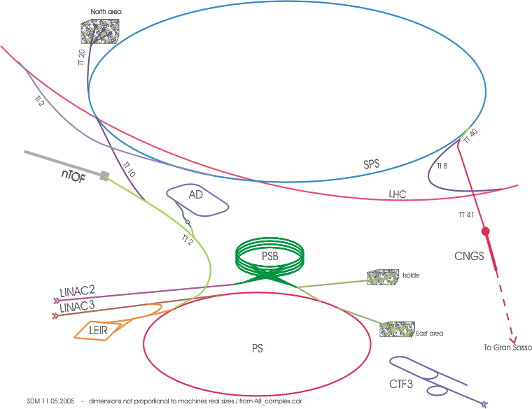
CERN testbeam facilities
North Area
SPS Test Beams & GIFpp
East Area
PS Test Beams
& EAIrrad

Slide 3
East Area at the PS
T11
CLOUD
T10
Alice, COMPASS, CMS,ATLAS,……
3.6GeV/c, 150mrad
7GeV/c, 60mrad
T9
Calice, ATLAS, CLICpix, CMS, LHCb, CBM, DAMPE,…
15GeV/c, 0mrad
Protons 24GeV/c
IRRAD
proton irradiation
CHARM
Mixed field irradiation
Mixed beams (h+e).
Equipped with Cerenkovs.
Max flux 10⁶p/spill.
5 spills (400ms) / 30-40s supercycle (typ. 3 irrad, 2 testbeam)

Slide 4
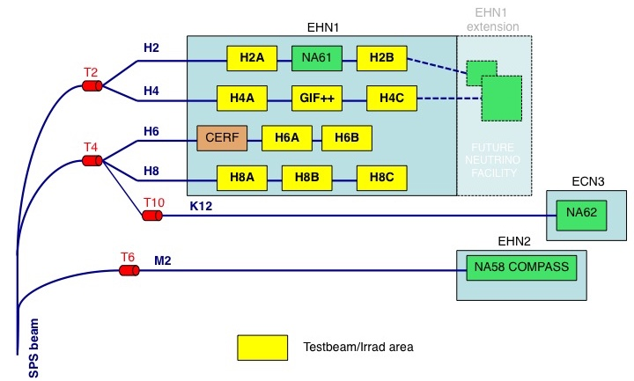
The North Area at the SPS
The SPS proton beam (400/450 GeV/c) slowly extracted to North Area
  2 x 4.8s spills per ~ 30-40s supercycle
Directed towards the three North Area primary targets T2, T4 and T6
From the primary targets:
  T2 → H2 and H4 beam lines (electrons from gama conversions, 400GeV max, 3-9.10⁷ π/spill max at 10¹²pot)
  T4 → H6 and H8 beam lines (electrons selected by Bremsstrahlung, 200/400GeV max, similar intensities as above),
  and P42/K12 beam line (NA62)
  T6 → M2 beam line (NA58/COMPASS)

Slide 5
Countries of recipients home institutes
In 2015-2016, 21 countries benefited from CERN TA support to their institutes employees coming to CERN test-beam facilities.

Slide 6
Communities supported
ALICE: ACORDE & PHOS.
ILC: CALICE (HCAL &SDHCAL), SiW-Ecal.
CMS: glass RPCs.
LHCb: RICH, VELO.
ATLAS: ITK (pixel & strips), Forward protons, BCM, Tilecal.
CERN R&D: RD42(Diamond), RD51(MGPDs), RD52(calorimetry).
ToTem: Timing detectors.
COMPASS: E-cal.
Neutrino: SCNETT , baby-MIND.
BELLE II: vertex detector.
OTHER: Various R&D for calorimeters (also for satellites), trackers, collimation with crystals…

Slide 7
AIDA TA beam time
2015
In 2015 we received 24 submissions, all were selected, 136 users benefited from the CERN TA program.

Slide 8
AIDA TA beam time
2016
In 2016 we received 18 submissions, 62 user stays supported through the CERN TA program.

Slide 9
List of publications
TA Project Acronym | Publication Year | Authors | Title | References | Publication type | Peer reviewed | DOI | Open Access
AIDA-2020-CERN-TB-2015-04 | 2016 | A. Berra et al. | Longitudinally segmented shashlik calorimeters with SiPM readout | NIM A | Journal publication | yes | 10.1016/j.nima.2016.04.025 | no
AIDA-2020-CERN-TB-2015-04 | 2016 | A. Berra et al. | A compact light readout system for longitudinally segmented shashlik calorimeters | NIM A | Journal publication | yes | 10.1016/j.nima.2016.05.123 | no
AIDA-2020-CERN-TB-2015-05 | 2016 | R. Thalmeier et al. | EMC studies for the vertex detector of the BELLE-II experiment | JINST 11 C01044 | Conference proceeding | yes | 10.1088/1748-0221/11/01/C01044 | no
AIDA-2020-CERN-TB-2015-05 | 2016 | C. Irmler et al. | Construction and test of the first BELLE-II SVD ladder implementing the origami chip-on-sensor design | JINST 11 C01087 | Conference proceeding | yes | 10.1088/1748-0221/11/01/C01087 | no
AIDA-2020-CERN-TB-2015-05 | 2015 | B. Würkner | Beam test data analysis and resolution studies for the Silicon Vertex Detector | TU Wien | Diploma thesis | N/A | N/A | yes
AIDA-2020-CERN-TB-2015-05 | 2016 | K. Adamczyk, et al., | The BELLE-II SVD assembly and mechanics | NIM A | Conference proceeding | yes | 10.1016/j.nima.2016.03.100 | no
AIDA-2020-CERN-TB-2015-07 | 2016 | S. Terzo, on behalf of the RD50 Collaboration | Radiation Hard Silicon Particle Detectors for HL-LHC - RD50 Status Report | NIM A | Journal publication | yes | 10.1016/j.nima.2016.05.035 | no
AIDA-2020-CERN-TB-2015-07 | 2015 | M. Bomben et al. | Performance of Edgeless Silicon Pixel Sensors on p-type substrate for the ATLAS High-Luminosity Upgrade | IEEE | Journal publication | no | https://arxiv.org/pdf/1609.02128.pdf | Yes
AIDA-2020-CERN-TB-2015-07 | 2015 | M. Bomben et al. | Performance of Edgeless Silicon Pixel Sensors on p-type substrate for the ATLAS High-Luminosity Upgrade | N/A | Presentation | No | N/A | Yes
AIDA-2020-CERN-TB-2015-10 | 2015 | M. Berretti | The timing upgrade project of the TOTEM Roman Pots detectors | NIM A | Journal publication | yes | 10.1016/j.nima.2015.09.112 | Yes

Slide 10
List of publications (cont.)
AIDA-2020-CERN-TB-2015-10 | 2016 | M. Berretti | The diamond time of flight detector of the TOTEM experiment | NIM A | Journal publication | yes | 10.1016/j.nima.2016.04.068 | no
AIDA-2020-CERN-TB-2015-11 & 22 | 2016 | E.Vannuccini for the CaloCube Collaboration | CaloCube: a new-concept calorimeter for the detection of high-energy cosmic rays in space | NIM A | Conference proceeding | yes | 10.1016/j.nima.2016.07.014 | no
AIDA-2020-CERN-TB-2015-15 | 2016 | A. Gorisek et al. | The edge transient current technique(E-TCT) with high energy hadron beam | NIM A | Journal publication | yes | 10.1016/j.nima.2016.03.061 | yes
AIDA-2020-CERN-TB-2015-15 | 2015 | M. Dunser et al. | Test Beam Results of a 3D Diamond Detector | PoS-(EPS-HEP 2015) 288 | Conference proceeding | yes | N/A | yes
AIDA-2020-CERN-TB-2015-15 | 2015 | G. Kasieczka et al. | RD42: Radiation hard diamond sensor | PoS (Vertex 2015) 033 | Conference proceeding | yes | N/A | yes
AIDA-2020-CERN-TB-2015-16 | 2015 | A. Cardini et al. | The small-angle performance of a dual-readout fiber calorimeter | NIM A808 (2015) 41-53 | Journal publication | yes | 10.1016/j.nima.2015.11.005 | no
AIDA-2020-CERN-TB-2015-16 | 2016 | R. Wigmans | New results from the RD52 project | NIM A824 (2016) 721-725 | Journal publication | yes | 10.1016/j.nima.2015.09.069 | no
AIDA-2020-CERN-TB-2016-01 | 2016 | E. Bagli et al. | Experimental evidence of independence of nuclear de-channeling length on the particle charge sign | European Physical Journal C | Journal publication | No | N/A | Yes
AIDA-2020-CERN-TB-2016-02 | 2016 | A. Berra et al. | Longitudinally Segmented Shashlik Calorimeters with SiPM Readout: the SCENTT Experiment |  | Presentation | No | N/A | Yes

Slide 11
List of publications (cont.)
AIDA-2020-CERN-TB-2016-02 | 2016 | A. Berra et al. | Longitudinally Segmented Shashlik Calorimeters with SiPM Readout: the SCENTT Experiment | IEEE, NSS | Journal publication | yes | 10.1016/j.nima.2016.04.025 | no
AIDA-2020-CERN-TB-2016-03 | 2016 | L.Pasqualini | A tracking detector to study O(1 GeV) n_m CC interactions, 14th Topical Seminar on Innovative Particle and Radiation Detector |  | Presentation | no | N/A | yes
AIDA-2020-CERN-TB-2016-08 | 2016 | Andrew Blue on behalf of the ATLAS Collaboration | Testbeam Results from Pre and Post Irradiated Modules for the Upgrade of the ATLAS Strip Tracking Detector |  | Poster | no | N/A | yes
AIDA-2020-CERN-TB-2016-08 | 2016 | Susanne Kuehn on behalf of the ATLAS Collaboration | First testbeam results of prototype modules for the upgrade of the ATLAS strip tracking detector |  | Presentation | no | N/A | yes
AIDA-2020-CERN-TB-2016-10 | 2016 | A. Macchiolo et al. | Development of n-in-p pixel modules for the ATLAS upgrade at HL-LHC | NIM A | Proceedings | Yes | 10.1016/j.nima.2016.03.081 | no
AIDA-2020-CERN-TB-2016-14 | 2016 | J. Lange et al. | Beam tests of an integrated prototype of the ATLAS Forward Proton detector | JINST | Journal publication | Yes | 10.1088/1748-0221/11/09/P09005 | yes
AIDA-2020-CERN-TB-2016-15 | 2016 | Andrej Gorišek et al. | The edge transient-current technique (E-TCT) with high energy hadron beam | NIM A | Journal publication | yes | 10.1016/j.nima.2016.03.061 | yes
AIDA-2020-CERN-TB-2016-18 | 2016 | E.Vannuccini for the CaloCube Collabboration | CaloCube: a new-concept calorimeter for the detection of high-energy cosmic rays in space | NIM A | Conference proceeding | yes | 10.1016/j.nima.2016.07.014 | no

