Slide 1
AIDA-2020 - WP12.2 :
Detector Characterization Facilities
EMC characterization
Fernando Arteche

Slide 2
OUTLINE
1. INTRODUCTION
2. TA EMC ACTIVITY
3. PUBLICATIONS
4. FUTURE ACTIVITIES
5. SUMMARY

Slide 3
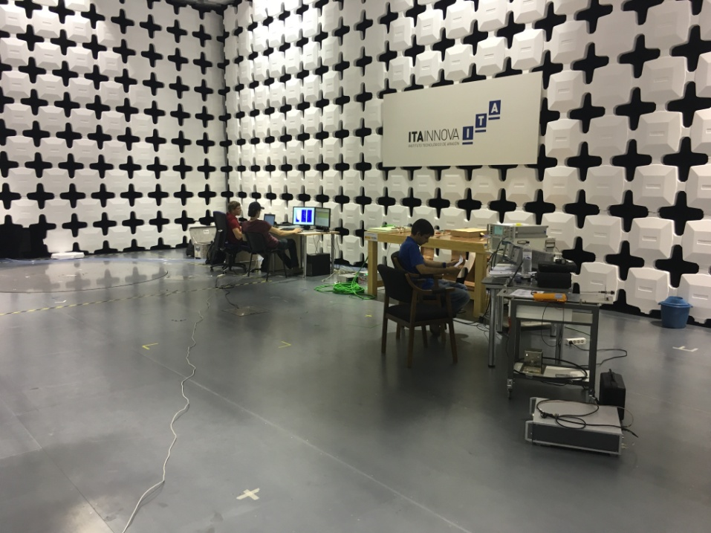
1. Introduction
The WP12 Transnational Access is focused on special detector and system characterization (NEW FACILITIES)
WP12.2.- EMC Laboratory of Instituto Tecnológico de Aragon (ITAINNOVA) in Spain for EM noise characterization.
EMC facilities allow to perform Electromagnetic Compatibility Test.
  Non–standard test (Specially focused on HEP)
  Standard ( According to European Directive 2004/108/EC)

Slide 4
1. Introduction
These tests may be used to define in any electronic device installed in HEP experiment:
  EM noise emission and immunity levels
  Filters designs & grounding configurations
2-3 Experiments expected per year on target have been planned under the project .
1200 TA units have been estimated:
  8 standard accesses ~ 50 TA units per access
  4 extended accesses ~ 200 TA units per access

Slide 5
2. TA EMC activity
4 TA-WP12.2 accesses have been already approved
  3 extended accesses ( 3/4 - 75% )
  1 standard access (1/8 - 13%)
3 TA-WP12.2 accesses have been completed
  TA-ITAINNOVA – (40 % TA units - Completed)
Access has been requested from 3 countries
  Germany, Austria and Italy
ITAINNOVA | User Projects |  | Total users | TA units
 | Submiss. | Selected
M1-M18 | 4 | 4 | 11 | 500
M1-M48 | 12 |  | 12 | 1200

Slide 6
2. TA EMC activity
3 TA have been completed (500 hours).
  AIDA-2020-EMC-2015-01 - EMC Studies with the Belle II SVD Readout System , HEPHY, Austria
    EXTENDED ACCESS for EMC characterization of Large system (240 TA units)
    4 users - 3 users have been present at the facility. 1 has been covered by AIDA-2020
  AIDA-2020-EMC-2015-02 – DC-DC converters noise emissions for Belle II SVD System, HEPHY Austria
    STANDARD ACCESS for EMC component testing (Remote access) 40 TA units
  AIDA-2020-EMC-2016-1 - EMC characterization of Belle II Pixel System, MPI Germany
    EXTENDED ACCESS for EMC characterization of Large system (220 TA units)
    3 users have been present at the facility. 1 has been covered by AIDA-2020
All of them have been focused on Belle II experiment
  A complementary facility of other TA
They have produced very useful and interesting results
6-11

Slide 7
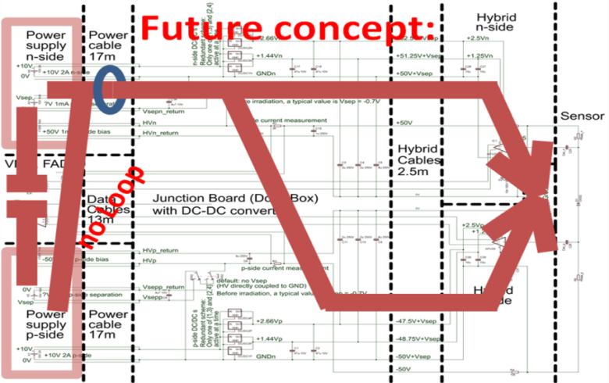
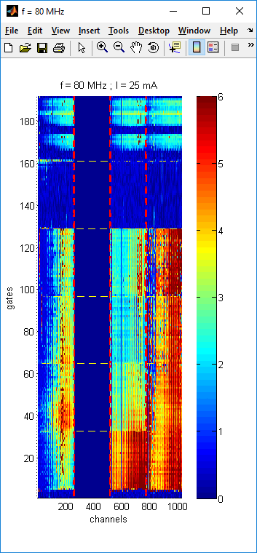
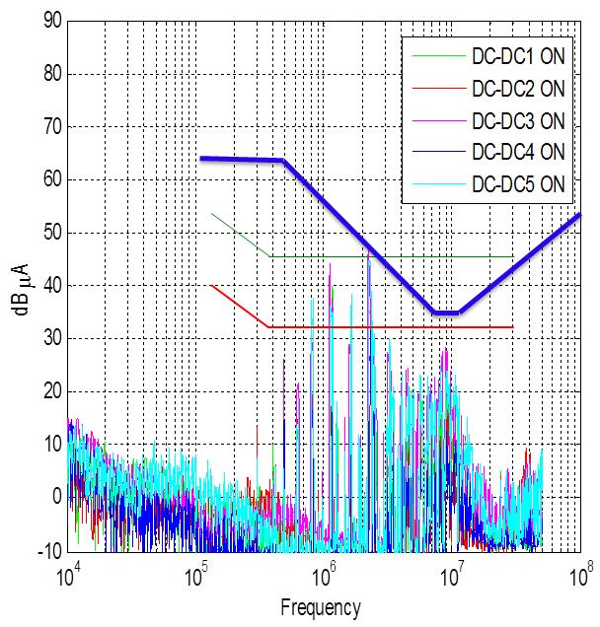
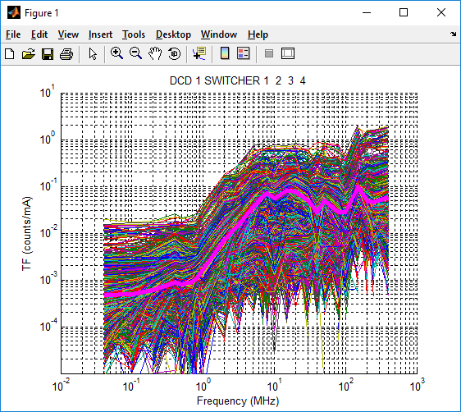
2. TA EMC activity
DC-DC converters noise emissions
Belle II Pixel
Noise mapping
SVD belle II FEE - Redesign
PXD Belle II – Noise compatible level
PXD Belle II – susceptibility level to beam pipe radiation
SVD Transfer Function

Slide 8
3. PUBLICATIONS
PUBLICATIONS
  2 paper have already been published
    Journal of Instrumentation, “EMC Studies for the Vertex Detector of the Belle II Experiment”, JINST 11 (2016) 01, C01044.
    IEEE publication “Analysis and quantification of coupling mechanisms of external signal perturbations on silicon detectors for particle physics experiments”, DOI: 10.1109
  3 Contributions to Conferences (2 oral contributions & 1 Poster)
    Topical Workshop on Electronics for Particle Physics, TWEPP 2015 (Sep. 2015, Lisbon)
    ESA Workshop on Aerospace EMC, Valencia, May 2016
    2nd Electromagnetic Pulse Workshop, Warsaw, Poland, January 2017
  2 contributions to Newsletter have been focused on some of the test campaigns
    Susceptibility characterization of DEPFET Pixel Systems : Hans-Günther Moser (MPI, Germany)
    EMC-TA On Track: Electromagnetic noise under control : F.Arteche (ITAINNOVA, Spain)
  1 paper is on preparation
    Journal of Instrumentation, “Characterization of the susceptibility for the PXD Detector in the Belle II Experiment”, JINST
  1 Tesis is on preparation based on some of the meaurements performed
8 - 11

Slide 9
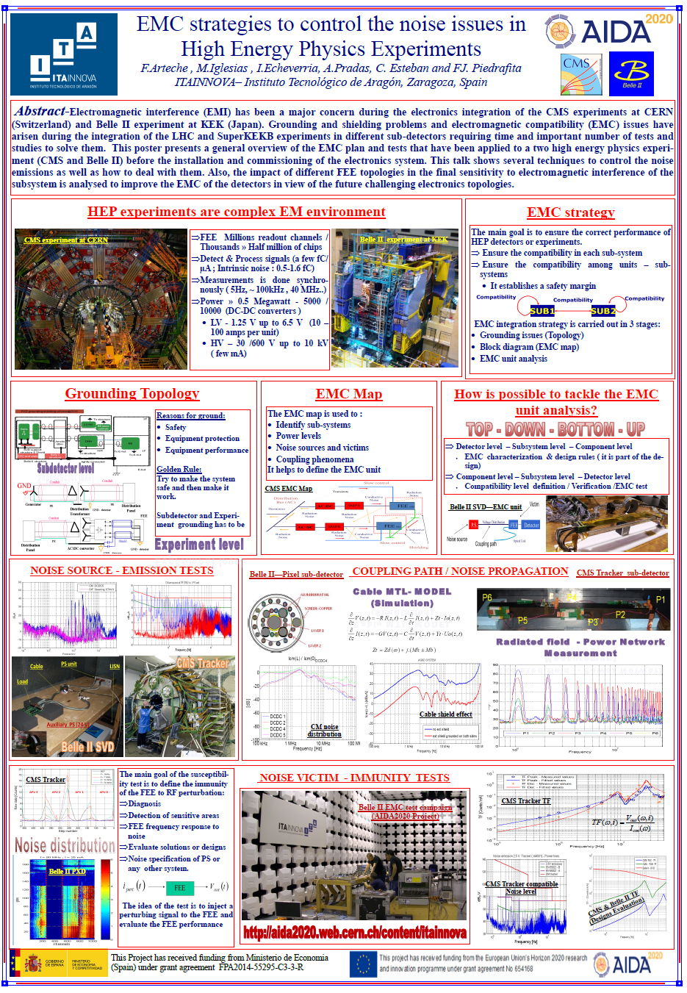
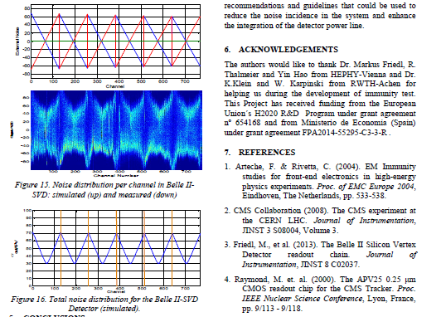
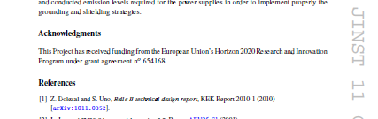
3. PUBLICATIONS

Slide 10
4. FUTURE ACTIVITIES
1 new TA proposal has been submitted in March.
    AIDA-2020-EMC-2017-01 - Electromagnetic compatibility characterization of the new neutron spectrometer CYSP , Italy
  More proposals are now under discussion TA
    They will be submitted soon : Italy and Germany
    Some of the new proposals come from “different area”(Short-Pulse Lasers Facilities )
      In January we have participated in an special Workshop focused on EMP generated in Laser Pulse Facilities
  In may, we will participate in two other workshops focused on:
    Experiments installed in neutrino facilities
    Linear Colliders Vertex Detector Workshop
    We will probably have more requests for the TA facility
10-11

Slide 11
5. SUMMARY
WP12.2 TA access is going well
  4 TA-WP12.2 access have been already approved
    3 TA-WP12.2 access have been completed (500/1200 TA units)
Most of the requested accesses are full EMC characterization
  We have already covered the 75% of what we have planned
  It will not generate any problem due to the low demand of standards access.
  TA activity has generated several publications, conference talks, posters as well as a Thesis (it is on going )
  Activity has been mainly focused on Belle II experiment but new proposals from different areas have recently been received.
Some “marketing ” focused on TA-EMC has been very useful and positive (we plan to keep this activity during this year)
11-11

