Slide 1



AIDA/RD53 activities in Perugia
(AIDA-2020 2nd Annual Meeting)
Sara Marconi, Pisana Placidi, Mauro Menichelli, G.M. Bilei

Slide 2
OUTLINE
  Introduction
  Verification Environment for PIXel chips (VEPIX53)
  Approach for reliability in radiation environments
  Digital architecture comparison and choice
  Low-power methodology for serial powering
  Analysis and optimization
Conclusions and future work

Slide 3
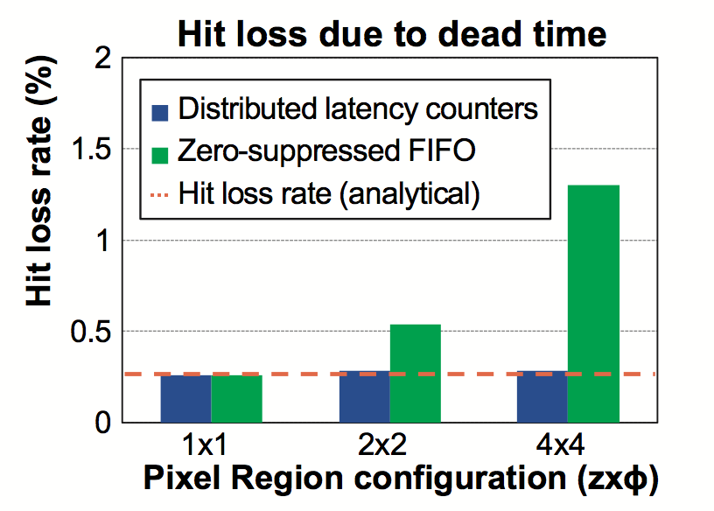
  Introduction (I)
Verification Environment for PIXel chips (VEPIX53) for:
  Modularity, reusability of same testbench:
    different tests
    multiple design stages
    different designs/design blocks
  Extended flexibility: stimuli generation
  Automated verification, performance assessment
  Test cases:
    simulation of previous pixel chips
    architectural study on PR architectures (behavioral level)
    for RD53A building blocks and/or full chip
    in addition: used by different projects at CERN as starting point for verification
[S.Marconi et al., Springer Lecture Notes, 2016]
[S.Marconi et al., JINST 2015]
Notes:
----- Note riunione (26.10.16 16:09) -----
1st year work: il lavoro è stato fondamentale ...

Slide 4
  Introduction (II)
  Approach for reliability in radiation environments
  In this presentation, focus on SEUs for the pixel array logic
  Based on estimated cross-section (5·10⁻¹⁴ cm²):
    protection strategy is needed for pixel configuration latches
      ~ 1% pixels already affected after 20s of operation
      hardening by cell design, special latches (CPPM, Marsiglia) and/or re-freshing configuration
    finite state machine protection not required if capable of recovering automatically after a transient of non-functionality
      to be proven with simulations under operating conditions
    no protection is needed for hit data during trigger latency
      corruption probability during latency < 10⁻⁸
  How to simulate SEU injection?
    Integrate random bit-flip in sequential elements during simulations of the gate-level or post P&R netlist in VEPIX53
      automated verification to identify eventual persisting effects
      initial simulations have shown no persistent error
DUT netlist (logic cells, latches, …)

Slide 5
  Digital architecture comparison and choice (I)
  Architecture optimization and comparison by means of the VEPIX53
1st architecture: distributed 1x4 pixel region
[S.Marconi et al., NSS 2016]
Logic resources shared in PR composed of 1x4 pixels
Distributed buffering (i.e. hit storage) scheme
  shared timestamp memory
  distributed memory for charge information
  (4-bit ToT = Time Over Threshold)
2nd architecture: centralized 2x8 pixel region
  Logic resources shared in PR composed of 2x8 pixels
  Centralized buffering scheme
    shared timestamp
    shared ToT information
  Data stored in buffer are reduced

Slide 6
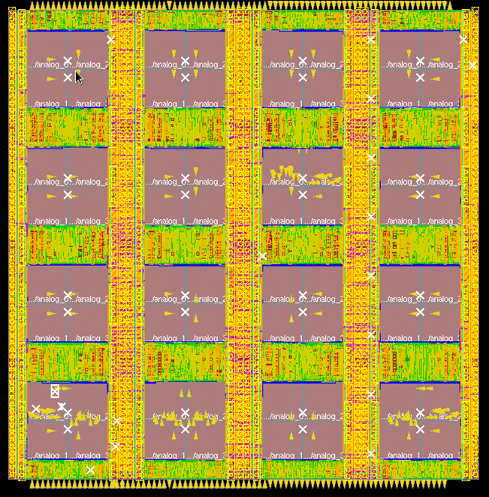
  Digital architecture comparison and choice (II)
  Digital architectural choices for RD53A
    both architectures have advantages, design optimization ongoing on both sides
    as RD53A is a prototype chip both are being integrated: 1x4 with asychronous front-ends and 2x8 with the synchronous front-end
    the choice on the pixel region shape is aimed to reduce buffer losses (elongated clusters)
1x4 pixel region
192(400)x400 pixels
8x8
pix
8x8
pix
OR
2x8 pixel region
8x8
pix
8x8
pix
    RTL simulations: after recent optimizations, both architectures featuring similar deadtime losses
    Area: centralized architecture has area advantages (with potential lower digital losses thanks to additional memories)
    Power: similar order of magnitude, with distributed architecture possibly lower (at current stage)

Slide 7
  Low-power methodology for serial powering (I)
Low-power analysis and optimization methodology
In this context, “concept” of low power is not obvious. Why?
  Serial powering across modules to reduce material
  → constant current is provided from the powering system
  The regulator circuit (combination Shunt and LowDrop Out
  regulator → Shunt-LDO) will burn “surplus” current
  to keep the serial power current constant
Different “definitions” of power:
  average (over long simulation, with realistic operation) → “usual” target for low power designs
  peaks (look power evolution over time, i.e. power profile):
  short time scale (~ps-25ns): should be filtered by on-chip decoupling
  longer time scale (~1us): power averaged over such time window seen at the powering system level
  → Optimization target → need for a methodology to guide optimization
  Need to know maximum current/power visible to the powering system
  Low-pass filtering from chip to serial power network:
  power variations are averaged over a time window (comparable with decoupling time constant)

Slide 8
  Low-power methodology for serial powering (II)
Low-power analysis and optimization methodology
Design flow
Main steps:
power analysis at gate-level (i.e. after synthesis to gates):
  drive architectural choices
accurate post Place&Route (P&R) power analysis
Application: detailed design optimization and choices
Remark: realistic digital activity based on simulations run with VEPIX53
System design and simulation
Power flow
Cadence Incisive
Logic synthesis
RTL/gate level power
Cadence RTL compiler
RTL compiler
Implementation
Floorplanning
Placement
Clock tree synthesis
Optimization (multiple stages)
Routing
Post-P&R
power analysis (actual parasitics)
Cadence Innovus
Cadence Voltus
Signoff analysis and verification

Slide 9
  Low-power methodology for serial powering (III)
Low-power analysis and optimization methodology
accurate post Place&Route (P&R) power analysis and optimization:
  average power estimations under different activity conditions to assess power impact of different factors
  dynamic power variations analysis under the variety of operating conditions and at different time scales (1ns, 25ns, 100ns, 1μs, 10μs):
    simulations with Shunt-LDO confirmed decoupling effect
Activity conditions | single pixel, digital | Final chip (400x400)
hits (3 GHz/cm²) and triggers (1 MHz/cm²) | 4.8 μW (52% clk tree) | 0.774 W
only clock (~ -20%) | 3.8 μW (62% clk tree) | 0.610 W
hits (3 GHz/cm²) and no trigger(~ - 2.5%) | 4.7μW (53% clk tree) | 0.752 W
[S.Marconi et al., TWEPP 2016]

Slide 10
  Low-power methodology for serial powering (IV)
Low-power analysis and optimization methodology
Presented methodology used for optimization of the pixel array logic:
  Example: 1x4 distributed architecture → most techniques applied to both digital architectures
  Metrics:
    area (density)
    power → “peak power” is obtained assuming 1 μs averaging time constant
    hit loss (for memory overflow)
Results: area improved, hit loss reduced (additional memory), power variations reduced
Further optimizations ongoing (multi-bit latches, clock tree optimisation, etc … )
8x8 digital core, hits and triggers activity TYPICAL corner | Average Power per pixel (μW) | Peak Power per pixel (μW) | Area Utilization
1. TOT counters, flip-flops for TOT storage, 7 mem, asynch read | 4.8 | 6.26 | 89%
2. No TOT counter, latches for TOT storage, 7 mem, asynch read | 5.6 | 6.54 | 85%
3. TOT counters, latches for TOT storage, 7 mem, asynch read | 4.98 | 5.8 | 80%
4. TOT counters, latches for TOT storage, 7 mem, synch read | 4.84 | 5.6 | 80%
5. TOT counters, latches for TOT storage, 8 mem, synch read | 5.2 | 6.1 | 82%
6. Same as 5. with Integrated Clock Gating cells | 4.68 | 5.38 | 80.5%
[S.Marconi et al., TWEPP 2016]

Slide 11
CONCLUSIONS AND FUTURE WORK
Conclusions
  High-level simulation and verification framework with enhanced reusability available
  Selected architectures for the pixel array logic:
    performance assessed and compared
    architectures further optimized for area, power and efficiency
    power methodology used to guide design choices
  Radiation: SEU to be taken into account in the verification process (TID not discussed in this presentation)
  Main further developments:
  Finalize pixel array logic for RD53 big scale prototype
  Possibly: further power optimisation to reduce system budget
  Extensive verification under radiation: design to meet timing with TID and simulate SEUs

Slide 12
BACKUP

Slide 13
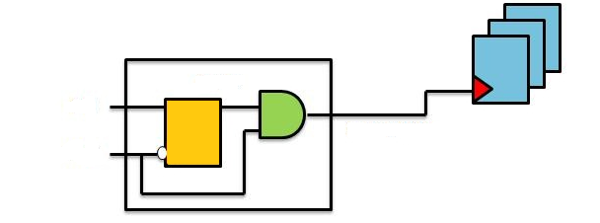
  Low-power methodology for serial powering (II)
Low-power analysis and optimization methodology
Design flow
Main steps:
power analysis at gate-level (i.e. after synthesis to gates):
  drive architectural choices
accurate post Place&Route (P&R) power analysis
Application: detailed design optimization and choices
System design and simulation
Power flow
Cadence Incisive
One fundamental architectural choice use of the
clock gating technique
source of power variations
initially discouraged to keep
power more constant
Logic synthesis
RTL/gate level power
EN
Cadence RTL compiler
CLK
GATED CLOCK
RTL compiler
Implementation
Floorplanning
Placement
Clock tree synthesis
Optimization (multiple stages)
Routing
Post-P&R
power analysis (actual parasitics)
Power variations at gate-level description (64x4 array):
more than x5 power increase to keep power constant can not be tolerated based on
chip specifications
power variations seen from the powering system acceptable
Cadence Innovus
Cadence Voltus
Signoff analysis and verification
[S.Marconi et al., TWEPP 2016]

