Slide 1




Update on CPPM activities towards development in 65nm
Mohsine MENOUNI, Denis FOUGERON, Renaud GAGLIONE (LAPP), Alexandre ROZANOV, Marlon BARBERO
CPPM - Aix-Marseille Université, CNRS/IN2P3, Marseille, France
AIDA-2020 2nd Annual Meeting
Paris - LPNHE - April 4-7, 2017
Notes:
This talk is dedicated to the CPPM activities concerning the 65 nm process qualification and design

Slide 2
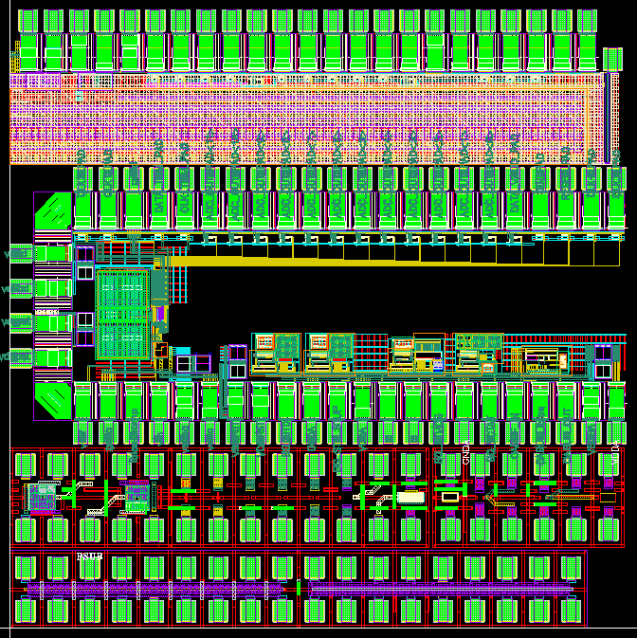
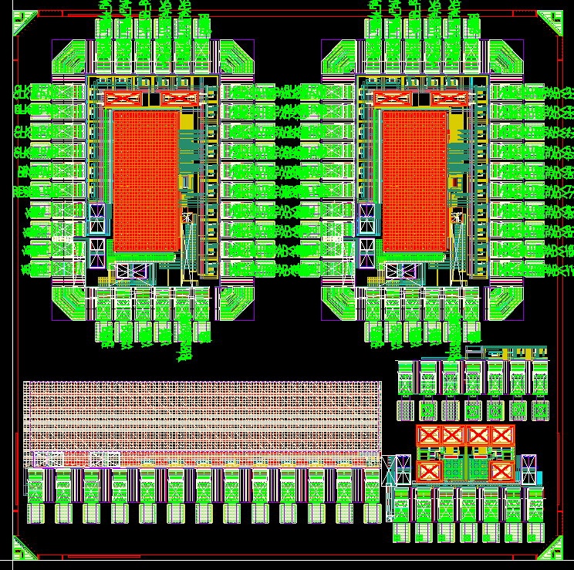
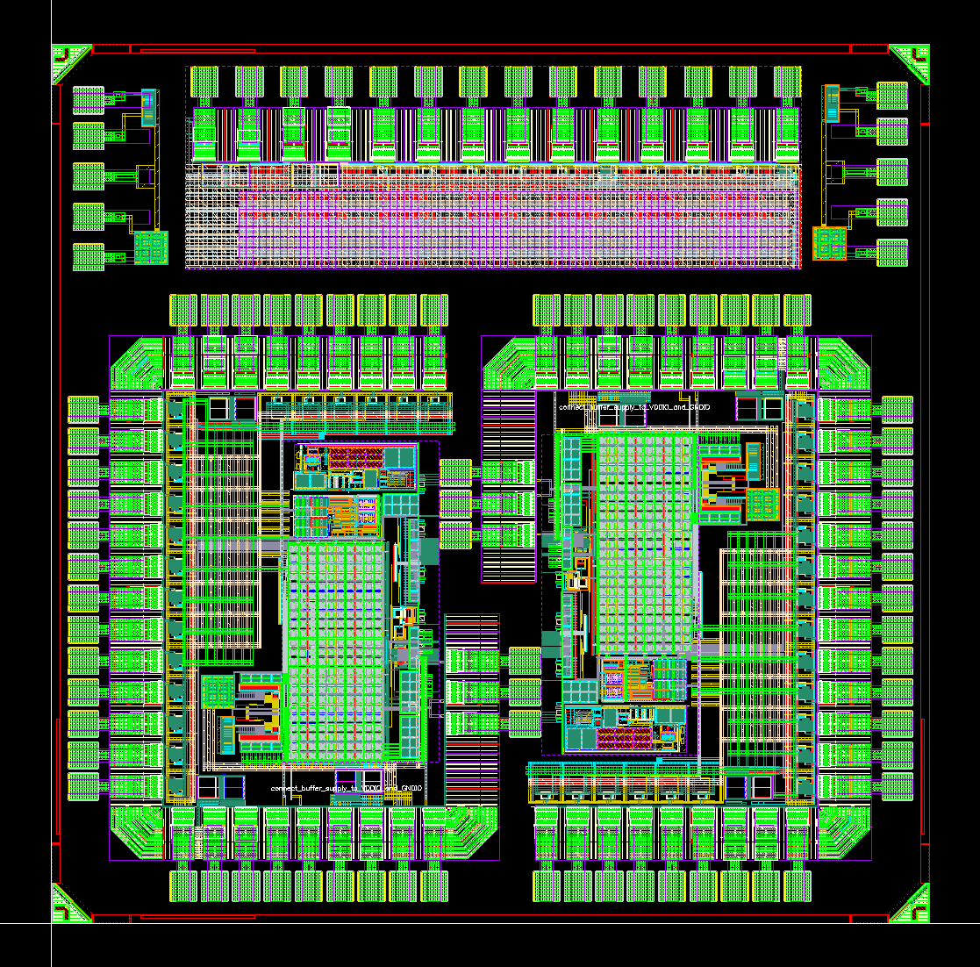
CPPM activities
PROTO65_V1
Submitted June 2014
PROTO65_V2
Submitted Feb 2016
PROTO65_V3
Submitted Feb 2017
Transistor devices, SEU memories, Bandgap, ADC, Monitoring block, Temperature and radiation sensors ..
Design, test and qualification of the 65nm devices and IP blocks for a dose level of 500 Mrad
The work is done in coordination with CERN RD53 program
Notes:
Several prototypes were designed and tested by our institute.
We implemented essentially, individual transistors and analog IP blocks as Bandgaps, ADC
for monitoring.
The designs were tested and qualified for a dose level of 500 Mrad
The work is done in coordination with the CERN RD53 project

Slide 3
  Radiation effects in CMOS
Baseline technology : 65nm CMOS for the RD53 project
The TID-induced charge in the thin oxide decreases with the thickness of the oxide
In highly scaled processes
  The thin gate oxide is very tolerant to the TID
  Thick oxide used for isolation : Thick Shallow Trench Isolation Oxide (STI)
  Thick oxide exists everywhere around the device
Radiation Induced Leakage Current (RILC)
Radiation Induced Narrow Channel Effect (RINCE)
Radiation Induced Short Channel Effect (RISCE)
Notes:
The 65 nm process is the base line for the RD53 project. The thikness of the oxide is below 2nm. The intrinsec device is very tolerant to the TID.
However, the thick oxide is used for isolation (STI) and other oxide are used everywhere in such a process (spacers for example)
The device can be a subject of :
Radiation induced leakege, because of the sensitivty of the STI parasitics transistor to the TID
RINCE and RISCE effects related to the electrical field related to the trapped charge in the STI or in the spacer near the intrisec device..

Slide 4
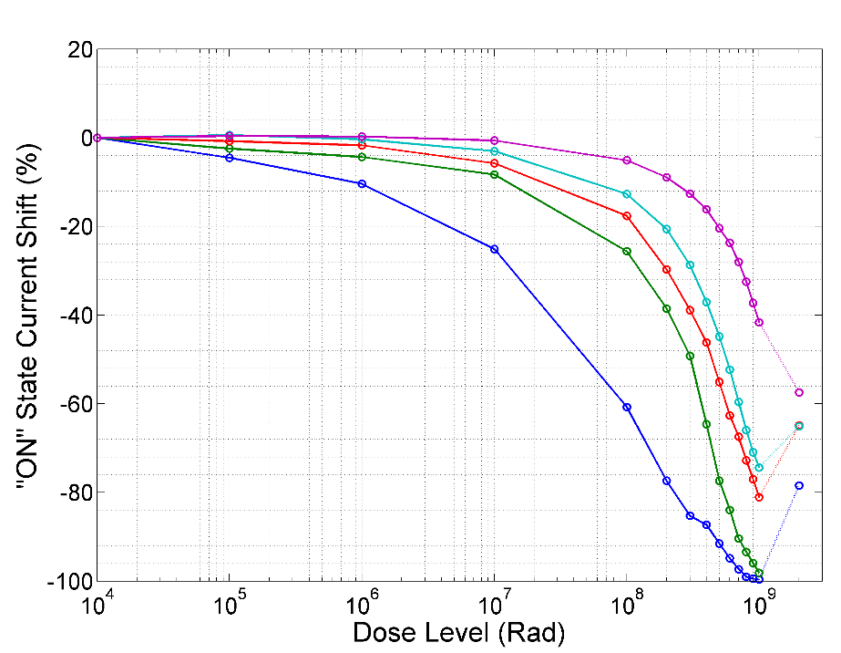
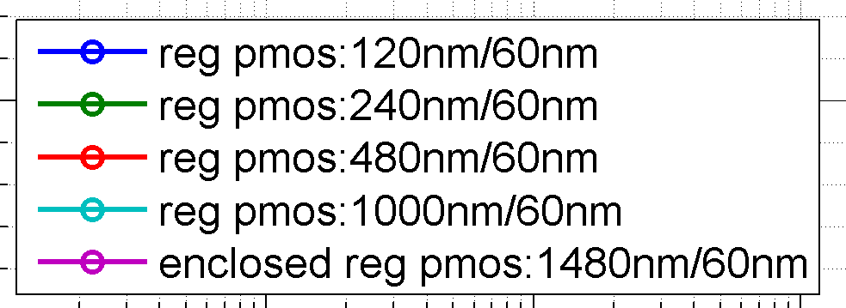
TID effects on the 65nm devices
PMOS : W/L= 1µ/1µ
The increase of the leakage current is very limited
  Factor 100 for the worst case
The enclosed layout is not needed
PMOS devices more sensitive than NMOS
TID effect on large and long devices (NMOS and PMOS) is limited
Analog Design : Avoid the use of narrow or short transistors
  Analog designs following these rules showed a good radiation tolerance up to 1 Grad
  Irradiation damage depends on the bias. This affect the matching and can be an issue
Digital design :
  Requires High integration density
  Digital cells are designed with minimum size devices and so are subject to RINCE and RISCE effects
W/L= 1µ/1µ
Supplier A - Temp=20°C
Pmos devices :ON state current versus TID
Annealing @100°C
pmos devices
Vds=1.2V
Notes:
Irradiatuion tests show that the increase of the leakage for the 65nm process is very limited. An increase of a factor 100 measured for the small size device. The enclosed layout is not always needed for this process. Pmos devices are more sensitive to the TID than nmos.
The plot on the top is showing the variation of the drain current as function of the gate voltage for different levels of dose for a transistor of 1µm/1µm. The degradation in this case is very limited. So, for analog design, a radiation hard design can be achieved with using a large area devices
However, the digital design is requiring a high integration density for pixel FE chips. Small size devices are used and in this case, the damage is very strong as we can see in the plot in the bottom showing the variation of the maximum current variation as function of the TID for devices with different width. Small devices becomes completely off at a level of 1 Grad.

Slide 5
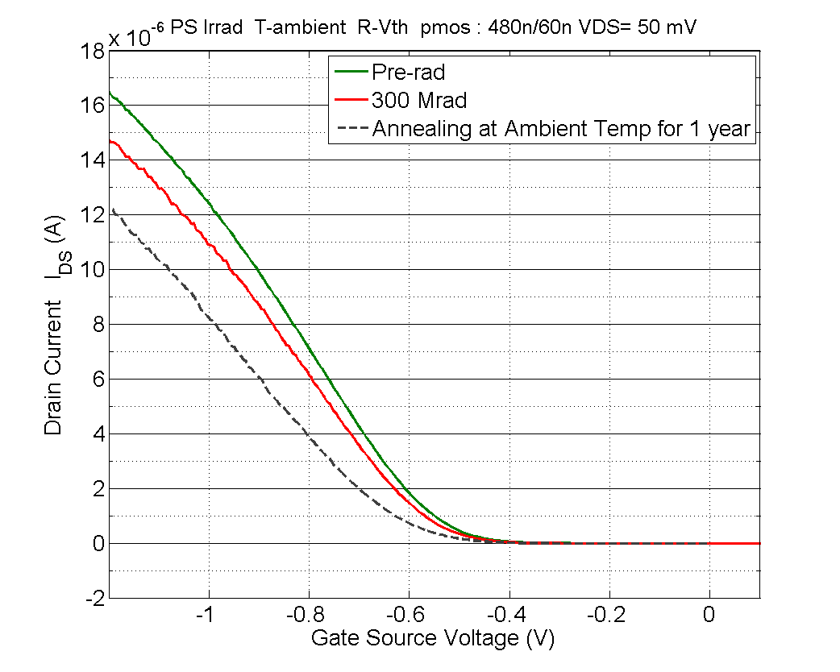
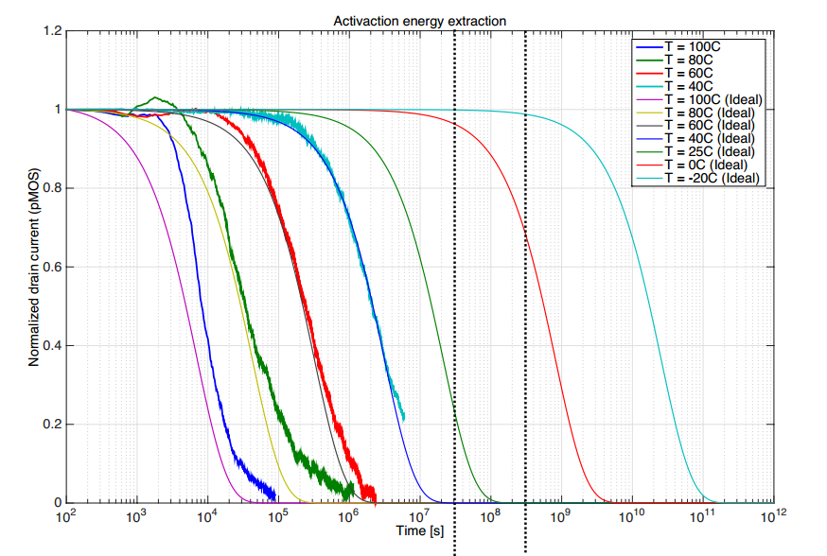
  Temperature and annealing Effect
Less damage for the PMOS and NMOS when Irradiation is done at low temperature
High temperature annealing (100 °C for 7 days) degrades strongly the DC parameters and show a high Vth shift
A long term annealing at room temperature was done for ~1 year on irradiation devices at the PS-CERN -> more degradation
Qualification and annealing for different temperature were done at CERN
The Vth shift of the PMOS device is a thermally activated process
Extrapolation for lower temperatures
For the RD53 Front end chip, this temperature effect can be avoided by keeping the system :
  In cold environment : -20°C for 5 years
  Unbiased at room temp for few months
  300Mrad :PS-CERN
  24 GeV protons
  Bias during irradiation and annealing : |V_{DS}|=|V_{GS}|=1.2V
Irrad
Annealing for 10 months at Troom
1 year
10 year
T=25°C
T= -20°C
Time (sec)
Notes:
Measurements show that there is less damage when the irradiation is carried out at low temperature. But the high temperature annealing degrades strongly the DC parameters. This degradation with annealing was reproduced on devices irradiated at the PS. A long term annealing at room temperature creates more dammage as we can see in the plot at the top.
From another hand, qualification and annealing at different temperatures were done by CERN team using the Xray machine and proves that the Vth increase of the pmos device is a thermally activated process. The effect of annealing can be extrapolated for lower temperature.
For the RD53, this bad effect of the temperature can be avoided by keeping the detector in a cold environment (-20°C) and by keeping it unbiassed during stopping phases

Slide 6
Irradiation effects Modeling
The current drive loss depends strongly on the device width W and on length L
Spectre Model Corners were developed based on the irradiation tests : 200 Mrad and 500 Mrad and the dependence on W and L is included:
  Transconductance degradation
  Threshold voltage increase
  Leakage current is implemented for NMOS
  Short channel effect and Subthreshold swing change are included for small size NMOS (60nm<L<240nm)
HVT and LVT models were extrapolated from RVT devices measurements
Assumptions :
  Room temperature irradiation
  Worst case biasing (VDS=VGS=1.2V)
  Annealing effect not included
Largely used for RD53A chip simulation, optimization and dose effect estimation
Analog designs : Directly done under Spectre virtuoso
Digital Designs : 200 Mrad, 500 Mrad Liberty files for synthesis based on the current model
  digital models extracted (Liberate) : Timing (delay …) and power (Leakage and internal power)
  Timing verification and digital simulation
Notes:
Measurements show that the current drive loss because of the TID depends strongly on the devices size (W and L). Based on this irradiation tests, a spice model corner was developed by fitting the current loss versus the W and L. Two corners are available : the first for 200 Mrad and the second for 500 Mrad.
Models for HVT and LVT devices were extracted from the Regular VT measurement. The models are related to the room temperature, worst case biasing (diode configuration) and the annealing effect is not included. Models are widely used for the RD53A design and simulation
For the analog design, we can use the spectre simulator directly. For the digital design, corner liberty files were generated and used for synthesis and simulation.

Slide 7
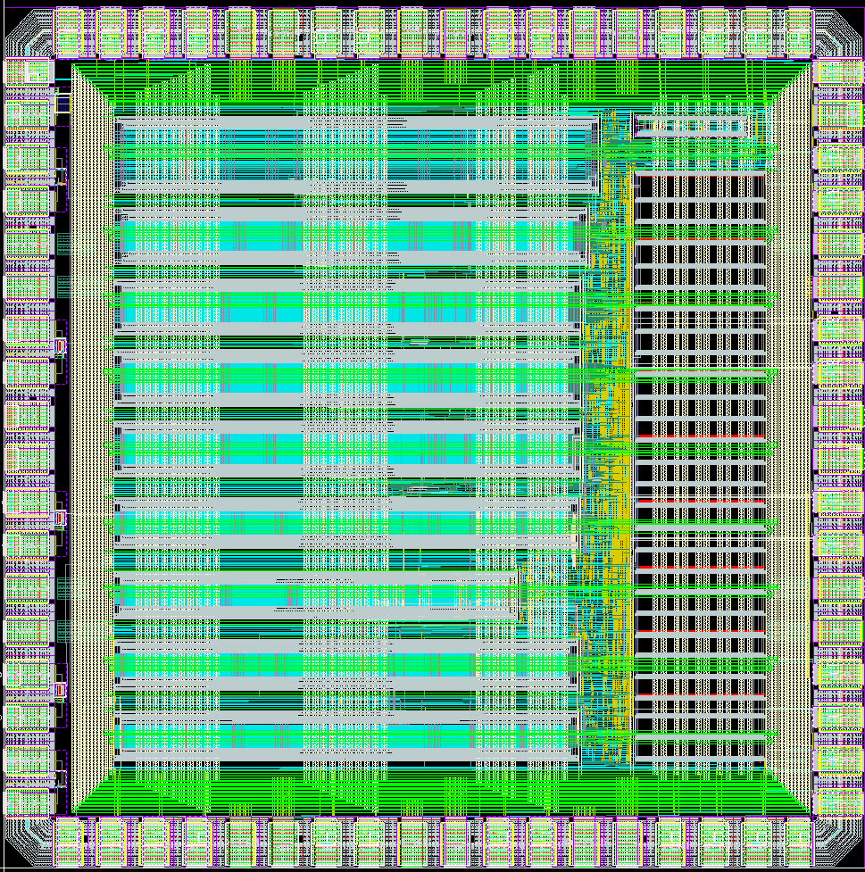
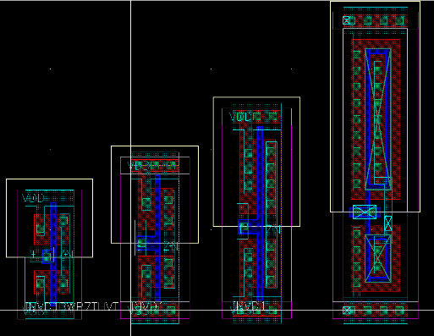
DRAD Chip : Test chip for digital design
DRAD chip is designed at CERN :
To study the effect of radiation on digital standard cells for the 65nm TSMC technology
To test the efficiency and the validity of the digital simulations with the irradiation corner model
Simulation results goes in the same direction than irradiation tests but the model overestimates the TID damage level
  Models were done for worst case of biasing
NOR gates should be avoided since show a strong degradation
9
8
7
6
5
4
3
ANNEALING NOT INCLUDED IN THE MODELS
2
1
7T
9T
12T
18T
CELL HEIGHT
7 Track: 1.4 uM
9 Track: 1.8 uM
12 Track: 2.4 uM
18 Track: 3.6 uM
Notes:
The DRAD chip was designed at CERN in order to study the effect of the total dose on the digital standard cells. Simulation results seems to vary in the same direction than irradiation tests. However, the model overestimates the effect of the dose. This is because this model is elaborated for worst case biasing for a transistor which is not happen in the digital circuit

Slide 8
SEU tolerant Cells for configuration
Cross section for the standard latch : σ = 2.8e-14 cm2/bit
High energy hadrons producing SEE in pixel barrel layer0 (3.7 cm) estimated : 0.5 E9 /cm2/s
160 000 pixels per FE chip and 8 configuration bit per pixel
  ~ 18 upsets/s per FE chip
Number of global configuration bits : 1 kbit
The cross-section of pixel and global configurations should be decreased by factor ~1000
 | Mean time between errors (1 FE chip)
 | Pixel Config | Global Config
Memory size | 1.28 Mbit/chip | 1 Kbit/chip
Single latch | 55 ms | 71 s
Notes:
For a standard latch taken from the foundry library, the SEU cross section is around 2.8 10-14 cm2/bit. If we consider the pixel barrel layer 0, the fluency of the high energy hadron is estimated to 5 108 p/cm2/s
Based on this, for each FE chip, the mean time between 2 errors is 55 ms for pixel configuration and 70 s for the global configuration.
This should be decreased by a factor of 100 to 1000.

Slide 9
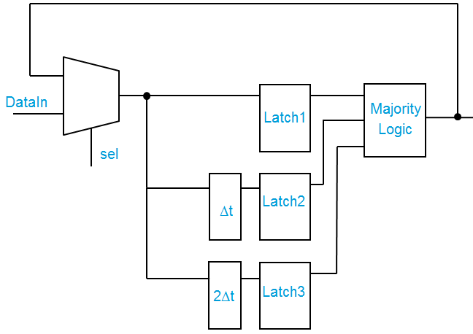
Pixel configuration memories
ON
OFF
ON
OFF
1
0
1
0
X1
X2
X3
X4
OFF
ON
OFF
ON
Sensitive pair node
  Structures tested intensively for the SEU tolerance at PS-CERN with 24 GeV proton beam :
  DICE Latch : Dual Interlocked Cell
  TRL : Triple redundancy Latch with error correction
Notes:
2 different latch structures were tested for the SEU tolerance at the PS with 24 GeV proton beam. The DICE latch and the Triple redundancy with error correction.

Slide 10
DICE Latches SEU test results
 | Number of errors/ spill |  |  | Cross section (cm²)
 | 0 to 1 | 1 to 0 | All
Single latch | 2.58 | 2.29 | 2.43 | 2.8 E-14 cm²/bit
DICE latch interleaved layout | 0.26 | 0.29 | 0.27 | 3.1 E-15 cm²/bit
  Enough Statistics for SEU
    640 cells for each tested cell and > 20 000 spills
  Cross section single latch ~ 2.8E-14 cm²
  With interleaved layout, improvement of the SEU tolerance : 9 x more tolerant than the Single latch -> cross section = 3.1E-15 cm²
Notes:
Enough statistics was reached in this irradiation test. The DICE latch with an interleaved layout allow to improve the SEU tolerance by a factor 10.

Slide 11
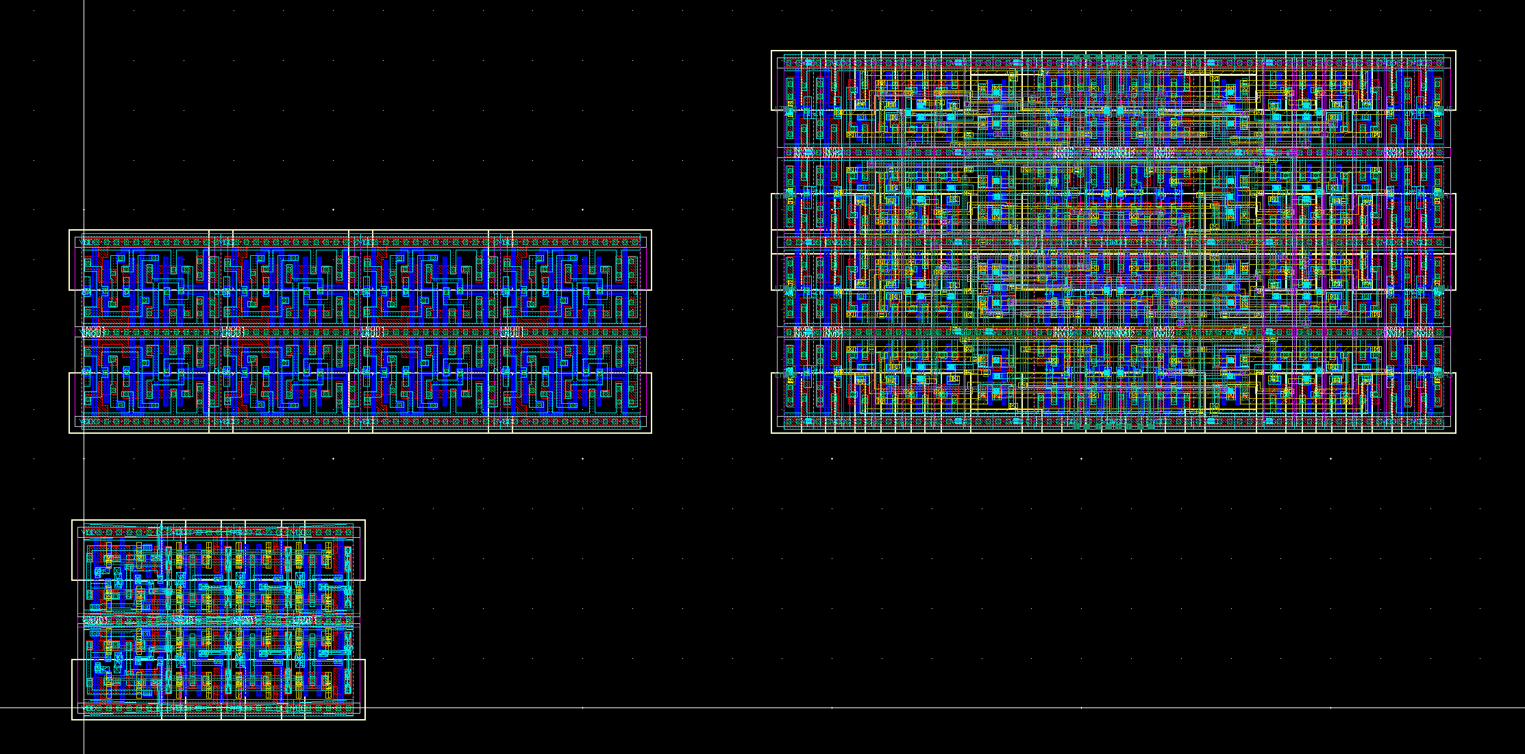
Area comparison
8 bit DICE LATCH
8 bit LNQD1 –VCAD
8 bit LNQD1shrink –VCAD
Interleaved DICE version
  Critical distance between 2 sensitive nodes = 7µm
 | Area (8bits) | Area/pixel | Routing
Single latch | 11.2µm × 3.6µm | 1.6 % (40 µm²) | M1/M3
Shrinked latch | 5.4µm × 3.6µm | 0.8 % (20 µm²) | M1/M3
DICE latch | 13.2µm × 7.2 µm | 3.8 % (96 µm²) | M1/M4
Notes:
The layout is representing 8 bit configuaration memories using standard latches , shrinked latches or DICE latches. This DICE configuration memory is indeed consuming more area but is still acceptable if we consider the whole pixel area.

Slide 12
TRL Latches results
 | Number of errors/ spill |  |  | Cross section (cm²)
 | 0 to 1 | 1 to 0 | All
Single latch | 2.58 | 2.29 | 2.43 | 2.8E-14 cm²
Ref TRL Latch | 20E-3 | 1.8E-3 | 11E-3 | 1.26E-16 cm²
TRL with load triplication | 4E-3 | 1.9E-4 | 2.1E-3 | 2.3 E-17 cm²
TRL with load triplication and interleaved layout | 1.2E-3 | 4.6E-5 | 6.2E-4 | 6.8 E-18 cm²
  TRL latch without optimisation is ~200x immune to SEU than single latch
  Interleaved layout in plus of the load signal triplicate improves the SEU tolerance by a factor 18
  Optimized TRL is 3600 x tolerant than the single latch
  RD53A : TRL used in the digital chip Bottom – Synthesis tool used
Notes:
TRL latch allow an improvement of the SEU tolerance by a factor 3600. It is consuming a large area and so can not be implemented in the pixel. For the RD53A chip, TRL is used in the digital chip bottom and the synthesis tool is used with the constraints of the sensitive nodes separation.

Slide 13
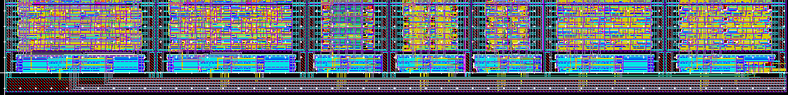
Test Chip
  Prototype chip just submitted the February 20 this year
  Study the effect of the DNW on the SEU tolerance
    The digital part of the RD53A chip is placed in a DNW to reduce the crosstalk
  Test and qualify the Monitoring block as it is implemented in the RD53A chip
Clmn1
Clmn2
Clmn3
Clmn4
Clmn5
Clmn6
Clmn7
Zone of interest
2nd 65nm prototype
Notes:
A new 65nm prototype have been submitted the end of february this year. The idea, is to study the effect of the DNW level on the SEU tolerance. In the RD53A chip the digital paert is always placed in a DNW to reduce the crosstalk effect. Some studies on another 65nm process reported a dgradation of SEU tolerance by a factor 5 when the DNW is used.
The second goal of this submission is to test and qualify the monitoring block as it is implemented in the RD53 A chip.

Slide 14
Monitoring block
PAD
PAD
VREF_ADJ
VREF
Res for VREF adjust
(outside the chip)
BG_trim
Buffer
BG reference
ADC_BUFDIS
PAD
V_{OUT0}
V->I
V_{OUT1}
IBIAS
VREF
ADC_OUT<0:11>
12 bit ADC
OUT
ADC_EoC
16 Channels Analog Multiplexer
VIN
EoC
ADC_Input<0:31>
DIS
SoC
CLK
V_{OUT31}
Clock divider
ADC_SoC
Ref_Clock
ADC_Select<0:4>
ADC_DIS

Slide 15
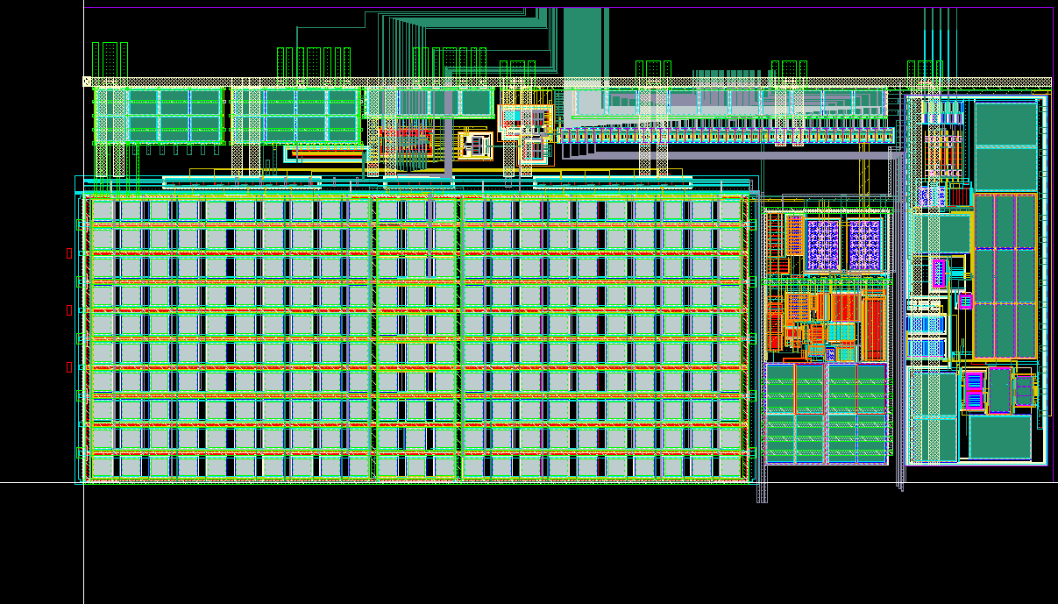
Monitoring block layout
Multiplexer
Buffer
12 bit ADC
BG voltage

Slide 16

Conclusion
The 65 nm process qualified for 500 Mrad
  Limited leakage current
  A strong drive loss for small size pmos devices and the damage increases with the temperature
  RD53 Front end chip (pixel environment )
    Avoid the use of narrow or short transistors for analog design
    Corner Models developed for 200 Mrad and 500 Mrad and used to characterize digital cells
    DRAD chip designed by CERN group indicates which digital libraries can be used
    The temperature effect can be avoided and delayed by keeping cold : -20°C for 5 years and keeping unbiased at room temp for few months
SEU tolerant latches for pixel and global configurations were designed and tested
A new prototype designed to test the effect of the DNW on the SEU tolerance and will be used to test and qualify the Monitoring block, temperature and irradiation sensors as it is implemented in the RD53A chip
Notes:
The conclusion : The CPPM activities are essentially driven by the design test and qualification of the 65nm process and analog Ips in coordination with the RD53 project.
The 65nm process was qualified for 500 Mrad. TID induces a very limited leakage.
A strong drive loss is measured for small pmos devices. This damage in increased with the temperature
For the RD53 Front end chip, the small devices can be avoided in the analog design. For the digital, corner models were developed and used to characterize the digital cells. The DRAD chip designed and tested by CERN group indicates which digital library is compatible with the RD53 requirements. The temperature effect can be avoided by keeping the detector in a cold environment
SEU tolerant latches for pixel and for global configuration were designed and tested.
The new prototype is designed to test the DNW effect on the SEU tolerance. It will be also used to test the design of monitoring block, radiation and temperature sensors implemented in the RD53A chip.

Slide 17
  Thank you for your attention
  Thank you for your attention

Slide 18
  Backup

Slide 19
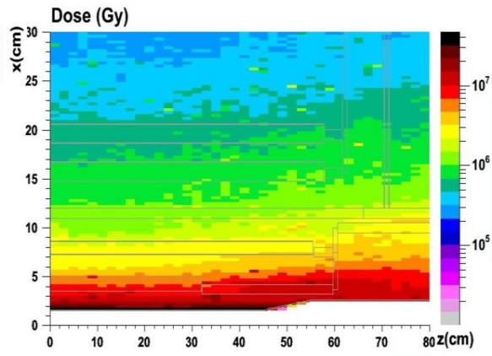
Introduction
The HL-LHC upgrades are planned for 2022
Consequences for the pixel detectors :
  Extreme particle flux
    From 200 MHz/cm2 in the current system to 2 GHz/cm2
    50 kHz per pixel for a 50 x 50 µm2 pixel
  Extreme radiation levels. Up to 1 Grad & 2.10¹⁶ neq/cm2 for the innermost layers (~5 cm)
RD53 collaboration :
  “Development of pixel readout IC for extreme rate and radiation” : ATLAS-CMS-CLIC working group on small feature size electronics
  6 working groups, among which one working on radiation effects
  Test and evaluate the 65 nm technology for a dose level of 1 Grad
The work presented here essentially done in this framework

Slide 20
RD53A prototype
  20 mm × 11.8 mm
  400 × 192 pixels de 50 µm × 50 µm
  Demonstrator chip and not the production chip
  Achieve all the specifications ?
  65 nm process in term of irradiation
  Test of Different design variants
  Bump bonded to the sensor
  Test of the serial powering
  To be submitted May 2017

Slide 21
Radiation Induced Leakage Current
STI
IDS
Drain N+
Main NMOS
Thin gate
Source N+
Parasitics NMOS
VT2
VT1
VTpre
VGS
Increasing TID
Concerns only NMOS transistors
Trapping in the isolation oxide (Shallow Trench Isolation – STI)
Increase in off-state leakage and Inter devices leakage
  Radiation-induced positive charges opens inversion channel / parasitic transistor
  Higher effect for narrow transistors
  Parasitic transistor is a strong competitor to main channel
Effects on IC design : increase power, overheating and failure
220 Mrad
Pre-Irrad

Slide 22
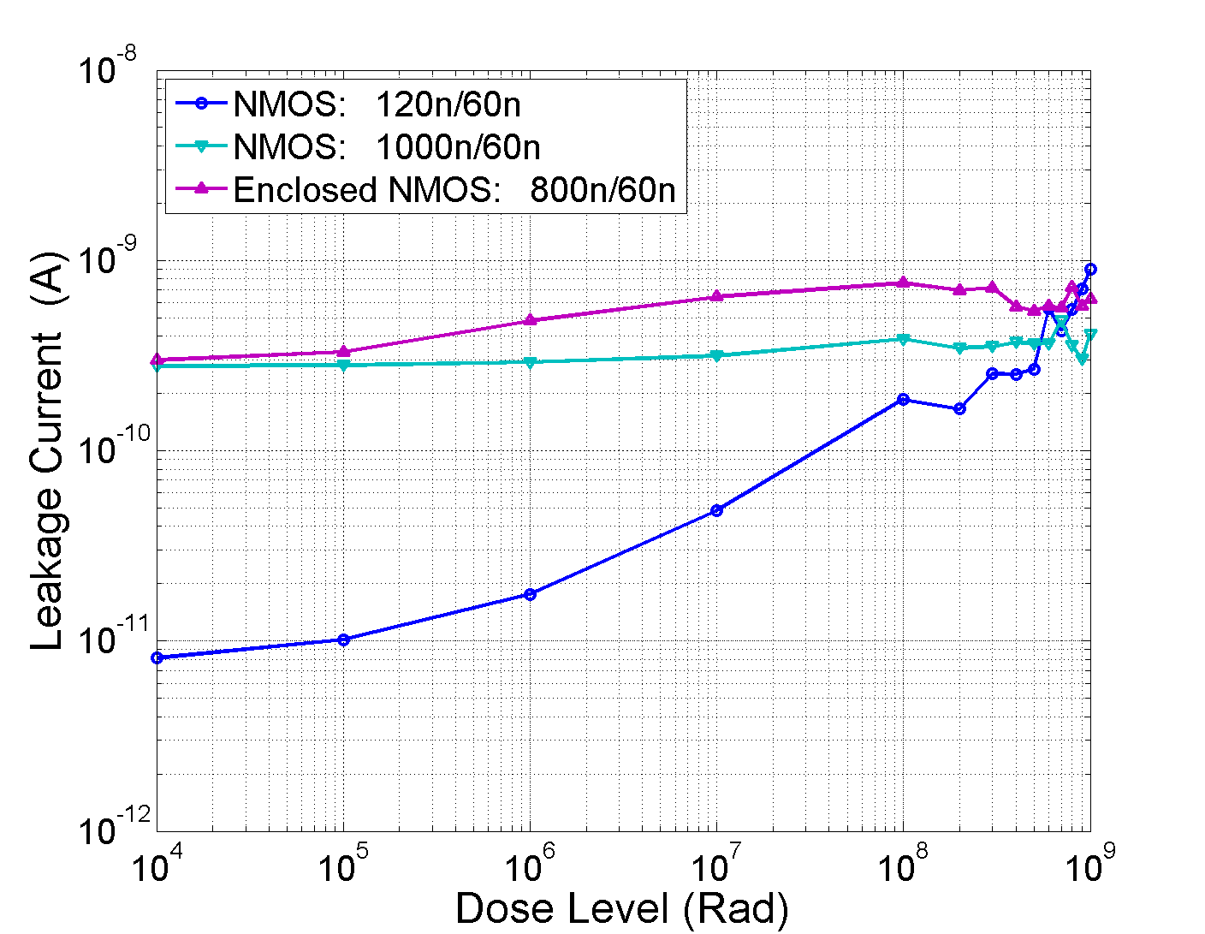
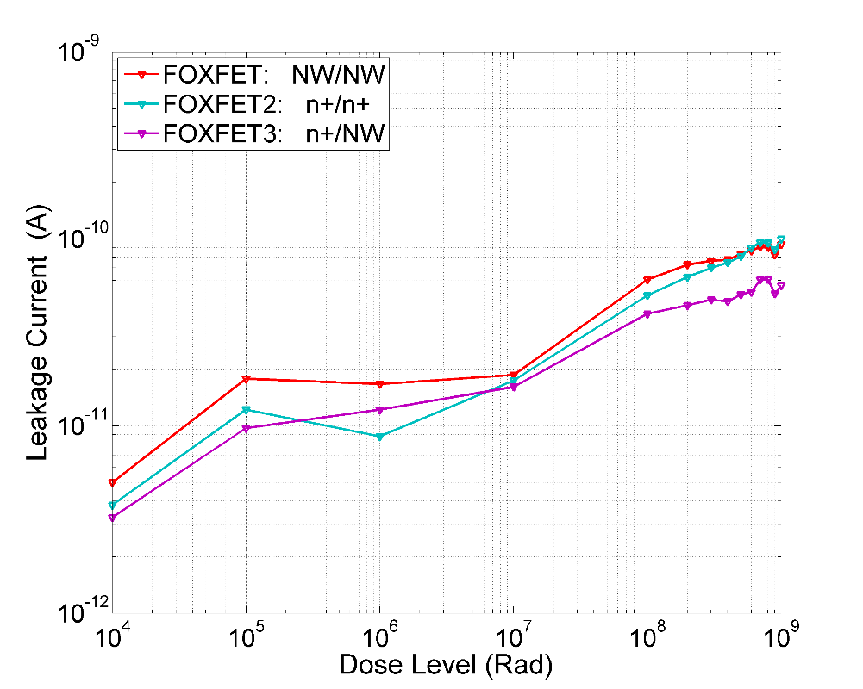
Leakage Measurements for TSMC 65 nm
Supplier A - room temperature -Leakage current
Device with 120nm/60nm (the narrower one) shows the highest increase in leakage :
  Parasitic device more influent
  ~ 2 orders of magnitude for the level of 1000 Mrad
  Same order of magnitude for the leakage variation with the process
  The leakage value is below 1 nA for 1 Grad
  Peak of 200 nA at 1-6 Mrad for IBM 130nm
Different FOXFET structures have been tested (NW/NW, n+/n+ and n+/NW)
  The current increase is low
  The increase of the Inter-device leakage is also limited
For this 65nm process, the increase of the leakage current is very limited
The enclosed layout is not needed
Vds=1.2V
FOXFET current for Vds=1.2 V vesus the TID level
FOXFET devices

Slide 23
Radiation Induced Narrow Channel Effect
Minimum width device
Pre-rad
Pre-rad
RINCE is caused by the charge trapped in the STI
This charge affects the electric field in the channel and modify the transistor characteristics
More relevant for narrow transistors
STI
STI
D
D
G
G
S
S
100 Mrad
100 Mrad
STI
STI
D
D
G
G
S
S
Radiation Induced Narrow Channel Effect:
F. Faccio and G.Cervelli, IEEE Trans. Nucl. Science,
Vol.52, N.6 (2005) pp.2413-2420
Regions influenced by the trapped charges in the STI

Slide 24
Radiation Induced Short Channel Effect
Radiation Induced Short Channel Effect:
F. Faccio et al., IEEE Trans. Nucl. Science,
Vol.62 , N.6 (2015)
RISCE is not related to the STI
May be attributed to the charge induced in the spacer’s oxide because of irradiation effects.
This charge affects the electric field and then the surface potential in the LDD (Lightly Doped Drain)
More damage for short channel device

Slide 25
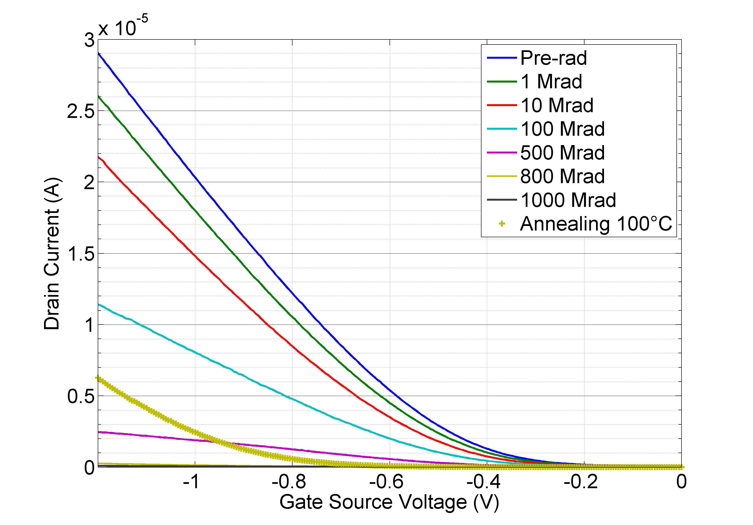
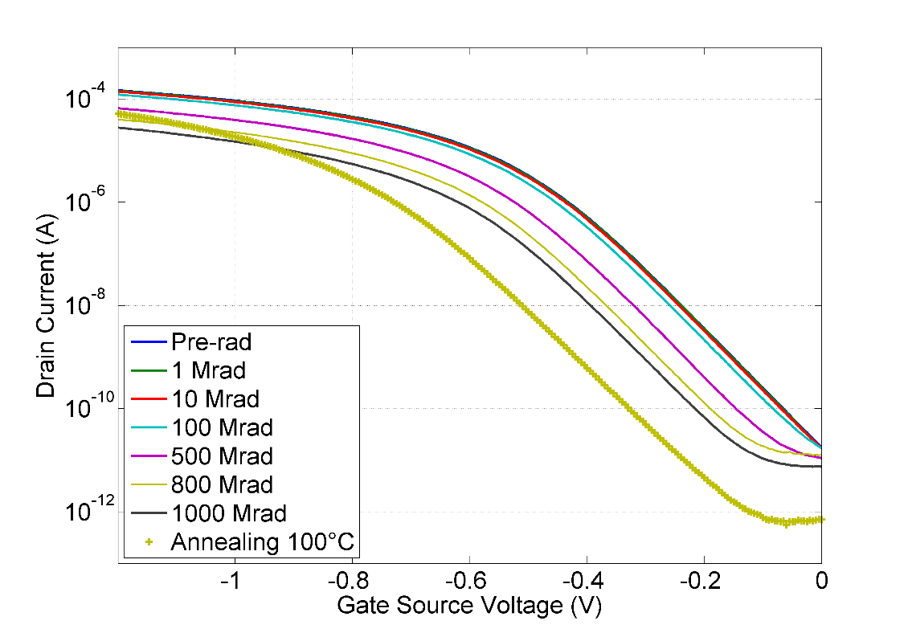
Ids(Vgs) variation for small pmos device
Supplier A - Temp=20°C
pmos:120n/60n
Vds=50mV
Id(Vg) for the narrower device (120nm/60nm)
At the high level of dose, The device becomes completely “OFF”
The transconductance factor G_{M} (mobility) is more affected than the threshold voltage
With high temperature annealing G_{M} recovers well but Vth increases
The Vth shift is ΔVth ~ 0.45 V for the small size devices
1 Grad
100°C Anneal
ΔVth
pmos:480n/60n
Vds=50mV
1 Grad
100°C Anneal

Slide 26
PMOS devices irradiation
Supplier A - Temp=20°C
Id(Vg) for the minimum size device (120nm/60nm)
At the high level of dose, The device becomes completely “OFF”
The GM factor (mobility) is more affected than the threshold voltage
No increase for the leakage current
With high temperature annealing GM recovers well but Vth increases
The Vth shift is ~ 0.45 V for the narrower device
pmos:120n/60n
Vds=50mV
pmos:480n/60n
Vds=50mV
Remplacer par 120/60

Slide 27
Short and Narrow transistors
PMOS
NMOS
Short and Narrow transistors are affected by RISCE and RINCE. Strong degradation of “Digital” devices
  RISCE is dominant for the NMOS devices
Strongly depends on temperature during irradiation and bias conditions of the devices
  Less damage for the NMOS and PMOS device when Irradiation is done at low temperature (-20 °C)
  More damage for the worst case bias : VGS=VDS=1.2 V (diode connected)
An issue for standard digital cells DRAD: Various digital libraries , various test cells…
Need to define libraries to be used for RDR53A

Slide 28
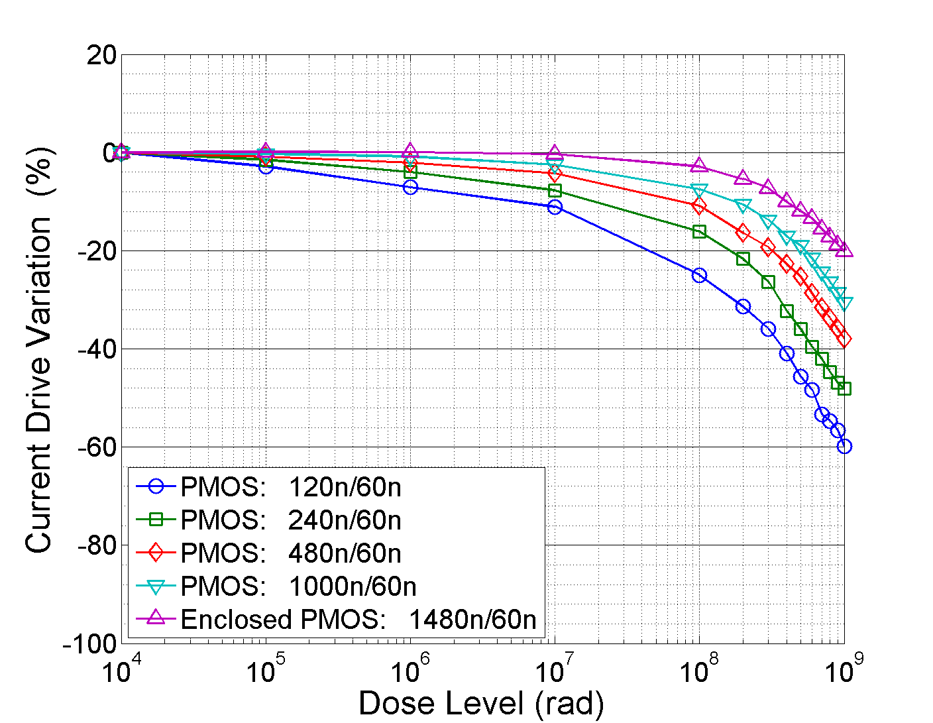
  Annealing Effect
Less damage for the PMOS device when Irradiation is done at low temperature
  Parameters shift does not compromise the digital design functionality
This TID testing and qualification is performed at a High Dose Rate (HDR) of 9 Mrad/hour
Several orders of magnitude higher than the Low Dose Rate (LDR) expected for the actual HL-LHC environment
In general, the qualification for LDR consists in performing HDR testing followed by the high temperature annealing under bias
Supplier A
PMOS devices : ON state current for Vds=50mV
Irradiation at -15°C

Slide 29
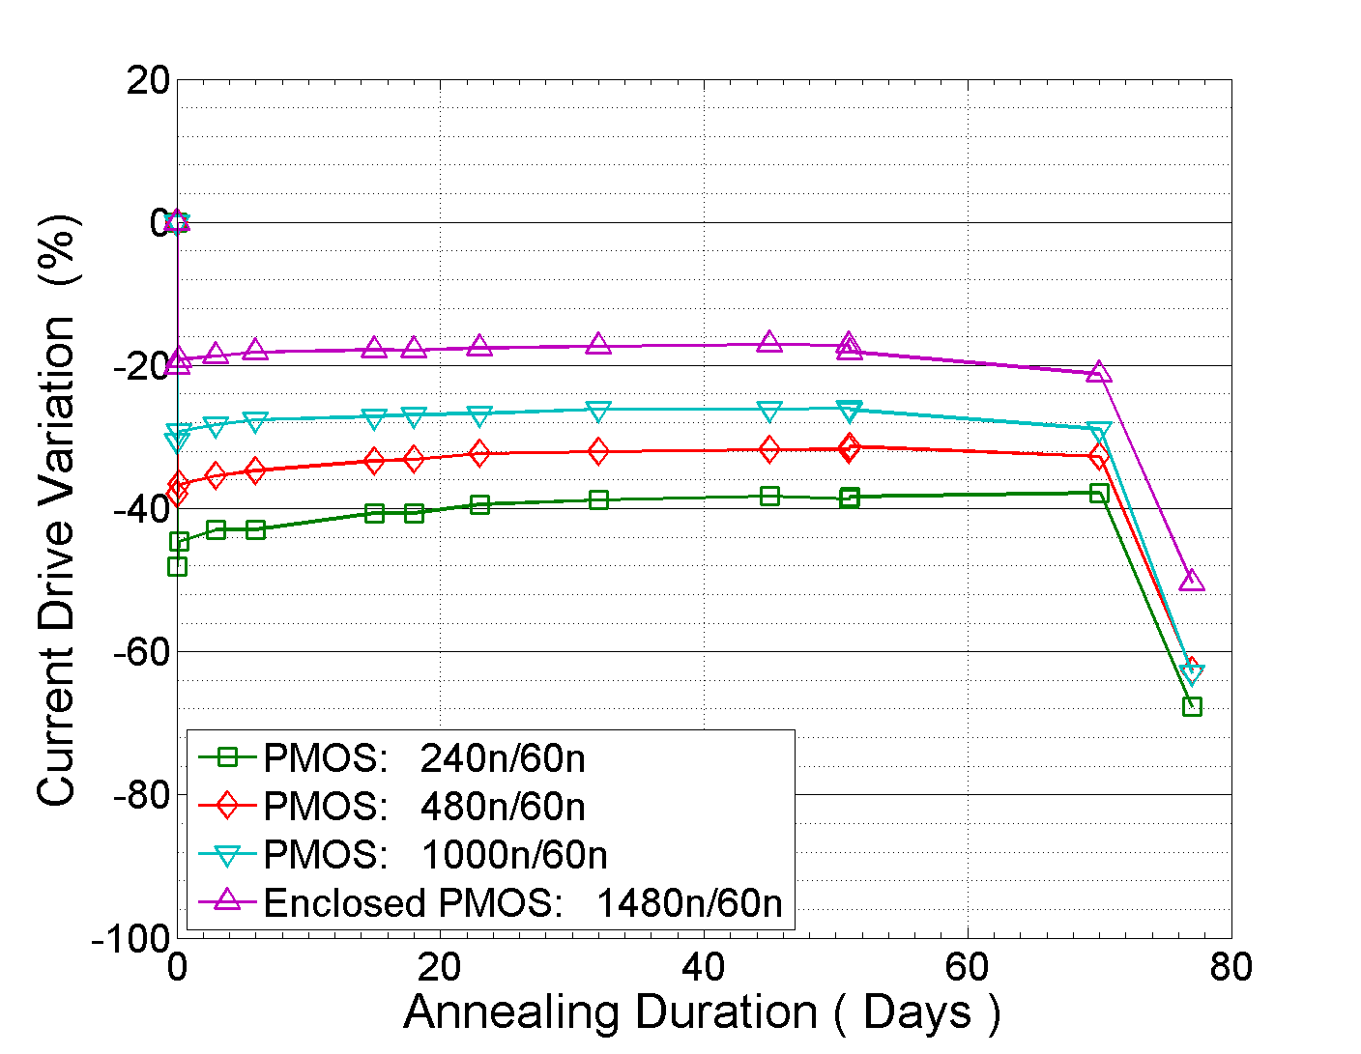
  Annealing Effect
Supplier A
PMOS devices : ON state current for Vds=50mV
Supplier A
PMOS devices : ON state current for Vds=50mV
Irradiation at -15 °C
Annealing
-25°C
25°C
100°C
This TID testing and qualification is performed at a High Dose Rate (HDR) of 9 Mrad/hour
In general, the qualification for LDR consists in performing HDR testing followed by the high temperature annealing under bias
High temperature annealing (100 °C for 7 days) degrades strongly the DC parameters
This degradation comes from the increase of the threshold voltage
  ΔVth = 0.28 V with respect the pre-irradiation value for the 240nm/60nm device

Slide 30
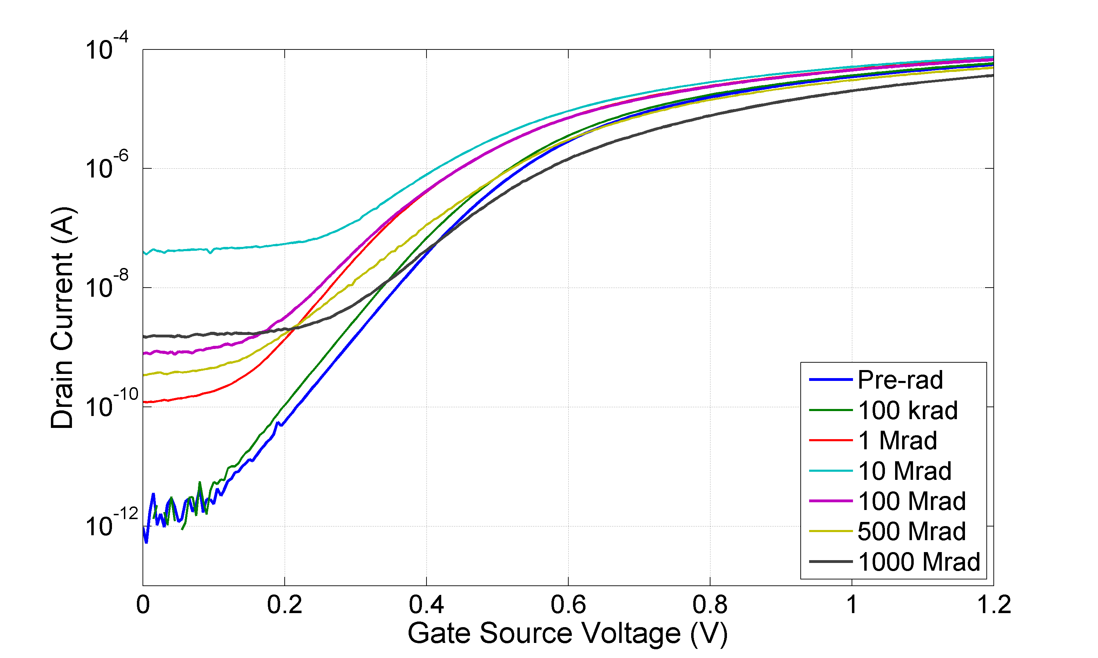
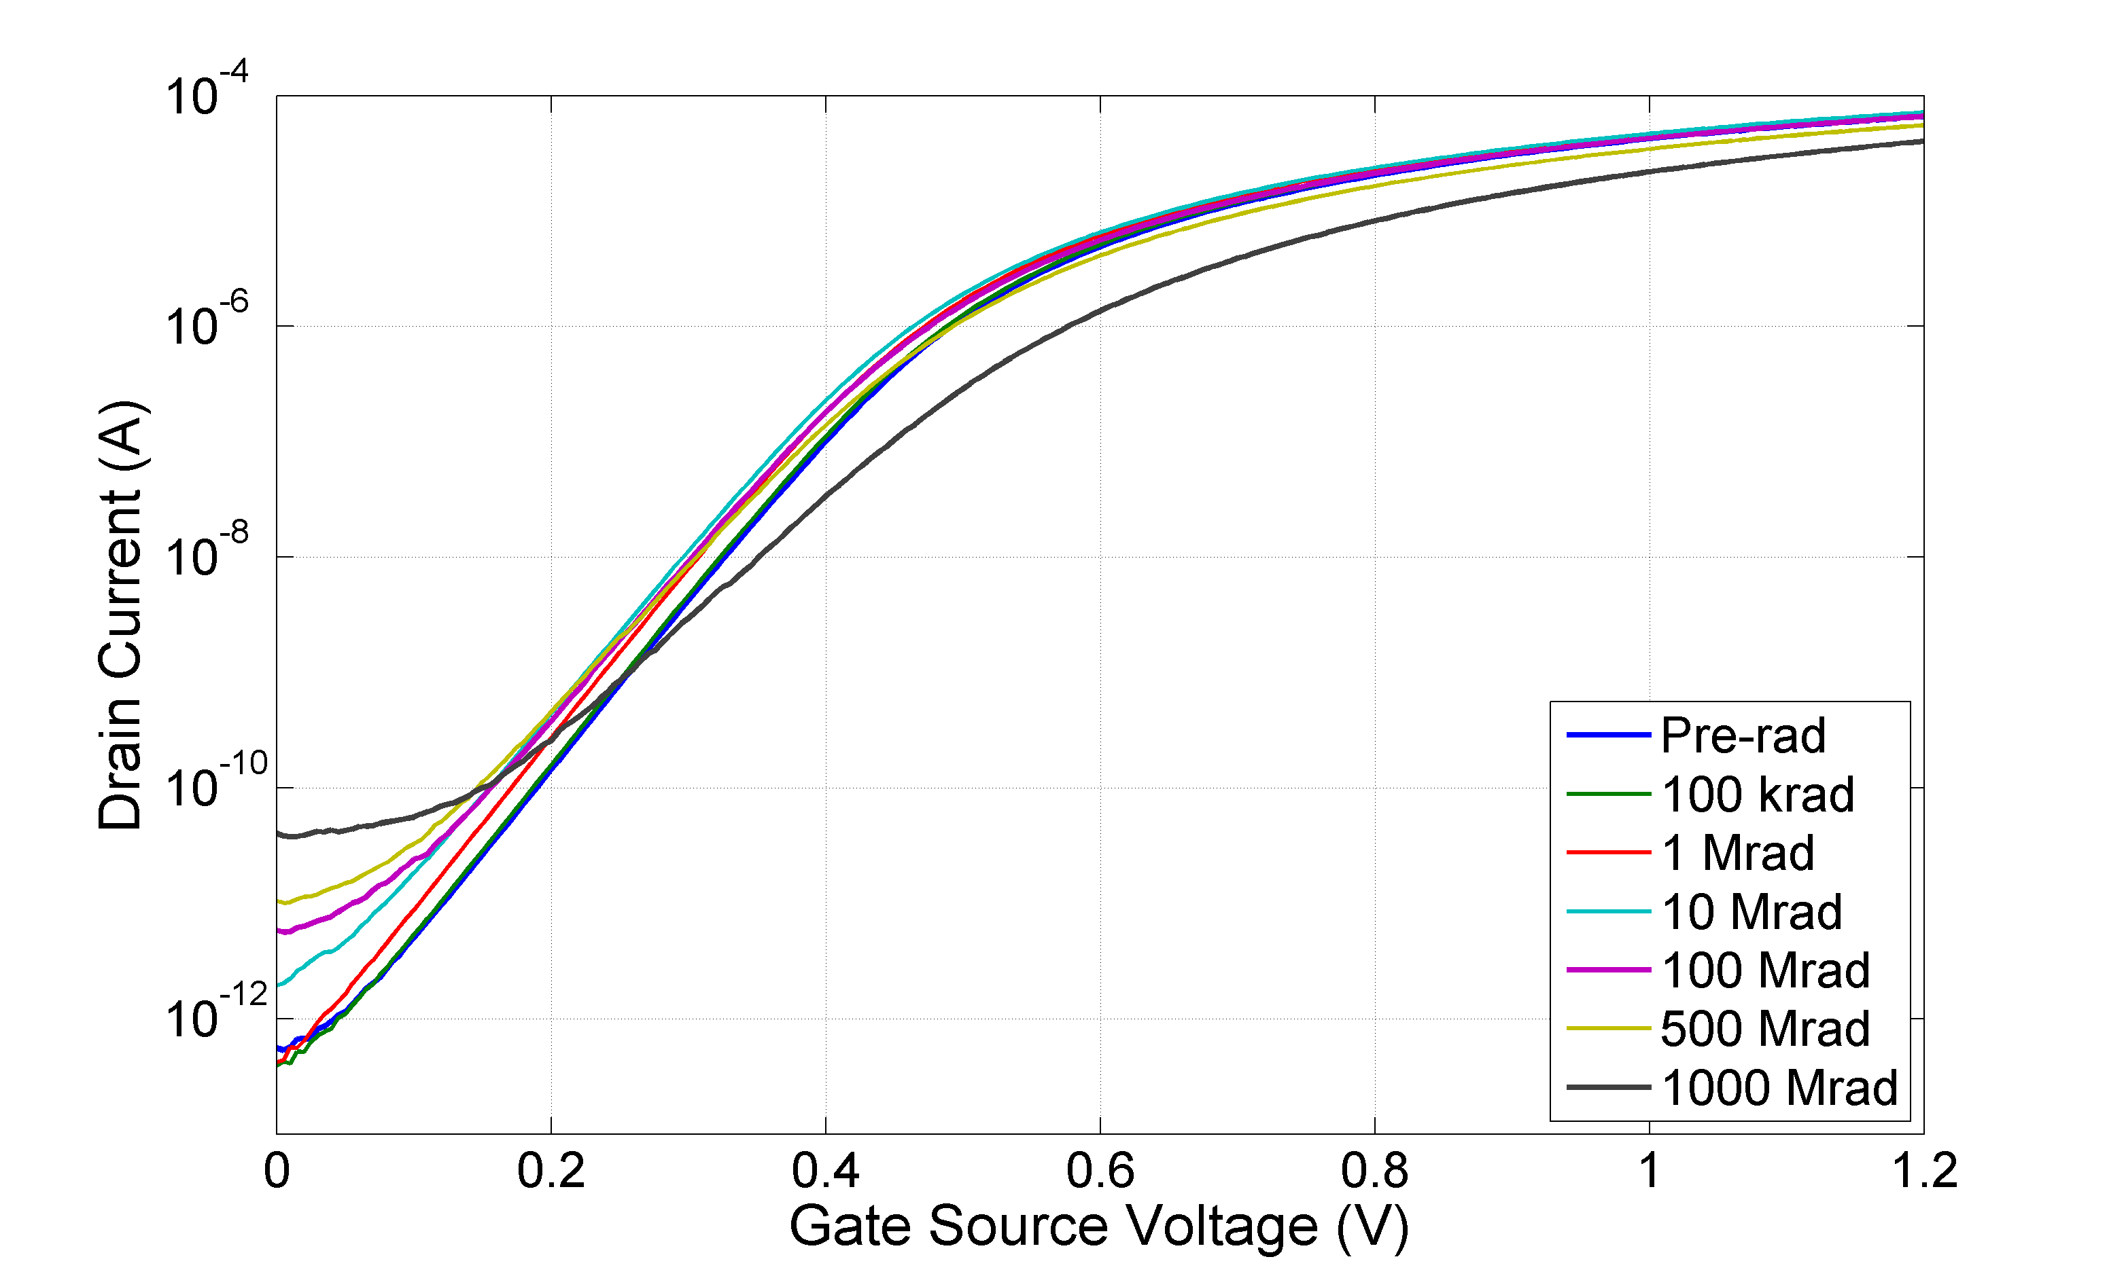
Comparison of processes A / B at -15°C
Temp=-15°C
The test chip (process B) provided by MOSIS through Berkeley
Compared devices : L=60 nm and W : 120nm, 240nm, 480nm and 1um
The process B devices show a higher increase for the leakage current
  The maximum value (~10 Mrad) is 200 nA
  10⁵ times the pre-rad value
  Parasitic transistor leaks much more than for the process A
Supplier B
nmos:120n/60n Temp=-15°C
Vds=1.2V
Supplier A
nmos:120n/60n Temp=-15°C
Vds=1.2V

Slide 31
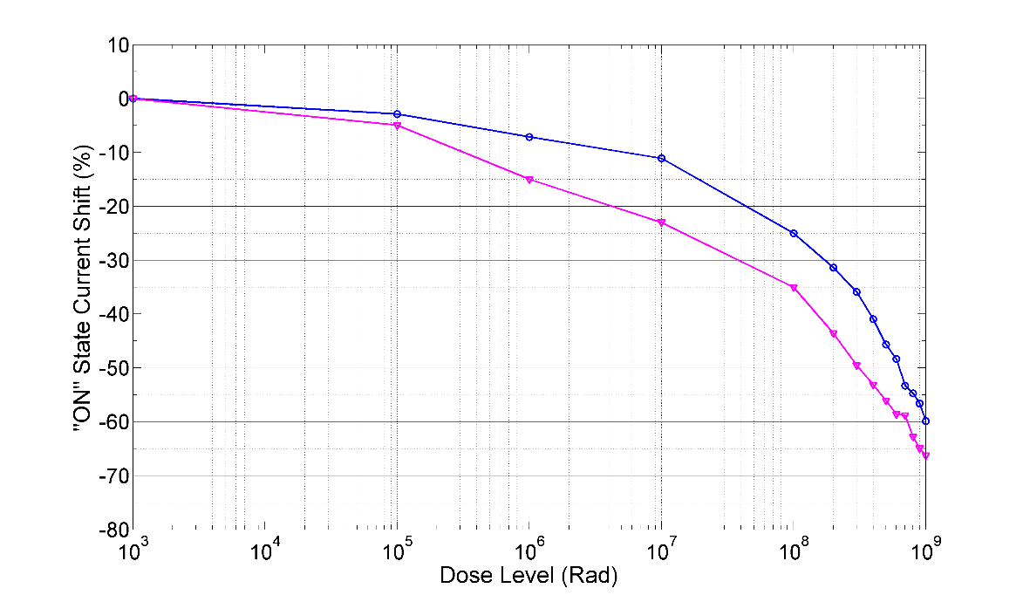
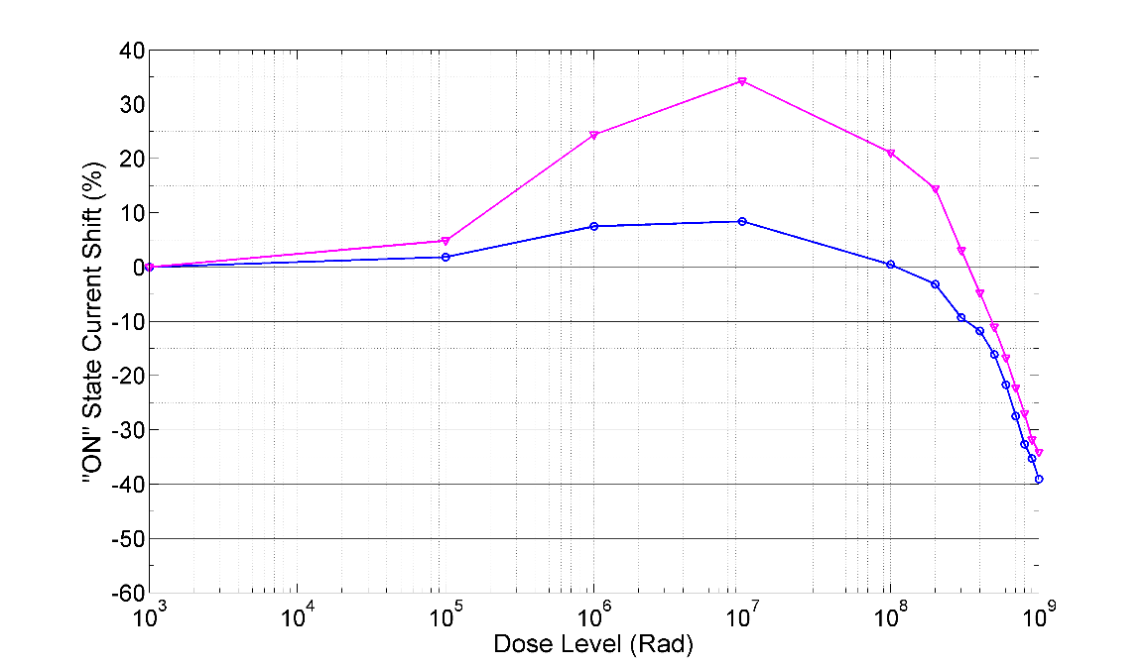
Comparison of processes A / B at -15°C
ON state current for Vds=1.2V
A similar behavior is observed for another 65nm process (supplier B)
Pmos : Loss of transconductance in both cases
Nmos : Larger rebound region between 100krad-100Mrad for the supplier B
The degradation depends more on the device width for B than for A in this region
  Confirms that the parasitic STI device is more influent for the process B
The degradation at the high level of dose is not related only to the 65nm process from the supplier A (CERN contract)
Supplier A
Supplier B/A
pmos:120n/60n Temp=-15°C
Vds=1.2V
Supplier B
Supplier B
Supplier B/A
nmos:120n/60n Temp=-15°C
Vds=1.2V
Supplier A

Slide 32
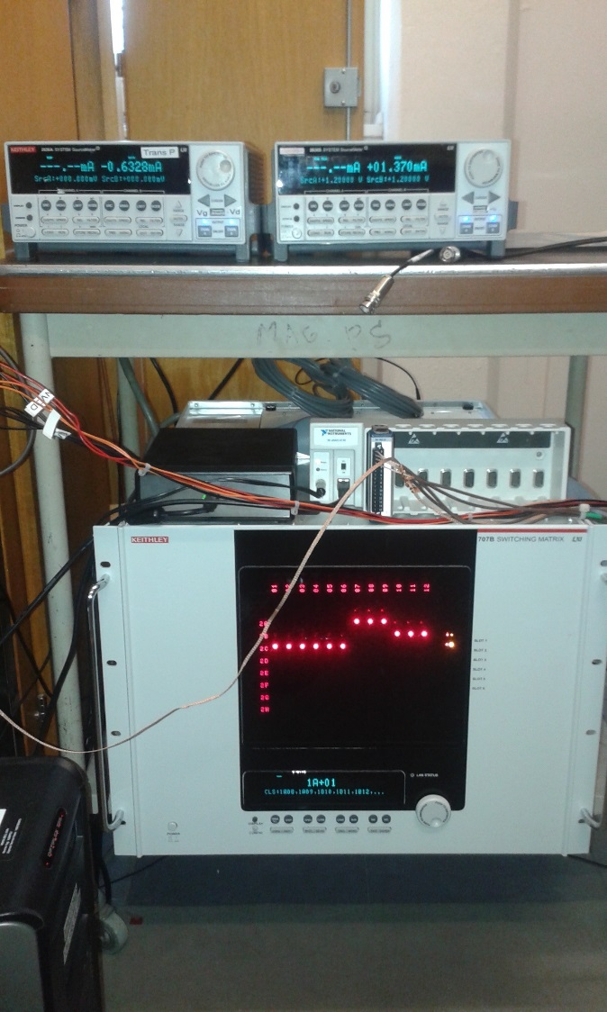
Test set up
65 nm Devices Irradiation Test Set-up
Different set up were designed (Denis Fougeron presentation)
  Stability of the set up
  External ESD to overcome the Pb of the static charge
-> First “reliable” characterization for 1 Grad was done by CPPM
Do we need to progress in this work ?
Which facility to use ?
Denis in contact with JL Autran (IM2NP)

Slide 33
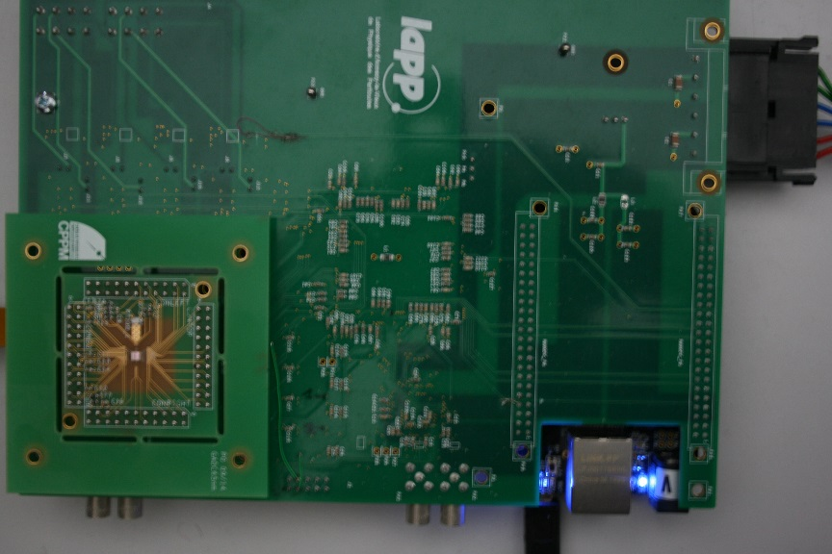
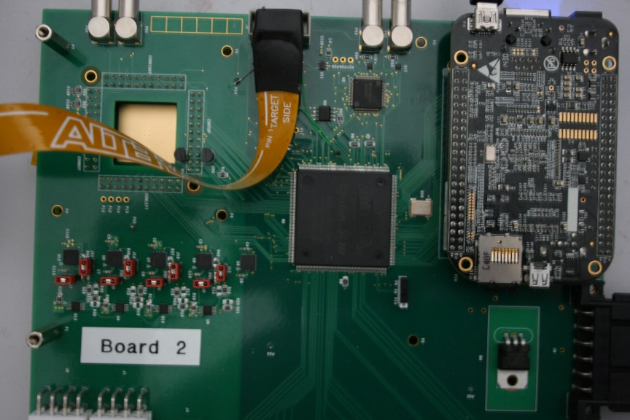
Test Set-up
The test board based on a nano PC boarb
  Easy Ethernet interface
  High level programming framework
  Up to 50 m link
  An FPGA deals with the low level interface (clock, IO. . . )
  16 bit DAC, 14 bit ADC implemented
The GADC reference voltage and the GADC input voltage are generated with 16 bit DAC controlled by the nano PC board
Collaboration with LAPP (Renaud Gaglione)
Preparation of the RD53A test firmware based on this test set-up

Slide 34
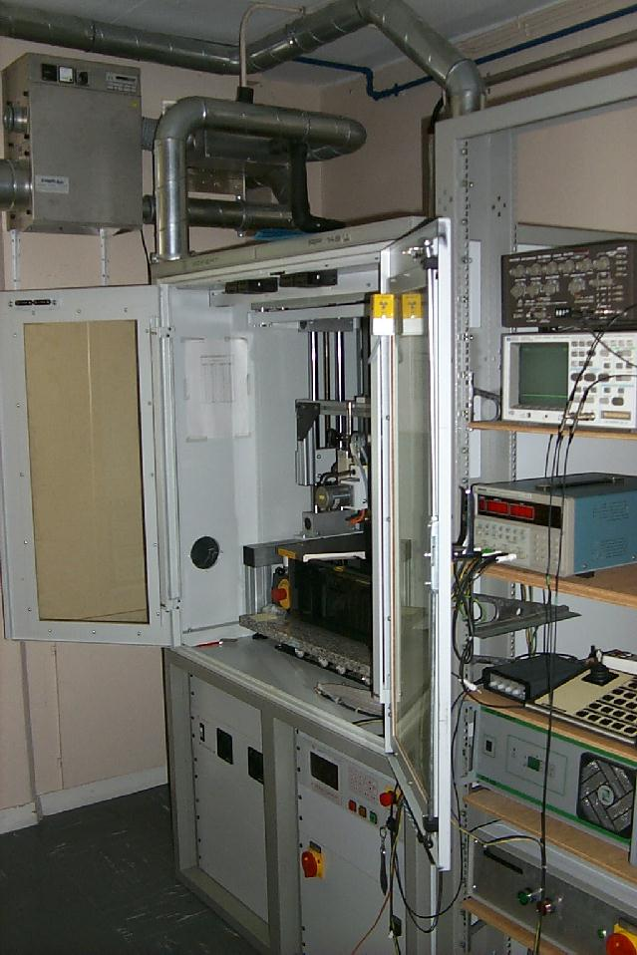
Xray Test Set up
Xray CERN Facility: 10 keV
A total dose of 1000 Mrad is reached in ~1 week following a Dose rate of 9 Mrad/hour (2.5krad/s)
Measurement of devices characteristics for (100 krad, 1Mrad, 10 Mrad, 100 Mrad, 200 Mrad …. 1000 Mrad) and takes 3-4 hours
Evaluate the irradiation tolerance of digital devices (120nm/60nm to 480nm/60nm)
Study the dependence of the irradiation hardbess on the device width
Set device size suitable for a radiation tolerant digital library
During irradiation and during annealing phase, pmos and nmos devices are set in :
  Nmos : VG=VD=1.2V and VS=VB=0V
  Pmos : VG=VD=0 V and VS=VB=1.2V

Slide 35
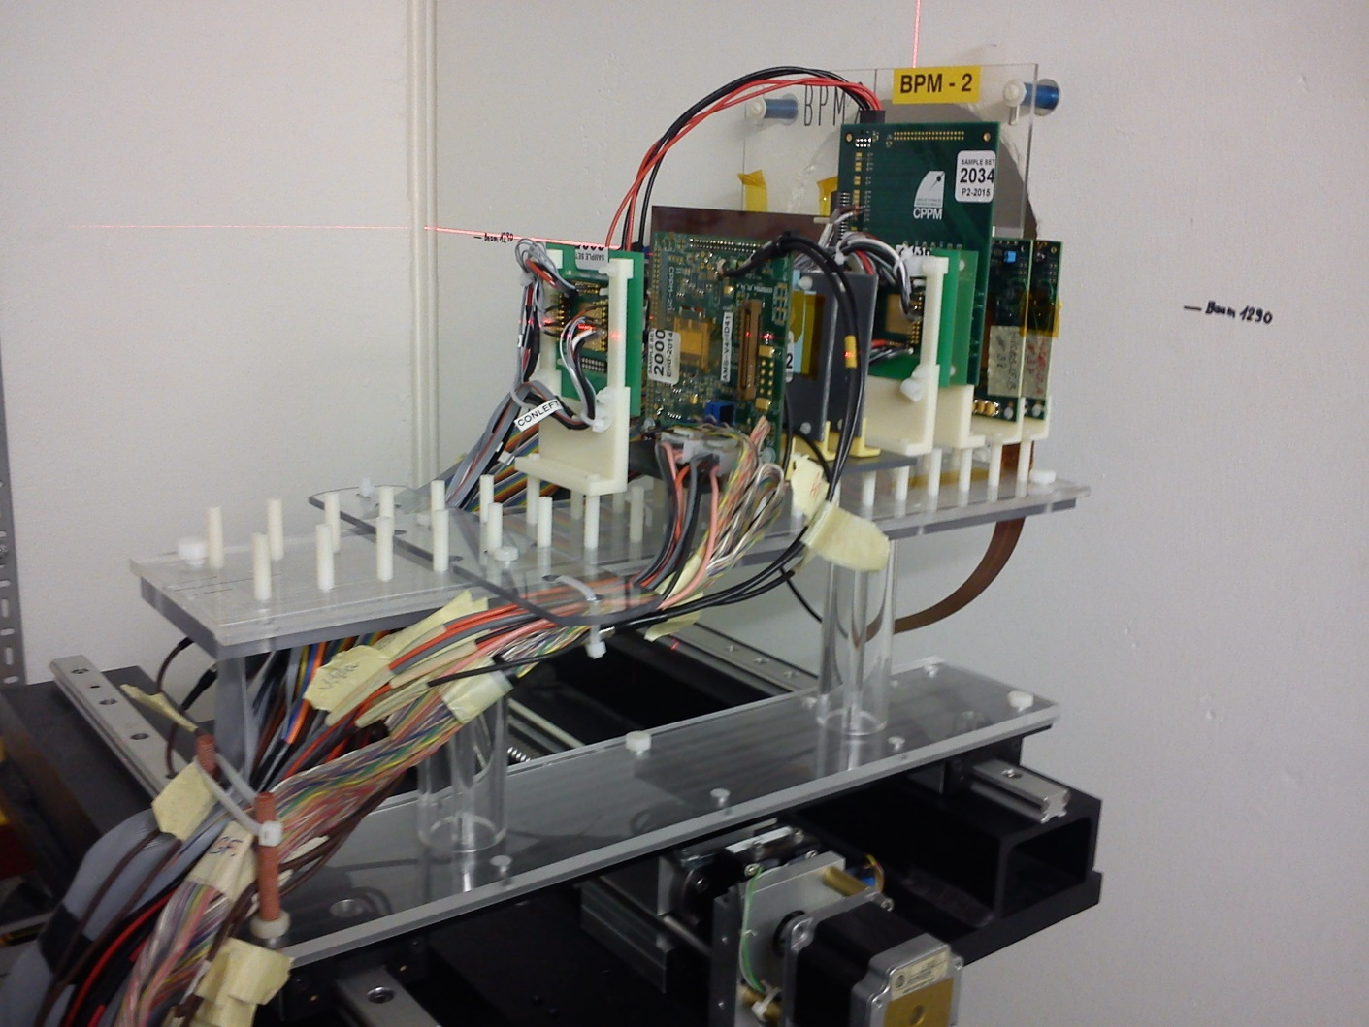
Next irradiation tests
The 24GeV primary proton beam is extracted from the PS ring
PS Irradiation tests (SEU and TID) scheduled on June 2016
SEU from the Digital radiation test chip ??

Slide 36
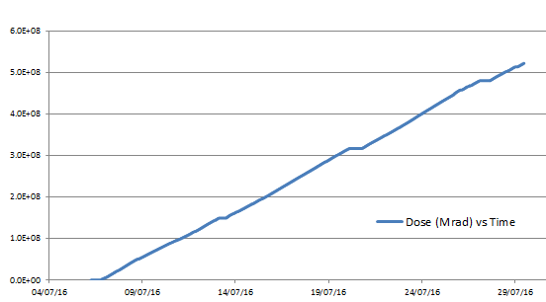
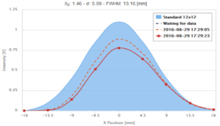
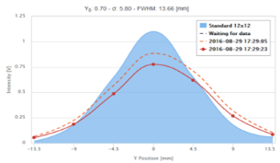
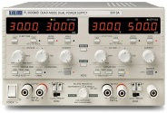

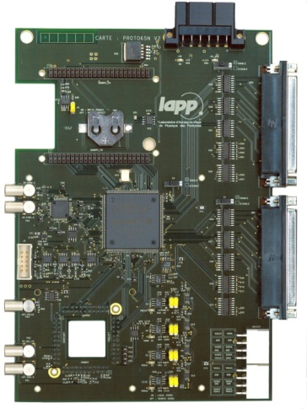
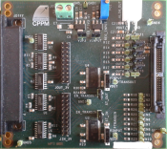

SEU setup
24 GeV protons beam line at CERN
  12.10¹⁰ protons/cm²/spill
  beam size1cm²
  mean dose rate
    950krad/h
  TID: 500Mrad
  exposure time 3 weeks
Mother board V2
  with a LAPP collaboration
  nanoPC BeagleBone card + FPGA
  Flexible programing
  30 logic signals available ^{(*)}
  Analog channels
    ADC (4 16 bits conversion channels SAR type)
    4 DAC (16 bits) ^{(*)}
  Monitoring (°C, current supply)
  Lab tests + irradiation tests
  ^{(*)}: evolution on going
Dose vs time
TID (rad)
X-Y Beam Profil Monitor
Date Time
CONTROL ROOM
IRRADIATION ZONE
+/-5V
20m length twisted
pairs cable
1.2V signals
beam
beam
RJ45 link
LVDS
Single Ended
Trigger machine
Intermediate board
samples
1.2V power supply
Mother board V2
SEU CERN setup

Slide 37
DNW effect on SEU
With DNW layer
NO DNW
SRAM structure with 65 nm ST process
No DNW : cross section ~2 E-14 cm² (Similar with our measurements)
DNW : increase of the proton cross-sections by a factor 5

Slide 38
SEU strategy for the digitalRD53A
Din
DFF
delay
Voter
DFF
Q1
Din
LD
Clk
DFF
Voter
delay
Voter
DFF
Voter
Clk
Din
Q2
LD
Clk
DFF
delay
Voter
DFF
Q3
Din
LD
Clk
For the data reg
For the global config reg
Minimum distance of 10 µm between redundant storage nodes
Synthesis tools used for the design

Slide 39
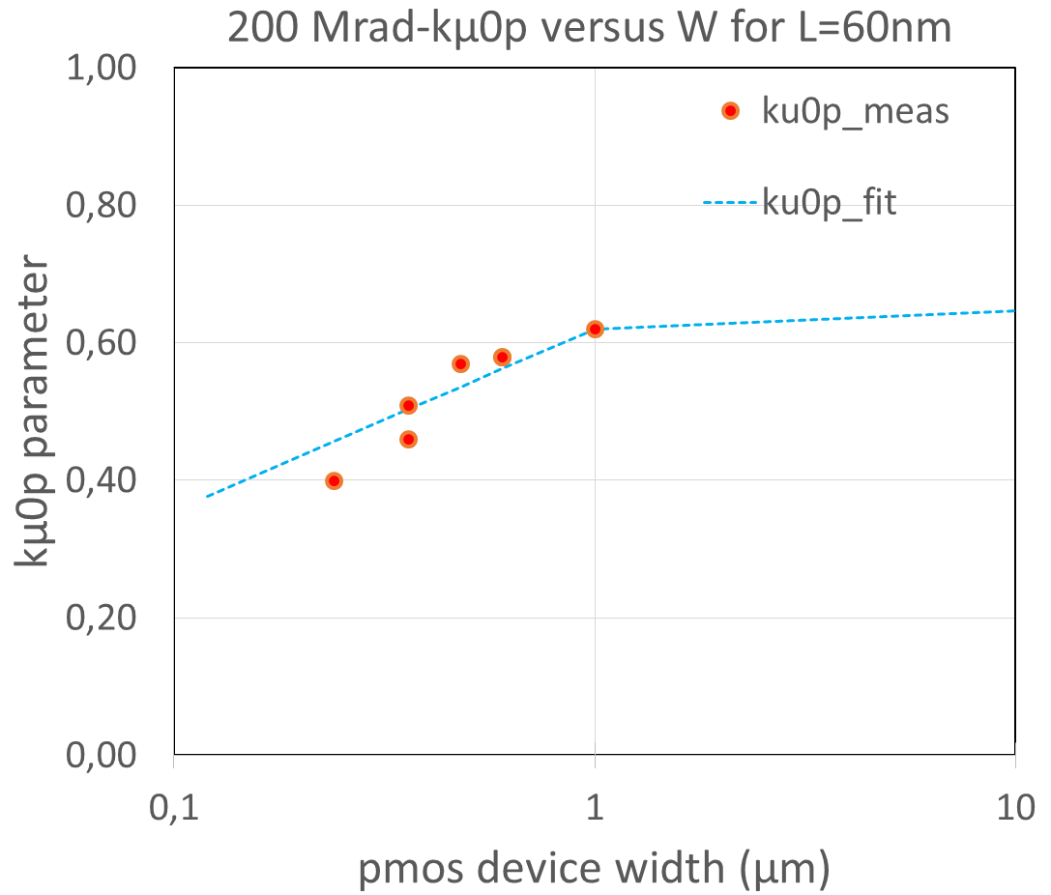
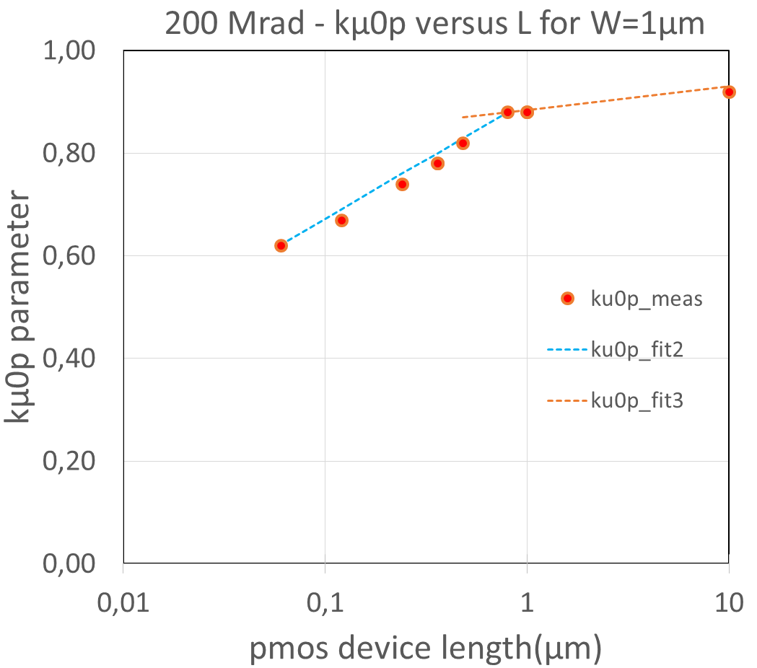
Pmos fitting parameters
The current drive loss depends strongly on the device width W and on length L
A large part of data used in the fit (200 Mrad and 500 Mrad) were provided by Stefano Michelis (CERN)
For pmos devices only the transconductance degradation is considered (Annealing is not included)
The mobility factor kµ0p is defined as the ratio µ0_rad/µ0_prerad
kµ0p depends on W and on the L

Slide 40
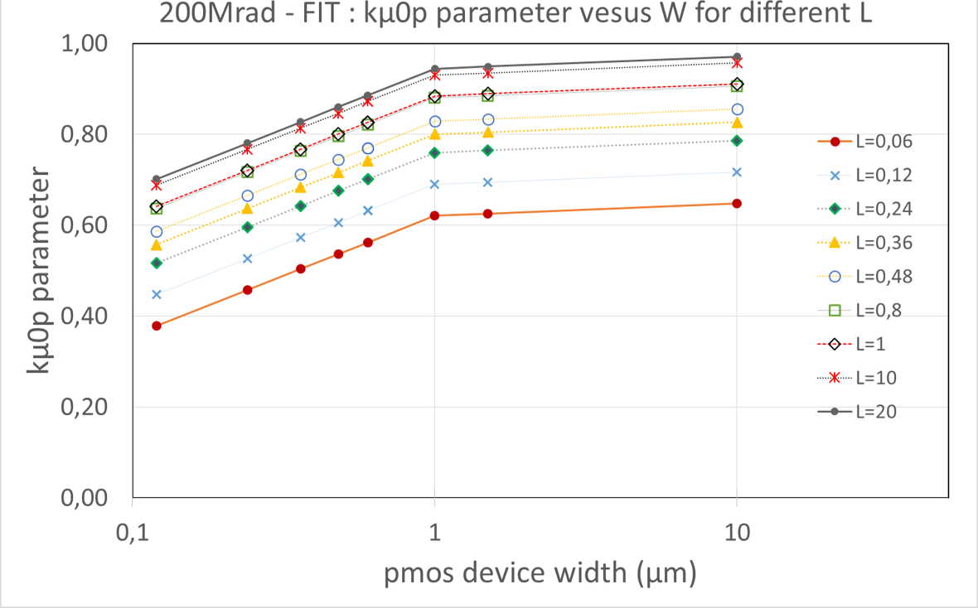
pmos fitting parameters
Increase of L
Data from measurements
The current drive loss depends strongly on the device width W and on length L
The mobility factor kµ0p is defined as the ratio µ0_rad/µ0_prerad
kµ0p depends on W and on the L
For PMOS devices the transconductance degradation is considered as the main effect (Annealing is not included)
  kµ0p relation to W and L is implemented inside the TSMC spectre model file

Slide 41
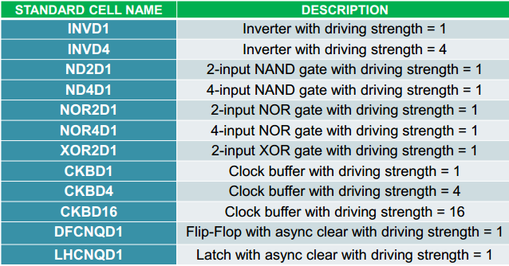
Digital Library Information
Timing
  Combinational
    Delay
    Transition time
  Sequential
    Delay & Transition time
    Hold & Setup
    Recovery and Removal
Power
    Leakage : Static power
    Internal Power
Library characterization
  Cadence Liberate based on the spectre model for 200 Mrad and 500 Mrad
Different standard cells implemented for each library

Slide 42
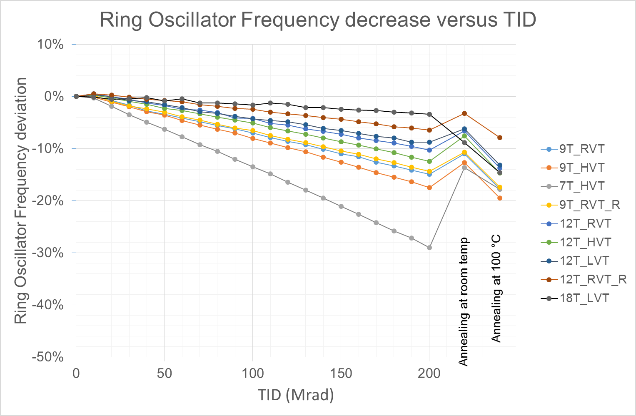
Results for 200 Mrad
Different behaviour after room temperature annealing for 18T_LVT library (ELT transistors)
7T_HVT more sensitive but recovers better (in %) respect the rest of the libraries.
For the rest of the libraries, the relationship of the behavior between libraries is the “expected”: libraries with smaller size behave worse than big ones, libraries with higher Vt behave worse than libraries with lower Vt.

Slide 43
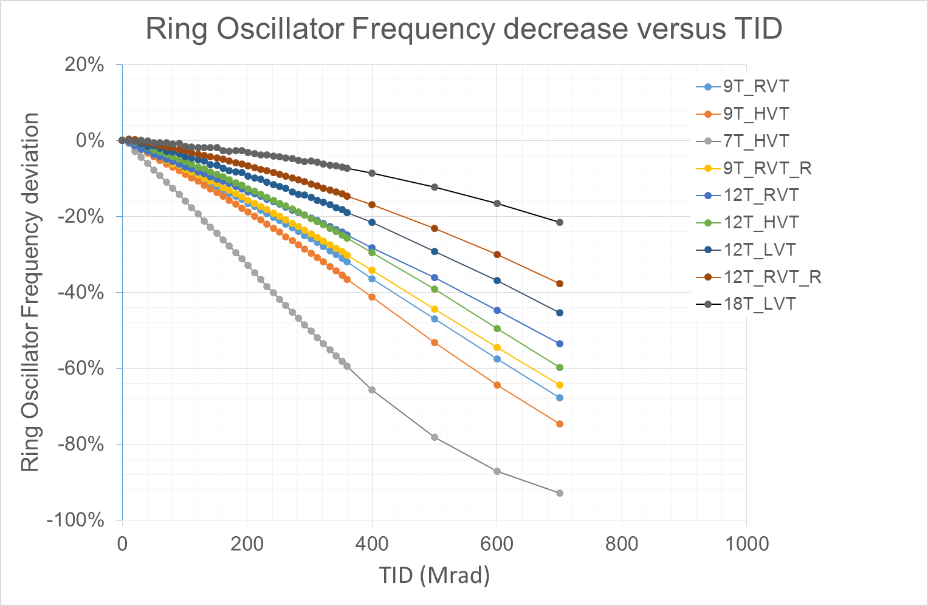
Results for 500 Mrad
  Irradiation at 500 Mrad at room temperature
  No annealing

Slide 44
Post-irradiation tests
Chip at Ambient temperature without bias for 1 day
Measurement of IDS = f(VGS)
Cooling down the chip to -20°C for 5 days
Measurement
of IDS = f(VGS) at Ambient Temperature
Annealing at Ambient temperature during ~ 41 days
Measurement of IDS = f(VGS)
Annealing at high temperature (100 °C)
T=100 °C for 168 hours (7 days)
T=100 °C for 5 days
Repeat…..
Cooled down to room
temperature before
IDS(VGS) measurement

