Slide 1

A High Precision TDC for CMS MG-RPC :
Vernier Ring Oscillator based TDC
CRONOTIC
(Cms Rpc muON detectOr Tdc IC)
(Amina Annagrebah (PhD Thesis since feb, 6, 2017), E.Bechetoille¹, H.Chanal², M.Dahoumane¹ , I.Laktineh¹, H.Mathez¹
1 IPN Lyon, 2 LPC Clermont-Ferrand

Slide 2
Outlines
Introduction :
  Fast-Timing detector - RPC
  Requirements
Chronology of TDC works at IPNL (Lyon)
Vernier Ring Oscillator technique
TDC design presentation
Some simulation results
Conclusions and outlooks

Slide 3
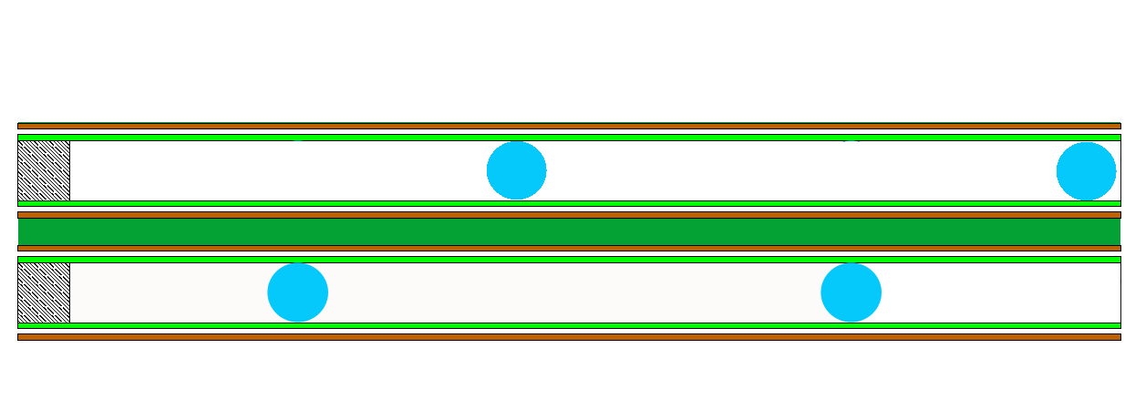
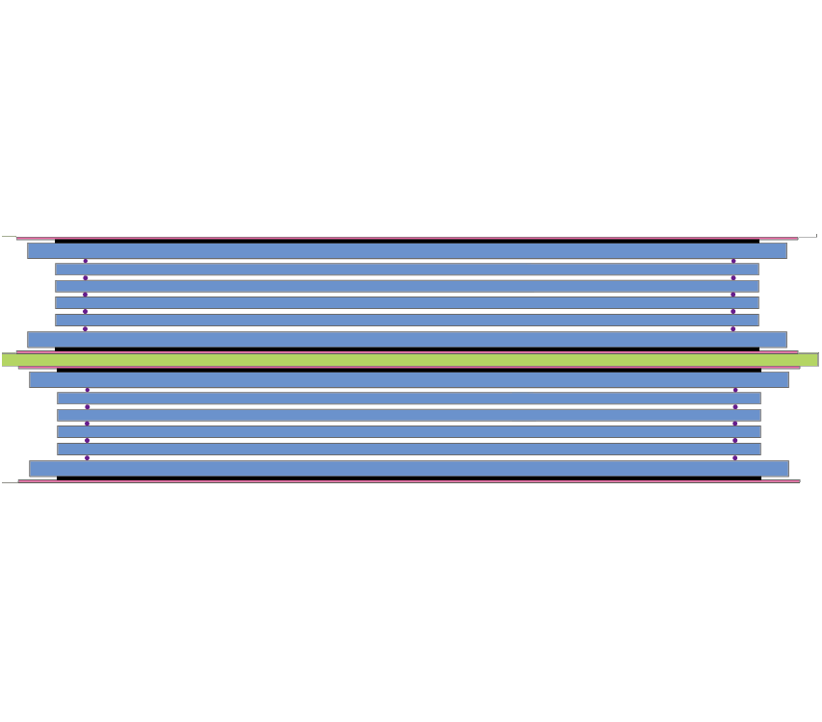
Fast Timing Detectors
iRPC: well known technology, suited for large detection surface and moderate particle rate.
Charge : few pC
Two scenarios are proposed:
Double single-gap RPC: time resolution < 1ns
Resistive plates
Spacers
Double multi-gap RPC: time resolution < 100 ps
Pick-up
strips
Resistive plates

Slide 4
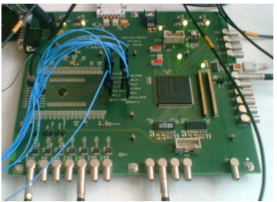
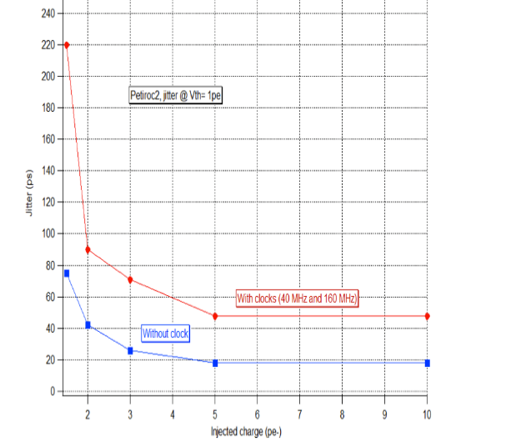

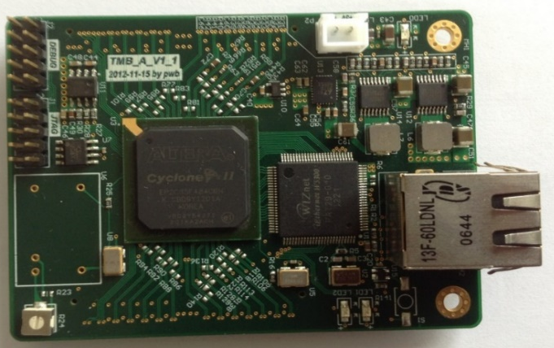
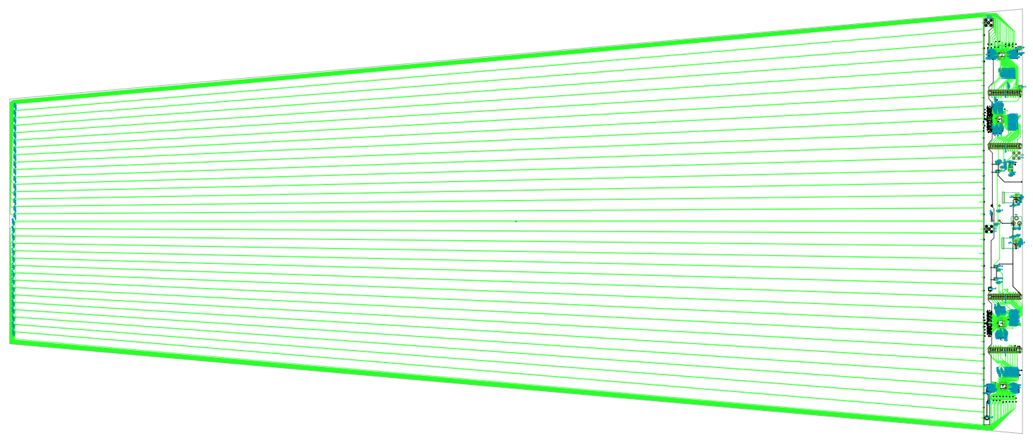
Electronics for Multi-Gap CMS-GRPC Detectors
- PETIROC ASIC : 32-channel,
high bandwidth preamp (GBWP> 10 GHz), <3 mW/ch, dual time and charge
measurement (160 fC-400 pC)
vey fast and low-jitter < 25 ps rms
1pe=150fc
- 24-ch, TDC of 25 ps time resolution developed by the Tsinghua university is being used to demonstrate the RPC/MRPC time capability
Y
New PCB with pick-up strips read from
both sides is being designed
with the aim to achieve Y-position
determination Y= L/2-v*(t₂-t₁)/2.
Time resolution can be measured: (t₁+t₂)- L/v
On-detector Strip
Off-detector Strip

Slide 5
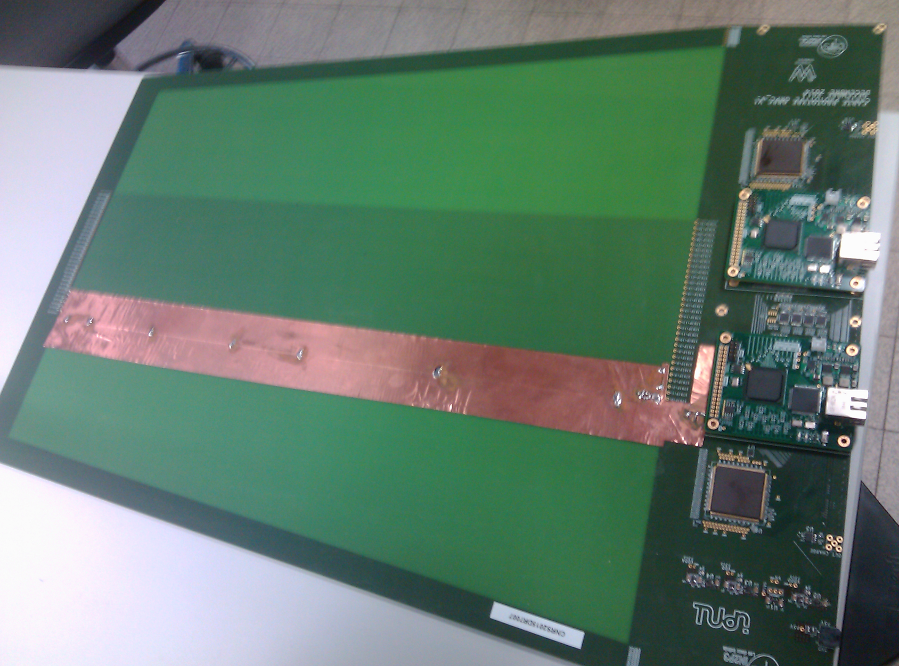
Electronics for Multi-gap CMS-GRPC detectors
A PCB was conceived to host : Pickup strips, 2 PETIROC, 2 TDC
A DAQ system was developed. The PCB is intended to equip large chambers
50 cm
Return strips outside
the detector
32 strips of 3 mm width
(4 mm pitch)
Tsinghua
FPGA TDC
IPNL
Test points
32-ch PETIROC

Slide 6
Requirements for the TDC ASIC development
LSB < 20 ps, adjustable
  RMS Resolution < 2 ps, including all noise types other than the quantization noise
  Dead time < 1μs
  The RPC output signal frequency is ~1 kHz (ie. the real dynamic range ~1 ms)
  The TDC dynamic range measurement : from 1 ns to 3 ns depending on :
    Gate unity rms Jitter , TDC reference clock frequency and the frequency of the Ring Oscillators
    Low power consumption (the total power (FEE+TDC) < 3 mW/channel)
  TSMC 130 nm process is chosen according to the technology of PETIROC (OMEGA group).

Slide 7
Chronology of TDC works at IPNL (Lyon)
FPGA :
A classic Vernier TDC has been used with success in some physics experiments (Cf [1])
An original technique which allows to control and to adjust the TDC resolution to a few ps has been designed. This architecture has already been tested successfully on FPGAs (10 ps RMS resolution over a range of 1 ns)
Main limitation : cumulated Jitter ➔ customized layout may be needed !
TDC_Brick ASIC :
TDC Building blocks have been integrated in an ASIC designed in the IBM 130 nm process.
Standard cells were used to build the Ring Oscillators (XORs gates)
Current TDC work :
TSMC 130 nm process
Vernier Ring Oscillator technique
Standard cells are used to build the Ring Oscillators (Inverters)
Fine adjusting of the oscillators frequency to tune the LSB of the TDC
A prototype was submitted last year - Nov 2nd 2016
[1] Implementation of sub-nanoseconds TDC in FPGA: applications to time-of-flight analysis in muon radiography
  J. Marteau (IPNL), J. De Bremond D'ars (GR), D. Gibert (GR, IPGP), K. Jourde (IPGP), S. Gardien (IPNL), C. Girerd (IPNL), J.-C. Ianigro(IPNL)

Slide 8
Clock reference of 1 GHz is used as stop signal on the fast oscillator
Vernier Ring Oscillator TDC principle
Vdd
D
Q
Slow
Oscillator
slow
Counter
Event (start)
Vdd
D
Q
R
T = (N0*T0)-(N1*T1)
Phase
detector
TDC result
R
Enable
D
Q
Fast
Oscillator
fast
Counter
Clk_Ref (stop)
R
Ready
Reset
Start
Stop
Clk ref
T
Event
1
2
3
4
5
Phase detection
T0
Oscillator stop
T1
t
1
2

Slide 9
Vernier Ring Oscillator working principal
Start(event)
T
Stop(Ref_clk)
Slow
1
2
3
4
5
--
--
Ns-1
Ns
Fast
1
2
3
--
--
--
Nf-1
Nf
Phase Detection
(1)
(2)
Where,
Is the conversion bin (LSB)
➔ It is necessary to be able to finely adjust the oscillator frequency

Slide 10
TDC block diagram (system view for 1 channel )
Top Clk ref (40 MHz)
Coarse
counter
Event (Trigger)
stop count
(Clk ref = k * 40MHz)
Fast Clk ref.
Generator (PLL)
TX_SLVS
c
stop count
Fine
counter
RX_SLVS
S
E
R
I
A
L
I
Z
E
R
Clk ref.
period
1 to 2 ns
Simplified TDC channel
Slow counter
10 bits
Signal processing Board
start
Osc.
Slow
Oscillator
In slow calib.
c
Phase
detector
Ready
start
Osc.
Fast
Oscillator
c
In fast calib.
c
Fast counter
10 bits
c
Calibration
I2C
RST global
c
ASIC (1 ch.)

Slide 11
Time measurement chronograms
Top Clk ref (40MHz, Coarse counter))
CLK_CERN
CLK_ref
Clk ref (1GHz, Fine counter)
25
1
2
3
4
5
6
7
8
9
10
11
12
13
14
15
16
17
18
19
20
21
22
23
24
25
1
2
3
Result (T)
T CLK_ref
T_{tdc}
TRIGGER (event)
Fine counter
Stop fine counter
23
0
1
2
3
4
--
--
Nf-1
Nf
0
1
Coarse counter
Stop coarse counter
Nc-1
Nc
0

Slide 12
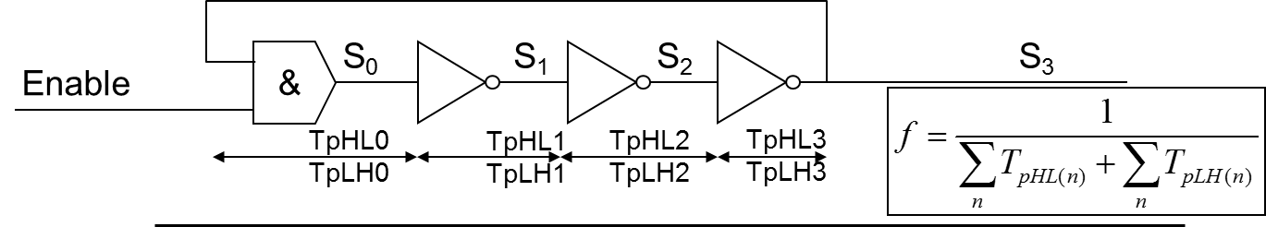
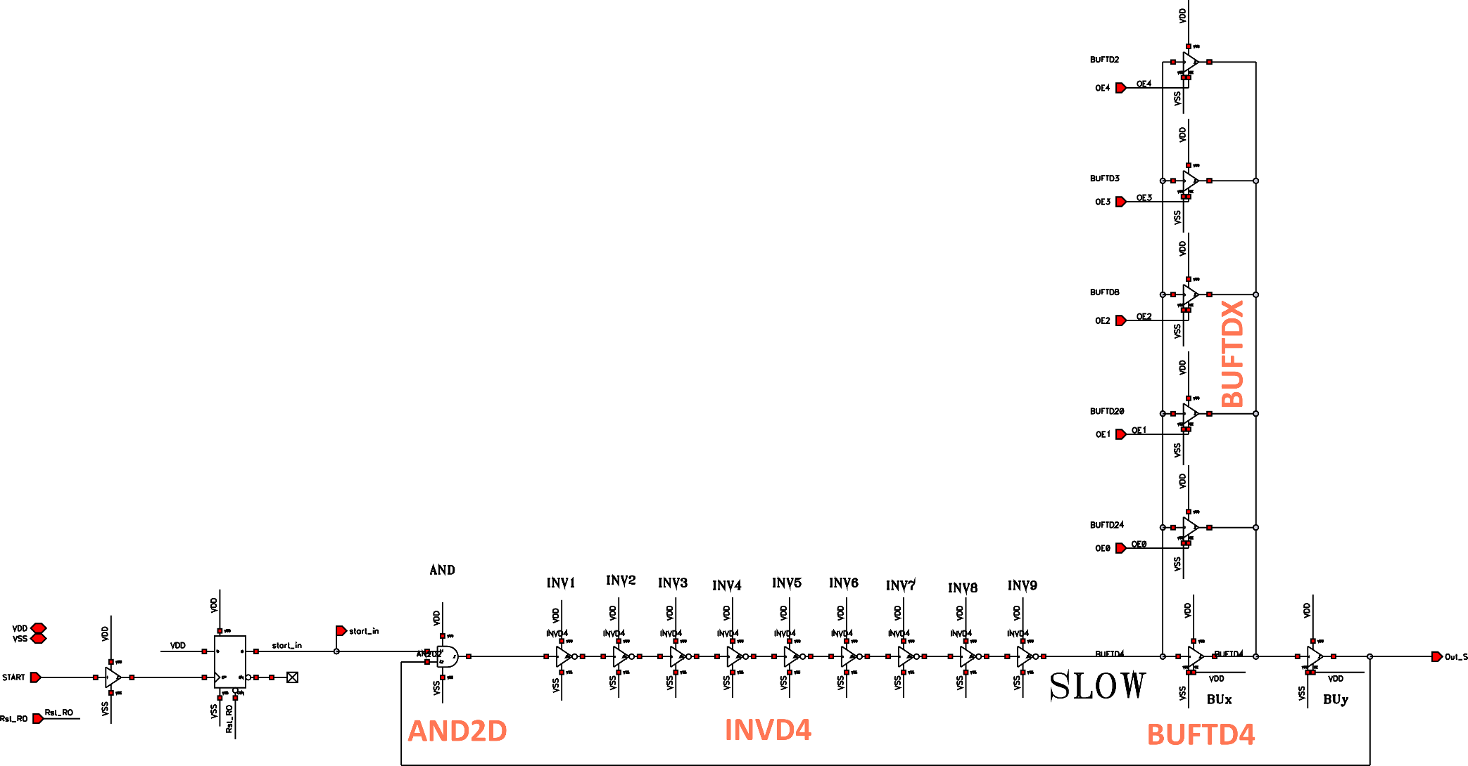
Cadence schematic of a Ring Oscillator in TSMC 130 nm process
A Simple Ring Oscillator (odd number of inverters):
Frequency tuning Ring Oscillator :
11 categories of inverters INVDx
11 categories of tristate Buffers BUFTDx
Choice of INVDx type to build the « R.O »
Choice of tristate Buffers to adjust finely the frequency of the two « R.O » :
  5 buffers are connected in parallel and can be activated with a 5-bit word (1024 LSB combinations )

Slide 13
Simulation of the LSB tuning in TSMC 130 nm
We proceed to LSB adjustment (quantization step of the TDC) by :
    Selecting either « buffer mode» or « high impedance mode» (HZ) of the tristate BUF.
LSB vs. code
Δt = ± 100 ps
Effect on the oscillation frequency | Max | Min
Frequency (MHz) | 1140 | 961
Period T (ps) | 875,7 | 1040,9
Tp : average delay (ps/gate) | 43,4 | 36,5

Slide 14
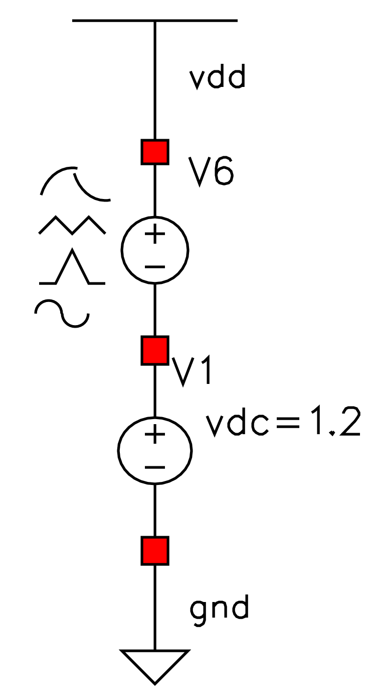
Cumulated Jitter of « R.O » (Ripple, Edge) in TSMC 130 nm
Code 31
Scheme = ring_osc_jitter_power
Output = Out_F
TR Noise sim moderate
Tsim = 150 ns
Fosc = 1,1 GHz
MOS Noise + Ripple on VDD
1 mV_{CC} @ 10 MHz on VDD ⬅
➔ 50 mV_{CC} @ 10 MHz on VDD
Cumulated Jitter rms [fs] vs. edge number.
Cumulated Jitter rms [fs] vs. edge number.
Jitter = 1,68 ps
Jitter = 1,96 ps
The ripple effect is weak : Jitter RMS < 2 ps

Slide 15
Cumulated Jitter of « R.O » (Power, VDD noise, edge) in TSMC 130 nm
Code 31, on schematic “ring_osc_jitter_power”
TR Noise sim moderate, Tsim = 150ns
Ring oscillator frequency = 1,1 GHz
MOS Noise + Ripple on VDD + noise VDD
50 mV cc @ ≠ F on VDD (6kHz ->200MHz)
Jitter < 30ps
Cumulated Jitter
➔PSD VDD = 100 nV/sqrtHz up to 10 GHz
➔ VDD noise = 10 mV RMS
➔PSD VDD = 10 nV/sqrtHz up to 10 GHz
➔VDD noise = 1 mV RMS
The effect of ripple is negligible compared to the power supply noise (PSD)
RMS Jitter ∝ sqrt(Edge number, inverter number, inverter jitter)
!A particular care must be taken when choosing the voltage regulators on PCB boards
Jitter < 3,5 ps
Edge number

Slide 16
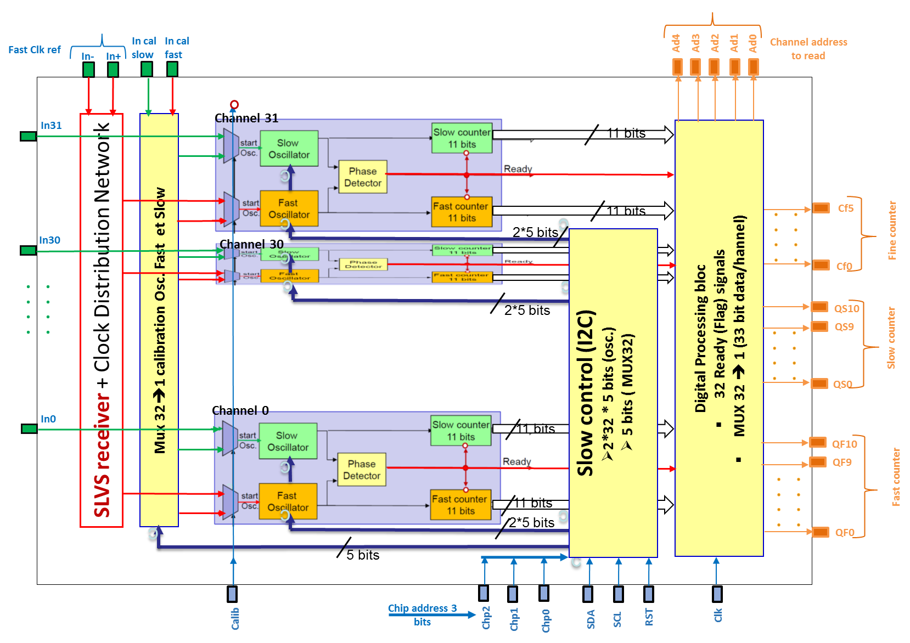
Global Floor Plan of the TDC
Intermediate nodes in the phase detector

Slide 17
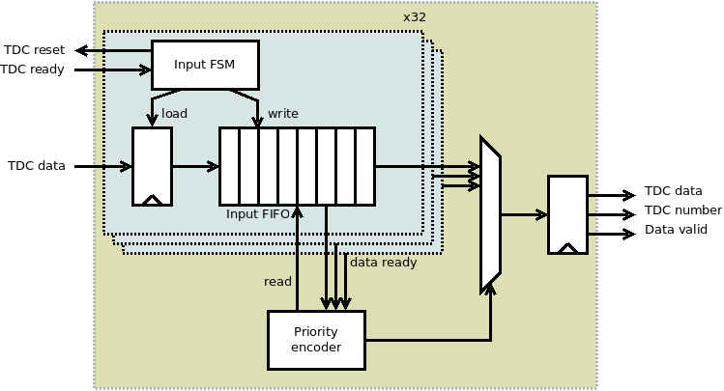
Digital processing part of the ASIC
Data : 33 bits
(from msb to lsb)
  5 bits channel address
  6 bits Fine counter
  11 bits slow counter
  11 bits fast counter
Readout Clock : <160 MHz
TDC Core side
Digital processing part

Slide 18
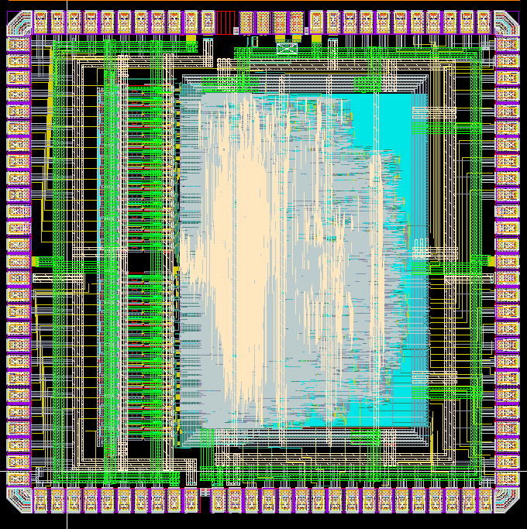
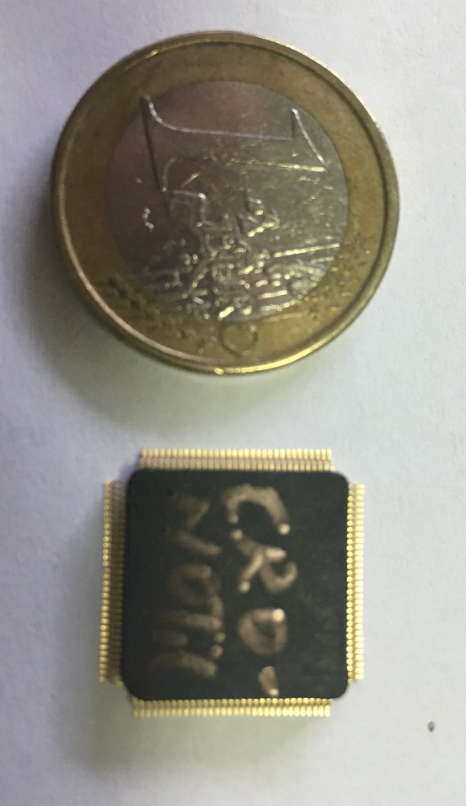
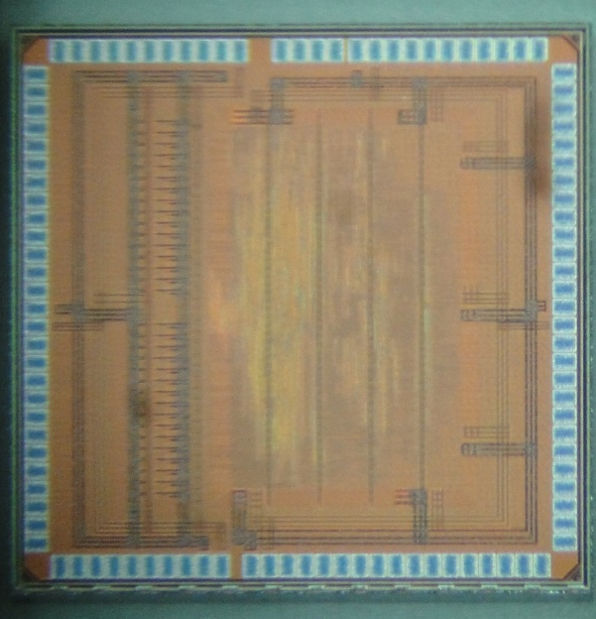
Layout of the submitted ASIC : CRONOTIC
TSMC 130 nm process
Triple-voting rad-hard digital
Dimensions :
  2,400 x 2,450 mm²
Submitted Nov 2nd 2016
ASIC returned from fab by end of January
Packaging is done (CQFP 128)
Test board must be designed, it started by beginning of March
Credit : M. Dahoumane

Slide 19
Conclusions and outlooks
Conclusions :
A 20 ps LSB and 2 ps rms noise TDC has been designed et sent to fabrication in TSMC 130 nm process
Noise constraints on power supply (VDD) have been identified
Test card design will start by March 2017
ASIC tests will begin by the end of May 2017
Integration of this ASIC and PETIROC ASIC on the same package
Integration of the TDC and a PETIROC on a same substrate
A PhD thesis on this design has began in early February (Amina ANNAGREBAH)
Acknowledgment :
  Mr. Marek IDZIK from the Department of Particle Interactions and Detection Techniques (Krakow) for providing us the SLVS receiver block
  CERN electronics group for the I2C slow control block
  H.Chanal who designed the digital part

Slide 20
Thank you

