Slide 1


TSV development with CEA Leti in the FEI4 chip
R. Bates, C. Buttar, L. Flores / Glasgow University
G. Pares / CEA LETI
A. Macchiolo, R. Nisius / MPI
E. Gkoukgoussis, A. Lounis / LAL
M. Campbell, K. Dette, H. Pernegger, P. Riedler, D. Schaefer / CERN EP Department

Slide 2
Goal
WP4 (NA3) Micro-electronics and interconnections:
  Task 4.4 Interconnections and TSVs.
Interconnection of 65 nm CMOS readout chips to silicon pixel sensors by using through-silicon vias (TSVs) across the substrate, full qualification and testing.
Fine pitch bump bonding techniques will be qualified by this WP

Slide 3
TSVs and RDLs with ATLAS FEI4 FE chips
Project started with CEA Leti on TSV-last process in FE-I4 chips
  Connect chip M1 metal layer from front to back of chip via TSVs
Front side processing with either UBM only or bumps
  UBM only → solder on sensors
  Bumps → UBM on sensor
Back side processing RDL
  Specific FE-i4 layout for laser soldering, same specs as Medipix
  Pad layout to compensate thermal stressed during re-flow after flip-chip (demonstrated to work in previous project between Glasgow and LETI)

Slide 4
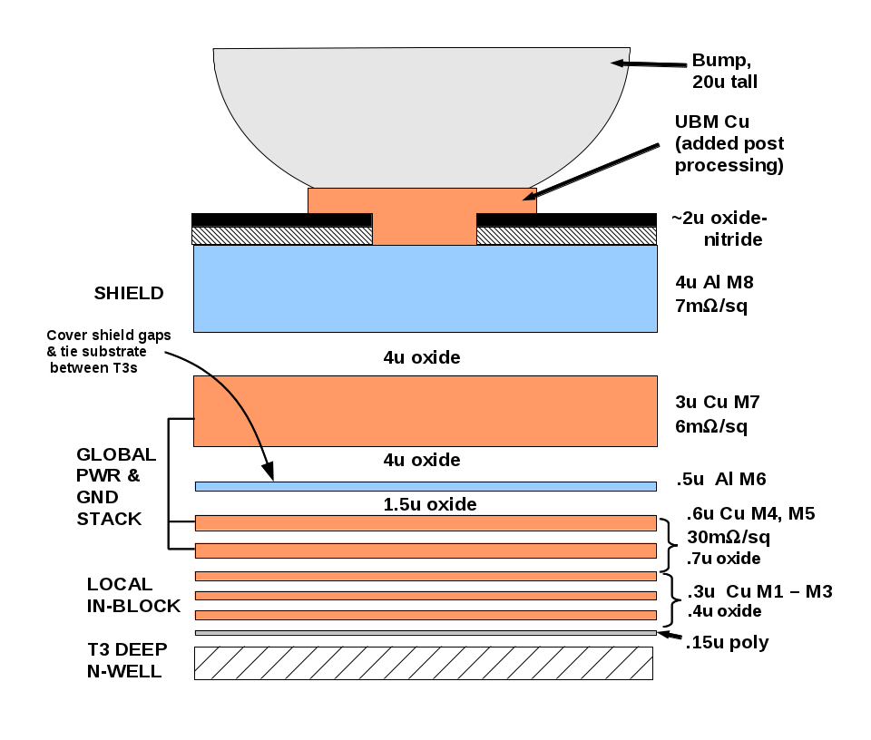
TSVs in FEI4
Require access to M1 from the chip backside
Re-spin of FEI4 wafers have reduced poly-Si to aid TSV etch
  During MPI TSV project with EMFT understood that there was poly-Si under M1
  Poly-Si causes issues with the TSV etch

Slide 5
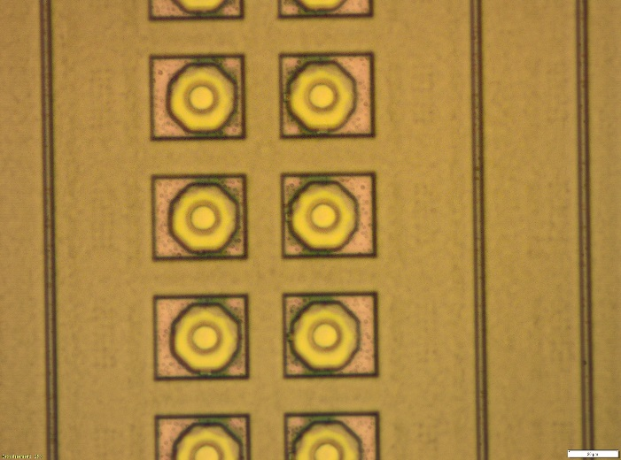
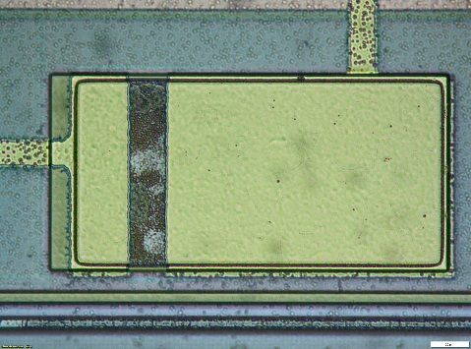
Front side UBM
Electrical characterization
  Results in line with expectation on UBM layer
    Critical dimensions
    Sheet resistance
    Planar insulation
    Contact with Al pads
UBM pads – optical inspection
Al pad
Passivation
UBM Ti/Ni/Au
Al pad
Guard ring Al 4 µm
i
Contact structure on pad

Slide 6
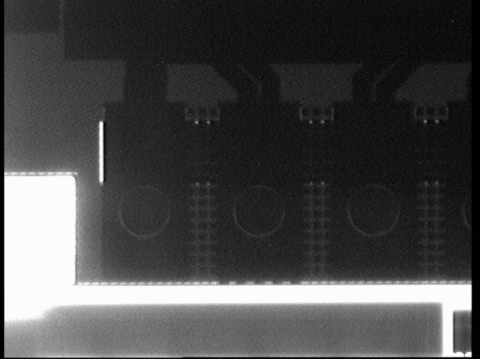
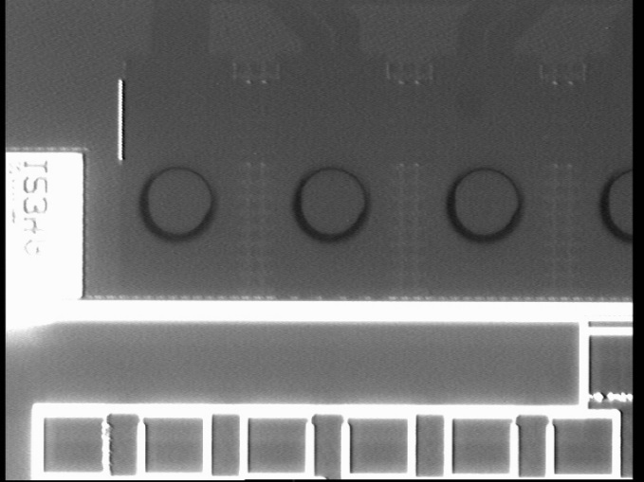
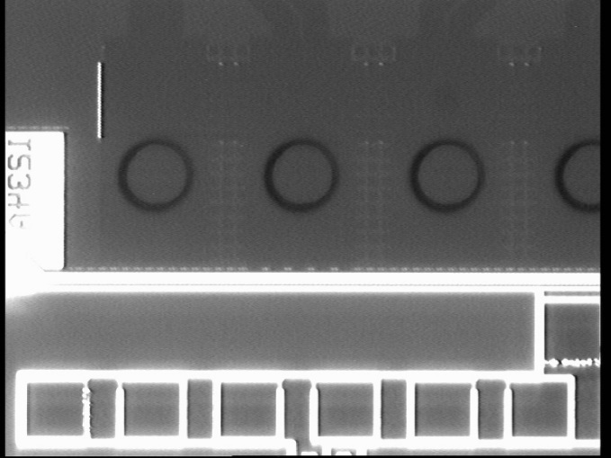
TSV last – Oxide etch mask
IR image of Oxide DRIE mask
Circles are mask
Good alignment to M1
Wafer 01
Wafer 02
Wafer 03

Slide 7
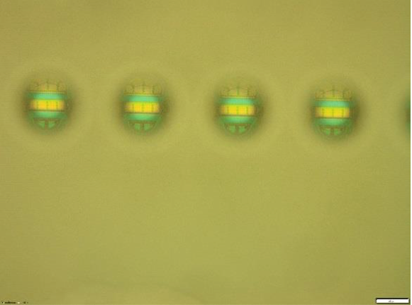
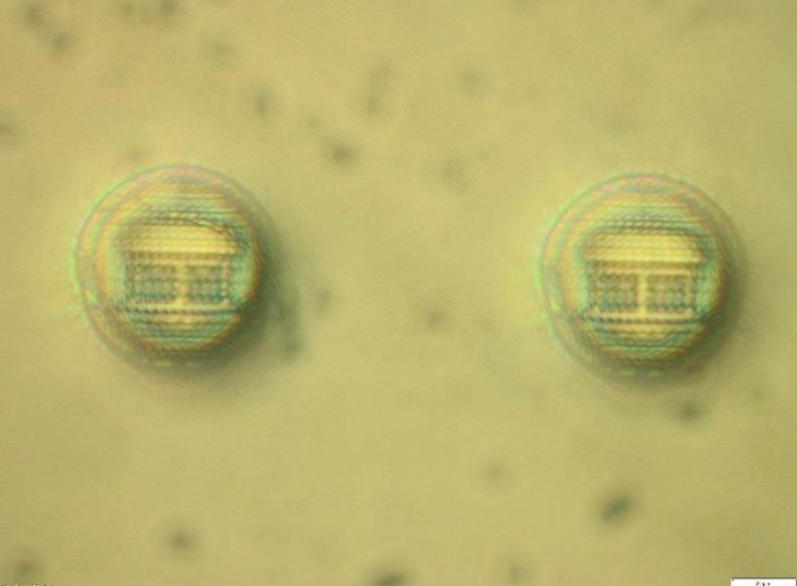
TSV etched through to the M1
TSV etched through silicon down to M1
60 μm
TSV lined using full wafer Silicon Oxide & Silicon Nitride deposition
Etch back full wafer to open the oxide/nitride on the bottom of the TSV
Damascene process to fill with copper
3 μm oxide liner on inside of TSV walls
All oxide removed at the bottom of the via
Notes:
The silicon oxide/nitride layer coats the wall of the via to isolate the subsequent metal infill from the silicon substrate. is thinner at the bottom of the via.But it is thinner on the bottom of the via than on the .

Slide 8
FEI4 ReDistribution Layer
RDL design for FE-i4B
  Copper layer on back side of chips
  Large solder pad array compatible with direct laser soldering
  Solder pads over full chip to compensate thin die bow – eases flip-chip
  Include probe pads/wire-bond pads near TSV to allow testing with mirrored test card after processing or wire-bonding after processing
  Designed at CERN and reviewed by LETI and ATLAS module experts, mask processed at LETI
RDL metal stack compatible with Bump Grid Array solder technology

Slide 9
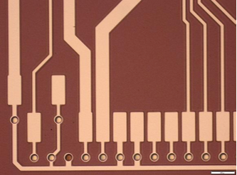
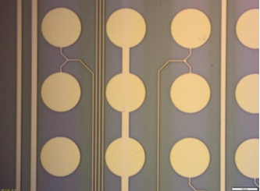
Lithography for RDLs
Wafer is coated uniformly with a thin copper seed layer
Resist is deposited and developed to realise the RDL pattern
Electroplating of thick copper in the exposed RDL pattern
  TSV filled during this stage
Blank etch to remove thin seed layer
Notes:
The TSV is not completely filled. The more copper in the TSV the lower the electrical resistance, which is desired.

Slide 10
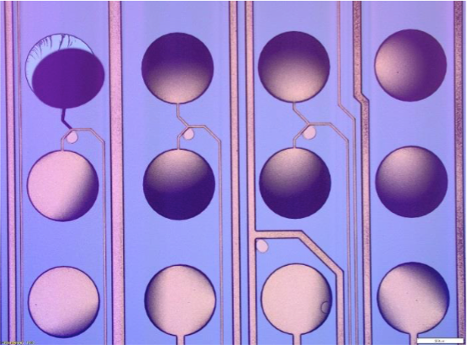
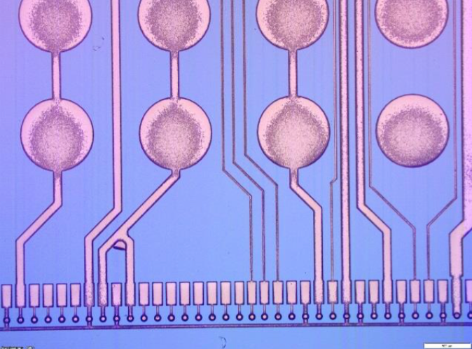
First RDL results
Excessive copper applied
  Aim was to reduce TSV resistance
  6-8 μm requested c.f. standard thickness < 5 μm
Caused delamination of large RDL laser solder pads
  Pulling away underlying oxide layer as well
  1 of the 3 wafers not so bad and useable for module building
TSV contact on front side metal : low and repeatable contact between 2 ground TSVs
  6 Ohm including RDL line and probe resistance

Slide 11
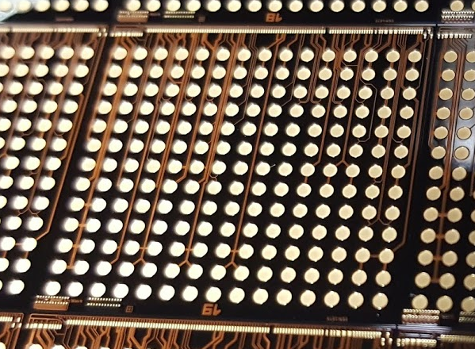
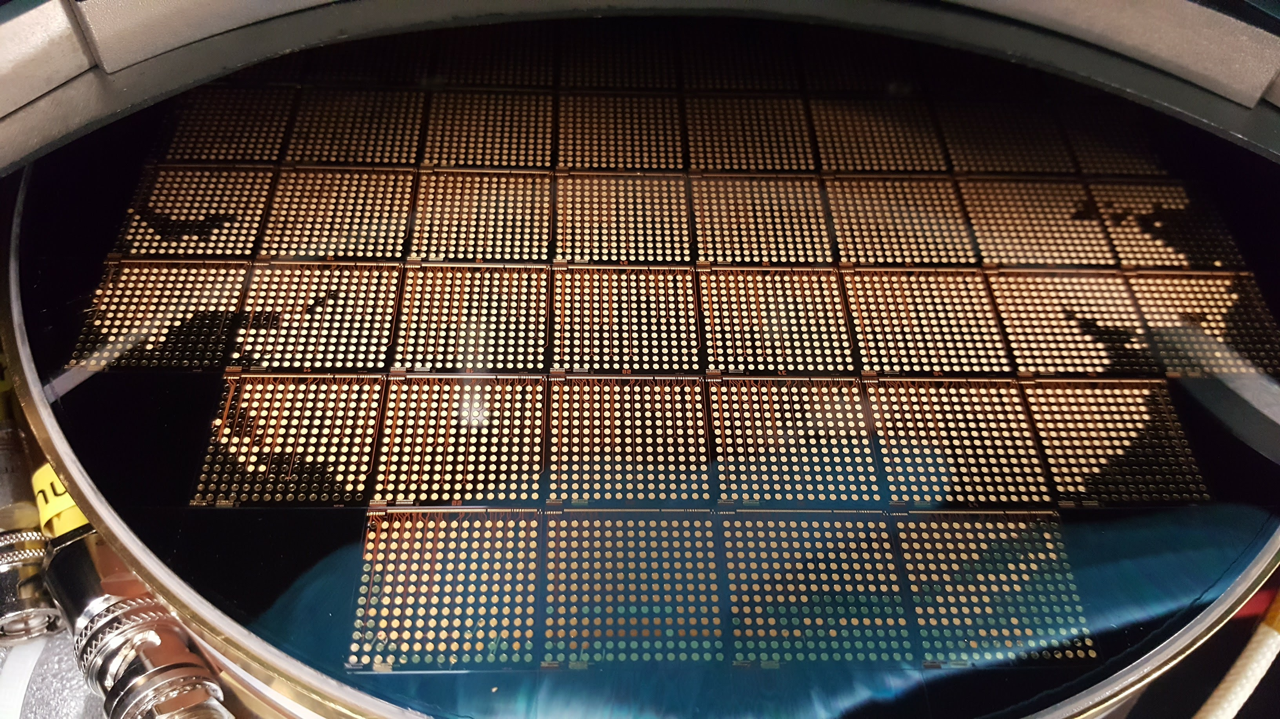
Frist Wafers
4 wafers started
  1 broke during processing
  2 had bad RDL delamination
  1 has good RDL in wafer central region

Slide 12
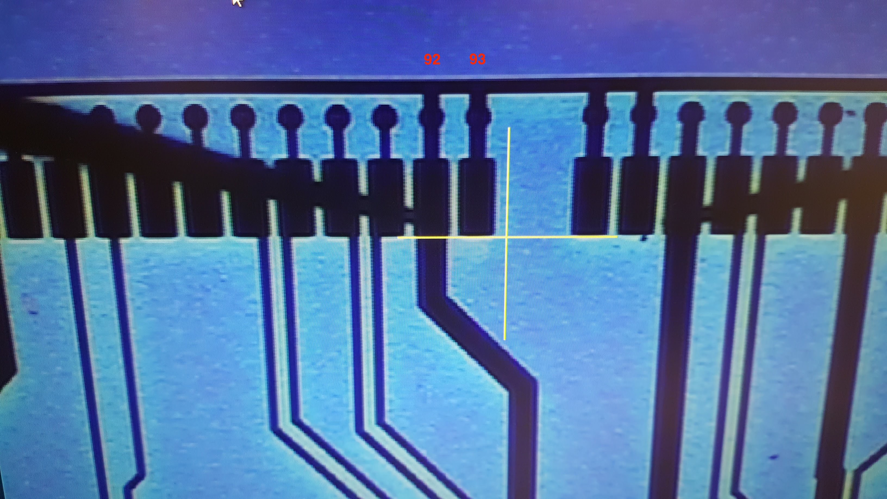
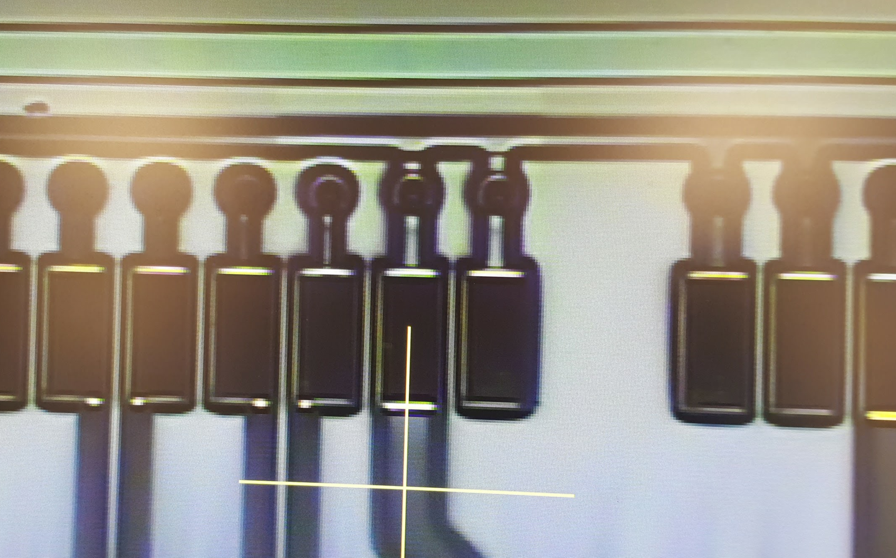
Frist wafer testing
Wafer level testing started Jan 2017
Soon realised that there was an RDL error
VDDD line connected to GND bus
  Error during translation of RDL design to wafer design software
  Chip not testable
Probed all power lines and currents reasonable
  TSVs connected to M1 and isolated from wafer
Wafers retuned to LETI for FIB
  Only central die edited due to FIB reach
  Error corrected
  Tested on probe – no shorts!

Slide 13
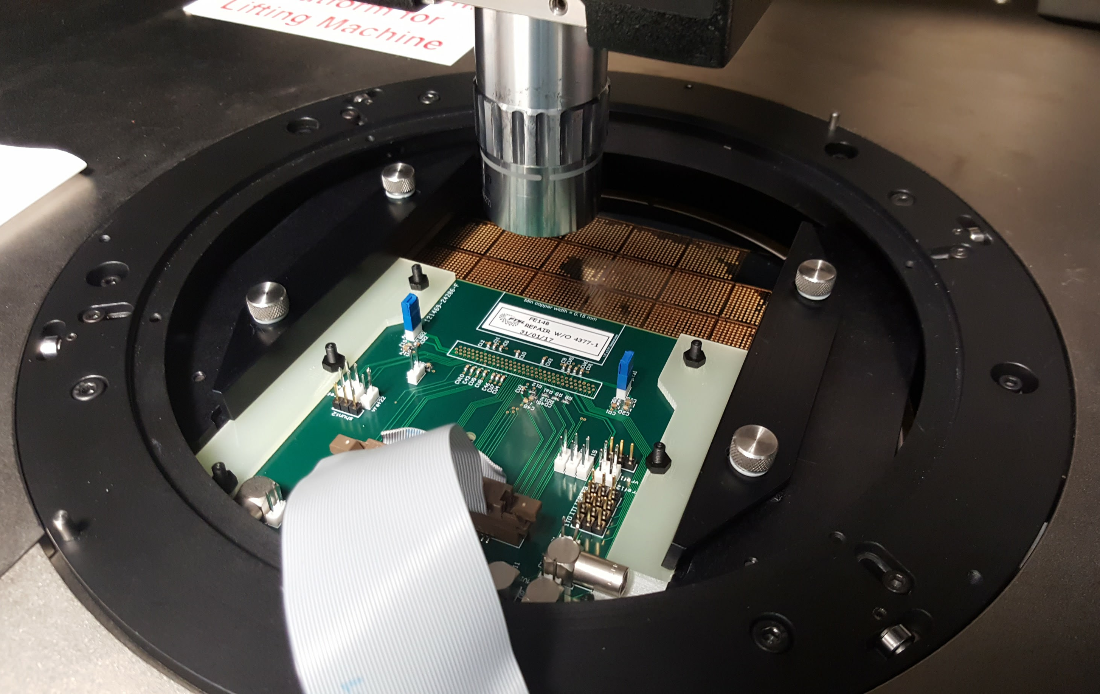
Post TSV testing
Wafer level chip testing
  On probe station
  Arrived yesterday
  Electrical contact to chip via TSV, probe on mirrored pad array

Slide 14
Next steps
Poor wafers from first run will be diced and used for flip-chip and soldering trails
Second run of wafers being processed at CEA LETI
  Front side with Solder bumps
  Front side processing finished
    Bumps inspected and appear perfect
  Ready for transfer to support wafer for backside processing
Aluminum flex PCB for laser soldering
  Designed
  Soldering trails with dummy parts taking place
    Using Medipix scrap parts
Flip-chip to sensor to take place after bare chip testing
  Sensors with solder bumps ready at Advacam

Slide 15
Summary
TSV and laser solder module concept worked out
CEA LETI TSV process well demonstrated on Medipix chip set
FEI4 chip set modified to aid TSV formation
TSV + RDL designed and processed
  Contact to M1 and low electrical resistance
Wafer probing (re-)started
Testing and laser solder processes understood

Slide 16
Backup

Slide 17
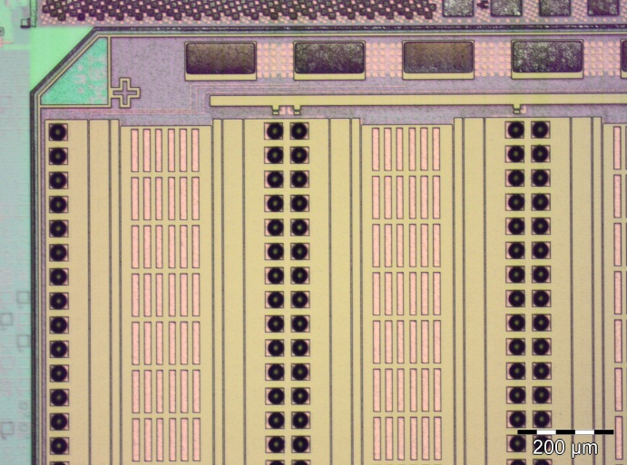
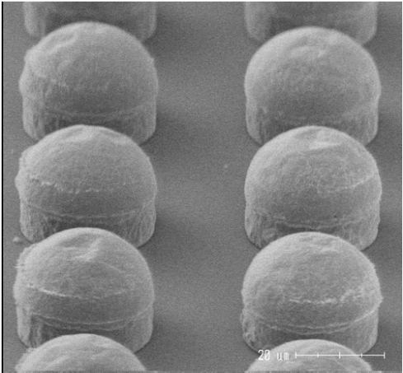
Bump deposition at CEA LETI
Developed process for SnAg solder capped copper pillars on FEI4 200 mm wafers
  Minimum pitch 50 μm in one direction
  10μm Cu & 8μm SnAg solder cap
  Electro-chemical deposition of bumps on seed layer
High yield (<99%) obtained after significant effort on process
Future work to transfer this to 300 mm wafer line for RD53 pixel chip

Slide 18
RD53 chip preparation
Process will be different on RD53 wafers
  Difference in tool set on 200 mm and 300 mm wafer lines
  50 µm pitch in both x & y direction
  Difference in chip surface topology
Building a test wafer for bump deposition and wafer handling tests
  Presently obtaining quotes
Daisy chain feature to measure bump and flip-chip yield
Allows:
  Early access to 300 mm wafer bump deposition experience
  300 mm wafer handling, thinning and dicing
  Use of automated visual inspection tool
  Flip-chip practice on large high density arrays

Slide 19
Hybrid pixel modules
Hybrid pixel are:
Inherent limitations
Wire bonds connect FE to flex:
  Oscillation in magnetic field
  Protection required or desired “To pot or not to pot”
  Limit on envelopes
Access to bond area on FE limits the sensor active area (not 4- side buttable)
Requires expensive die-to-die assembly
Wire bond Inductance limits signal speed
Edge access -> power distribution over large chip challenging

Slide 20
TSV module concept
Using a TSV last process
  Use existing chip set with post-processing technology
  Build on Medipix experience with CEA Leti
Remove wire bonds from the module
  Connect flex via solder balls on back of chip
  Less fragile module
  Reduced interconnect inductance
Remove wire bond pads
  Reduced chip edge
Compact, low mass hybrid pixel modules with minimal modification to the FE layout and using standard CMOS technology

Slide 21
Wirebond less TSV enabling technologies
TSV-last + RDL
Direct laser soldering: flex to FEIx
TSV connect chip M1 from front to back of chip
  TSV aspect ratio 2:1
RDL distributes FEI4 connections over full chip surface.
  Do not need fine-pitch connections.
  Power can be brought to chip at several places , not just on the edge
Thin 2-layer Al flex
No glue layer needed
Connections are solder 1-by-1, module stays at RT
Re-workable

Slide 22
TSV + RDL project in FEI4
Working with CEA LETI on TSV last process in FEI4
  Connect chip M1 from front to back of chip via TSV
Front side processing in two batches
  UBM only (4 wafers) – solder on sensors
  Bumps (3 wafers) – UBM on sensors
Backside RDL distributes all FEI4 connections over full chip surface
  Same specs as Medipix but with dedicated FEI4B layout for laser soldering to flex
  Pad layout to compensate thermal stresses during reflow after flip chip (SCL)
    Stress compensation has been previously demonstrated between Glasgow & LETI

Slide 23
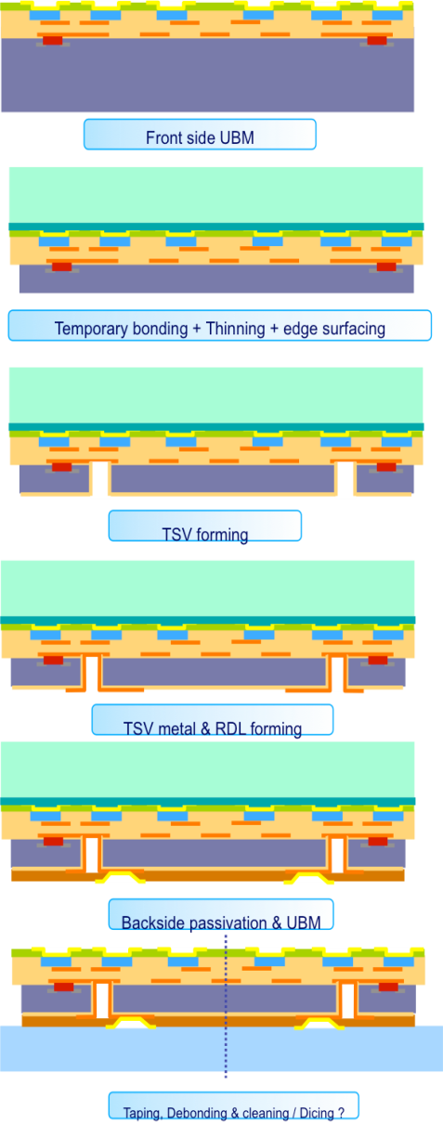
TSV process description
Under Bump Metallisation is deposited on the front side of the wafer.
  Identical to the step used normally by the bump bonding suppliers
  Finished die can be flip-chip assembled to sensors with solder bumps.
  Second batch with have solder bumps
Wafer thinning
  Wafer front side bonded using a temporary adhesive to a dummy support wafer.
  The wafer is thinned to 120 um (2 times the diameter of the TSV opening).
TSV formation
  Vias are drilled in the wafer using deep reactive ion etching
  Vias are coated conformally with an insulating layer.
  Contact holes are etched through the insulation in the bottom of the vias
  5um thick Cu layer is deposited on the side of the vias and on the back side of the wafer.
Redistribution layer
  The Cu layer is then etched to form the redistribution layer on the backside.
  The back side of the wafer is passivated and the openings for the solder contacts etched.
  UBM metallization deposited on the solder pads the same way as on the front side.
Wafers are probed for electrical functionality
Die release
  Wafers are released from the support wafer and transferred onto a dicing tape.
  Wafers are shipped for subsequent dicing and flip chip assembly.

