Slide 1
WP4: microelectronics and interconnections
WP Coordinators: Christophe de la Taille, Valerio Re
Goal : provide chips and interconnections to detectors developed by other WPs
Task 1: Scientific coordination (CNRS-OMEGA, INFN-UNIBG)
Task 2 : 65 nm chips for trackers (CERN)
  Fine pitch, low power, advanced digital processing
Task 3 : SiGe 130nm for calorimeters/gaseous (IN2P3)
  Highly integrated charge and time measurement
Task 4 : interconnections between 65 nm chips and pixel sensors (INFN)
  TSVs in 65 nm CMOS wafers, bonding of 65 nm chips to sensors, exploration of fine pitch bonding processes

Slide 2
AIDA WP4 milestones
MS4.1 Architectural review of deliverable chips in 65nm run M14 (accomplished)
MS4.2 Final design review of 65nm M30 (October 2017)
MS4.3 Test report of deliverable D4.1 M46 (February 2019)
MS4.4 Selection of SiGe foundry M14 (accomplished)
MS4.5 Final design review of deliverable chips in SiGe run M30 (October 2017)
MS4.6 Test report of deliverable D4.2 M46
MS4.7 Selection of TSV process M14 (accomplished)
MS4.8 Final design review of deliverable D4.3 (TSV in 65nm) M30 (October 2017)
MS4.9 Test report of deliverable D4.3 M46

Slide 3
Deliverable chips in 65 nm
This work is carried out in the frame of the CERN RD53 international R&D program developing a first generation of pixel readout chip prototypes for ATLAS and CMS at HL-LHC
Develop expertise on TSMC 65 nm CMOS selected by CERN for HEP
Two small size prototypes were fabricated and are available for testing with sensors
A large-scale prototype will be submitted May 2017 in an engineering run
This will deliver full wafers for the interconnection with pixel sensors (task 4.4)

Slide 4
Small-medium size 65 nm CMOS prototypes
Two different chips with a 64x64 50 µm x 50 µm pixel matrix ( about 16 mm²) with different architectures for the analog front-end and the digital readout, different techniques for digital-to-analog isolation,…
FE65_P2 (Bonn, LBNL), submitted end of September 2015, delivered by the foundry in December 2015 and successfully tested by UBONN with good results. FE65-P2 chips were connected to pixel sensors and the resulting modules were tested in a beam at CERN and SLAC
CHIPIX65 demonstrator (INFN): submitted July 2016, delivered by the foundry at the end of September 2016. This chip is also fully functional, and tests gave very good results in terms of noise and threshold dispersion. The CHIPIX65 prototype will be soon connected to 3D and planar pixel sensors.

Slide 5
Submission of large-scale 65 nm chip RD53A
Full design review (with external experts) at CERN in December 2016.
The review was successful: reviewer’s recommendations provided useful guidelines towards the submission of the chip
Schedule is probably going to shift by a month of two (May 2017)

Slide 6
WP4.3 : SiGe 130 nm
(CNRS-IPNL, CNRS-OMEGA, DESY, AGH-UST)
Select best SiGe 130/180 nm process for high speed/high dynamic range ASIC design to upgrade current SiGe 350 nm AMS process MS22 M14
Deliver SPIROC3 SiPM readout for calorimeter readout of WP14
Deliver RPC high timing readout chip for WP13
D4.2 M36 resp CNRS (OMEGA)
Share expertise within SiGe HEP community
  Studies for LHC run 2, ILC…

Slide 7
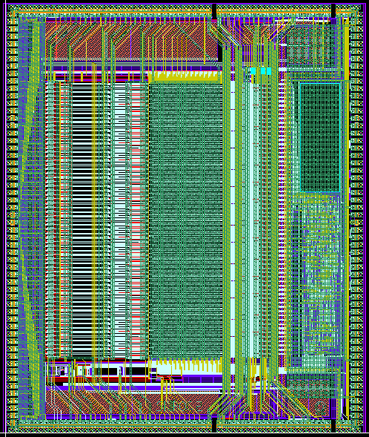
SiGe processes evaluation
130 nm SiGe processes evaluated
  Tower Jazz design kit not supplied
  ST Micro 130 nm SiGe
Evaluation on different test vehicles
  ATLAS LAr upgrade
  CMS HGCAL
  ATLAS HGTD high speed timing
  CMS muon RPCs high speed timing
No significant improvement compared to regular CMOS
  Better transconductance hindered by Rbb’
Proposal to choose TSMC 130 nm
  Qualified by CERN for high radiation environment
  Wider community (see examples next slides)

Slide 8
Task 4.4 Interconnections and TSVs
(CERN, INFN-GE, INFN-PV, INFN-PG, CNRS-CPPM, CNRS-LAL, MPG-MPP, UBONN, UNIGLA)
Produce through-silicon vias on wafers from Task 4.2
Connect chips with TSVs to detectors from WP7
Test radiation hardness of interconnections

Slide 9
Candidate processes for TSV
WP4 groups are currently working with two different technology providers for Through-Silicon Vias in 130 nm CMOS FE-I4 pixel readout chips:
IZM (via last tapered TSVs) (Bonn)
CEA-LETI (via last TSVs + RDL + direct wafer-to-wafer bonding) (Glasgow)
Results are available. Plans are to extend this study to 65 nm CMOS wafers from the RD53 engineering run.

Slide 10
Goals of TSV processing
Test processes for peripheral TSVs on the 130 nm FEI4 chip, and apply them to the 65 nm RD53A chip
  Allow for 4 side buttable modules
  Enable wafer-to-wafer assembly
  Remove wirebonds for greater module robustness
The RD53A chip will be designed so that it is “TSV enabled” (i.e. , compliant with TSV design rules); this involves the peripheral bonding pad regions
MS4.7 Selection of TSV process M14 (June 2016) was accomplished: both processes (IZM and CEA-LETI) were selected for the following stages of WP4

Slide 11
WP4 outlook
WP4 appears to be on track with respect to the 2017 milestones (delay possible in MS4.8)
Pixel readout chip prototypes in 65 nm CMOS are available for testing sensors from WP7
Thanks to synergies with RD53 (65 nm CMOS engineering run), also longer term schedule looks reasonable

Slide 12
AIDA WP4 deliverables
D4.1 CMOS 65 nm engineering run (availability of the run with the “ATLAS/CMS” and CLICPIX pixel chips) (CERN)
M36 (April 30, 2018)
D4.2 BICMOS SiGe engineering run (availability of run with SiPM calorimeter-WP14 and gas detectors-WP13 chips) (CNRS)
M36 (April 30, 2018)
D4.3 Through Silicon Vias production (fabrication of TSV in wafers of deliverable 4.1) (INFN)
M42 (October 31, 2018)

