Slide 1
WP7 - 2nd Annual Meeting
Introdution
Anna Macchiolo, Iván Vila
4/4/2017

Slide 2
Outline
Review of Milestones & deliverables.
Common sensor production at CNM and FBK.
Goals for the meeting.

Slide 3









Overview: Tasks
Device Simulation
Layout optimization.
Radiation damage modeling
Sensor manufacturing
Development & improvement of manufacturing processes for planar, 3D and LGAD devices.
MPWR for thinned 3D and slim/active edge planar.
Detector performance assessment
Hybrid thin planar & 3D pixels for HL-LHC environment.
Very small size and thin pixel sensors for CLIC.
Optimization signal multiplication structures.
Low Gain Avalanche Detectors for timing and tracking

Slide 4
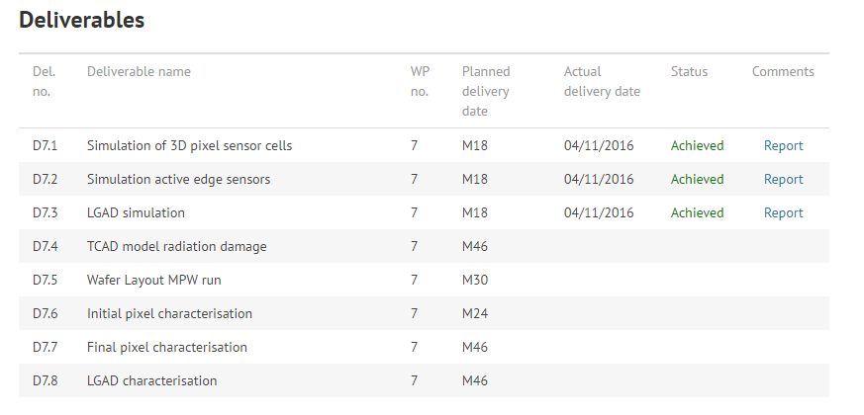
Deliverables

Slide 5
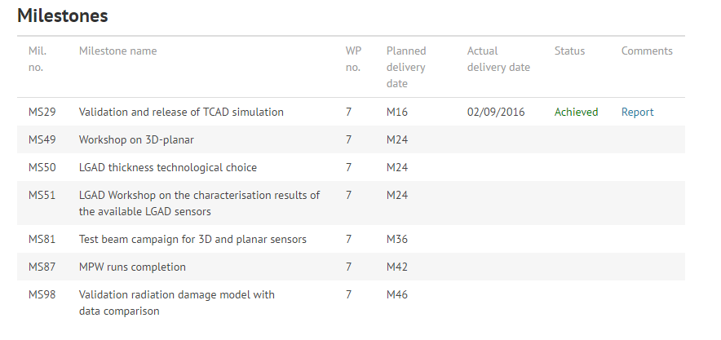
Milestones

Slide 6
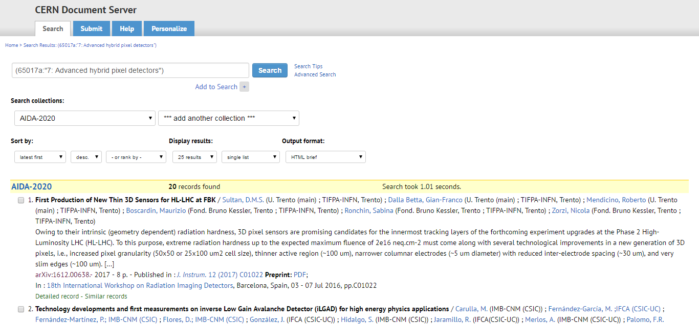
Publications

Slide 7
Common sensor productions
At least three common productions foreseen in WP7, one for each technology
  Processing of MPWR for 3D and planar pixel sensors on thinned substrates, compatible with the RD53 chip
Common submission of LGAD sensors
  Prototyping of LGAD sensors on thin substrates.
Deliverable | Responsible Group | Month due
D7.5 Wafer Layout MPW | CSIC | M30 (OCT 2017)
Milestone | Responsible Group | Month due
MS87 MPW runs completion | CSIC | M42 (OCT 2018)
3D production at FBK about to start.
Active edge production at FBK second half 2017, trench technology to be defined with test wafers
or test batches beforehand
3D production at CNM already started..
LGAD production at CNM to be decided during this meeting.

Slide 8
Goals of this meeting
Converge on the technology and the devices to be included in the LGAD Common Run
Continue the discussion on the active planar common Run, not to be closed today.
Define the devices and groups to participate on the coming WP7 Test beam at SPS (baseline to continue the activities of the last year test-beam)

Slide 9
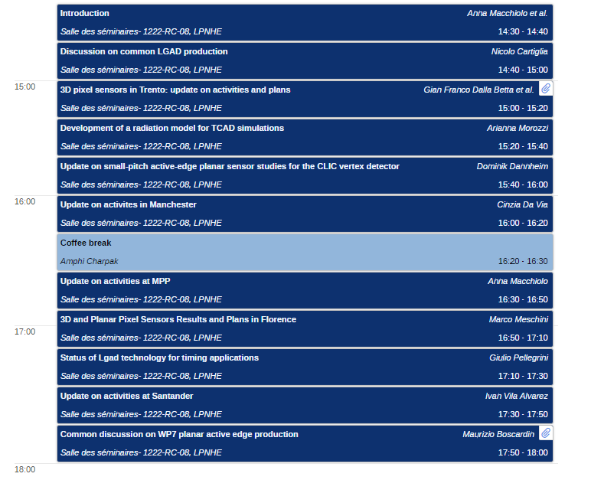
Agenda

Slide 10
THANK YOU!

Slide 11
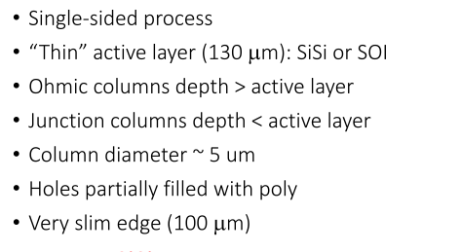
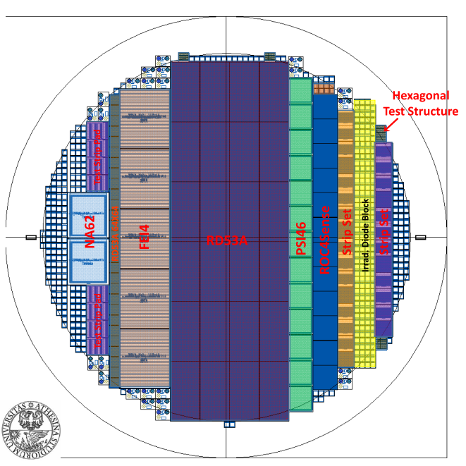
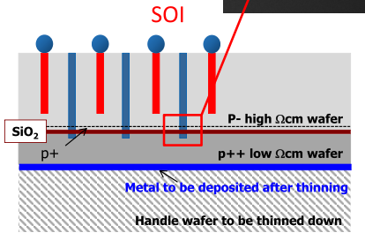
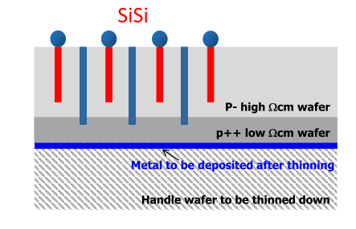
3D Common production @ FBK

Slide 12
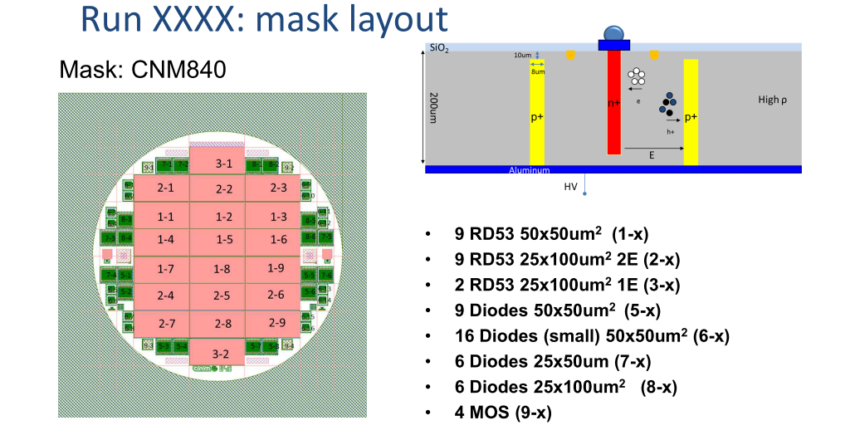
3D Common Production @ CNM
Ready to start this week.

Slide 13
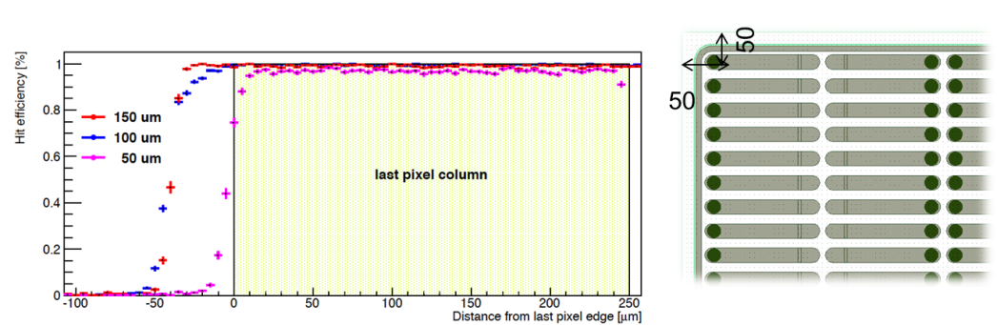
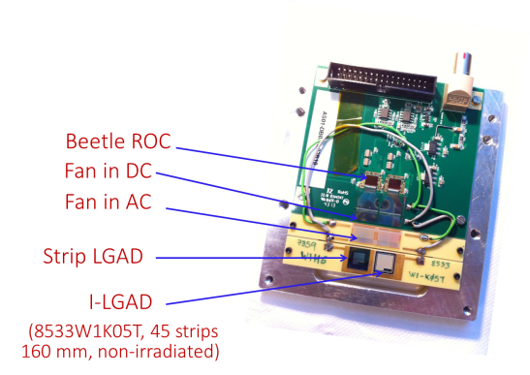
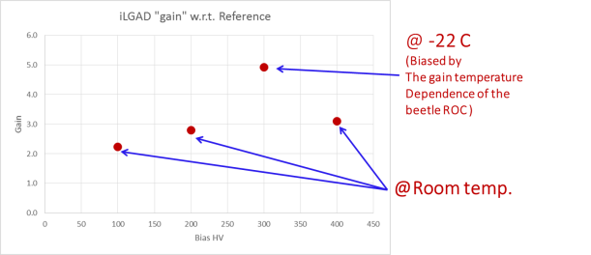
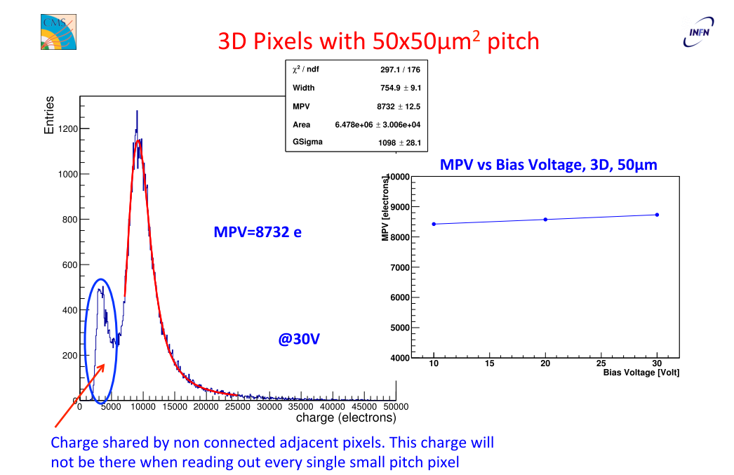
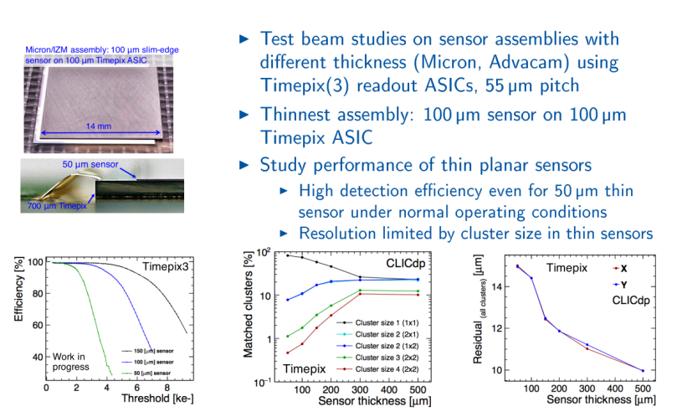
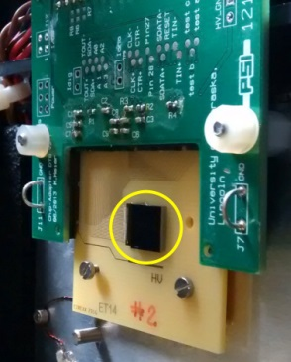

Results Snapshot
Inverse-LGAD
@ Wp7 TB
Gain vs V_{bias}

Slide 14

Progress report: 2016 TB @ SPS
  First WP7 Test Beam @ CERN-SPS from July 27th through August 3 + one additional week parasitically with Atlas ITK
  The use of the ATLAS tracker/vertex test beam infrastructure (motor stages, cooling box, etc) was capital (and support from A. Macchiolo team support)
Telescope: ACONITE (AIDA telescope)
Devices:
  50x50 mm² 3D pixel strips: non-irradiated (CNM)
  25x100 mm² 3D pixel strips: non-irradiated (CNM)
  25x100 mm² 3D pixel strips: 7x10¹⁵ n_{eq}/cm² protons (CNM)
  I-LGAD (p-in-p strip LGADs) (CNM)
  Thinned planar pixel detectors (50um, 100um & 150um) slim/active edges from Advacam (FE-I4 footprint), fresh and irradiated (10¹⁵ n_{eq} cm⁻²)
  THIN n-in-p pixel sensors 130µm and 100µm active thickness (PSI46dig footprint), fresh and proton irradiated (8.3E15 p/cm2)

