Slide 1

Ion microbeam facility at RBI as a tool for detector characterization
N. Skukan, M. Jakšić, I. Bogdanović-Radović, T. Tadić, S. Fazinić, Z. Siketić, I. Zamboni, I. Božičević Mihalić, I. Sudić, D. Španja, Ž. Periša, A. Kovačević
(Veljko Grilj)
Ruđer Bošković Institute, Bijenička c. 54, 10000 Zagreb, Croatia

Slide 2
Outline
1. Facility
2. Statistics in brief
3. Ion Beam Induced Charge
4. Some AIDA runs

Slide 3
WP12 -Detector Characterization Facilities
WP12.1. – RBI Accelerator Facility
8 TA projects have been already approved
7 TA access have been completed by 30th March 2017
( on schedule –completed)
Users from 6 countries supported
RBI | User Projects |  | Total users | TA units
 | Submissions | Selected
M1-M22 | 8 | 8 | 17 (11 supported) | 280
M1-M48 | 16 |  | 24 | 640

Slide 4
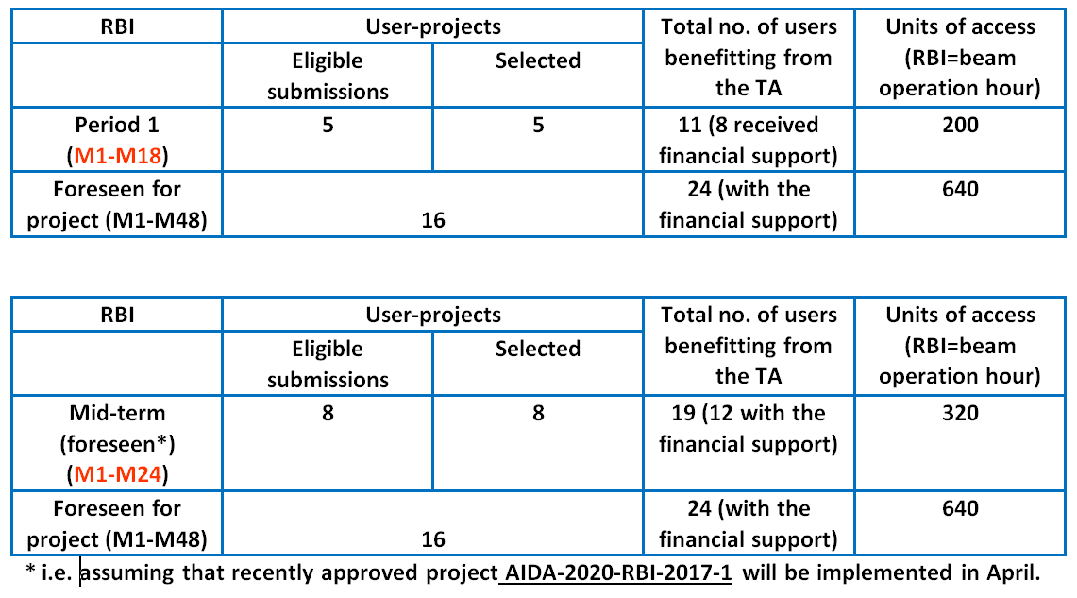
WP12 .1 :
RBI Accelerator Facility
4-4
AIDA-2020 2nd Annual Meeting
Mar 30th 2017
4-5

Slide 5
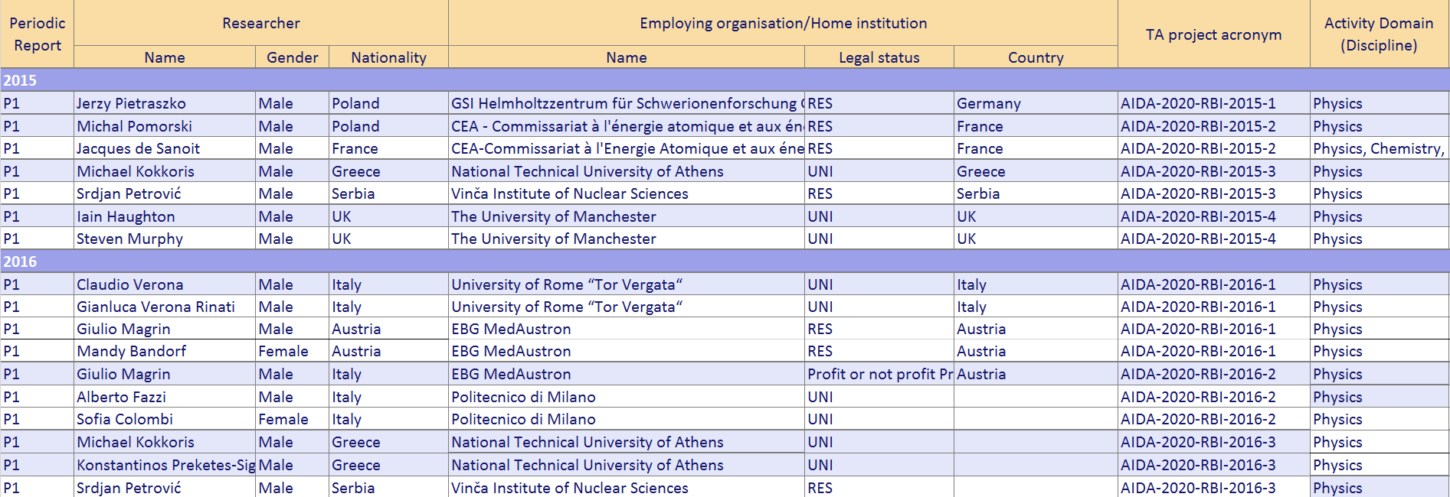
WP12 .1 :
RBI Accelerator Facility
5-4
AIDA-2020 2nd Annual Meeting
Mar 30th 2017
5-5

Slide 6
WP12 .1 :
RBI Accelerator Facility
PUBLICATIONS
  4 Oral contributions to conferences :
  Jerzy Pietraszko at al., “Radiation damage in scCVD diamond material measured with relativistic Au ions for future CBM/HADES experiments at FAIR“ 4th ADAMAS Workshop at GSI , December 4, 2015, GSI Helmholtzzentrum für Schwerionenforschung,, Germany
  Jerzy Pietraszko at al., DPG Spring Meeting, Darmstadt, 14 - 18 March 2016 “Systematic study of radiation hardness of single crystal CVD diamond material investigated with an Au beam and IBIC method.”
  Veljko Grilj at al., 15. ICNMTA 2016, 31. Jul-5. Aug 2016 “Radiation hardness study on multi-strip diamond sensor ”, invited
  Alex Oh "3D diamond detectors for particle tracking and dosimetry", invited talk, European Materials Research Society Symposium Materials for electronics and optoelectronic applications, Warsaw, Poland, 19-22 September 2016.
  1 paper publication
  M. Erich et al, EBS/C proton spectra from a virgin diamond crystal, NIMB 381 (2016)96-102.
  3 papers in preparation
  + several posters
6-4
AIDA-2020 2nd Annual Meeting
Mar 30th 2017
6-5

Slide 7
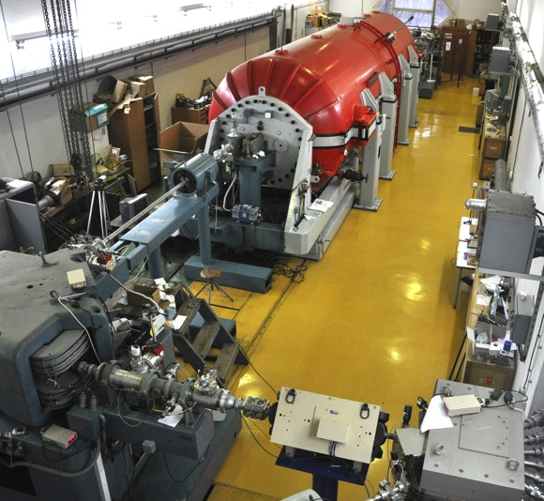
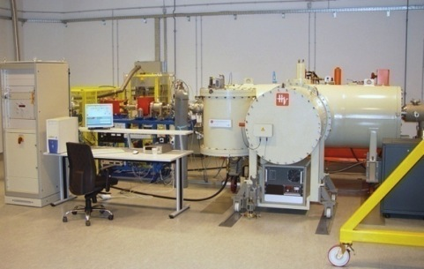
Laboratory for ion beam interactions
Accelerator facility
6.0 MV EN Tandem Van de Graaff accelerator
1.0 MV HVE Tandetron accelerator

Slide 8
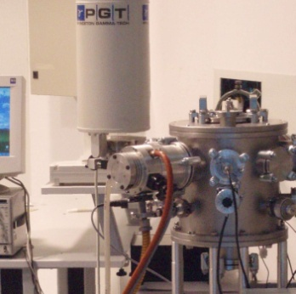
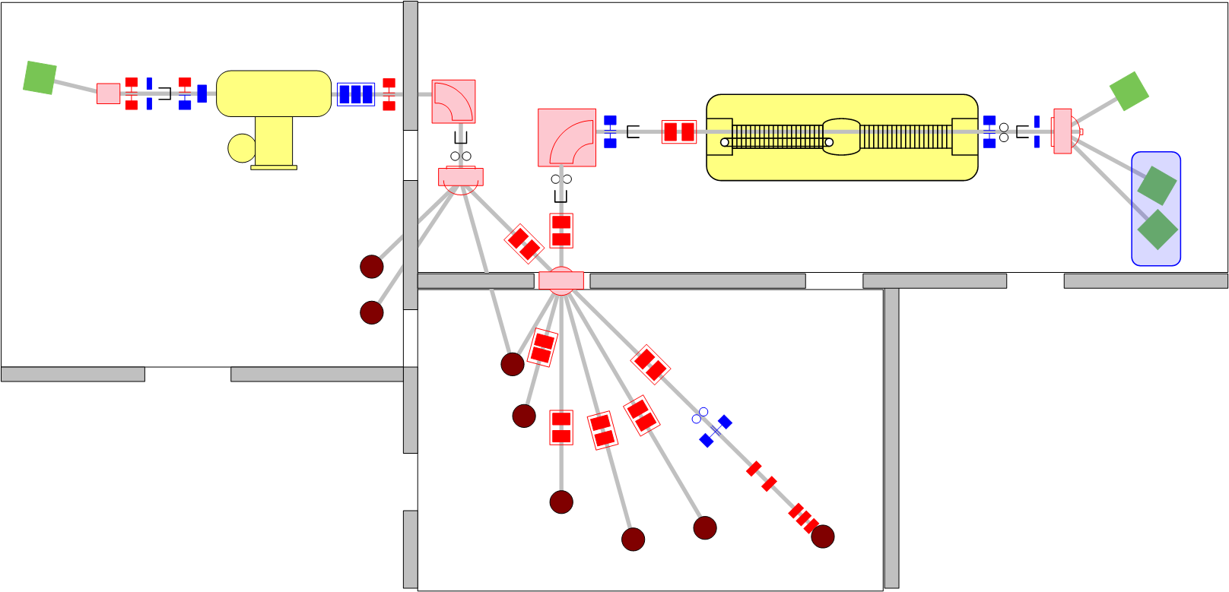
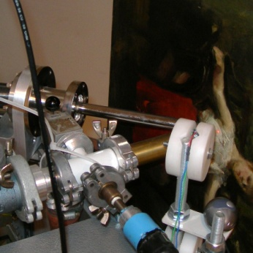
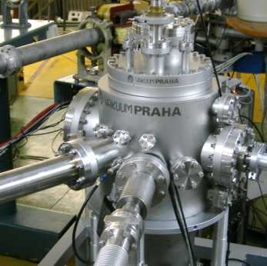
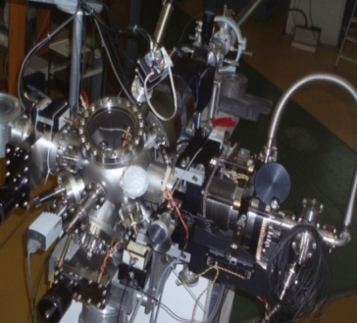
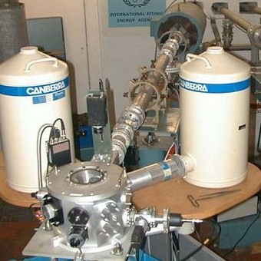
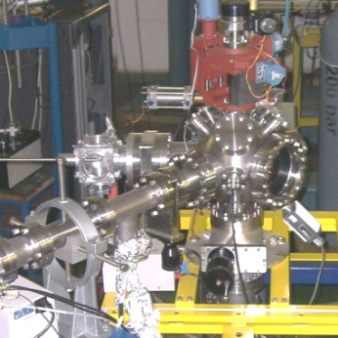
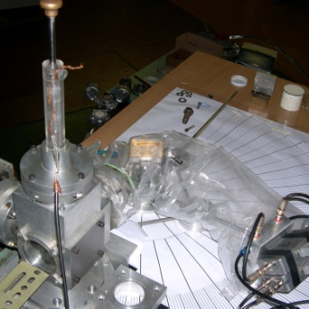
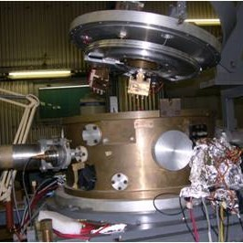
PIXE/RBS
1.0 MV HVE Tandetron accelerator
6.0 MV EN Tandem Van de Graaff accelerator
In-air PIXE
Dual-beam irradiation
Ion microprobe
IAEA beam line
TOF-ERDA
PIXE crystal spectrometer
Nuclear reactions
Dual beam,
Detector
testing

Slide 9
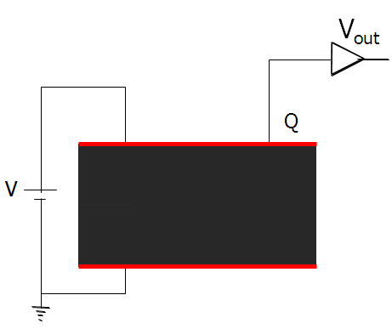
Ion Beam Induced Charge
Deposited energy
Free charge generation and transport
-
Ouput signal V_{out}
+
Gunn’s
Theorem:
V_{out} = F (deposited energy, free carrier transport)

Slide 10

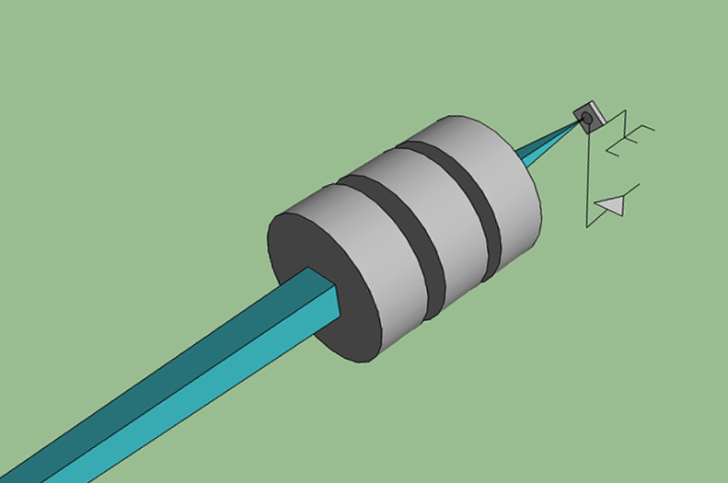
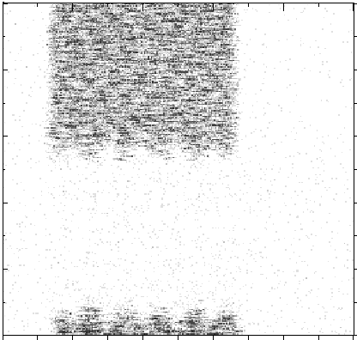
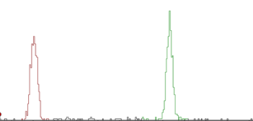
What is needed for IBIC?
❷ POSITION
- Focusing and scanning
❸ IONS
- p, α, Li, C, O,..
❹ RANGE
- 1 to 1000 μm
100 pA current –
620 ions in 1 μs
signal
ion beam
+V
❶ RATE
- 0 - 10⁶ p/s
0.1 fA current –
620 ions/second
250 nm

Slide 11
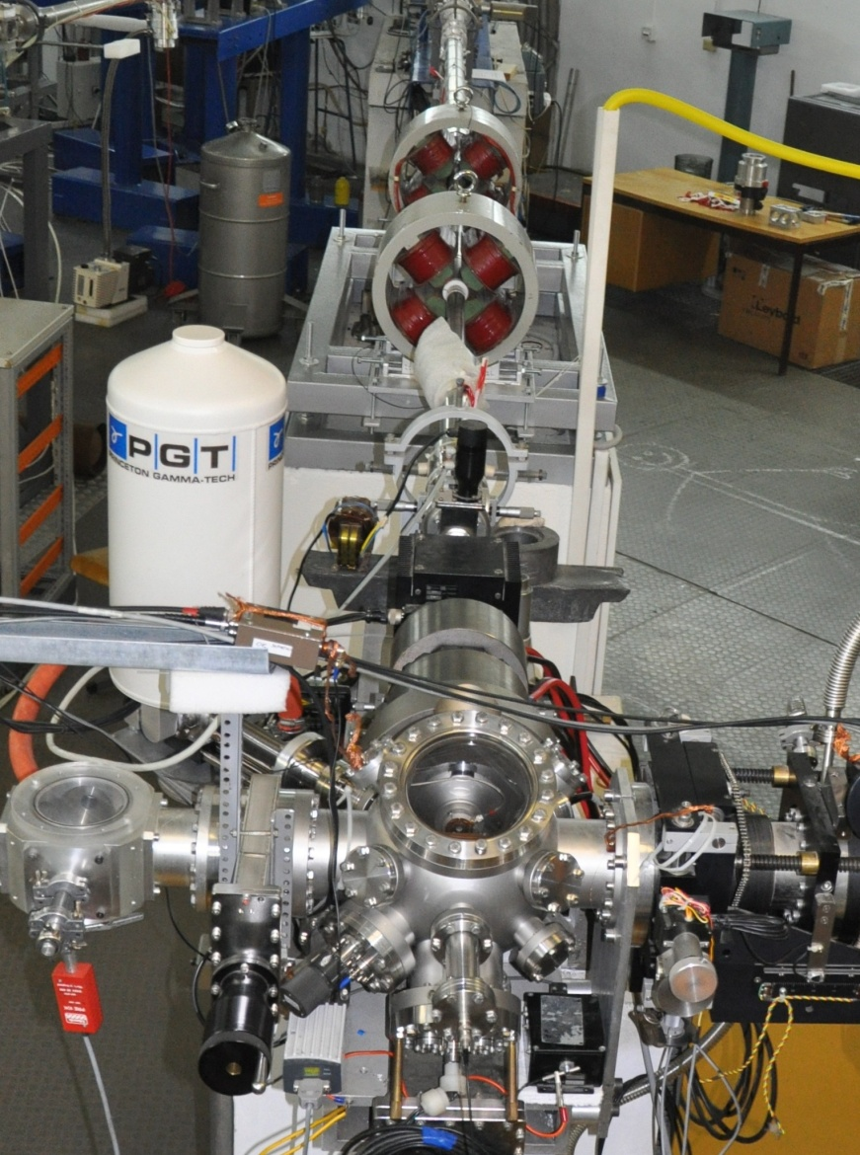
Nuclear microprobe

Slide 12
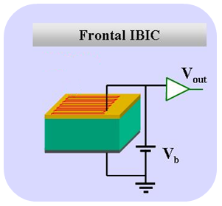
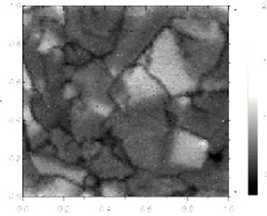
IBIC imaging
Configurations:

Slide 13
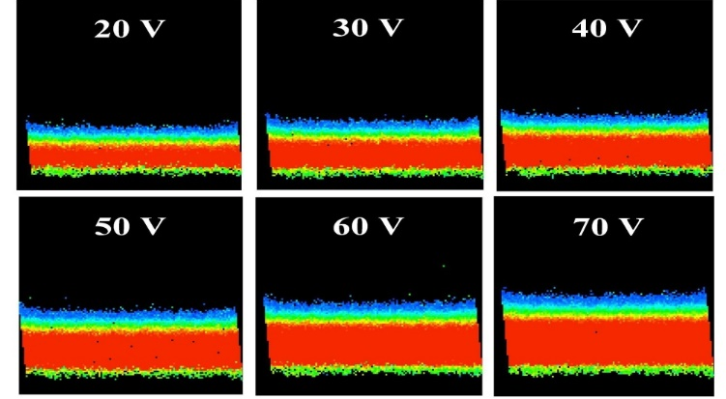
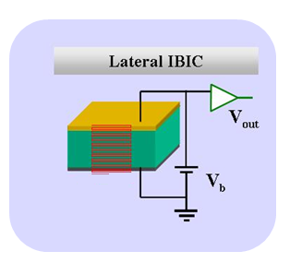
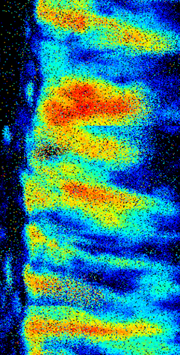
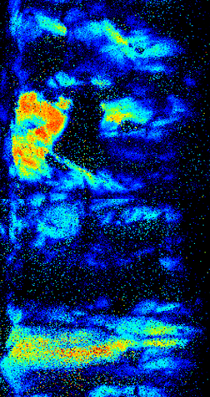
IBIC imaging
Configurations:
2 MeV p⁺
2 MeV He⁺

Slide 14

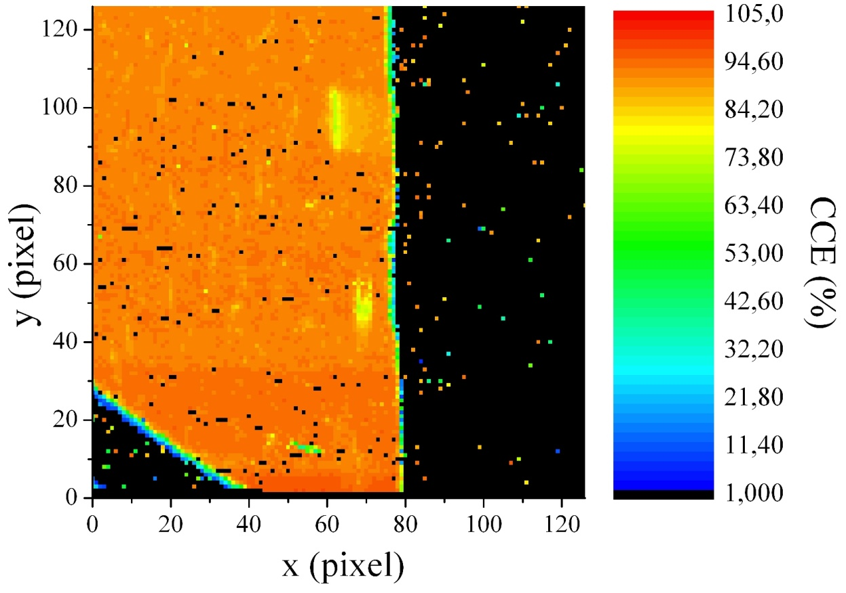
Examples – defects mapping
http://www.unito.it/
Lateral damage creation
frontal IBIC defect mapping
Bragg peak clearly visible

Slide 15
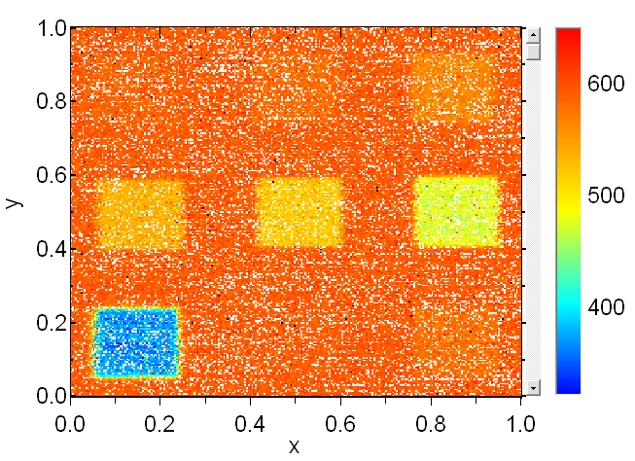
Examples – radiation hardness tests
An ion microprobe allows for:
selective damage introduction
on-line monitoring of CCE degradation and total fluence

Slide 16
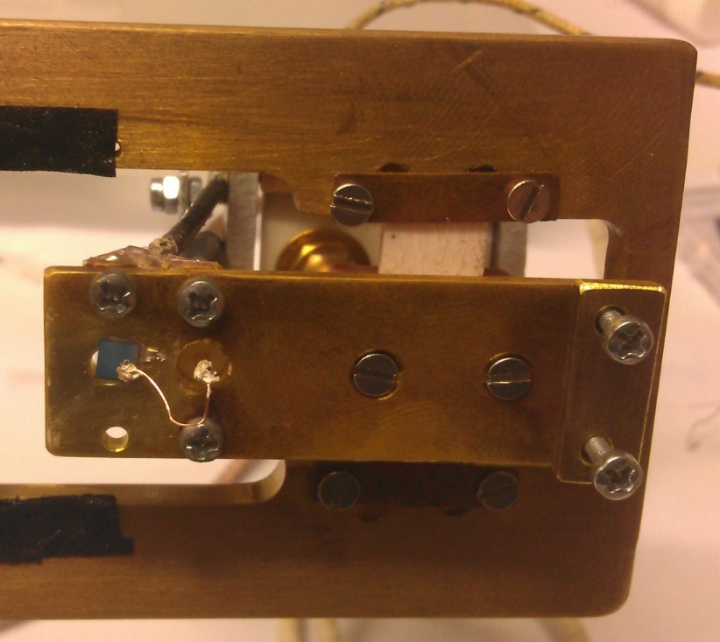
Charge transient spectroscopy (QTS) setup
(similar to DLTS)
CoolFET preamplifier
+WaveMaster 8500A oscilloscope
Target temperatures:
-100°C to +700°C
Achieved:
-40°C to 600°C
Stability ± 0.5°C
NDT sample mounted on QTS setup

Slide 17
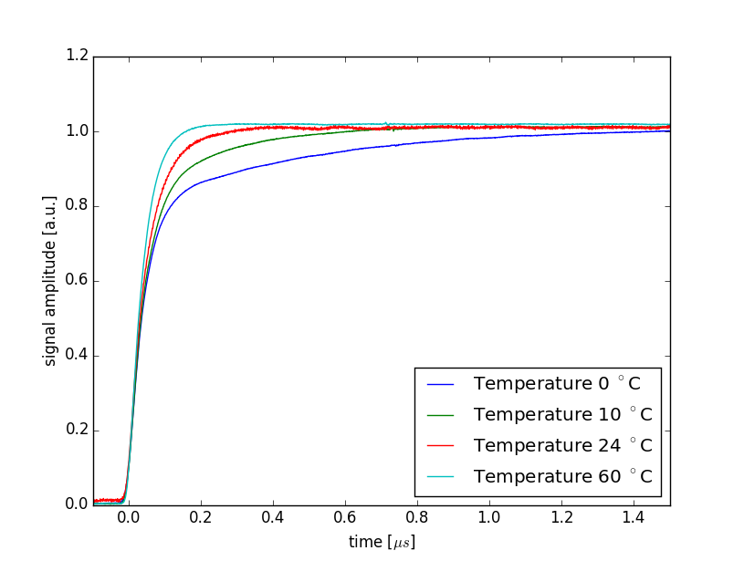
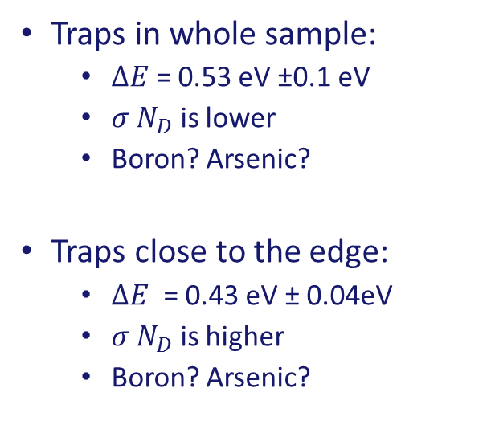


QTS trace analysis- NDT HPHT sample
$$A=A_{0}(1−e^{−e_{1}t})$$
$$e_{1}\sim σ N_{D}e^{−\frac{ΔE}{kT}}$$
Traps in whole sample:
  $ΔE$= 0.53 eV ±0.1 eV
  $σ N_{D}$ is lower
  Boron? Arsenic?
Traps close to the edge:
  $ΔE$ = 0.43 eV ± 0.04eV
  $σ N_{D}$ is higher
  Boron? Arsenic?
Heating

Slide 18






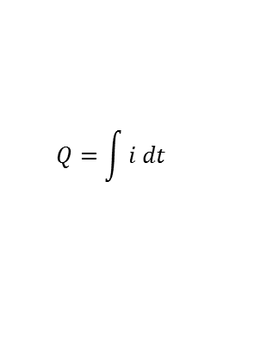
Time resolved IBIC (AKA mapped TCT)
$\sim (1−e^{−\frac{t}{RC}}$)
$$\sim v_{e,h}=E μ_{e,h}(E)$$
If no plasma effect
and L=0
$$\sim e^{−\frac{t}{τ}}$$
$$\sim e^{−\frac{t}{RC}}$$
TCT gives different information about physical parameters of the sample depending on the beam and energy chosen
Coupled with beam scanning, possible to characterize the sample spatially
$$detrapping$$
$$T=\frac{D}{v_{e,h}}$$
$$Q=\int{i dt}$$
scCVD diamond
Ideal case

Slide 19

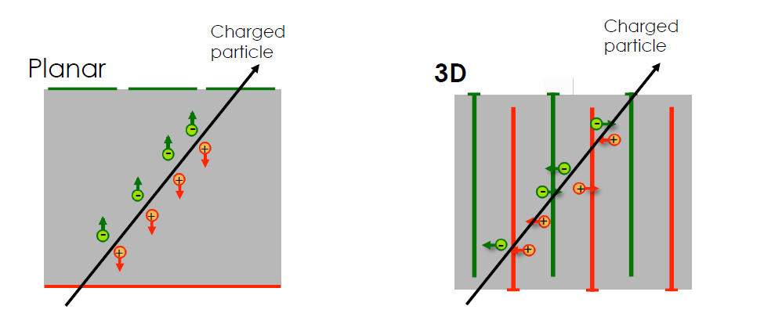
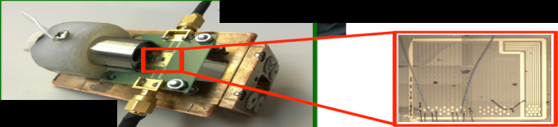
  AIDA-2020-RBI-2015-4
  3D diamond, Alexander Oh, University of Manchester, UK
  CCE maps for different biases and geometries
  TRIBIC (TCT) amplitude maps

Slide 20



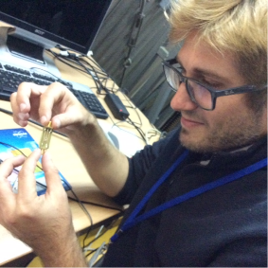
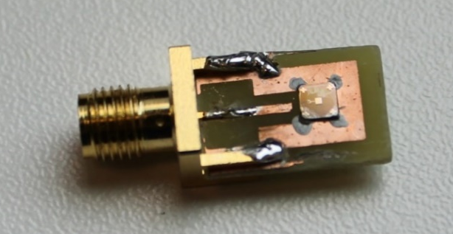
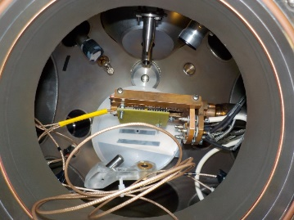
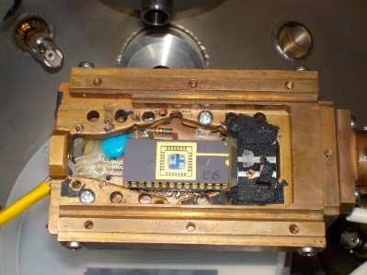
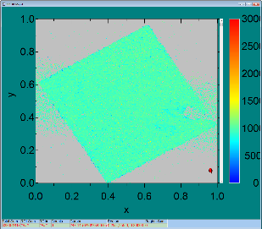
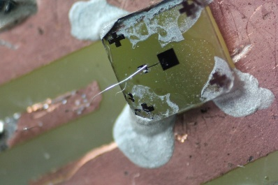
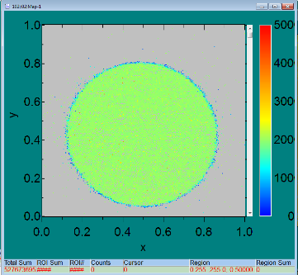
  AIDA-2020-RBI-2016-1
  IBIC characterization of single crystal diamond based Shottky diodes for microdosimetry application, Claudio Verona, ‘Tor Vergata’ University, Italy
  AIDA-2020-RBI-2016-2
  Microbeam tests of silicon telescope for clynical dosimetry, G. Magrin, Austron, Austria

Slide 21

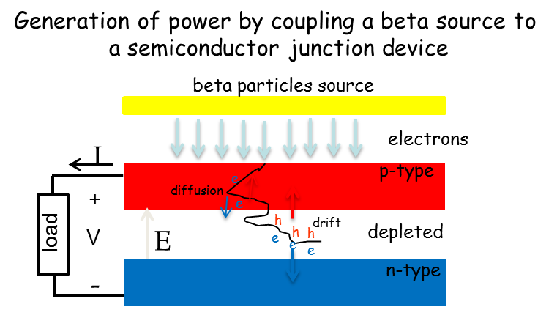
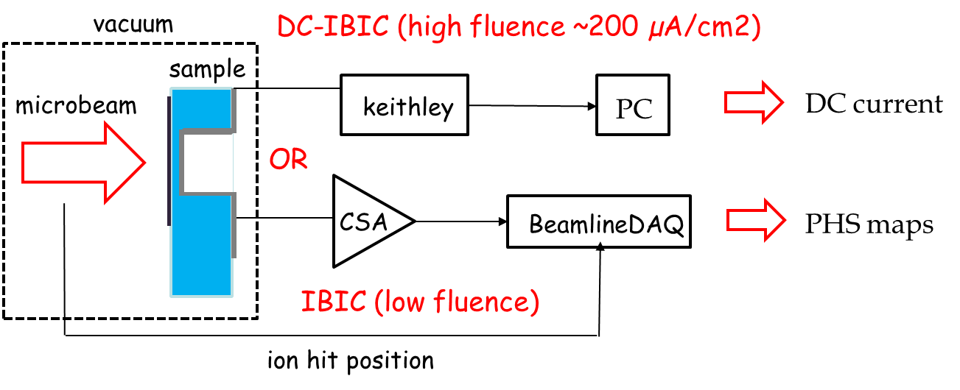
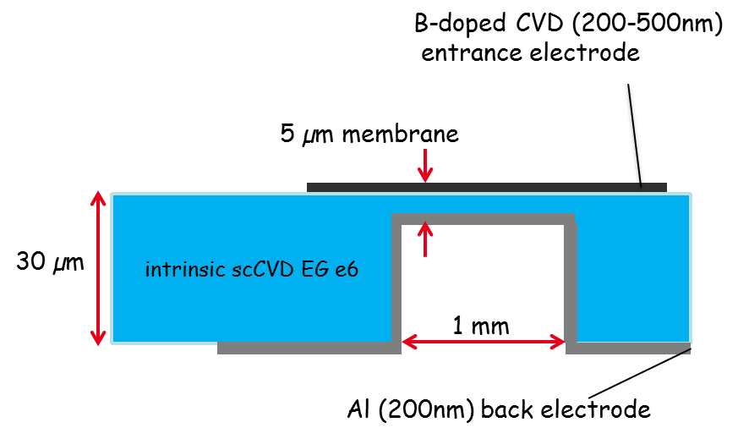
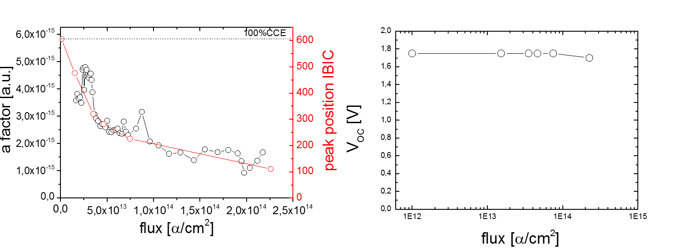
  AIDA-2020-RBI-2015-2
  Diamond Membranes for Radioisotope Batteries BATDiαm, Michal Pomorski, CEA, LIST, France
α instead of β
particles

Slide 22

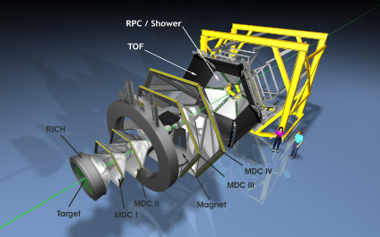
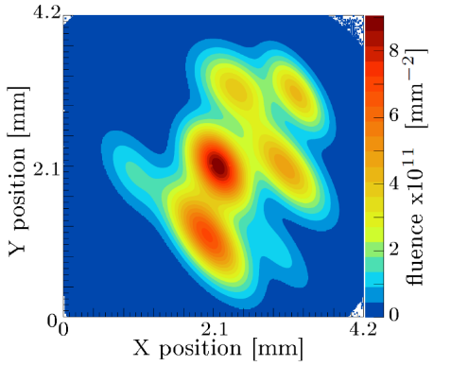
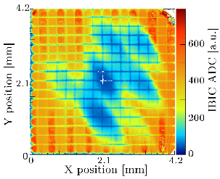
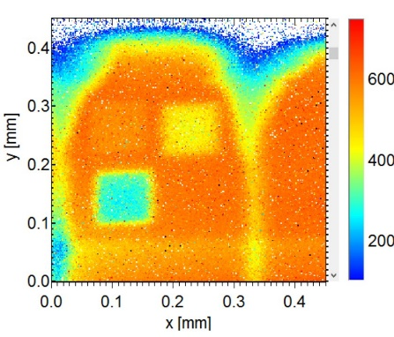
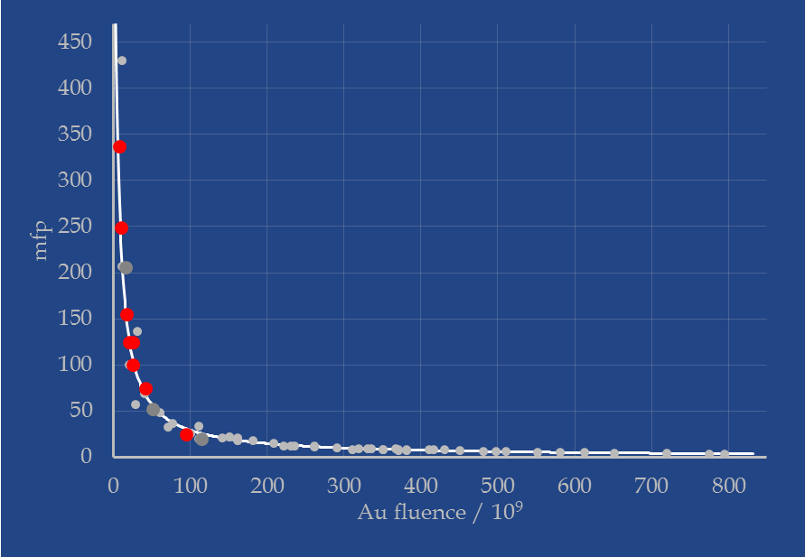
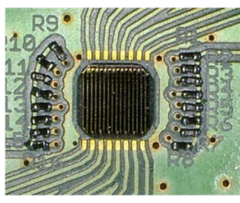
AIDA runs
  AIDA-2020-RBI-2015-1
  Systematic study of radiation damage in scCVD diamond material irradiated with relativistic Au beams, Jerzy Pietraszko, GSI Darmstadt, HADES, Germany
Number of traps:
Au / p_{4.5MeV} / p_{24GeV} = 1 / 30 / 2430
p_{4.5MeV} / p_{24GeV} = 81
Correlating fluences from different sources and detector degradation scCVD diamond strip detector

Slide 23
To conclude:
RBI accelerator facility hosts microbeam line used for IBIC and semiconductor modification among other uses
Ion Beam Induced Charge/Current is efficient method for mapping basic properties of semiconductor and insulator detector materials
Several different setups of IBIC exist: Lateral, Frontal, TRIBIC (TCT), Temperature dependent…
So far 7 (+1 in the following month) different characterizations carried out through AIDA transnational access program

Slide 24
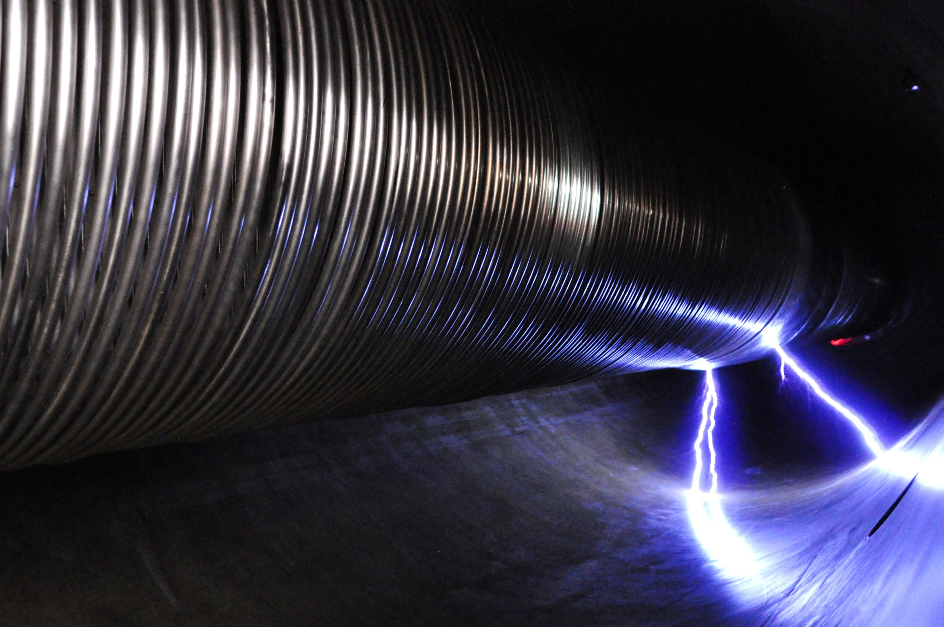
Thank you for attention!

Slide 25
WP12 .1 :
RBI Accelerator Facility
TA completed:
  AIDA-2020-RBI-2015-1
  Systematic study of radiation damage in scCVD diamond material irradiated with relativistic Au beams, Jerzy Pietraszko, GSI Darmstadt, HADES, Germany.
  AIDA-2020-RBI-2015-2
  Diamond Membranes for Radioisotope Batteries BATDiαm, Michal Pomorski, CEA, LIST, France
  AIDA-2020-RBI-2015-3
  Investigation of channeling depth profiles of high energy carbon and silicon ions implanted in diamond and SiC crystals for detector characterization, Michael Kokkoris, National Technical University of Athens, Greece
  AIDA-2020-RBI-2015-4
  3D diamond, Alexander Oh, University of Manchester, UK
  AIDA-2020-RBI-2016-1
  IBIC characterization of single crystal diamond based Shottky diodes for microdosimetry application, Claudio Verona, ‘Tor Vergata’ University, Italy
  AIDA-2020-RBI-2016-2
  Microbeam tests of silicon telescope for clynical dosimetry, G. Magrin, Austron, Austria
  AIDA-2020-RBI-2016-3
  Investigation of channeling depth profiles of high energy carbon and silicon ions implanted in SiC /Si crystals for detector characterization, University of Athens, Greece
25-4
AIDA-2020 2nd Annual Meeting
Mar 30th 2017
25-5

Slide 26
WP12 .1 :
RBI Accelerator Facility
The last TA proposal submitted and approved in March 2017:
  AIDA-2020-RBI-2017-1
  Diamond Membrane Microdosimeter, Michal Pomorski, CEA, LIST, France
  expected two users; one or both supported by the project
  Realization expected before the end of April (although there is high possiblity to delay
  the experiment due to some problems in the sample preparation as reported recently by the PI).
26-4
AIDA-2020 2nd Annual Meeting
Mar 30th 2017
26-5

Slide 27



Slide 28


Ion beam analysis
_{Molecular Desorption}
→ Secondary Ion Mass Spectrometry-SIMS

