Slide 1
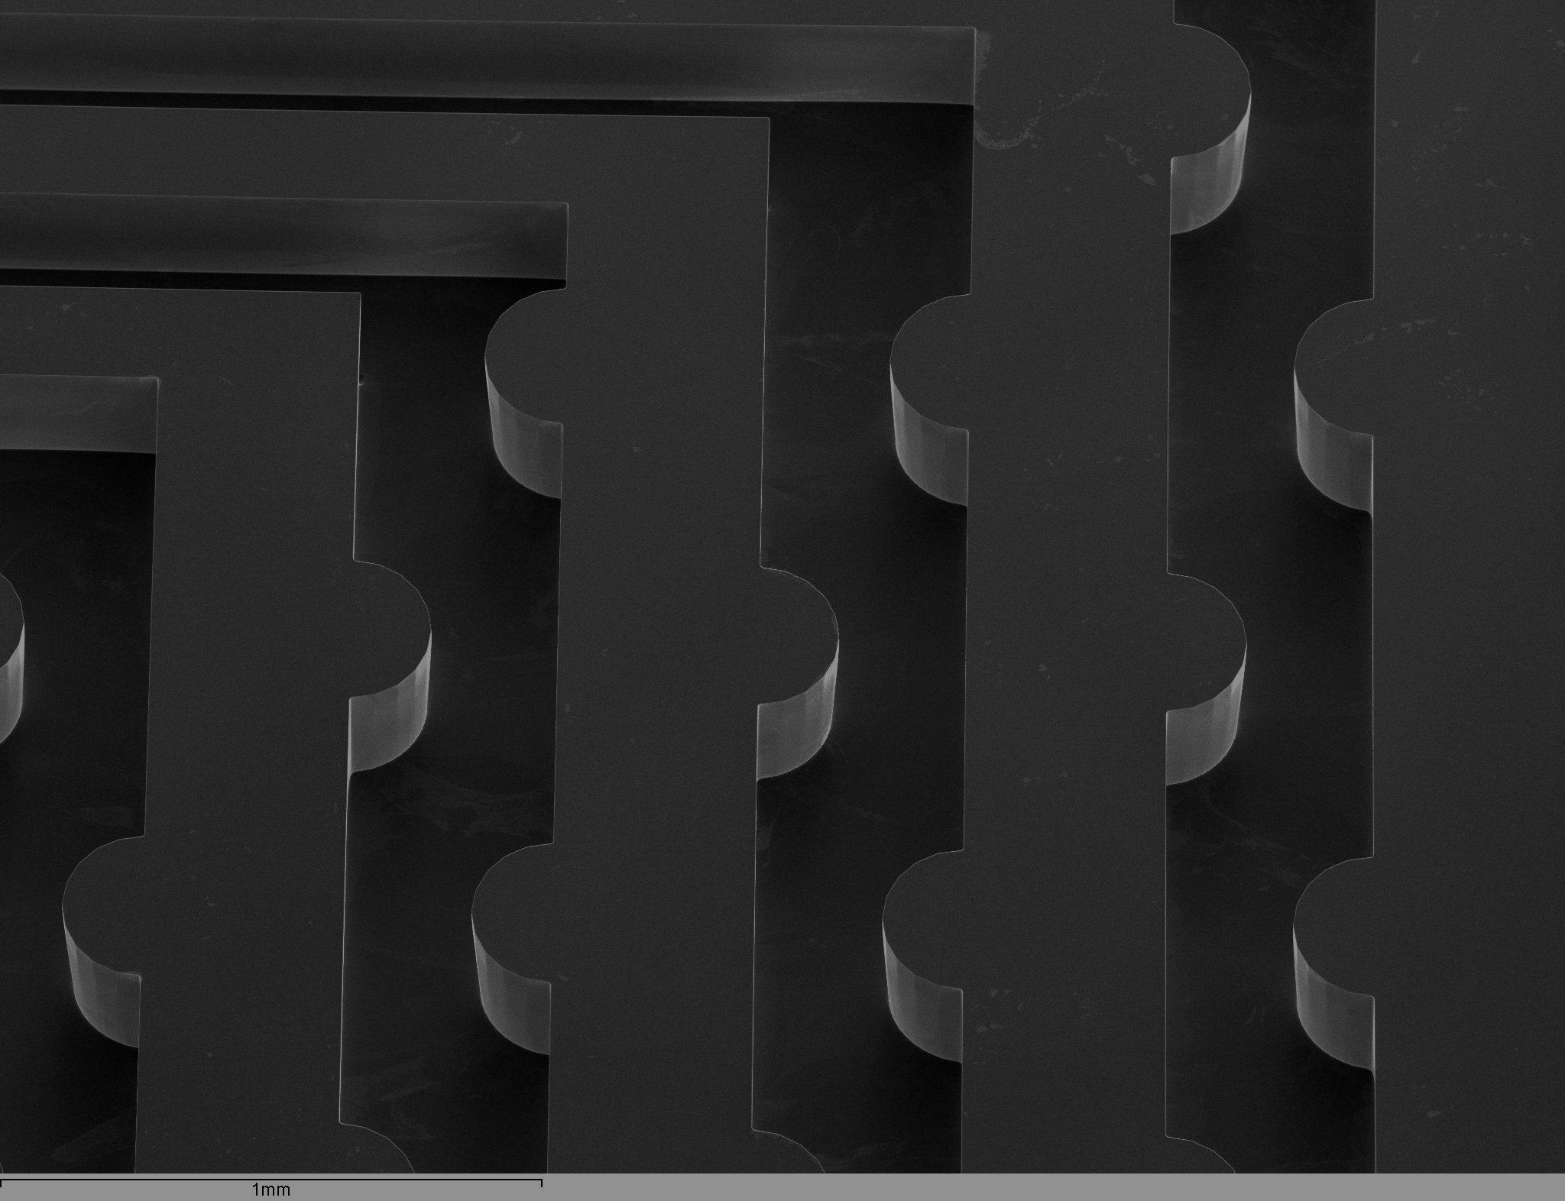
The CSOI approach for integrated micro channels
L. Andricek¹, J. Dingfelder², I. Garcia³, C. Lacasta³, G. Liemann¹, C. Marinas²,
D. Markus², J. Ninkovic¹, E. Scheugenpflug¹, M.A. Villarejo³, M. Vos³
¹MPG Halbleiterlabor Munich, ²Bonn University, ³IFIC Valencia

Slide 2
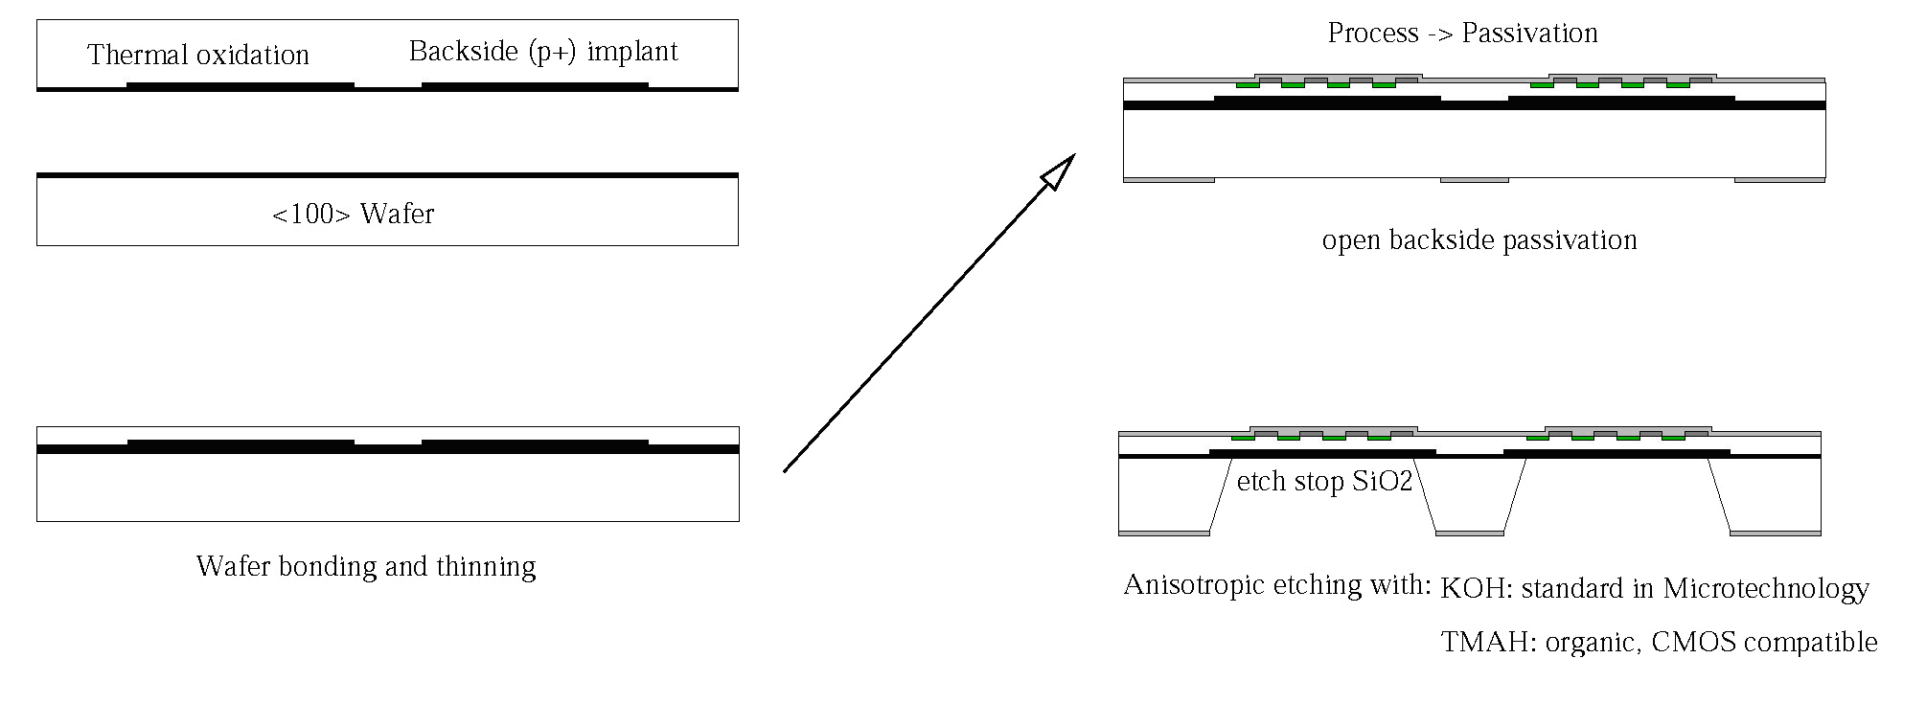
Processing thin detectors - the SOI approach
a) oxidation and back side implant of top wafer
c) process ➔ passivation
Top Wafer
Handle <100> Wafer
open backside passivation
Custom made SOI Wafer
b) wafer bonding and grinding/polishing of top wafer
d) anisotropic deep etching opens "windows" in
handle wafer
The sensor thickness becomes a free parameter, adjustable to the needs of the experiment!
Key Process Modules:
:- Wafer Bonding and thinning of top layer (external)
:- Sensor fabrication on SOI
:- Etching of the Handle Wafer
DEPFET for Belle II PXD (75µm)
Direct electron detectors (30 and 50 µm)
SiPMs - SiMPL (down to ~14 µm)
ATLAS ITk (150 and 100µm)

Slide 3
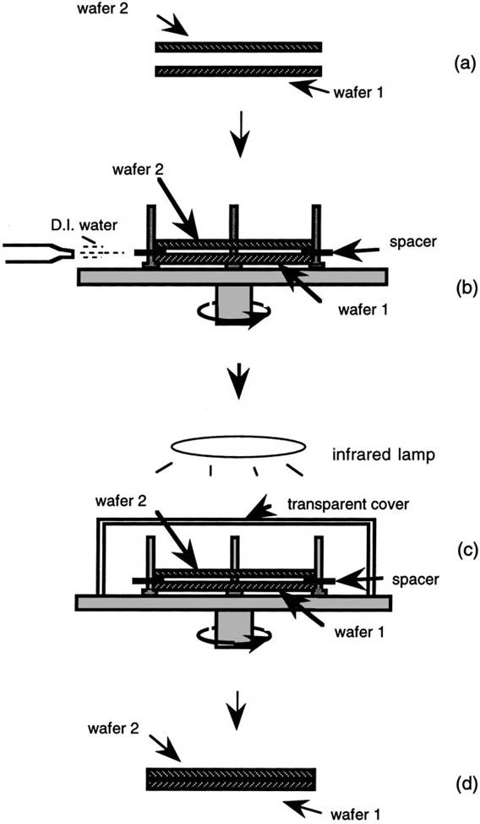
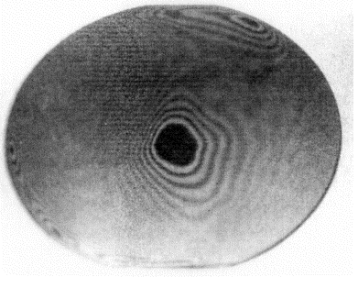
Direct Wafer Bonding in "Micro-Cleanroom"
Q.-Y. Tong and U. Gösele “ Semiconductor Wafer Bonding ”
John Wiley & Sons, Inc.
picture from: www.mpi-halle.mpg.de

Slide 4
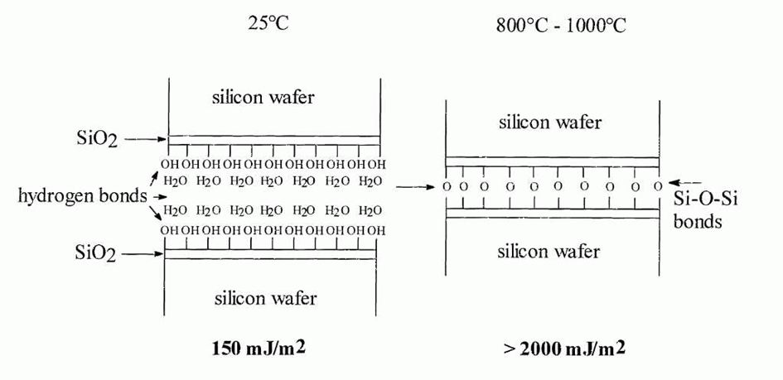
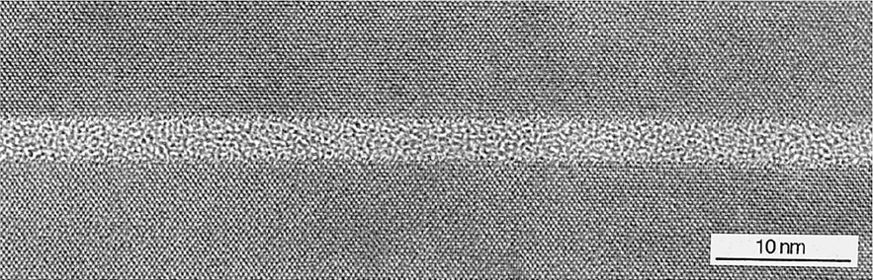
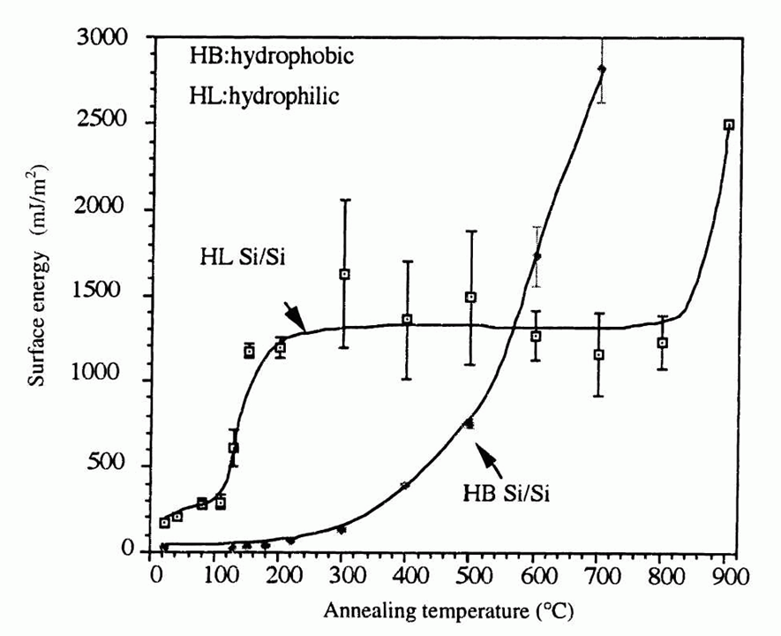

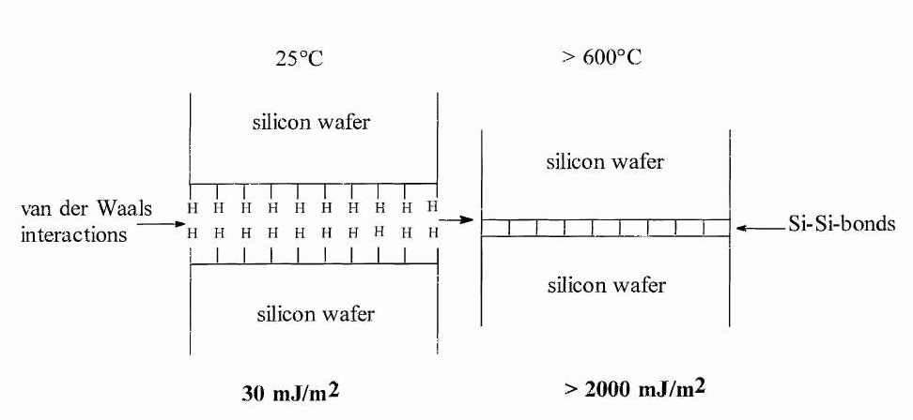
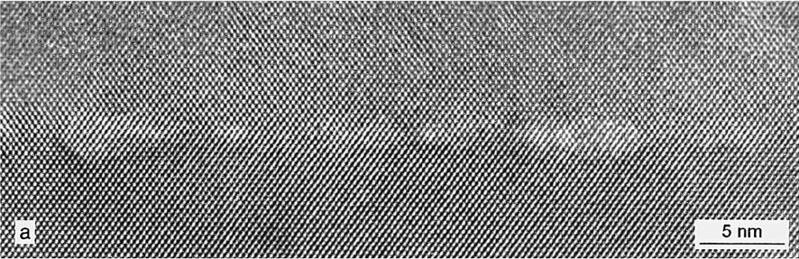
Direct Wafer Bonding
qlso native

Slide 5
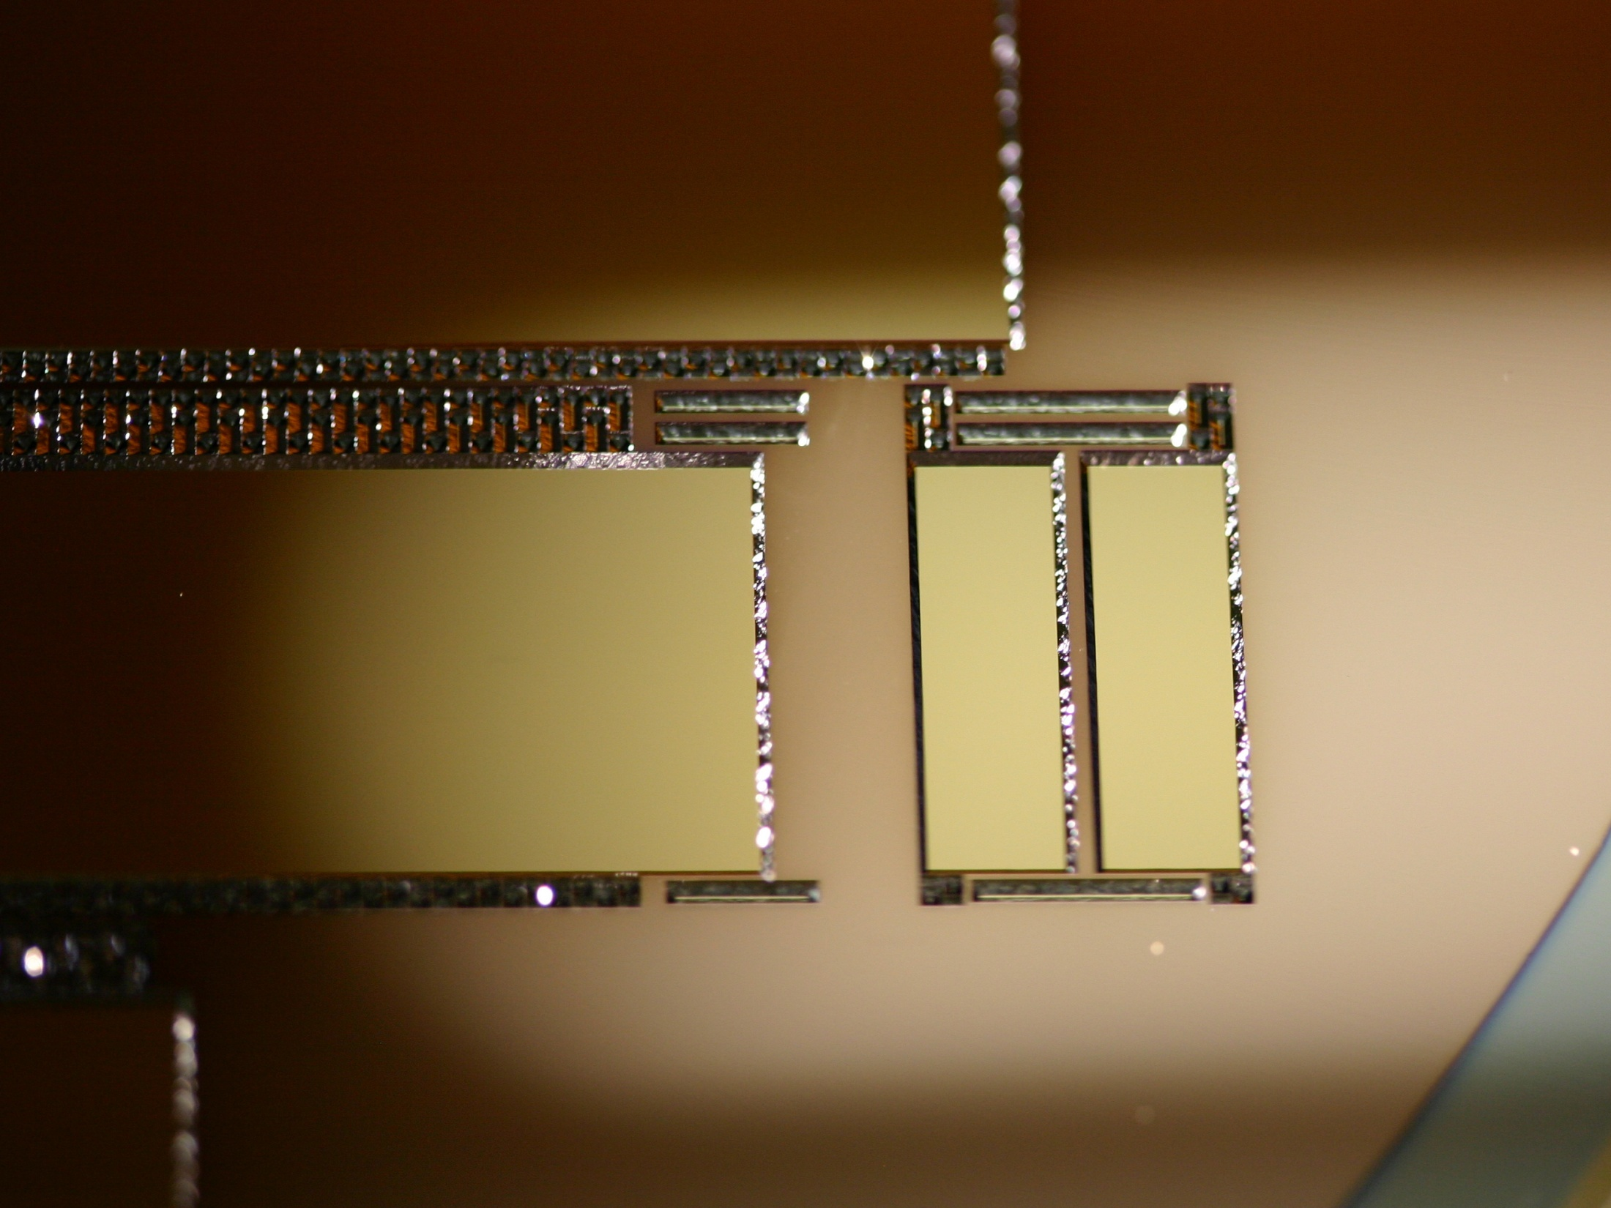
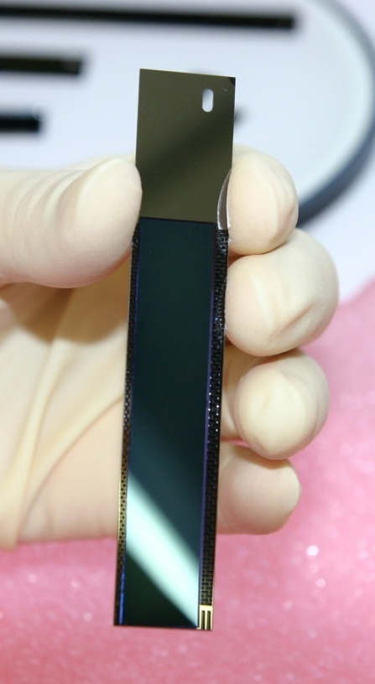
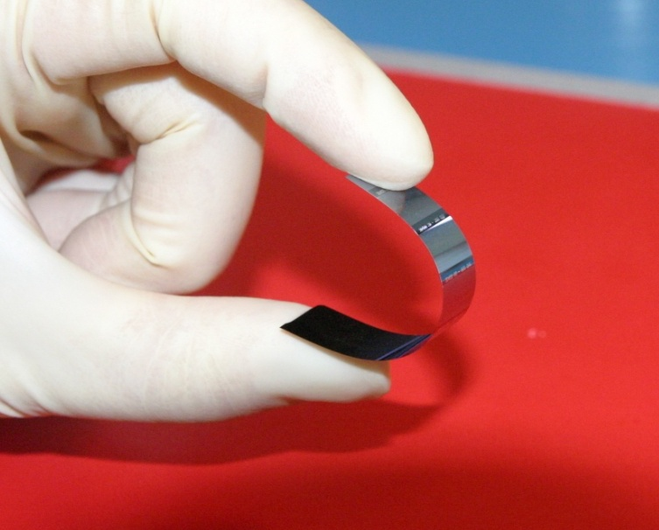
integrated silicon frame

Slide 6
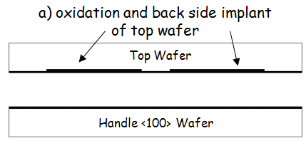
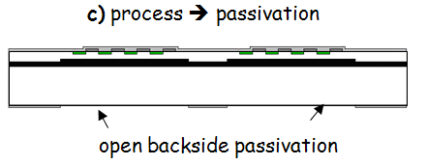
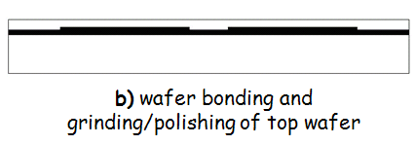
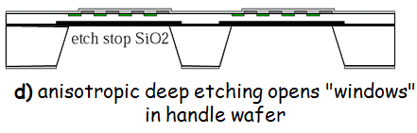
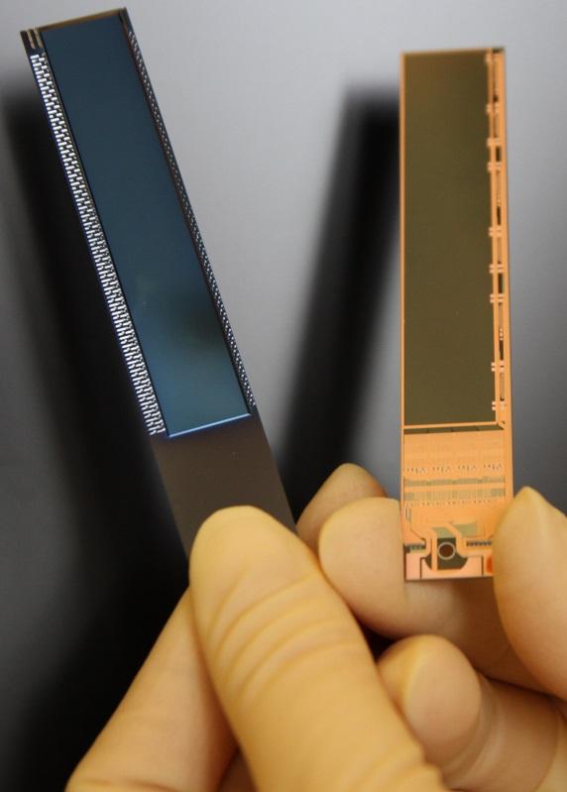
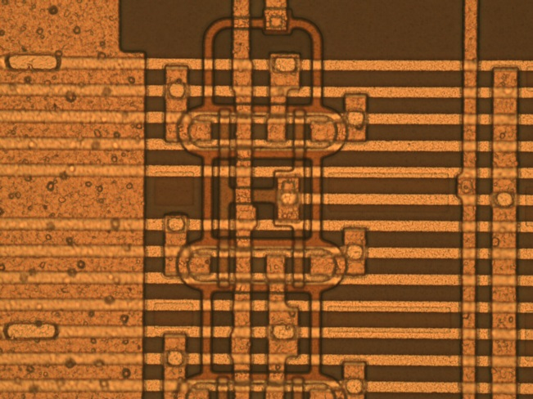
thin DEPFETs
full DEPFET technology in thin area
thin area supported by a monolithically integrated silicon frame

Slide 7
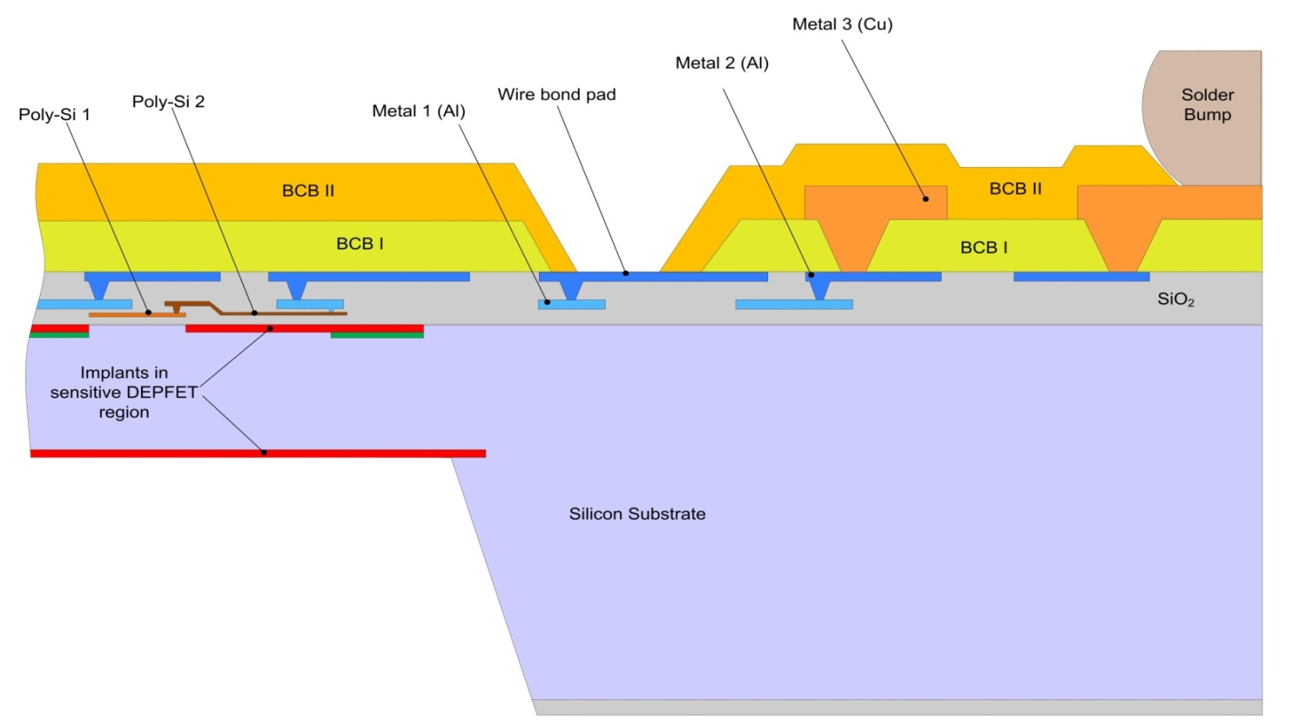
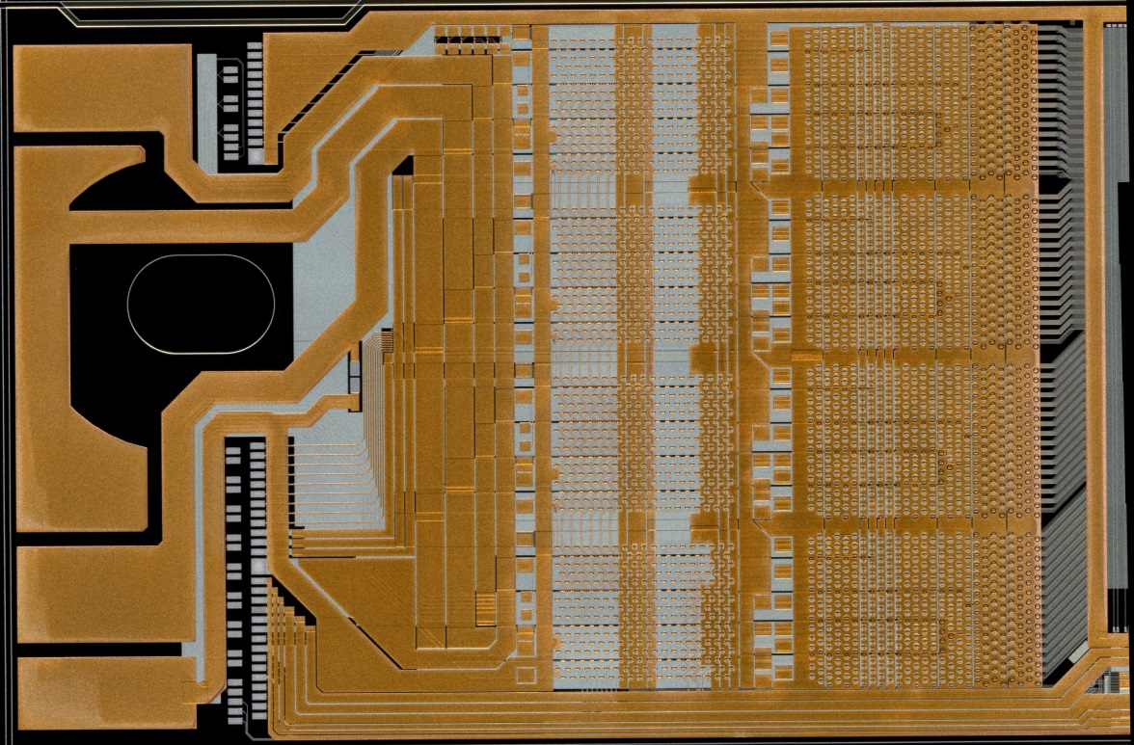
introducing a Cu layer on the DEPFET module
three metal layer system in periphery
  Copper as third metal
  low-k dielectric to Alu2
  UBM for flip chip
  landing pads for passives
  Solder connection to kapton

Slide 8
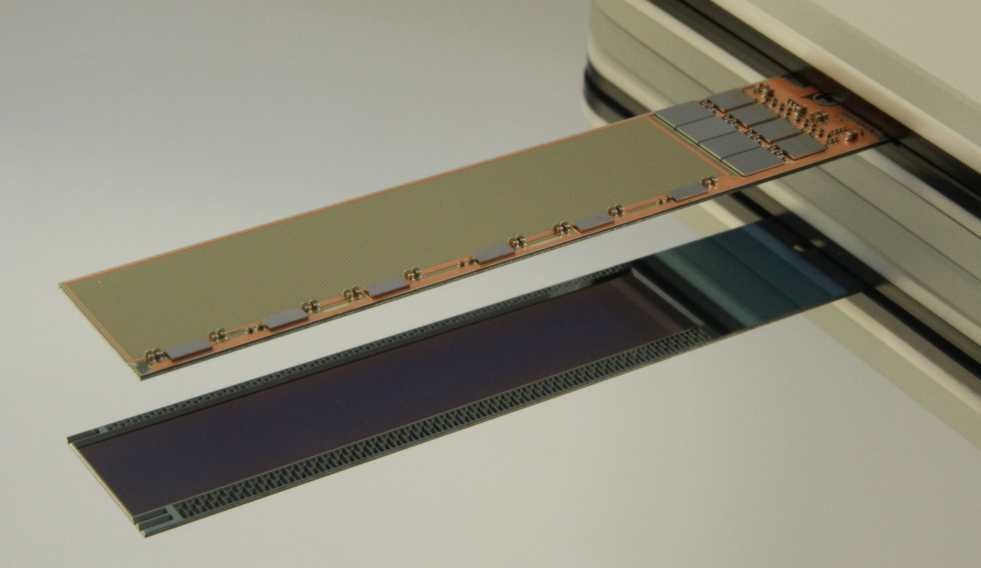
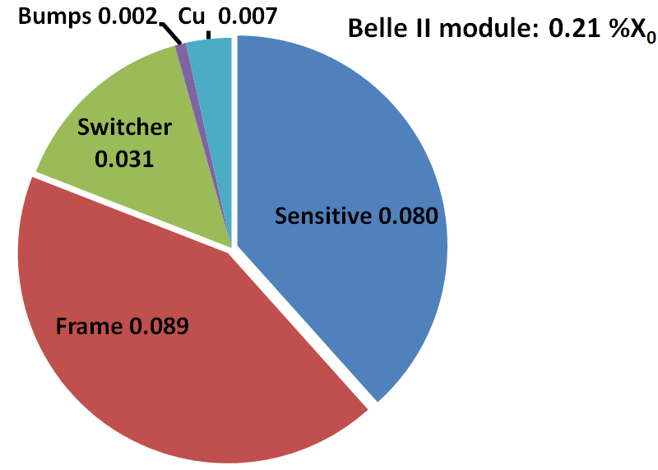
Belle II Module 0
X/X0 = 0.21%

Slide 9
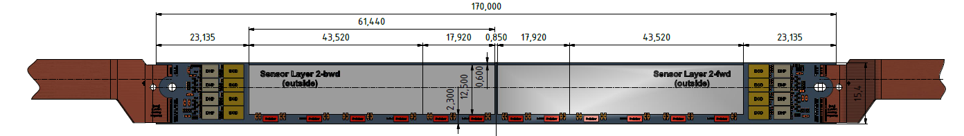
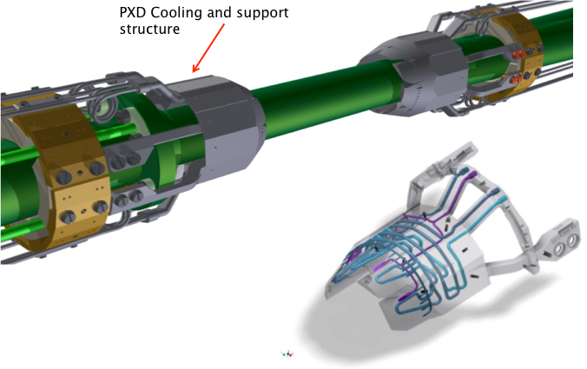
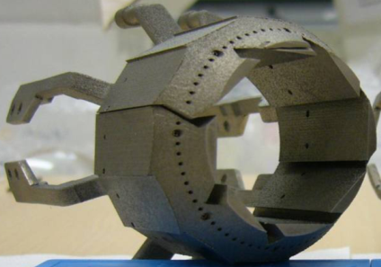
Thermal management and material
1W sensor & SWB → gas cooling
8W DCD&DHP
Belle II
  9W/half ladder, 8W at EOS
  Active (CO₂) cooling at EOS, cooling block outside acceptance
difficult for experiments with larger acceptance region
at EOS still high power density, active cooling would be good
  → How about silicon integrated cooling channels there ????

Slide 10
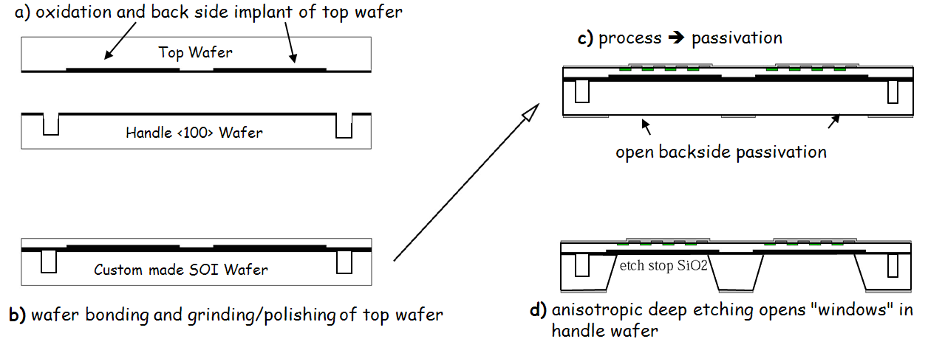
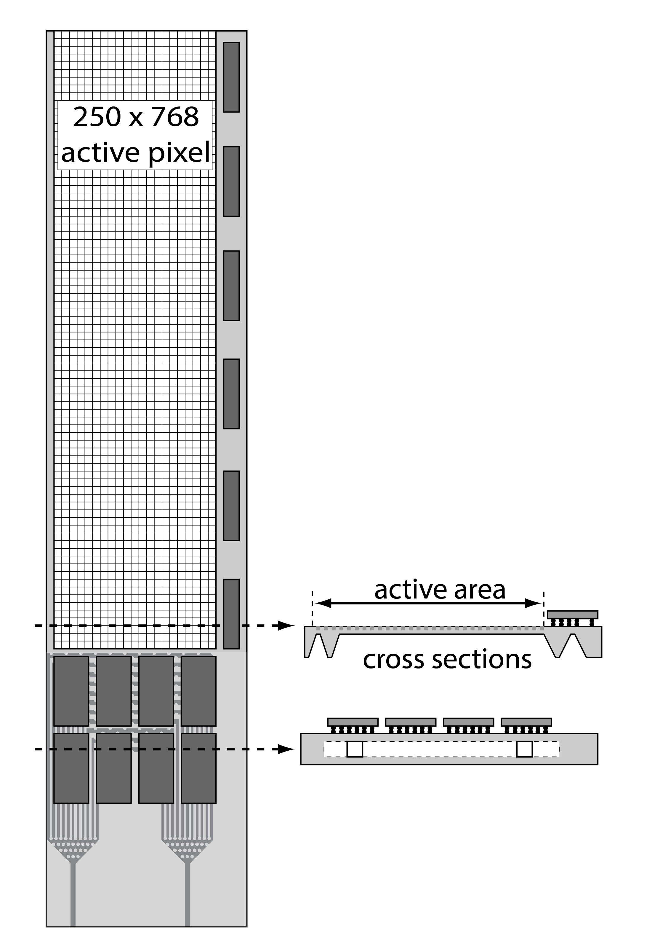
Integrated micro-channels
A spin-off of SOI approach : thinned all-silicon module with integ. cooling
:- idea: integrate channels into handle wafer beneath the ASICs
:- channels etched before wafer bonding → cavity SOI (C-SOI)
:- full processing on C-SOI, thinning of sensitive area
:- micro-channels accessible only after cutting (laser)

Slide 11
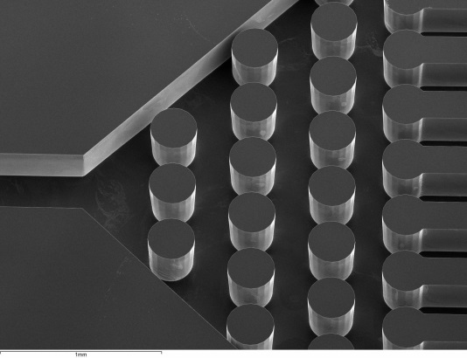
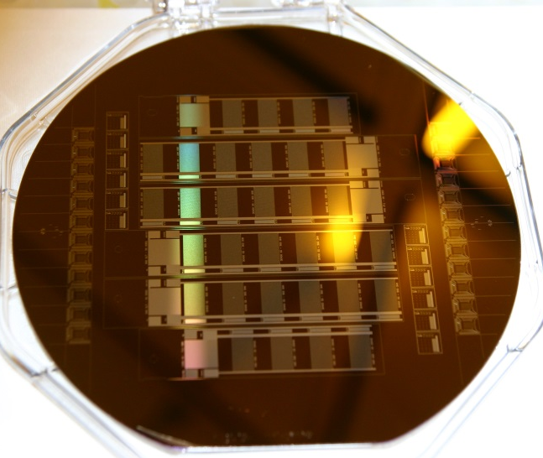
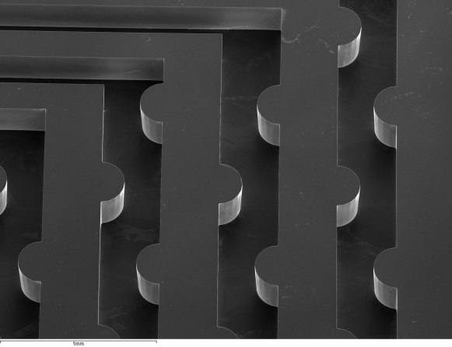
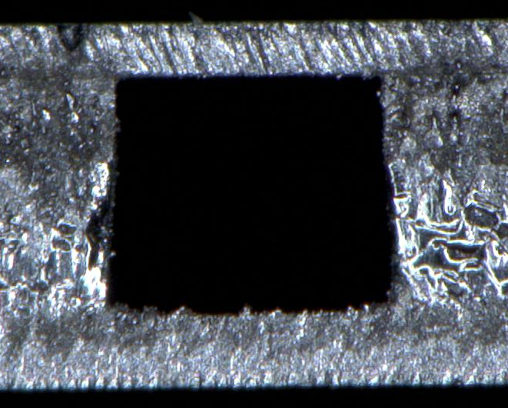
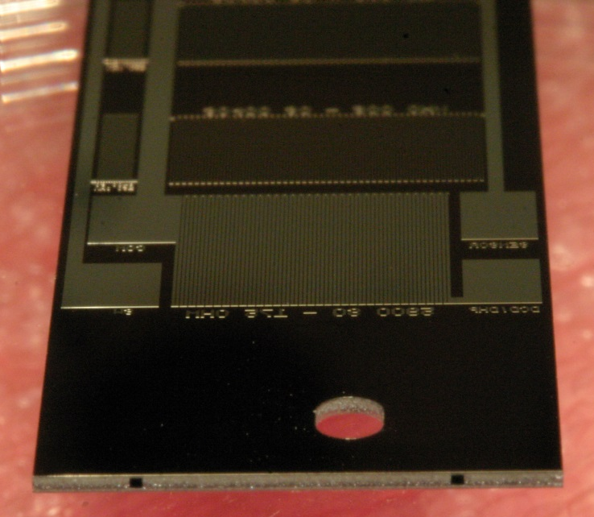
Prototypes with resistive heating and micro channels
CSOI wafer with integrated ressistors
DRIE etching of handle wafer
Detail: inlet for the cooling fluid
Module after cutting
~350 µm

Slide 12
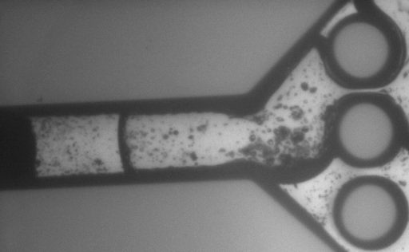
IR movie – just for entertainment
:- silicon particles in water
:- low flow 300µl/s

Slide 13
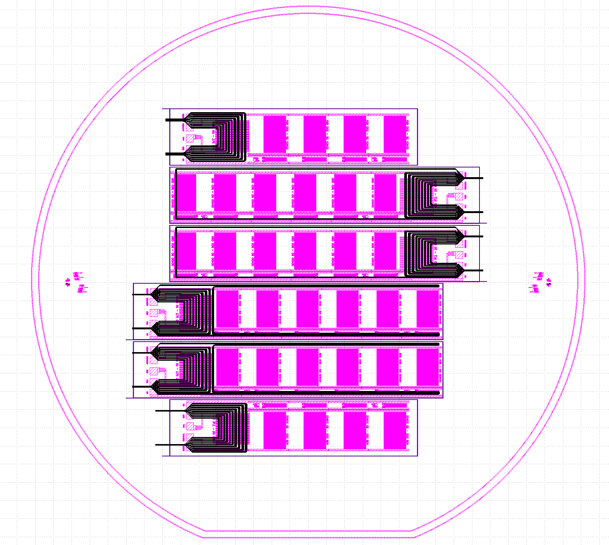
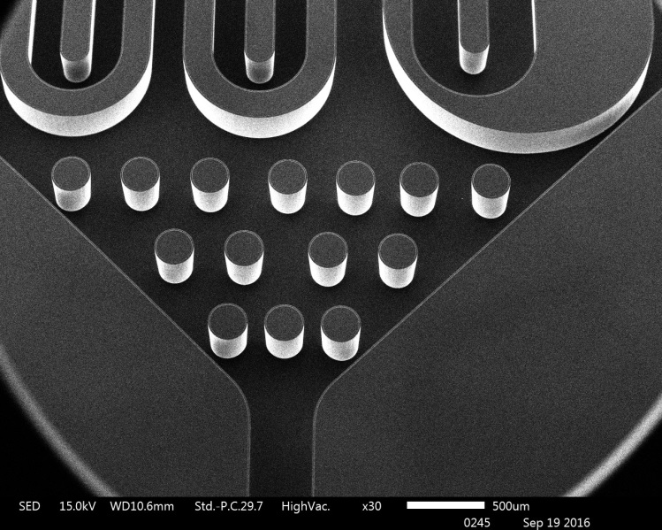
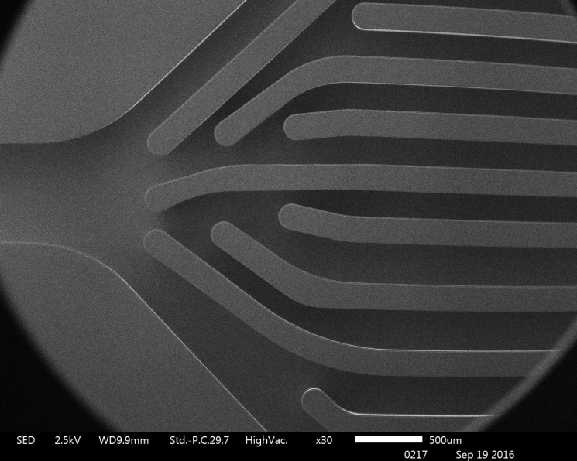
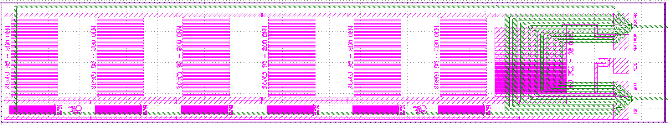
2nd round

Slide 14
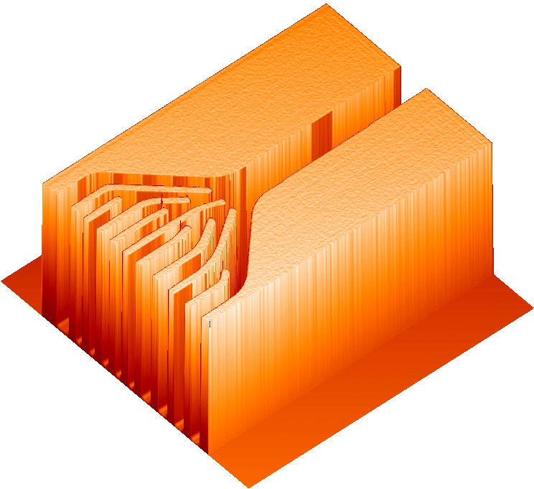
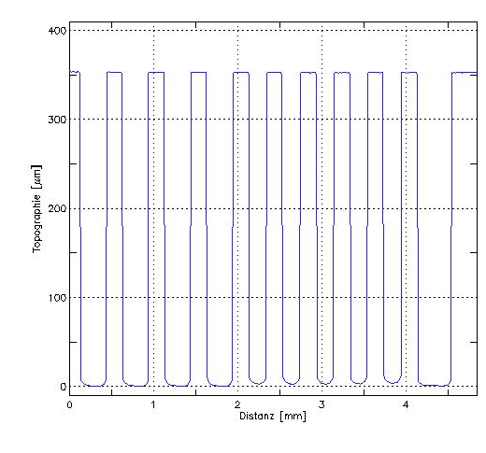
2nd round: Profiles before wafer bonding

Slide 15
Summary
Active pixel sensors for Belle II are already fabricated on SOI wafers
  Convection cooling in thin sensitive region, “aggressive” CO2 at the end-of-stave (EOS)
Natural next step is the introduction of integrated cooling channels at the EOS
  Cavity SOI
Feasibility studies done, look promising
Concept can be extended to any kind of sensors on SOI, in particular hybrid pixel sensors as in ATLAS/CMS
  Would of course require re-design of the module ..

Slide 16
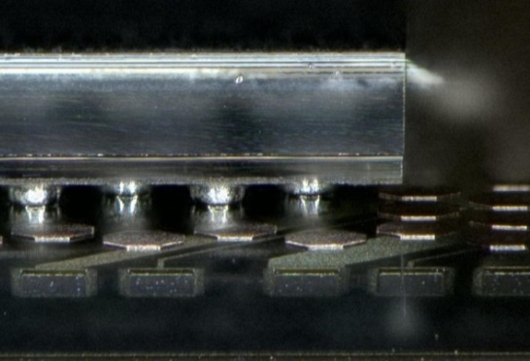
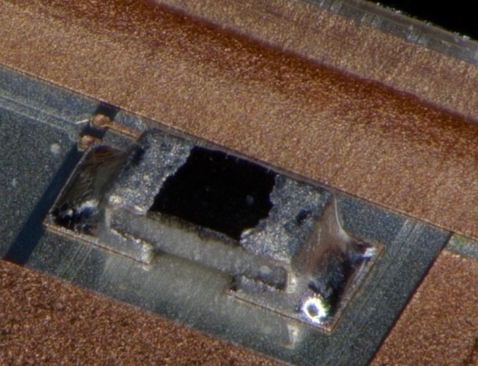
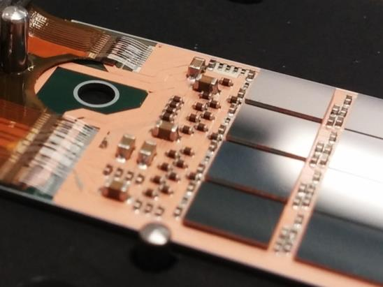
Module Assembly – overview
Flip Chip of ASICs (~240°C):
  Bumped ASICs have the same solder balls (SAC305)
    DHP bumping at TSMC, DCD bumping via Europractice
    So far SWB bumping on chip level
  Flip Chip of PXD modules on custom made support plates
SMD placement (~200°C):
  Passive components (termination resistors, decoupling caps)
  Dispense solder paste/jetting of solder balls, pick, place and reflow
    PbSn 37/63 solder
Kapton attachment (~170°C), wire bonding:
  Solder paste printing on kapton,
    SnBi solder
  Wire-bond, wedge-wedge, 32 µm Al bond wires

