Slide 1

Structural characterization of silicon channels for fluidic applications
Richard Meunier
Diego Alvarez Feito, Clémentine Lipp, Alessandro Mapelli, Jerome Noel

Slide 2
Introduction
Thermal management of detectors electronics
  Cooling large surface detectors
  Keeping the detectors cool at all time
Problems and constraints
  Confined space with very limited access
  Different types of liquid coolants
  Using material with low particle interaction
Envisioned solution
  Silicon micro-channels
  Ideally integrated in a monolithic detector

Slide 3

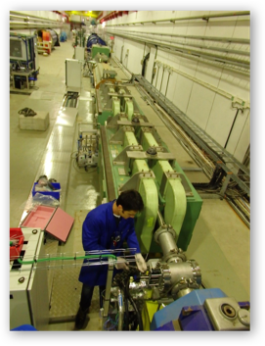
NA62-GTK – SILICON MICROCHANNEL COOLING
NA62 is the first experiment to use silicon microcooling plates for the thermal management of their GTK pixel detectors (since 2014).
3 detector modules
Liquid C₆F₁₄
T_{op} below -10ºC
Power dissipation 25W-48W over 6x4cm²
A. Mapelli et al. 2012 JINST 7 C01111
P. Petagna et al., Microelec. Journal 44 (2013) 612–618
G. Romagnoli et al., Microelec. Eng. 145 (2015) 133-137

Slide 4
Silicon Microchannel Cooling
Why Silicon or SiC?
  Detectors are in silicon
  Controlled interaction with particles
  Availability
  Extensive processing knowledge and technologic applications (Micro-electronics, MEMS, etc)
Interest and goals:
  Size advantage
  Design advantage: large pattern possibility
  Can be integrated in the detector’s fabrication process combining versatility of standard micro-fabrication processes with high thermal efficiency of micro-fluidics
Mechanical problematics:
  Young’s modulus of 169 GPa <110> or 130 GPa <100> or 187 GPa <111> or…?
  Possible fatigue in monocrystalline silicon can accumulate and lead to rupture
  Lots of publications and tests on silicon mechanical properties, but so far no link between them…

Slide 5



Micro-Channel Fabrication
Two different approaches:
  Wafer bonding
  Buried micro-channels
Wafer bonding
  Etching step
  Wafer bonding
  Problem: wafer bonding can be tricky
WAFER BONDING APPROACH

Slide 6
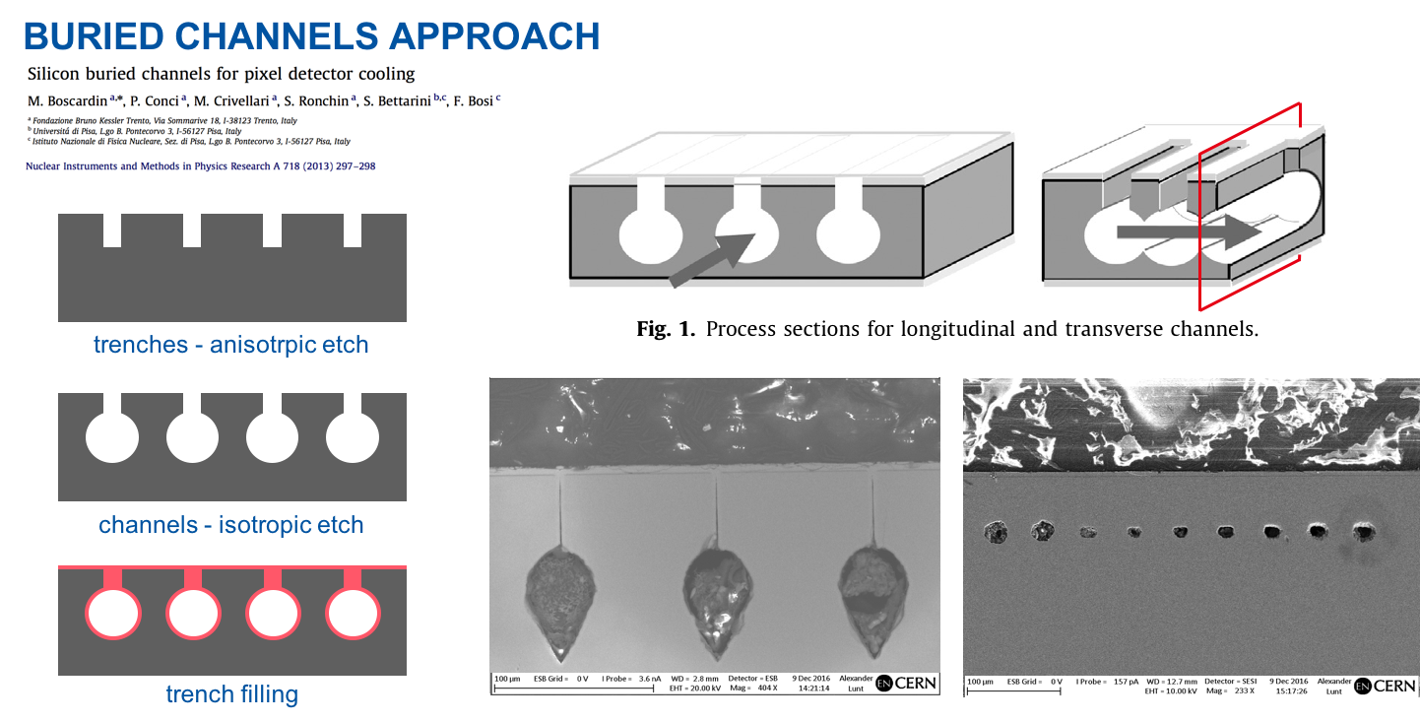
FBK-CERN Embedded Channels
Buried channels
  Trench through Bosch Process etching
  Channel engraving with SF6 isotropic etching
  Channel filling with PE/LPCVD poly-silicon

Slide 7
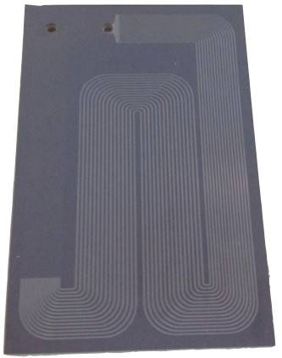
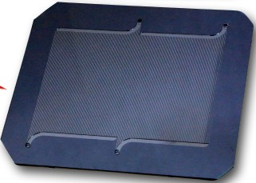
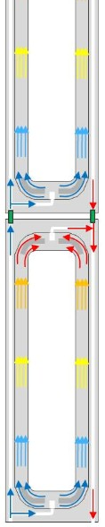
Characterization
Objective at CERN: defining a standard procedure to validate and ensure reliability of the cooling systems ➔ Leak test and pressure tests
Reasons to perform pressure tests:
  Gaining a better understanding of the mechanical response of ScSi
  Assess effect of channel geometry to optimize design of new devices
  Evaluate wafer-to-wafer bond strength
  Serve as quality control procedure
NA62 GTk
LHCb VELO
ALICE ITS

Slide 8
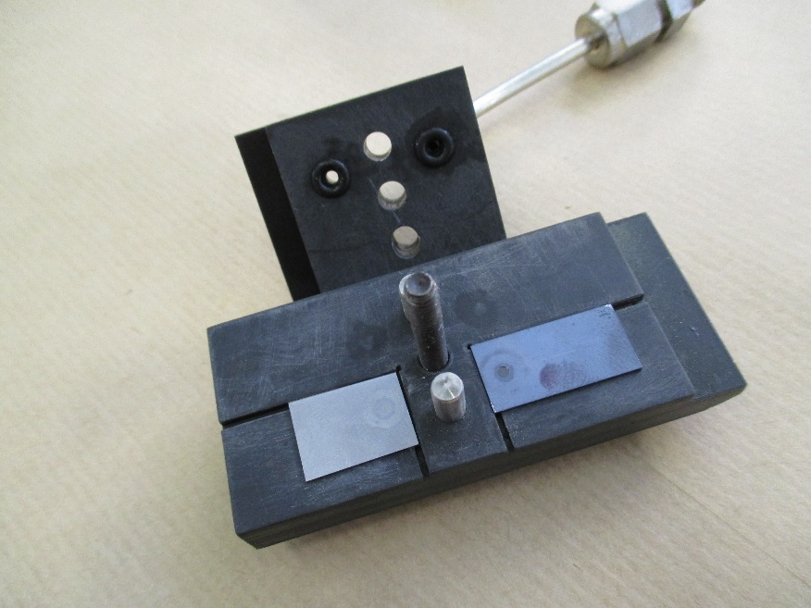
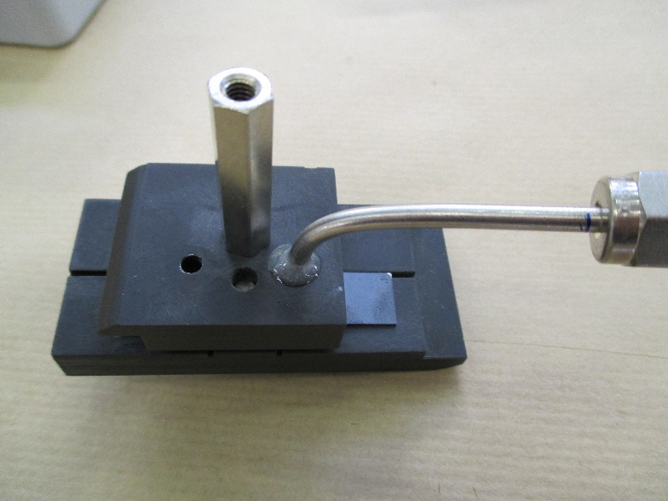
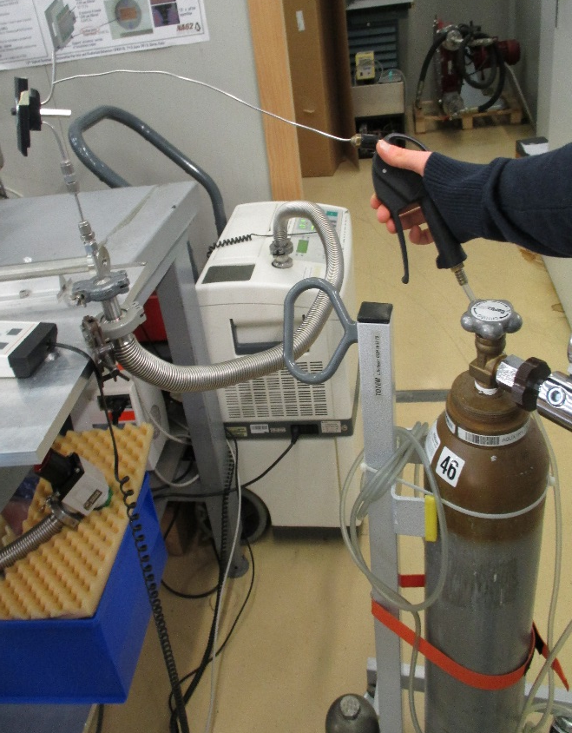
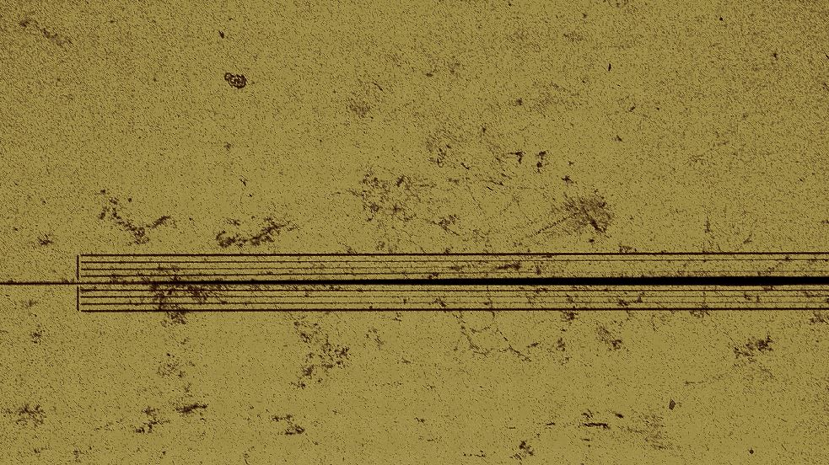
Leak Test
Positioning
Pumping and leak recording
Objective:
Testing if samples are leak tight

Slide 9
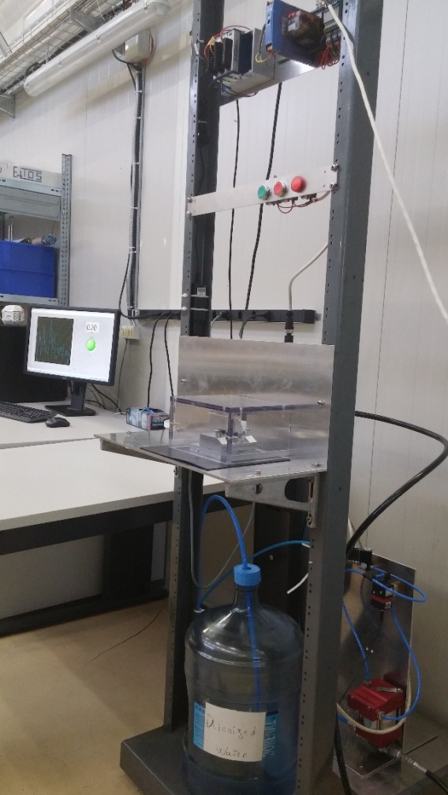
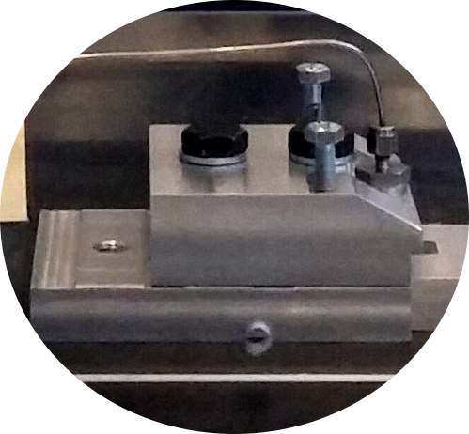
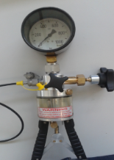
Pressure Test: Setup
DAQ + Control
Pressure sensor
Connector
Sample
Air
H₂O
Manual Pump
Water

Slide 10
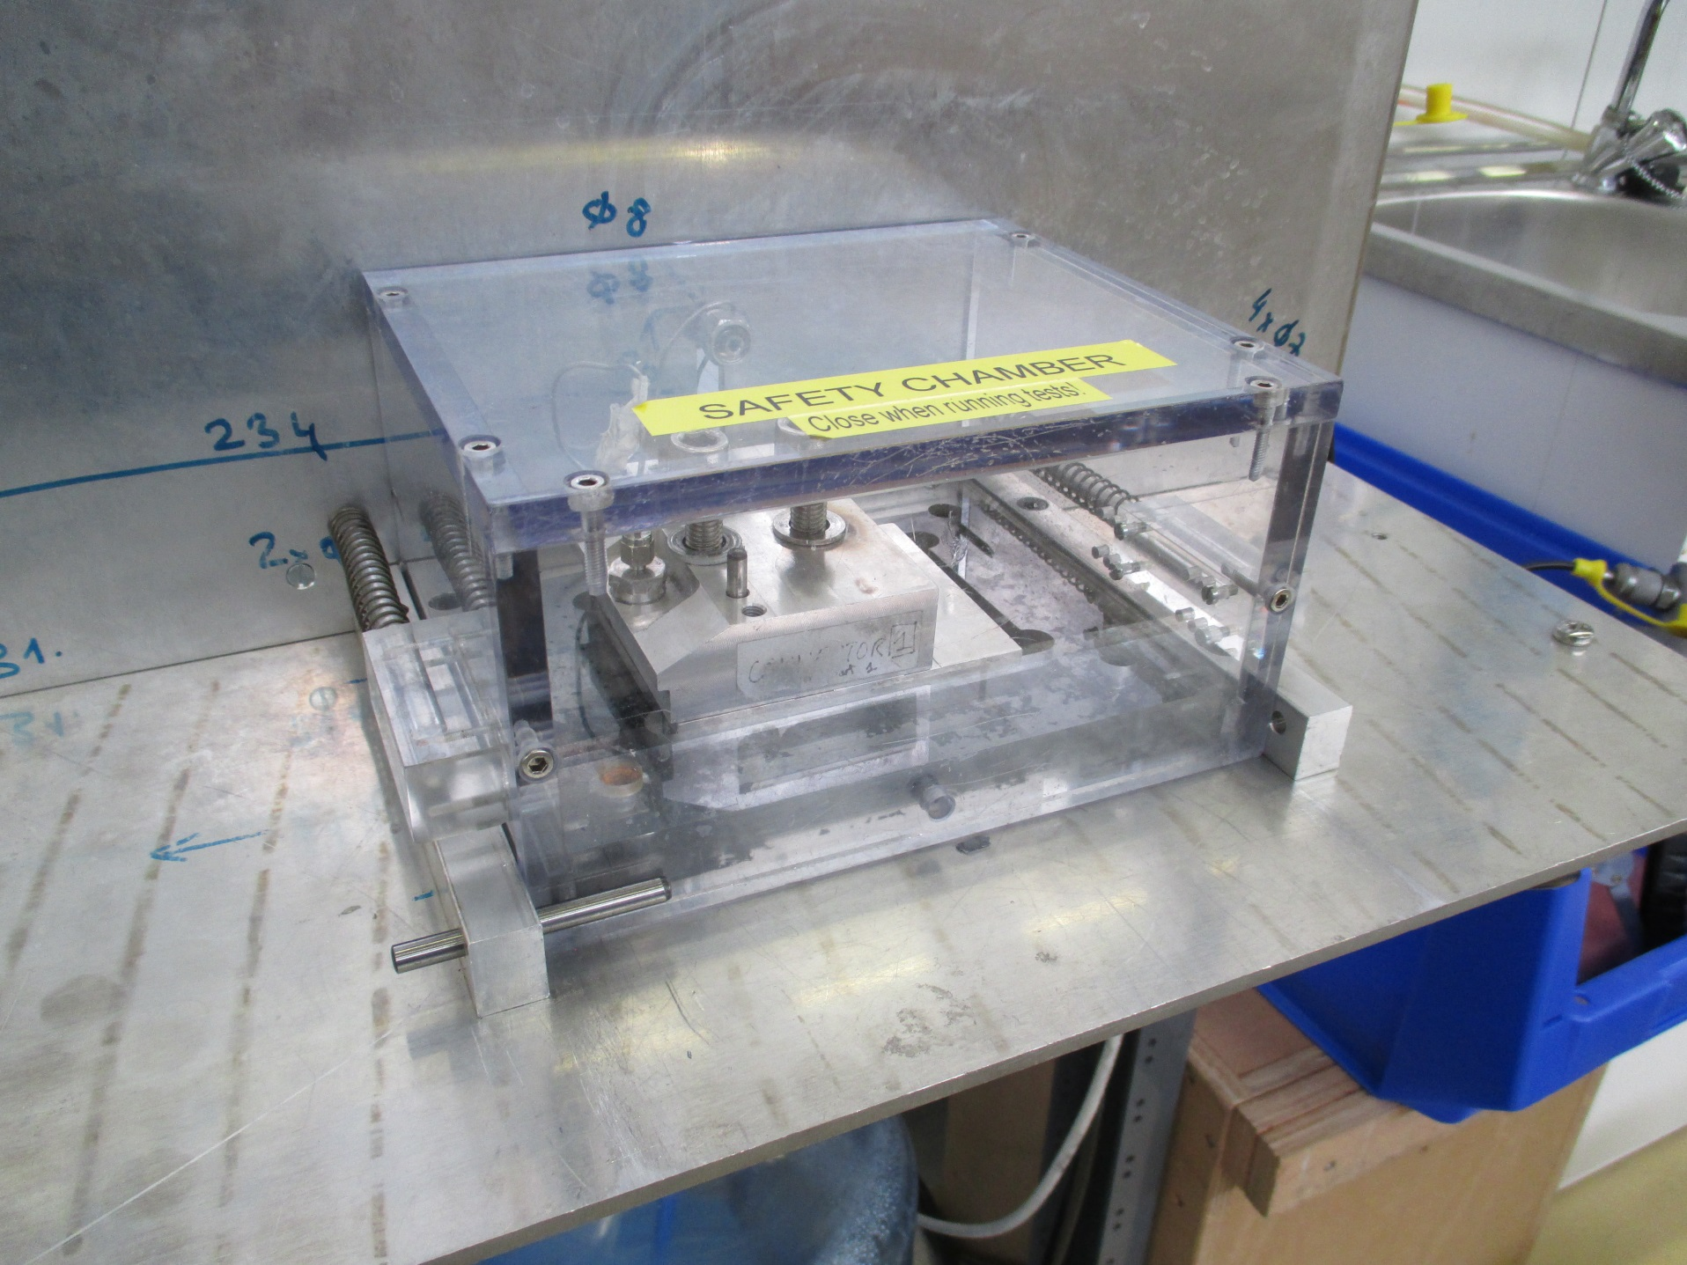
Safety Chamber

Slide 11
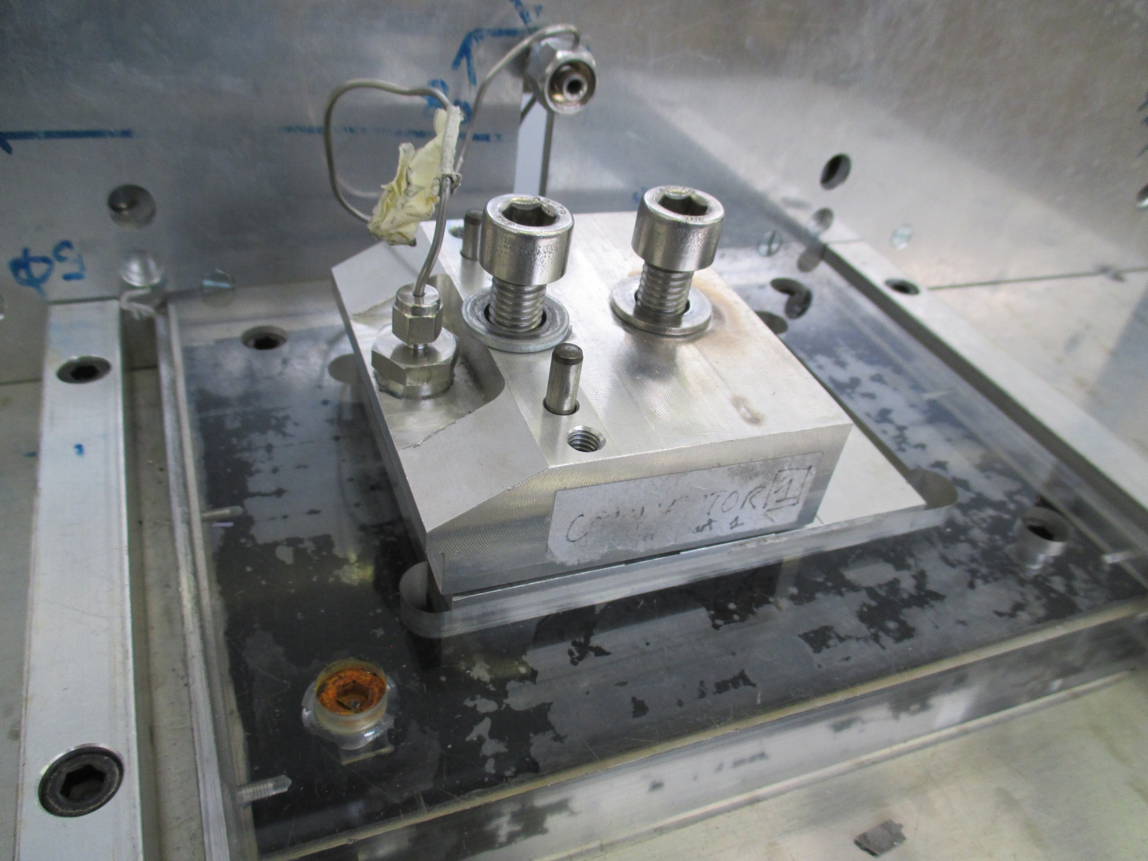
Sample Holder

Slide 12
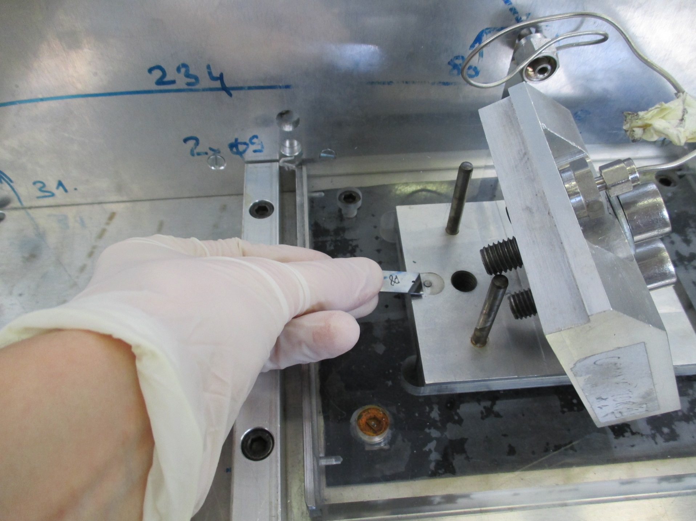
Sample Positioning

Slide 13
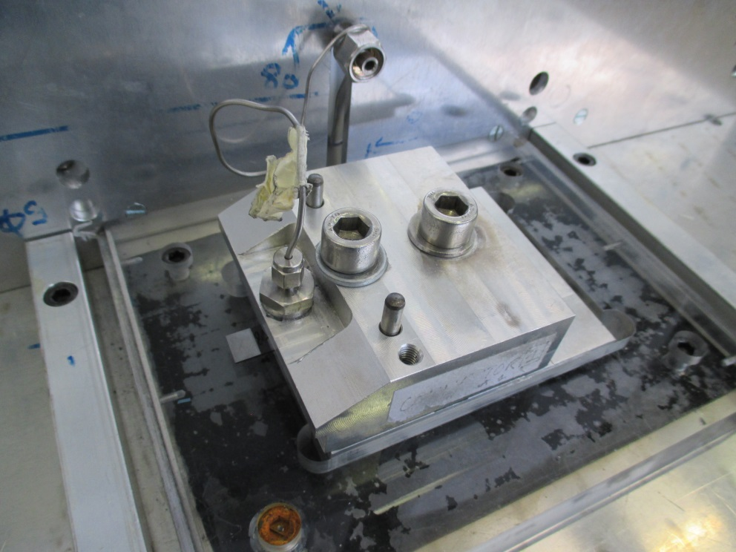
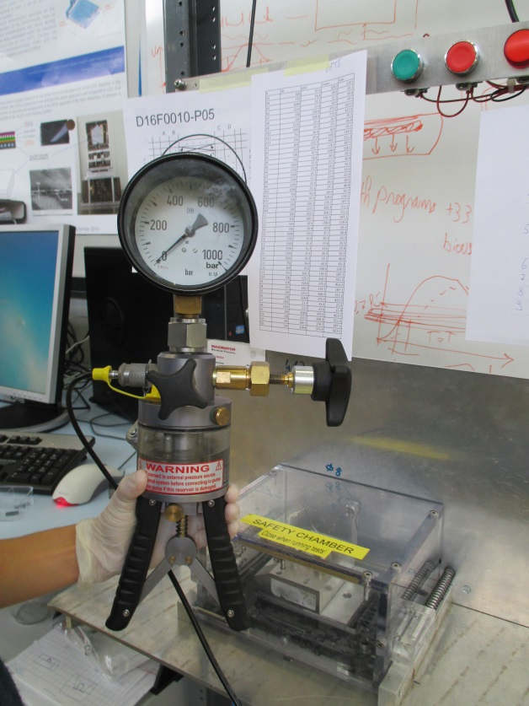
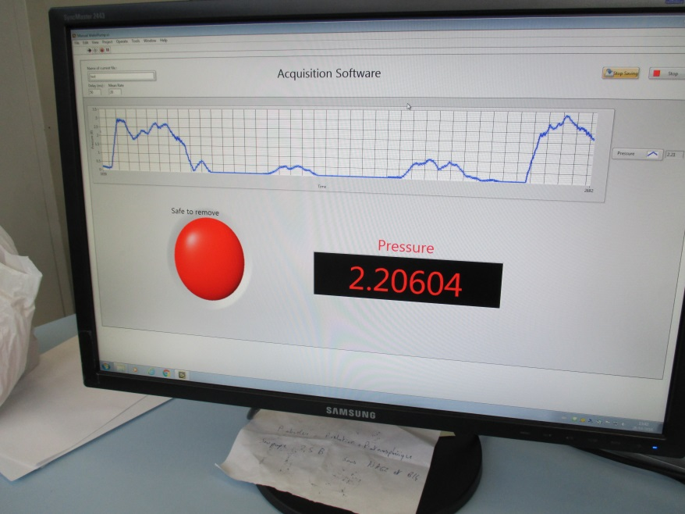
Pressure Test & Acquisition

Slide 14
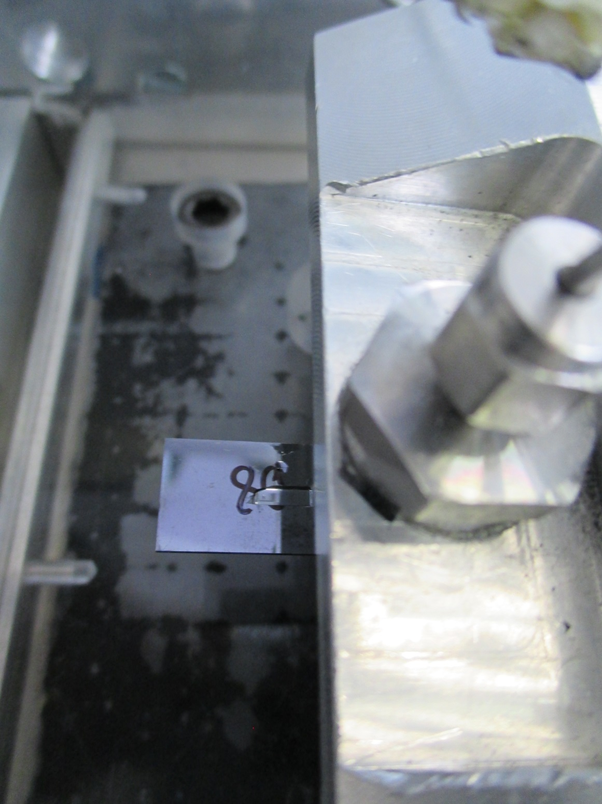
Failure

Slide 15
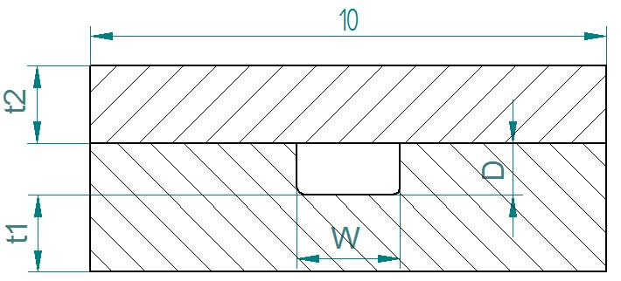
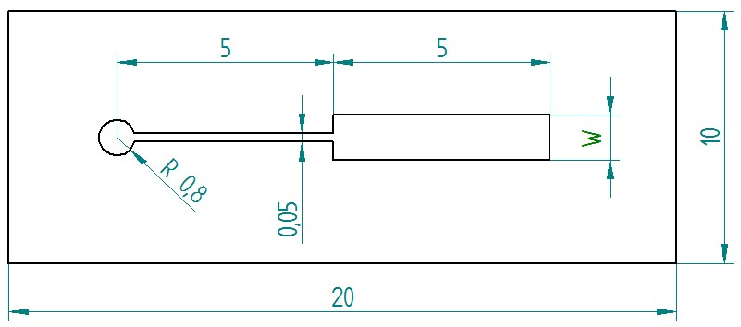
Results
Si-Si wafer bonding:
  Good implementation
  Pressure resistance depends on boding quality and channel geometry
Single-channel samples
  Etched together with real cooling devices for quality control of bond strength

Slide 16
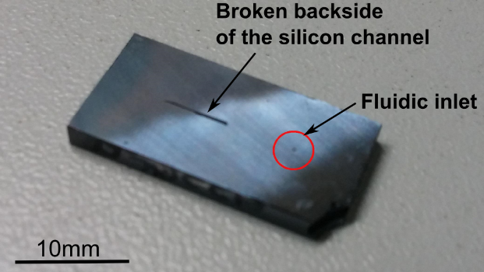
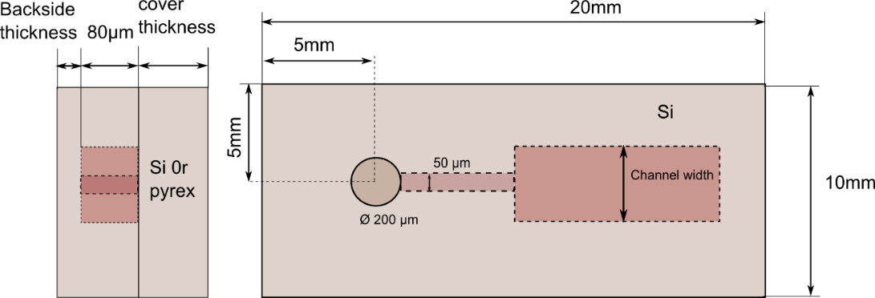
Observed with Si-Si bonded channels
Example of Si-Si bonded channel failure:
Break visible to the naked eye
P06_B12: Graph of pressure vs time, sharp decrease of pressure at failure
Si-Si bonded sample design
Repeatable pressure at rupture

Slide 17
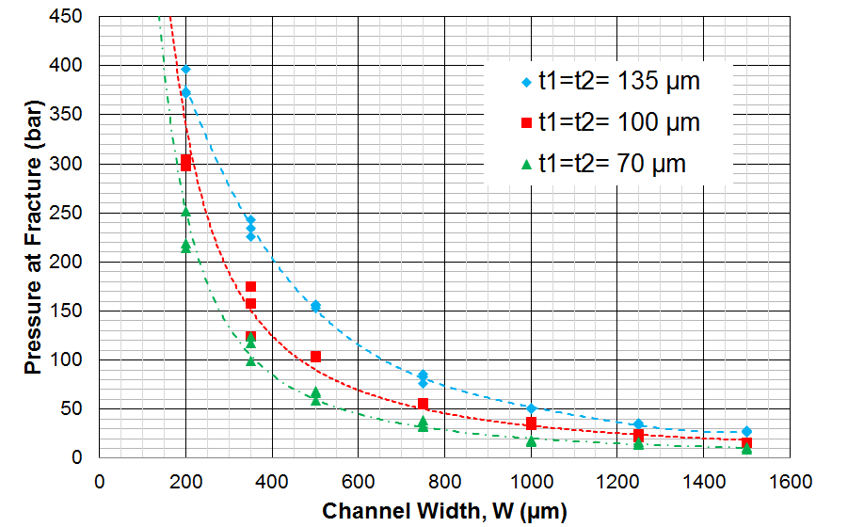
Failure in Silicon Cover

Slide 18
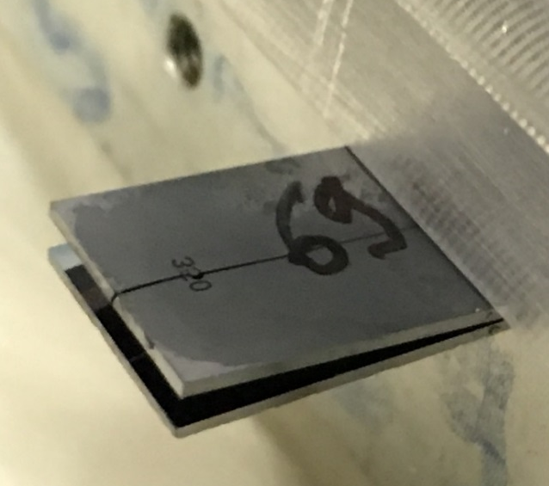
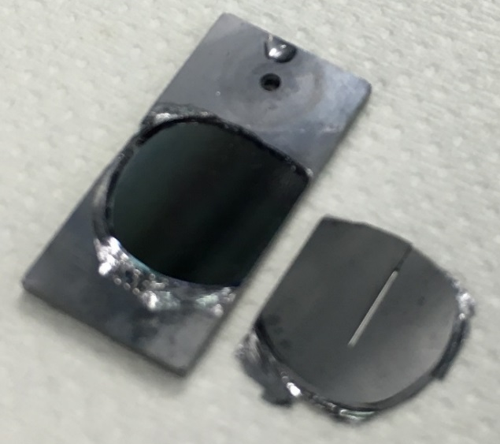
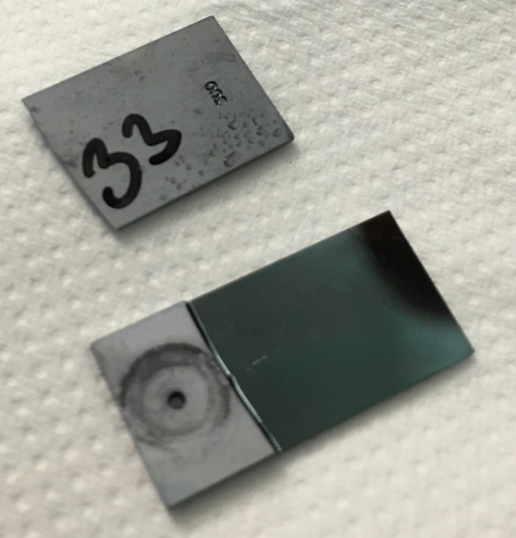
Experimental Results: Typical Failure Models
Interfacial Failure
  Clean surfaces observed after testing suggest poor wafer bonding

Slide 19
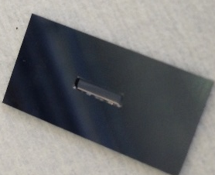
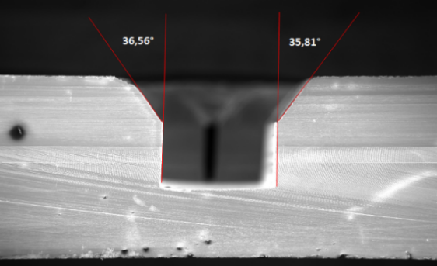
Experimental Results: Typical Failure Models
Silicon Failure
  Good bonding often results in the explosion of the channel cover

Slide 20
Results
Buried micro-channels:
  Challenging process
  Very good leakage and pressure resistance
Two types of channels:
  Longitudinal channels
  Transversal channels
Pressure test @250-300 bars

Slide 21
Pressure Samples Longitudinal
SINGLE: P_S_L_CX_W50
P1
W
W
RAMIFIED: P_R_L_CX_W50
W/#
of channels
P1
inlet
P1 = 25
W = 50; 100; 200; 350
trench
Buried channel
W/# of channels

Slide 22
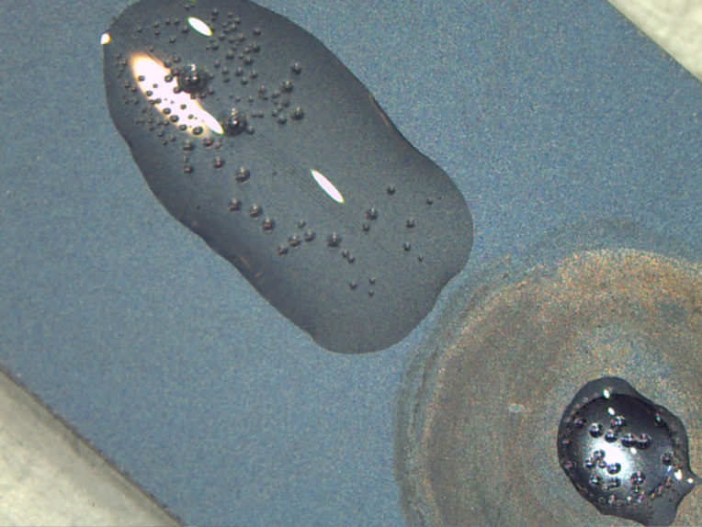
Failure in a Longitudinal Sample @ 236 bar

Slide 23
Pressure Samples Transversal
SINGLE: P_S_T_CX_W50
P1
W
RAMIFIED: P_R_T_CX_W50
W/# of channels
P1
P1 = 25
W = 50; 100; 200; 350

Slide 24
Failure in a Transversal Sample @ 300 bar
Transversal/Single/W=50, exploded at 335 bar

Slide 25
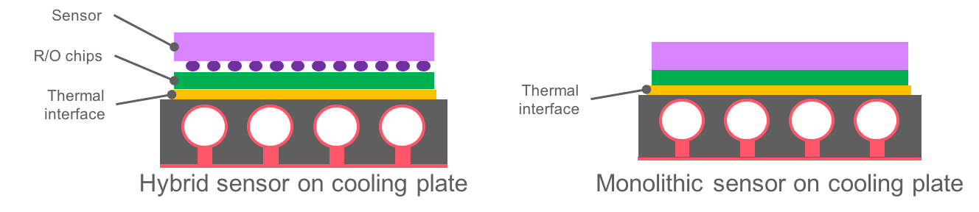

Monolithic Integration
If not CMOS compatible ➔ separate channel processing, with direct wafer bonding at the end
If CMOS compatible ➔ direct integration at the end of detector processing
Ultimate objective: monolithic bloc for the detector requiring minimum intervention once installed

Slide 26
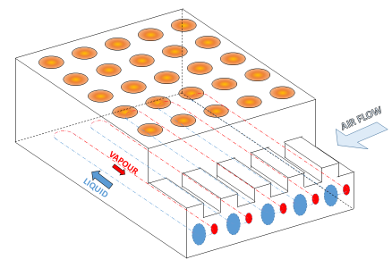
Full integration

Slide 27
Conclusion & Outlook
SCOPE OF AIDA-2020 to gather this knowledge and bring building blocks together
Thermal management represents a major challenge in HEP.
Continuous advances in micro-engineering have opened the door to the development of smaller and more efficient cooling devices capable of handling increasing power densities with a minimum mass penalty.
AIDA-2020 is bringing together a community to develop and study silicon microchannel cooling devices and low mass mechanical structures .
By 2019, a catalog of building blocks, design guidelines and standards for characterization and qualification of devices and systems for microchannel cooling (single phase and evaporative) will be available.
Long term objective:
    Fully understanding failure parameters and how to avoid failure
  Full-proof characterization and reliability protocol

Slide 28
The End
Thank you for your attention!

