Slide 1


New CERN CO₂ Test Facility for Mini- and Micro-channels
WP 9 - D9.1
AIDA Annual Meeting
Paris
Desiree Hellenschmidt, Paolo Petagna
EP-DT-FS
CERN, Geneva, Switzerland

Slide 2

OVERVIEW
Motivation
Approach
Test facility
Research plan
Conclusion

Slide 3
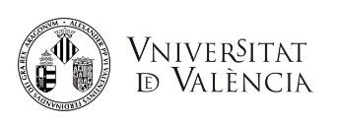

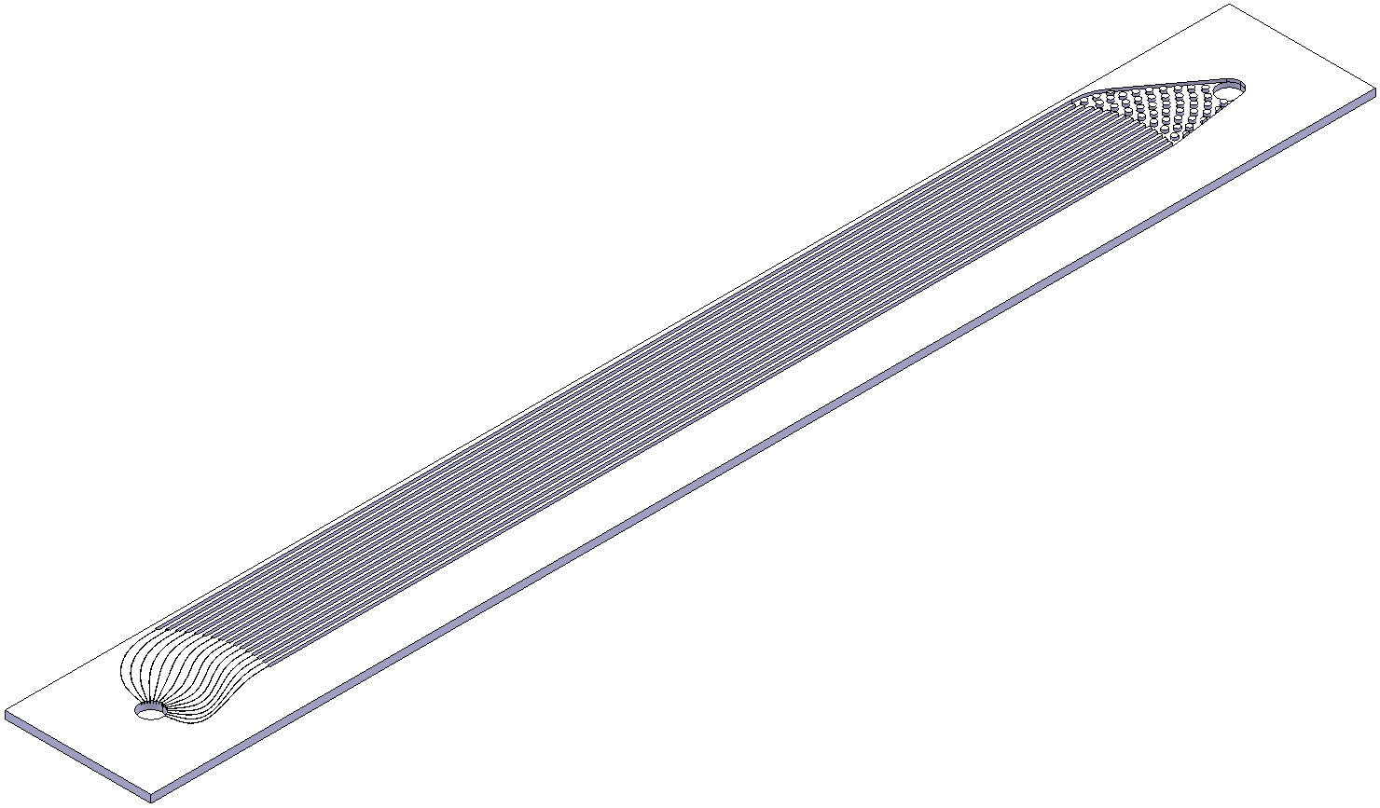
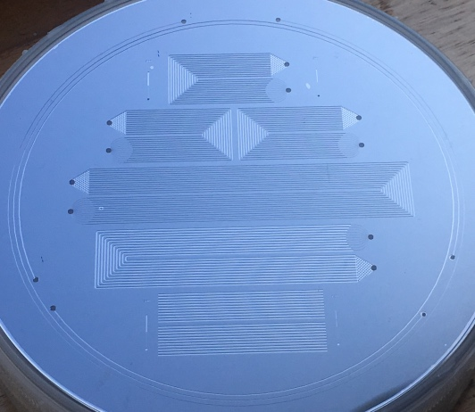

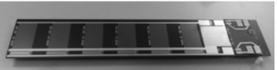

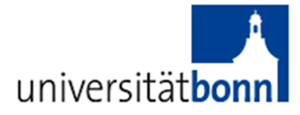
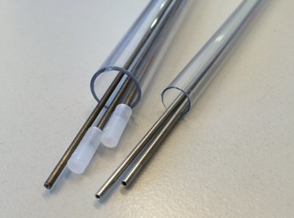
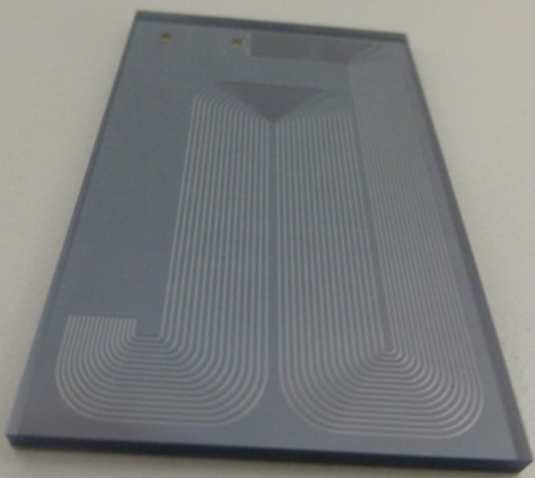
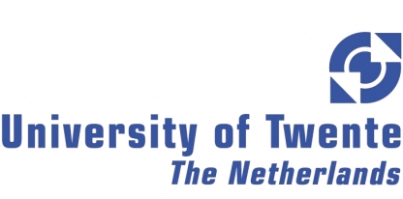
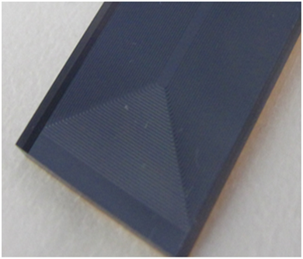
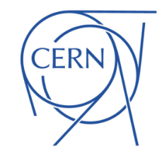
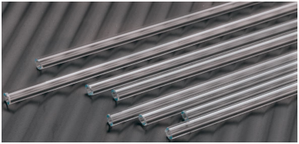
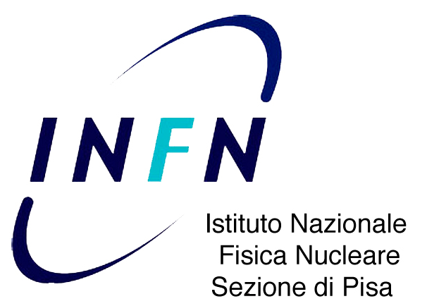

MOTIVATION
REQUIRED:
Internal standard to test
μ-channel cooling devices

Slide 4
MOTIVATION

Slide 5
MOTIVATION
MAIN OBJECTIVE:
Characterization of
thermal properties and
pressure drop behavior of
μ-channel cooling devices

Slide 6
APPROACH
Definition of common needs for the institutes
Resources available at CERN
Definition of the state-of-the-art test stand
active re-definition of a
high quality test stand
BALANCE
BALANCE
BALANCE

Slide 7
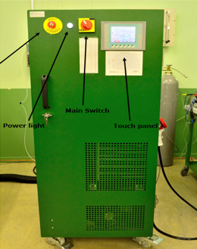

APPROACH
Common parameters of interest
mass flux
fluid pressure
fluid temperature
heat dissipation
pressure drop
Resources available at CERN
evaporative CO2 is the chosen refrigerant
Transportable Refrigeration Apparatus for CO2 Investigation = TRACI developed at CERN
  CO2 is an eco-friendly alternative
  mass flux is adjustable (by-passing)
  temperature range from ~ +20 to -25 ̊C
  CO2 is re-circulated
Fig. 1 CO₂ refrigeration apparatus at CERN

Slide 8
APPROACH
State-of-the-art test stand extended version
Parameters under test | Method
Fluid flow properties | DIRECT: Flow visualization with high speed camera
 | INDIRECT: Temperature & pressure sensors
Heat transfer | DIRECT: Temperature measurements in the flow and on surrounding equipment
 | INDIRECT: Heat transfer visualization with infrared camera
Pressure drop | Absolute & relative pressure transducers

Slide 9
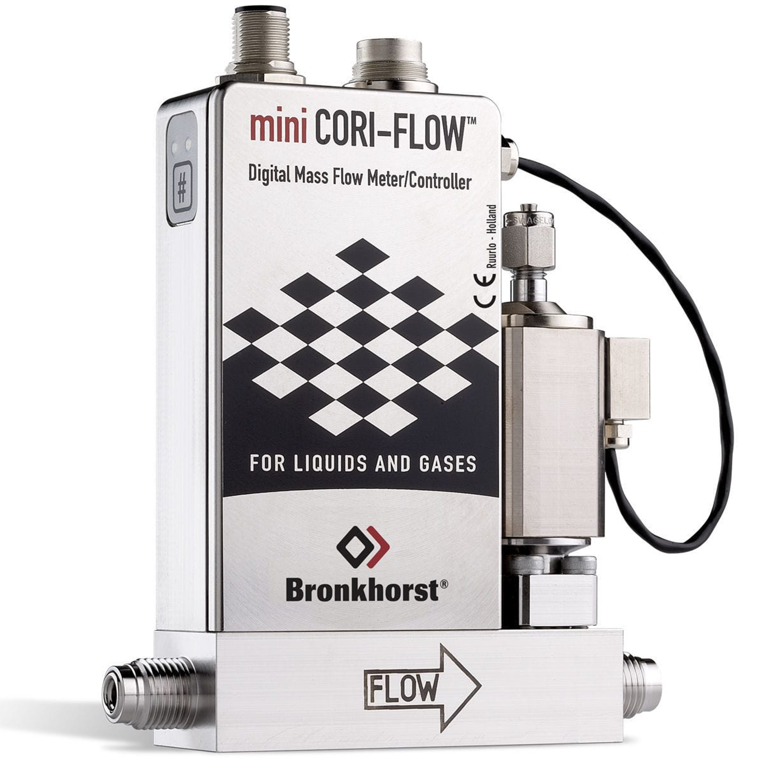
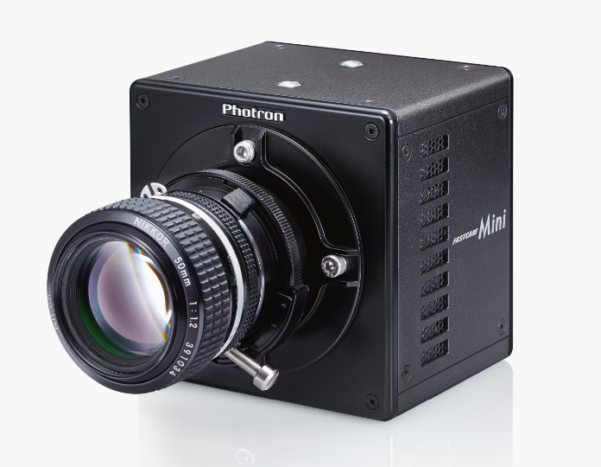

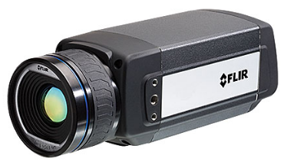
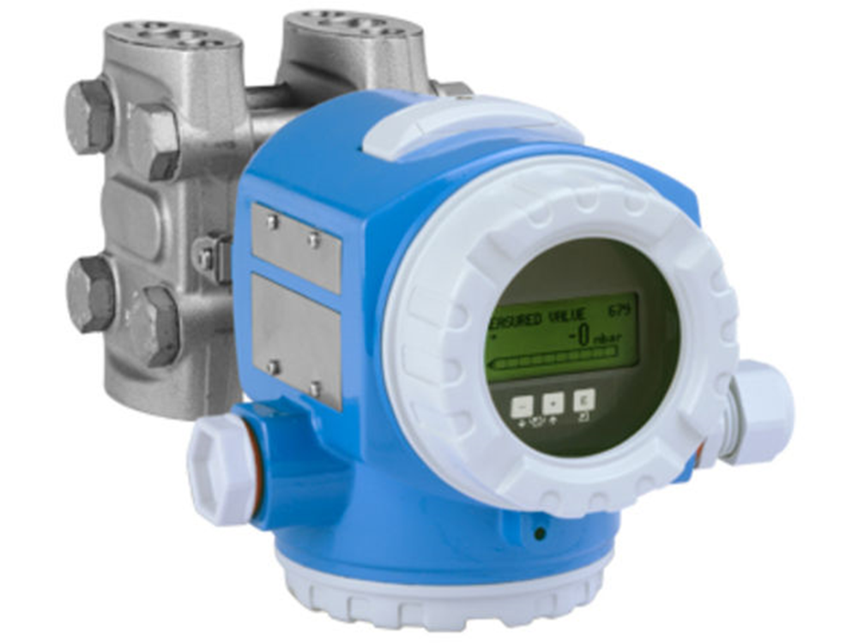
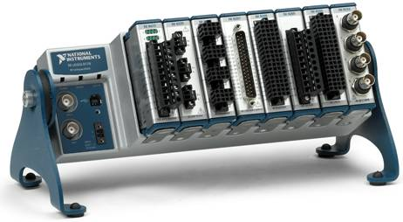
APPROACH
More controlled measurement surroundings are ensured by following components:
2-phase CO2
Transportable Refrigeration Apparatus for CO₂ Investigation
Vacuum vessel
Adiabatic test conditions for more accurate heat transfer measurements
P & T sensors
High precision measurements for pressure & heat transfer
Flow meter
Direct high precision measurement of the mass flow rate
High speed cam
IR Camera
Heat transfer visualization
Visualization of details on bubble dynamics
(100 000 fps)
+ Data acquisition

Slide 10
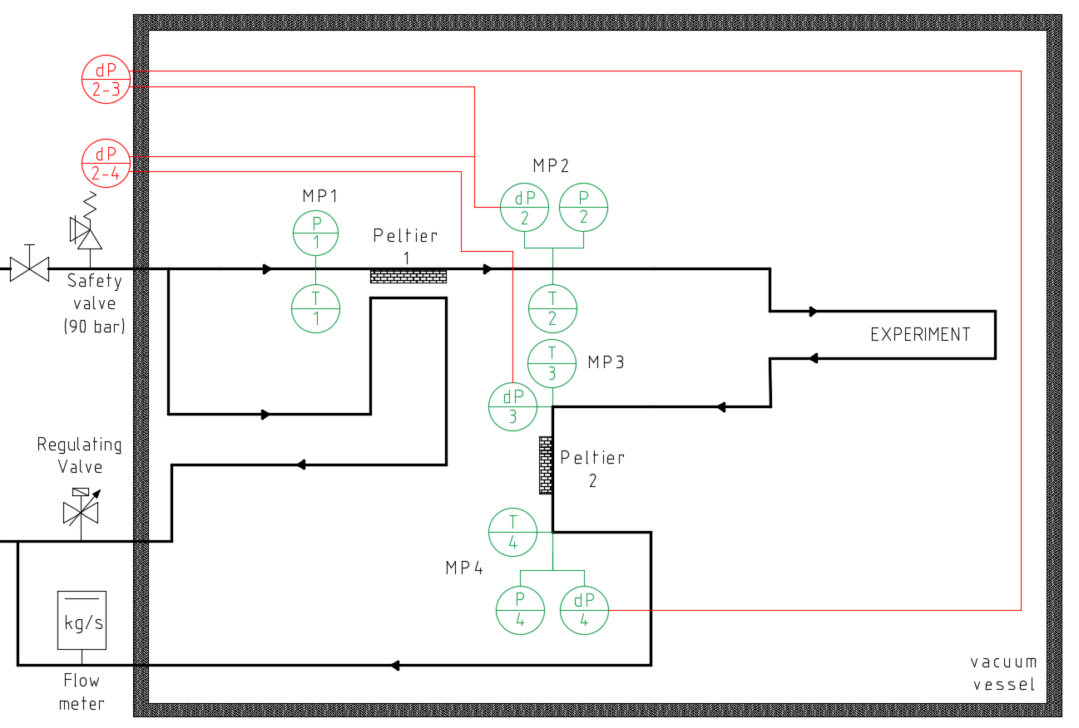
TEST FACILITY
pressure and temperature sensors before and after the experiment
( Measurement points = MP1 to MP4 )
CO₂
temperature
sensors
temperature sensors on the experiment
two Peltier elements
as pre- and
post-heater
Mock-up heater (Joule Heater)
Fig. 2 Schematic of the new CO₂ test facility

Slide 11
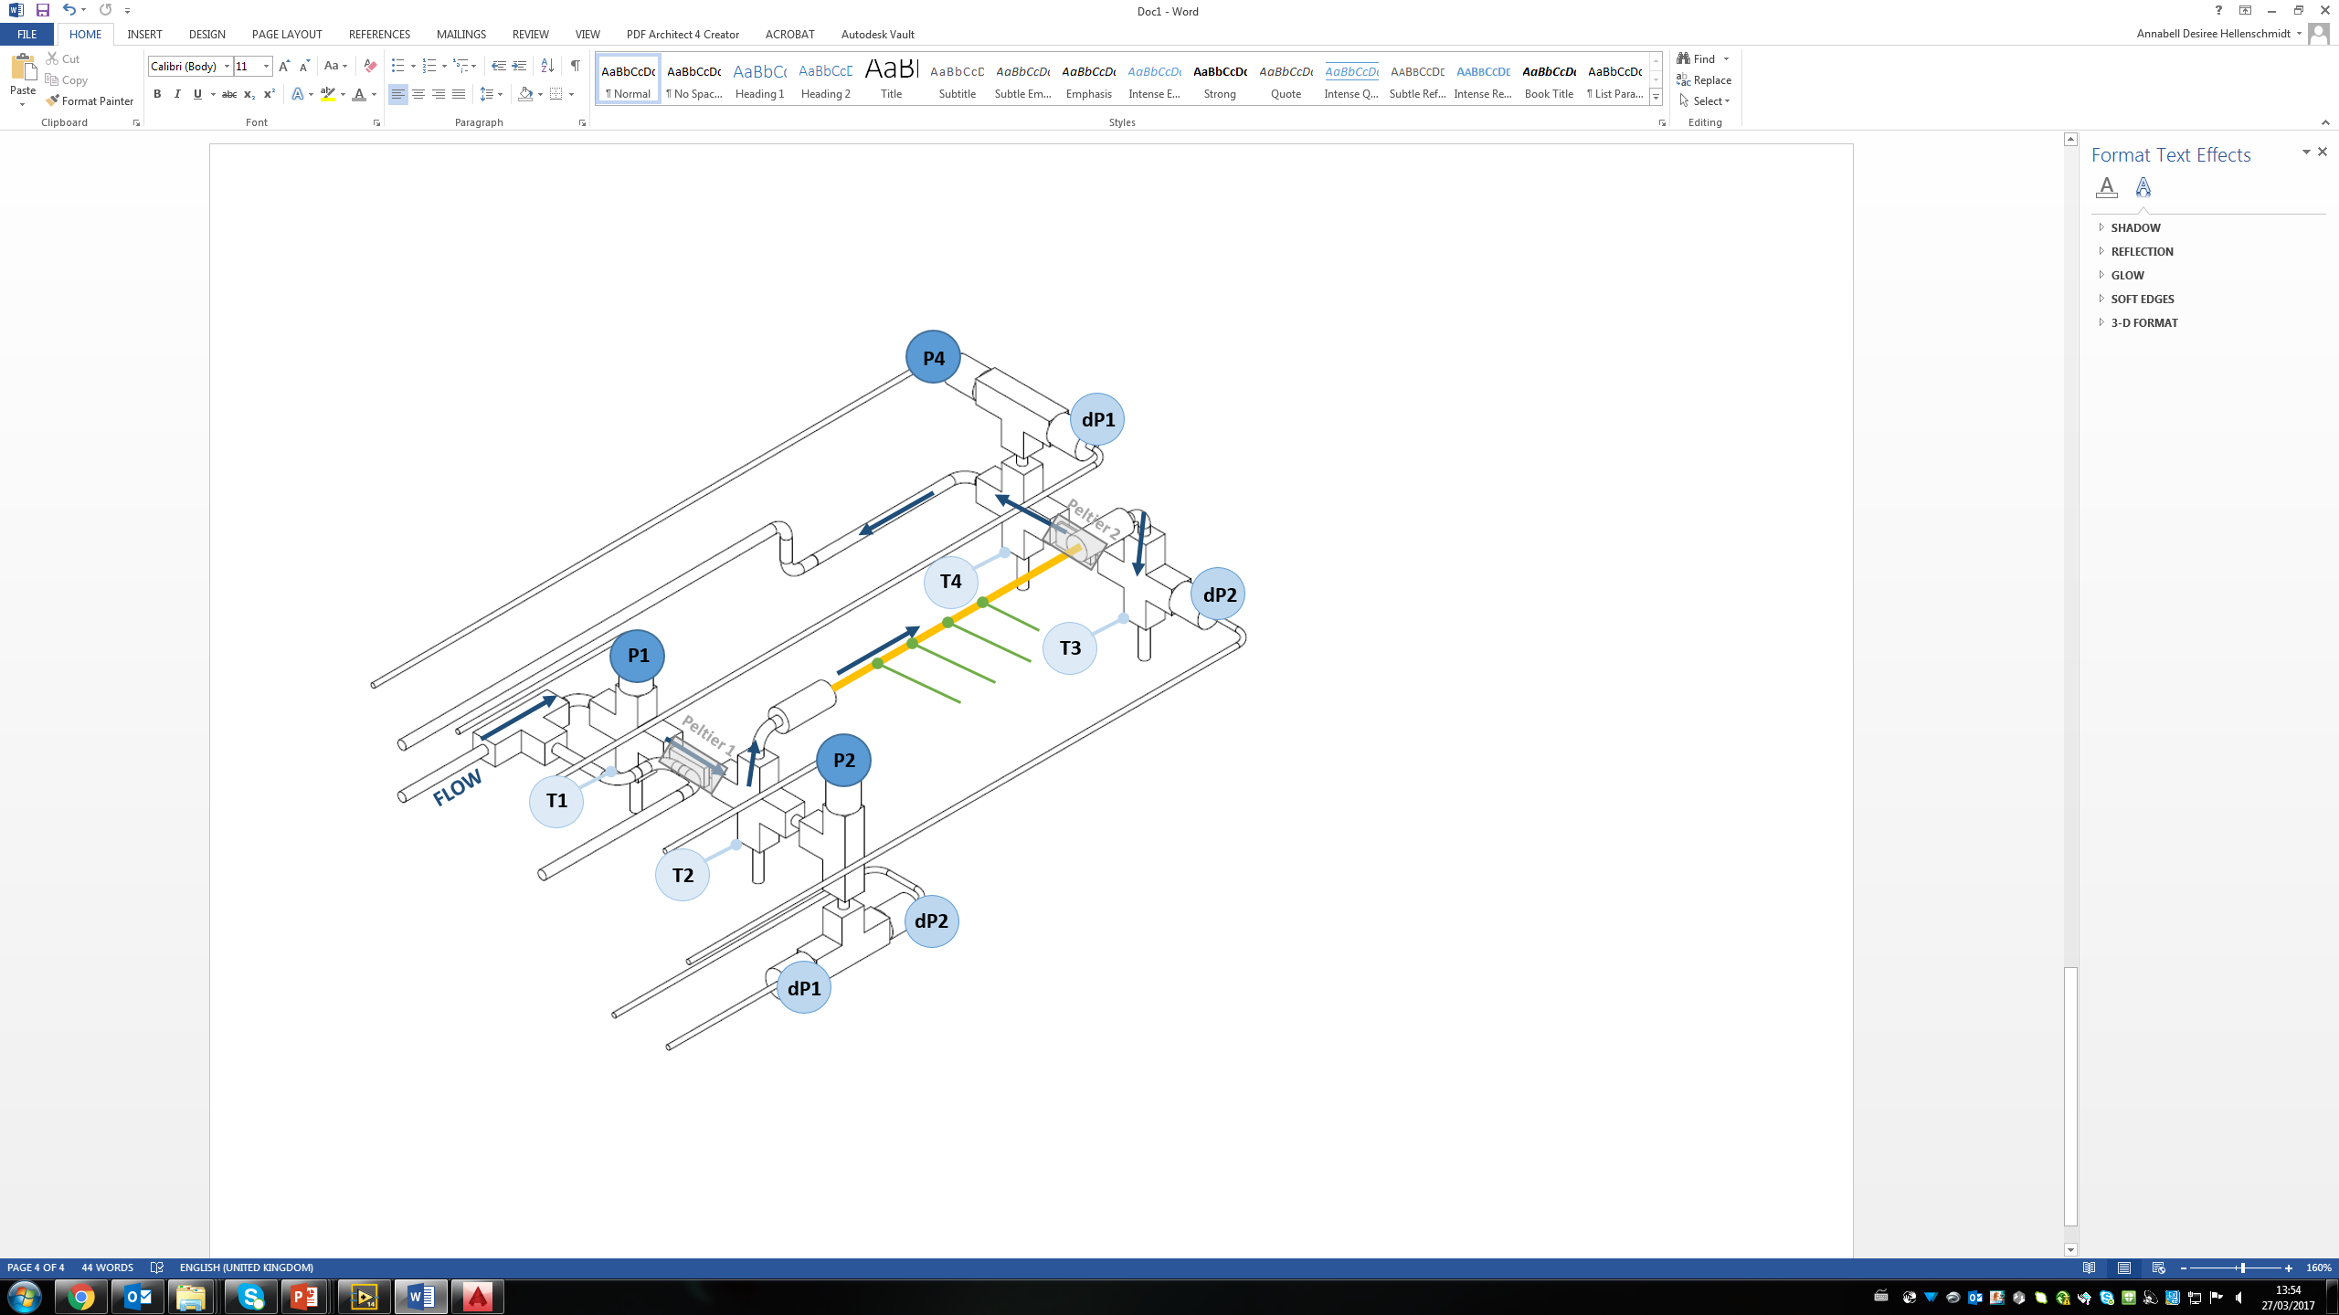
TEST FACILITY
pressure and temperature sensors before and after the experiment
( Measurement points = MP1 to MP4 )
MP4
MP3
MP1
temperature sensors on the experiment
MP2
two Peltier elements
as pre- and
post-heater
Mock-up heater (Joule Heater)
Fig. 3 Design of the new CO₂ test facility

Slide 12
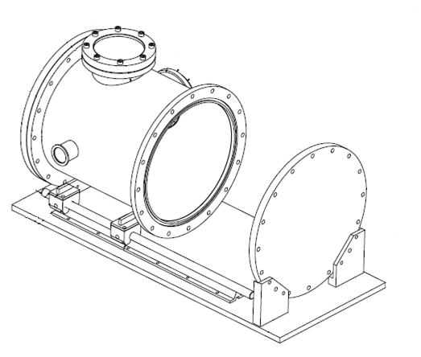
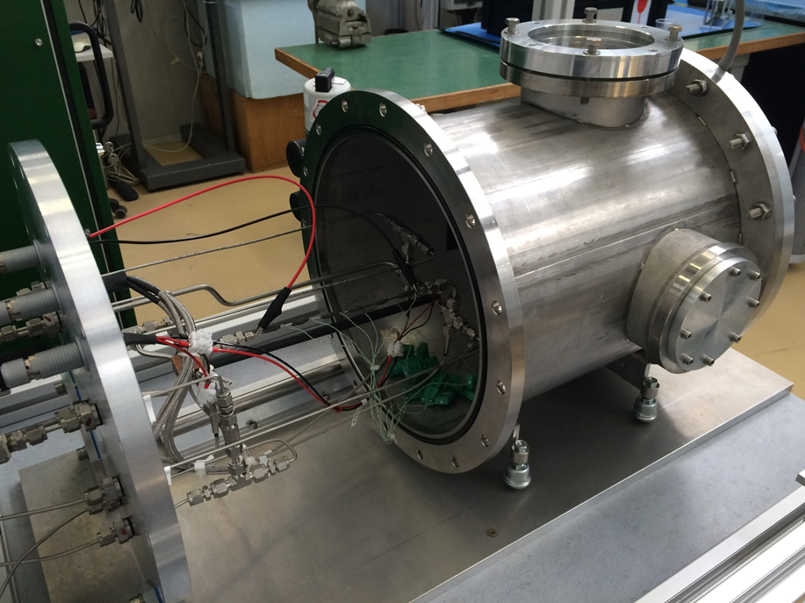
TEST FACILITY
Fig. 4 Schematic of the new CO₂ test facility with vacuum vessel
Fig. 5 Experiment section and vacuum vessel of the new CO₂ test facility

Slide 13

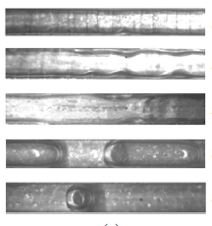
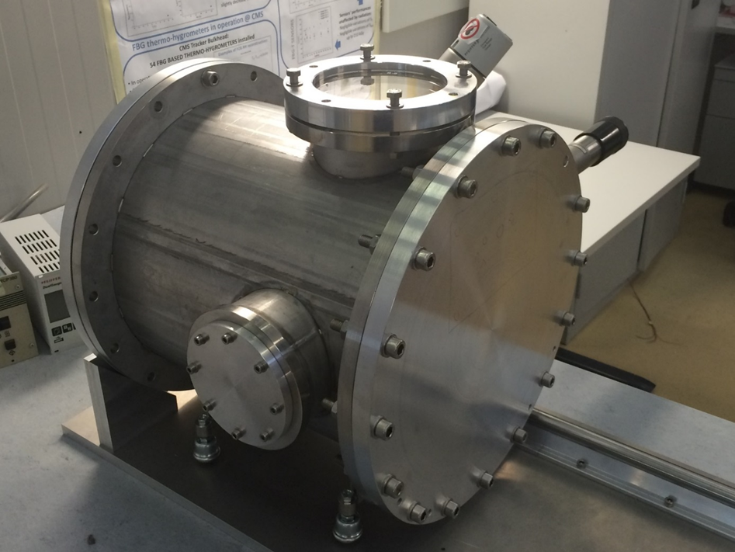
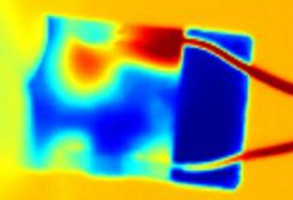

TEST FACILITY
HIGH SPEED
CAMERA
EXPERIMENT
INFRA-RED CAMERA
Fig. 6 Vacuum vessel of the new CO₂ test facility

Slide 14
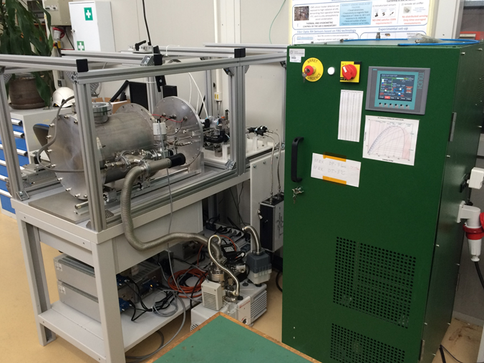
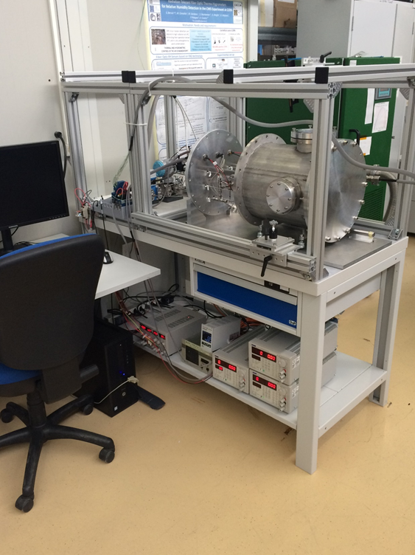
TEST FACILITY
Fig. 7 New test facility for evaporative CO₂ flow measurements in mini- and micro-channels (I)
Fig. 8 New test facility for evaporative CO₂ flow measurements in mini- and micro-channels (II)

Slide 15
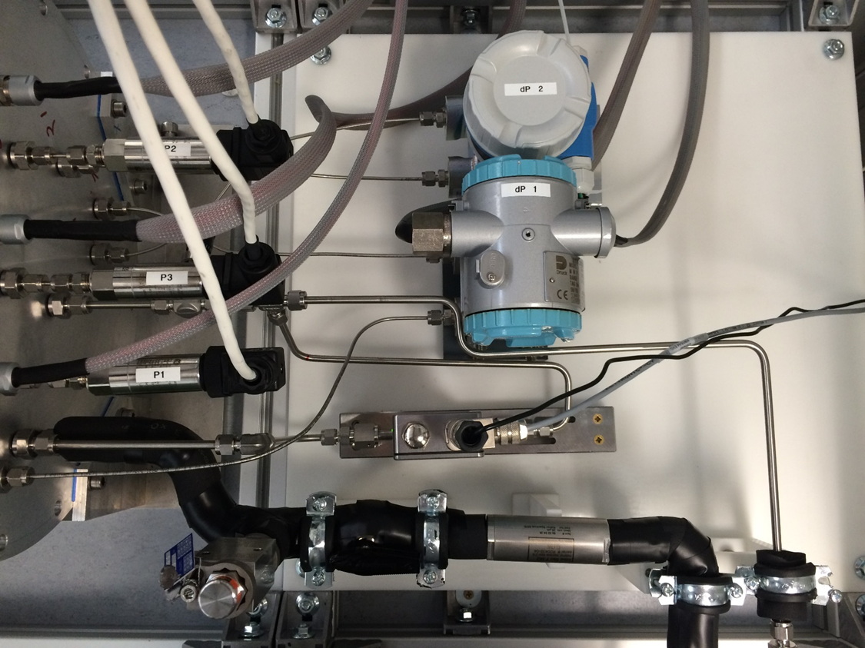
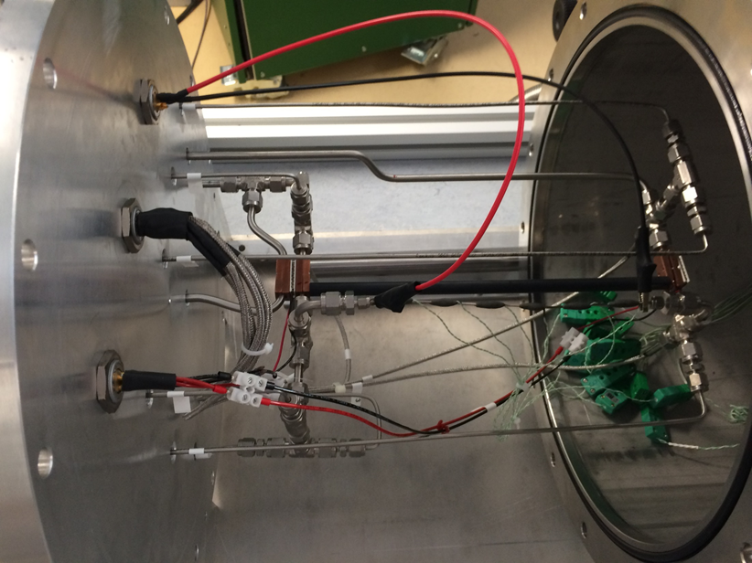
TEST FACILITY
Fig. 9 Differential & absolute pressure sensors and flow meter outside the vacuum vessel
Fig. 10 Experiment section within the vessel

Slide 16
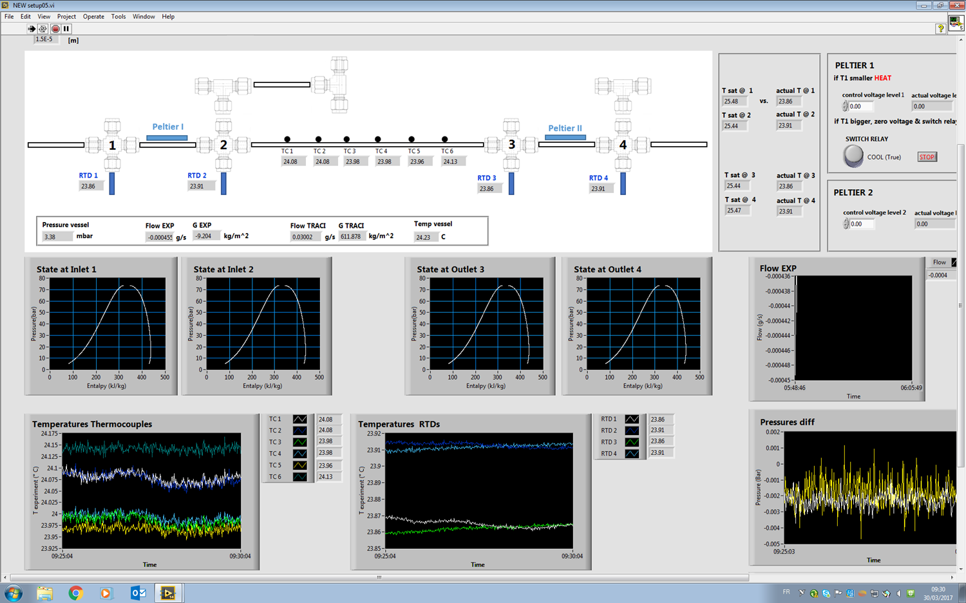
TEST FACILITY
DATA AQUISITION with LabVIEW®
experiment sensors
flow meter
vacuum level
temperature inside vacuum vessel
control of Peltier & Joule heater
online-evaluation of fluid state
acquisition in parallel with cameras possible
→ MATLAB® code for analysis

Slide 17
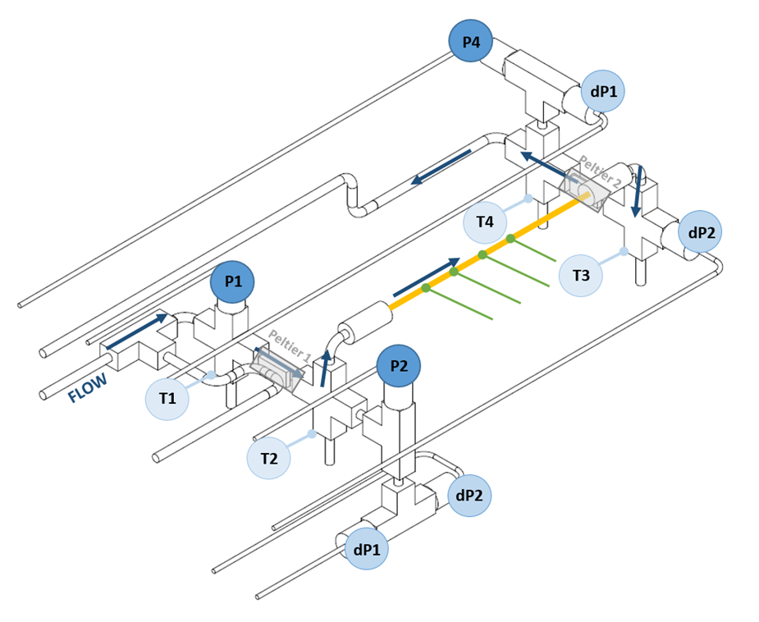
TEST FACILITY
SENSOR CHECK: Temperature
Δ = 0.3 ̊C

Slide 18
TEST FACILITY
SENSOR CHECK: Pressure
Δ = 0.3 bar
Δ = 0.005 bar

Slide 19

RESEARCH PLAN
GOALS for experimental research on evaporative flow of CO₂ in mini- and micro-channels at CERN:
Create a larger and reliable database for CO₂ pressure drops, heat transfer coefficient and flow patterns in mini- and micro-channels for model upgrades
Extend research towards negative fluid temperatures and micrometer sized channel diameters
Find and test a theoretical micro-channel definition

Slide 20
RESEARCH PLAN
STEP 1 : Test simple single channels / tubes (ID < 2 mm)
To address the complexity of the physical processes occurring in micro-channels and for their better understanding
STEP 2 : Test more complex channel geometries
To address the immediate need for micro-channel cooling in HEP experiments using the gathered insights and results from Step 1

Slide 21
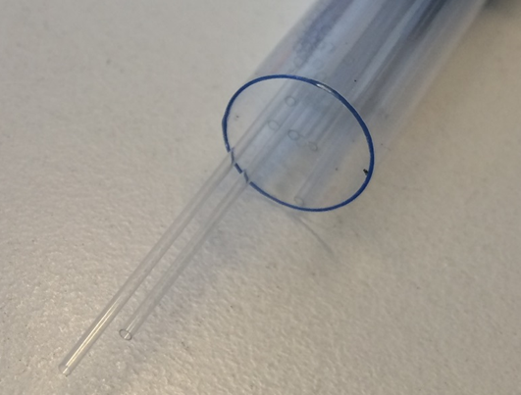
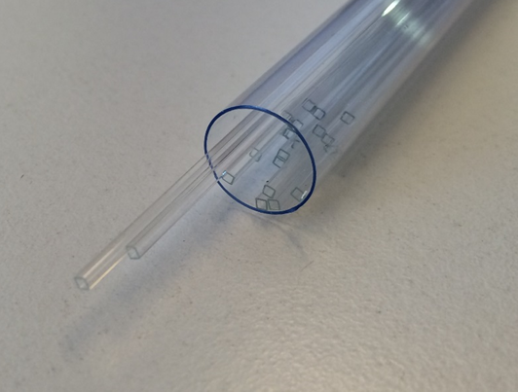
RESEARCH PLAN
STEP 1:
ROUND SINGLE CHANNELS
Stainless Steel |  |  | Glass (Borosilicate) |  |  | Titanium
ID [mm] | OD [mm] |  | ID [mm] | OD [mm] |  | ID [mm] | OD [mm]
0.13 | 1.58 |  | 0.1 | 0.17 |  | 0.3 | 1.58
0.25 | 1.58 |  | 0.15 | 0.25 |  | 0.5 | 1.58
0.5 | 1.58 |  | 0.2 | 0.33 |  | 0.8 | 1.58
0.75 | 1.58 |  | 0.3 | 0.4
1 | 1.58 |  | 0.5 | 0.7
1.5 | 3.175 |  | 0.7 | 0.87
2 | 3.175 |  | 0.8 | 1
 |  |  | 1 | 1.2
 |  |  | 1.5 | 1.8
 |  |  | 2 | 2.4
SQUARED SINGLE CHANNELS
Glass (Borosilicate)
inner cross-section [mm] |  |  | wall thickness [mm]
0.1 x 0.1 |  |  | 0.05
0.8 x 0.8 |  |  | 0.16
0.3 x 0.3 |  |  | 0.15
0.2 x 0.2 |  |  | 0.1
1.0 x 1.0 |  |  | 0.2
0.5 x 0.5 |  |  | 0.1
0.7 x 0.7 |  |  | 0.14

Slide 22
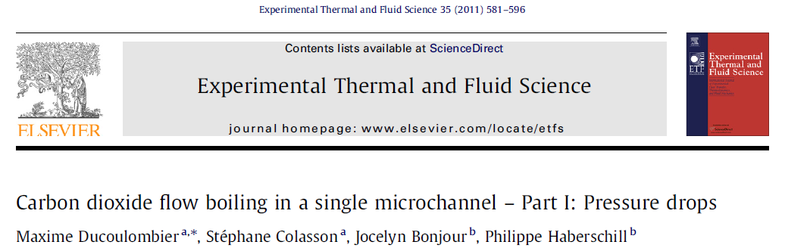
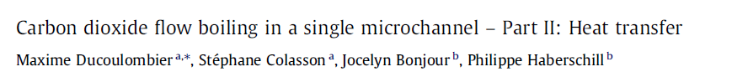
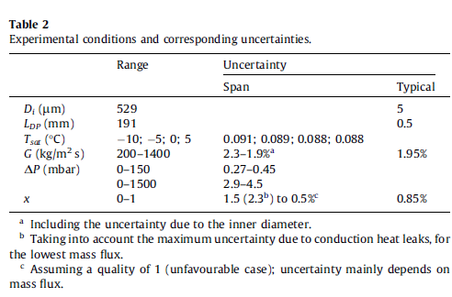

RESEARCH PLAN
RESEARCH PROPOSALS for STEP 1:
Micro-channel definition
based on the preliminary work of Y. Moussy
a possible definition was found
by means of the bubble departure diameter
$${Def}_{μ}= ℱ (G, Δp, T…)$$
?
VALIDATION
PENDING
VALIDATION
PENDING

Slide 23

CONCLUSION
Internal setup to test μ-channel cooling devices is completed
Uncertainty level of the experiments can be limited
Test stand allows for a wide temperature range
CO2 is an eco-friendly alternative to other refrigerants
Component test finished
Research program launched for first tests

Slide 24
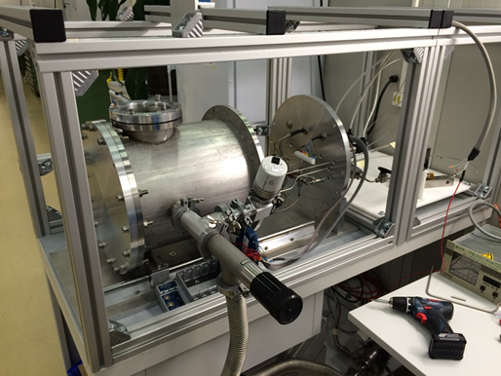
OUTLOOK
Control the new setup for flow of evaporative CO₂ in μ-channels
Carry out measurements
Compare results with literature
Use findings for better understanding of the physical behaviour of the flow in μ-channels

Slide 25
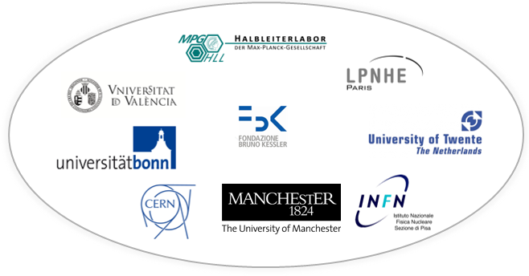
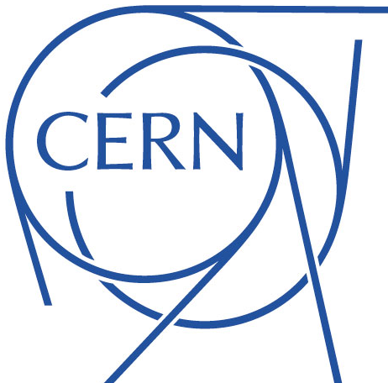
...
…g blue
Notes:
Invitation for all AIDA members to come to Cern and do their testing!

