Slide 1
WP9 (NA8) PARALLEL MEETING
AOB:
(Apr 4th 2017)
Brief news from other labs
Status of Milestones and Deliverables
Paolo Petagna (CERN)

Slide 2
News from other labs:
PISA (F. Bosi)
1. Setup of a refrigerator closed circuit unit for CO2 production
2. Experimental setup for CO2 boiling study in microchannel diam hy. 500-300-200 mm
3. Prototype realization of hydraulic interface in peek material for carbon fiber microchannel ( structure section700 mmx700 mm, diam hy 300 mm)

Slide 3
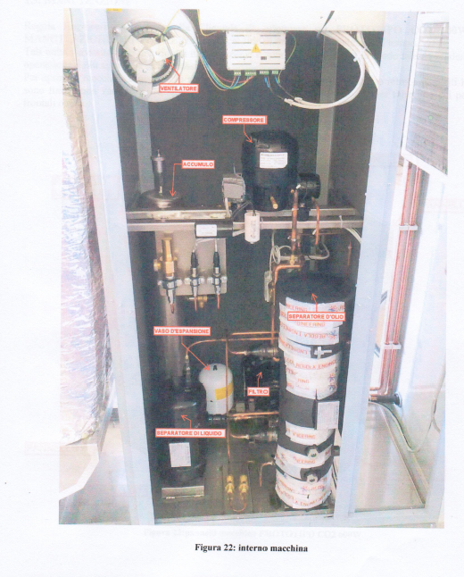
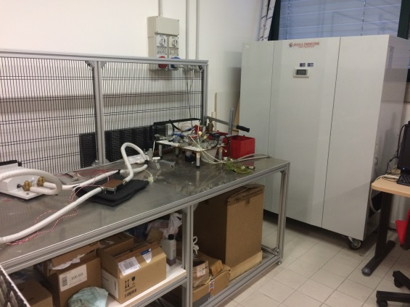
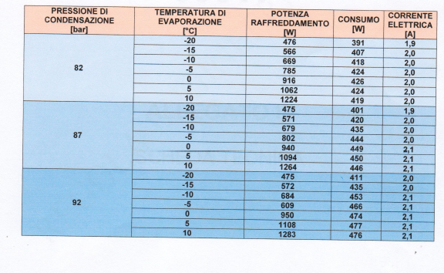
News from other labs:
PISA (F. Bosi)
CO₂ Production UNIT (closed circuit)
Refrigerator Unit tested in December.
Actually not running for problem on the PLC control of thermostatic valve.
Repairing operation planned at end April.

Slide 4
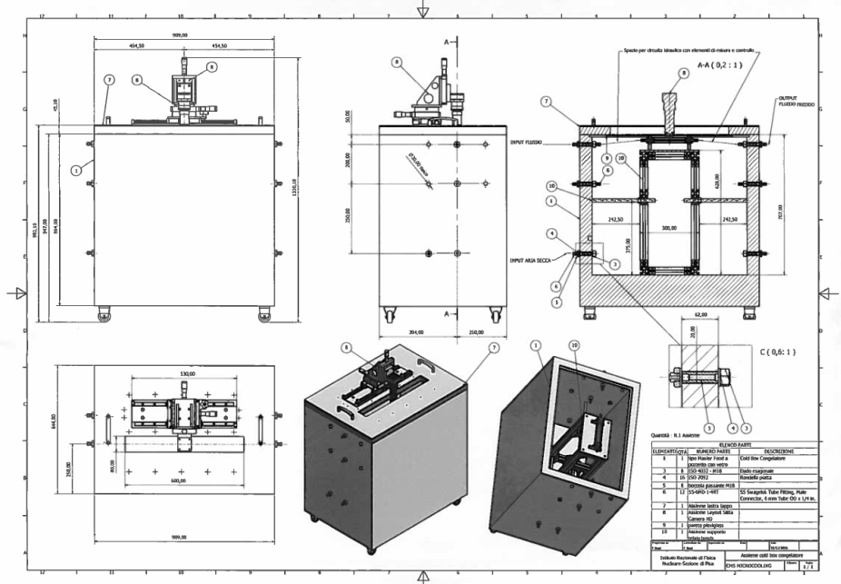
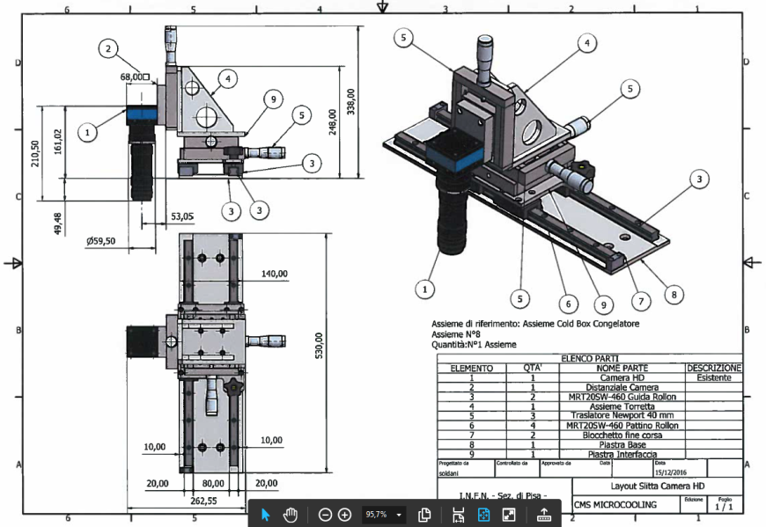
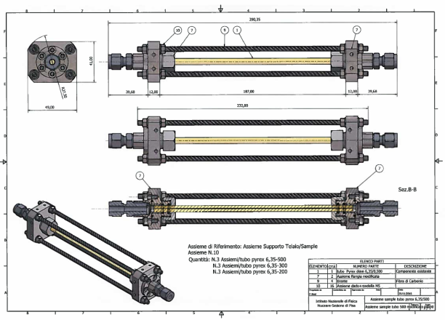
News from other labs:
PISA (F. Bosi)
Experimental setup boiling study
Actually in production, ready in April.
Study on pyrex tube with the same hydraulic diameter of the carbon fiber microchannel tube.

Slide 5
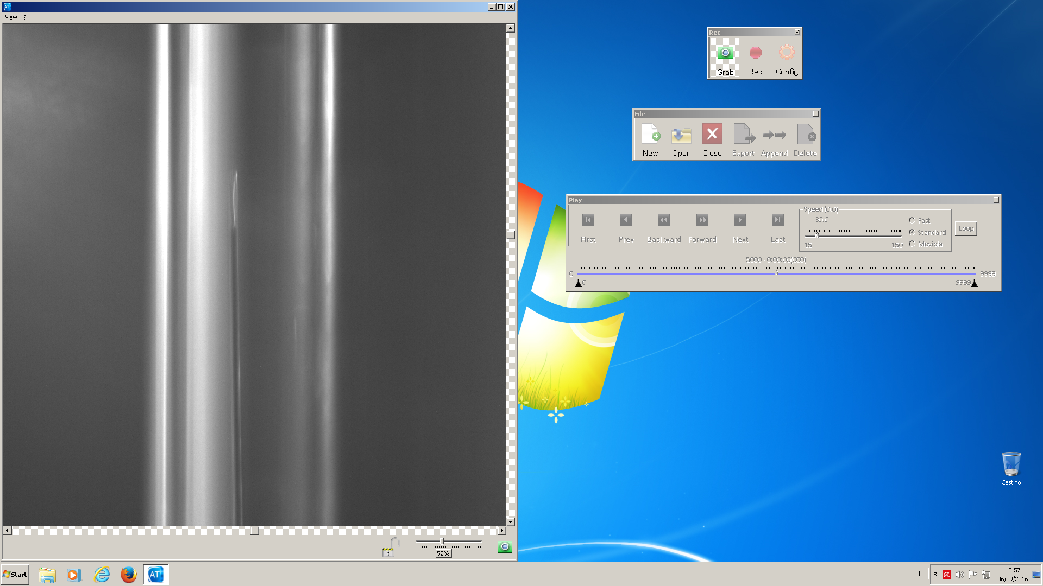
News from other labs:
PISA (F. Bosi)
Recording system setup for nucleation study
Microchannel in a Pyrex rod, hydraulic diam. 500 μm. For demonstration purposes, inside a wire of 25 μm as seen by the high resolution camera system able to record and stores dynamically for 40 sec the fluid flow .

Slide 6
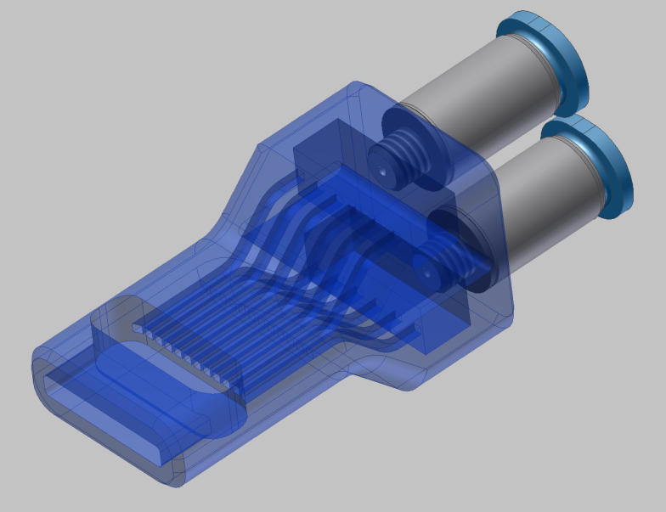
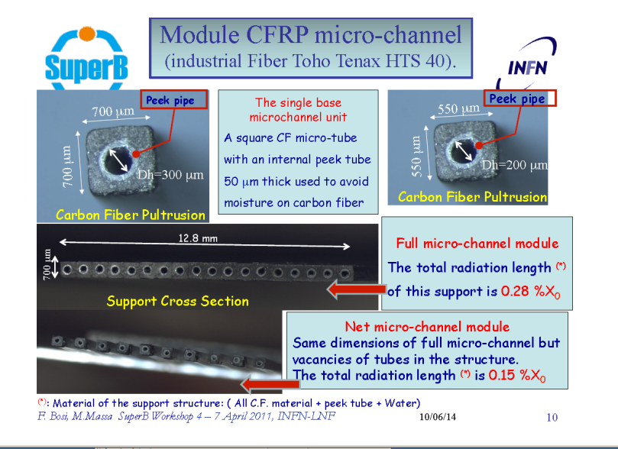
News from other labs:
PISA (F. Bosi)
Hydraulic interface (manifold)
First prototypes 3D printing in PEEK material of manifold suitable for microchannel carbon fiber structure not good due to the extreme miniaturization.
Used a special noozle of about 160 micron in diameter but problem during the melting process
In progress further test and prototypes

Slide 7
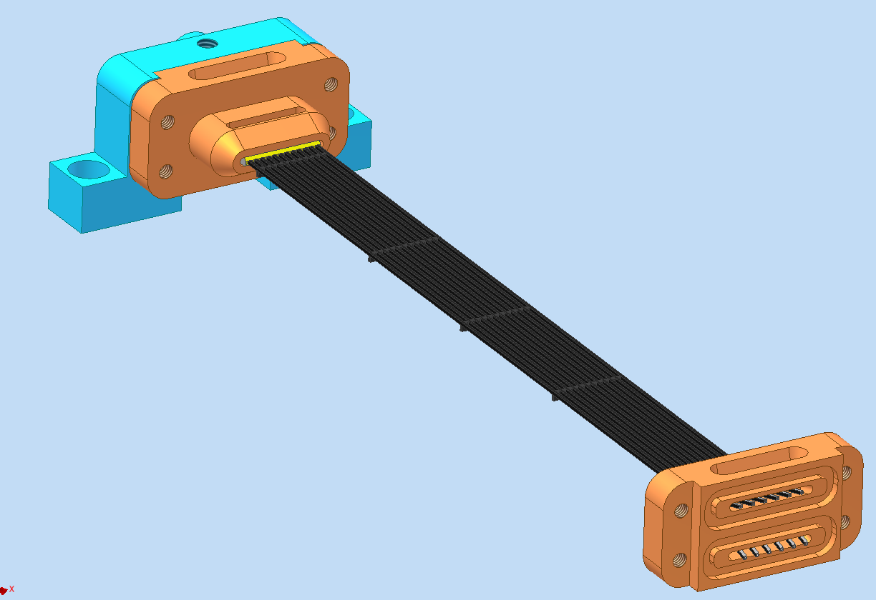

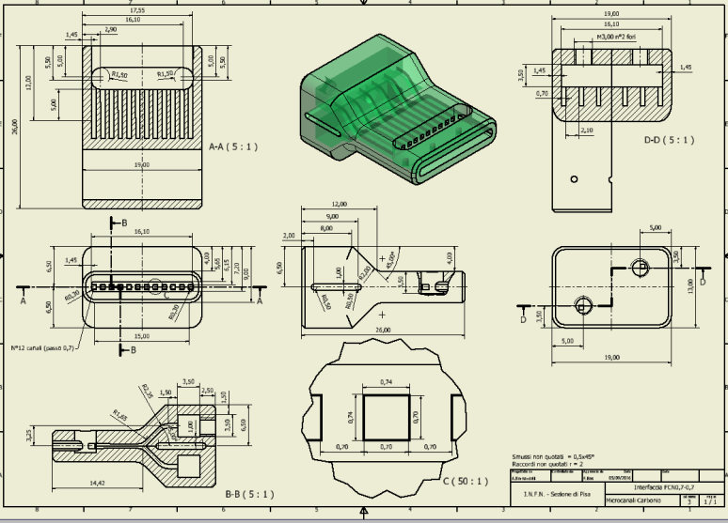
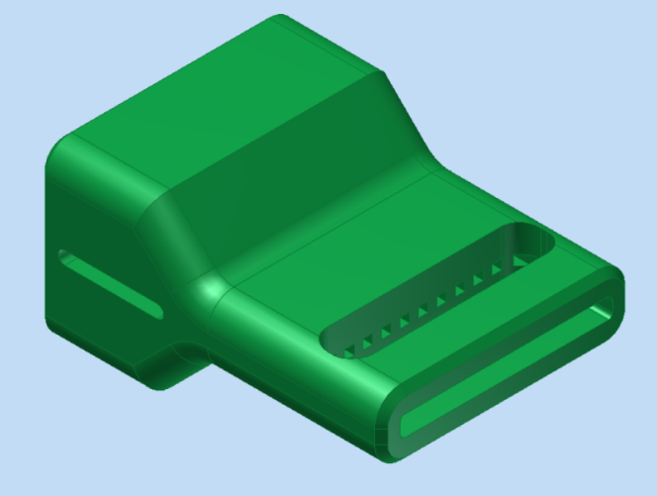
News from other labs:
PISA (F. Bosi)
Hydraulic interface (manifold)

Slide 8
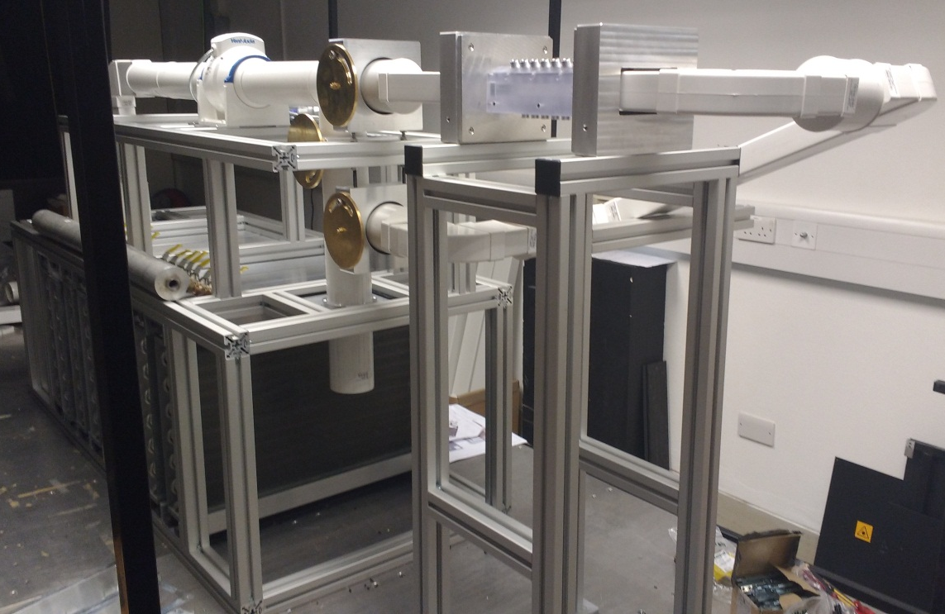
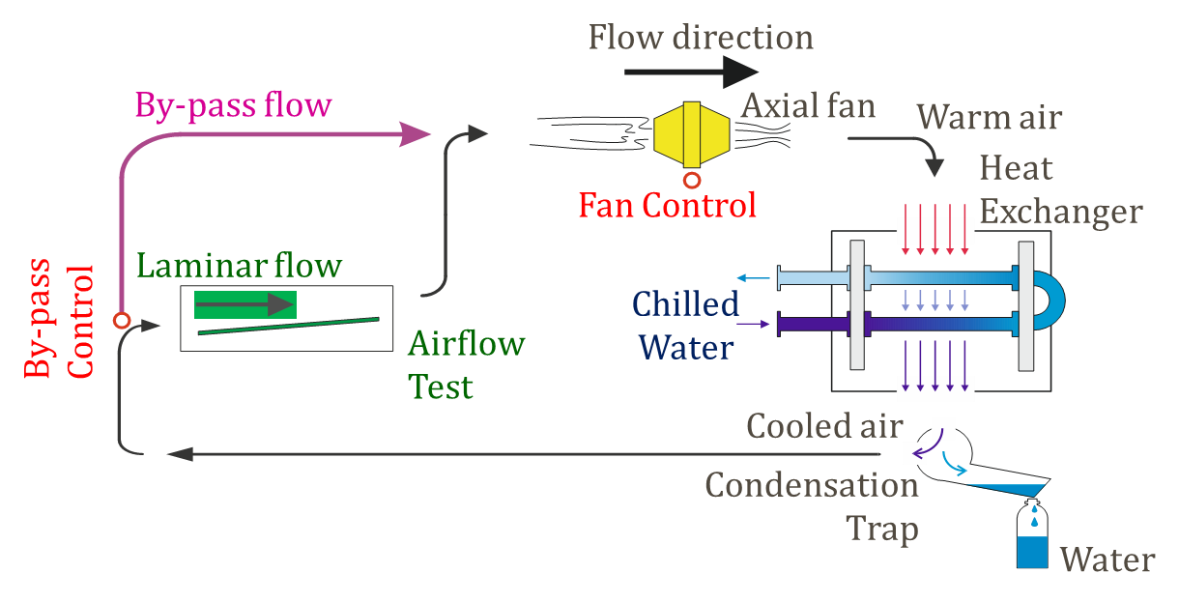
News from other labs:
OXFORD (G. Viehhauser, P. Coe)
Air flow cooling setup
Good progress with air cooling rig: commissioning to start in April
Confirmed funding from UK funding agencies (total 205k£) for:
Medium sized (for up to 1.5m long objects) climate chamber
8-line Frequency Scanning Interferometer for precision distance measurements
Large optical table

Slide 9
WP9: Status of Milestones and Deliverables
T 9.2 Milestones
T 9.2 Deliverables
 | Milestone Description | Beneficiary | Due Date | Verification
MS 24 | CFD models available (Preliminary models to be used for thermofluidics simulations implemented in the available software and ready to launch comparison with experimental results) | CERN | Jun 2016 | Agenda, attendance list on Indico
MS 77 | Standard connectors available (Engineered design of a family of miniaturized connectors suited for both testing and final applications. Order for procurement submitted) | CERN | Mar 2018 | Purchase order submitted
MS 82 | Validated CFD models ready (Advanced models, based on subsequent improvements of the preliminary definition provided in MS24 , validated for use and ready for final phase of comparison with experimental results) | CERN | Apr 2018 | Report to St Com
Next deadlines coming
 | Deliverable Description | Beneficiary | Due Date | Type
D 9.1 | Station for tests on μ-channel test devices Fully engineered design of a test station available to partners, including detailed list of instruments and components, and manual of operation. One prototype test station built and in use for tests | CERN | Oct 2017 | Other
D 9.2 | μ-channel prototypes μ-channel cooling devices in Si-Si and Si-Glass available to the partners for execution of the agreed test programme, including final model validation. Specifications, geometries and features previously agreed by the partners | CSIC | Oct 2017 | Demonstrator
D 9.3 | Technology recommendations for μ-channel cooling Report detailing the state-of-the-art technologies selected for the production process of μ-channel cooling devices to be installed in future HEP experiments | CERN | Feb 2019 | Report
D 9.4 | Qualification and characterisation of μ-channel cooling Report detailing the standardized procedures endorsed to qualify and characterise μ-channel cooling devices to be installed in future HEP experiments | CNRS | Feb 2019 | Report

Slide 10
WP9: Status of Milestones and Deliverables
T 9.3 Milestones
T 9.3 Deliverables
 | Milestone Description | Beneficiary | Due Date | Verification
MS 8 | Advanced Mechanical Distributed facility requirements (Report outlining the range of measurement setups and their capabilities to be installed within the Advanced Mechanical Distributed Facility) | UOXF | Jan 2016 | Agenda, attendance list on Indico
MS 99 | Advanced Mechanical Distributed facility ready (Report listing experimental setups within the Facility, and their performance as demonstrated with realistic prototypes) | UOXF | Feb 2019 | Report to St Com
Report in preparation
 | Deliverable Description | Beneficiary | Due Date | Type
D 9.5 | Advanced Mechanical facility Definition of facility requirements: Identification of parameters characterizing the performance of support structures and identification of experimental techniques which make these parameters accessible, prioritization of the need by the international community for these measurements at a central facility | UOXF | Jun 2016 | Other
D 9.6 | Common test structures Identification of test structure designs which allow discriminating measurements of relevant structural performance parameter, prediction of performance by FEA, production of test structures and benchmarking results of these structures with the facility | CSIC | Apr 2017 | Other
D 9.7 | Standard procedures for qualification and characterisation Setup of measurement facilities, operation of the facility, evaluation of measurement hardware and procedures, development of definition of standard measurement procedures at the Advanced Mechanical facility | UOXF | Feb 2019 | Report

