Slide 1

Brunel University London
WP14 (Task 14.2) Contributions
Prof Peter Hobson, Dr David Smith
5 April 2017

Slide 2
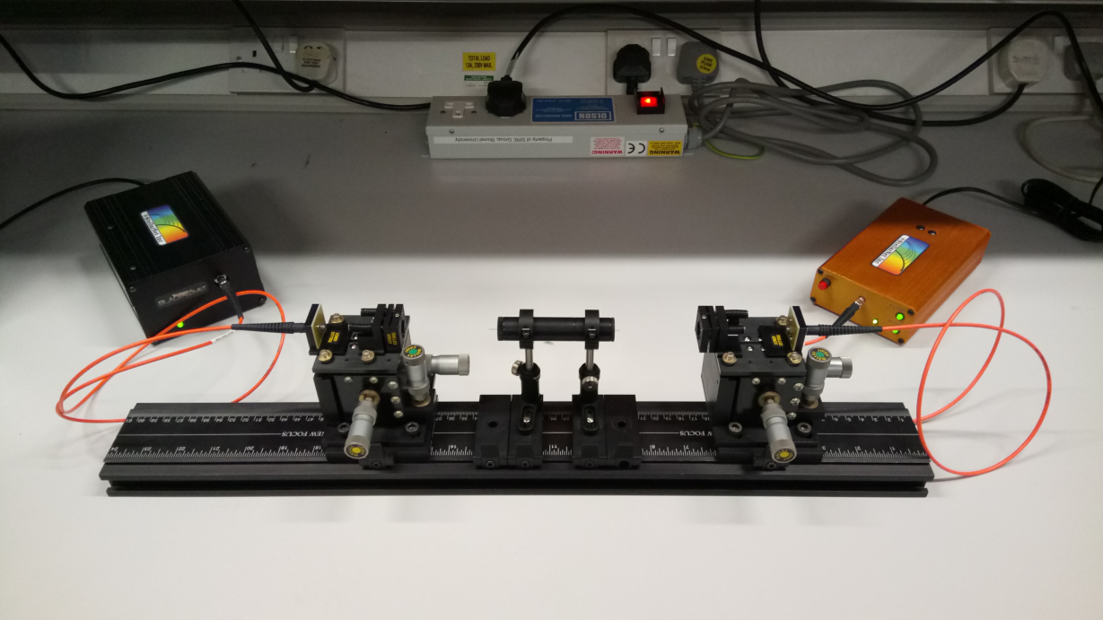
Fibre test bench hardware
Use of StellarNet spectrometer and light source with test fibre:
  Black Comet Spectrometer (190 nm - 850 nm)
  Combined deuterium and tungsten halogen light source (190 nm - 1100 nm)
  Thorlabs silica core, 200 μm diameter, 0.22 NA fibre (fibre type FG200UEA)
spectrometer
light source
test fibre holder

Slide 3
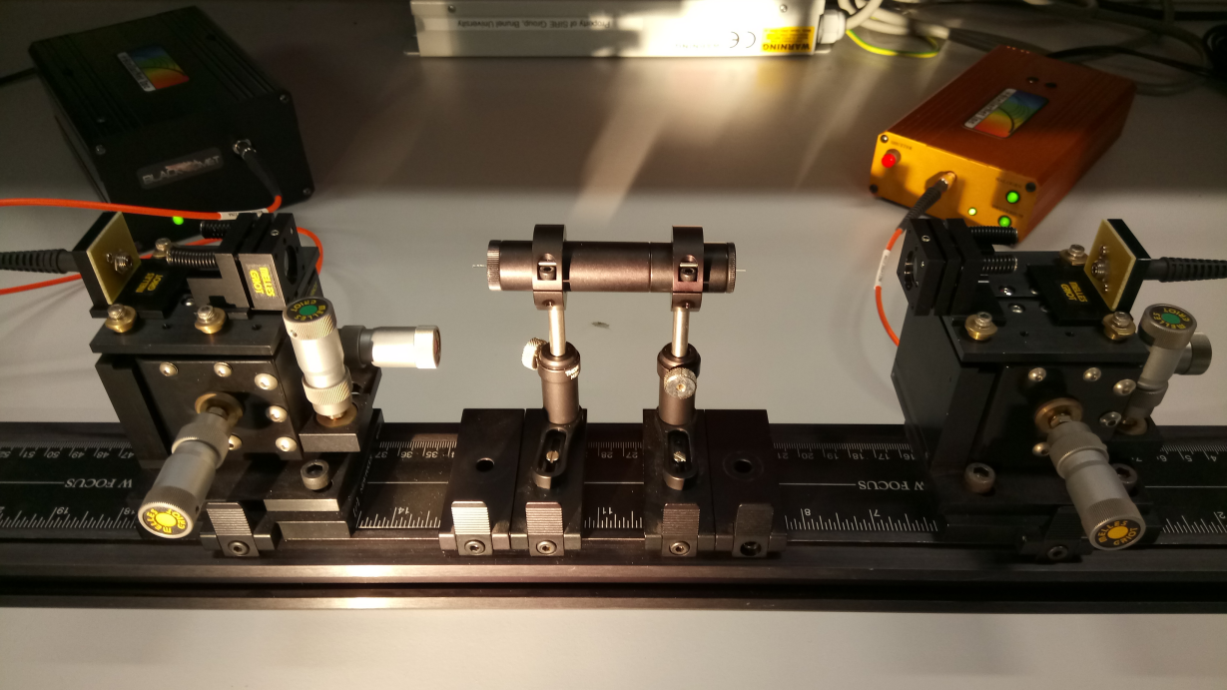
Fibre test bench hardware

Slide 4
Fibre test bench operation
The test bench set up in ‘focused mode’:
  ThorLabs LB4003 UV fused silica bi-convex lenses with 12.7 mm diameter and 30.0 mm focal length each lens being positioned at 2× focal length distance (i.e. 60.0 mm) from the end of the test fibre (fused silica chosen for its gamma radiation tolerance)
  ZEMAX OpticStudio software used to simulate path of photons using non-sequential ray-tracing and circular symmetry about the axis of the test fibre
  Test fibre shown is a 100 mm long, 2 mm diameter quartz rod matching the reference standard rod provided to Brunel as part of the AIDA-2020 project for testing
(Note that the y-axis of the figure has been stretched)
lens 1
lens 2
test fibre
photon direction

Slide 5
Initial fibre characterisation
Three sample fibres tested using the system:
  100 mm long, 1 mm diameter cerium doped quartz fibre
  140 mm long, 1×1 mm square cross-section cerium doped YAG fibre
  100 mm long, 2 mm diameter quartz reference fibre (UQG Optics Ltd, Cambridge)
Data collection settings:
  Integration time of 400 ms
  Average of 16 spectra collected
  Light source spectra background subtracted
raw spectra obtained from light source

Slide 6
Cerium doped quartz
(Note that the three ‘spikes’ in the background signal are fixed pattern noise from the spectrometer)
dark frame

Slide 7
Cerium doped YAG
(Note that the ‘bump’ in the background signal level is due to the longer fibre channelling ambient light)
dark frame

Slide 8
Quartz reference
(Note that the background signal level increased due to increased ambient light level)
dark frame

Slide 9
Summary
A fibre test bench has been commissioned and demonstrated to successfully allow the focusing of light through a test fibre and resulting spectra to be obtained
Further optimisation of the test bench with regard to the positioning of the lenses and test fibre holder can be carried out to greatly enhance the signal to noise in the collected spectra
Ambient light will be absent during data collection under irradiation as the Brunel shielded ⁶⁰Co irradiation cell is completely dark
The test bench is portable and can be used in other radiation facilities for real-time monitoring of test fibres during irradiation (a pair of 20 m long FG200UEA fibres can be used to operate the system remotely)
The system can be adapted to provide specific fluorescence excitation of scintillating or WLS fibres
Testing in Brunel shielded ⁶⁰Co irradiation cell planned for late April/May

