Slide 1


Gain Stabilization
Of SiPMs
Task 14.2.2
J. Cvach¹, G. Eigen², J. Kvasnicka¹, I. Polak¹, A. Træet², J. Zalieckas²
¹Institute of Physics of the ASCR, Czech Republic
²University of Bergen, Norway
Second annual AIDA 2020 meeting
Paris, 4-7 April 2017

Slide 2
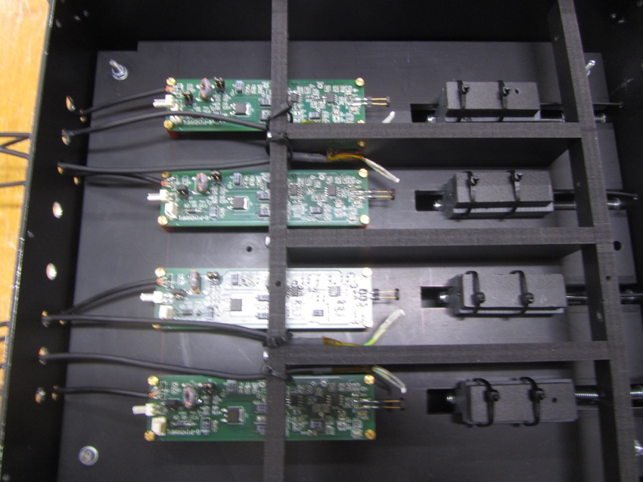
Introduction
The gain of SiPMs increases with bias voltage V_{bias} and decreases with temperature T
To operate SiPMs at stable gain, V_{bias} can be adjusted to compensate for T changes
This requires the knowledge of dV/dT, which is obtained
from measurements of dG/dV and dG/dT
We tested this procedure in a climate chamber at CERN
in February 2016 using a linear approximation for dV/dT
performing automatic dV/dT adjustments with an
adaptive power supply
We tested gain stabilization for 30 SiPMs from Hamamatsu, KETEK and CPTA
stabilizing 4 SiPMs simultaneously with one dV/dT setting ➔goal: achieve stable gain:
ΔG/G <±0.5% in 20°-30°C range
G. Eigen, AIDA annual meeting, Paris 5. April 2017

Slide 3
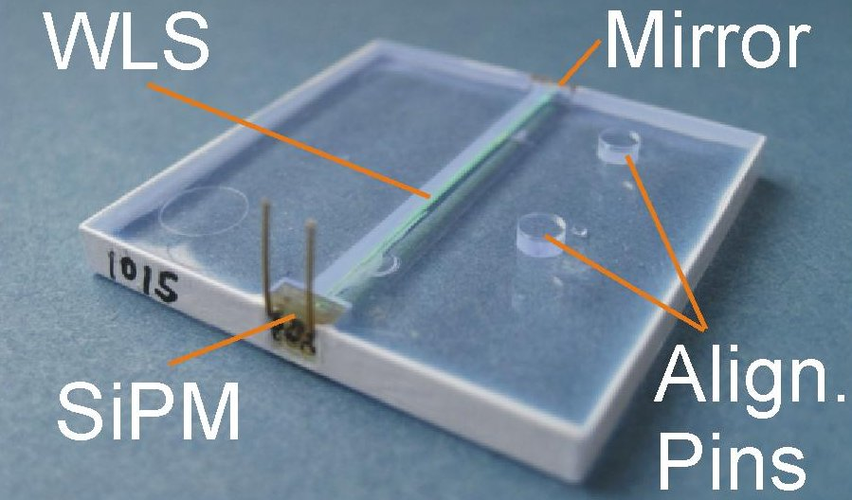
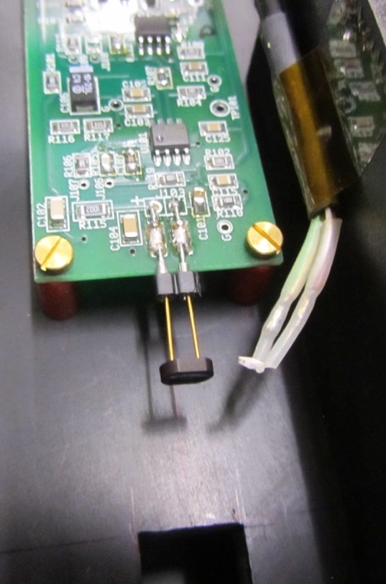
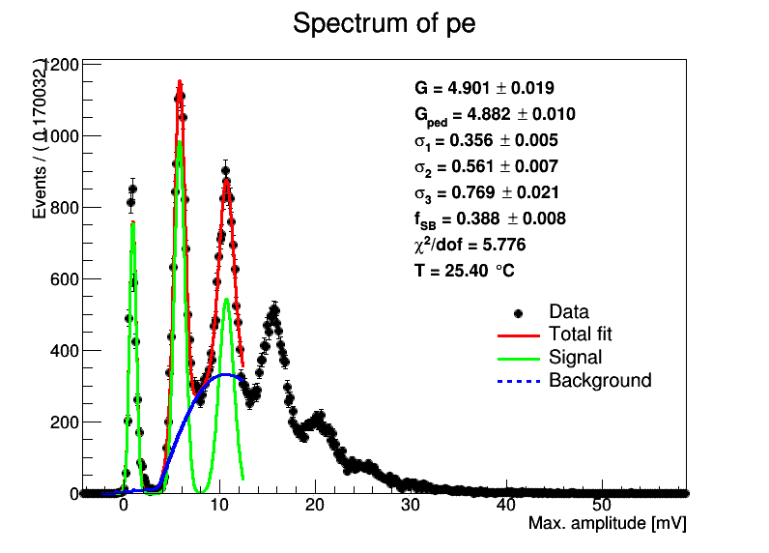





Extraction of Photoelectron Spectra
For 18 Hamamatsu MPPCs, we integrate each waveform over time window waveform stays below the baseline ➔ pe spectra are obtained from the measured total charge
For 8 KETEK and 4 CPTA SiPMs, we determine the waveform minimum for each pulse from which we extract the pe spectra
With
trenches
variable
T=25ºC
Hamamatsu S13360-1325
[au]
CPTA #922
1pe
1pe
2pe
pedestal
2pe
pedestal
3pe
3pe
4pe
5pe
6pe
G. Eigen, AIDA annual meeting, Paris 5. April 2017

Slide 4
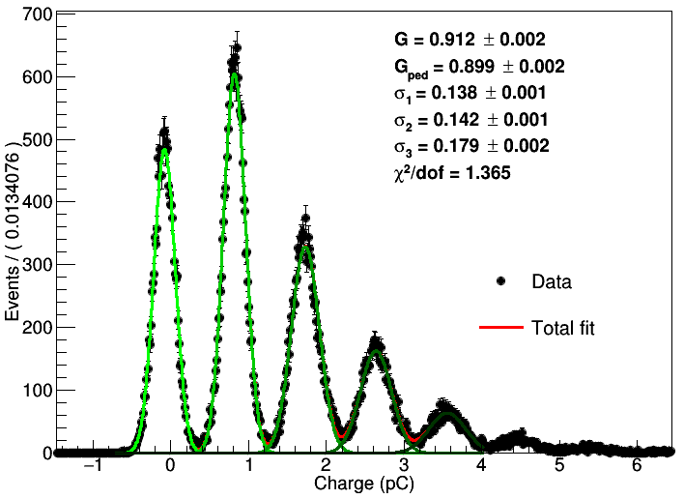
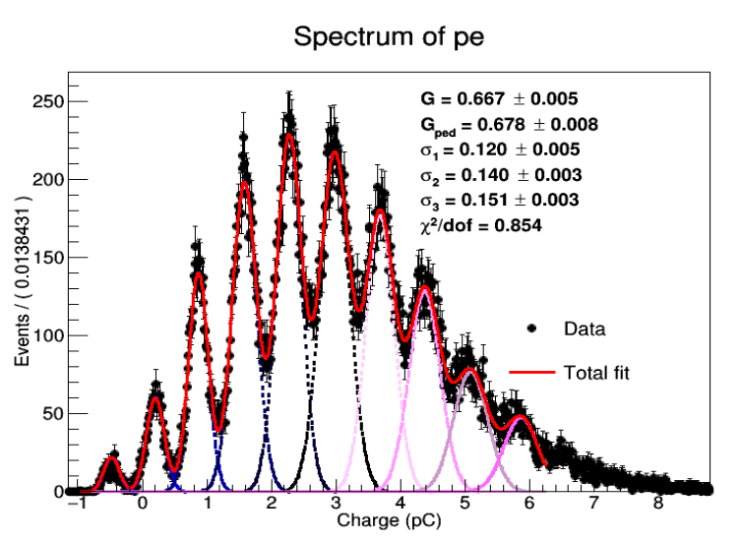
Gain Determination
We define the gain as the distance between the first and the second pe peaks
In the standard fit, we fit the pedestal, first pe peak and second pe peak each with a Gaussian G_{i} and fractions f_{ped}, f₁
Besides the signal peaks, we include a background F_{bkg} that is determined by a
sensitive nonlinear iterative peak-clipping algorithm (SNIP)
Thus, the likelihood function is
In the new fitting methodology, we fit the pedestal and all visible peaks with Gaussians G_{ped} and G_{i}, where all widths are free parameter but the distance between pe peaks is fixed, except for the distance between pedestal and first pe peak
No background
polynomial yet
We perform binned
fits of the pe spectra
extracted from
50000 wave forms
f_{s}: signal fraction
G. Eigen, AIDA annual meeting, Paris 5. April 2017

Slide 5
dG/dV, dG/dT & dV/dT Measurements (new fits)
For fixed T
measure dG/dV_{bias}
For fixed V_{bias}
measure dG/dT
For fixed T
extract all dV_{bias}/dT
and average them
Do this for each
SiPM
Gain vs V_{bias}
Gain vs T
Hamamatsu
B2-20
dG/dV_{bias} vs T
dG/dT vs V_{bias}
dV_{bias}/dT vs T
dG/dV=(33.12±0.02_{stat})×10⁶/V
dG/dT=-(1.8762±0.0031)×10⁵/°C
dV/dT=(57.0±0.1_{sys}) mV/°C
G. Eigen, AIDA annual meeting, Paris 5. April 2017

Slide 6






Compare 2 Fitting Strategies
New fit
Old fit
dV/dT=57.0±0.7mV/$°$C
dV/dT=56.5±0.4mV/$°$C
We obtain the same dV/dT for
Hamamatsu A, B & S12571
MPPCs within errors for both
fitting strategies
For KETEK and CPTA SIPMs
we have tested the new fitting
methodology on one channel
so far
For these two SiPMs, dV/dT
values agree within two agree
within 2 standard deviations
We will do the remaining
KETEK and CPTA SiPMs
soon
Hamamatsu B2-20
dV/dT=23.0±0.3mV/$°$C
dV/dT=22.3±0.2mV/$°$C
CPTA 1065
dV/dT=20.1±0.4mV/$°$C
dV/dT=19.1±0.3mV/$°$C
KETEK PM3350_6
G. Eigen, AIDA annual meeting, Paris 5. April 2017

Slide 7

Gain Stabilization for Hamamatsu MPPCs (old fits)
Gain vs T
A sensors
Gain vs T
B sensors
All 16
MPPCs satisfy requirement
that
deviation
from
stability
Is <±0.5% in 20$°−$30$°$C T range
A1-20
B1-20
A2-20
B2-20
A1-15
B1-15
A2-15
B2-15
Gain vs T
S12571
Gain vs T
S13360
S12571-136
S13360-3025
10103
S12571-137
S13360-3025
10104
S13360-1325
10143
S12571-271
S12571-273
S13360-1325
10144
G. Eigen, AIDA annual meeting, Paris 5. April 2017

Slide 8

Gain Stabilization for Hamamatsu MPPCs (new fits)
Gain vs T
A sensors
Gain vs T
B sensors
All 12
MPPCs satisfy requirement
that
deviation
from
stability
Is <±0.5% in 20$°−$30$°$C T range
A1-20
B1-20
A2-20
B2-20
A1-15
B1-15
A2-15
B2-15
Gain vs T
S12571
S12571-136
S12571-137
S12571-271
S12571-273
G. Eigen, AIDA annual meeting, Paris 5. April 2017

Slide 9
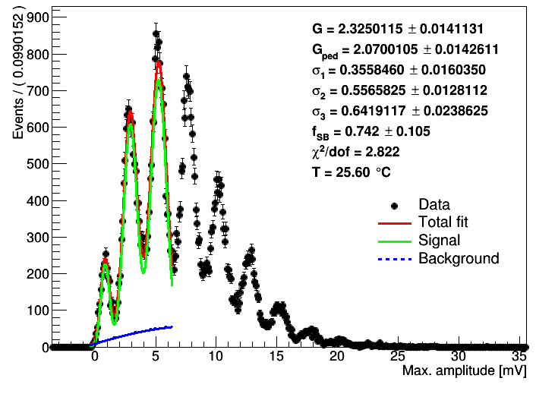
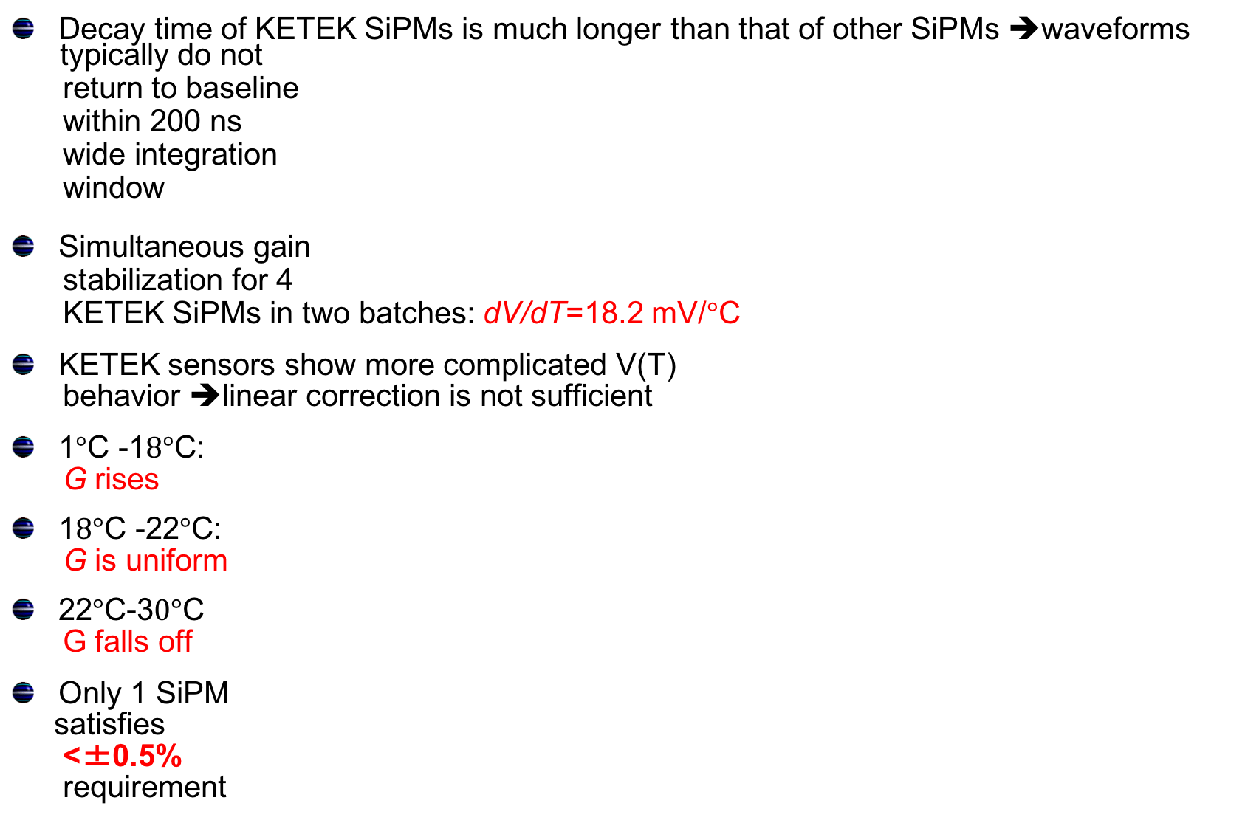
Gain Stabilization of KETEK SiPMs
Decay time of KETEK SiPMs is much longer than that of other SiPMs ➔waveforms
typically do not
return to baseline
within 200 ns
wide integration
window
Simultaneous gain
stabilization for 4
KETEK SiPMs in two batches: dV/dT=18.2 mV/$°$C
KETEK sensors show more complicated V(T)
behavior ➔linear correction is not sufficient
1$°$C -1$8°$C:
G rises
1$8°$C -22$°$C:
G is uniform
22$°$C-3$0°$C
G falls off
Only 1 SiPM
satisfies
<±0.5%
requirement
Gain vs T
Gain vs T
PM3350-1
PM3350-7
PM3350-5
PM3350-2
PM3350-8
W12-B
PM3350-6
W12-A
G. Eigen, AIDA annual meeting, Paris 5. April 2017

Slide 10

Gain Stabilization of CPTA SiPMs
CPTA #922
CPTA SiPMs
are illuminated
via scintillator
tile
We adjust V_{bias}
with regulator
board using
dV/dT=21.2 mV/$°$C to stabilize 4 CPTA SiPMs
simultaneously
We test gain stability within T=1°- 48°C
taking $≥1$8 50k waveform samples
at each T
The gain is nearly uniform up to 30$°$C,
SiPMs in ch# 2 and ch#4 look fine;
ch#1 is noisy, ch#3 changed gain
but looks ok
Three SiPMs satisfy our requirement of
>±0.5% within 20$°$C -30$°$C T range
Gain vs T
Average over 18 points
#1065
#922
#975
#857
G. Eigen, AIDA annual meeting, Paris 5. April 2017

Slide 11
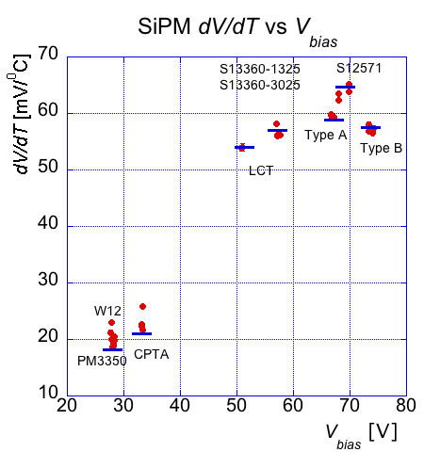
Measured dV/dT Values vs V_{bias} (old fits)
Look for correlations between operating voltage and measured dV/dT for all SiPMs
dV/dT increases with V_{bias}
KETEK & CPTA SiPMs have larger
dV/dT spread than Hamamasu
MPPCs
MPPC | dV/dT [mV/°C]
A1-15 | 59.2±0.4
A2-15 | 59.3±0.3
A1-20 | 59.6±0.4
A2-20 | 59.8±0.3
B1-15 | 57.3±0.5
B2-15 | 56.5±0.3
B1-20 | 56.9±0.4
B2-20 | 58.0±0.5
S12571-271 | 63.9±0.2
S12571-273 | 65.2±0.2
S12571-136 | 63.5±0.3
S12571-137 | 62.3±0.3
LCT4#6 | 53.9±0.5
LCT4#9 | 54.0±0.7
S13360-10143 | 56.2.±0.3
S13360-10144 | 58,1±0.3
S13360-10103 | 56.0±0.2
S13360-10104 | 56.1±0.1
SiPM | dV/dT [mV/°C]
W12A | 21.2±0.4
W12B | 23.0±0.2
PM3350 | 20.0±0.3
PM3350 | 18.7±0.4
PM3350 | 18.8±0.2
PM3350 | 19.1±0.3
PM3350 | 20.5±0.2
PM3350 | 19.8±0.4
#857 | 21.6±0.4
#922 | 22.6±0.2
#875 | 25.9±0.3
#1065 | 22.3±0.2
G. Eigen, AIDA annual meeting, Paris 5. April 2017

Slide 12
Conclusions and Outlook
We successfully completed gain stabilization tests for 30 SiPMs and demonstrated that batches of SiPMs can be stabilized with one dV/dT correction
All 18 Hamamatsu MPPCs, 6 with trenches and 12 without trenches, satisfy the goal:
ΔG/G < ±0.5% in the 20°C-30°C T range ➔ most MPPCs satisfy ΔG/G < ±0.5% in the
extended T range 1°C-50°C
Gain stabilization of KETEK SiPMs is more complicated,
  Signals are rather long and are affected by afterpulsing
  range of stabilization is limited to 1°C-30°C T range where SiPMs have more complex V(T) behavior ➔need individual dV/dT values to stabilize gain of 4 SiPMs in 1°C-30°C T range
Gain stabilization of CPTA SiPMs works fine
➔ for 3 SiPMs, ΔG/G < ±0.5% is satisfied in 20°C-30°C range
➔ procedure works with scintillator and wavelength shifter attached
We checked all Hamamatsu MPPCs without trenches with new fit model and get the same results; for MPPCs with trenches we need 2 Gaussians per peak
We are checking KETEK and CPTA gain stabilization with new fit model
Paper draft is progressing
G. Eigen, AIDA annual meeting, Paris 5. April 2017

Slide 13

Questions
Infrastructure: To what extend is your work an infrastructure or part of an infrastructure that can be used in the European (and beyond) Research Area? ➔ This work is relevant for the AHCAL and other large arrays of SiPMs
Network: Does your work belong to a bigger network on similar research topics (this is similar but not exactly the same as 1) )? ➔ Large calorimeter systems such as those used in medical applications (PET, etc)
Synergies: Do you create synergies beyond your actual field of working? ➔ We think of extending measurements to temperatures below 0$°$C, which are of interest for neutrino experiments such as DUNE
Industrial partners: Are you in contact or will you in the near future establish sustained contacts with industrial partners (of any size)? ➔We have not contacted any company yet, this may be useful for applications
G. Eigen, AIDA annual meeting, Paris 5. April 2017

Slide 14
Acknowledgment
We would like to thank L. Linssen, Ch. Joram, W. Klempt, and D. Dannheim
for using the E-lab and for supplying electronic equipment
We further would like to thank the team of the climate chamber at CERN for their support
G. Eigen, AIDA annual meeting, Paris 5. April 2017

Slide 15
dG/dV, dG/dT & dV/dT Measurements
For fixed T
measure dG/dV_{bias}
For fixed V_{bias}
measure dG/dT
For fixed T
extract all dV_{bias}/dT
and average them
Do this for each
SiPM
Gain vs V_{bias}
Gain vs T
Hamamatsu
S13360-1325
dG/dV_{bias} vs T
dG/dT vs V_{bias}
dV_{bias}/dT vs T
dG/dV=(4.636±0.002_{stat})×10⁶/V
dG/dT=(2.6775±0.004)×10⁵/°C
dV/dT=(57.8±0.1_{sys}) mV/°C
G. Eigen, AIDA annual meeting, Paris 5. April 2017

Slide 16
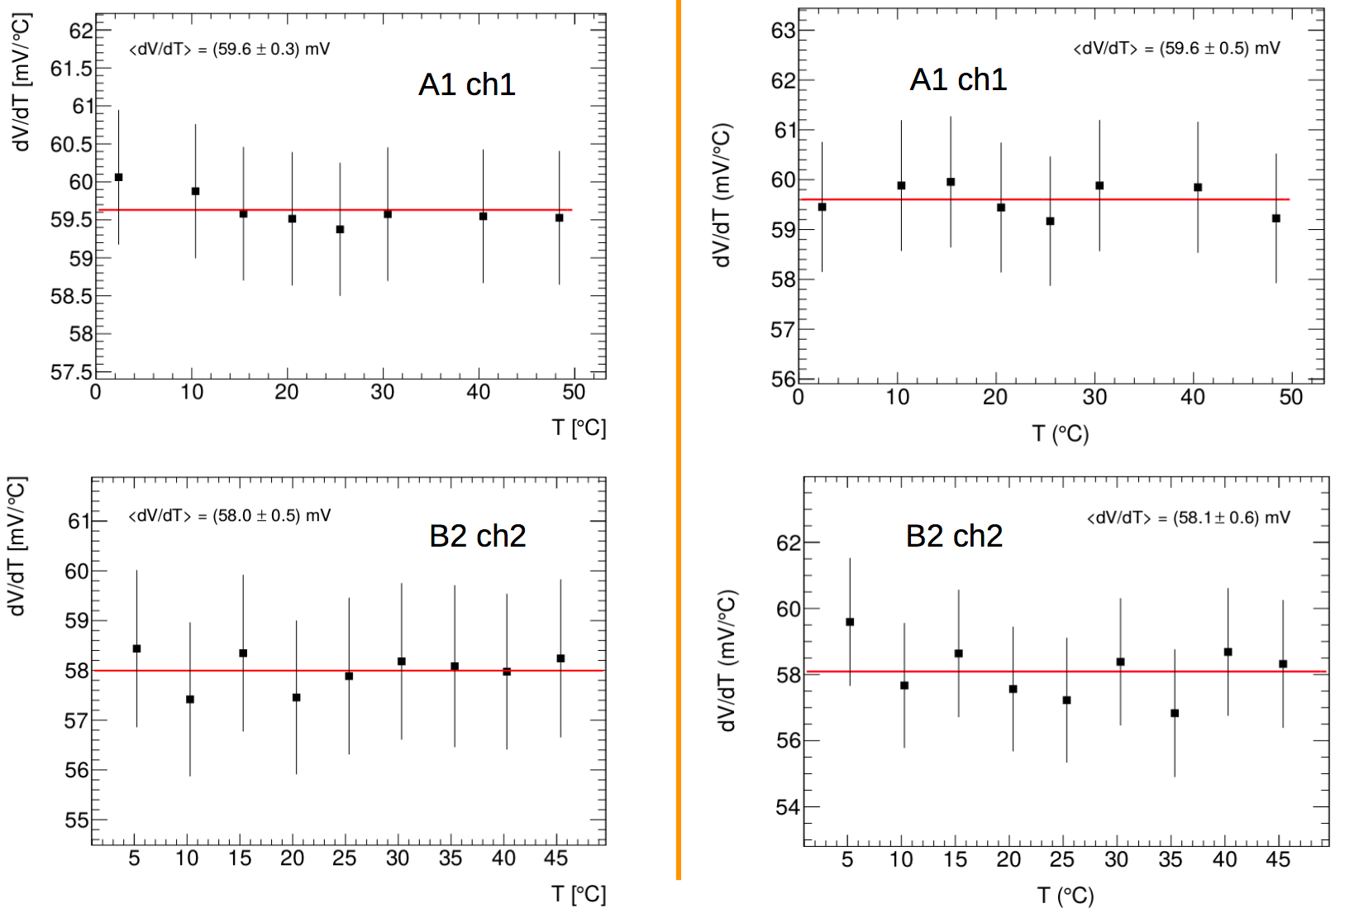
Compare 2 Fitting Strategies for A & B SiPMs
We obtain same dV/dT for Hamamatsu A and B SiPMs for both fitting strategies
G. Eigen, AIDA annual meeting, Paris 5. April 2017

Slide 17
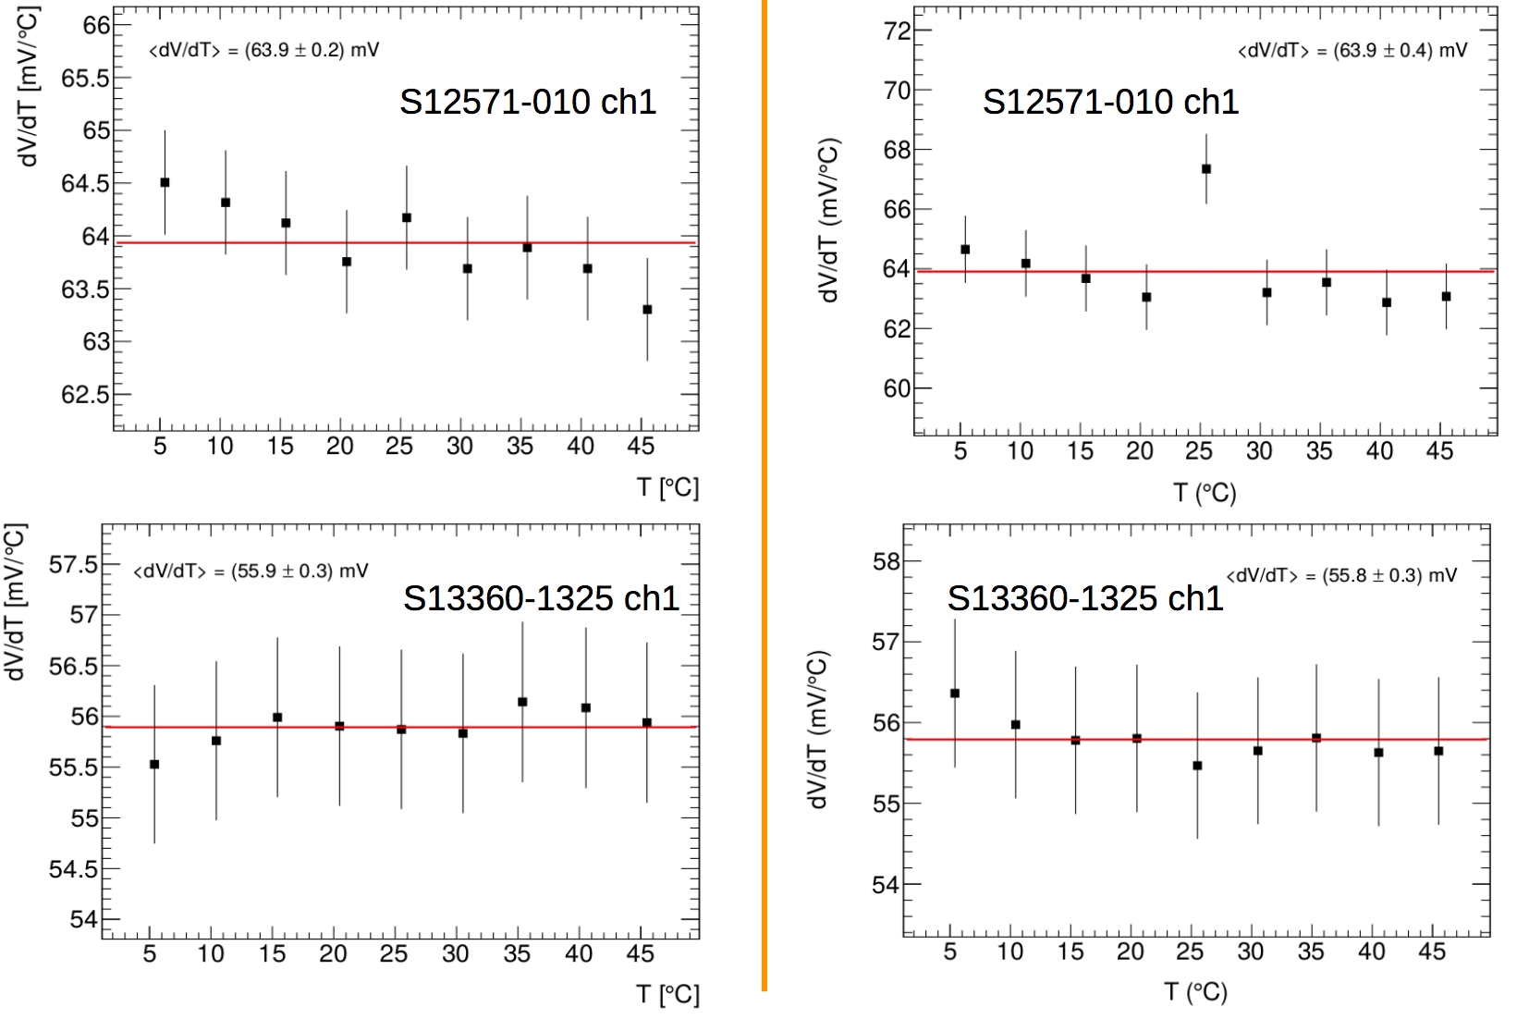
Compare Fitting Strategies for S12571 & S13360 SiPMs
We obtain same dV/dT for Hamamatsu S12571 and S13369 SiPMs for both fitting
strategies
G. Eigen, AIDA annual meeting, Paris 5. April 2017

