Slide 1



14.5 Mechanical and thermal tools for innovative calorimeters
Task 1 | Precision mechanics for calorimeter structures
Task 2 | Infrastructure to evaluate thermal properties of calorimeter structures
Enrique Calvo Alamillo (CIEMAT)
AIDA-2020 Second Annual Meeting
WP14 meeting. Paris, 05/04/2017

Slide 2
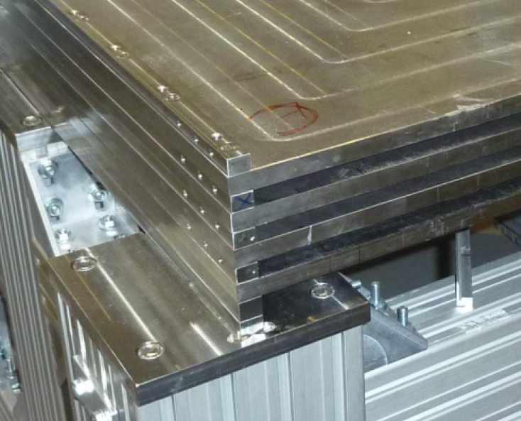

Planned activities
WP14.5-Task 1 | Precision mechanics for calorimeter structures (CIEMAT)
Goal
To investigate the suitability of the electron beam welding (EBW) technology for very precise absorber mechanical structures for highly compact imaging calorimeters
Deliverable : D14.7 (Month 42) (End of 2018)
To design and build a mechanical absorber structure with 4 long plates using EBW
The deliverable will be based in the SDHCAL design for the ILD @ ILC (Sampling Calorimeter made of Stainless steel + GRPC-Glass Resistive Plate Chambers)
DELIVERABLE CHARACTERISTICS
~1m3 CALICE PROTOTYPE
Plates ~3x1 m² . 15 mm thick (Roller leveled)
Slot for the casette ~12 mm thick
(needed to create the space between absorber plates to insert the GRPCs):
Surface planarity < 1mm ,
Lateral thickness tolerance +-100μm
Material: Inox AISI 304
(stainless steel – non magnetic)
Assembly: Electron Beam welding (EBW)
Plates ~1x1 m² . 15 mm thick (Machined)
Slot for the casette ~13 mm thick
Plates assembled together by using an intermediate spacer insuring the place for introducing the detectors
Bolts
Plates
spacers
Detail after assembly the first 4 absorber plates
of the 1.3m³ prototype
Assembly: M8 Bolts

Slide 3
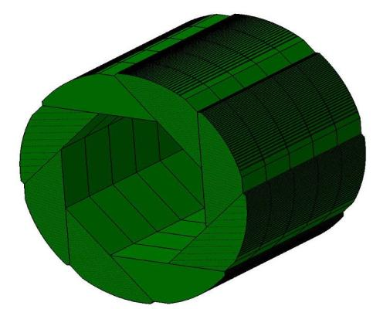
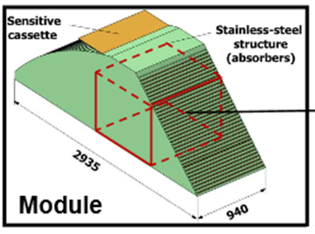
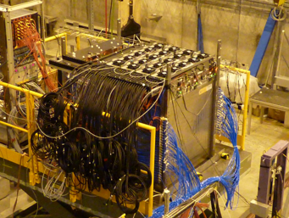
Semi-Digital Hadronic Calorimeter (SDHCAL)-ILD prototypes
The structure will be focused to the SDHCAL-GRPC, proposed for ILD of ILC.
Sensor detectors are made of GRPC (Glass Resistive Plate Chambers) and placed in self-supporting mechanical structure to serve as absorber as well.
SDHCAL ILD barrel
SDHCAL ILD module
SDHCAL 1.3m³ prototype
Module
Absorber: Stainless Steel
Active Medium: GRPC
SemiDigital readout. 1cm² pads
Electronics embeded in the detector
ILD SDHCAL
Plates & GRPCs:
up to ~3x1 m²
Absorber assembly
Welding?
(To minimize dead space)
~1.3m3 SDHCAL prototype
Plates & GRPCs :
~1x1 m²
Absorber assembly:
Bolted
HIGH GRANULARITY CALORIMETER

Slide 4
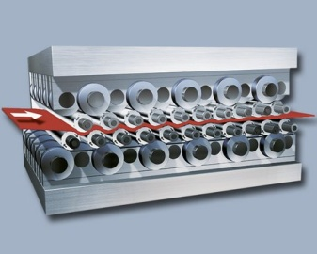
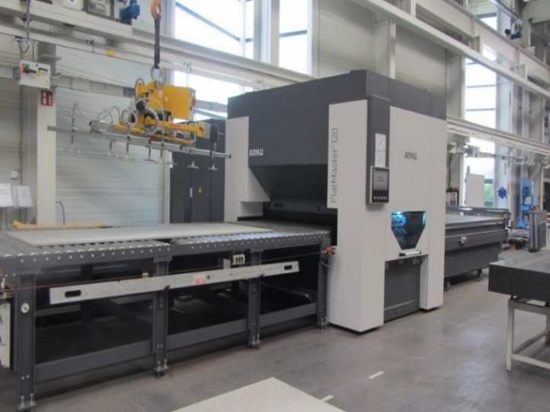
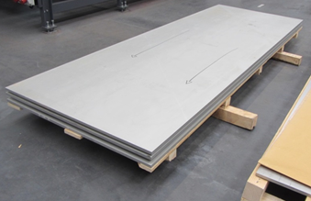


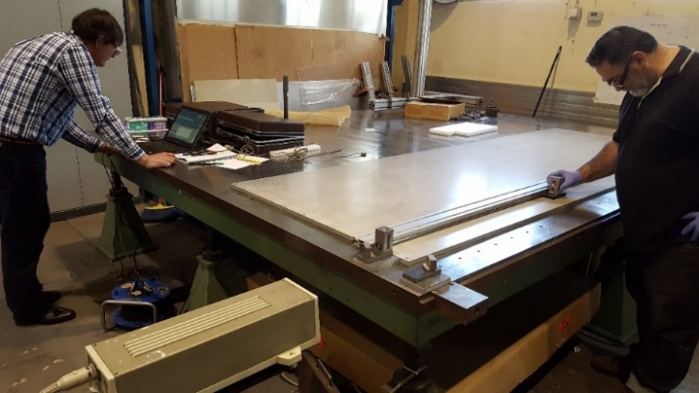


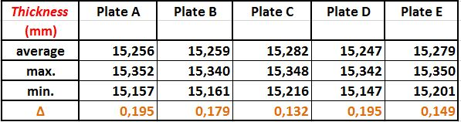
Plates production & Quality Control
The best standard plates in the market have a larger planarity (~several mm) than the required one (<1mm)
Planarity achieved using roller leveling at ARKU
Baden-Baden (Germany) www.arku.de/
5 Plates (~3x1 m2) available at CIEMAT
Initial planarity between 1 and 3mm
(8 smaller (~0.4x1 m2) plates for previous test)
Final planarity inside the required tolerances
(Plates for the PT3)
(Plates for the PT3)
Planarity
Thickness
Measurements using laser interferometer.
Over a flat table (~0.1mm planarity)

Slide 5
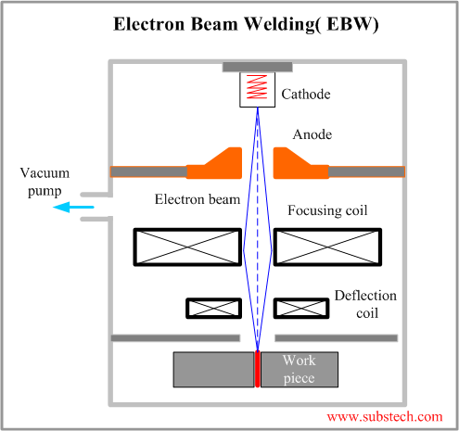
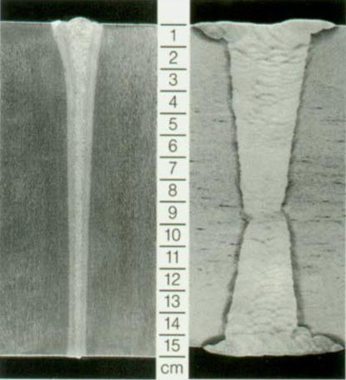
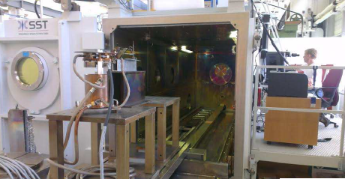
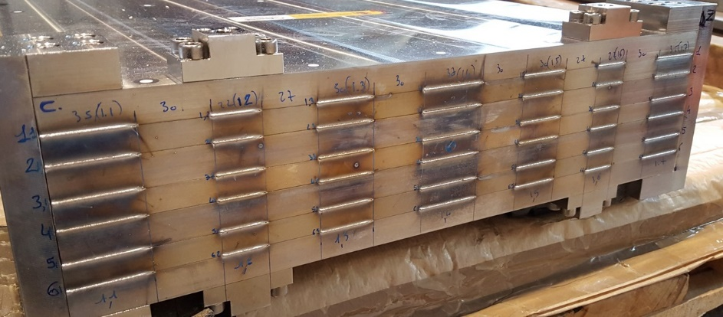
Mechanical Structure: Welding procedure
Improvement on the present system is being made by using Electron Beam Welding (EBW) at CERN rather tan bolts to reduce the lateral dead space.
Collimate electron beam
➔ Very narrow welding ➔ Less deformations
Vacuum conditions needed
EBW Machine @ CERN
(PT2):
~0.4x1 m² (4 slots) welded prototype

Slide 6
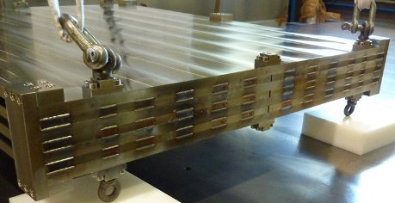
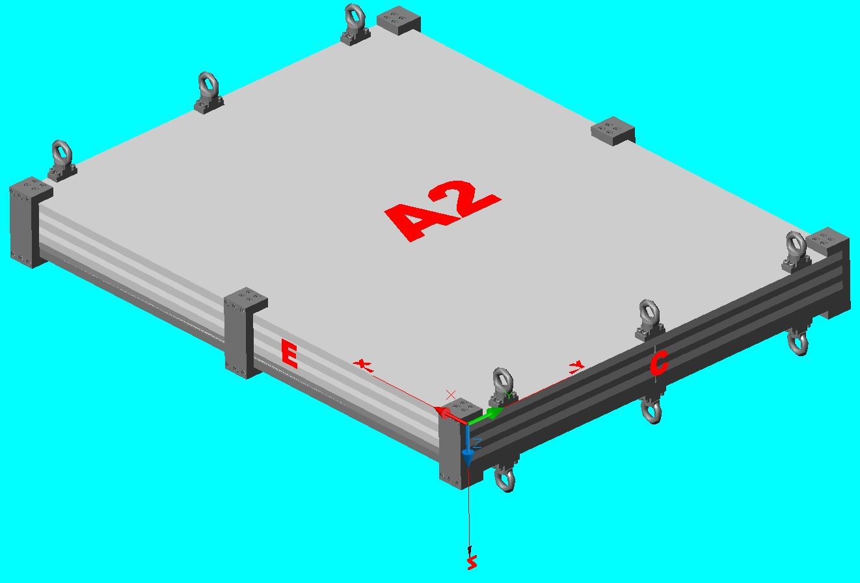
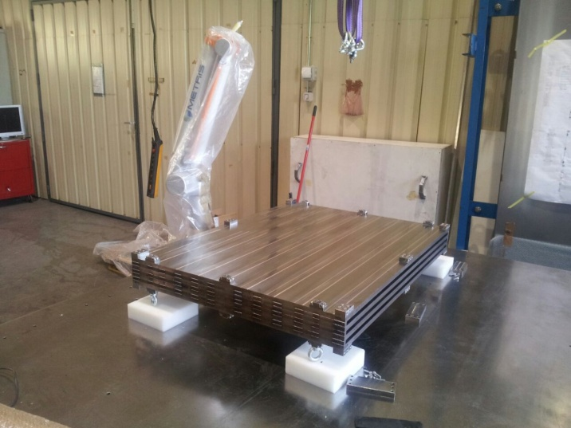
Assembly of the Structure
Previous Welding tests
(PT1)
First small prototype (PT1): 4 plates ~0.8x1 m²
-0.56
+0.26
+0.13
+0.22
+1.01
+0.72
Differences with respect to the initial status of the plate in Z.
Differences with respect to the initial status of the distance between plates
-0.52
+0.5
+0.59
+1.11
-0.51
+0.73
+0.49
+0.43
+0.53
-0.54
+0.24
+0.49
+0.51
+0.1
+0.07
+0.1
-0.51
+0.11
+0.57
+0.16
+0.57
+0.53
-0.50
+0.21
Measurements have been done AFTER REMOVING the PIECES used FOR RIDIGITY (the picture includes them)
+0.81
+0.64
-0.49
+0.54
+0.62
-0.48
+0.85
+0.06
+0.14
+0.18
After comparing the measurements before and after welding Z-axis deformations found (~1mm the external plates) in X-direction. O.K in Y-direction (this is positive for the 3 m long prototype).
Deformations not symmetric Z-direction ➔ Probably due to the not symmetry welding sequence used??
(PT1)
Coordinate 3D measuring machine
Welding has been performed column by column following the same row order ABCDEF.
F
E
A
B
C
D
Penetration ~5 mm

Slide 7
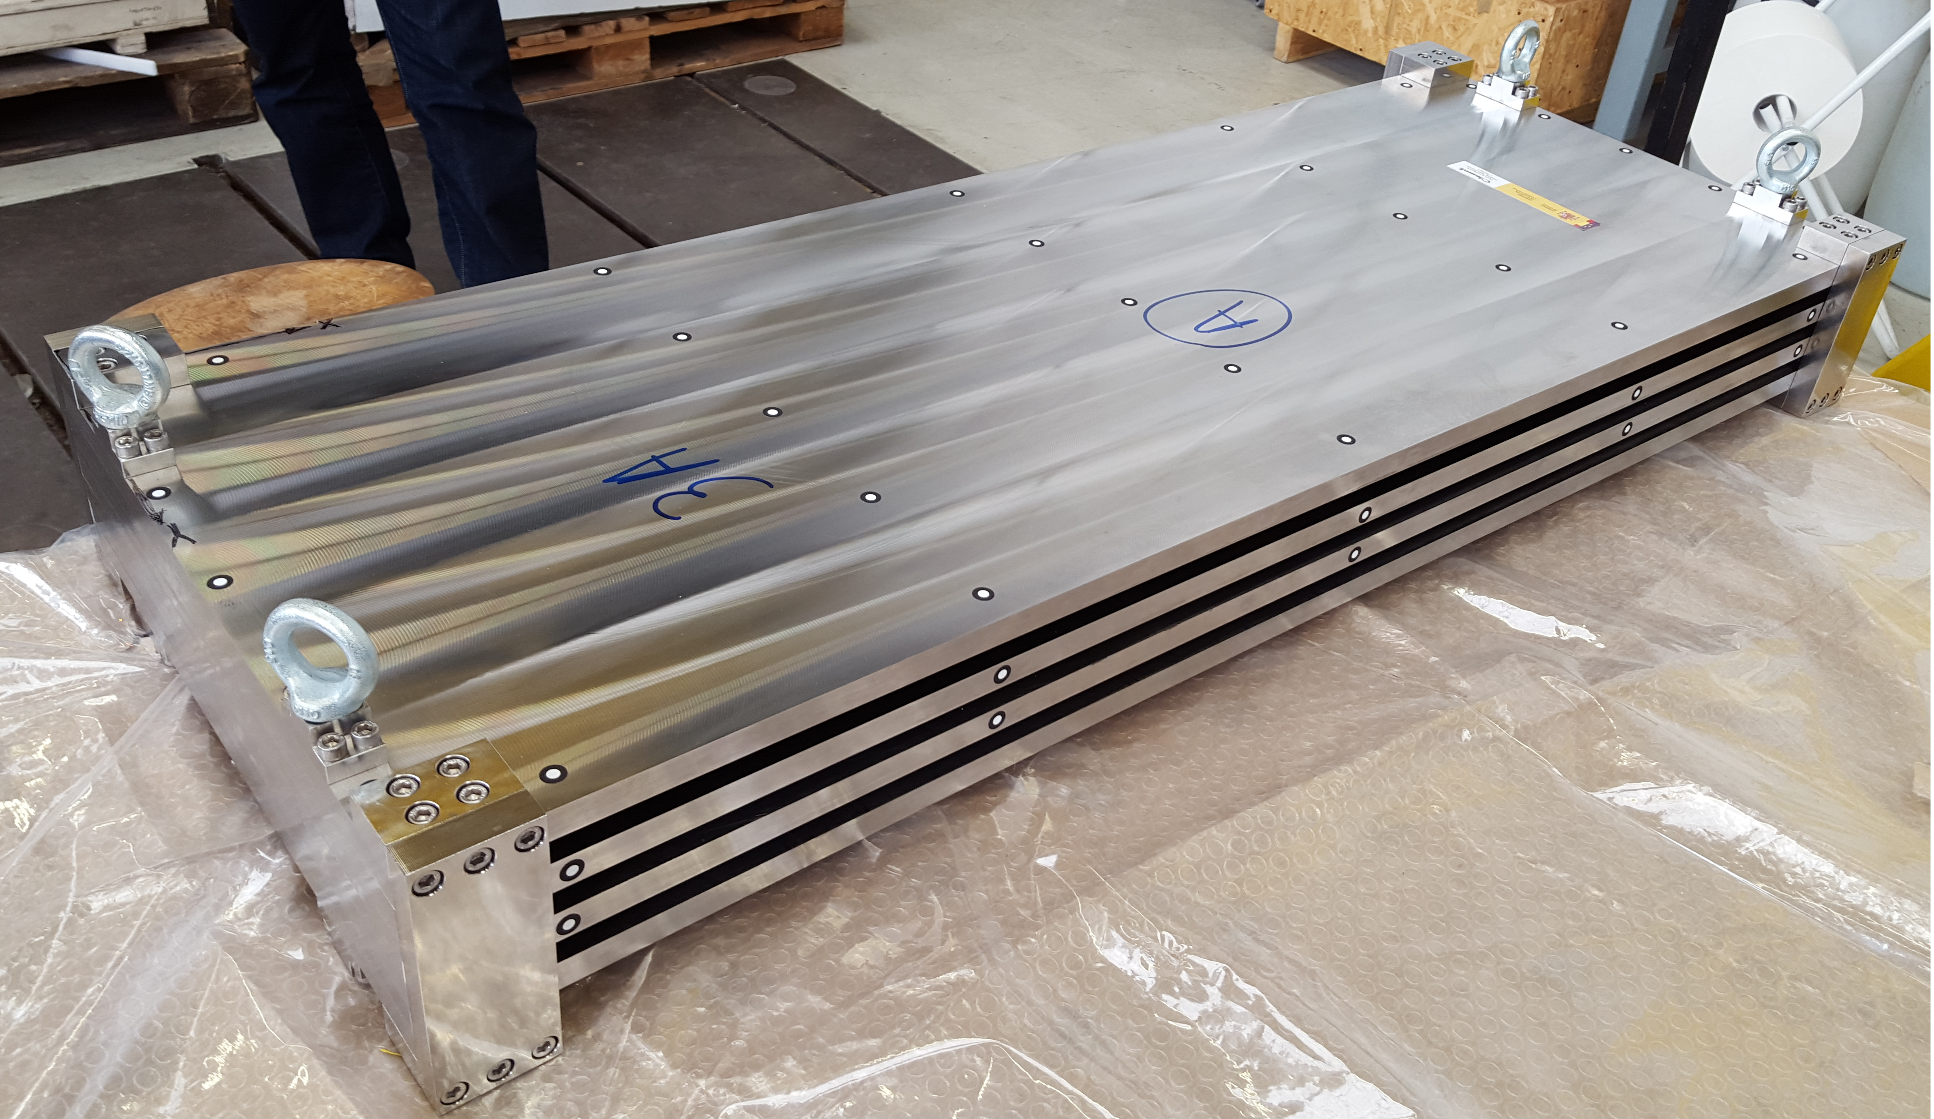
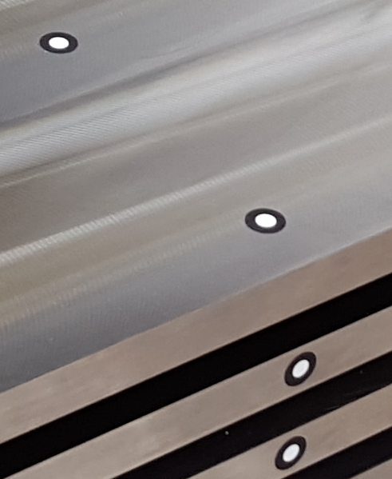
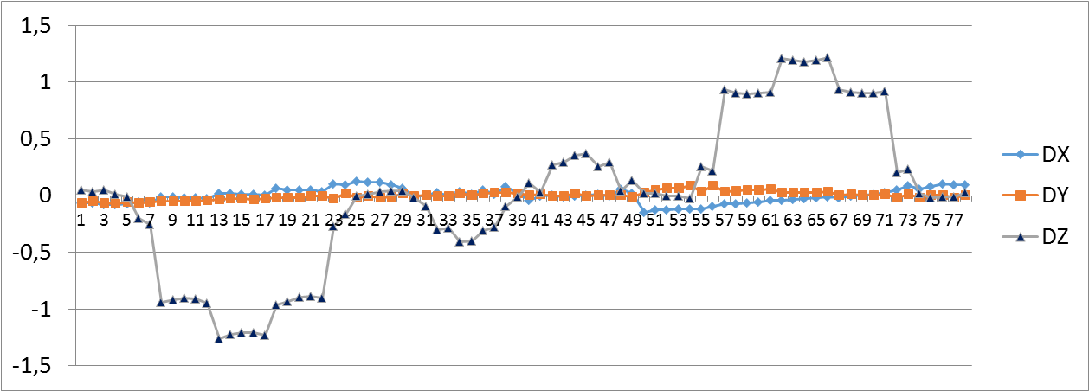
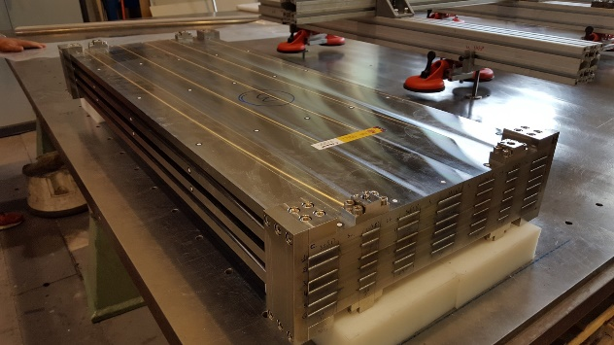
Assembly of the Structure
Previous Welding tests
Welding performed changing a bit the welding sequence and machine parameters with respect to the first prototype:
Second small prototype (PT2): 4 plates 0.4x1 m²
2nd Prototype before welding
Penetration ~5 mm
(PT2)
zoom
Photogrammetry targets
After comparing the measurements before and after welding Z-axis deformations found (~1mm the external plates) in X-direction.
O.K for Y-direction (this is positive for the 3 m long prototype).
Now the Z-direction deformations is symmetric.
➔ Similar deformation results.
(PT2)

Slide 8
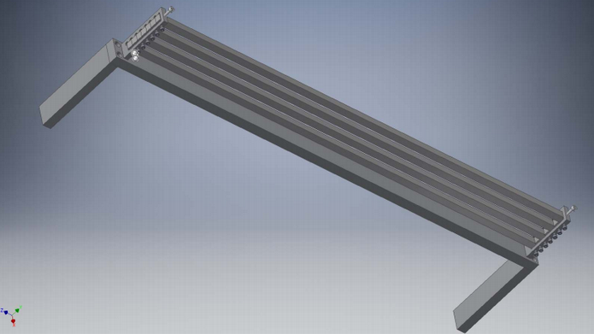
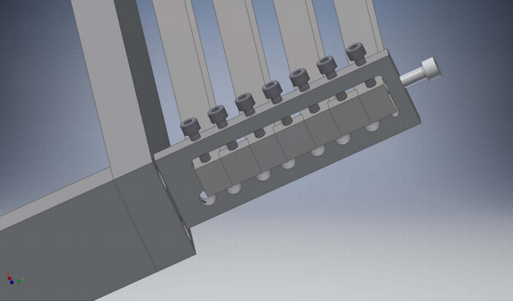
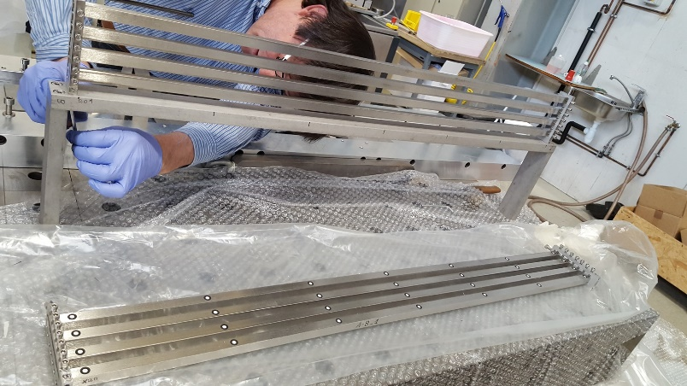
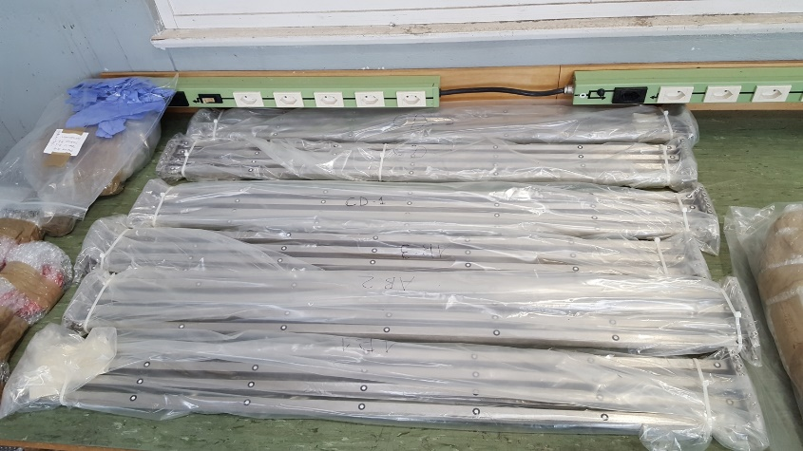
Assembly of the Structure
Next Welding tests
Before to weld the next prototypes with 10 mm penetration (greater strength), some tests using smaller pieces are foreseen to evaluate “qualitatively” the best way for performing the final welding sequence.
This should allow to make several fast & cheaper tests, changing the sequence & machine parameter of welding in order to find the procedure producing the lowest deformation.
Pieces produced at CIEMAT and waiting at CERN after the photogrammetry for the EBW during April.
Penetration ~10 mm
6x prototypes

Slide 9
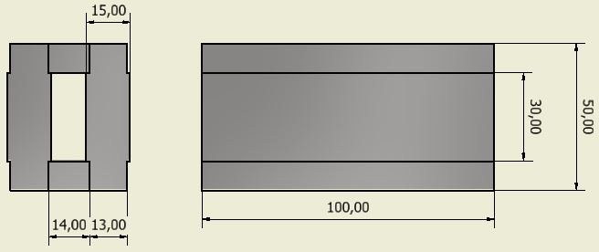
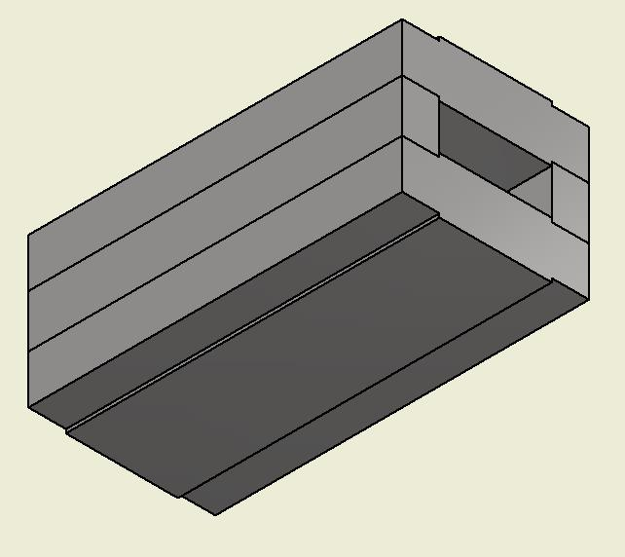
Assembly of the Structure
Next Welding tests
Welding sequence for the “qualitatively” smaller tests:
Three different option to try with.
Penetration ~10 mm
➔ At the same time, will be tested two very small prototypes to fix the machine parameters.
2x prototypes
Once the procedure is optimized two identically prototypes ( plates ~0.4x1 m²) will be welded with those parameter to validate the procedure.

Slide 10
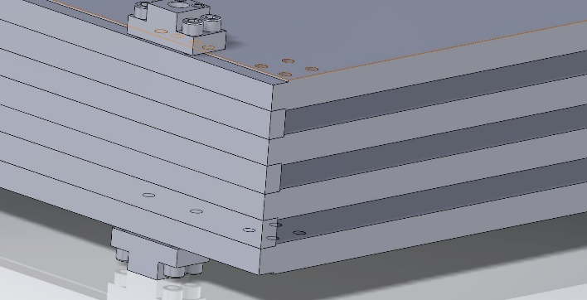
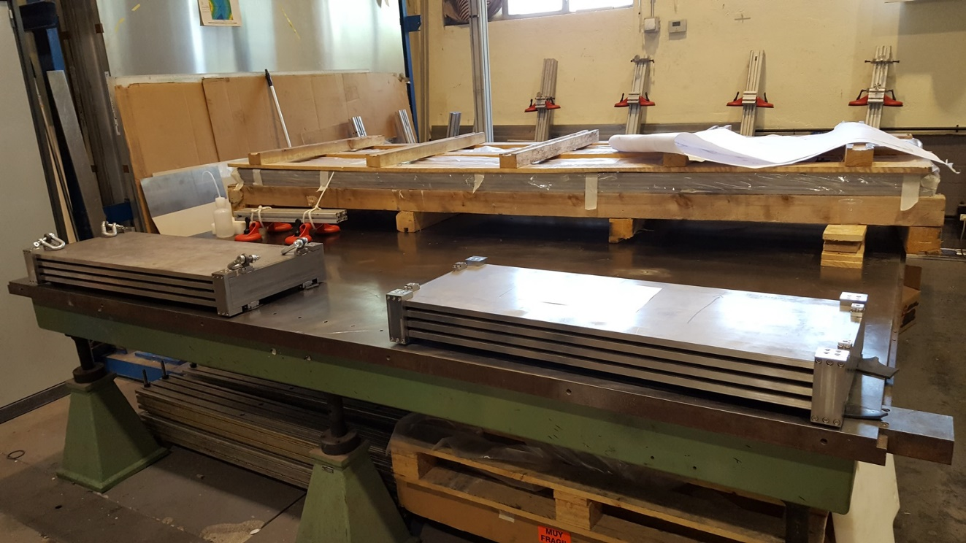
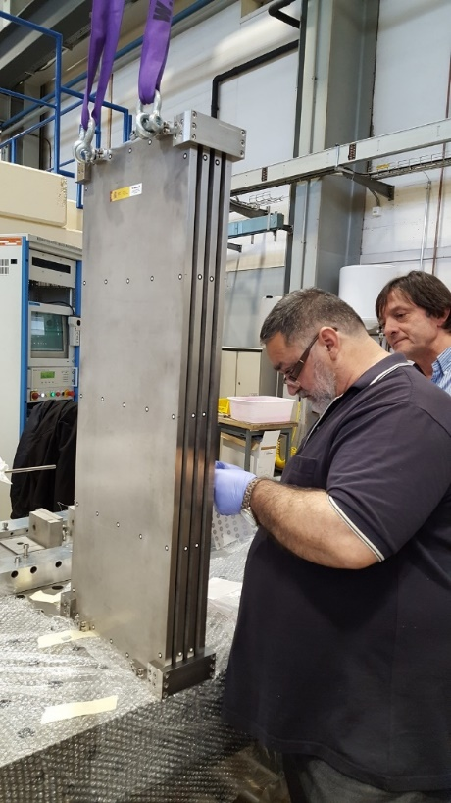
Assembly of the Structure
Next Welding tests
Two identical small prototypes (PT4): 2x (4 plates 0.4x1 m²)
Complete Penetration ~10 mm
Greater strength of the structure.
Welding will be performed in functions of the results of the previous welding tests:
(Plates for the PT3)
(PT4)
(PT4)
(PT4)
Pieces produced at CIEMAT and waiting at CERN for the EBW. The date needs to be decided (Could be at the end of 2017).
Once validated the procedure, will be welded the big demonstrator ( plates ~3mx1m)

Slide 11
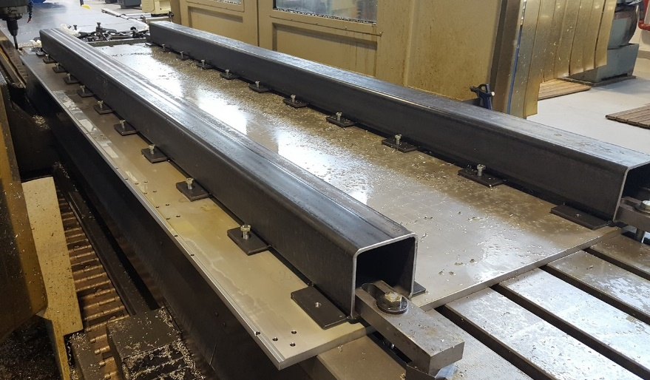
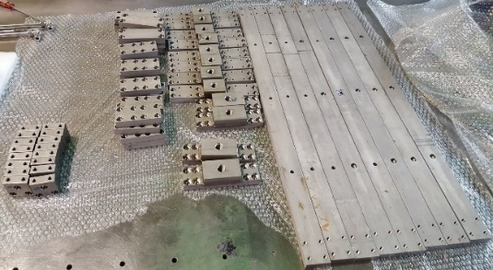
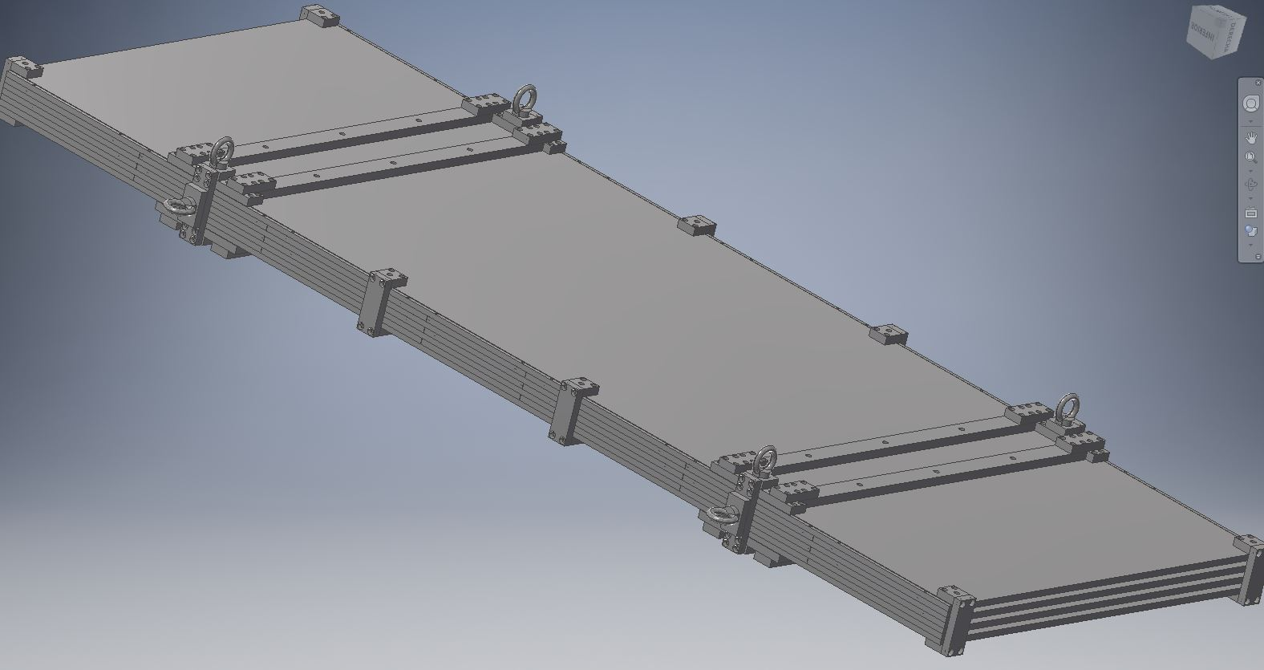
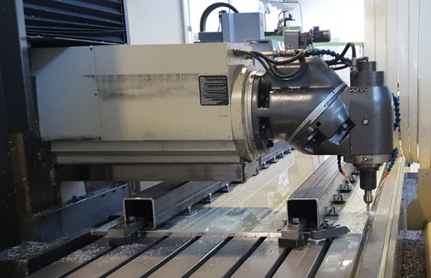
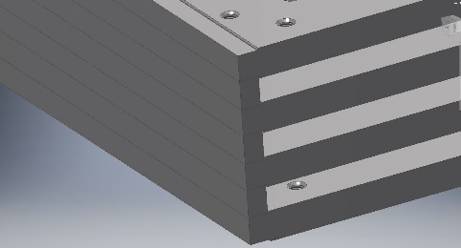
Assembly of the Structure
Next Welding tests
Sampling calorimeter prototype (PT3): 4 plates 3x1 m²
Complete Penetration ~10 mm
Greater strength of the structure.
Welding will be performed in functions of the results of the previous welding tests:
Pieces for the demonstrator produced and waiting for the preliminary measures and assembly at Ciemat (April to June 2017).

Slide 12
Next actions & Status of the final absorber structure
Next prototypes
Small pieces for tests and the last 2 small prototypes (PT4) ➔ Done
Start of tests with small pieces during April
(Lasts small prototypes will be welded after defined the best welding parameters with the small pieces)
Final demonstrator
Big Plates (~3x1m²) with planarity <1mm ➔ Done
Big Plates Handling and machine tool ➔ Done
Auxiliary pieces for fixing rigidity ➔ Done
Spacers ➔ Done
Small machining on 3x1m2 plates needed for fixations and assembly ➔ Done
Verification of the plates and spacers ➔April 17
Demonstrator assembly and preliminary measures at Ciemat ➔ May-June 17
Transport to CERN, Photogrammetry before EBW ➔ to be decided with CERN (End of 17)
EBW & photogrammetry after EBW ➔ to be decided with CERN (beginning 2018)
Additional tests that could be implemented with the previous prototypes
Could be welded both PT4 to create a bigger one prototype (8 plates prototype (PT5)).
Could be welded PT2 & PT1 (8 plates prototype (PT6)).
Could be welded those previous prototypes (PT5 & PT6) to create a 16 plates prototype (PT7).

Slide 13
Conclusions
At present the project advances well according to the schedule steps needed for arriving to have the demonstrator on time
No special problems are envisaged
(The goal is to show the capabilities of this welding method, in the project no claim was written about the expected performance going to be achieved)
Topics:
We have created infrastructure and tools to follow with this task in the future.
We are developed technological procedures that can be translate to the companies during the fabrication of the final modules phase:
We developed a procedure with the world leader on Roller levelers technology (ARKU), to minimize the planarity for 3 m x 1m x 15 mm Stainless Steel plates. They can supply us the European companies with the necessary machines to carry out this task.
We are developing, in cooperation with CERN, the procedure to weld by EBW technology some of the biggest prototype expected for the future hadron calorimeter. CERN people know several European companies with the necessary machines to carry out this task.

