Slide 1
AIDA-2020 Communication
Jennifer Toes, CERN
AIDA-2020 2nd Annual Meeting, 3-7th April 2017

Slide 2





Highlights
4 newsletter issues
483 newsletter subscribers
13,500+ website visitors
600,000 website hits
8/10 TA videos published
Notes:
Headline comms info:
4 newsletter issues published as of March 2017 – May, Oct & Dec 2016, & March 2017.
483 subscribers total, which is +7 than the original list. Have had a few un-subscriptions too, so net gain of subscribers.
13.5k unique visitors to the website total (593 per month, on average)
~600k hits total (26k per month, on average)
8/10 TA videos have been published. Final 2 just in final stages of approval.

Slide 3
Task 2.2 – Communication, Dissemination & Outreach
Task 2.2 Objectives:
Plan and implement project communication strategy
Establish & integrate communication commitment into all WPs
Ensure the flow of information within the project (internal)
Report the results of the project to a wider audience (external)
Create engagement materials for industry and public
Establish links with new detector communities within/beyond HEP

Slide 4


Communication actions
Product | When | Responsible | Status
Logo | February 2015 | CERN | Completed
Website | March 2015 | CERN | Completed
Newsletter | Reuse LC platform, then in Q4 or 2nd year Q1 start own newsletter | CERN + DESY | Completed – Launched May 2016
LHC Experiments media channels | After start of the project | Coordinator and Deputy Coordinators | Ongoing
Social media | When triggered by article, newsletter, big AIDA-2020 event | DESY | Ongoing – Reuse existing channels as needed
Educational resources | In Y2/Y3 | With the help of the communication working group, tbd | Ongoing – future goal to be achieved in Y2/Y3.
TA videos | Expected for the 1st annual meeting | CERN with in-kind contribution from INFN | Ongoing – 8/10 videos published
Industrial forums | Represent AIDA-2020 at industrial fairs | CERN KTT (TTN) | Ongoing

Slide 5
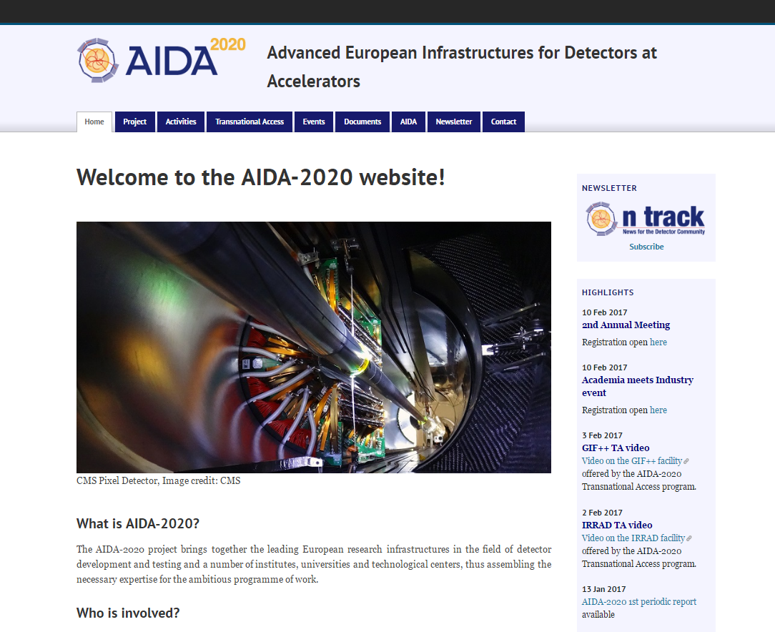
Website
Notes:
Website screengrab
Regularly updated with highlights: job postings, newsletter articles, project news, publication of TA videos, events etc.

Slide 6
Website stats
13.5k unique visitors
593/month
600k website hits
26k/month
Notes:
Website:
13.5k unique visitors total (593/month on average)
600k website hits total (26kmonth on average)
General positive trend – can see blue trend line on next slide
Data only up to March 2017 (Does not include April 2017, aka Month 24).
Can see a version of the monthly visitors on the next slide, to see more clearly (without cumulative line)

Slide 7
Unique visitor stats by month
Notes:
A version of the graph from the previous slide just without the cumulative line, so can see the monthly website visitors more clearly.
Trendline – positive trendline, so website visitors continue to increase.
Dips usually around the summer and December, as people are on vacation or away for the winter holidays.

Slide 8
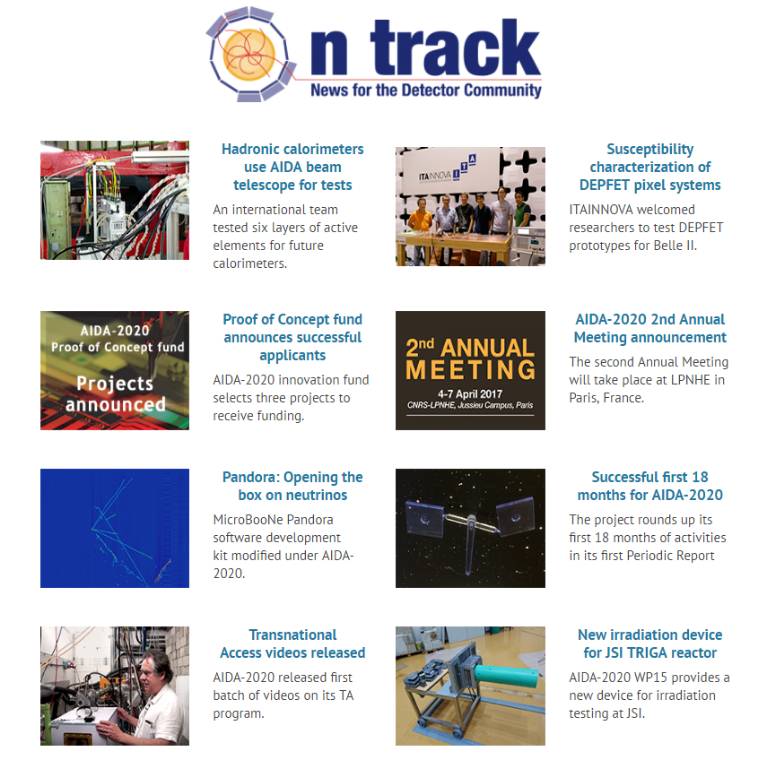
Newsletter
Project newsletter “On Track:
Initially bi-annually publication, aiming to increase frequency to quarterly (at least)
Topics: AIDA-2020 news, events, announcements + highlights from the detector community
4 issues published to date
483 subscribers (+7 since P1)
Updated layout/design of website and
email since launch
Notes:
Initially proposed bi-annual publication, with an aim to increase this up to quarterly.
We do not have set publication dates – articles and published live on the website and once we reach at least 5 articles, we publicise the issue with a summary email.
HTML email created using MailChimp template.

Slide 9
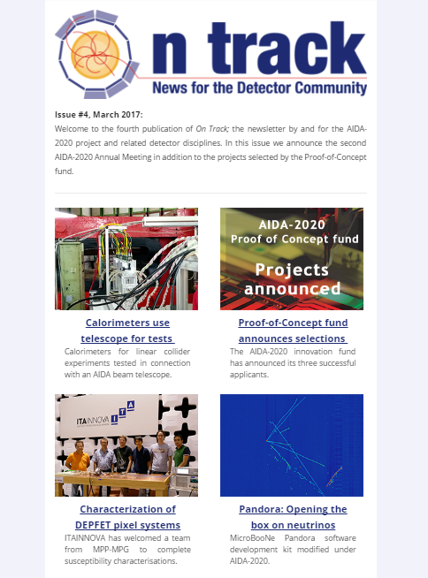
Newsletter
Editorial team of two – Jennifer Toes (CERN) & Barbara Warmbein (DESY)
Editors source, research, write and publish stories about AIDA-2020 and related research
Article pitches are always welcome!
  AIDA-2020-newsletter-editor@cern.ch
Article submissions accepted - JT & BW will provide editorial support
Notes:
Articles handled by Jennifer Toes & Barbara Warmbein. We source & write articles with input from relevant contacts. We also provide editorial support to researchers who may want to write an article themselves.

Slide 10
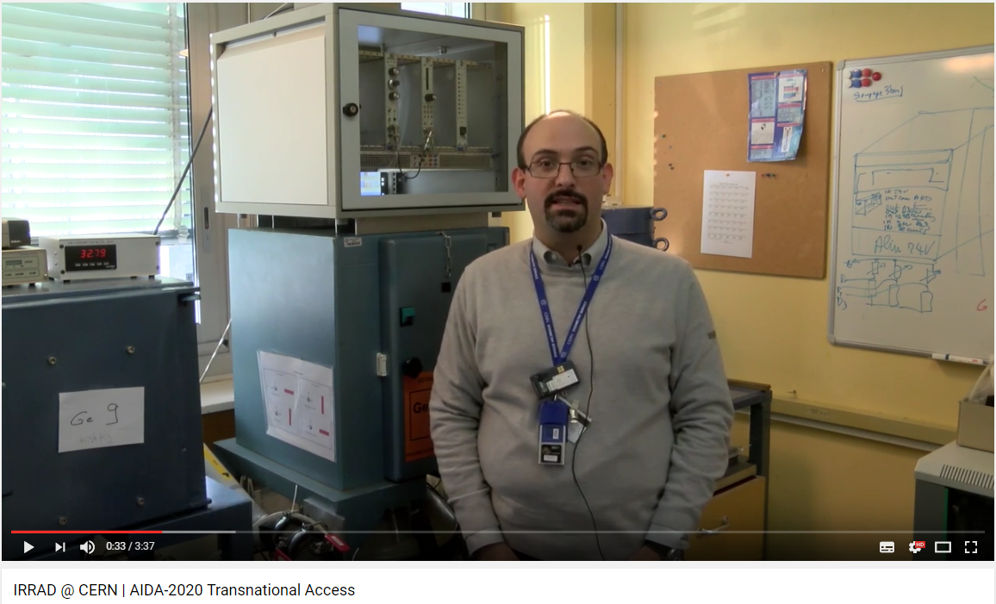
Transnational Access videos
Informational video series for the 10 facilities available via the TA programme
8 out of 10 videos completed & published
2 out of 10 videos are in final approval stage
  Once published, series can be further publicised.
Dedicated AIDA-2020 YouTube channel set up
Future -> to get feedback, assess use of videos
Screenshot of the IRRAD facility video (ft. Federico Ravotti)
Notes:
TA videos – informational video series advertising the facilities of the TA programme.
Content of videos:
Location tour
Facility tour
Interview with Facility Coordinator
Interview with users (where available)
Description of lab + facility particulars
8/10 videos completed + published
On YouTube
On CERN CDS
On TA facility page (on AIDA-2020 website)
As a “Highlight” on the front page of the AIDA-2020 website
2/10 videos in the final approval stages
AIDA-2020 YouTube channel set up for their publication & to facilitate easy sharing.
Content of videos:
Location tour
Facility tour
Interview with Facility Coordinator
Interview with users (where available)
Description of lab + facility particulars
Business trip (2-3 days, with one full day of filming) by INFN Multimedia Group
Editing in Bologna ~1 day for each video (difficult to estimate production times)

Slide 11
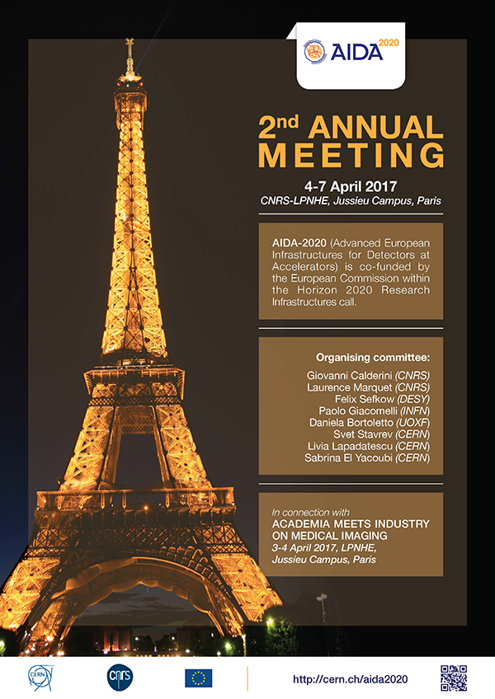
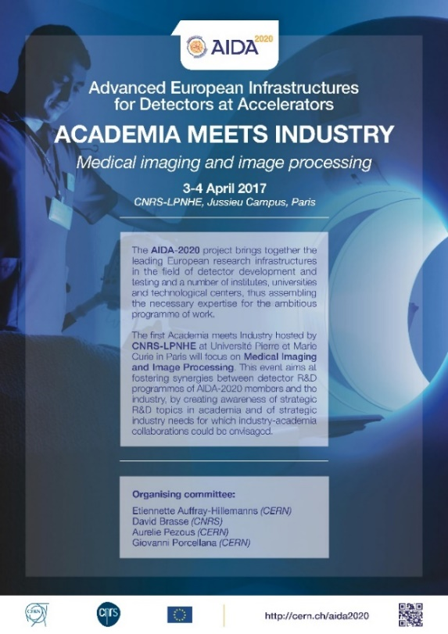
Event posters
2nd Annual
Meeting poster
Academia meets Industry event poster
Notes:
Posters coordinated by Livia & Sabrina in the CERN EU Office.
Posters produced for 1st Annual Meeting, the Proof of Concept Fund, the 2nd Annual Meeting, and the Academia Meets Industry event.
For the 2nd Annual Meeting + AMI even posters:
Displayed around CERN, taken to Trento workshop.
Slide presented at Trento workshop to advertise.

Slide 12
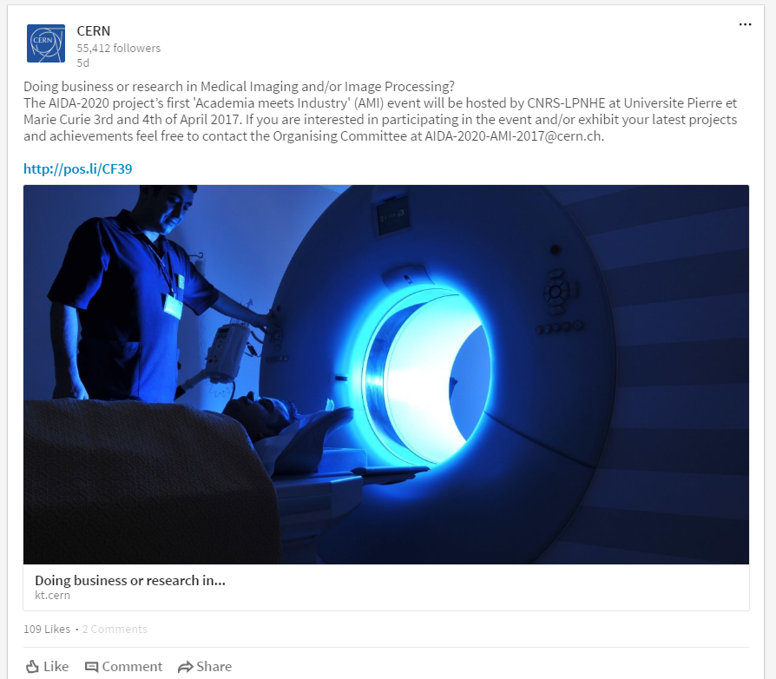
Academia Meets Industry event advertising
Posters
  Around CERN
  At Trento workshop
Presentation slide
  At Trento workshop
Websites
  AIDA-2020 & On Track
  CERN KT
  Université Paris Diderot
  Scintacor
Social media
  CERN LinkedIn account (to 55k followers)
  Personal LinkedIn accounts (of KT staff)
Notes:
AMI event advertising: posters, presentation slides, website announcements, social media

Slide 13
Publications
Target = 180 publications (over duration)
  Incl. 60 journal + 50 conference proceedings
Current = 78 publications
  Incl. 17 journal (28%) & 12 conference papers (24%)
78/180 = 43%
To be expected - many publications will
come at the end of the project.
Notes:
The total number of publications to be achieve is set at 180, which should include 60 journal papers and 50 conference proceedings.
We have reached 78 publications (which includes journals, conferences, presentations, posters, newsletters etc). This is 43% of our overall publications target as of Y2.

Slide 14
Future plans
Publish final 2 TA videos + publicise elsewhere
More articles in external outlets (ie. CERN Courier)
Educational resources – to be defined in Y3
  Please share your own resources with us -> AIDA-2020-comms@cern.ch
At least 4 issues of ‘On Track’ in 2017
Notes:
The final 2 TA videos will allow us to further publicise the videos in other channels (ie, related CERN or facility channels)
With increase number of results and increased articles for On Track, we aim to have more articles in other outlets on the project.
Education resources – this might be lecture slides, flyers, factsheets, videos etc. If you have some resourced of your own, or ideas for the types of resources we could be producing, please share them with us.
On Track published 3 times in 2017 (despite beginning as a bi-annual newsletter). As such, we aim to publish at least quarterly in 2017.

Slide 15
Thank you for listening
Contact: Jennifer.Toes@cern.ch
Notes:
Feedback on anything else we could do for project participants re communication. This could be internally or externally.

