Slide 1
BA6 Crab cavity test-stand
EYETS sequencing
EDMS 1738907
Planning of the SPS crab-cavity test stand activities in EYETS2016-2017
Giovanna Vandoni

Slide 2
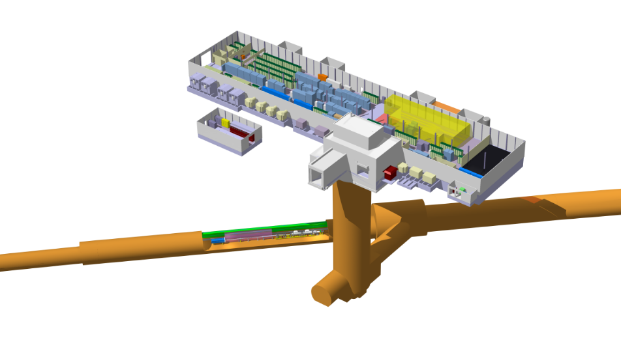
BA6
ZONE CRAB CAVITY
S.Mehanneche 20161115
LSS6
PA6
TA6

Slide 3
GENERAL DATES
Activity | Start | End |  | Duration | Comment
EYETS access in tunnel | 15/12 | 24/3 |  | 12.4 weeks | More time under the false floors?
Magnet campaign | 9/1 | 13/1 |  | 1 week | Magnets through BA6
Cabling campaign | 23/1 | 24/3
Cryoline installation | 23/1 | 10/3 |  | (4 weeks in tunnel, 7 weeks total) | Pressure test 15/3
Scaffold installation (crab zone) | 5/1 | 6/1 |  |  | If Cryotech is not ready, scaffold may be installed on the crab zone with some days delay to ease the other activities here.
Scaffold installation (tunnel) Reduction of transport lane to 1.4m | 16/1 earliest | 20/1 |  | 7 weeks of presence of scaffold | If Cryotech is not ready, scaffolding installation in the tunnel may be delayed by 1 week
Scaffold removal |  | 3/3 |  |  | 3 weeks before EYETS ends, precaution for TPSG bakeout
TIDVG removal | End Feb |  |  | 1 day | Scaffold in place
TIDVG reinstallation | 13/3 |  |  | 1 day | “

Slide 4
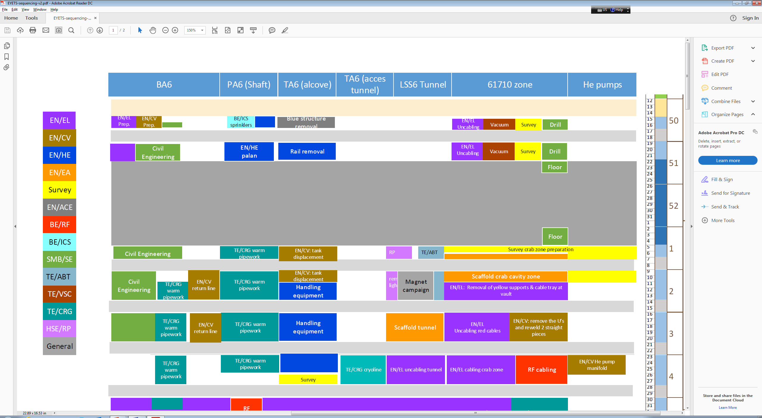
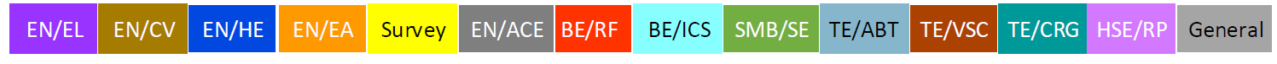

Slide 5
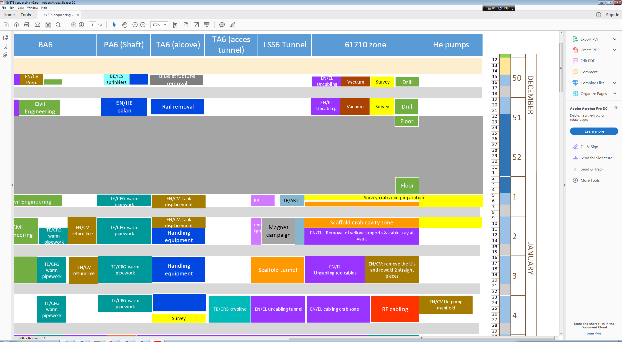
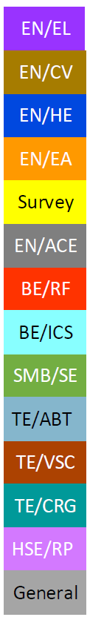

Slide 6
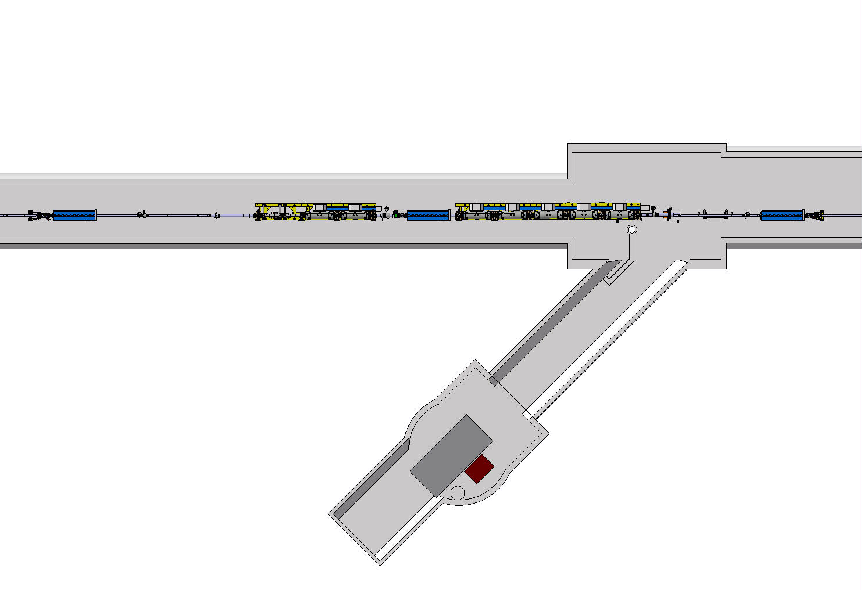
TUNNEL, before Xmas
DATES
Team | Task | Days | Comments
VSC | removal of vacuum pipe, installation of new valves. TPSG and following sectors under N2 QDA and preceding, under vacuum | 3dd | No VIC Team of 3
EN/EL | Uncabling black cables, tunnel wall | 2d | Team of 2
 | Removal of cable tray and smaller connection boxes | 2d
SU | Marking position of the AT401 pillars Inspection, marking positions for wall fiducial holes at crab area | 1d | Team of 2
 | drilling holes and gluing fiducials | 1d
 | measurement of metrology network at crab | 1d | No coactivity 0.5d
 | marking on the floor details of movable table supporting plates, holes for plates threaded rods, etc | 1d
SMB | DIMENSIONE: drilling the AT401 pillar holes and installing the anchors and covers. VIC | 5d | 17:00-20:00

Slide 7
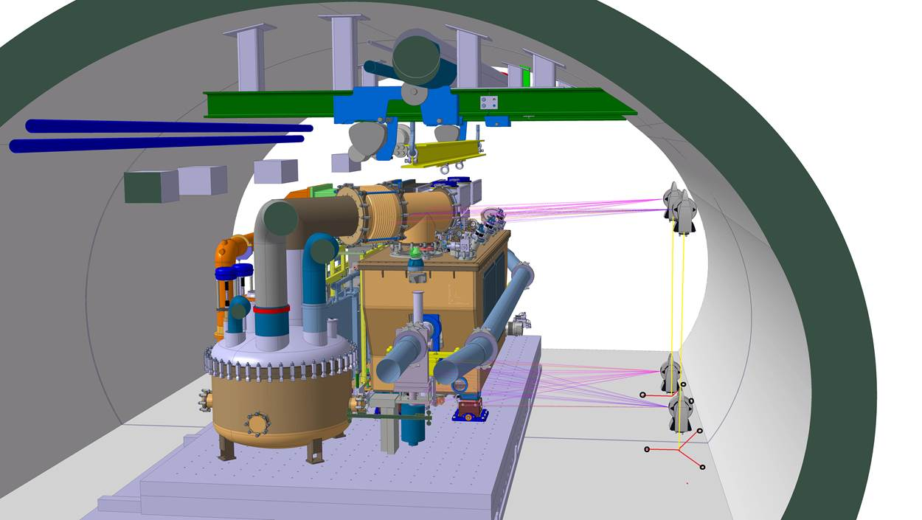
Marking position of the AT401 pillars
Inspection, marking positions for wall fiducial holes at crab area

Slide 8
TUNNEL, during Xmas break
DATES
Team | Task | Days | Comments
SMB | PREZIOSO LINJEBIGG, 22/12 and 23/12 and 2/1 - 5/1 6 persons max, accessing tunnel during Xmas break Preparation of the floor for the transfer table | 5d | VIC
Reason for work during X-mas break: drying of the resin

Slide 9
PREPARATION OF THE FLOOR
CERN supervision?
Activity by PREZIOSO LINJEBYGG for SMB/SE
Filling in the big cracks and holes (if any) with a suitable cement-based mortar. The micro-cracks cannot be filled in.
Installation of a reinforcing mesh (40 cm X 40 cm) fixed to the existing concrete by using screws
Application in the mesh of a Resin Sikafloor 156
Application of a grout Sikafloor 156 to cover the heads of the screws.
On the top of that, application of the thick resin usually used in tunnel (Primer Sikafloor 161 and two layers of Sikafloor 263)
The thickness of all the layers together is about 5 mm.
DATES
TA6
PA6
QDA 61910

Slide 11
TUNNEL, after Xmas break
Activity for Survey before scaffold is set up, to prepare for the installation of the cryoline (Cryotech) and the cabling campaign
Day 1 ACE/SU mark dcum
Day 2-3 Scaffold
Day 4-5 EN/EL uncabling
Day 6-8 EN/CV works
Flexibility of 1 day between scaffold installation and survey, right after Xmas
Team | Task | Days | Comments
ACE/SU | Mark dcum (1m) from QDA61710 to BL61771 for EN/EL campaign | 1d | Volume of work?
EN/EA | Scaffold in the crab-cavity zone alone | 2dd | VIC
EN/EL | Uncabling red cables, removal of yellow supports & cable tray at vault and tunnel wall | 3d | Need scaffold
EN/CV | remove the U’s and reweld 2 straight pieces | 3d | Need scaffold

Slide 12
MAGNET CAMPAIGN
Magnets transit through BA6: from 9th Jan to 13th Jan
TIDVG removal: end February
TIDVG installation: 13th March

Slide 13
TUNNEL, before scaffold installation
DATES
Team | Task | Days | Comments
RP | Removal of RP lights from the MST/MSE zone to free for scaffolding | 0.5d | Before 16/1
TE/ABT | Preparation of the MST/MSE for scaffolding: removal of delicate equipment, cables etc. | 2d | Before 16/1
Minor work, but must be finished before 16th Jan (scaffold installation)

Slide 14
TUNNEL, scaffold
Team | Task | Days | Comments
EN/EA | Scaffold over LSS6, 40m | 5d | VIC
See next slides for scaffold use regulations

Slide 15
SCAFFOLD USE AND REGULATIONS
Cryotech
TE/CRG
EN/EL
EN/CV
250
Ouvaroff (C.Ruby)
Cryotech
TE/CRG
EN/EL
EN/CV
G.Vandoni
If during the activity it becomes necessary to modify the scaffold, (e.g. dimount partially a barrier), the mdification is done by Ouvaroff. One week notice is sufficient.

Slide 16
TUNNEL, with scaffold
Team | Task | Days | Comments
EN/EL | Uncabling |  | VIC
 | Removal of cable tray and yellow supports at the vault | 5d
BE/RF | Coaxial cables installation

Slide 17
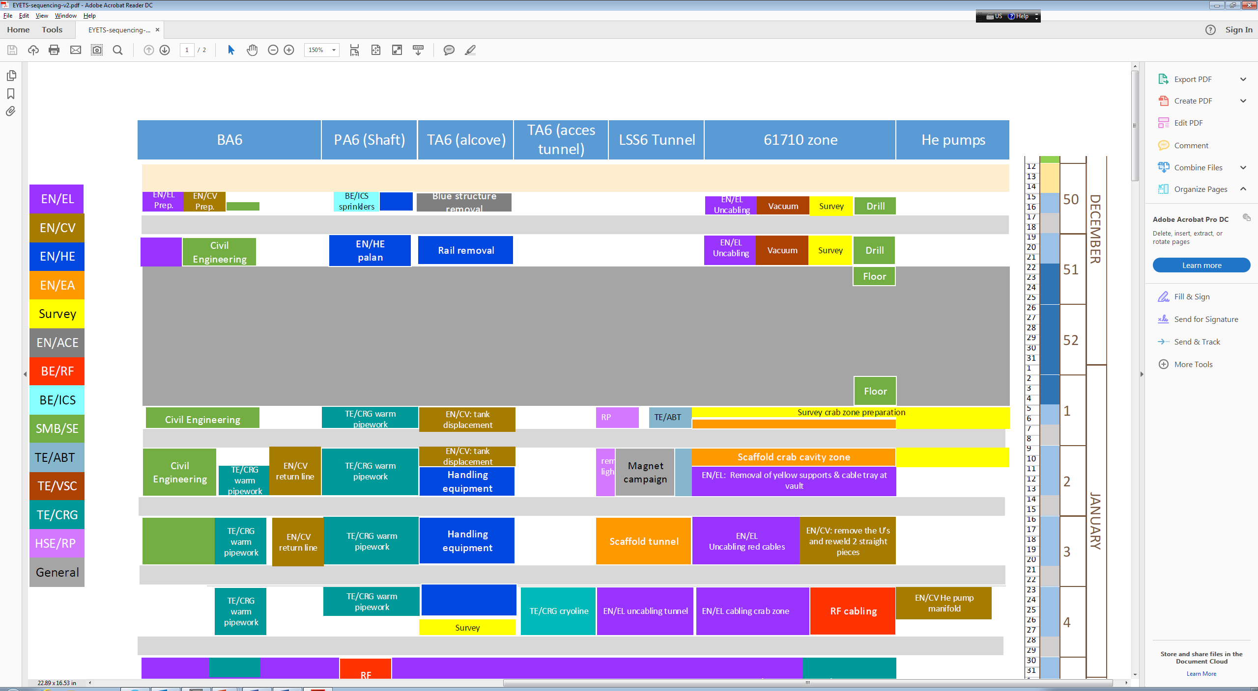
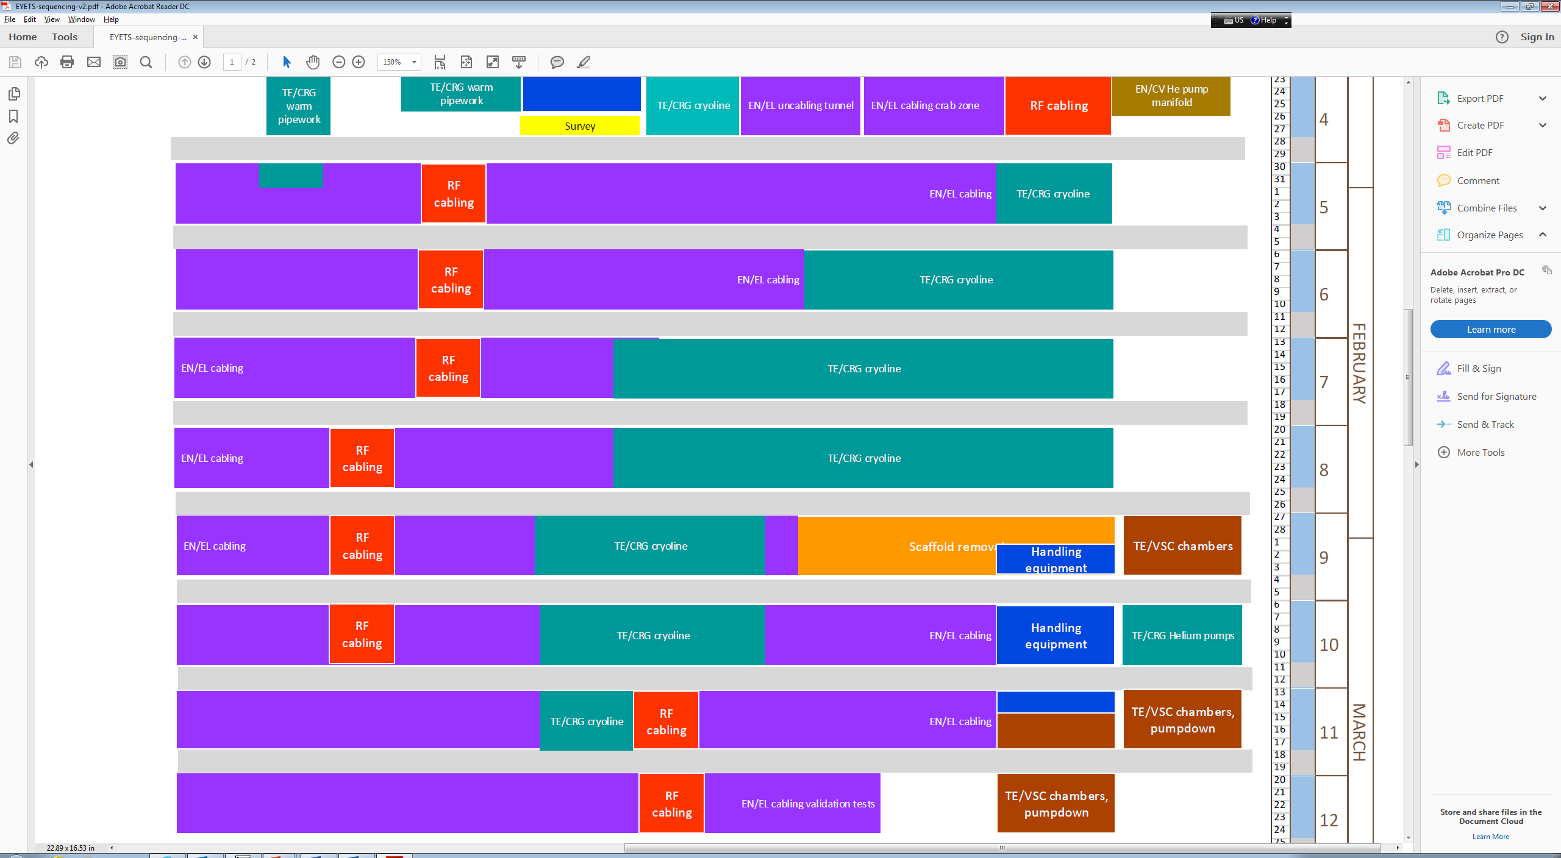

Slide 18
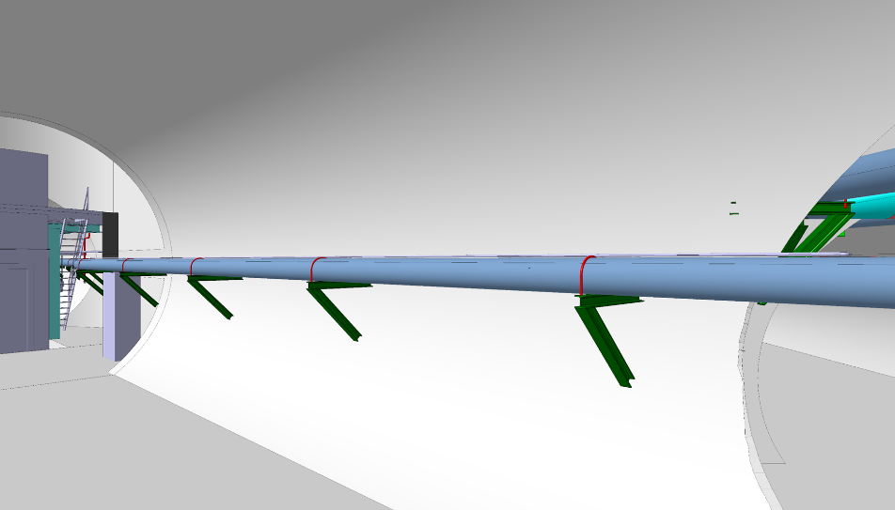
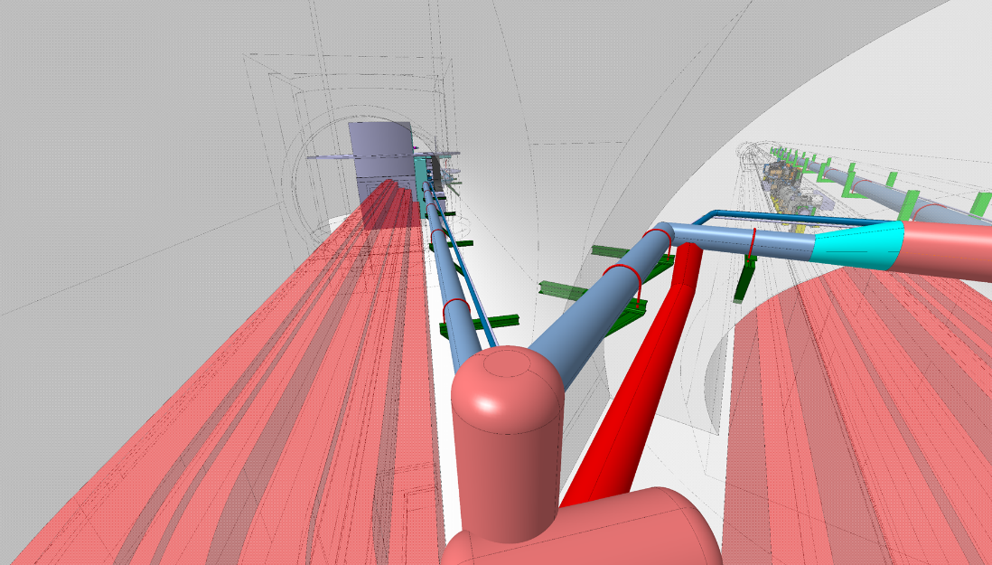
CRYOGENIC DISTRIBUTION LINE
Delivery 23-27 Jan
Installation 30/1 to 10/3
Pressure test 15/3 latest
DATES

Slide 19
CRYOGENIC DISTRIBUTION LINE
Mask training, VIC
Temporary storage of segments in TA6
Installation of supports at the ceiling
Positioning of segments on the supports at the ceiling
Welding of internal lines (in the tunnel, TA6, compensator boxes)
X-rays
Leak test internal lines
Welding external vacuum envelope (tunnel)
(Scaffold removal)
Pressure test
Scaffold can be removed after the tunnel segments are welded, while still working on the TA6 part and compensator boxes
DATES

Slide 20
EN/EL CABLING CAMPAIGN
Overall duration: 8 weeks (+1)
Work in the technical gallery
BE/RF coaxial cables are pulled in parallel

Slide 21
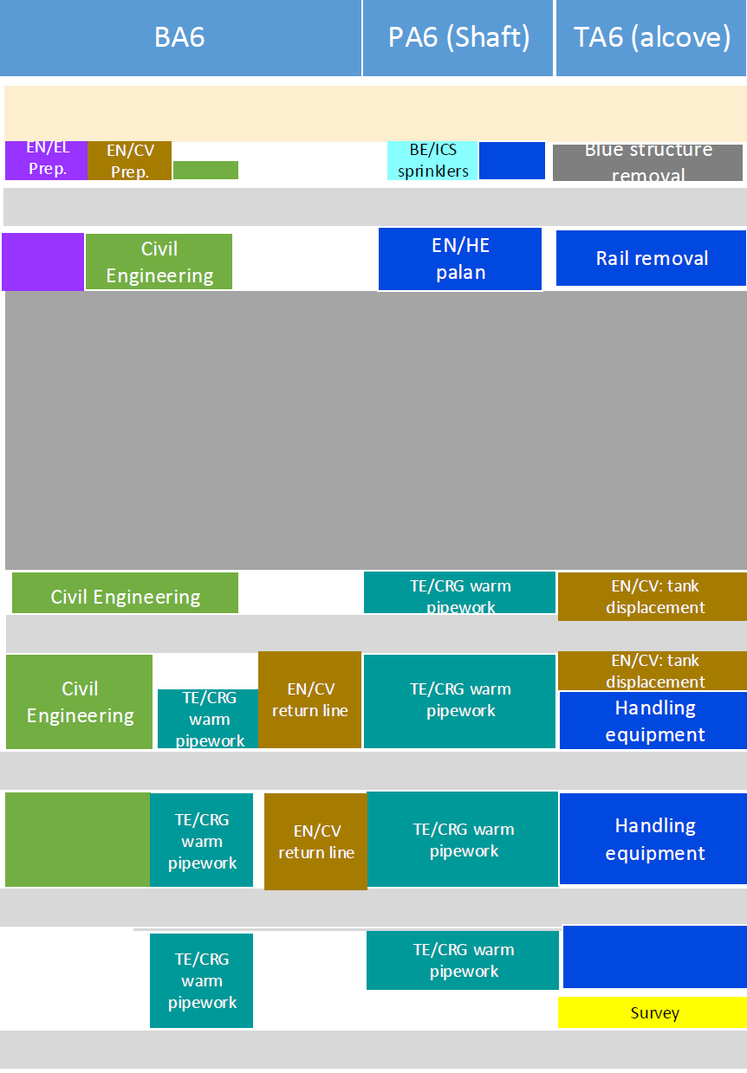
TA6 alcove, PA6 shaft, BA6 – before cabling

Slide 22
TA6 ALCOVE, EYETS activities
Team | Task | Days | Comments
EN/ACE | Removal of blue structure | 2dd | M.Arnaud
EN/HE | Removal of 0.5 ton handling rail | 3dd | G.Roche
EN/CV | Displacement of compressed air tank | 3dd | P.Pepinster
EN/HE | New handling equipment | 2wk | C.Bertone
 | Load test of new rail | 25/1 | L.Colly
ACE/SU | Mark positions for EN/EL campaign | 2d
EN/EL | Installation of new cable trays | 8wks
 | Cabling campaign
TE/CRG | Cryogenic distribution line installation, welding | 6 wks
 | Pressure test | 15/3

Slide 23
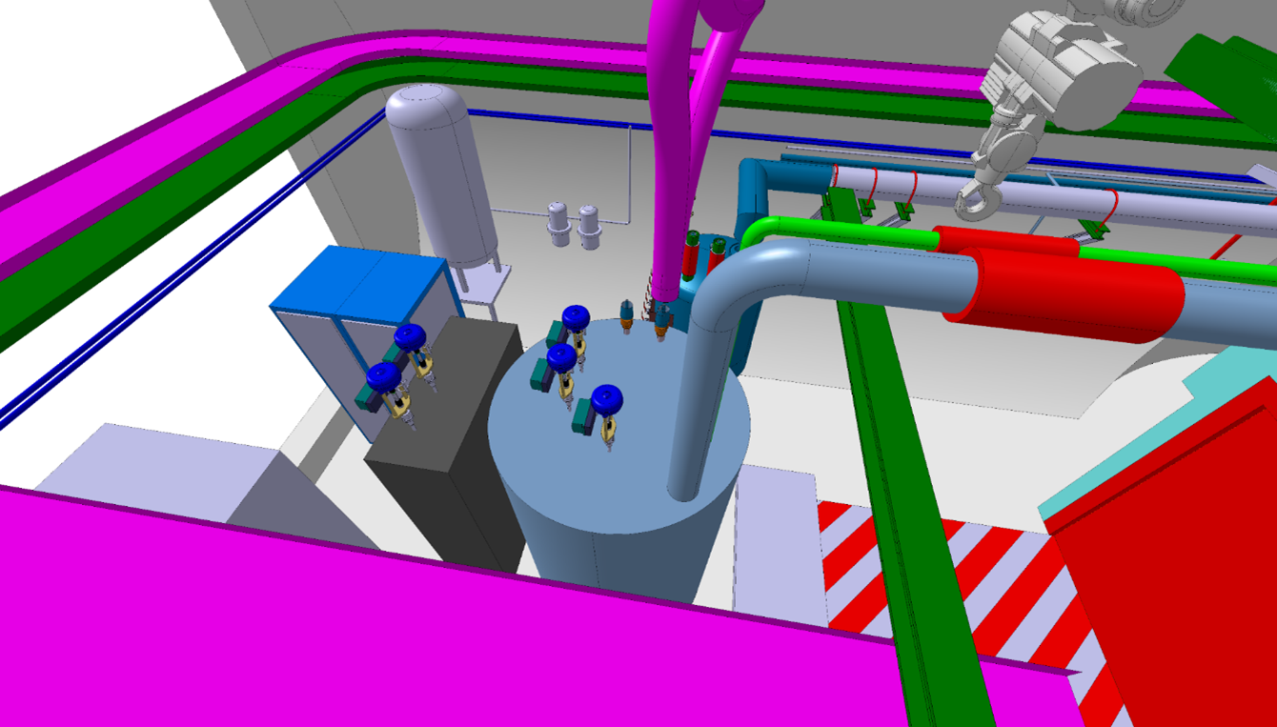
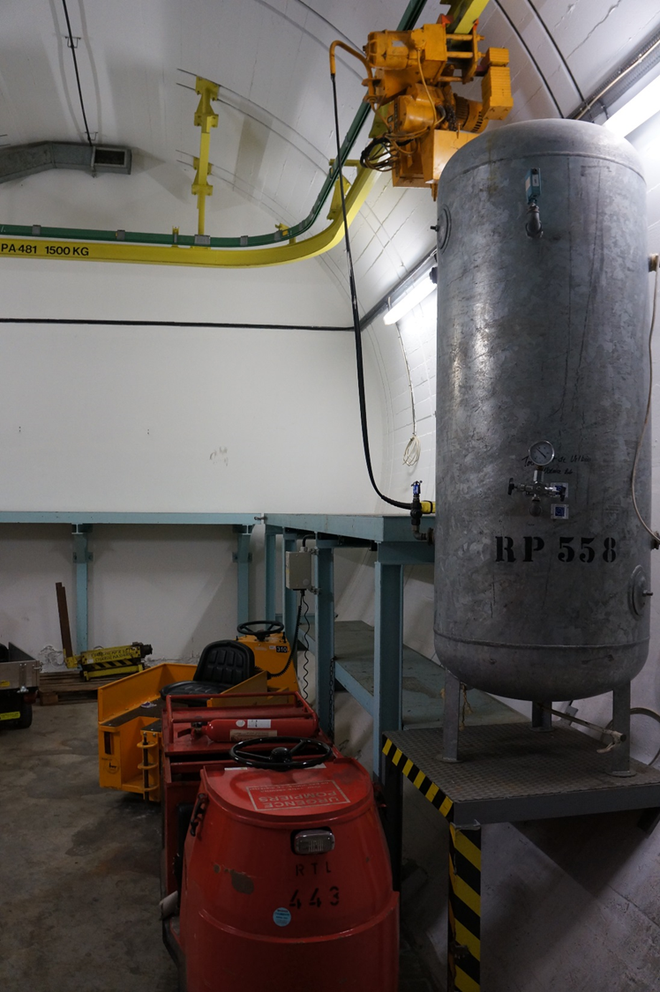

Slide 24
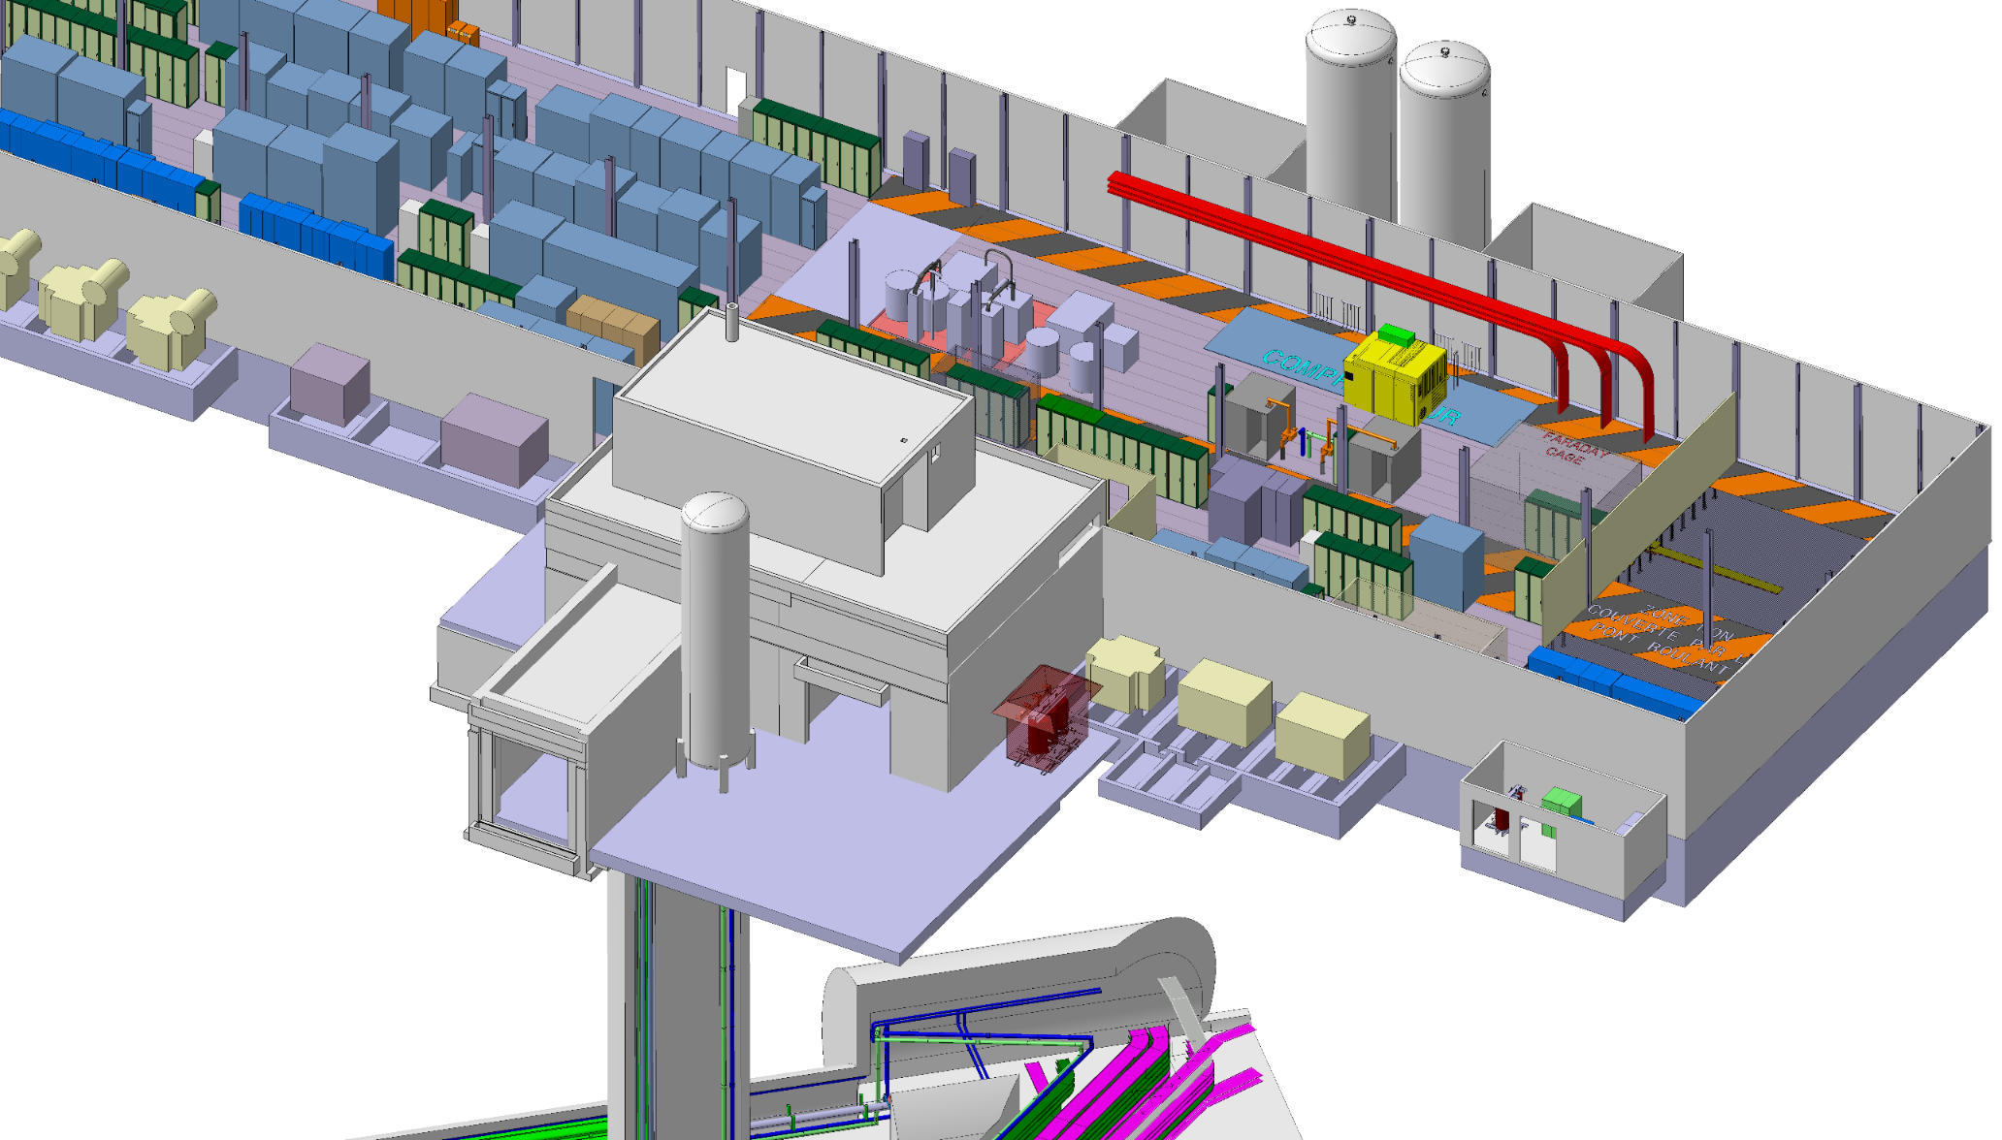
BA6 and shaft
S.Mehanneche 20161115

Slide 25
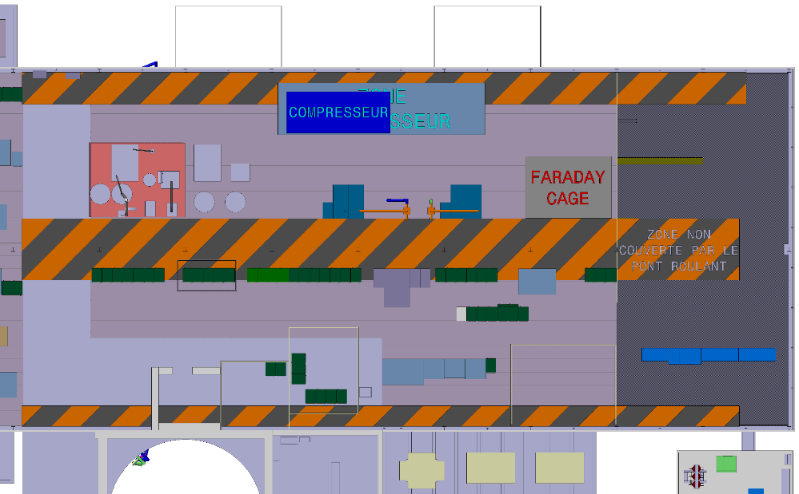
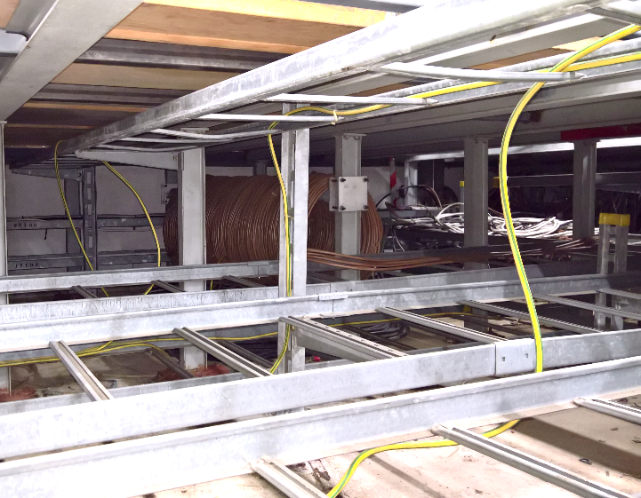
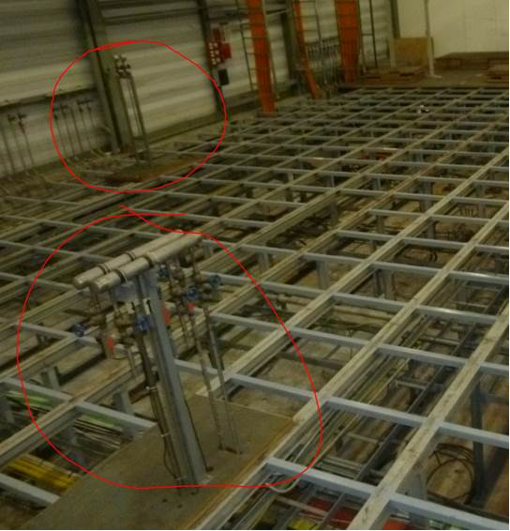
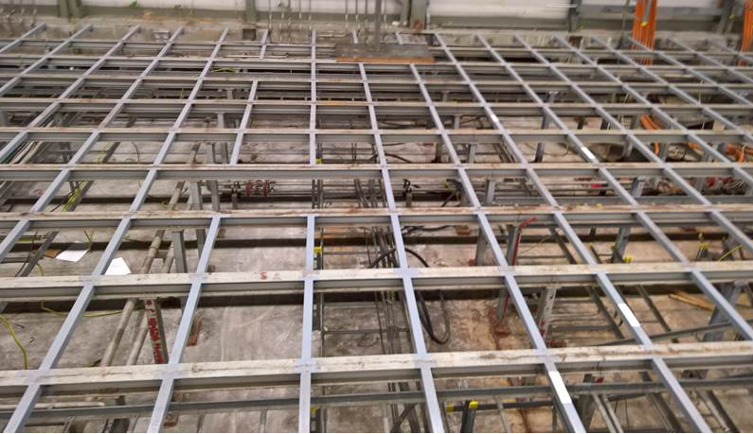
BA6, PREPARATORY WORK
clarinettes
Team | Task | Days | Comments
EN/EL | Removal of cable coil at Faraday cage position | 2dd | Owner??
 | Removal of unused cable trays | 2dd
EN/CV | Removal of unused “clarinettes” | 2dd
SMB/SE | Consolidation of BA6 false floor supporting structure | 1d | 16 december

Slide 26
BA6 CIVIL ENGINEERING
Intervention to consolidate the false floor structure before work underneath is possible
16th december
Team | Task | Days | Comments
SMB/SE | Consolidation of BA6 false floor supporting structure | 1d | 16/12/2016

Slide 27
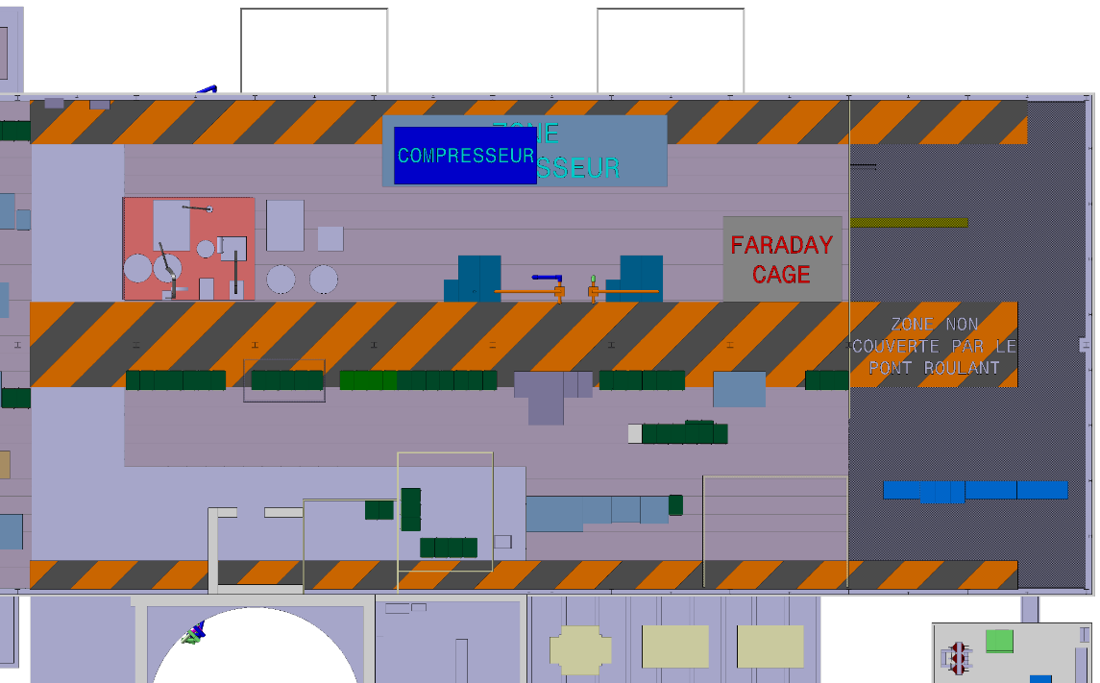
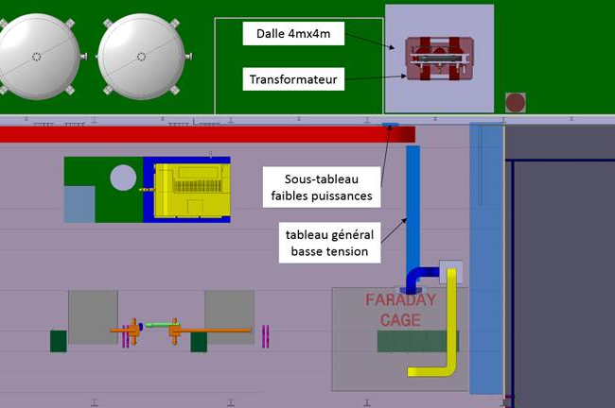
BA6 CIVIL ENGINEERING
Team | Task | Days | Comments
SMB/SE | Installation of supporting structures for IOTs |  | 3 weeks
 | Faraday cage
 | TGBT Tableau General Basse Tension
 | Cryo compressor |  | Position and supports not yet defined

Slide 28
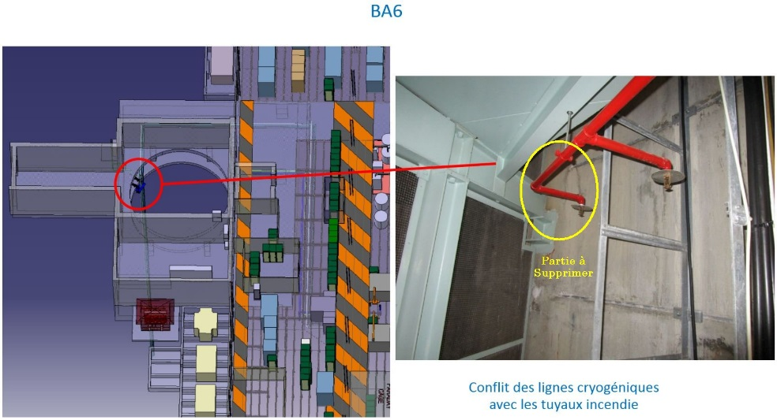
PA6 SHAFT, PREPARATORY WORK
EN/HE
Old “palan” removal
New “palan” connection and load test
Team | Task | Days | Comments
BE/ICS? | Removal of sprinklers in PA6 shaft | 2dd
EN/HE | Removal of old “palan” | 5dd | Large slot, to be arranged with BE/ICS
 | Connection of new “palan”
 | Load test (Laurent Colly) | 0.5d | 20/12
Removal of the sprinklers? Same team as cryo warm pipework (P.Cruz)?

Slide 29
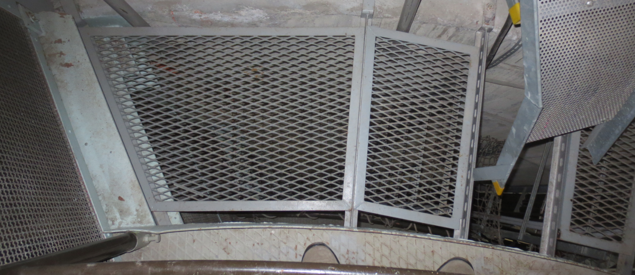
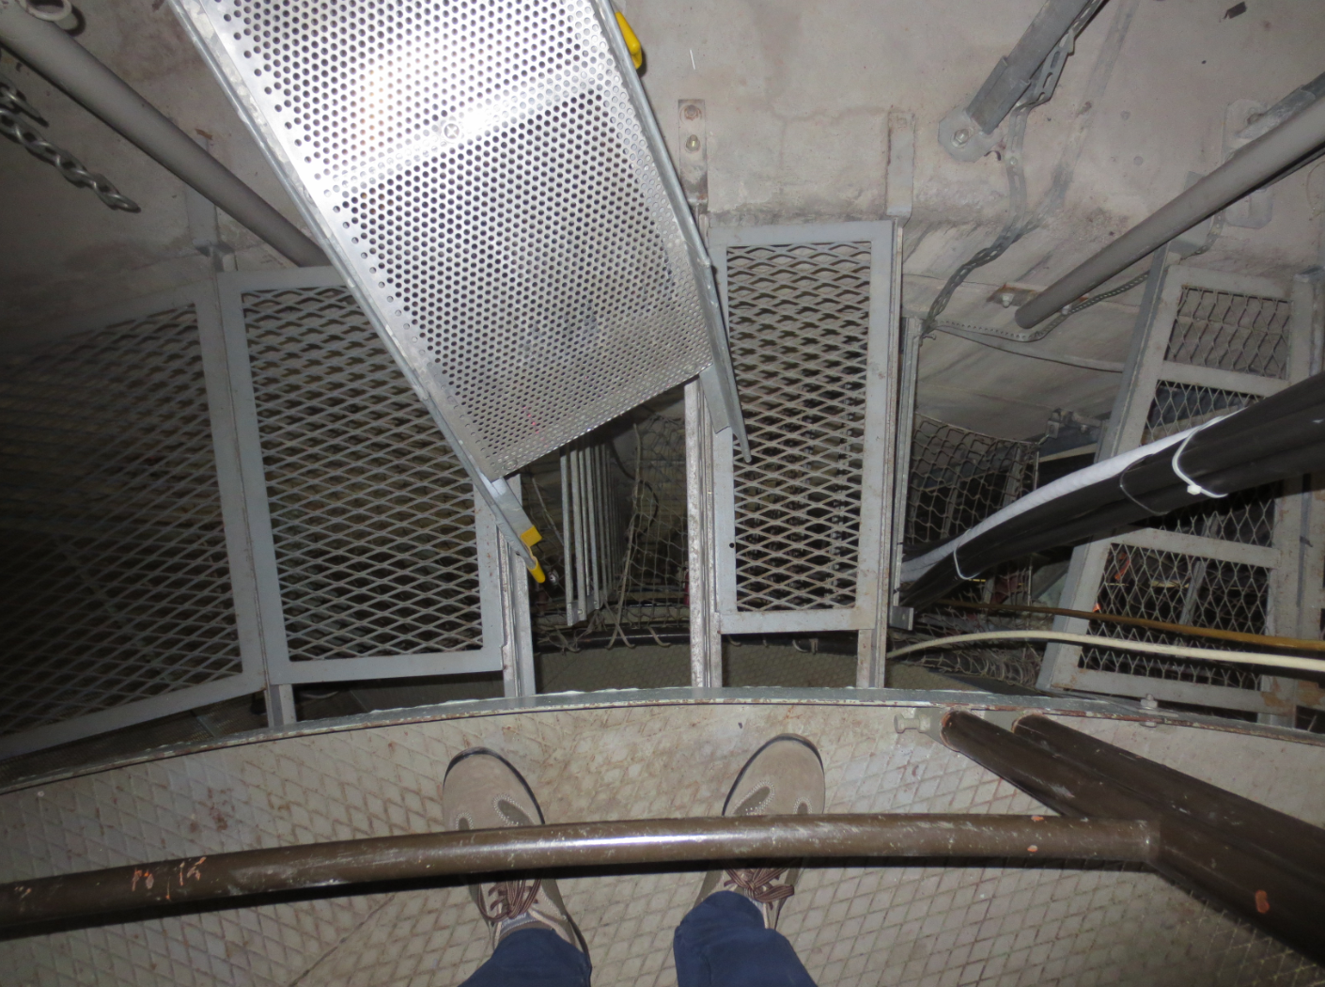
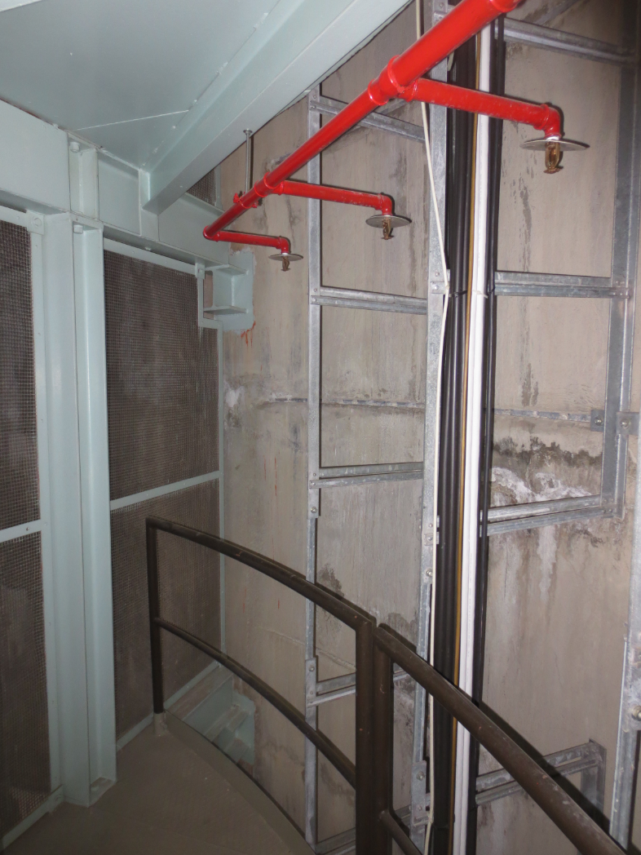
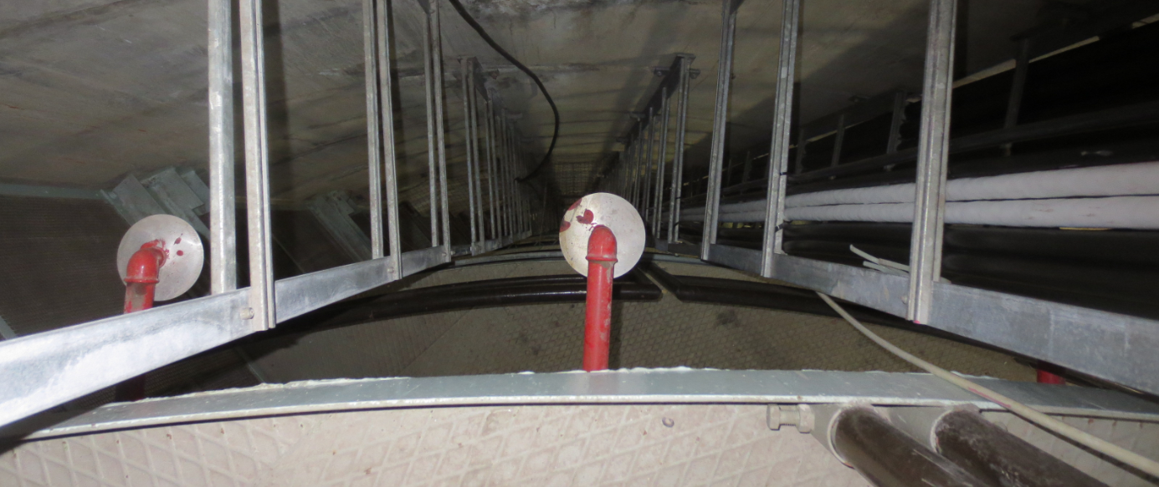
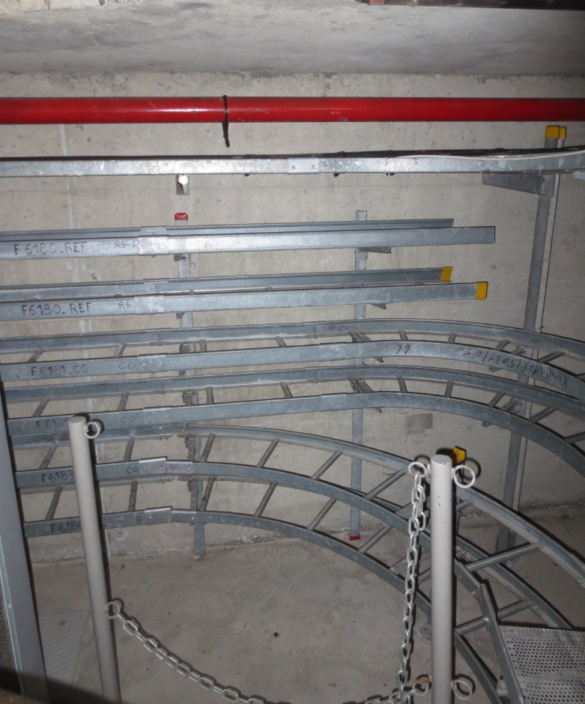
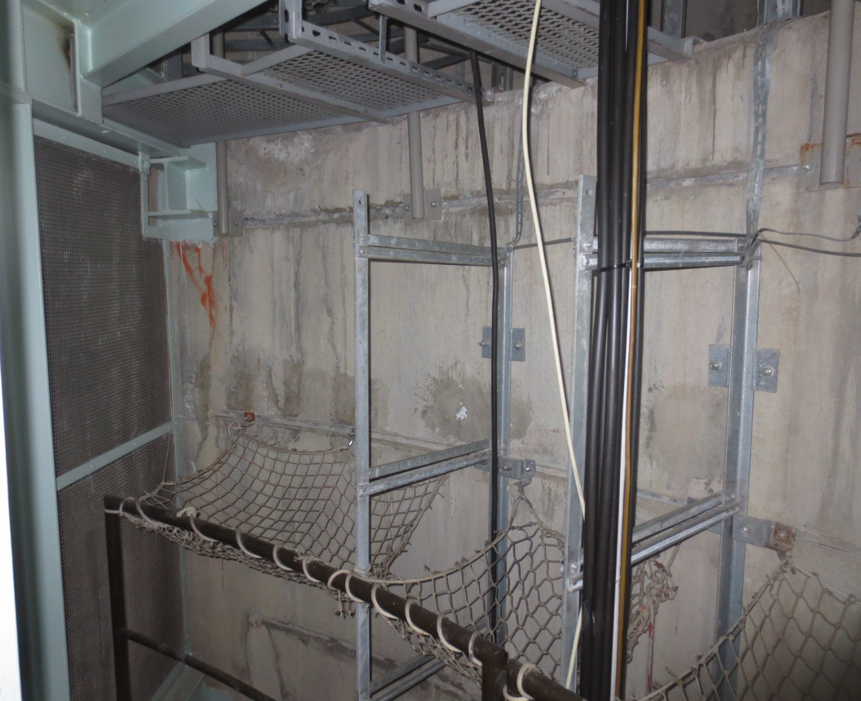
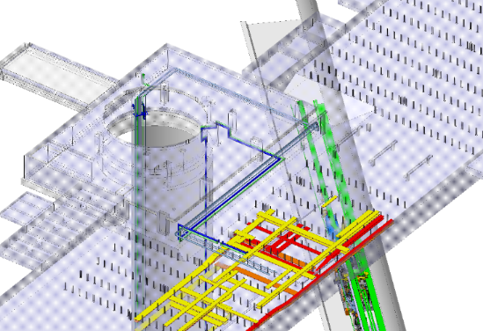
Zone PA6
Integration conflit : warm cryo pipework / sprinklers
/ cable tray
S.Mehanneche 20161115

Slide 30

PA6 SHAFT, INTEGRATION CONFLICT
To be solved out of this meeting but urgently!

Slide 31
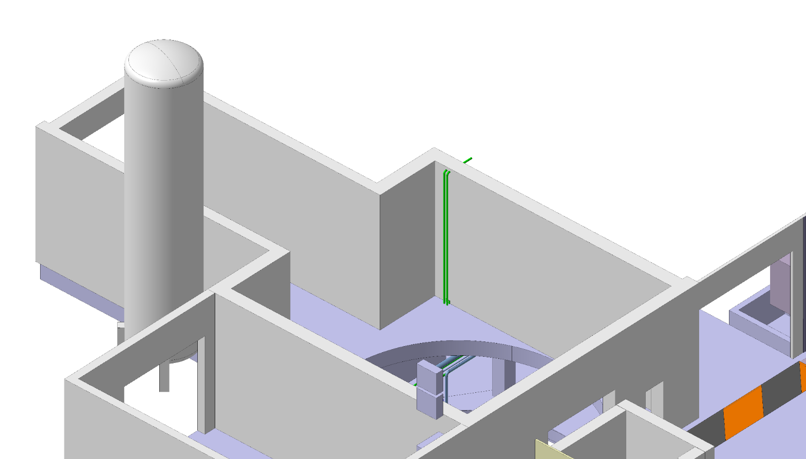
PA6 SHAFT, «carottage» for cryogenic vent
Has this been asked to SMB?
Is it acceptable for RP and EN/CV?
…to go in the ECR
S.Mehanneche 20161115

Slide 32

BA6 CRYOGENIC (and CV) WARM PIPEWORK
S.Mehanneche 20161115

Slide 33
BA6 CRYOGENIC (and CV) WARM PIPEWORK
SHAFT
Shaft exit
BA6 compressor zone
To EN/CV zone
1 week
1 week
1 week
1 week
1 week
1 week
1 week
1 week
1 week
Team | Task | Days | Comments
TE/CRG | Pipework in the shaft, welds, handling | 3wks
 | Pipework at the exit of the shaft, welds | 1wk
 | Pipework to the compressor zone, welds | 2wks
EN/CV | Pipework (DN80) from the exit of the shaft to the EN/CV zone | 2wks
Is there a possibility to mutualize the common zone (same supplier?)

Slide 35
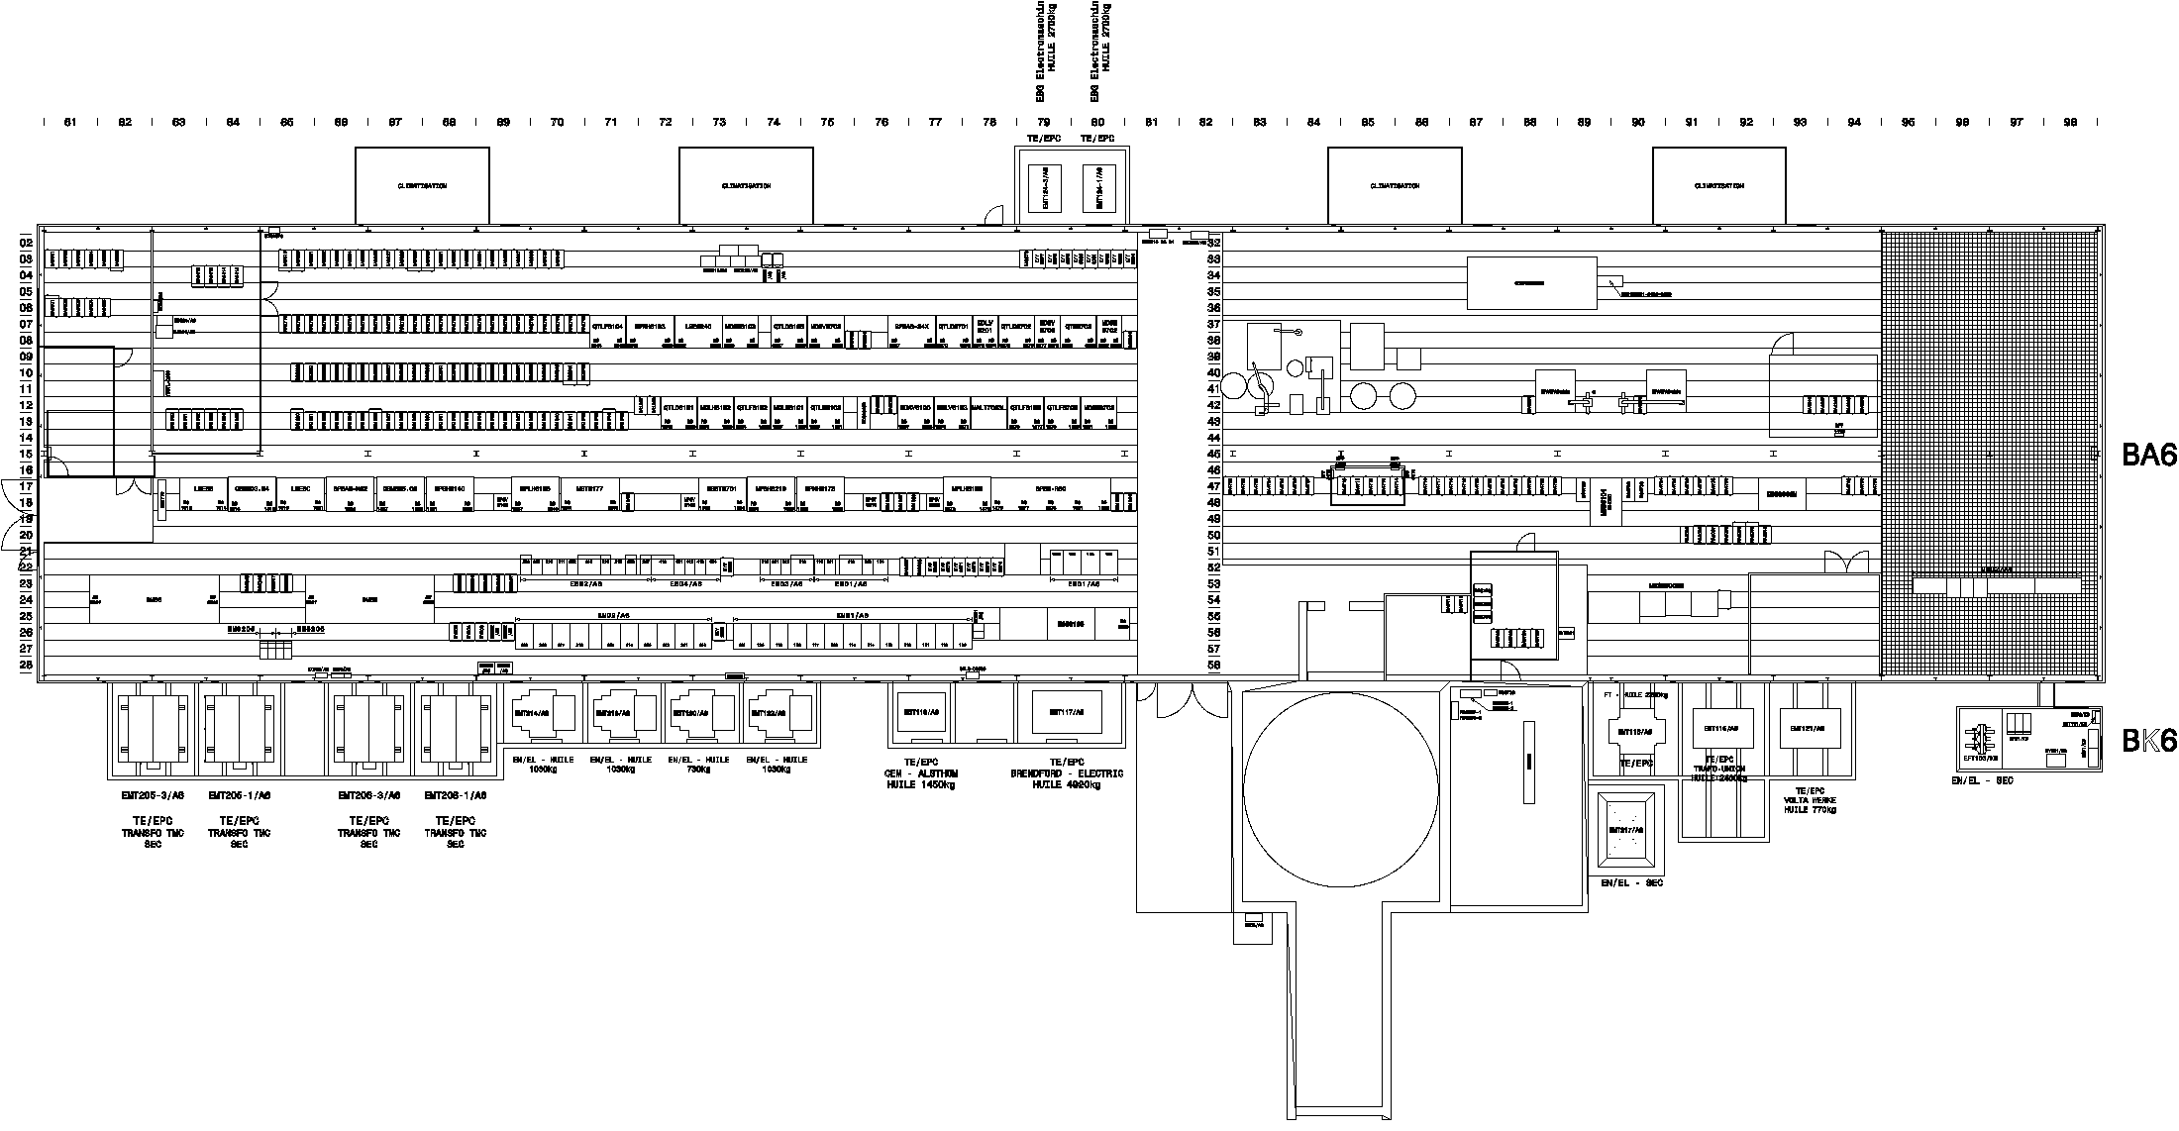
BA6 - EN/EL CABLING CAMPAIGN

Slide 36
TUNNEL, end of EYETS

Slide 37
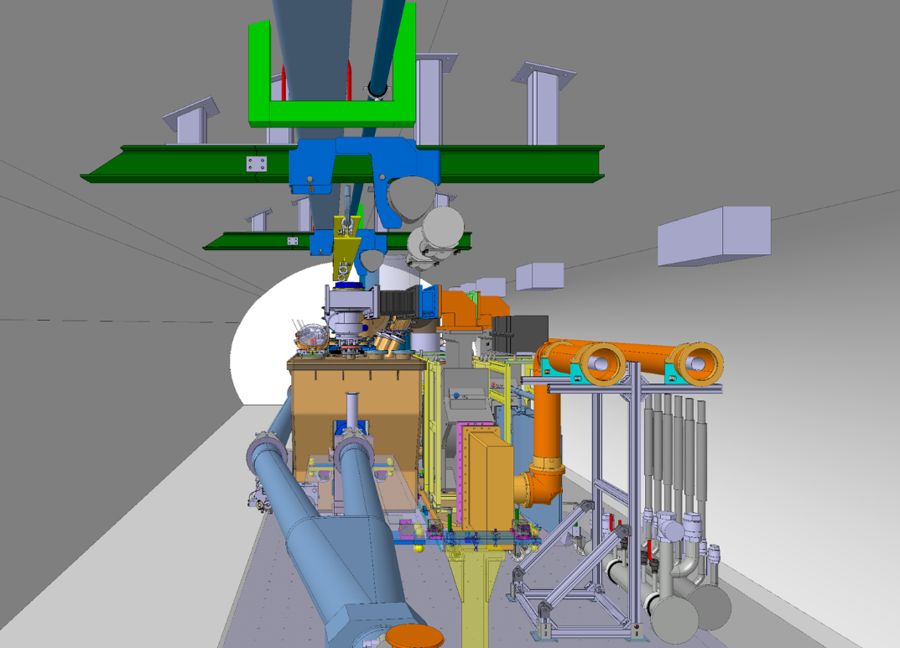
TUNNEL, end of EYETS
Team | Action | Days | Comment
EN/EA | Scaffold removal, first on crab zone | 5d
(EN/CV | Piquages for He pumps | 2d | Only contraint: before He pump installation
TE/VSC | Check of vacuum in MST/MSE
EN/HE | Installation of new handling rail on top of the crab cavity zone, with load test | 2wks | Nothing underneath VIC
TE/VSC | Closure of vacuum on crab zone, pumpdown, leak check

Slide 38
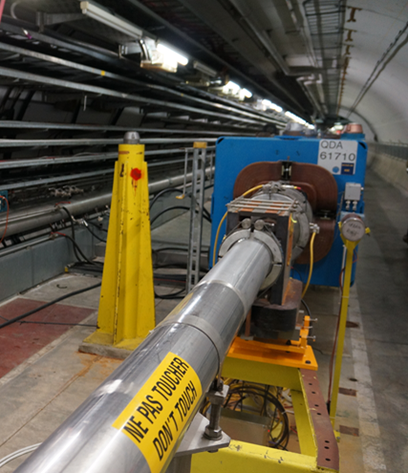
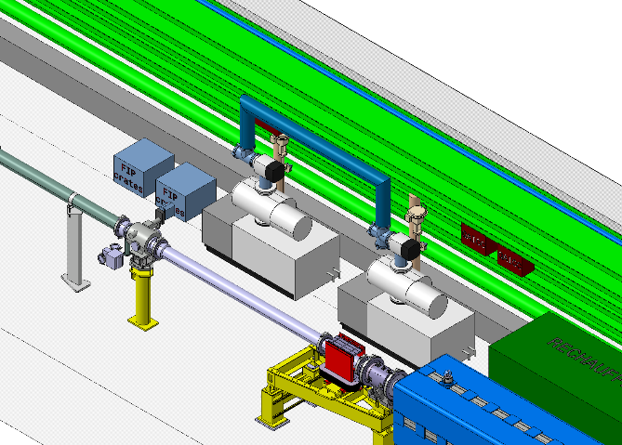
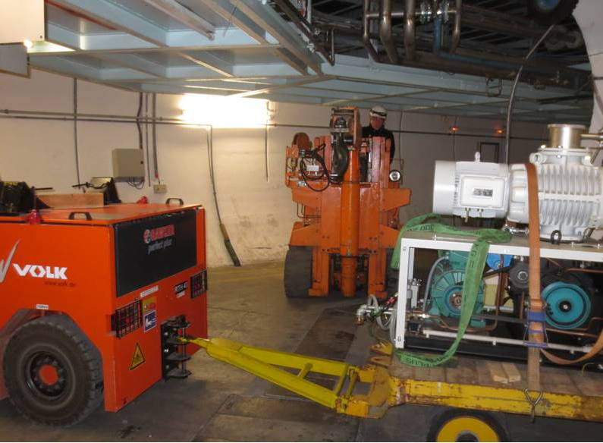
Helium PUMPS ZONE
Team | Action | Duration | Comment
ACE/SU | Removal of yellow pillar | 1d
 | Mark dcum at the floor | 1d
EN/CV | Piquages for He pumps | 2d
TE/VSC | Removal of vacuum chambers upstream of QDA | 5dd
TE/CRG | Positioning of He pumps | 5dd
TE/VSC | Closure of vacuum chambers upstream of QDA | 5dd

