Slide 1
LN4 connection
H- beam hazard coming from LINAC4
  Objective : personnel protection for the PSB zone
  Assign the EIS-beam of the LN4 transfer line (L4T.TDISA.740 & L4T.MBH.250)
  Remove the two existing beam stoppers (BI.STP FA & BI.STP SW)
Operation constraints
H- beam operation (from LN4), only when both areas, PSB and SWY, are switched in BEAM mode;
no measurements in LBE with H- so long as PSB is in access
LN4 becomes the upstream zone for both PSB & SWY (intrusion → LN4 beam cut off)

Slide 2
LN4 connection
H- beam hazard coming from LINAC4
  INTEGRATION OF EIS-b IN THE ACCESS SAFETY SYSTEM
  SOLUTION 1
  Management of EIS-b by both PPS : Switch-Yard & Booster
Interface signals for 1 EIS-b with the PASS : S1
 | NE12 | CABLE (A) |  |  |  | NE12 | CABLE (B)
 | 1 | SAFE_1 | [from EIS to PLC] | (NO) |  | 1 | SAFE_2 | [from EIS to PLC] | (NC)
 | 2 |  |  | input |  | 2 |  |  | input
 | 3 | "out of Beam" (Beam stopper) | [from EIS to PLC] | 0 (or NO) |  | 3 | SAFE | [from EIS to redundant System] | 0 (or NO)
 | 4 |  |  |  |  | 4
 | 5 | VETO_1 | [from PLC to EIS] | (NO) |  | 5 | VETO_2 | [from redundant System to EIS ] | (NO)
 | 6 |  |  | output |  | 6 |  |  | output
 | 7 | F.B. VETO_1 | [from EIS to PLC] | (NC) |  | 7 | F. B. VETO_2 | [from EIS to redundant system] | 0 (or NO)
 | 8 |  |  | input |  | 8 |  |  | input
 | 9 | spare | - | - |  | 9 | spare | - | -
 | 10 |  |  |  |  | 10
 | 11 | Cable connected | - | (NC) |  | 11 | cable connected | - | (NC)
 | 12 |  |  | input |  | 12 |  |  | input
L4T.TDISA.740
L4T.MBH.250
Switch-Yard
PPS
Booster
PPS
  Add sensors & veto for wiring EIS-b of both areas (SWY & PSB) ? Not conceivable

Slide 3
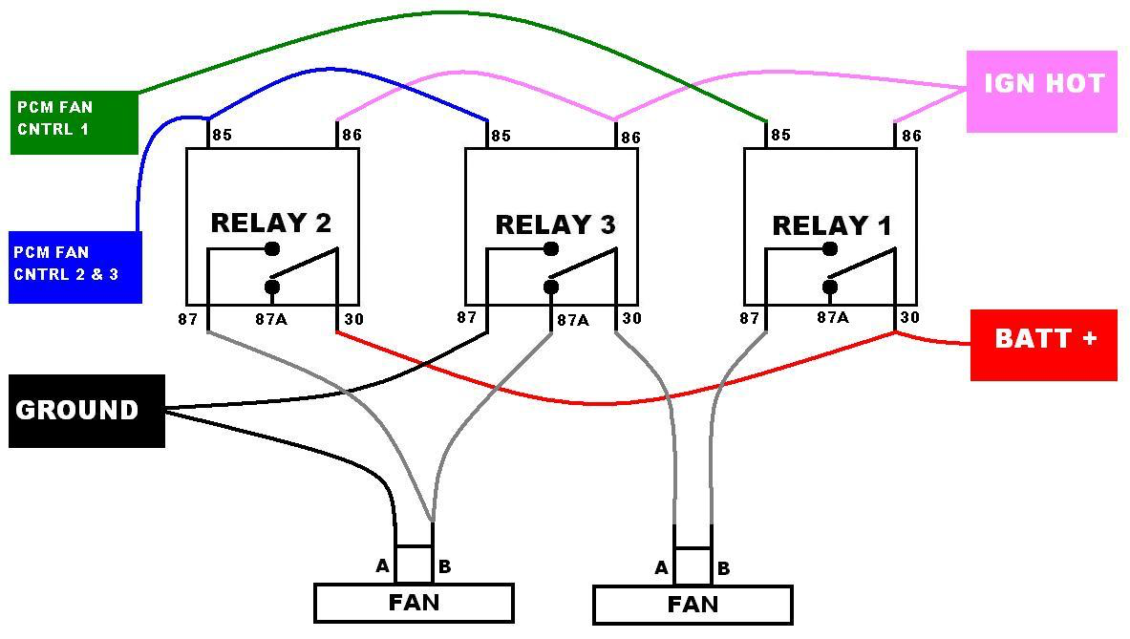
LN4 connection
H- beam hazard coming from LINAC4
  INTEGRATION OF EIS-b IN THE ACCESS SAFETY SYSTEM
  SOLUTION 1
  Management of EIS-b by both PPS : Switch-Yard & Booster
  Need to add relays for signal duplication (2 PPS sub-systems)
L4T.TDISA.740
L4T.MBH.250
Switch-Yard
PPS
Booster
PPS

Slide 4


LN4 connection
Solution 1 : add relays between EIS-b et PPS for connection of both areas
(duplication of contacts)
Difficulties to tackle (pros and cons)
Avoid a hidden common mode (relays)
Manage the veto discrepancies (according to operation modes of both machines)
EIS- b test → PSR-SWY and PSB in test mode
Technical implementation more difficult (main & redundant system) and never carried out
PSB and SWY can be independently switched to beam mode (but H-beam requires both)

Slide 5
LN4 connection
H- beam hazard coming from LINAC4
  INTEGRATION OF EIS-b IN THE ACCESS SAFETY SYSTEM
  SOLUTION 2
  Management of EIS-b only by the Booster PPS
L4T.TDISA.740
L4T.MBH.250
Switch-Yard
PPS
Booster
PPS
Safety condition
Switch Yard shall be under “Beam ON” mode in order to enable and maintain “Beam ON” mode for the Booster

Slide 6

LN4 connection
Solution 2 : EIS-b managed only by the PSB
(additional safety condition for PSB)
recommended solution
Pros and cons
“Beam ON” mode of PSB depends on “Beam ON” mode of SWY
EIS- b test → PSB in test mode → ion beam injection possible for LEIR
Separation of PPS sub systems (PLC & logic wired)
No duplication of objects (GUI)
Technical implementation easier and already achieved (AD)

