Slide 1

CC Inside LARP/AUP
Giorgio Apollinari
US HL-LHC AUP Project Manager
CERN – April 3rd – 5th, 2017

Slide 2
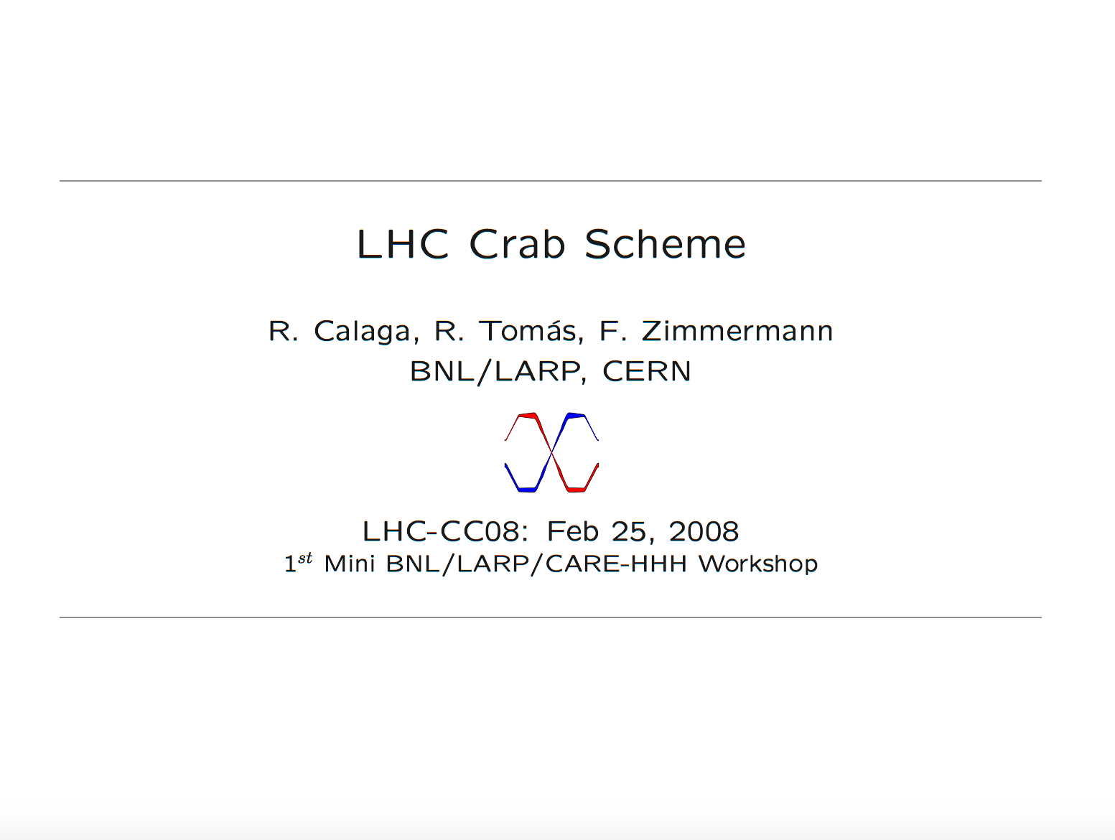
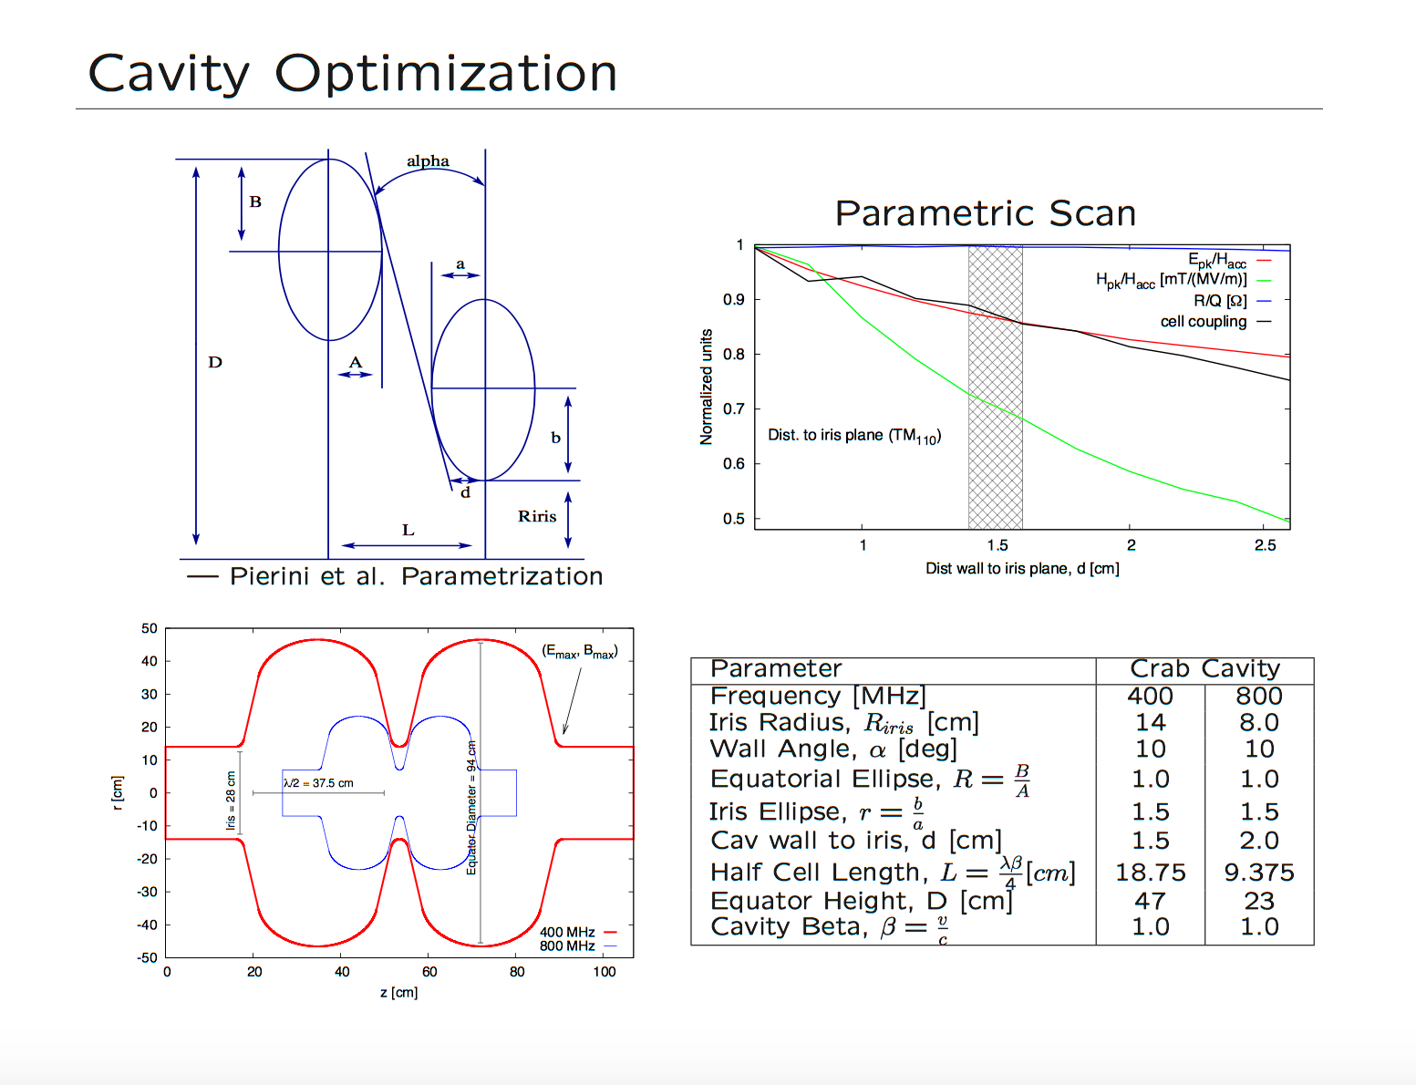

CC in LARP
Efforts on CC concepts started in LARP back in ~2008 and earlier
  Benefit from 1st LARP Toohig Fellow
CC are ballistic and are presently entertained as a US in-kind contribution to the HL-LHC upgrade.
(See A. Ratti presentation for a recent history and everybody else presentations for the present status)
..to make a long story short..
Main motivation to co-sponsor the Review

Slide 3
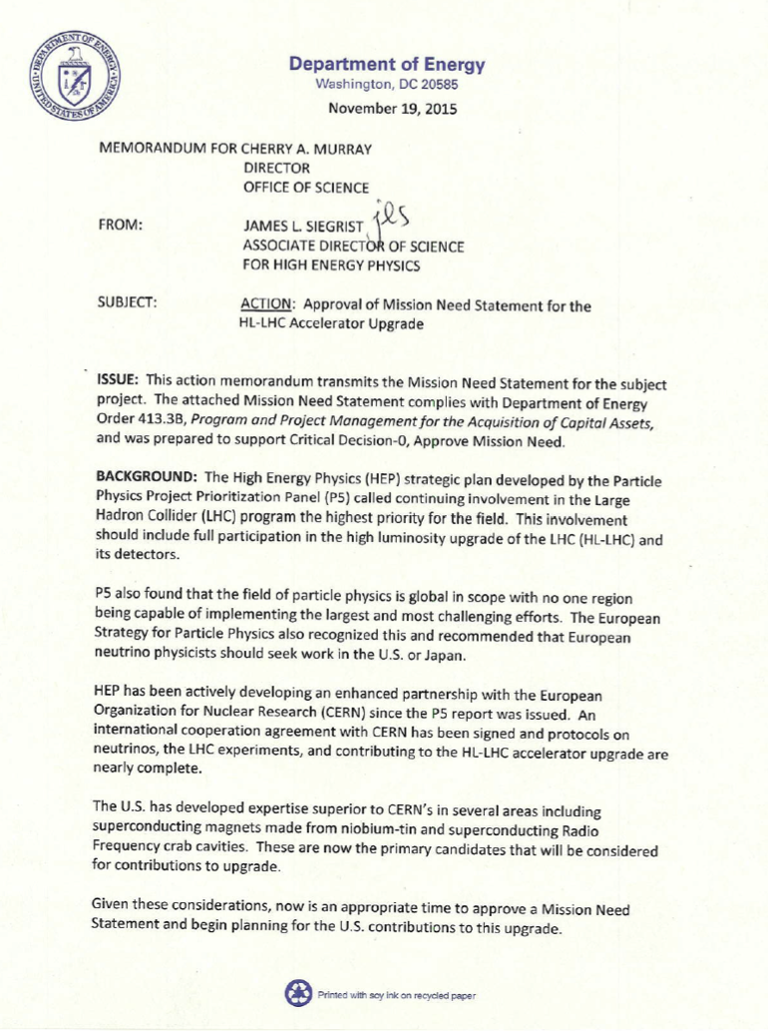
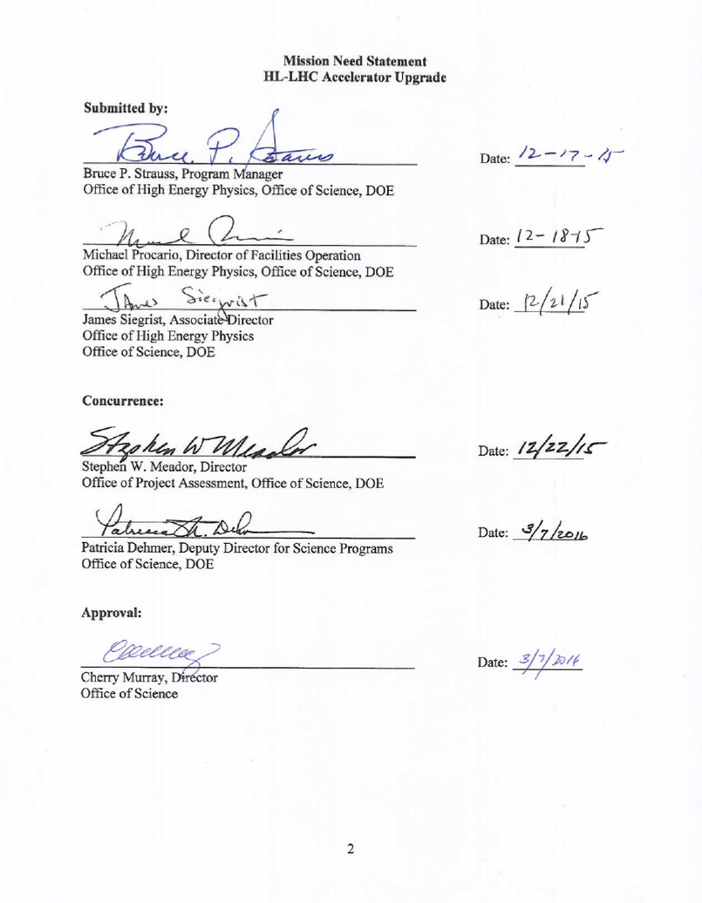
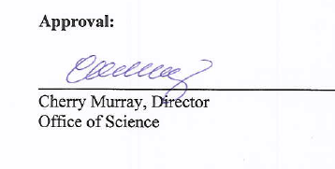
HL-LHC AUP – CD-0 (or Mission Need) Approval
ESAAB meeting approved CD-0 for HL-LHC Accelerator Upgrade (HL-LHC AUP) Project on April 13th 2016.

Slide 4
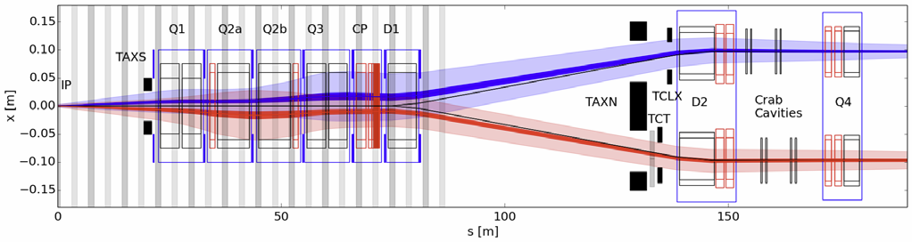
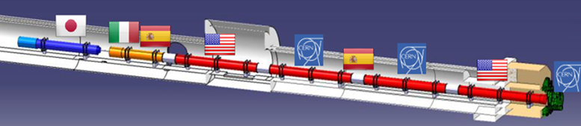
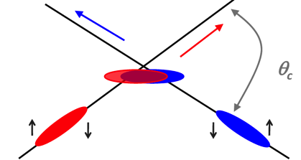
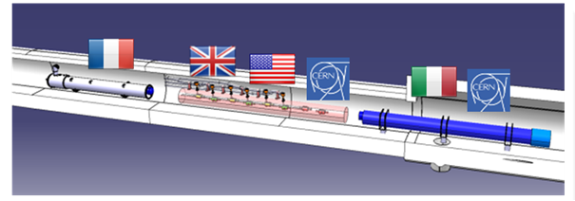
Possible U.S. contributions to HL-LHC
(in pictures)
Insertion Region layout from the IP to Q4
Large Aperture IR Quadrupoles:
From 70 mm MQXA/B to 150 mm MQXF
From NbTi to Nb₃Sn for higher field/gradient
Minimum β* from 0.55 m to 0.15 m
Compatible with 10x integrated luminosity
Crab cavities:
Deflect bunch at IP to collide head-on
Restore luminosity loss due to crossing angle
Requires compact superconducting cavities

Slide 5
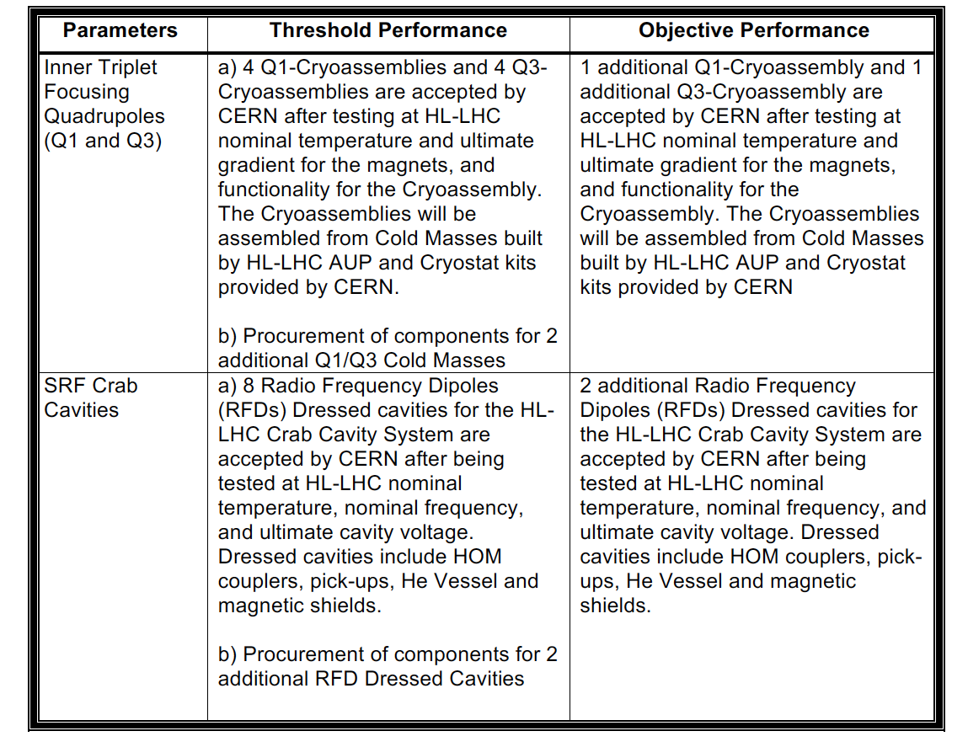

Possible U.S. contributions to HL-LHC
(in words)
At this time (pre-CD-1) the following deliverables are entertained for the US contribution to HL-LHC:
  From the PPEP Draft exchanged with AUP FPD
Delivery Date Needs (from CERN):
  Q1/Q3 Cryoassembly #1 at CERN by Late ’21
  Cryoassembly #8 at CERN by Summer ’24
  RFD Dressed Cavity #1 at CERN by Late ’22
  Dressed Cavity #8 at CERN by Summer-Fall ‘23
Slightly more than 50%
of the Q1/Q2a & b/Q3 Final Focusing Triplets of HL-LHC
50% of the total number
of Crab Cavities for
HL-LHC
CERN is also suggesting financial contribution to cavities built in Europe as Objective KPP (“Up-scope” Opportunity ?)

Slide 6
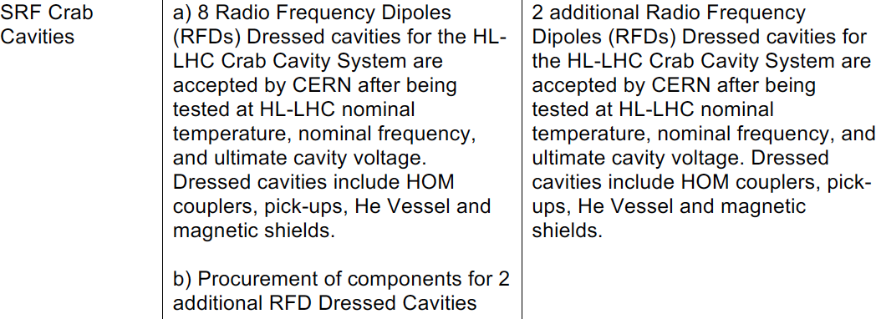
RFD in US Project (AUP)
The difference between Threshold and Objective KPPs represents scope contingency that provides technical, schedule, and cost margin for successful completion of the project.
Tentative agreement on RFD deliverables achieved between CERN and AUP Management in July 2016.
Final agreement to be struck between CERN and DOE “shortly”.

Slide 7
RFD in US Project (AUP)
A DOE construction project is governed by DOE Order 413.3B
  https://www.directives.doe.gov/directives-documents/0413.3-BOrder-b
  Applies to capital assets projects having a Total Project Cost greater than or equal to $50M
DOE projects typically progress through five Critical Decision (CD) gateways, which serve as major milestones
  Each CD marks an authorization to increase the commitment of resources by DOE and requires successful completion of the preceding phase or CD
Critical Decision (CD) Gateways
  CD-0: Approve Mission Need
  CD-1: Approve Alternative Selection and Cost Range
  CD-2: Approve Performance Baseline
  CD-3: Approve Start of Construction/Execution
  CD-4: Approve Start of Operations or Project Completion

Slide 8
CD-1 for AUP
HL-LHC AUP CD-1 planned for Aug 8th-10th 2017 (4 months from now !)
  Is RFD the “right” alternative ?
  Is scope (cost and schedule) properly defined to allow a Cost and Schedule Range estimate ?
DOE is known to be subject to “CD Scope Creep”
  The more “CD-2 like” information we can present at CD-1 time, the more likely it is to obtain CD-1 approval.
  In any case, consolidated CD-2/CD-3 will be pursued in ~1 year from now,

Slide 9
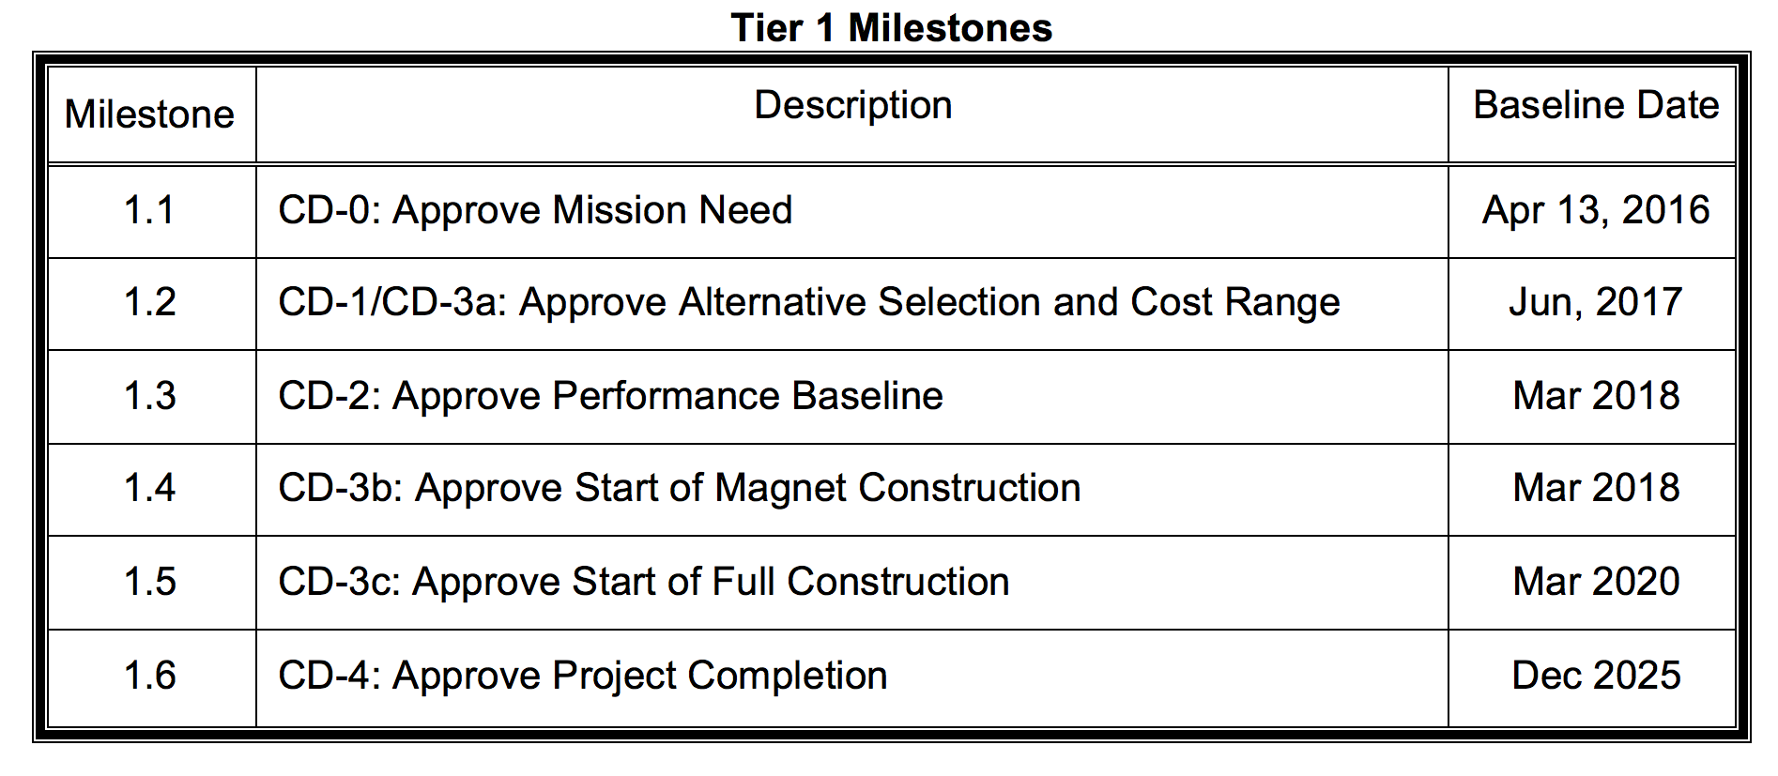
CD Tailoring for AUP
Aug. 2017
CD-3b (Summer 2018):
  Baseline for Magnet and RFD cavities established. Need to start Nb procurement for RFDs
CD-3c (Spring 2020):
  Approval for RFD (Cavities) and Cryoassembly (Magnets) Production

Slide 10
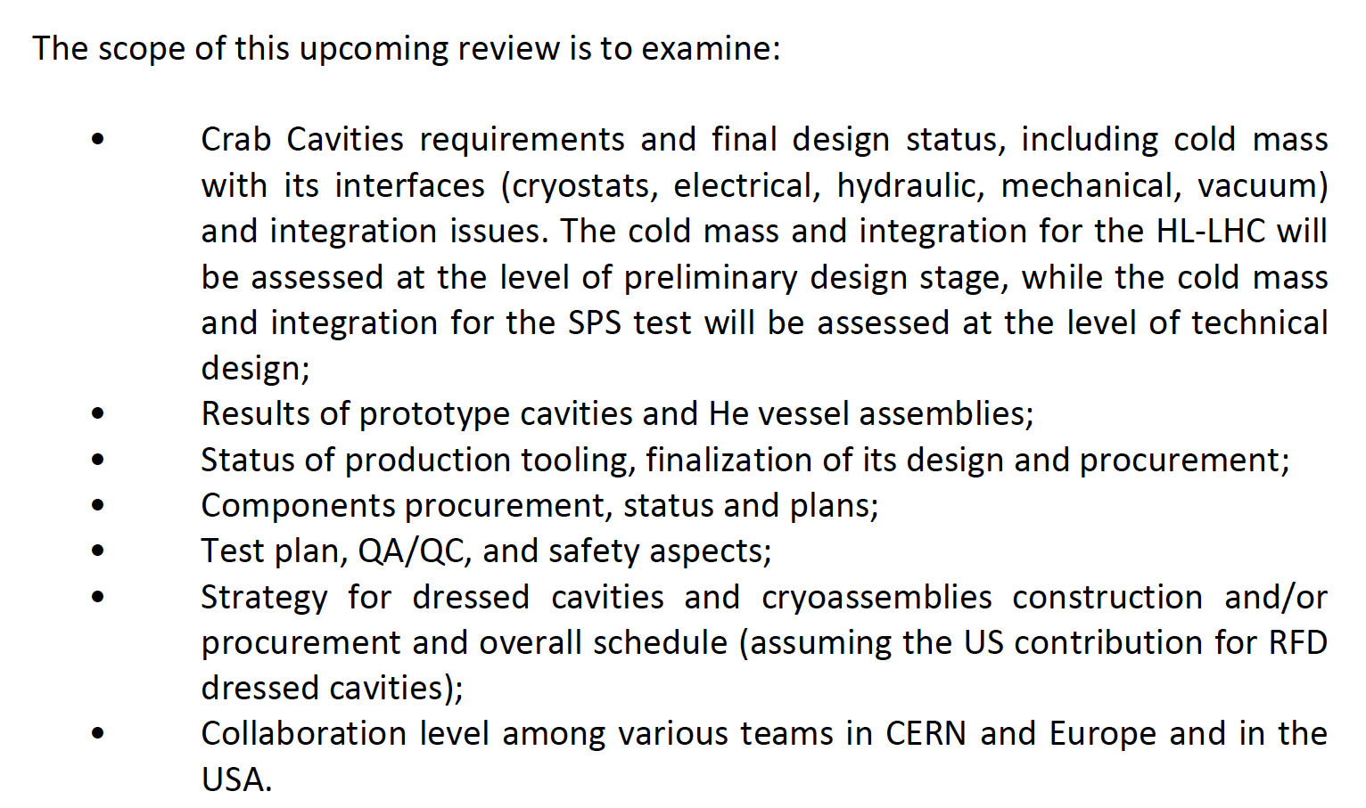
Charges to Reviewers
AUP interest in your contribution to this review is that all items that will support CD-1 (and, partially, CD-2 & CD-3b/CD-3c) are reviewed and are deemed to be OK (or on track to be OK in a ~month time-scale).
Are CD-1 elements finalized or reasonably
close to be finalized in next ~month ?
Functional Requirement Specifications
Conceptual & Technical Design (Tooling, Cavities & Processes)
Interface Specifications
Acceptance Criteria
Are plans for execution credible ?
  Nb Procurement
  Cavities Fabrication

Slide 11
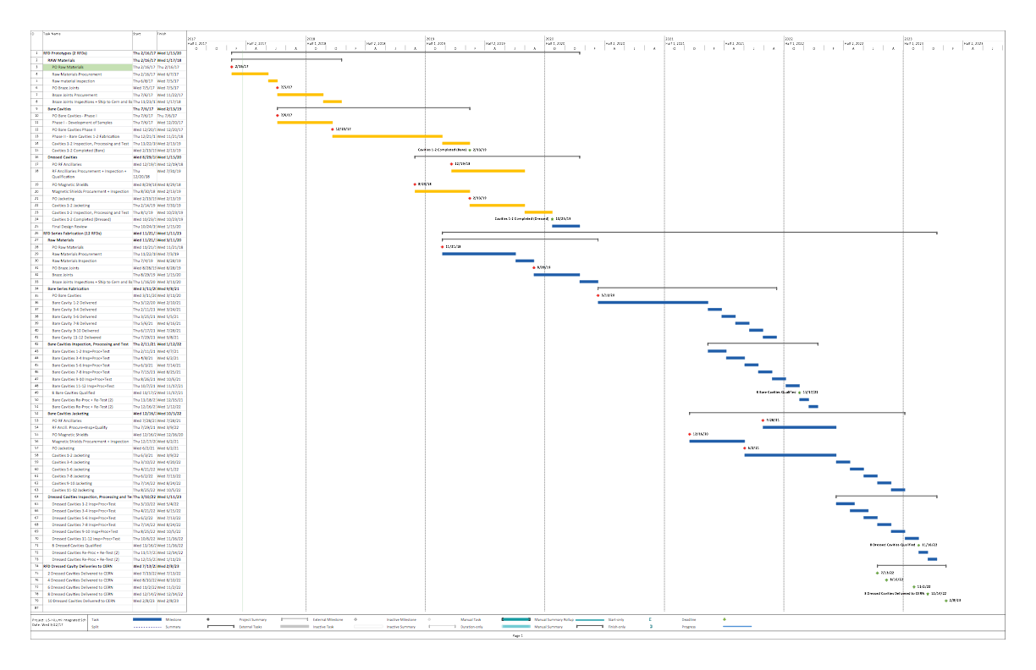
RFD Prototypes and Production Schedule
FY17
FY18
FY19
FY20
FY21
FY22
FY23
: Proto
: Series
CD-2/
CD-3b
December 2022
CD-1
CD-3c
Functional Requirement Specifications
Conceptual & Technical Design (Tooling, Cavities & Processes)
Interface Specifications
Acceptance Criteria
Are plans for execution credible ?
  Nb Procurement
  Cavities Fabrication
Functional Requirement Specifications
Conceptual & Technical Design (Tooling, Cavities & Processes)
Interface Specifications
Acceptance Criteria
Are plans for execution credible ?
  Nb Procurement
  Cavities Fabrication
Functional Requirement Specifications
Conceptual & Technical Design (Tooling, Cavities & Processes)
Interface Specifications
Acceptance Criteria
Are plans for execution credible ?
  Nb Procurement
  Cavities Fabrication

Slide 12
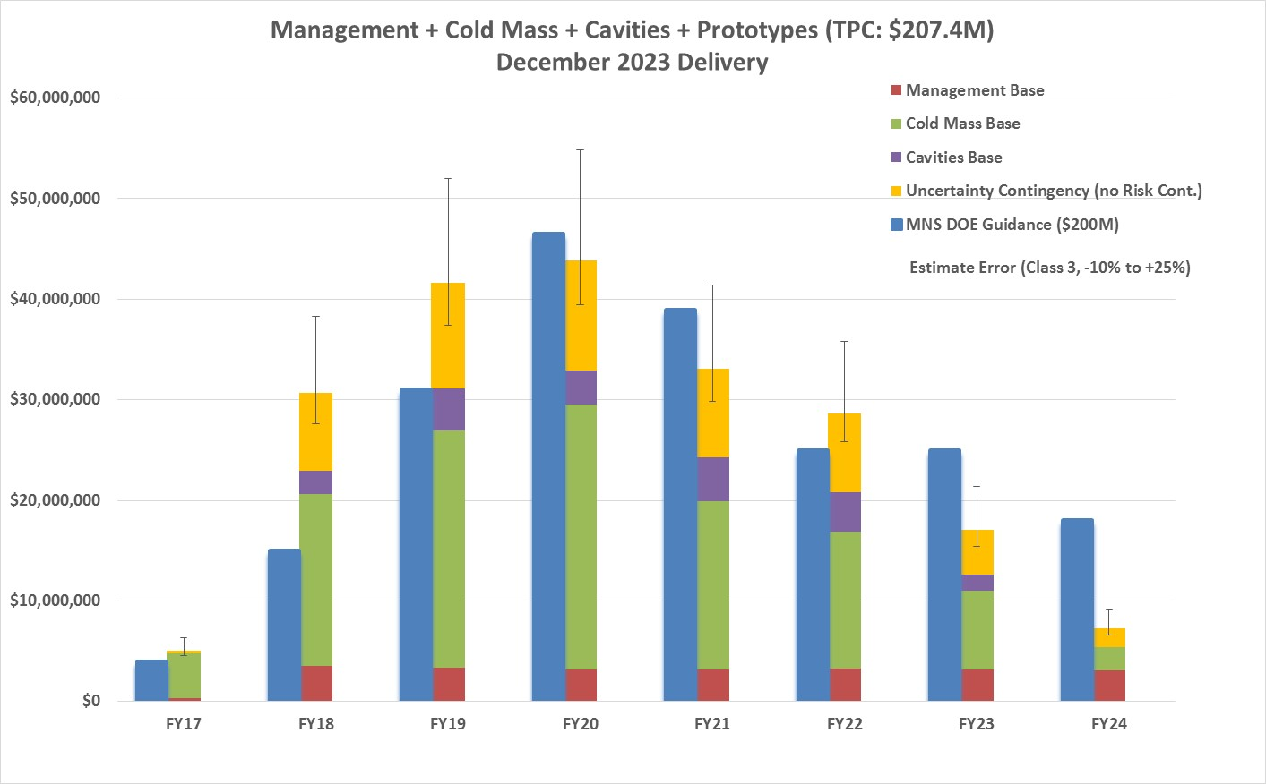
Time-Phased Cost Estimate Comparison to Funding Profile (Dec ‘23 Delivery)
Dec. 2023 delivery of Cryo-assembly #8 and Dec. 2022 delivery of RFD Cavity #8
  ~6-7 months schedule float respect to CERN deadline for delivery of magnets and cavities
Total Project Cost: ~ $207M (Risk contingency NOT included)
Total Project Range: ~$186M to $258M (No Risk Contingency)
Positive feedback from DOE to continue planning to “Dec.2023” delivery schedule

Slide 13
To Begin…

