Slide 1

Overview of Crab Cavities for HL-LHC
HL-LHC WP4, CERN
International Review of the Crab Cavity Performance for HiLumi
Special thanks to EN-MME, RF-PM/SRF, TE-CRG/VSC, KEK, USLARP, UK-STFC

Slide 2
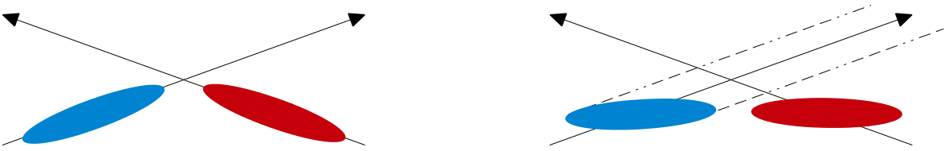
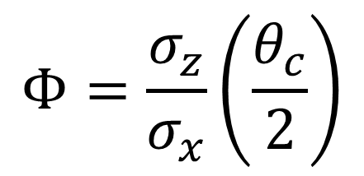
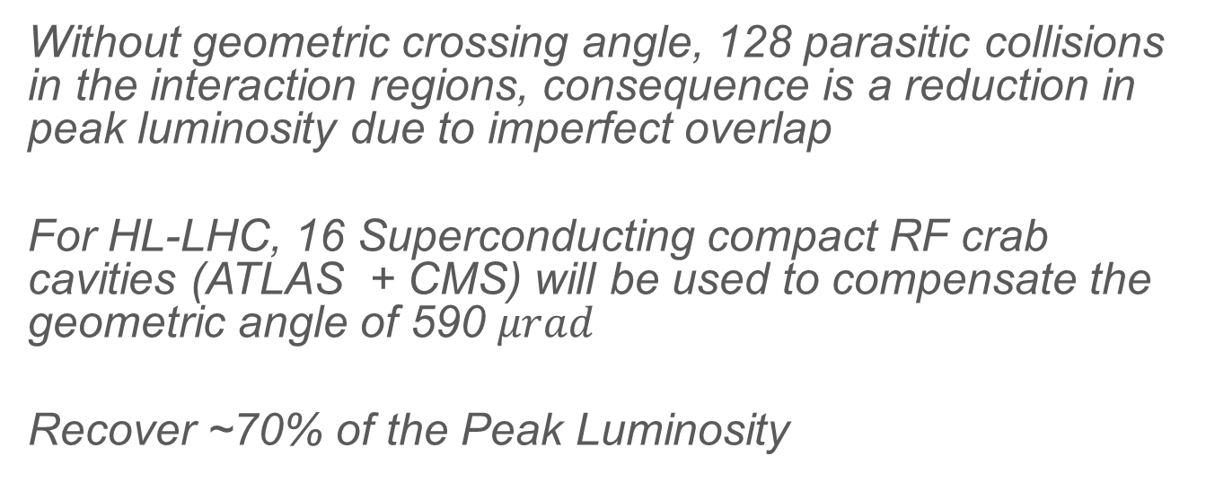


HL-LHC Crab Cavity System
Without geometric crossing angle, 128 parasitic collisions in the interaction regions, consequence is a reduction in peak luminosity due to imperfect overlap
For HL-LHC, 16 Superconducting compact RF crab cavities (ATLAS + CMS) will be used to compensate the geometric angle of 590 $μrad$
Recover ~70% of the Peak Luminosity
$$7.55 cm$$
$$Φ=\frac{σ_{z}}{σ_{x}}\left(\frac{θ_{c}}{2}\right)$$
$$\sim 7 μm$$

Slide 3
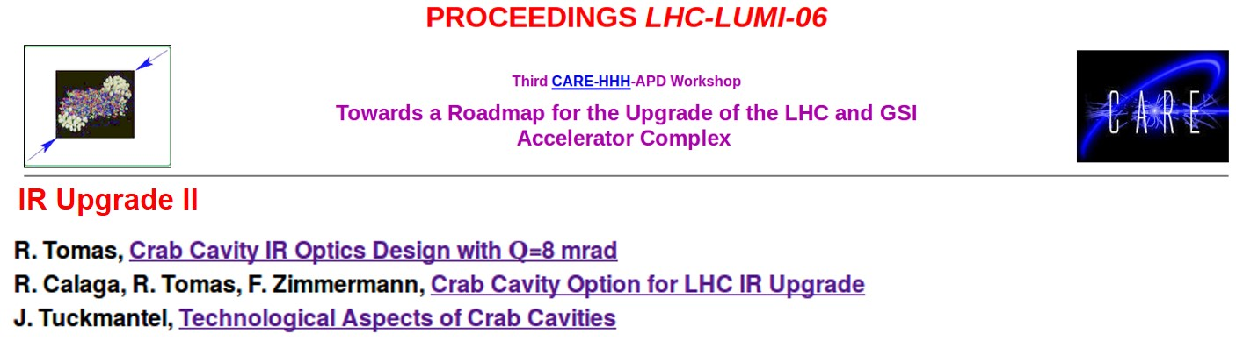
In 2006
The first ideas on LHC crab cavities emerged… at that time we were discussing about voltages & crossing angles in excess of 200 MV and 8 mrad!
HL-LHC baseline ($θ_{c}=590 μrad$, $β^{∗}=15 cm$) with present optics implies
$V_{c}=11−12 MV$per beam per IP side for full compensation

Slide 4


Basic Parameters
Frequency $=400.79 MHz$
Aperture $= 84 mm$
Voltage $=3.4 MV$ /cavity (2 cavities /beam /IP side – 16 total*)
Cavity tuning $=±100 kHz$ (LFD $<500 Hz)$
$Q_{ext}=5×{10}^{5}$, $Q_{0}≈{10}^{10}$ ($R_{s}=10 nΩ)$
RF power source $=40 kW$ (80 kW peak, SPS $≤40 kW)$
Operating temperature $= 2.0 K$
D2
Q4
Beam 1
IP
194 mm
Optional
Phase II
<3 m
Beam 2
$$L=6.6 m$$
*For full compensation, 4 cavities /beam /IP side

Slide 5
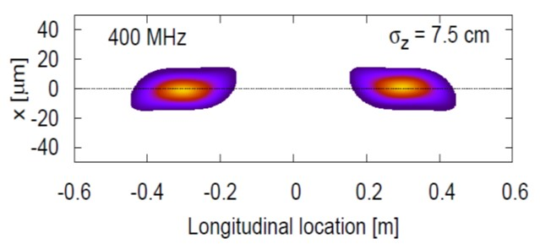
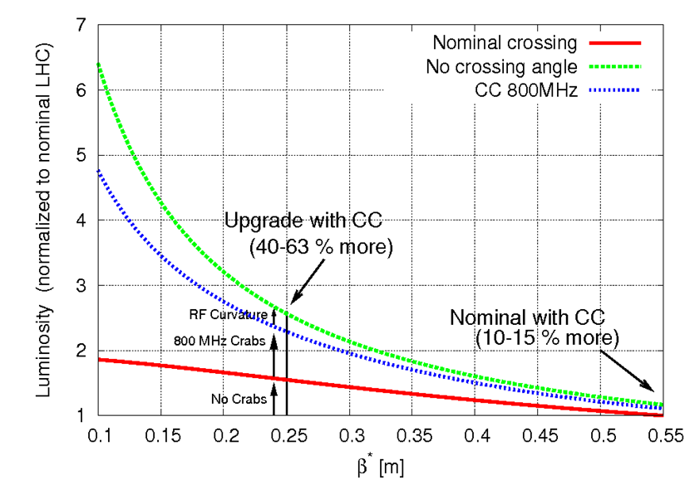
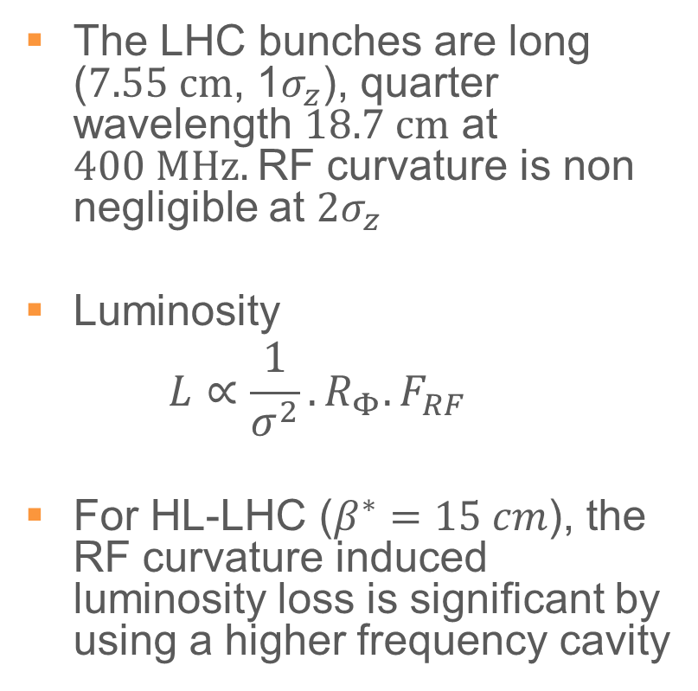
Why 400 MHz
The LHC bunches are long ($7.55 cm$, 1$σ_{z}$), quarter wavelength $18.7 cm$ at $400 MHz.$RF curvature is non negligible at $2σ_{z}$
Luminosity
  $$L∝\frac{1}{σ^{2}}. R_{Φ}.F_{RF}$$
For HL-LHC ($β^{∗}=15 cm$), the RF curvature induced luminosity loss is significant by using a higher frequency cavity

Slide 6
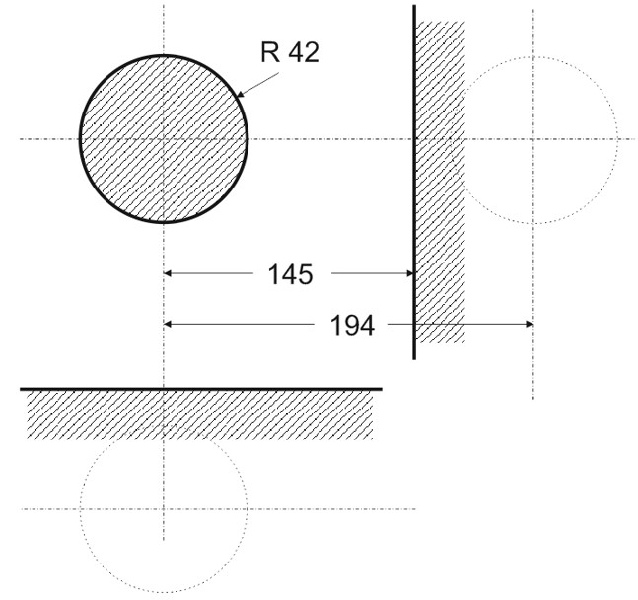

Cavity Aperture
A minimum cavity aperture of $84 mm$ was assumed as a baseline
The maximum cavity envelope transversely cannot exceed $145 mm$
B1
B2
The specification was imposed on both hor/ver planes for a design to accommodate both crossing angles

Slide 7
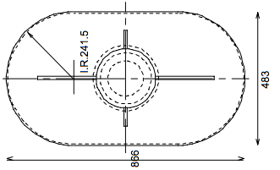
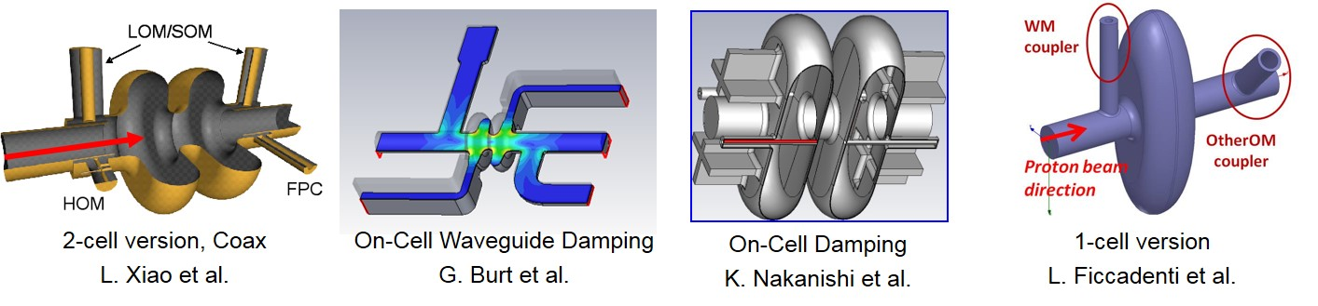
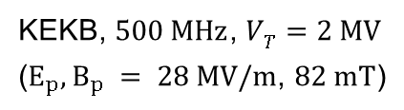
2006-09: Elliptical Cavity (800 MHz)
Conceptually simple, but practically difficult
Main Constraints:
  Frequency at 800 MHz !
  Damping LOM/SOM/HOMs remains a challenge
  Only vertical crossing at both IPs
  Surface field to kick gradient ratio is poor
KEKB, $500 MHz$, $VT=2 MV$
($E_{p}, B_{p} = 28 MV/m$, $82 mT$)
LHC B2
866 mm

Slide 8
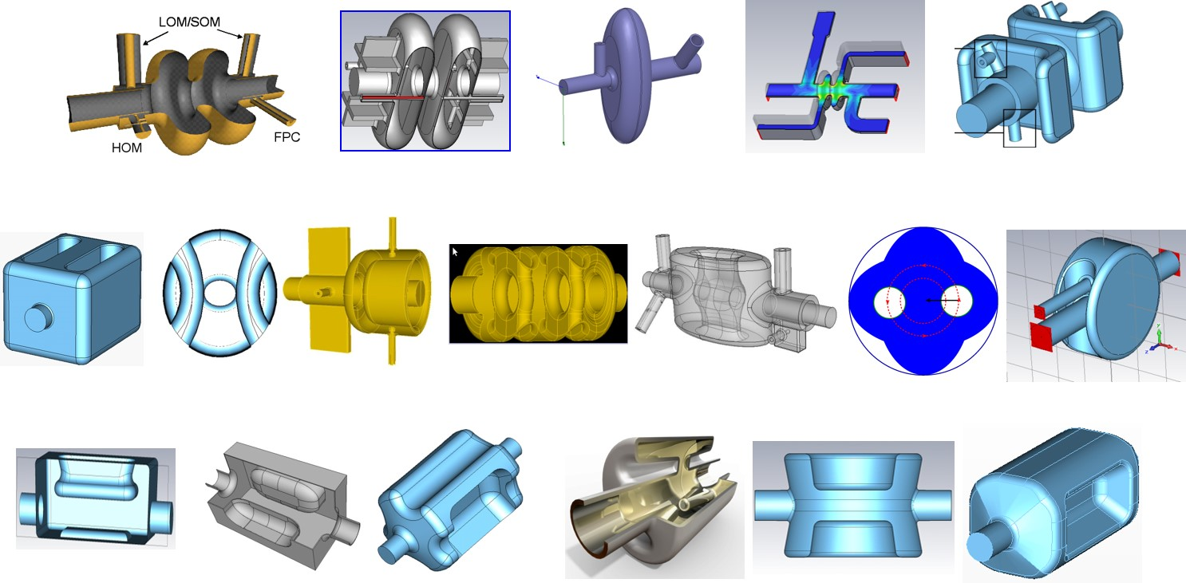
2006-12: The Crab Zoo

Slide 9
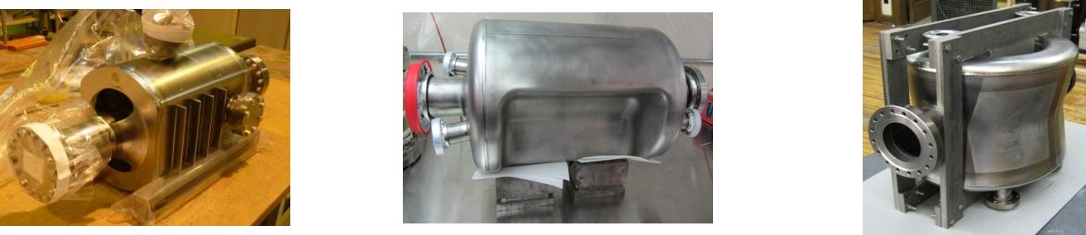
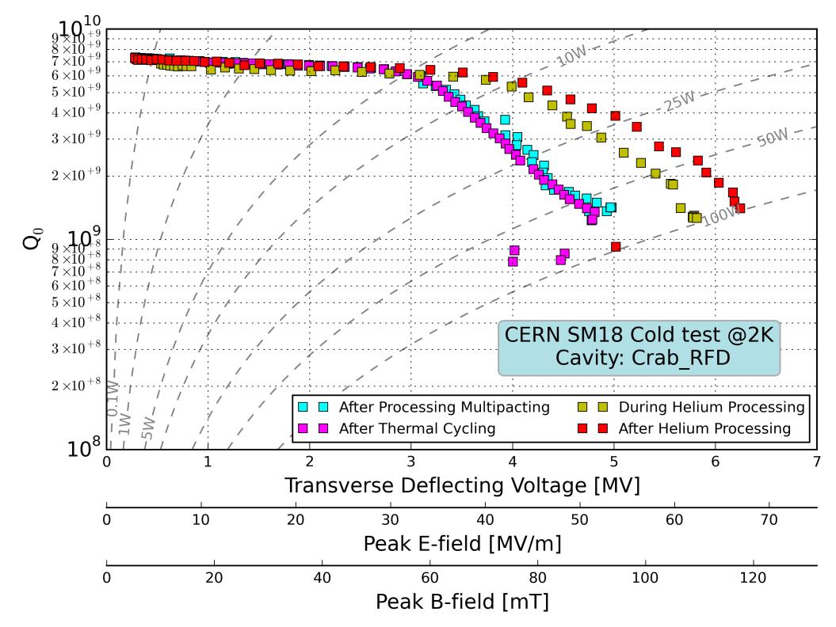
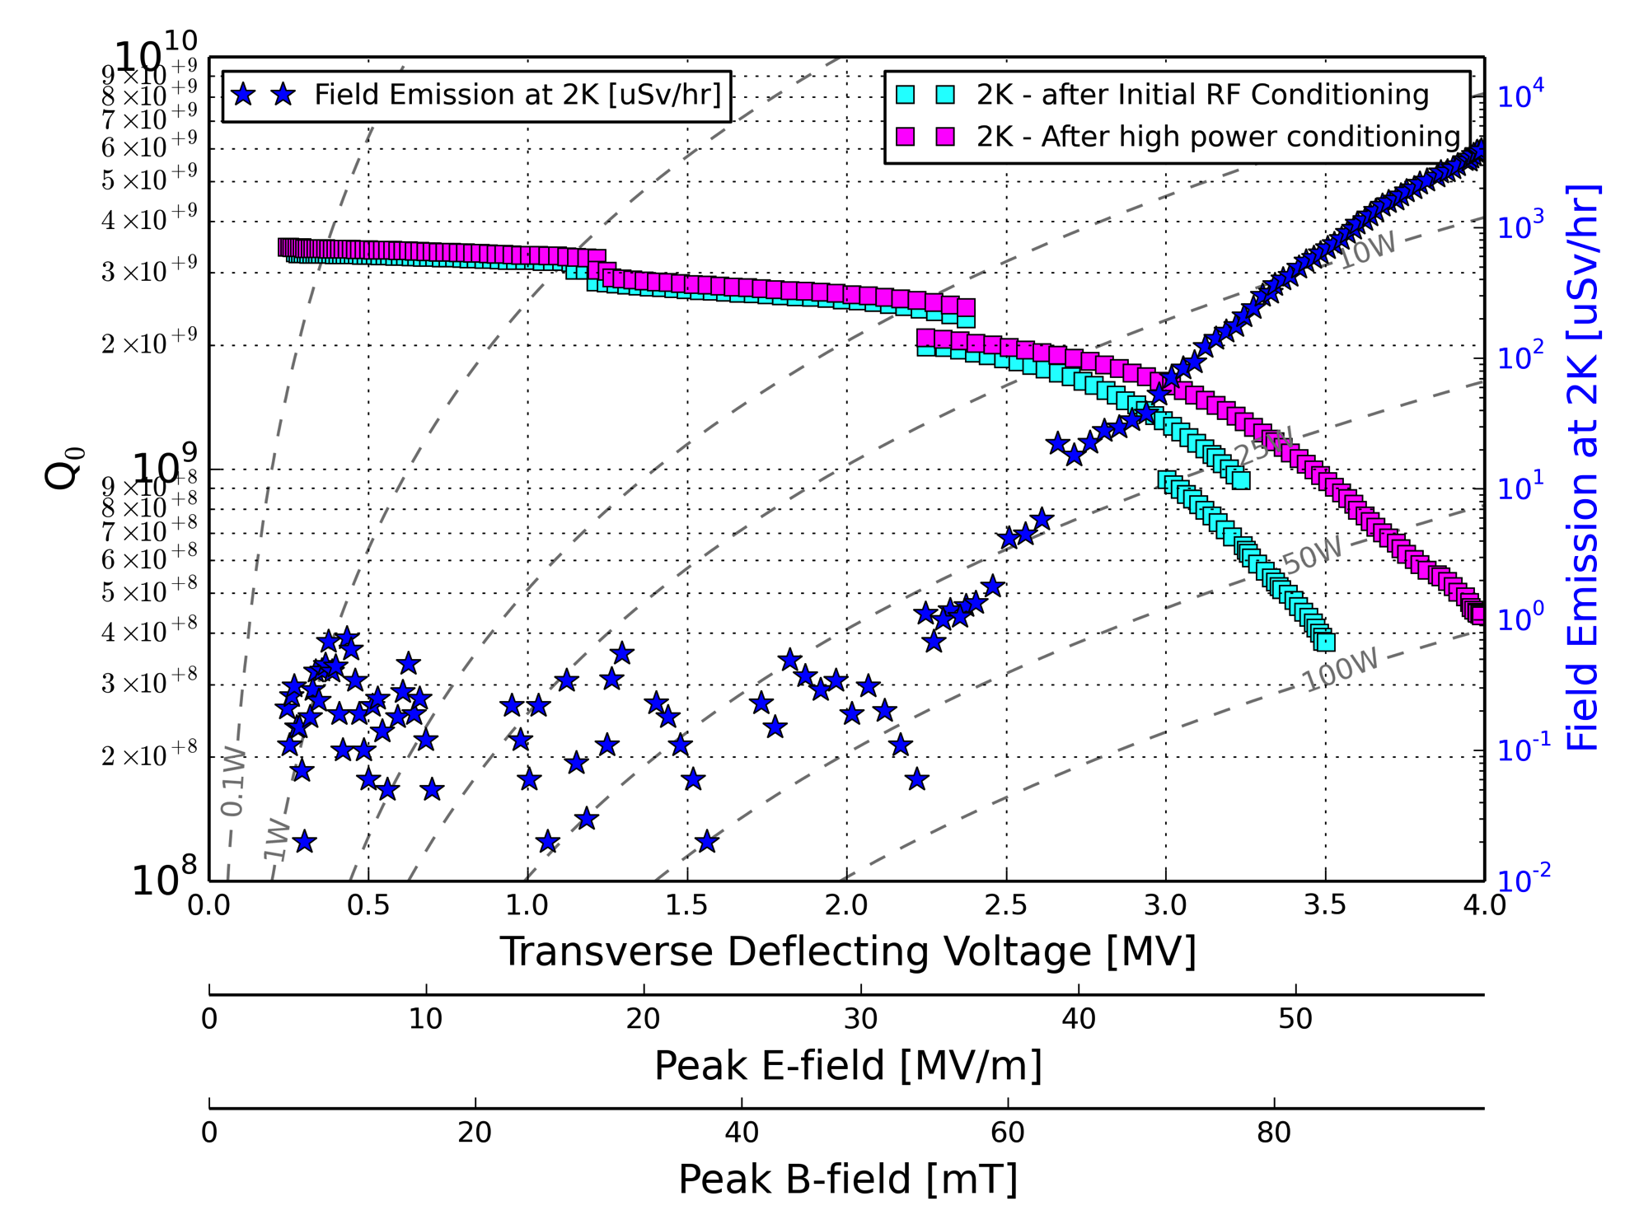
2011-14: 3 Proof of Principle Cavities
Review committee recommendation in 2014 to focus on two designs for the SPS tests
4 Rod
(2.5 MV)
RF Dipole
(6.5 MV)
Double Quarter Wave
(4.0 MV)
RF tests at Jlab/BNL exceeded these voltages

Slide 10
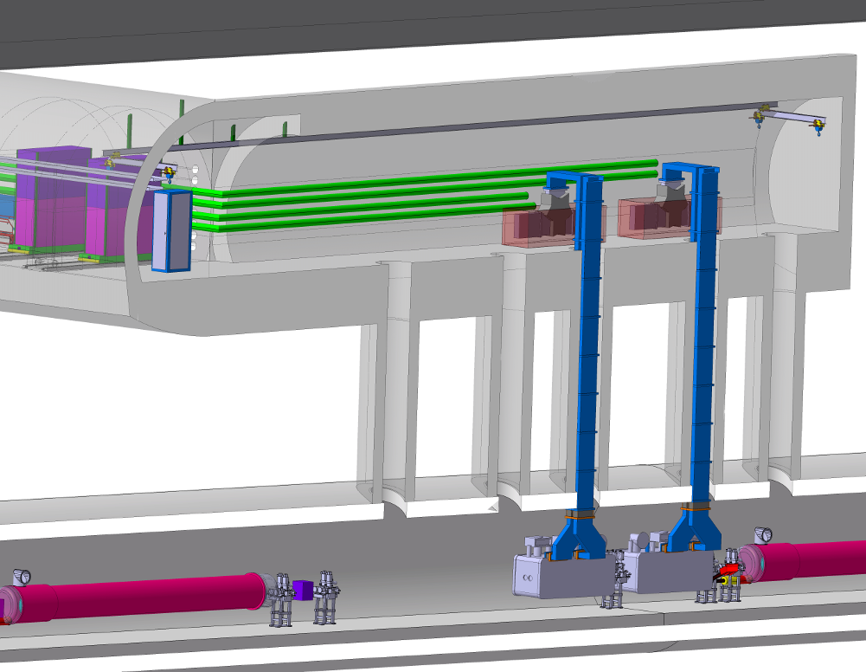
WP4 Planning
today
SPS prototype beam tests
preparation
SPS Test
(DQW CM1)
SPS Test
(RFD CM2)
2015
2016
2017
2018
2019
2020
2021
2022
2023
2024
2025
2026
EYETS
YETS
Run 2
LS2
Run 3
LS3
Run 4
LHC pre-series
(2 Industrial Dressed Cavities)
LHC series production & Installation (8 CMs)
LHC Installation
SPS Test Setup

Slide 11
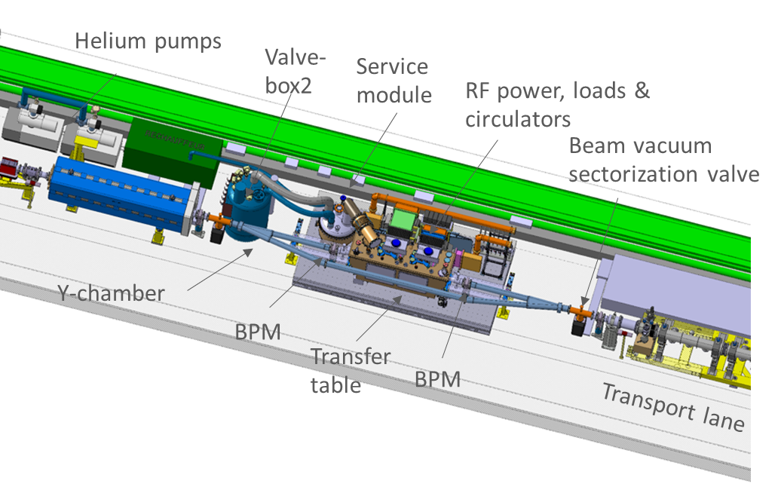
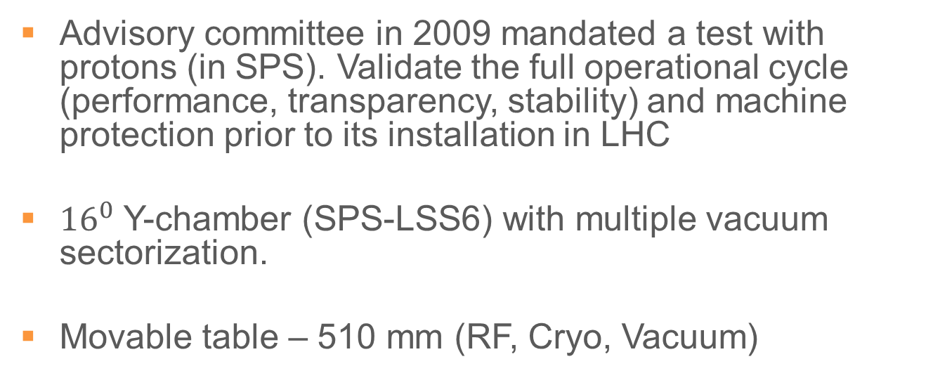
Crab Cavity SPS Tests
Advisory committee in 2009 mandated a test with protons (in SPS). Validate the full operational cycle (performance, transparency, stability) and machine protection prior to its installation in LHC
${16}^{0}$ Y-chamber (SPS-LSS6) with multiple vacuum sectorization.
Movable table – 510 mm (RF, Cryo, Vacuum)

Slide 12
Reviews & Technical Outcome
May 2014: Cavity design review
  Led to down selection to 2 cavities for SPS/LHC
Feb 2015: HOM coupler review
Mar 2015: Cost & Schedule review I
  Study the effect of only ½ of system (16 instead of 32)
May 2015: CERN-STFC Helium vessel review
Nov 2015: SPS Cryomodule review
  Integrated production/test planning including infrastructure
Oct 2016: Clean room assembly review
Oct 2016: Cost & Schedule review II
  Reduction to ½ system endorsed with new strategy
Nov 2016: Operational safety review in SPS
April 2017: This review

Slide 13
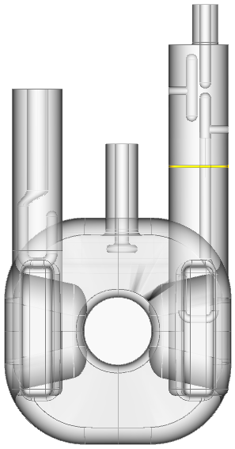
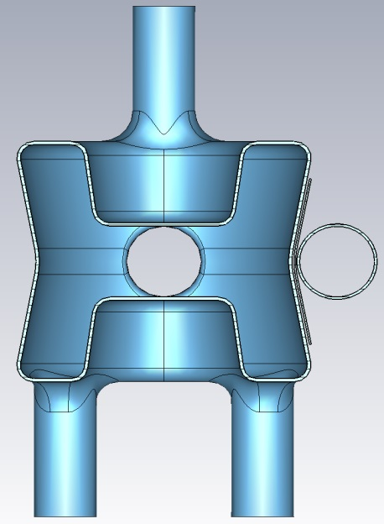
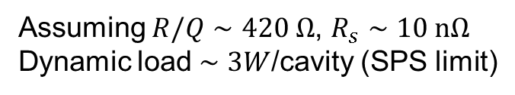
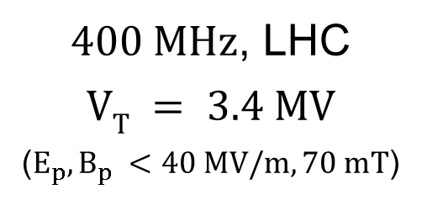
2014-17: SPS Crab Cavities
Cavity geometries evolved to accommodate for strong HOM damping for SPS tests
RF Dipole
Double Quarter Wave
$400 MHz$, LHC
$$VT = 3.4 MV$$
($E_{p}, B_{p} <40 MV/m, 70 mT$)
Assuming $R/Q∼420 Ω$, $R_{s}∼10 nΩ$
Dynamic load $∼3W$/cavity (SPS limit)
280 mm
281 mm
*The most important reason for the voltage limit is operate well below the quench limit to minimize RF trips for machine protection

Slide 14
2015 SPS CM-Review Recommendations
Clarify “the minimum functional requirement/goal” for the SPS test
    Detailed acceptance criteria (EDMS 1577565) being followed
A decision/action on the ordering/implantation of the refrigerator
    Procurement and fabrication launched (see cryo talks tomorrow)
The system integration workflow, including tooling, fixtures, and intermediate tests must be studied in greater detail
  In place & coordinated under a new WG-CCTC with weekly planning
The critical components such as FPCs and tuners shall be individually reviewed (deferred till test results, see later talks)
Cryogenic-safety and failure-mode analyses should be performed
  1st safety analysis & review performed (see safety talk tomorrow)
Reinforce the supporting system & limiting forces on the FPCs.
  Blade type supporting system was optimized (see later talks)

Slide 15
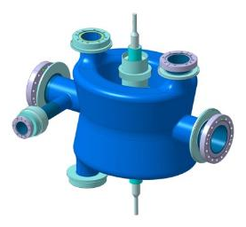
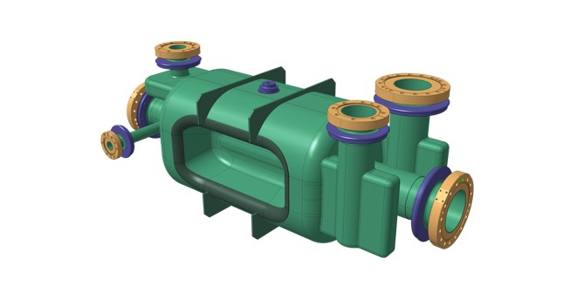
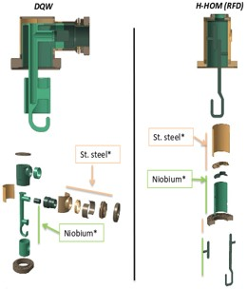
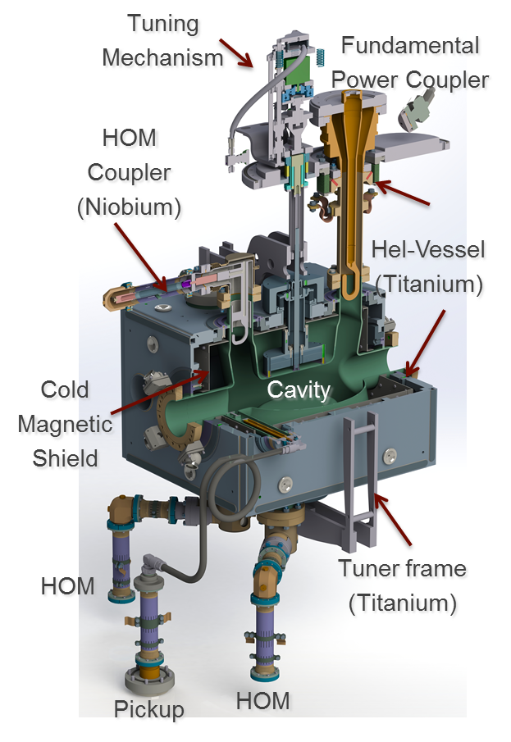
SPS Cavities 2K Volume
Main Mechanical interfaces:
He-vessel: New Bolted-welded concept
Tuner: Symmetric tuning with warm actuation
Three point support + alignment system
Main RF interfaces
1 FPC: Single ceramic coaxial line
3 HOMs: Two stage filter, coaxial
1 PU: Cu-Nb for field probe + HOM
Similar concept for RFD with different HOM interfaces

Slide 16
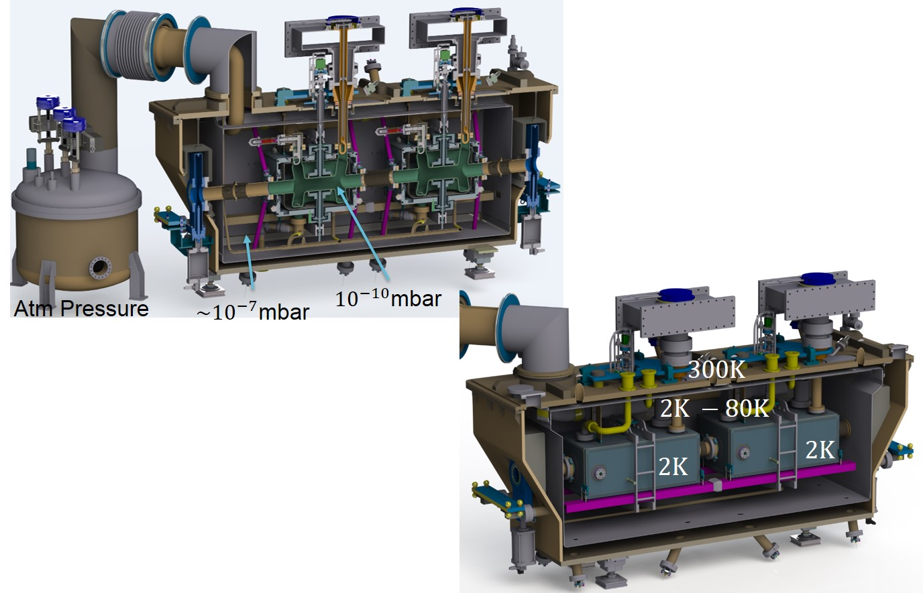


Prototype Cryomodules
Vertical crossing for ATLAS, first one to go to SPS 2018
$$300K$$
Horizontal crossing for CMS
Cavities fabrication starting 2017
$$2K −80 K$$

Slide 17

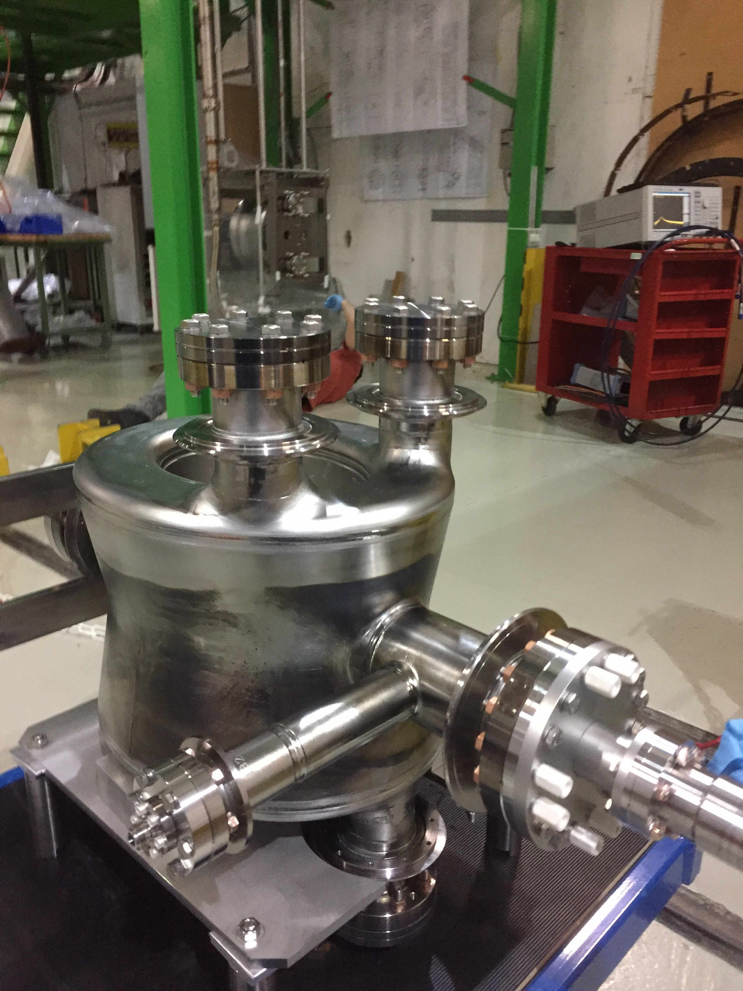



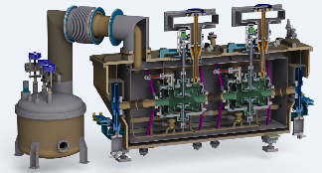

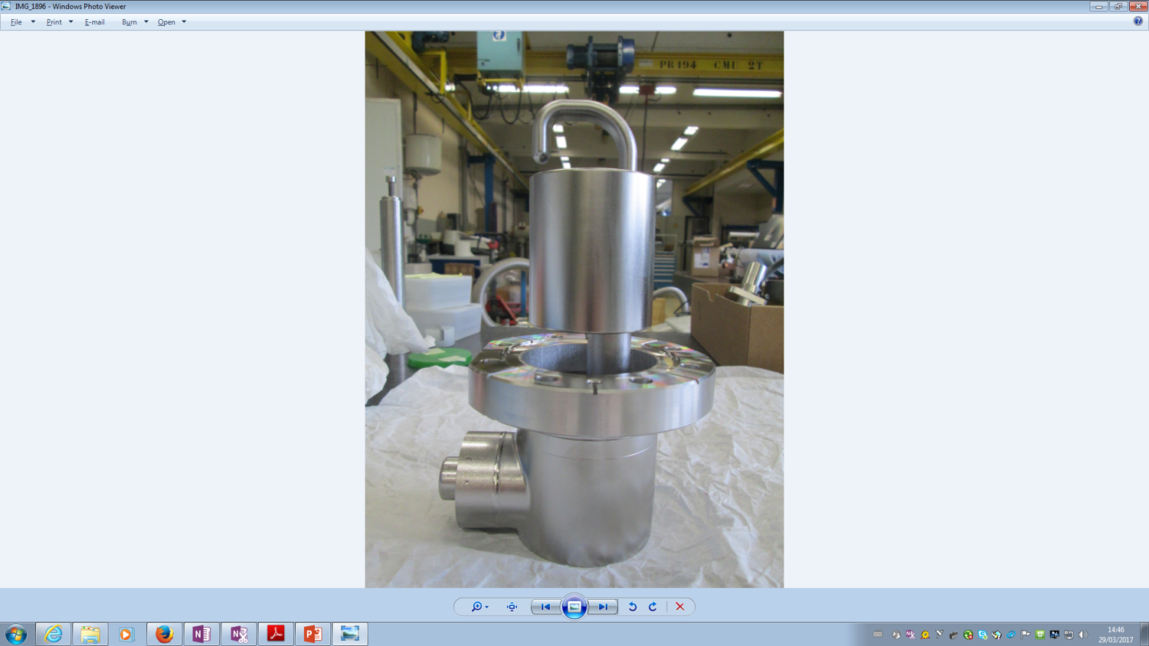

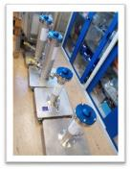
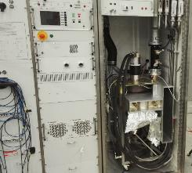



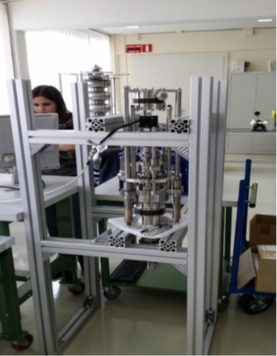
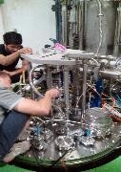
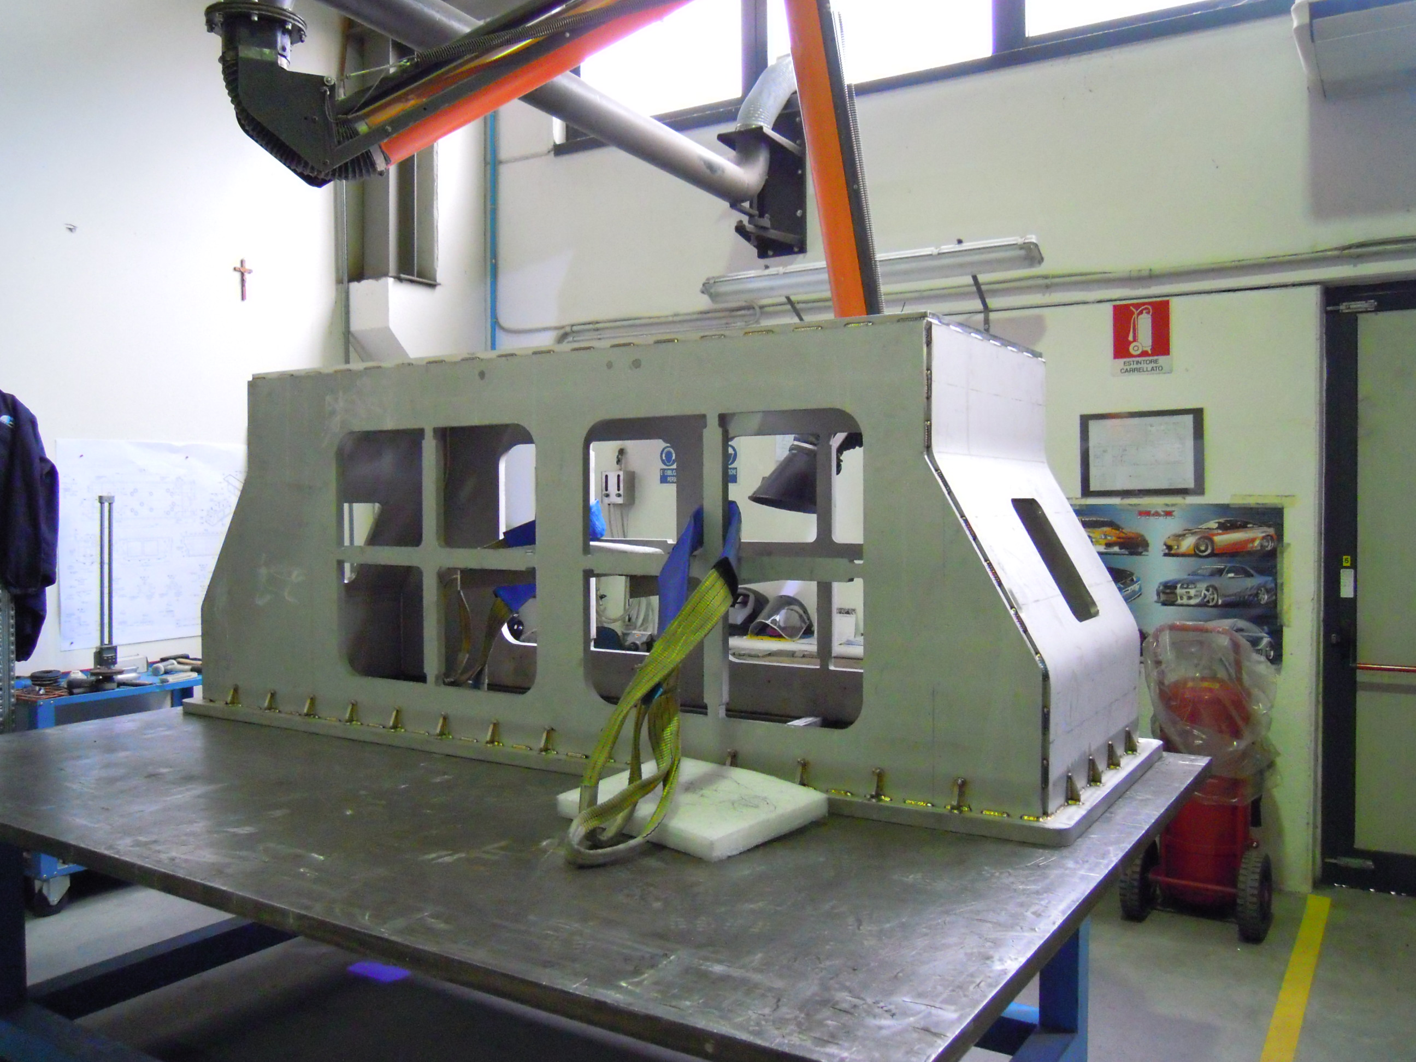
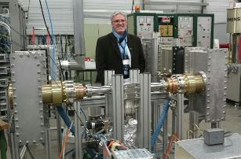

Major Milestones in 2016/17
Several novel concepts designed/developed to meet HL-LHC needs,
Prototyping of all critical items where possible
Cavity
Cavity #1&2 Testing
He-Tank Protoype
FPC
DQW
FPC
RFD
DQW
DQW Cryomodule
HOM
B-Shield
4 FPCs
Assembled
High Power (IOT)
RF Validation, 60 kW
HOM Test boxes
Tuner Tests
Tuner Validation
Vacuum vessel
Coupler
Conditioning
Multipoles (Beadpull/Wire)

Slide 18
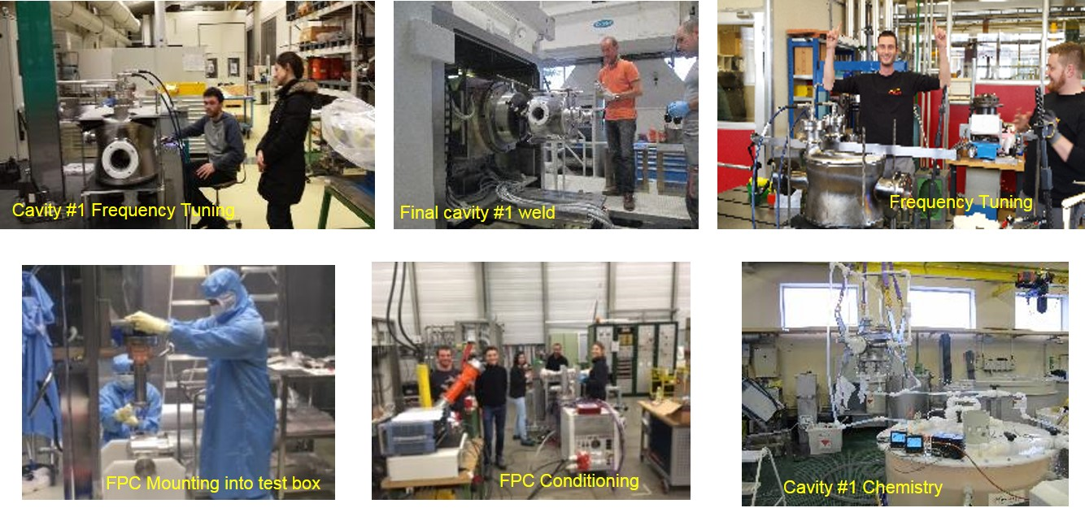
Some Lessons Learned, 2016-17
Several “unexpected” observations (both at CERN & USLARP) → “On the fly” corrections
Big risk mitigation for the Series Production

Slide 19
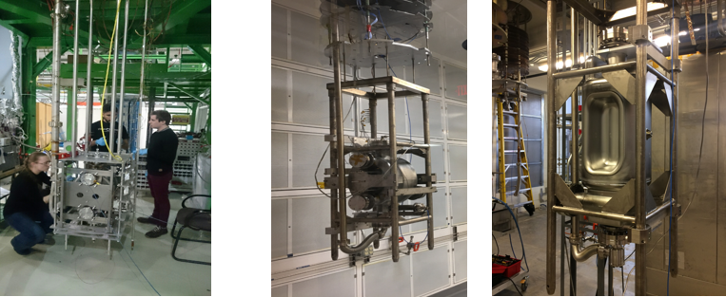
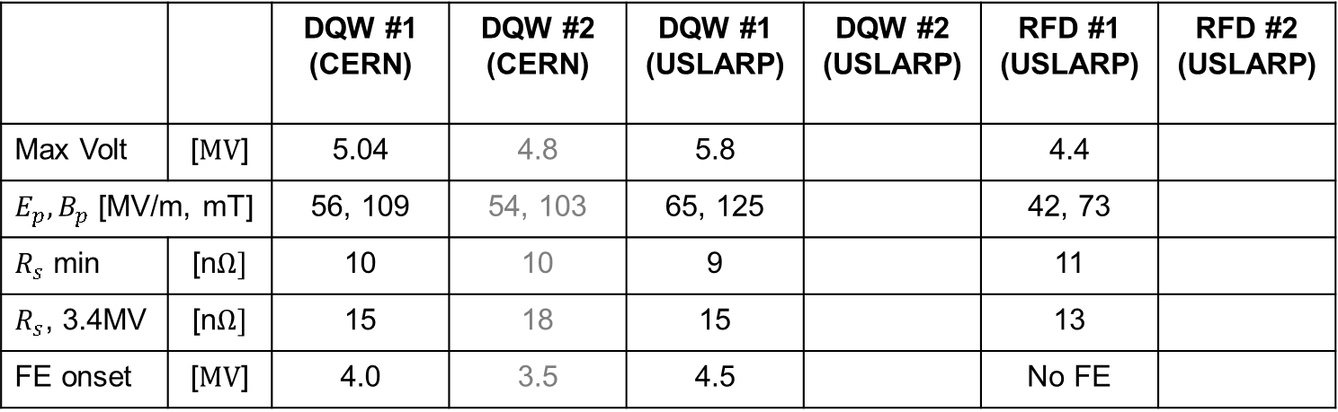

SPS Cavity Results, Feb-Apr 2017
Nominal $V_{kick}=3.4 MV$, $R_{s}=10 nΩ$
 |  | DQW #1 (CERN) | DQW #2 (CERN) | DQW #1 (USLARP) | DQW #2 (USLARP) | RFD #1 (USLARP) | RFD #2 (USLARP)
Max Volt | [$MV$] | 5.04 | 4.8 | 5.8 |  | 4.4
$E_{p}, B_{p}$ [MV/m, mT] |  | 56, 109 | 54, 103 | 65, 125 |  | 42, 73
$R_{s}$ min | [n$Ω]$ | 10 | 10 | 9 |  | 11
$R_{s}$, 3.4MV | [n$Ω]$ | 15 | 18 | 15 |  | 13
FE onset | [$MV$] | 4.0 | 3.5 | 4.5 |  | No FE
CERN DQW
USLARP DQW & RFD
Biggest unknown is performance after dressing with He-tank & HOM couplers
DQW/RFD #2 are ready for testing in Jlab

Slide 20
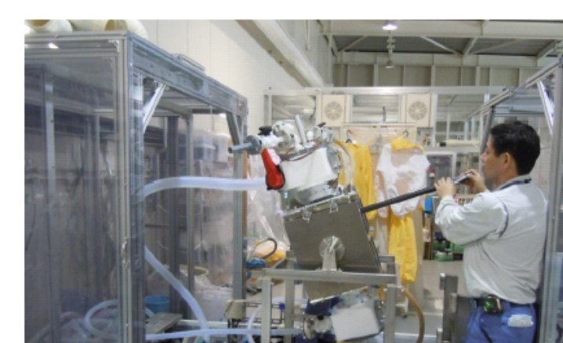
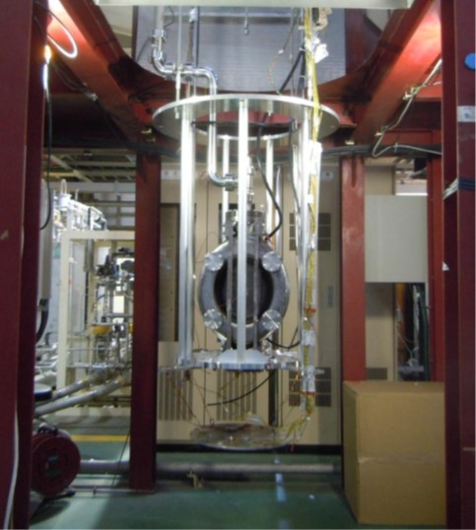
KEK Electro-Polishing R&D
Joint KEK-CERN proposal to develop EP for the complicated shape of crab cavities (2015-19)
The EP system was built in 2016 and ready to be applied (Apr/May, 2017)
If successful, the goal is to adopt it for the future production
EP apparatus preparation at KEK
PoP-DQW Testing at KEK

Slide 21
Some Important Highlights
Prototype He-vessel – Validated both mechanical deformation and vacuum integrity; Magnetic measurements of shields to confirm the attenuation factor
Trapezoidal cryostat for integration of cavity string & design concept validated
Mockup tuner test – On PoP cavity reached well below the 100 Hz resolution/step specification
RF power – Transformation of a SPS-IOT to 400 MHz and reached up to 60 kW. 30 kW CW on a load (thermal limitation due to the test box in stainless steel). 75 kW pulsed up to 10 ms @52.6 Hz
Activities planned for EYETS for crab infrastructure was implemented. Vacuum sectorization for LSS6-crab zone implemented in SPS, Y-chamber under construction. Cryogenic and RF transfer lines including all cabling installed in SPS Long lead cryogenic items procurement launched.
SPS test day I – Review of the measurement program, instrumentation and operational aspects

Slide 22
WP4, Documentation QA/QC
EDMS WP4 - CERN-0000096385
  Centrally managed (specifications, drawings, manufacturing inspection plans, test procedures, results, quality control) including collaborations
Acceptance criteria & Cavity/CM workflow
Safety documents (CM & SPS)
MIP
Workflow (SPS, EMDS 1703245)
HL-LHC WP4: https://espace.cern.ch/HiLumi/WP4/default.aspx

Slide 23
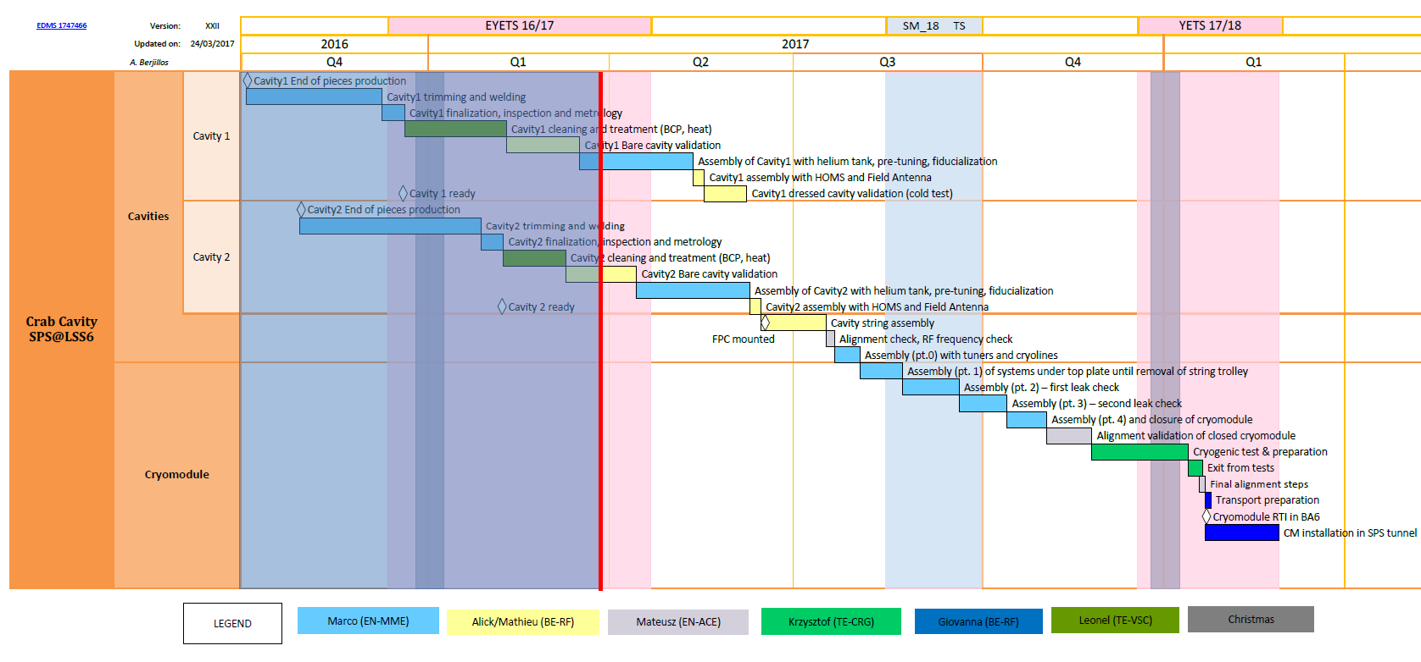
SPS Tests Program – Weekly Schedule
Cavity I
Cavity II
Cryostating
Cryomodule delivered to SPS on 22nd Jan’18
Vacuum & cryo validation in SM18, RF tests insitu
Notes:
As already said, the Master Schedule is elaborated starting from the detailed Workflow. Let’s go into the details of this programme. We follow fabrication & testing of each cavity separately. Once ready, the cavity undergoes cleaning and heat treatment, cold testing, then it is dressed with FPC, HOM couplers and helium tank. Then comes string assembly in clean room. The string goes into the assembly of the cryomodule, which is finally validated in SM18 by cooldown.
If we now proceed backwards from the ending day of the YETS, we see that we need 5 weeks for installation and cold commissioning in SPS, before the end of YETS, which gives us the TARGET date minus 5 weeks for the CM to be ready for installation in SPS.
The present Master Schedule misses this target date, by 12 working days.
Which represents a time slot shorter than 3% of the overall duration of the program

Slide 24
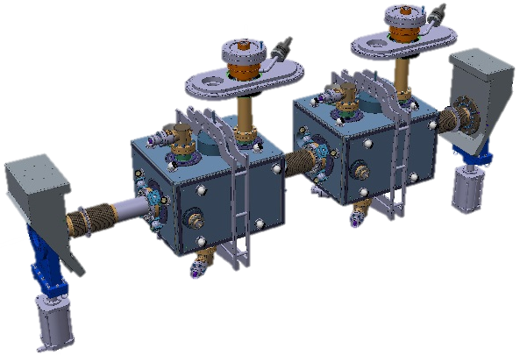
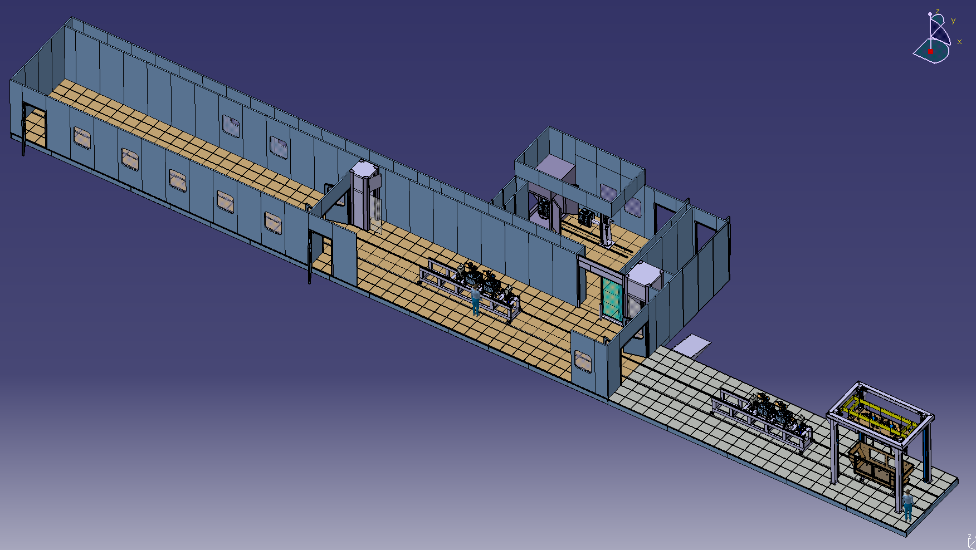
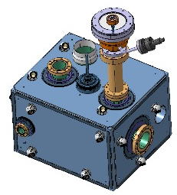
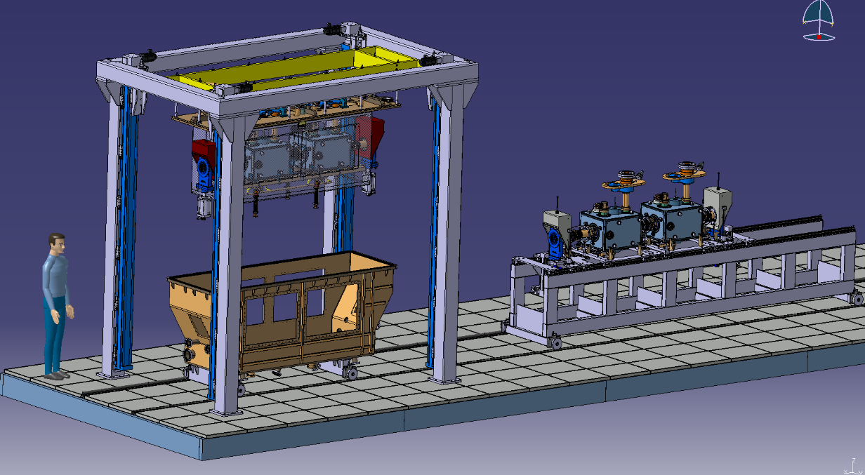
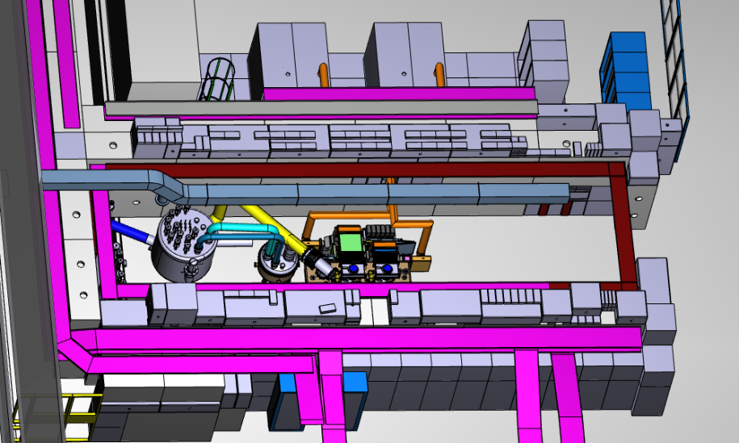
SM18 Assembly & Testing
Two bare cavity testing
One dressed cavity testing
CM vacuum/cryo ok
See talk M. Therasse
HPR (ISO4/5)
Clean Room (ISO4/5) String Assembly
CM Vertically mounted on Top Plate
CM Bunker Testing
(See Talk A. Macpherson)
See talk T. Capelli

Slide 25
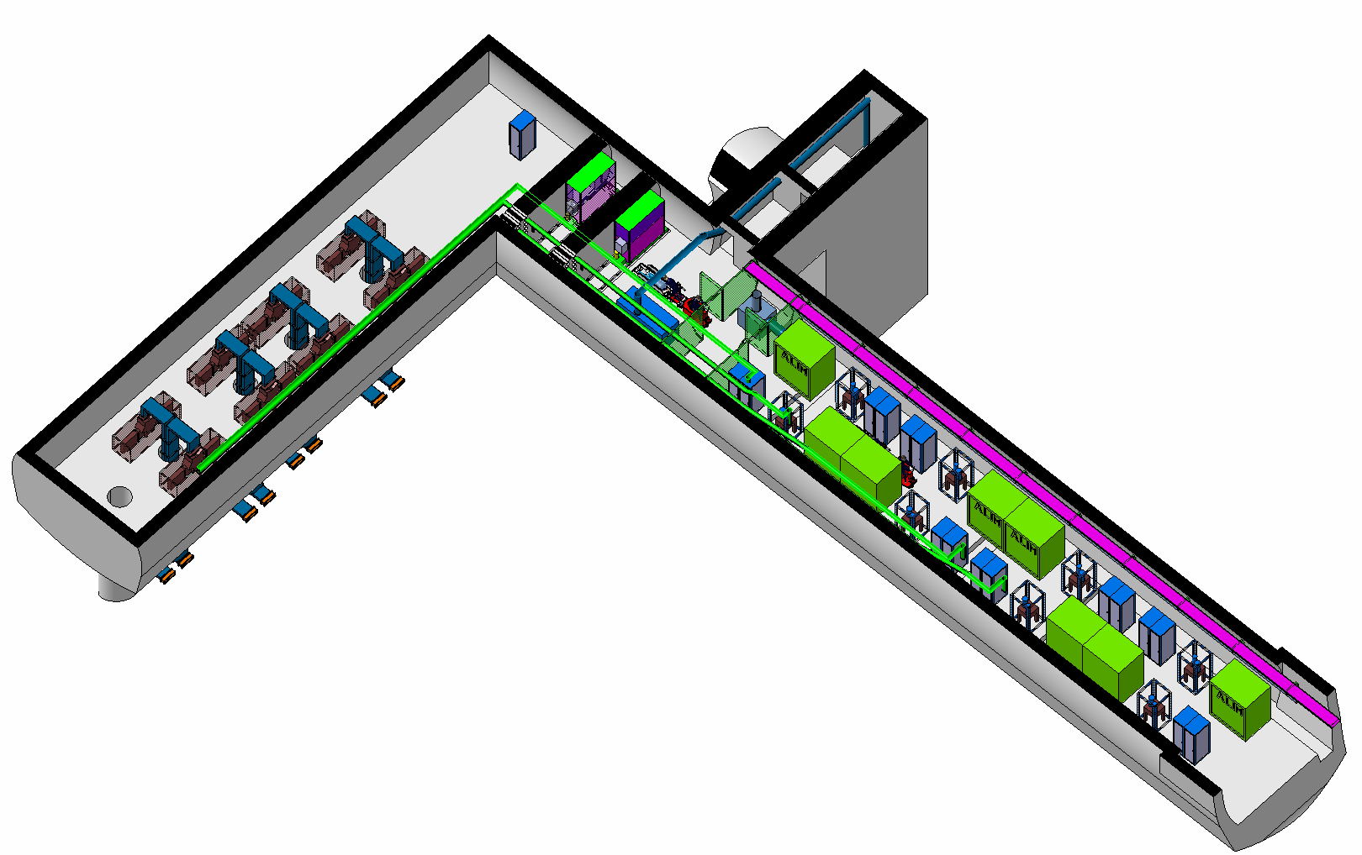

RF System Integration (WP15-WP4)
LHC
RF Cavern
SPS
(150m Routing
for RF, Cryo & cabling)
Illustration with full installation (4 x 8 HPRF)
Only half (4 x 4 HPRF) will be installed during LS3
The space has been reserved for full installation (32 HPRF, see P. Fessia’s talk tomorrow)
  Cores, all built in LS3 even if not use
  Larger UA/Faraday Cage to allow space for HPRF, HV transformers and CV eqp

Slide 26




SPS CC-RF Fast/Slow Controls
Strong synergy with the Linac4 design, that was an evolution of the LHC design (VME based)
  Identical VME crates (installed in SM18), Self-excited loop test early 2017 + Tuner driven tests Spring 2017
  PLC based RF power system, tuning, table control & fast interlocks, also LINAC4 based
  Amplitude/phase stability with realistic loop delays to derive the specs for the LHC
Motor controller
Interlock module

Slide 27


SPS Tunnel: EYETS (Dec 2016-Mar 2017)
Vacuum operational layout implemented
Cryo lines from surface installed
2K pumps moved to crab zone
HPRF Lines installed from surface
Required cables pulled (RF, Equip, BI)
4 ton handling rails installed (CM, table)
In 2018
See G. Vandoni’s talk tomorrow
Rails
Cryo-lines
RF Cables
RF Lines
Vacuum sectorization

Slide 28



EYETS/2017: Surface Installation
RF Amplifiers & lines
Faraday Cage & RF Controls
Cryogenics
Electrical power distribution
See cryo/infrastructure talks tomorrow
BA6 platform reinforcement completed during EYETS
In 2018
Faraday cage platform

Slide 29

Impact of Cost & Schedule Reviews
$β^{∗}$ luminosity levelling makes the integrated luminosity less sensitive than the peak luminosity the presence of crossing angle.
In an (not overly) optimistic scenario the cavities may achieve a gradient performance higher than at present specified and a crab angle significantly higher than half the optimum angle may actually be achievable with half of the system.
Impact & Actions taken
  ½ system (16 cavities) adopted a new baseline with potential, machine protection for operating at higher voltage ($\sim 5 MV$) is under study
  New production strategy with industry started 2017
  UK pre-series cryostat with RFD cavities as LHC prototype (+SPS compatibility)
  US contribution (10 RFD dressed Cav)
  RF power infrastructure reduction to 40 kW-CW (80 kW peak)

Slide 30

HL-LHC WP4 Schedule
DQW
SPS
RFD
UK
Preseries + Series
spares
US-contribution
The production (2021-25) assumes SM18-RF facility available
(Storage/assembly from SPS experience is a bottleneck)

Slide 31
Summing Up
The final design choices for the CM & RF services (many iterations) are robust. Validated all important elements by design or prototyping (cavity, tuner, He-vessel…)
  Very important lessons learned, some already adopted for SPS (under tight schedule pressure) and later for the LHC in the industrialization phase
Baseline planning for the SPS CC is feasible
  Availability of all infrastructure and flexibility in adapting with other activities is mandatory
Intense level of activity on many fronts, our primary focus is SPS test
  USLARP, UK & Japanese collaborations were an integral part w/o which the SPS tests would be impossible
  The USLARP cavities will serve an important role in performance optimization
  Preserving this expertise through production phase is mandatory
The most critical path items remain cryomodule & refrigeration system
  Gain time during CM assembly, not evident today

Slide 32
Thank you
(mainly to those behind the scenes)

Slide 33
Status of work progress
Equipment / Systems | March 2015 status | October 2016 status | Remarks
Cavities | US delivery | CERN cavity parts ready for assembly | On critical path
Cryomodule | Concept presented | Parts arriving at CERN | On critical path
FPCs | Concept finalized | All FPC fabricated | On time
High Power RF | Tetrode/IOT/SS | IOT/SS | On time
Low Level RF | Concept presented | Hardware in Preparation for SM18 | On time for CM-tests
Vacuum | Concept preparation | Under fabrication | EYETS/YETS installation staged
Cryogenics |  | Under procurement | Refrigerator on critical path
Other Infrastructure | Still old location | Defined and being prepared for LSS6 | Large items for YETS17

Slide 34

Cryogenics architecture
TE-CRG

Slide 35
Need for SPS Tests
Operation of such type of cavities in high current and high energy CW (proton) circular machines has never been done!
Injection, capture, acceleration where the cavities are carefully counter-phased (transparency) and re-phased during collisions Ultra-precise control of cavity voltage and phase guarantee the preservation of beam quality throughout the cycle.
Guarantee the operation of cavities with a trip rate significantly below the LHC availability. To validate this is in SPS is pre-requisite both with and w/o beam.
Unlike electrons, there are many aspects (emittance growth, machine protection, RF non-linearity, instabilities) where proton beam tests are the only conclusive answer.

