Slide 1
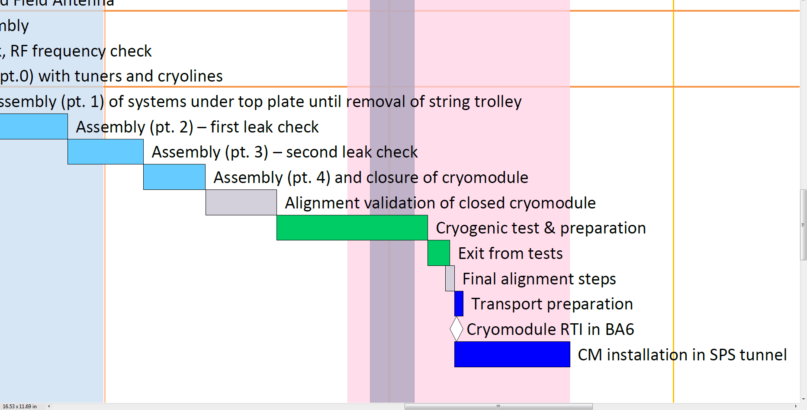
SM18 Minimal Plan
Frequency tracking in cooldown
Tuner validation with (low power) RF
LLRF (cavity & tuning loop)
HOM spectrum
Pick-up probe & connectors
Initial RF conditioning, 1kW solid state amplifier
24/11
Notes:
1. Frequency tracking of the two cavities through-out the CM assembly procedure, vacuum/pressure testing, cryogenic cooldown. Coupling measurements at warm
2. Tuner validation both mechanical and with RF feedback (low power)
3. LLRF validation (cavity loop and tuner loop) to the extent time allows, already validated in vertical setup on PoP+Tuner
3. HOM spectrum between the two cavities both at cold and warm
4. Check of the Pickup probe and all needed connectors.
5. Initial RF conditioning with the available 1 kW amplifier, extent of Rf conditioning depending on the time available.

Slide 2
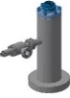
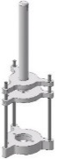
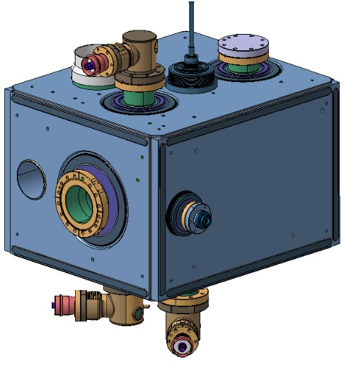
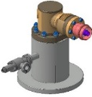
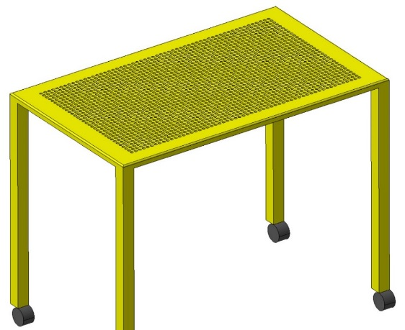
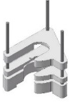
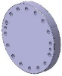
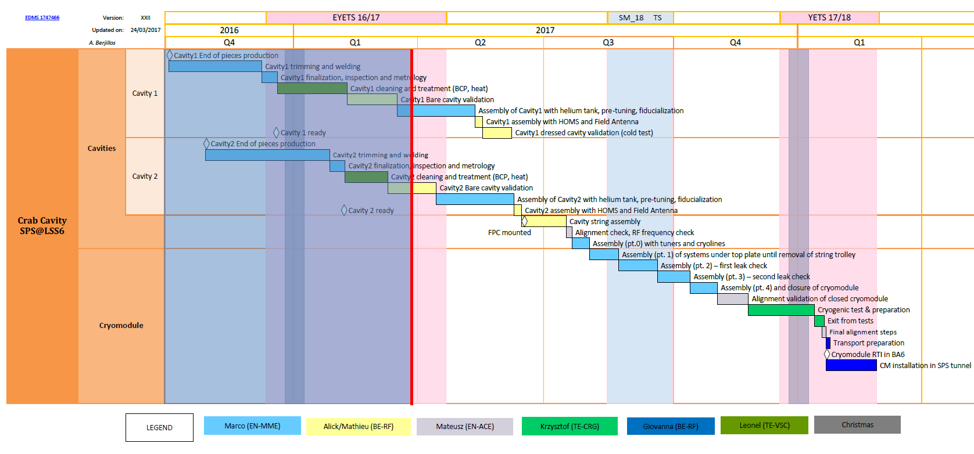
HOM Assembly
Courtesy E. Montesinos et al.
Assembly of 3 HOMs + PU
Beginning of May 2017
Cold testing with HOMs
mid-May
Additionally requesting HOM testing with US-DQW#1 at Jlab

Slide 3
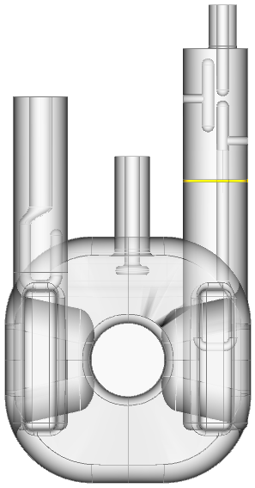
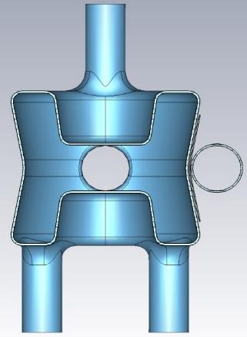
Impedance Spectrum

Slide 4

HOM Power including LHC Filling
The HOMs were designed for $1 kW$
We are monitoring HOMs for both cavities during cooldown to understand the freq/spread
More details from E. Metral

Slide 5
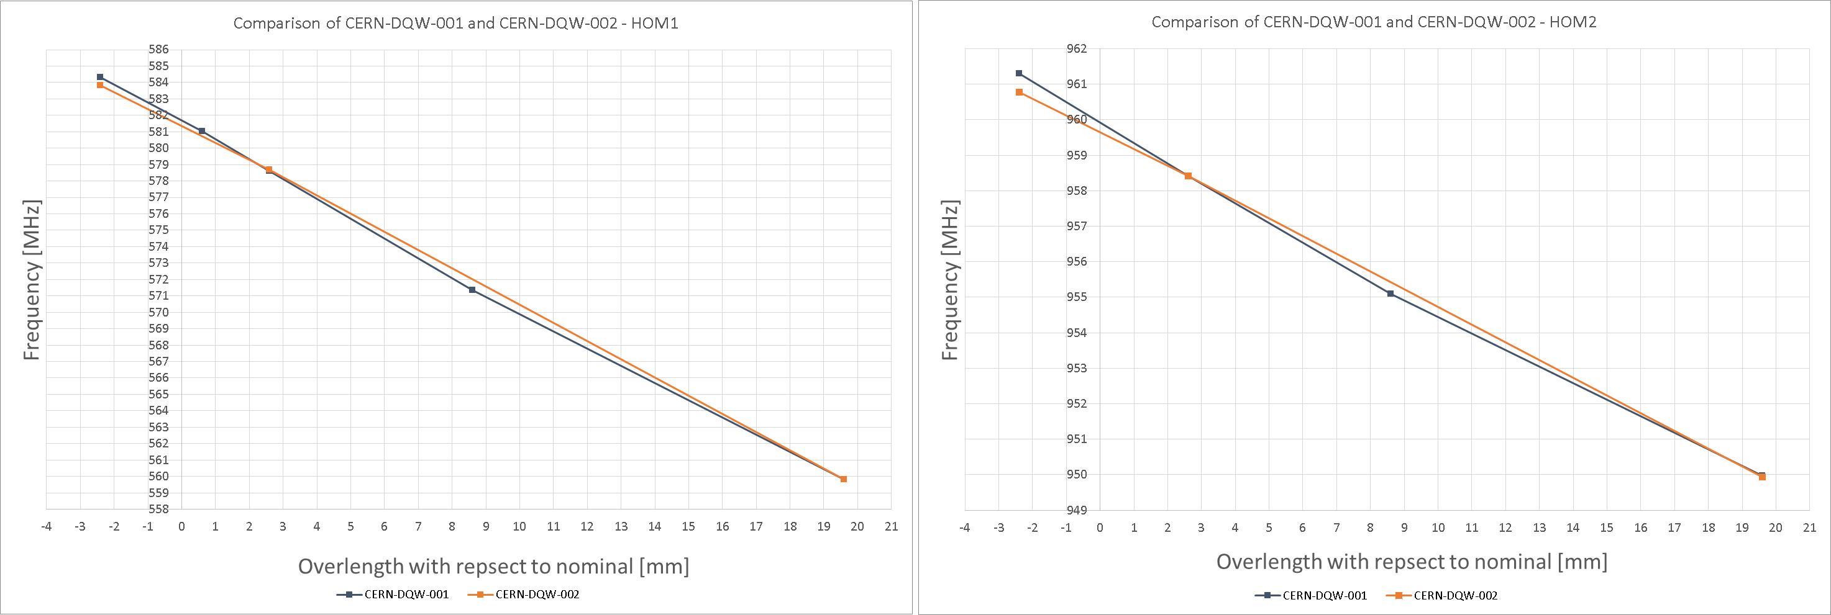
HOM Tracking during Cavity Tuning
960 MHz
585 MHz

Slide 6
Success Criteria for SPS test:
O. Bruning, CC-Review
Operate crab cavities w/o interrupting SPS
Demonstrate ‘transparency’ of the system and ability to ‘turn-off the system’ (detuned and anti-phased)
Characterize failure scenarios and beam response during failure for MP studies in the HL-LHC
Observe Crabbing on the longitudinal beam profile and demonstrate reliable system operation with high beam current
Demonstrate system functionality and current design choices and assumptions (e.g. cryo load, RF power, HOM power…)
Transverse alignment and the need for active alignment in LHC

Slide 7
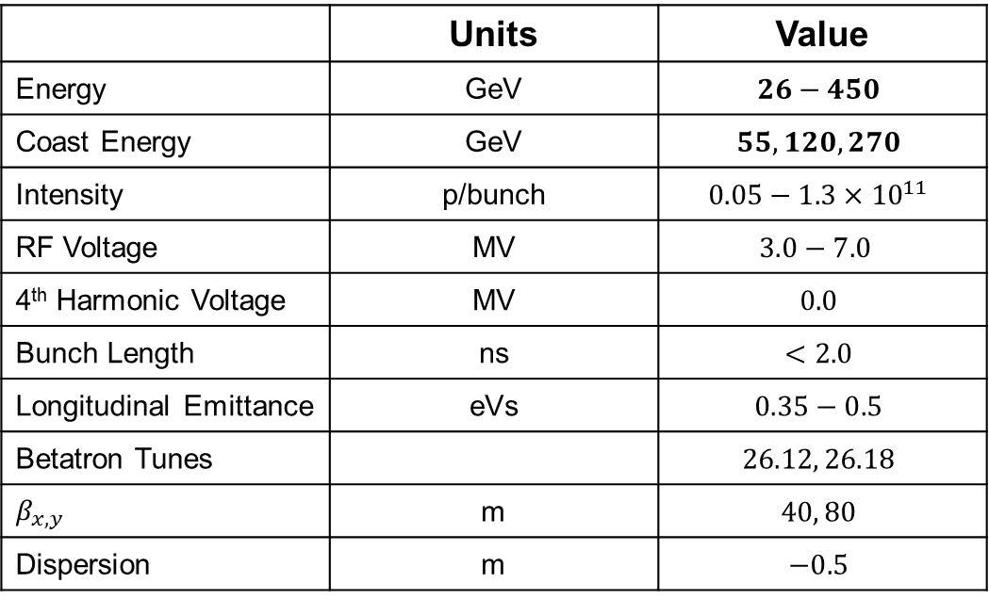
Beam Parameters for Crab Tests
 | Units | Value
Energy | GeV | $$26−450$$
Coast Energy | GeV | $$55, 120, 270$$
Intensity | p/bunch | $$0.05−1.3×{10}^{11}$$
RF Voltage | MV | $$3.0−7.0$$
4th Harmonic Voltage | MV | $$0.0$$
Bunch Length | ns | $$<2.0$$
Longitudinal Emittance | eVs | $$0.35−0.5$$
Betatron Tunes |  | $$26.12, 26.18$$
$$β_{x,y}$$ | m | $$40, 80$$
Dispersion | m | $$−0.5$$

Slide 8
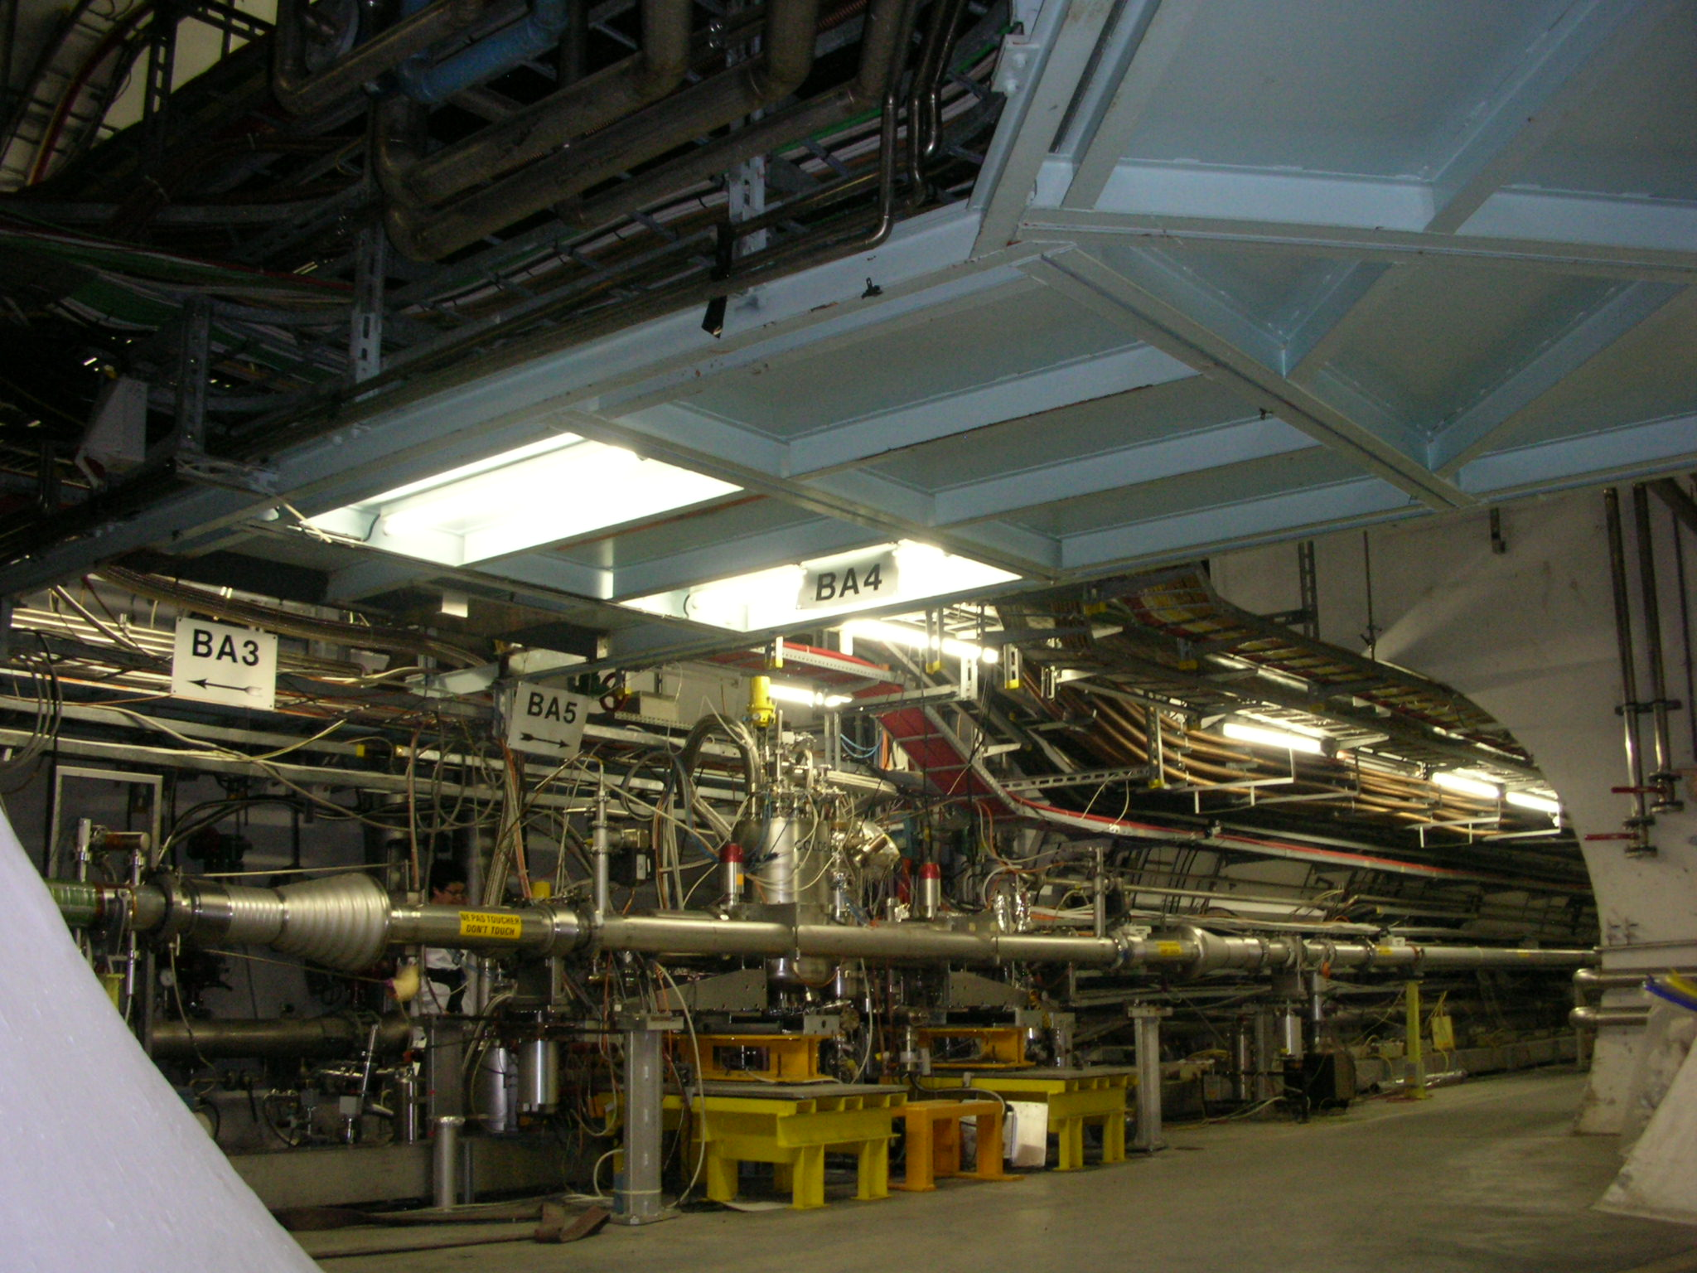
Transparency to SPS
The mechanical bypass is specifically designed to be an independent vacuum system. SPS operation not interrupted in case of RF commissioning or “catastrophic” failure of cryomodule
Crabs
LSS6
COLDEX in LSS4

Slide 9
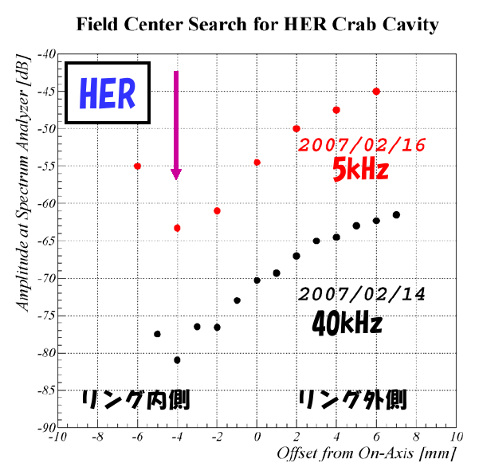
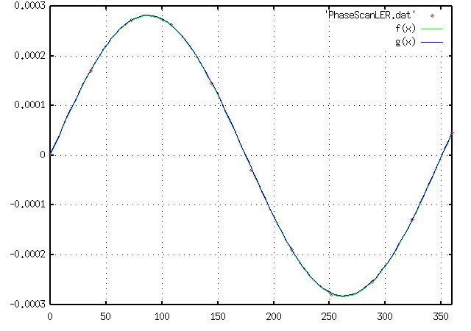
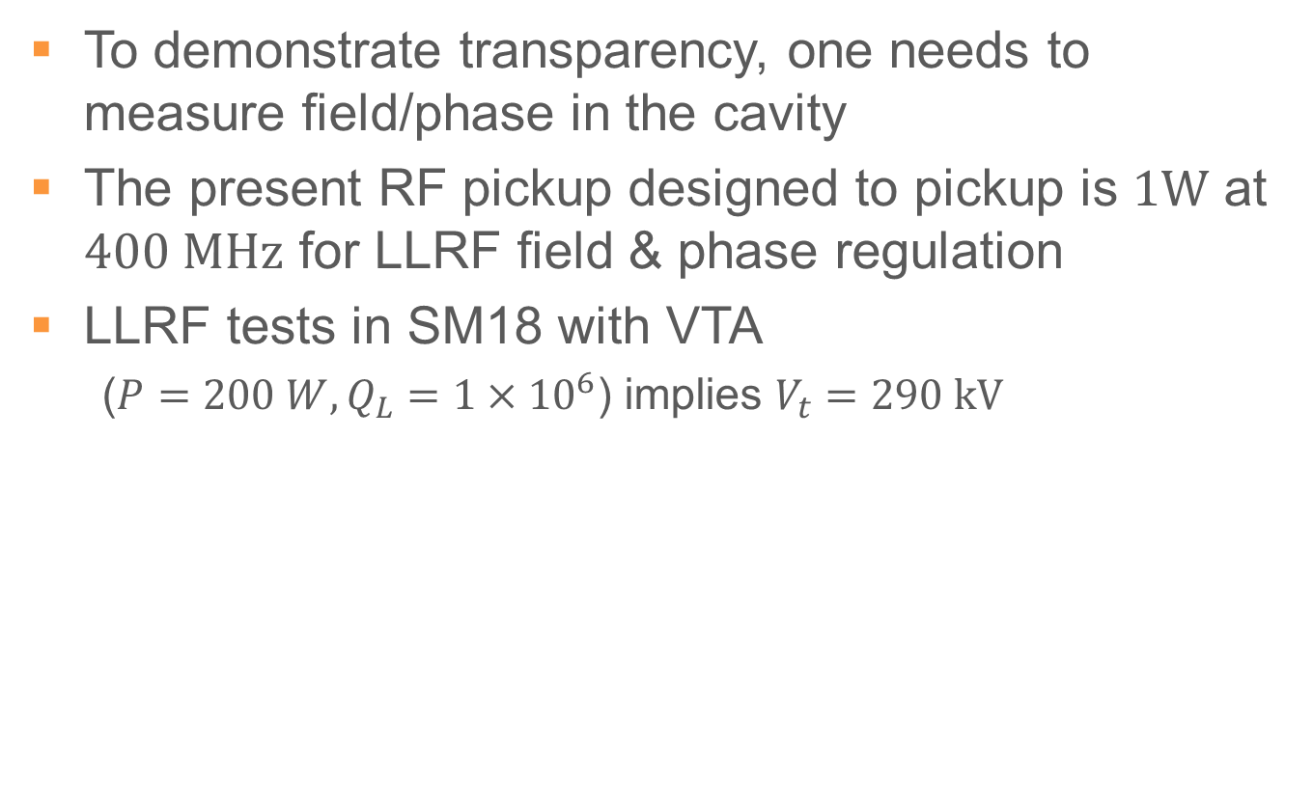
Transparency
To demonstrate transparency, one needs to measure field/phase in the cavity
The present RF pickup designed to pickup is $1W$ at $400 MHz$ for LLRF field & phase regulation
LLRF tests in SM18 with VTA
  ($P=200 W, Q_{L}=1×{10}^{6}$) implies $V_{t}=290 kV$
RF Phase w.r.t to Beam
LER Scan
KEKB Commissioning
Zero crossing

Slide 10
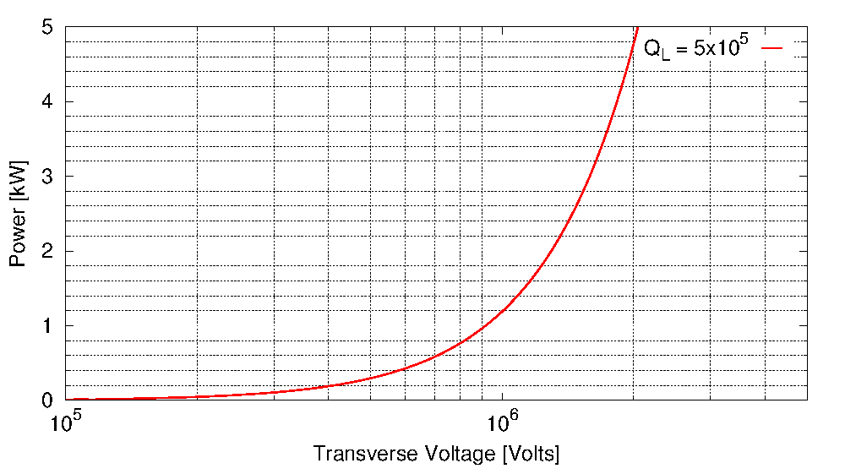

RF Input Power w/o Beam
The present baseline is to install $1 kW$ in SM18 to reach $∼0.9 MV$ per cavity

Slide 11
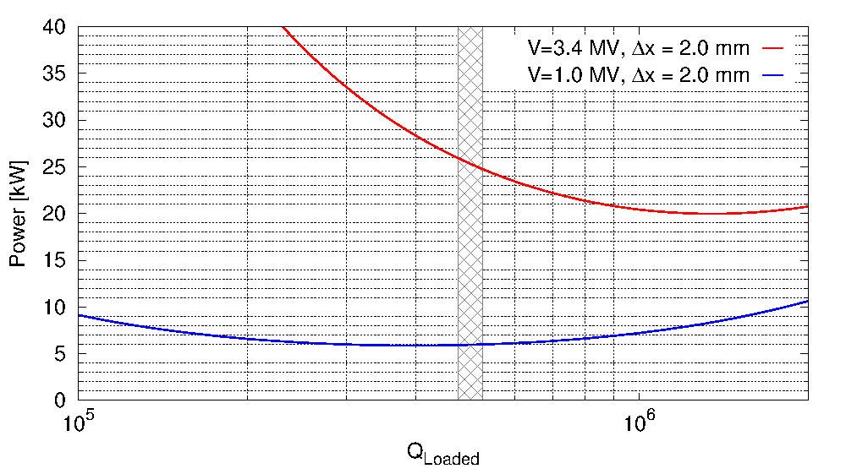

RF Input Power w/o Beam
The required power with $I_{b}=350 mA$
(200 bunches, $N_{b}=1.7×{10}^{11}$p/b)

Slide 12
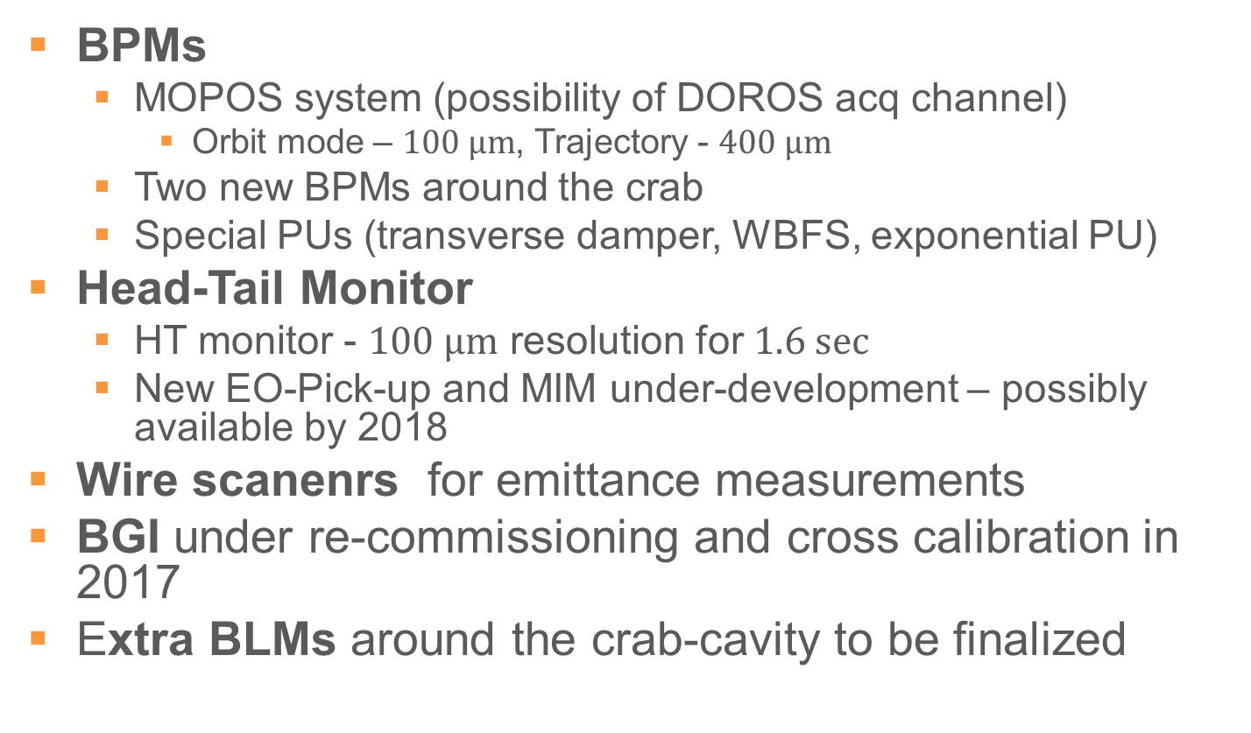
SPS Instrumentation
BPMs
  MOPOS system (possibility of DOROS acq channel)
    Orbit mode – $100 μm$, Trajectory - $400 μm$
  Two new BPMs around the crab
  Special PUs (transverse damper, WBFS, exponential PU)
Head-Tail Monitor
  HT monitor - $100 μm$ resolution for $1.6 sec$
  New EO-Pick-up and MIM under-development – possibly available by 2018
Wire scanenrs for emittance measurements
BGI under re-commissioning and cross calibration in 2017
Extra BLMs around the crab-cavity to be finalized

Slide 13
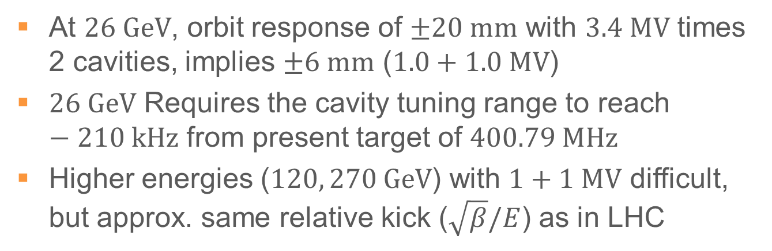
What can be Observed
At $26 GeV$, orbit response of $±20 mm$ with $3.4 MV$ times 2 cavities, implies $±6 mm$ ($1.0+1.0 MV$)
$26 GeV$ Requires the cavity tuning range to reach $−210 kHz$ from present target of $400.79 MHz$
Higher energies ($120, 270 GeV$) with $1+1 MV$ difficult, but approx. same relative kick ($\sqrt{β}/E$) as in LHC
Courtesy: R. Tomas

Slide 14
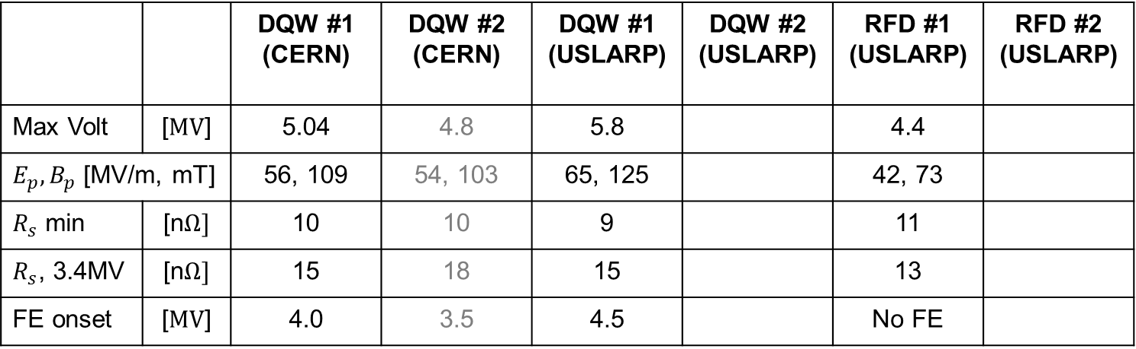
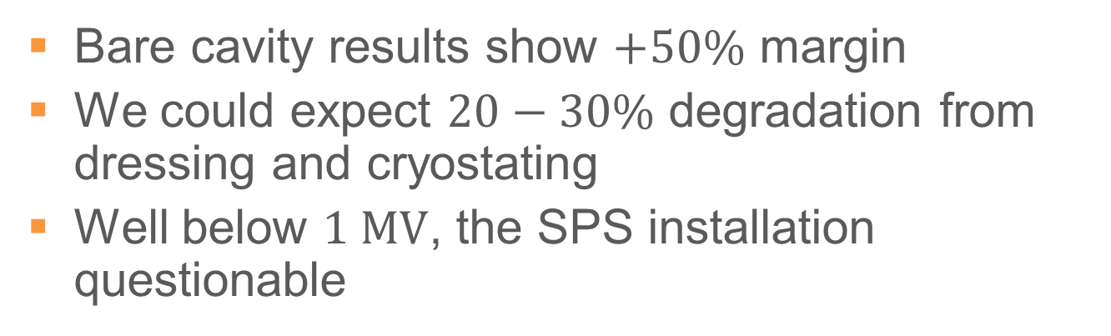

Cavity Performance, Minimum Acceptance
Bare cavity results show $+50\%$ margin
We could expect $20−30\%$ degradation from dressing and cryostating
Well below $1 MV$, the SPS installation questionable
 |  | DQW #1 (CERN) | DQW #2 (CERN) | DQW #1 (USLARP) | DQW #2 (USLARP) | RFD #1 (USLARP) | RFD #2 (USLARP)
Max Volt | [$MV$] | 5.04 | 4.8 | 5.8 |  | 4.4
$E_{p}, B_{p}$ [MV/m, mT] |  | 56, 109 | 54, 103 | 65, 125 |  | 42, 73
$R_{s}$ min | [n$Ω]$ | 10 | 10 | 9 |  | 11
$R_{s}$, 3.4MV | [n$Ω]$ | 15 | 18 | 15 |  | 13
FE onset | [$MV$] | 4.0 | 3.5 | 4.5 |  | No FE
Nominal $V_{kick}=3.4 MV$, $R_{s}=10 nΩ$

