Slide 1












Evolution of Crab Cavities in LARP
Alessandro Ratti – SLAC

Slide 2
Outline
A historic perspective of crab cavities in LARP
Major program accomplishments so far
An update since the last review
Ongoing R&D
Program objectives
Transition to the construction project
Alessandro Ratti – International Review of the CC program - CERN- April 2017

Slide 3
Global Crab Cavity Team Organization
CERN leads the global collaboration
  Directly responsible for several tasks
    RF power and controls, local installation, cryogenics, machine protection…
  Cross disciplinary working group to prepare SPS validation test
    Operations, RF, Vacuum, Cryogenics, Beam Dynamics, Machine Protection, Collimation, Instrumentation…
Lancaster Univ. and STFC actively involved
  EM design, HOM and FPC test boxes
  Cryomodule design
LARP playing a key role in R&D for the cavities
  Proposing a part of the HL-LHC project now defined
Alessandro Ratti – International Review of the CC program - CERN- April 2017

Slide 4
The Team – Principal Contributors
LARP
  BNL – Q.Wu, S. Verdu-Andres, B. Xiao, J. Skaritka, Ilan Ben-Zvi
  FNAL – T. Nicol, L. Ristori
  JLAB – A. McEwen, E. Daly, H. Park (also ODU)
  LBNL – J. Qiang
  ODU – J. Delayen, S. De Silva, H. Park
  SLAC – Z. Li, A. Ratti
World Wide Collaboration
  CERN – R. Calaga, O. Capatina, M. Garlasche’, C. Zanoni
  STFC – G. Burt, N. Templeton, T. Jones
Many others are actively involved, in particular in the work centers of CERN and JLAB
  and many contributed in the past
Alessandro Ratti – International Review of the CC program - CERN- April 2017

Slide 5
LARP Team Organization
Cavity EM Design - BNL, ODU/SLAC
  RF measurements, Frequency Analysis (w. Proc.), HOM studies
Cavity processing and testing – Jefferson Lab
  Parts inspection and acceptance
  Welding (w. procedures)
  Chemistry (w. procedures)
  Vertical Testing (w. procedures)
Project Coordination – SLAC
Project Engineering – FNAL
  Development of Pre-Series cavities
  Planning for AUP
  Working as a team, everyone encouraged to contribute
  CERN actively involved
Alessandro Ratti – International Review of the CC program - CERN- April 2017

Slide 6
Historic Perspective
CC proposal started before the commissioning of the LHC
  First CC workshop (CC-08 BNL/LARP/CARE-HHH) held at BNL 24/5 Feb. 2008
  Great benefit in luminosity leveling and coping with the necessary crossing angles
  HL-LHC makes it even more compelling
Initial challenge → demonstrate sufficient deflecting voltage in the limited space available
  Beampipe separation 40 cm
  Limited longitudinal space in the IR → significant gradients
Three candidate designs were built and successfully tested by 2013
  LARP led the DQW and RFD;
  STFC led the 4-rod cavity
  All PoP cavities built by Niowave
Alessandro Ratti – International Review of the CC program - CERN- April 2017

Slide 7
Two Crab Cavity Designs Selected
LARP supported the R&D that led to both designs that are part of the baseline HL-LHC design
Proof of Principle cavities were built and tested in a VT
  Successful measurements demonstrated feasibility
Both LARP designs were chosen to address kicks in the H (CMS) and V (ATLAS) planes. Two main reasons to keep both designs:
  HOMs are a dominant factor
    different cavities have different spectra
  Cryomodule integration
    90 deg rotations are “easy” only in principle

Slide 8
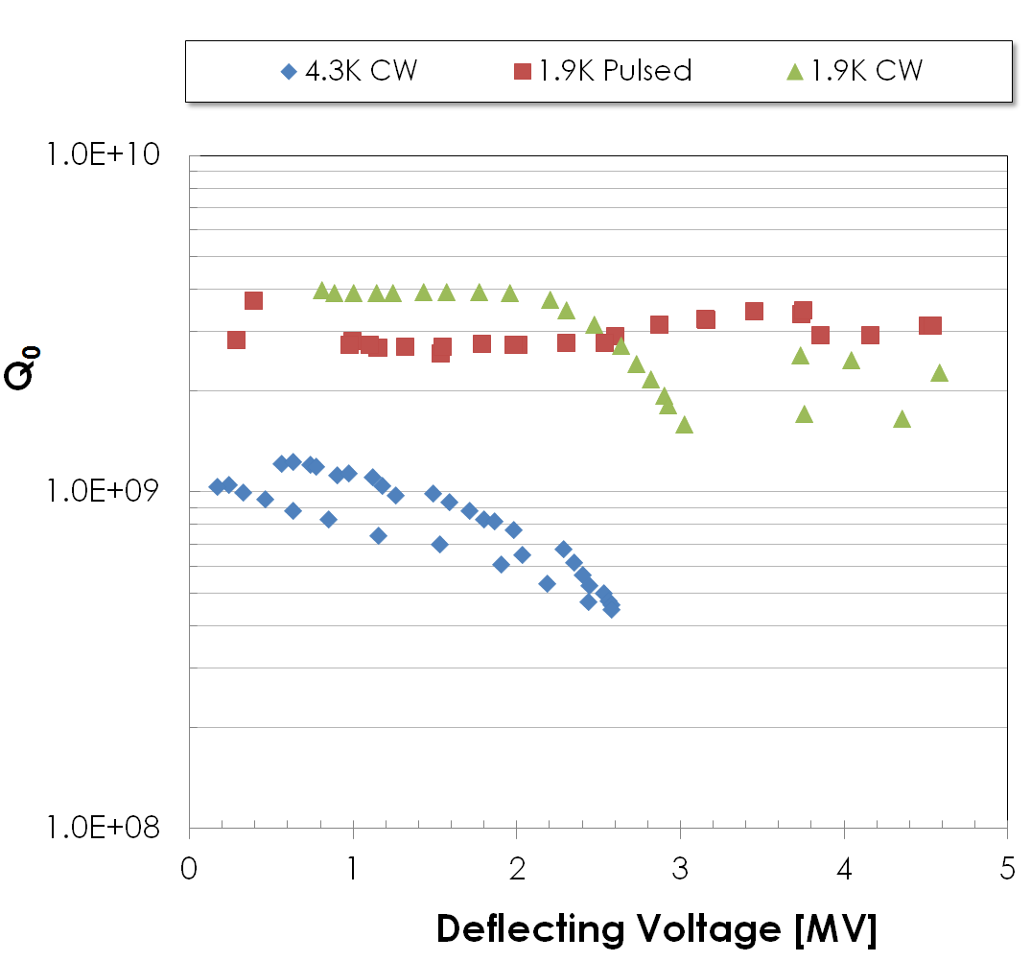
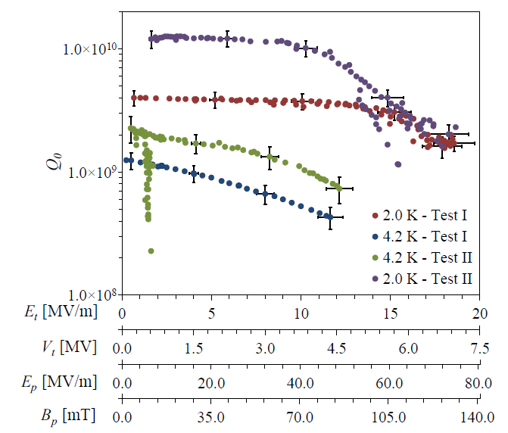
PoP Test Results
DQW
RFD
JLab
3.4 MV
4.6MV
quench
7 MV
quench

Slide 9
Cavity System Requirements
Resonance frequency [MHz] 400.79
Bunch length [ns] 1.0 (4 σ)
Maximum cavity radius [mm] ≤145
Nominal kick voltage [MV] 3.4
R/Q (assumed, linac convention) [Ω] 400
Dynamic Load ~3W (for SPS)
Q_{ext} (fixed coupling range) 3 × 10⁵–5 × 10⁵
RF power [kW] 80
Power coupler OD (50Ω) [mm] 62
LLRF loop delay [μs] ≈1
Cavity detuning [kHz] ≈1.0
From HL-LHC PDR, Dec. 2015

Slide 10
E(in)volution of LARP proposals
(AKA Via Dolorosa)
LARP initial proposal was to contribute all cryomodules, for both the SPS test and the HL-LHC then….
Nov 2013
  LARP and CERN realize this was too ambitious
  New LARP scope → deliver all cold masses only
May 2014
  CC System External Project Review
    A. Yamamoto (Chair), M. Champion (SNS), A. Facco (INFN), M. Kelly (ANL), C. Pagani (U. Milano), H. Padamsee (Cornell/FNAL)
  Down-selected cavities and established a prioritization criteria for SPS CC production
LARP is not able to secure funding for M&S and cavity fabrication
  Only option to team up with an ongoing SBIR effort at Niowave
    No contractual agreement between Niowave and LARP

Slide 11
E(in)volution of LARP proposals (2)
Aug. 2014
  Niowave starts the extensive manufacturing qualification process requested by CERN
Winter of 2014/5
  LARP and CERN agree to modify the scope of the collaboration a second time
    CERN loans magnet wire to LARP freeing up M&S funds
    LARP engages JLAB to weld all cavity parts, process and test the completed cavities
    Niowave agrees to provide formed cavity parts for welding at JLAB
March 2015
  CERN takes on responsibility for tuners and HOM dampers for the SPS
    LARP held the HOM Design Review - Feb. 2015, JLAB
  LARP now delivering for the SPS only DQW and RFD cavities with He tanks

Slide 12
E(in)volution of LARP proposals (3)
May 2015
  Niowave informs the collaboration that it will weld cavity subassemblies
  JLAB is now only welding the final sub-assemblies
August 2015
  Niowave provides the first welded cavity parts for inspection
October 2015
  After a ~6 months process, JLAB receives the funding to start the work

Slide 13
E(in)volution of LARP proposals (4)
Jan 2016
  CERN starts its effort to produce DQW cavities for the SPS
  LARP decides to build bare cavities only, without He tanks
    CERN and LARP agree the DQW cavities produced at CERN are the lead candidate for integration in the SPS test.
Mar 2016
  In light of schedule constraints for the SPS test, CERN decides to test the DQW first, before LS2
  The RFD prototypes for the HL-LHC will be tested after LS2
May 2016
  LARP-AUP and CERN agree on the US contribution to the HL-LHC: limited to all RFD dressed cavities only.

Slide 14
DQW and RFD processing
Niowave-produced cavities have parallel paths
  RFDs received from Niowave go to JLAB for final machining, thinning, trimming and processing
  DQWs received from Niowave go to BNL for dimensional measurement, shipped back to Niowave for thinning and final machining, then back to JLAB for welding, processing and testing.
All four cavities (2+2) arrived at JLAB by October 2017
In light of CERN’s ongoing development of DQW cavities, it is important that LARP remains ahead of CERN in processing and testing the DQW cavities to feed useful information back into CERN’s process
  BNL staff in particular is very engaged in the processes on both sides of the ocean

Slide 15
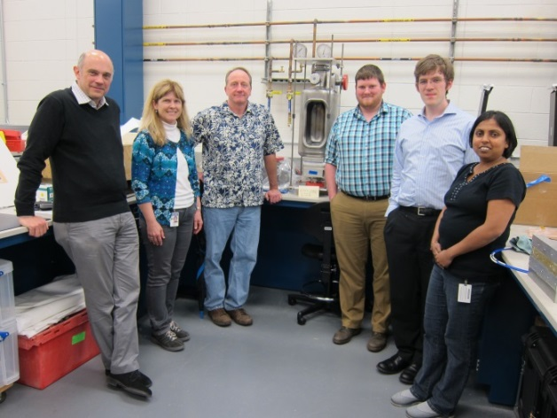
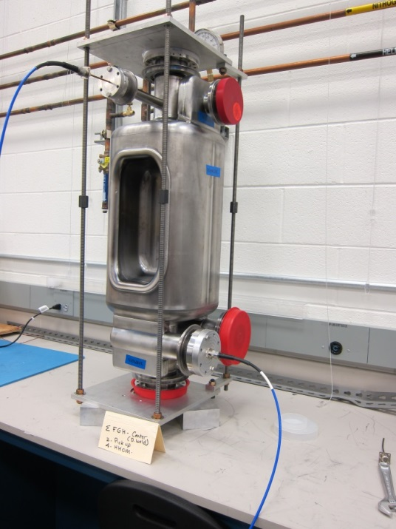
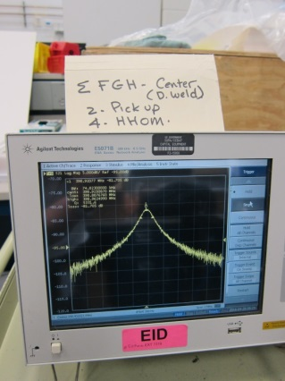
Niowave RFD Cavities at JLAB
28 April 2016
Two cavity sub assemblies arrive at JLAB

Slide 16
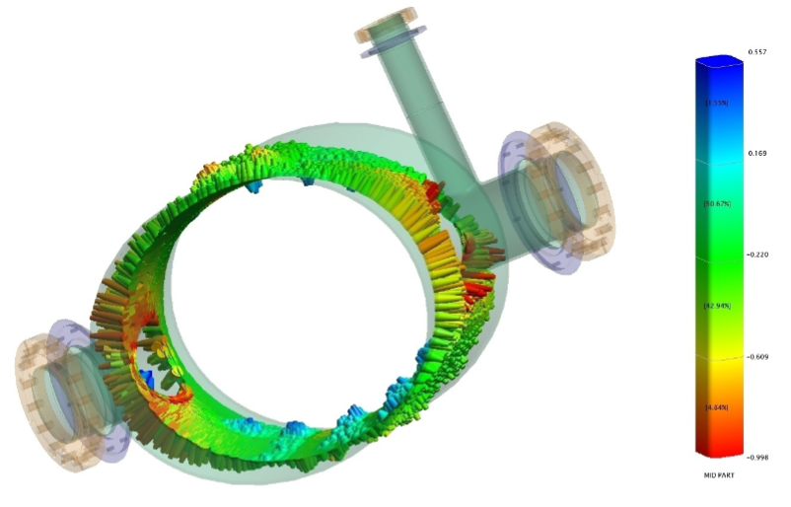
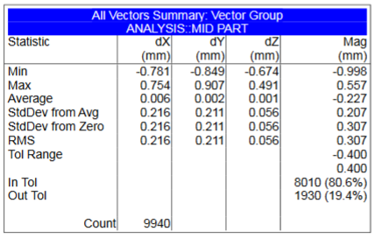
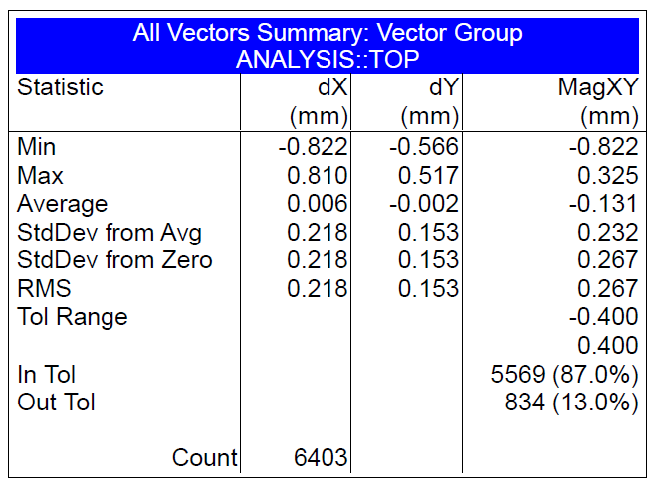
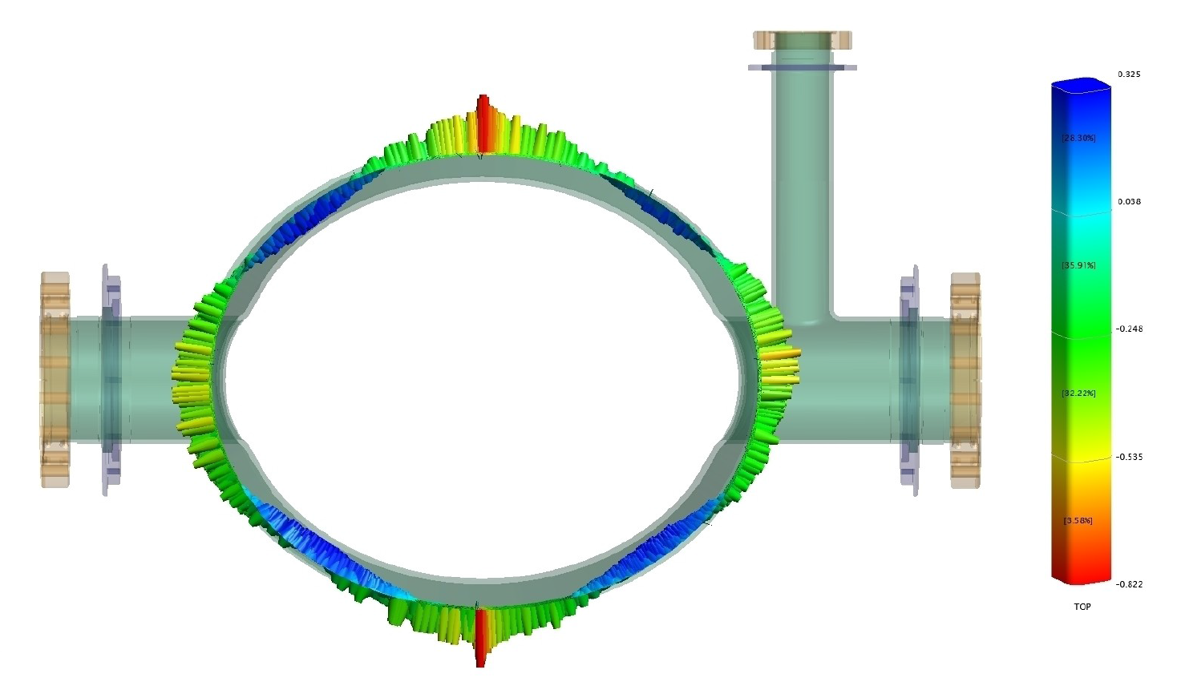
DQW Received at BNL on Jun 26, 2016
Inspected at BNL
Visual and Dimension Check
Profile spec ≤ 0.8 mm
Edge deviation 9.293 mm down from the edge

Slide 17
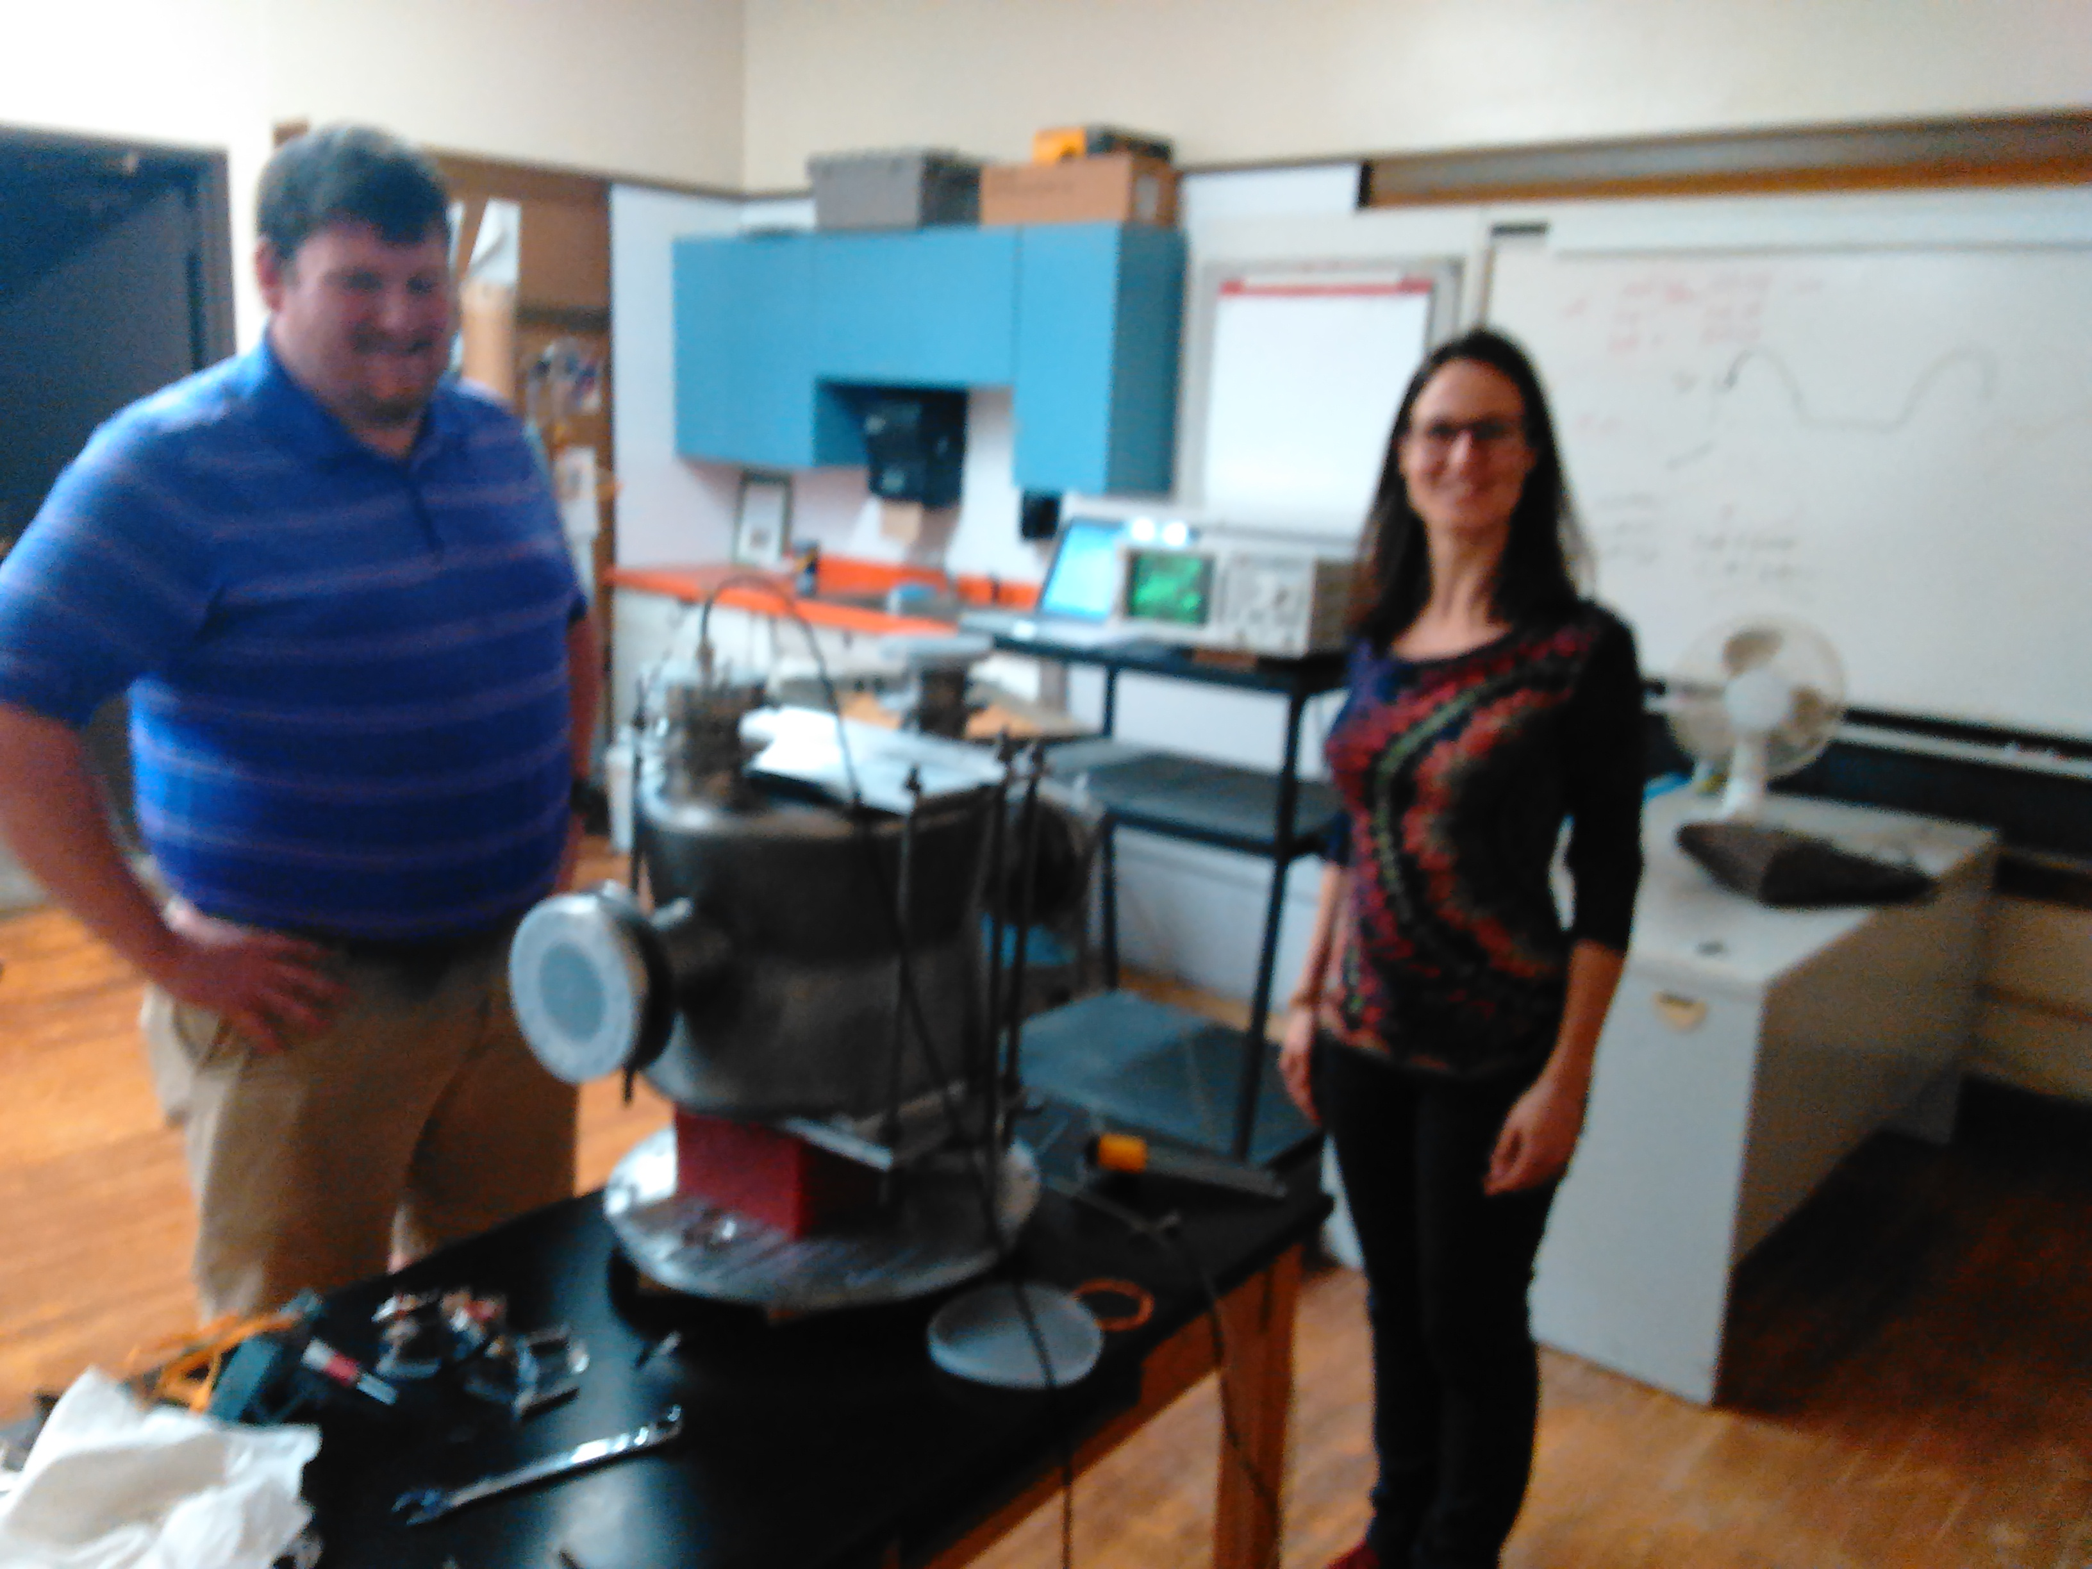
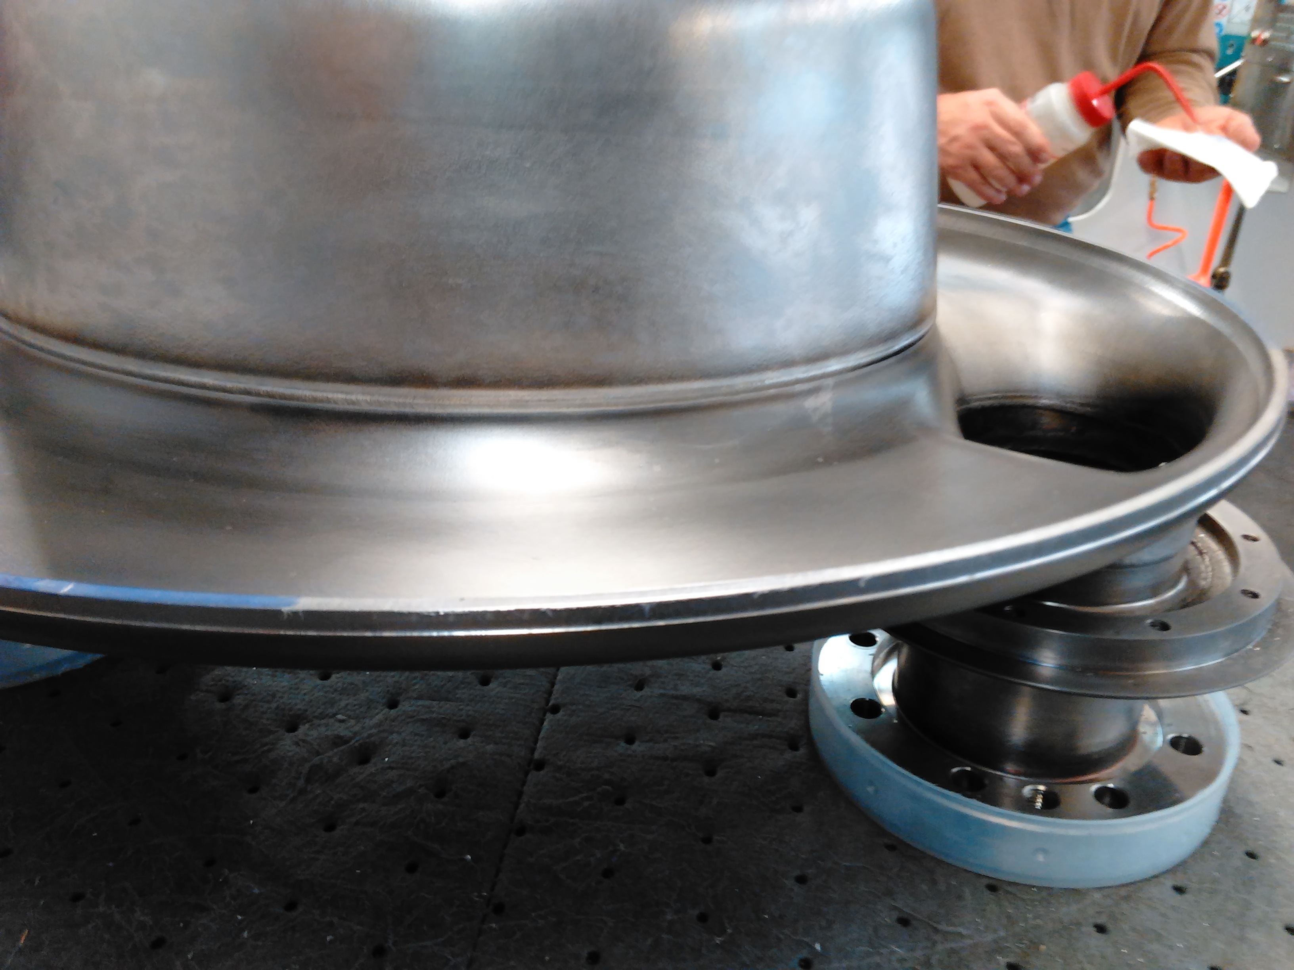
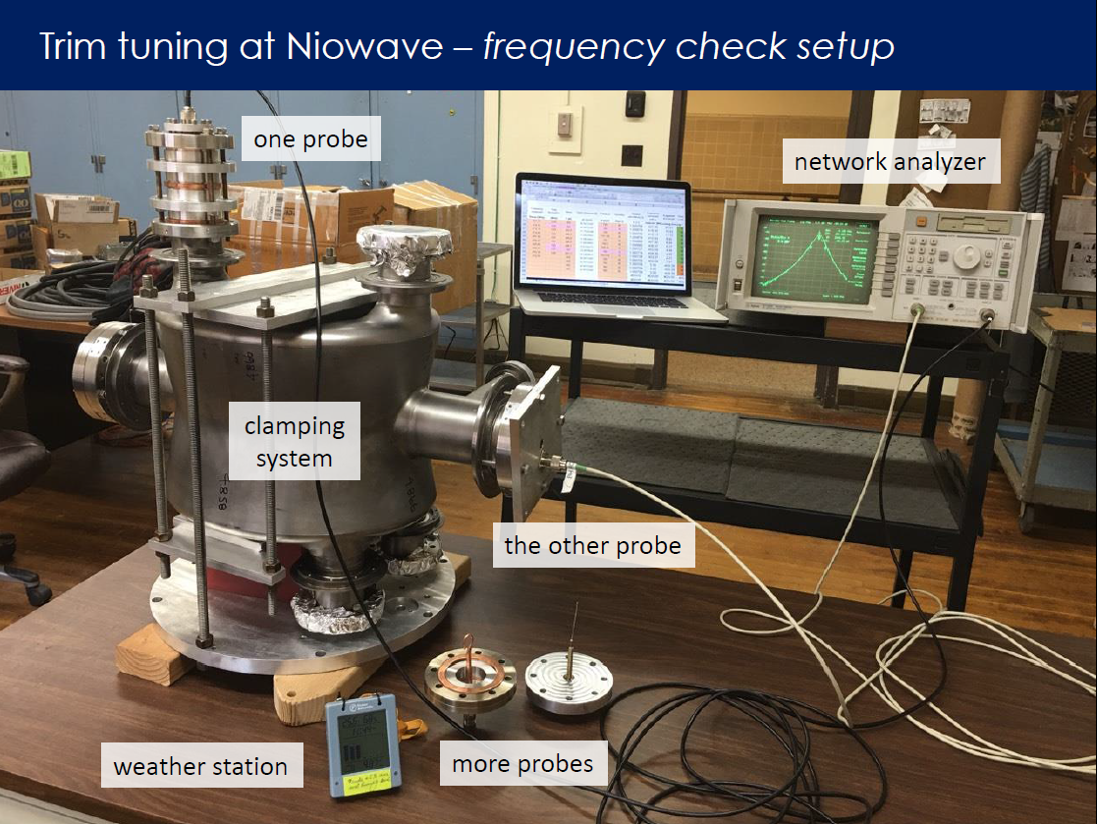
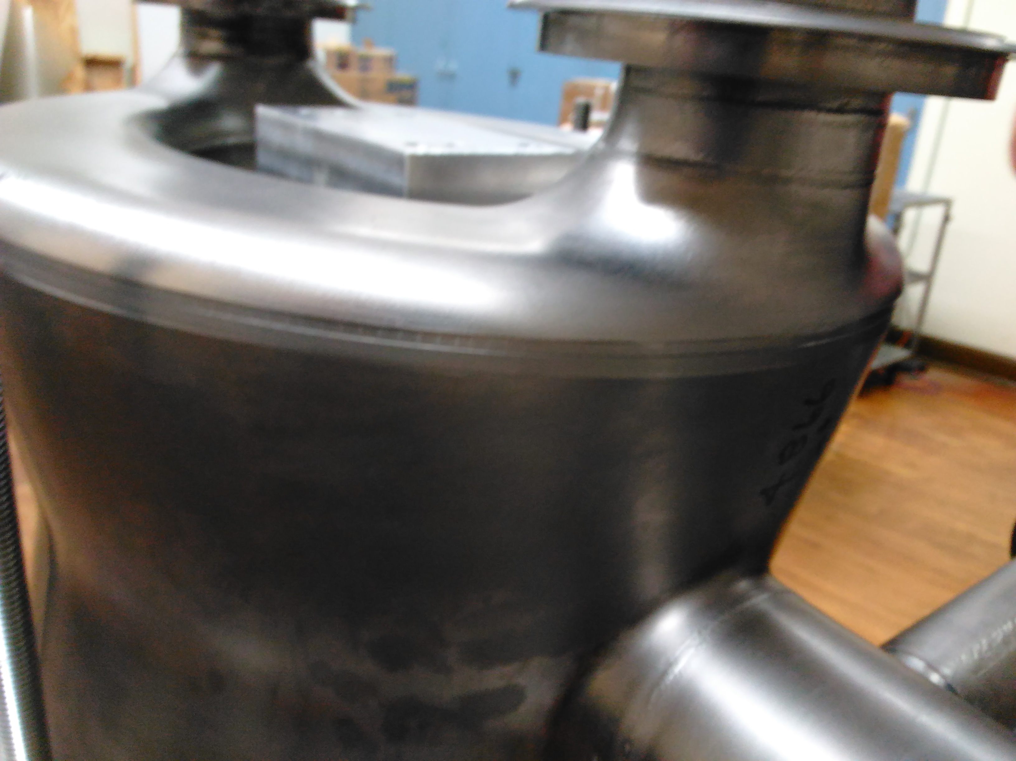
DQW n 1 Final Trimming at Niowave
15 Sep 2016

Slide 18
DQW Tracking Trim Tuning
Good reproducibility: both cavities follow the same behavior
Measured trim tuning sensitivity, 0.9-1.0 MHz/mm-gap, close to predicted by simulations, 0.98 MHz/mm-gap (using 2nd order polynomial fit)
Accepted cavities are about 0.2 MHz above from target frequency
TARGET
401.20 MHz

Slide 19
Many more details available
One presentation on processing and testing at JLAB
Two presentations on DQW and RFD measurement results, lessons learned and improvements towards the pre-series and production for the HL-LHC
One presentation on the planning for contributions to the HL-LHC through the AUPL Project

Slide 20
Ongoing Future LARP Plans
Continue and complete testing of all bare cavities
Test cavities with HOMs where possible
Move tested cavities from JLab to BNL and FNAL for further testing
Collaborate with CERN and support CERN’s development of RFD cavities towards the SPS tests post LS2 (and post LARP)
Contribute to the definition and planning for the pre-series and series
Support the SPS test with planning, RF measurements and MDs, analysis and synthesis
Start planning for L-AUP with the limited availability of M&S funding within the LARP program and support the transition to the US construction project.

Slide 21
Conclusions
LARP was a key contributor to enable the CC program by demonstrating the feasibility of SRF cavities meeting the constraints of the HL-LHC upgrade
Current program is giving very important results
  Both cavity designs exceed performance requirements
    Shown in later presentations
  Developed processes that lead to successful results
    For the DQW good results came from both sides of the ocean -> good sign of the maturity of the design
The team intends to continue supporting this program through the SPS tests and into the HL-LHC construction
  Funding permitting
    outside of the scope of this review

Slide 22

Questions

Slide 24
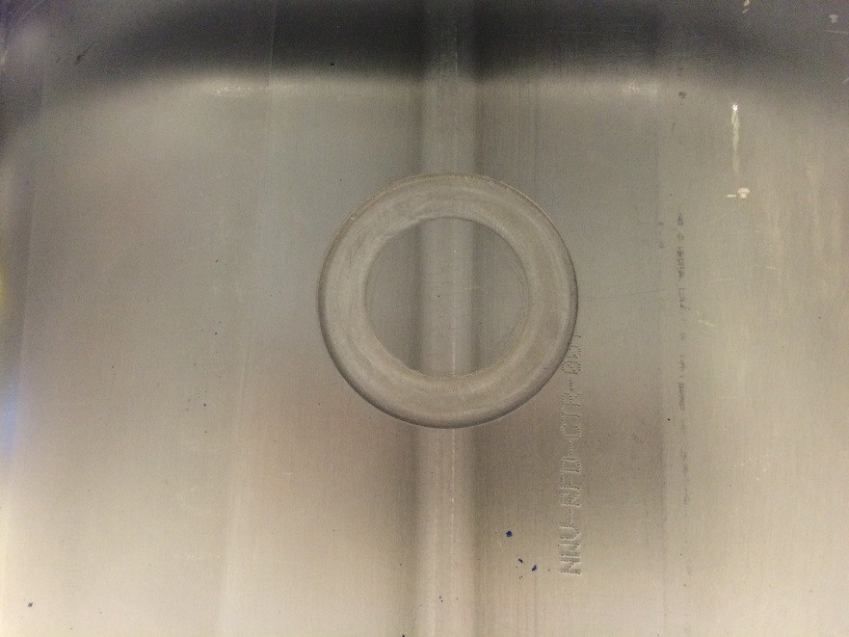
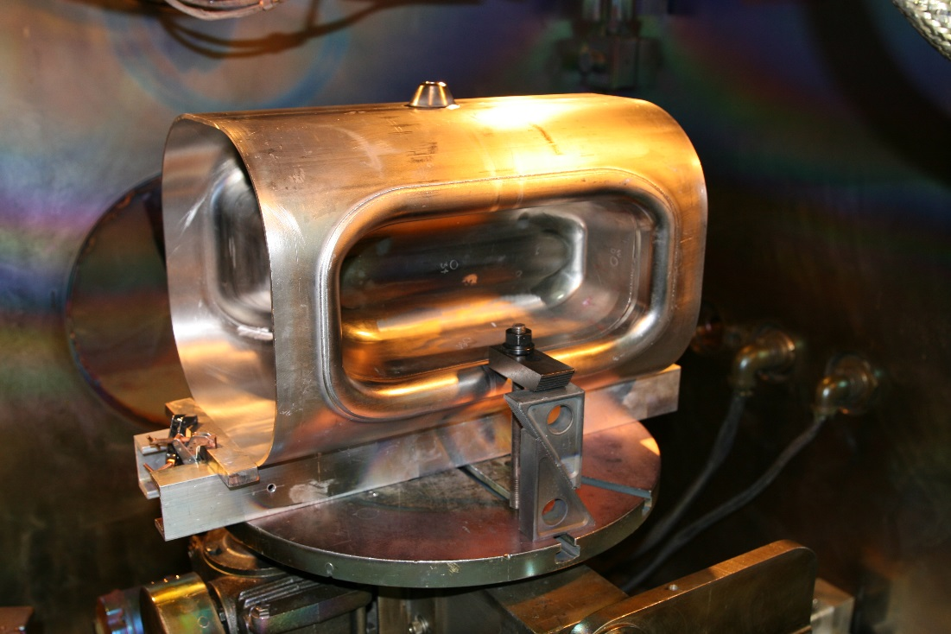
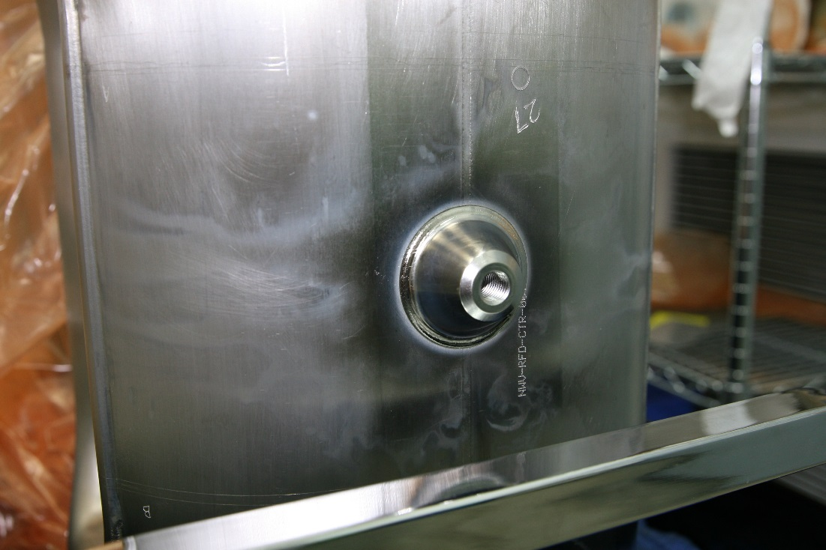
RFD Tuner Attachment Weld at JLAB
Tuner tab weld of both center bodies are complete
Measurements of CAV-001:
  Freq = 399.20411 MHz
  Q = 7943.46

Slide 25
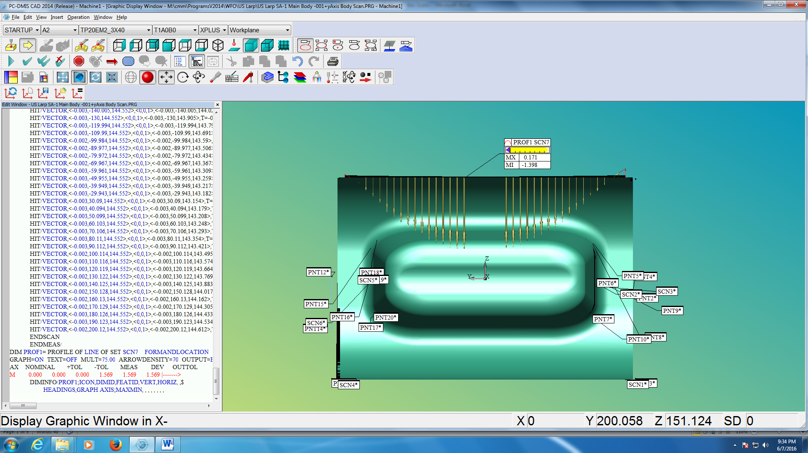
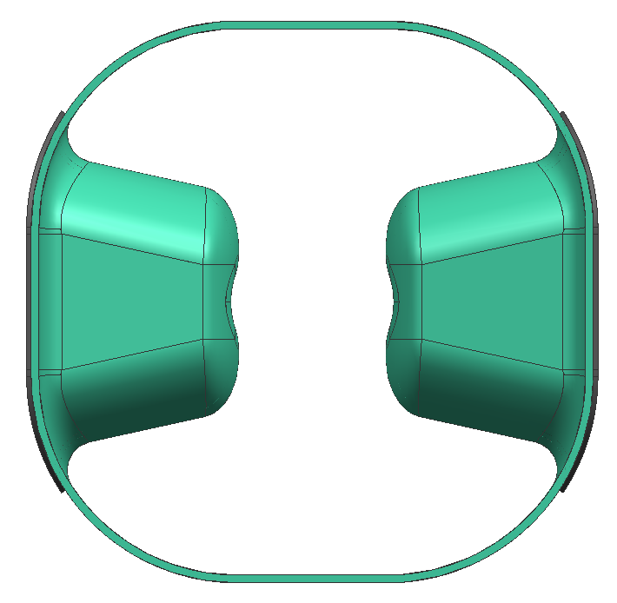
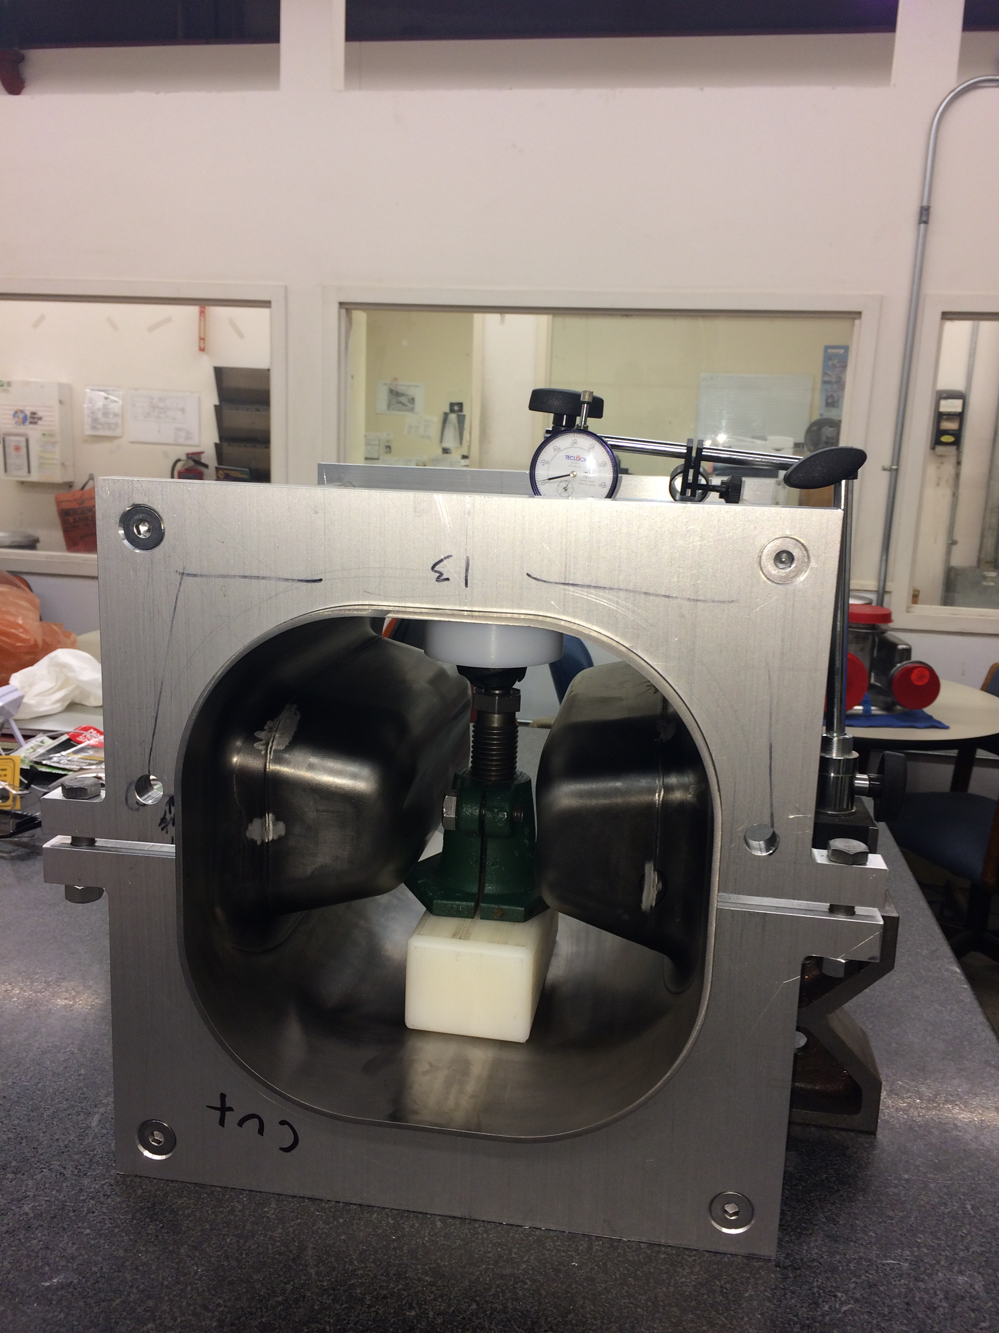
RFD Cav 1 Frequency Correction
Center body measurement showed 1.5 mm deviation from design profile which corresponds to about 1 MHz frequency deviation from earlier tuning range analysis.
Measured 400.9 MHz vs. desired max 399.9MHz.
Decision made to correct the center body.
After fix, center body annealed for stress relief.
Achieved desired starting frequency 399.2 MHz
Constrain edge
Concave both sides
Mechanical jack

Slide 26
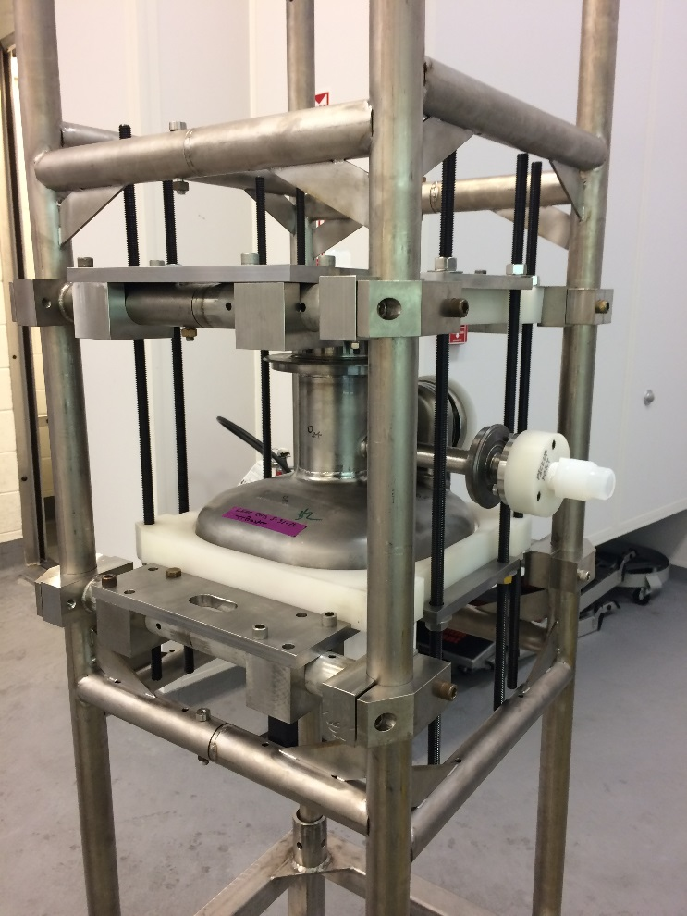
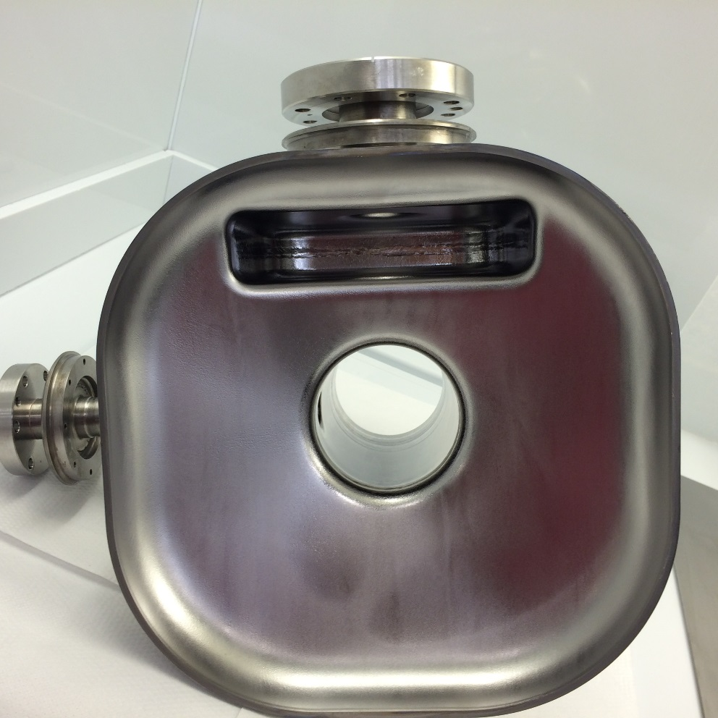
RFD Bulk BCP Chemistry at JLAB
Assembly
VHOM-002 After BCP
Bulk BCP completed for HHOM-002 and VHOM-002

Slide 27
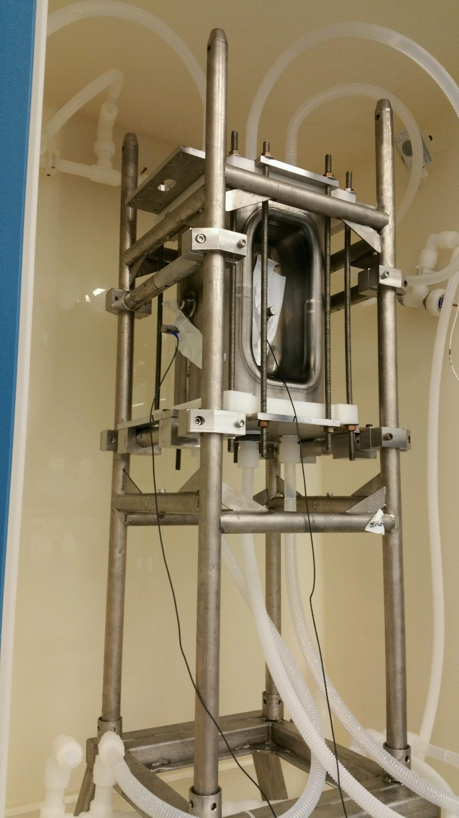
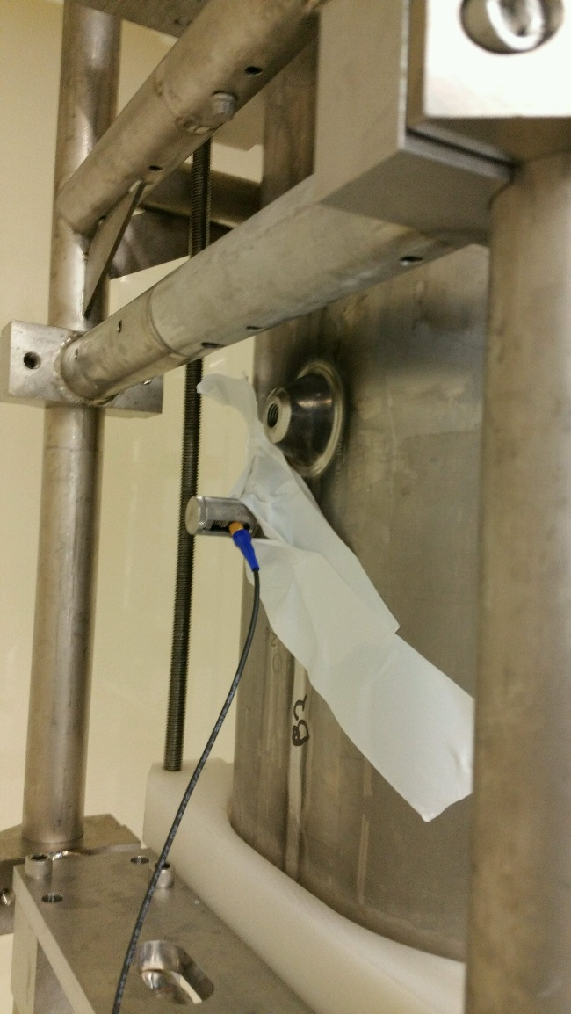
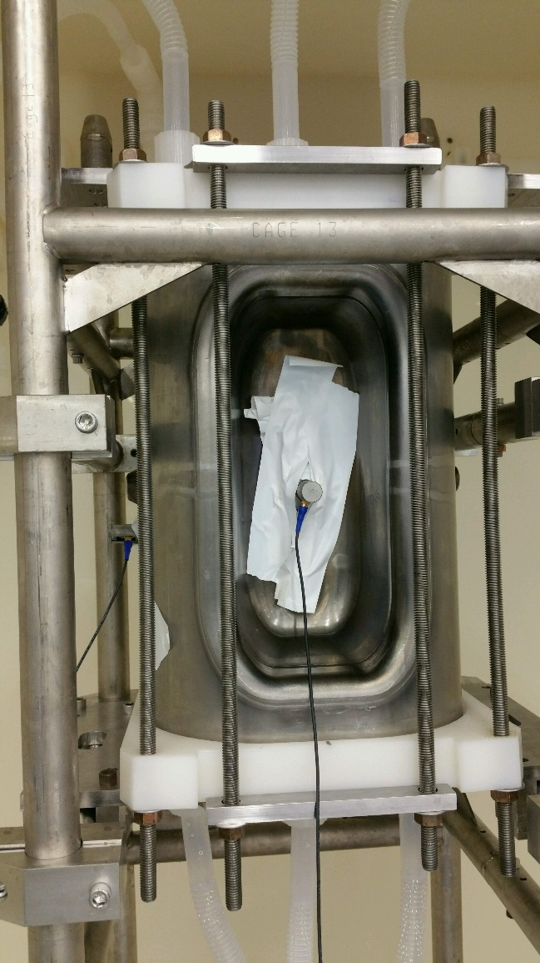
RFD BCP Setup – CTR-002
Two thickness gauges were used.

Slide 28
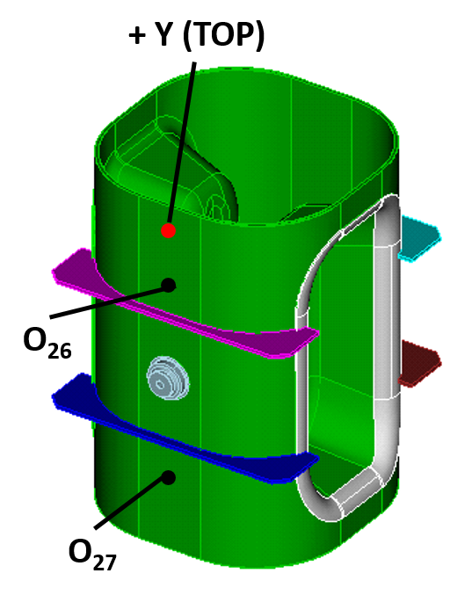
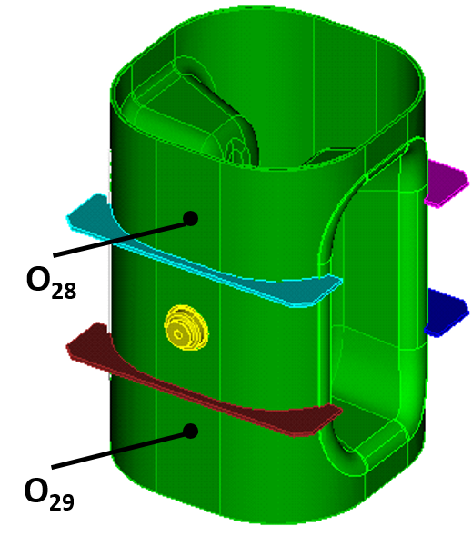
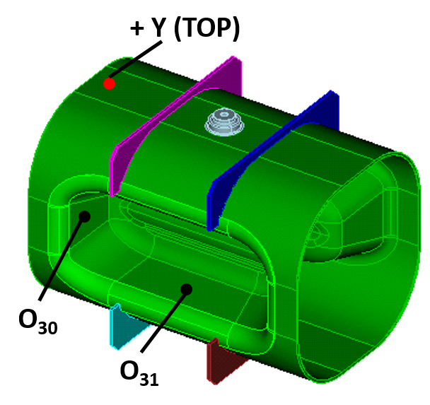
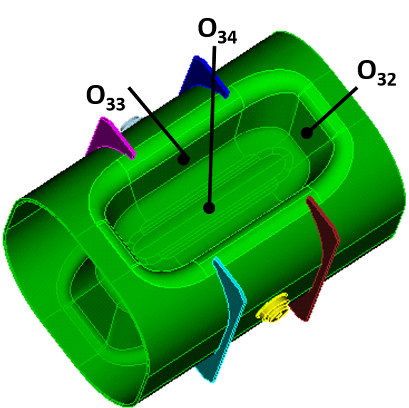
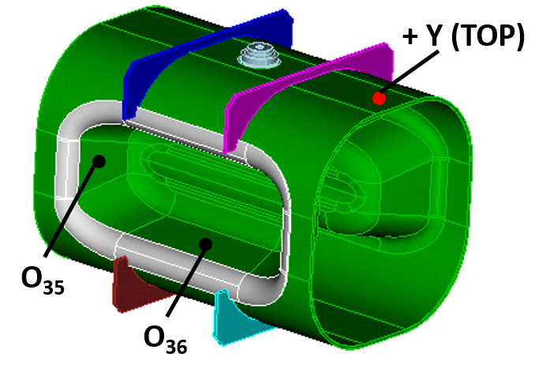
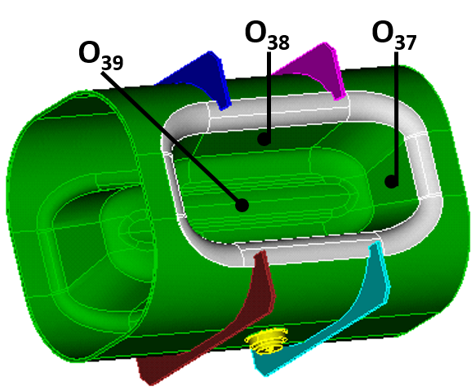
RFD Thickness Measurements Results – CTR-002
94
111
106
101
81
105
115
84
56
97
123
85
82
96
Average removal – 95 micron

Slide 29
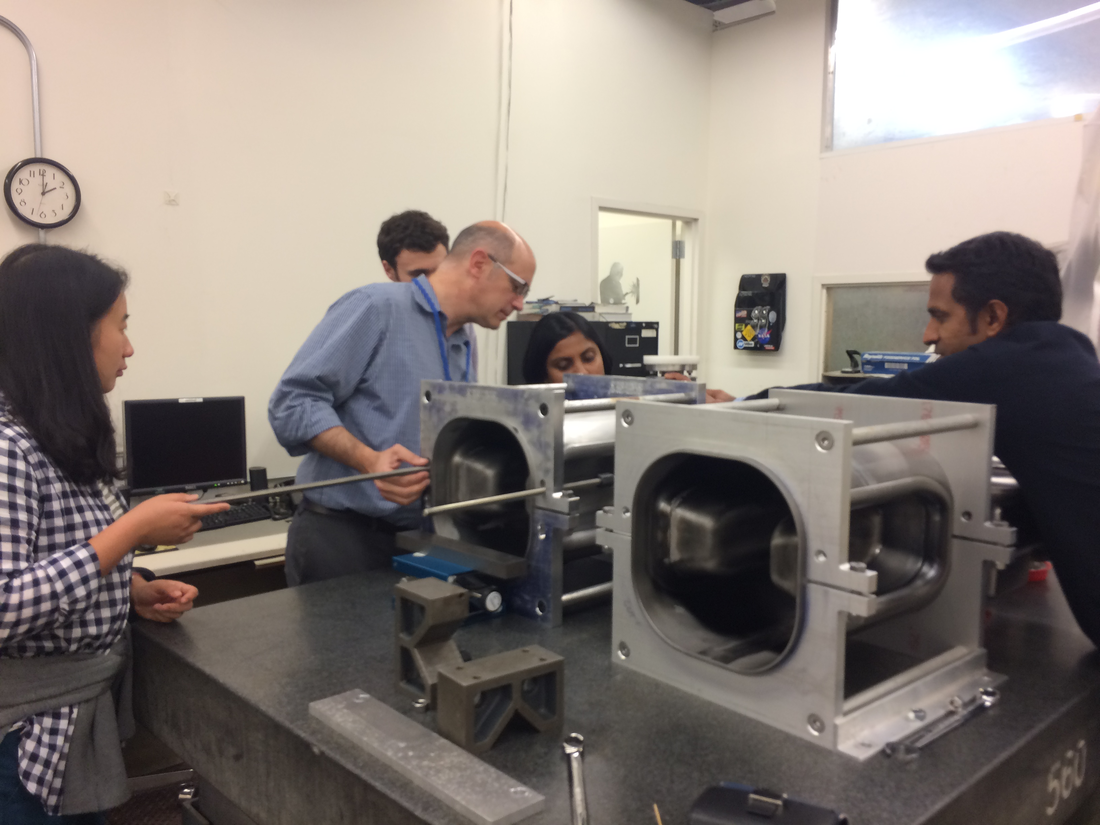
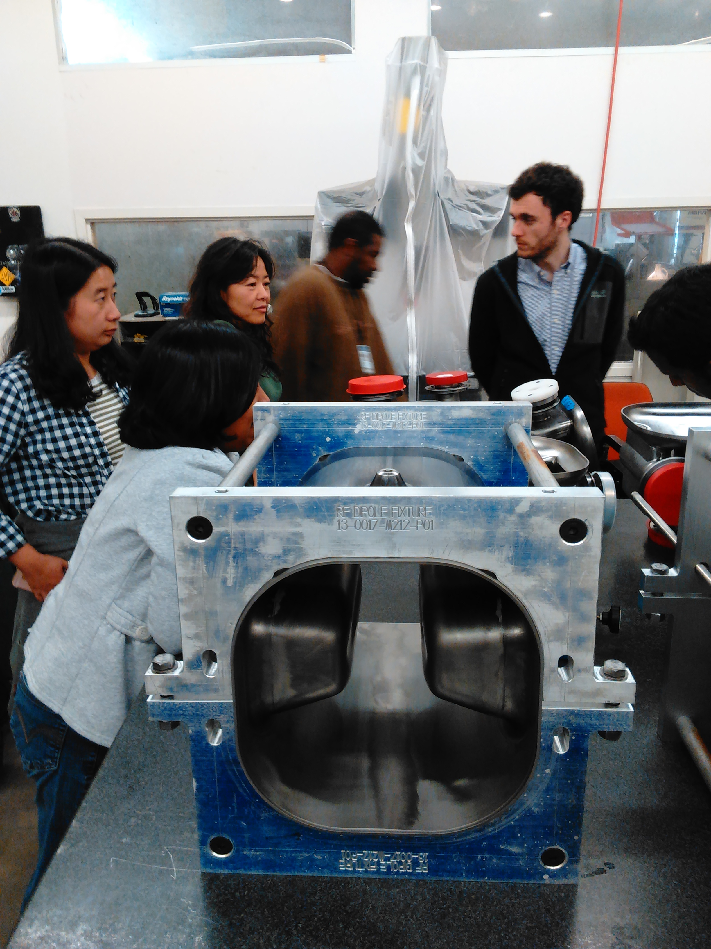
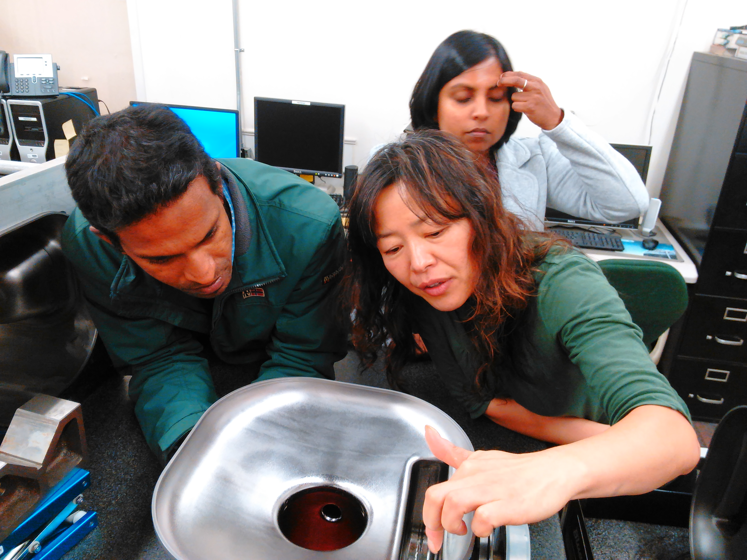
RFD final Machining at JLAB
27 Oct 2016

Slide 30
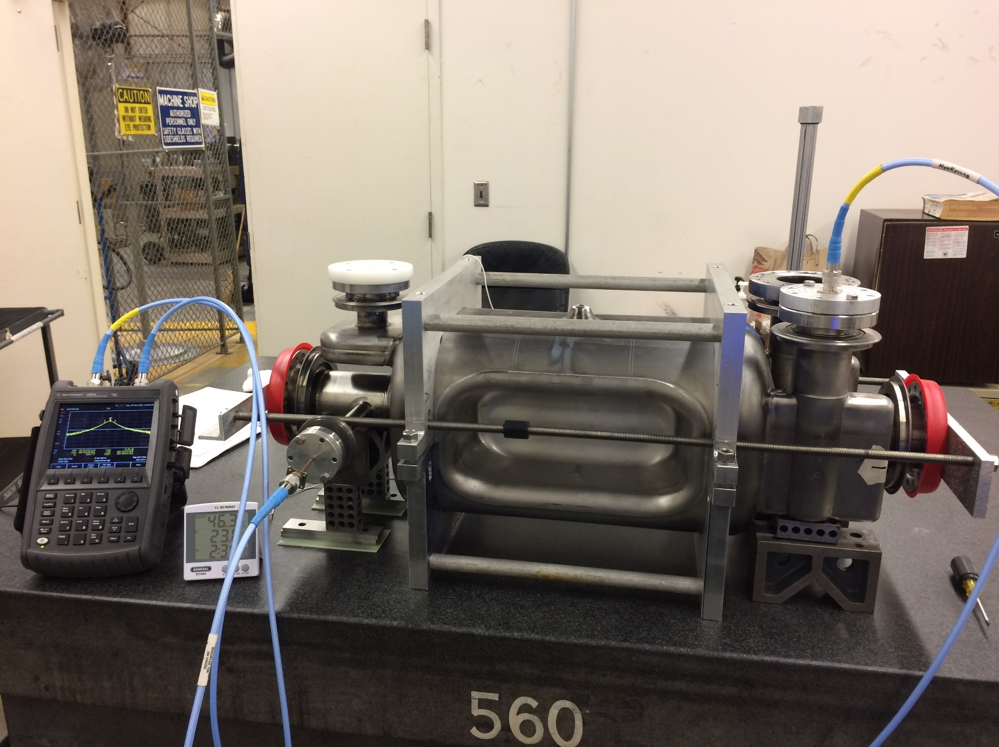
RFD Frequency Measurement Setup

Slide 31
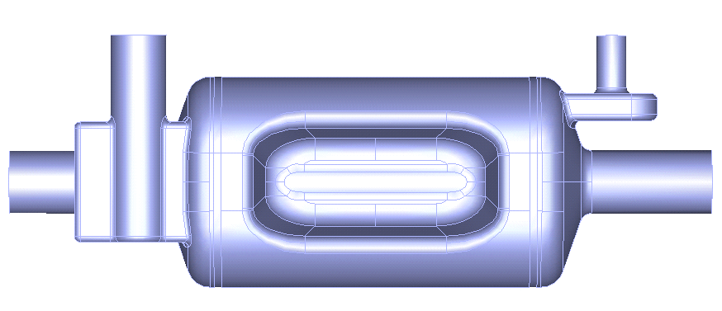
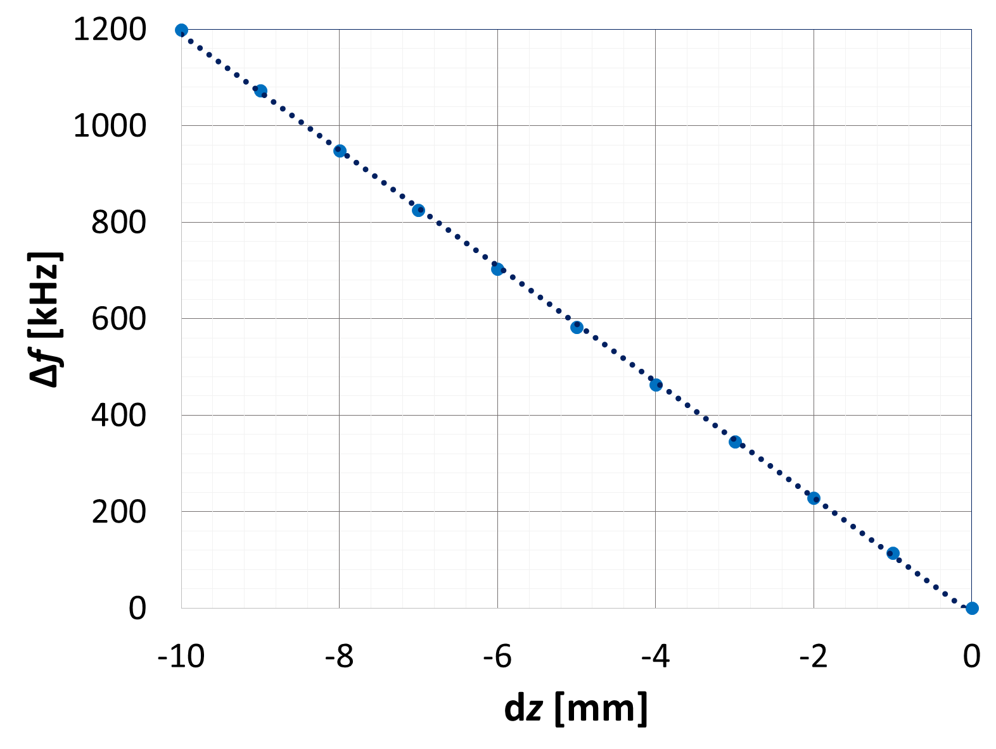
RFD Frequency Measurements
Trim center body to achieve target frequency at pre welding
df/dz = -119.85 kHz/mm
Trimming sensitivity for
  CAV-001 → df/dz = -129.3 kHz/mm
  CAV-002 → df/dz = -116.1 kHz/mm
dz/2
dz/2

Slide 32
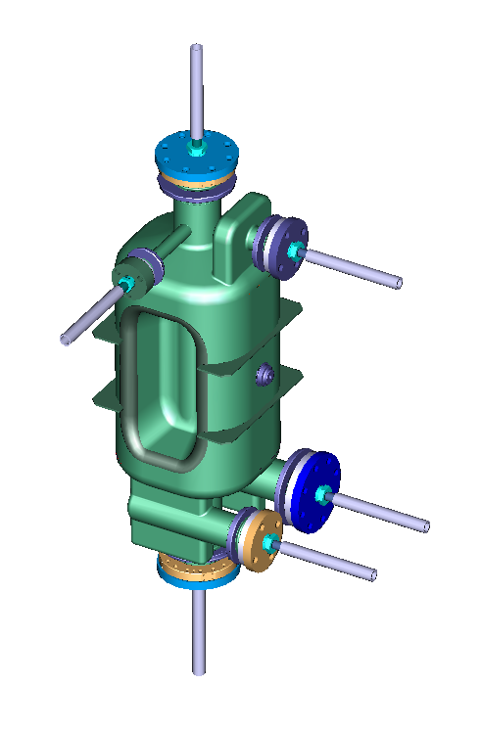
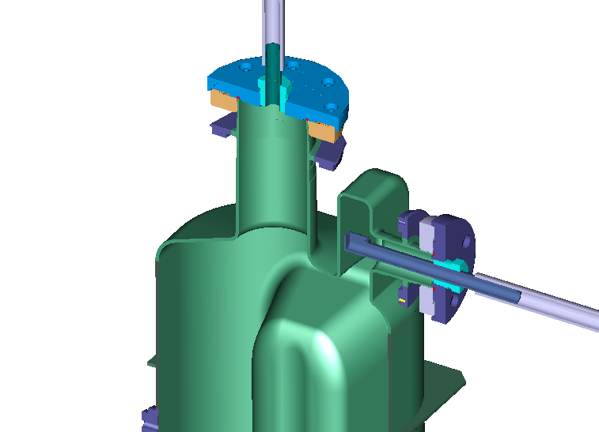
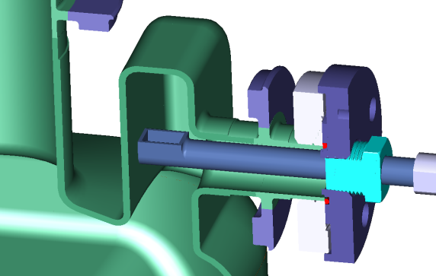
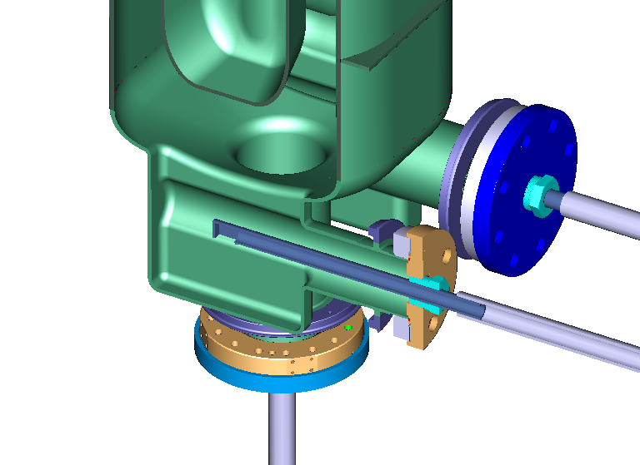
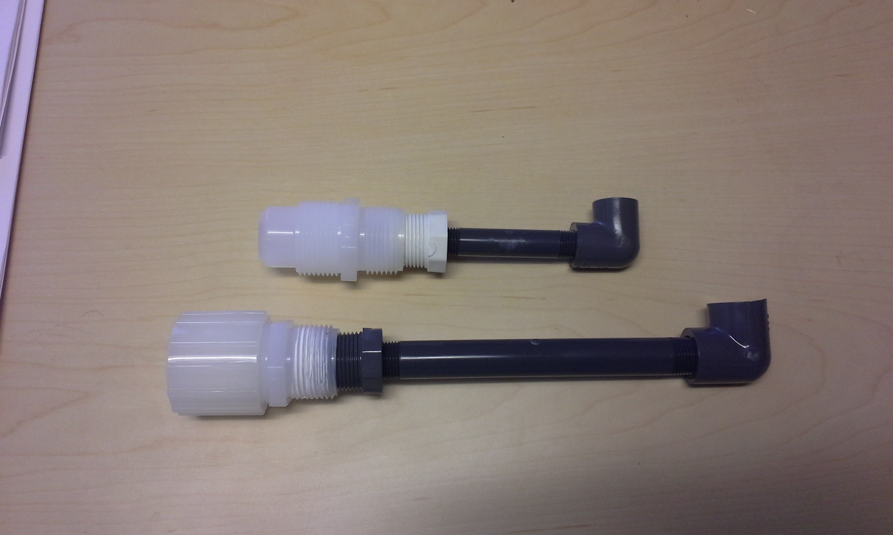
Final BCP Closed Chemistry Cabinet
End Cap mating to
Vertical HOM
Acid out
Acid In
Chemical Injection Quill “Snorkel” directs the flow of Acid & Water
Acid In
End cap mating to
Horizontal HOM
Acid In

Slide 33
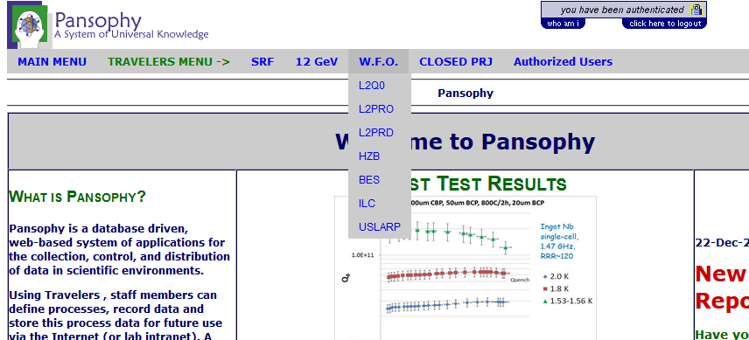
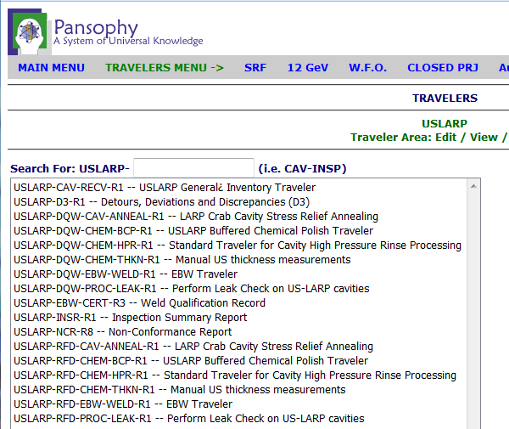
JLAB Documentation System
MIP points to associated standards, procedures and travelers.
Travelers also point to procedures and cavity specific instructions.
Traceability is paramount to identify activities and their effect on cavity performance.
HK Park – 15 Nov 2016

Slide 34
Team integration
Weekly coordination meetings
  Recent mini-meeting at JLAB, included CERN and UK
Frequent ad-hoc phone conferences
Trips to Niowave to monitor cavity frequency behavior and cavity machining
BNL staff spending extended time at CERN
BNL-CERN phone calls and information sharing
ODU staff located at JLAB

