Slide 1










HL-LHC-UK: UK contribution to HL-LHC Crab Cavities and evolution
1
Dr Graeme Burt
Cockcroft Institute of Accelerator science and technology
Lancaster University
International Crab Cavity Review April 17

Slide 2

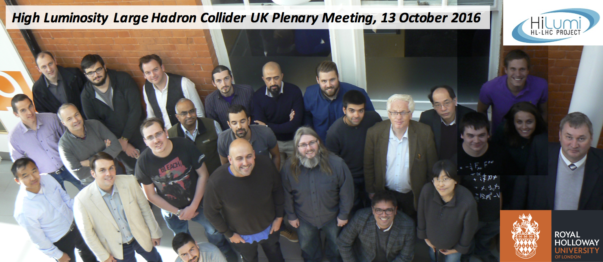

HL-LHC-UK
£8M project to deliver key components and studies for HL-LHC-UK prototyping phase. It is funded equally by CERN and STFC. The tasks are:
  Collimation
  Crab Cavities
  Diagnostics (EO-BPM and Gas Jet)
  Cold powering (superconducting links)
Each task will include simulation, design and delivery of key hardware
The project will run from April 2016 to March 2020. After which we hope the UK can play a lead role in the
HL-LHC upgrade.
2

Slide 3
WP2 Crab Cavity Tasks
Testing of crab cavities at SM18 and SPS
HOM coupler design, and measurement
Design of SPS DQW cryomodule
Design of RFD SPS/Pre-series cryomodule
Assembly of RFD SPS/Pre-series cryomodule
LLRF system modelling
Beam dynamics modelling for SPS
Quench dynamics
Crab Cavity WP is 19.4 (21.5) FTE over 4 years

Slide 4
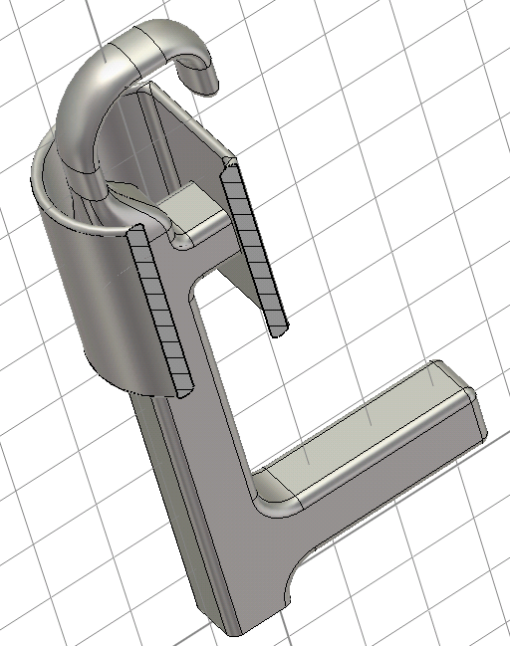
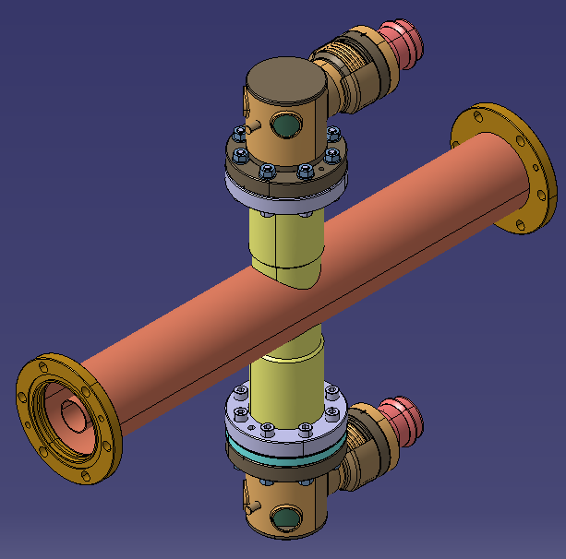
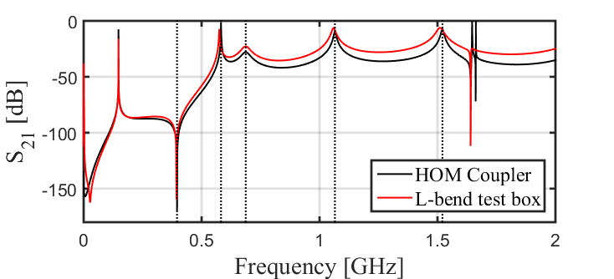
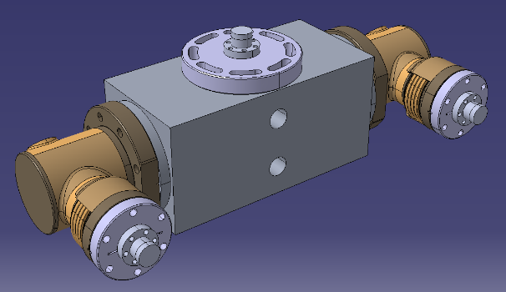
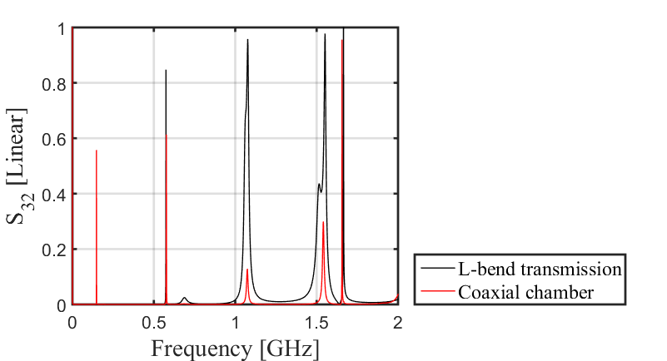
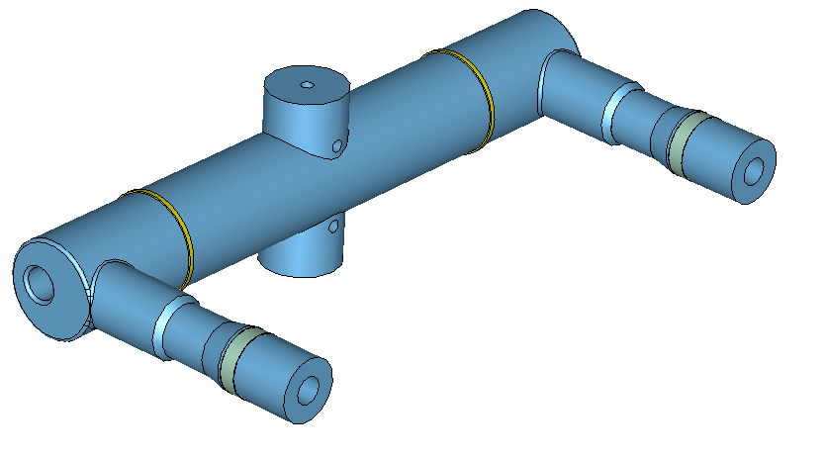

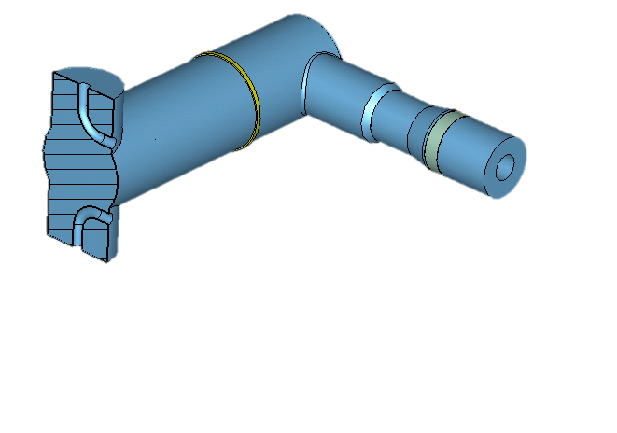
DQW HOM coupler test boxes
The DQW has three Higher Order Mode (HOM) couplers mounted ‘on-cell’.
To assess the RF performance of the couplers pre-installation - ‘test-boxes’ have been designed and manufactured.
Aim of the warm, low power test boxes:
  Analyse transmission response of couplers.
  Assess feasibility of high power conditioning of the HOM couplers.
Also looking at HOM redesign to ease manufacturing
Coax chamber
L-bend test box
Discrete frequencies available for power transmission and hence conditioning.
1
2
Vacuum models for L-bend test box

Slide 5
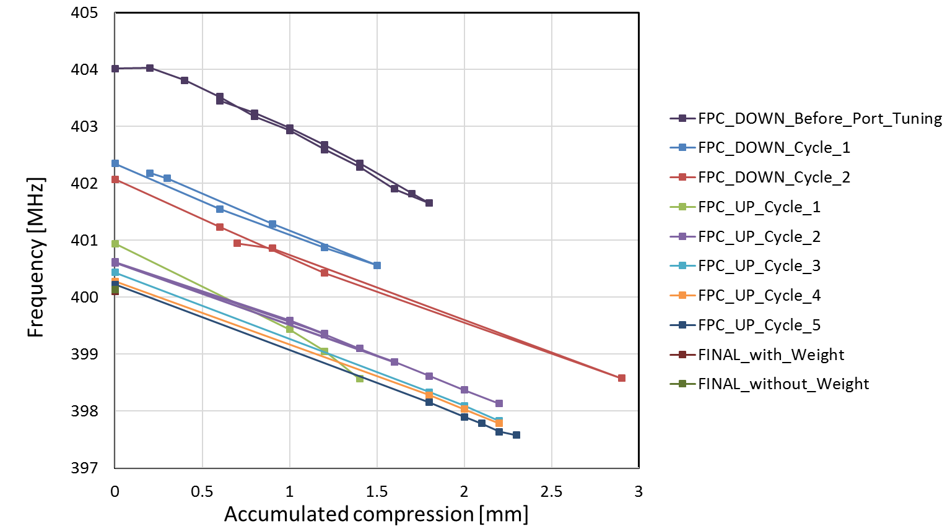
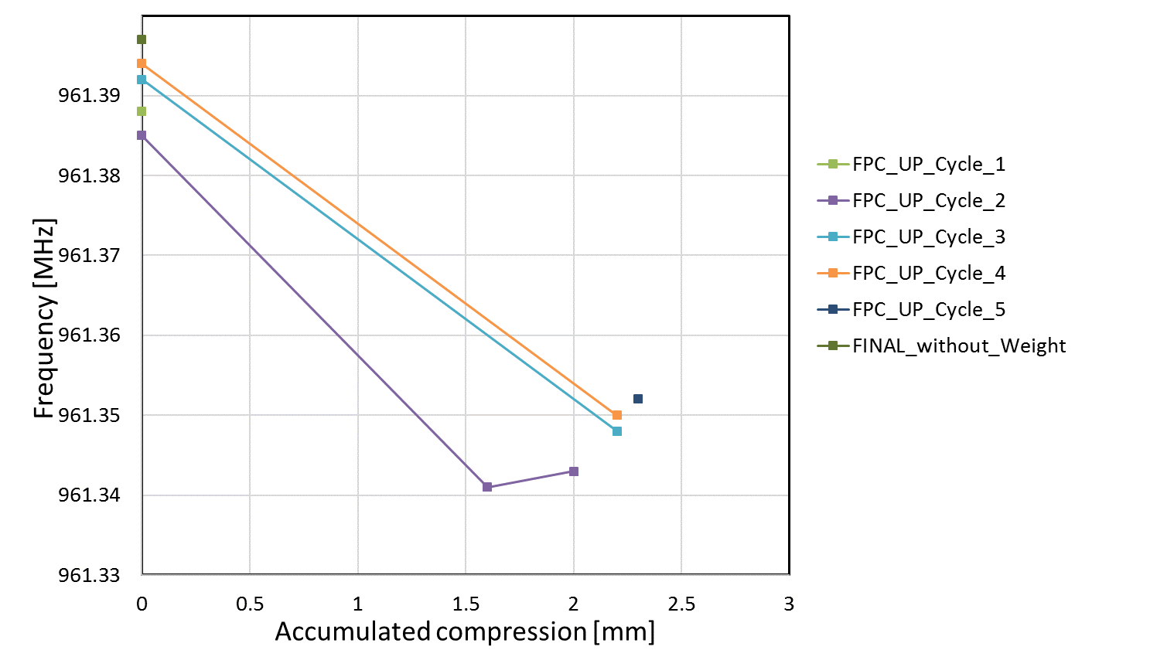
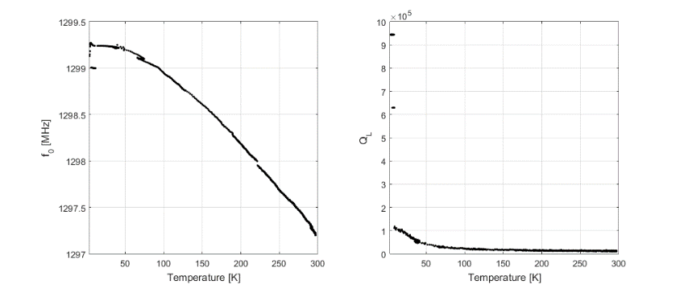
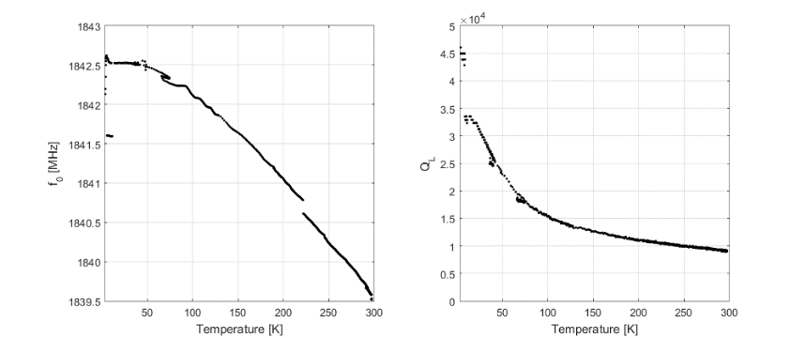
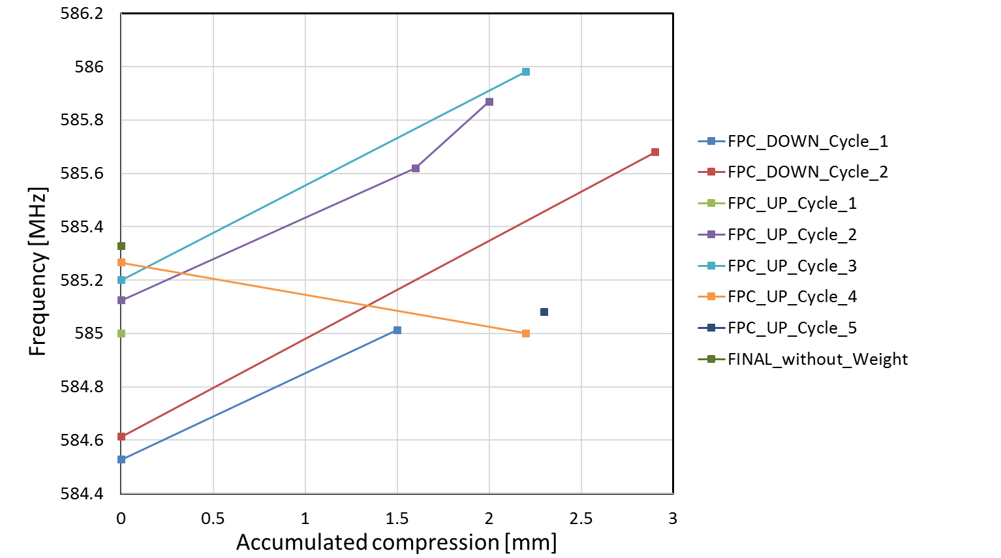

Crab mode and HOM monitoring
The frequencies and Q_{L}’s of a selection of high impedance HOMs were tracked.
  This was done throughout both the trim tuning (see talk by S. Verdu Andres) and alternative tuning for both cavities.
Knowing the parametric weighting on the mode frequency, tracking would allow geometric evaluation of cavity deformation in specific areas other than the capacitive plate.
Additionally HOMs were also tracked with the tuner in the tuner tests and in the warm-up and cool-down stages for both CERN-DQW-001 and CERN-DQW-002.
Example of tracking for alternative tuning of CERN-DQW-002 after welds
Frequency and QL tracking with temperature in the VTF
Frequency deviations with trim tuning:
Fundamental: + 2.21 MHz
‘HOM_1’: - 0.80 MHz
‘HOM_2’: -0.08 MHz

Slide 6
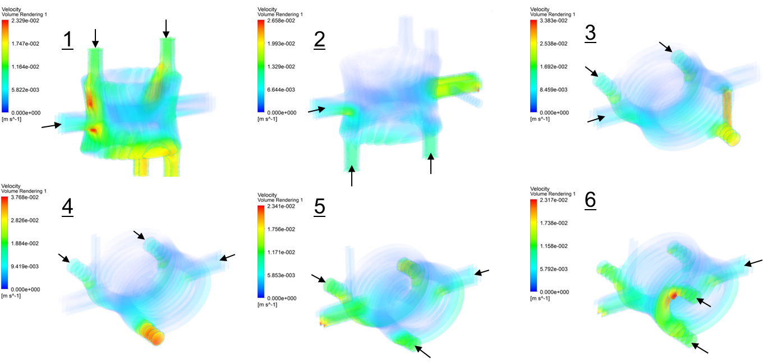
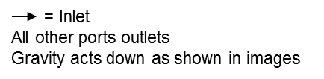
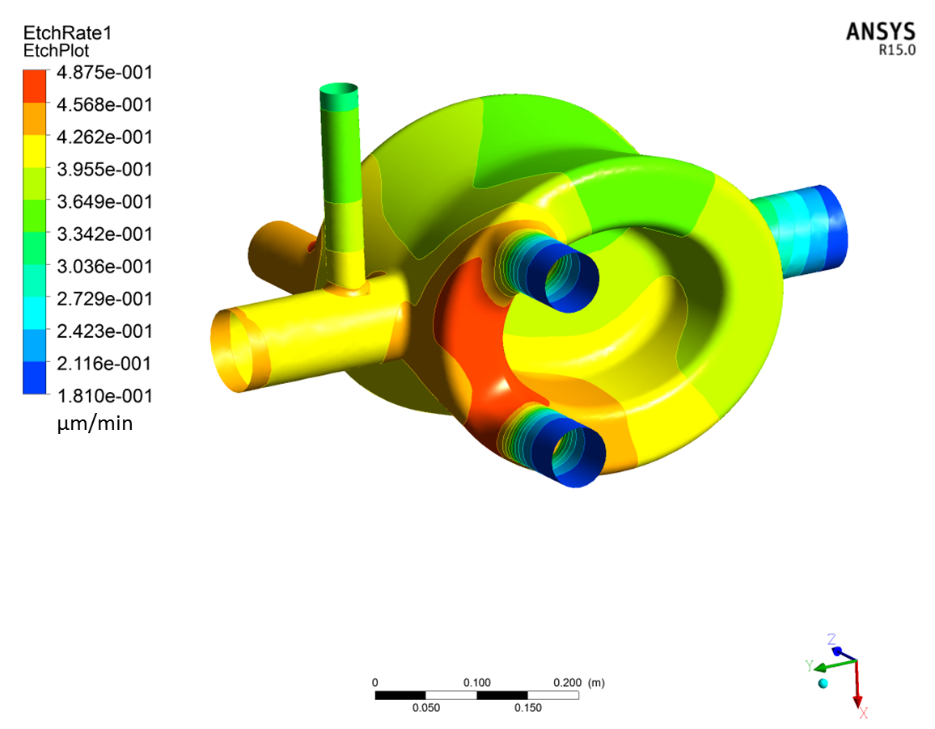
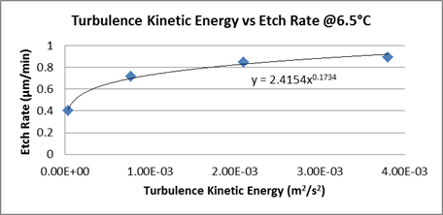
Fluid analysis of BCP processing

Slide 7
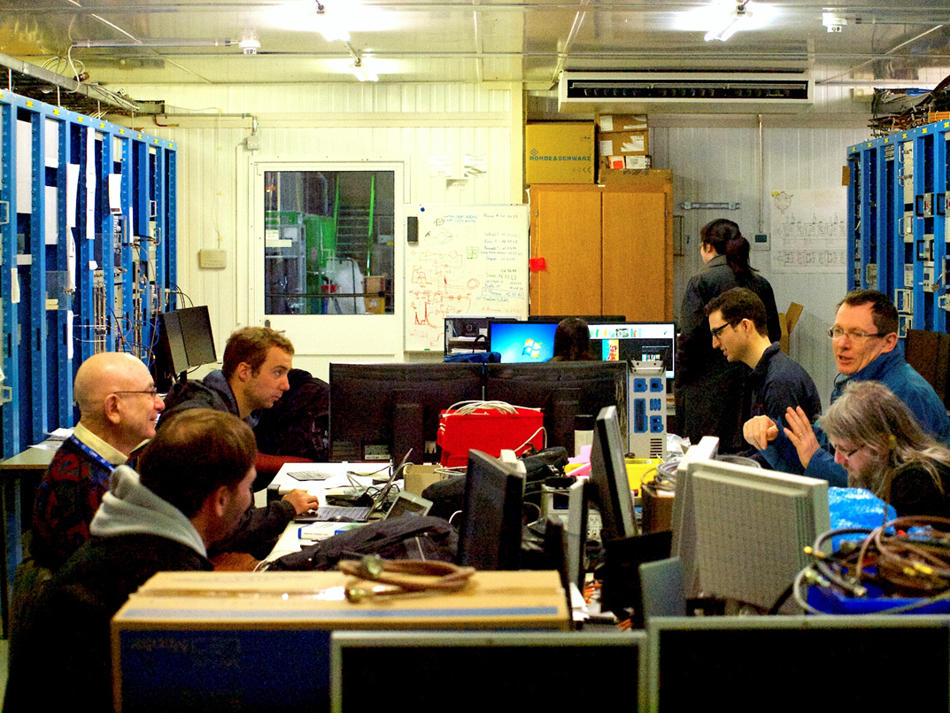
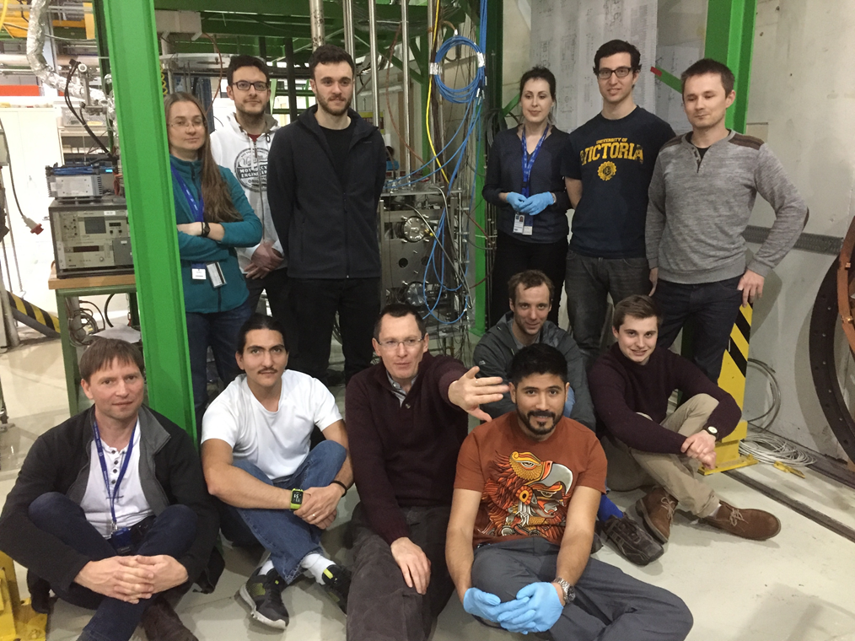
UK involvement in vertical testing
G Burt and N Shipman part of the crab cavity testing team in SM18
J Mitchell responsible for HOM measurements during cooldown

Slide 8
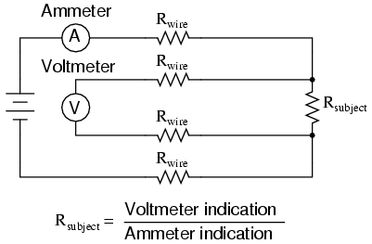
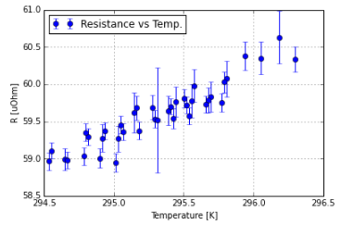
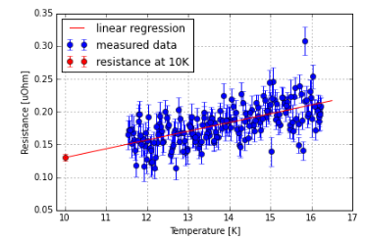
In situ bulk RRR measurements
Cavity | Resistance at 300K uOhm | Resistance at 10K uOhm | RRR
DQW SPS 1 | 64.247 +- 0.282 | 0.189 +- 0.025 | 340 ± 45
DQW SPS 2 | 49.022 ±0.112 | 0.130 ± 0.005 | 377 ± 15
A four wire measurement was used to measure the resistance of cavities at 300K and 10K
This is more challenging than with a sample as the larger cross-sectional area of the cavity means the resistance is far smaller.

Slide 9
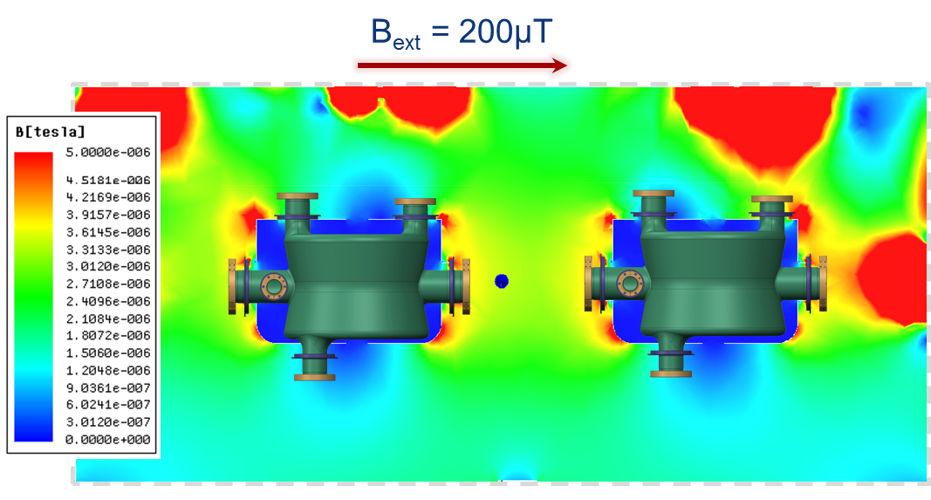
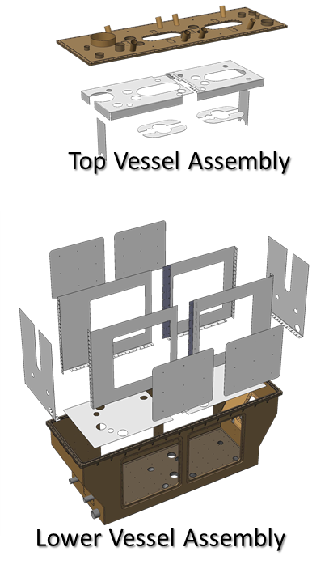
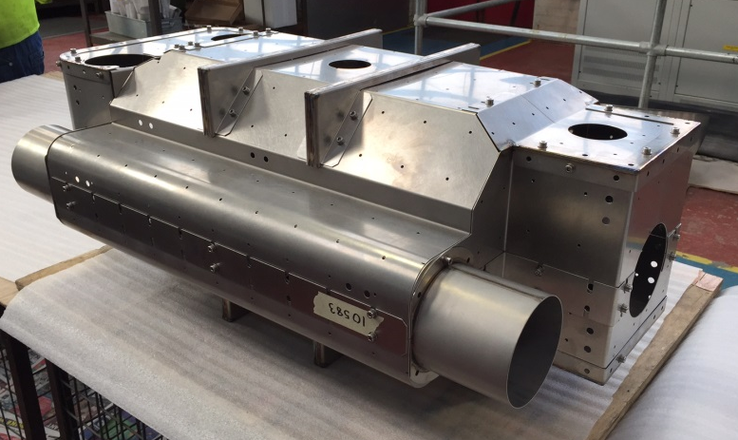
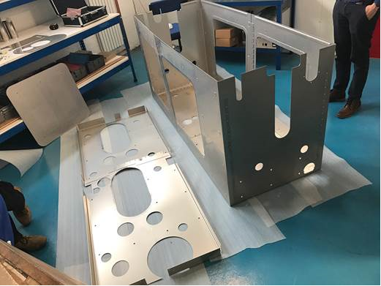

WP2.2.1 Magnetic Shields
STFC have led the development of the magnetic shields for the SPS cryomodule, and procured the cold magnetic shield via Lancaster.
Cold magnetic shield has been delivered to CERN and warm shield has just underwent factory acceptance tests

Slide 10
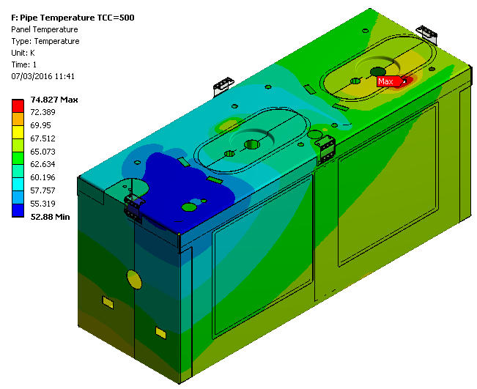
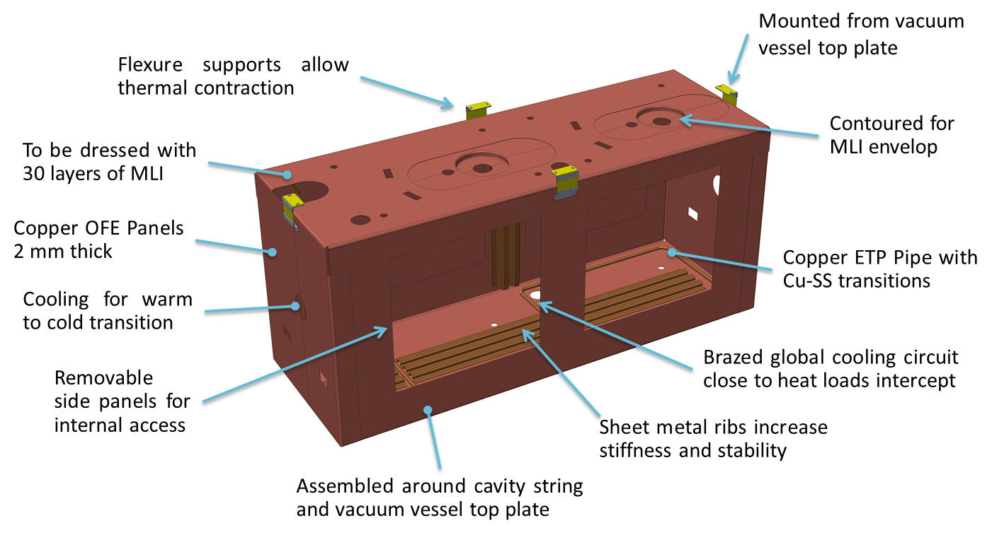
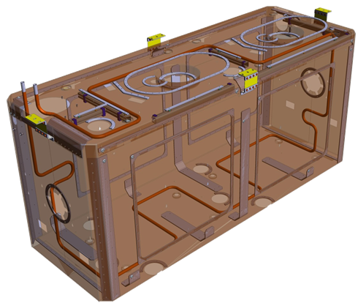
WP2.2.1 Thermal Shields
STFC have also led developments on the thermal shield.
Baseline decision to make shield in copper with copper tubing brazed to stainless steel transitions.
Drawings are being finalised presently.

Slide 11
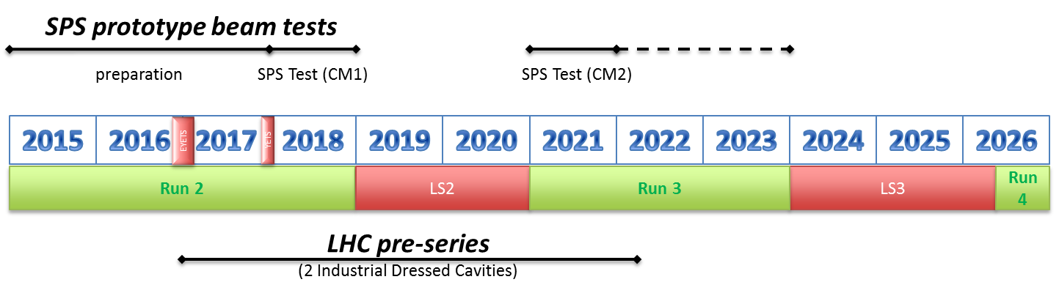
Pre-series Schedule Compatible with HL-LHC
Cockcroft and STFC technology will produce the pre-series cryomodule for HL-LHC crab at Daresbury Lab.
Design Study/ Concept Design
& Specification development
Engineering Design (6-8M)
Design Review ( May/ June 2018)
Procurement and Manufacturing ( 12-15M)
(Cryomodule parts/ Cavities/Couplers/Tuners…)
Final Design Review (Jan 2019)
Assembly (6-8 M)
Cavity String assembly in Clean Room Sept – Dec
Cryomodule assembly (outside the clean room)
Warm Acceptance Tests
Ship to CERN
Today

Slide 12
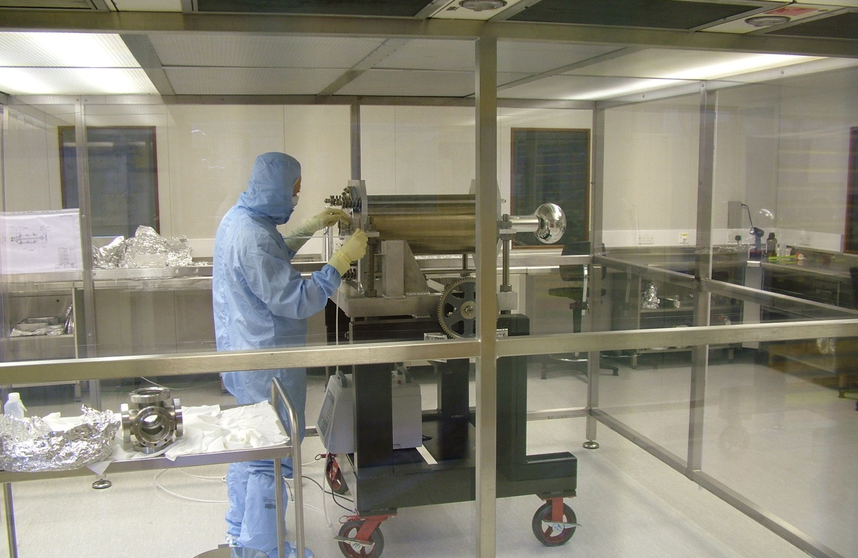
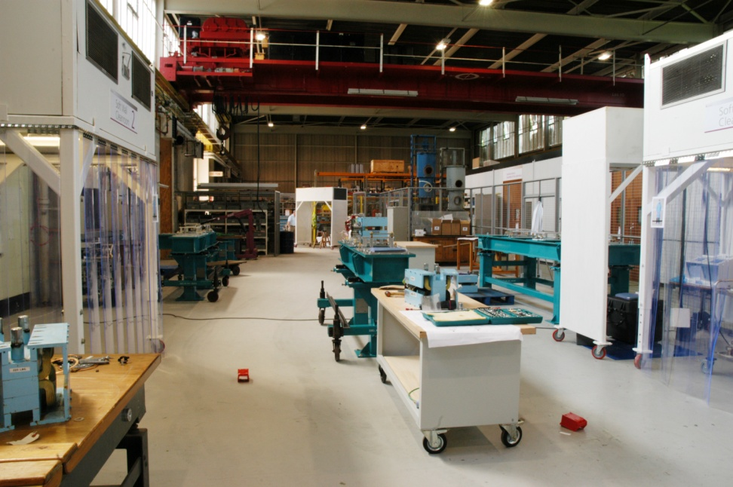
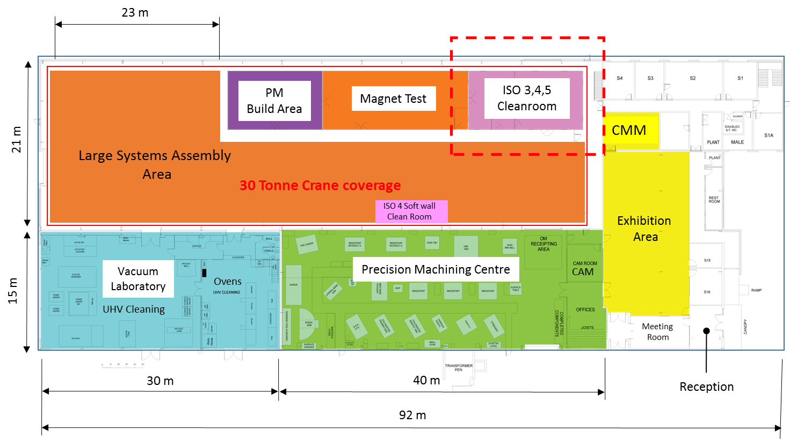
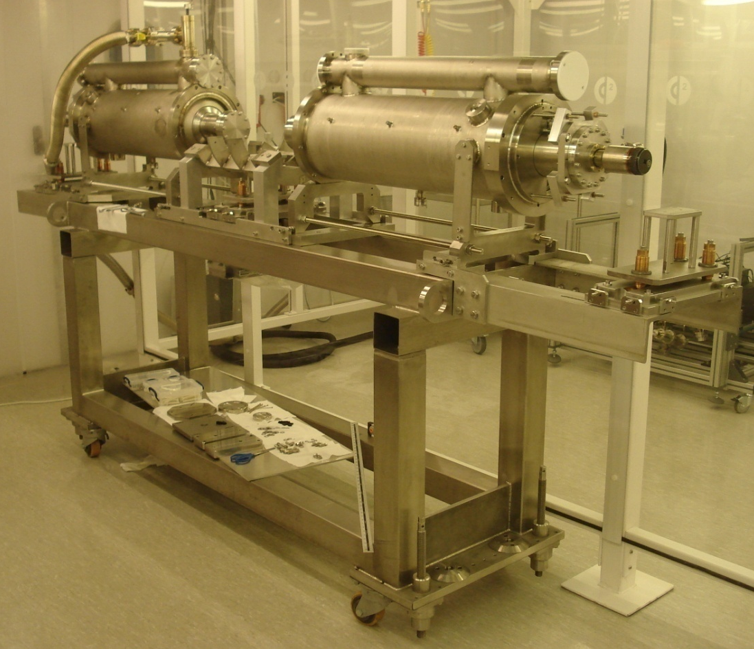
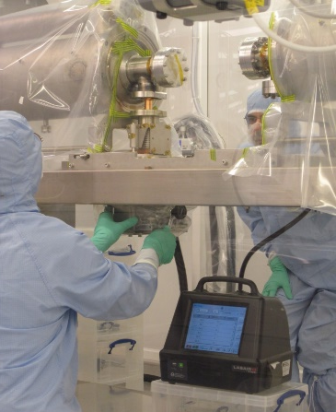
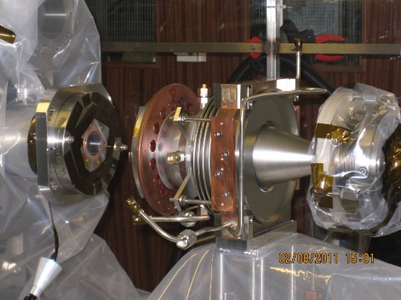
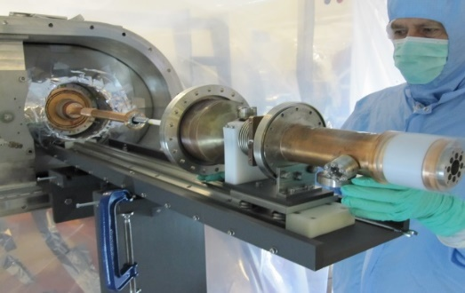
Capabilities at STFC Daresbury Laboratory
ISO 4 – 10.8m x 7.2 m x 2.6 m (height)
ISO 3 – 4.8m x 3.6 m x 2.6 m (height)
30 Tonne Crane
Assembly Hall
Assembly of 2 x 1.3GHz SRF cavity string
Assembly of HOMs
Assembly of FPC

Slide 13
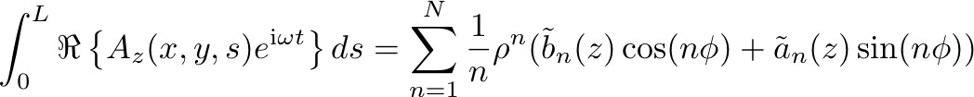


2.1.2 Crab Cavity beam dynamics
We’ve a strong history of modelling time dependent RF structures, here crab cavities.
For example, we’ve studied, and published in the last year, time dependent multipole models for LHC crab cavities:
And looked previously at more complex models using generalised gradients:
J. Barranco Garcia, R.B. Appleby et al, Phys. Rev. Accel. Beams 19, 10100
    D. R. Brett, R. B. Appleby et al, Phys. Rev. ST Accel. Beams 17, 104001 (2014)
In HL-LHC-UK, we’ve two new PDRAs (just started) to work on beam dynamics issues, including key roles in driving the tests of the crab cavities in the SPS, and looking at single/multi particle issues for HL-LHC.

Slide 14
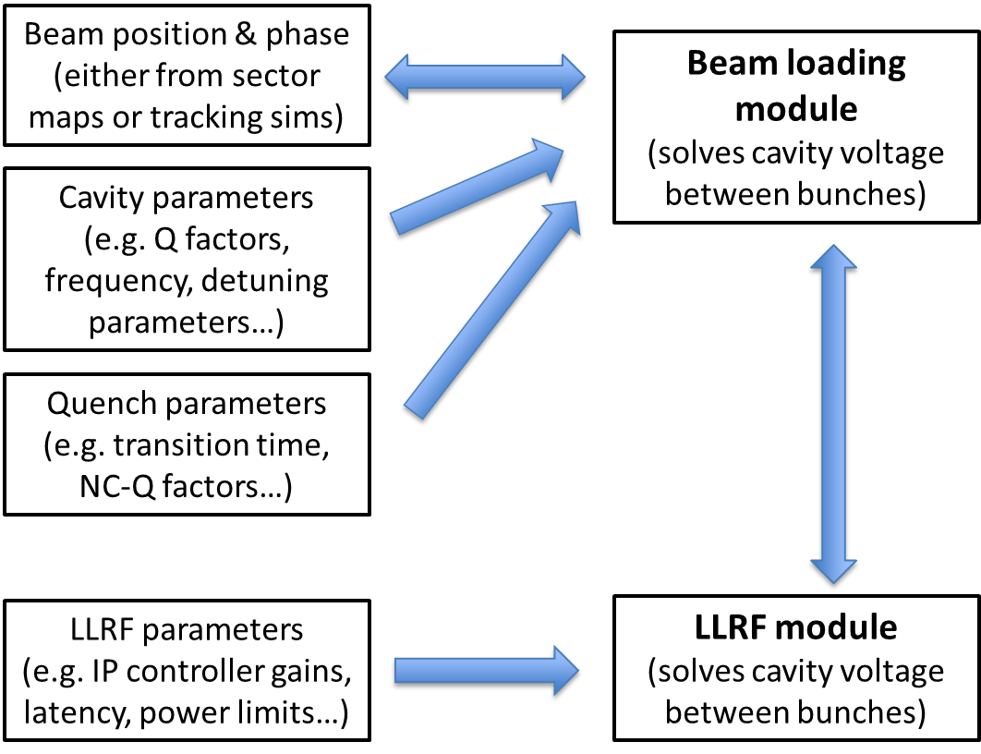
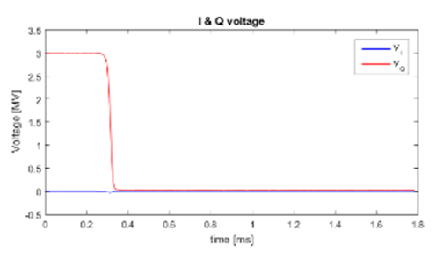
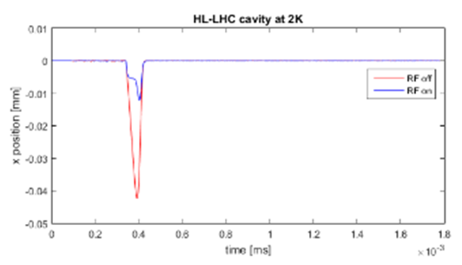
WP2.1.2 Machine protection with quench
Developed a LLRF module that includes beamloading, quench and feedback.
This interfaces with Sixtrack or other codes to accurately model what happens during a quench
Was able to replicate the controversial KEKB results that show huge phase shift.
Results show LLRF, 2K operation and stiff beam enable the LHC cavity to not to shift phase on quench.

Slide 15
Conclusions
HL-LHC-UK is a 4 year program to deliver key components for HL-LHC.
In particular for the crab cavities we have three main aims
Test SPS and Pre-series crab cavities and ancillaries
Design and manufacture the RFD Pre-series crab cryomodule
Simulate and perform experimental runs on SPS to understand crab dynamics.

