Slide 1

Crab Cavity engineering and production overview
Ofelia Capatina (CERN, EN-MME) on behalf of the WP4 members
International Review of the Crab Cavities Performance, 3 April 2017

Slide 2

Overview
SM18 Area
Cavity cold testing, clean room facilities & cryomodule qualification
SPS Test Prototype Module before LS2
LHC Point 5 (horizontal)
2 cavities / IP side/ beam
to be installed during LS3
LHC Point 1 (vertical)
2 cavities / IP side/ beam
to be installed during LS3

Slide 3
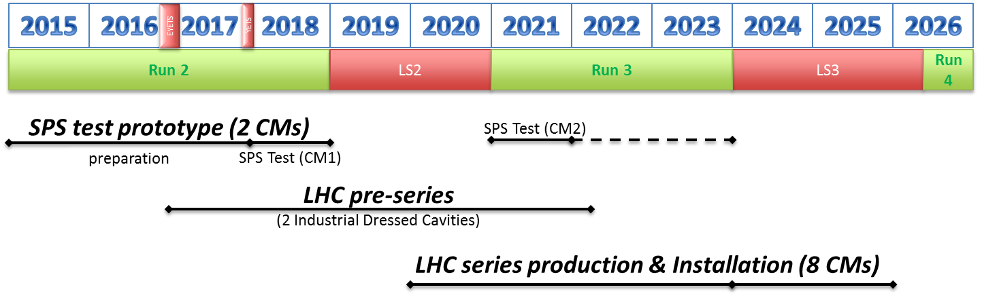
General plans
2 cryomodules for SPS tests
  1 cryomodule with 2 identical cavities (type «vertical» - DQW)
    Design as much as possible coherent with LHC
    To be tested in SPS in 2018
  1 cryomodule with 2 identical cavities (type «horizontal» - RFD)
    Design to be done as LHC prototype
    To be tested in SPS after LS2, in 2021
2 cavities pre-series for LHC (one of each type)
8 cryomodules (4 of each type) for installation in LHC during LS3
+ 2 spares (1 of each type)

Slide 4
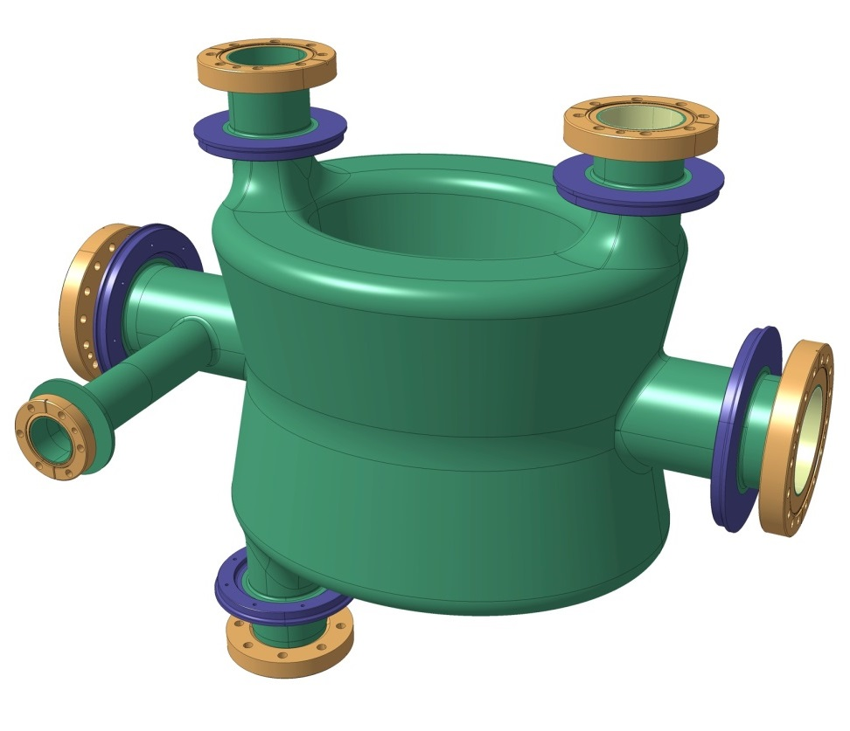
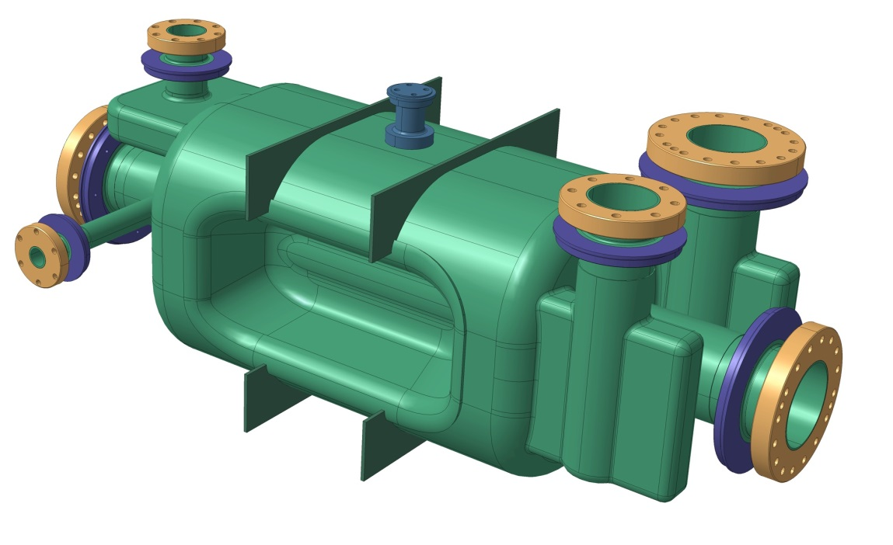
Cavity types
Two types of cavities required (vertical, horizontal)
Two types of cavities under development
    Baseline : adopt both cavity types and exploit their natural RF topology
          Note: Both cavities could be used in the other plane
    Enforced common intra-cryomodule interfaces and platform
Double Quarter Wave (DQW) cavity – Vertical – to be used in Point 1 (ATLAS)
RF Dipole cavity – Horizontal – to be used in Point 5 (CMS)

Slide 5
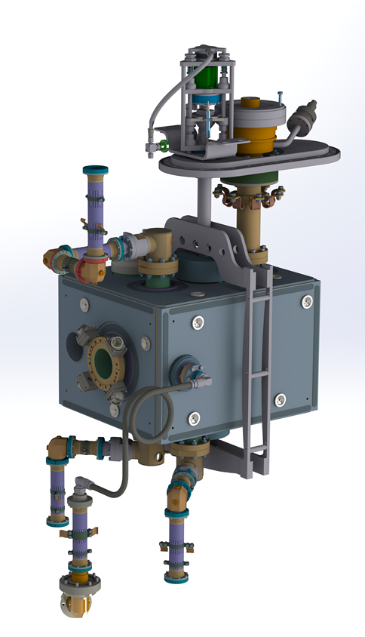
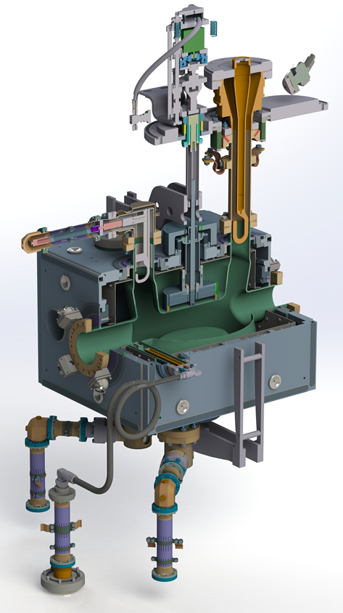
DQW Cavity
Bare DQW cavity
Dressed DQW cavity
See talk S. Verdu
See talk T. Capelli

Slide 6
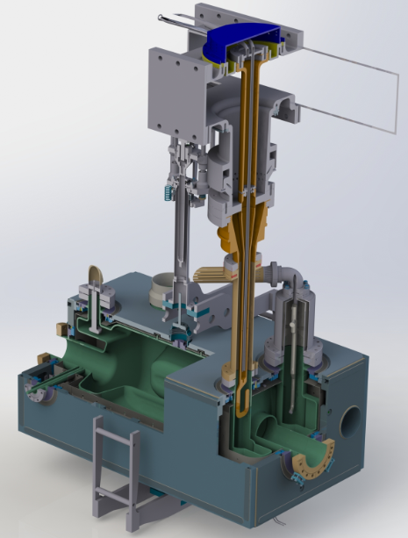
RFD Cavity
Bare RFD cavity
Dressed RFD cavity
See talk S. De Silva

Slide 7
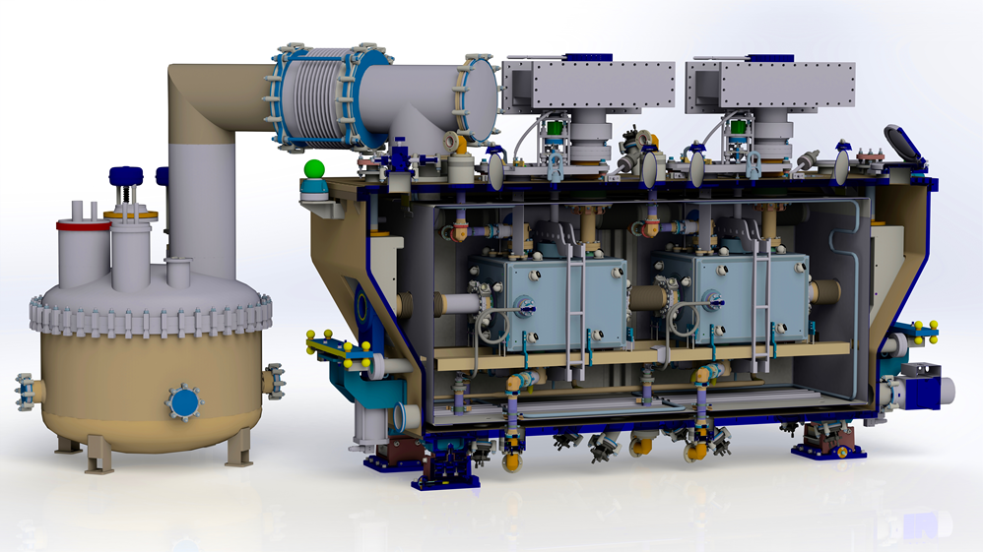
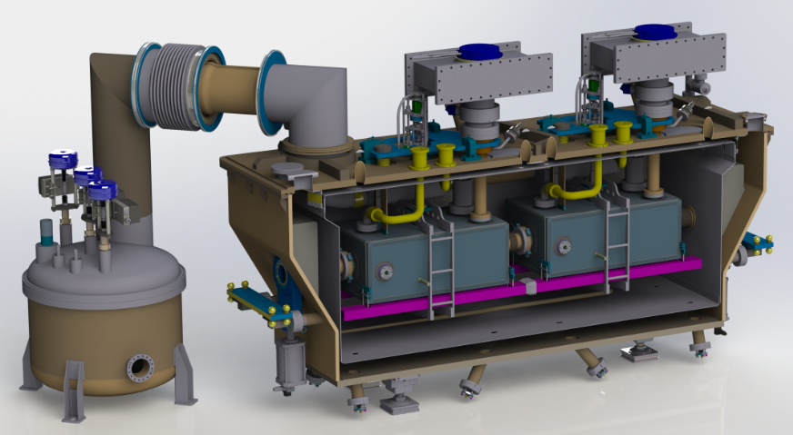
Cryomodules
SPS DQW cryomodule + service module
See talks T. Capelli M. Sosin
See talk K. Brodzinsky
RFD

Slide 8
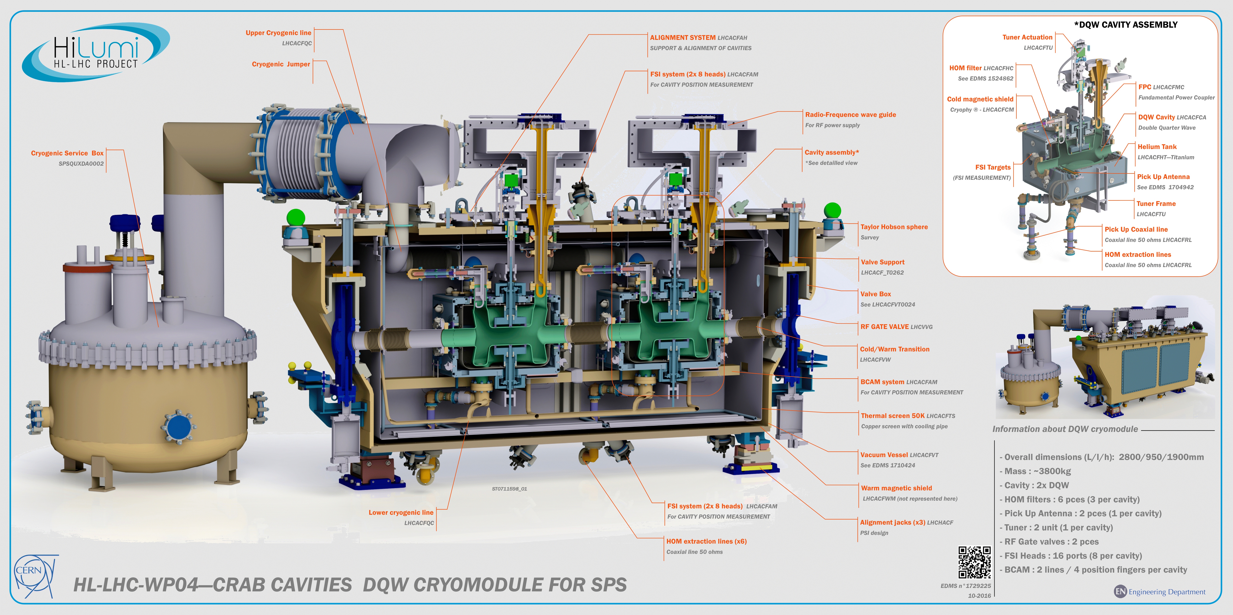
DQW Cryomodule for SPS

Slide 9
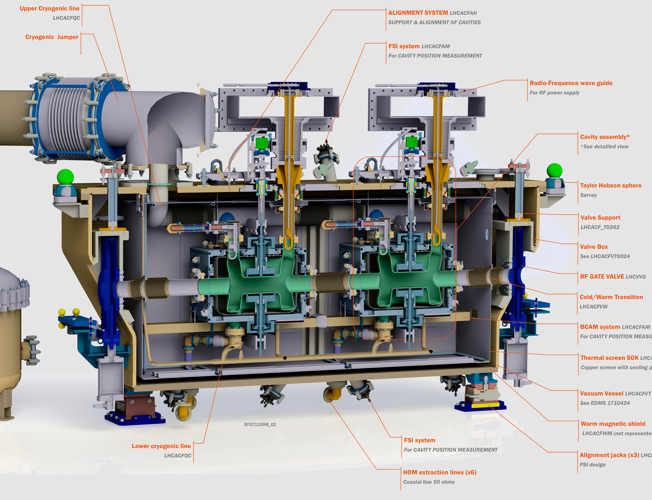
DQW cavity manufacturing sequence

Slide 10
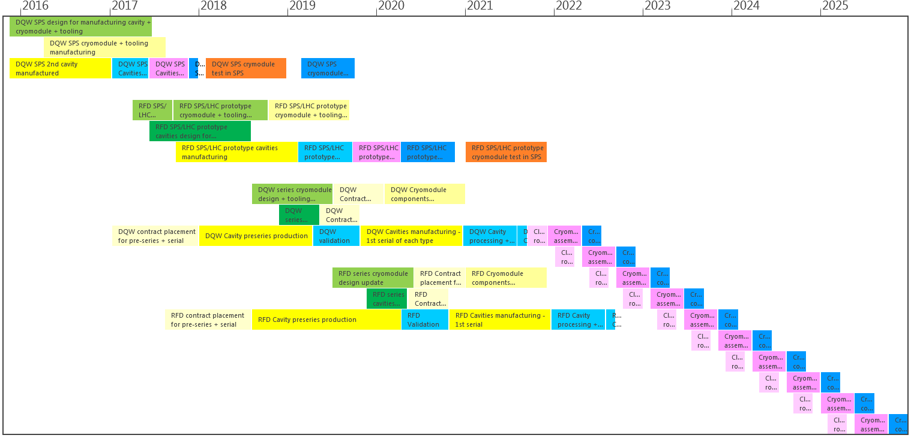
Cavities and CM General schedule

Slide 11
Cavities and CM General schedule
DQW
SPS
RFD
Preseries + series
Design
Manufacturing
Processing & cold tests
Assembly
SPS Tests

Slide 12
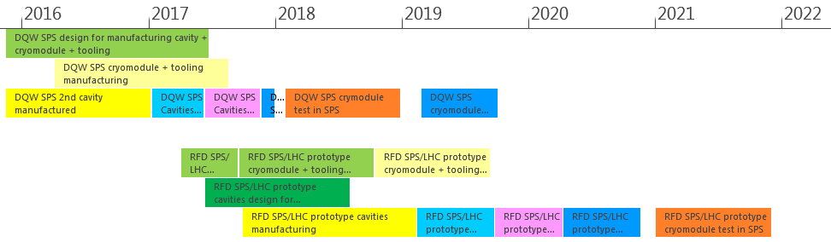
Schedule SPS
UK+CERN
CERN
DQW
CERN
UK+CERN
CERN
RFD
CERN
UK
CERN

Slide 13
Schedule SPS
UK+CERN
CERN
DQW
CERN
UK+CERN
CERN
RFD
CERN
UK
CERN
DQW:
1 cryomodule with 2 identical cavities
  Design as much as possible coherent with LHC
  Design collaboration CERN, USLARP, UK
  Manufacturing
    Cavities – CERN
    Cryomodule – CERN and UK
  Cryomodule assembly & cold test CERN
  To be tested in SPS in 2018
  RFD:
  1 cryomodule with 2 identical cavities
    Design to be done as LHC prototype
    Design collaboration CERN, USLARP, UK
    Manufacturing
      Cavities – CERN
      Cryomodule – UK and CERN
    Cryomodule assembly – UK
    Cold test – CERN
    To be tested in SPS after LS2, in 2021
See talk T. Jones

Slide 14
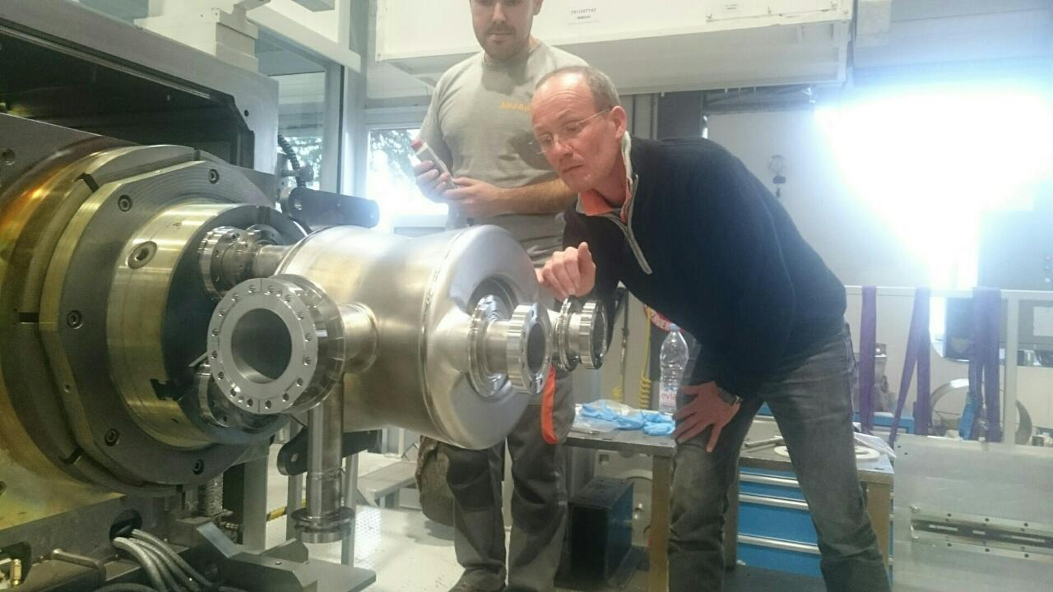
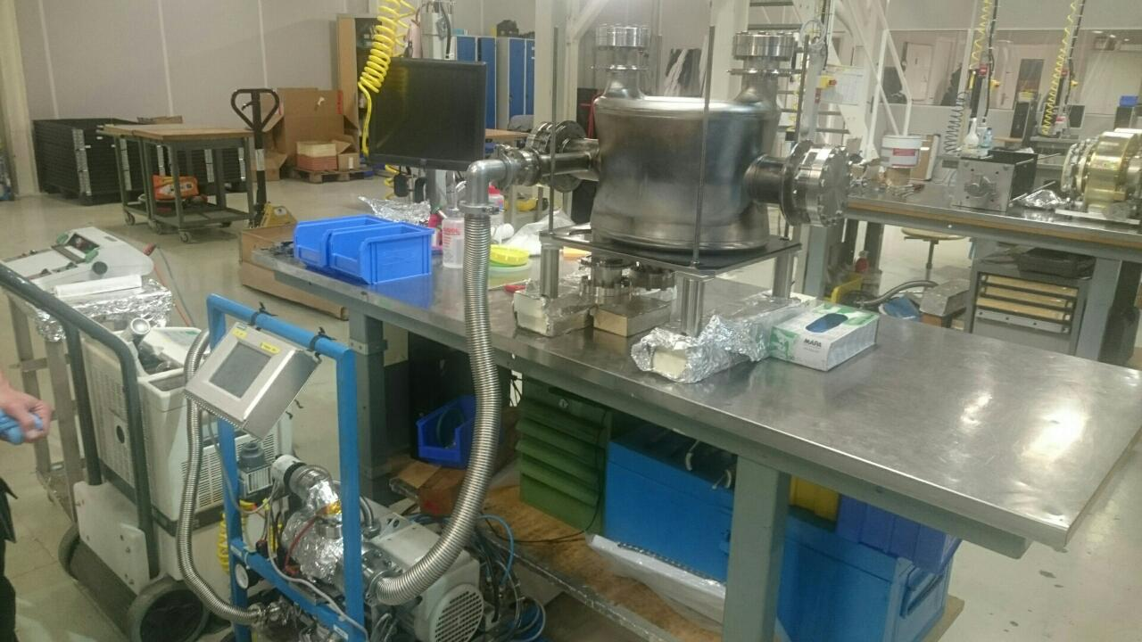
DQW for SPS Status - Cavities
Both cavities manufactured
See talk M. Garlasche

Slide 15
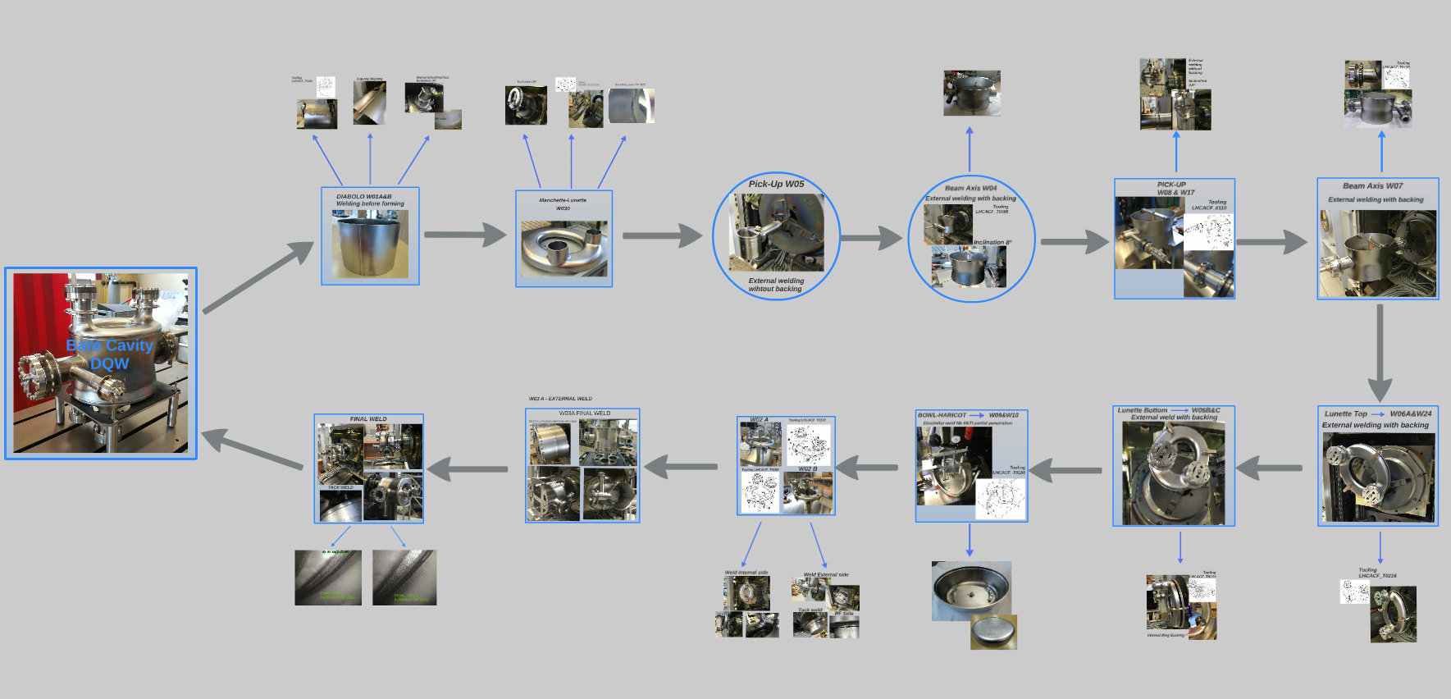
DQW for SPS Status - Cavities
DQW cavity manufacturing sequence
All manufacturing steps documented
See talk I. Bejar

Slide 16
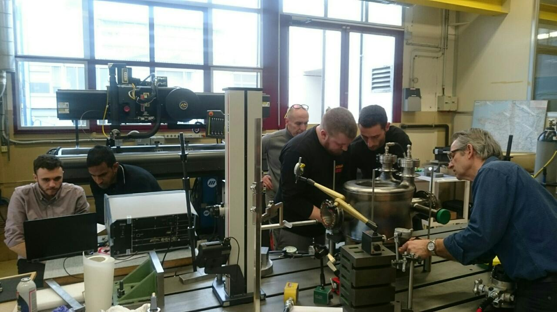
DQW for SPS Status - Cavities
Cavity tuning
See talk S. Verdu

Slide 17
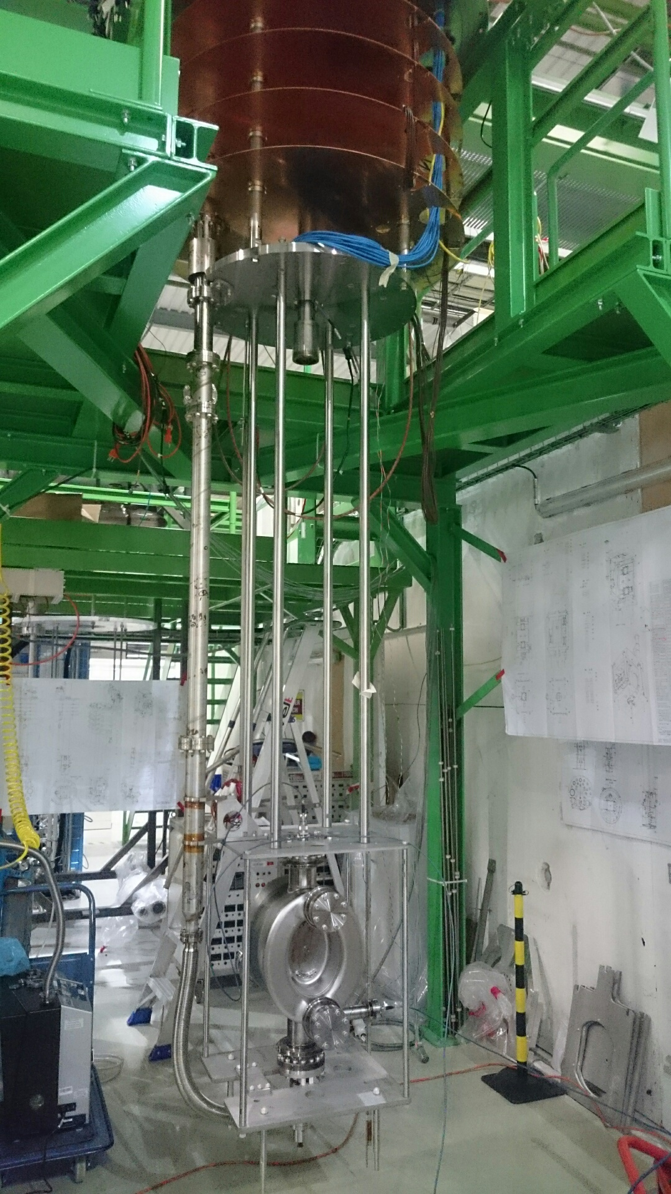
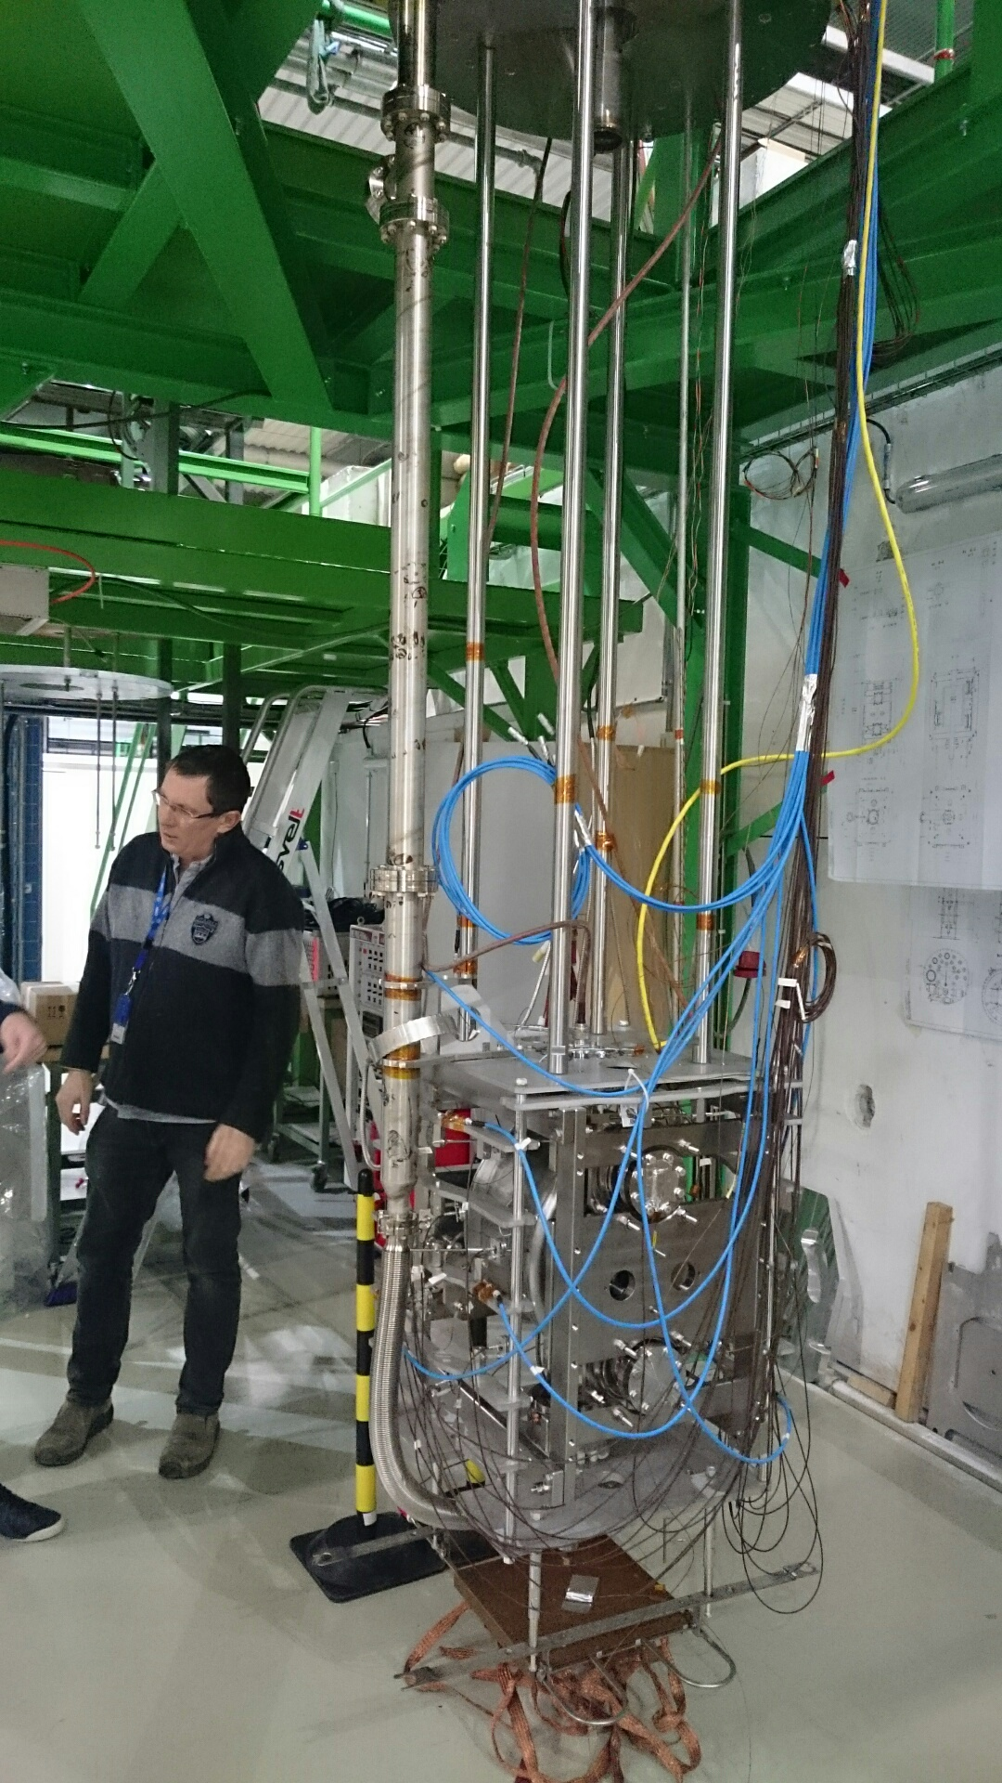
DQW for SPS Status – Cold tests
Cavity cold test
See talks A. Castilla & A. Macpherson

Slide 18
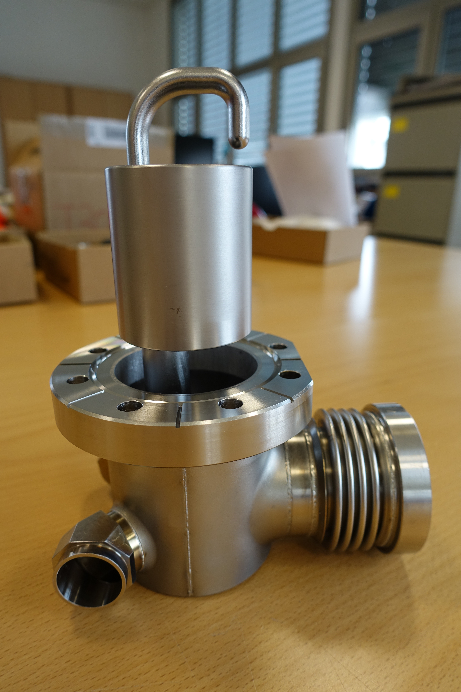
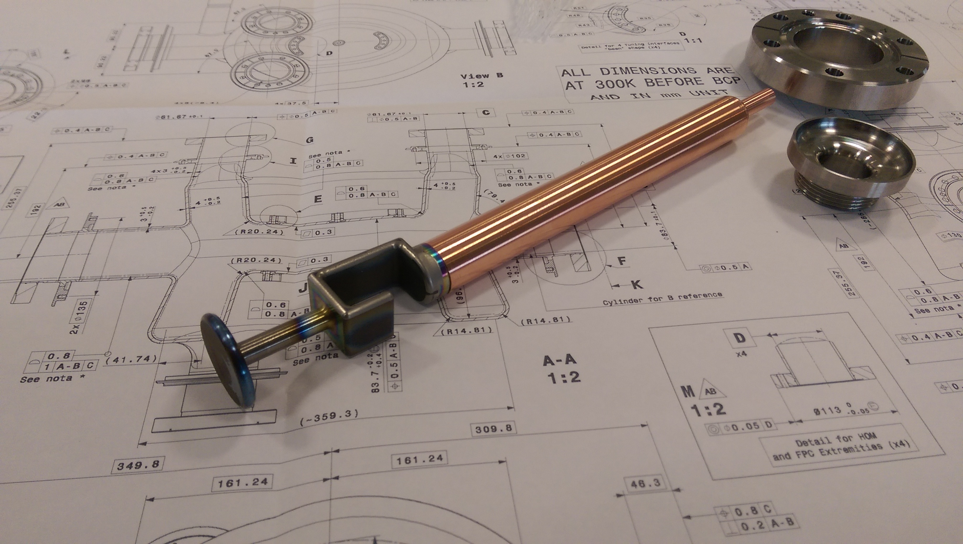
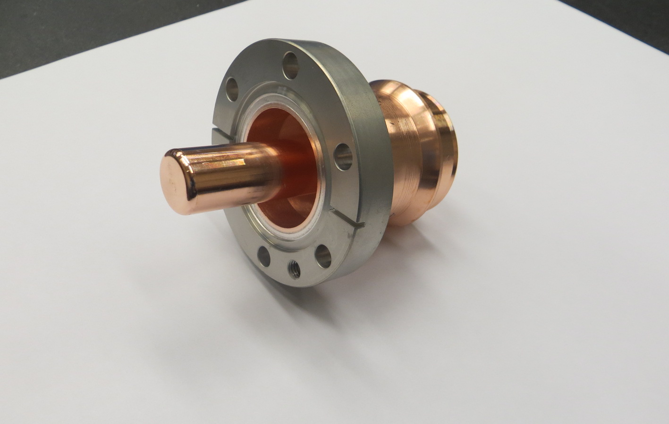
DQW for SPS Status – HOMS & Pick-up
Pick-up
See talks
M. Garlasche
E. Montesinos
HOMS

Slide 19
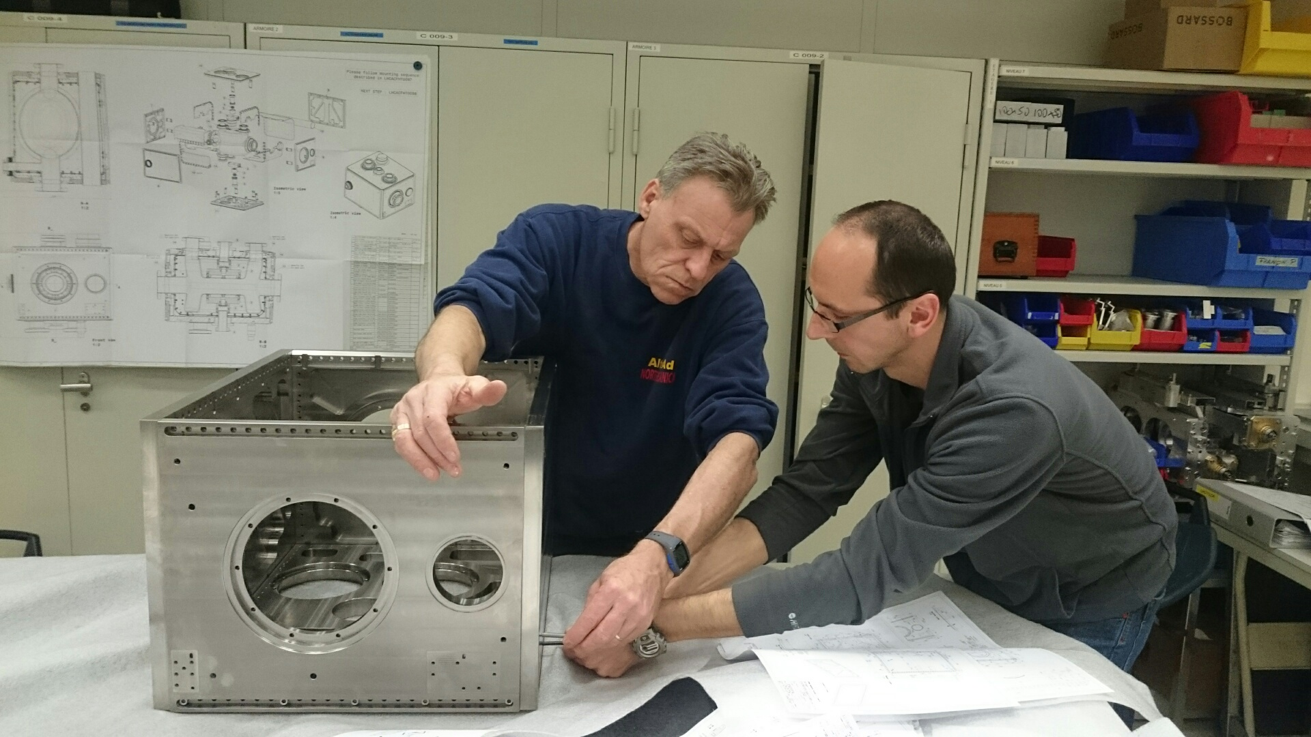
DQW for SPS Status – Helium vessel
Helium vessel
See talk P. Freijedo

Slide 20
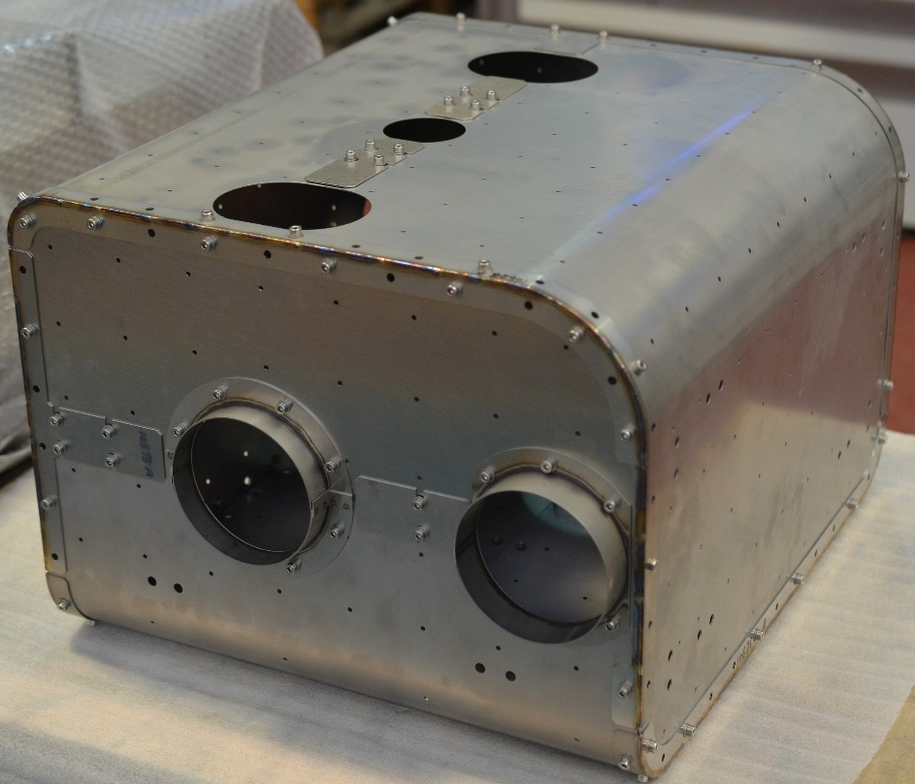
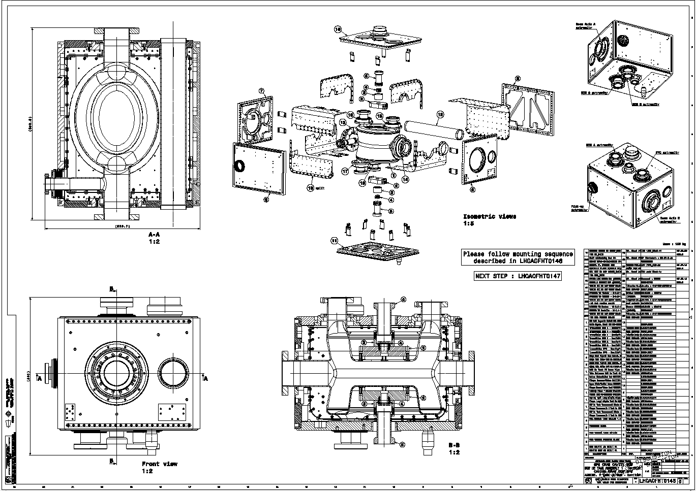
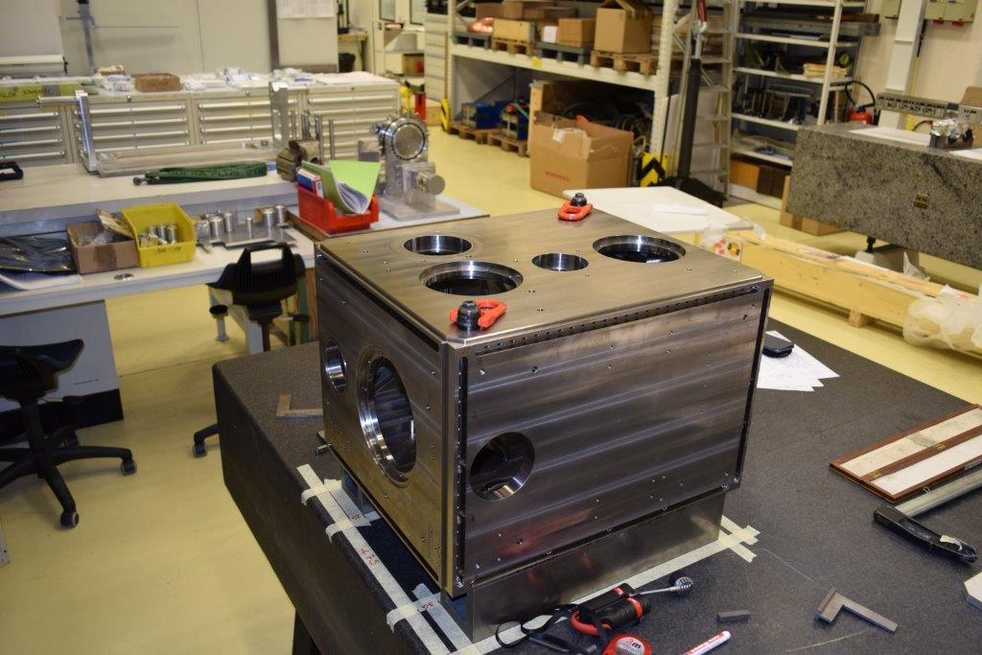
DQW for SPS Status – Helium vessel & cold magnetic shield assembly
Cold magnetic shield
See talks
P. Freijedo
N. Templeton
Helium vessel

Slide 21
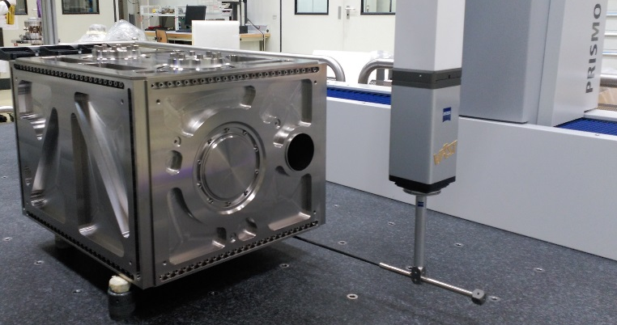
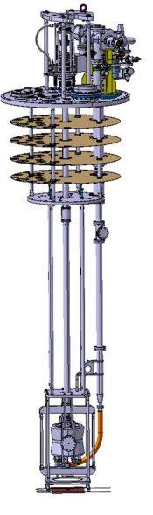
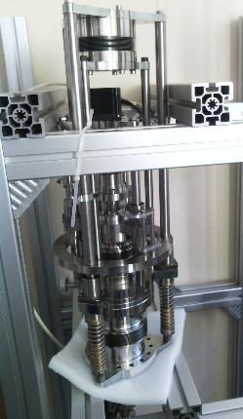
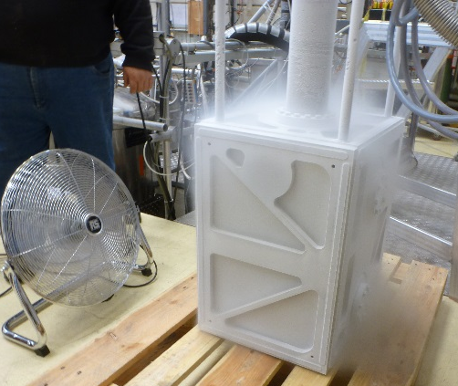
DQW for SPS Status – Tuning system
All complex components individually tested for validation
Helium vessel built and successfully tested
Tuning system built and successfully tested at cold
See talk K. Artoos

Slide 22
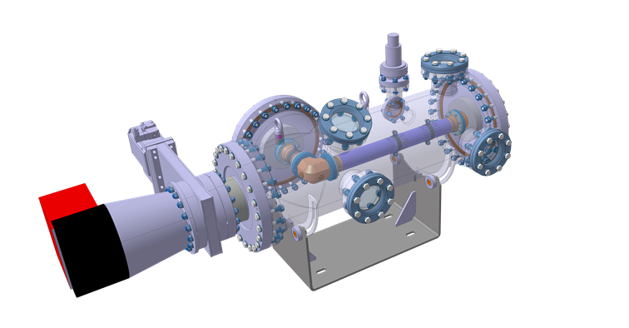
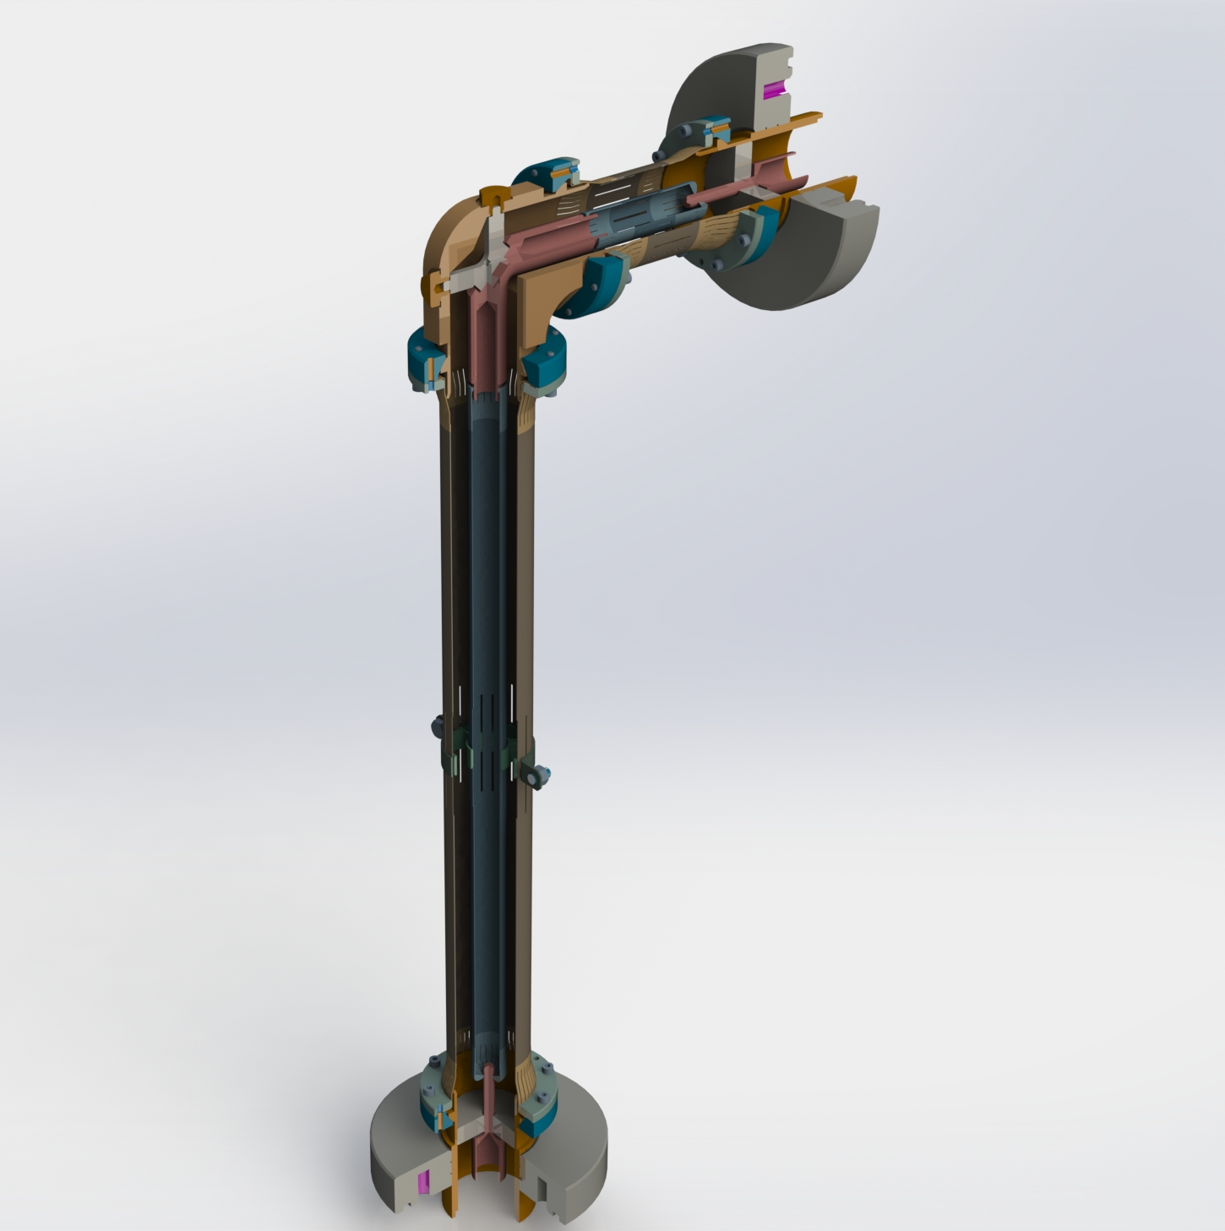
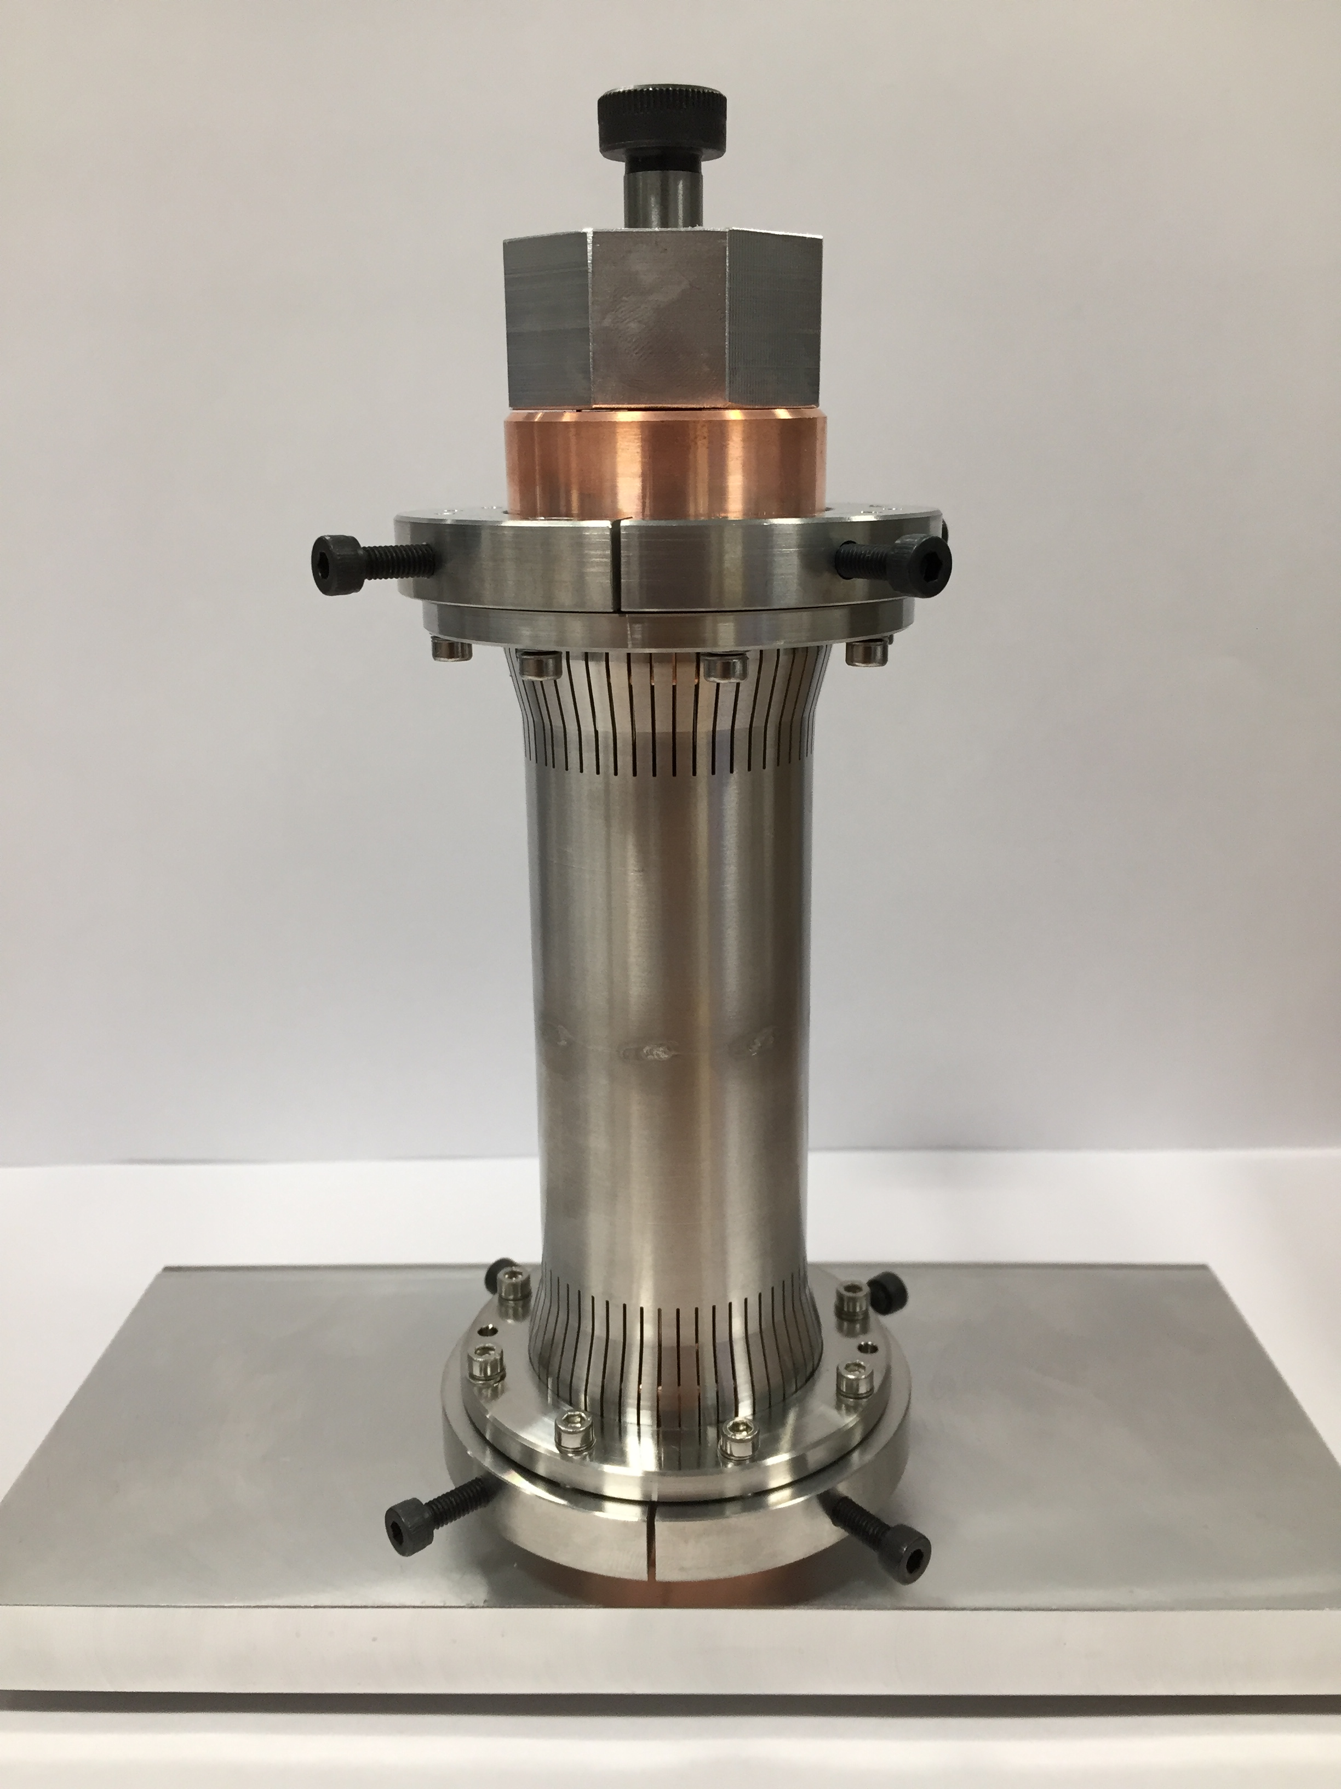
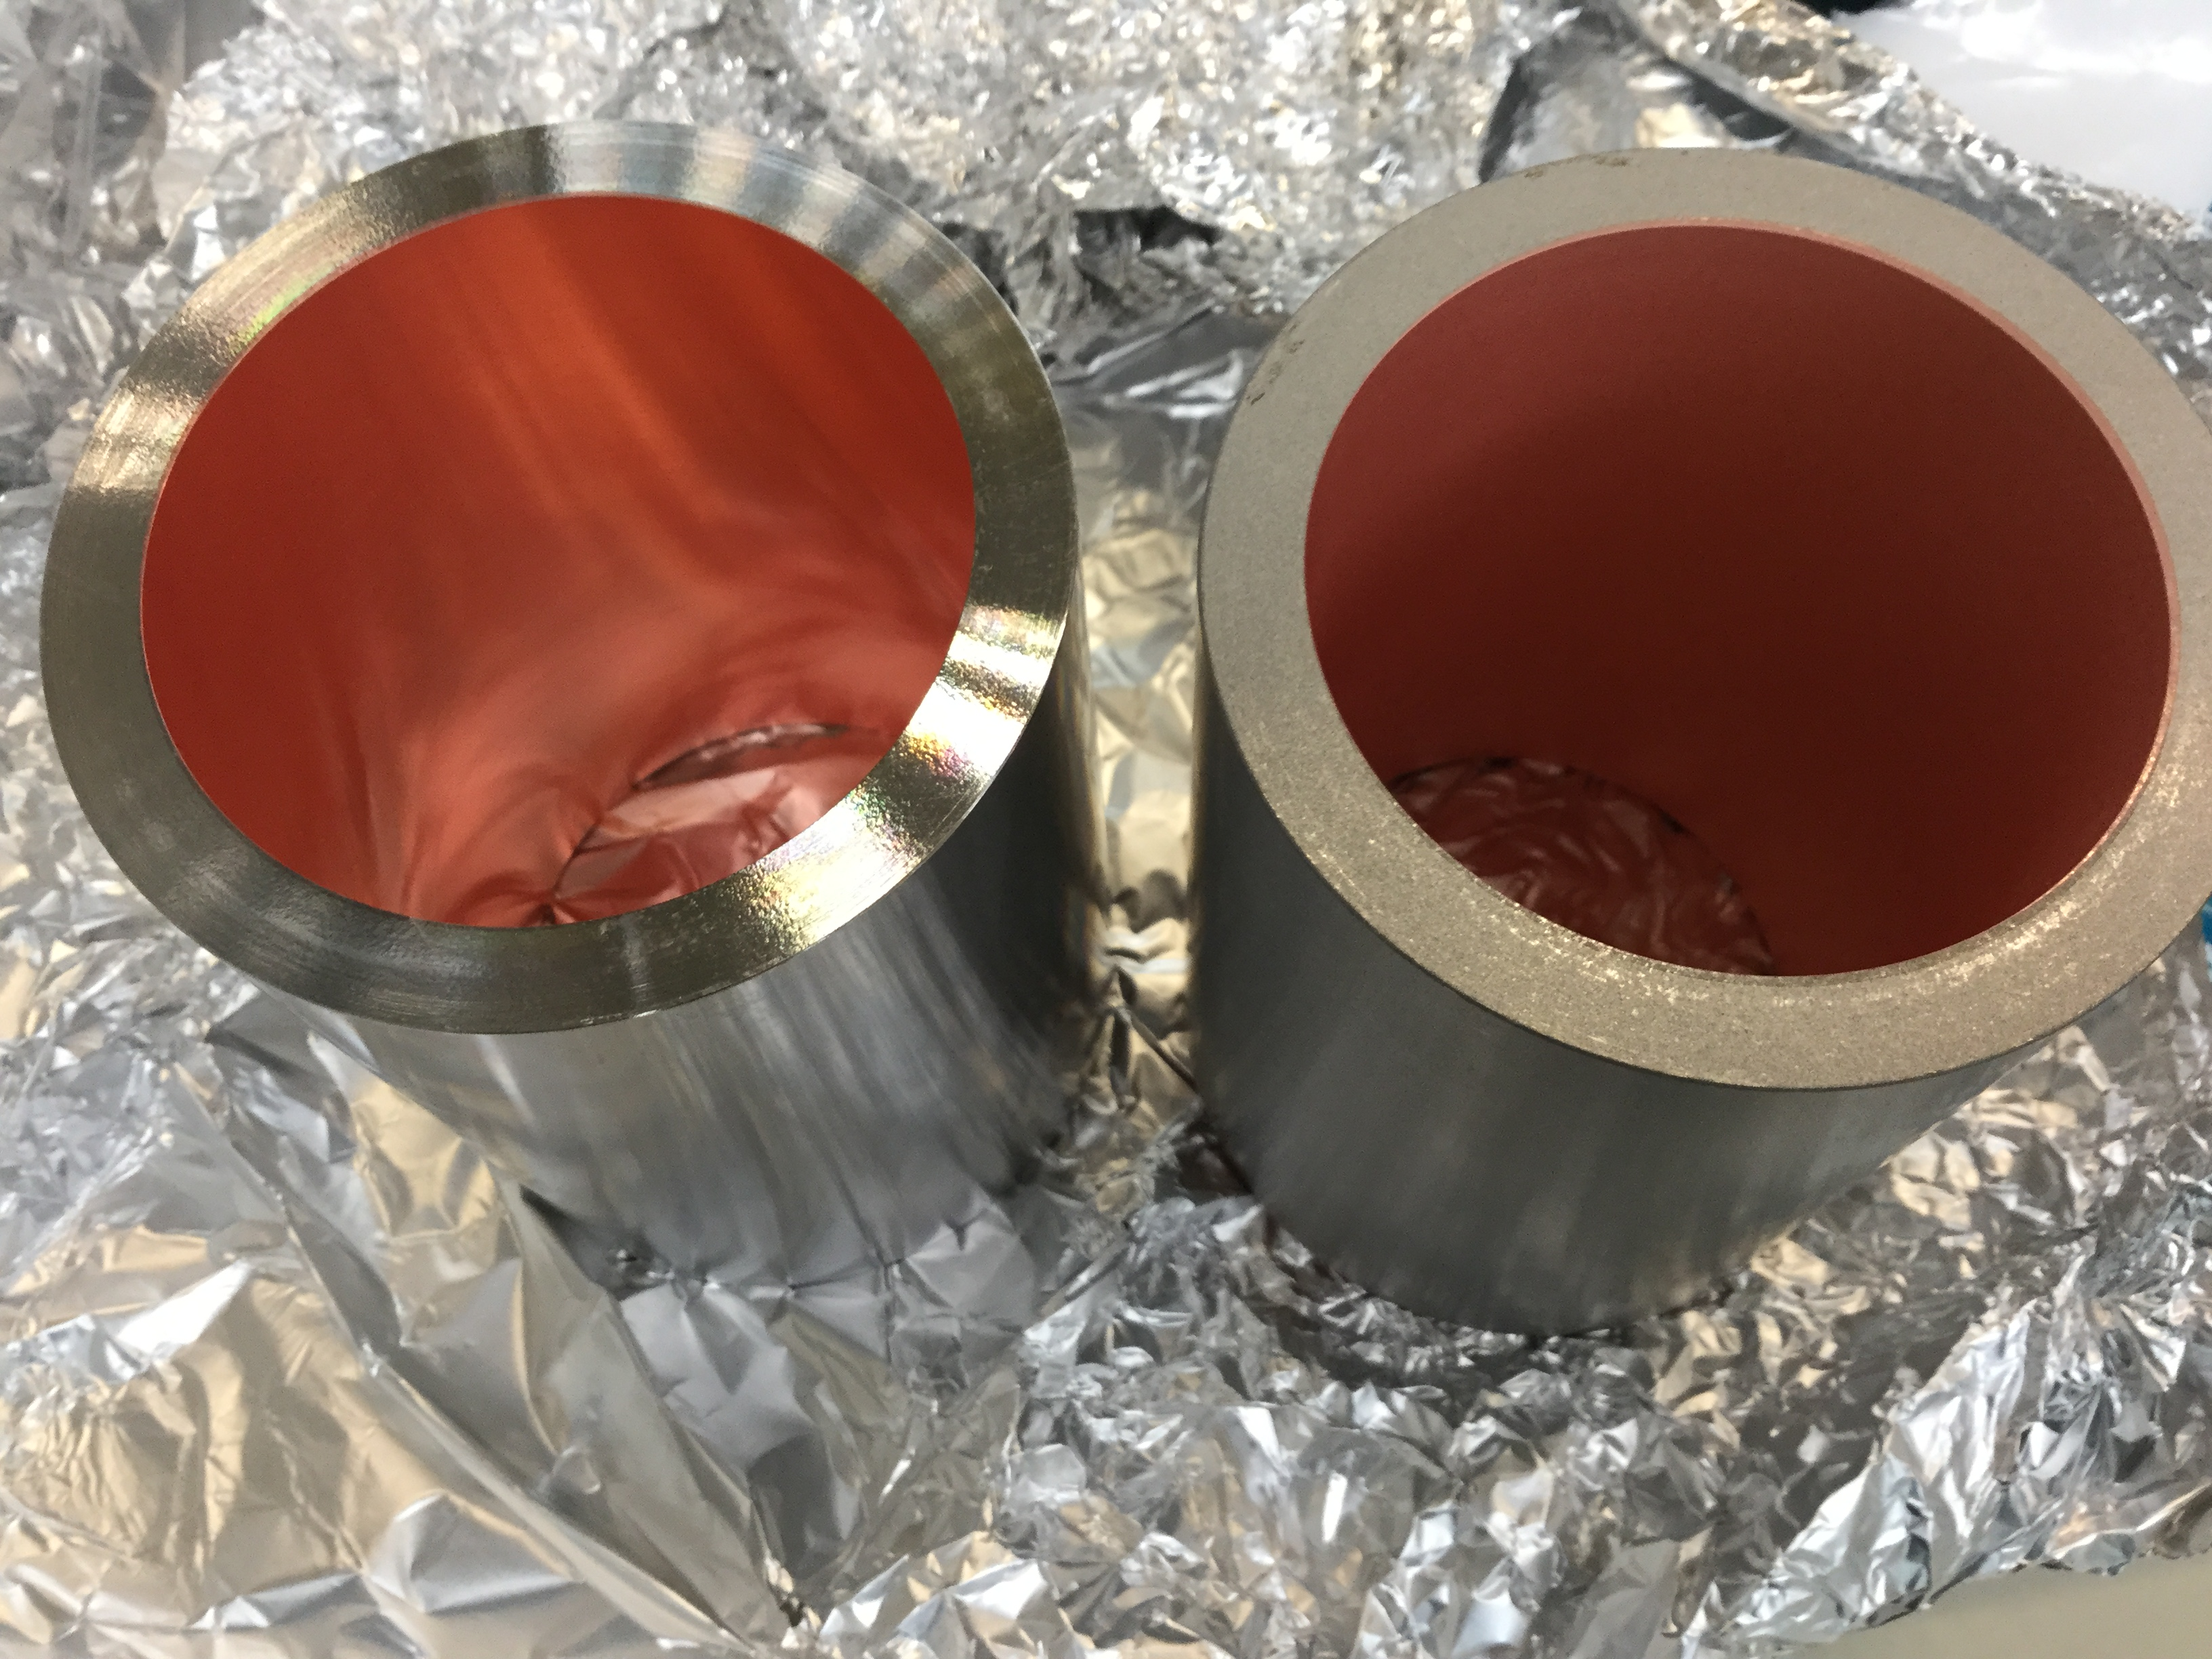
DQW for SPS Status – CM RF internal lines
All complex components individually tested for validation
RF internal line for HOM extraction manufactured for extensive tests
See talks
T. Capelli
E. Montesinos
Successful copper on stainless steel sputtering for FPC outer conductor by TE-VSC

Slide 23
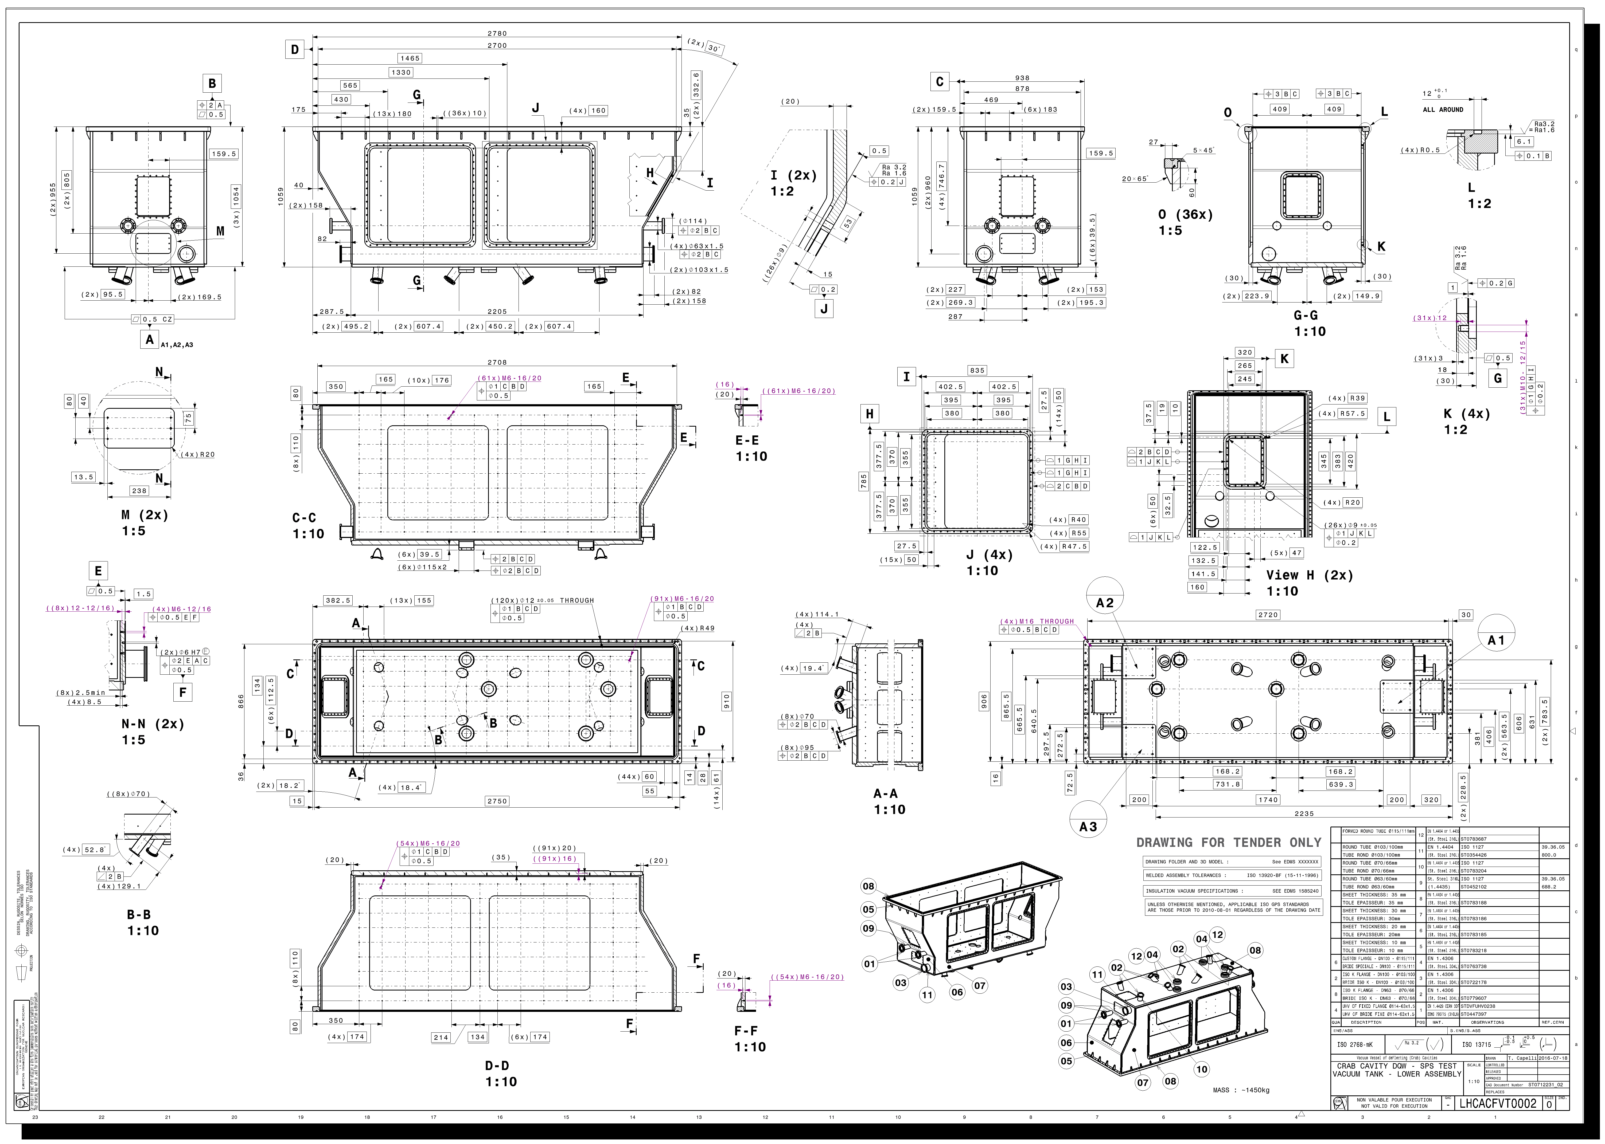
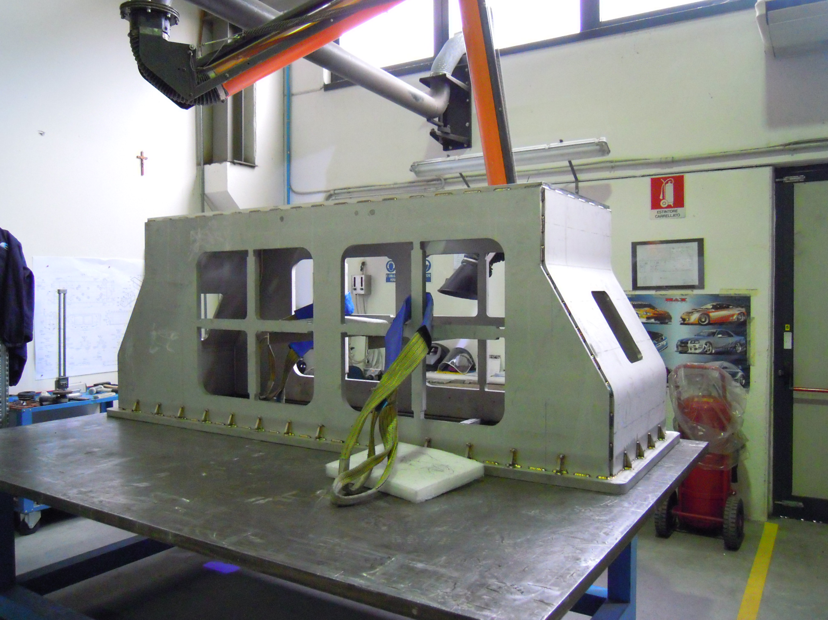
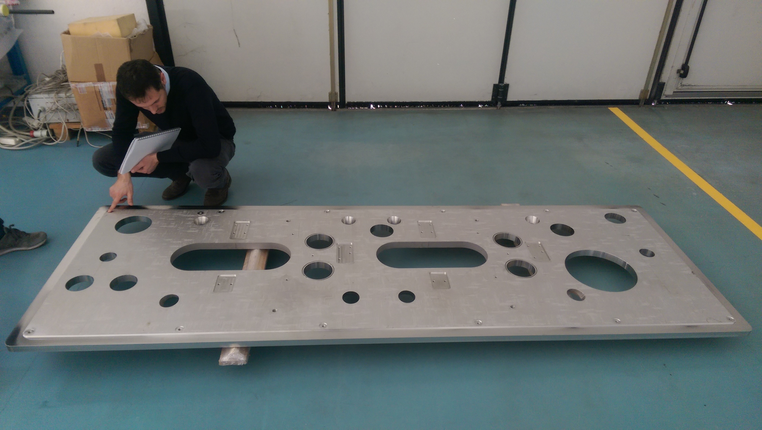
DQW for SPS Status – Vacuum vessel
Vacuum vessel

Slide 24
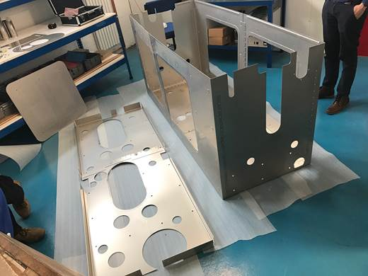
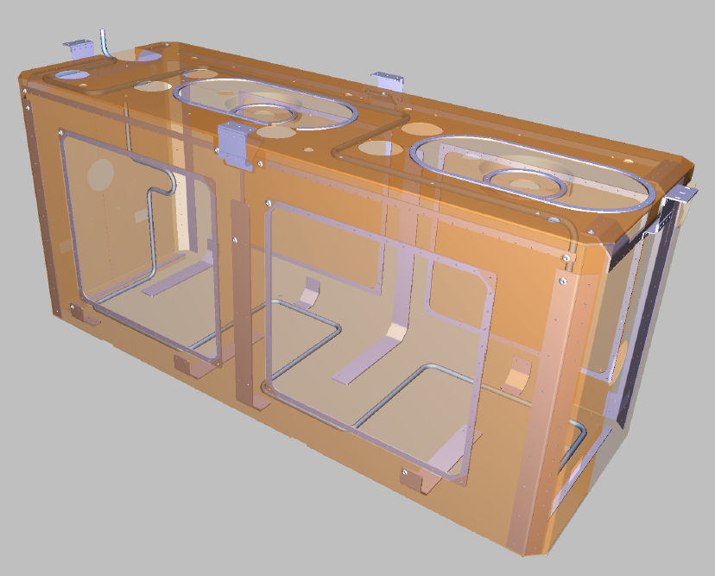
DQW for SPS Status – Magnetic & thermal shields
Warm magnetic shield
See talk N. Templeton
Thermal shield

Slide 25
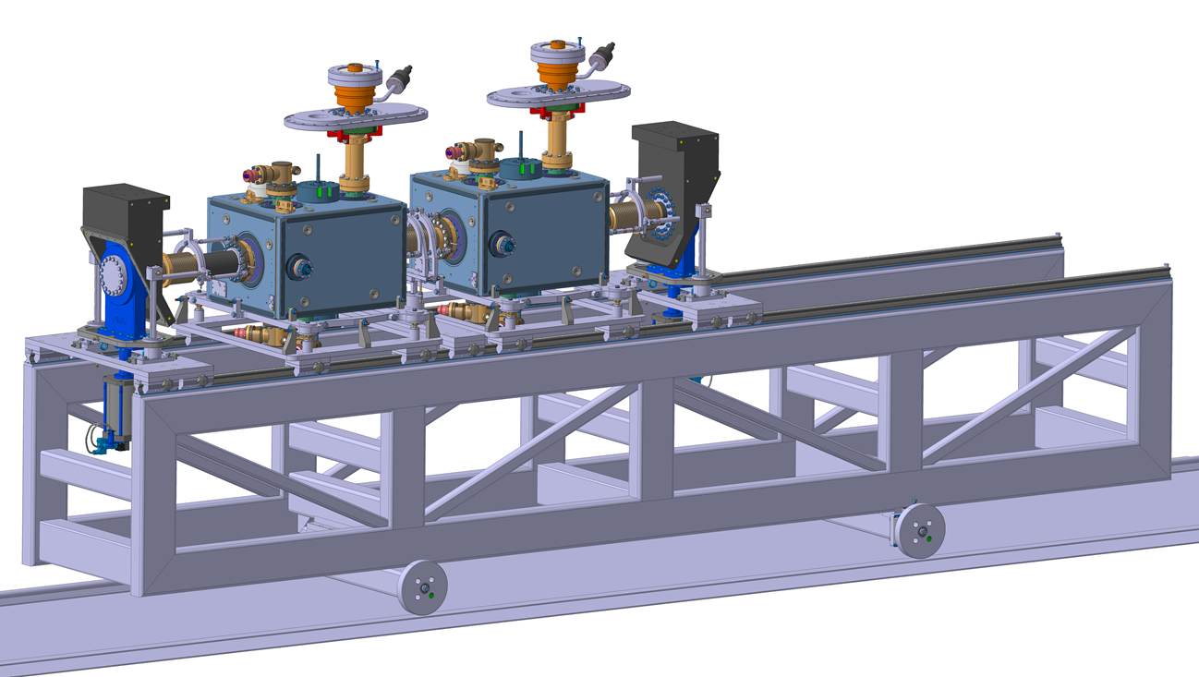
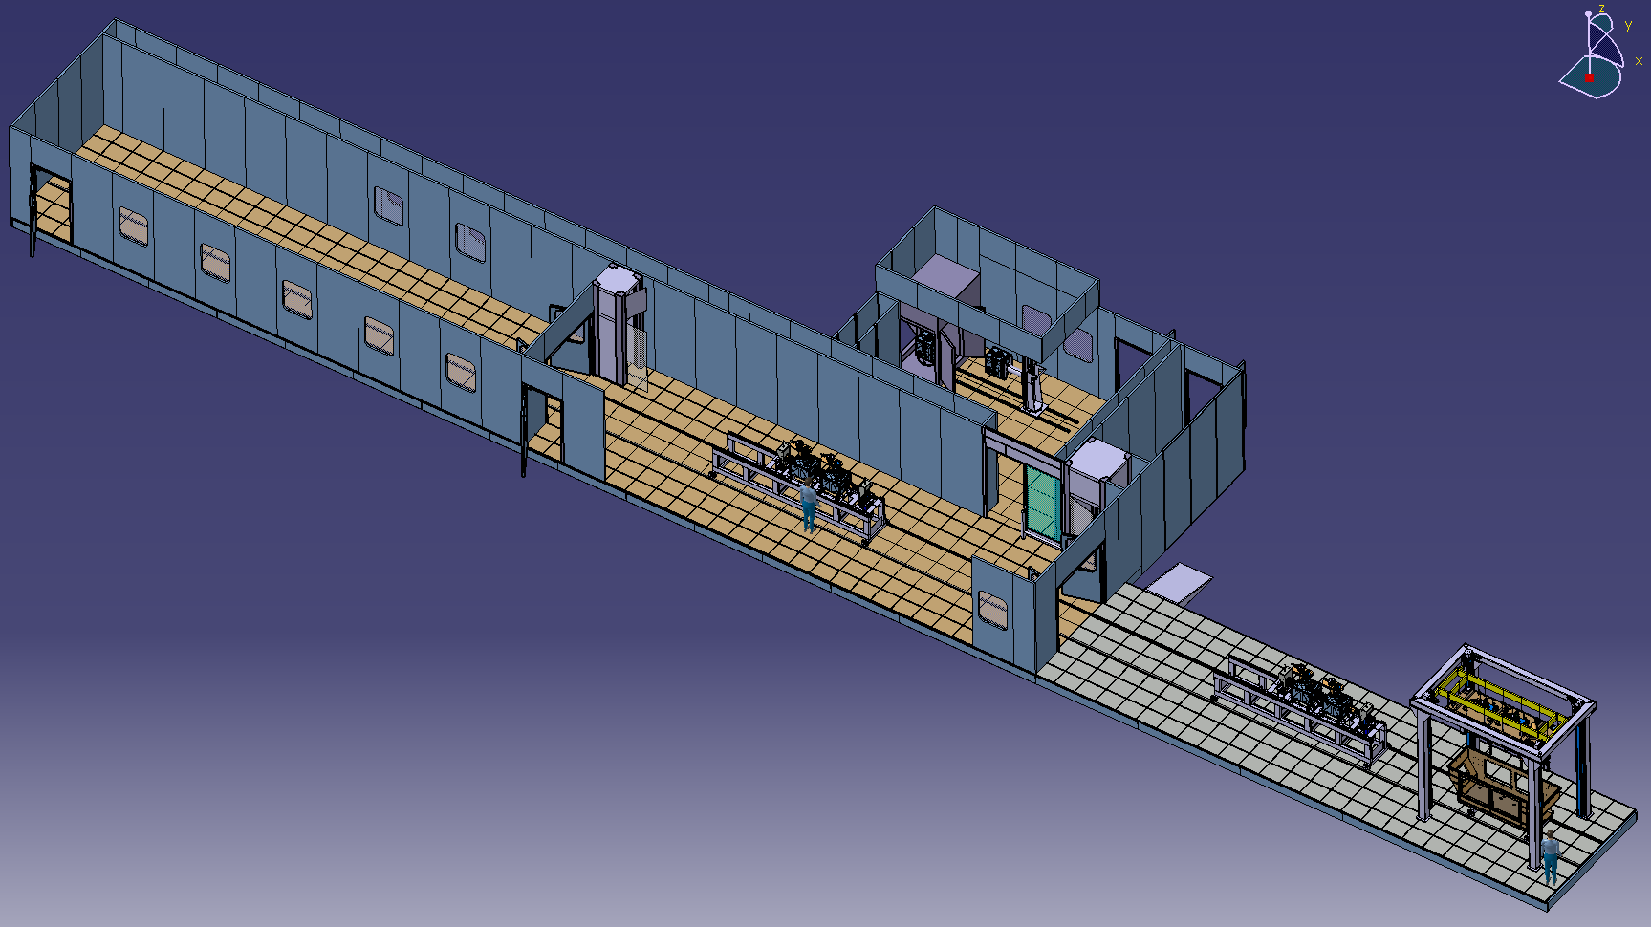
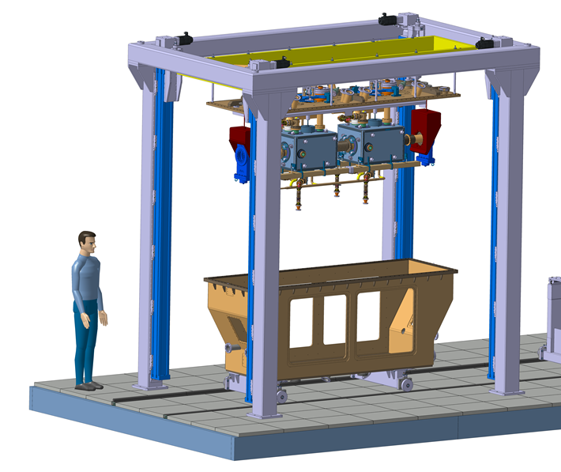
DQW for SPS Status – CM assembly
Assembly in
SM18 @ CERN
String assembly in clean room
See talks
E. Montesinos
M. Therasse
T. Capelli
Vertical loading of equipment in vessel outside clean room

Slide 26
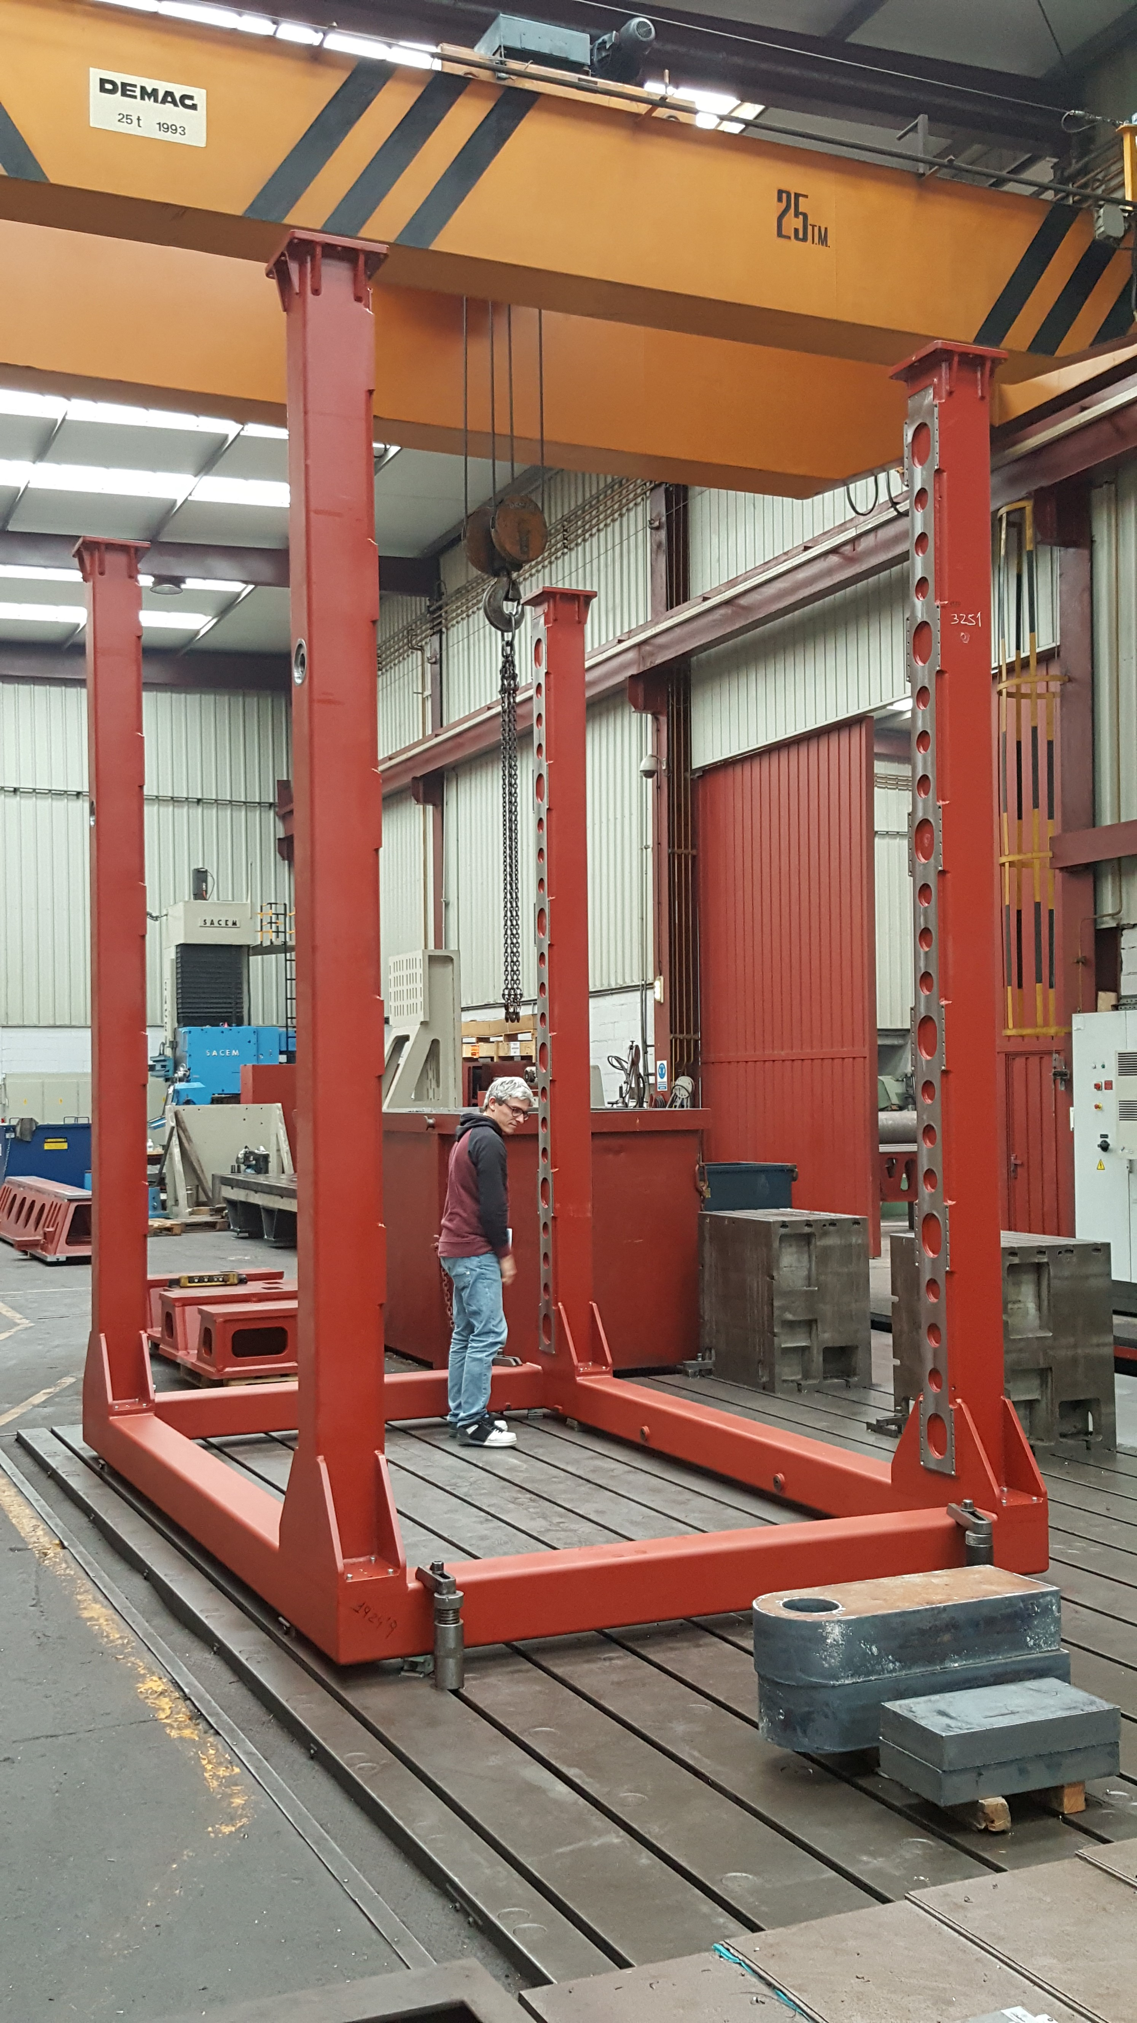
DQW for SPS Status – CM assembly tooling
Gantry for CM assembly

Slide 27
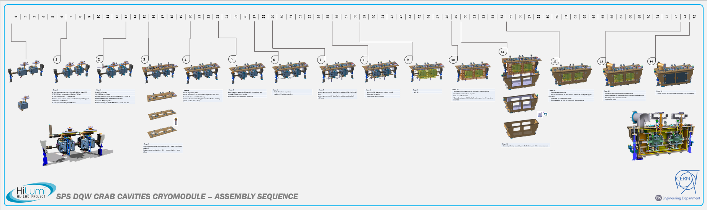
DQW for SPS Status – CM assembly sequence

Slide 28
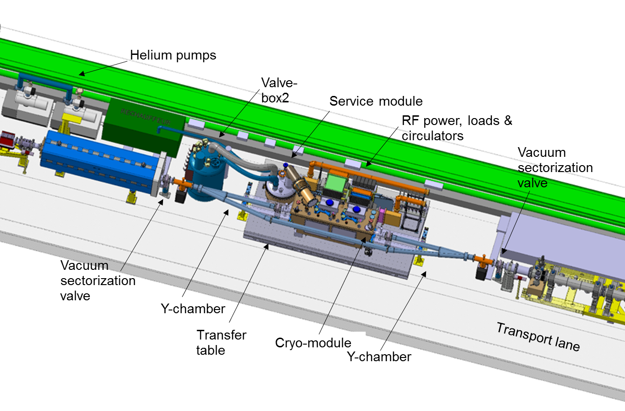
SPS test zone
See talk G. Vandoni
V. Baglin
S. Claudet

Slide 29
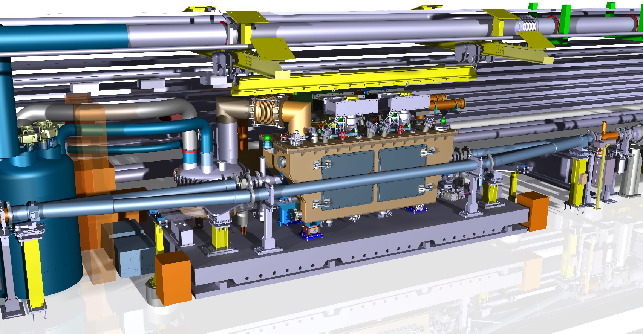
SPS test zone
See talk G. Vandoni
V. Baglin
S. Claudet

Slide 30
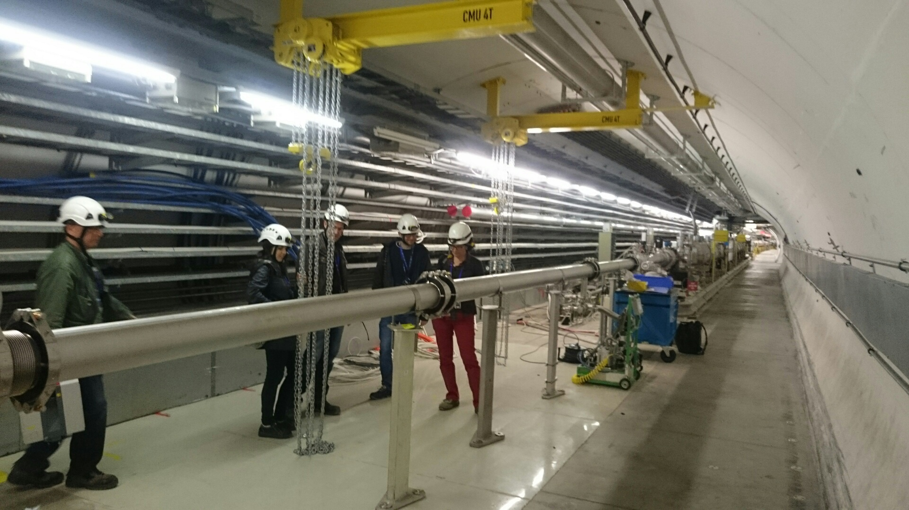
SPS test zone
See talk G. Vandoni

Slide 31
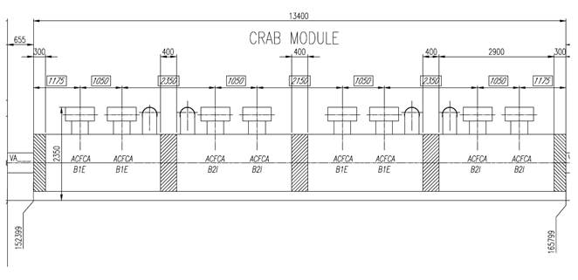
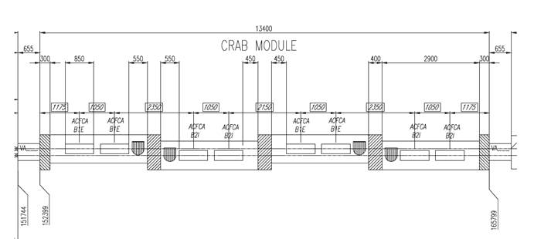
LHC
LHC layout: 4 “SPS like” cryomodules x 2 cavities each / IP side (high modularity)
Lateral view
Top view
See talk P. Fessia

Slide 32
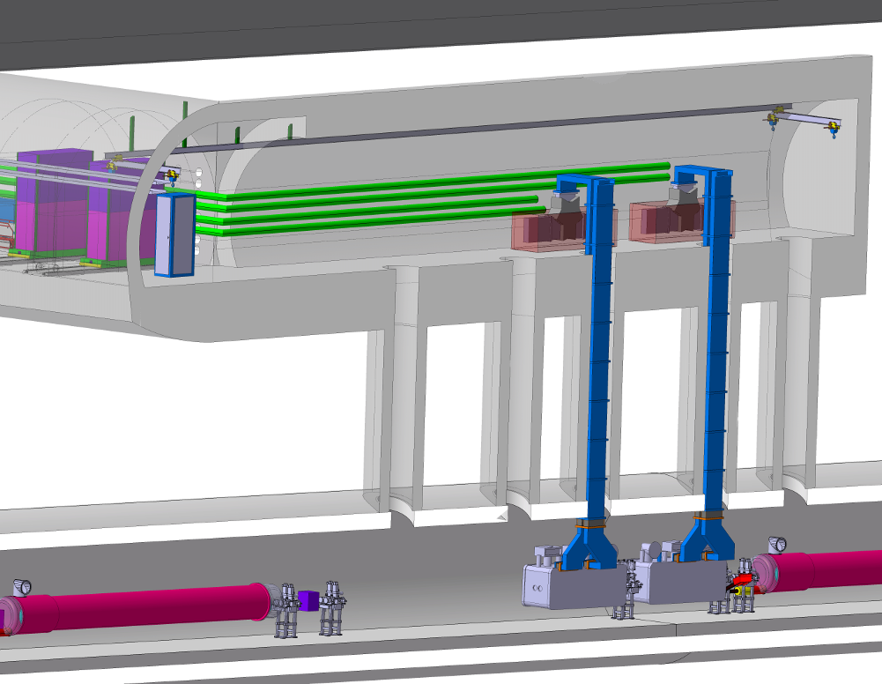
LHC
See talk P. Fessia

Slide 33
Cavities and CM General schedule
DQW
SPS
RFD
Preseries + series
Design
Manufacturing
Processing & cold tests
Assembly
SPS Tests

Slide 34
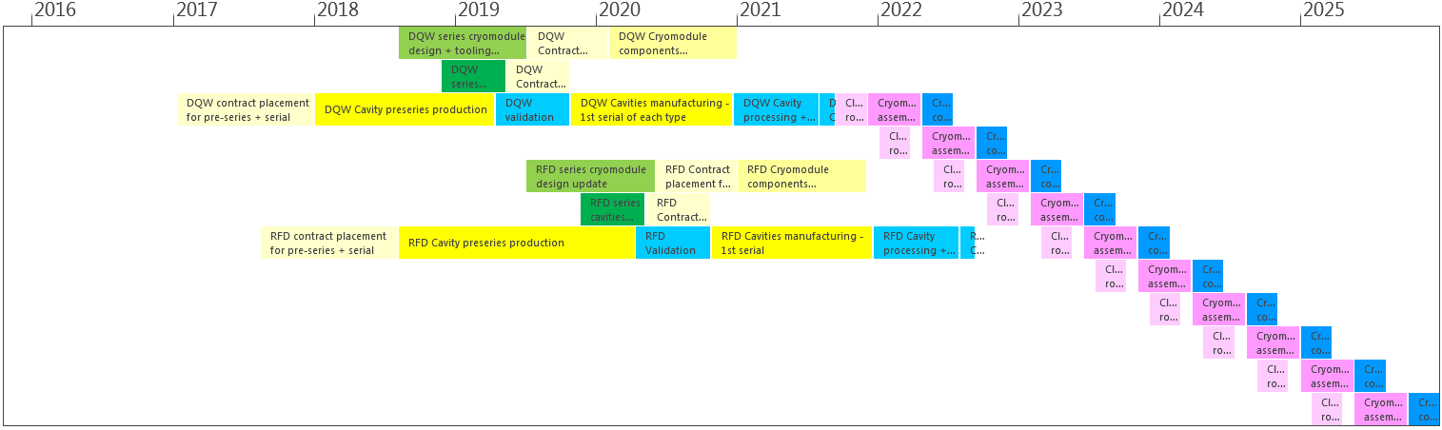
Schedule preseries and series

Slide 35
Schedule preseries and series
March 2025 start tunnel installation last cryomodule
2x Preseries cavities to be manufactured in Industry (by the same companies that will produce series cavities)
Preseries DQW contract to be started in 2018 by CERN
Series production of 10 fully dressed DQW cavities followed up by CERN
Preseries RFD contract by US
Series production of 10 fully dressed RFD cavities followed up by US
  including processing + cold test of bare and dressed cavities
(8x + 2x spare) Cryomodule components manufacturing by CERN
Cryomodule assembly + cold tests at CERN (UK assembly of LHC prototype for RFD)
Only one existing infrastructure considered for series production strategy (processing, clean room, assembly benches,
cold tests)
See talk T. Jones
See talk C. Zanoni
See talk L. Ristori

Slide 36

Schedule series

Slide 37

Schedule series
DQW spare
US contribution
RFD spare
Infrastructure needed at CERN (existing):
One BCP stand
One thermal treatment furnace
Two vertical tests stands (one for bare and one for dressed cavities)
One clean room string assembly zone (SM18)
One cryomodule assembly zone (SM18)
One cryomodule cold test stand in bunker (SM18)

Slide 38
Summary
Cavities and cryo-module on track for DQW SPS tests before LS2; Very tight schedule
Same planned for RFD to be tested in SPS after LS2
  Cavities for SPS will be manufactured by CERN; Cavities manufactured by US LARP will feed useful information back into CERN’s process
  Cryo-module will be designed as LHC prototype
  Cryo-module assembly will be done in UK
Know-how will be transferred to industry for pre-series and series cavities production
  DQW dressed cavities manufacturing under CERN responsibility
  RFD dressed cavities manufacturing under US AUP responsibility
Plan for cryo-modules series production based on existing infrastructure at CERN;
  Know-how in UK developed during prototyping would be very helpful

Slide 39

Thank you!
Teamwork and commitment

