Slide 1

WP4 QA, QC status and documentation
EDMS: 1773548 v1.0
Hector Garcia Gavela, Isabel Bejar Alonso
HL-LHC Quality, Configuration and Resources Office
3 April 2017 International Review of the Crab Cavities Performance

Slide 2
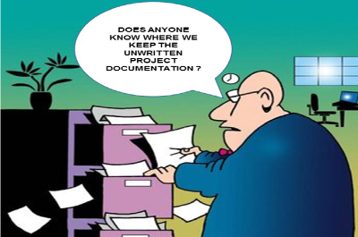
What use to happen at the end of the projects
other

Slide 3




Why is not the case for WP4

Slide 4

Classification & rules from the beginning

Slide 5
Key concepts
A tool for each type of Information
Short term documents
Records
Long term documents
Volatile information

Slide 6
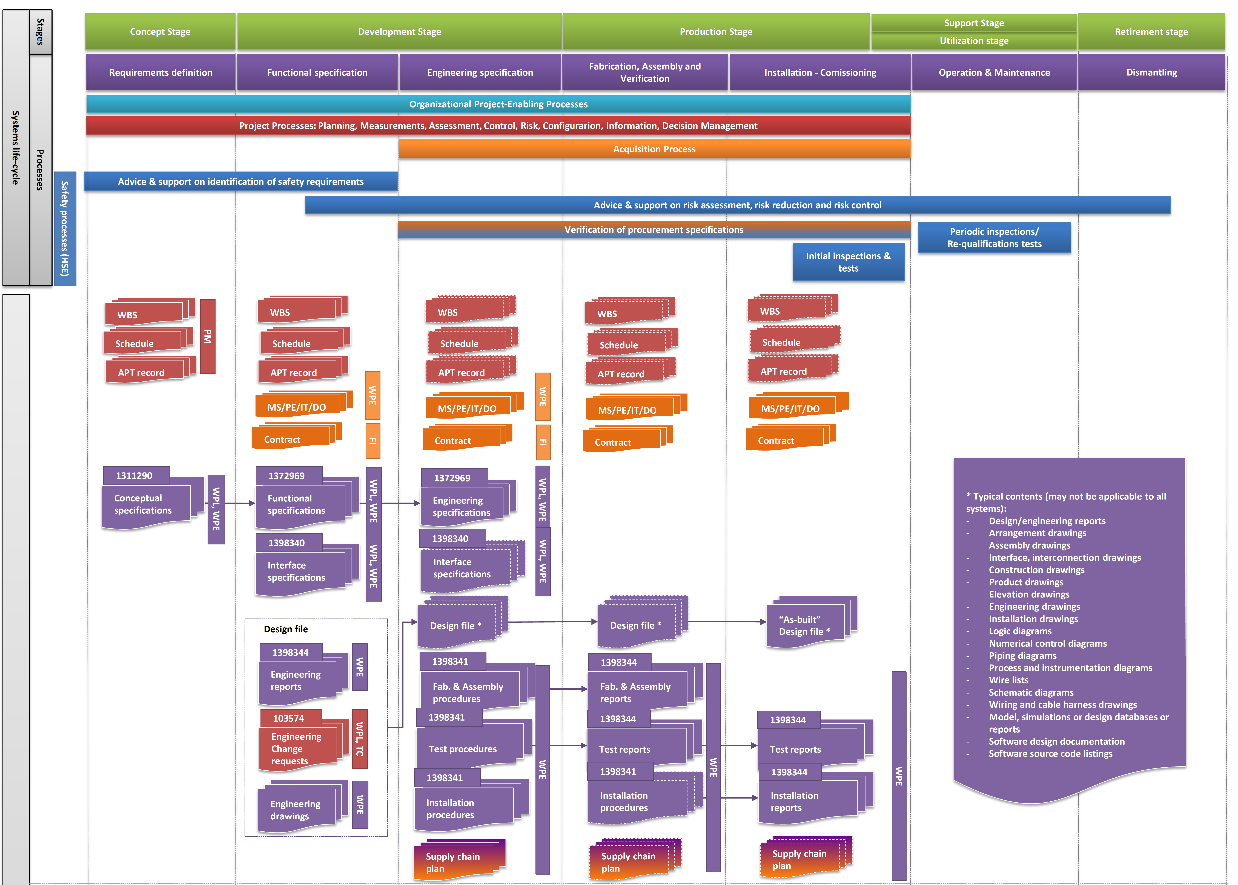
Long term documentation (1/2)
EDMS #1361462
From system requirements to technical solutions and products
Project management
Acquisition
Technical
Safety

Slide 7
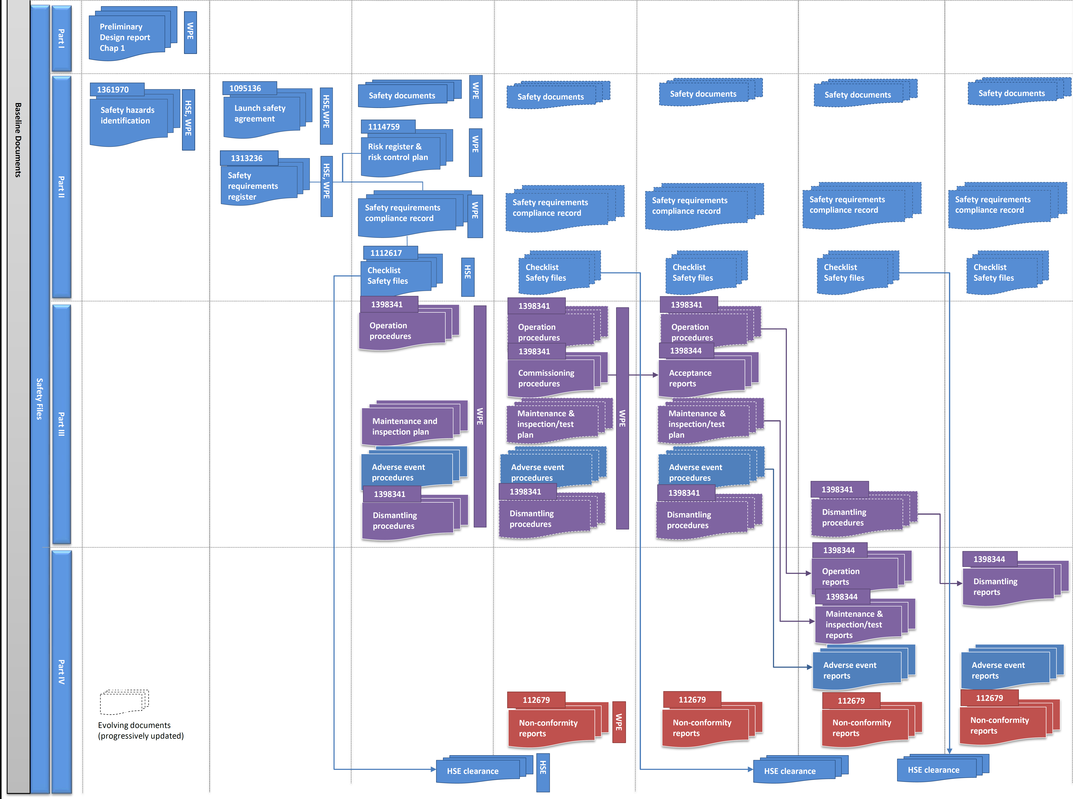
Long term documentation (2/2)
EDMS #1361462
Safety File
Links to already
existing documentation
will be made,
whenever required
Project management
Acquisition
Technical
Safety

Slide 8

A great team working together

Slide 9
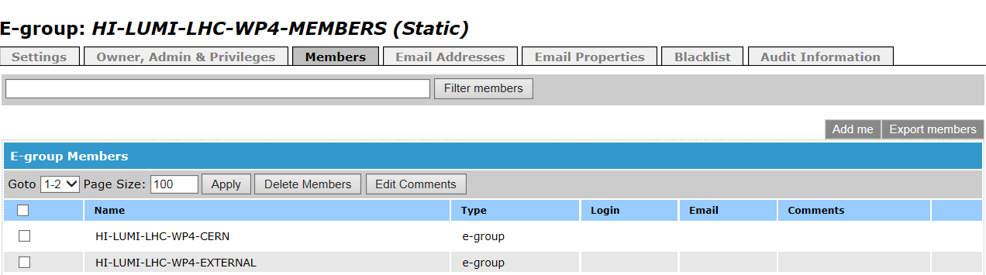









An E-Group that comes across the world

Slide 10
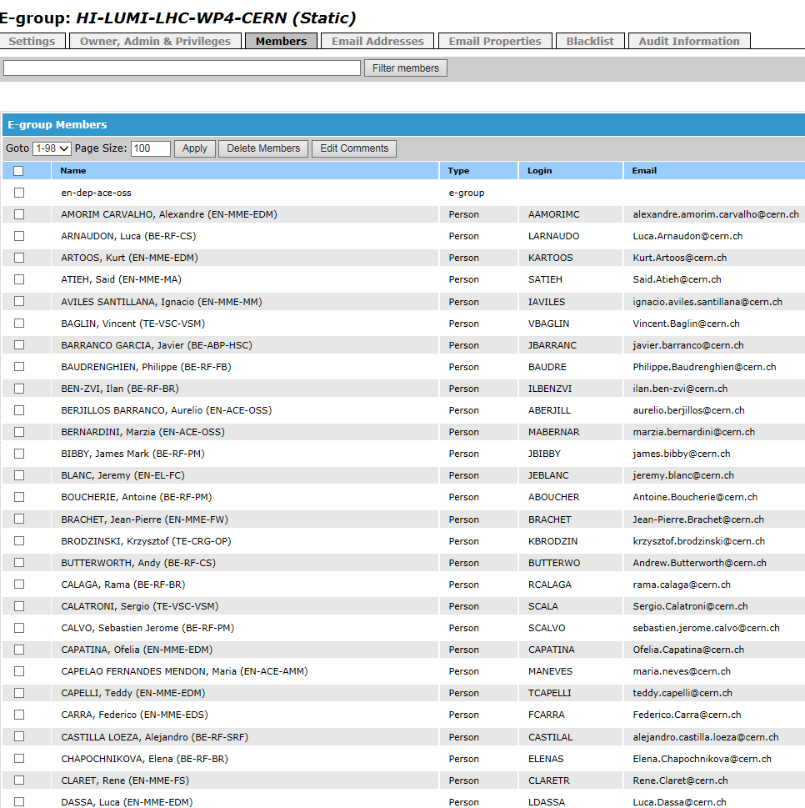
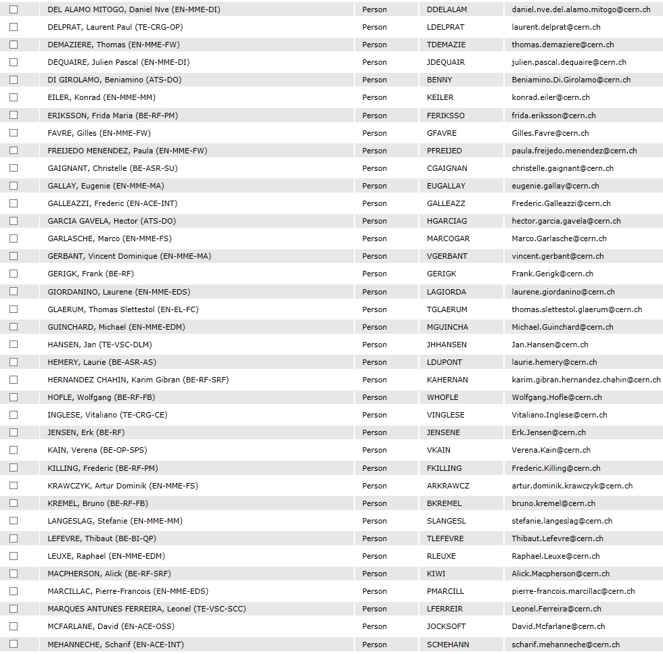
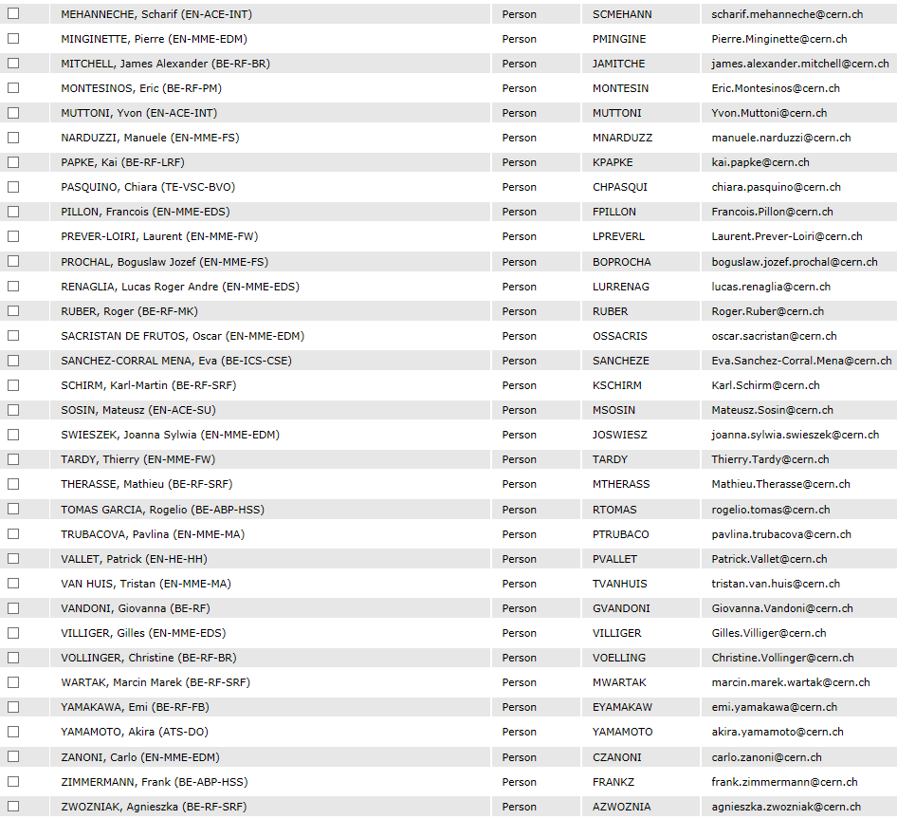
Good practises put in place
Thanks not only to the 98 people from CERN - from all Departments (EN, TE, BE) of ATS sector - directly involved in the WP4…..But also….

Slide 11
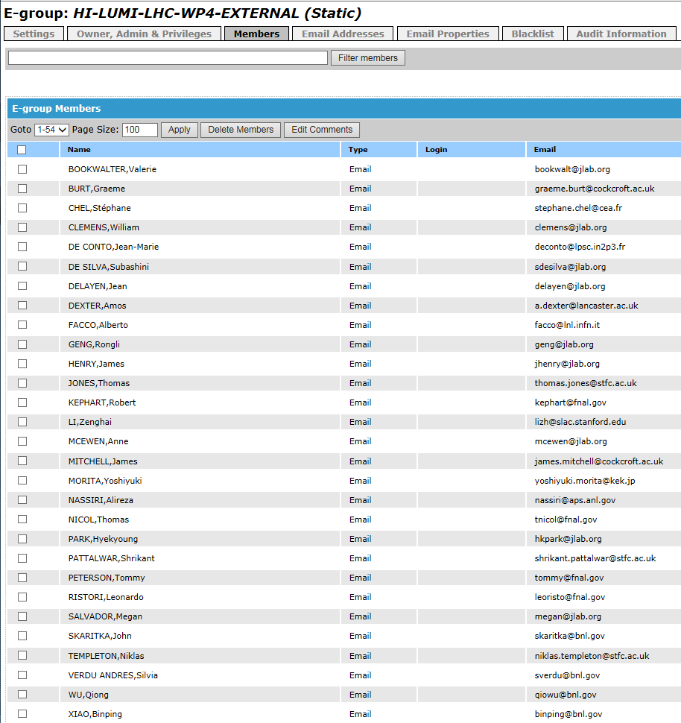
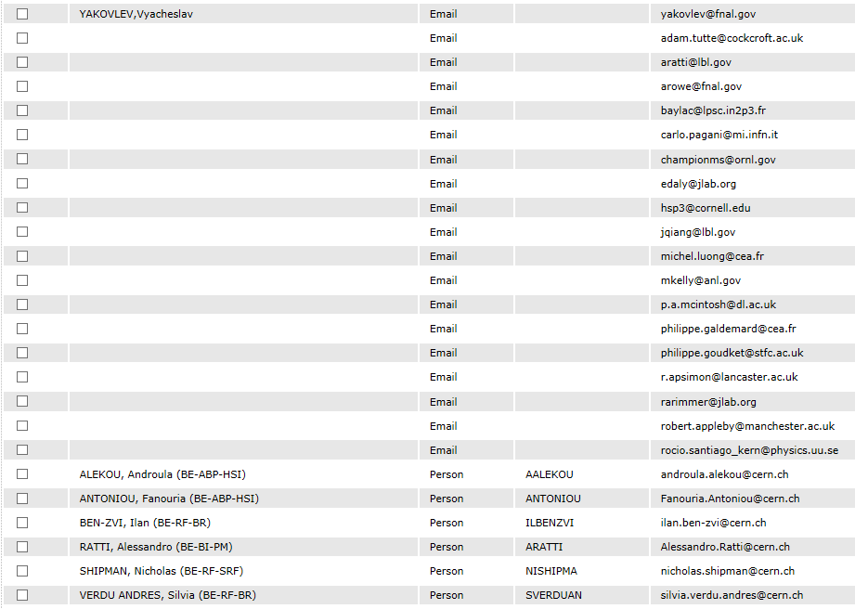
Good practises put in place
….to all the collaborations from other Institutions….

Slide 12
Good practises from day 1

Slide 13
A tool for each type of information
Main documentation EDMS (CDD, MTF)
Drawings (link to CDD)
Specifications & calculations
Qualifications (material, welding processes, etc.)
Manufacturing & Inspection Plan (MIP) of components
Manufacturing records obtained during the production
Sharepoint for in-preparation documents (drafted and issued among several people)
Indico used for meetings (internal and with collaborations)

Slide 14
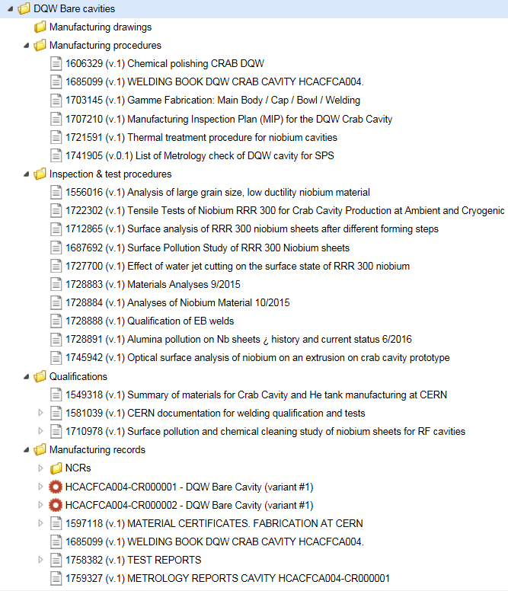
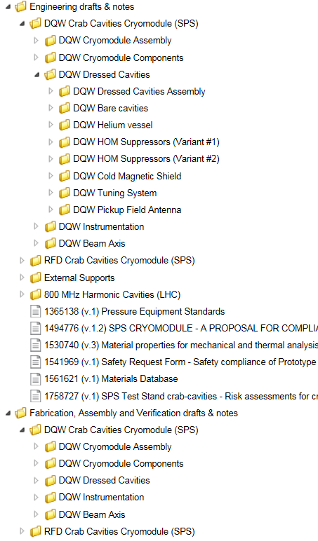
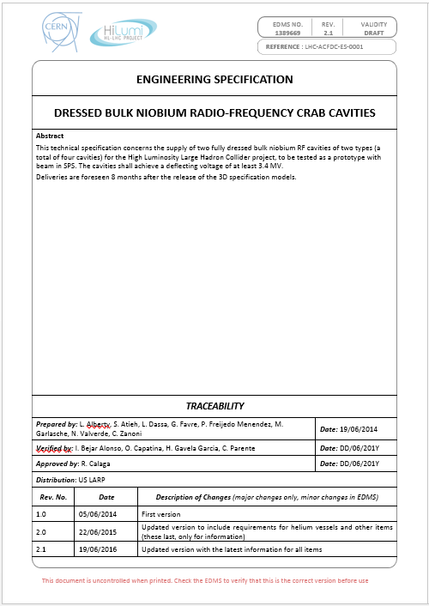
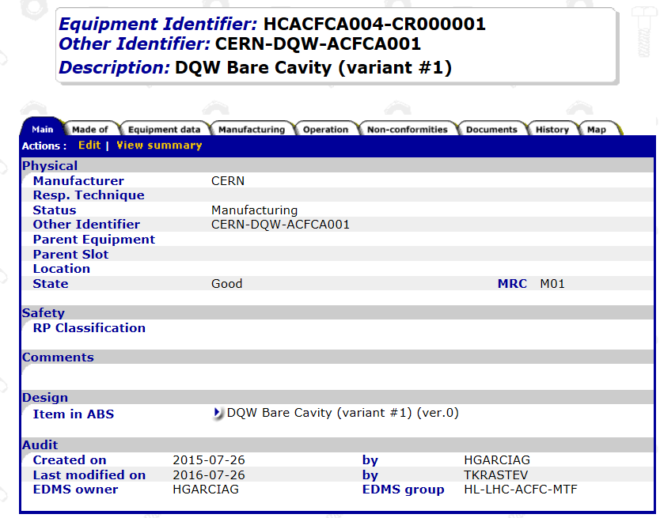
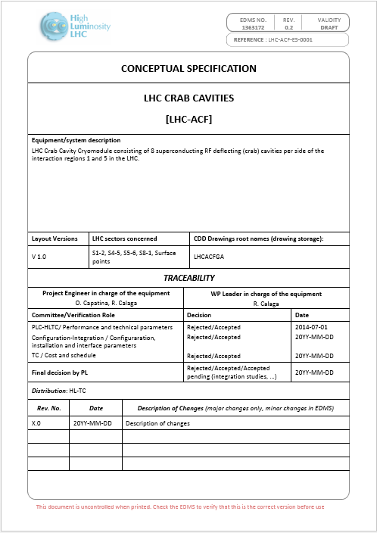
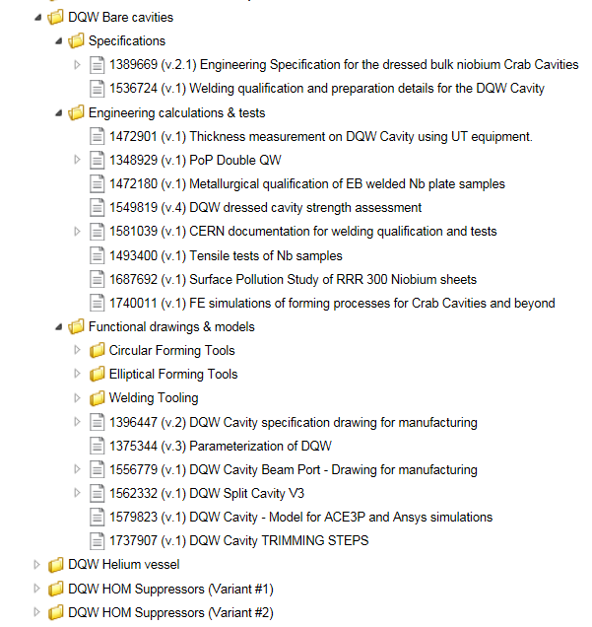
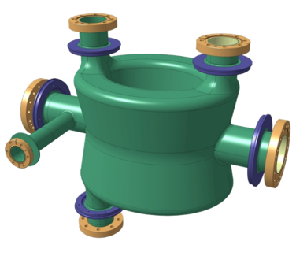
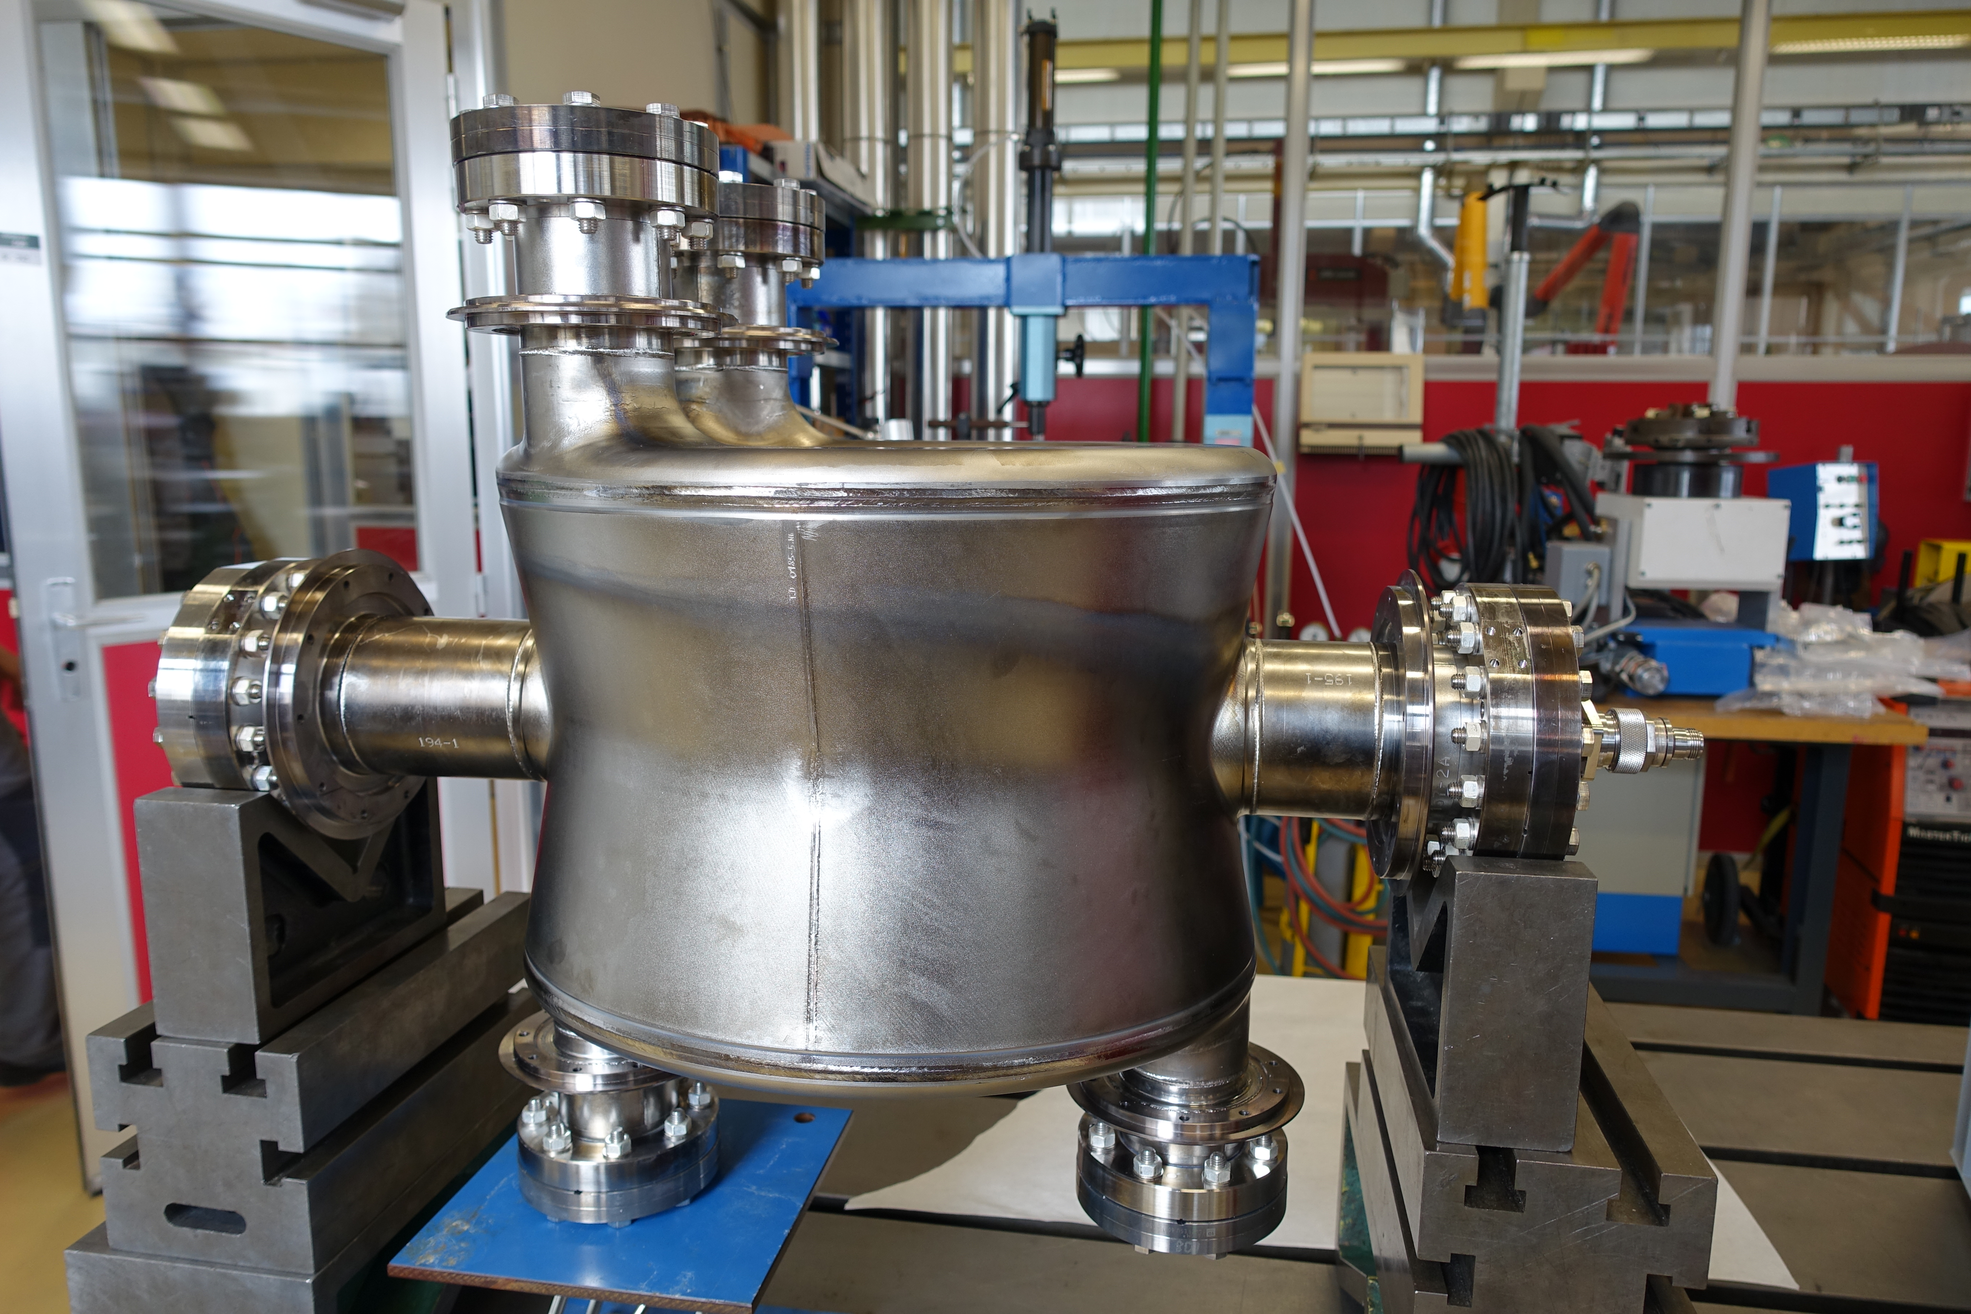
Good practises put in place
EDMS Structure acc. PBS –Documentation for each specific equipment along the entire lifecycle (full traceability)

Slide 15
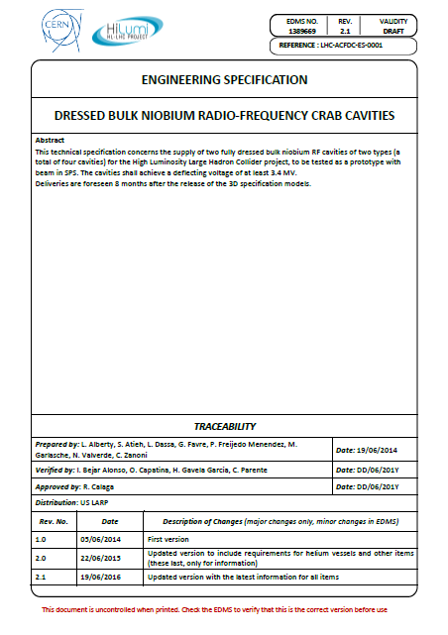
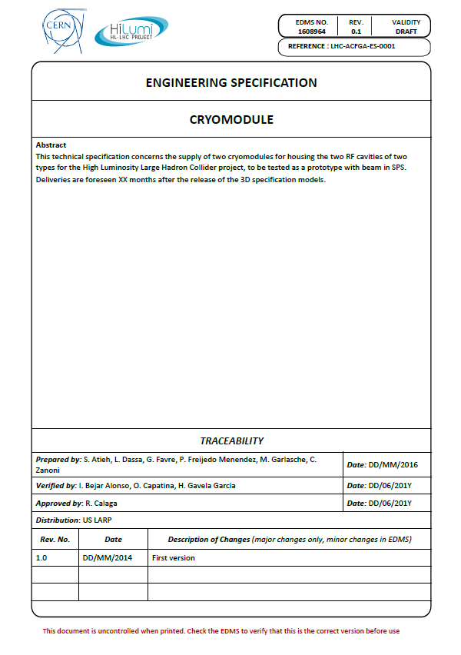
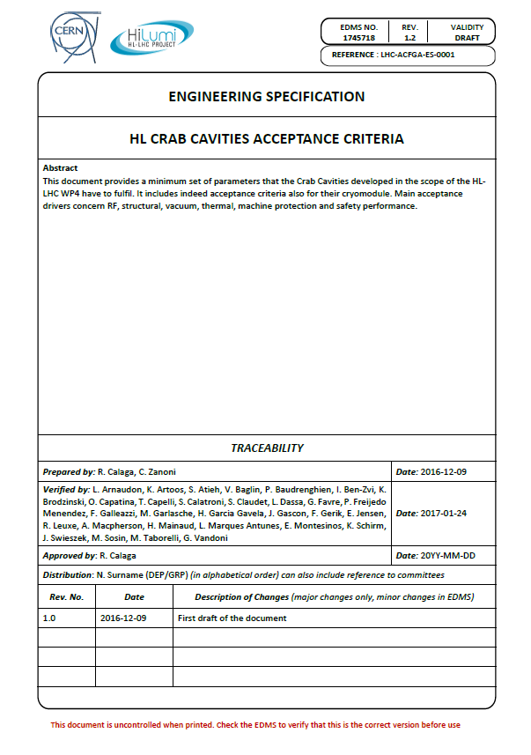
Key Documents of CC
Engineering Specifications which contain the minimum requirements for design/production/performance of the cryomodule components and the dressed cavities
    Cryomodule: EDMS 1608964 v.0.1 (in work)
    Dressed Cavities: EDMS 1389669 v.2.1 (to be updated)
CC Acceptance Criteria with the minimum set of parameters that the CC have to fulfil. EDMS 1745718 v.1.2
Documents issued by the Crab Cavities Team

Slide 16
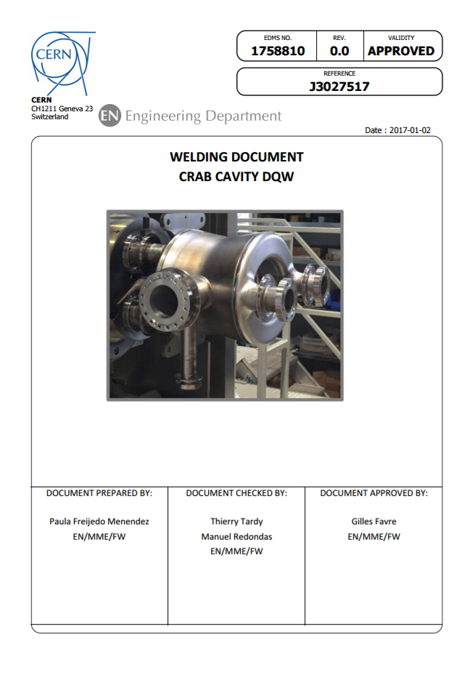
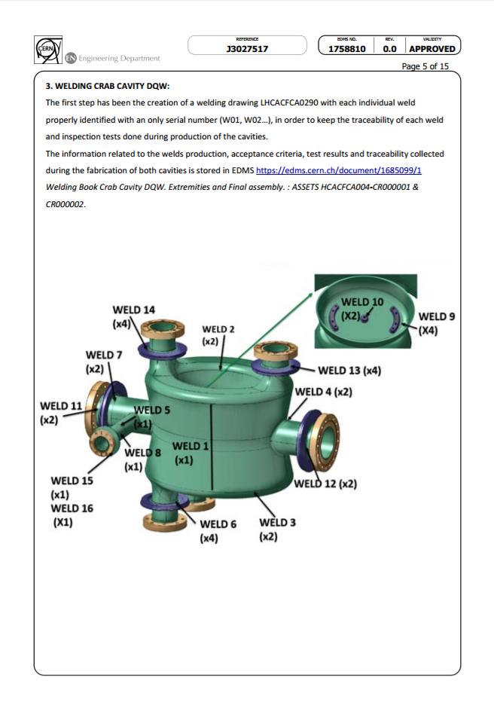
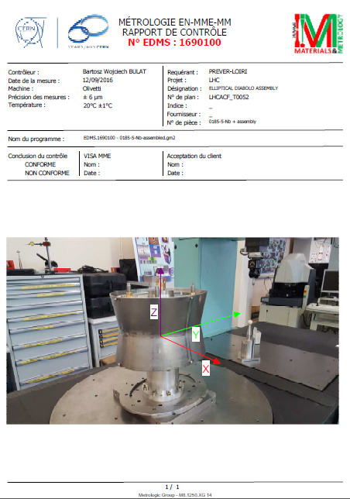
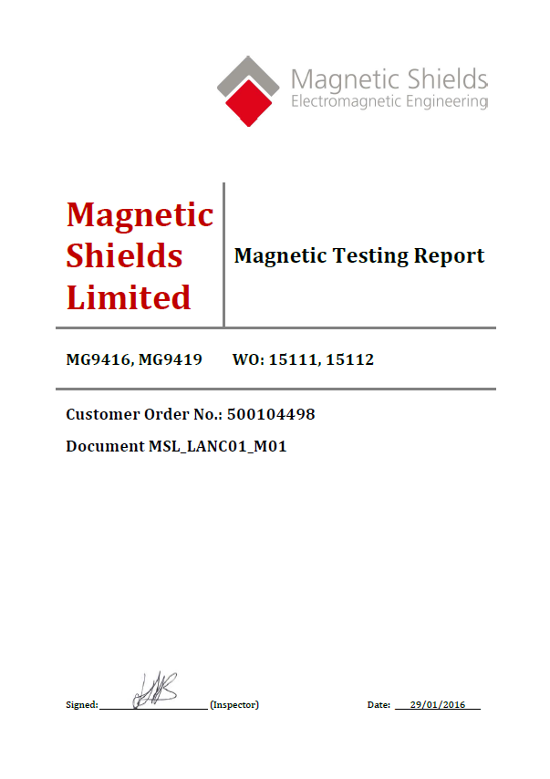
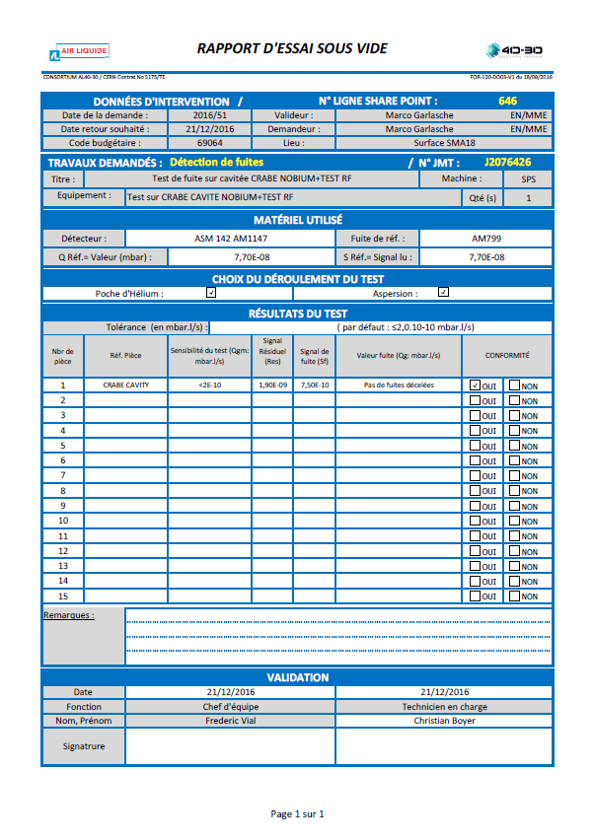
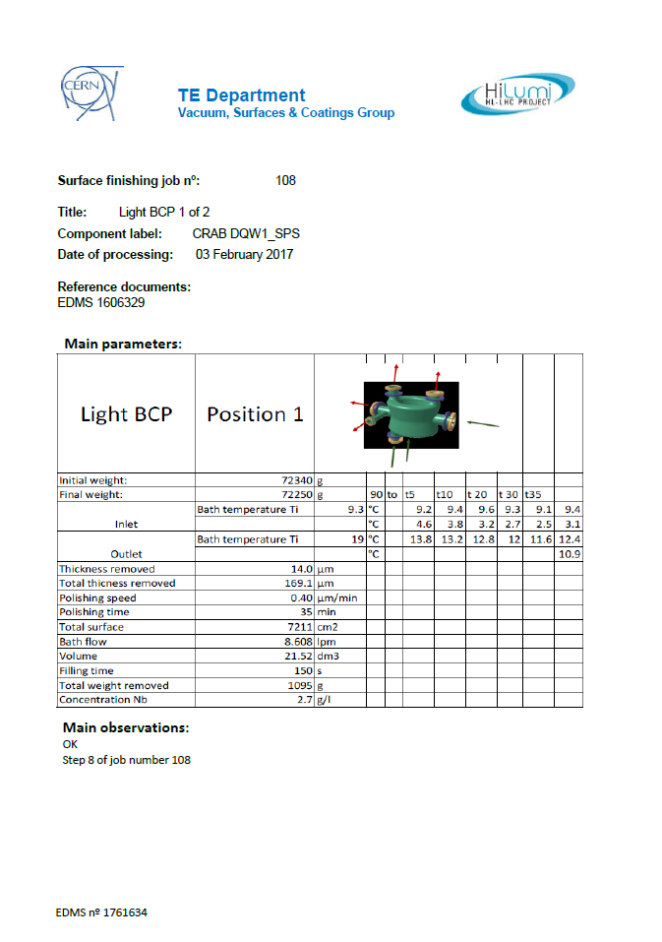
Key Documents of CC
Document issued by Paula Freijedo Menendez
Welding document (one of the big challenges of the production) which contains all the welding information (parameters, sequence, programs and testing) during the fabrication of the CC.
All manufacturing data obtained during the production of WP4 components (everything in MTF).

Slide 17
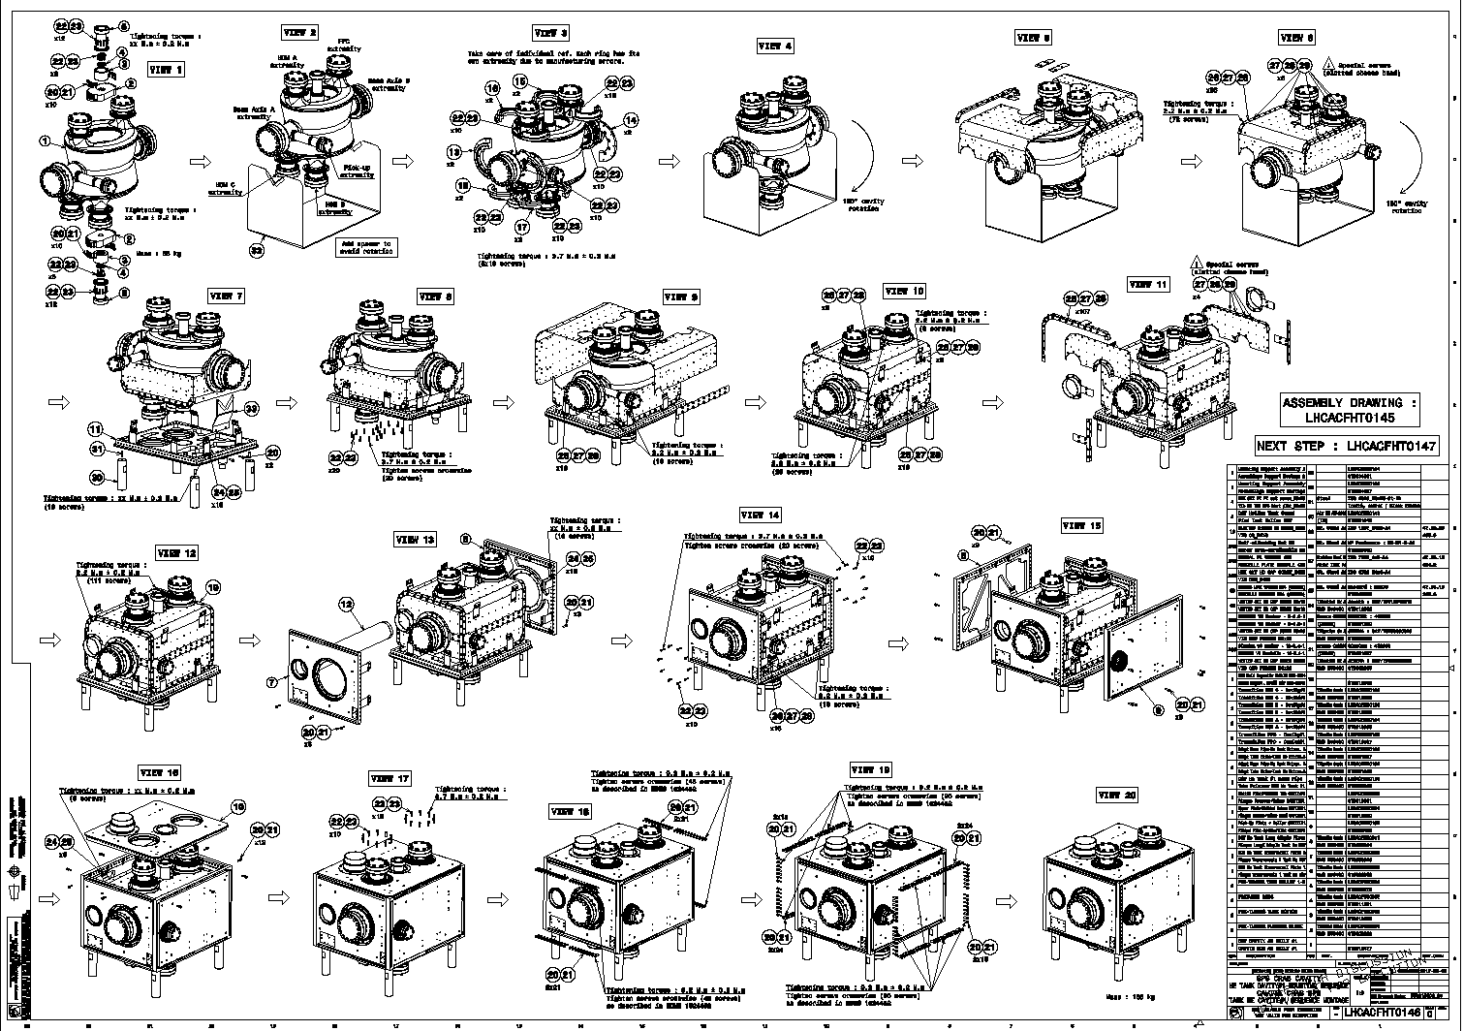
Key Documents of CC
DRAWINGS ISSUED BY EN-MME-EDM TO SUPPORT AND FACILITATE THE ASSEMBLY OF COMPONENTS – GREAT HELP!!!!
Drawing courtesy of Raphael Leuxe & Laurene Giordanino

Slide 18
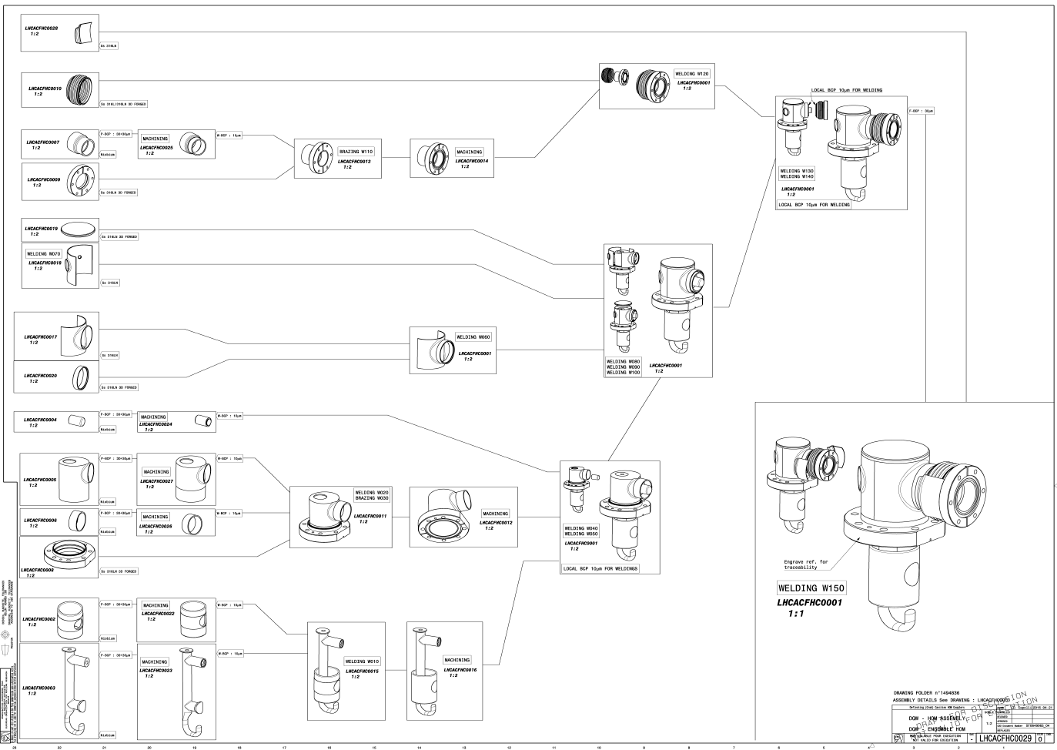
Key Documents of CC
DRAWINGS ISSUED BY EN-MME-EDM TO SUPPORT AND FACILITATE THE ASSEMBLY OF COMPONENTS – GREAT HELP!!!!
Drawing courtesy of Teddy Capelli

Slide 19
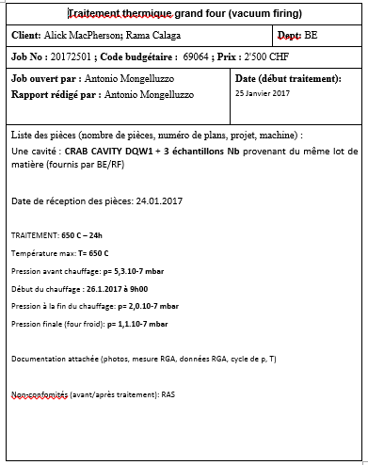
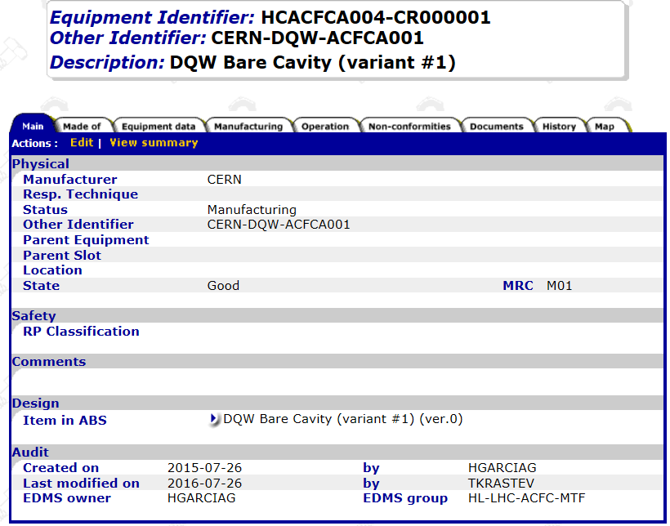
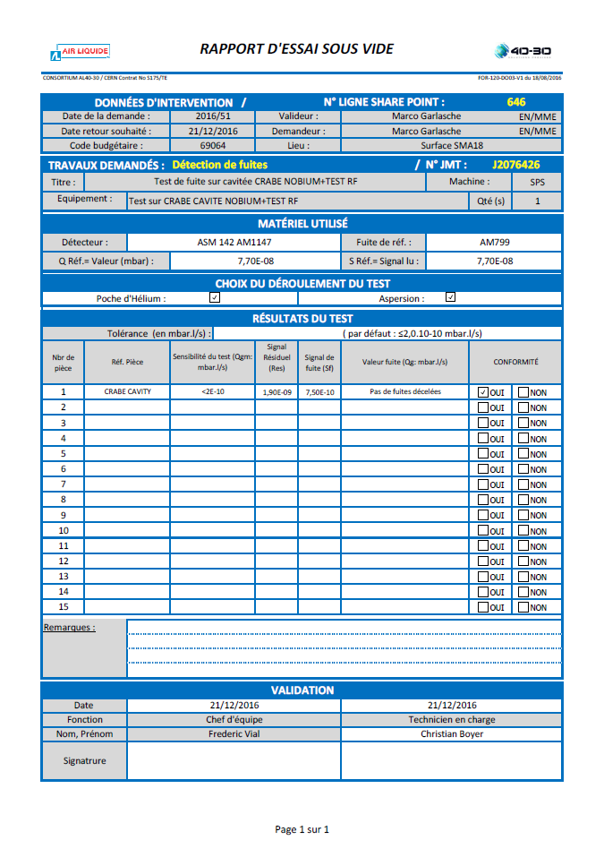
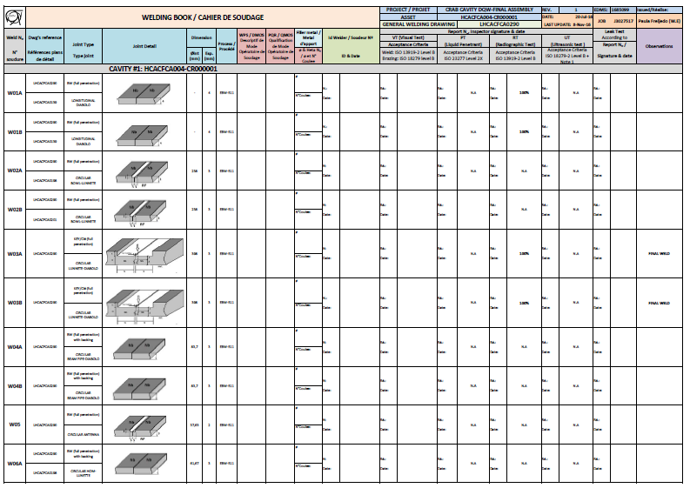
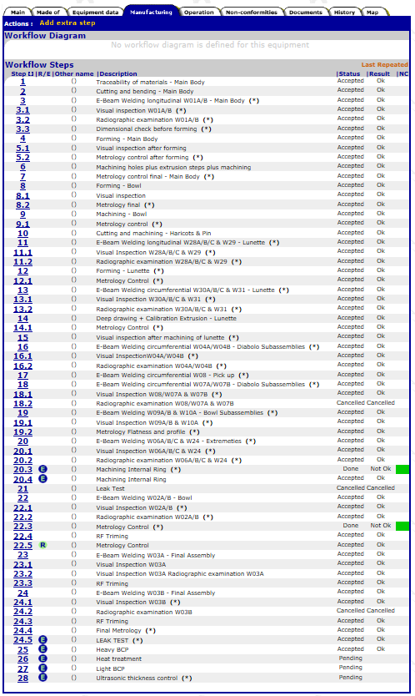
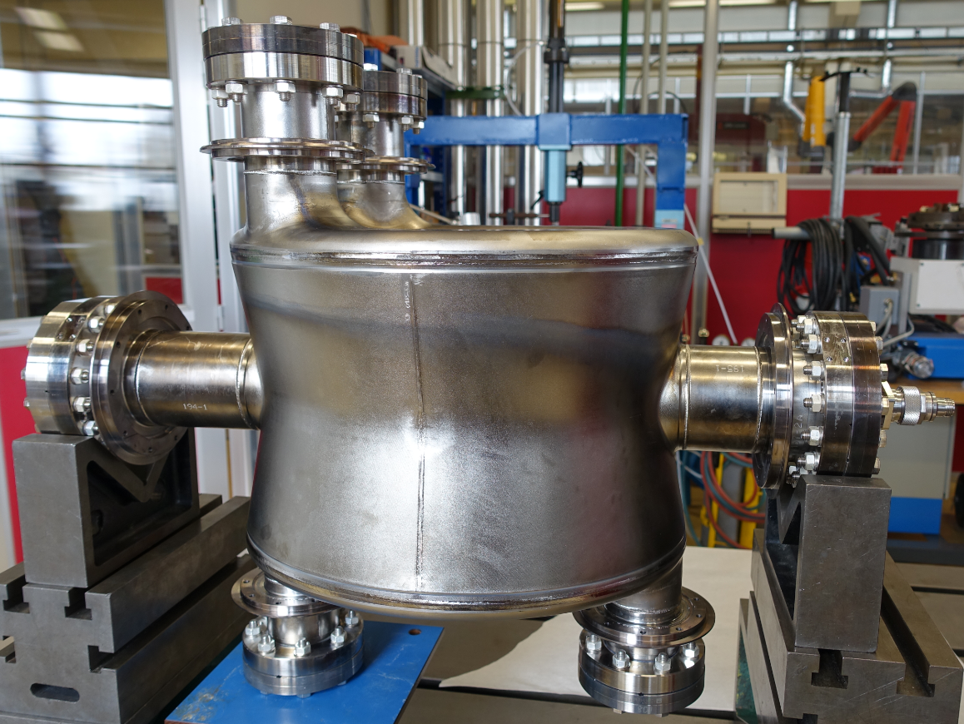
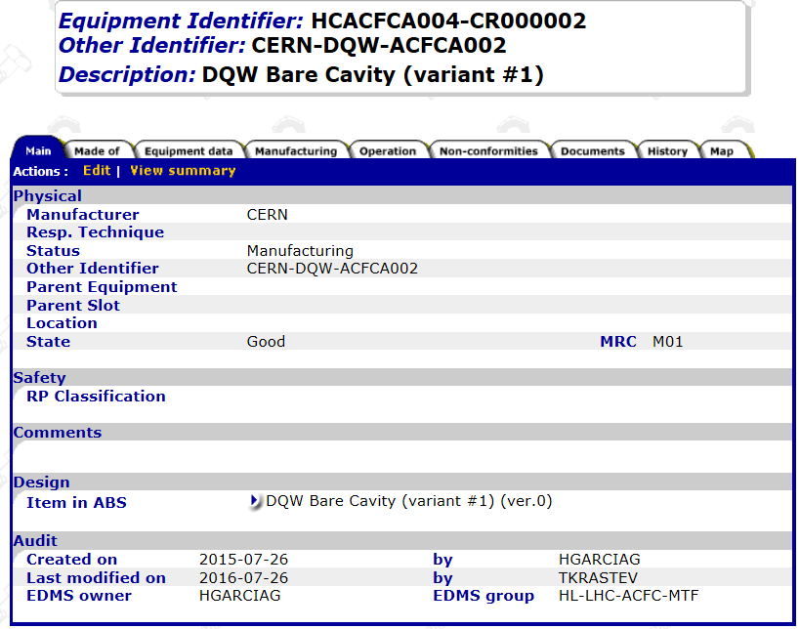
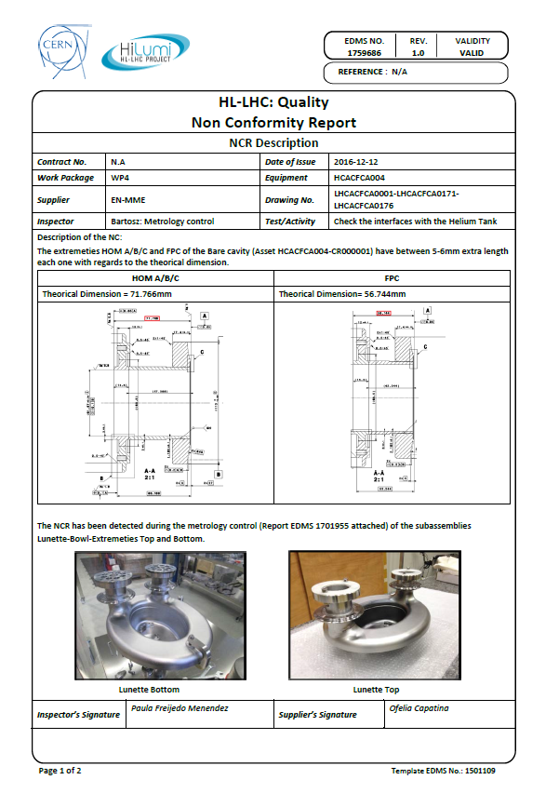
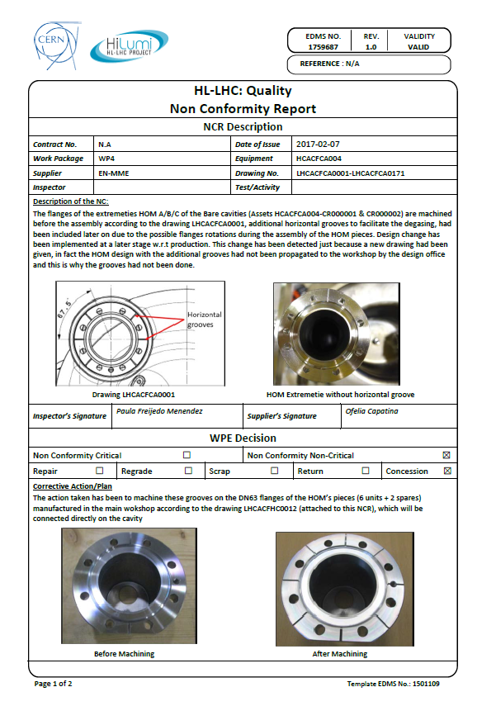
MTF for the CC components
DQW Bare Cavities
Not only all Manufacturing Records….
….but also the NCRs found

Slide 20
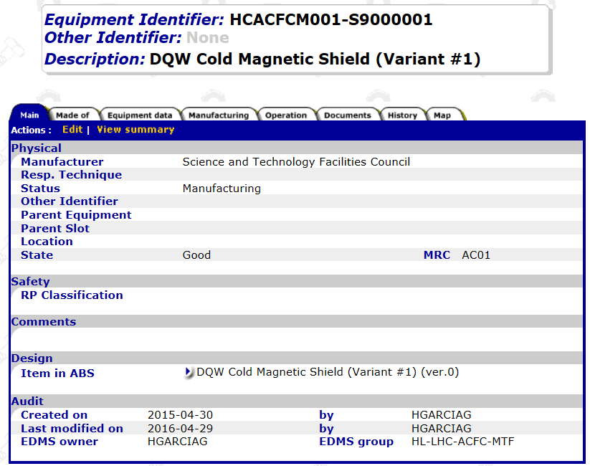
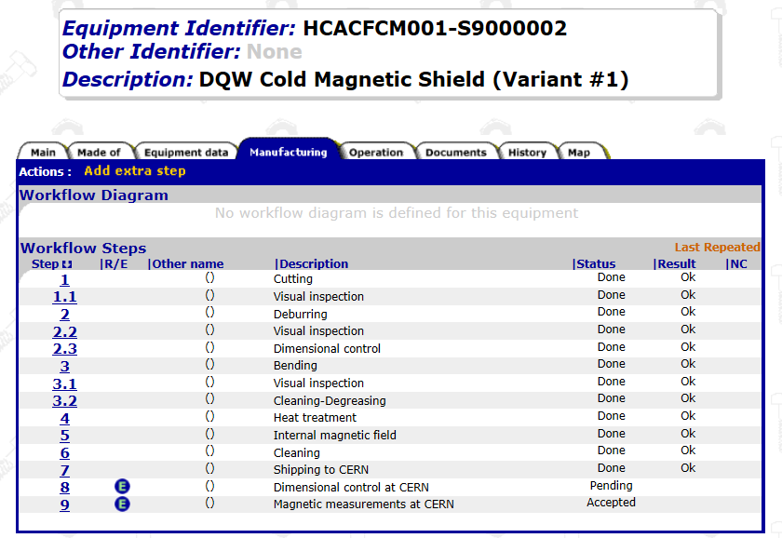
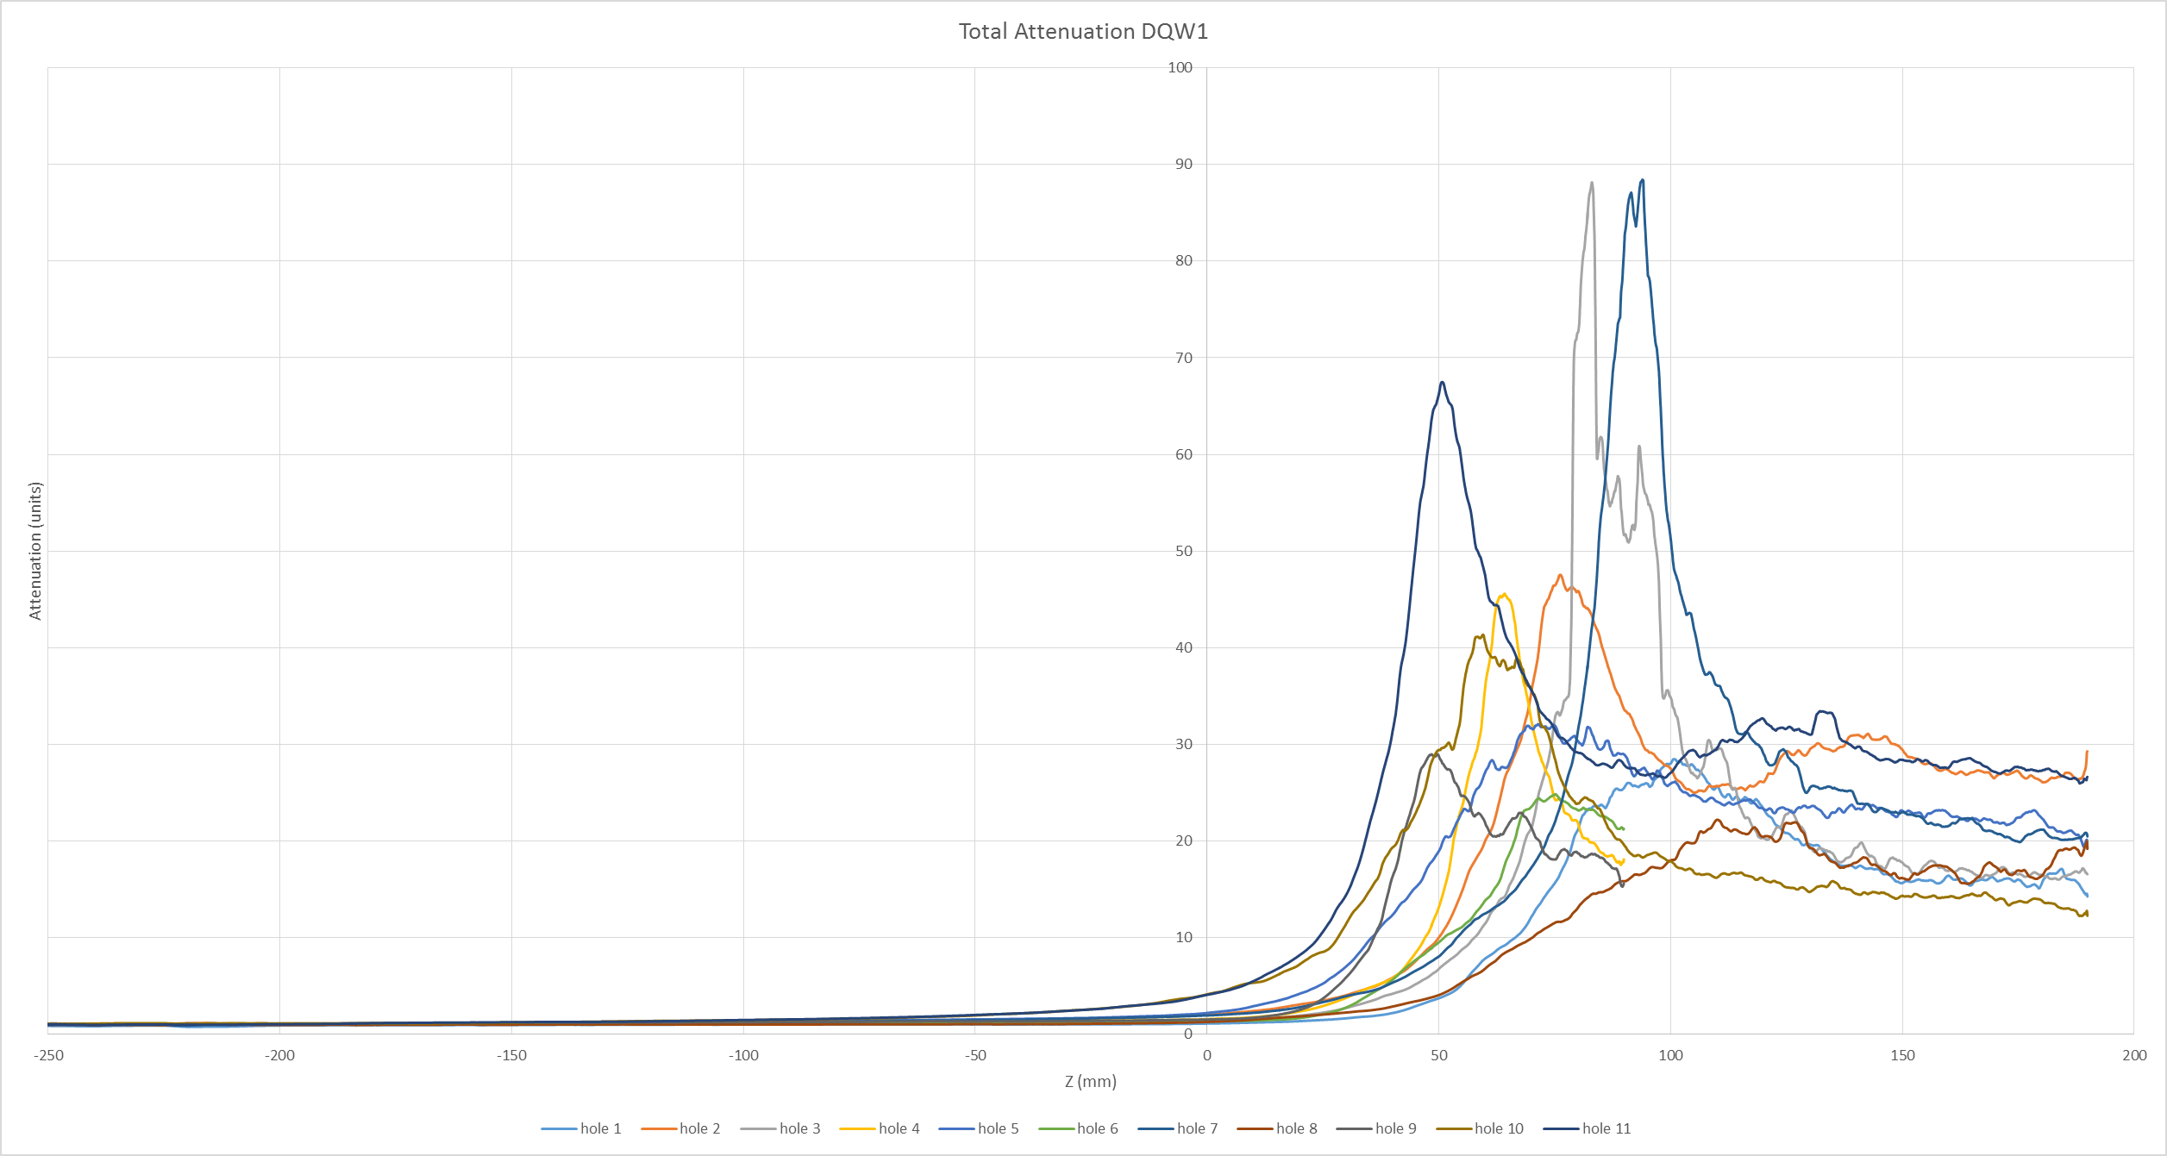
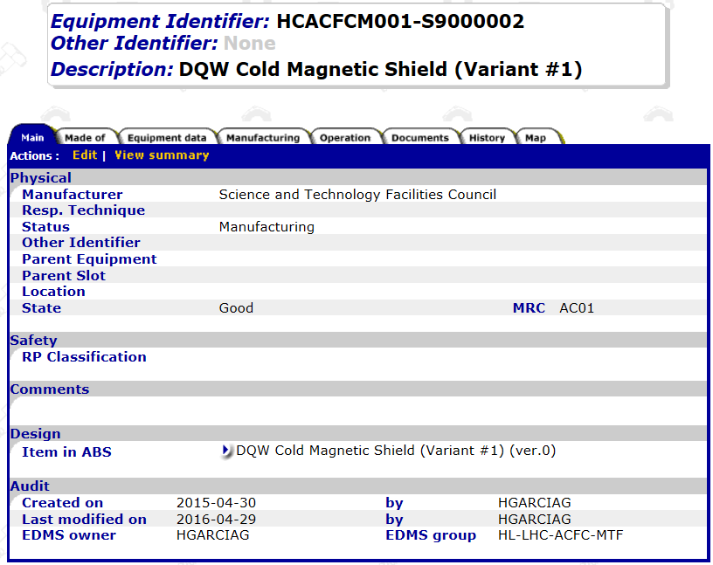
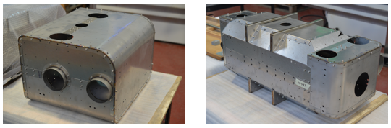
MTF for the CC components
Cold Magnetic Shields

Slide 21
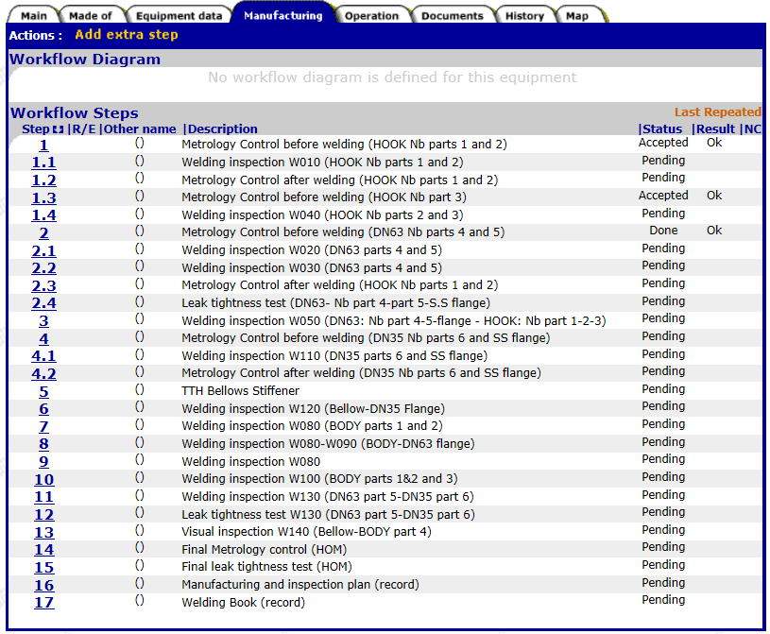
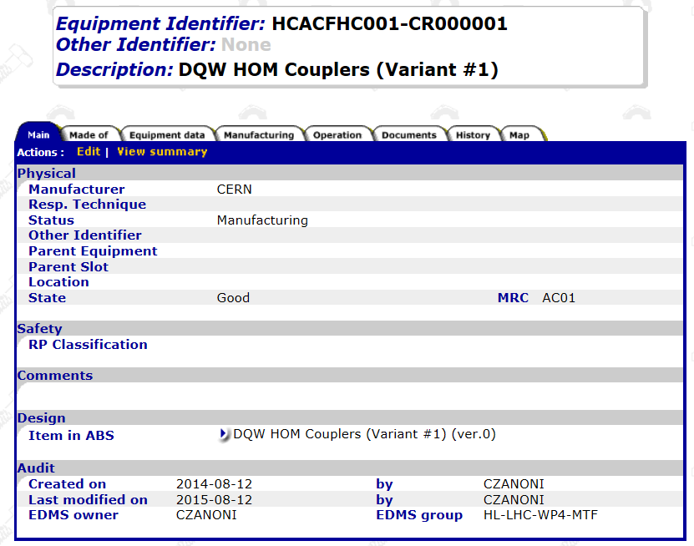
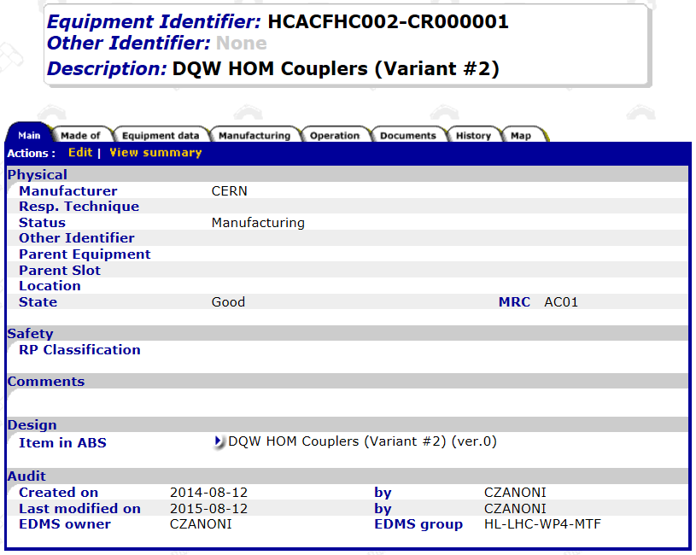
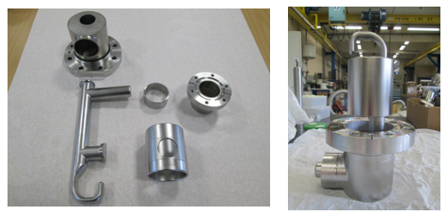
MTF for the CC components
HOMs (ongoing)

Slide 22
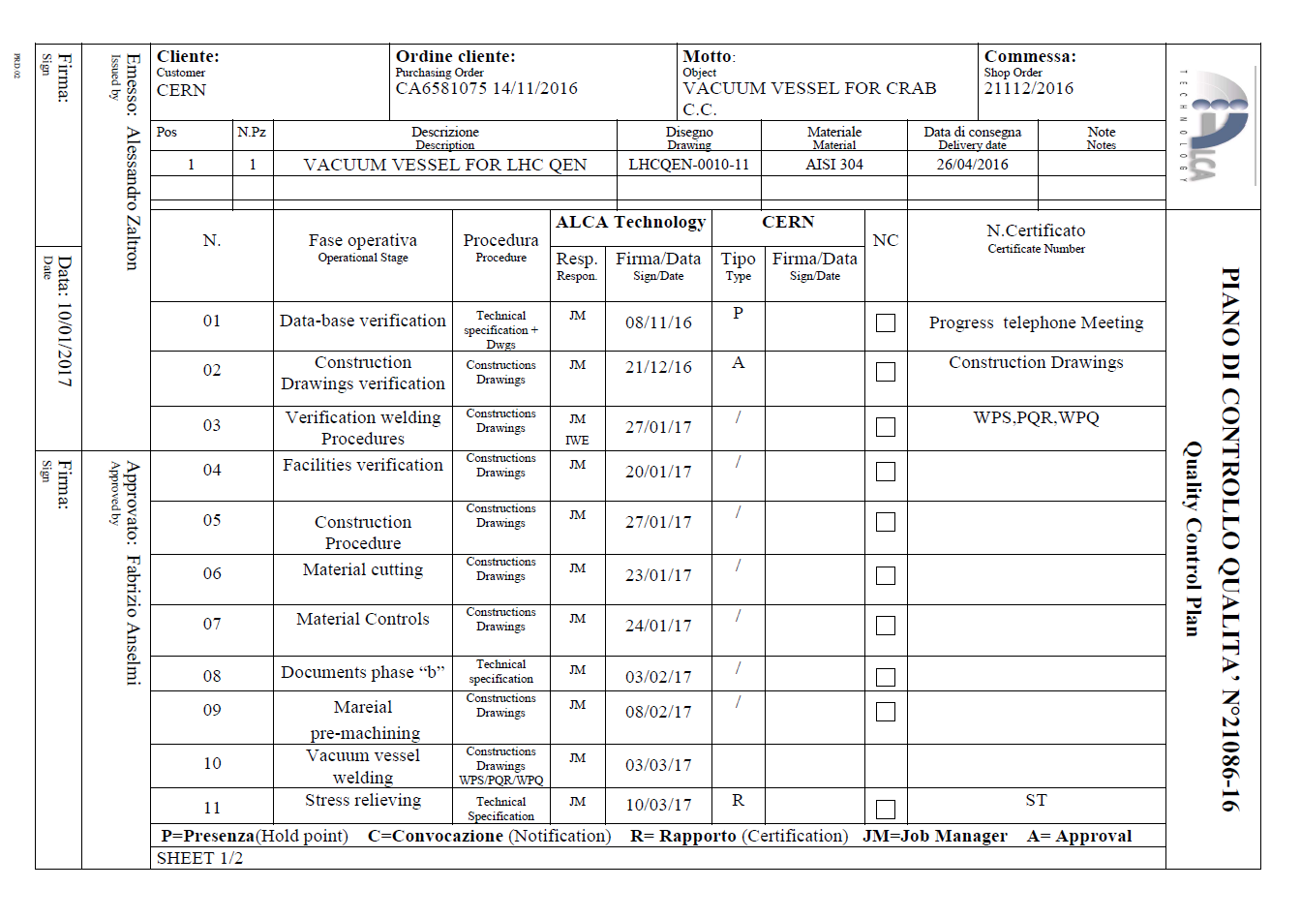
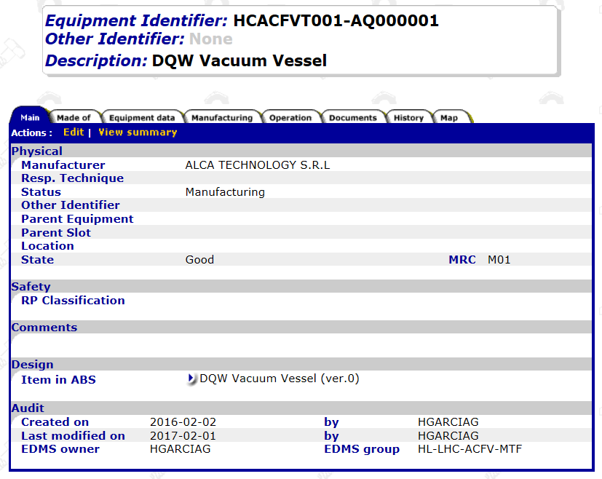
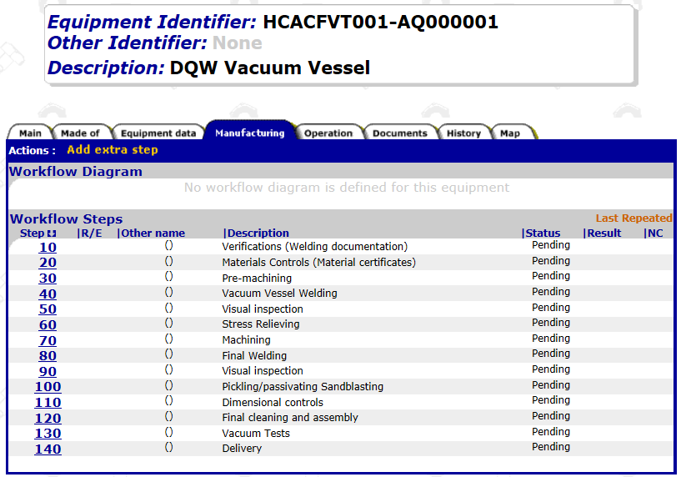
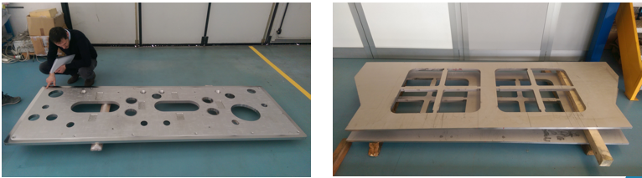
MTF for the CC components
Vacuum Vessel (in the industry)

Slide 23


… and for the future components
All the other components will be created in MTF in the upcoming months (Pick-ups, He Tanks, shields, cryo and RF lines…)

Slide 24
Next steps
LHC components procurement in the pipeline (already DRs launched for dressed cavities). SPS is a key milestone but not the end point
Same approach followed for SPS
Industries will be in charge of issuing the documentation and using the different tools (EDMS/MTF). Special contexts will be required
High level of monitoring and following up (several contracts to be launched)

Slide 25
Support from WP1

Slide 26
Key elements
Correct use of HL-LHC tools available (CDD, EDMS, MTF, Sharepoint) for handling, sharing, approving and storing documentation
Good practices from the different collaborations (large WP with collaborations around the world)
Great commitment from all people involved (from different departments, different groups/sections of same one…)
  All Drawings available in CDD
  More than 1000 thousand documents in EDMS
  Assets created (or in process) for all the components with their manufacturing data

Slide 27
Summing up
WP4 great example of how to meet the QA/QC requirements for HL-LHC project
Great effort from all the people involved (documentation, traceability, etc.)
Same approach and commitment to continue for the LHC production
Support from PO to the American Collaboration for the LHC RFD Dressed Cavities
Challenges ahead:
  Commitment of the industries to meet HL requirements
  Monitoring of the QA/QC performance of contractors

Slide 28
Thanks to all those that contributed to make this possible!

