Slide 1






RFD Experience for SPS and
Evolution to LHC
Subashini De Silva
Center for Accelerator Science
Old Dominion University
International Review of the Crab Cavity Performance for HiLumi
CERN – April 3-5, 2017

Slide 2
Content
RF-Dipole (RFD) Cavity Designs
  Proof-of-principle (PoP) Design (ODU)
  SPS Design (ODU/SLAC)
SPS-RFD Cavity Performance
  Cavity Processing Plan
  RF Test Results
SPS-RFD Cavity Lessons Learned
Recommendations and Evolution to LHC-RFD Cavity Design
  RF Design Modifications
  Engineering Design Modifications

Slide 3
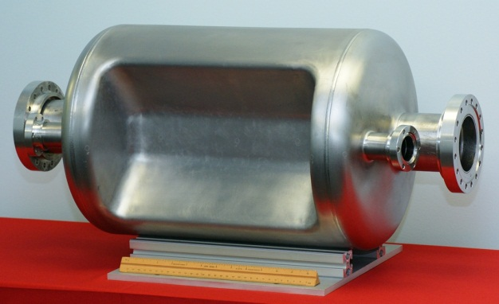
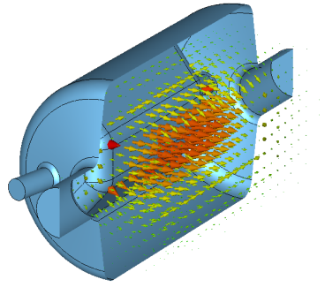
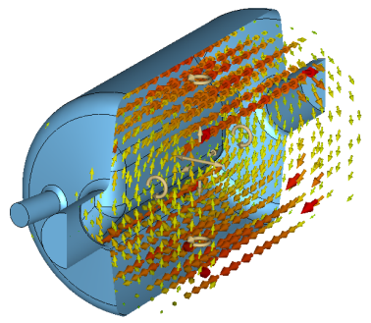
PoP-RFD Cavity: Design
PoP-RFDCavity – 2010-2012
Operates in TE₁₁-like mode
  Cylindrical shaped design
Fabricated by Niowave Inc. and tested at Jefferson Lab
Frequency | 400.0 | MHz
Aperture | 84 | mm
Nearest HOM | 590 | MHz
E_{p}* | 4.02 | MV/m
B_{p}* | 7.06 | mT
[R/Q]_{t} | 287 | Ω
Geometrical Factor (G) | 120 | Ω
R_{t}R_{s} | 3.4×10⁴ | Ω²
At E_{t}* = 1.0 MV/m
V_{t} | 3.4 | MV
E_{p} | 36.5 | MV/m
B_{p} | 64 | mT
34 cm
53 cm
E Field
B Field

Slide 4
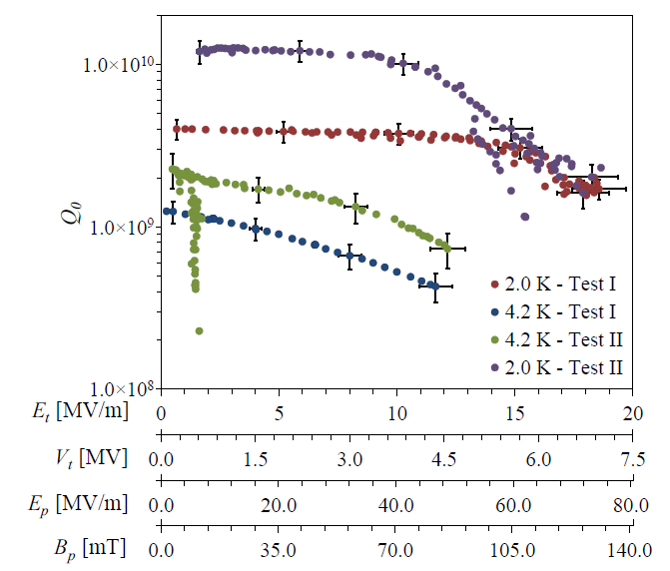
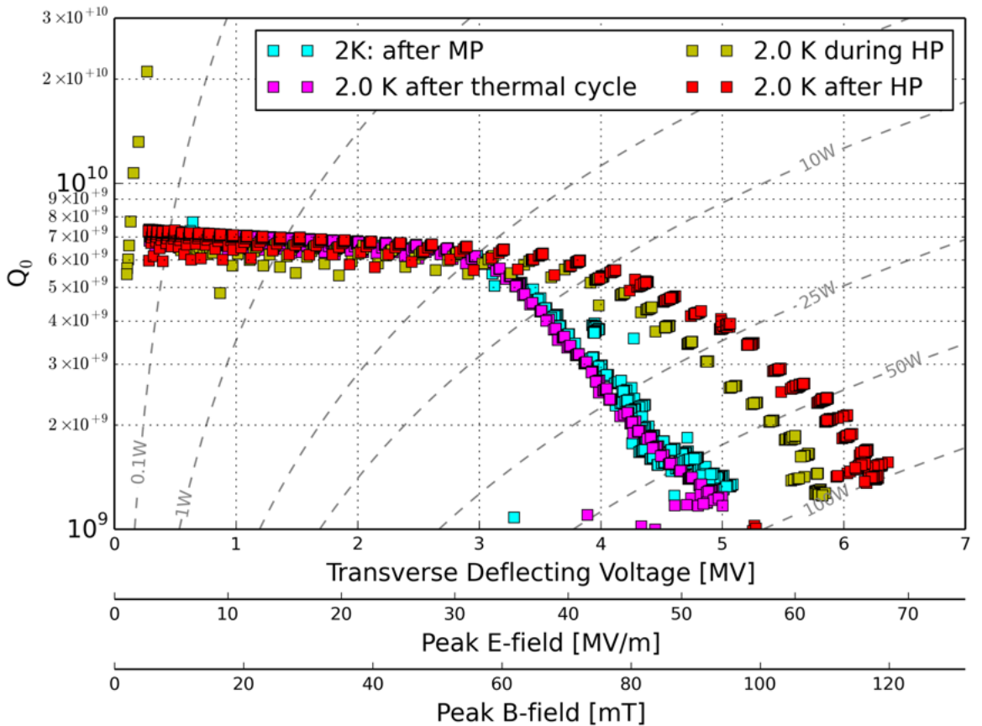
PoP-RFD Cavity: Performance Results
Processing and rf testing done at Jefferson Lab
RF tests
  Test I – Jefferson Lab – April, 2012
  Test II – Jefferson Lab – June, 2014
  Test III – CERN – October, 2014
Cavity reached a V_{t} of 7.0 MV
Processed multipacting easily and did not reoccur
Test II and III → Cavity was retested with Nb coated blank flanges at beam ports, provided by CERN
  Q₀ increased by a factor of 3 from 4×10⁹ to 1.2×10¹⁰
  Reduced Q₀ at Test III (at CERN) due to inadequate magnetic shielding (30 mG)
JLab
CERN
3.4 MV
3.4

Slide 5
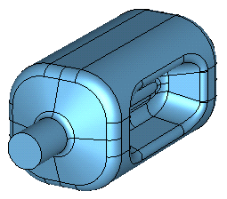
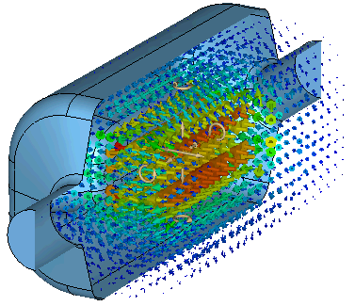
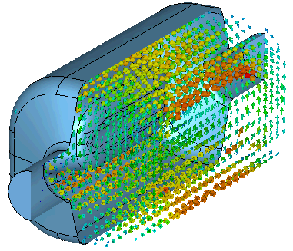
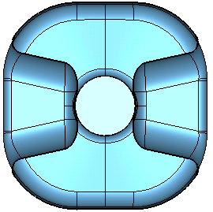
SPS-RFD Cavity: Design
Operates in TE₁₁ like mode
 | PoP | SPS
Frequency | 400 | 400.79 | MHz
Aperture | 84 |  | mm
Nearest HOM | 590 | 633.5 | MHz
E_{p}* | 4.02 | 3.6 | MV/m
B_{p}* | 7.6 | 6.2 | mT
[R/Q]_{t} | 287 | 429.7 | Ω
Geometrical Factor (G) | 120 | 106.7 | Ω
R_{t}R_{s} | 3.4×10⁴ | 4.6×10⁴ | Ω²
At E_{t}* = 1.0 MV/m
V_{t} | 3.4 | 3.4 | MV
E_{p} | 36.5 | 33 | MV/m
B_{p} | 64 | 56 | mT
E Field
Next HOM is 1.5 times fundamental mode
Lower surface fields compared to PoP cavity
Higher shunt impedance
Improved multipacting
Reduced multipoles components with curved poles
H Field
281 mm
194 mm
SPS-RFD Cavity for
Crabbing in horizontal plane
281 mm

Slide 6
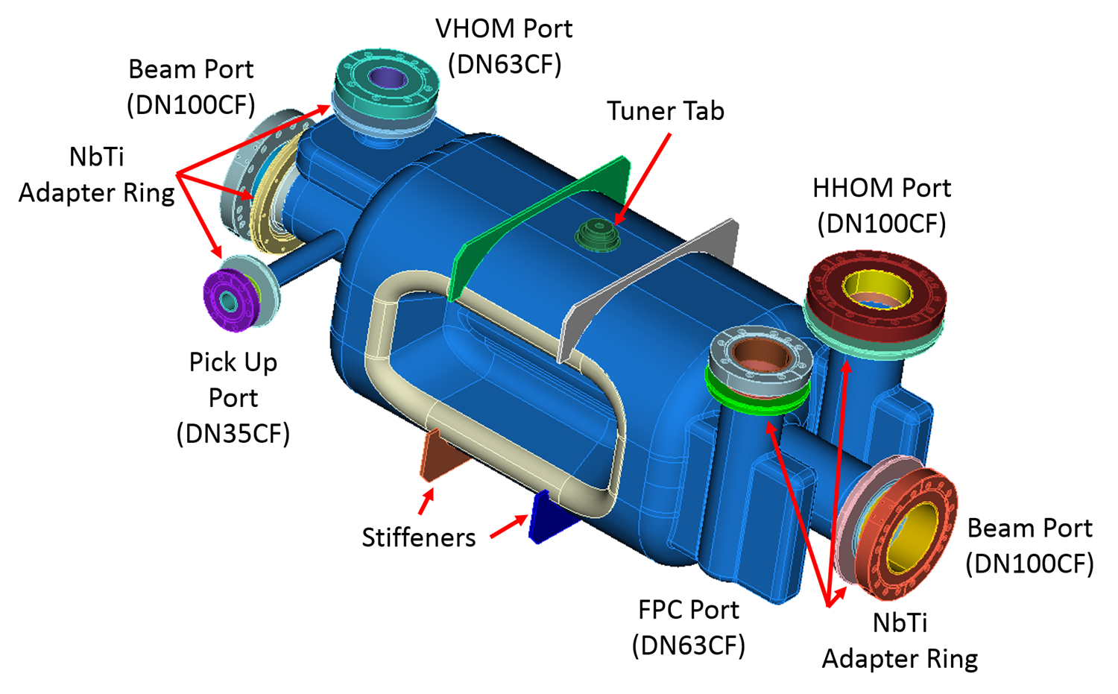
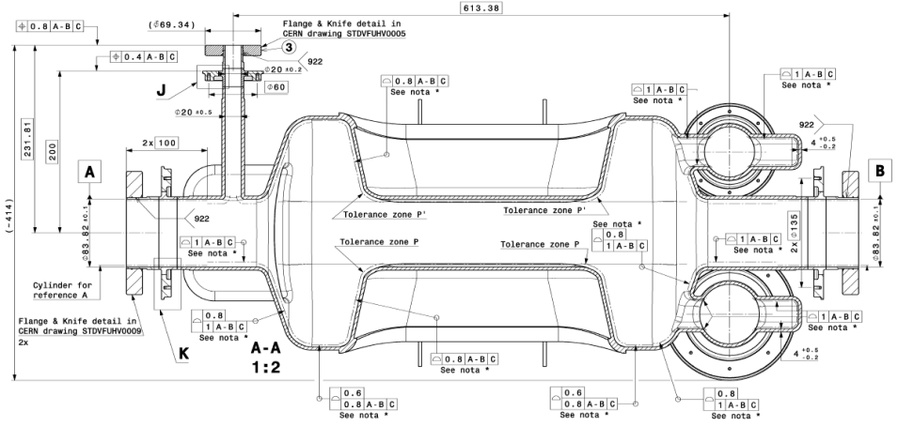
Final SPS-RFD Cavity
SPS-RFD Specifications Drawing - CERN
Electromagnetic and mechanical design completed by ODU/SLAC team
Interfaces to Helium vessel completed by CERN
Fully integrated design:
  Includes FPC and HOM couplers
  Reinforcements to reduce pressure sensitivity and Lorentz detuning due to radiation pressure
  Tuner interfaces

Slide 7
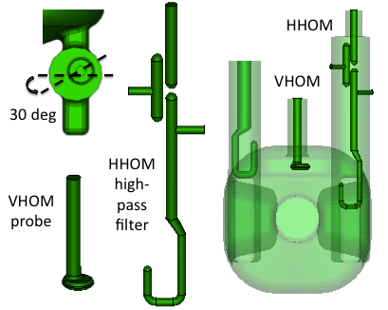
FPC and HOM Couplers for SPS-RFD Cavity
Couplers are at locations of low field region on cavity body
  Minimizes RF heating on the coupler components
  Location preserves the field symmetry
Two HOM couplers (HHOM and VHOM)
  HHOM → High pass filter
  VHOM → Simple coax coupler
Z_{L} < 50 kΩ per cavity and Z_{T} < 1 MΩ/m per cavity except for two HOMs near 2.0 GHz
Hook shaped FPC coupler → Q_{L} = 5.0×10⁵
Reduced rf heating at hook (69 W)

Slide 8
SPS-RFD Cavity: Processing Path
Reprocessing
steps for
RFD-CAV-001/002

Slide 9
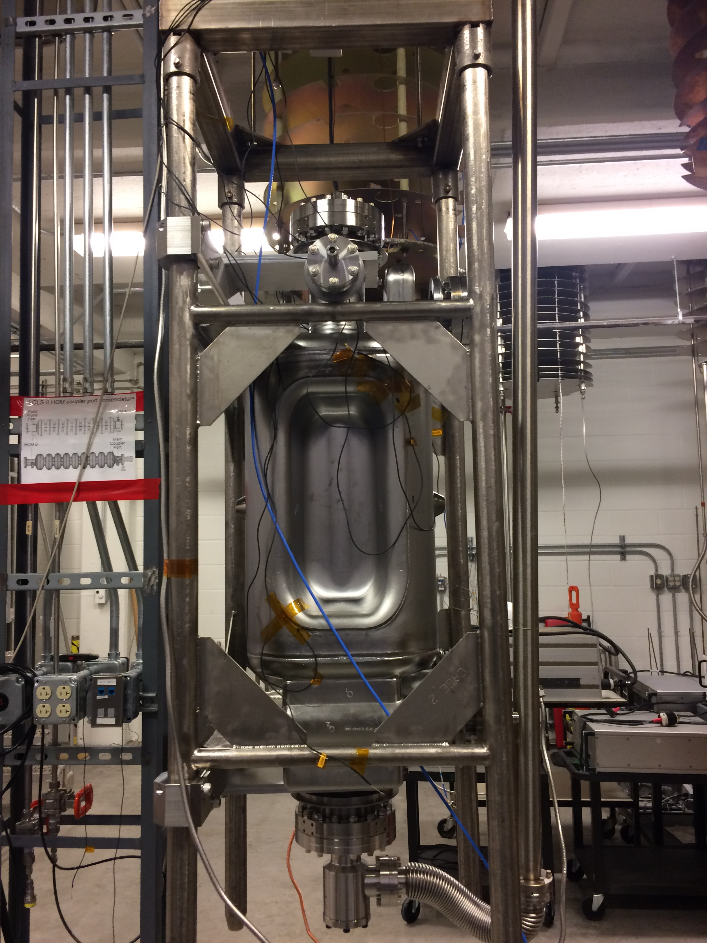
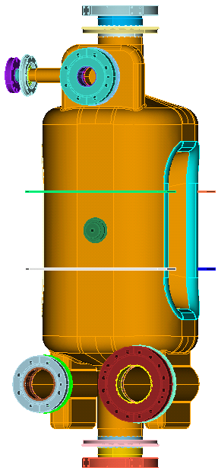
SPS-RFD Cavity: RF Test Preparation
Accommodate both tests without and with HOM couplers
Measured Q_{ext}
  Input probe → Q_{ext} ~ 5×10⁹
  Pick Up probe → Q_{ext} ~ 2×10¹¹
VHOM and HHOM ports are blanked
  HHOM blanked with a Nb coated flange
Safety valve
Pick Up Port
Q_{ext} ~ 2×10¹¹
(B)
Total losses expected 12 mW at 3.4 MV
- Losses at SS flanges (σ = 6.99×10⁶ S/m)
(F)
(E)
 | Port | Power Loss [W]* | Q
(A) | Beam Port (HHOM) | 3.0×10⁻⁴ | 9.5×10¹³
(B) | Beam Port (VHOM) | 3.1×10⁻³ | 9.3×10¹²
(C) | FPC Port | 6.7×10⁻⁴ | 4.4×10¹³
(D) | HHOM Port | 7.5×10⁻³ | 3.9×10¹²
(E) | VHOM Port | 3.5×10⁻⁸ | 8.3×10¹⁷
(F) | Pick Up Port | 2.0×10⁻¹⁷ | 1.5×10²⁷
(C)
(D)
* At 3.4 MV
FPC Port
Q_{ext} ~ 5×10⁹
(A)

Slide 10
SPS-RFD Cavity: Performance
At low fields for both rf tests Q₀ is > 1.0×10¹⁰
Multipacting was processed easily and didn’t reoccur
No field emission observed during Test 2
At 2.0 K | Test 1 | Test 2
Max V_{t} [MV] | 4.0 MV | 4.4 MV
E_{p} [MV/m] | 38 | 42
B_{p} [mT] | 66 | 73
Q₀ at 3.4 MV | 5.5×10⁹ | 8.5×10⁹
P_{diss} ar 3.4 MV [W] | 4.9 | 3.2

Slide 11
SPS-RFD Cavity: More Measurements
Lorentz detuning
  Simulated → -122 Hz/(MV/m)²
  Measured –> -112 Hz/(MV/m)²
Pressure sensitivity
  Simulated → -80 Hz/torr
  Measured → -56 Hz/torr
Good agreement with simulations

Slide 12
SPS-RFD Cavity: Frequency Recipe
Step (Recipe for 20 C, 50 % and 1013.25 mbar) | Δf [kHz] | f_{n} [MHz]
Cavity after trimming and thinning |  | 399.840296
Shift due to bulk BCP (140 microns) | -39.441
Cavity after bulk BCP |  | 399.800855
Weld shrinkage | 115.645
Weld bead | 5.000
Cavity after final weld |  | 399.921500
Shift due to light BCP (20 microns) | -5.762
Cavity after light BCP |  | 399.915738
Shift due to mounted couplers | 4.906
Fully assembled cavity with HOM couplers |  | 399.920644
Pressure effect (760 torr differential) | -60.800
Dielectric effect air to vacuum | 130.341
Evacuated cavity at 20 C |  | 399.990185
Thermal shrinkage | 572.877
Cooled down cavity at 4.2 K |  | 400.563062
Shift due to change in skin depth | 28.000
Pressure from 760 torr to 23 torr in He tank | 58.960
Cooled down cavity at 2.0 K |  | 400.650022
Shift due to tuner activation to its mid range | 150.000
Cavity with tuner activated |  | 400.800022
Lorentz detuning | -10.022
Operational cavity with RF on |  | 400.790000

Slide 13
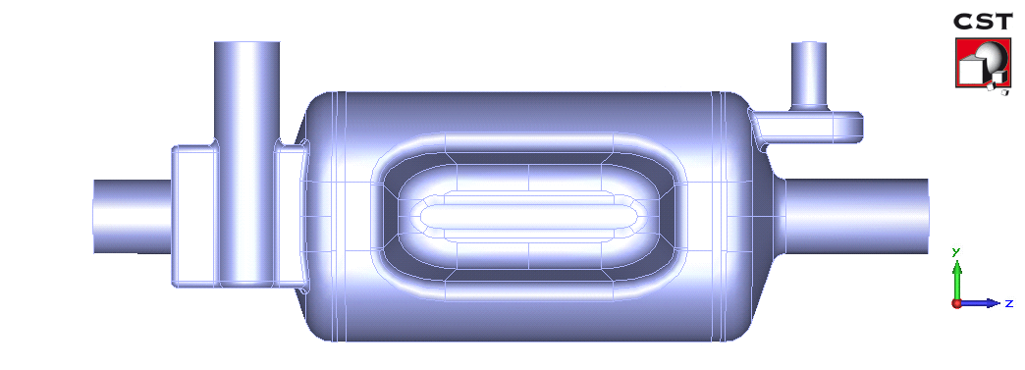
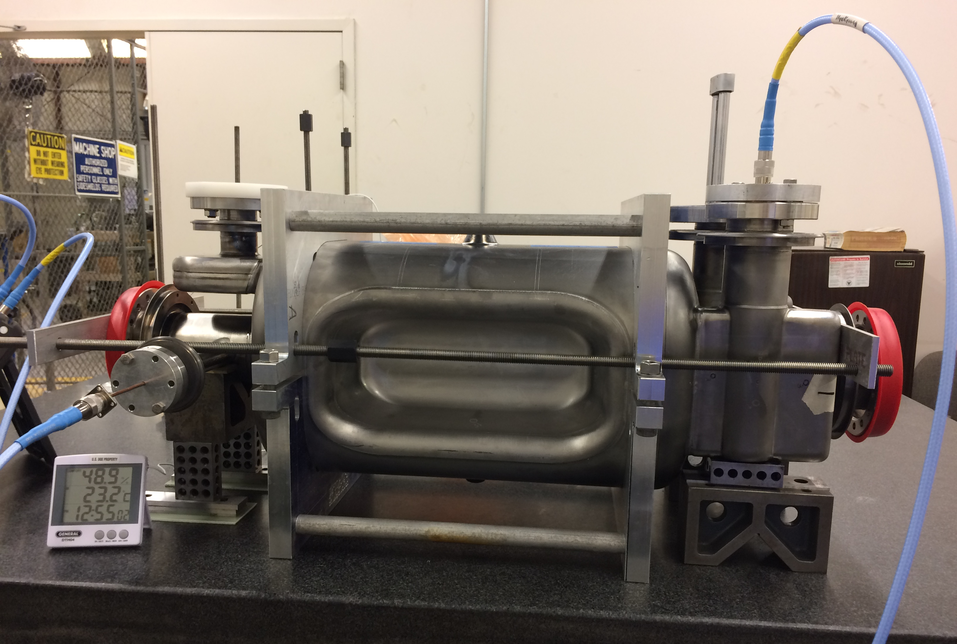
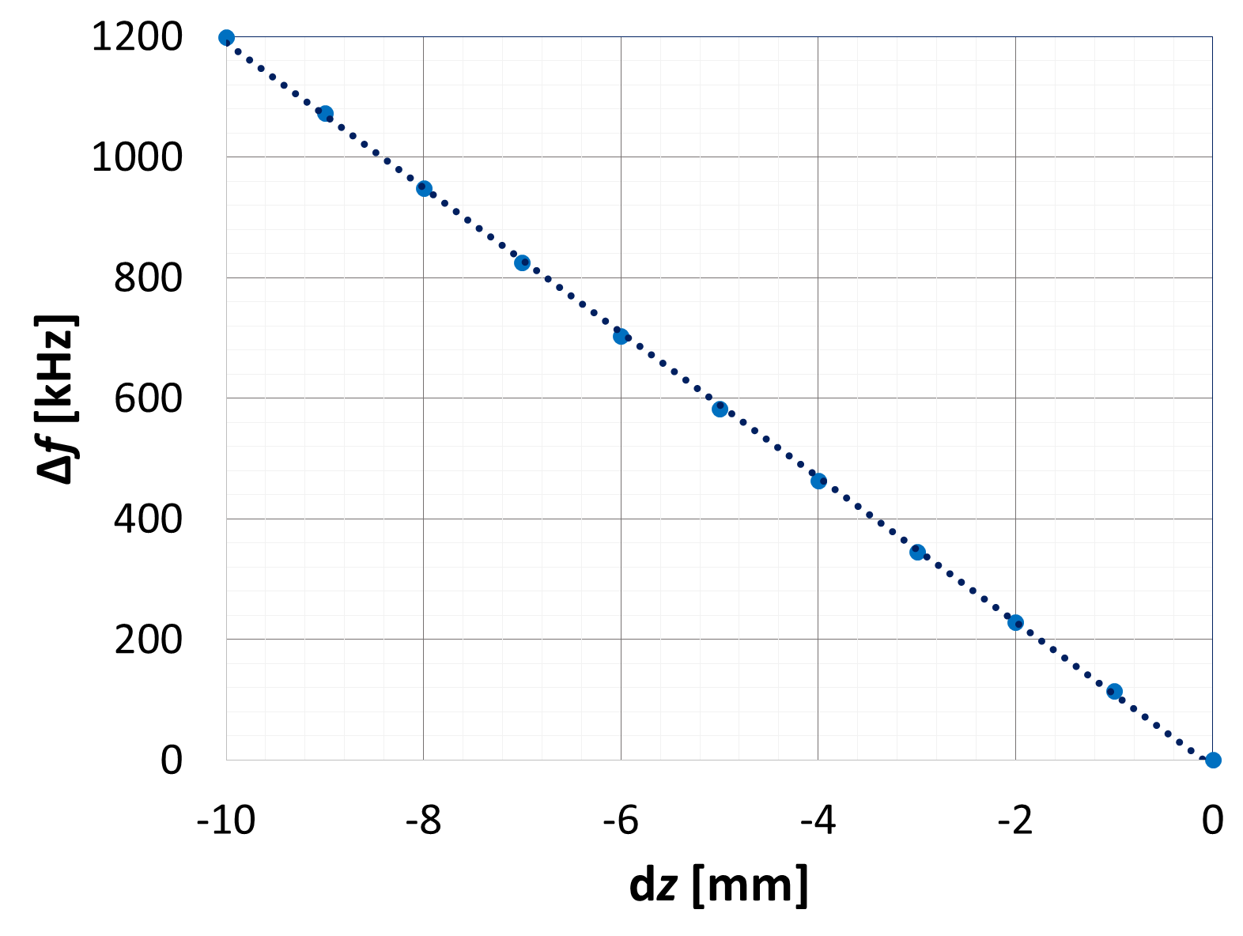
SPS-RFD Cavity: Trimming Sensitivity
Trimming sensitivity for RFD cavities
df/dz = -119.85 kHz/mm
Measured sensitivity:
  CAV001: -129.3 kHz/mm
  CAV002: -116.1 kHz/mm
dz/2
dz/2

Slide 14
SPS-RFD Cavity: Frequency Measurements
Frequency shifts are in agreement between simulation and measurements
Step (Recipe for 20 C, 50 % and 1013.25 mbar) |  | Simulated |  | Measured
 |  | Δf [kHz] | f_{n} [MHz] | Δf [kHz] | f_{n} [MHz]
Cavity after trimming and thinning |  |  | 399.840296 |  | 399.846841
Shift due to bulk BCP |  | -39.441 |  | -21.924
Cavity after bulk BCP |  |  |  |  | 399.824917
Shift due to frame |  |  |  | -765.648
Cavity after removing fixture |  |  | 399.800855 |  | 399.059269
Weld shrinkage and weld bead |  | 120.645 |  | 114.686
Cavity after final weld |  |  | 399.921500 |  | 399.173955
Shift due to heat treatment |  |  |  | -10.743
Cavity after heat treatment |  |  |  |  | 399.163212
Shift due to light BCP |  | -5.762 |  | -16.473
Cavity after light BCP |  |  | 399.915738 |  | 399.146739
Pressure effect (23 torr) | -1.84
Dielectric effect air to vacuum | 130.341
Thermal shrinkage | 572.877
Shift due to change in skin depth | 28.000
 |  | 729.378 |  | 755.615
Cooled down cavity at 2.0 K |  |  | 400.645116 |  | 399.902354
The unaccounted frequency shift was due to the use of the frame during some of measurements [400.645 – 399.902 = 743 kHz]

Slide 15
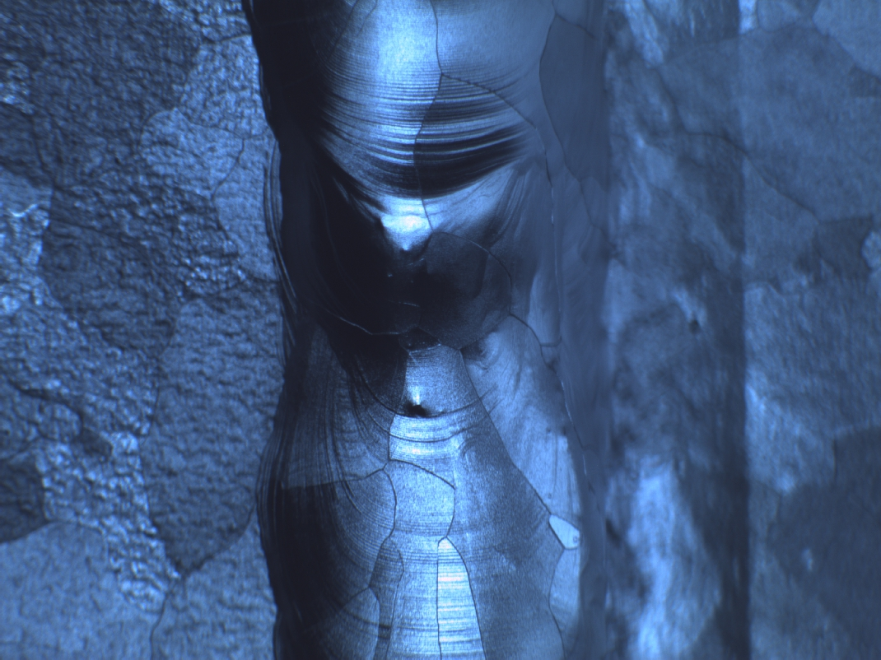
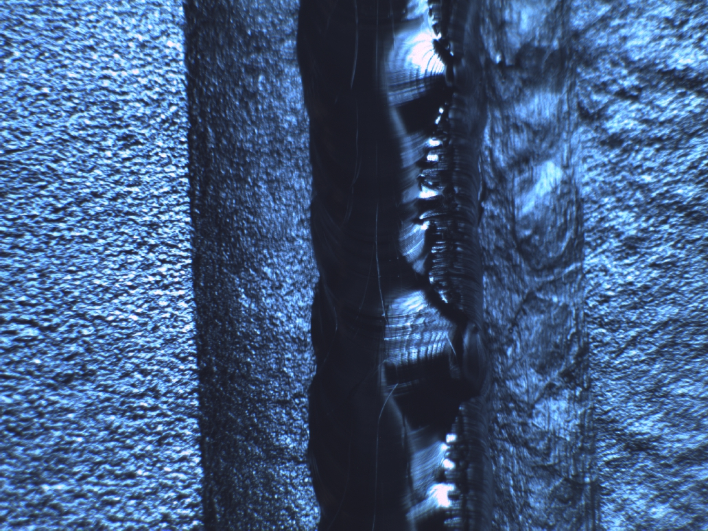
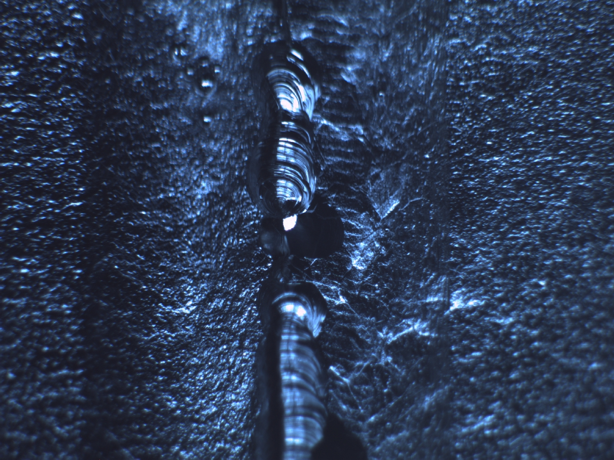
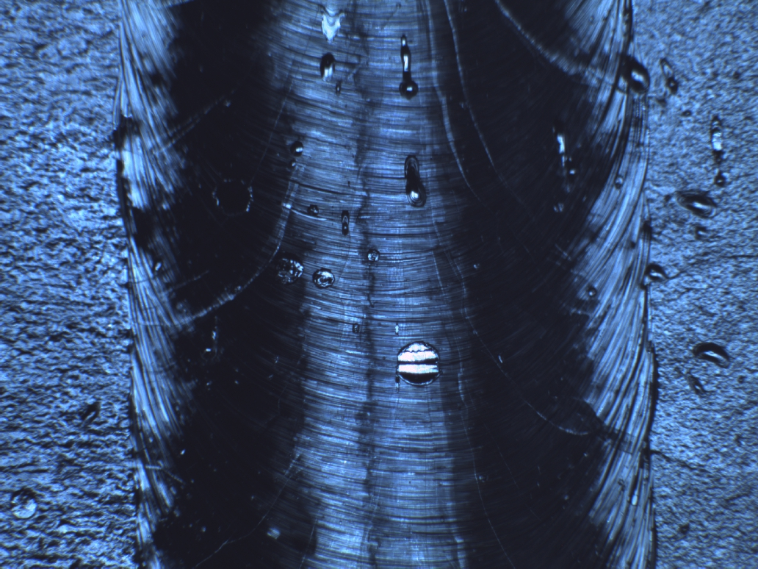
SPS-RFD Cavity: Lessons Learned
Bulk BCP on sub-assemblies provides no benefit
Bulk BCP of the two SPS-RFD cavities were done before final weld to control frequency shift due to processing
Due to quality of final welds additional bulk BCP was done on both RFD cavities
Frequency shift due to bulk BCP → 40 kHz (140 microns uniform removal)
RFD-001
Frequency shift is comparatively small → Not a critical parameter in frequency control
RFD-002
RFD-002
RFD-002

Slide 16
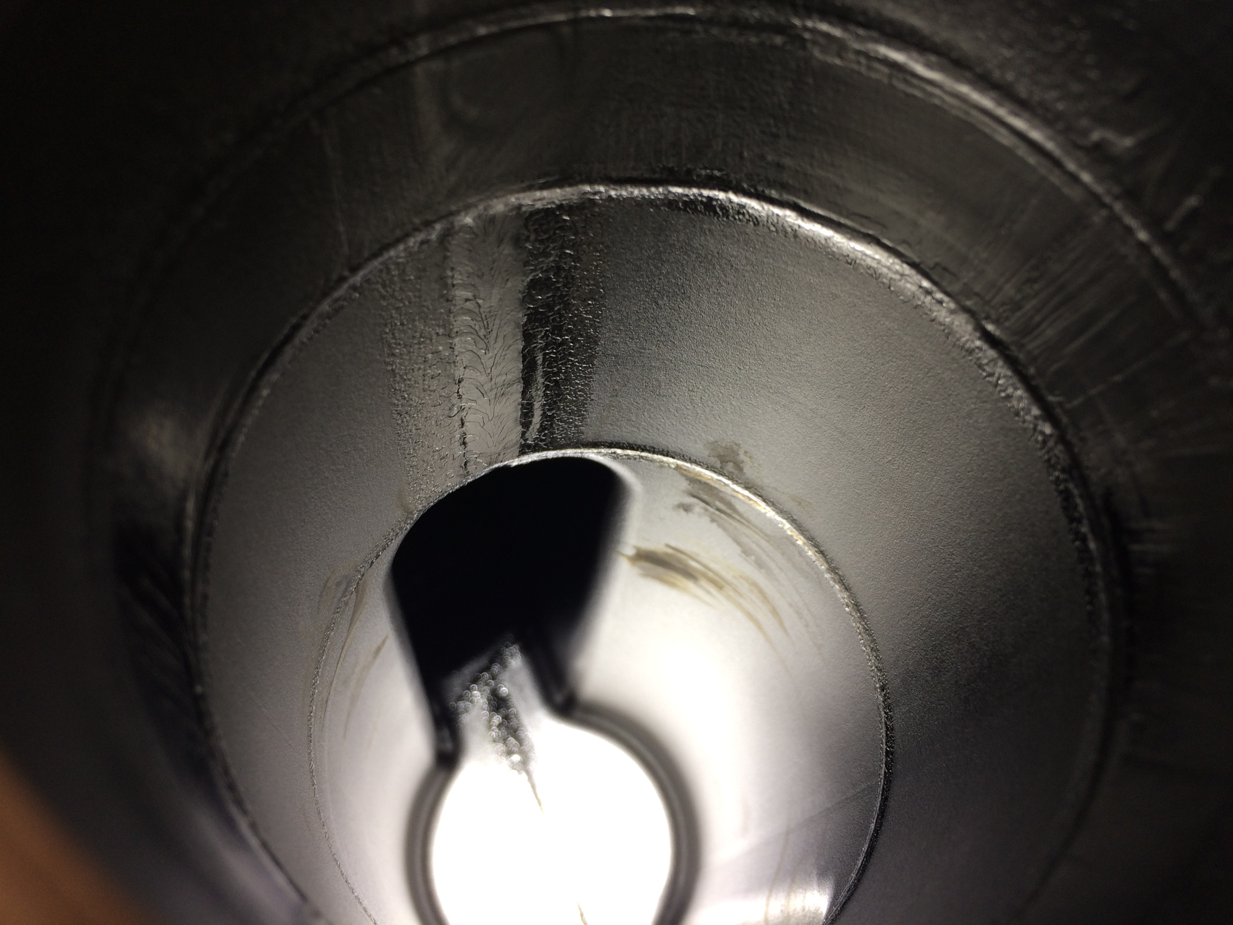
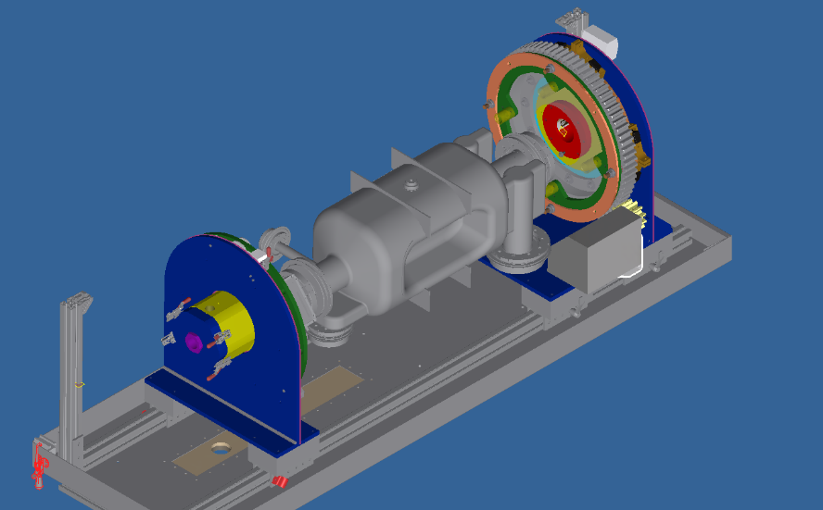
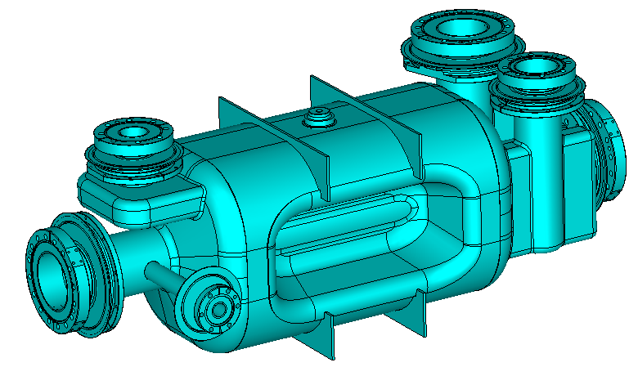
Recommendations for LHC-RFD: Cavity Processing
Currently bulk BCP, light BCP and HPR are done in vertical orientation
Recommendation → Perform chemical processing in horizontal orientation with rotation and tilting
  Allows more uniform removal
  Better acid circulation and drainage
Use of a high pressure rinse set-up using multiple ports e.g. MSU (Rinsing through FPC and HHOM ports)
  Allows minimizing field emission
Stains left from BCP
Horizontal BCP/EP tool – (ANL)

Slide 17
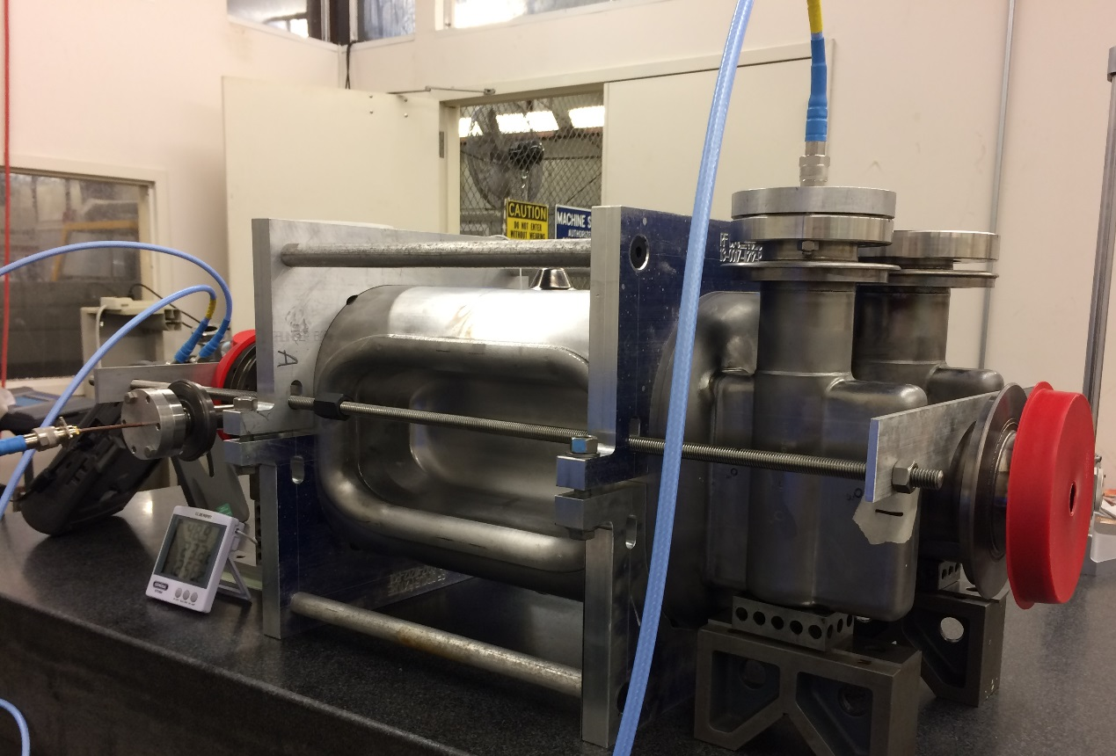
Recommendations for LHC-RFD: Warm Tuning
Warm tuning of RFD cavity to achieve target frequency → By pushing/pulling at the top and bottom surface of the center body
Experience from
  Fixing the center body of RFD-CAV-001
  Use of fixtures during trim tuning of sub assemblies
Profile held at the edge
Fixture on center body to match end profiles for trimming
Jack mechanism
Frequency shift with and without fixture = -0.77 MHz
Frequency shift after fixing center body = 1.84 MHz

Slide 18

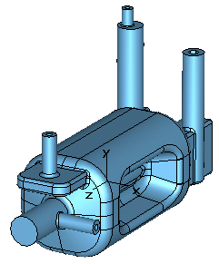
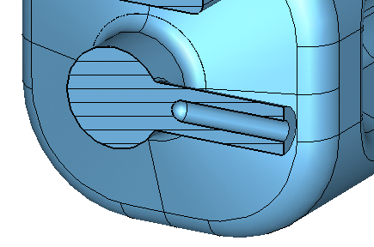
LHC-RFD Design: Modifications (1)
LHC-RFD design under US-HL-LHC-AUP
No major modifications are required for LHC-RFD cavity design
Proposed changes are not radical (to be confirmed with CERN)
Change 1: Modify pick up port diameter
  Pickup port radius increased to 40 mm from 20 mm for easier cavity cleaning
  Pickup probe coupling: 2.7×10¹⁰ to extract 1 W at operating field
  No change has been seen in simulations on cavity properties or on HOM spectrum and damping

Slide 19
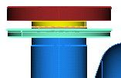
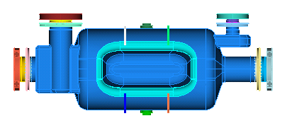
LHC-RFD Design: Modifications (2)
No major modifications are required for LHC-RFD cavity design
Proposed changes are not radical (to be confirmed with CERN)
Change 2: Increase FPC, HHOM and VHOM ports flange location
  Present design gap between flange and NbTi adapter ring is tight
  Would ease and speed assembly in cleanroom
  Doesn’t change the cavity to He vessel interface locations
  Need to cross check the flange location of demountable HHOM coupler
Tight gap between SS flange and
NbTi adapter ring

Slide 20
Conclusions
Two SPS-RFD cavities have been fabricated and processed
  RFD-CAV-001 → Completed
  RFD-CAV-002 → Ready to be tested
Performance levels above requirements for HL-LHC
  Cavity (RFD-CAV-001) reached V_{t}=4.4 MV
  E_{p}=42 MV/m and B_{p} =73 mT → Still much room for improvement
  Achieved 3.4 MV (operating V_{t}) with a Q₀ of 8.5×10⁹ (3.2 W)
  Achieved 4.4 MV (maximum V_{t}) with a Q₀ of 8.0×10⁹ (5.6 W)
No major alteration to the cavity processing plan; Recommendations for future cavities
  Do bulk BCP after final welding
  Horizontal orientation while cavity processing (BCP and HPR)
No major modifications to RFD cavity design for LHC
  Increase pick up port diameter
  Increase port height for ease of assembly in clean room

Slide 21








Collaboration
THANK YOU

