Slide 1






HOMs for RFD
Subashini De Silva
Center for Accelerator Science
Old Dominion University
International Review of the Crab Cavity Performance for HiLumi
CERN – April 3-5, 2017

Slide 2
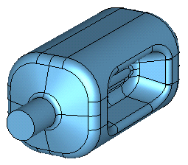
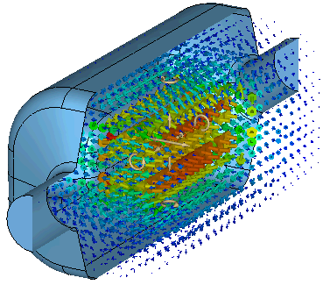
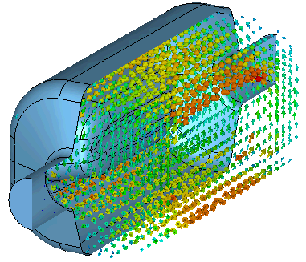
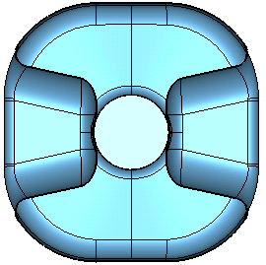
SPS-RFD Cavity: Design
Operates in TE₁₁ like mode
 | PoP | SPS
Frequency | 400 | 400.79 | MHz
Aperture | 84 |  | mm
Nearest HOM | 590 | 633.5 | MHz
E_{p}* | 4.02 | 3.6 | MV/m
B_{p}* | 7.6 | 6.2 | mT
[R/Q]_{t} | 287 | 429.7 | Ω
Geometrical Factor (G) | 120 | 106.7 | Ω
R_{t}R_{s} | 3.4×10⁴ | 4.6×10⁴ | Ω²
At E_{t}* = 1.0 MV/m
V_{t} | 3.4 | 3.4 | MV
E_{p} | 36.5 | 33 | MV/m
B_{p} | 64 | 56 | mT
E Field
Next HOM is 1.5 times fundamental mode
Lower surface fields compared to PoP cavity
Higher shunt impedance
Improved multipacting
Reduced multipoles components with curved poles
H Field
281 mm
194 mm
SPS-RFD Cavity for
Crabbing in horizontal plane
281 mm

Slide 3
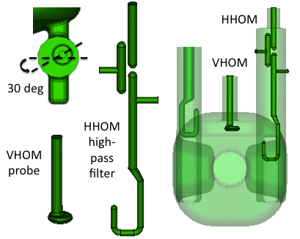
FPC and HOM Couplers for SPS-RFD Cavity
Couplers are at locations of low field region on cavity body
  Minimizes RF heating on the coupler components
  Location preserves the field symmetry
Two HOM couplers (HHOM and VHOM)
  HHOM → High pass filter
  VHOM → Simple coax coupler
Z_{L} < 50 kΩ per cavity and Z_{T} < 1 MΩ/m per cavity except for two HOMs near 2.0 GHz
Hook shaped FPC coupler → Q_{L} = 5.0×10⁵
Reduced rf heating at hook (69 W)

Slide 4
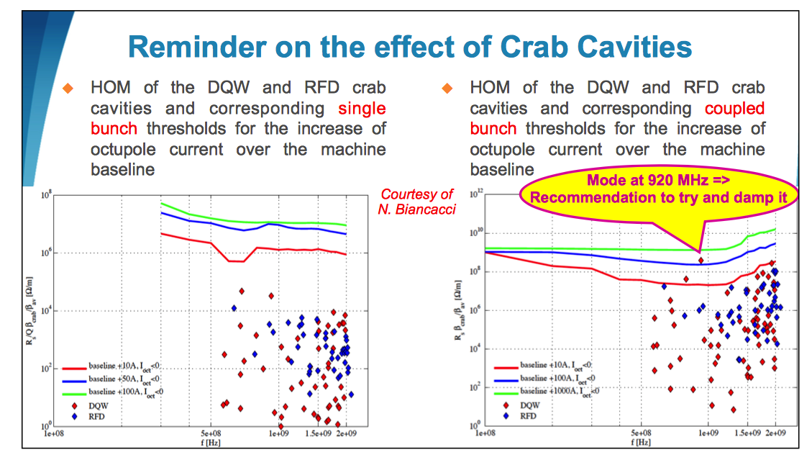
Impedance Update – Elias Metral (LARP CM26, SLAC 2016)

Slide 5
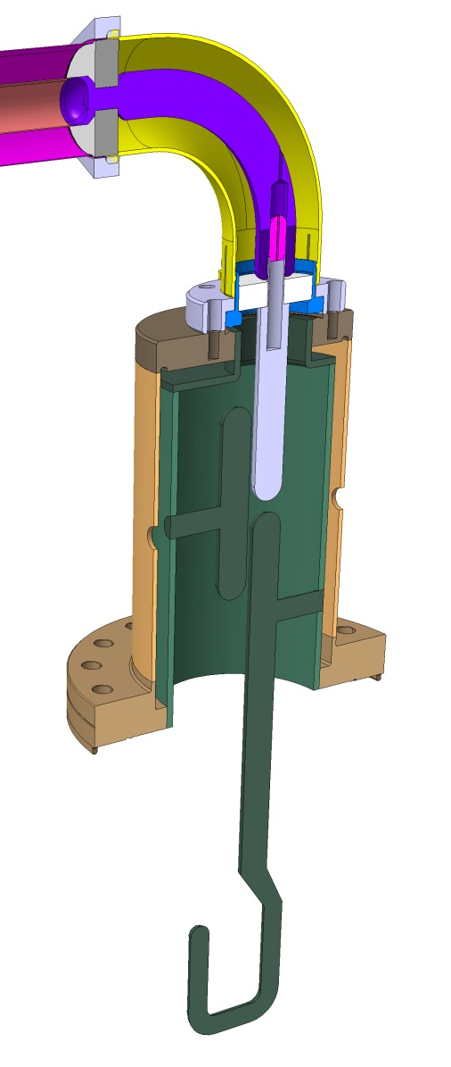
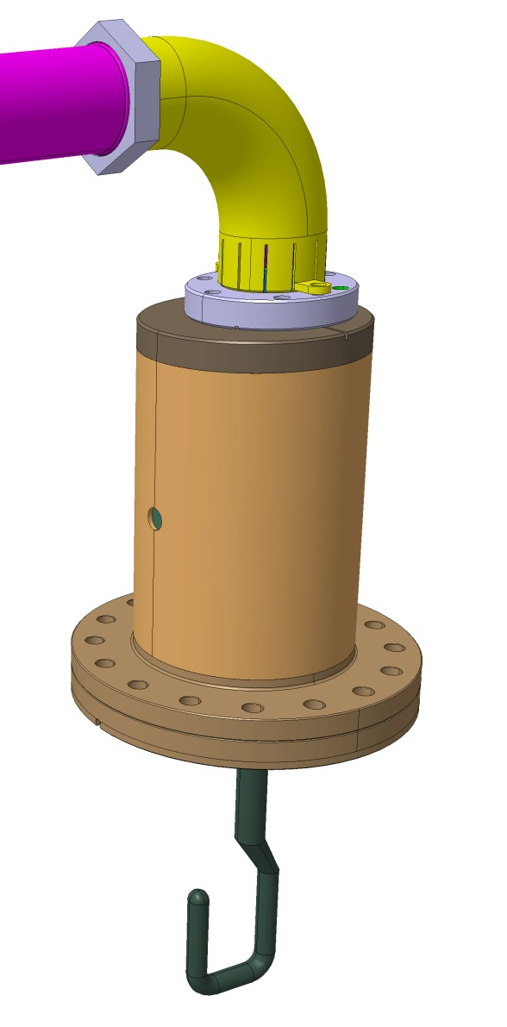
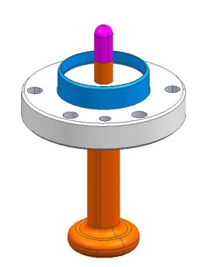
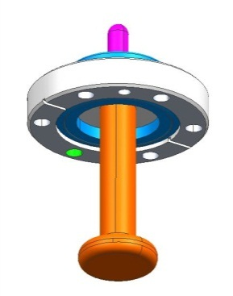
HOM Couplers
Vertical HOM Feedthru
Horizontal HOM Coupler

Slide 6
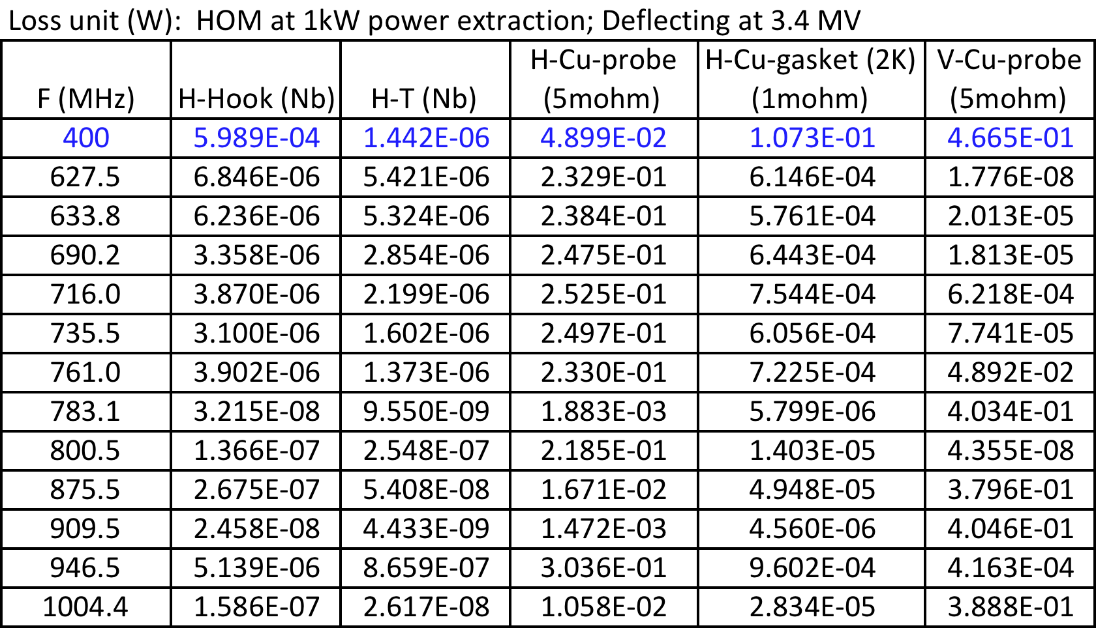
HOM Power Analysis
Zenghai Li/SLAC

Slide 7
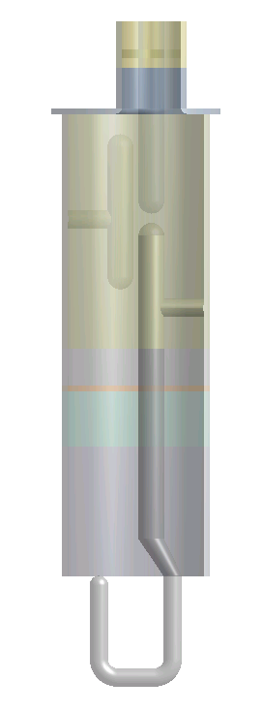
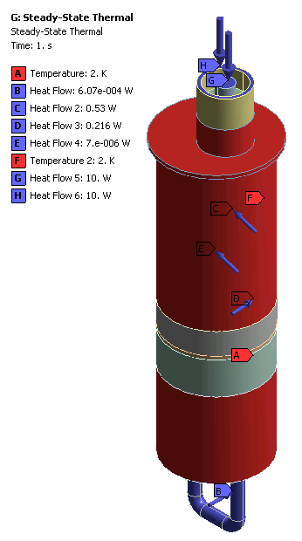
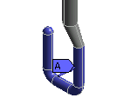
Boundary Conditions
Ceramic
Copper sleeve
Nb can
*
Copper
Nb
* 1mohm increased to 2mohm to account the roughness and strain effect of copper. (Anomalous skin effect and resistive wall heating by Weiren Chou and Francesco Ruggiero, 9/8/1995 CERN)
LHe jacket starts ~20mm above copper gasket
Copper gasket
HV joint
Power applied on extremity only for worst case scenario

Slide 8
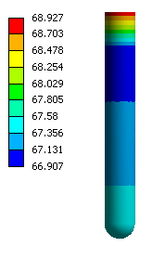
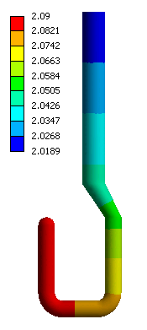
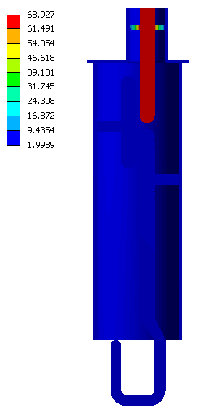
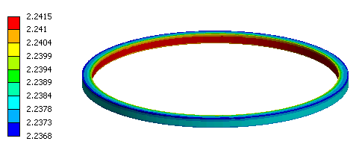
Results
Copper probe
Nb hook
Copper gasket

Slide 9
Conclusion – Thermal Study
Niobium hook and tee maintains 10 nΩ range temperature (< 2.1 K).
Copper gasket temperature under 2.3K with doubled heat load.
No thermal runaway → Estimated power dissipation all valid.
No internal helium channel is necessary.

