Slide 1
DQW Cryomodule and cryostating overview
Teddy Capelli – EN/MME (CERN) on behalf of the design team
Internationnal review of the Crab Cavity performance for HiLumi – CERN – 3 april 2017

Slide 2
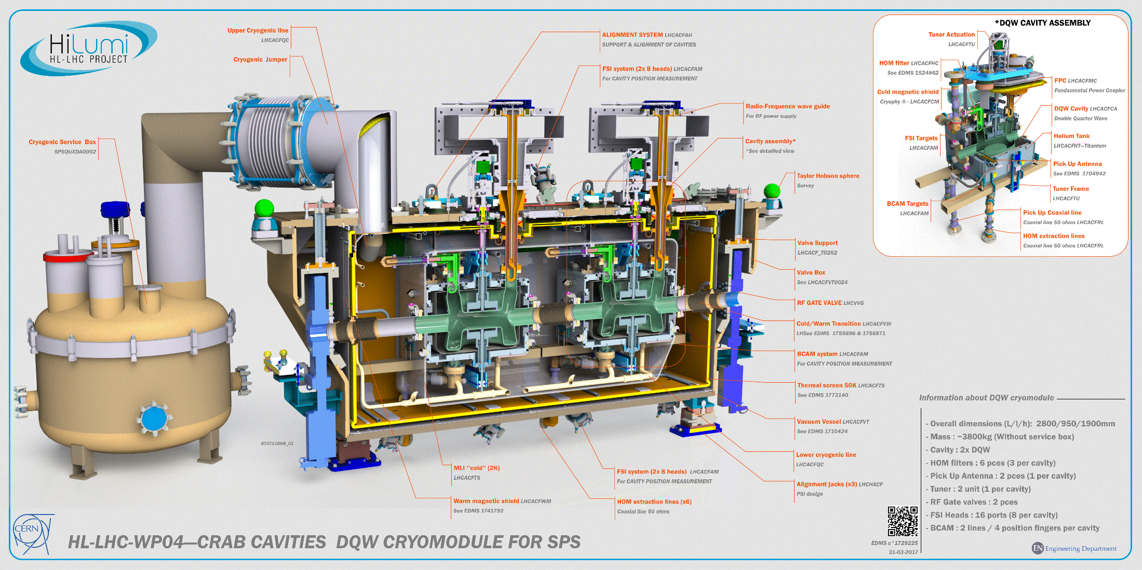

Slide 3
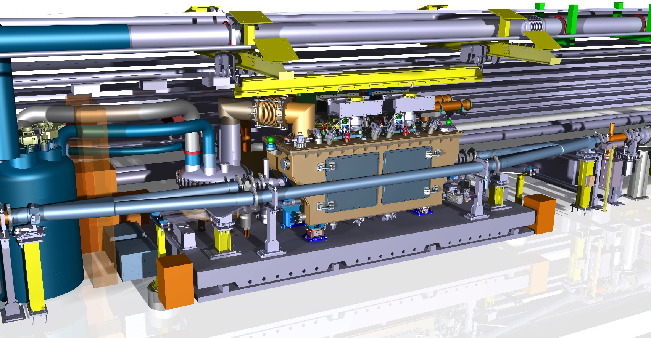
Preview of SPS test stand
More details in the presentation of G.VANDONNI
Extract from integration study S.MEHANNECHE (CERN) – G.VANDONI (CERN)

Slide 4
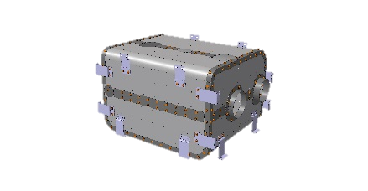
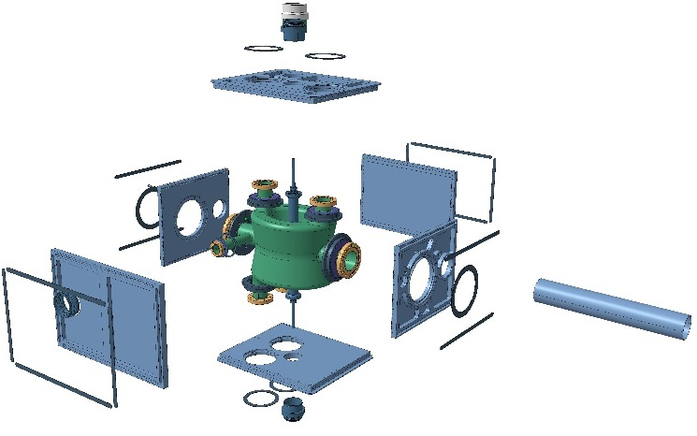
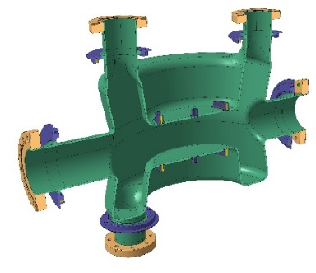
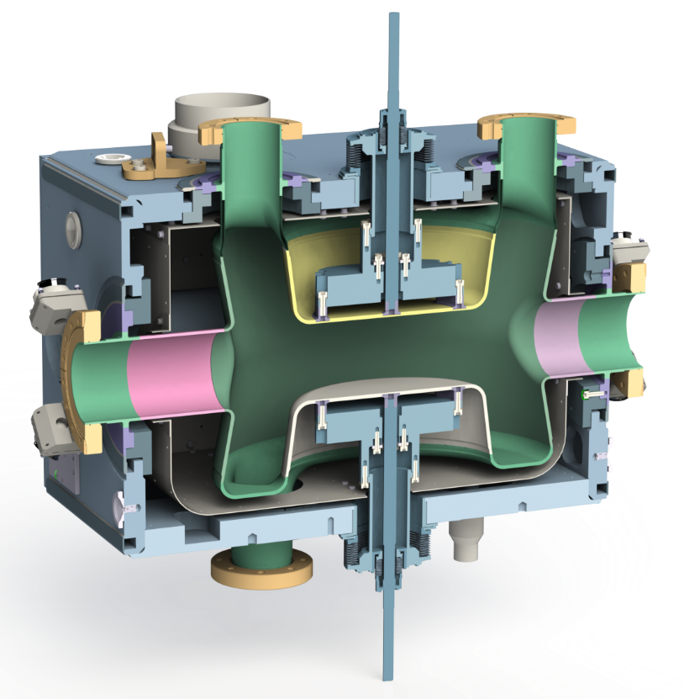
Cavity
More details in the presentation of M.GARLASCHE (CERN)
and S.VERDcU (BNL)c
Cryo connexion
Titanium to Stainless Steel
Edge welded bellows x4
Titanium
Tuning Rod x2
LHCACFTU – Titanium
see presentation of K.ARTOOS (CERN)
DQW Cavity LHCACFCA
Double Quarter Wave – Bulk Niobium
Pre-tuning x2
LHCACFTU – Titanium
see presentation of K.ARTOOS (CERN)
Cold magnetic shield
Cryophy ® - LHCACFCM
See presentation of N.TEMPLETON (SFTC)
Helium Tank
LHCACFHT—Titanium
See presentation of P.FREIJEDO (CERN)

Slide 5
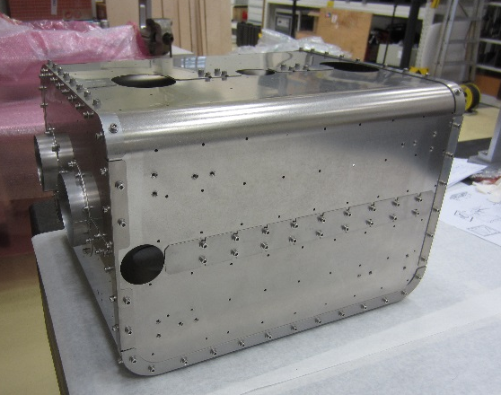
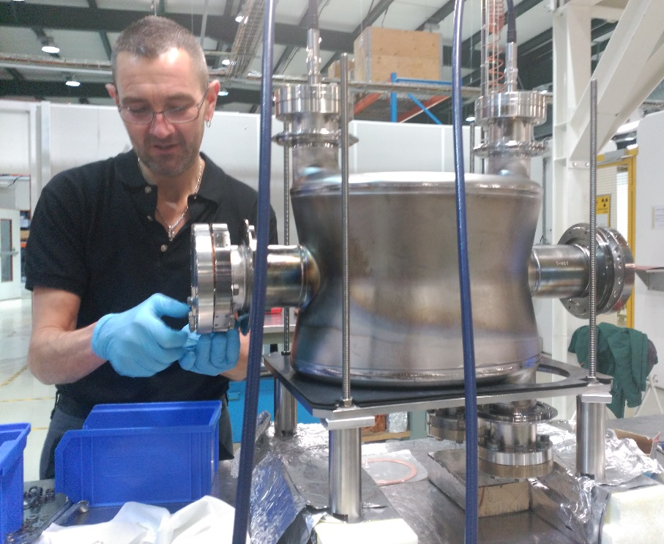
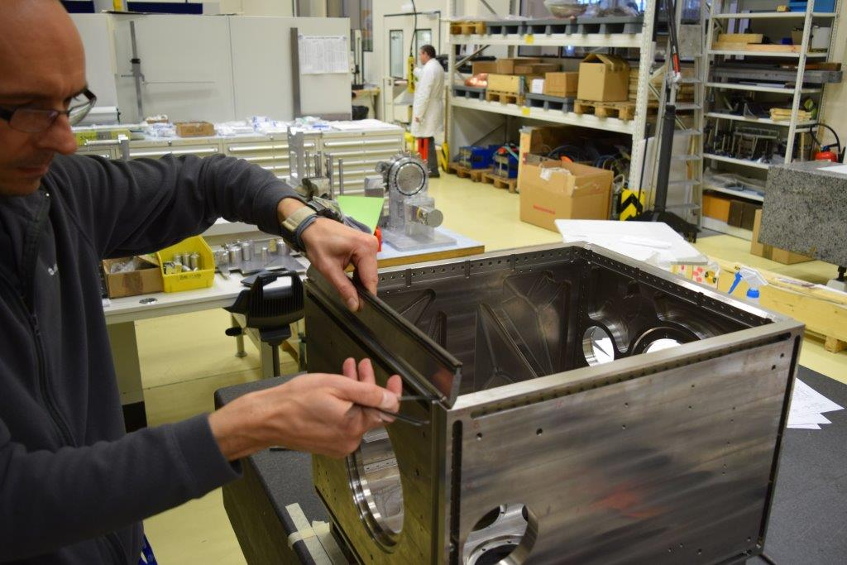
Cavities
Cold magnetic shield
The manufacturing and assembly of the cavities started mid 2016 and should be finish in June.
Cavity
Helium tank

Slide 6
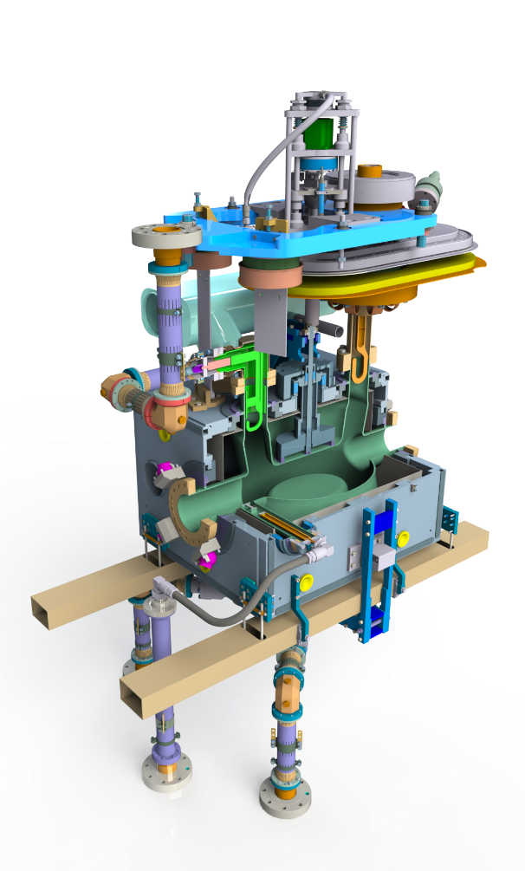
Cavity equipments
Tuner Actuation
LHCACFTU
see presentation of K.ARTOOS (CERN)
Cavity alignment LHCACFAH
1 system / cavity
see presentation of M.SOSIN (CERN)
FPC LHCACFMC
Fundamental Power Coupler
see presentation of E.MONTESINOS (CERN)
HOM extraction lines
Coaxial line 50 ohms LHCACFRL
see presentation of E.MONTESINOS (CERN)
Cryogenic biphase line
Stainless steel
HOM Suppressor LHCACFHC
See EDMS 1524862
see presentation of E.MONTESINOS (CERN)
Tuner Frame
LHCACFTU
see presentation of K.ARTOOS (CERN)
FSI Targets
LHCACFAM
see presentation of M.SOSIN (CERN)
Pick Up Antenna
See EDMS 1704942
see presentation of E.MONTESINOS (CERN)
BCAM Targets
LHCACFAM
see presentation of M.SOSIN (CERN)

Slide 7
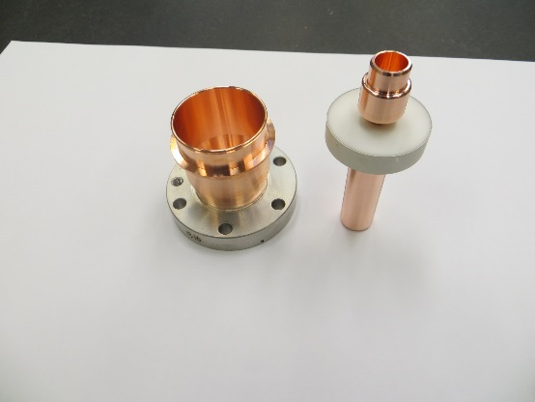
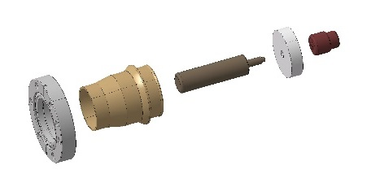
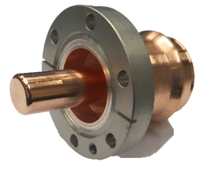
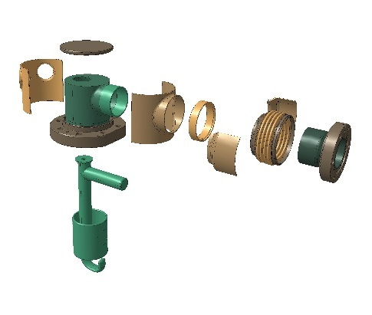
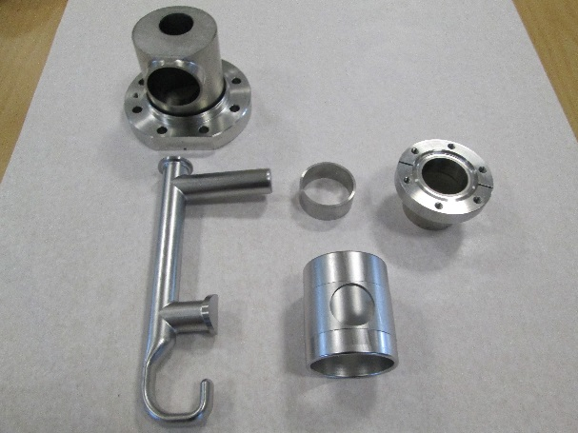
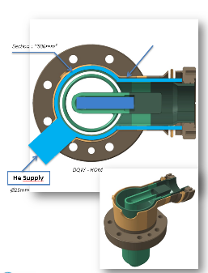
HOM Suppressors + Feedthroughs
More details in the presentation of E.MONTESINOS (CERN)
HOM Feedthrough (1 per HOM)
HOM Suppressor (3 per cavity, 8 pces are under fabrication)

Slide 8
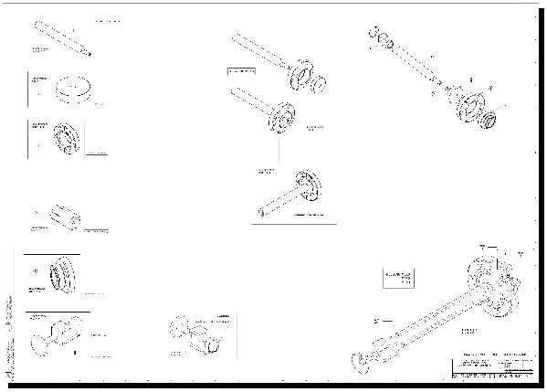
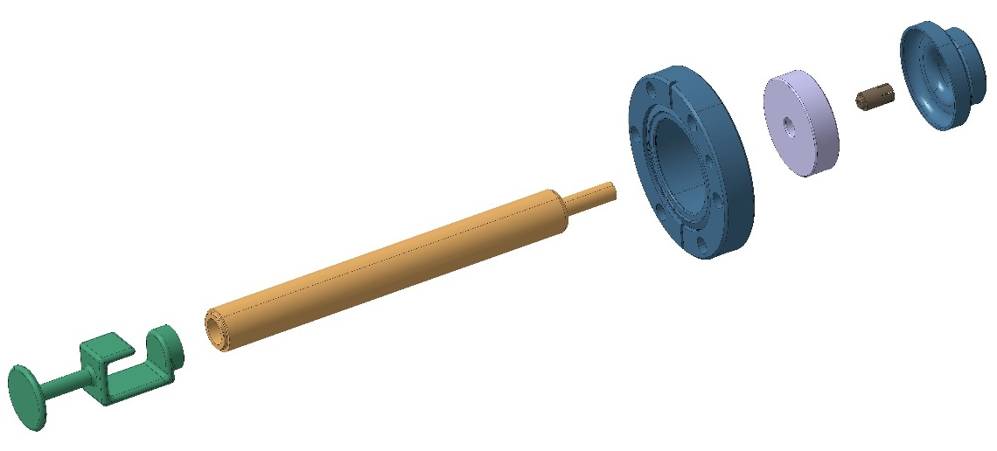
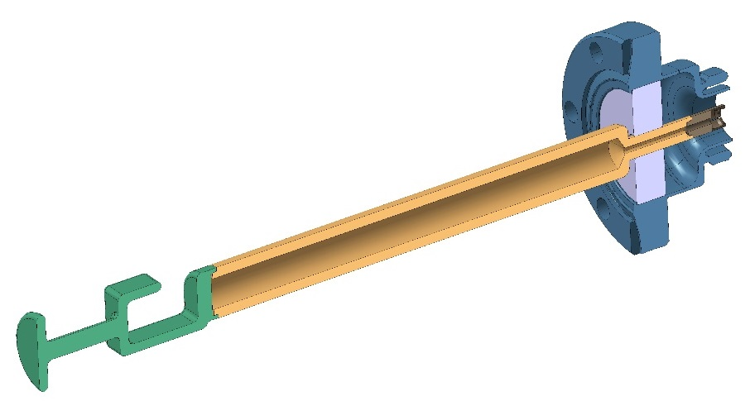
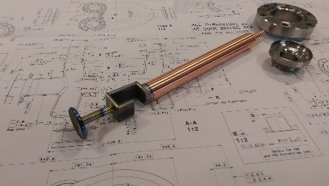
Pick Up field antenna
More details in the presentation s of E.MONTESINOS (CERN) and M.GARLASCHE (CERN)
This antenna has two functions :
-measure of the field inside the cavity
-HOM suppressor
Conflat UHV Flange
Titanium
Ceramic
Beam vacuum / insulation vacuum
Rod
OFE Copper
Hook
Niobium
Custom connector
Design BE/RF

Slide 9
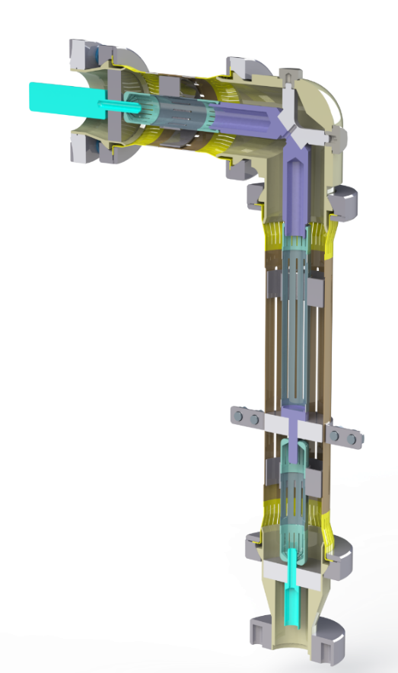
Coaxial lines 50 (HOMS & Pick Up antenna)
More details in the presentation s of E.MONTESINOS (CERN)
Coaxial lines
  -6 HOMS coaxial lines
  -2 Pick up coaxial lines
  -Standardized coaxial line for both equipments (also compatible with RFD cryomodule)
HOM Feedthrough 2K
LHCACFRL
Datas
  - 1 KW, 1 GHz
  - Stainless steel tubes, Cu coating: 5 microns
  - D_{ext} = 40.8 mm, D_{int} = 17.4 mm, thickness 0.5 mm
  - Length: 4x350 mm, 2x550 mm
  - Interception needed both on inner and outer conductors (80K)
  - Inner tube: interception with a ceramic electrical insulator, thermal conductor
  - Thermal calculation performed semi-analytically (F.Carra – EN/MME)
  - Total heat to 2K : 3.9W (static) – 4.9W (dynamic) / per cryomodule
Flexible contacts
Stainless steel / Copper
Thermalisation ~80K
Ceramic
Extracted from Federico CARRA thermal calculations
Coaxial conductors
Stainless steel 0.5mm copper coated ~5µm
Insulation vacuum feedthrough (300K)
LHCACFRL

Slide 10
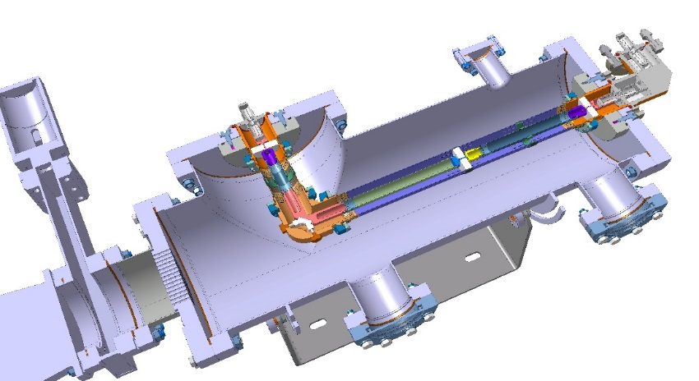
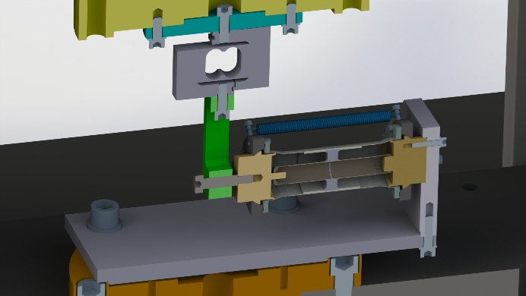
Tests and prototype line
More details in the presentation s of E.MONTESINOS (CERN)
Test of line in vacuum (BE/RF):
-Rf tests
-Measure of line temperature in charge
-Test of fabrication
Mechanical tests EN/MME:
-Displacement forces
-Capaticities of lateral movement
L.Bianchi (CERN)
Mechanical measurment lab

Slide 11
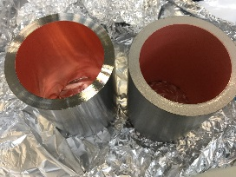

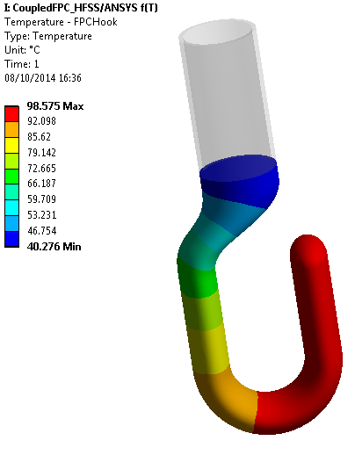
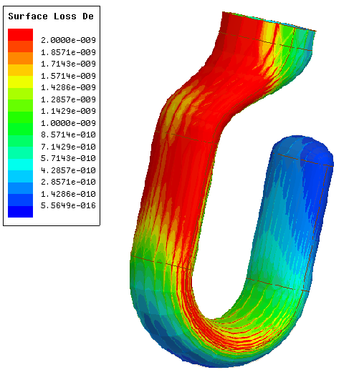
Fundamental power coupler (FPC)
More details in the presentation s of E.MONTESINOS (CERN)
Manufacturing done
FPC antenna – Copper OFE
Heating on the antenna generated when RF is on
Can lead to high temperatures of Cu (creep, outgassing, high radiation to cold mass)
Water cooling necessary, water speed: 1.5 m/s
Thermal loss on the antenna:
  DQW ~ 100 W
RF/UHV Gasket
Iterative HFSS/ANSYS analysis to evaluate T field on hook and radiation to cold mass
With the final solution: 0.9W/FPC to 2K by radiation
T_{max} hook < 100 ºC
Heaters (~50W)
Heating catridge
Thermalisation (80K)
Connected to thermal screen
Hook cooling
Water flow – 300K
Outer pipe Stainless Steel (316LN)
Ø62 int th 3mm - Copper layer 7µm
RF/UHV Gasket
Extracted from Federico CARRA thermal calculations
FPC surface loss density distribution & temperature increase

Slide 12
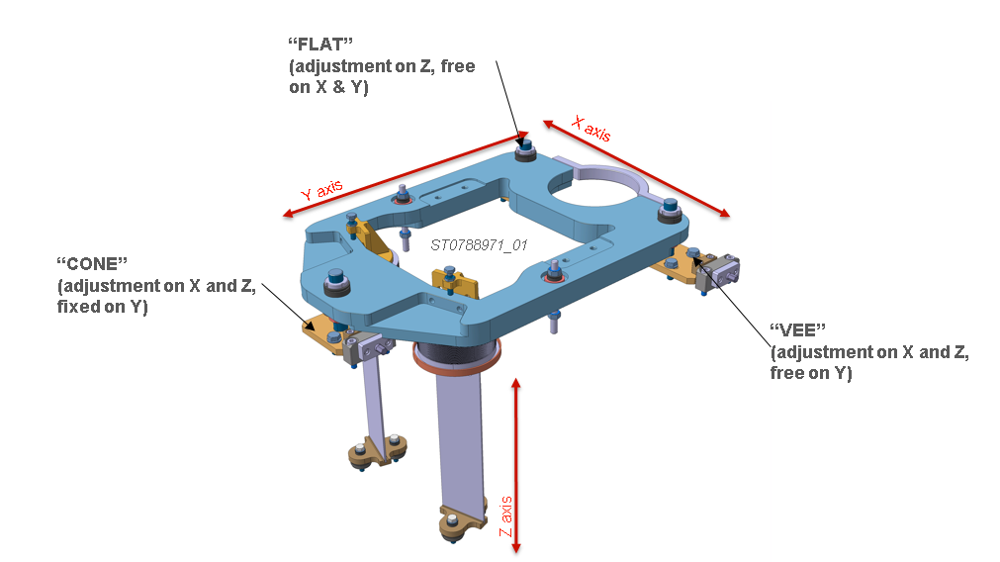
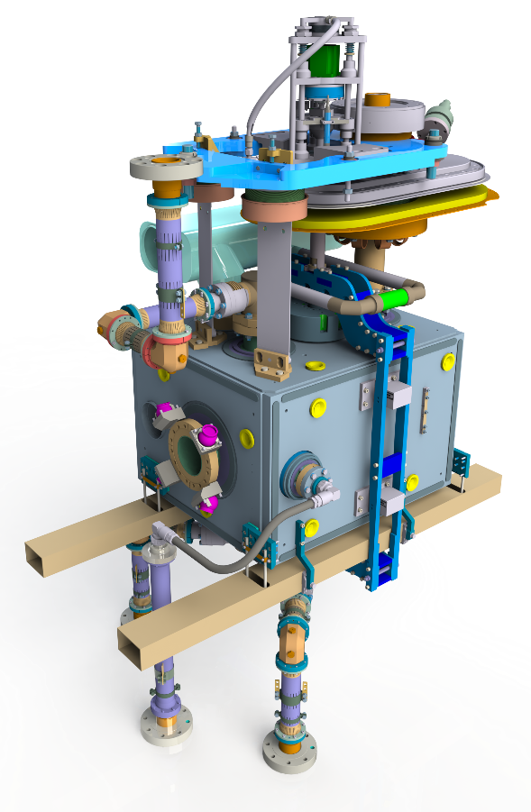
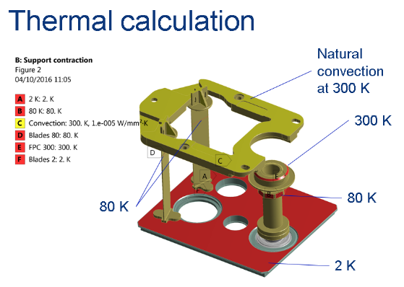
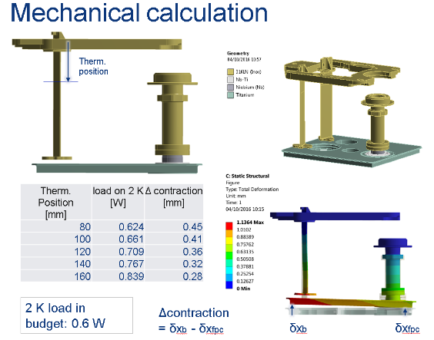
Support and alignment of cavity
More details in the presentation s of M.SOSIN (CERN)
External plate
LHCACFAH
Thermalisation ~80K
Copper braids
Support blades x 2
Stainless steel / Copper
FSI
LHCACFAM
BCAM
LHCACFAM
C. Zanoni EN/MME

Slide 13
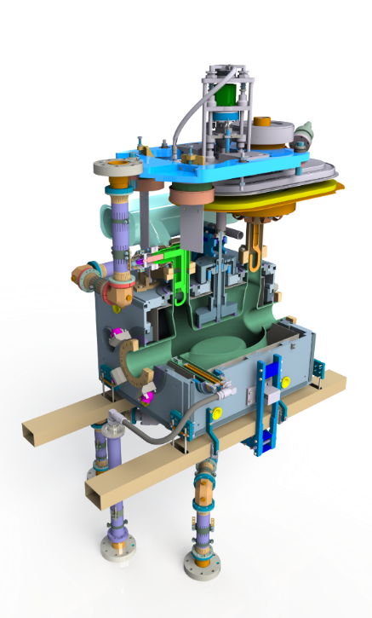

Tuning system
More details in the presentation s of K.ARTOOS (CERN)
Actuation
Cryomodule limit
300k
Thermalisation
80k
Tactuation double pipe
Stainless steel
Titanium frame
Pretuning plate
Titanium
Tuning rod
Titanium
Flexible guides (x4)
Titanium

Slide 14
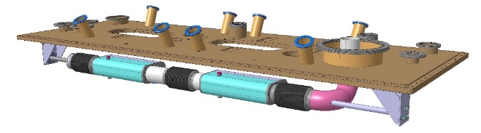
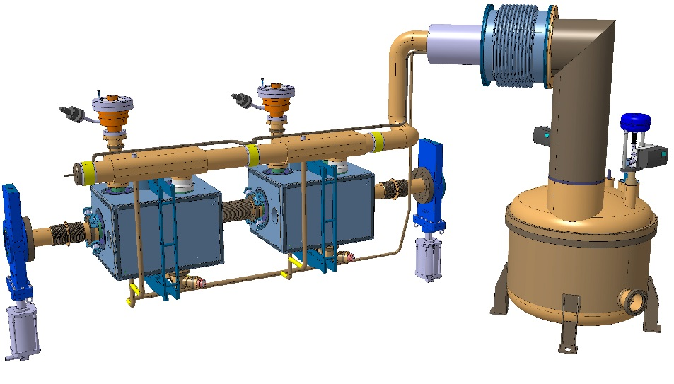
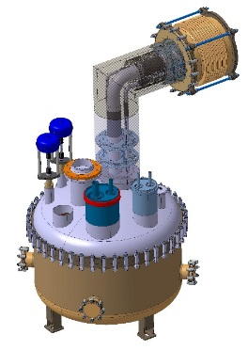
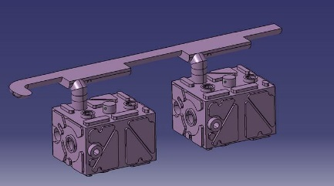
Cryogenic
More details in the presentation of K. Brodzinski (CERN)
Specification of Service module and jumper
Delivery : August 2017
Biphase line and supports
Bellows
Hydroformed
Support
Stainless steel & G10
Jumper
DN300
Volume of Helium : 145L / cryomodule
Lower cryoline
DN25
Level gauge port
DN10
Material : Stainless steel (procurement started)
Foreseen end of fabrication : mid July

Slide 15
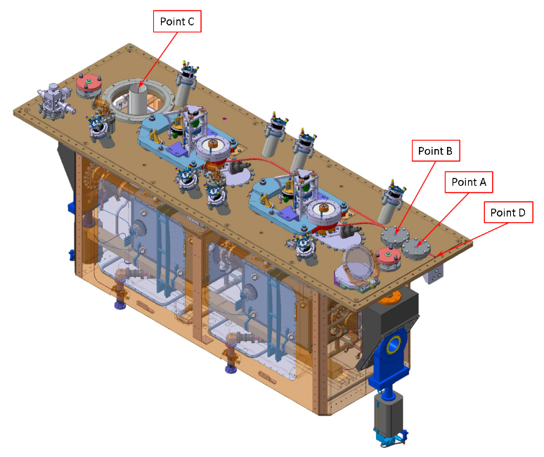
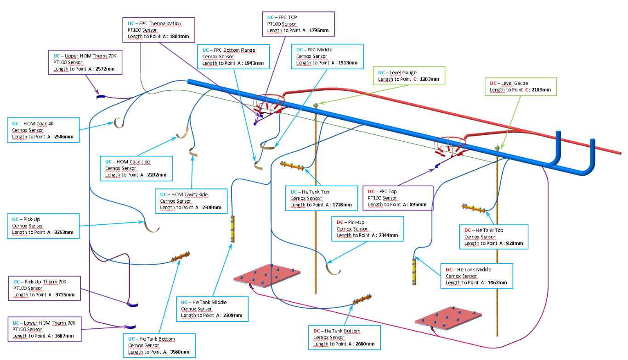
Instrumentation
Liste of instrumentaion (cryo + mechanical) :
-13 CERNOX temperature sensors
-~20 PT100
-2x 8x heating cartridge 5W
-2x He tank heater 100W
-~20 strain gauges
…
Many of this equipments are already at CERN
Cryogenic instrumentation (not complete, for illustration)

Slide 16
Thermal screen and MLI
More details in the presentation s of N.TEMPLETON (SFTC)
Material : Copper, 2mm thick
Manufacturing at CERN : material procured, preparation of manufacturing started, tests on going for pipe brazing and bending.
End of fabrication : mid June
MLI delivery : mid June
Blade support x4
Stailess steel / titanium
Cooling pipes
Ø14 int - copper
Copper plates
Stiffeners
Stainless steel (bolted to copper)
Doors
Only for SPS design
Total mass : ~200kg

Slide 17
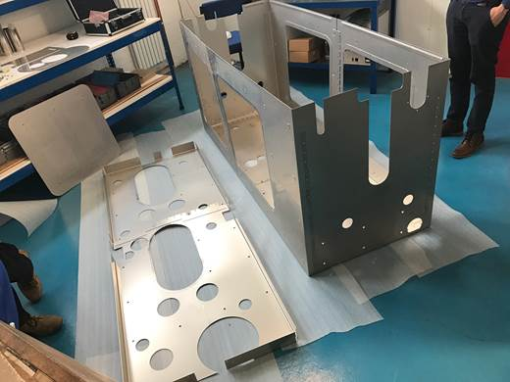
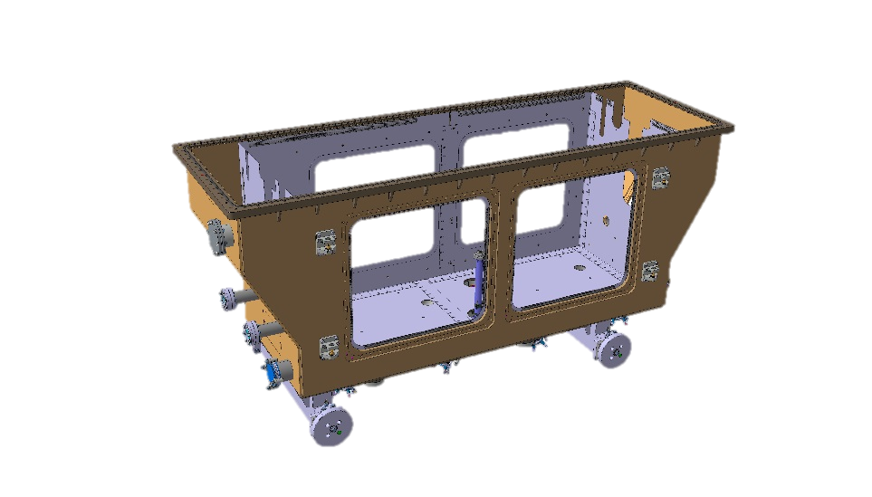
WARM MAGNETIC SHIELD
More details in the presentation of N.TEMPLETON (SFTC)
Material : Mumetal, 2mm thick
Manufacturing is over, delivery foreseen mid April
Total mass : ~150kg

Slide 18
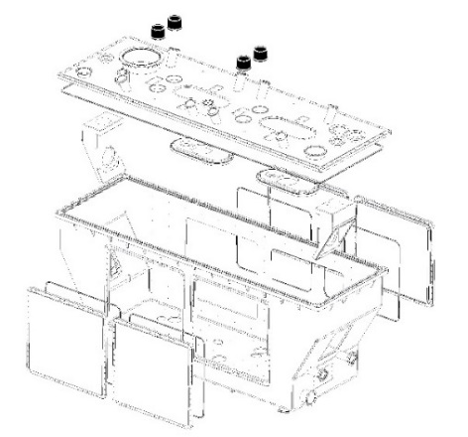
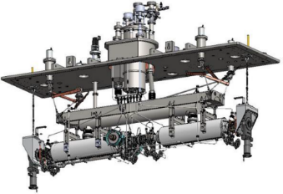
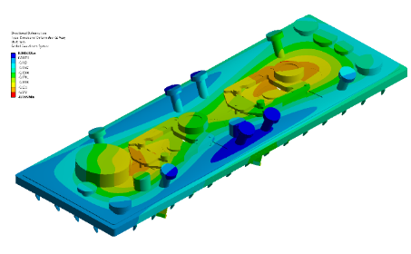
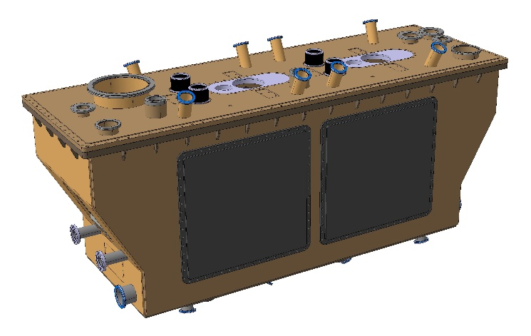
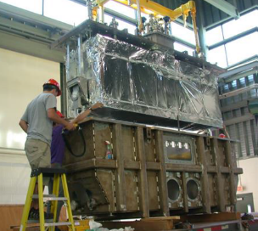
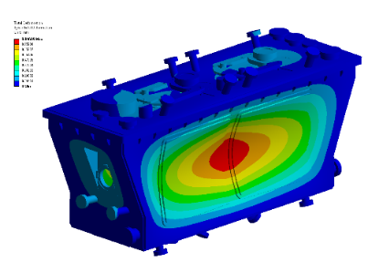

Vacuum tank
Design from Triumph
Advanced Rare IsotopE Laboratory (ARIEL)
Advantages :
-Externalization of valves
-Reduction of lateral openings
-Vacuum tank more rigid
-Simplification of assembly sequence
-Space available for assembly
C. Zanoni/N.Kuder EN/MME
Mechanical simulation of charges

Slide 19
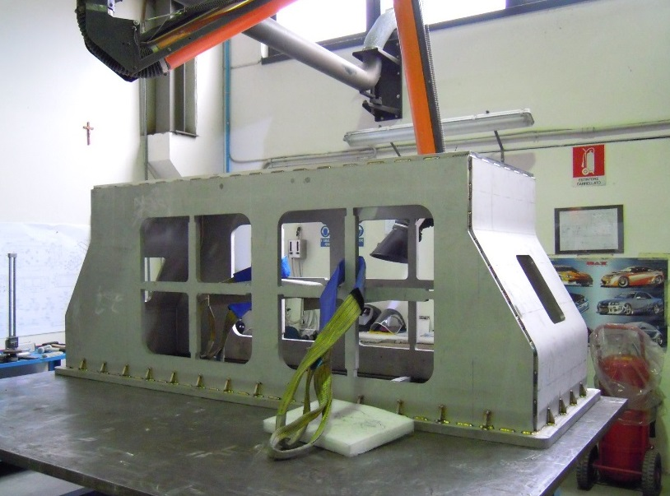
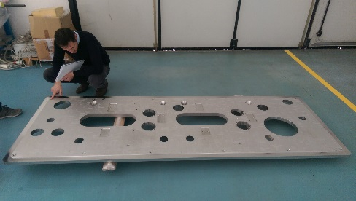
Vacuum tank
Material : Stainless steel
Delivery date : mid April
Final leak test at CERN : end April

Slide 20
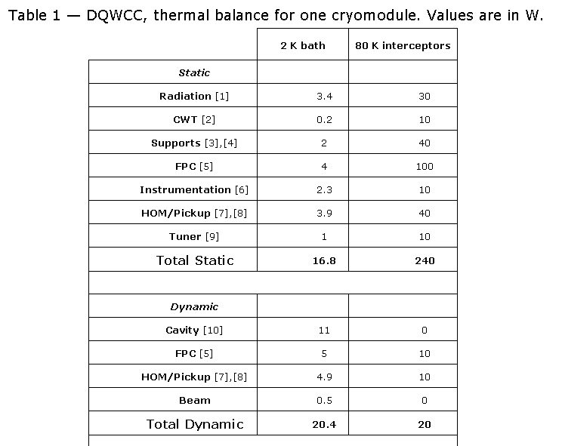


Thermal balance
In SPS there is not the same cryogenic plan than in LHC which
means that we have to be sure that we can cool the cryomodule.
Every critical equipments have been study and analysed in order to
validate the SPS cryogenic plan (see presentation of K.Brodzinski (CERN)).
Extracted from F.CARRA (CERN) thermal calculations

Slide 21
Assembly and cryostating
July
November

Slide 22
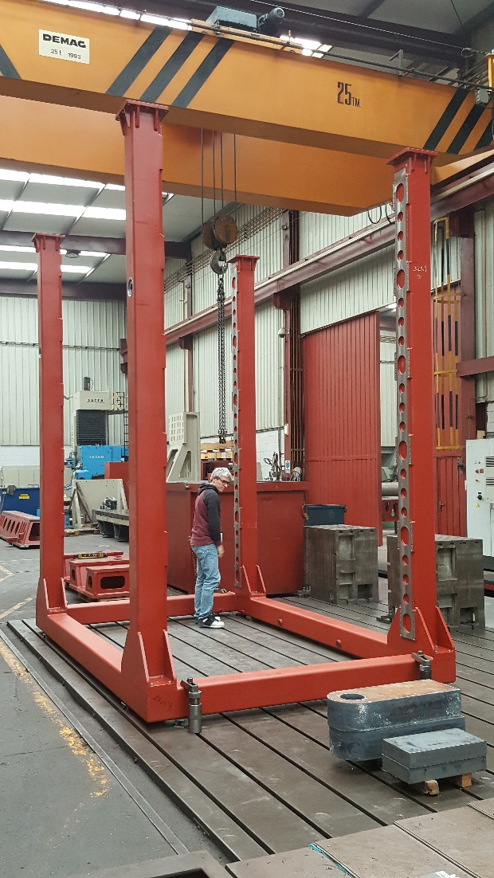
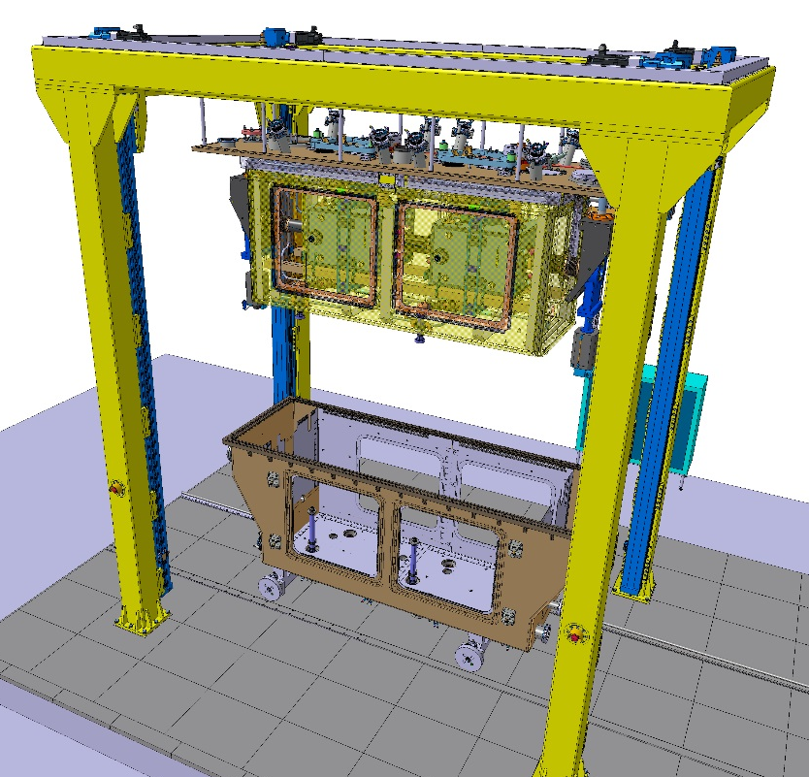
Assembly and cryostating
Assembly portique
Manufacturing done, installation foreseen mid April in SM18
A lot of other assembly tools are under fabrication

Slide 23

Assembly and cryostating
There is a lot of people and different teams involved in the assembly of this cryomodule. The planing must be very well detailled, and all the steps are listed in the official planing.

Slide 24
Thank you for your attention
Questions ?

Slide 25



Slide 26



Advantages :
Externalization of valves
Simplification of assembly sequence
Overall size reduced
Disadvantages :
Limited space available for assembly
Vacuum tank less rigid compare to other solutions
Multiplication of large size sealing
Insertion of thermal screen and MLI very complex

Slide 27



Advantages :
Simplicity of conception / manufacturing
Large openings
Disadvantages :
Vacuum valves inside vacuum tank
Overall dimensions
Insertion of thermal screen and MLI very complex
Heavy side doors (~300kg)

Slide 28

Test performed at Mechanical Measurment lab of CERN (L.Bianchi – M.Guinchard)

Slide 29








Assembly sequence of cryomodule
Clean room assembly detailled in the presentation of M.THERASSE
c
From july – untill september

Slide 30


Assembly sequence of cryomodule
Clean room assembly detailled in the presentation of M.THERASSE
Etape 1
Mount screens magnetic + thermal + MLI on plate FPC
Weld HOMs cryo extensions (2 sides / HOM)
Mount tuning frame + tuning tubes
Mount protection flange on RF valve
Etape 2
Insert level gauges
Weld 2K top cryo lines
Mount tooling to block 2K cryo line bellows + cover on helium tank to close the bottom cryo lines
Leak test 2K top cryo line
Remove tooling to block 2K bellows + cover cryo line

Slide 31


Etape 4
Mount alignment plate
Mount and connect RF lines for the top HOMs (full line)
Thermalisations on 50K for the top
Remove clean room tooling (inter-cavities bellow blocking system + valve tool + etc )
Etape 3
Connect supports (cavities blades and FPC plate + cryo lines + valves)
Heaters mounting (cavities + FPC + support blades + tuner tubes)

Slide 32


Etape 5
Load transfert, assembly lifting with the portque and removal of clean room trolley
Instrumentation connection and check
Etape 6
Weld 2K bottom cryo lines
Leak test 2K bottom cryo line

Slide 33


Etape 7
Mount and connect RF lines for the bottom HOMs (only half lines)
Mount and connect RF lines for the bottom pick-up (only half lines)
Etape 8
Mount BCAM alignement system + mask
Alignment of cavities
Mechanical measurements

Slide 34


Etape 9
MLI 2K
Etape 10
Thermal shield installation of lateral and bottom panels
Weld 50K thermal shield cryo line
Leak test 50K cryo line
Thermalisations on 50K for CWT and support for 2K cryo lines
MLI 50K

Slide 35


Etape 12
Remove valve supports
Mount and connect RF lines for the bottom HOMs + pick-up (last half lines)
Protection on connectors + misc
Thermalisation on 50K for bottom RF lines + pick-up
Etape 11
Lowering the top assembly into the bottom part of the vacuum vessel

Slide 36


Etape 13
Displacement cryomodule outside portique
Jumper welding (10 welds with 2 x 2 intermediate leak tests)
Mounting tuner actuation system
Alignement check
Etape 14
Doors closure including magnetic shield + MLI + thermal

Slide 37


