Slide 1
Frequency tuning system and p.o.p. tuning results
K. Artoos on behalf of WP4 CRAB cavity team
International Review of the Crab Cavity Performance for HiLumi CERN 3rd April 2017

Slide 2
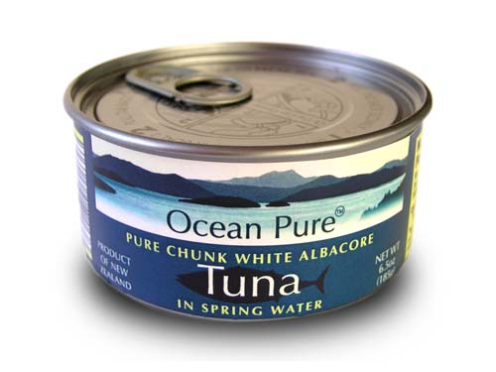

Outline
Tuning of the cavity
P.O.P. DQW tuning test in SM18
SPS DQW tuner

Slide 3
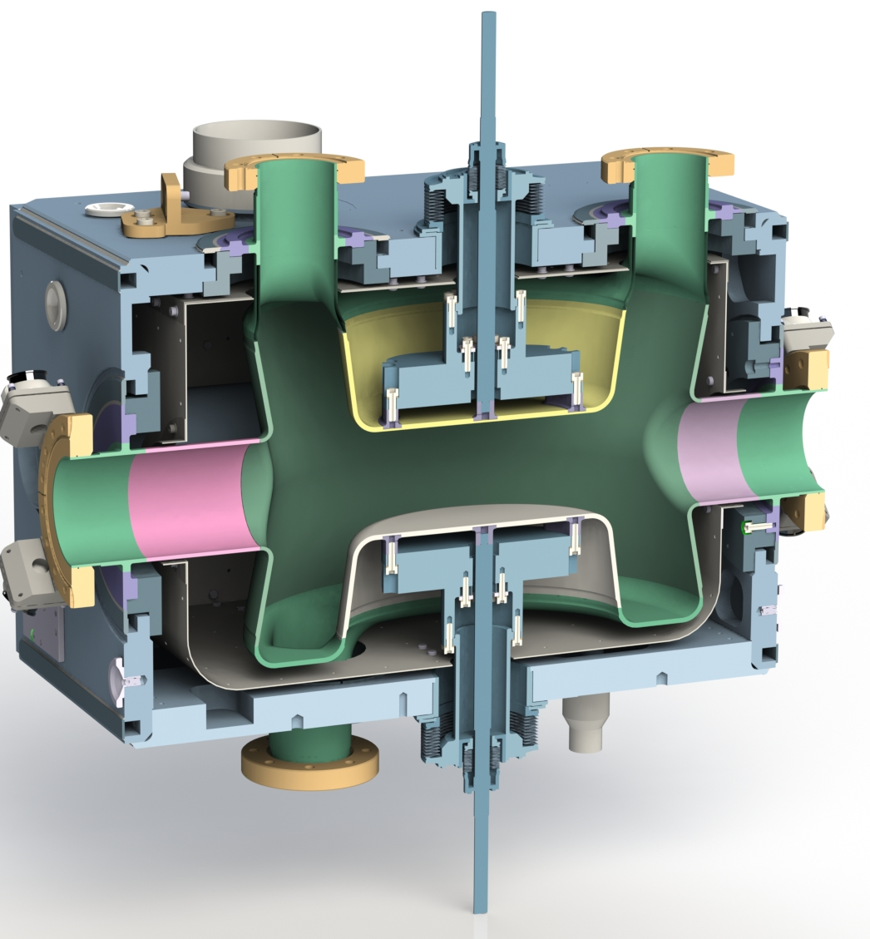
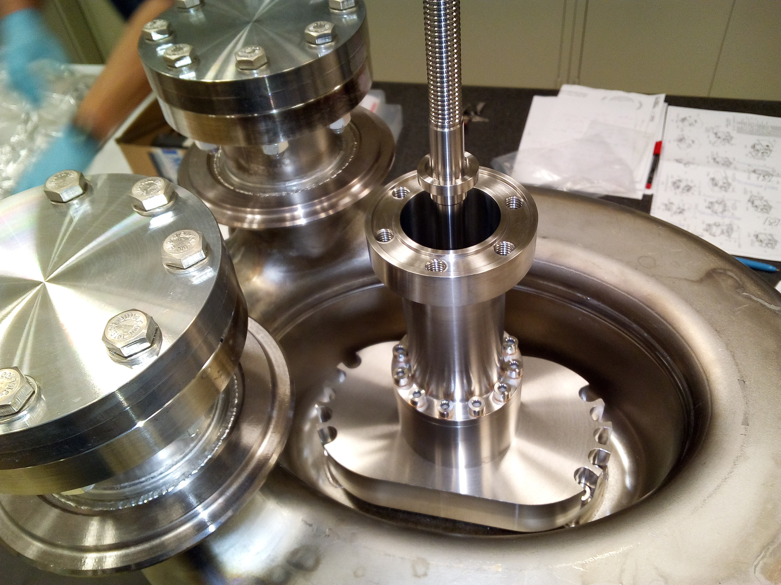
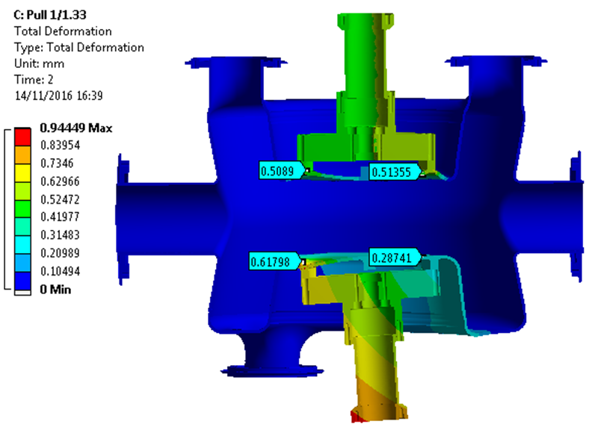
DQW Pre tuning
Base line: elastic deformation ± 0.2 mm* or ± 209 kHz
Non base line: elasto plastic ± 0.4 mm*
(1046 kHz/mm* revised value Silvia)

Slide 4
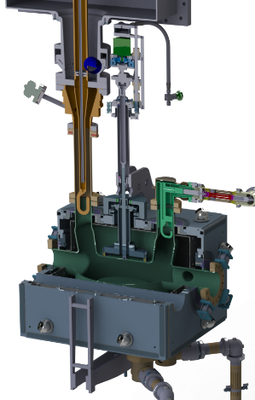
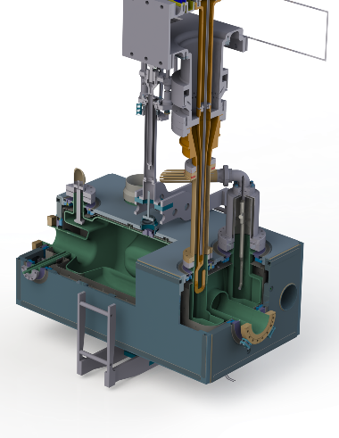
«Fine» Tuning: Symmetric actuation through tuner frame and concentric tubes.
Actuator outside cryostat and floating
DQW
318 kHz/mm*
Revised value by S. Verdú Andrés
± 509 kHz
±1.6 mm*
elastic range at 2K
± 3.7 kN
2.3 kN/mm*
RFD :
345 kHz/mm *
H. Park
± 966 kHz
± 2.8 mm*
elastic range at 2K
± 7 kN
2.5 kN/mm*
*Measured as tuner stroke or Δdistance between 2 plates

Slide 5
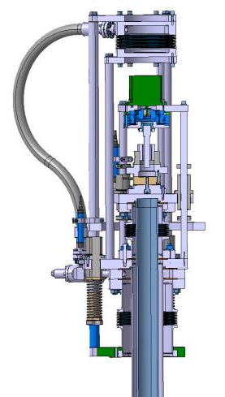
Fine tuning actuator (SM18)
Bipolar stepper 1.3 Nm, motor step 1.8 deg
HD ellipsoidal gear HFUS-20-100-2SO, Ratio 100
Accuracy < 1 arcmin, precision <0.1 arcmin (5 nm)
Fa Dyn 7.7 kN
Roller screw Rollvis RV 12 x 1
static load capacity 17 kN
Precision linear bearings FLI SMKC16 and 20
2 bellows + 1 pressure equalisation bellow
P. Minginette

Slide 6
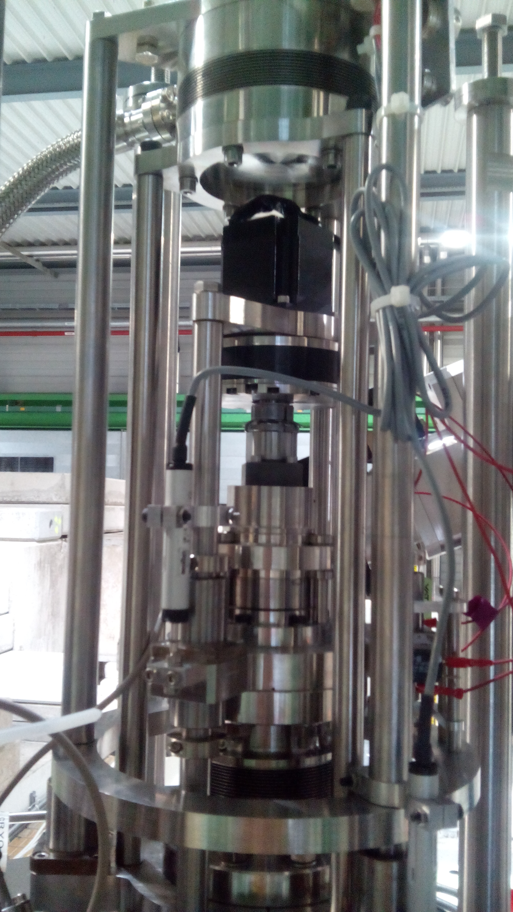
Fine tuning actuator (2)
Instrumentation for diagnostics and safety
Potentiometers 1kΩ, resolution L.S.B. 0.8 µm
Loadcell Kistler 4576A55C1 class 0.1
End switches and end stops

Slide 7
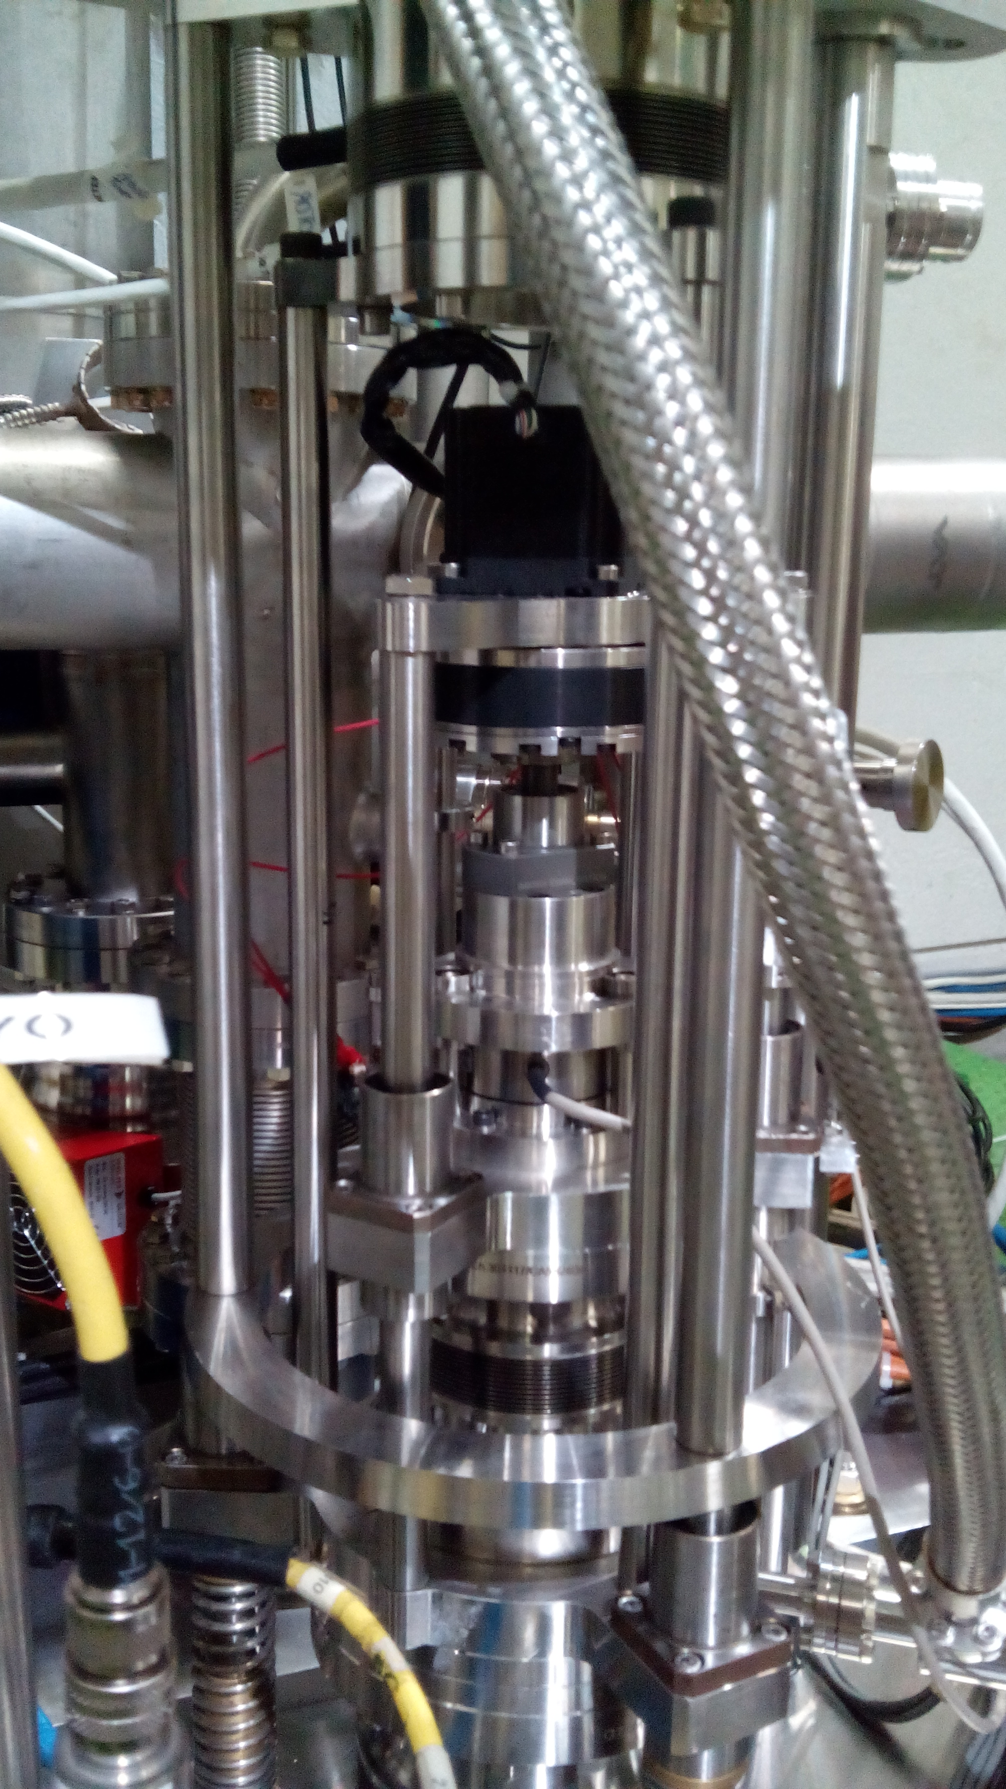
SM 18 tuning test with DQW p.o.p. cavity

Slide 8
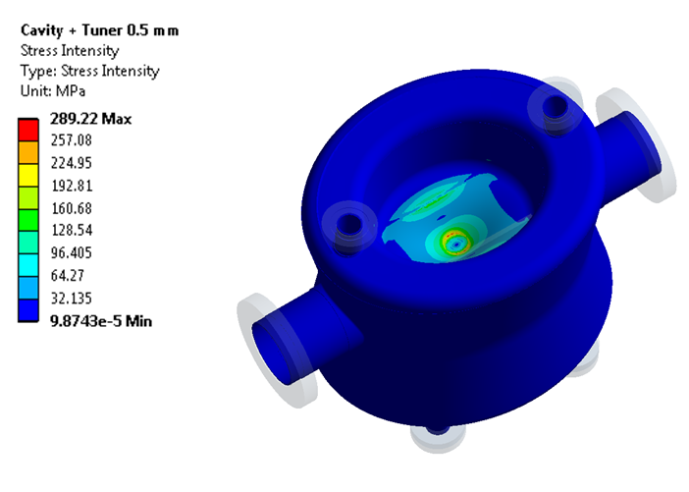
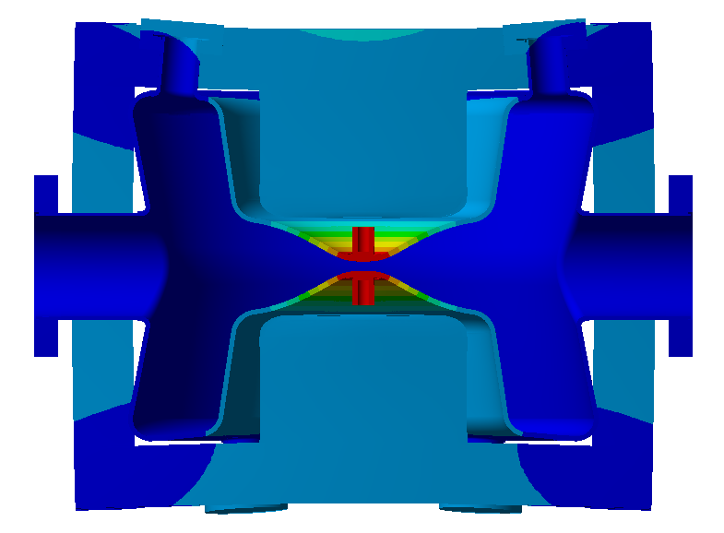
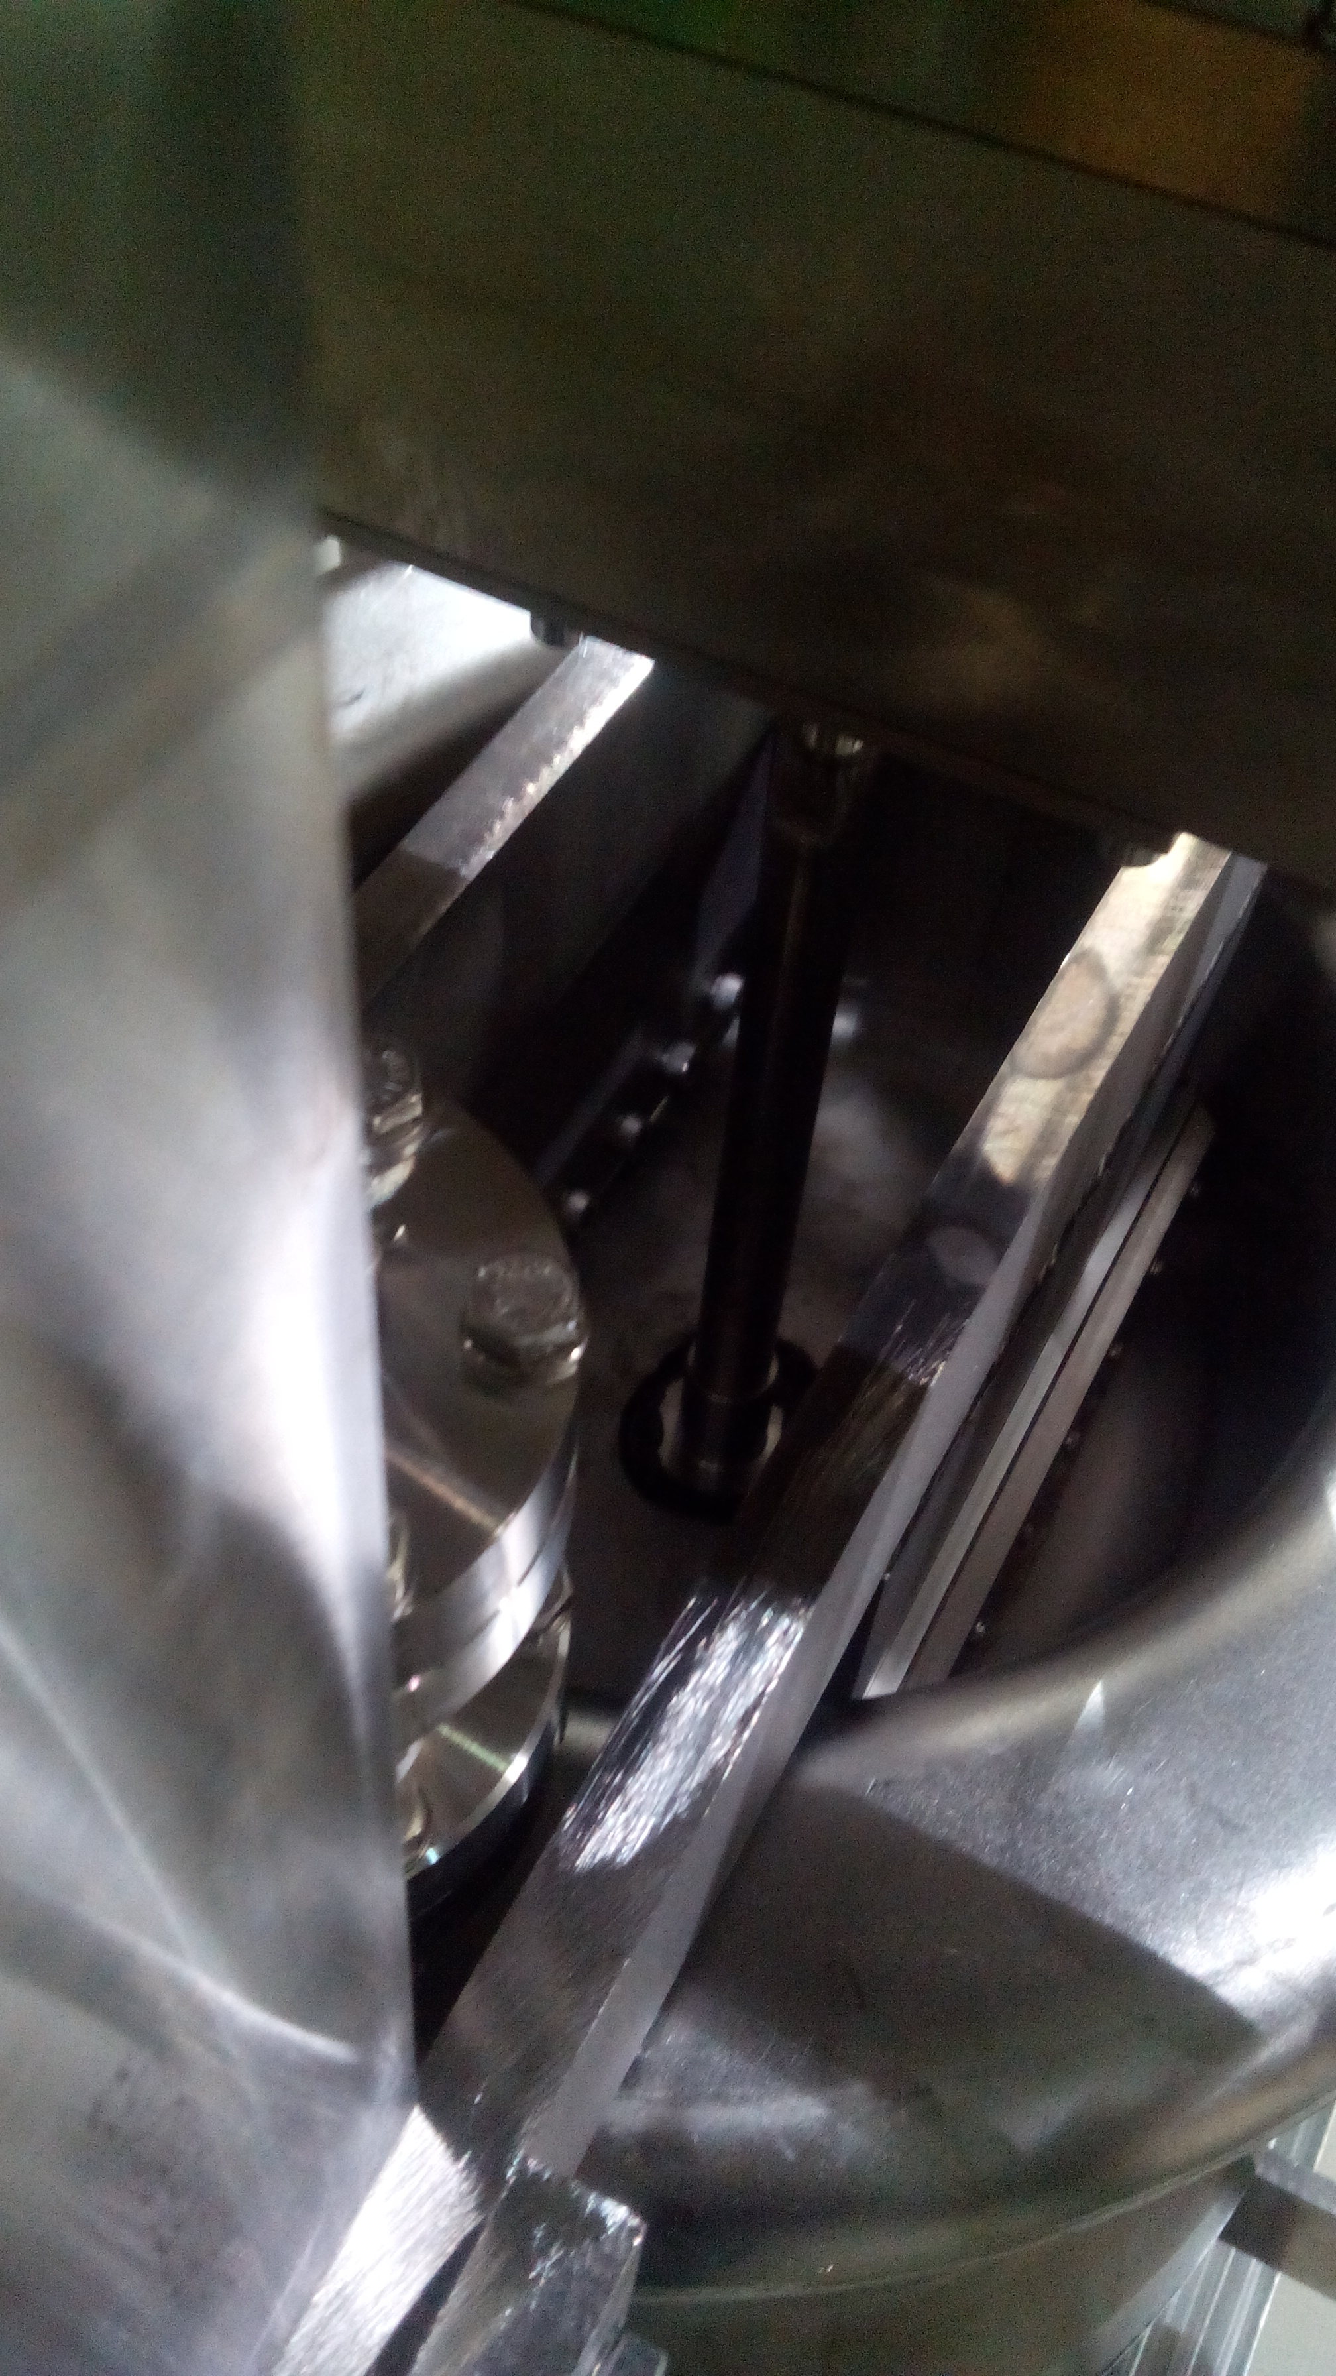
DQW p.o.p. mechanical limitations
N. Kuder
4 kN/mm*
Taking into account unknown factors such as the welds, thickness, Re Nb, a limit of 0.5 mm* tuning deformation was decided
Tuning stubs glued (attempt) , only compression of cavity could be tested
During cool down, (3 m long) tuning tubes were disengaged at motor, partial pressure equalisation

Slide 9
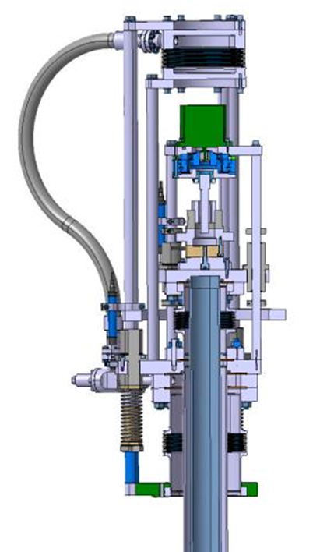
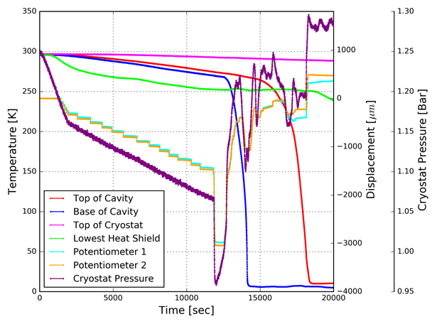
Pop tuner test cool down

Slide 10
p.o.p. tuning test : tested range
Measured range: ~100 kHz, ~180 kHz/mm*, 1.7 kN/mm*
A. Castilla

Slide 11
Frequency stability
Simple PI control (Labview) on motor in parallel with PLL
Reached ± 2 Hz stability
A. Castilla, A. Macpherson

Slide 12
Some lessons from Sm18 test
End stops and end switches difficult to set
Coupling motor-gear-screw to be reviewed
Actuator can not be dismounted from cryostat
Alignment + assembly of push-pull tube
Pressure equalisation at cold not useful

Slide 13
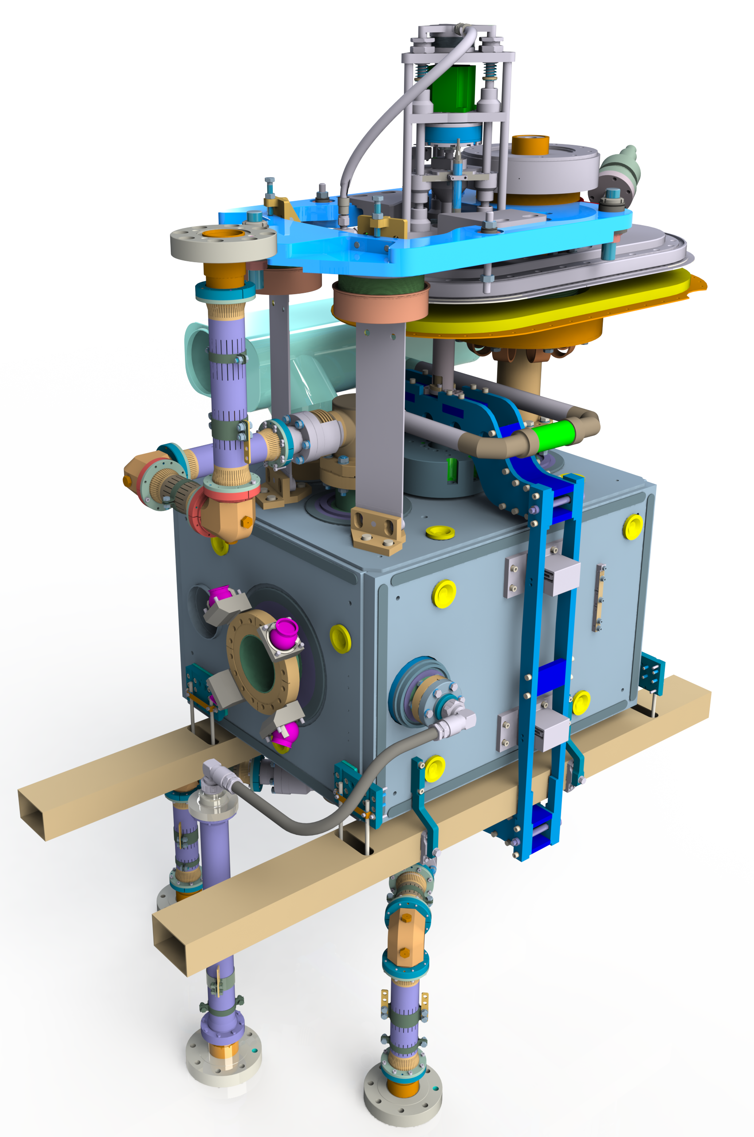
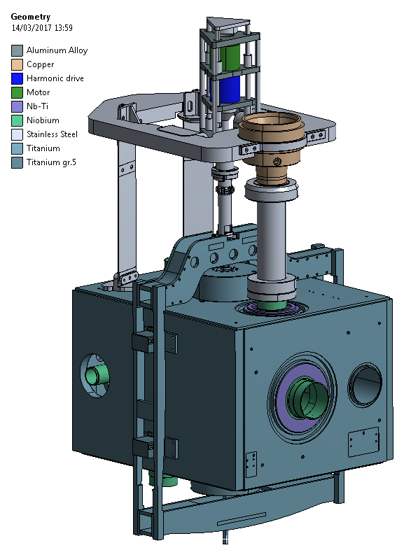
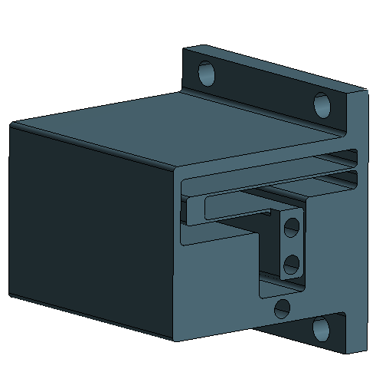
SPS DQW tuner
Tuner frame design has been improved (buckling, mass, stiffness, mounting)
Flexure guidance was introduced
  To eliminate low frequency mode for the tuner
  To increase buckling safety factor
T. Capelli
Joanna Swieszek

Slide 14
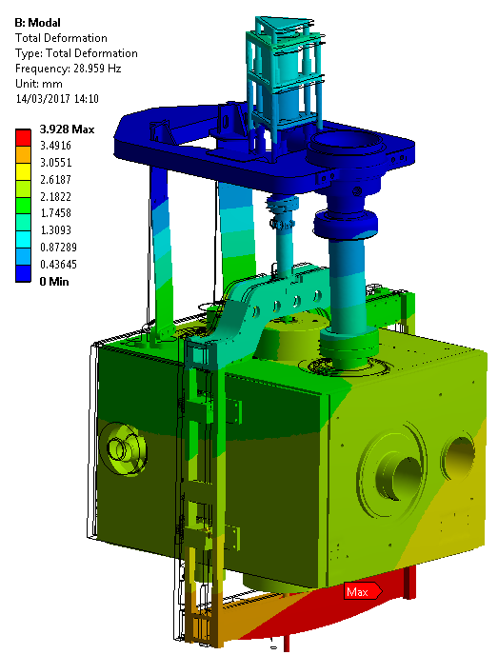
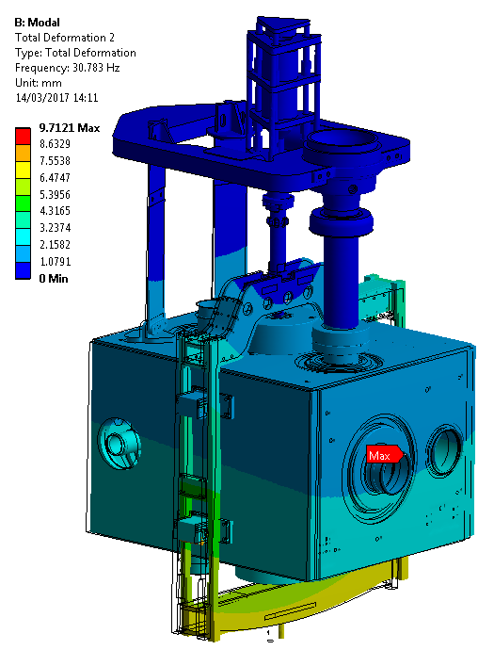
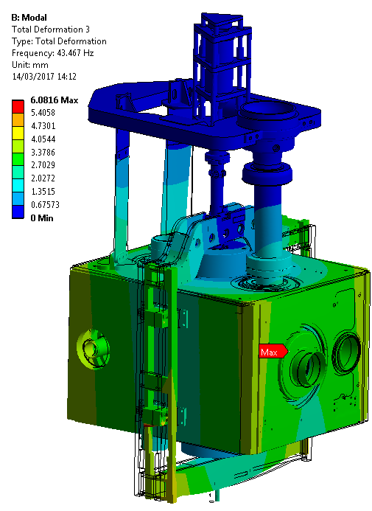
Modal analysis tuner (and support)
Joanna Swieszek
Mode number | Frequency (Hz) | Description
1 | 28.959 | Helium tank swing around x axis
2 | 30.783 | Helium tank swing around y axis
3 | 43.467 | Helium tank rotation around z axis
4 | 46.661 | Tuner frame rotation around y axis

Slide 15
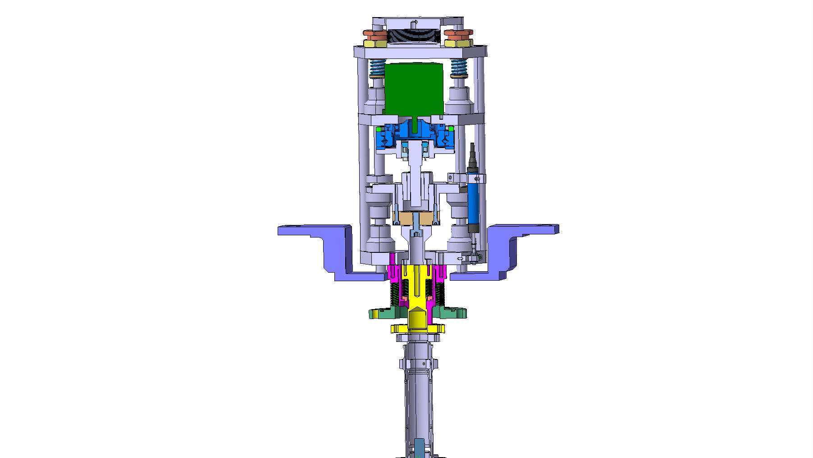
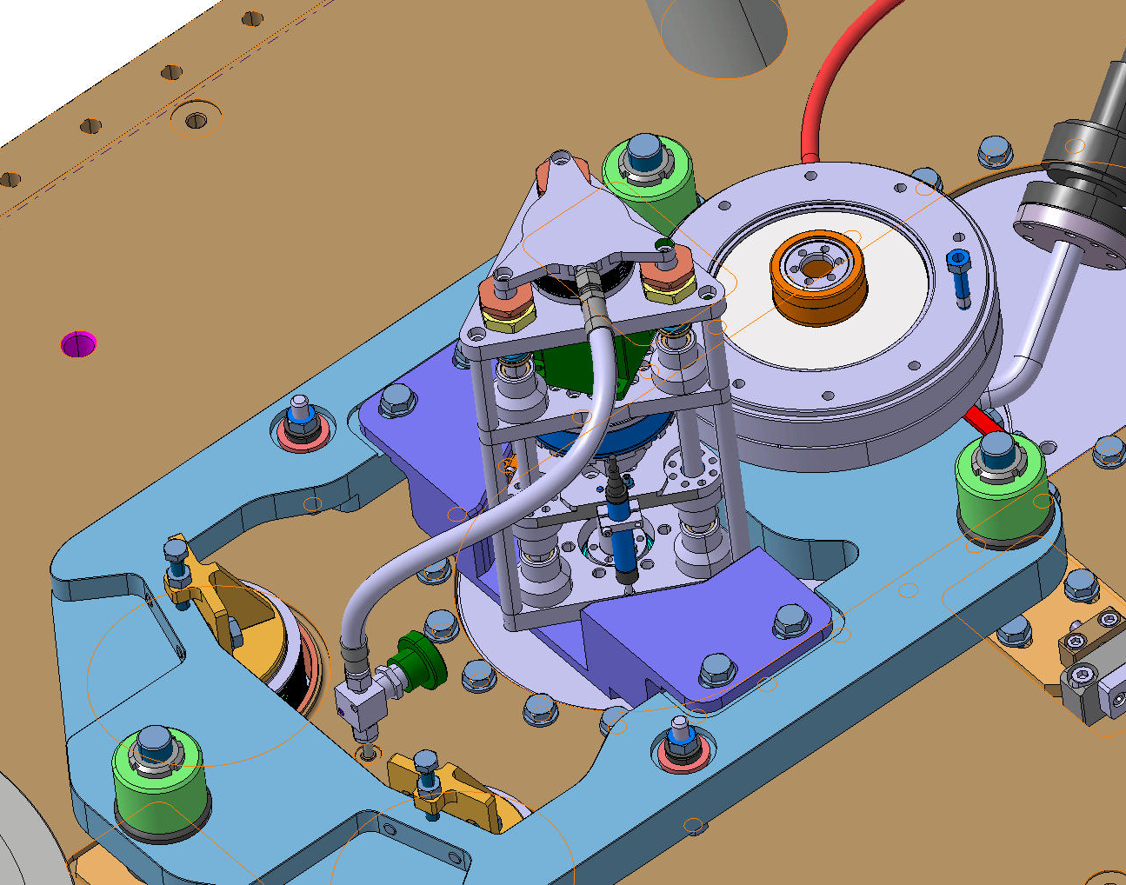
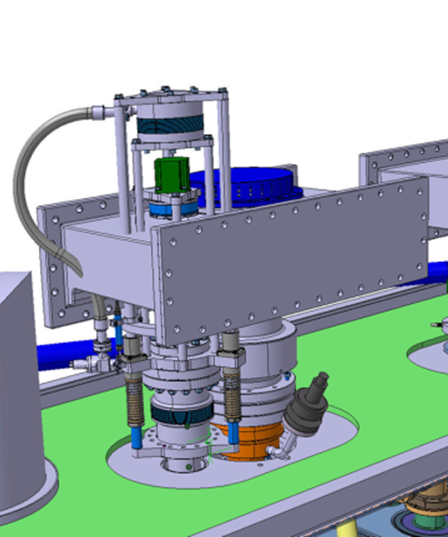
SPS DQW Tuner actuator
Limited space
Combination with alignment support
Maintainability (dismountability)

Slide 16
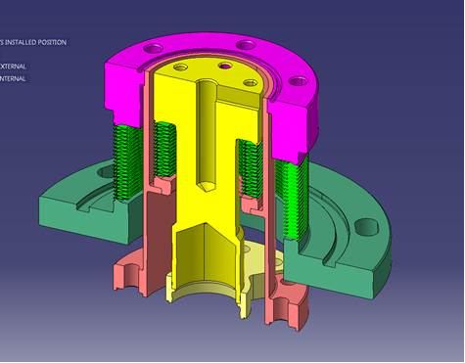
SPS DQW Tuner actuator
Same motor, gear, roller screw as SM18 actuator
Same load cell, potentiometers
Improved couplings
Smaller bellows and in series with actuator
Pressure equalisation no longer really needed
Actuator can be removed without breaking vacuum
End stops and switches still to be finalised

Slide 17
Conclusion
SM18 test on p.o.p. DQW validated tuning principle and tuner actuator
Solutions for the integration in the SPS cryomodule were found
Last stage of the design of the tuner components

Slide 18
Thank you

